Slide 1
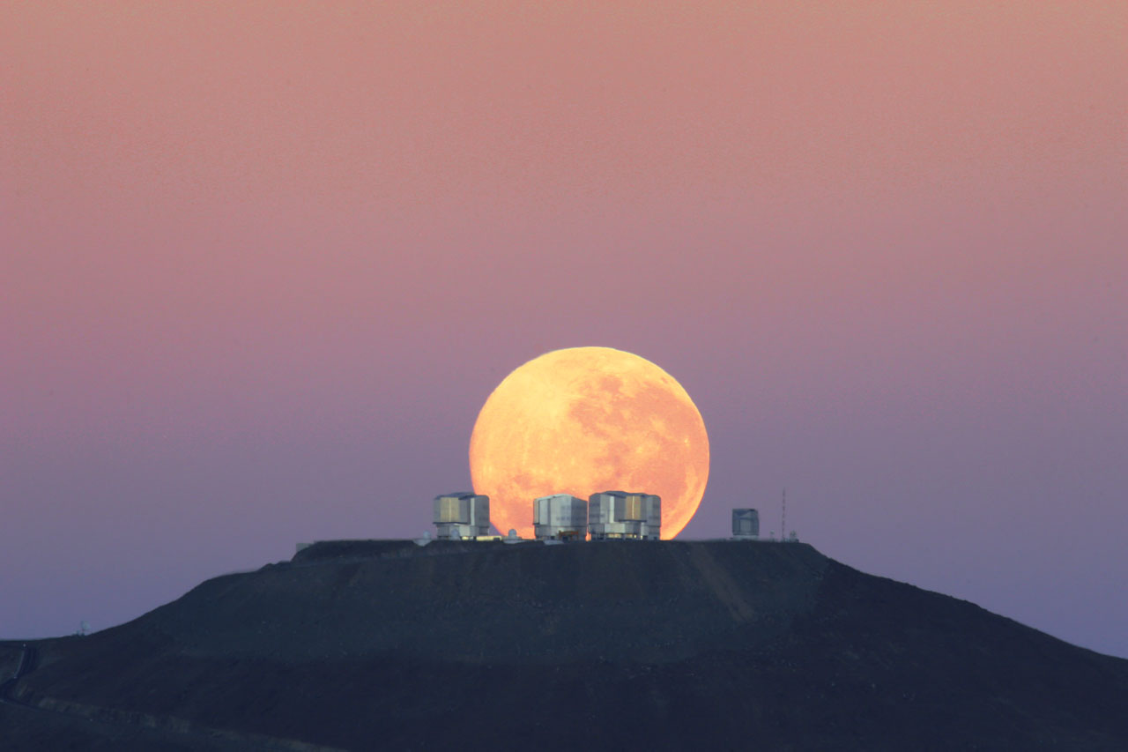
ESO’s Future Projects
Bruno Leibundgut

Slide 2
European Southern Observatory
Mission
Develop and operate world-class observing facilities for astronomical research
Organize collaborations in astronomy
Intergovernmental treaty-level organization
Founded in 1962; today 15 member states
La Silla Paranal: VLT, VLTI, 3.6m, NTT, VISTA, VST
Chajnantor: APEX and ALMA partnerships
Armazones: ELT
Paranal/Armazones: CTA-S
Headquarters in Garching and Office in Santiago

Slide 3
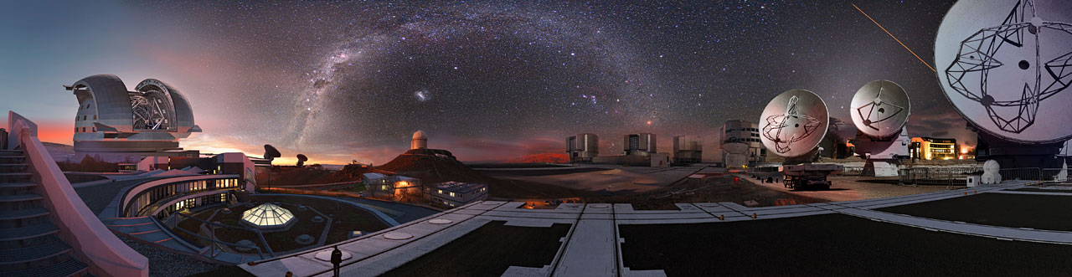
European Southern Observatory

Slide 4
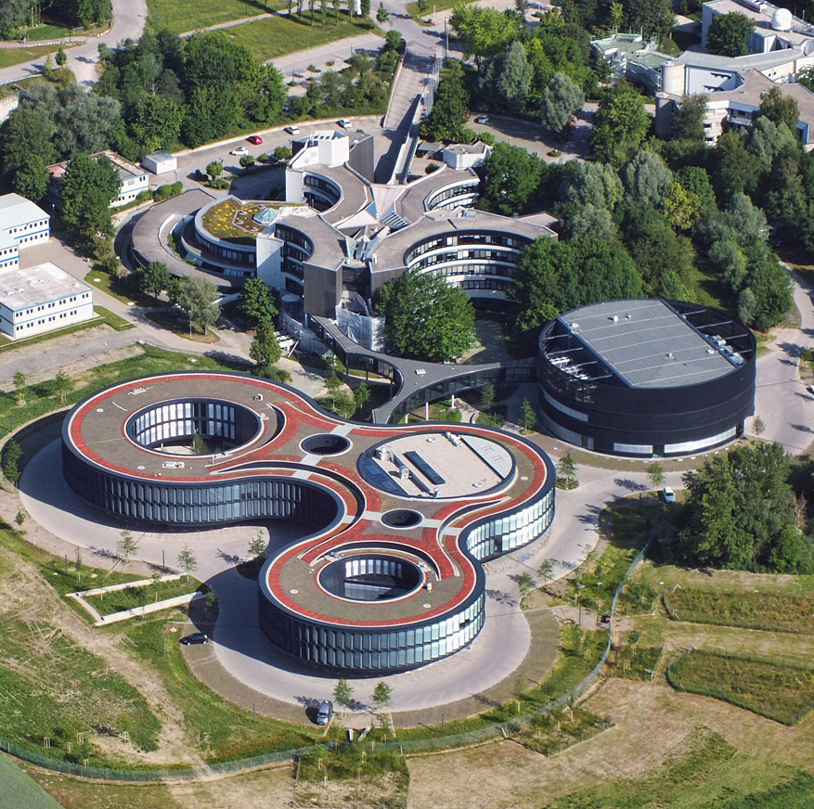
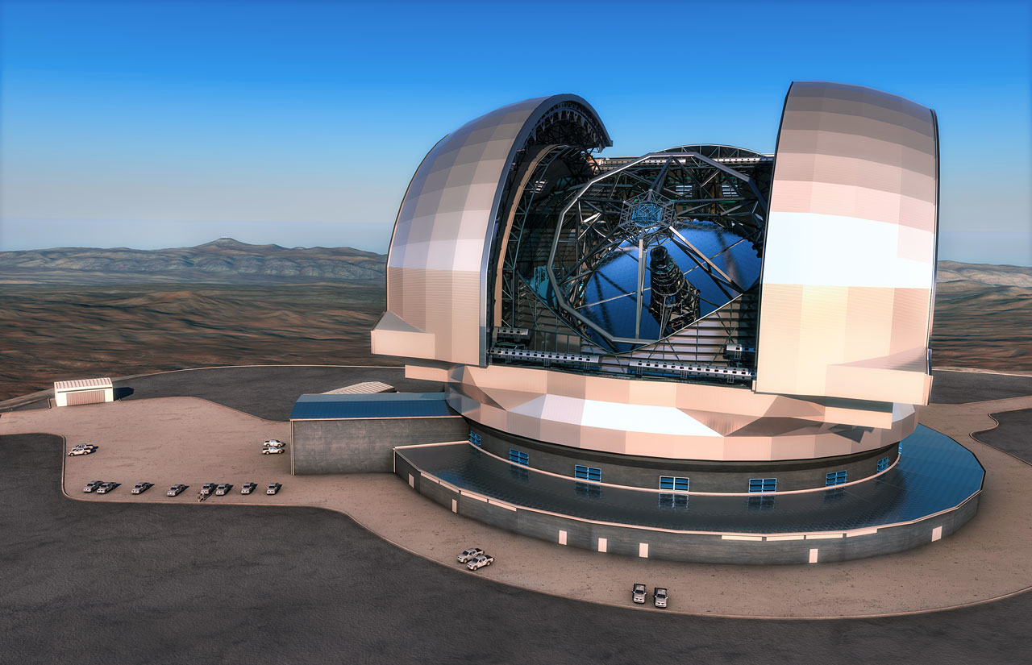
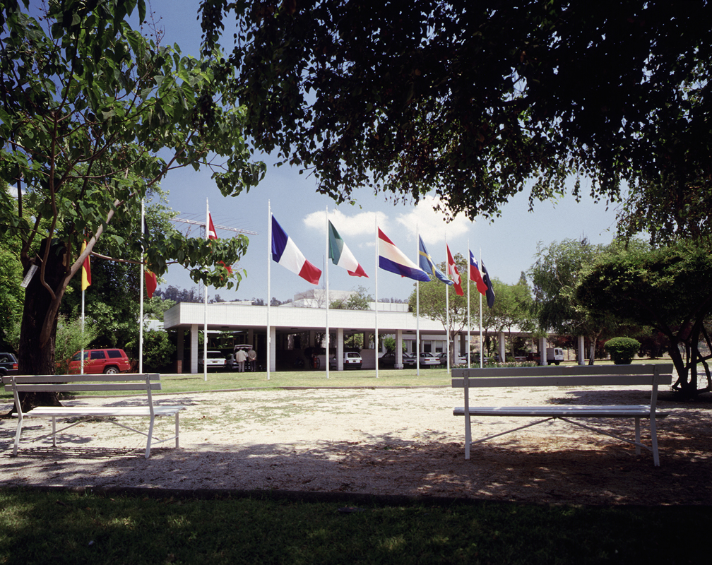
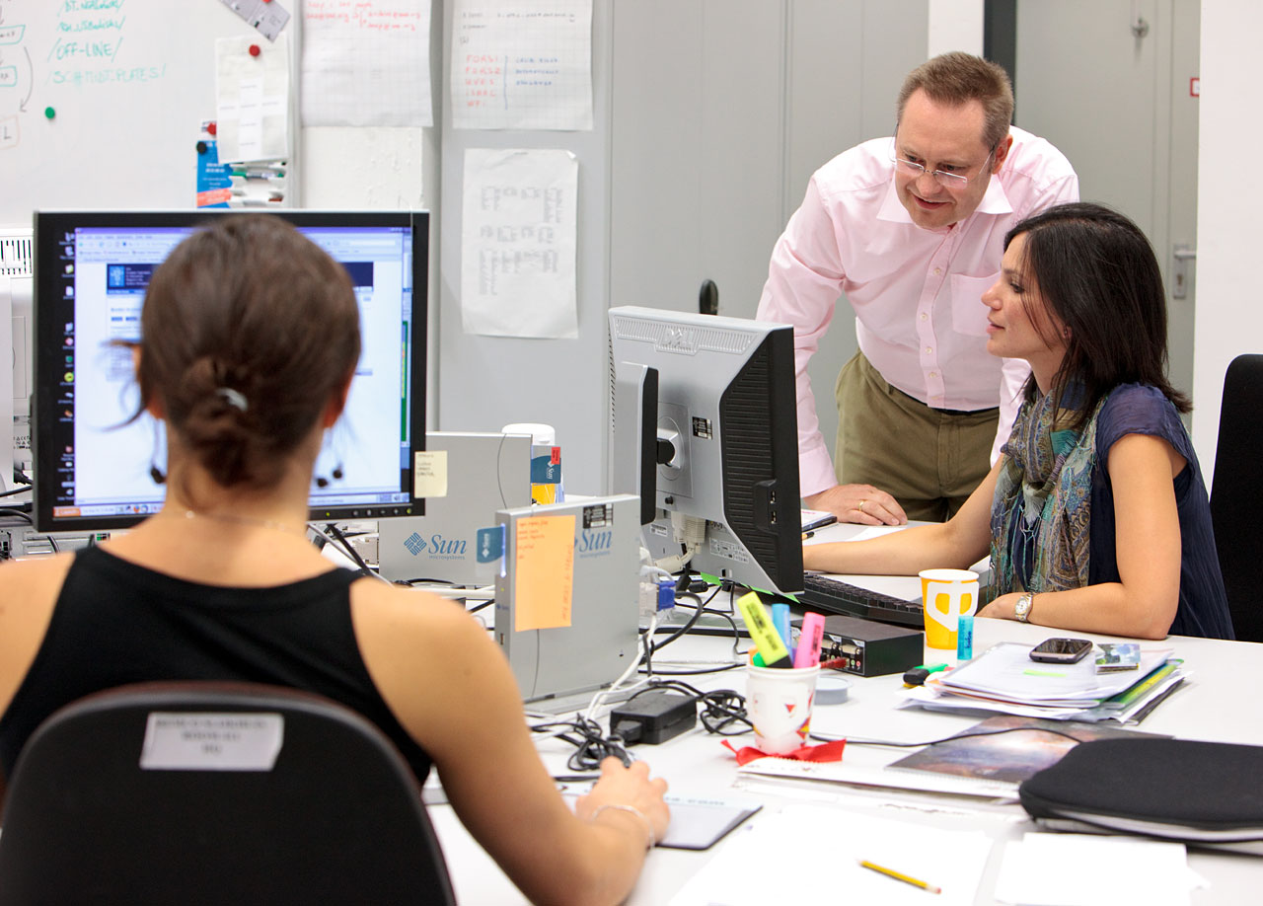
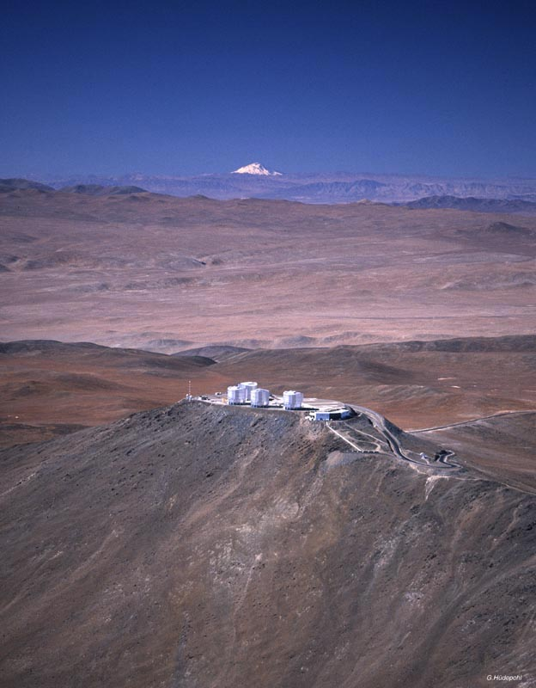
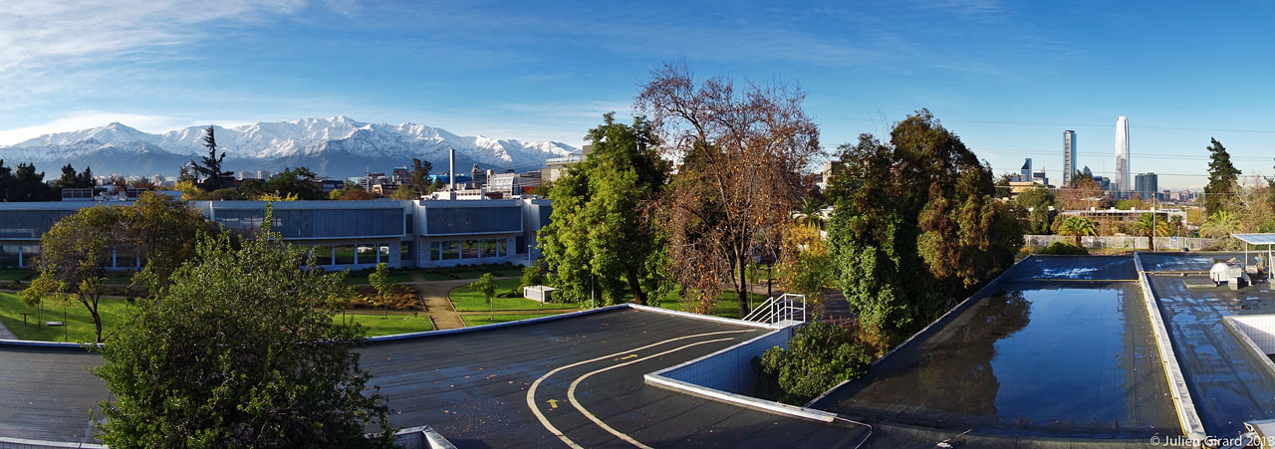
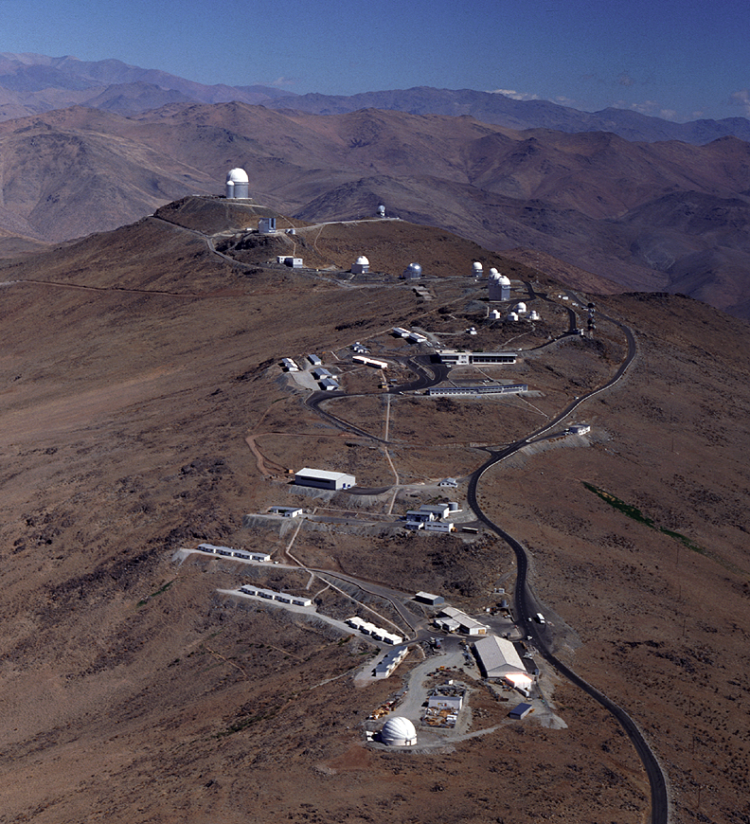
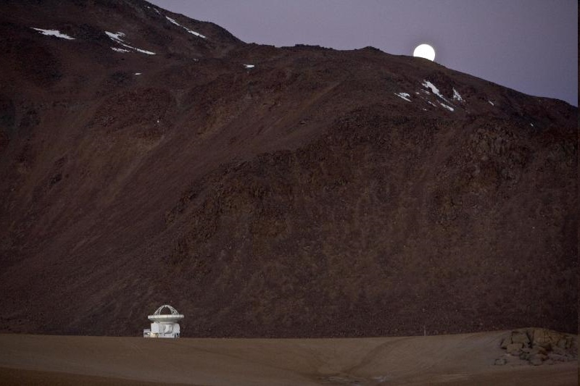
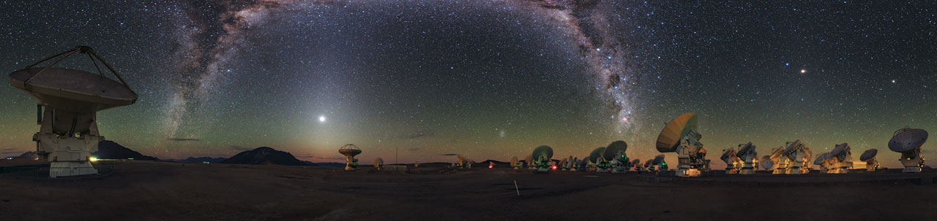

ESO
Observatories La Silla and Paranal in operation 8 Telescopes, plus 4 telescopes for Interferometry
APEX in operation on Chajnantor
Atacama Large Millimeter Array (ALMA)
Public data archive
ESO Extremely Large Telescope under construction
Headquarters in Garching, Germany
Representation in Santiago de Chile
Joint ALMA Office in Santiago

Slide 5

Paranal 2022
Paranal 2018

Slide 6
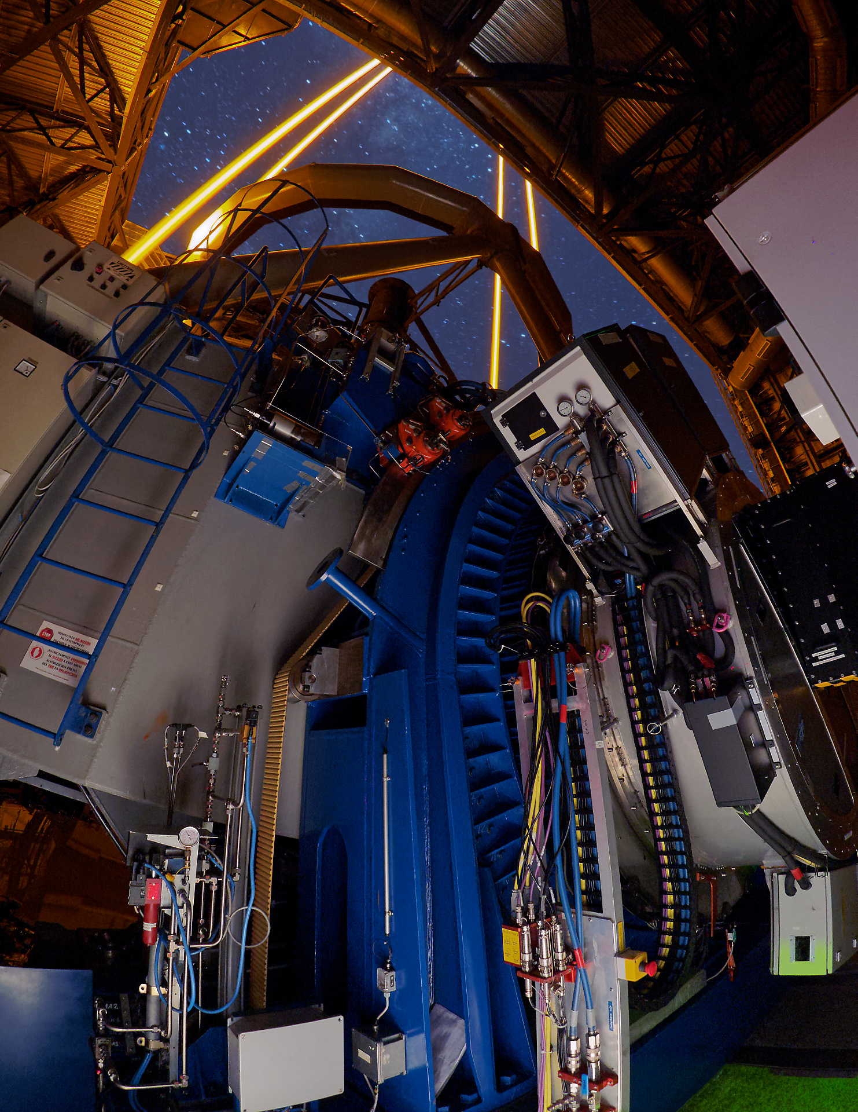
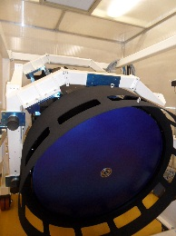
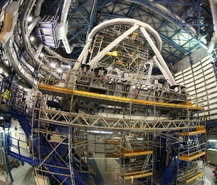
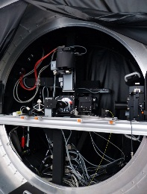
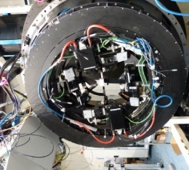
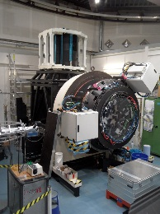
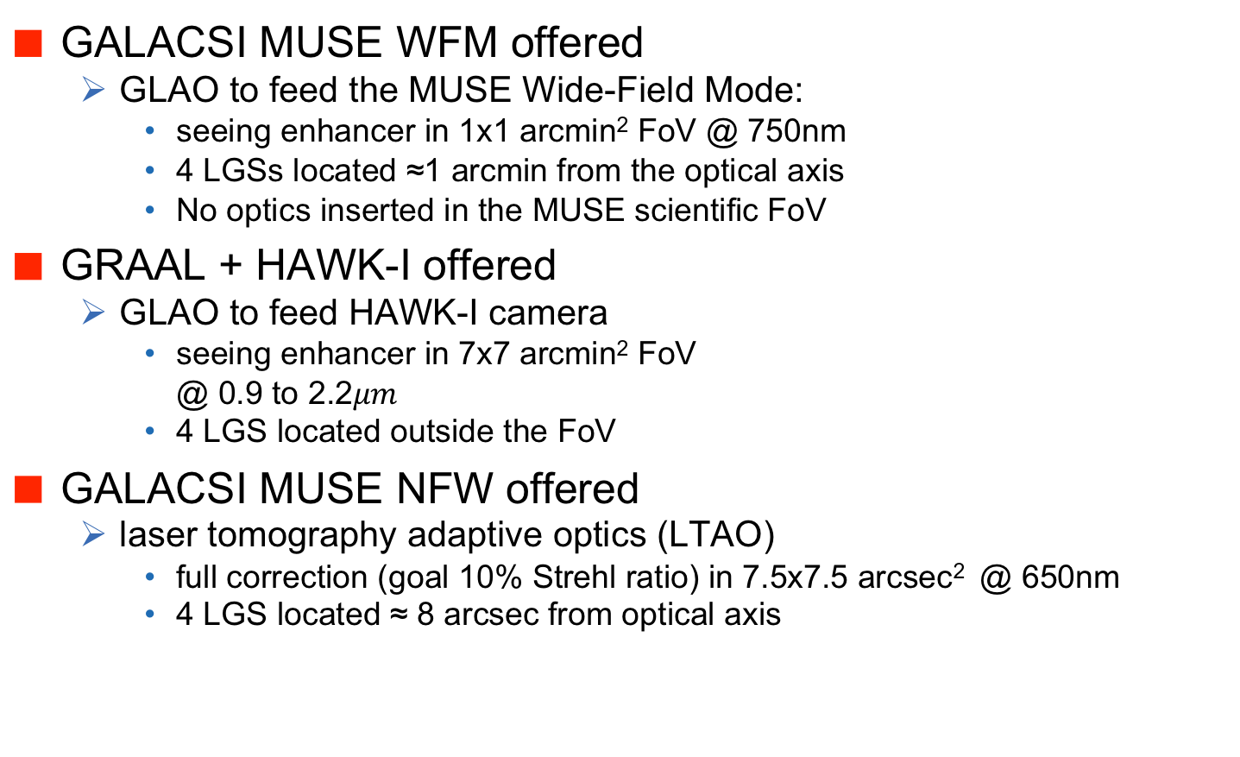
Adaptive Optics Facility
GALACSI MUSE WFM offered
GLAO to feed the MUSE Wide-Field Mode:
seeing enhancer in 1x1 arcmin² FoV @ 750nm
4 LGSs located ≈1 arcmin from the optical axis
No optics inserted in the MUSE scientific FoV
GRAAL + HAWK-I offered
GLAO to feed HAWK-I camera
seeing enhancer in 7x7 arcmin² FoV @ 0.9 to 2.2$μm$
4 LGS located outside the FoV
GALACSI MUSE NFW offered
laser tomography adaptive optics (LTAO)
full correction (goal 10% Strehl ratio) in 7.5x7.5 arcsec² @ 650nm
4 LGS located ≈ 8 arcsec from optical axis

Slide 7
Four Lasers

Slide 8
New VLT/I Instruments
GRAVITY – highest angular resolution in K-band
ESPRESSO – extremely stable high-resolution spectrograph
Matisse – mid-infrared interferometry instrument
ERIS – new NIR AO imager (NACO replacement)
includes SINFONI upgrade
MOONS – high multiplex NIR spectroscopy
4MOST (VISTA) – high multiplex optical spectroscopy
Optical AO imager and spectrograph
FORS2 upgrade – maintain instrument operational
UV high-resolution spectroscopy

Slide 9

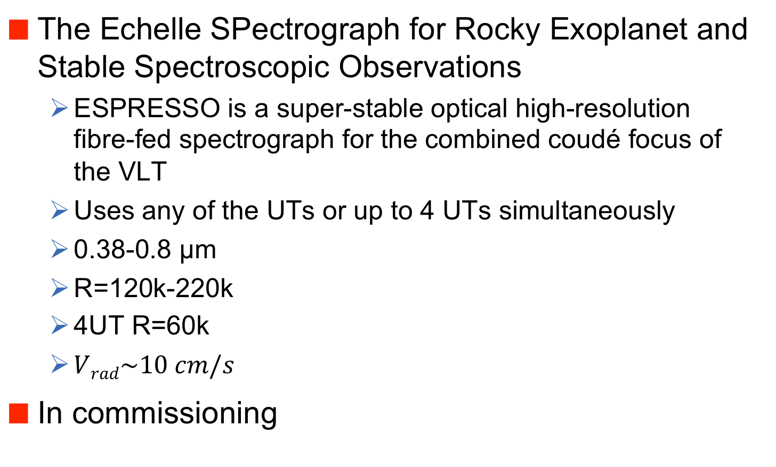
ESPRESSO
The Echelle SPectrograph for Rocky Exoplanet and Stable Spectroscopic Observations
ESPRESSO is a super-stable optical high-resolution fibre-fed spectrograph for the combined coudé focus of the VLT
Uses any of the UTs or up to 4 UTs simultaneously
0.38-0.8 μm
R=120k-220k
4UT R=60k
$Vrad\sim 10 cm/s$
In commissioning

Slide 10
MATISSE
Multi-Aperture mid-Infrared SpectroScopic Experiment
VLTI four-telescope L, M and N-band imager
Multi-axial beam combination, closure phase imaging
Spectral resolutions between R=30 and 5000
Operating with UTs and ATs
Will use GRAVITY as a fringe tracker
Offered in P103

Slide 11
CRIRES Upgrade
CRIRES Upgrade project
1-5 microns spectral coverage, R~20k–100k
Cross-disperser + new detectors will enlarge simultaneous wavelength coverage by ~10 times, will cover simultaneously one IR band
Gas cells will provide few m/s radial velocity precision
Polarimetric capabilities
Refurbished AO system
Offered in 2019

Slide 12
ERIS
SPIFFI Integral field spectroscopy
FoV 0.8”, 3.2”, 8”; R~3000 & 8000; J‐K bands
NIX (camera)
J‐K narrow/broad bands; 13/27 mas pix (26”/55” FoV)
L‐M broad bands; 27 mas pix (55” FoV)
High contrast imaging
Pupil plane coronagraph (L‐M)
Focal plan coronagraph (L‐M)*
Sparse aperture Masking (J‐M)
Long slit spectroscopy
R=500, LM band simultaneously
Offered after 2020

Slide 13
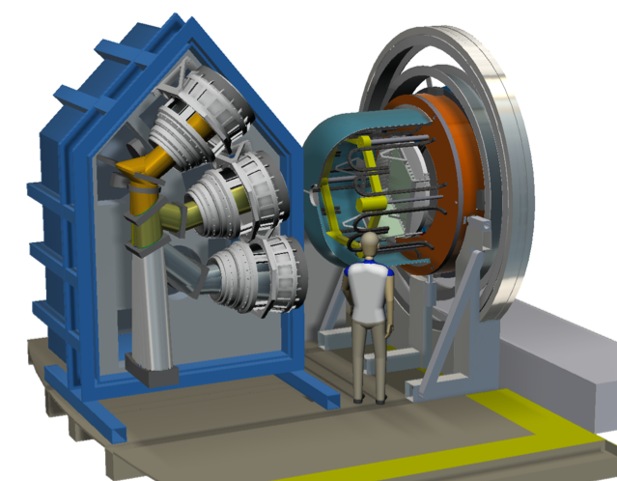
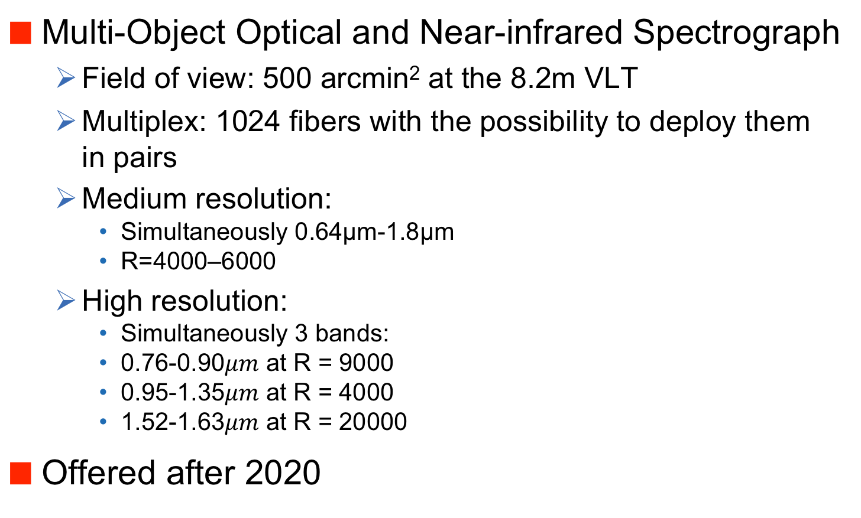
MOONS
Multi-Object Optical and Near-infrared Spectrograph
Field of view: 500 arcmin² at the 8.2m VLT
Multiplex: 1024 fibers with the possibility to deploy them in pairs
Medium resolution:
Simultaneously 0.64μm-1.8μm
R=4000–6000
High resolution:
Simultaneously 3 bands:
0.76-0.90$μm$ at R = 9000
0.95-1.35$μm$ at R = 4000
1.52-1.63$μm$ at R = 20000
Offered after 2020

Slide 14
4MOST
4MOST will be a world-class facility for fiber-fed multi-object spectroscopy
large field of view (> 4 deg²)
spectral resolutions (LRM: R>5,000, HRM: R>18,000) for both Galactic and extragalactic applications
high multiplex (1600 in LRM, 800 in HRM)
broad wavelength coverage in LRM (400-885 nm)
broad wavelength coverage in HRM (393-435 nm and 521-571 nm, 610-675 nm)
implementation at the Cassegrain focus of the VISTA telescope
Offered after 2022
Community workshop 6-8 May 2019

Slide 15
Visible Adaptive Optics Instrument
VISIBLE MCAO
Maintain optical imaging at the level of HST into the next decades
Strong synergies with ELT
Optical camera
~7 mas per pixel
30 arcsec diameter FoV
Focus on VRI but also UBz sensitivity
IFU Spectroscopy
~3x3 arcsec² FoV
Spec. res. at R~5000
Adaptive Optics
Diffraction limited in V-band (AOF + 2 more DMs)
Strehl ratio >10% in V-band
4 or 5 Lasers
Near IR WFS

Slide 16
OIR Future Strategies
Flexibility
Astrophysics covers many topics and techniques
Completeness of instrumentation
Reaction to interesting new events, object and topics
Coordination
Instrumentations programmes at different facilities
either through a large pool or through collaboration between observatories
Planning between ground and space
Time allocation between observatories
Operations
inbuilt flexibility
archive → open distribution of data

Slide 17
La Silla beyond 2020
Dedicate large telescopes to specific science topics
3.6m telescope: exo-planets, radial velocity studies
HARPS; NIRPS
NTT: transient sky
EFOSC2, SOFI, (ULTRACAM); SOXS
Hosted telescopes
in operation upcoming
2.2m MPG TBT
1.54m Danish BlackGEM
1.2m Euler NEOSTEL
REM
TAROT-S
TRAPPIST
ESO 1m
ExTra
MASCARA

Slide 18
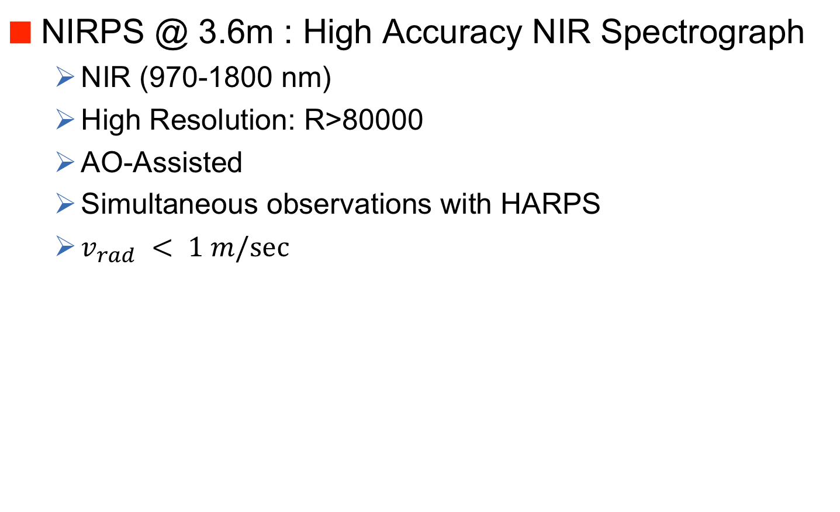
NIRPS
NIRPS @ 3.6m : High Accuracy NIR Spectrograph
NIR (970-1800 nm)
High Resolution: R>80000
AO-Assisted
Simultaneous observations with HARPS
$v_{rad} < 1 m/sec$

Slide 19
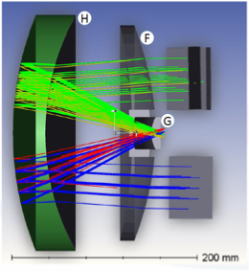
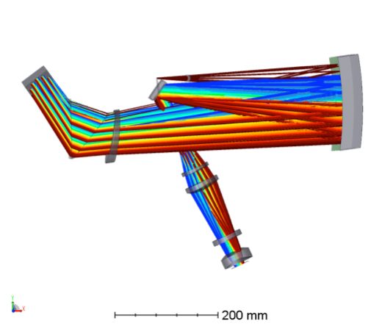
SOXS
SOXS @ NTT
Broad-band spectrograph, 350nm through 2.0μm
R ~ 4,500 (3,500–6,000)
Two arms (UV-VIS + NIR)
S/N ~ 10 spectrum, 1-hr exposure at R ~ 20
Acquisition camera (3’x3’) to perform photometry in ugrizY
Vis
IR

Slide 20
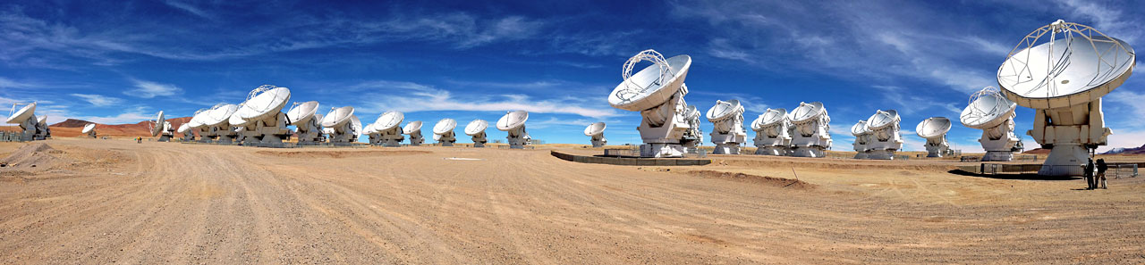
ALMA
Observe the cold universe
wavelengths from 300μm to 1.3mm (1 THz to 200 GHz)
Global Partnership
Europe (ESO), North America (USA/NSF and Canada/NRC), East Asia (Japan/NINS, Taiwan/NSC/ASIAA, South Korea/KASI)
66 antennas located at 5000m altitude
50 12m antennas
12 7m + 4 12m antennas (compact array)

Slide 21
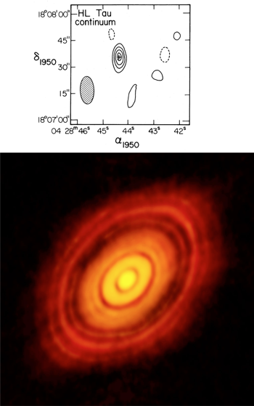
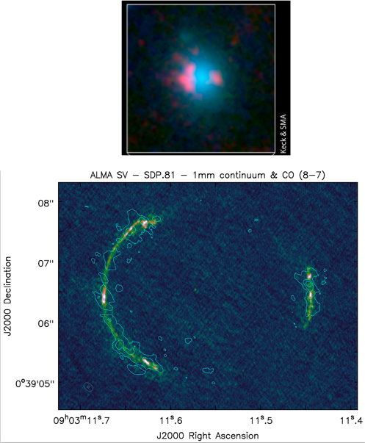
The ALMA Revolution
Increased sensitivity, higher angular resolution

Slide 22
ALMA Receivers

Slide 23
ALMA Plans
Defined in the roadmap
Increase receiver bandwidth
Increased survey speed
Improve archive capabilities
Longer-term plans
Increase maximum baseline
Focal plane arrays
More 12m antennas

Slide 24
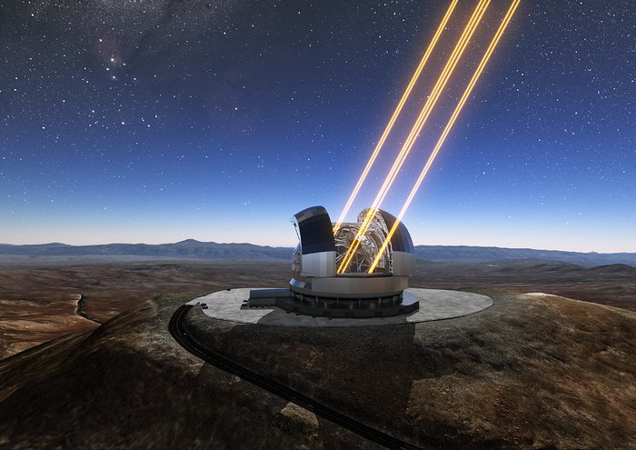

Slide 25
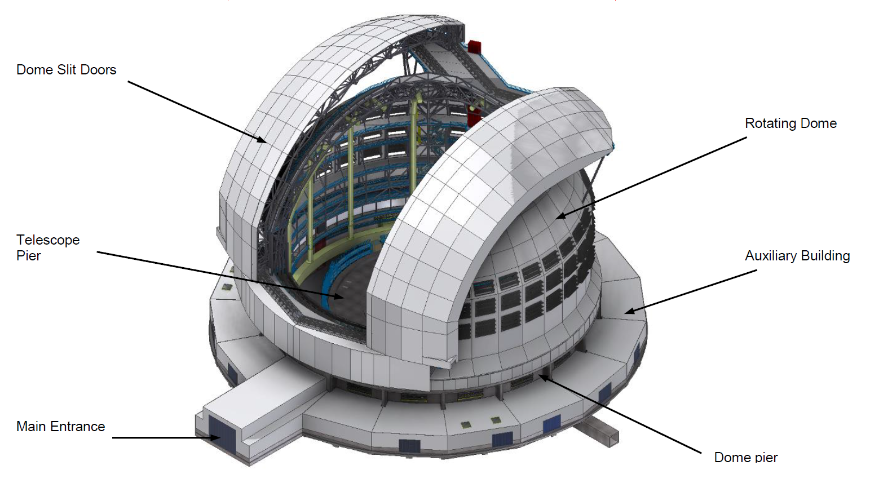
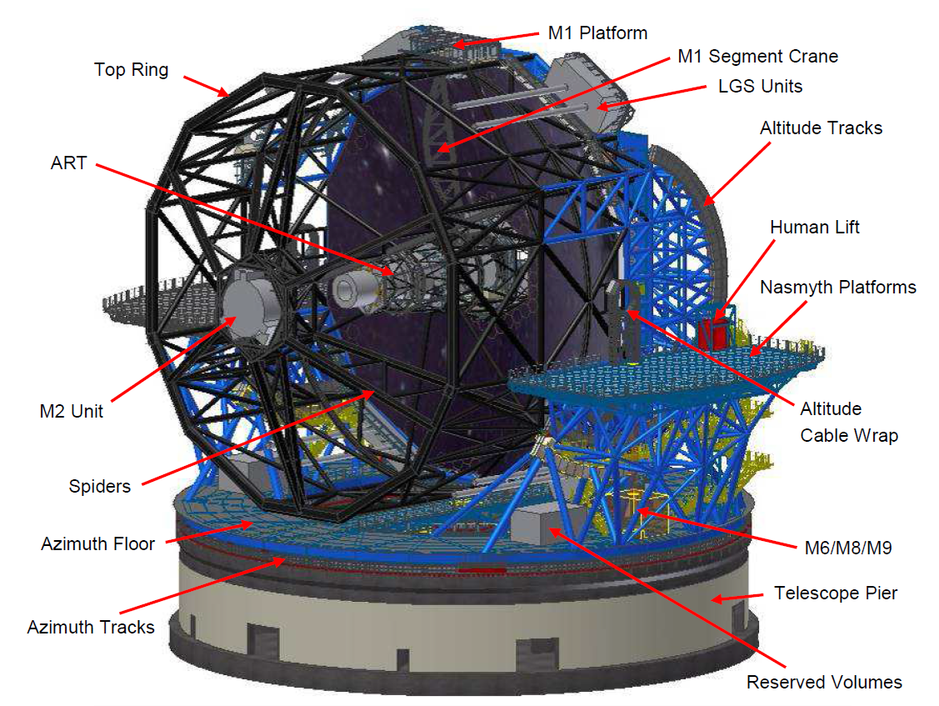
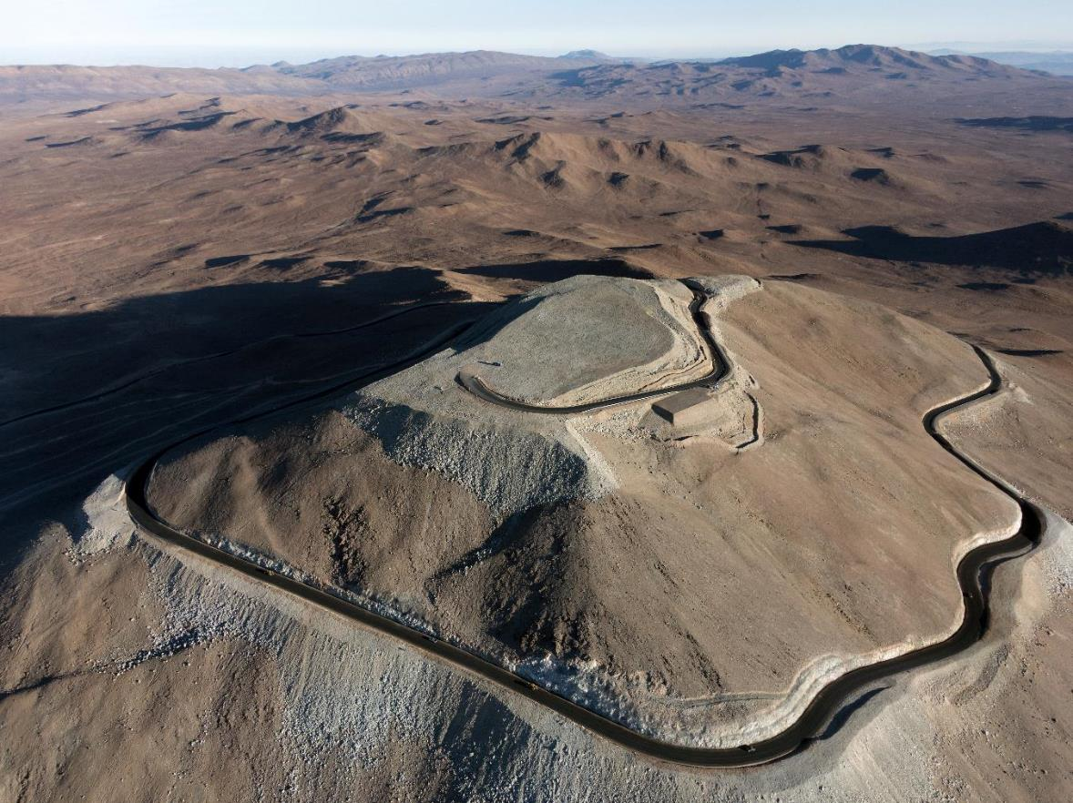
ELT - ESO’s next large telescope
~52 m (Horizon)
54 m

Slide 26
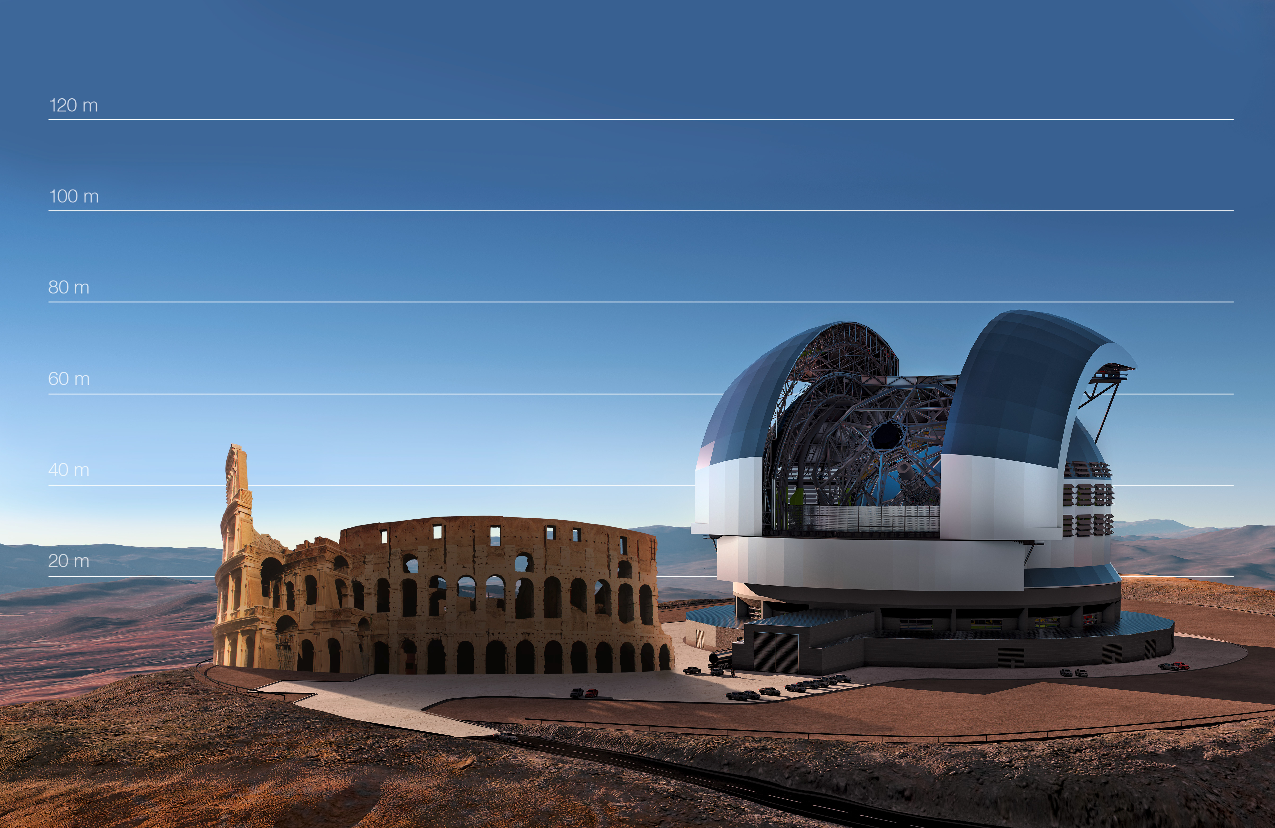
ELT

Slide 27
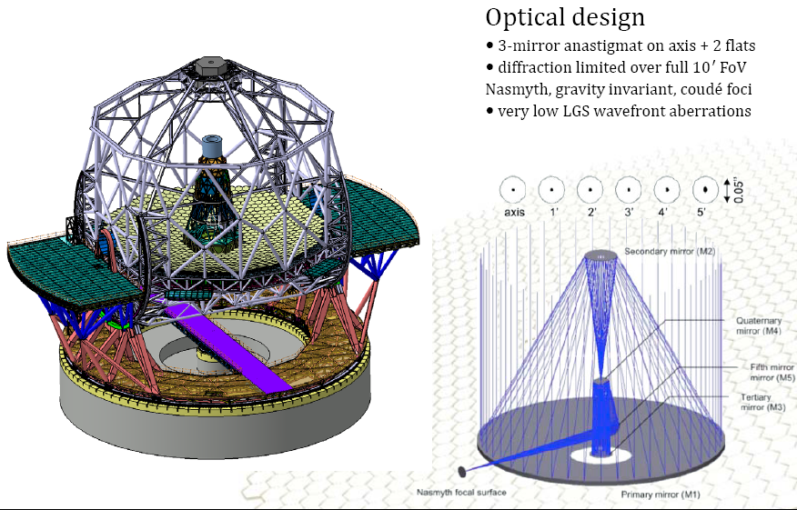
ELT Design
5 mirror telescope with 798 hexagonal segments making up the 39-m primary mirror

Slide 28
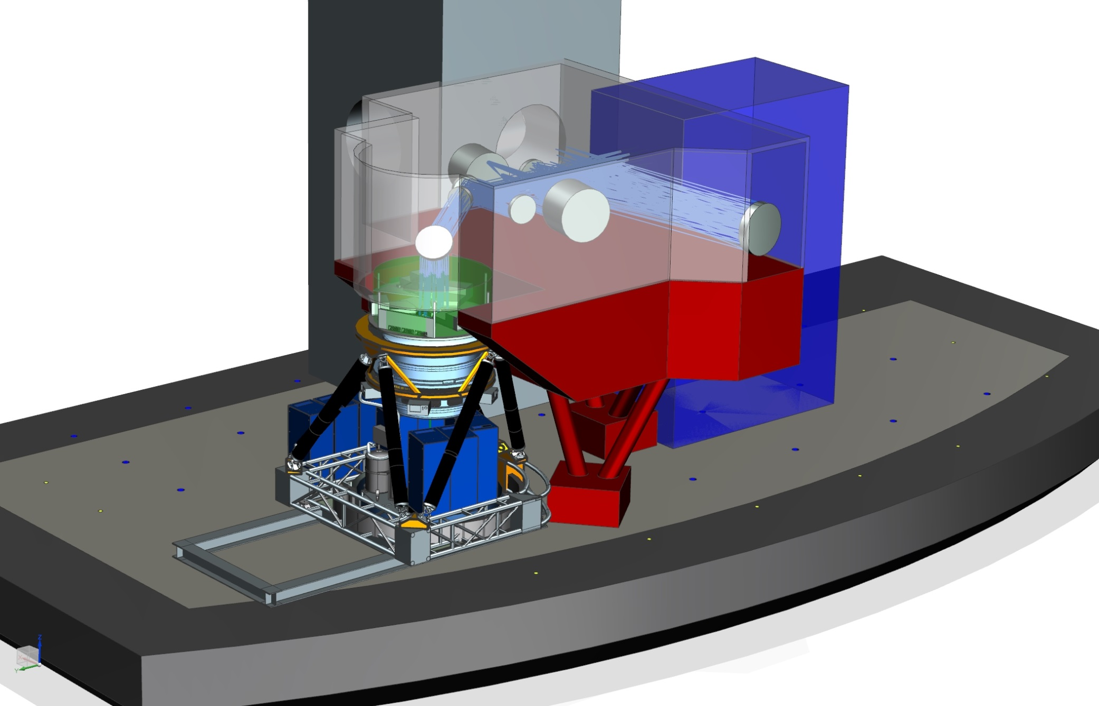
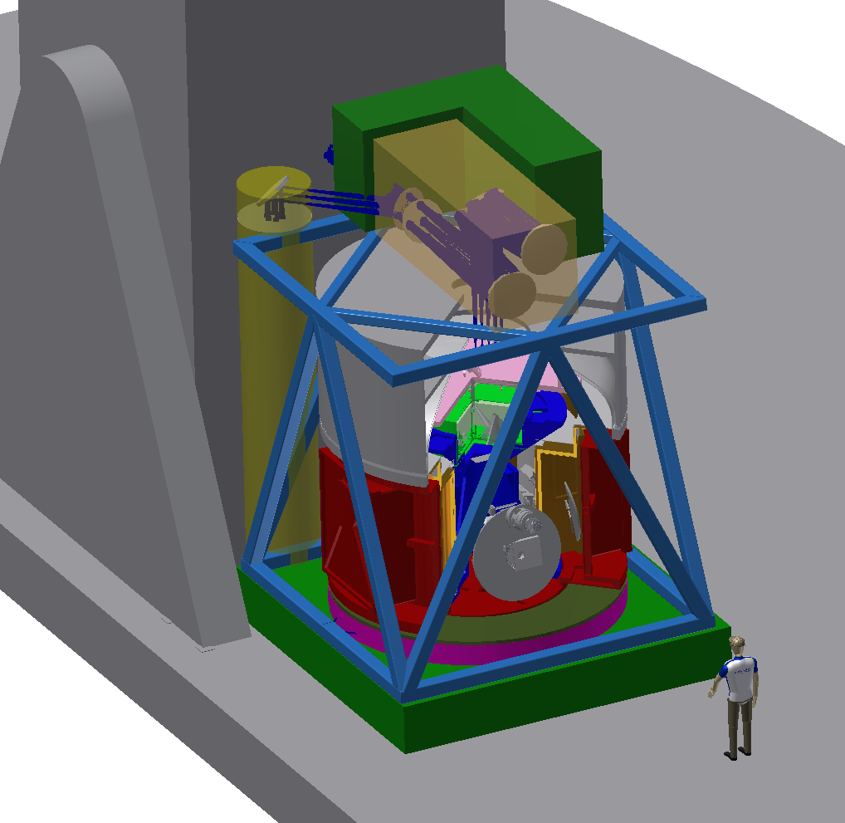
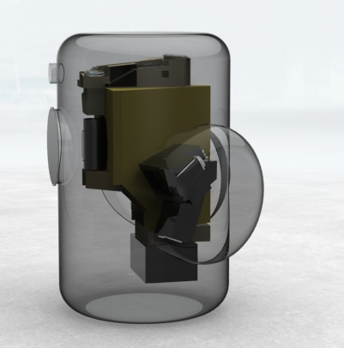
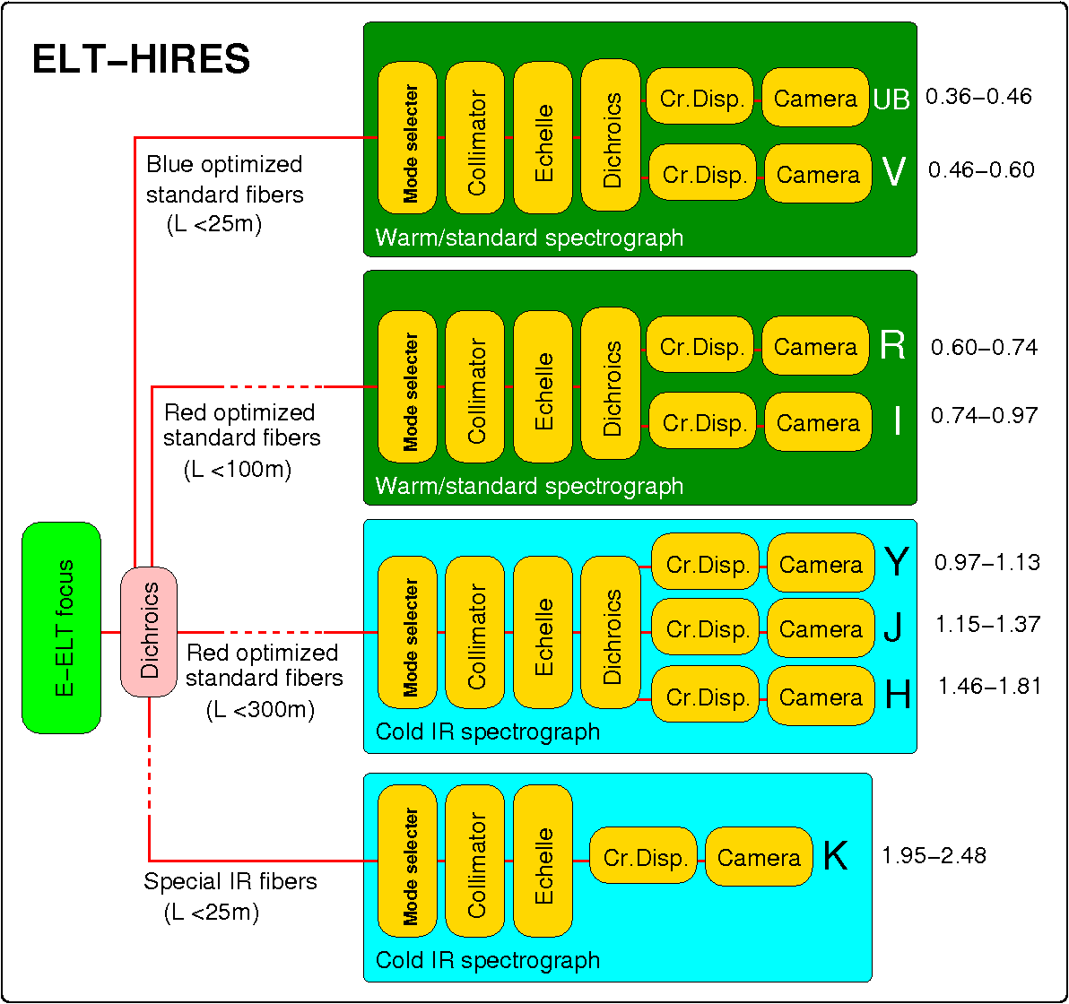
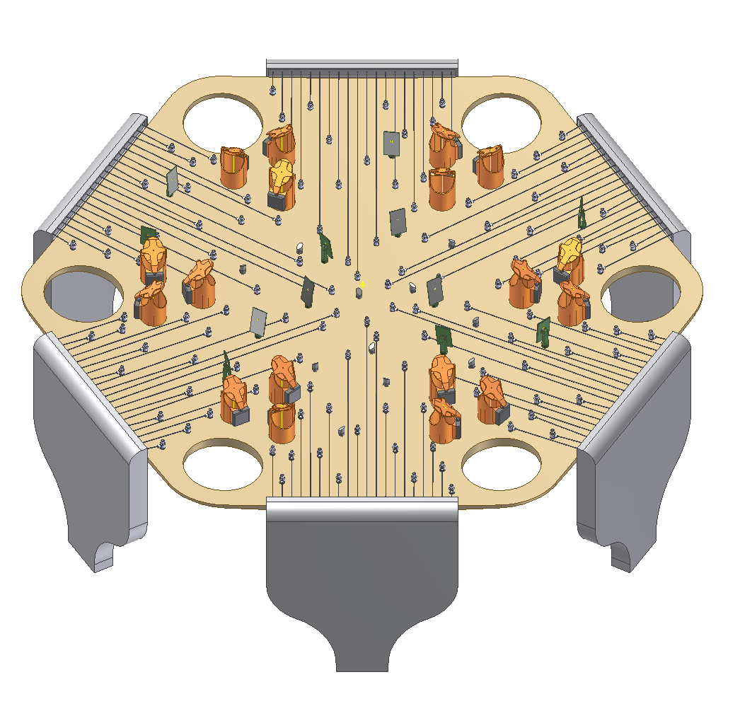
ELT Instrumentation Programme
MICADO+MAORY
Imager and single slit spectrograph
HARMONI
Integral Field Spectrograph
METIS
Mid-IR imager and spectrograph
Second generation instruments (completed Phase A)
HIRES
High resolution spectrograph
MOSAIC
Multi-object spectrograph
PCS
Extreme AO imager and spectrograph

Slide 29
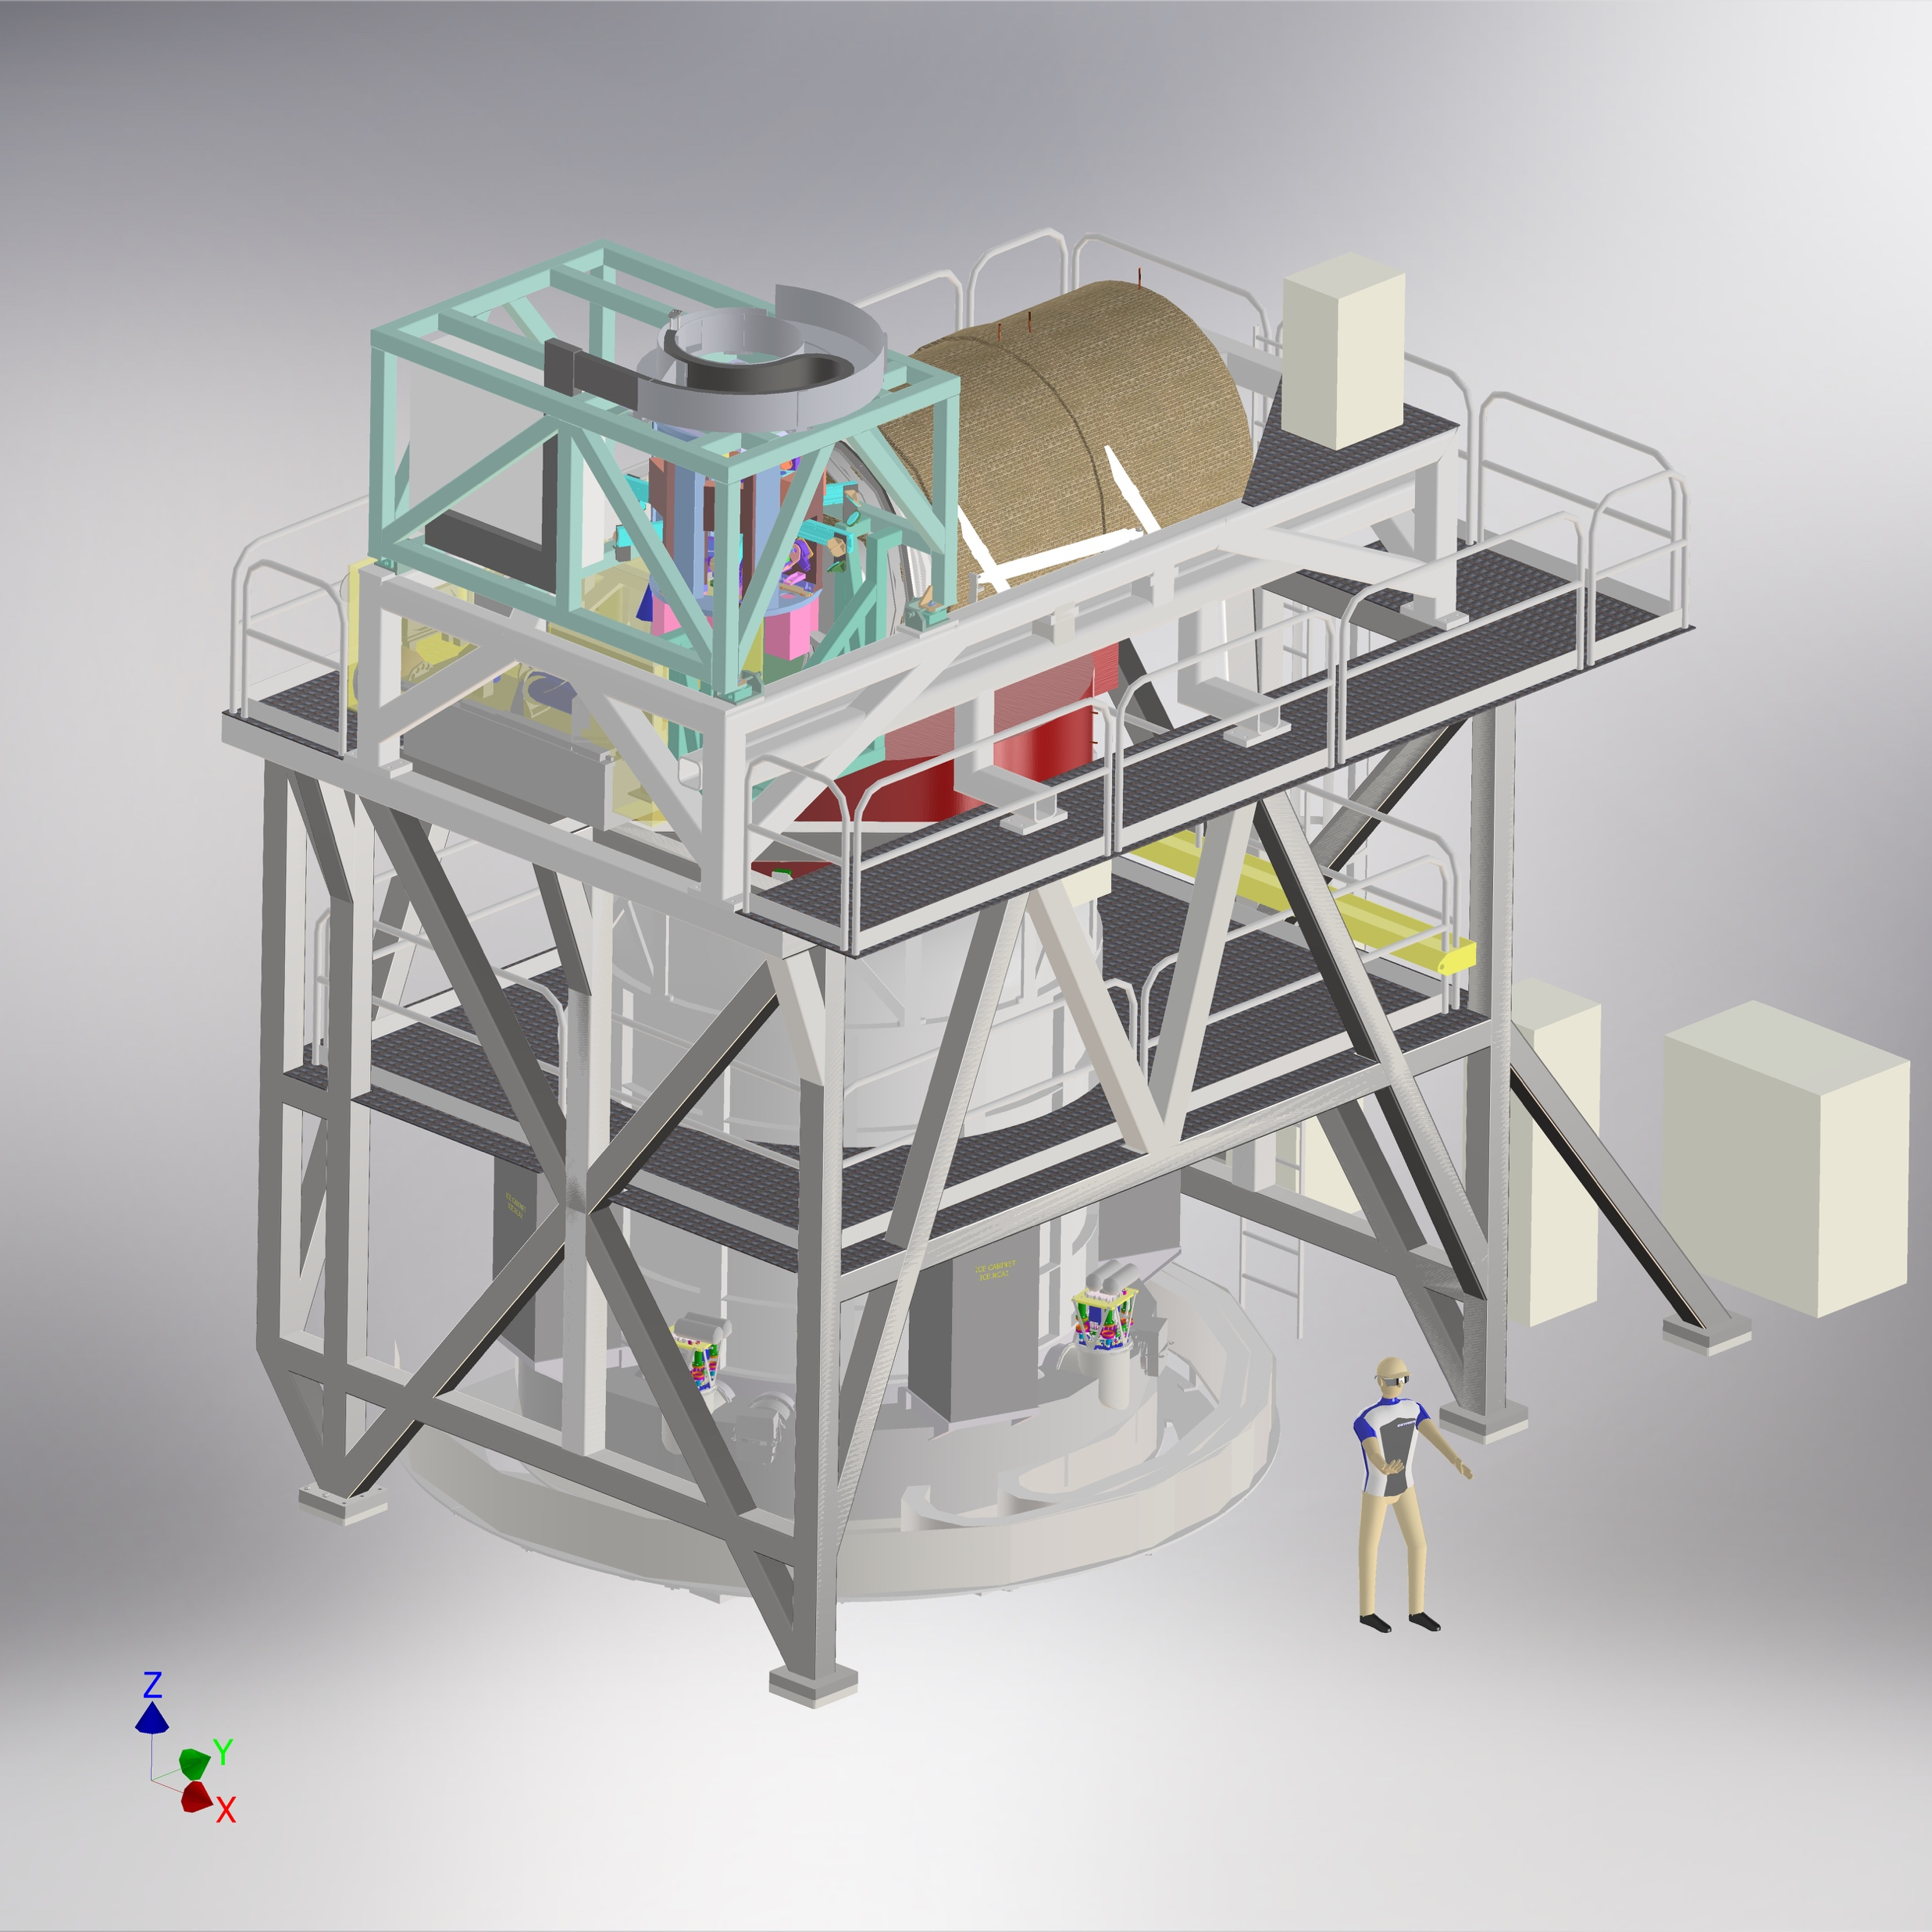
HARMONI Integral-field spectrograph
3D spectrograph (IFU) covering optical (0.47 μm) to NIR (2.45 μm)
Resolving power R=3500 - 20000
32000 spatial pixels
From seeing limited down to the diffraction limit with SCAO and LTAO
Range of spatial scales with field of views from 9”x6” to 0.8”x0.6”
Laser Guide Star System
Relay optics
Natural Guide Star System
Integral Field Spectrograph
IFS rotator and cable wrap
IFS electronics

Slide 30
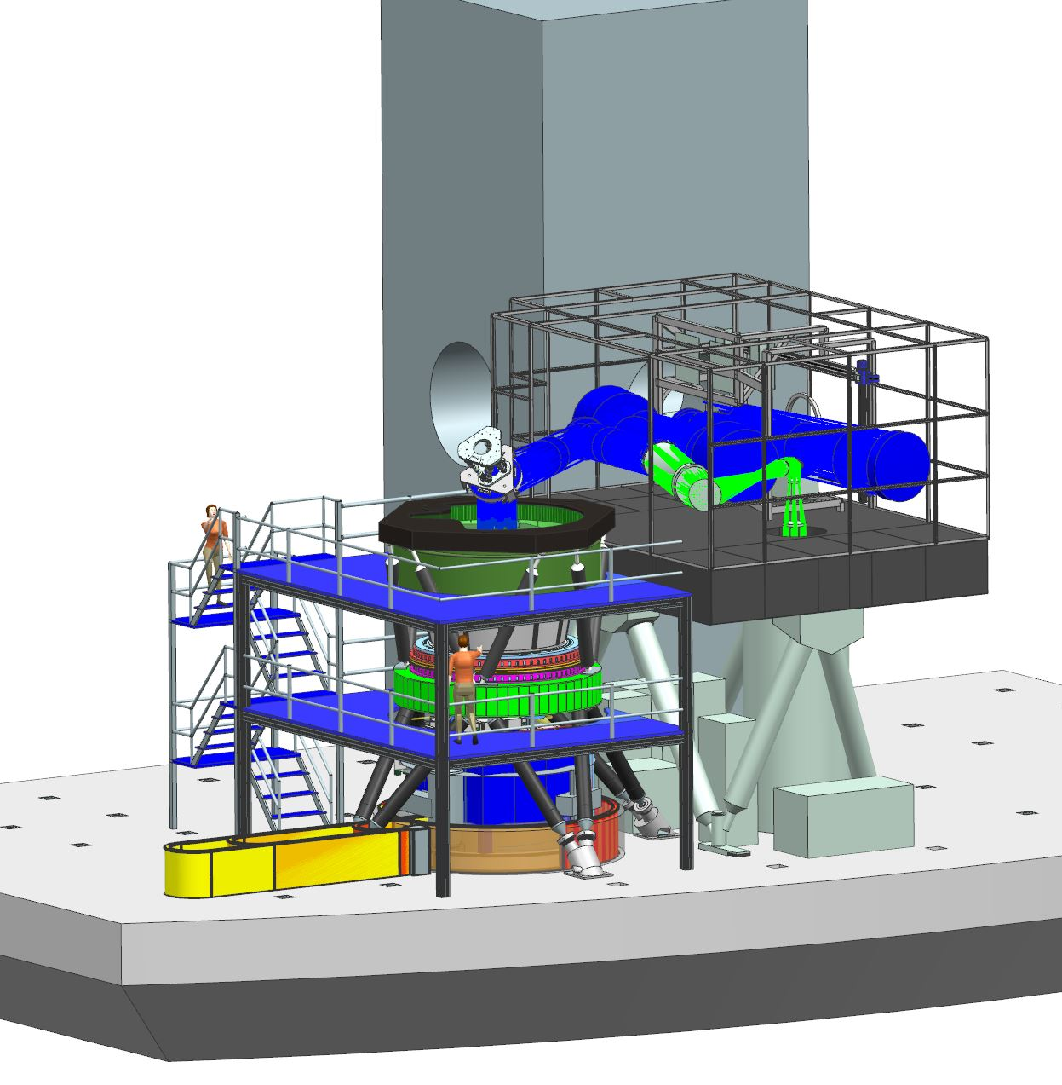
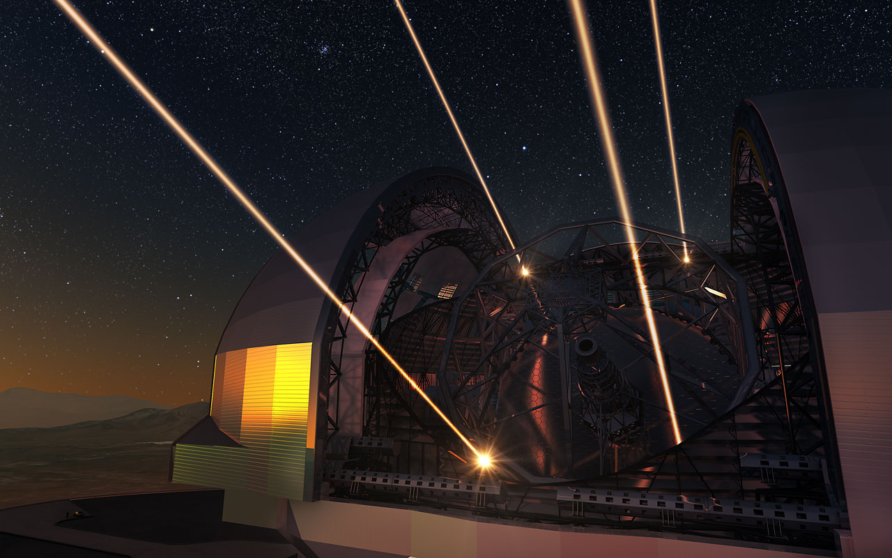
MAORY
Multi-conjugate AO system using 6 laser guide stars and 3 natural guide stars
1 or 2 deformable mirrors in addition to ELT M4 to correct atmospheric turbulence over 120arcsecs field of view

Slide 31
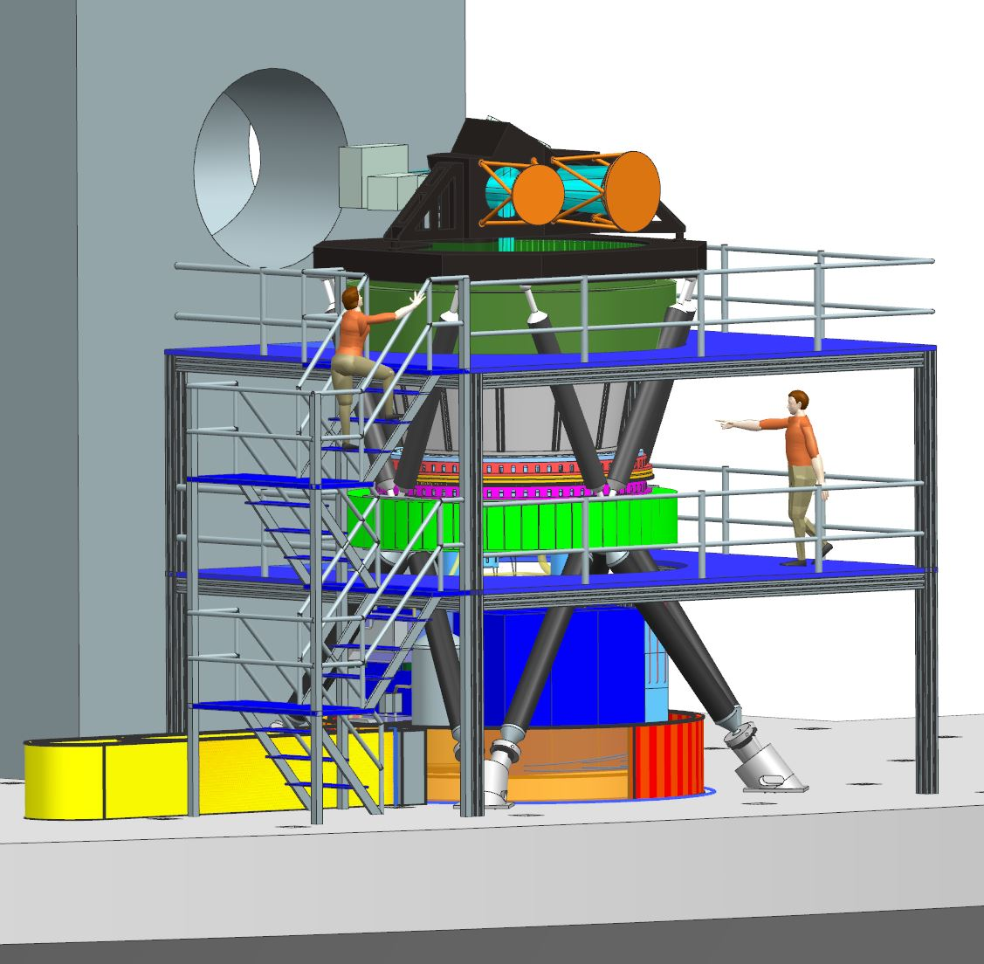
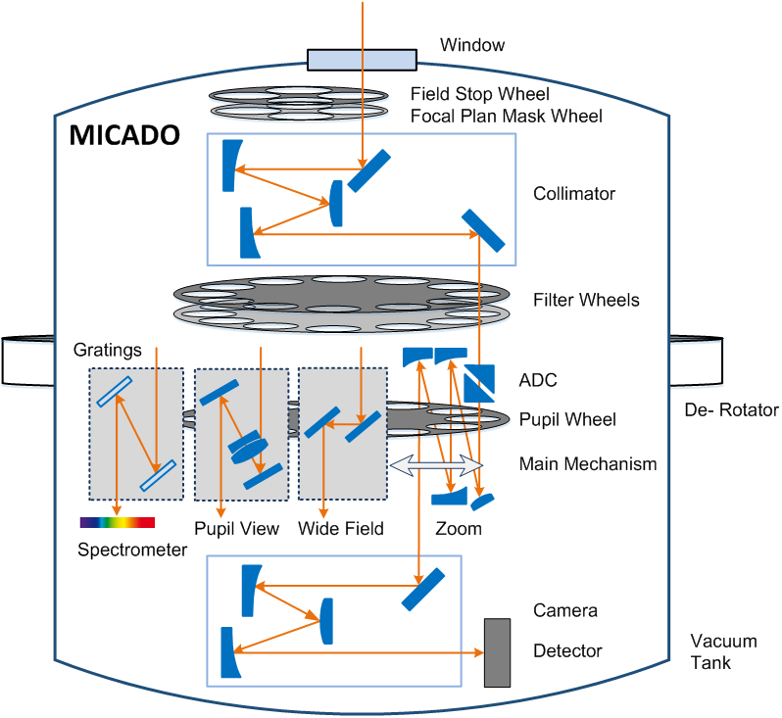
MICADO
Imaging from 0.8-2.4µm, > 30 filters, an array of 3x3 detectors with 4096x4096 Pixel scales of 4mas (field of view ~53”) and 1.5mas (FoV ~20”)
Astrometric imaging to 50µarcsec precision across whole image
Spectroscopy for single compact objects, two settings (0.8-1.4µm and 1.5-2.4µm) at spectral resolving power ~8000.
Coronagraph plus single conjugate AO
Time Resolved Astronomy as fast as 4mas

Slide 32
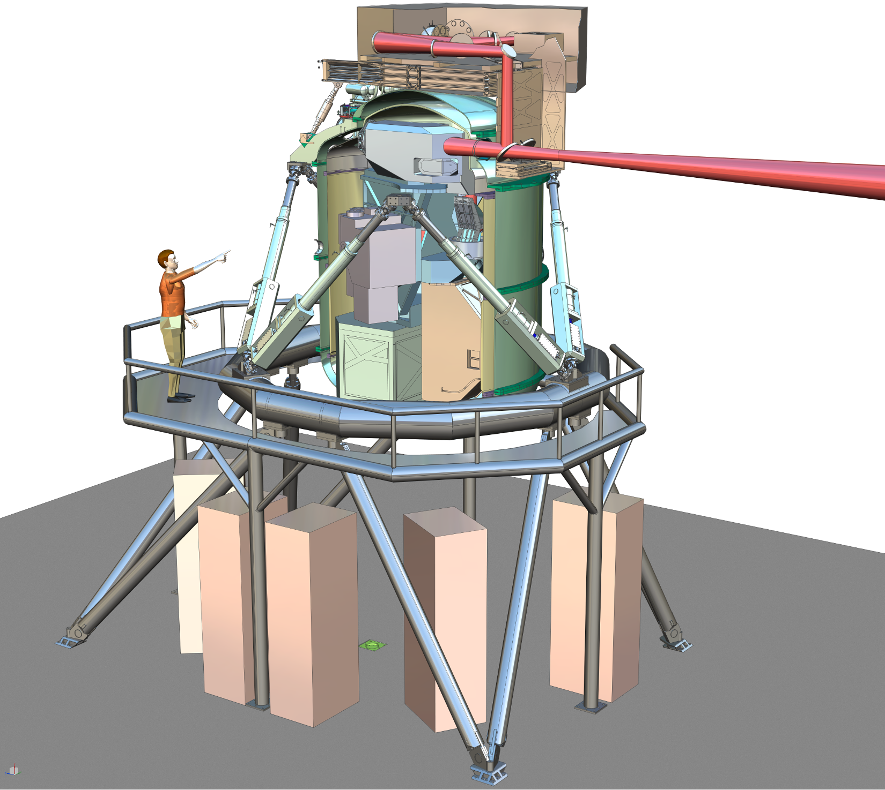
METIS
METIS covers the thermal / mid infrared wavelength range from 3µm to 19µm
All observing modes diffraction limited. SCAO
Imaging at L,M, N, Q bands: FoV 10”x10”
Low resolving power spectroscopy
R ~ few 102-103, slit spectroscopy, LMN bands
High resolving power (R ~ 100,000) IF spectroscopy at L,M-band, FoV 0.5”x0.5”
GOAL: High resolving power N-band IFS
Coronagraphy for high contrast imaging
Warm Cal Unit
LM IFU
Spectro.
METIS cryostat
AO WFS
Imager

Slide 33
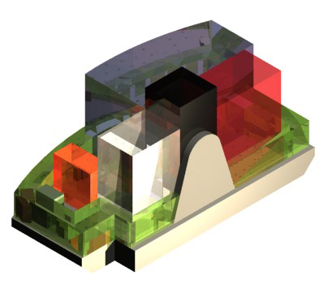
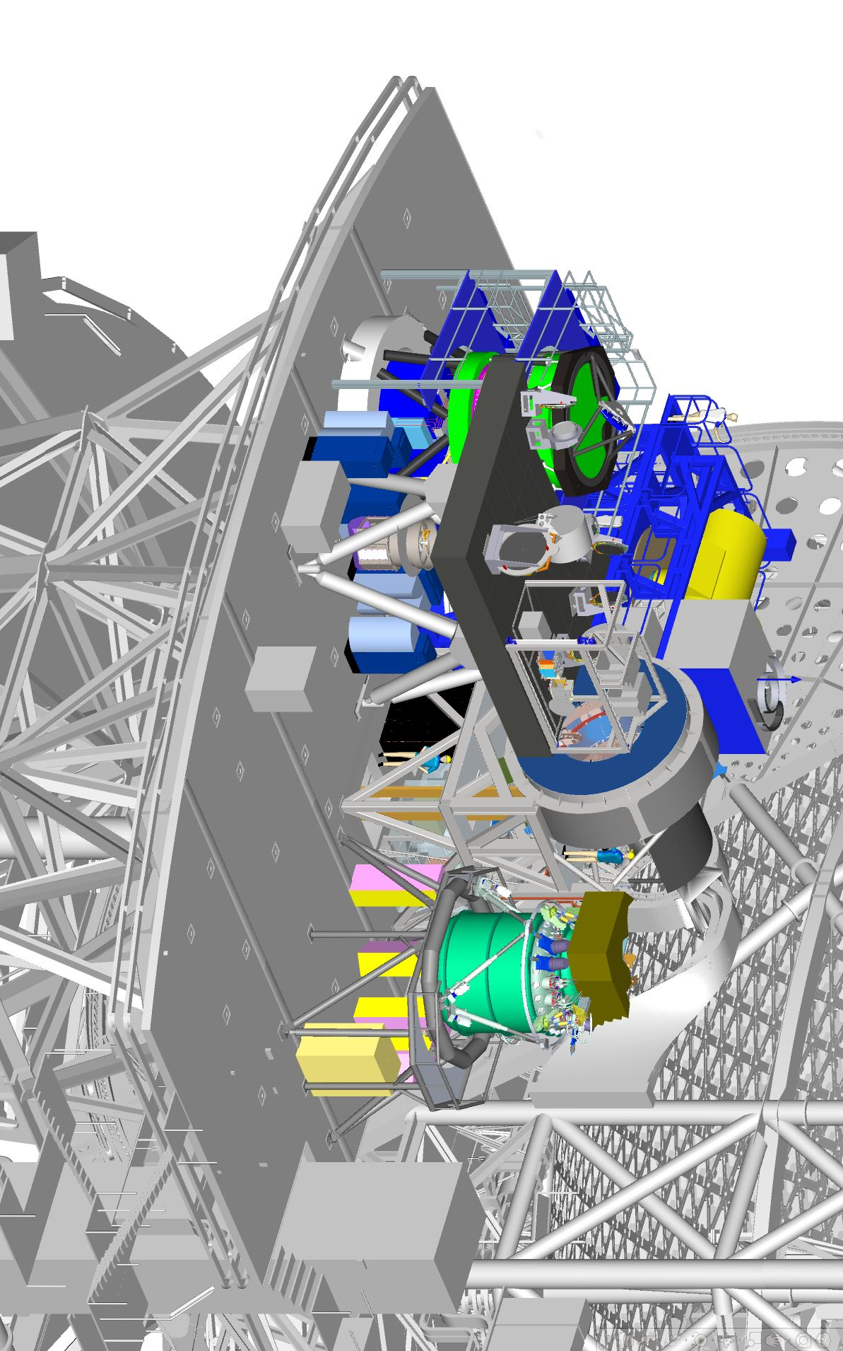
Instruments on Nasmyth A
MAORY/MICADO
HARMONI
METIS

Slide 34
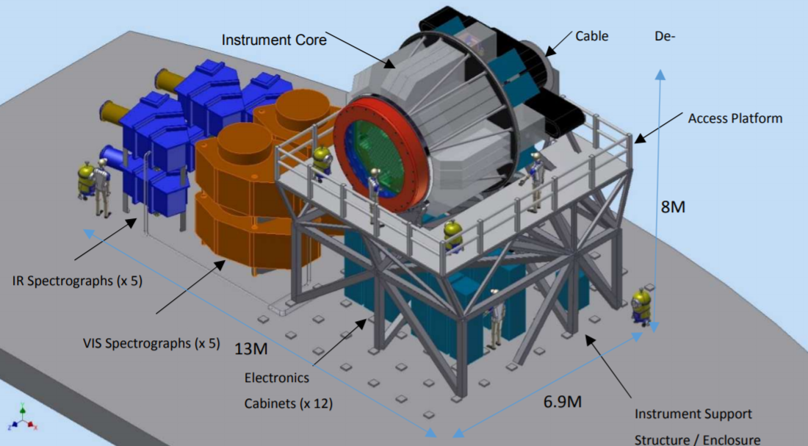
Phase A studies
HIRES
High spectral resolving power (R>100000)
Optical to near infrared
MOSAIC
Multi-object spectrograph
Optical to near infrared
Single object and multi-IFU

