Slide 1
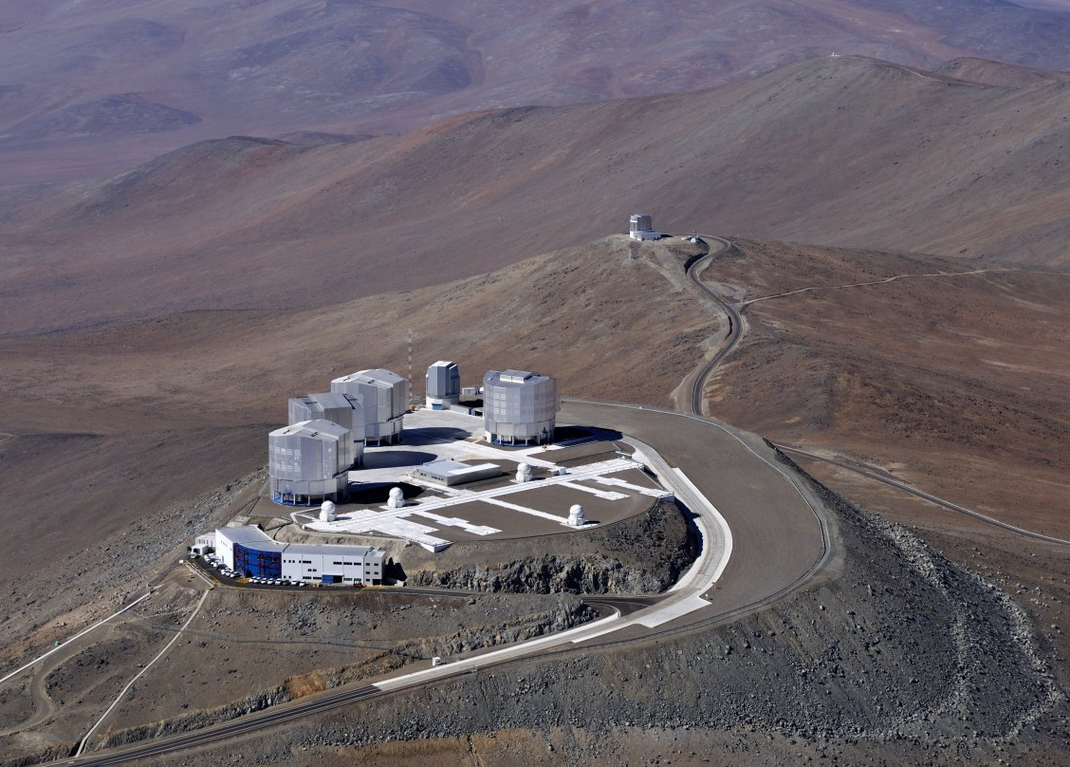
Next Decade of SN Cosmology
ESO Perspectives

Slide 2

Paranal 2016
?
?
?

Slide 3
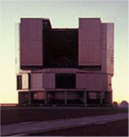
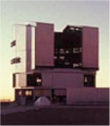
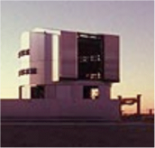
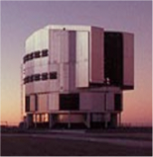
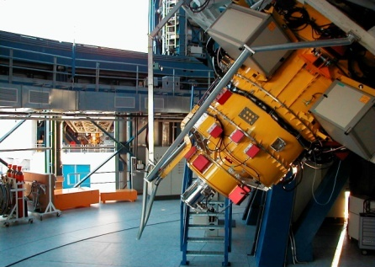
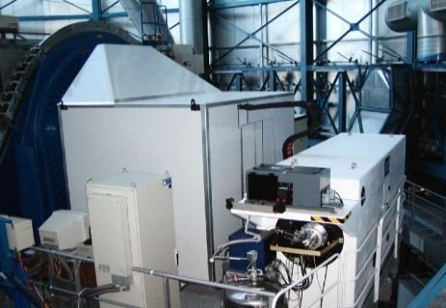
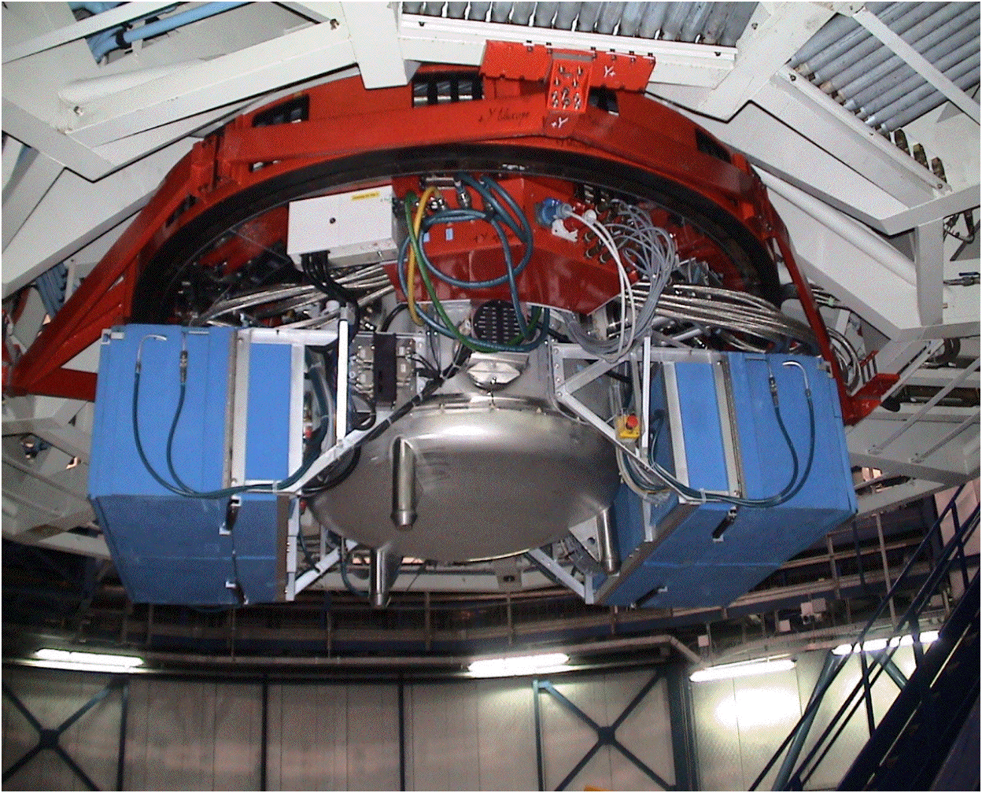
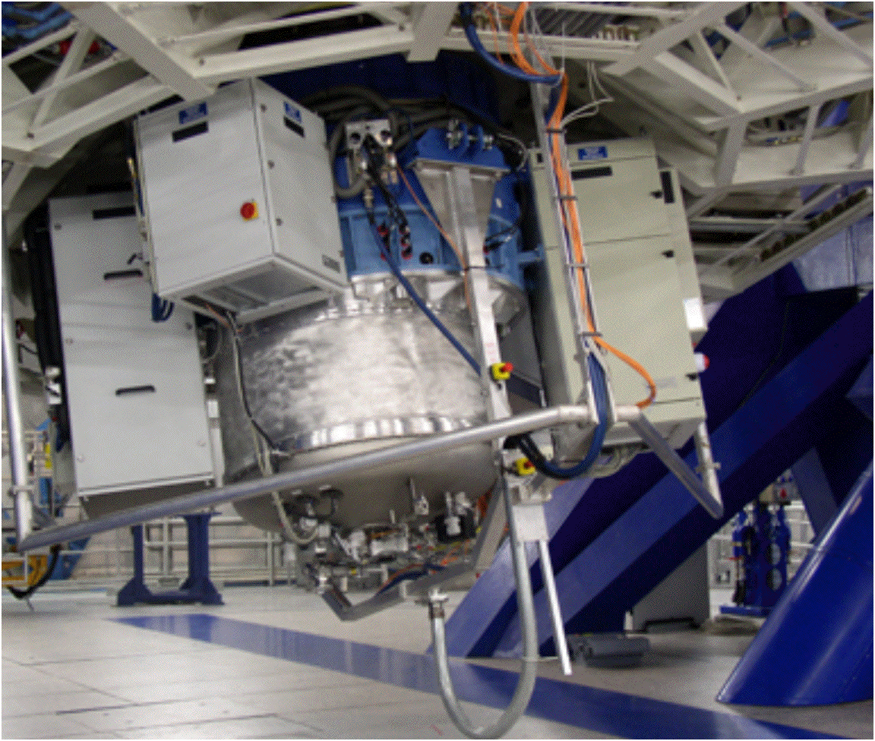
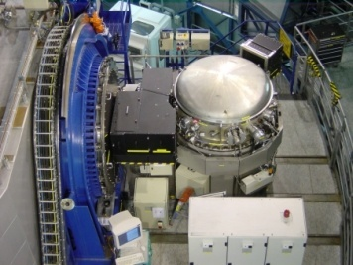
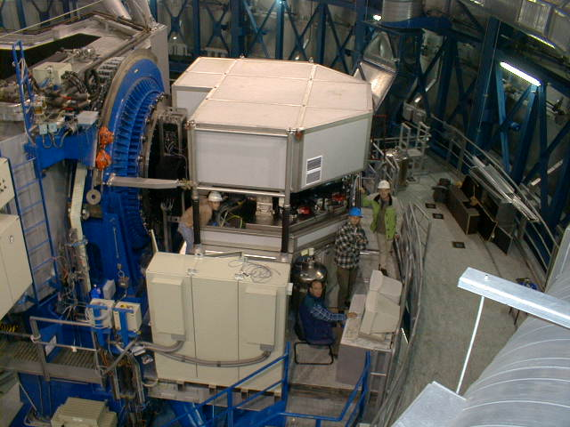
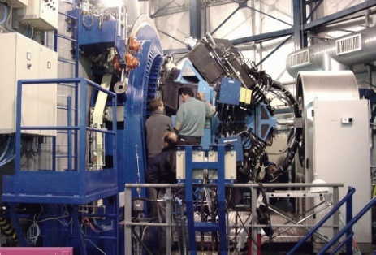
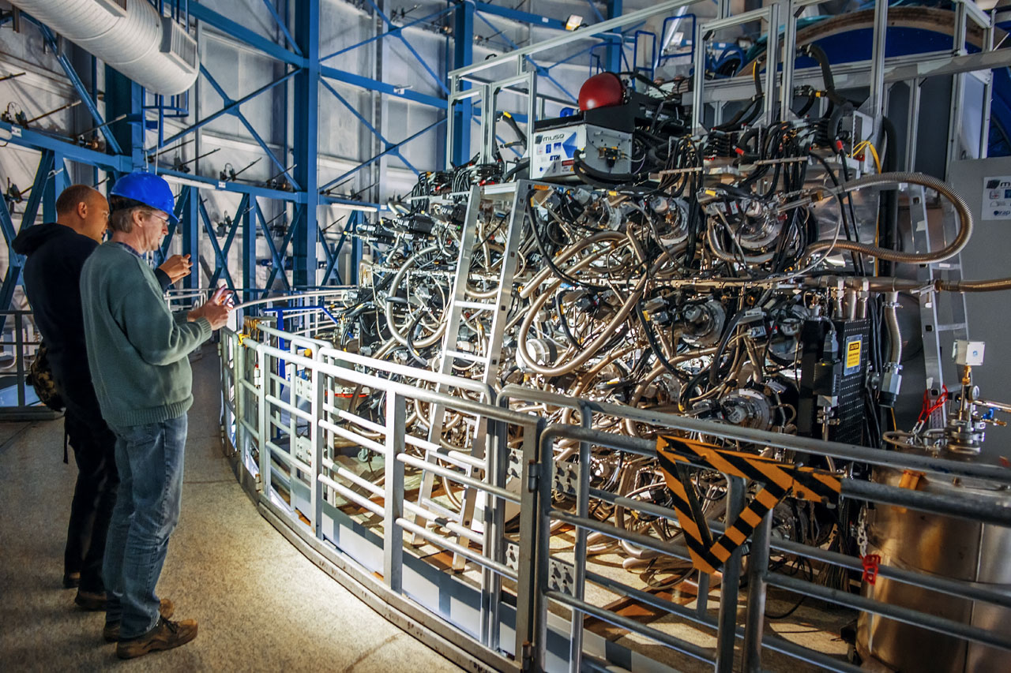
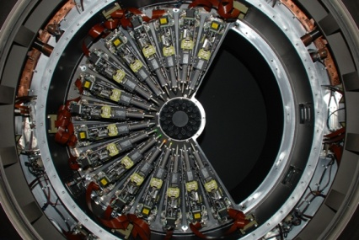
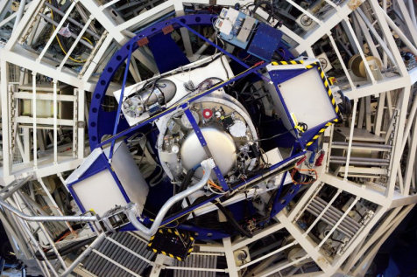
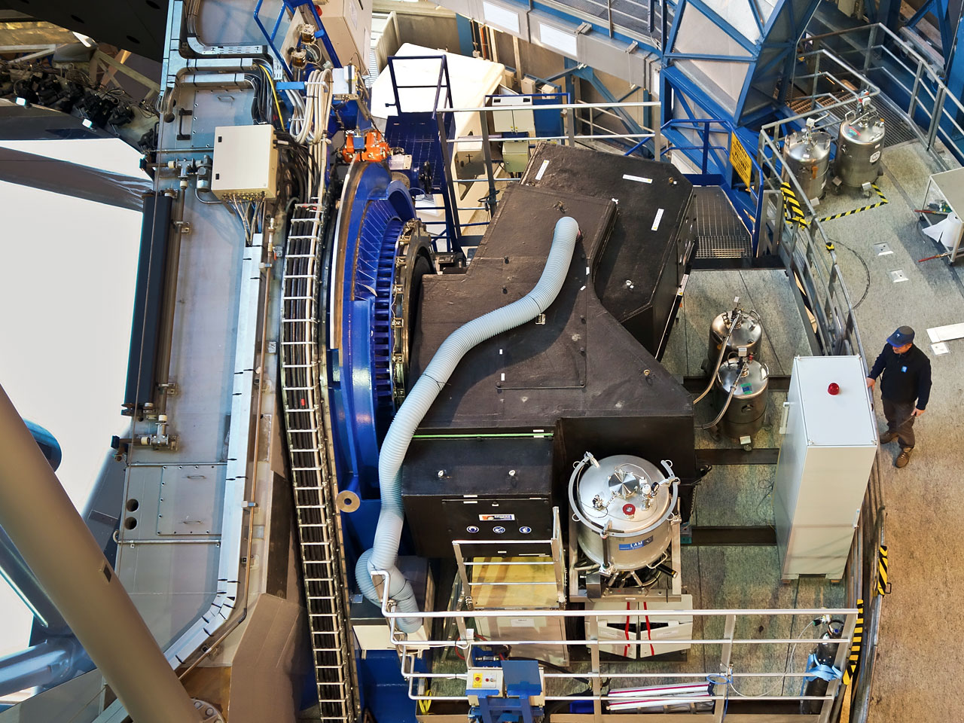
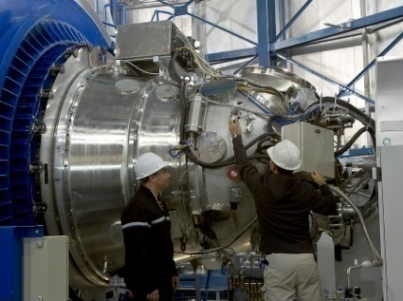
VLT Instruments 2016
FORS2
FLAMES
VISIR
SINFONI
CRIRES
UVES
VIMOS
MUSE
KMOS
X-shooter
SPHERE
HAWK-I

Slide 4
Individual objects
Most VLT instrumentation is for follow-up observations
Large instrument complement for nearby SNe
  NACO – progenitors
  FORS2 – SN spectra
  UVES – environments, abundances
  XSHOOTER – redshifts (CANDELS SNe), late phases
  VISIR – mid-infrared
  MUSE – SN environments (SN Refsdal)
  HAWK-I – near-IR follow-up
  EFOSC2/SOFI - PESSTO
Detailed investigations of individual objects

Slide 5
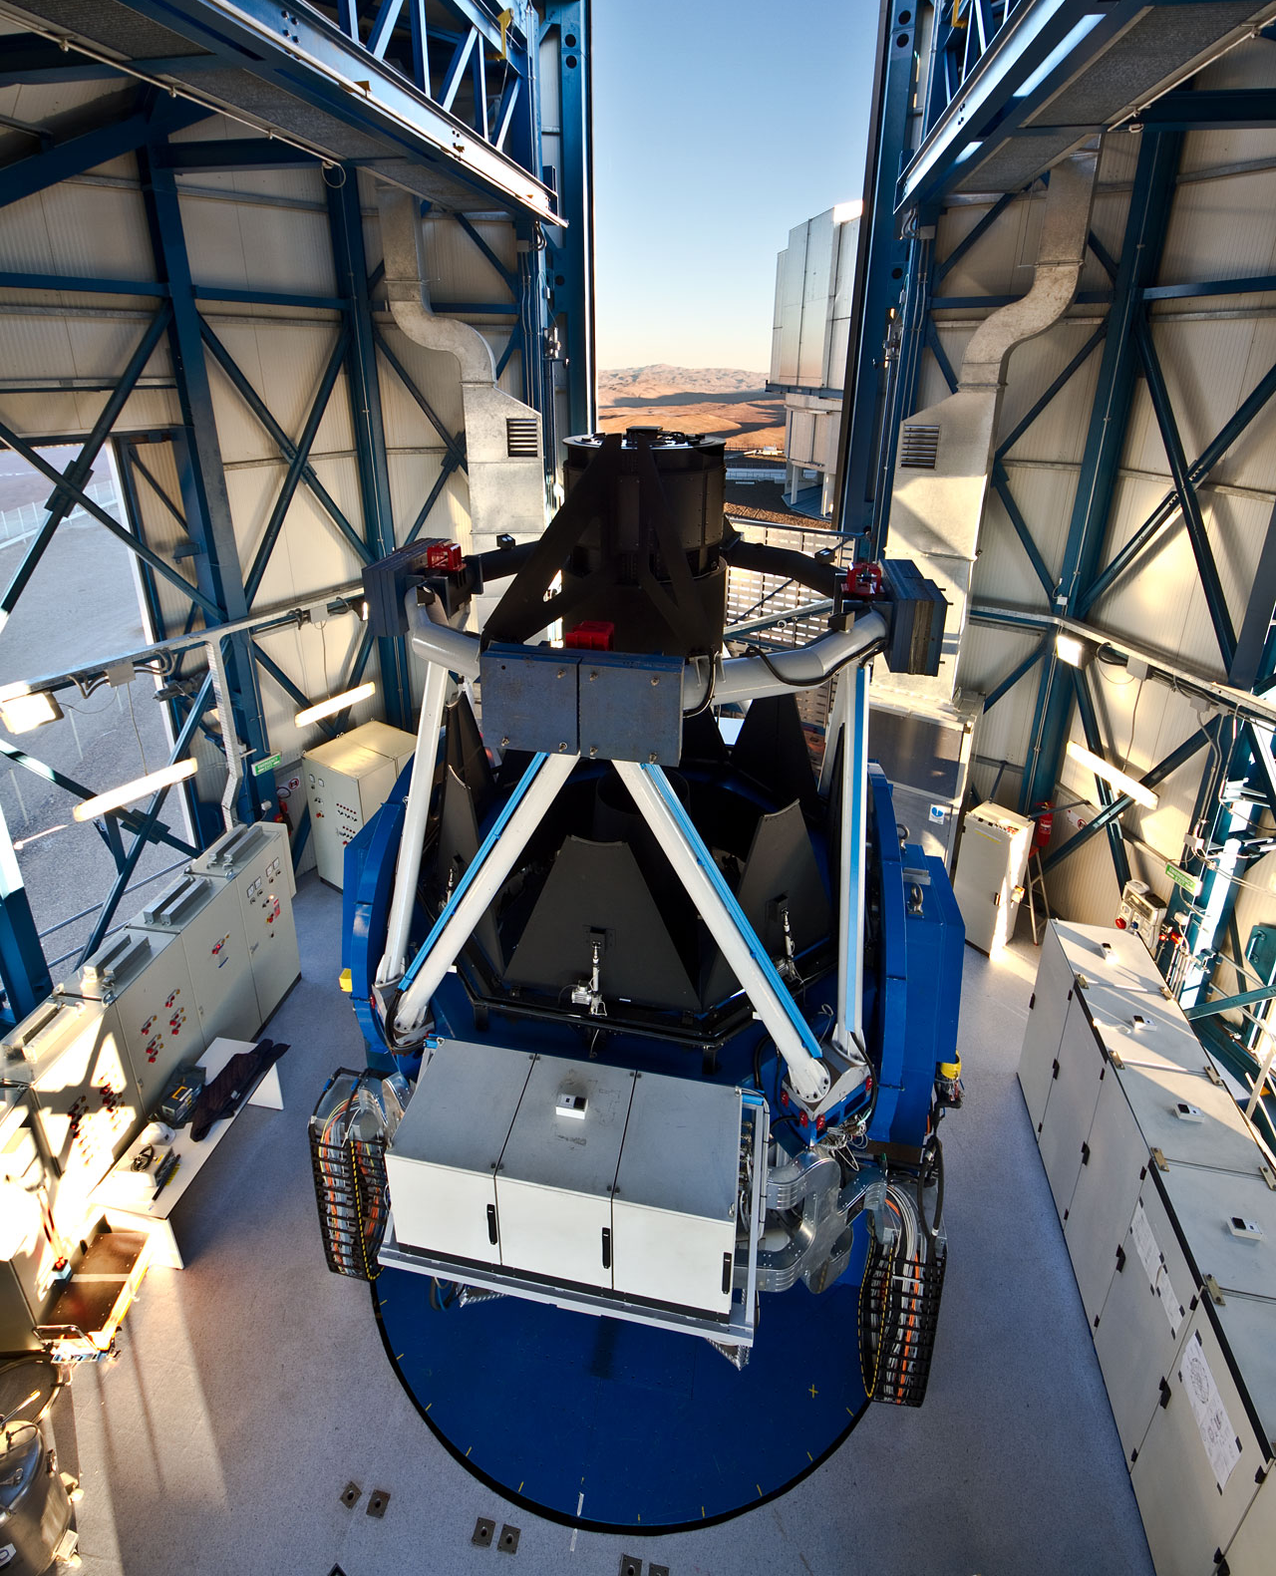
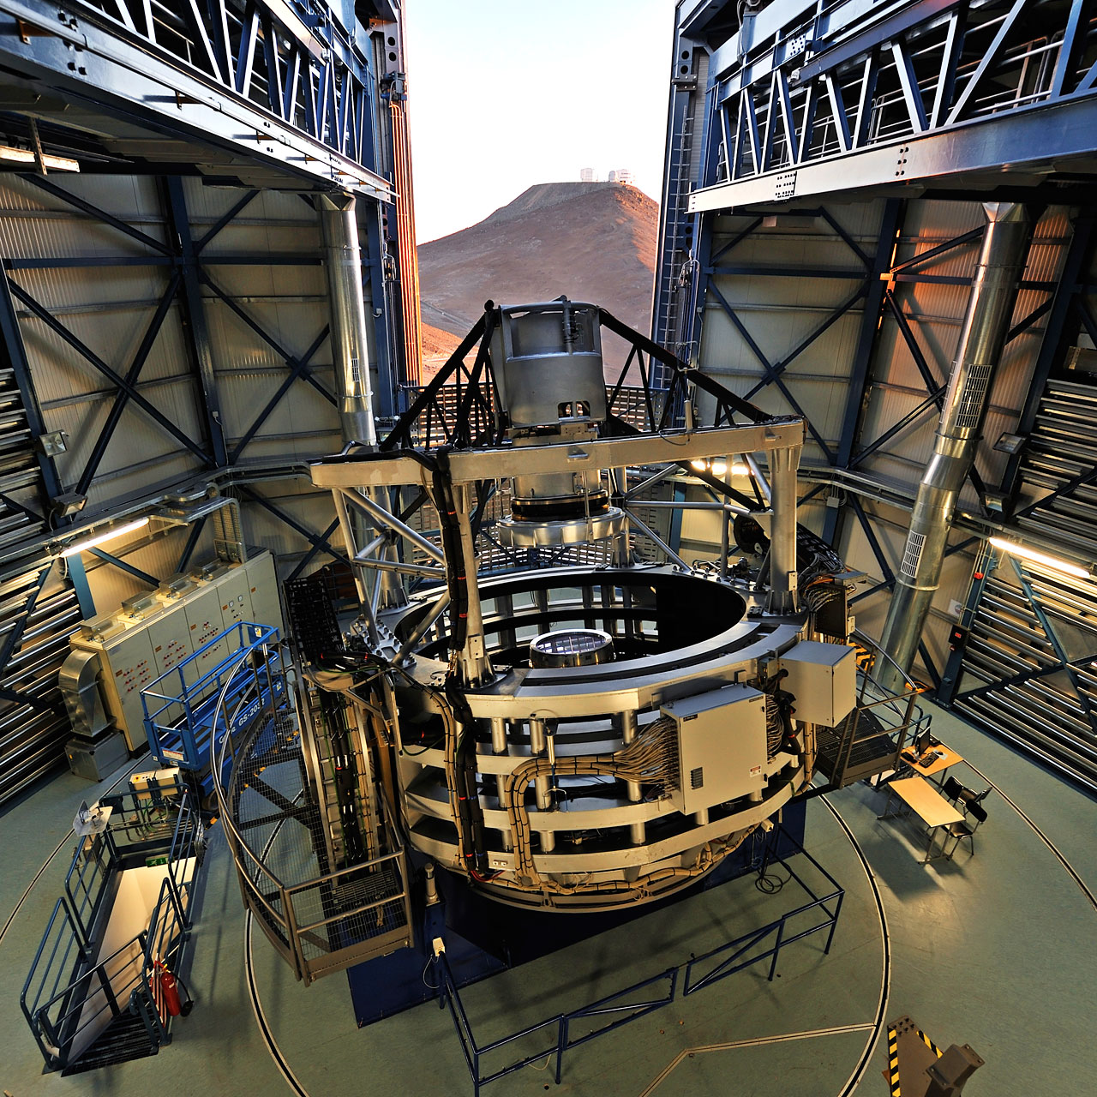
The Survey Telescopes
VST 2.6m for optical and VISTA 4.1m for infrared observations
Coordinated sky surveys in 5-year projects

Slide 6
Survey Telescopes
Cappellaro et al. 2016
VST
  SN search SUDARE
VISTA
  VVV SNe behind bulge
VLT follow-up of DES SNe
  HAWK-I provides IR
  X-SHOOTER for host galaxy redshifts

Slide 7
Long-Term Monitoring Programs
Supernovae
  Key Program in 1980s
  Several Large Programs
    Turatto et al., Benetti et al.
  Public Spectroscopic Survey
    PESSTO
      90 nights per year for spectroscopic SN follow-up
      concentrate on peculiar and rare types of supernovae

Slide 8
Paranal 2020

Slide 9
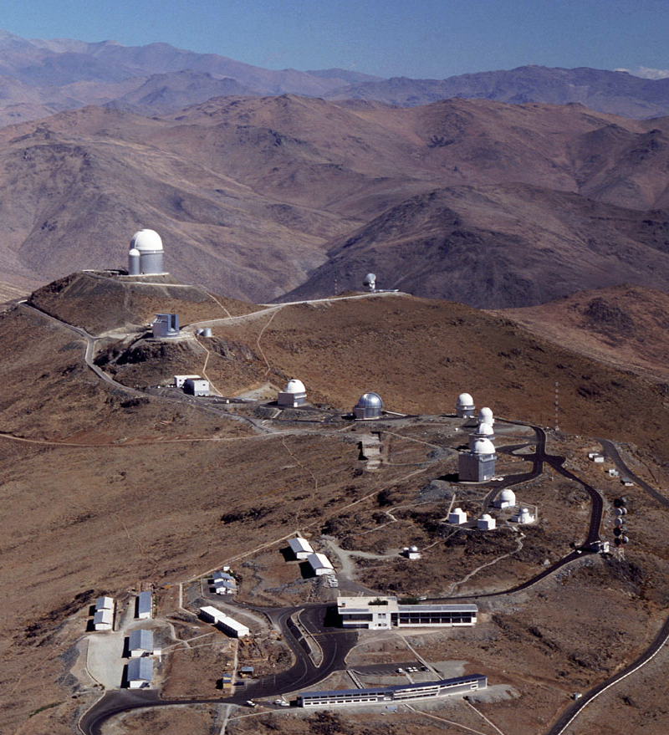
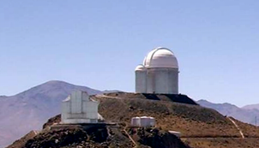
ESO Optical/NIR Telescope System after 2020
Paranal >2020
3.6m/exoplanets
NTT
transients

Slide 10
The ESO Transient Sky
Traditionally challenging for community observatories
Adapt operational modes
  flexible scheduling
  variable timescales
  large Target of Opportunity fraction
  rapid response mode
  service mode operations
  dedicate telescopes
Systematic archiving
  time series

Slide 11
Strategic Changes - next decade
Move towards a systems approach
  Big problems need coordinated observations
    Milky Way dynamics
    → Gaia astrometry plus velocities and abundances
    Cosmology
    → EUCLID and redshifts
    Particle Physics
    → messengers and electromagnetic follow-up
  Coordination between different observatories
    Multi-wavelength and multi-messenger approach
    Complex astrophysical sites
    → e.g. star formation regions, SN remnants, galaxy clusters, distant universe

Slide 12
SOXS on the NTT
Negotiations with a consortium to provide a single-object spectrograph for the NTT - SOXS
  copy of Xshooter
  simultaneous coverage from 400nm to 1.8μm
  significant investment of observing time over many years
  continuation of PESSTO-like survey

Slide 13
Future SN Cosmology
Promise of the (rest-frame) infrared
  Reduced absorption
  Greater uniformity in the light curves

Slide 14
SN Ia infrared light curves
IR light curves from the literature
  mostly Carnegie Supernova Project
Individual evolution after first maximum
Uniform late decline rate
Dhawan et al. 2015

Slide 15
Correlations with the optical
IR properties correlate
with optical decline rate
Phase of secondary
maximum strongly
correlated Δm₁₅
Biscardi et al. 2012
Dhawan et al. 2015

Slide 16
Correlation with colour evolution
Phase of second maximum and beginning of the Lira relation are also tightly linked
Dhawan et al. 2014
Phillips et al. 1999

Slide 17
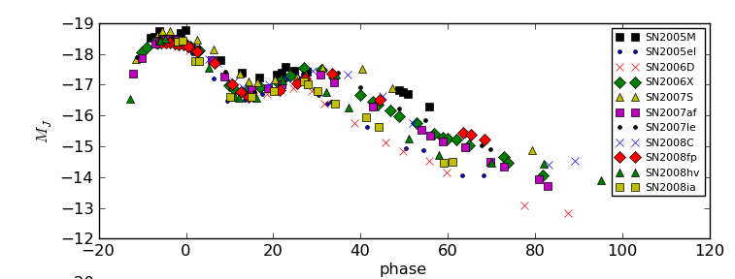
Consistent picture emerging
Second peak in the near-IR is the result of the recombination of Fe++ to Fe+ (Kasen 2006)
  he predicted a later second maximum for larger Ni masses
Optical colour evolution faster for objects with lower nickel mass
(Kasen & Woosley 2007)
Ejecta structure uniform
  late declines very similar
higher luminosity indicates a higher Ni mass
later secondary peak also indicates higher Ni mass
Ni mass and (optical) light curve parameters correlate (Scalzo et al. 2014)
Dhawan et al. 2015

Slide 18
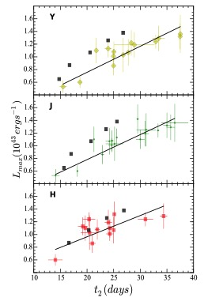
Nickel masses
Dhawan et al. 2016
Using a timing parameter for nickel masses
  completely independent on reddening and multiple light curves
Test with a sample of unreddened SNe Ia
Explore different methods to calculate the nickel mass
(currently still all Chandrasekhar-mass progenitors)

Slide 19
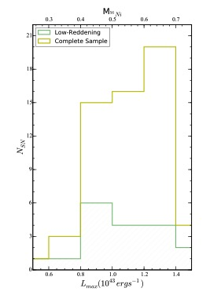
Luminosity and mass functions
Reddening independent distribution functions
  fails for super-Chandra objects
    SN 2007if
    Different physics? Interactions?
Luminosity from second IR maximum?

Slide 20
EUCLID
Use EUCLID deep fields to provide IR light curves
  Rest frame Y out to z~0.8; J to z~0.5
Monitor/shadow the fields from the ground in the optical
  Full optical light curves
  Exact phases
    Important for the (sparse) IR light curves
Spectroscopic follow-up programme
  FORS2 would be ideal

Slide 21
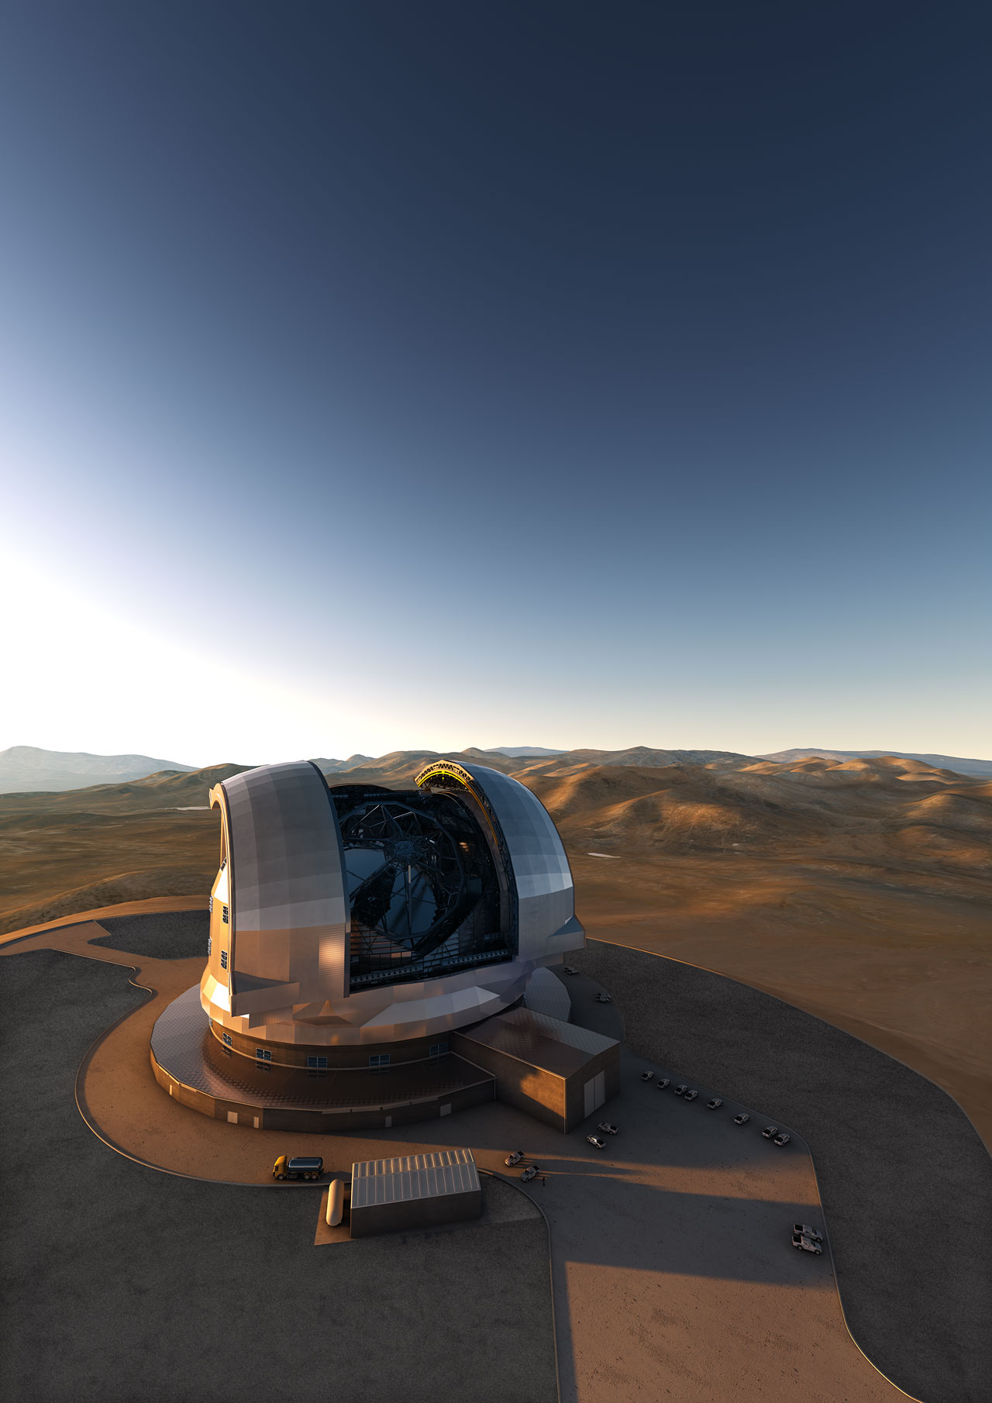
Future Facilities
MOONS (VLT) and 4MOST (VISTA)
  Massive multi-object spectrographs
  Follow-up spectroscopy
    Host galaxies
    Supernovae?
      ‘random phase’
      No systematic follow-up
E-ELT
  Operational from 2025
  First-light instruments
    HARMONI – spectrograph
    MIKADO – camera (0.8-2.4μm)
  Individual objects (0.5-2.4μm)
  High redshift

Slide 22
Astronomy in the 2020s
OIR sky measured to ~25 mag
Thousands of transient alerts per day
Matching capabilities at (almost) all other wavelengths
  angular resolution
  sensitivity
  sky coverage
Astroparticle detections
Diverse astronomical community with considerable overlap with other sciences (chemistry, biology)

