Slide 1
If the observational evidence upon which these claims are based are reinforced by future experiments, the implications for cosmology will be incredible.
Preprint August 1999

Slide 2
Cosmology with Type Ia Supernovae and the
Physics Nobel Prize 2011
Bruno Leibundgut
European Southern Observatory

Slide 3
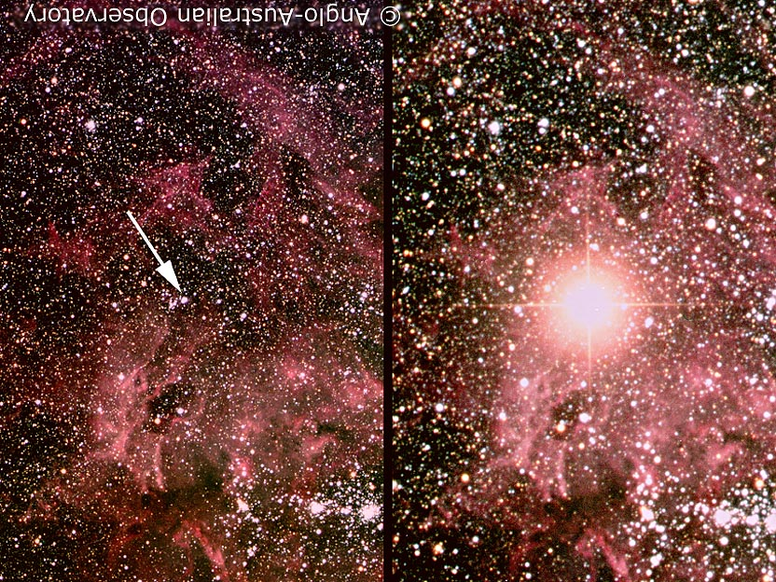
Supernova!
SN 1987A
© Anglo-Australian Telescope

Slide 4
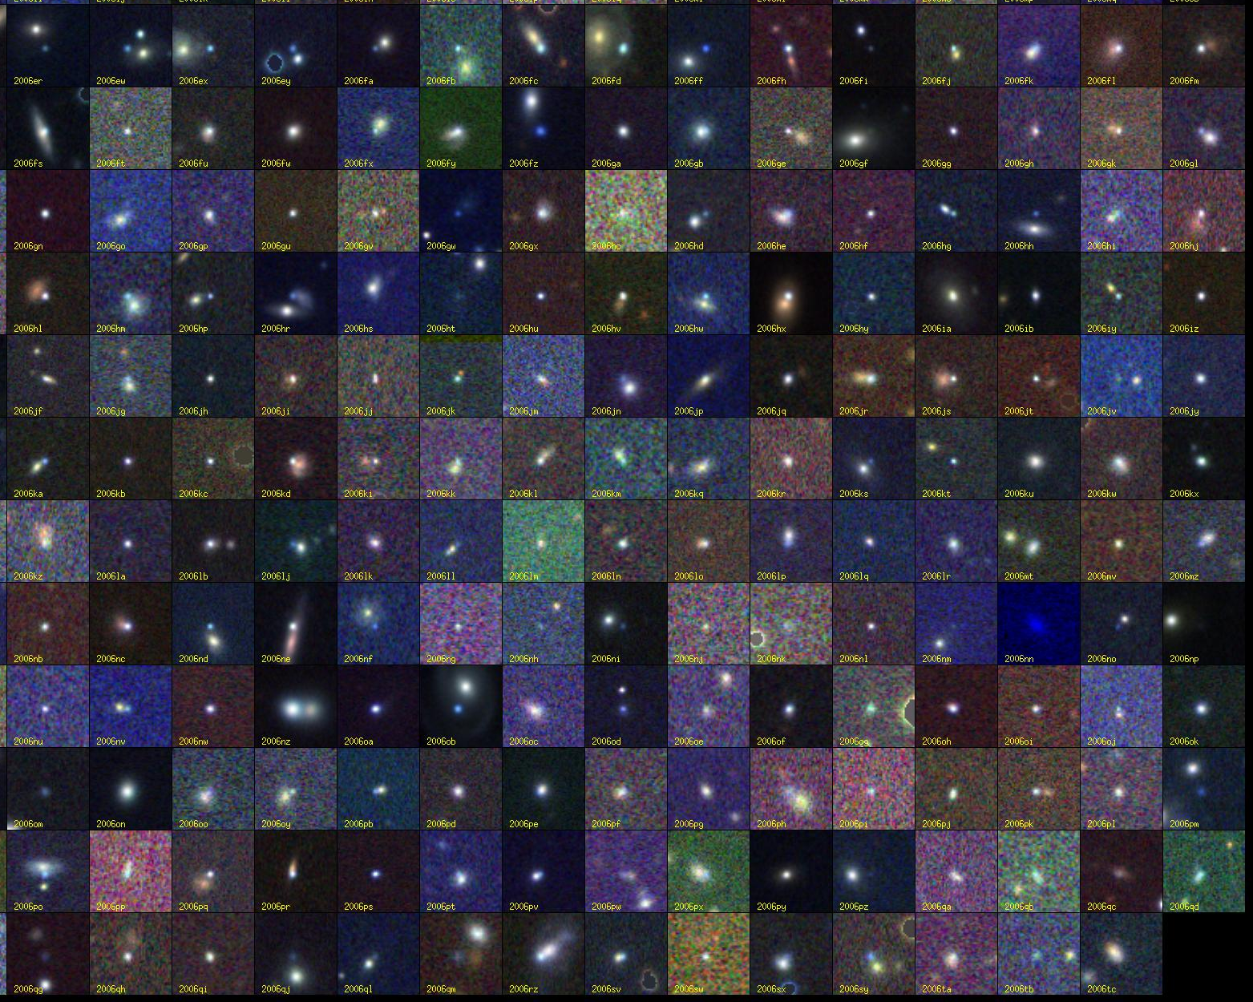
Supernovae!
© SDSSII

Slide 5
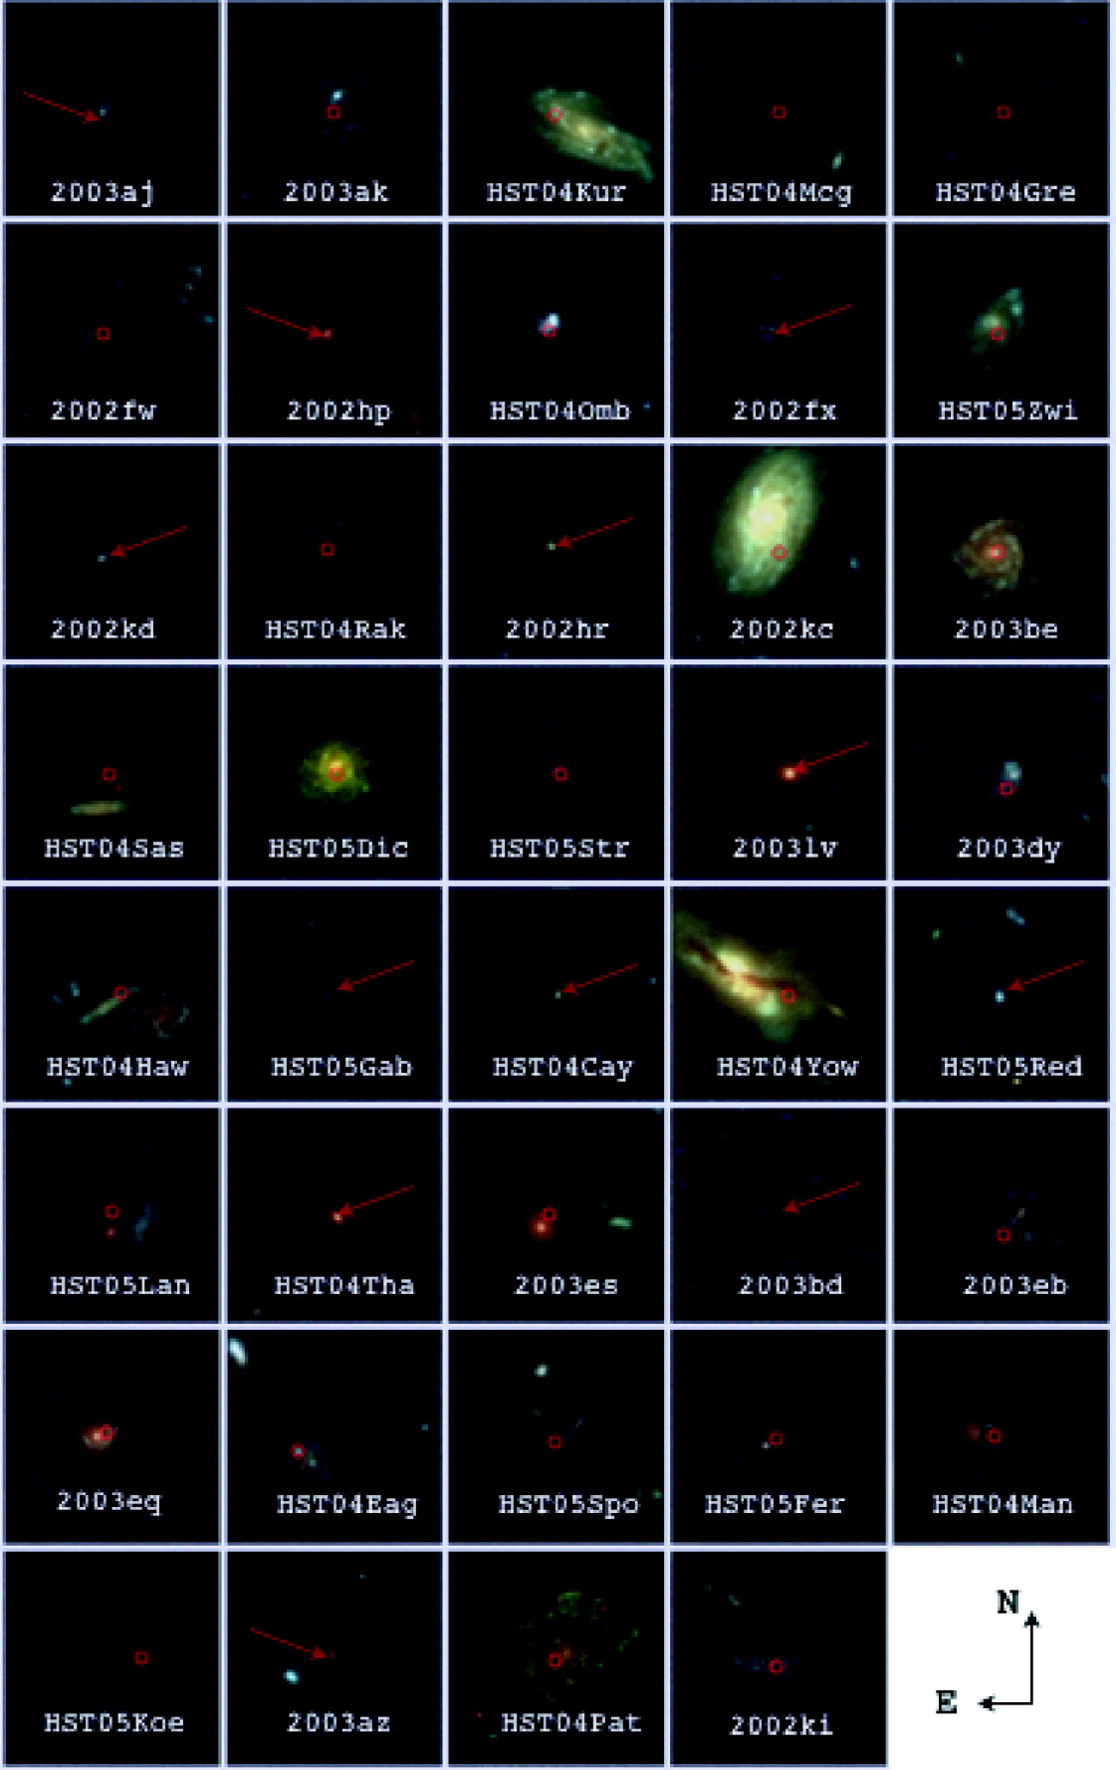
Supernovae!
Riess et al. 2007

Slide 6

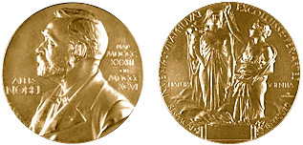
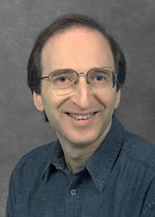

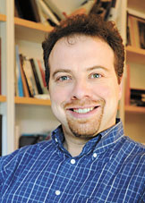
Congratulations!
Saul Perlmutter
Brian Schmidt
Adam Riess
"for the discovery of the accelerating expansion of the Universe through observations of distant supernovae"

Slide 7
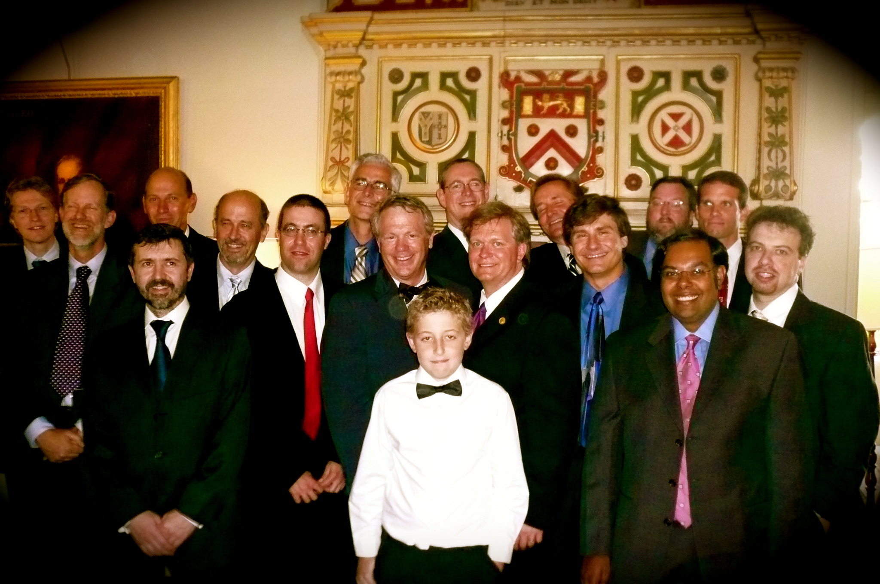
High-z Supernova Search Team

Slide 8
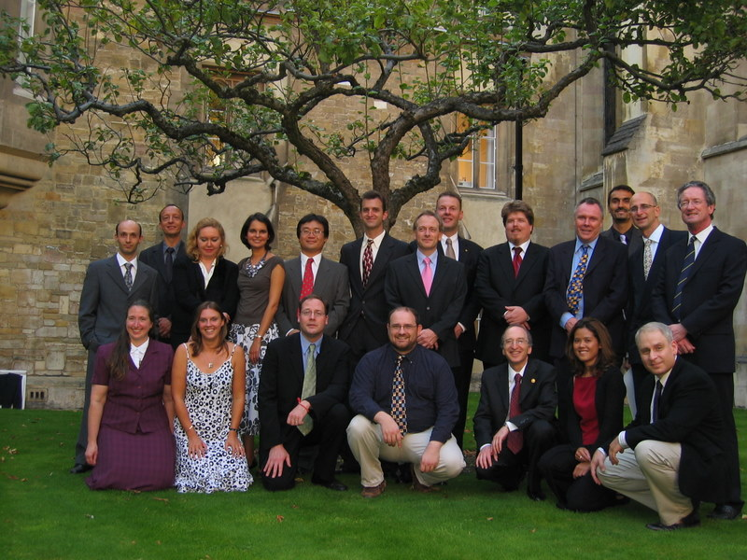
Supernova Cosmology Project

Slide 9
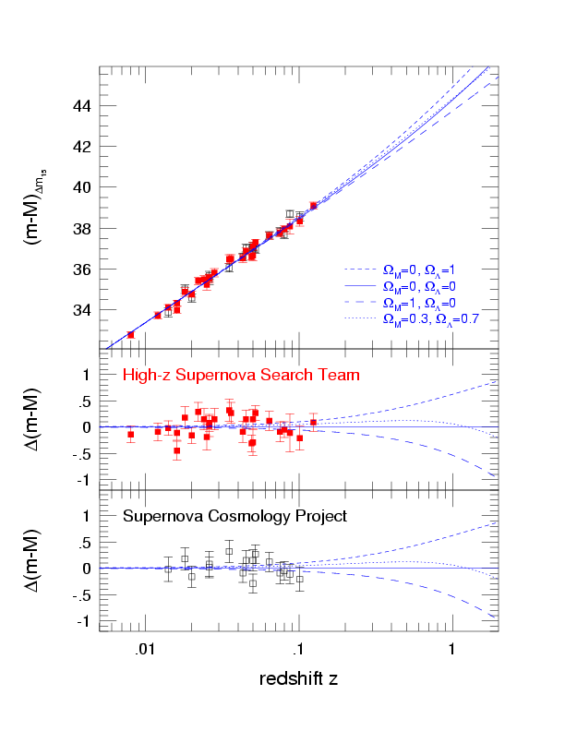
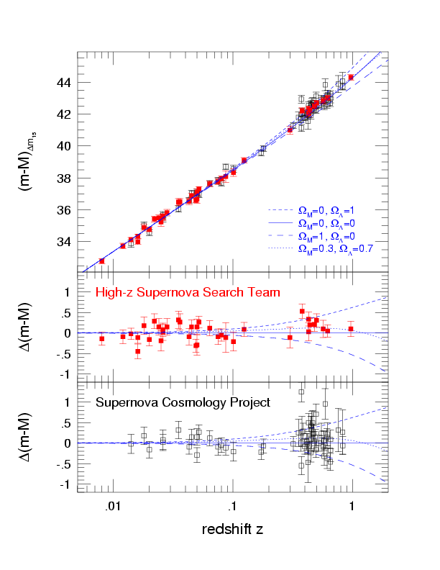
The SN Hubble Diagram
Distance
“expansion”

Slide 10
Astrophysics
To measure cosmological parameters (distances) you need to
  understand your source
  understand what can affect the light on its path to the observer (‘foregrounds’)
  know your local environment

Slide 11
Supernova Classification
Based on the spectral appearance near maximum light
core collapse in massive stars
SN II (hydrogen H)
SN Ib/c (no H/He)
Hypernovae/GRBs
SN Ia (no H)
thermonuclear
explosions

Slide 12
Supernova Types
Thermonuclear SNe
  Progenitor stars have small mass (<8M)
  highly developed stars (white dwarfs)
  Explosive C und O burning
  Binary star systems
  Complete destruction
Core collapse SNe
  Progenitor stars have large mass (>8M)
  large envelope (Fusion still ongoing)
  Burning because of the high density and compression
  Single stars (double stars for SNe Ib/c)
  Neutron star as remnant

Slide 13
Energy Sources
Shocks
  Outburst on stellar surface
  Kinetic Energy
Cooling
  adiabatic due to the expansion of the ejecta
Radioactivity
  Nucleosynthesis
Recombination
  Atoms recombine in the shocked material

Slide 14
Energy Sources
Gravitation →Typ II Supernovae
  Collapse of one solar mass to a neutron star
  Release of 10⁴⁶ Joule
    mostly electron neutrinos ν_{e}
    10⁴⁴ Joule in kinetic energy (Expansion of stellar material)
    10⁴² Joule in radiation
Nuclear (binding-)energy → Typ Ia
  explosive carbon and oxygen burning of one solar mass to Fe
  Release of 10⁴² Joule

Slide 15
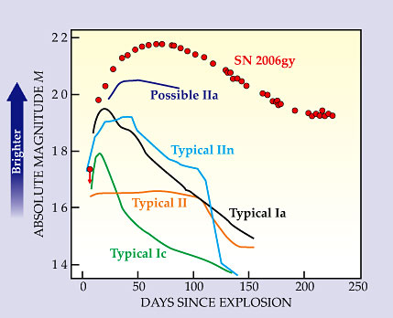
Supernova classification based on maximum light spectroscopy
Thermonuclear supernovae
Core-collapse supernovae
hydrogen
no
yes
silicon
yes
no
Ia
Ib/c
II
Tycho’s SN SN 1991T
SN 1991bg
SN 1992A
SN 1998bu
SN 2001el
SN 2002bo
SN 2002cx
SN 2005hk
IIb
SN 1979C
SN 1980K
SN 1987A
SN 1999em
SN 2004dt
helium
SN 1993J
Smith et al. 2007
no
yes
Ic
Ib
SN 1994I
SN 1996N
SN 2004aw
SN 1983N
GRBs
SN 1998bw
SN 2003dh
SN 2006aj

Slide 16
What do we want to learn about supernovae?
What explodes?
  progenitors, evolution towards explosion
How does it explode?
  explosion mechanisms
Where does it explode?
  environment (local and global)
  feedback
What does it leave behind?
  remnants
  compact remnants
  chemical enrichment
Other use of the explosions
  light beacons
  distance indicators
  chemical factories
deep imaging
late phases?
deep imaging/
integral-field spectroscopy
deep imaging
high resolution spectroscopy
faint object photometry
faint object spectroscopy

Slide 17
Supernova Cosmology
Required observations
  light curve
  spectroscopic classification
  redshift
Required theory
  cosmological model
  (supernova explosions and light emission)
Required phenomenology
  calibrations (photometric systems)
  normalisations (light curve fitters)

Slide 18
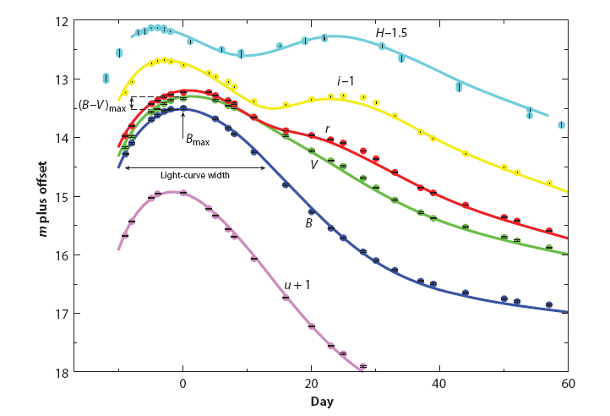
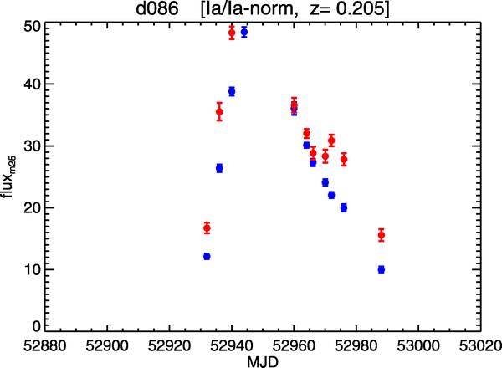
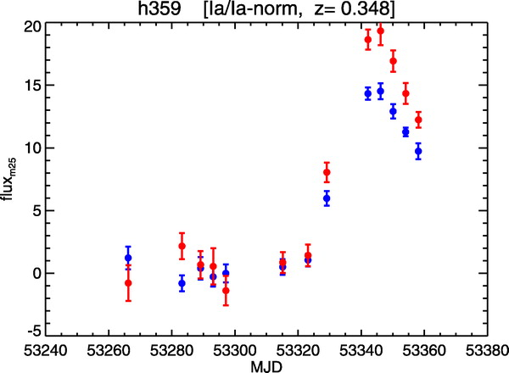
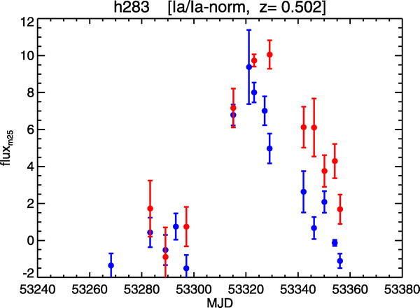
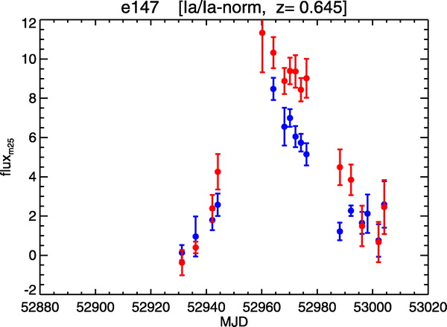
Required observations
Light curves
SN 2007af
Stritzinger et al., in prep
Miknaitis et al. 2007
Miknaitis et al. 2007

Slide 19
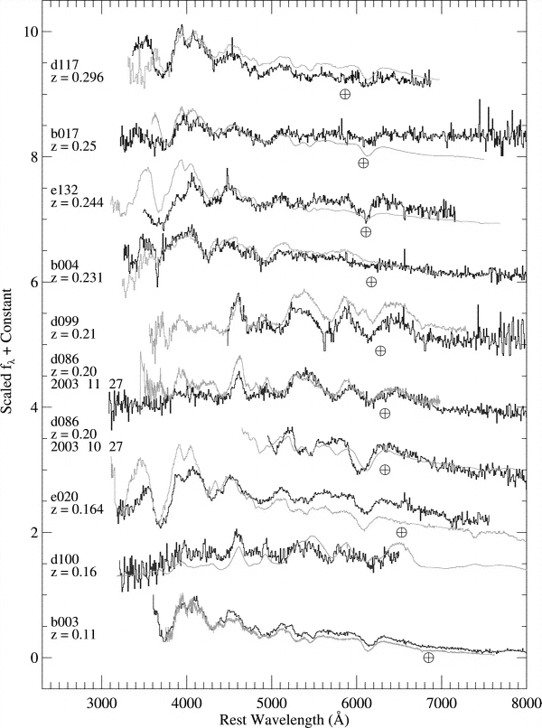
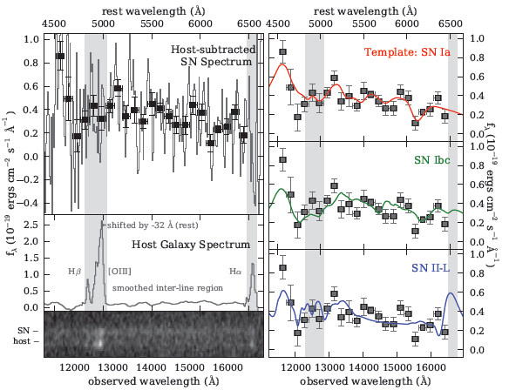
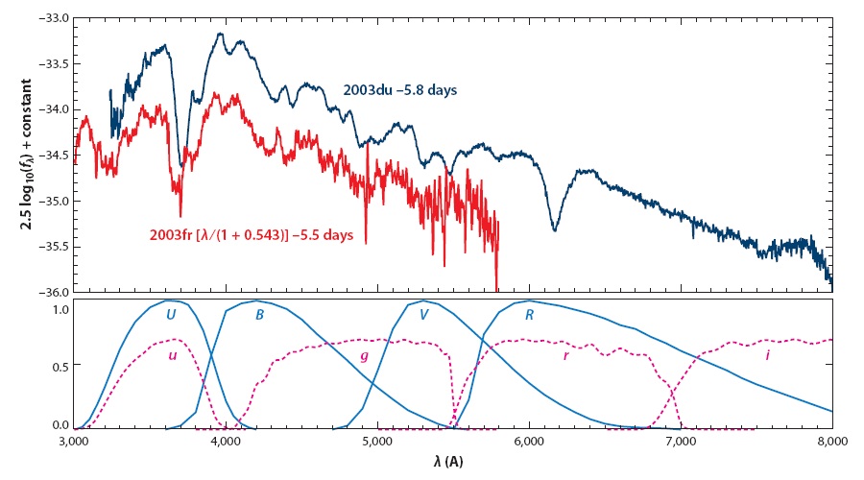
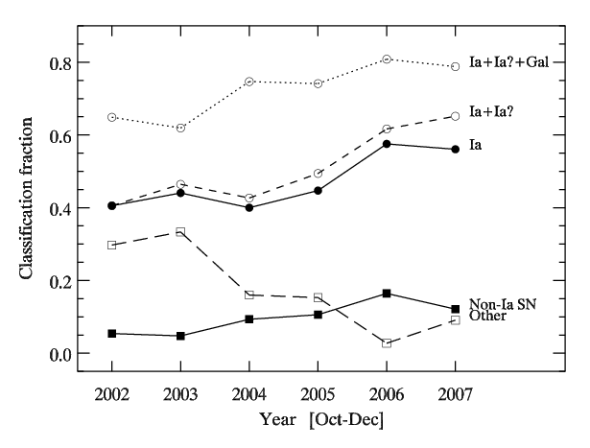
Required observations
Matheson et al. 2007
Spectroscopic
classification
Goobar & Leibundgut 2011
Rodney et al. 2012
Blondin et al., in prep.

Slide 20
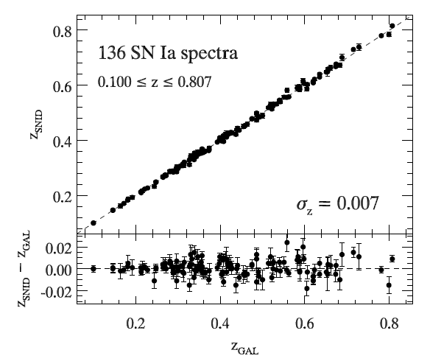
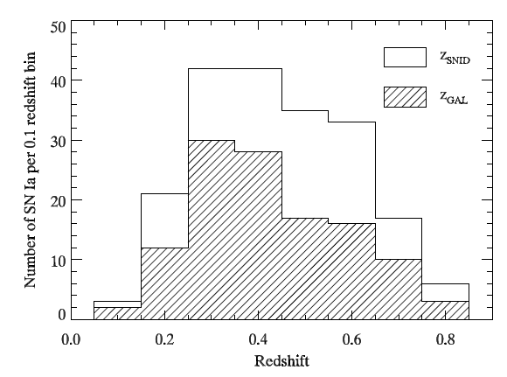
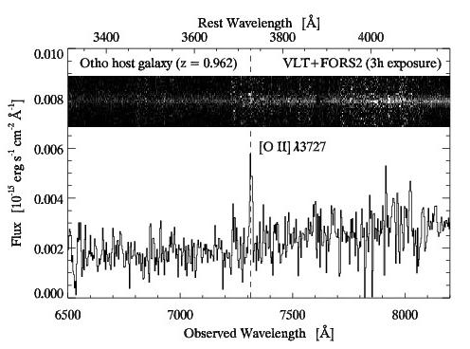
Required observations
Redshifts
Blondin et al., in prep.
Blondin et al., in prep.
Courtesy: Stéphane Blondin

Slide 21
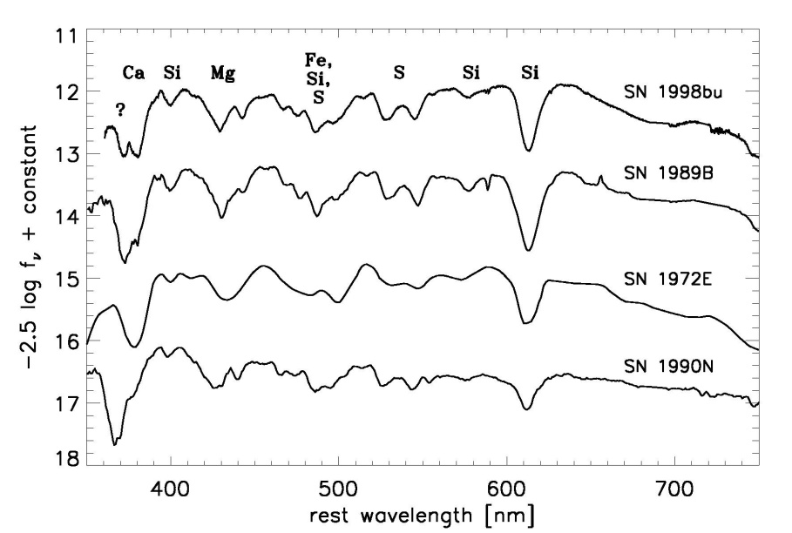
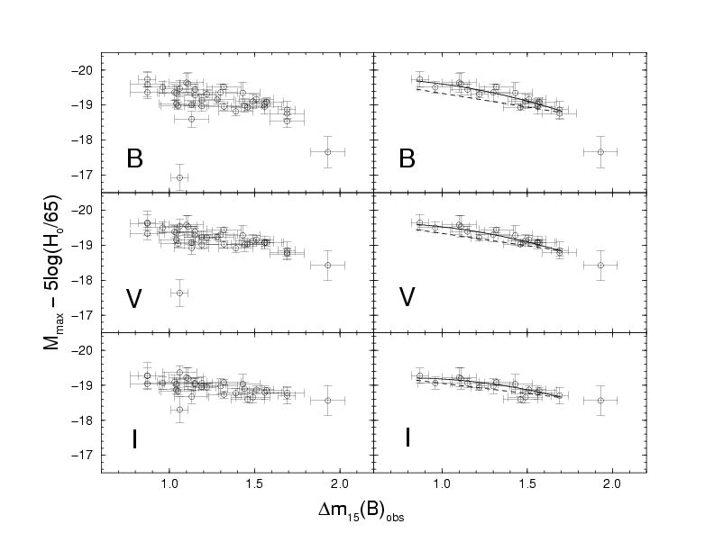
Supernovae as ‘standard candles’
Uniform appearance
  light curves
    individual filters
    bolometric
  colour curves
    reddening?
  spectral evolution
  peak luminosity
    correlations
Jha 2005
Phillips et al. 1999

Slide 22
Systematics
“[T]he length of the list indicates the maturity of the field, and is the result of more than a decade of careful study.”
Contamination
Photometry
K-corrections
Malmquist bias
Normalisation
Evolution
Absorption
Local expansion field

Slide 23
Systematics
Contamination
Photometry measurement
K-corrections
Malmquist bias
Normalisation source
Evolution
Absorption path
Local expansion field local environment

Slide 24
Know your source
Type Ia Supernovae
  complicated source
  interesting physics
  progenitor systems
  determine the global parameters of the explosions
    fuel → nickel mass → distribution in the ejecta
    total mass
    explosion energy

Slide 25
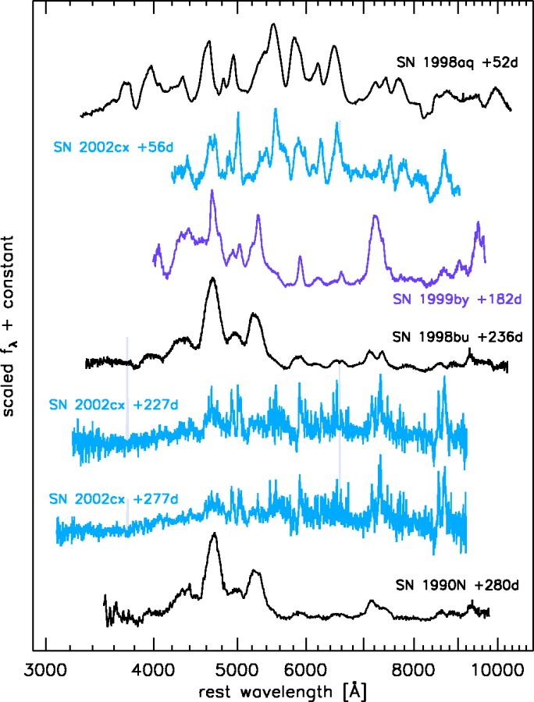
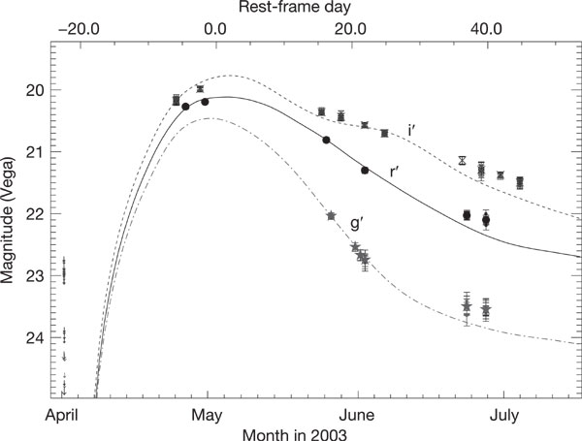
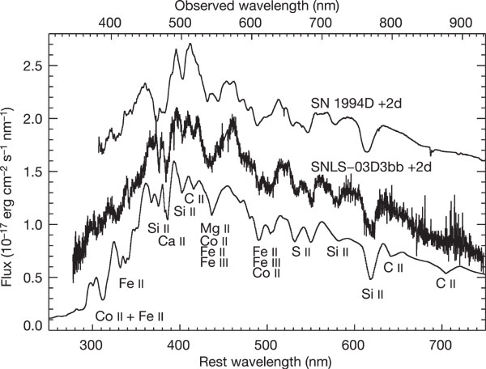
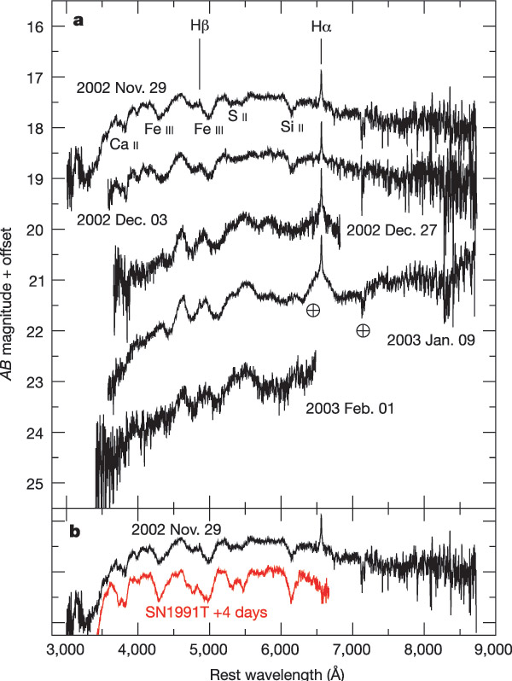
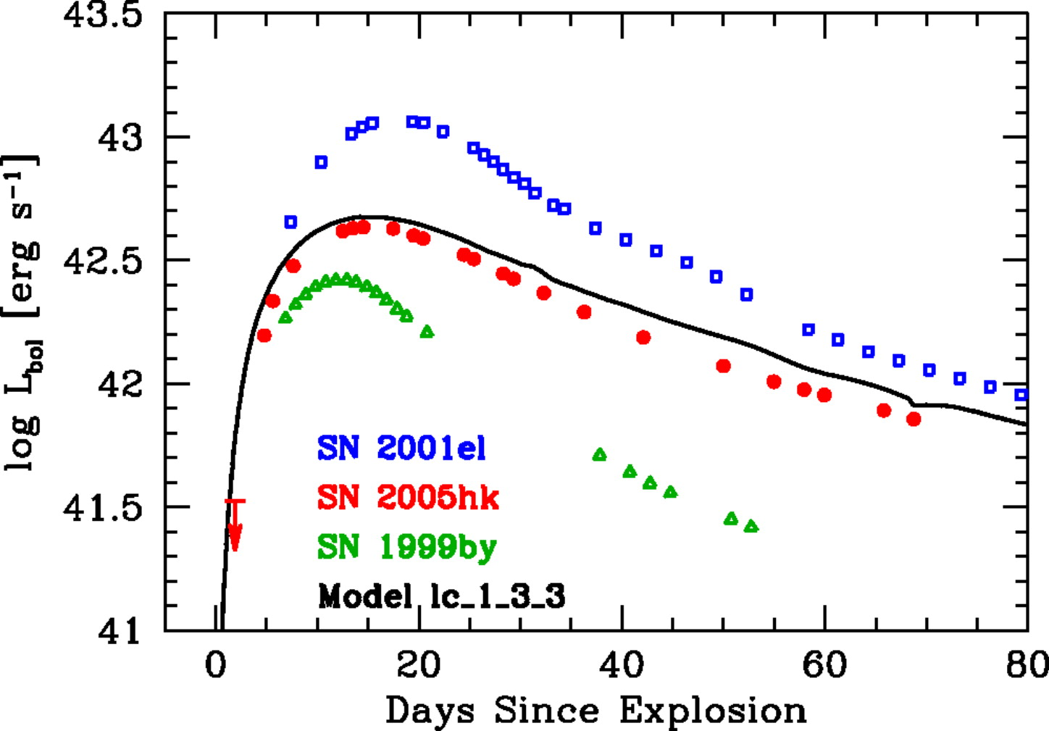
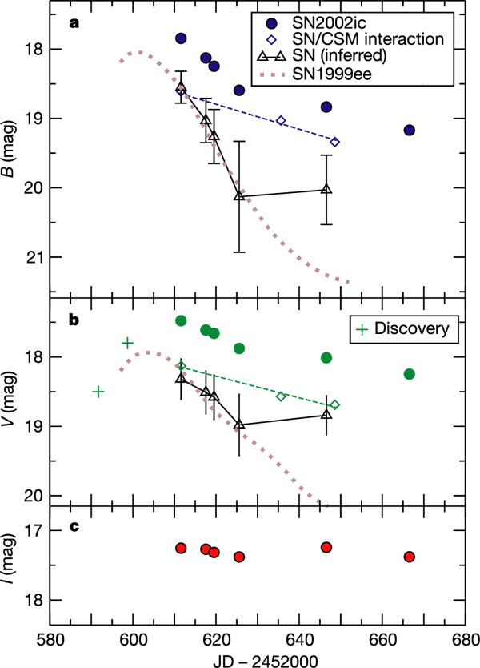
What is a SN Ia?
Jha et al. 2006
Phillips et al. 2007
Peculiar cases abound …
  SN 1991T, SN 1991bg
  SN 1999aa, SN 1999ac
  SN 2000cx, SN 2002cx
  SN 2002ic
  SN 03D3bb
  SN 2005hk
  and more
Howell et al. 2006
Howell et al. 2006
Hamuy et al. 2003

Slide 26
Global explosion parameters
Determine the nickel mass in the explosion from the peak luminosity
  large variations (up to a factor of 10)
Possibly determine
  total mass of the explosion or
  differences distribution of the nickel, i.e. the ashes of the explosion or
  differences in the explosion energies

Slide 27
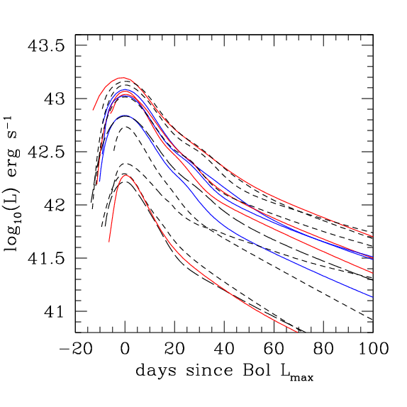
Bolometric light curves
Stritzinger

Slide 28
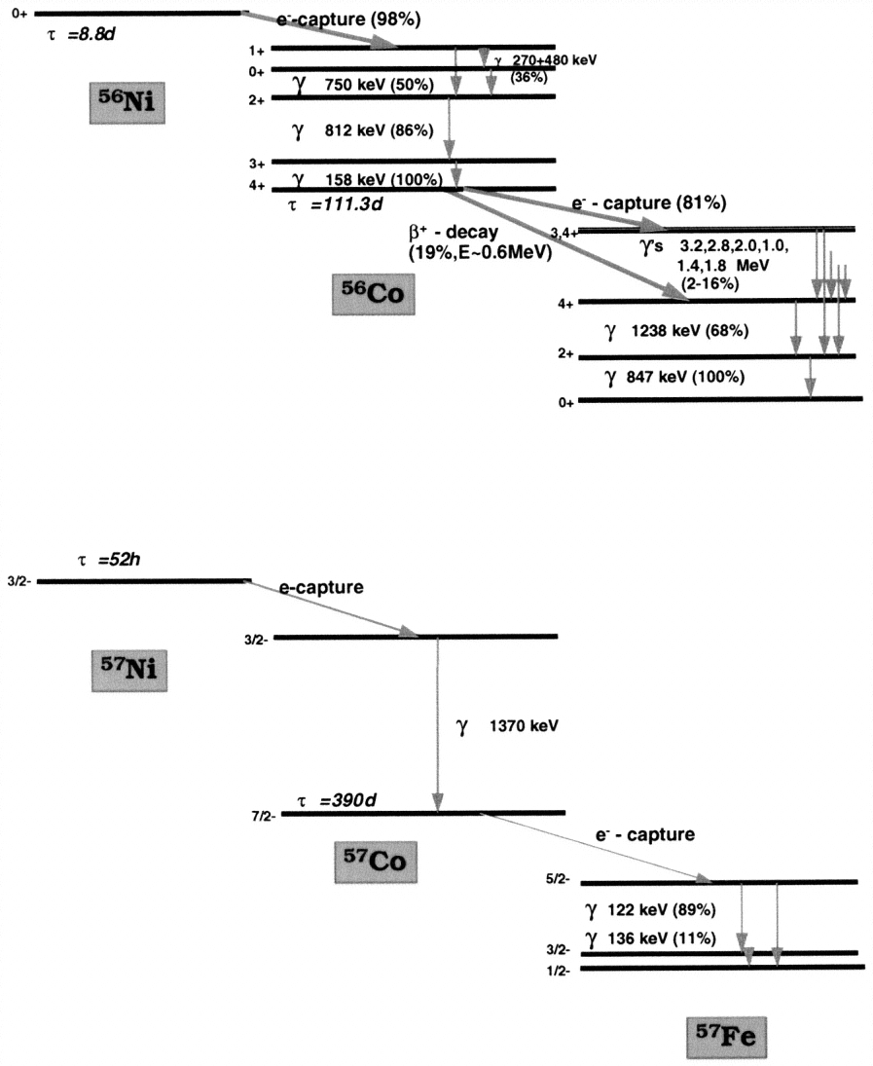
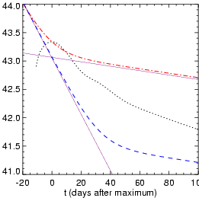
Radioactivity
Isotopes of Ni and other elements
  conversion of γ-rays and positrons into heat and optical photons
Contardo (2001)
Diehl and Timmes (1998)

Slide 29
Determining H₀ from models
Hubble’s law
Luminosity distance
Ni-Co decay

Slide 30
H₀ from the nickel mass
Hubble law
Luminosity distance
Arnett’s rule
Ni-Co decay
and rise time
α: conversion of nickel energy into radiation (L=αE_{Ni})
ε(t): energy deposited in the supernova ejecta
Need bolometric flux at maximum F and the redshift z as observables
Stritzinger & Leibundgut (2005)

Slide 31
Assumptions
Rise time (15-25 days) → about 10% uncertainty
Arnett’s rule
  energy input at maximum equals radiated energy (i.e. α≈1, ε(t_{max}) ≈1)
Nickel mass from models
→ uniquely defines the bolometric peak luminosity

Slide 32
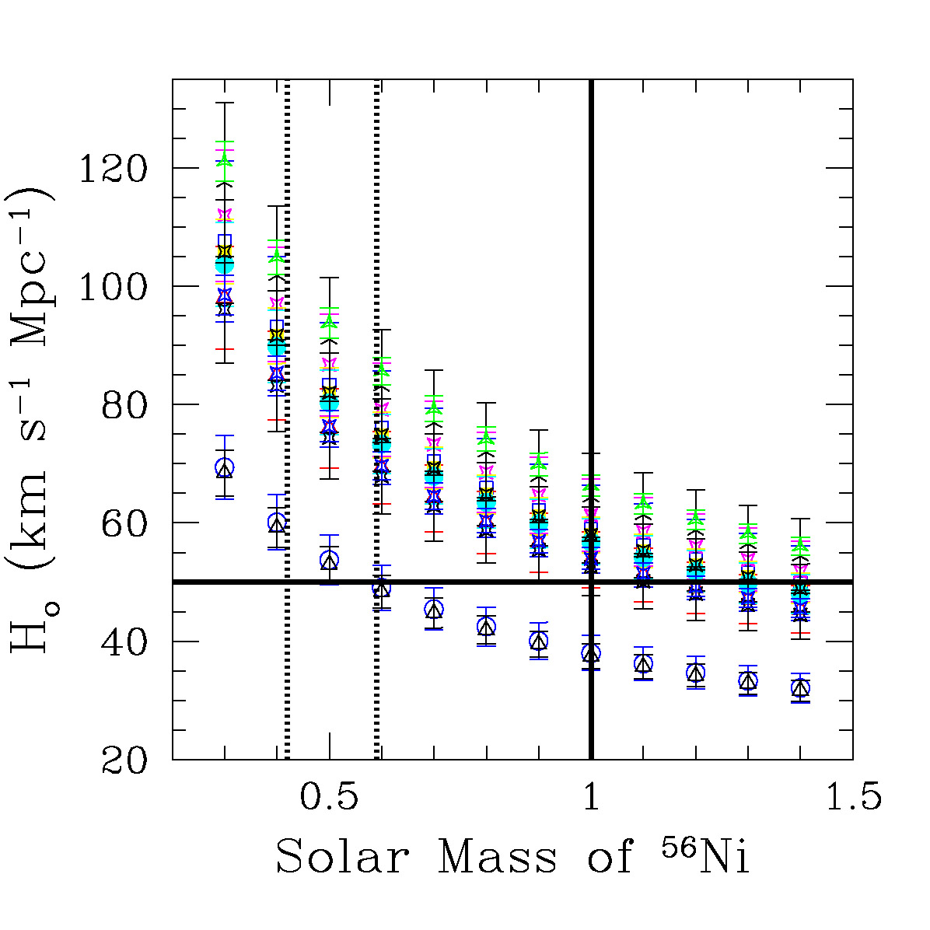
H₀ and the Ni mass
Individual SNe follow the M^{-½}
dependency.
Problem:
Since they have individual Ni masses it is not clear which one to apply!

Slide 33
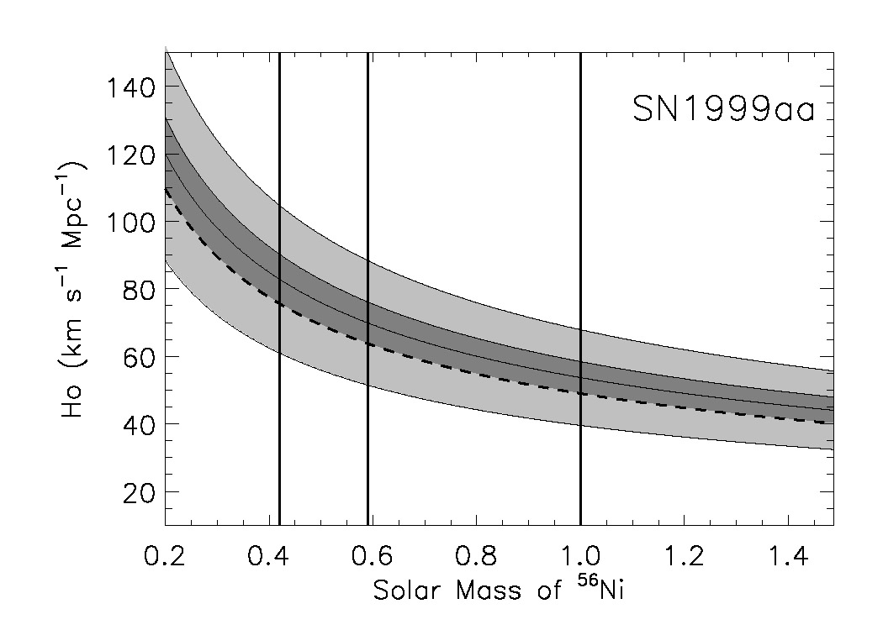
Determine a lower limit for H₀
MPA
W7
1M

Slide 34
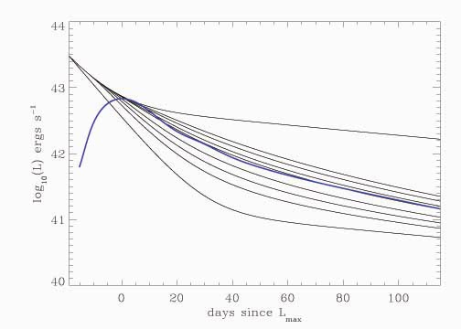
Ejecta masses from light curves
γ-ray escape depends on the total mass of the ejecta
v: expansion
velocity
κ: γ-ray
opacity
q: distribution
of nickel
Stritzinger et al. 2006

Slide 35
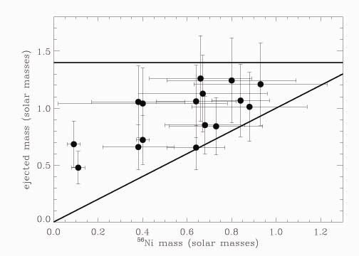
Ejecta masses
Large range in nickel and ejecta masses
  no ejecta mass at 1.4M
  factor of 2 in ejecta masses
  some rather small
  differences between
  nickel and ejecta
  mass
Stritzinger et al. 2006

Slide 36
Type Ia Supernovae
Individual explosions
  differences in explosion mechanism
    deflagration vs. delayed detonations
  3-dimensional structures
    distribution of elements in the ejecta
    high velocity material in the ejecta
  explosion energies
    different expansion velocities
  fuel
    amounts of nickel mass synthesised
  progenitors
    ejecta masses?

Slide 37
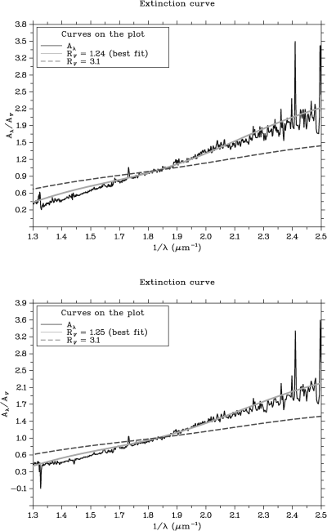
Know what happens on the way
Do we know the reddening law?
  indications from many SNe Ia that R_{V}<3.1
    e.g. Krisciunas et al., Elias-Rosa et al.
  free fit to distant SNe Ia gives R_{V}≈2
    Guy et al., Astier et al.
  Hubble bubble disappears with R_{V}≈2
    Conley et al., Wang
Need good physical understanding for this!
Elias-Rosa et al. (2007)

Slide 38
Varying dust properties in nearby SN hosts
SN2001el
SN2006X
Wang et al.
SN2003cg
Krisciunas et al.
But for high-z SNe it is assumed all SNe hosts have same dust properties!
Elias-Rosa et al.

Slide 39
Are SNe Ia standard candles?
No!
  large variations in
    light curve shapes
    colours
    spectral evolution
    polarimetry
  some clear outliers
    what is a type Ia supernova?
  differences in physical parameters
    Ni mass
    ejecta mass

Slide 40
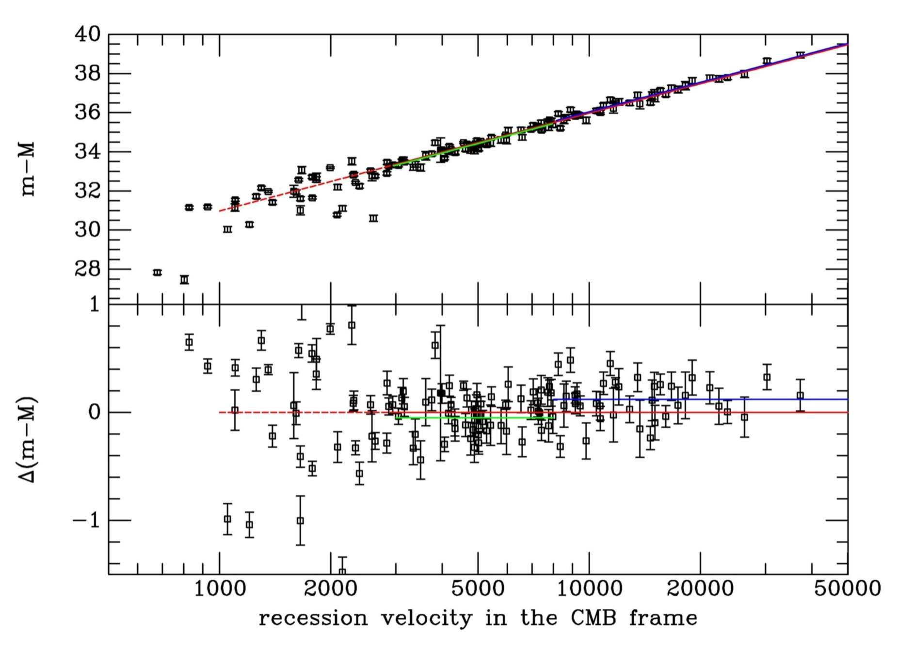
Distance indicator!

Slide 41
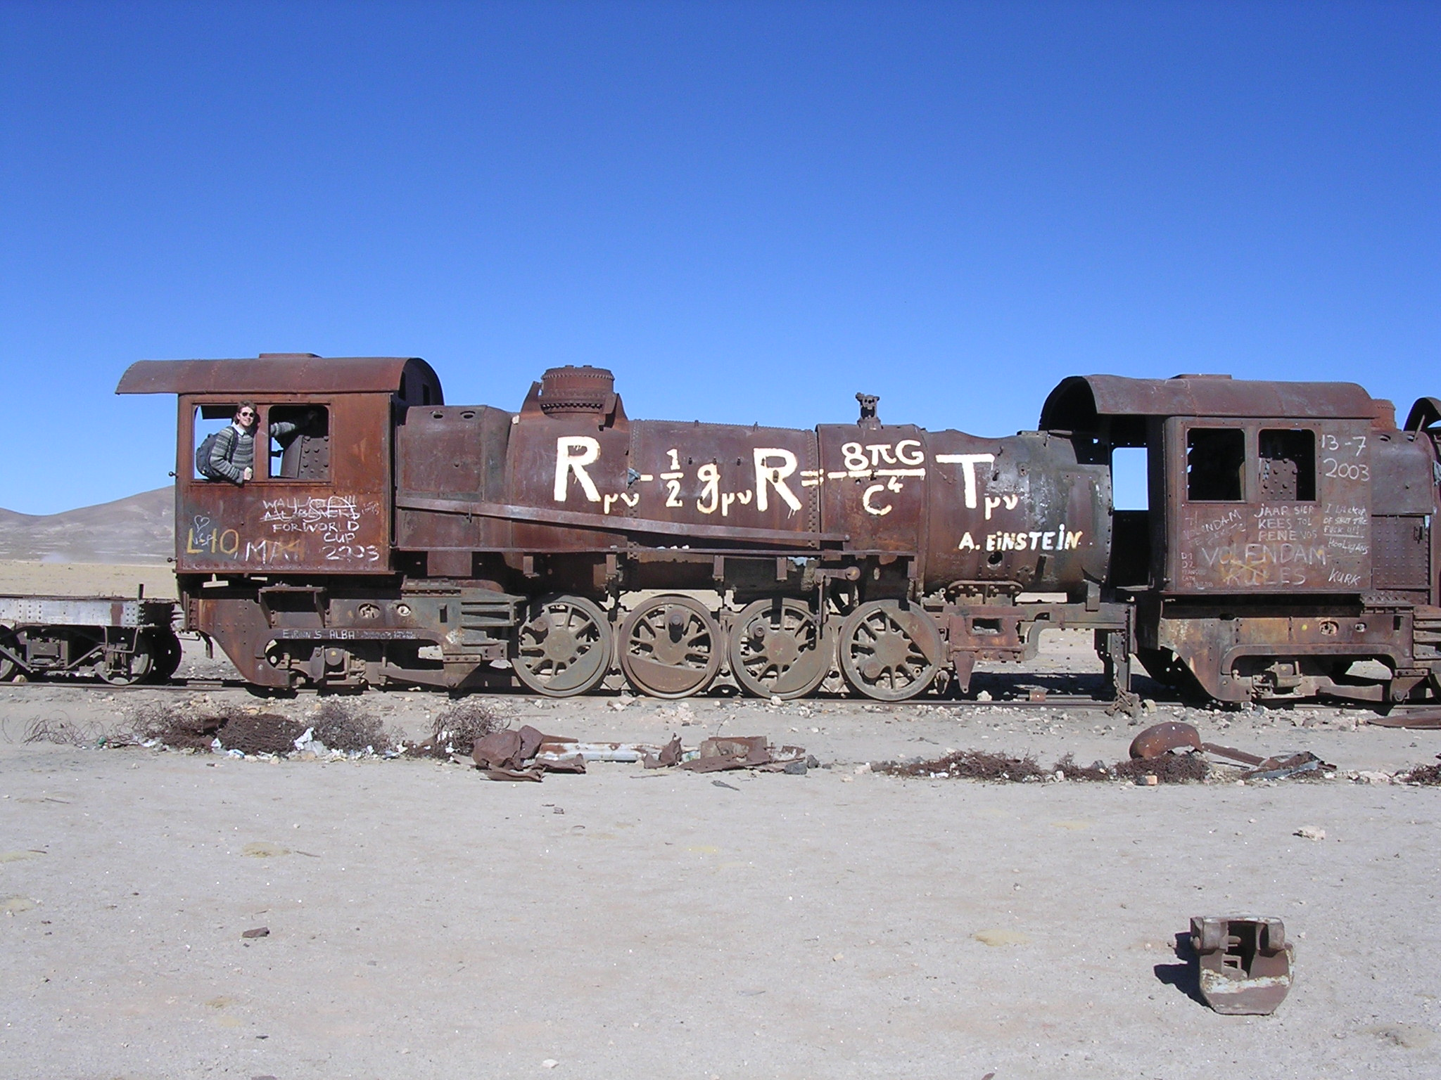
Supernova Cosmology

Slide 42
Friedmann cosmology
Assumption:
homogeneous und isotropic universe
Friedmann-Robertson-Walker-Lemaître metric:
Ω_{M}: matter density
Ω_{k}: curvature
Ω_{Λ}: cosmological constant

Slide 43
Ω=0
Scale factor
‘Mean distance between galaxies’
Ω=1
Ω>1
- 14
- 9
- 7
Time
today
billion years

Slide 44
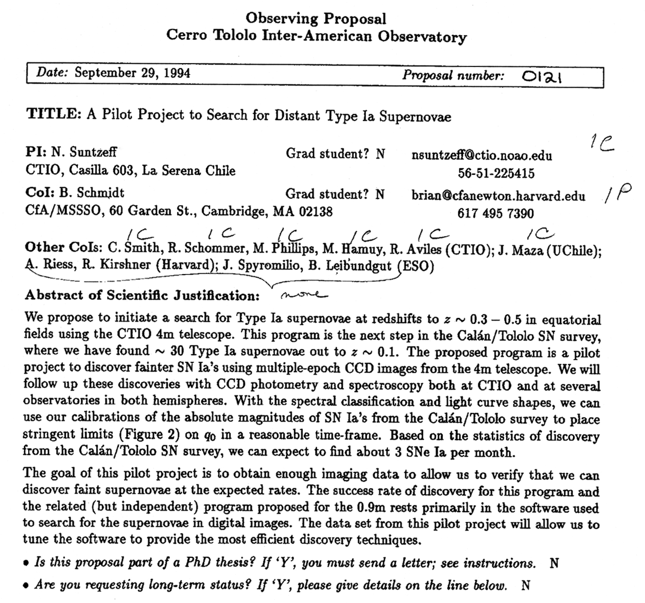
Original High-z SN Search Team Proposal
CTIO

Slide 45
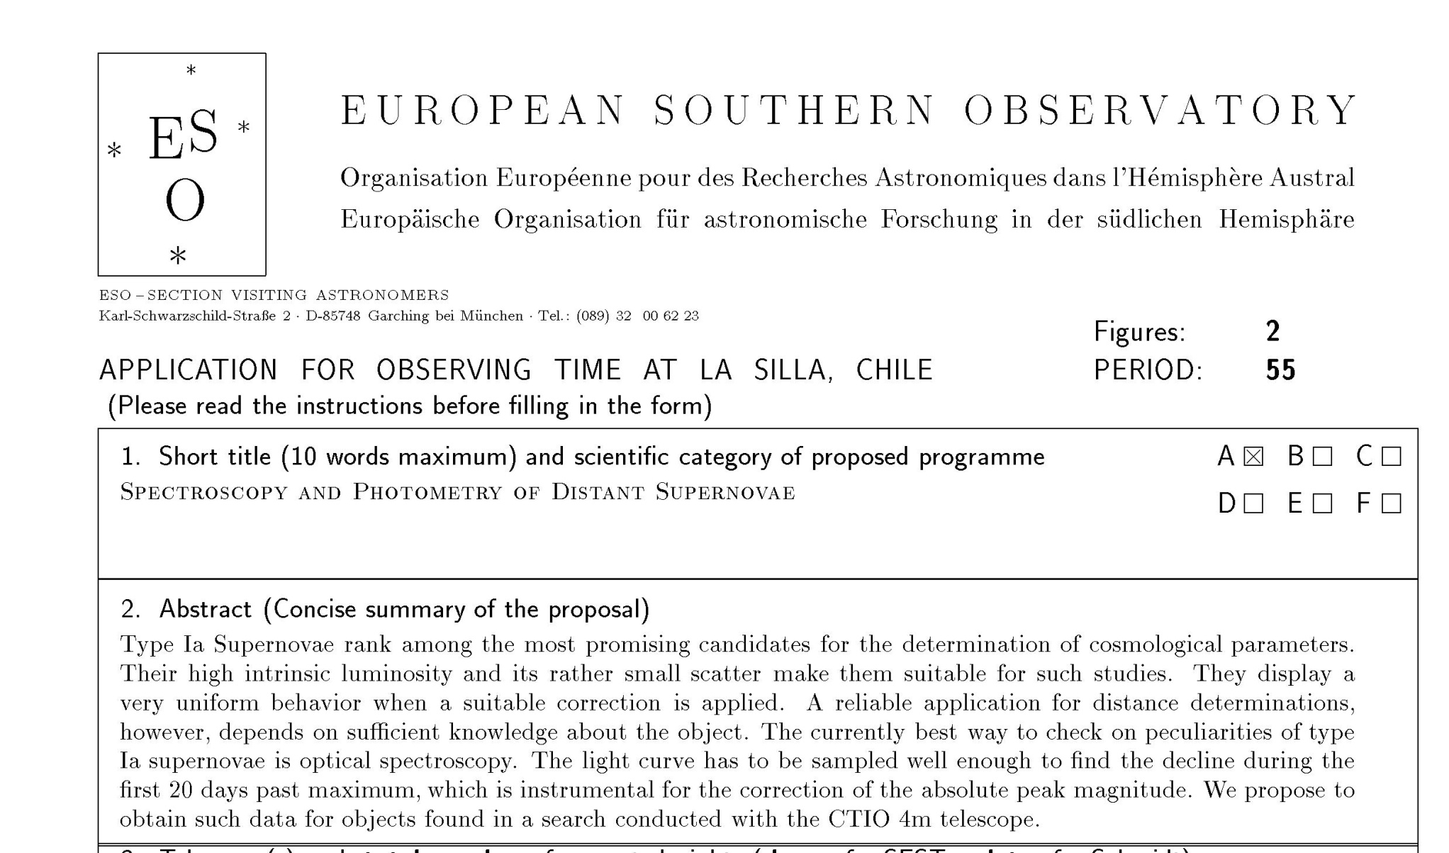
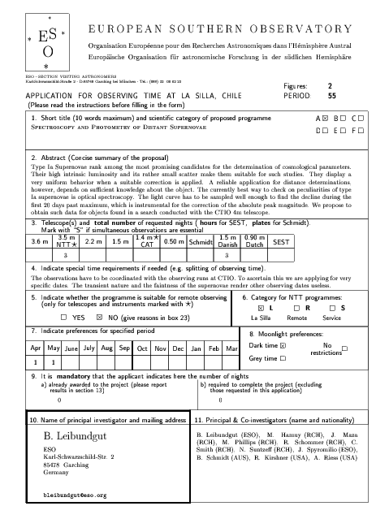
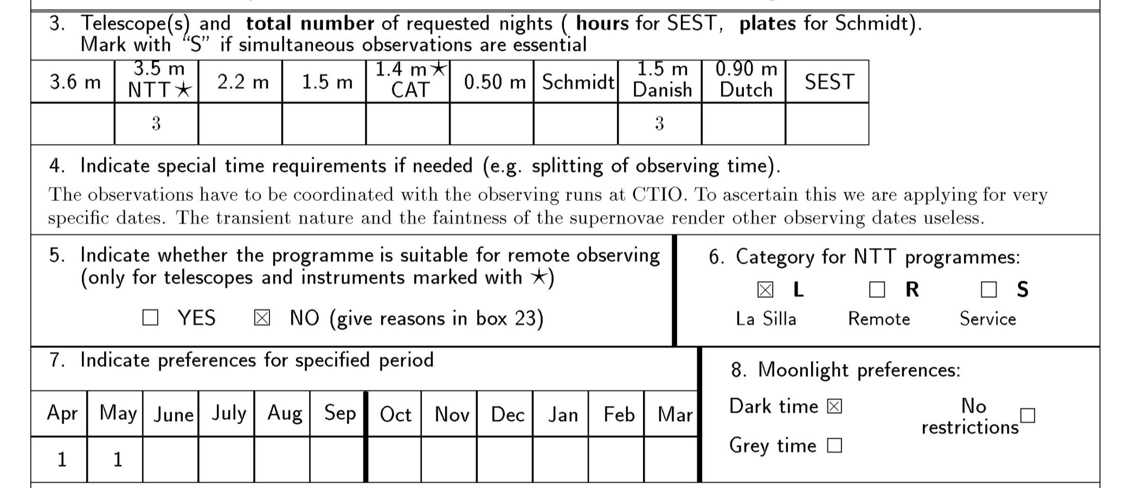
Start of the project
CTIO proposal
  search
    photometry
ESO proposal
  follow-up
    photometry
    spectroscopy
MMT proposal
  follow-up
    spectroscopy
ESO

Slide 46
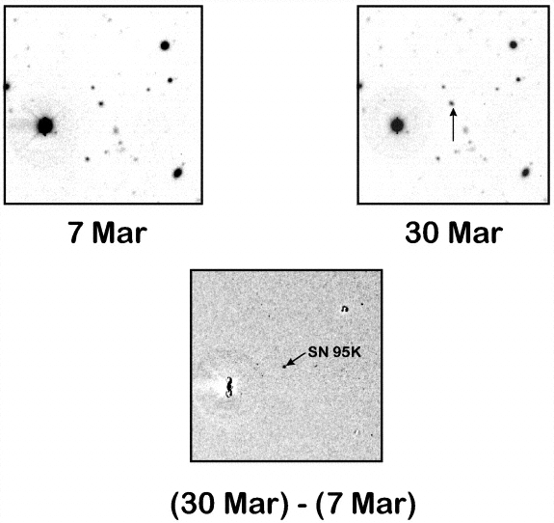
SN 1995K at z=0.479
First SN of
High-z SN Search Team
Schmidt et al. 1998

Slide 47
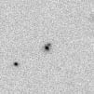
Observing SN 1995K
3 April 1995
EMMI image
  only SN
  candidate for
  the night
  plenty of time
  for the
  integration
Slit position
2.5h integration
Slit position
2h integration

Slide 48
Data reductions
Took over two months
Tried everything in the book, but could not extract a good spectrum
  2.5 hours without galaxy useless
    Galaxy contamination dominating
  2-hour integration with galaxy at least gave me the SN location

Slide 49
Extracting the spectrum
Thank you Sandro, Hans, Jean-Louis and the La Silla team who set up EMMI!

Slide 50
Extracting the spectrum
Extracted a single row
  Perfect alignment of the spectrum on the CCD
Extracted spectrum still did not look like a supernova
  Strong contamination by galaxy remained
Arbitrarily subtracted fraction (1/10) of the galaxy spectrum and rebinned to lower resolution
BINGO!

Slide 51
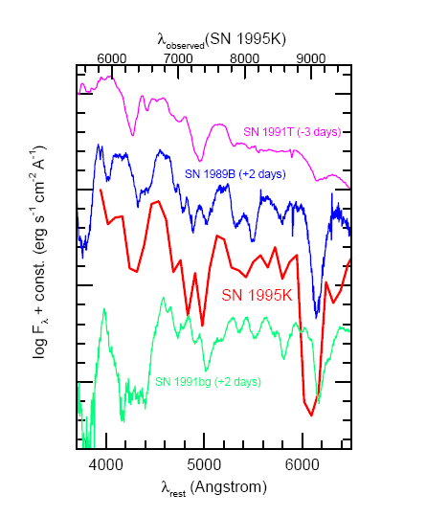
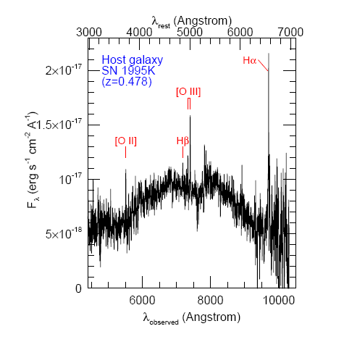
It worked!
SN Ia @ z=0.478
Schmidt et al. 1998

Slide 52
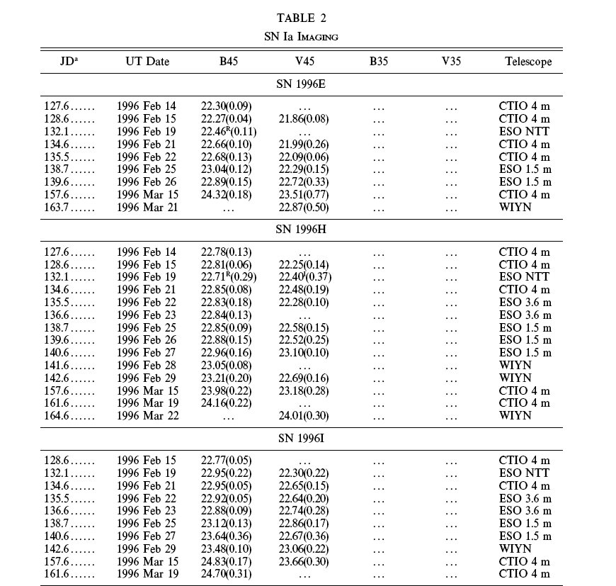
Photometry
Riess et al. 1998

Slide 53

ESO’s contributions
Spectroscopy
Riess et al. 1998

Slide 54
ESO’s contribution to the first set of distant SNe Ia

Slide 55
The SN Hubble Diagram
Distance
“expansion”

Slide 56

Where are we …
SN Factory
Carnegie SN Project
SDSSII
ESSENCE
CFHT Legacy Survey
Higher-z SN Search
(GOODS)
Euclid/WFIRST/LSST
Plus the local searches:
LOTOSS, CfA, ESC

Slide 57

SDSS-II Supernova Search
World-wide collaboration to find and characterise SNe Ia with 0.04 < z < 0.4
Search with Sloan 2.5m telescope
Spectroscopy with HET, ARC, Subaru, MDM, WHT, Keck, NTT
Goal: Measure distances to 500 SNe Ia to bridge the intermediate redshift gap

Slide 58





ESSENCE
World-wide collaboration to find and characterise SNe Ia with 0.2 < z < 0.8
Search with CTIO 4m Blanco telescope
Spectroscopy with VLT, Gemini, Keck, Magellan
Goal: Measure distances to 200 SNe Ia with an overall accuracy of 5%
→ determine ω to 10% overall

Slide 59



SNLS – The SuperNova Legacy Survey
World-wide collaboration to find and characterise SNe Ia with 0.2 < z < 0.8
Search with CFHT 4m telescope
Spectroscopy with VLT, Gemini, Keck, Magellan
Goal: Measure distances to 700 SNe Ia with an overall accuracy of 5%
→ determine ω to 7% overall

Slide 60





Current surveys
SNLS
  Astier et al. 2006 – 71 distant SNe Ia
  various papers describing spectroscopy (Lidman et al. 2006, Hook et al. 2006, Garavini et al. 2007, Bronder et al. 2008, Ellis et al. 2008, Ballande et al. 2009), rise time (Conley et al. 2006), SN rates (Sullivan et al. 2007, Graham et al. 2008) and individual SNe (Howell et al. 2006, 2009)
ESSENCE
  Wood-Vasey et al. 2007 – 60 distant SNe Ia
  Miknaitis et al. 2007 – description of the survey
  Davis et al. 2007 – comparison to exotic dark
  energy proposals
  spectroscopy (Matheson et al. 2005,
  Blondin et al. 2006, Foley et al. 2008, 2009)
  time dilation (Blondin et al. 2008)
  “other”: Becker et al. (2007 – TNOs)
  Boutsia et al. (2009 – AGNs)

Slide 61


Required phenomenology
photometric calibration
normalisation
  (“standardisable
  candle”;
  “standard crayon”)
  different light curve
  fitters
    Δm₁₅,SALT, SiFTO,
    MLCS
Goobar & Leibundgut 2011
SNLS SN04D2gp
z=0.732

Slide 62

Required phenomenology
Checks
  selection effects? evolution?
Goobar & Leibundgut 2011

Slide 63

Supernova Cosmology 2011
Goobar & Leibundgut 2011
560 SNe Ia

Slide 64




et voilà ...
Garnavich et al. 1998
Tonry et al. 2003
10 years of progress
Goobar & Leibundgut 2011

Slide 65
The equation of state parameter ω
General luminosity distance
  with and
  ω_{M}= 0 (matter)
  ω_{R}= ⅓ (radiation)
  ω_{Λ}= -1 (cosmological constant)

Slide 66

Supernova cosmology
ω firmly established
  general agreement between different experiments
N_{SN} | Ω_{M}(flat) | w (constant, flat) | Light curve fitter | Reference
115 |  |  | SALT | Astier et al. 2006
162 |  |  | MLCS2k2 | Wood-Vasey et al. 2007
178 |  |  | SALT2
288 |  |  | MLCS2k2 | Kessler et al. 2009
288 |  |  | SALT2
557 |  |  | SALT2 | Amanullah et al. 2010
472 |  |  | SiFTO/SALT2 | Conley et al. 2011
580 |  |  | SALT2 | Suzuki et al. 2011

Slide 67

Time dilation
Spectroscopic clock in the distant universe
(z ~ 0.5)
Observed Wavelength [Å]
Δt_{obs} [days]
Blondin et al. (2008)

Slide 68

35 spectra of
13 distant SN Ia
(0.28 ≤ z ≤ 0.62)
VLT [5]
ESSENCE [4]
Literature [3]
VLT SNLS [1]
Blondin et al. (2008)

Slide 69
Time dilation
‘Tired Light’ can be excluded beyond doubt (Δχ²=120)
Blondin et al. (2008)

Slide 70
Where are we?
Already in hand
  about 1000 SNe Ia for cosmology
  constant ω determined to 5%
  accuracy dominated by systematic effects
    reddening, correlations, local field, evolution
Test for variable ω
  required accuracy ~2% in individual distances
  can SNe Ia provide this?
    can the systematics be reduced to this level?
    homogeneous photometry?
    handle 250000 SNe Ia per year?

Slide 71
Why are we not done yet?
Problems with the following items:
  Intrinsic SN Ia colours
  Reddening law
  Sample contamination
  “demographics” or “secondary evolution”
  systematics
Further work:
  Evaluation of the supernova properties
  Reconstruction of the expansion history
  Combination with other cosmological measurements
  Comparison with exotic cosmology models

Slide 72


Comparison of different fitters
MLCS2k2
SALT2
Kessler et al. 2009

Slide 73

Systematics table
Wood-Vasey et al. 2007

Slide 74
Systematics
Current questions
  calibration
  restframe UV flux
    redshifted into the observable window
  reddening and absorption
    detect absorption
      through colours or spectroscopic indicators
    correct for absorption
      knowledge of absorption law
  light curve fitters
  selection bias
    sampling of different populations
  gravitational lensing
  brightness evolution

Slide 75
Time variable ω?
Wood-Vasey et al. 2007

Slide 76
Work to do
Collecting thousands of supernovae may be fun, but for future cosmology applications we
  need to understand photometry
    accuracy requirements strongly increased
  need to understand their variations
    simple correlations may work, but are ad hoc
  need to solve the reddening problem
    go to rest-frame IR?
      JWST will show whether this works
      Euclid offers a fantastic possibility here
    understand another ‘dark’ component of the universe (dust)

Slide 77
What next?
Already in hand
  >1000 SNe Ia for cosmology
  constant ω determined to 5%
  accuracy dominated by systematic effects
Missing
  good data at z>1
    light curves and spectra
  good infrared data at z>0.5
    cover the restframe B and V filters
    move towards longer wavelengths to reduce absorption effects
  I-band Hubble diagram
    Freedman et al.
    Nobili et al.

Slide 78


I-band Hubble diagram
Freedman et al. 2009
Currently only 35 SNe Ia
Goobar & Leibundgut 2011
560 SNe Ia

Slide 79
Supernova Cosmology – do we need more?
Test for variable ω
  required accuracy ~2% in individual distances
  can SNe Ia provide this?
    can the systematics be reduced to this level?
    homogeneous photometry?
    further parameters (e.g. host galaxy metalicity)
    handle >100000 SNe Ia per year?
Euclid
  3000 SNe Ia to z<1.2 with IR light curves (deep fields) → I-band Hubble diagram
  16000 SNe discovered

Slide 80

Cosmology – more?
Goobar & Leibundgut 2011
(courtesy E. Linder and J. Johansson)

Slide 81



Predicting the future ...
What will we know about
supernovae 10 years from now?
  ~5400 SNe reported until end of 2009
  expect up to
  100000 SNe (?)
  for the coming
  decade
    PanSTARRS,
    PTF/PTF2,
    LSST

Slide 82
Summary
Concentrate on λ not covered so far
  particular IR is interesting
    reduced effect of reddening
    better behaviour of SNe Ia(?)
Understand the SN zoo
  many (subtle?) differences observed in recent samples (PanSTARRS and PTF)
    subluminous and superluminous
  understand potential evolutionary effects
    spectroscopy important → PESSTO
    DES?, LSST?, Euclid follow-up?

