Slide 1
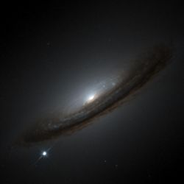
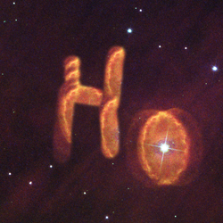
The continuous quest to measure the Hubble Constant - is there a Hubble tension?
Bruno Leibundgut
ESO and TUM

Slide 2
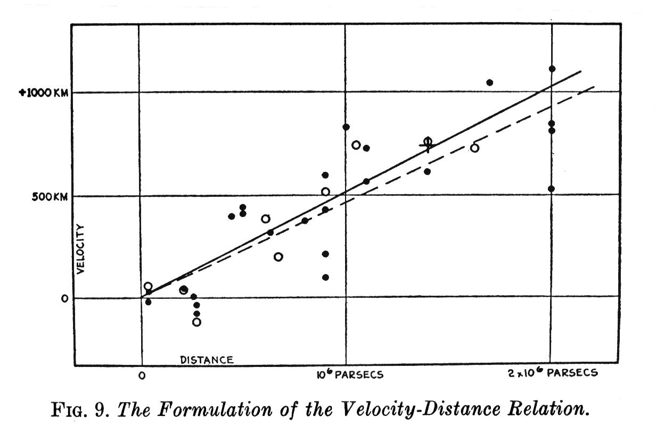
Background
Expanding universe
→ expansion rate critical for cosmic evolution
STScI
Hubble 1929

Slide 3

History of $H0$
Expansion rate by G. Lemaître (1927)
Footnote!

Slide 4
Intermezzo Age of the Universe
A matter-dominated universe has the following age
age of the Earth: 4.5⋅10⁹ years
oldest stars: ~1.3⋅10¹⁰ years
H₀ (km/s/Mpc) | t₀ (yr)
500 | 1.30⋅10⁹
250 | 2.61⋅10⁹
100 | 6.52⋅10⁹
80 | 8.15⋅10⁹
70 | 9.32⋅10⁹
60 | 1.09⋅10¹⁰
50 | 1.30⋅10¹⁰
30 | 2.17⋅10¹⁰

Slide 5
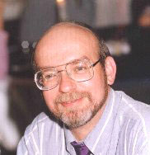



History of $H_{0}$
https://www.cfa.harvard.edu/~dfabricant/huchra/hubble/
$$2.6⋅{10}^{9}years$$
$$6.5⋅{10}^{9}years$$
Notes:
625 50 -50 1927. O Lemaitre, G. 1927, Ann. of the Scientifc Society of Bruselles 47A, 49
460. 40 -50 1928. O Robertson, H. 1928, Phil. Mag. 5, 835. (error bars estimated jph)
500 +50 -50 1929.046 A Hubble 1929, PNAS 15, 168 (10\% error)
558 +50 -50 1931.18 A Hubble and Humason 1931, ApJ 74, 43 (<10\% error)
290 +290 -145 1931.914 O Oort 1931, BAN 6, 155.
865 +100 -100 1935.1 O Eddington, 1935, MNRAS 95, 636 (Large Number Hypothesis)
524 +50 -50 1936.000 O Hubble 1936, Realm of the Nebulae (Dover)
260 170 -100 1951.080 O Behr 1951, Astr. Nachr. 279, 97
280 28 -28 1952.694 O Baade, 1954, Trans IAU 8, 397

Slide 6



History of $H_{0}$
$$6.5⋅{10}^{9}years$$
$$13⋅{10}^{9}years$$

Slide 7
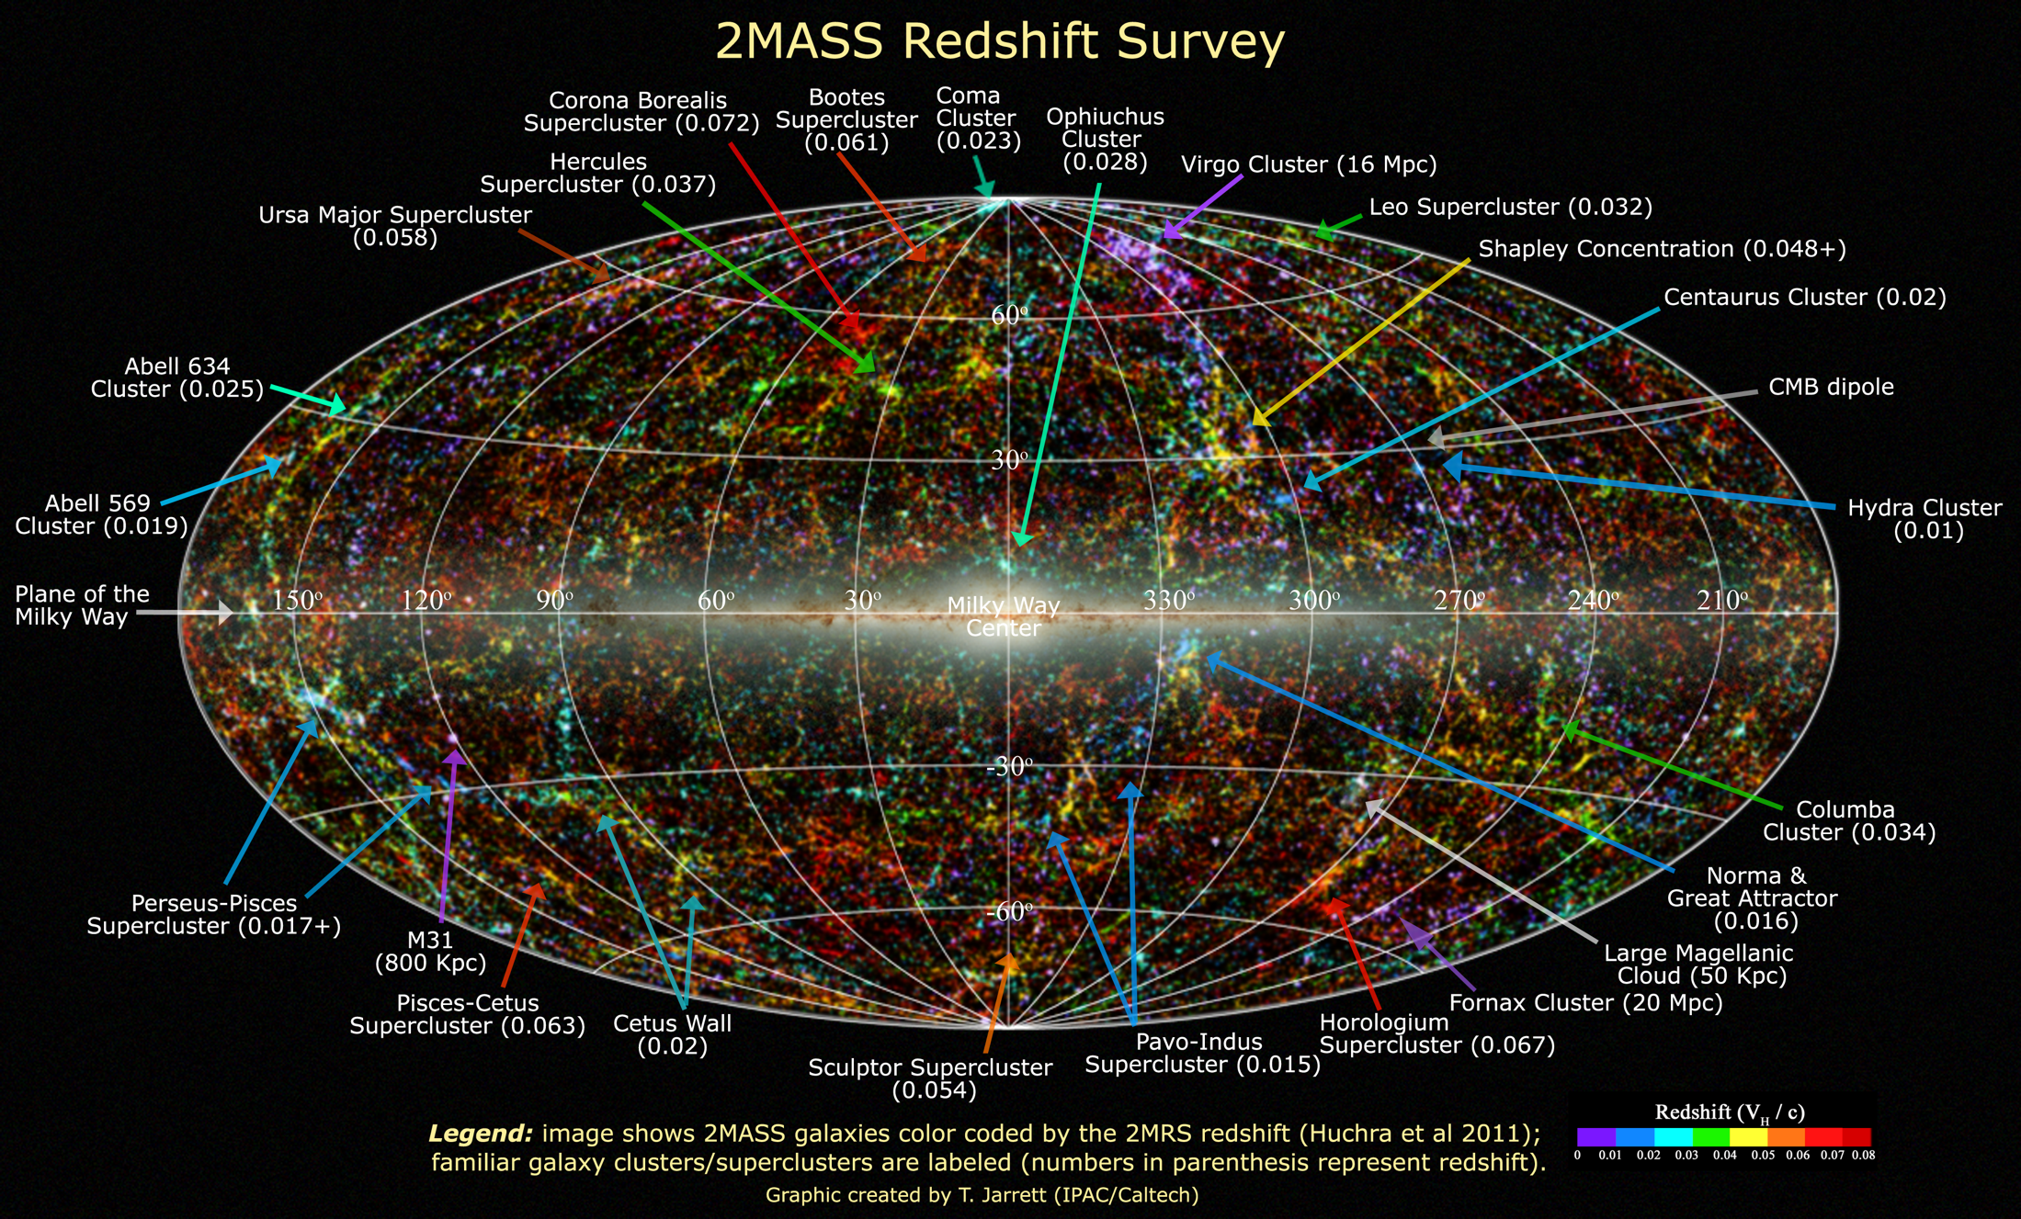
Extragalactic Distances
Required for a 3D picture of the (local) universe

Slide 8
Extragalactic Distances

Slide 9
Local Flows
Inhomogeneous mass distribution in the local Universe
Pomarède et al. 2020

Slide 10
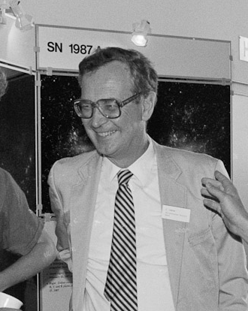

Measuring $H_{0}$
Classical approach
→ distance ladder to reach (smooth) Hubble flow
Sandage & Tammann 1974

Slide 11
Classic Distance Ladder
Primary distance indicators (within the Milky Way)
trigonometric parallax
proper motion
apparent luminosity
main sequence
red clump stars
RR Lyrae stars
eclipsing binaries
Cepheid stars
Jacoby et al. 1992

Slide 12
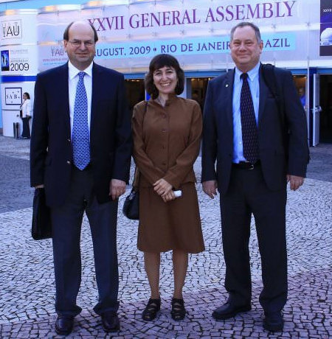
Classic Distance Ladder
Secondary distance indicators (beyond the Local Group)
Important check
Large Magellanic Cloud
Tully-Fisher relation
Fundamental Plane
Supernovae (mostly SN Ia)
Surface Brightness Fluctuations
Gruber Cosmology Prize
Freedman & Madore 2010
Notes:
Jeremy Mould
Wendy Freedman
Robert Kennicutt

Slide 13
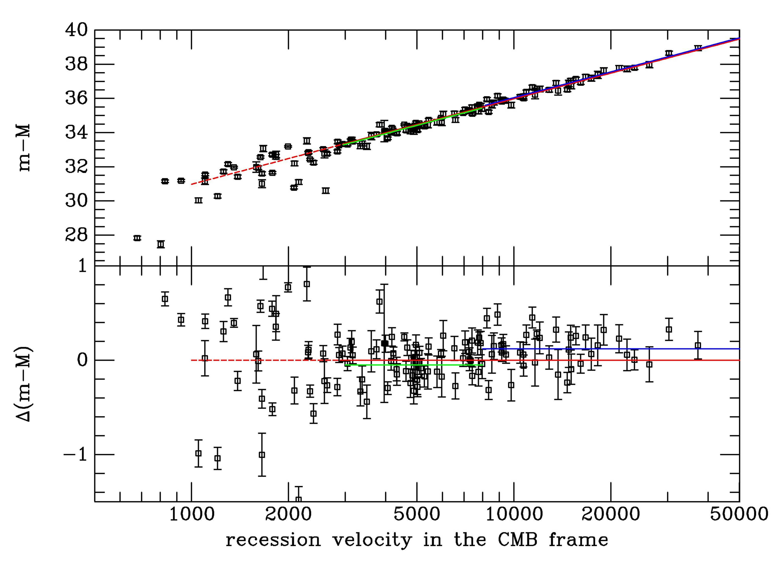

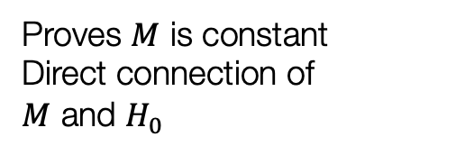
Hubble Constant
SN Ia Hubble diagram
$$m−M=5\log{v+25−5\log{H_{0}}}$$
Proves $M$ is constant
Direct connection of $M$ and $H_{0}$
Leibundgut

Slide 14
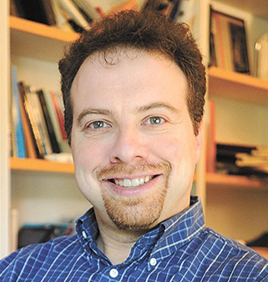
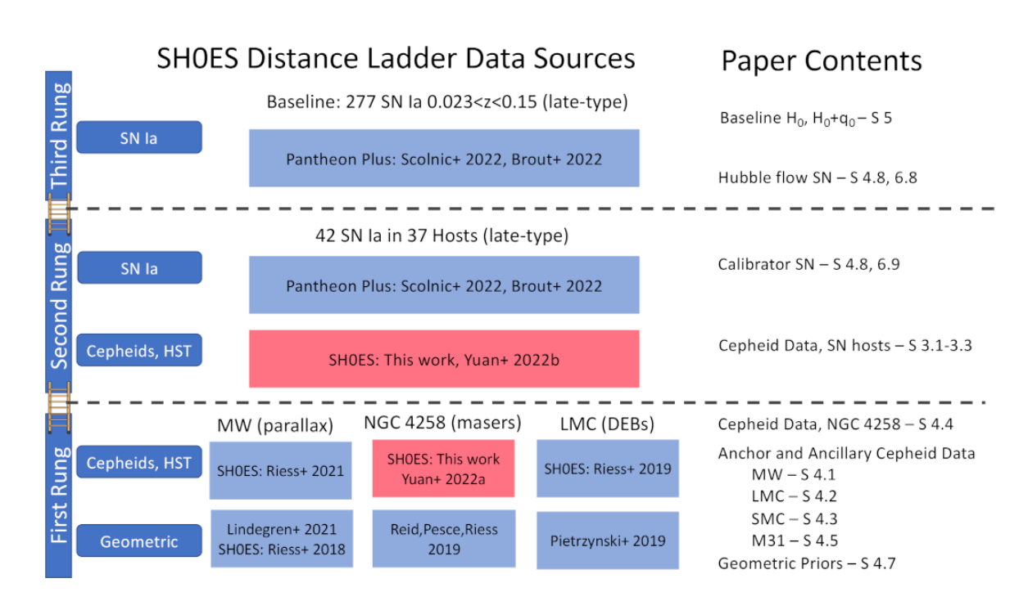
Hubble Constant
Calibration of M(SN Ia @ max)
Distance ladder
Riess et al. 2022
Adam Riess

Slide 15
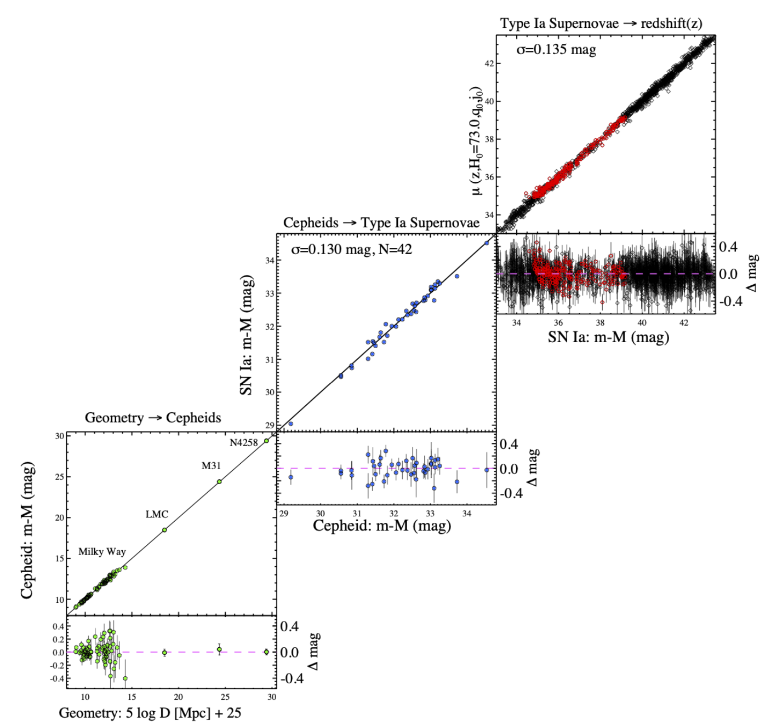
Hubble Constant
Supernova Ia Hubble diagram
Riess et al. 2022

Slide 16
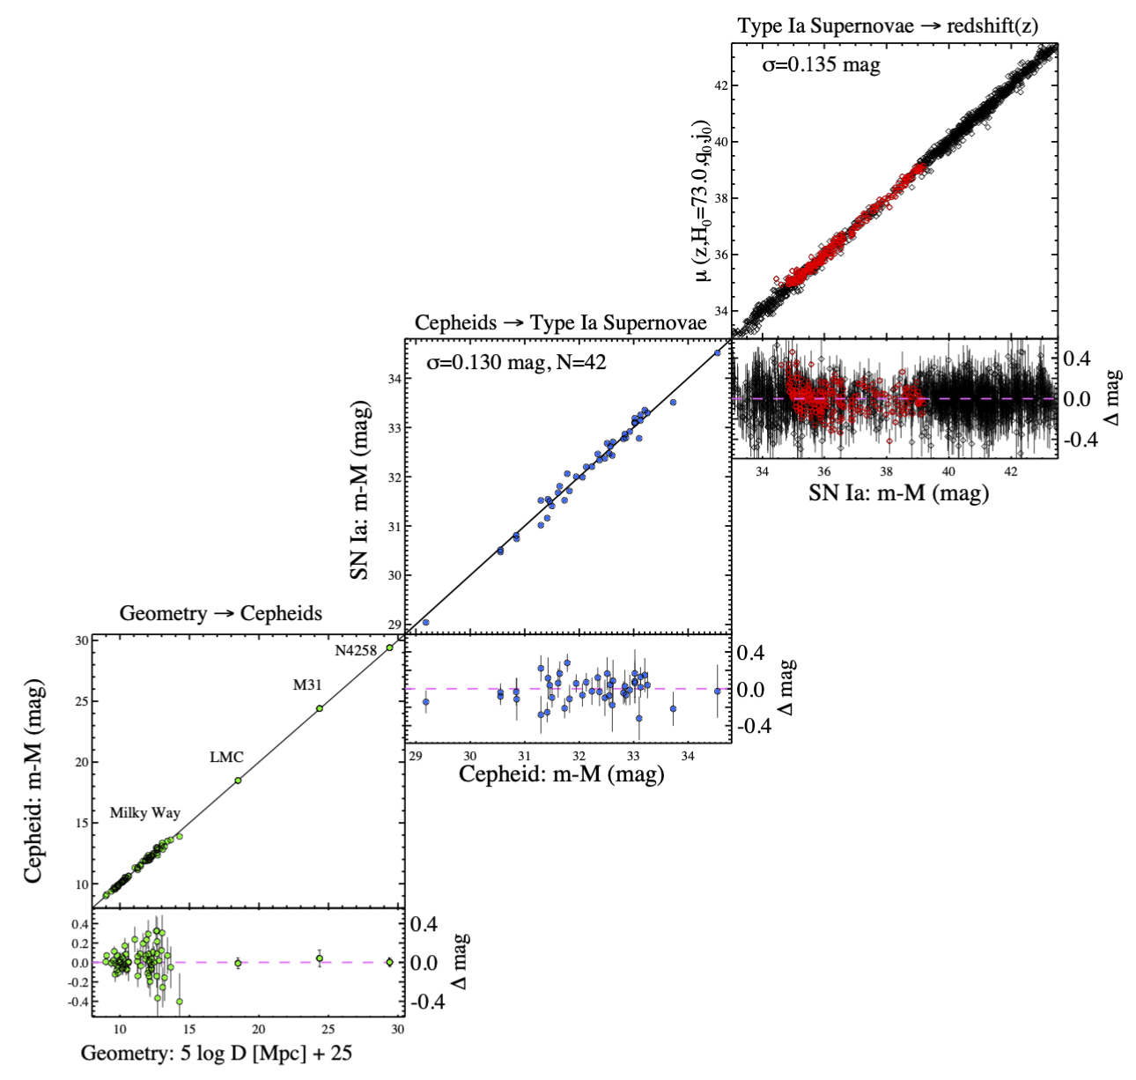

Hubble Constant $H_{0}$
Supernova Ia Hubble-Lemaître diagram
Riess et al. 2022

Slide 17
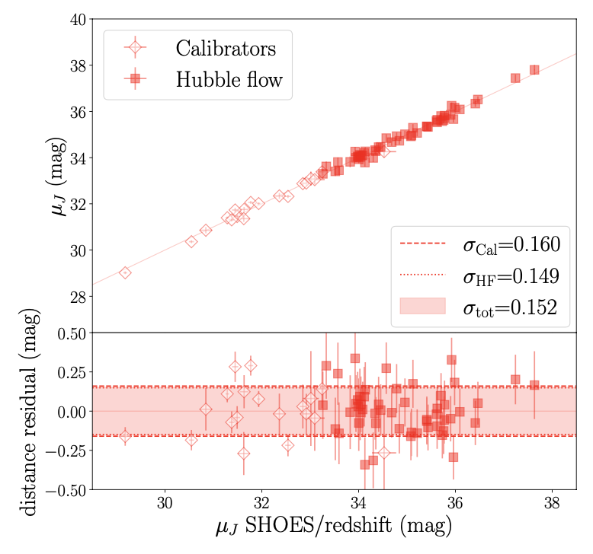

SNe Ia Hubble Diagram (NIR)
9 calibrators + 27 Hubble flow SNe
Galbany et al. 2022
Dhawan et al. 2018
$$H_{0}=(72.8±1.6\left(stat\right)±2.7 \left(syst\right)) km s^{−1} Mpc^{−1}$$

Slide 18
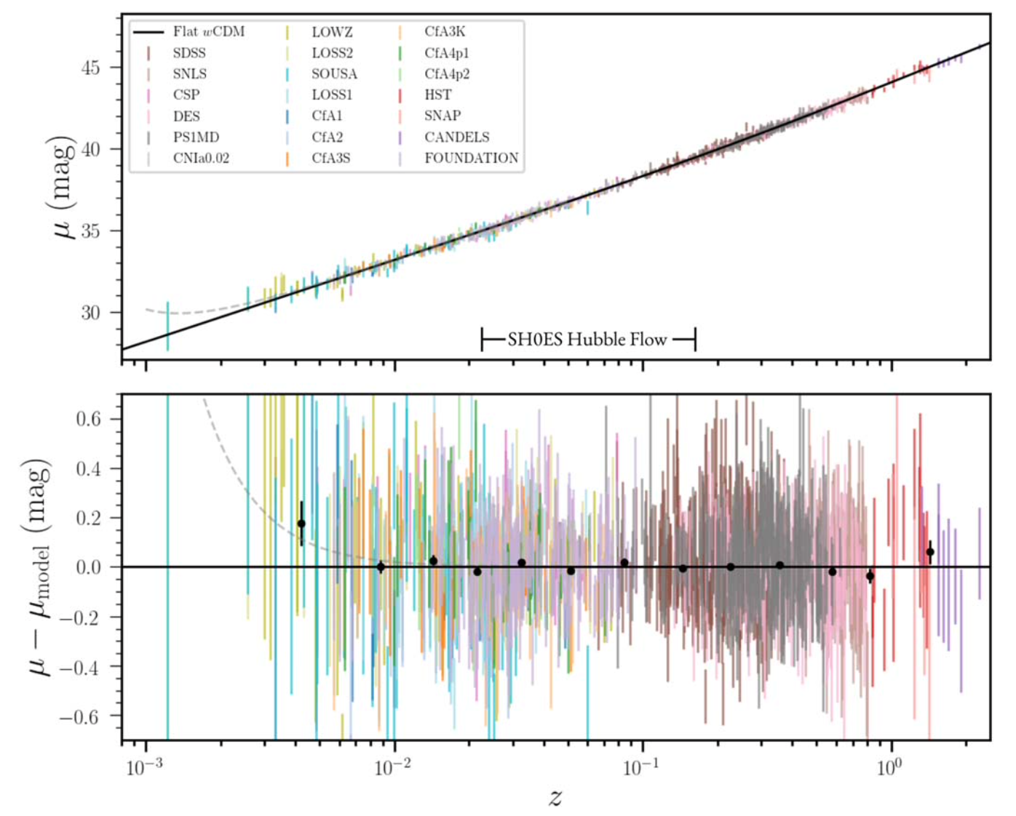
Latest results (Pantheon+)
Brout et al. 2022
1550 SNe Ia

Slide 19
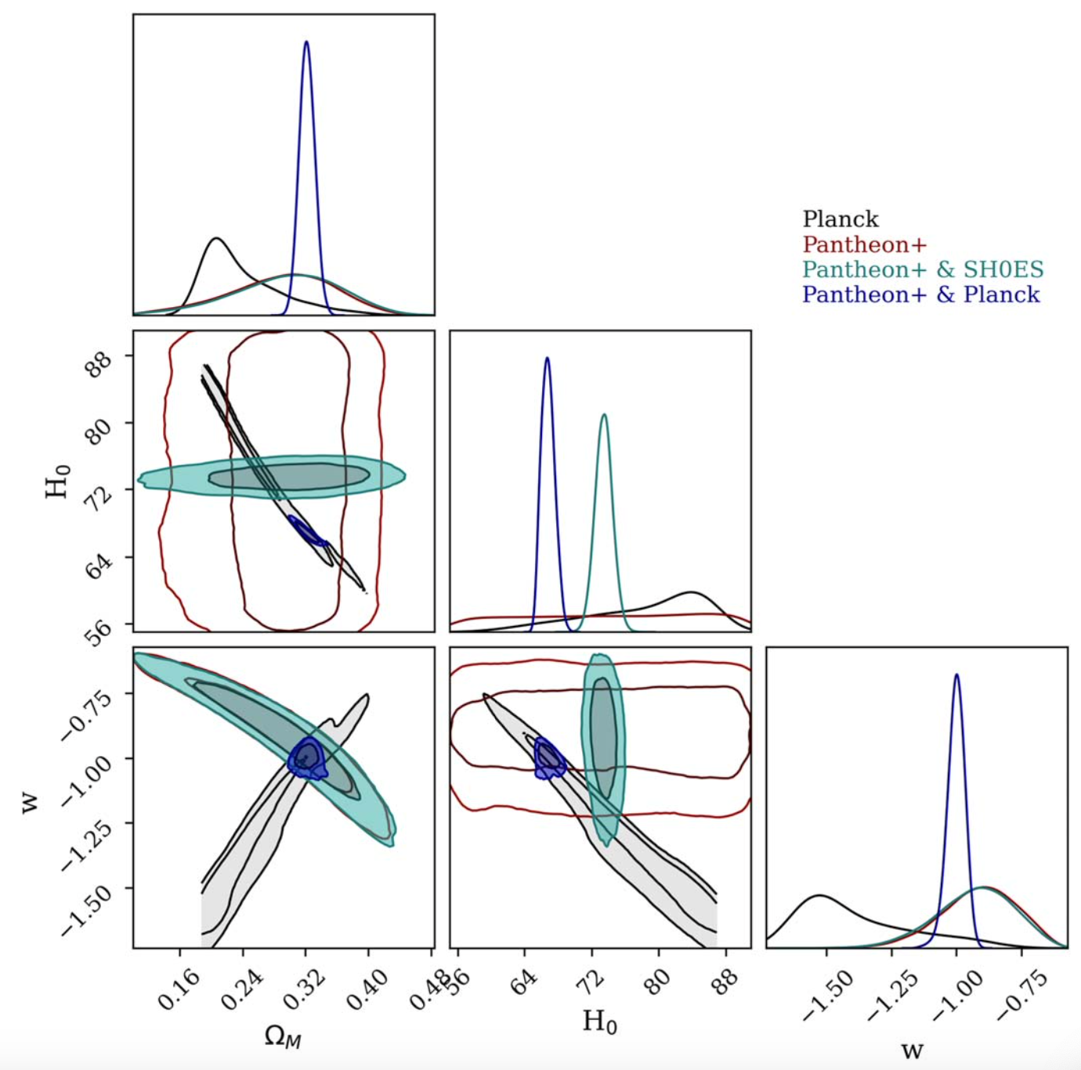
Combined analysis (Pantheon+)
Brout et al. 2022

Slide 20
Problem solved?
New discrepancy between the measurements of the local H₀ (distance ladder) and early universe (CMB)
Indication of an incomplete model of cosmology?
Freedman 2021
Planck Consortium 2020
Notes:
Magenta diamond in lower plot is due to the ‘standard siren’ from GW170817 event (Abbott et al. 2017).

Slide 21
There is more …
Linear (Hubble-Lemaître) law does not longer hold with distance accuracies of better than 10%!

Slide 22
Cosmological model important

Slide 23
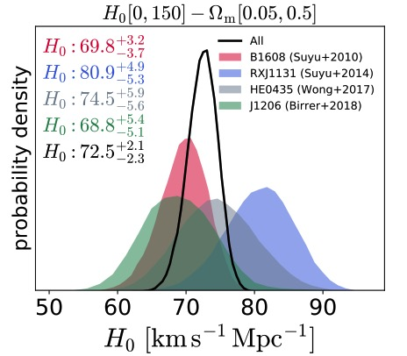
Promising Results from strong lensing
Time delays in lensed quasars
Birrer et al. 2018

Slide 24
Gravitational Lenses
Sherry Suyu (J. Wiedersich / TUM)
Time delays in lensed quasars
Wong et al. 2020

Slide 25
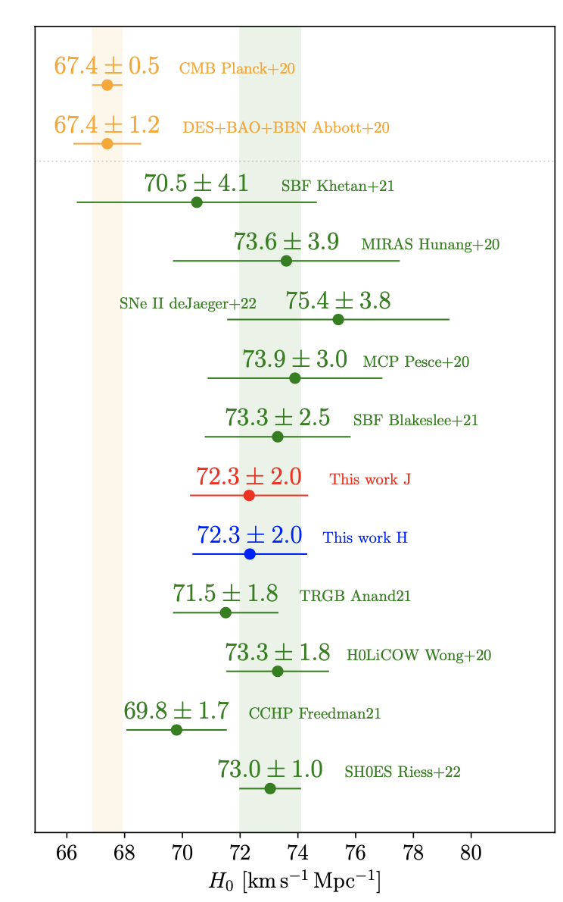

$H_{0}$ Summary
Bonvin and Millon https://doi.org/10.5281/zenodo.3635517
Galbany et al. 2022

Slide 26
Distance ladder trouble
Major uncertainty from the stringing together of disjoint astrophysical objects
Sandage & Tammann 1974
Riess et al. 2022

Slide 27
Ideal Method
Independent of a cosmological model
low redshift (z<0.1)
No distance ladder
keep cumulative errors small
Overall accuracy <3%
Type II Supernovae

Slide 28
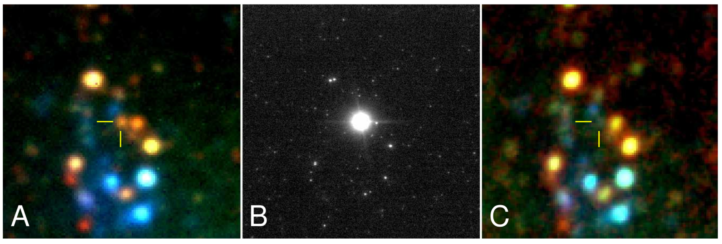

Type II Supernovae
Core-collapse explosions of massive, red-supergiant stars
Peak absolute mags between -16 and -18
$→$ observable up to z $≈$ 0.4
Most common type of SN by volume
Mattila et al. 2010

Slide 29
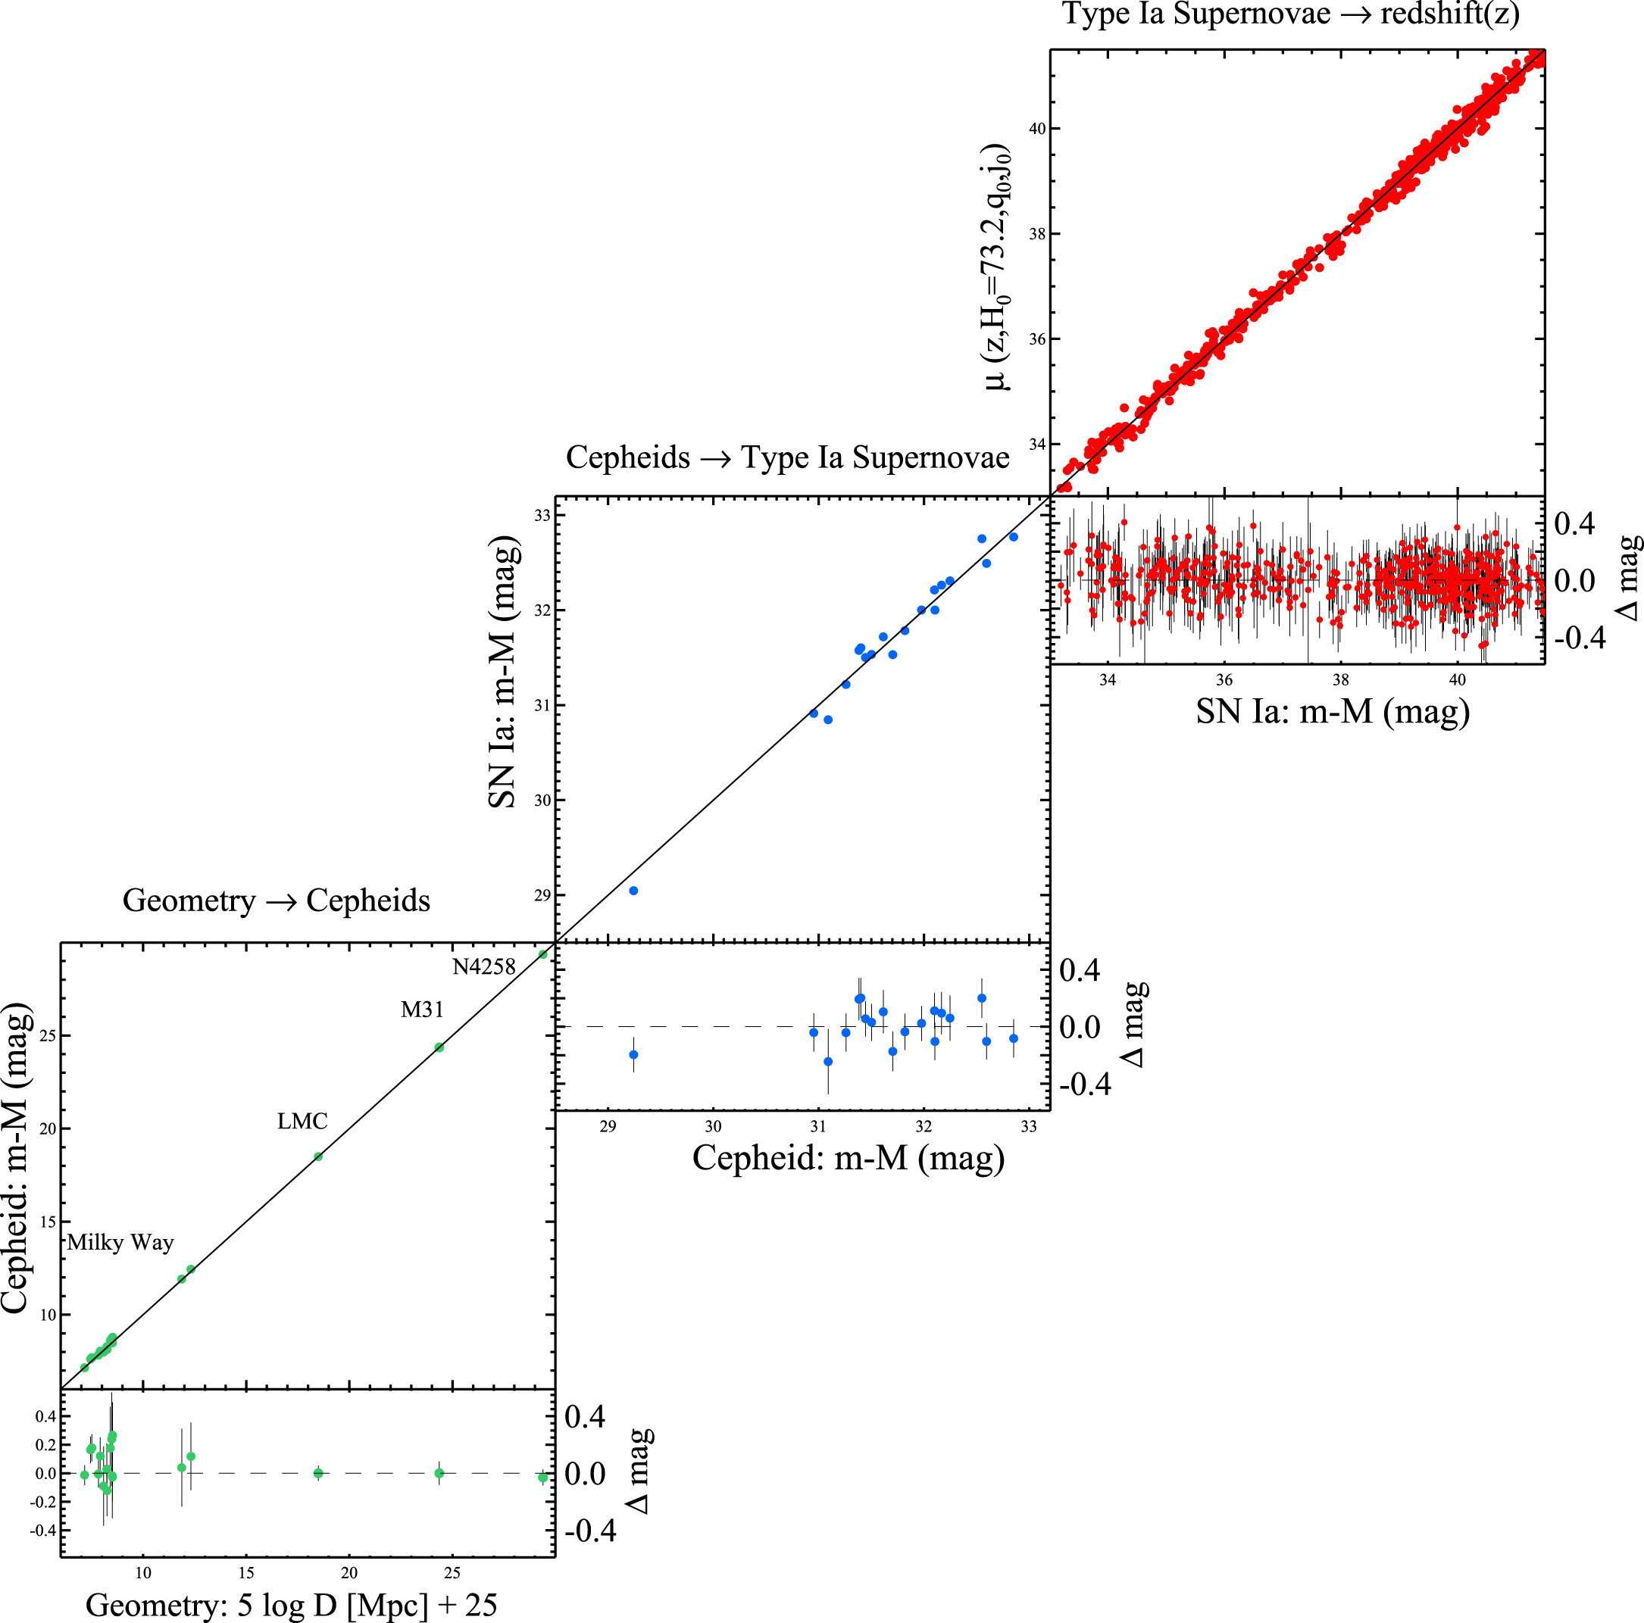
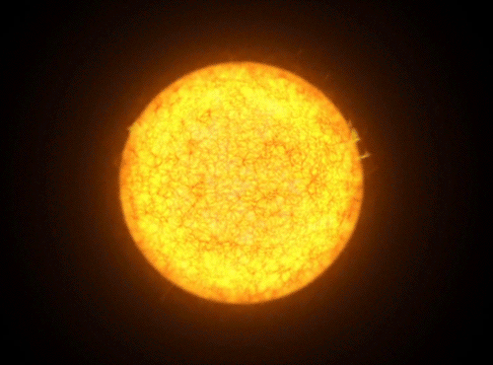
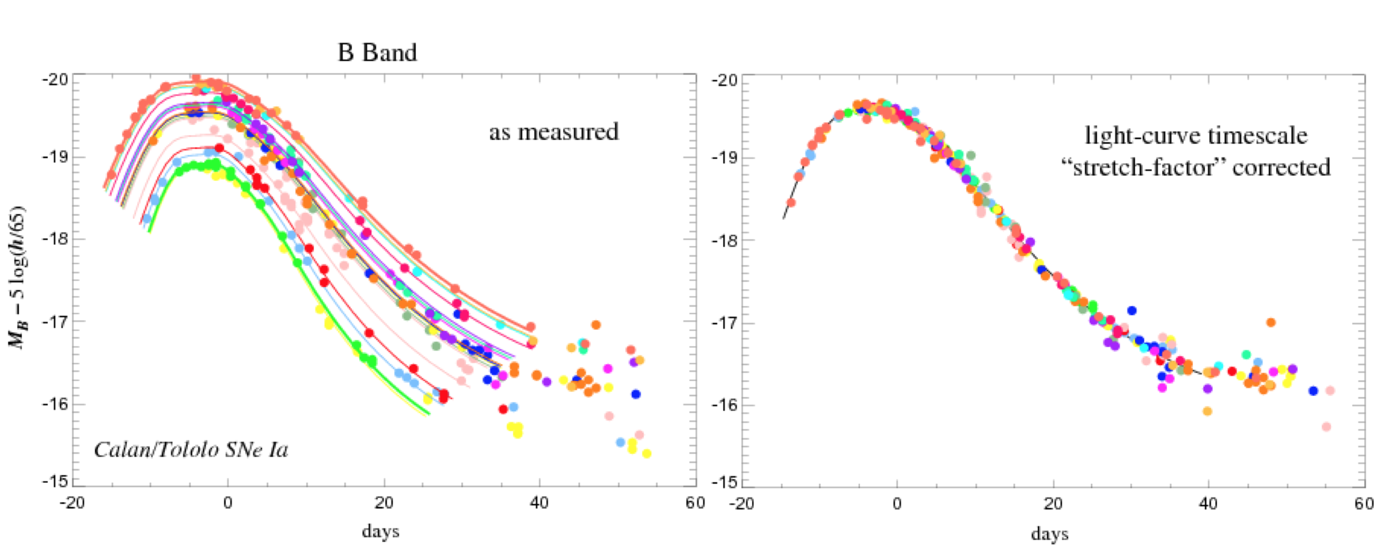
Why type II supernovae?
Christian Vogl
Luminosity ~ Period
Type II supernovae
Type II supernovae:
luminosity directly from models
simple physics
physics based
one-step measurement
Luminosity ~ light curve width
Riess et al. 2016

Slide 30
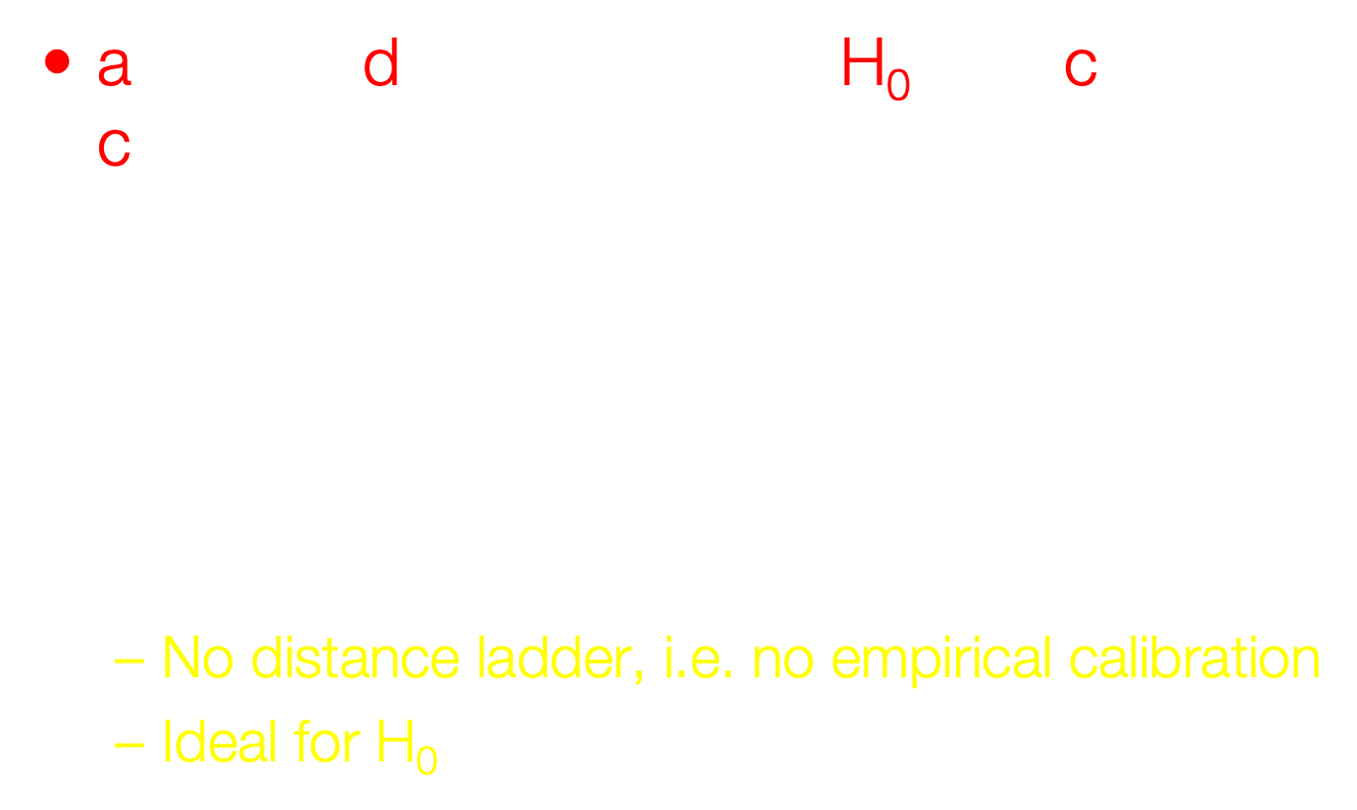
adH0cc – Basics
accurate determination of H₀ with core-collapse (supernovae)
Individual distances (to about 10%) to Type II supernovae in the Hubble flow ($0.03<z<0.15$)
Distance determination based on calibrated physics
No distance ladder, i.e. no empirical calibration
Ideal for H₀

Slide 31
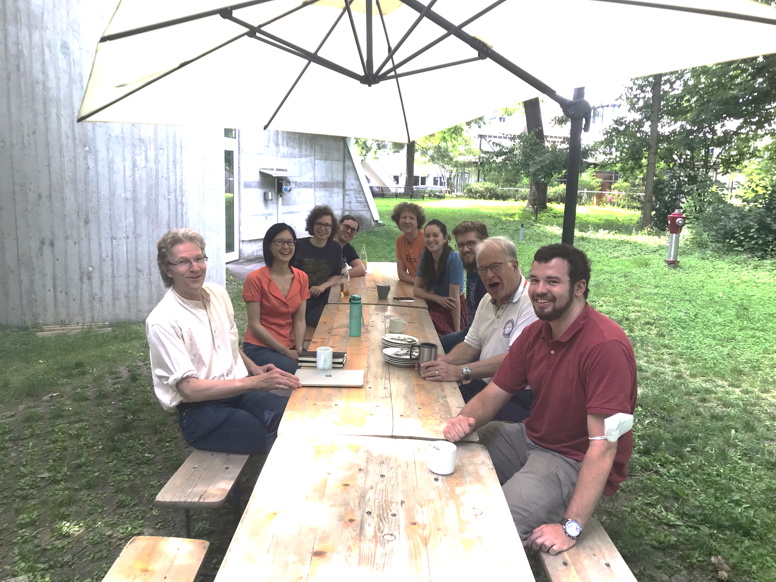





adH₀cc – Team
J. Spyromilio
S. Blondin
B. Leibundgut
S. Suyu
C. Vogl
A. Floers
S. Taubenberger
M. G. Cudmani
A. Holas W. Hillebrandt
G. Csörnyei
S. Kressierer
S. Smartt
R. Kotak
C. Lemon
A. Gal-Yam
R. Bruch

Slide 32



EPM in a nutshell
Christian Vogl
Luminosity ~ Radius² x Temperature⁴
How hot?
How big?
homologous expansion
RSG
How old?
~10000 km/s
SN
How fast?
$$R_{ph}^{}$$
$$t_{0}$$
$$t$$
Radius = velocity x time since explosion

Slide 33
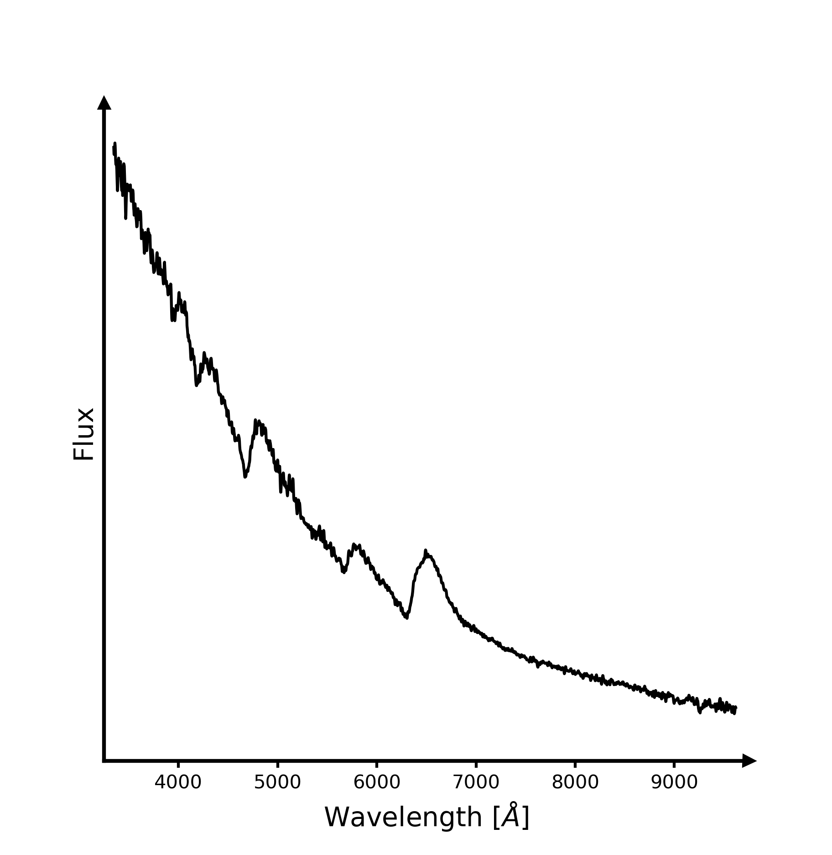
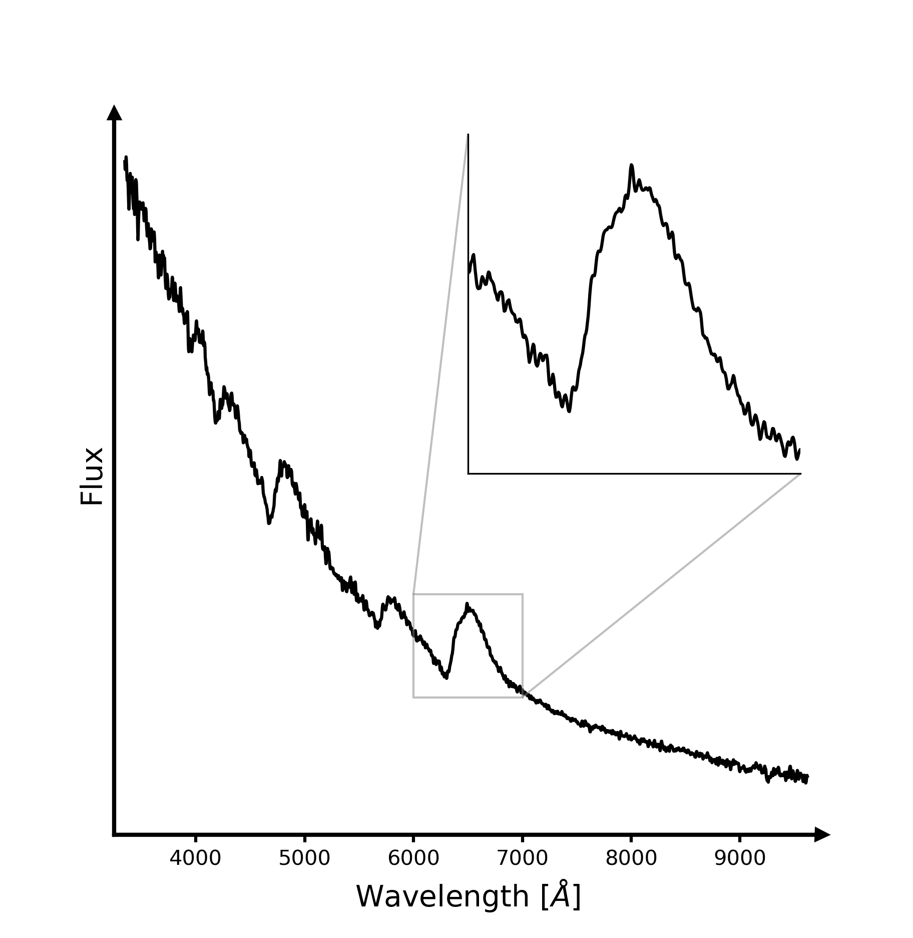
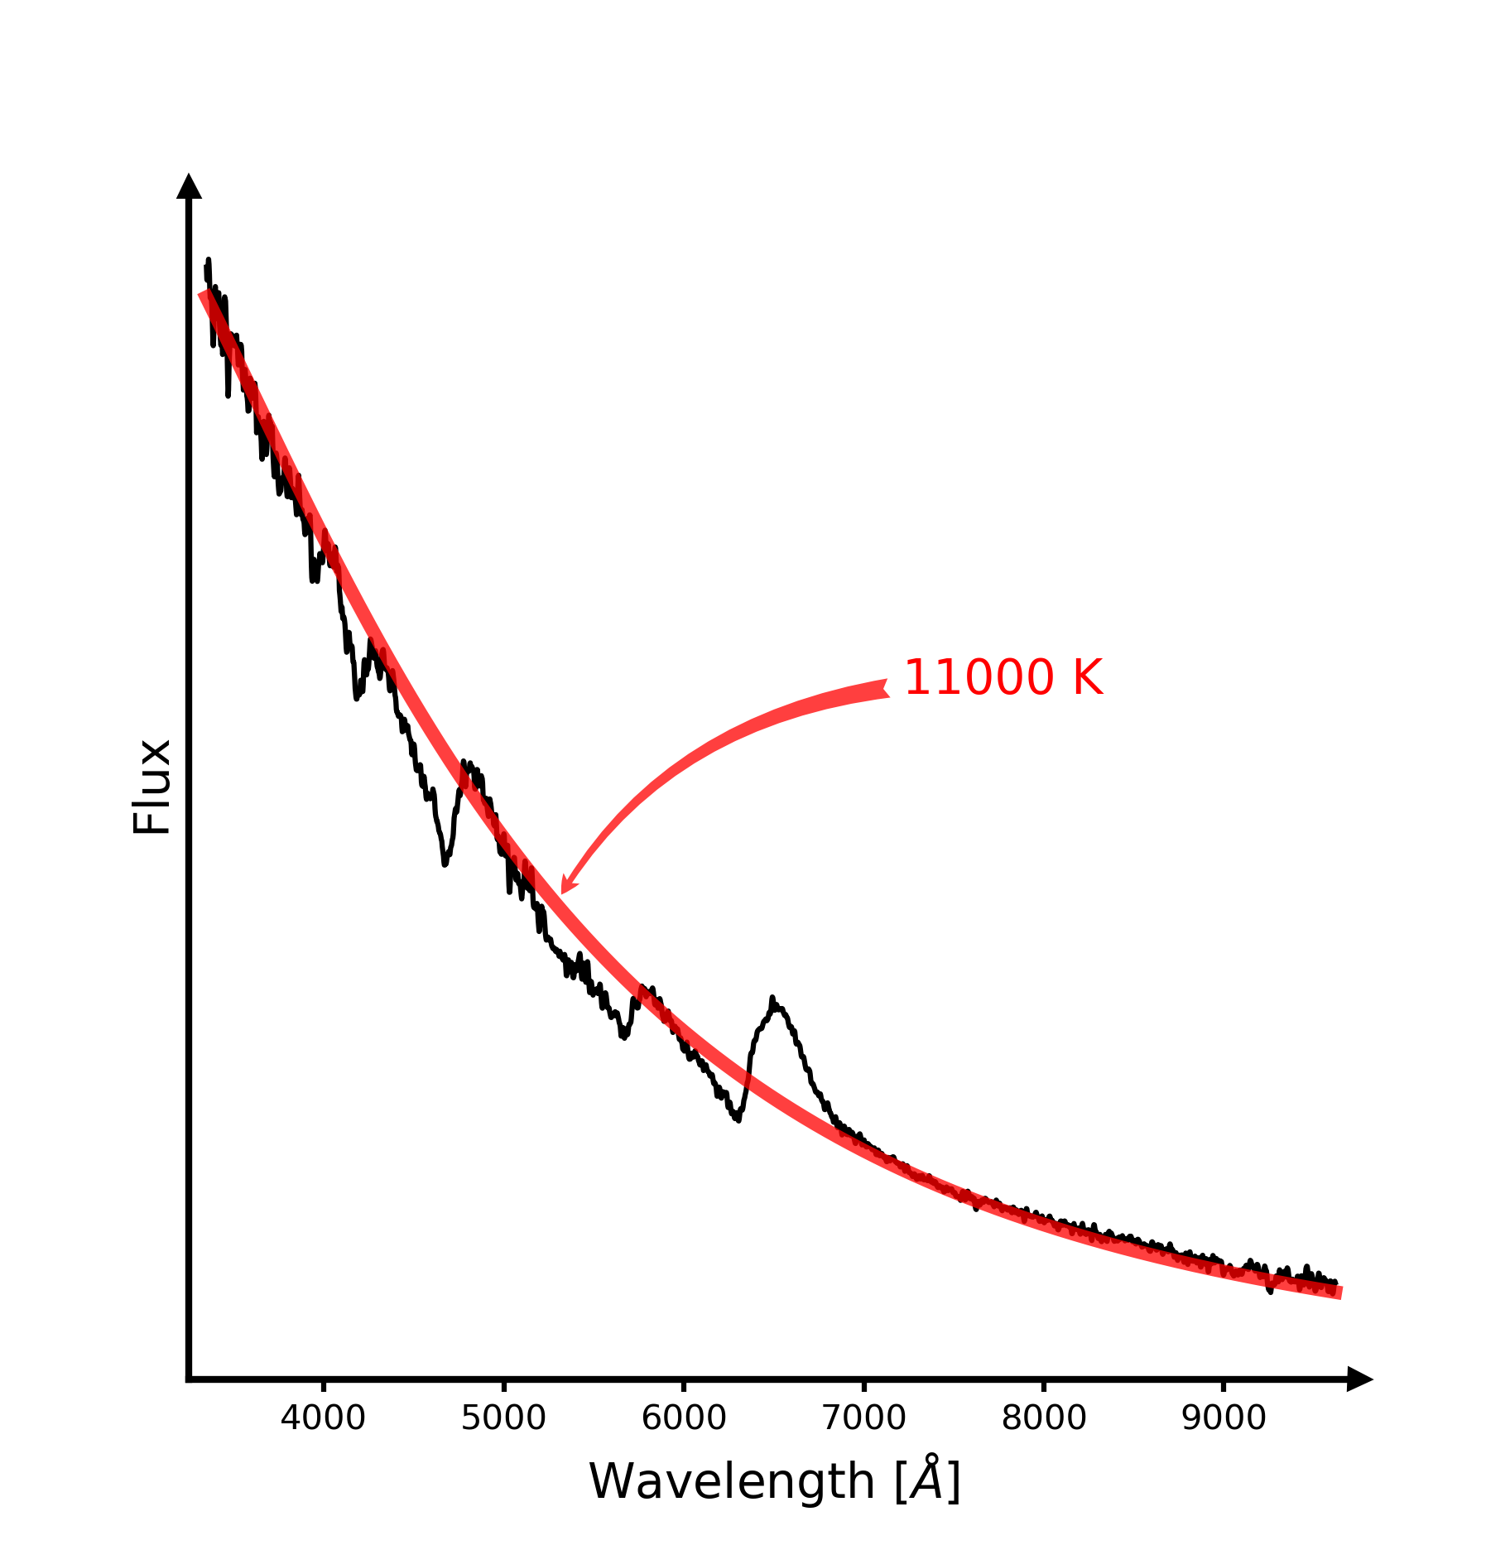
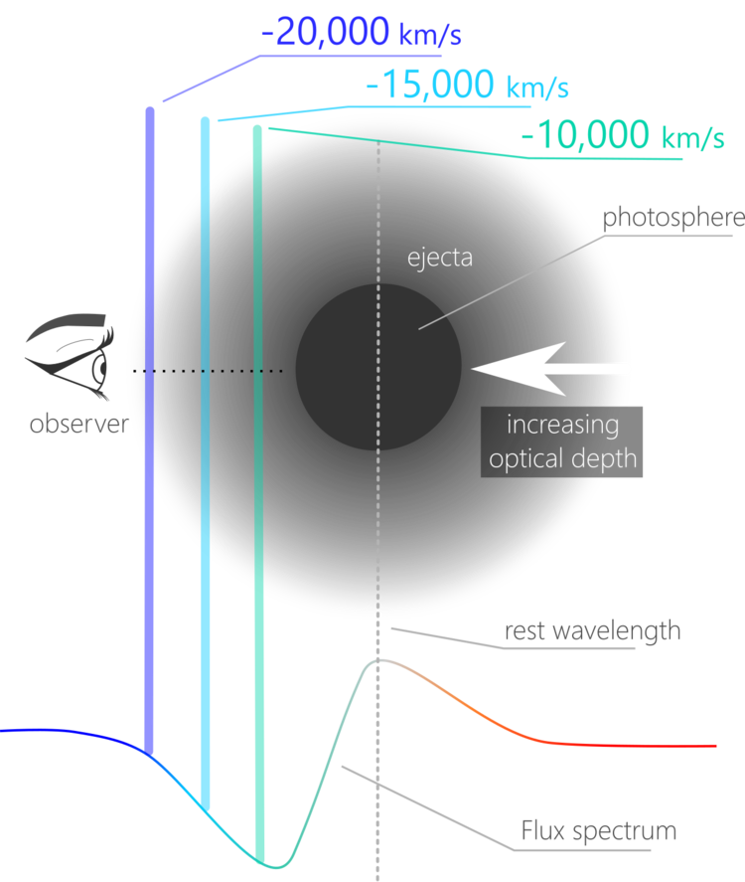
EPM: it’s all in the spectra
C. Vogl
Image: Héloïse Stevance

Slide 34
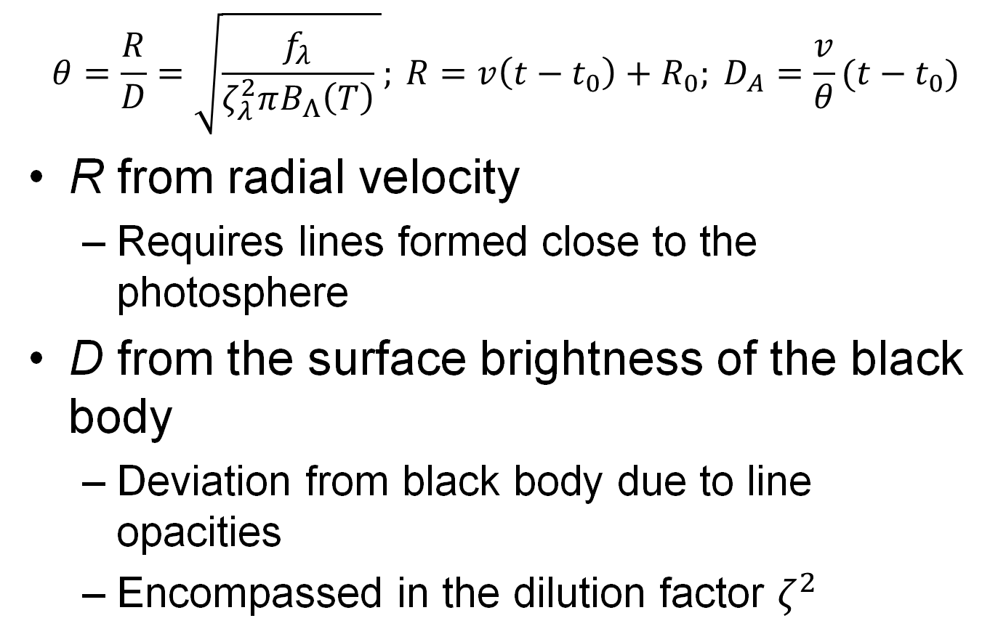
Expanding Photosphere Method
$$θ=\frac{R}{D}=\sqrt{\frac{f_{λ}}{ζ_{λ}^{2}πB_{Λ}\left(T\right)} }; {R=v\left(t−t_{0}\right)+R_{0}; D}_{A}=\frac{v}{θ}(t−t_{0})$$
R from radial velocity
Requires lines formed close to the photosphere
D from the surface brightness of the black body
Deviation from black body due to line opacities
Encompassed in the dilution factor $ζ^{2}$

Slide 35
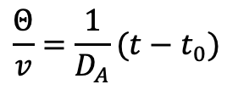


Expanding Photosphere Method
$$\frac{Θ}{v}=\frac{1}{D_{A}}(t−t_{0})$$
Gall et al. 2018
$$Θ/v$$
$$Θ/v$$
t-t₀
t-t₀

Slide 36
Preliminary Results
Consistent results
Gall et al. 2018

Slide 37
Expanding Photosphere Method Reloaded
Use individual atmospheric models for the spectral fits
use of the TARDIS radiation transport model
absolute flux emitted
Accurate explosion date
accurate zero point
At least 5 epochs per supernova

Slide 38
Atmosphere Models
TARDIS fits for different epochs

Slide 39
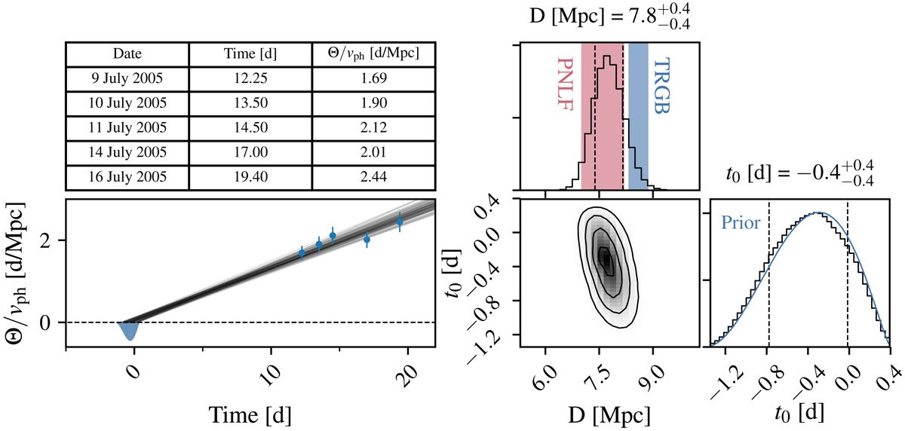

Distance Determination
Slope is inverse distance: $\frac{Θ}{v}=\frac{1}{D_{A}}(t−t_{0})$
Vogl et al. 2020
SN 2005cs

Slide 40
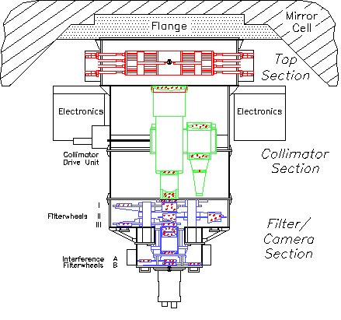

adH0cc – status
FORS2
C. Vogl (2020)
Image: ESO/Y. Beletsky

Slide 41
adH0cc observations
Distribution on the sky

Slide 42
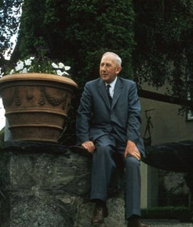
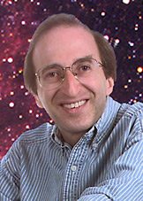


Conclusions
Hubble constant sets absolute scale (and age) of the universe
Past conflicts resolved
Age of Universe is bigger than age of the Earth
recognition of different stellar populations
Age of Universe bigger than oldest stars
cosmological constant

Slide 43
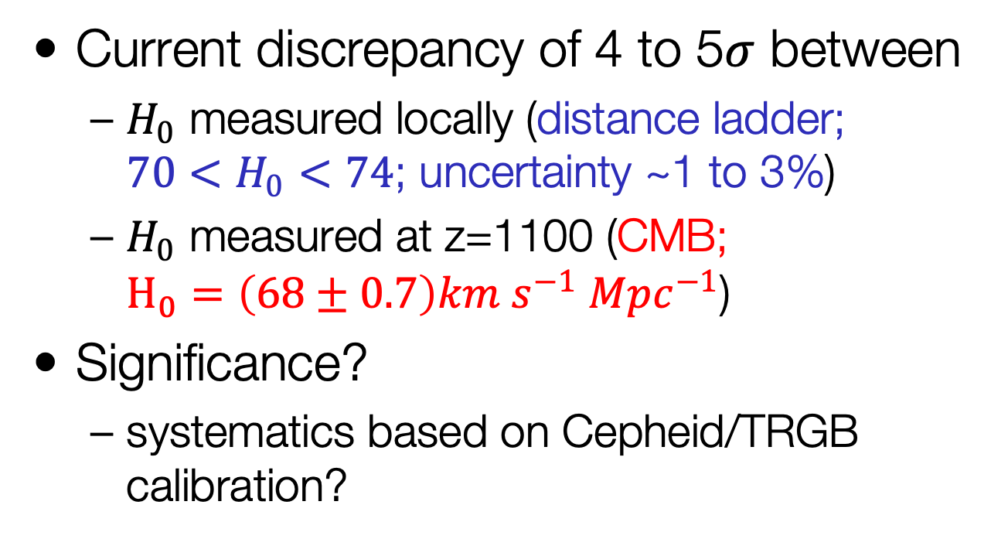
Conclusions
Current discrepancy of 4 to 5$σ$ between
$H_{0}$ measured locally (distance ladder; $70<H_{0}<74$; uncertainty ~1 to 3%)
$H_{0}$ measured at z=1100 (CMB; $H_{0}=\left(68±0.7\right)km s^{−1} Mpc^{−1}$)
Significance?
systematics based on Cepheid/TRGB calibration?

Slide 44
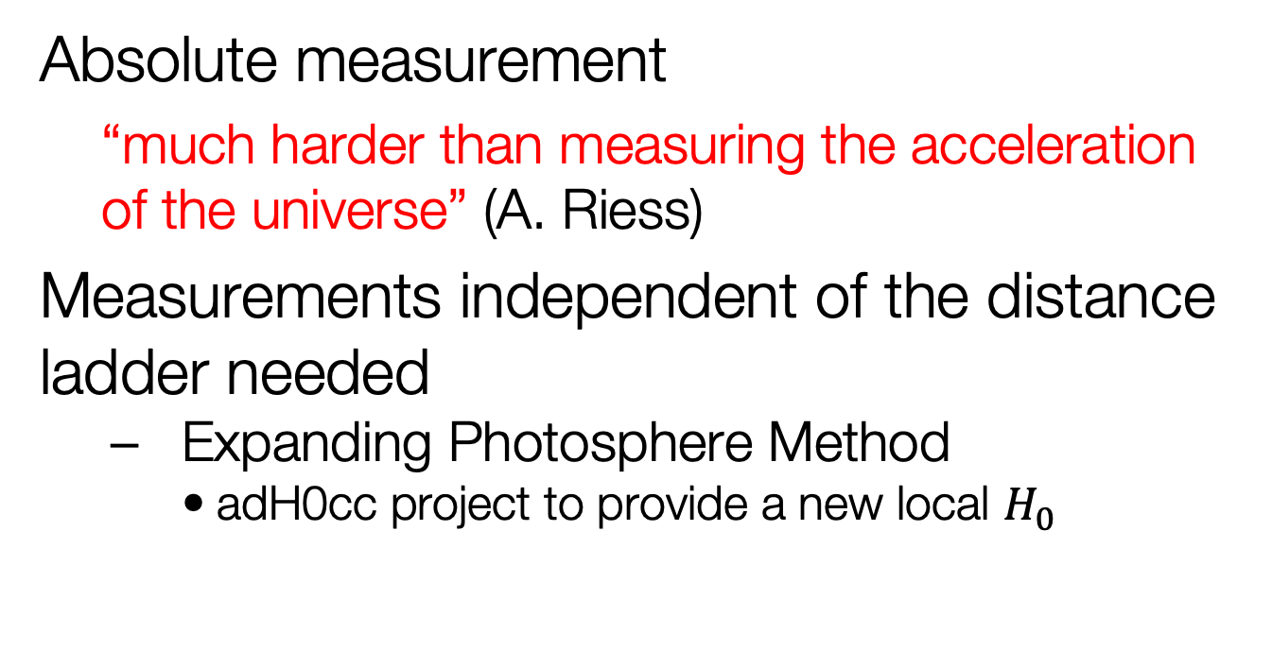
Conclusions
Absolute measurement
“much harder than measuring the acceleration of the universe” (A. Riess)
Measurements independent of the distance ladder needed
Expanding Photosphere Method
adH0cc project to provide a new local $H_{0}$

Slide 45
Hubble Tension?
Systematics underestimated?
Small uncertainties can add up along the distance ladder
Reddening, Cepheid Period-Luminosity relation (e.g. metallicity), crowding, SN light curve corrections
Galbany et al. 2022

