Slide 1
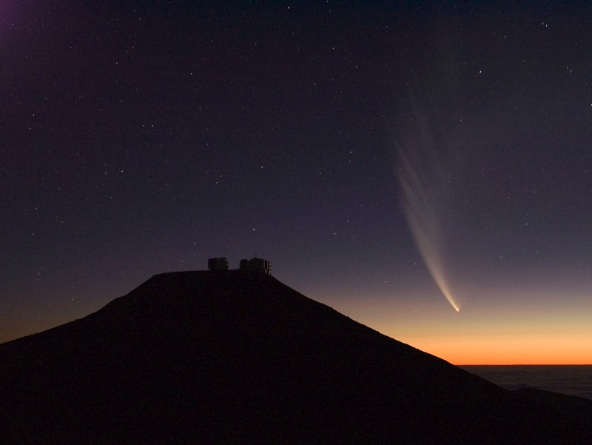
ESO - The European Southern Observatory
Bruno Leibundgut
Director for Science

Slide 2
European Southern Observatory
Mission
Develop and operate world-class observing facilities for astronomical research
Organize collaborations in astronomy
Intergovernmental treaty-level organization
Founded in 1962 by 5 countries (50 years in 2012!)
Today 14 member states, Brazil will become 15th
Observatories in Chile
La Silla Paranal: VLT, VLTI, 3.6m, NTT, VISTA, VST
Chajnantor: APEX and ALMA partnerships
HQ in Garching and Office in Santiago

Slide 3
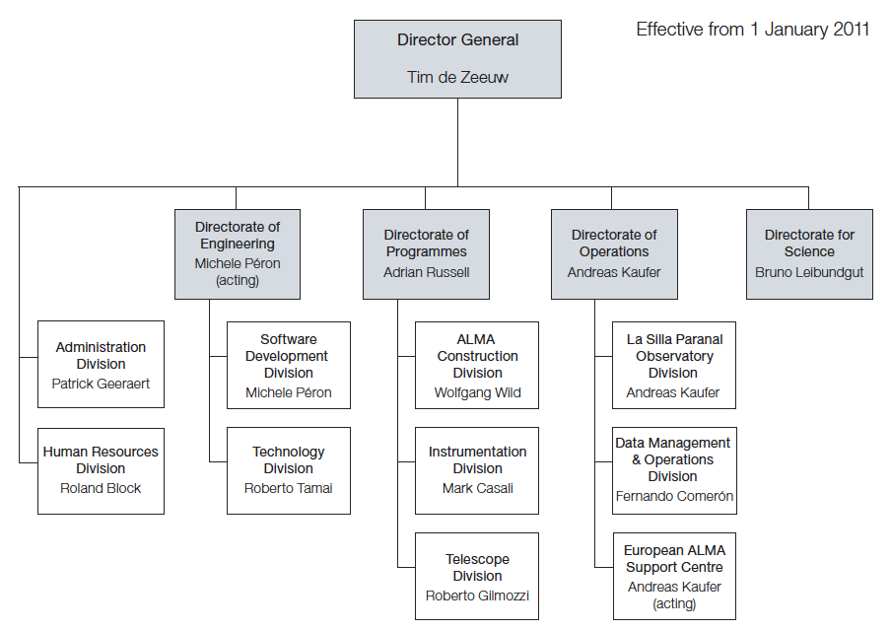
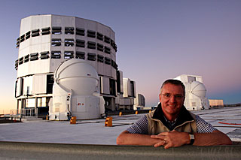

Slide 4
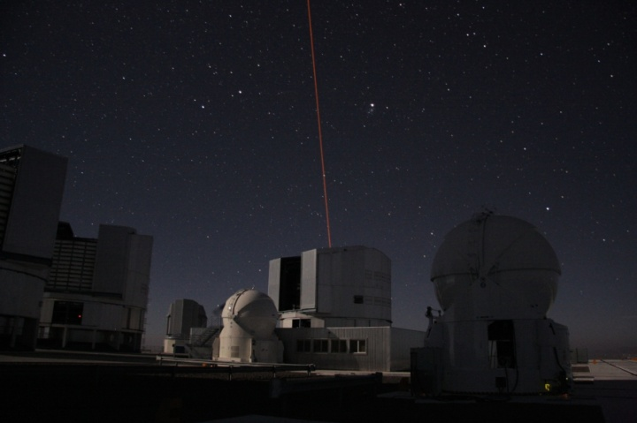
Three major programmes
La Silla Paranal Observatory
VLT, VLTI, 4m telescopes, survey telescopes, APEX
mature observatory
classical observing (‘visitor mode’)
service observing (VLT/I, survey telescopes)
extensive data archive
European Partner in ALMA
next large ground-based observatory
opening up mm/sub-mm window for large community
E-ELT design study
39m optical/infrared telescope
to be constructed in the next 10 years

Slide 5
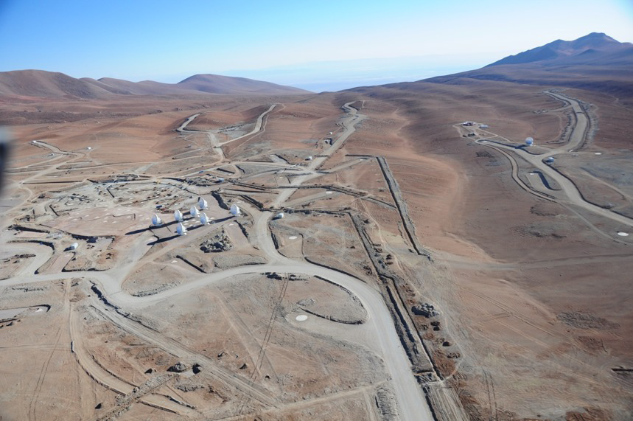
Three major programmes
La Silla Paranal Observatory
VLT, VLTI, 4m telescopes, survey telescopes, APEX
mature observatory
classical observing (‘visitor mode’)
service observing (VLT/I, survey telescopes)
extensive data archive
European Partner in ALMA
next large ground-based observatory
opening up mm/sub-mm window for large community
E-ELT design study
39m optical/infrared telescope
to be constructed in the next 10 years

Slide 6
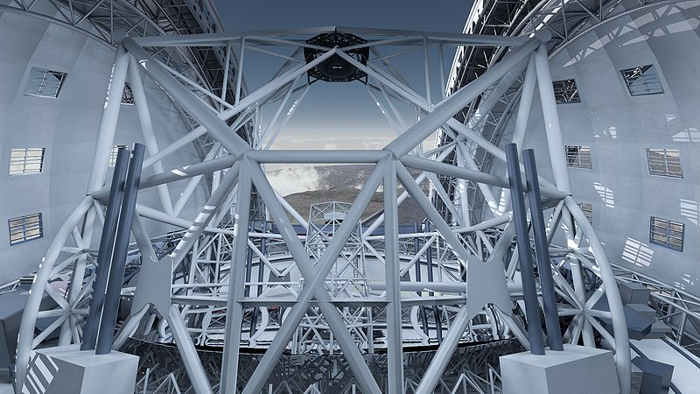
Three major programmes
La Silla Paranal Observatory
VLT, VLTI, 4m telescopes, survey telescopes, APEX
mature observatory
classical observing (‘visitor mode’)
service observing (VLT/I, survey telescopes)
extensive data archive
European Partner in ALMA
next large ground-based observatory
opening up mm/sub-mm window for large community
E-ELT design study
39m optical/infrared telescope
to be constructed in the next 10 years

Slide 7
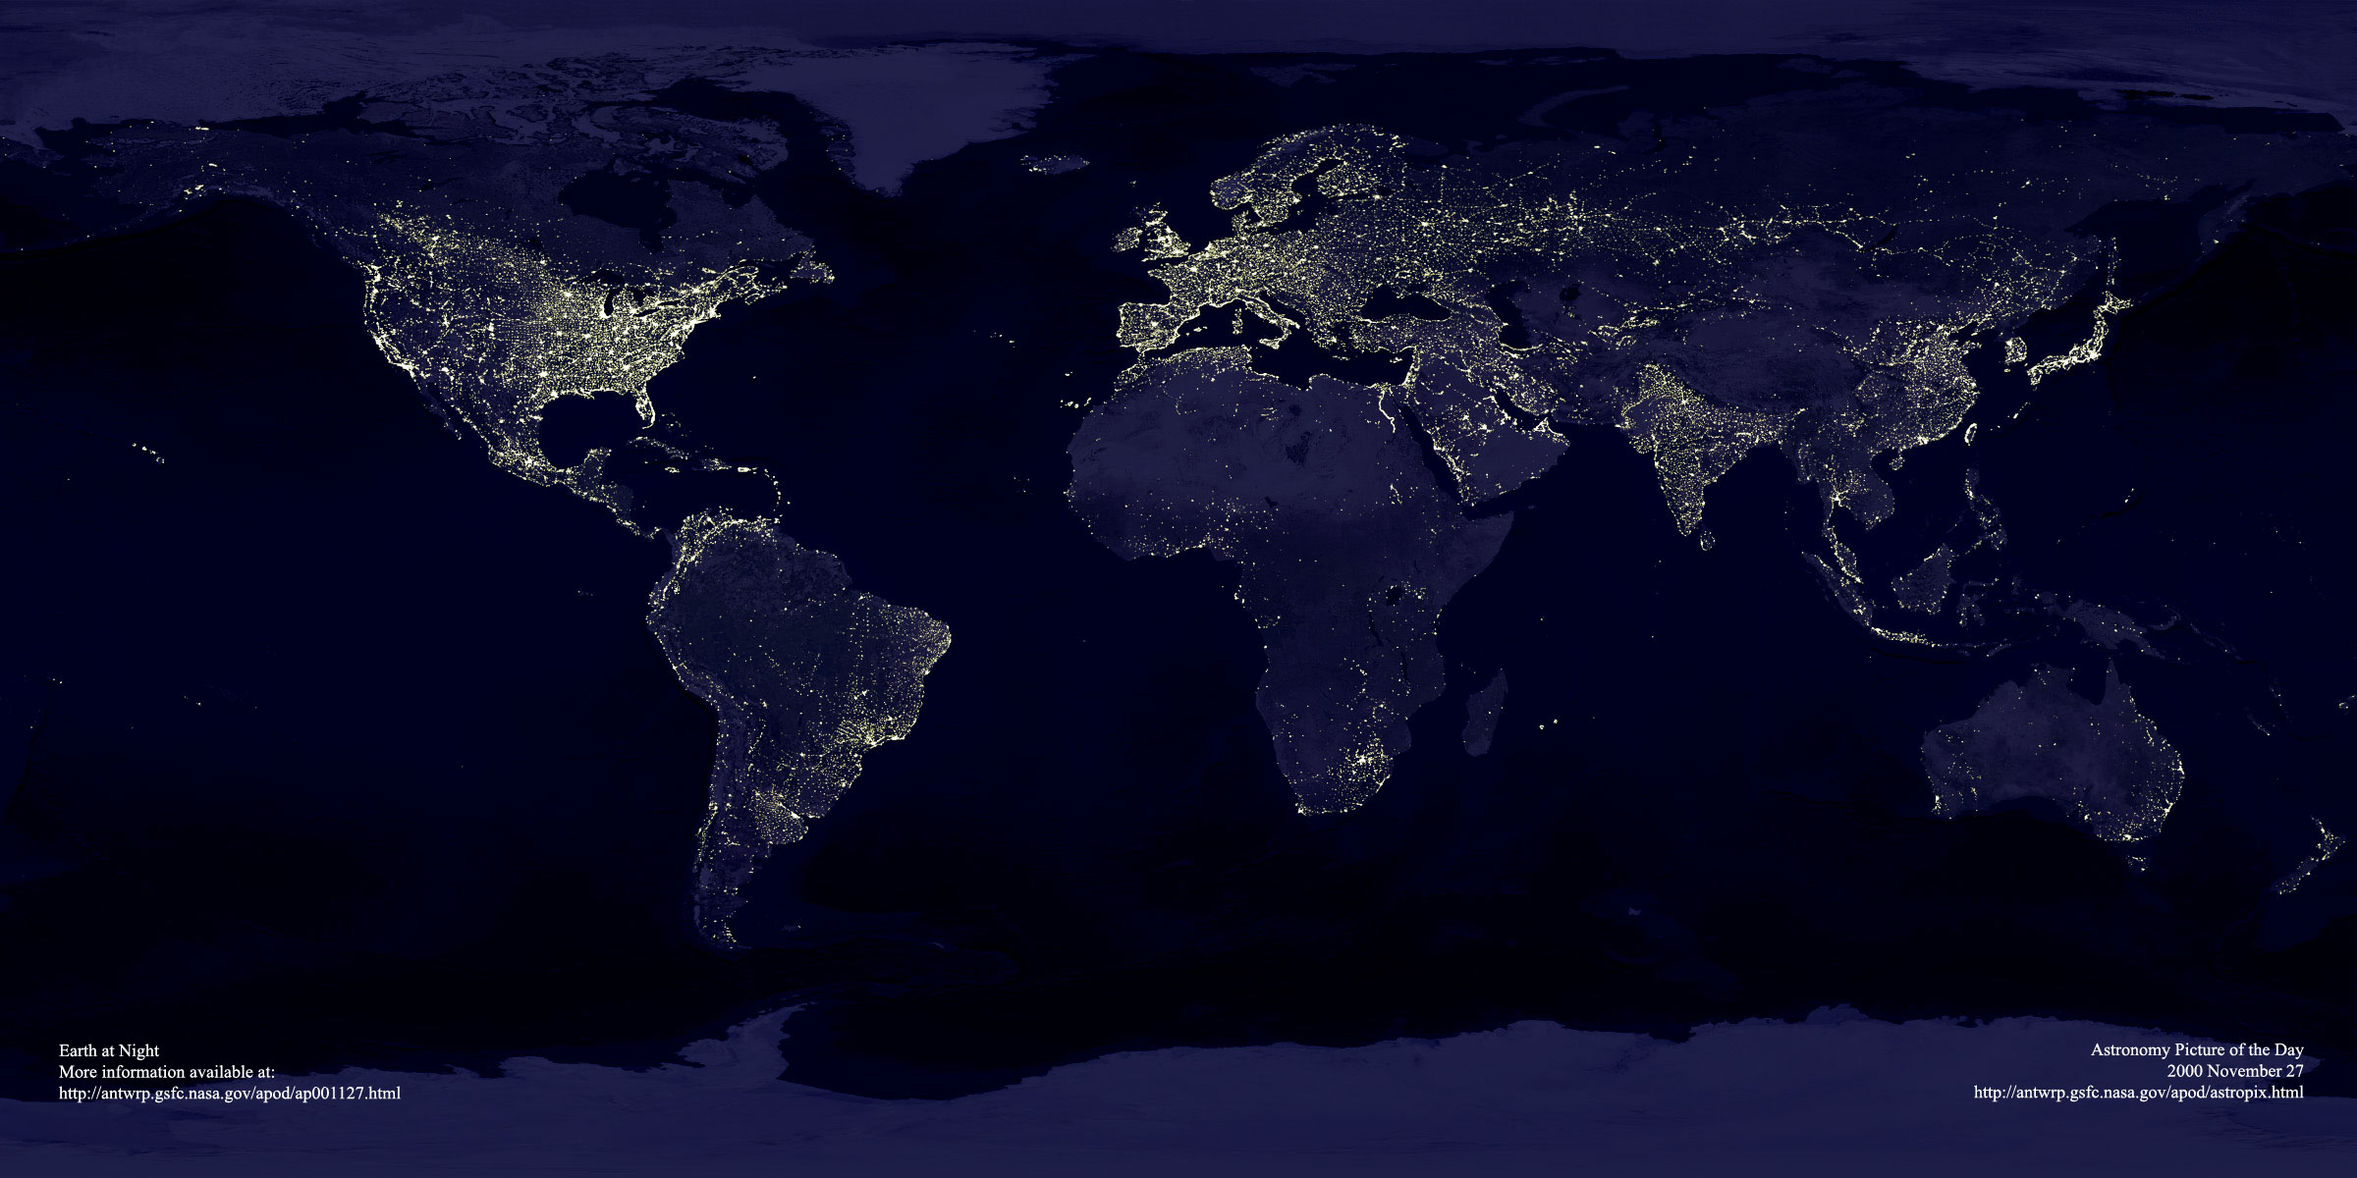
ESO’s sites
Garching bei München
Chajnantor
Paranal
La Silla
Santiago

Slide 8
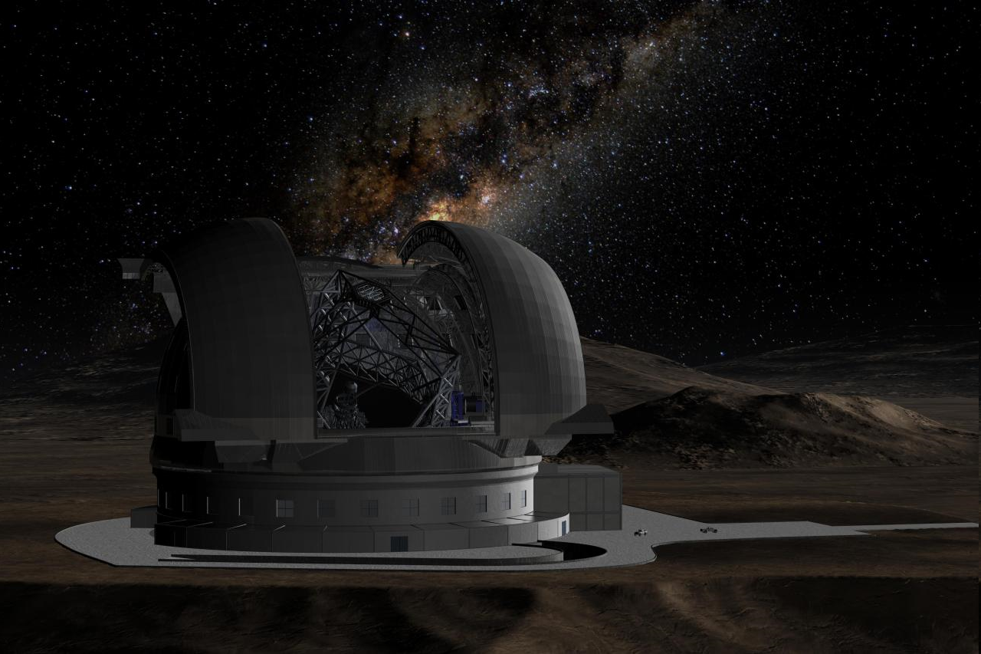
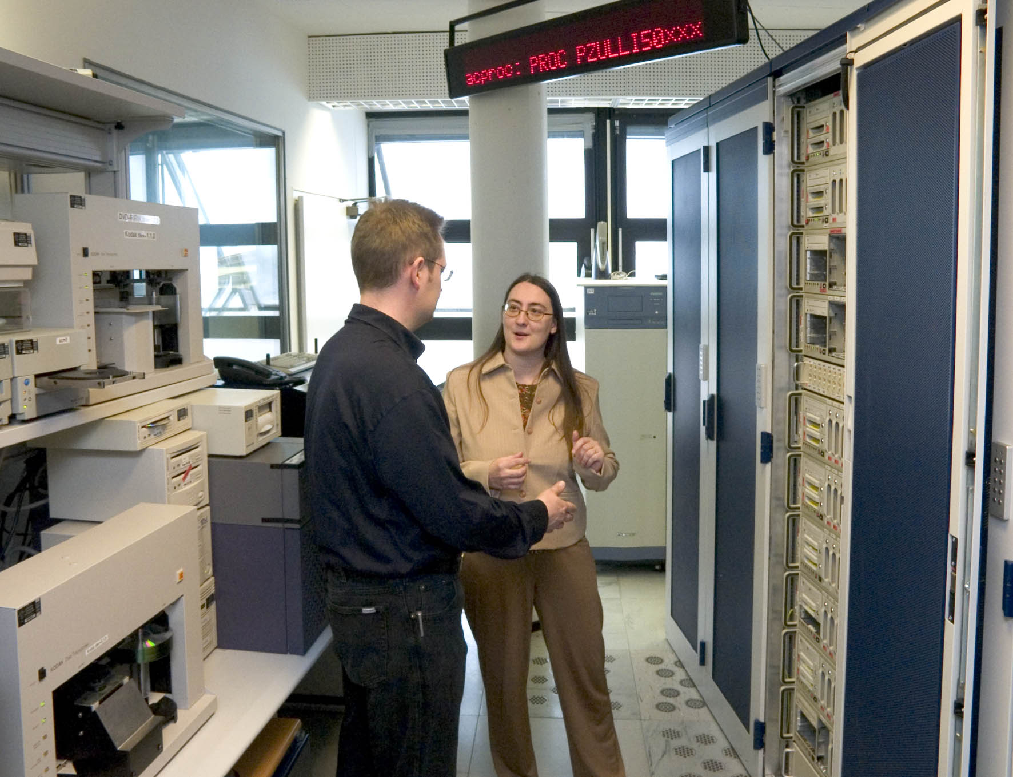
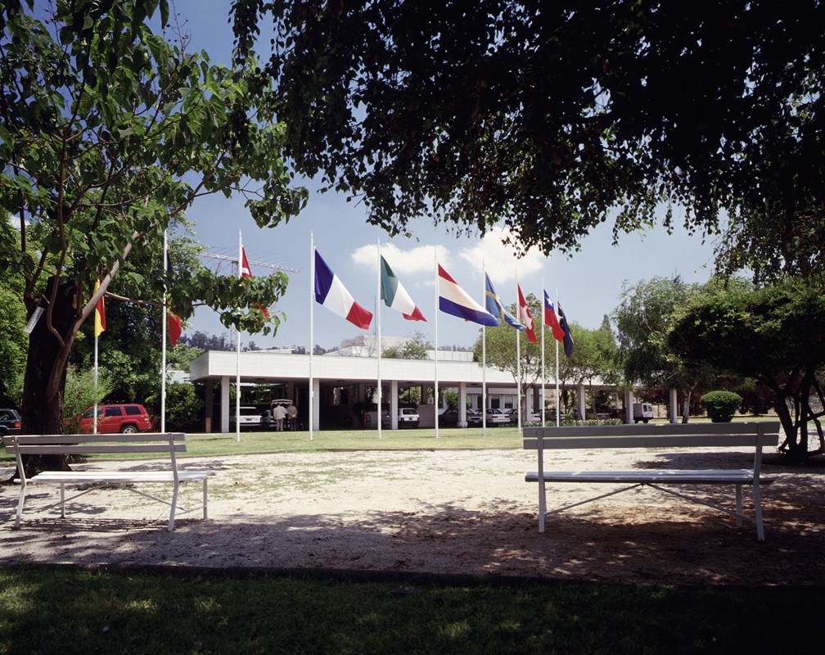
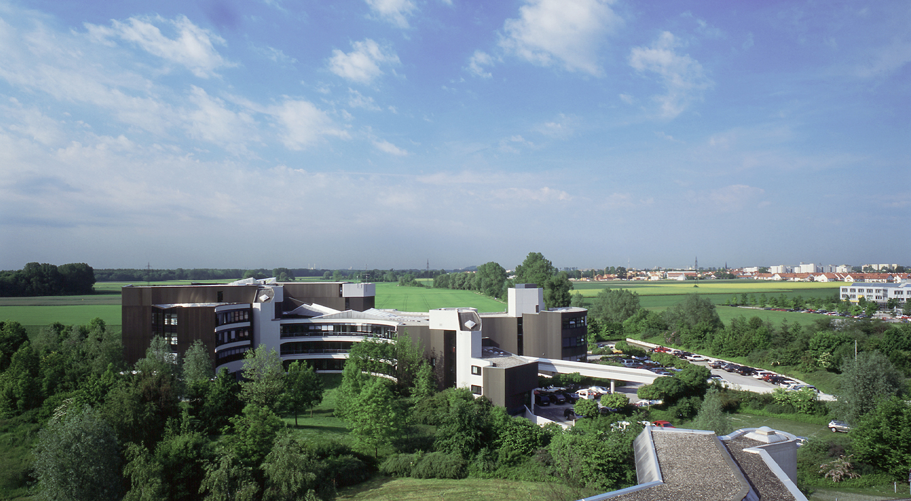
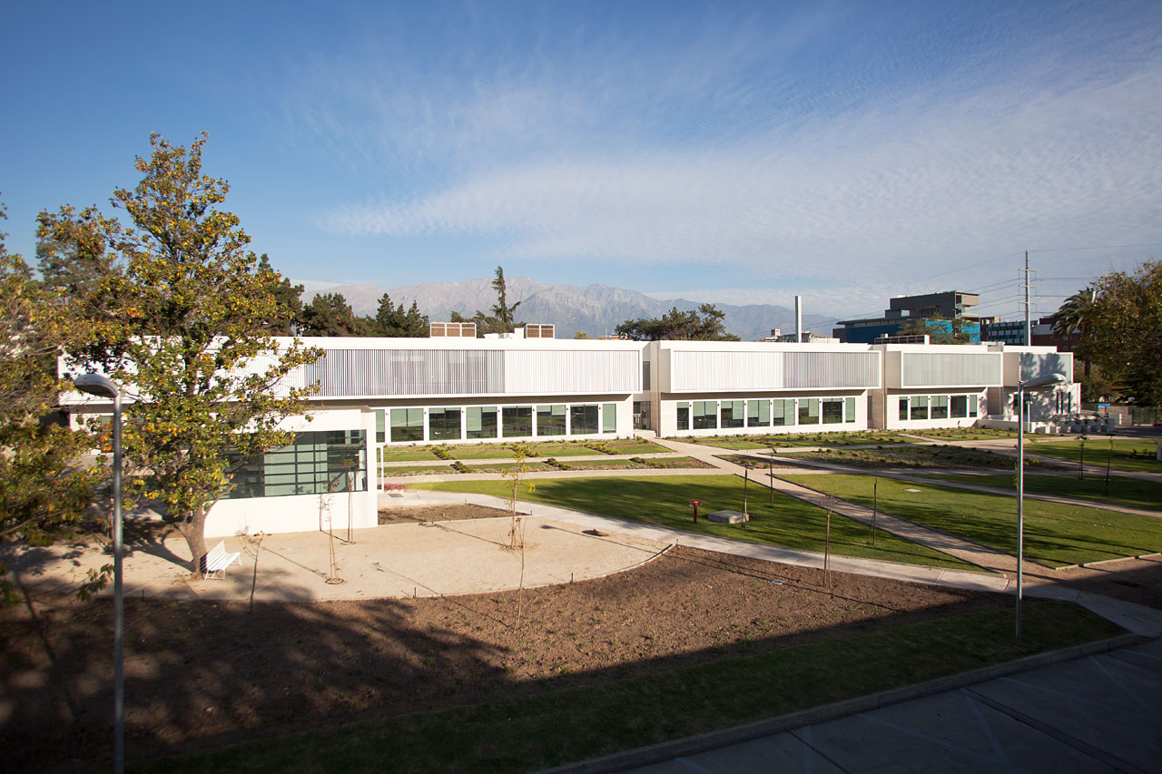
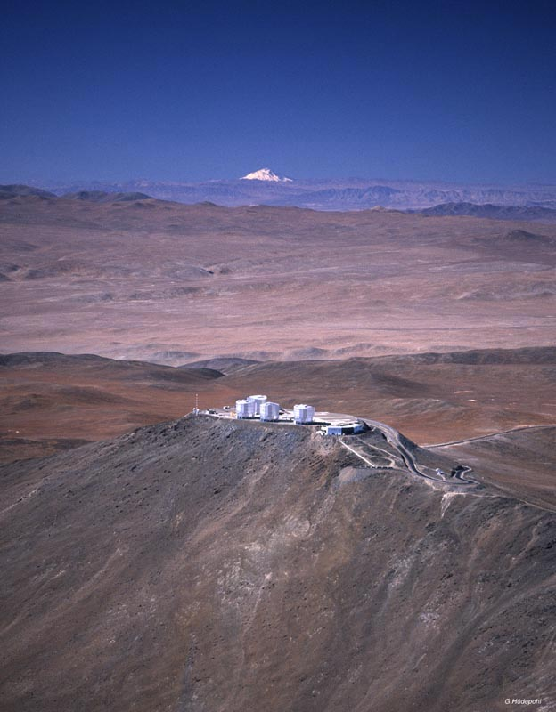
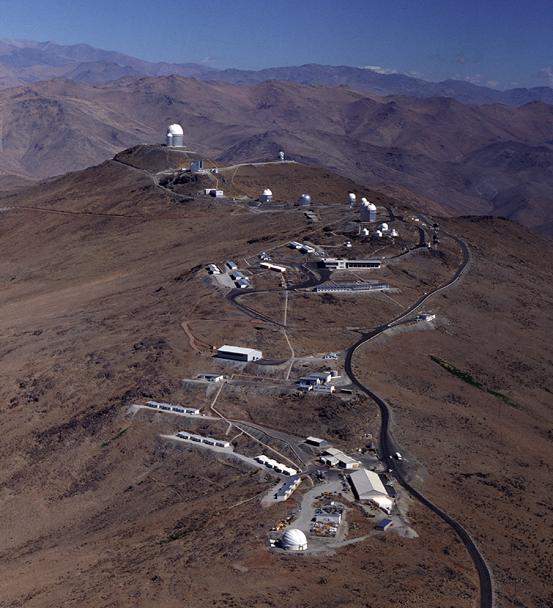
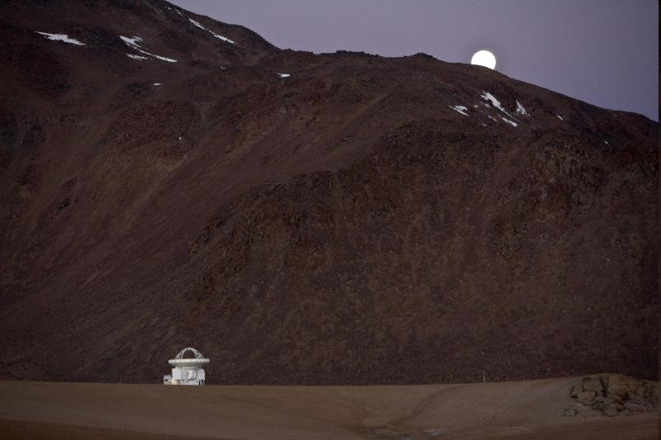
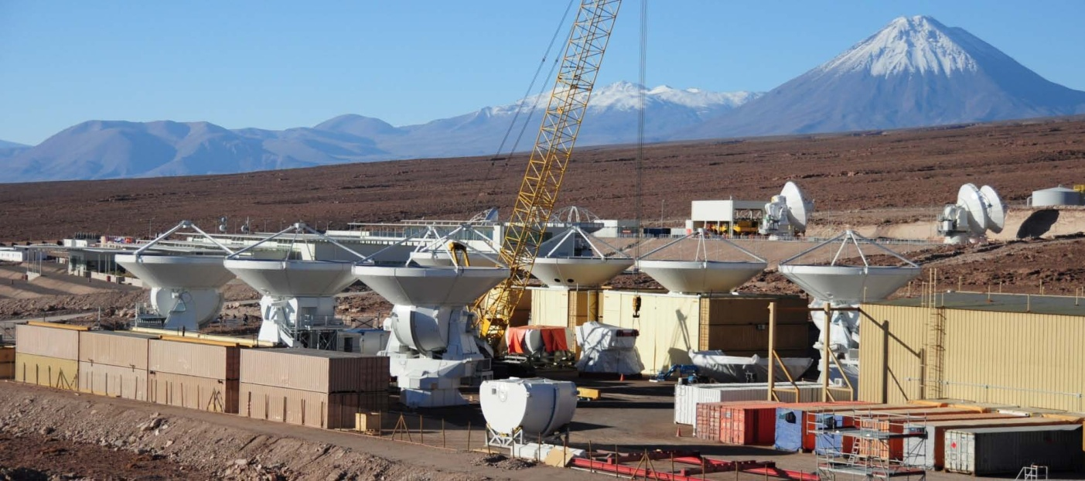
ESO Today
La Silla and Paranal Observatory in full operations 8 (soon 9) telescopes in 2011, plus 4 telescopes for interferometry)
APEX operating on Chajnantor
ALMA under construction (early science in 2011, full operations in 2013)
Operational data archive
European Extremely Large Telescope in design phase
Headquarters in Garching, Germany
Representation in Santiago, Chile

Slide 9
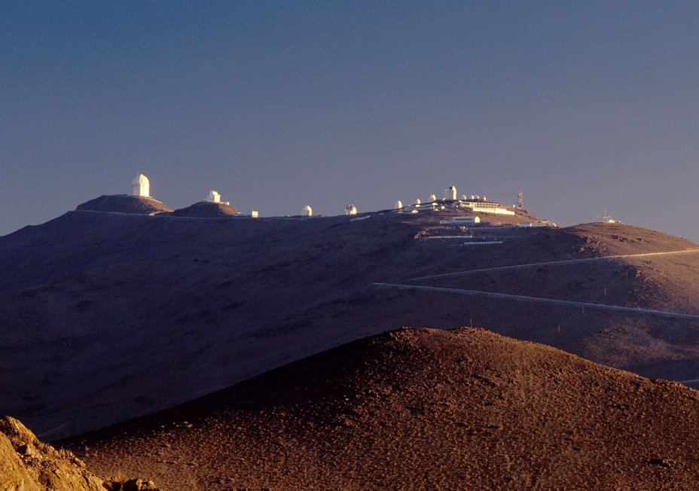
La Silla: ESO’s first observatory
Two of the most productive 4-m class telescopes
in the world
ESO 3.6-m telescope, since 1976
New Technology Telescope NTT (3.58 m), since 1989
300 refereed publications per year!

Slide 10
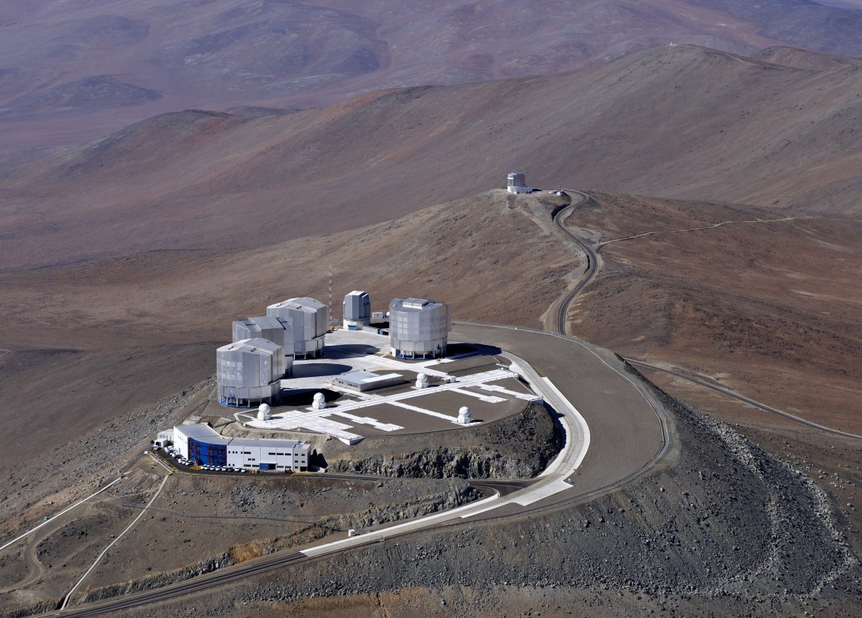
The VLT is the world´s most productive ground-based facility producing more than one scientific paper per day!

Slide 11
La Silla Paranal
VLT/I (Paranal)
Instrumentation operating, in assembly and planned
Covers the available optical infrared wavelengths 300nm to 20μm
Angular resolution from seeing limit to 50 μ-arcseconds
FORS2, ISAAC, UVES, FLAMES, NACO, SINFONI, CRIRES, VISIR, HAWK-I, VIMOS, X-Shooter, laser guide star facility KMOS, MUSE, SPHERE, Adaptive Optics Facility, ESPRESSO
MIDI, AMBER, PRIMA (astrometry), (PIONIER), GRAVITY, MATISSE
VISTA/VIRCAM
VST/ΩCam

Slide 12
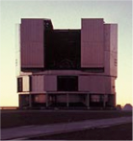
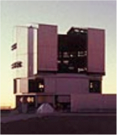
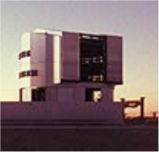
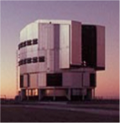
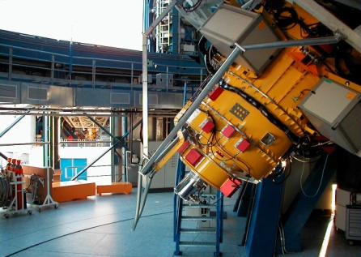
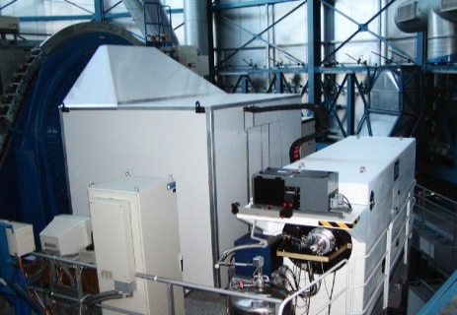
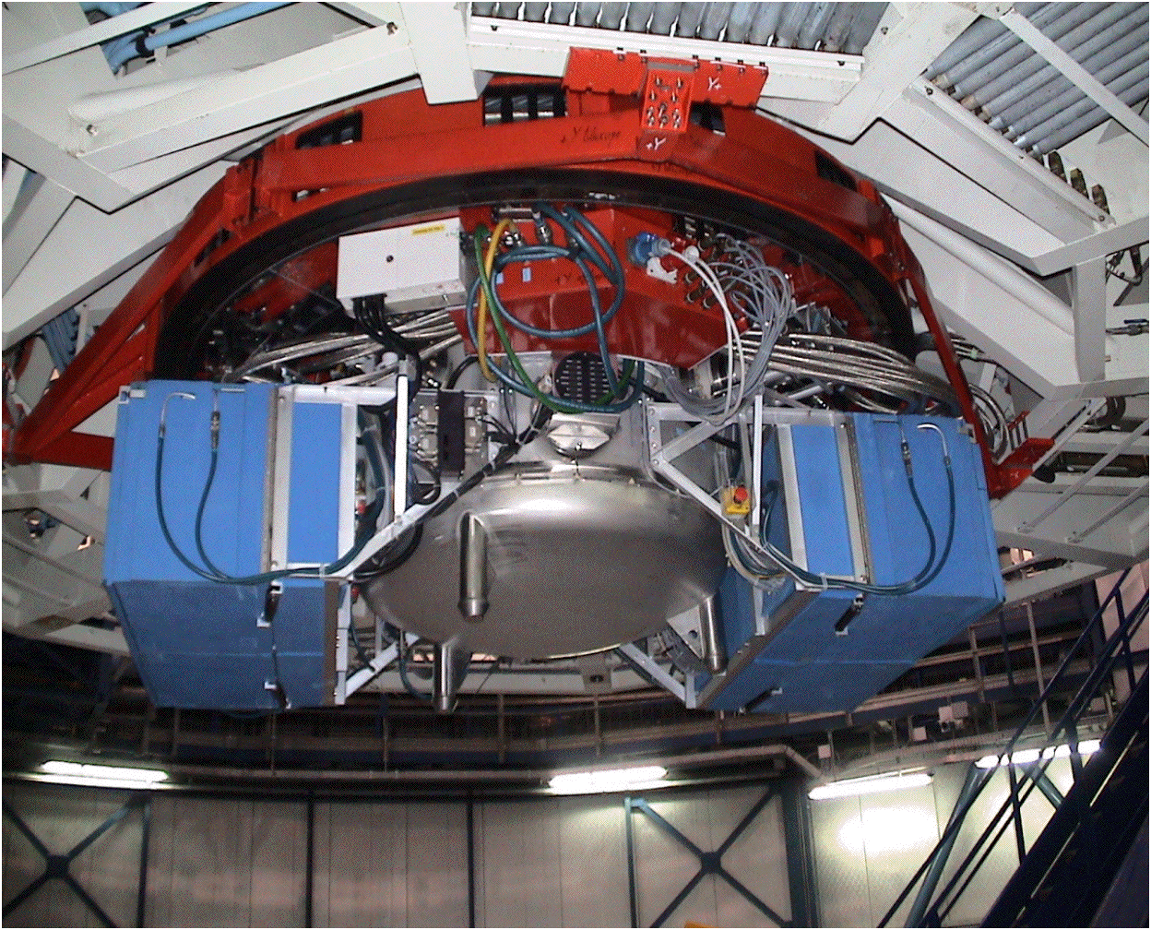
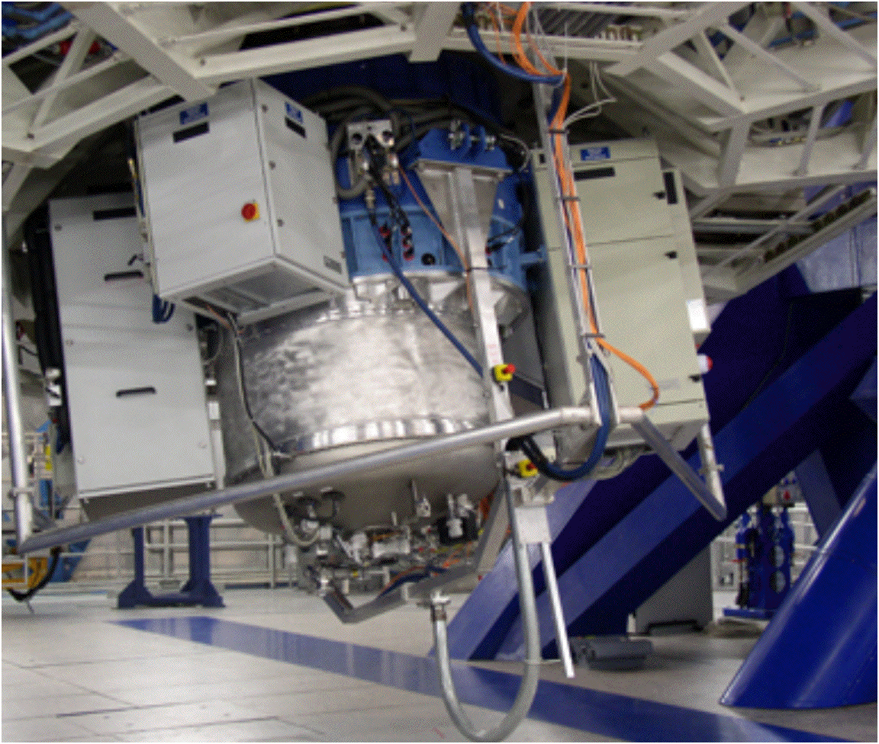
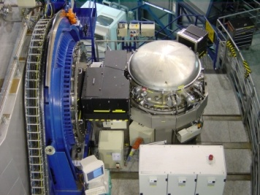
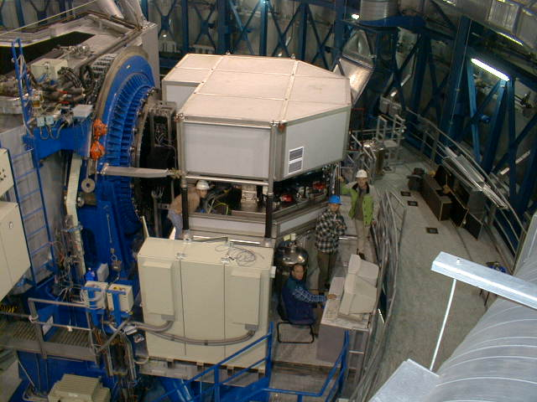
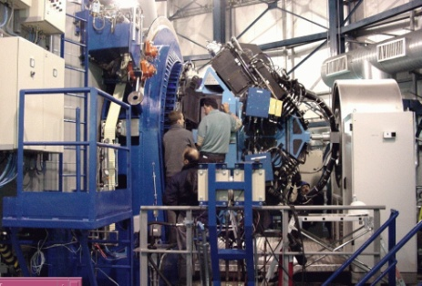
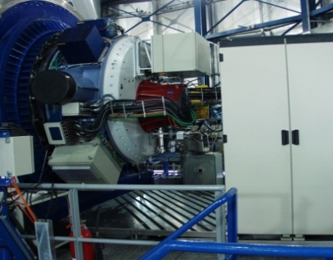
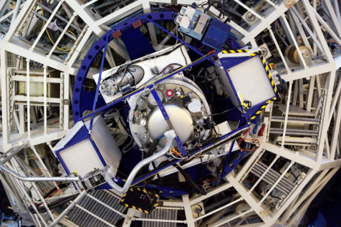
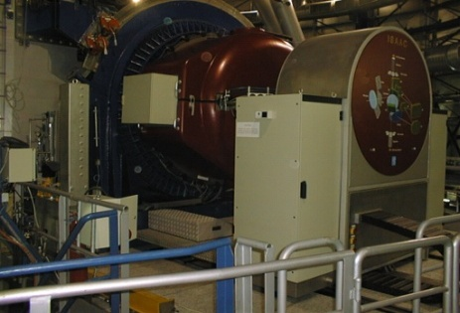
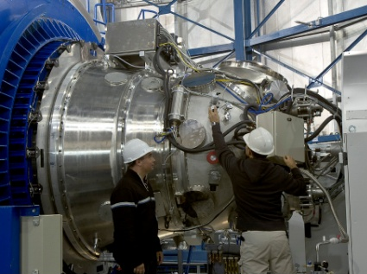
Current VLT Instruments
FORS2
FLAMES
VISIR
SINFONI
CRIRES
UVES
VIMOS
NACO
X-shooter
ISAAC
HAWK-I

Slide 13
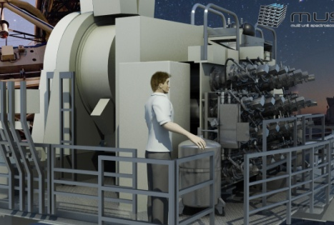
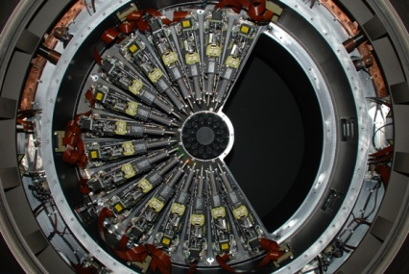
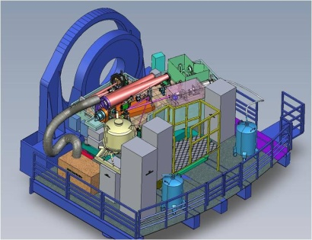
VLT Instruments 2012
FORS2
FLAMES
VISIR
SINFONI
CRIRES
UVES
VIMOS
MUSE
KMOS
X-shooter
SPHERE
HAWK-I

Slide 14
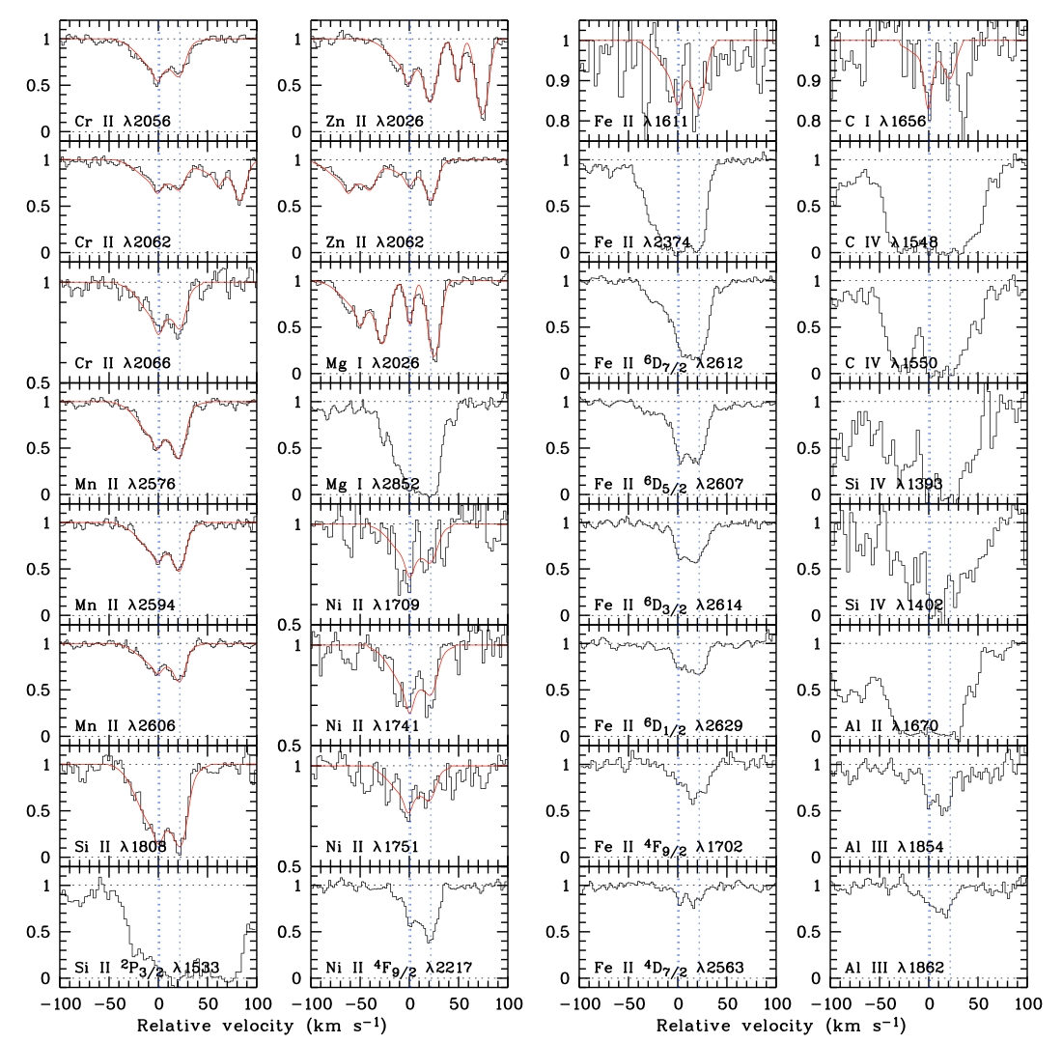
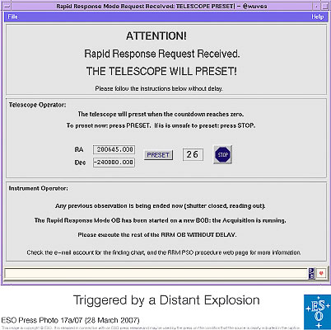
Rapid Response Mode (RRM)
UVES observations of
GRB 060418
10 minutes
after the initial
Swift trigger
Many metal line systems
at 3 redshifts.
[Zn/Fe] >> QSO abs.

Slide 15
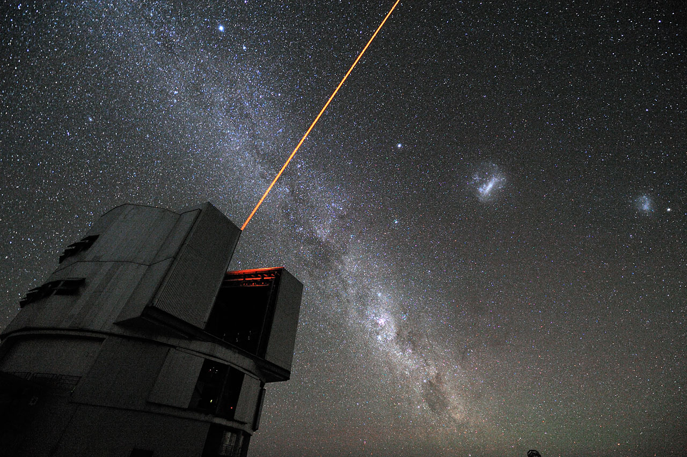
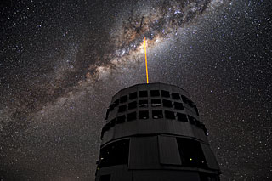

Slide 16
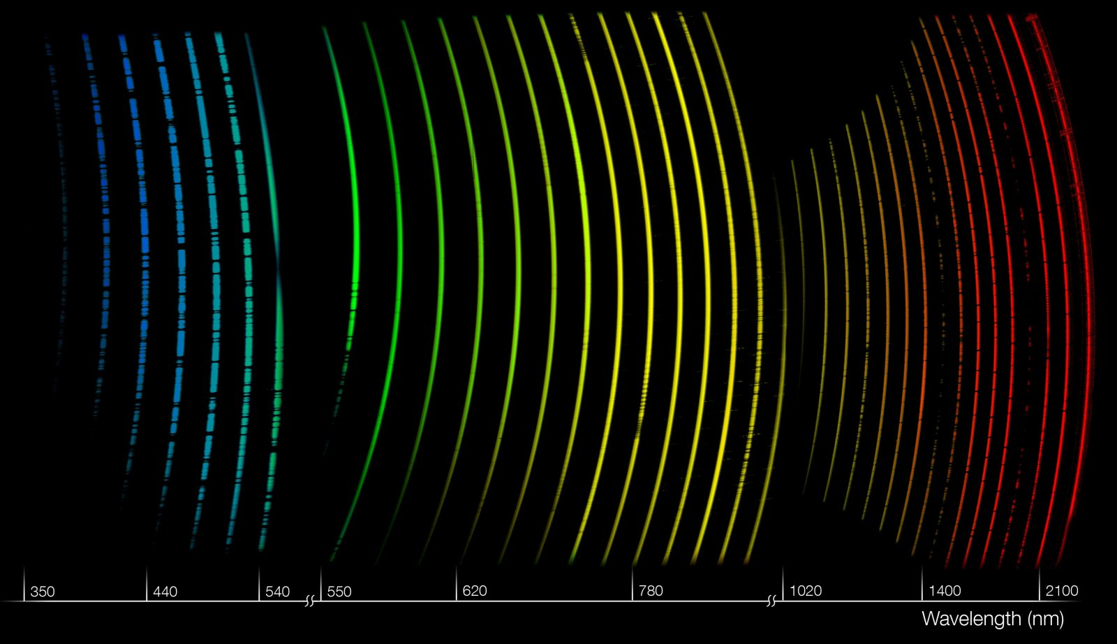
X-shooter: simultaneous spectra from the UV to NIR

Slide 17
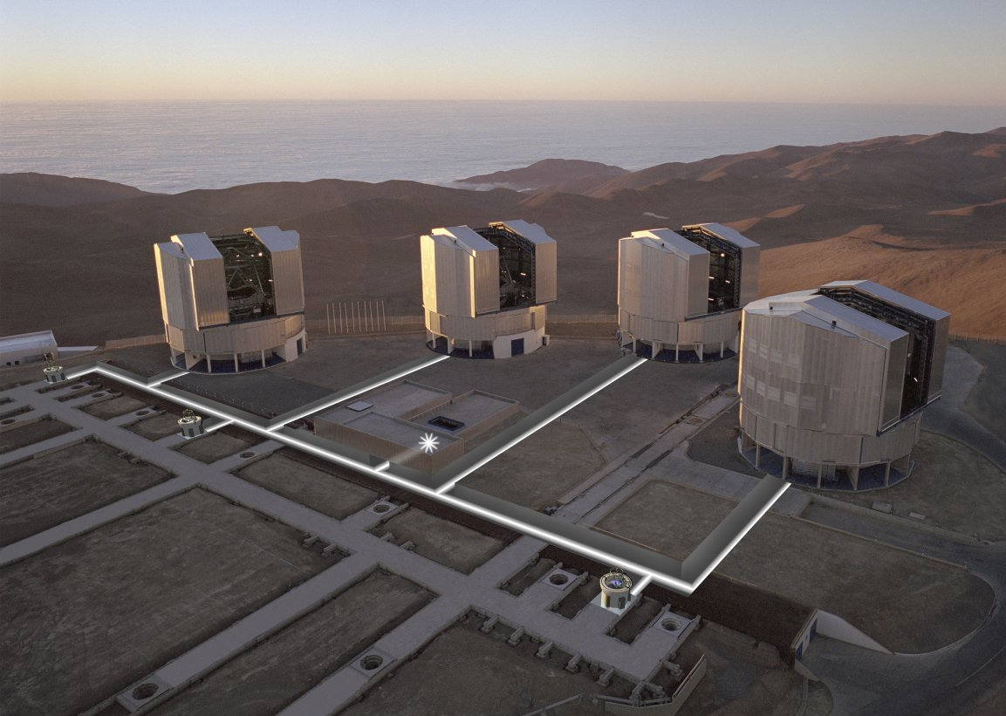
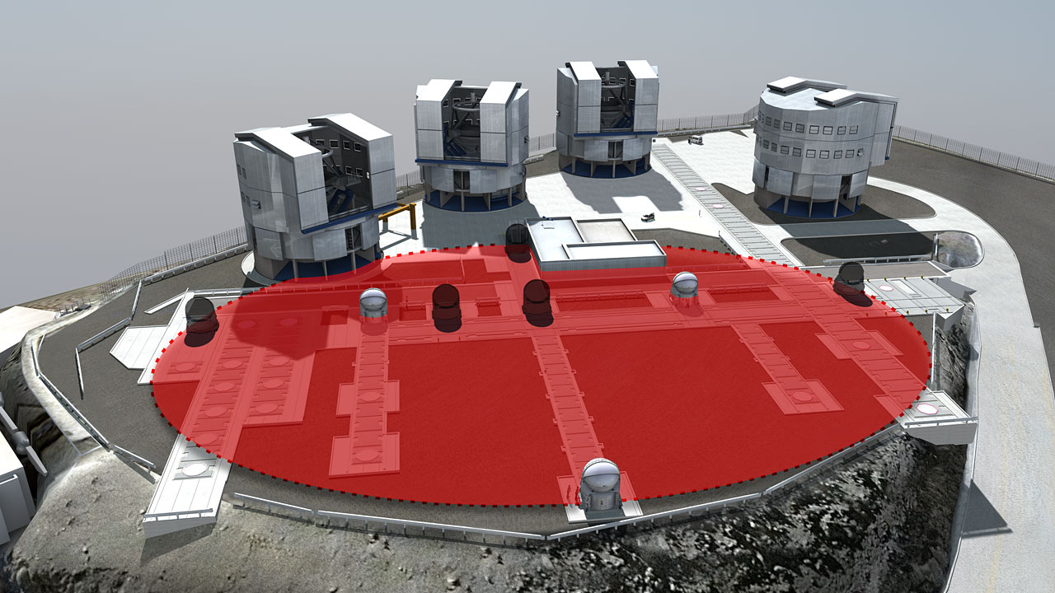
VLTI - Very Large Telescope Interferometry
VLTI acts like a virtual 100-meter telescope

Slide 18
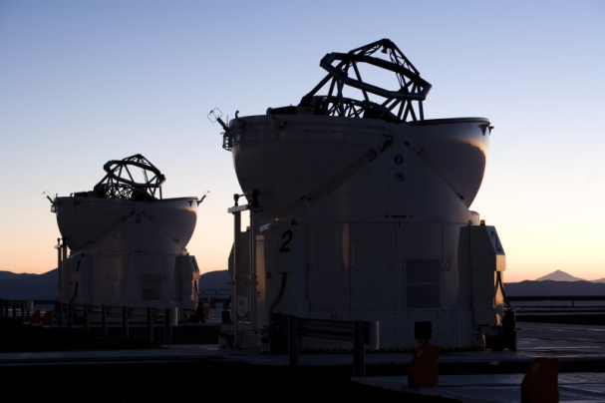
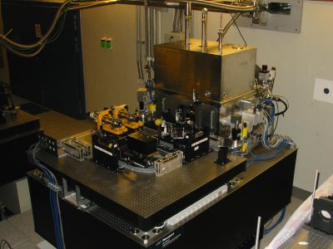
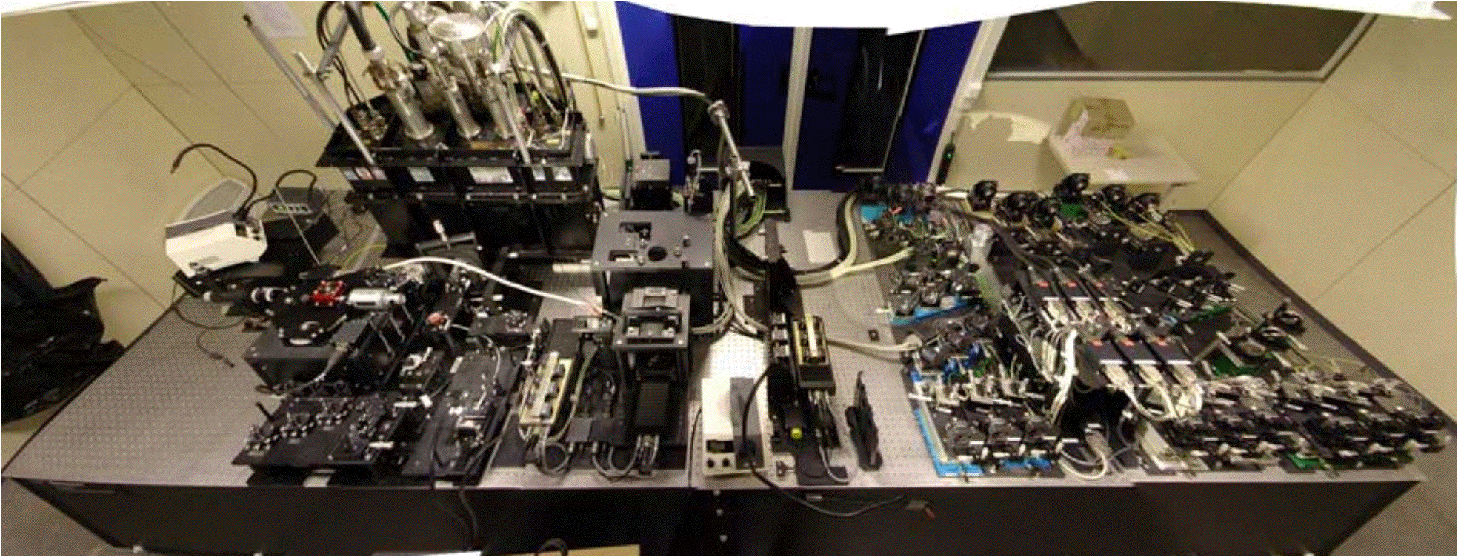
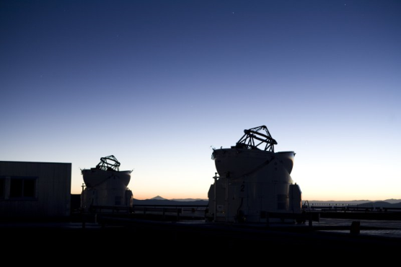
VLTI Instruments
MIDI
AMBER

Slide 19
La Silla Paranal
La Silla
Medium-sized telescopes (3.6m, 3.5m NTT, 2.2m)
Small telescopes closed/funded externally
Continue operations with long-term programmes
HARPS, EFOSC2, SOFI, FEROS, WFI, visitor instruments
New initiatives and specific experiments
Euler, Tarot-II, REM, QUEST, TRAPPIST
APEX
Covers sub-mm and mm wavelengths 0.3 to 3 mm
SHFI (Swedish Heterodyne Facility Instrument), LABOCA, SABOCA, CHAMP+, Z-Spec

Slide 20
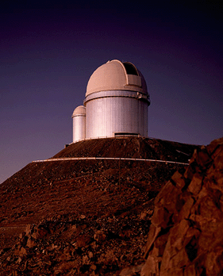
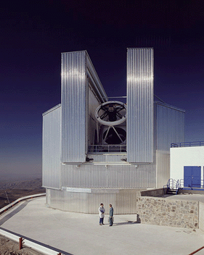
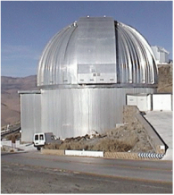
La Silla: 5 Operational Instruments
3.6m
NTT
2.2m
HARPS
SOFI
WFI
EFOSC2
FEROS
GROND

Slide 21
VISTA: Visible and Infrared Survey Telescope for Astronomy
4.1-m survey telescope
in operation since April 2010
In operations for one year
Multi-year programme of large public surveys VHS, VVV, VIDEO, VIKING, VMC, UltraVISTA
limited access to regular programmes (~10%)

Slide 22
VISTA Public Surveys
Six public surveys ongoing

Slide 23
VST: VLT Survey Telescope
2.6-m optical telescope with 32 CCDs
Science Verification ongoing
Start of operations in October 2011
focus on three public surveys (KIDS, ATLAS, VPHAS+)
VST

Slide 24
VST Public Surveys
Three public surveys (and several GTO surveys)

Slide 25
APEX: an ALMA prototype
APEX in operation on
Chajnantor

Slide 27
Operational data archive

Slide 28
Scisoft package

Slide 30
www.eso.org

Slide 32
Headquarters in Garching, Germany
Office in Santiago, \ Chile

Slide 33
today
1968

Slide 34
The Scientific Impact of ESO Telescopes

Slide 36
ESO publication statistics
13 Nature papers in 2010
2 Science papers in 2010

Slide 37
Publications of major observatories

Slide 38
Top 10 ESO Scientific Discoveries
Accelerating universe
First image of an exoplanet
Stars orbiting Milky Way’s black hole
The gamma-ray burst–supernova connection
The motion of stars in the Milky Way
Oldest star known in the Milky Way
Neutron star–gamma-ray burst connection
Cosmic temperature independently measured
Most distant object measured
Lightest exoplanet found
More info: http://www.eso.org/public/science/top10.html

Slide 39
Most-cited ESO papers

Slide 40
ESO in the news

Slide 41
ALMA currently under construction
Partnership between ESO, NRAO, NAOJ
Early science in 2011
Full operations in 2013
ALMA will operate at wavelengths of 0.3 to 9.6 mm

Slide 42
ALMA will be a single telescope of revolutionary design, with 66 high-precision antennas
Resolution to 0.005" at highest frequencies 10 times better than HST

Slide 43
ALMA
Science requirements
Detect CO and [CII] in Milky Way galaxy at z=3 in < 24 hr
Dust emission, gas kinematics in proto-planetary disks
Resolution to match Hubble, JWST and 8-10m with AO
Complement to Herschel
Specifications
66 antennas (54x12m, 12x7m)
14 km max baseline (< 10mas)
30-1000 GHz (10–0.3mm), up to 10 receiver bands
HST
ALMA
5AU
850 GHz

Slide 44
Atmosphere above Chajnantor

Slide 45
Adding the 7m antennas

Slide 47
Reconfigurable baselines ranging from 15 m to 18 km
compact array

Slide 48
extended array

Slide 49
ALMA Early Science
Call for Early Science in March
16 dishes, at least 4 received bands, limited time
Configurations up to perhaps 500 m
Routine science operations 75% of time with 40+ antennae extpected in 2012
End of construction/full operations in 2013

Slide 50
An ELT in the making
ALMA now has more collecting area than any of the future E-ELT
17 antennas working as array (7 August 2011)
136 baselines
>900 proposals for Early Science (Cycle 0)

Slide 51
www.almaobservatory.org

Slide 52
ALMA regional centres (ARCs) will serve the ALMA user community

Slide 53
E-ELT: The World’s Biggest Eye on the Sky

Slide 55
Cerro Armazones
Cerro Paranal

Slide 56
ESO Today
Extremely Large Telescope is in design phase
revolutionary 5-mirror system with built-in adaptive optics
39-m primary mirror

Slide 58
A clearer view of the universe
1 arcsecond
HST
Seeing
limited
VLT+AO
E-ELT

Slide 59
E-ELT’s Vision

Slide 60
E-ELT: first light instruments
First Light Instruments
Multi-AO Imaging Camera
for Deep Observations
Optical/NIR IFU

Slide 61
Extremely Exciting Science
Exoplanets
detection and characterisation down
to Earth masses
Fundamental physics
expansion history of the universe, physics laws variations with time
Black holes
physics at the edge of black holes, evolution of black holes with time
Structure formation
watching the first galaxies form, resolving distant galaxies into stars

Slide 62
Extremely Exciting Science
Synergies with the VLT, JWST
and ALMA
The Unknown

Slide 63
E-ELT first light possible in 2021

Slide 64
ESO Fellowship programme
Open to all nationalities, but preference to ESO member countries
3 years in Garching or 4 in Chile
Chile Fellows do research plus observatory work
Garching Fellows do research plus support work
Deadline for applications is 15 October

Slide 65
Fellows and students are the next generation of ESO users

Slide 66
ESO Visitor Programme
ESO welcomes short and long term visits by astronomers from around the world
Visitor applications can be submitted any time

Slide 67
ESO Studentship Programme
Open to all nationalities, but preference to ESO member countries
Students spend one or two years at ESO
Also 2-3 month research opportunities for student interns
Deadline for student applications is June 15th

Slide 68
ESO Workshops

Slide 69
ESO’s goals for the next five years
Best science from La Silla Paranal Observatory
Second generation instruments (VLT/VLTI)
Key surveys with VST and VISTA
Long-term programs for unique science on La Silla
Prepare for ALMA science with APEX
Deliver ALMA on time and budget
Design world-leading E-ELT, and secure funding for construction and operations

