Slide 1
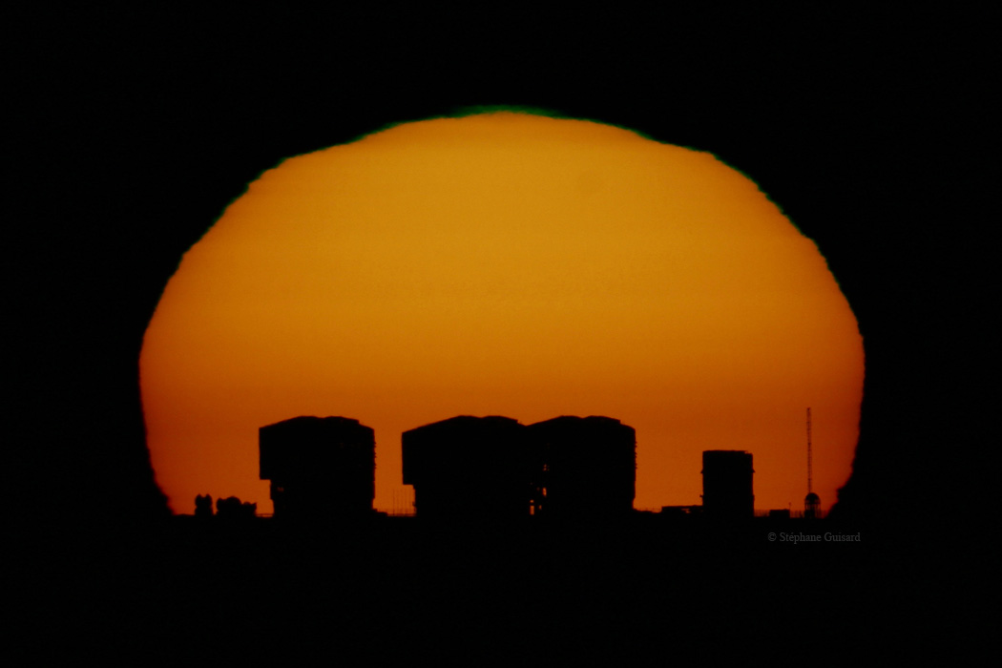
Recent Developments at ESO
Bruno Leibundgut

Slide 2
European Southern Observatory
Mission
  Develop and operate world-class observing facilities for astronomical research
  Organise collaborations in astronomy
Intergovernmental treaty-level organization
  Currently 14 member states
  Some interest by other countries
Observatories in Chile
  La Silla Paranal: VLT, VLTI, 3.6m, NTT, VISTA, VST
  Chajnantor: APEX and ALMA partnerships
HQ in Garching and Office in Santiago

Slide 3
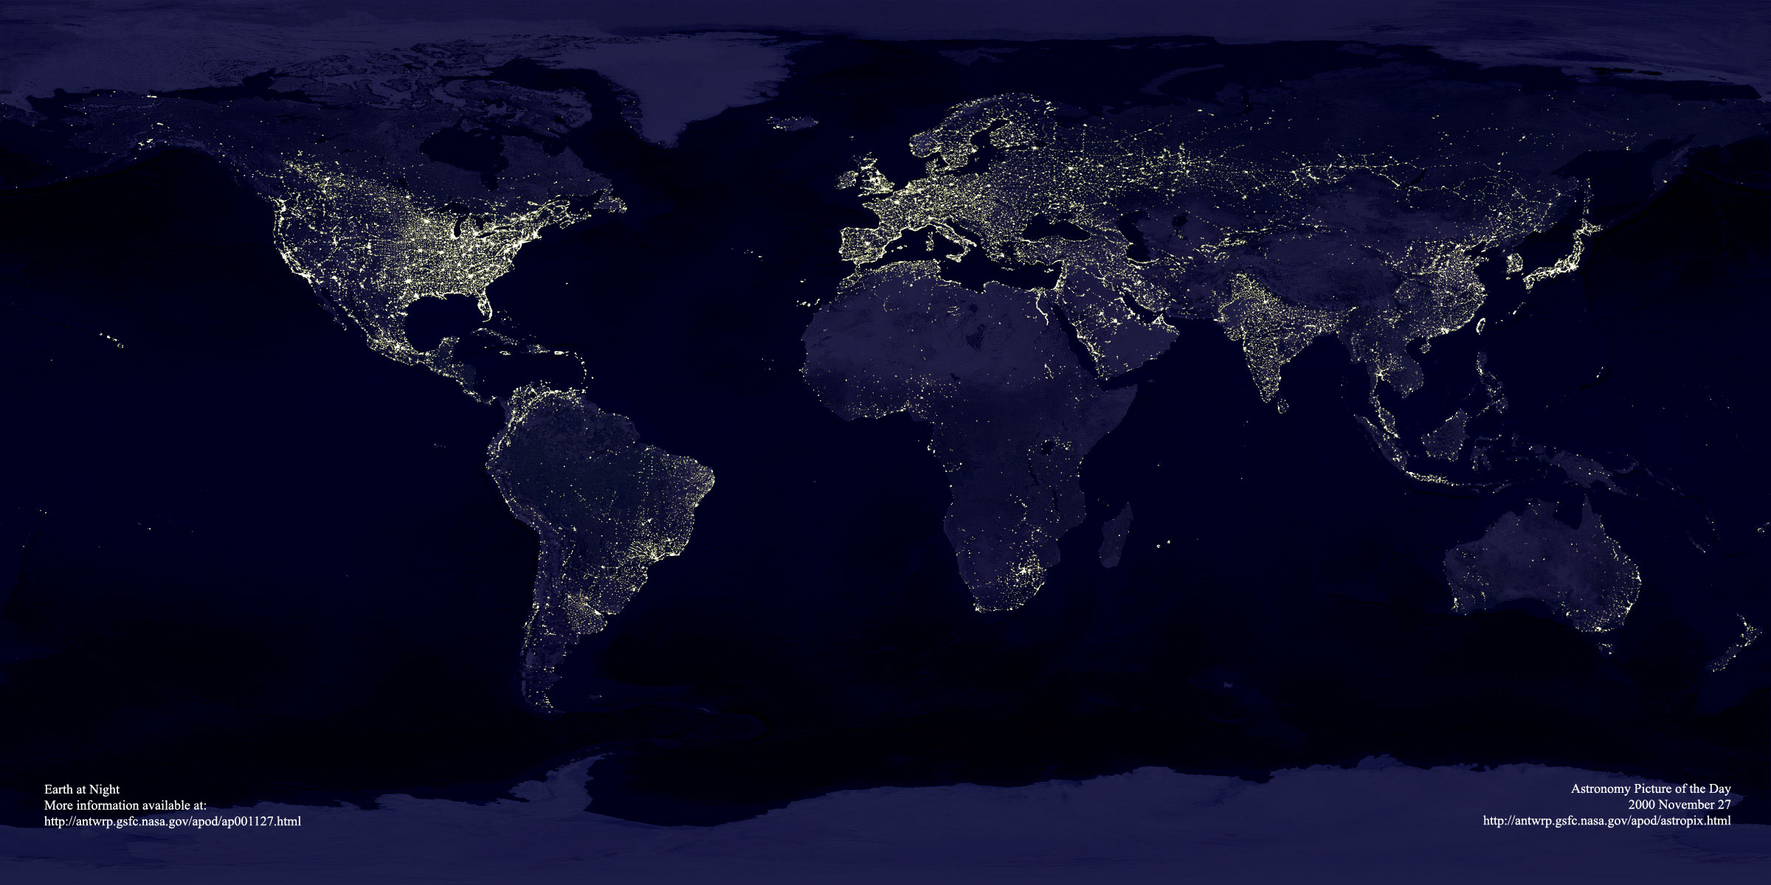
ESO’s sites
Garching bei München
Chajnantor
Paranal
La Silla
Santiago

Slide 4
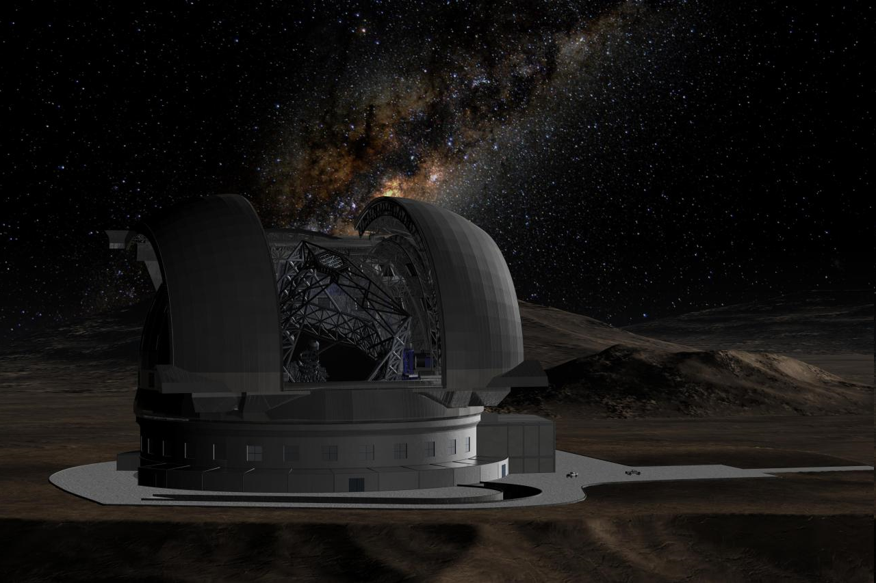
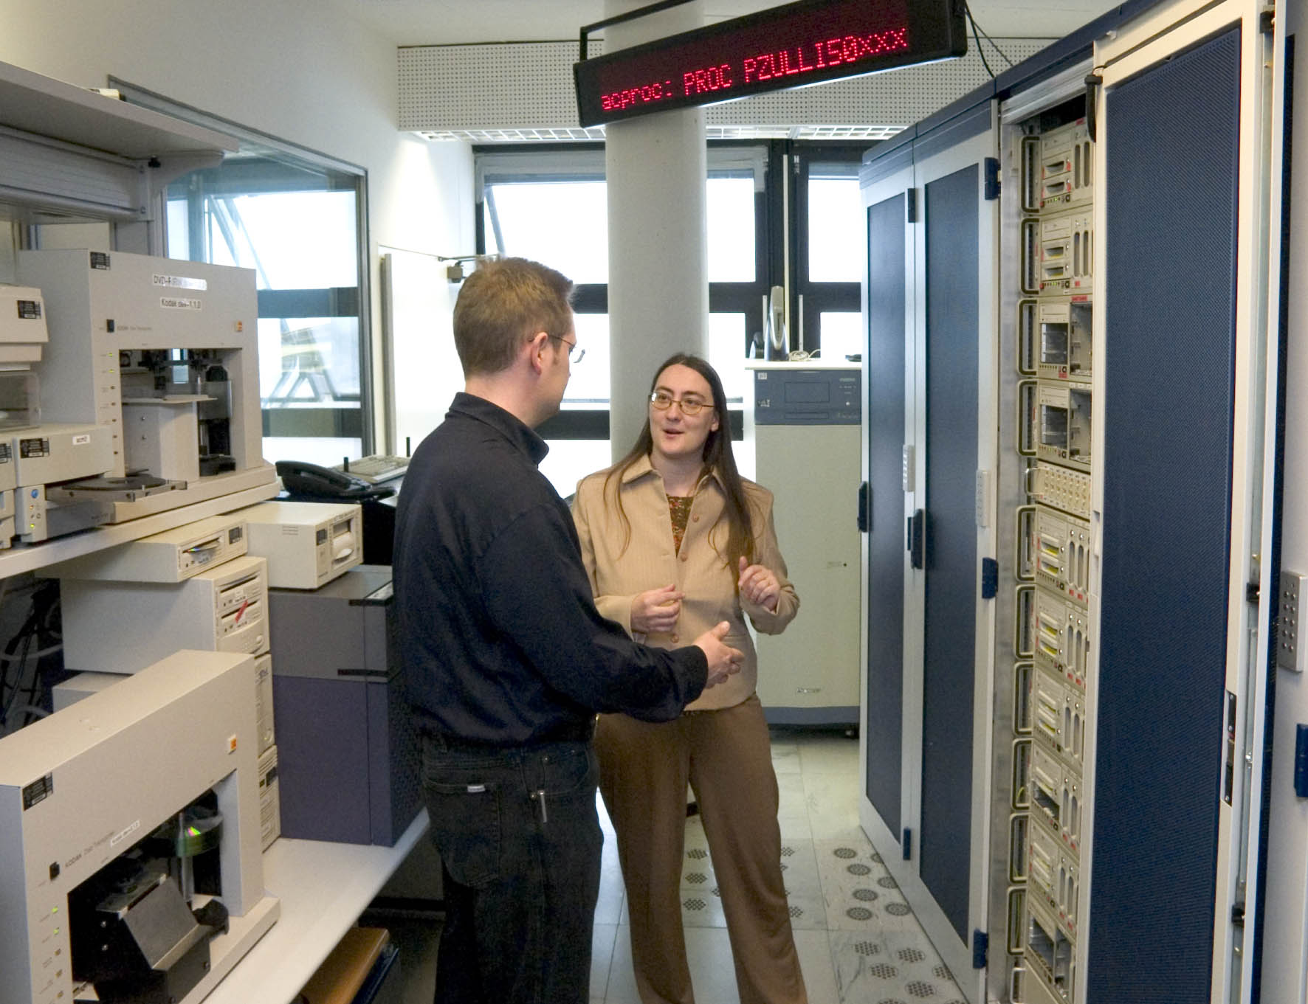
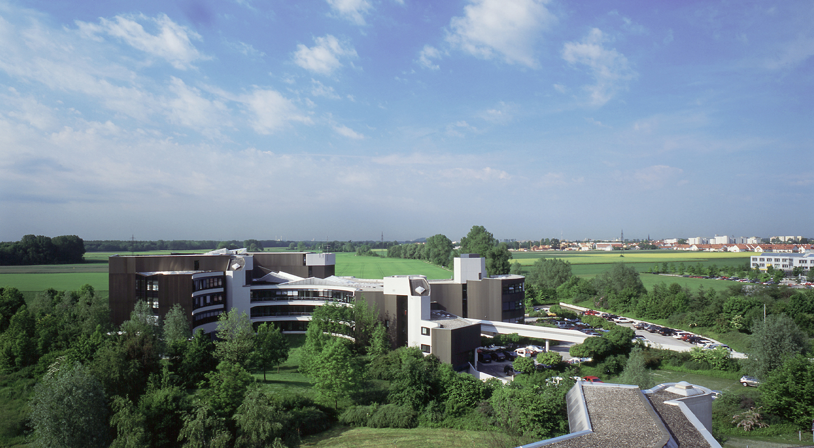
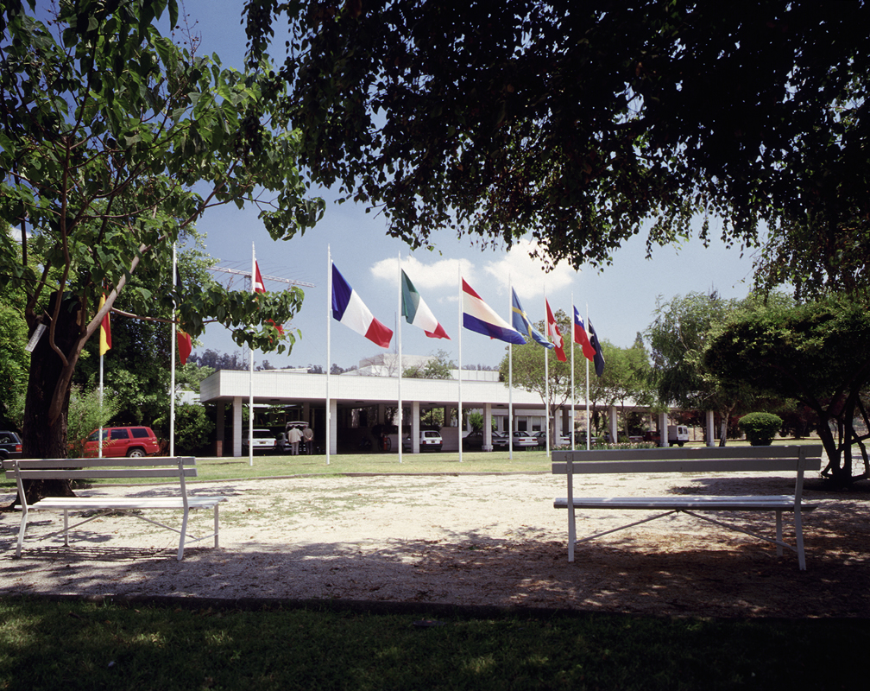
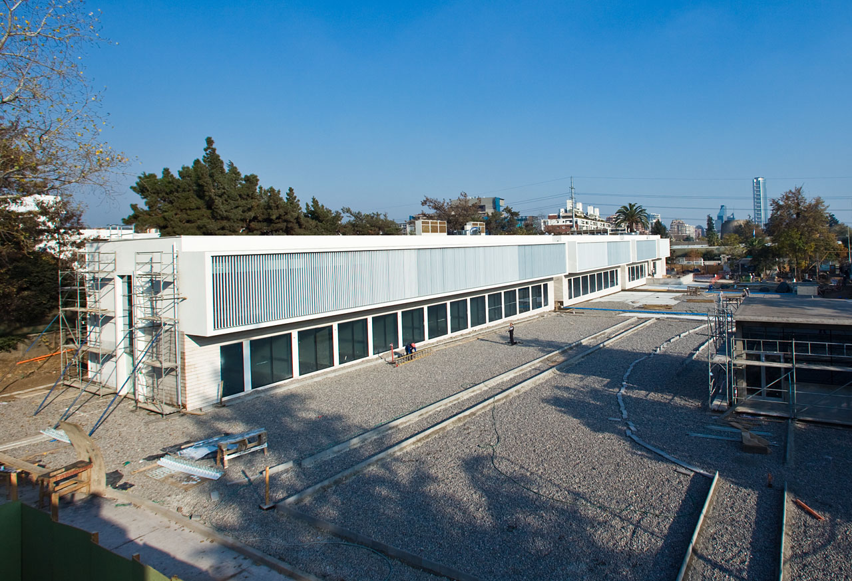
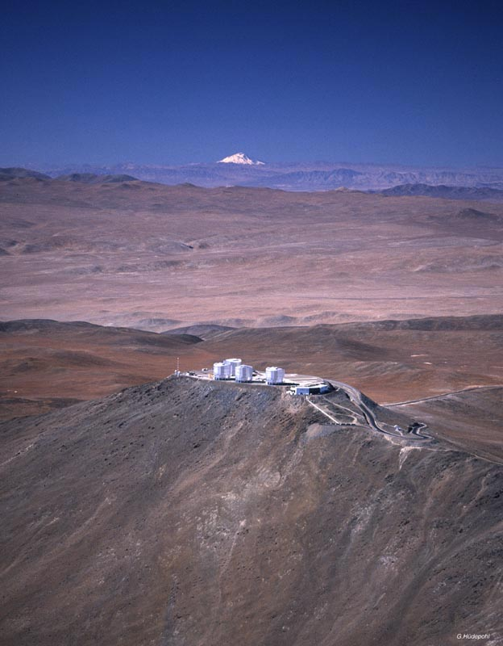
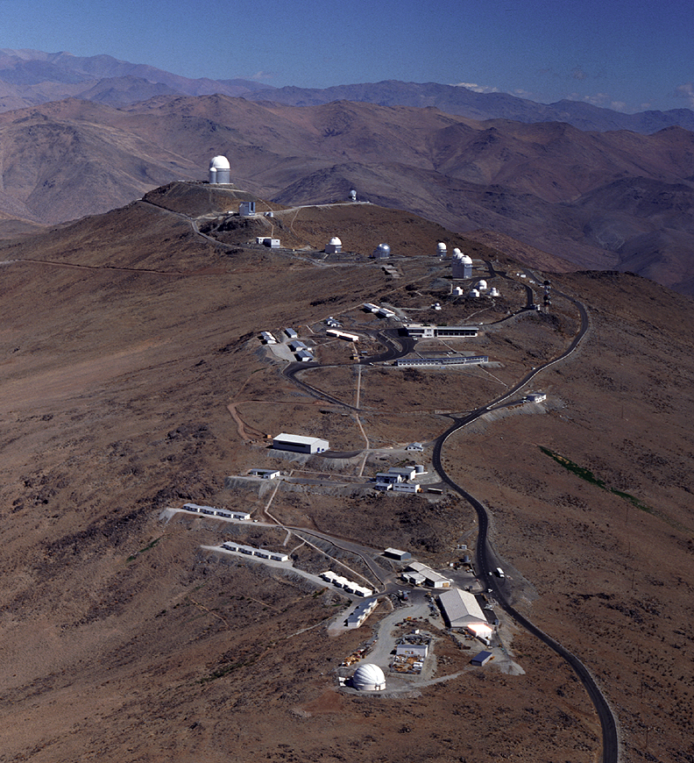
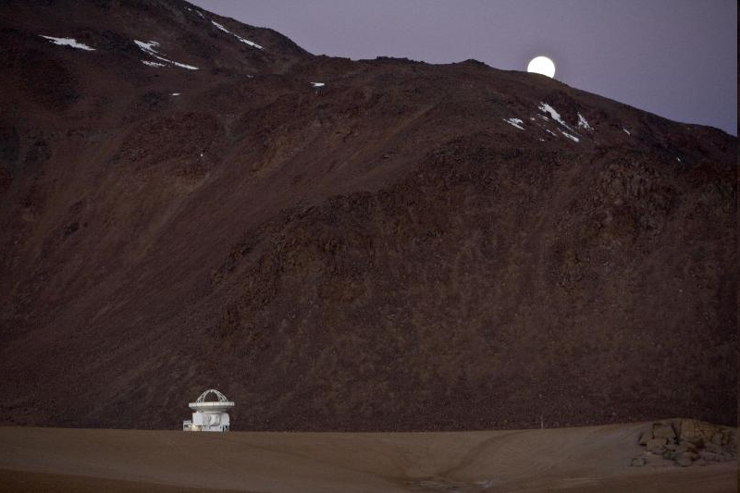
ESO Today
La Silla and Paranal Observatory in full operations
(8 telescopes in 2010, plus four telescopes for interferometry)
APEX operating on Chajnantor
ALMA under construction (early science in 2011, full operations in 2013)
Operational data archive
European Extremely Large Telescope in design phase
Headquarters in Garching, Germany
Representation in Santiago, Chile

Slide 5
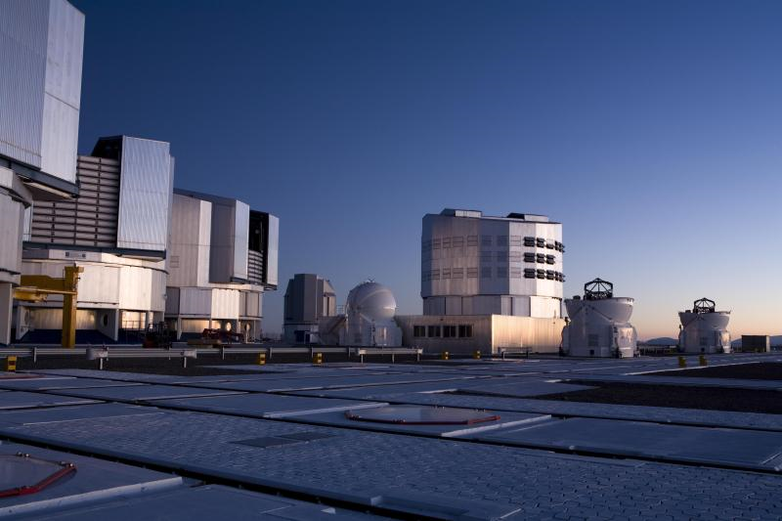
La Silla Paranal
VLT/I (Paranal)
  Instrumentation operating, in assembly and planned
    Covers the available optical infrared wavelengths
    300nm to 20μm
    Angular resolution from seeing limit to 50 μ-arcseconds
    FORS2, ISAAC, UVES, FLAMES, NACO, SINFONI, CRIRES, VISIR, HAWK-I, VIMOS, X-Shooter, laser guide star facility
    KMOS, MUSE, SPHERE, Adaptive Optics Facility, ESPRESSO
    MIDI, AMBER, PRIMA, GRAVITY, MATISSE
    VISTA/VIRCAM
    VST/ΩCam

Slide 6
La Silla Paranal
La Silla
  Continue operations with long-term programmes
    HARPS, EFOSC2, SOFI, FEROS, WFI, visitor instruments
APEX
    Covers sub-mm and mm wavelengths 0.3 to 3 mm
    SHFI (Swedish Heterodyne Facility Instrument), LABOCA, SABOCA, APEX-SZ, CHAMP+, Z-Spec

Slide 7
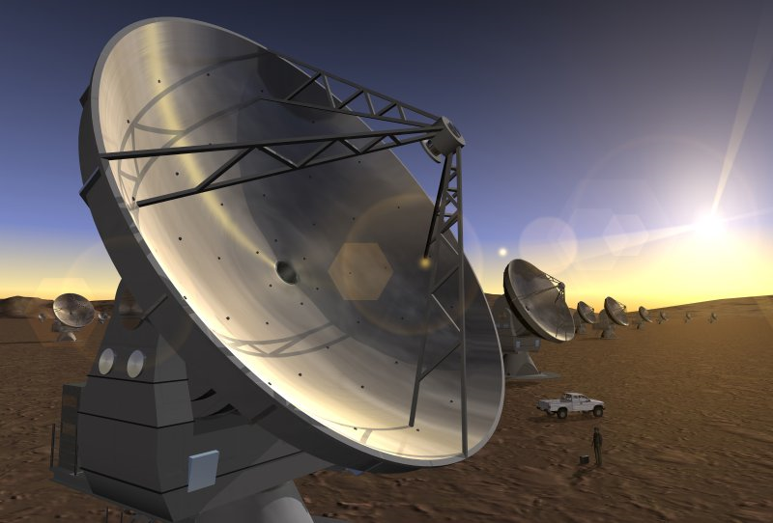
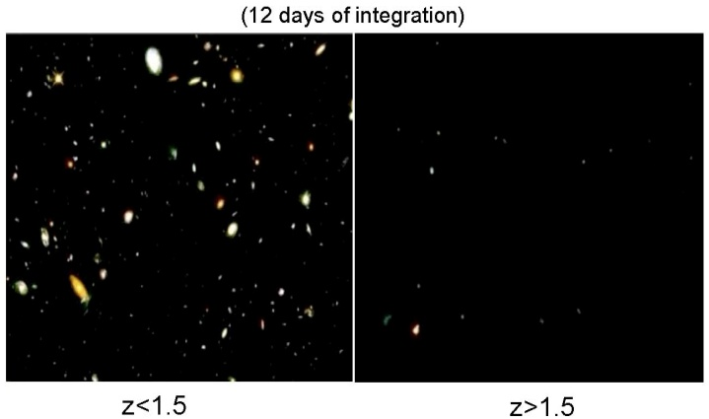
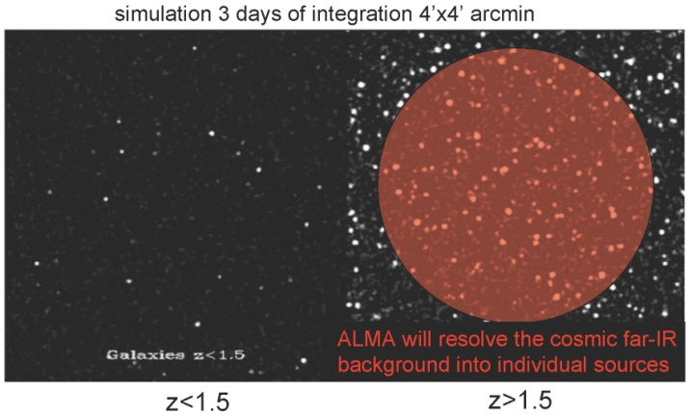
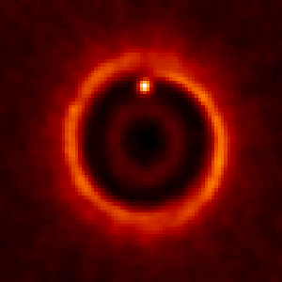

ALMA
Science requirements
  Detect CO and [CII] in Milky Way galaxy at z=3 in < 24 hr
  Dust emission, gas kinematics in proto-planetary disks
  Resolution to match Hubble, JWST and 8-10m with AO
  Complement to Herschel
Specifications
  66 antennas (54x12m, 12x7m)
  14km max baseline (<10mas)
  30-1000 GHz (10–0.3mm), up to 10 receiver bands
HST
ALMA
5AU
850 GHz

Slide 8
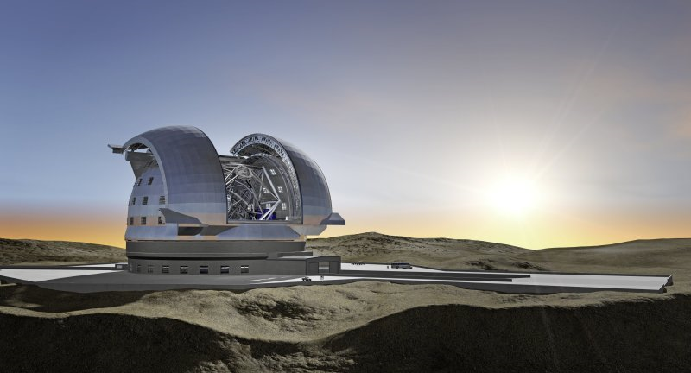
E-ELT
Detailed design study
  Baseline 42m primary mirror
  Adaptive optics built-in
  8 instrument studies and 2 adaptive optics modules studies finished
  Industry strongly engaged
  Construction proposal completed and under review
Project
  Builds on entire expertise at ESO and in the member states
  Synergy: JWST/ALMA/SKA

Slide 9
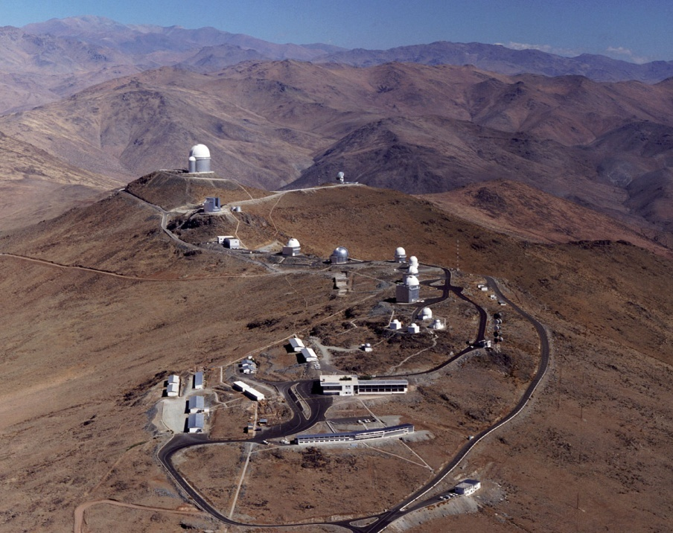
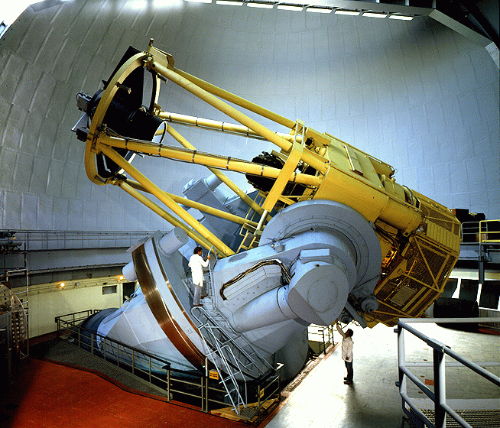
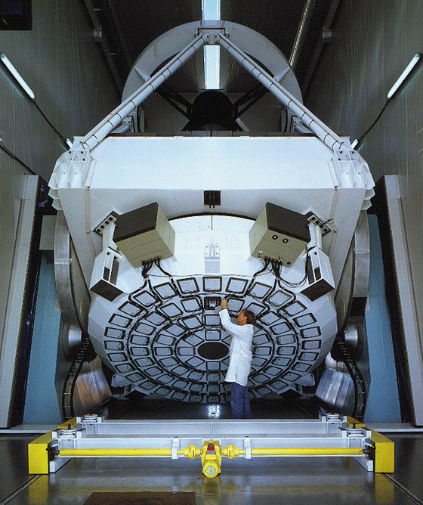
La Silla
Medium-size telescopes
  3.6m: HARPS for exo-planet searches
  3.5m NTT: EFOSC2, SOFI
  & visitor instruments
  2.2m: WFI & FEROS in partnership with MPG
Small telescopes
  Closed/funded externally
“Platform” for initiatives and specific experiments
  Euler, Tarot-II, REM, QUEST, TRAPPIST

Slide 10
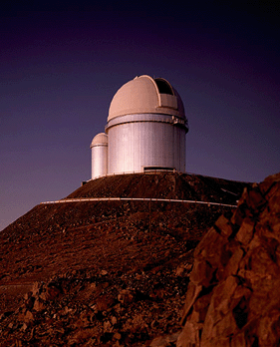
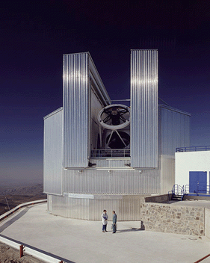
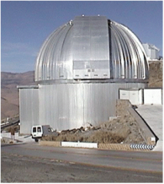
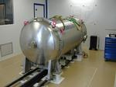
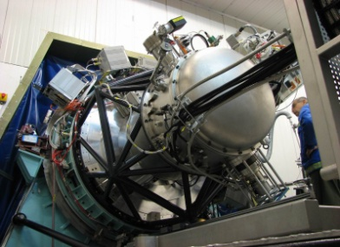
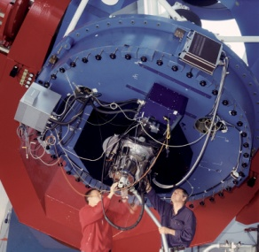
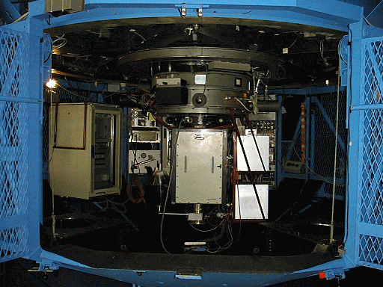
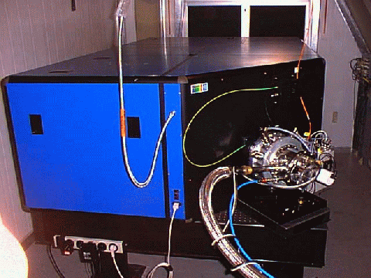
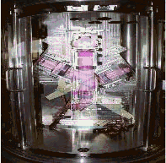
La Silla: 5 Operational Instruments
3.6m
NTT
2.2m
HARPS
SOFI
WFI
EFOSC2
FEROS
GROND

Slide 11
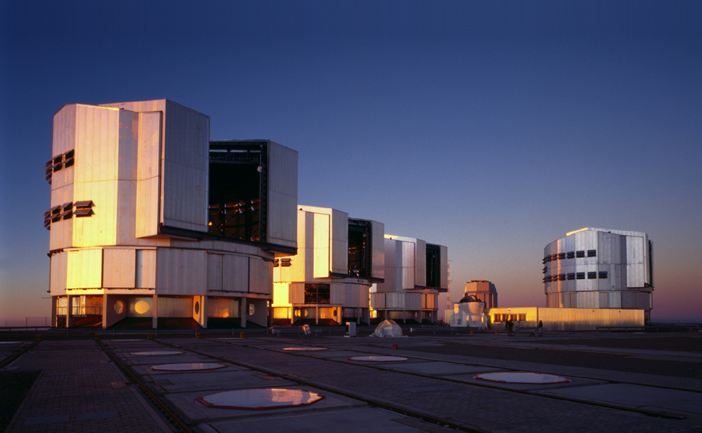
Paranal

Slide 12
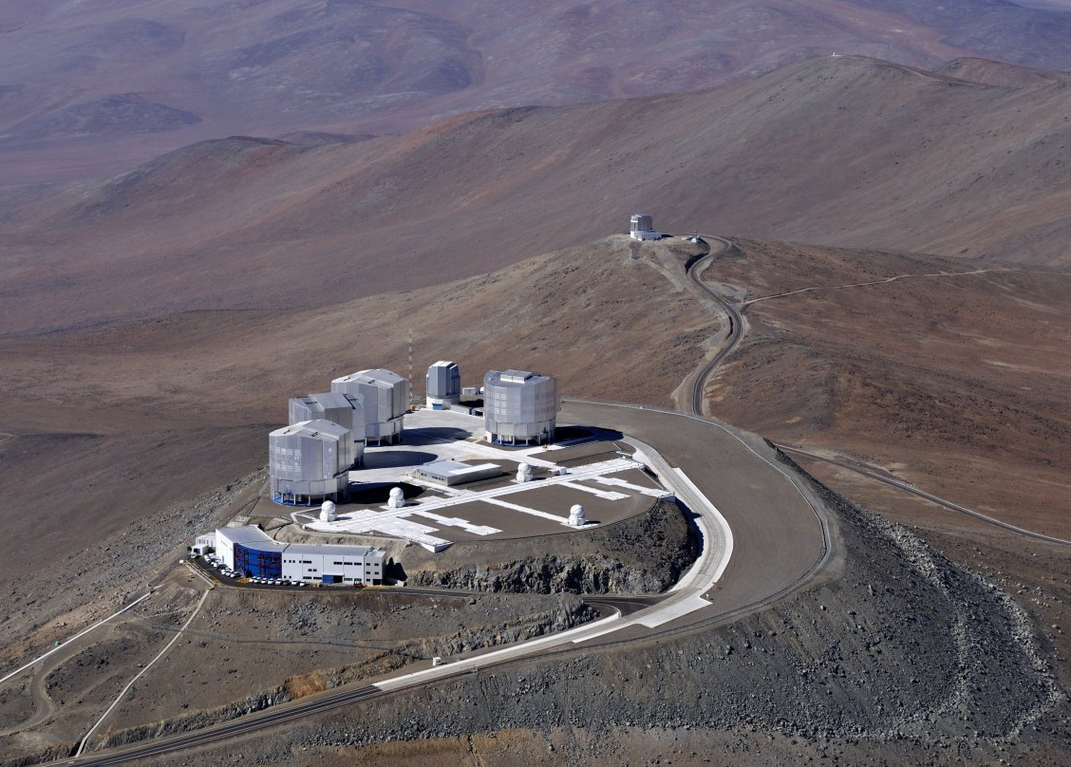

Slide 13
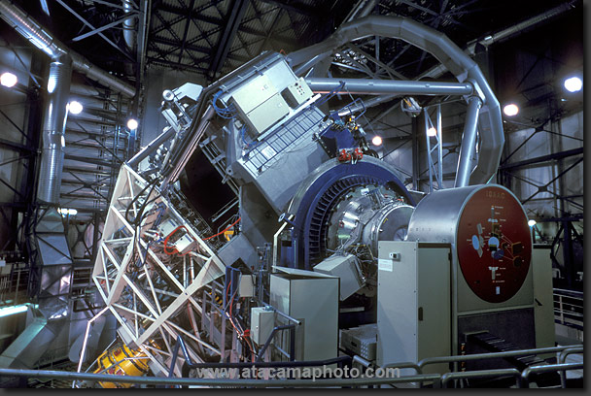

Slide 14
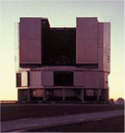
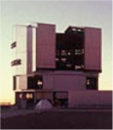
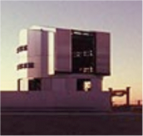
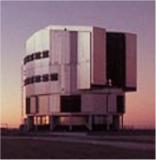
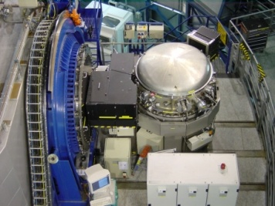
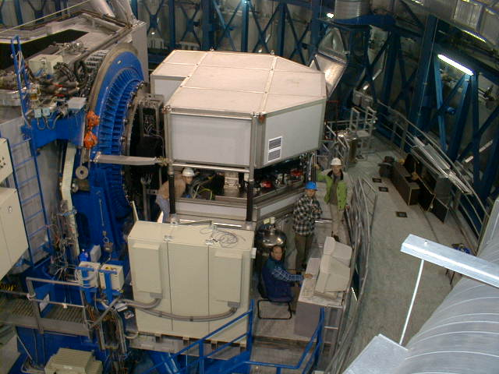
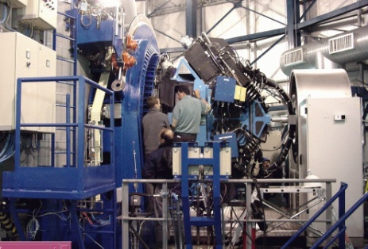
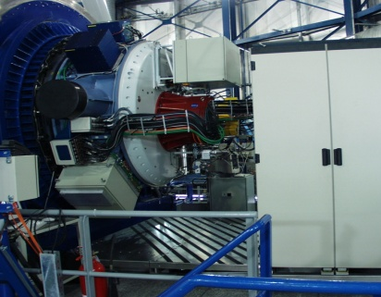
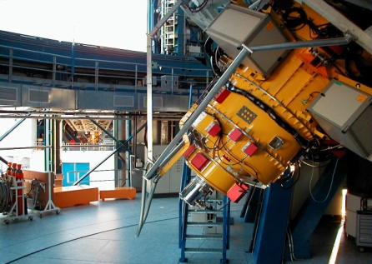
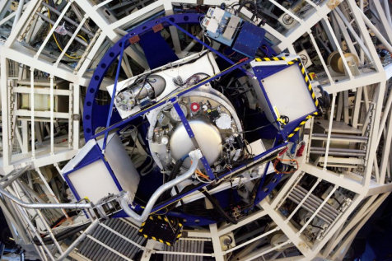
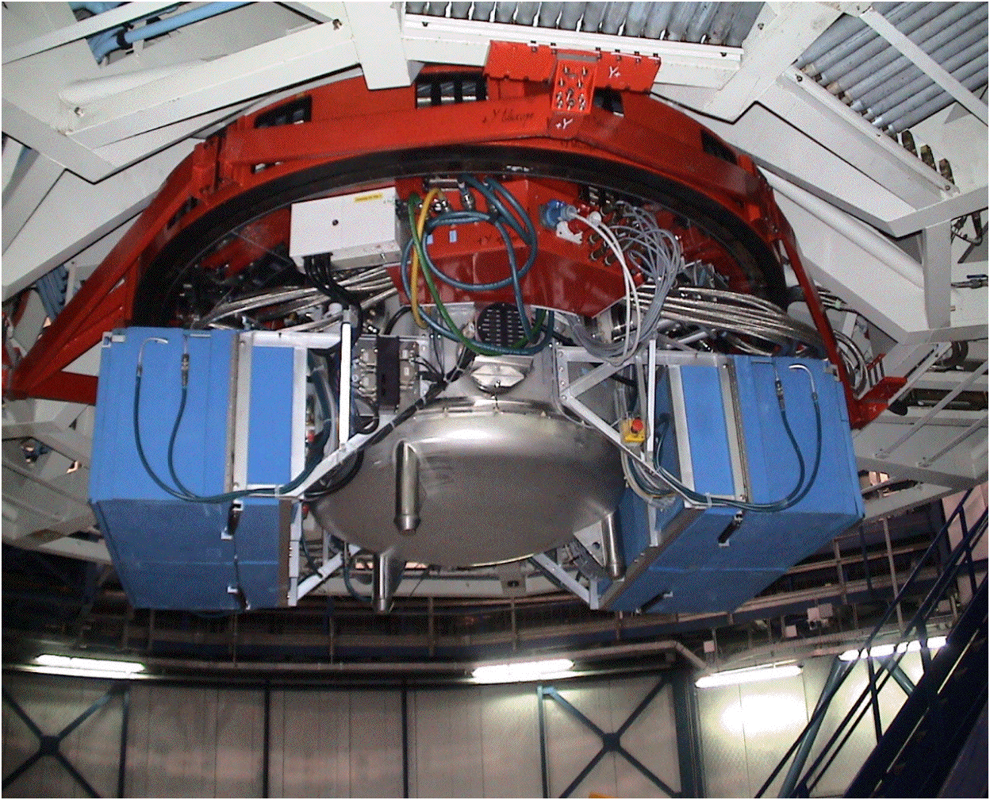
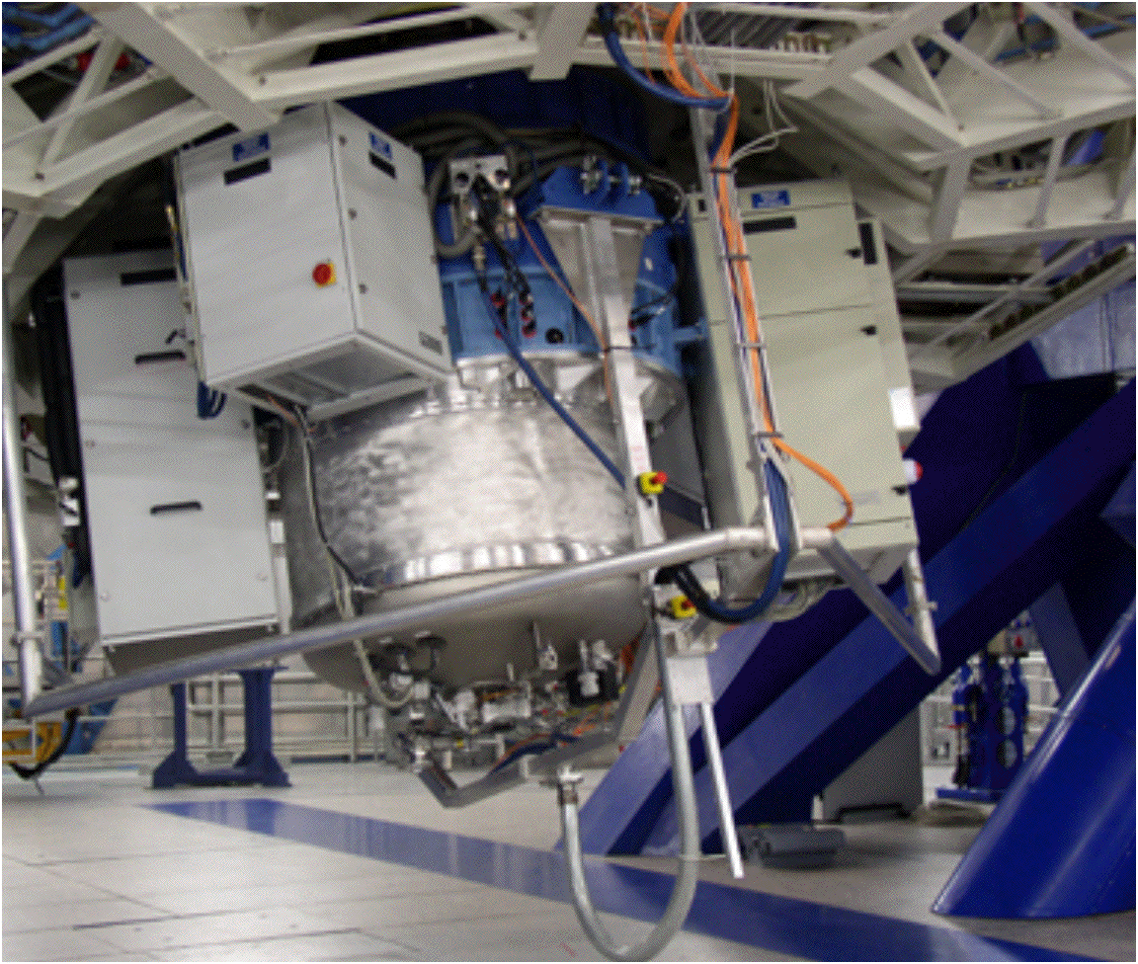
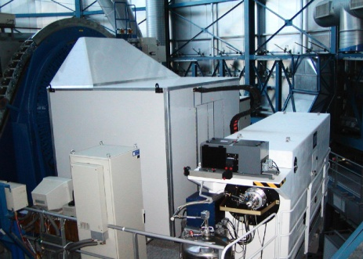
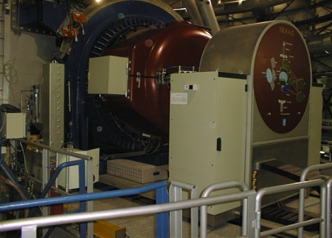
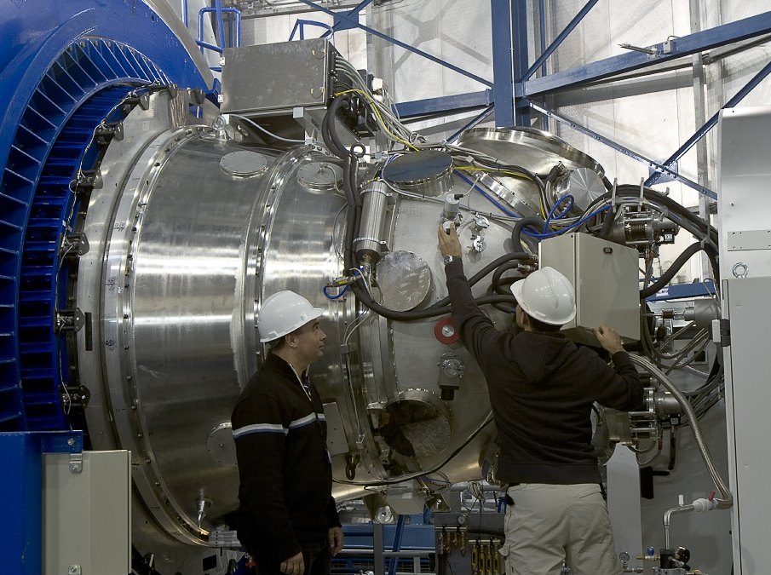
VLT Instruments
CRIRES
UVES
VIMOS
NACO
FORS2
X-shooter
VISIR
SINFONI
FLAMES
ISAAC
HAWK-I

Slide 15
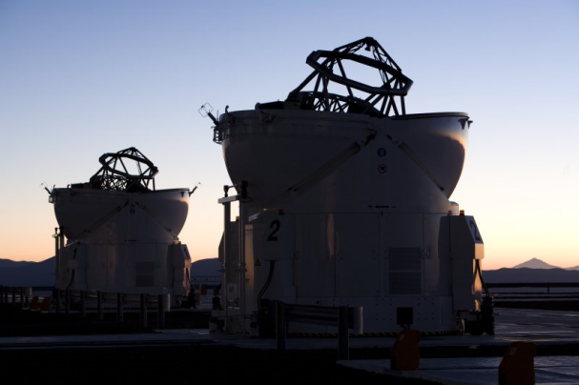
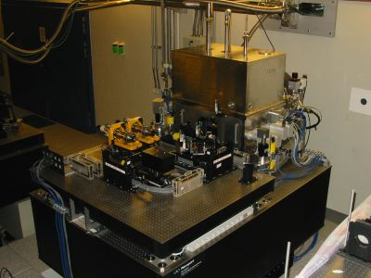
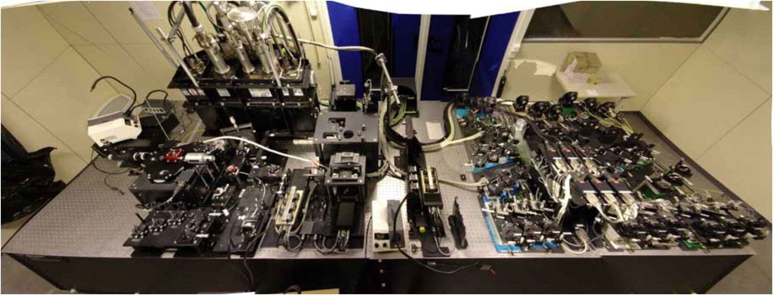
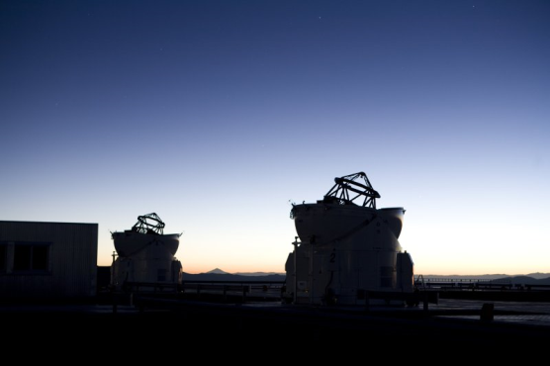
VLTI Instruments
MIDI
AMBER

Slide 16

VISTA
VISTA in operations since April 2010
Science Verification in late 2009
Multi-year programme of large public surveys
More in
Magda’s
presentation
VST
VISTA

Slide 17

VISTA
Science Verification finished
  NGC 253 and Orion
Public Surveys started
  VHS, VVV, VIDEO, VIKING, VMC, UltraVISTA

Slide 18

VST
Final assembly and systems tests during the second half of 2010
Surveys possibly will start in mid-2011
Review of the public surveys in September 2010
  surveys were originally selected in 2005
VST

Slide 19
Top list of ESO science
Galactic Centre
  Supermassive black hole
Extrasolar planets
  First images of exo-planets
  Lightest known planets
  First direct spectrum of an exo-planet
Accelerating Universe
  Spectroscopy of distant supernovae
Gamma-Ray Bursts/Supernovae
  Explosion physics
  Tracers of the distant universe

Slide 20
Other top science from ESO
Metal-poor stars
  Tracing the chemical enrichment
  Finding the oldest known stars
Stellar populations in nearby galaxies
  Measuring stars beyond the Local Group
Massive galaxies in the distant Universe
  Puzzles in galaxy formation
Varying physical constants?
  Measure the fine-structure constant over time
Testing the cosmological model
  Cosmic background temperature

Slide 21
More top science
Detecting and imaging the tori around AGN
Measure the geometric shape of stars
Determine the size of stars
  E.g. Cepheids to calibrate the period-luminosity relation
Star formation
  Debris disks, chemistry in circumstellar disks
Measure the structure of the Milky Way
  Local spiral arm
  Bulge, disk and halo, run-away stars
Solar System objects
  Comets, asteroids, weather on Titan

Slide 22

ESO Publication Statistics
available at http://www.eso.org/sci/libraries/edocs/ESO/ESOstats.pdf

Slide 23

ESO and other Observatories

Slide 24



Richest planetary system known
Five planets with 12M⊕ < M < 25M⊕ at distances 0.06AU < D < 1.4AU
One candidate with
M=1.4M⊕ at
D=0.02AU and
another with
M=65M⊕ at 3.4AU
HARPS detections
Lovis et al. 2010

Slide 25

HD10180

Slide 26


The ESO exo-planet machinery
HARPS at 3.6m telescope
  best radial velocity machine at a 4m telescope (supported by UVES on VLT)
  extremely stable spectrograph
NACO
  adaptive optics supported
  imaging and spectroscopy
VLTI
  highest spatial resolution for follow-
  up observations of known systems
NACO/SINFONI/FORS2
  transit measurements, atmospheres of exo-planets
Janson et al. 2010

Slide 27


Gamma-Ray Bursts
Most distant stellar objects ever observed
  redshifts 6.7 and 8.2 (tentative)
  lookback time of nearly 12.5 billion years (or 95% of the age of the universe)
VLT equipped with rapid response mode
  allows to observe a gamma-ray burst 10 minutes after detection
i
z
J
GRB080913

Slide 28

Most distant stellar object yet observed – GRB 090423
Tanvir et al. 2009
Optical drop-out, bright in the near-infrared
Rapid decline

Slide 29


GRB 090423
ISAAC
SINFONI
Spectroscopy 17 hours after outburst
Lyman break indicates a redshift of z≈8.2

Slide 30


Inner ejecta of SN 1987A resolved
Inner ejecta resolved and mapped in [Si I] and [Fe II] as well as He I lines
Kjær et al. 2010

Slide 31




Chajnantor
APEX
  12m sub-millimeter antenna, operated by ESO @ Sequitor
  MPG (50%), Sweden (23%) and ESO (27%)
ALMA
  66 antennas at 5050m
  Operations support at 2950m
  Global partnership with North America East Asia & Chile
APEX
OSF
OSF

Slide 32

Chajnantor
Three facility and three `PI` instruments on APEX
Watch out for ALMA
  early science in 2011
  be prepared

Slide 33




ALMA 2010
May 2010
September 2010
January 2010

Slide 34




Closure phase
Commissioning and Science Verification started on 22 Jan 2010

Slide 35
ALMA Main Deliverables
ESO deliverables correspond to ~460 M€
35

Slide 36
ALMA
Progress
  Nearly all European deliverables on track
  Closure phase with three antennas at the AOS
  Santiago Central Office building completed – JAO moved in two weeks ago
  Multi-fuel turbine being procured
  First four European antennas mechanically integrated
    two more in assembly
Concern
  Antenna delivery schedule: under close scrutiny

Slide 37

AEM Antenna #1

Slide 38

AEM Antenna #2

Slide 39

European antennas

Slide 40
ALMA Early Science
16 antennas with four frequency bands
Baselines up to 1 km
Up to 1/3 of the time used for this
Call for proposals towards the end of 2010
Deadline probably around February 2011
Observations start September 2011
Learn more about ALMA this afternoon in the special session
ALMA Band | Frequency Range (GHz) | Wavelength range (mm)
3 | 84-116 | 3.6-2.6
6 | 211-275 | 1.4-1.1
7 | 275-373 | 1.1-0.8
9 | 602-720 | 0.5-0.4

Slide 41

ALMA 2013

Slide 42

E-ELT

Slide 43


E-ELT Design
Detailed design study
  M1: ~1000 1.45m segments
  Innovative five-mirror design ⇒ adaptive telescope
  Suite of instruments
  Industry strongly involved
  Study cost: ~60 M€
  Precursor work: ~40 M€, in part from EU programs
Status
  Construction proposal completed in Aug 2010
  External review Sep 2010

Slide 44

Telescope
Novel 5 mirror concept (3 mirror anastigmat + 2 flats)
Diffraction limited over full 10′ field of view
Flat, almost telecentric focal plane
‘Zoom’ capability (Nasmyth, gravity invariant, coudé foci)
Laser “friendly” (very low aberrations even at zenith)

Slide 45



















Mirrors
M1
27 point whiffle tree
2 X 7 prototypes
1m prototype
M4
Two industrial studies will deliver working prototypes
1148 segments:
984 mirror +
1 spare/family
M2
Cell contract ongoing
Mirror offers received
M5
Deliverable of industrial
electromechanical study:
scale 1 prototype

Slide 46
Instrument Studies
ACRONYM (P.I.) | INSTRUMENT TYPE
EAGLE | Wide Field, Multi IFU NIR Spectrograph with MOAO
EPICS | Planet Imager and Spectrograph with XAO
MICADO | Diffraction-limited NIR Camera- AO assisted
HARMONI | Single Field, Wide Band Spectrograph - AO assisted
CODEX | High Spectral Resolution, High Stability Visual Spectrograph
METIS | Mid Infrared Imager & Spectrograph –AO assisted
OPTIMOS | Wide Field , Visual, MOS (fibre or slit-based)- AO assisted?
SIMPLE | High Spectral Resolution NIR Spectrograph –AO assisted
 | POST-FOCAL AO MODULES
MAORY | Multi Conjugate AO module (high Strehl, field up to 2’)
ATLAS | Laser Tomography AO Module (high Strehl, narrow field)
STC recommendation on the first two instruments
  imager and integral-field spectrograph to be pursued first
  make sure AO is developed at the same time
MICADO

Slide 47
Site: Cerro Armazones
Selection by ESO Council 26-04-2010
  Paranal property will be extended through a generous donation by the Chilean government
Cerro Armazones
  Best overall atmospheric quality
  Highest science return
  Lowest cost for construction and for operations
  Optimal scientific synergy with VLT, ALMA, LSST, SKA
Overall program
  Strengthening of Paranal with another unique capability, ensuring its long-term scientific future
  World-leading ground-based observatory

Slide 48

Armazones and Paranal

Slide 49

Time to turn of the lights and start observing

Slide 50

Proposing for ESO time
Deadline for P87 proposals:
30 September 2010

Slide 51

Proposal submission
1977
2010

Slide 52
Structure of the ESO OPC
Observing Programmes Committee
  4 scientific categories
    Cosmology (A)
    Galaxies and Active Galactic Nuclei (B)
    Interstellar Medium, Star Formation and
    Planetary Systems (C)
    Stellar Evolution (D)
  13 panels
    3 for category A
    2 for category B
    4 each for categories C and D

Slide 53
Proposal types
5 proposal types all handled by OPC
  normal programmes
  short programmes
  large programmes
  Coordinated VLT/XMM projects
  Target of Opportunity
  calibration programmes
    all considered by the OPC
Director Discretionary Time
    submission any time
    decided by ESO Director General

Slide 54
ESO proposals
Pressure factor typically high
  typical oversubscription for ESO telescopes is >3
    often reaching 5 and in certain periods/RA ranges 8 or higher
  Large Programmes have an acceptance rate of about 20% or less
  Pressure on ToO proposals is extremely high
    GRBs, supernovae, novae, stellar occultations by TNOs, microlensing

Slide 55
Call for Proposals
Important document
  contains a lot of relevant information
  especially important for first-time
  users
  contains many useful links
  to instrumentation and other useful
  information
  binding document, if proposal is approved

Slide 56
OPC Working Group
Composed by current OPC members, representatives of other observatories and ESO
Chair: Elias Brinks (Hertfordshire)
Evaluation of the current OPC process
  efficiency in handling 1000 proposals twice per year
  keep the load on panel members manageable
  keep the process at ESO manageable
Investigated ‘tweaks’ and alternatives
  included some radical solutions
Current process fairly good
  any changes need to be accepted and trusted by the community

Slide 57
Public Spectroscopic Surveys
Call for Letters of Intent issued
  deadline: 15 October 2010
  http://www.eso.org/sci/observing/proposals/Call_for_Public_Spectroscopic_Surveys_2010.pdf
Pre-selection by a Public Spectroscopic Survey Panel
  analogue to the public imaging surveys
Proposals to be submitted for P88 (April 2011) for a start in October 2011
no restriction on instrument or telescope

Slide 58
Wide-Field Spectrograph Study
Call for Letter of Interest issued
  Deadline: 1 October 2010
  http://www.eso.org/sci/announcements/MOS_final_combined.pdf
Conceptual Design of a multi-object spectrographic facility
no restriction on telescopes
  change of UT top ends excluded
Invitation for full proposal by end of October based on the received Letters of Interest
  closing date for the proposals: 1 March 2011

Slide 59
ESO Archive
The ESO data archive
  is a rich source of excellent data
  abstracts of previous proposals available
  data public one year after they have been delivered to the PI
  great way to compete with your competitor, if they got observing time
  easy retrieval and selection of calibration data

Slide 60
Get involved
Participate in OPC
Participate in other ESO activities
  get to know the organisation better
  active interactions with ESO people
Have a lively scientific exchange with the (European) astronomical community
  conferences, workshops
  regularly publish your results

Slide 61
Information available
http://www.eso.org/sci
ESO Electronic Newsletter
  http://www.eso.org/enews
ESO Messenger
  http://www.eso.org/

Slide 62





ESO’s goals for coming years
Best science from La Silla Paranal Observatory
  Second generation instruments (VLT/VLTI)
  new instrument call
  Key surveys with VST and VISTA
  Public surveys (imaging and spectroscopy)
  Long-term programs for unique science on La Silla
  Prepare for ALMA science with APEX
Deliver ALMA on time and in budget
Secure funding for construction and operations of the world-leading E-ELT

Slide 63
How others see us
US Decadal Survey:
  The 14-nation ESO consortium is on track to become the undisputed leader in ground-based OIR astronomy with its planned construction of the 42m European Extremely Large Telescope (E-ELT) …
  By concentrating most of its resources into a single international partnership, Europe has minimized duplication of capability between facilities, created a major international research center, and established a funding line for construction that is intended to lead from ALMA, to E-ELT …

