Slide 1
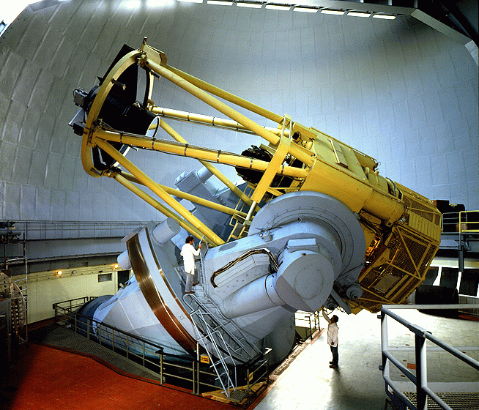
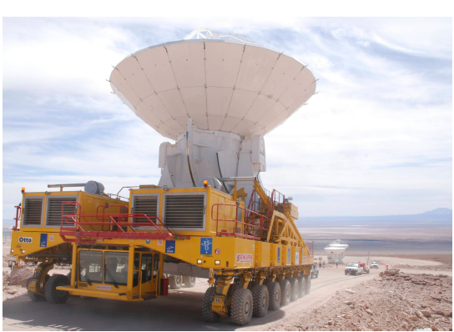
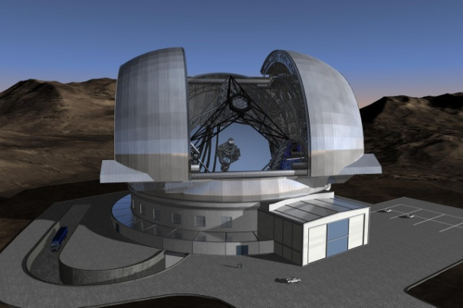
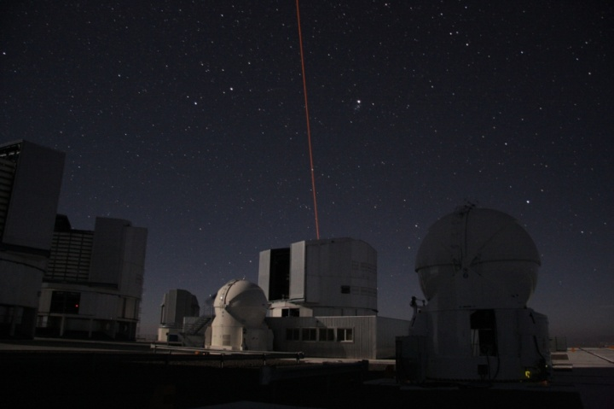
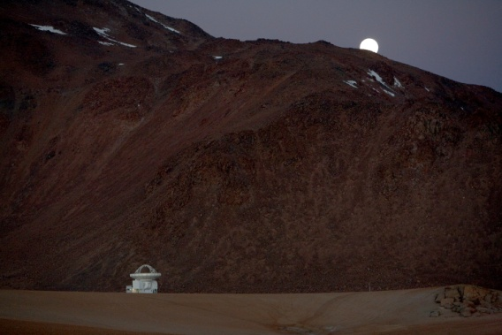
Exciting Astrophysics
Bruno Leibundgut
(ESO)

Slide 2
Astronomy is different …
No direct experiments
  Our Lab is the sky! Very little of the conditions in the universe can be re-created in the laboratory (e.g. densities, scales, temperatures)
Information
  Light → electro-magnetic radiation
  ‘carrier particles’ → neutrinos, cosmic rays

Slide 3
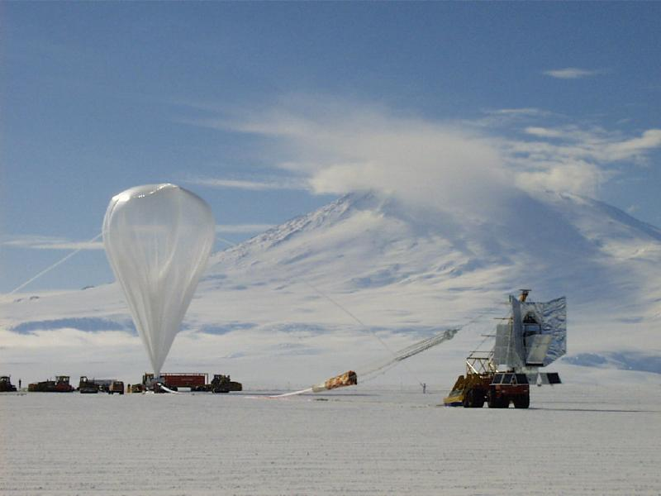
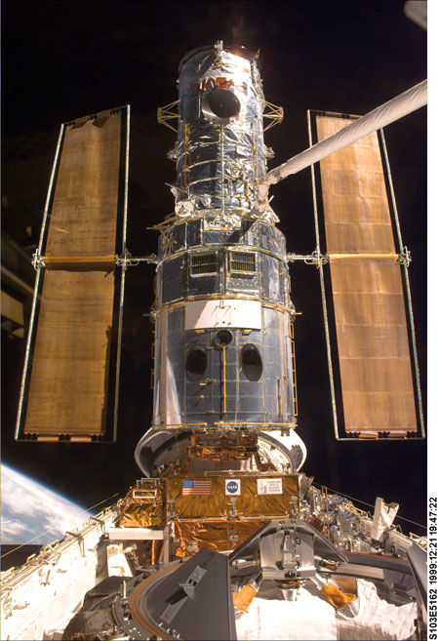
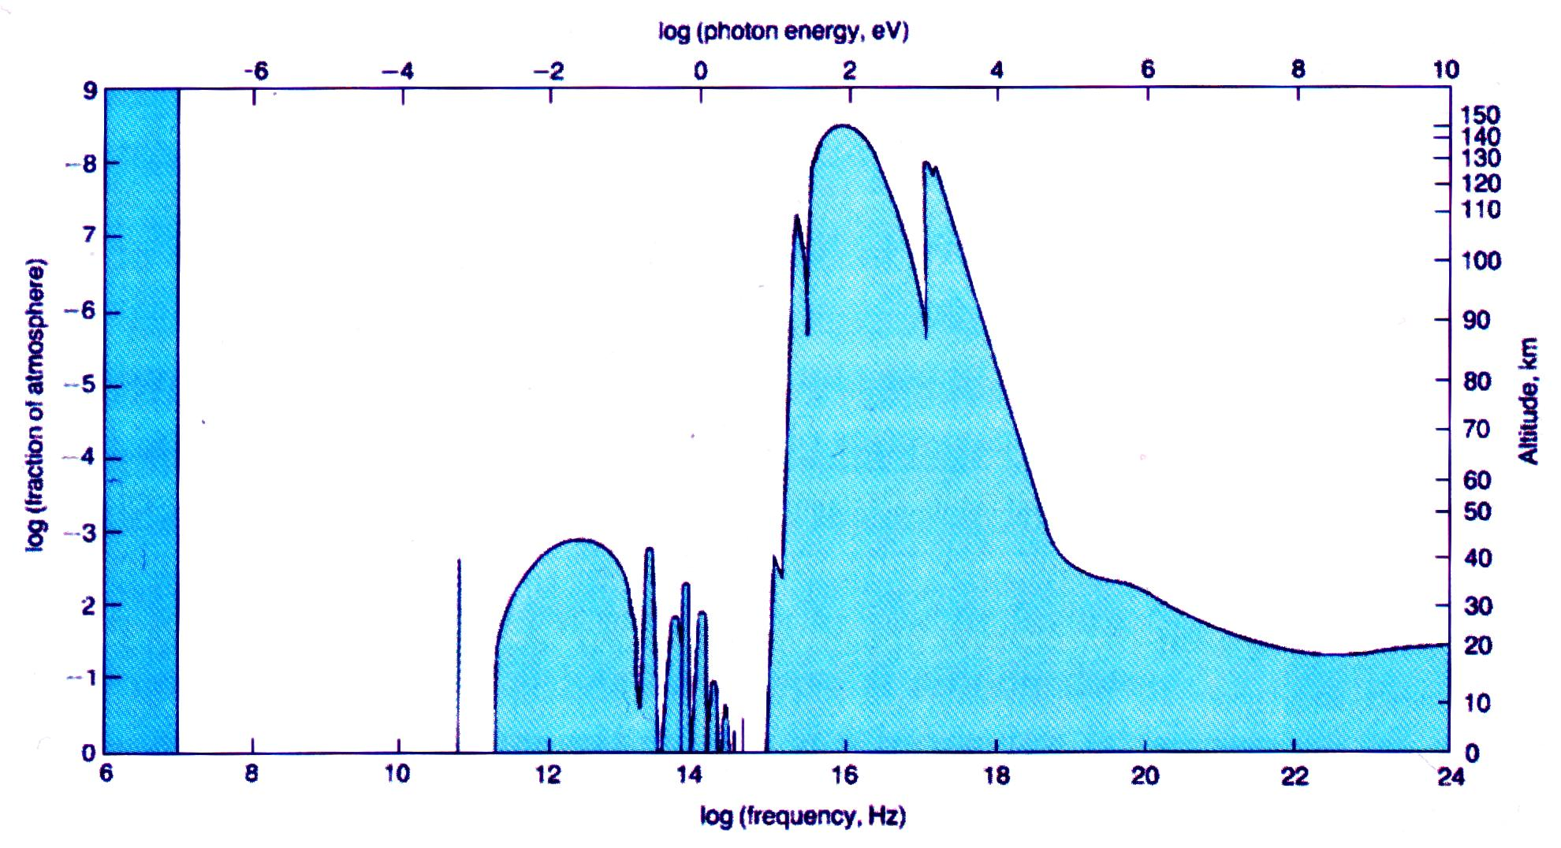
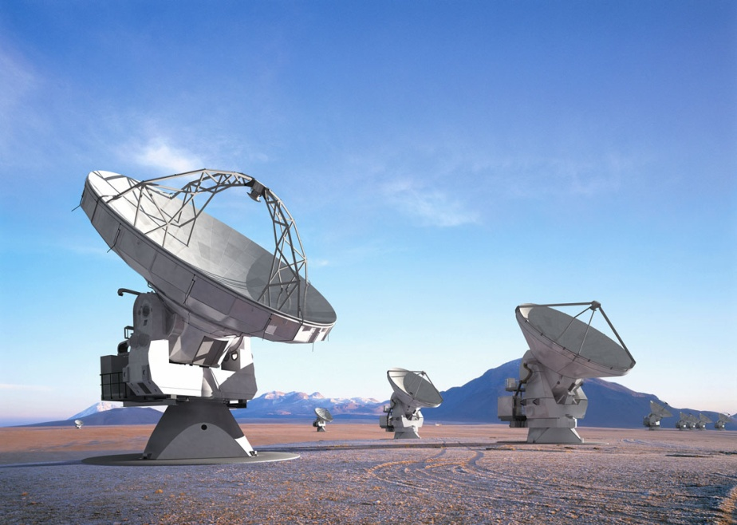
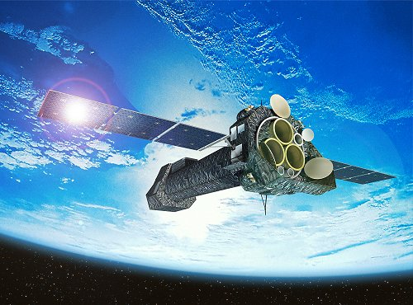
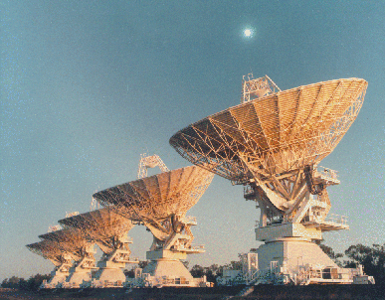
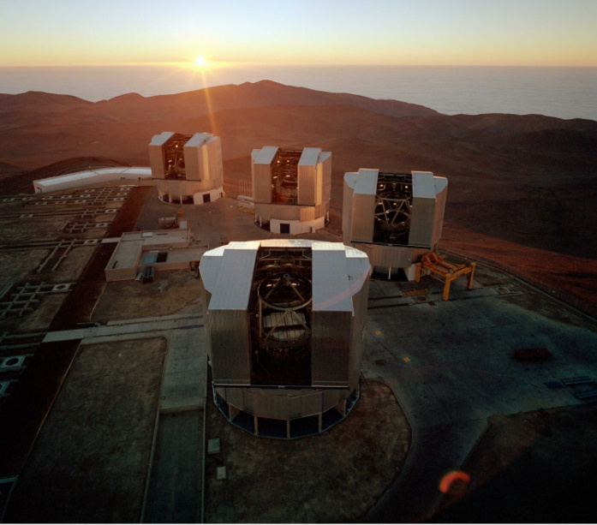
The Atmosphere
300m
3m
3cm
0.3mm
3μm
30nm
3Å
3pm
30fm
300am
X–
radiation
radio
γ–
optical

Slide 4
Astrophysics in a Golden Age
Full coverage of electro-magnetic spectrum
      MAGIC/HESS/VERITAS (ultra-high energy photons)→Fermi/INTEGRAL (γ-rays)→ XMM/Chandra/Swift/Rossi XTE (X-rays) → Galex (UV) → HST/Gaia (optical)→ ground-based optical/IR → Spitzer (infrared)→ Herschel/Planck (sub-mm) → IRAM/JCMT/APEX/ALMA → radio telescopes
      20 orders of magnitude in wavelength/frequency/energy
      Large archive collections (e.g. ROSAT, ISO, ESO, HST, MAST)
      Astro-particles joining in
        cosmic rays, neutrinos, gravitational waves, dark matter searches

Slide 5

Astrophysics in a Golden Age
International Year of Astronomy
  Fantastic boost in the public
  Increased awareness
  Strong public support
  Continued interest
    Connected to the ‘big’ questions
    Where do we come from?
    What is our future?

Slide 6
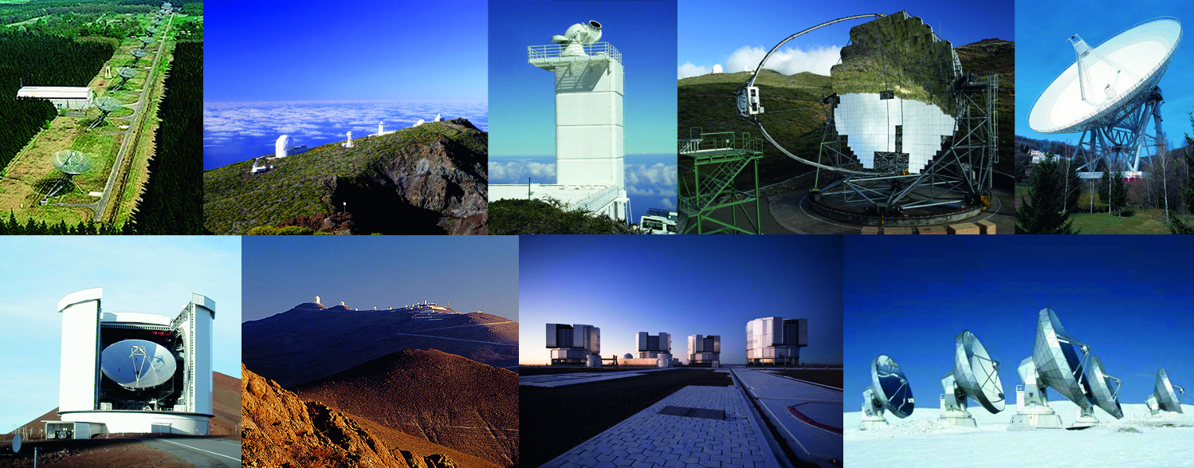
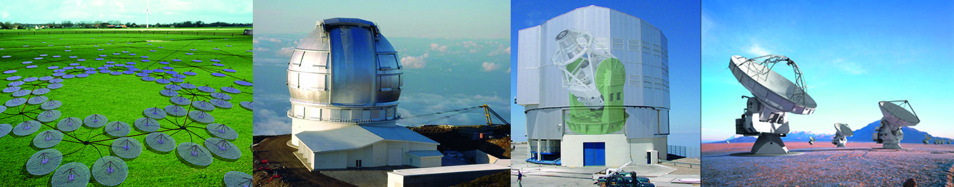

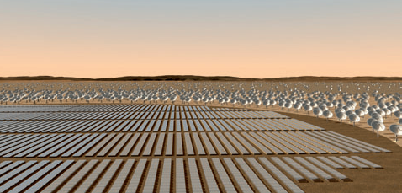
Fantastic opportunities
Already existing ground-based facilities in Europe
  Westerbork, Roque de los Muchachos (GTC, WHT, TNG, NOT, ING, MAGIC), Solar telescope on El Teide, Effelsberg, JCMT, La Silla, Paranal, IRAM (Plateau de Bure, Pico Veleta), HESS, MAGIC
New facilities
  Just started:
  VISTA, LOFAR,
  To come soon:
  VST, ALMA
Under discussion
  E-ELT, SKA, EST, CTA

Slide 7
You do not have to observe yourself any longer!
Service observing at many telescopes
Massive surveys publicly available
  Sloan Digital Sky Survey (SDSS)
  CFHT Legacy Surveys
  UK Infrared Deep Sky Survey (UKIDSS)
  GOODS/COSMOS
  VST Public Surveys
  VISTA Public Surveys
  PanSTARRS (US)
  Dark Energy Survey (US/European)
  Large Synoptic Survey Telescope (LSST – US; proposed)
Large Archives
  ING, ESO, HST/MAST (US and mostly space)
  Presentation by Eduardo Gonzalez

Slide 8
Science themes
What matters in the universe?
Planets, planets, planets
How did stars and planets form?
The Milky Way our Home
Our own black hole
How galaxies form and evolve?
Fashions and other transients
When opportunity knocks

Slide 9
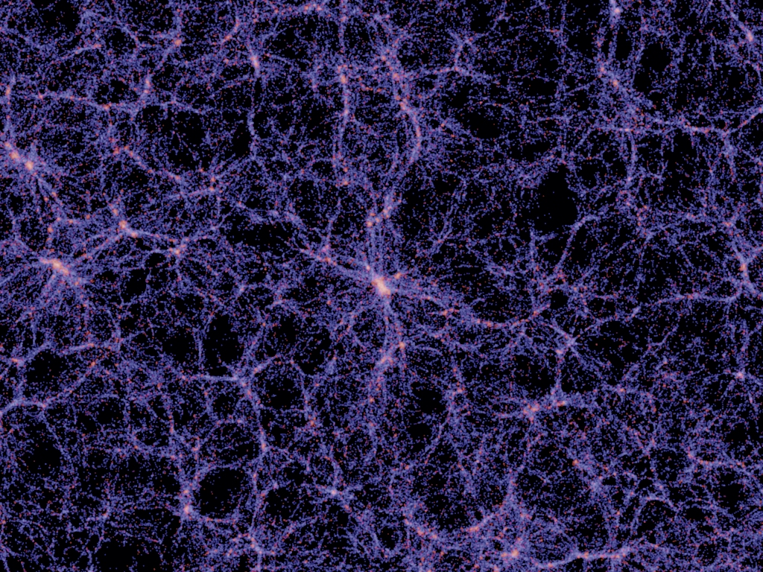
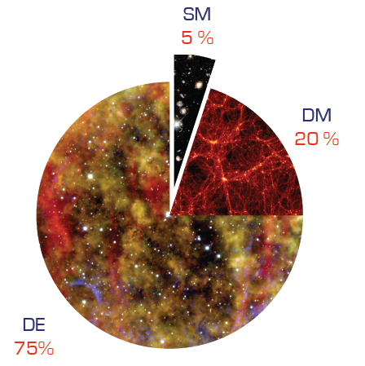
What matters in the Universe?
Characterisation of dark matter and dark energy
  Requires large samples
    sample a large fraction of the universe
  Multi-year and (often) multi-telescope projects
  Measure the distribution of matter and the expansion history of the universe
    Baryonic acoustic oscillations
    Weak lensing
    Supernovae
    Galaxy clusters
    Redshift distortions
Millenium simulation (Springel et al.)

Slide 10
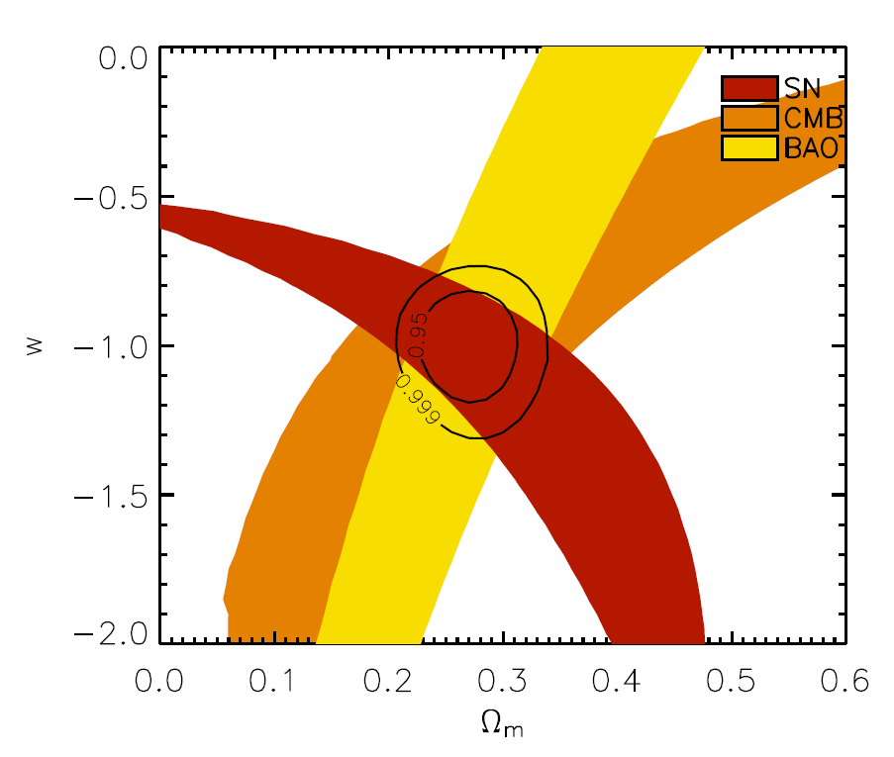
Dark Energy
Weak lensing, BAO, supernovae, clusters
  Important: massive surveys and large sky coverage
  Current state of the art with 4m telescopes (2dF, SDSS, WiggleZ, VIPERS)
  EUCLID → ground-based follow-up/calibrations
    spectroscopic calibration of the photo-z
    spectroscopic follow-up of supernovae
    spectroscopic follow-up for cluster members
    optical imaging for photo-z
  FMOS (Subaru), LSST, HETEX, LAMOST
  8-10m telescopes
Direct measurement of expansion dynamics
  Important: high spectral resolution and stability
  CODEX at E-ELT
Davis et al. (2008)

Slide 11
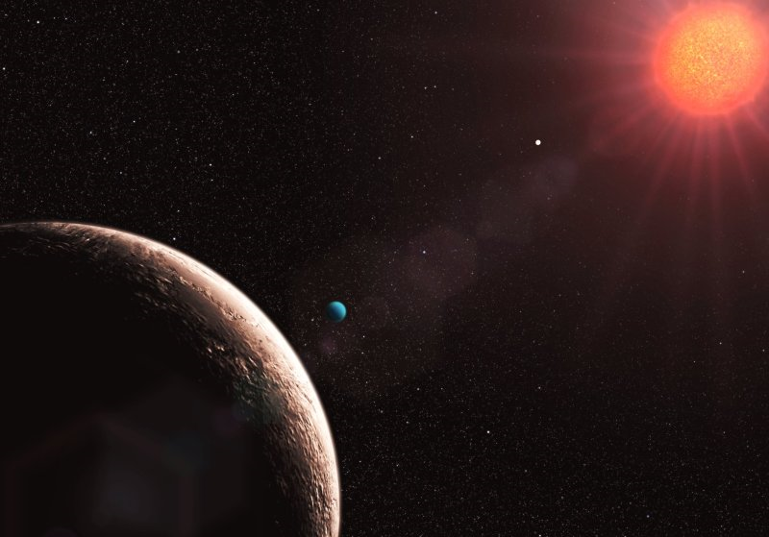
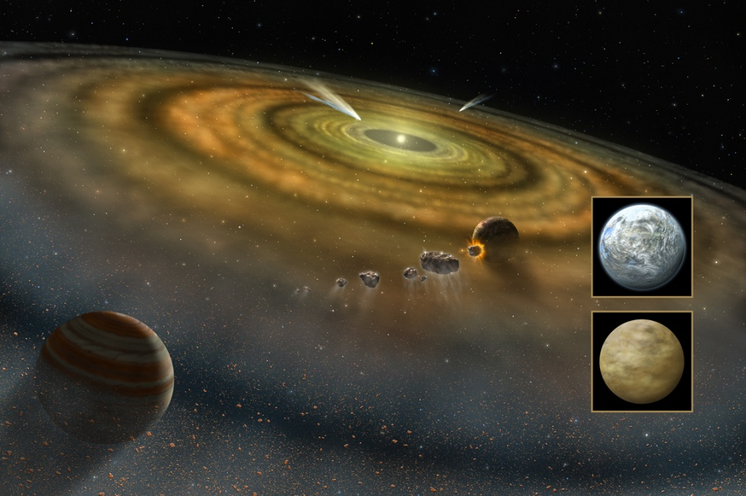
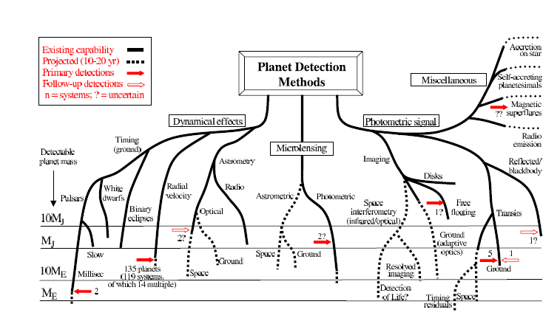
Planets, planets, planets
Planets everywhere
  Radial velocities
  Direct imaging
  Transits
Characterisation
  Planetary systems,
  masses,
  chemical composition,
  temperatures

Slide 12
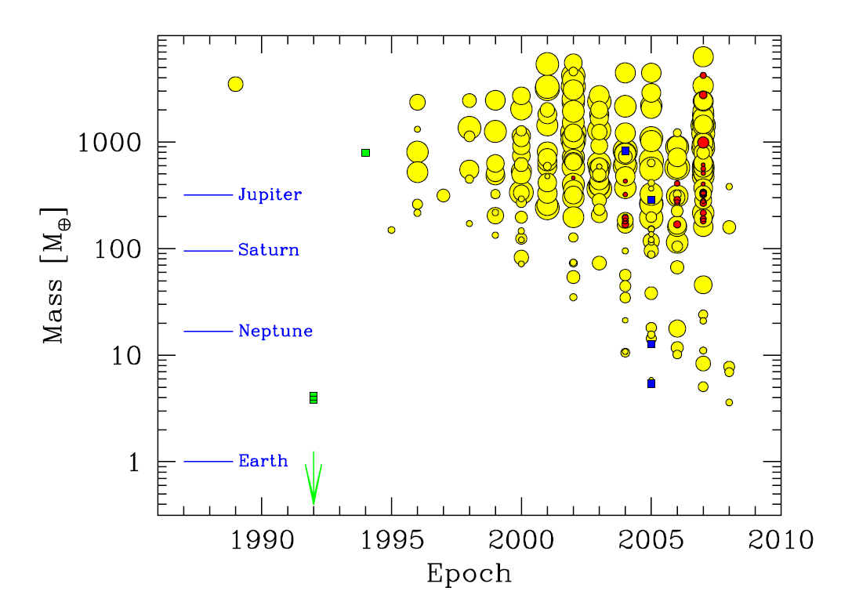
Planets
Radial velocities
  Important: time series and high-resolution spectroscopy
  complementary with space missions (CoRoT, Kepler)
  Currently done with 1m to 10m telescopes
    HARPS/HARPS-N, HIRES, UVES
  ESPRESSO (VLT) and CODEX (E-ELT)
Direct imaging
  Important: spatial resolution and IR
    large telescopes (>8m) with adaptive optics or interferometry (or space telescopes)
  HST, NACO (VLT), NIRI (Gemini), Keck AO, SPHERE (VLT),
  GPI (Gemini), MATISSE (VLTI) and EPICS (E-ELT), JWST, ELTs
Transits
  Important: time series and accurate photometry
  Mostly space missions (photometric stability) and long, uninterrupted time series (CoRoT, Kepler, PLATO)
  Spectroscopy follow-up (HST, 4m to 8m telescopes)
  OSIRIS (GTC)
Udry et al. (2009) Science with the VLT in the ELT Era

Slide 13
The ESO exo-planet machinery
HARPS at 3.6m telescope
  best radial velocity machine at a 4m telescope (supported by UVES on VLT)
  extremely stable spectrograph
  fast pipeline → nearly immediate results
NACO
  adaptive optics system on an 8m telescope
VLTI
  highest spatial resolution for follow-up observations of known systems
NACO/SINFONI/FORS2
  transit measurements
  atmospheres of exo-planets

Slide 14

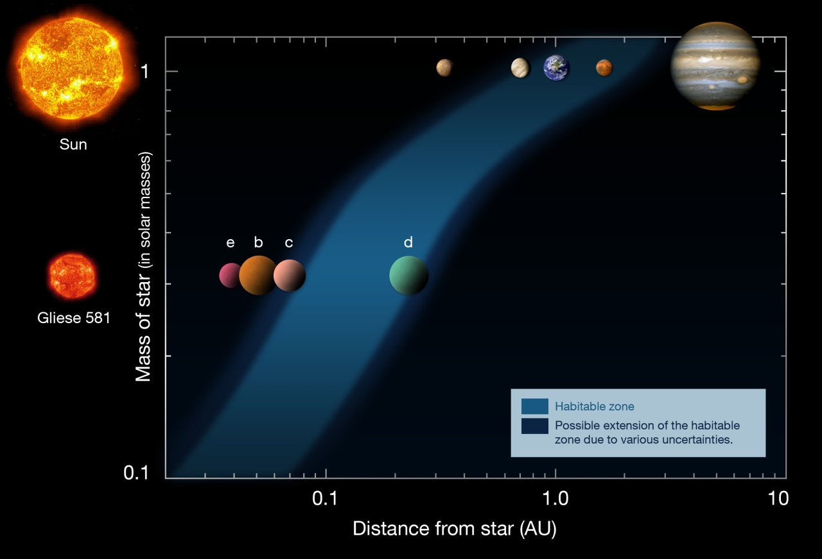
A planet with 1.9M⊕ and one in the habitable zone
Mayor et al. 2009

Slide 15
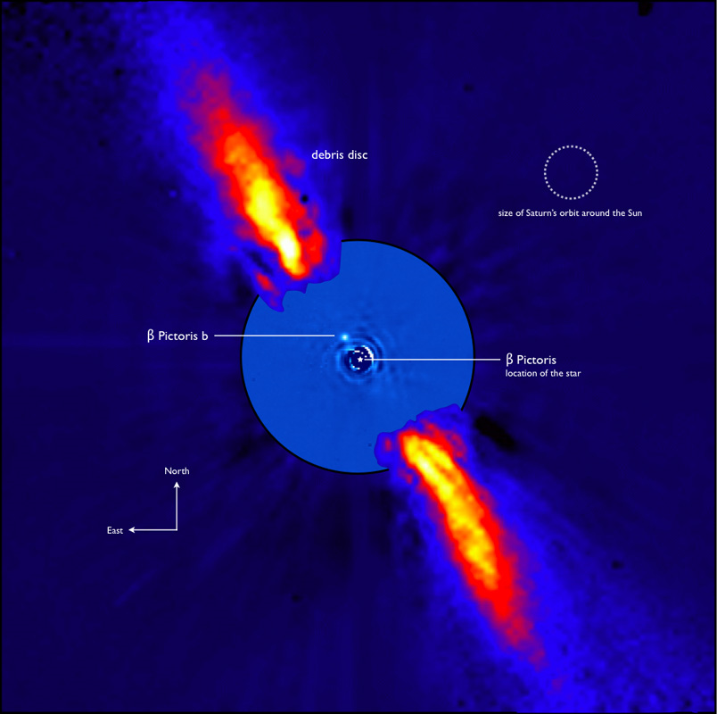
β Pic planet
Planet within the massive dust disk
Orbit only a few astronomical units
Lagrange et al. 2009, A&A, 493, L21

Slide 16


Searching for other earths
HARPS is the most successful planet finder right now
Almost all low-mass planets found with HARPS
  lowest mass planet found (1.9 M⊕)

Slide 17
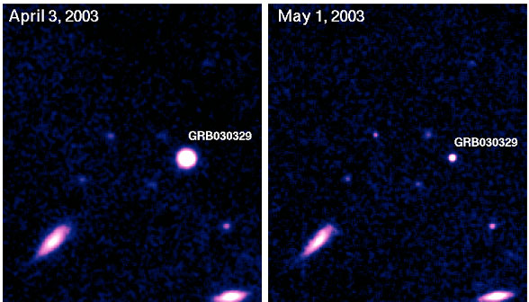
Gamma-Ray Bursts
Identification relied on optical data
  redshifts, explosion energies, explosion physics
Cosmological probes
  the most distant observable stars
  light houses to measure the intergalactic medium
  tracers of chemical
  enrichment?
Very short duration
  require special
  instrumentation and
  software to observe
  adequately

Slide 18
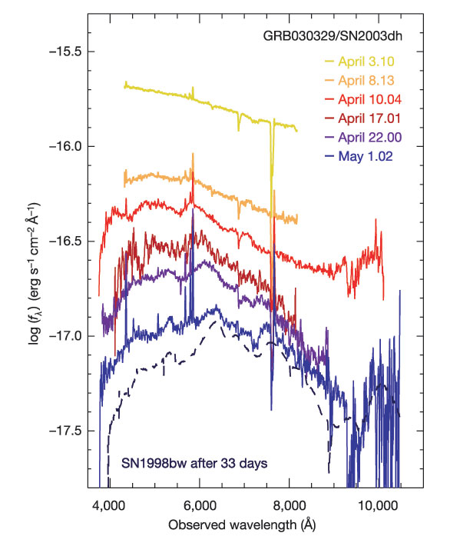
SN/GRB connection
Spectral signatures of supernovae appear in Gamma-Ray Bursts
GRB 030329/SN2003dh (earlier
GRB 980425/SN 1998bw)
  UVES spectrum found z=0.1685, i.e. second closest known GRB – “cosmological” GRB
  FORS1 and 2 observations of afterglow (starting April 3 until May 1)
Hjorth et al. 2003, Nature, 423, 847
Della Valle et al. 2003, A&A, 406, L33

Slide 19
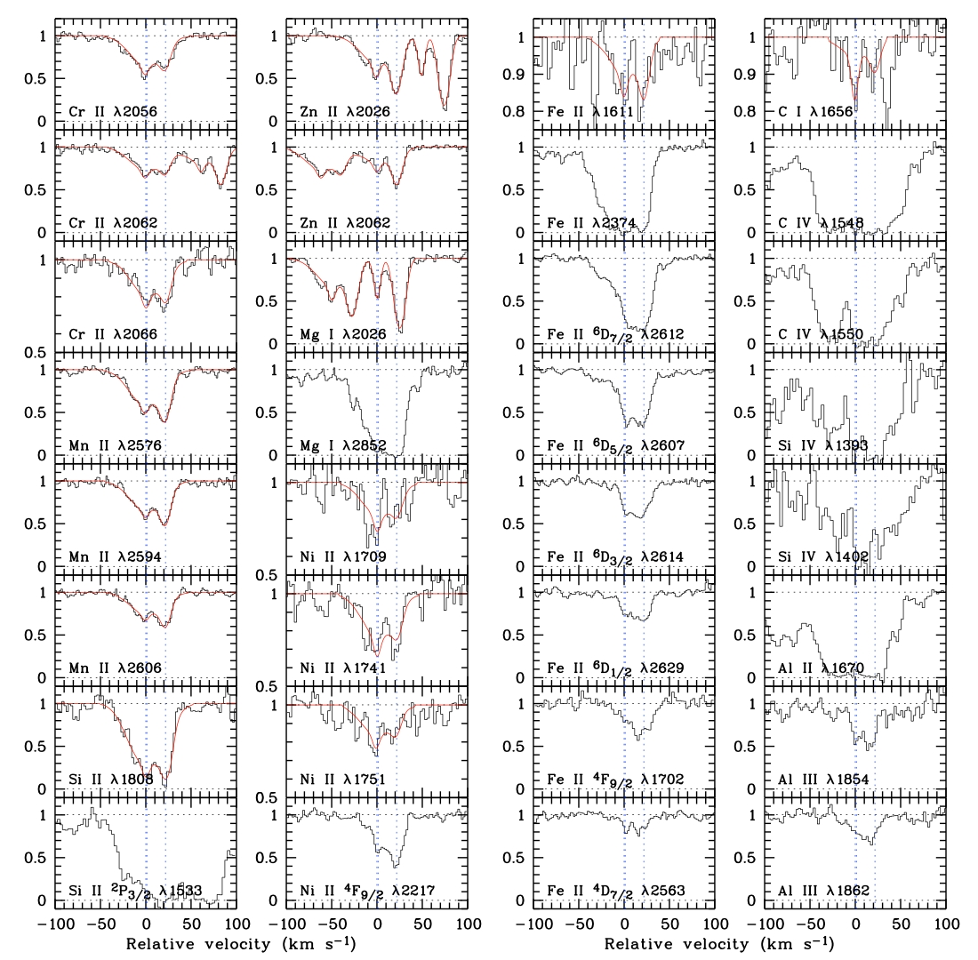
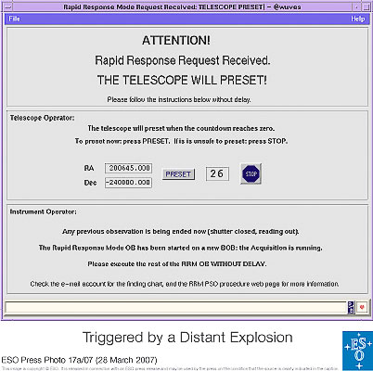
Rapid Response Mode
UVES observations of
GRB 060418
10 minutes
after the initial Swift trigger
Many metal line systems
at 3 redshifts.
[Zn/Fe] >> QSO absorbers

Slide 20
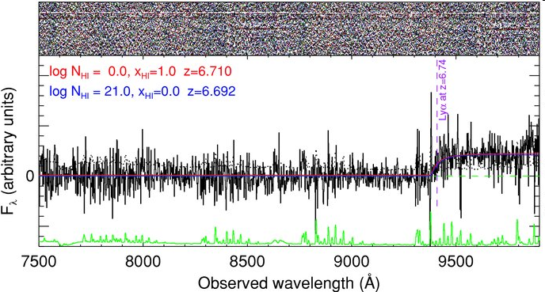
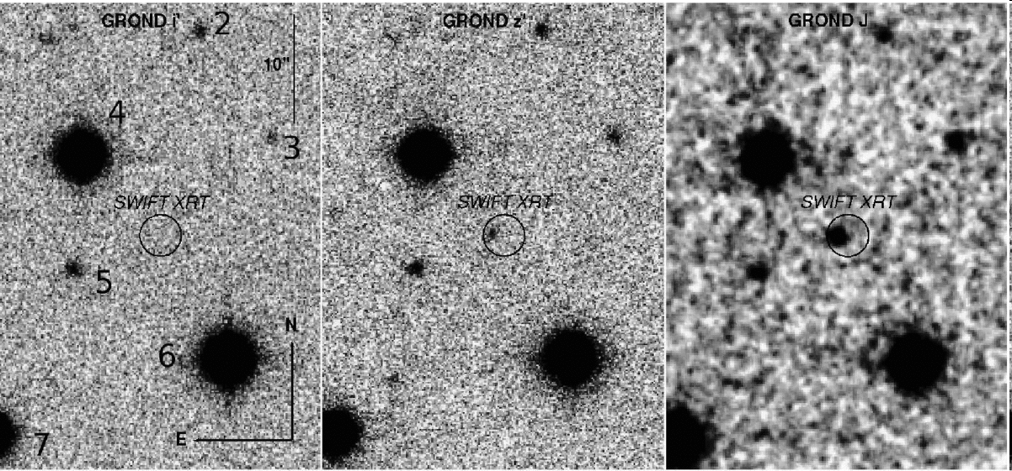
Gamma-Ray Bursts
Most distant stellar objects ever observed
  redshifts 6.7 and 8.2 (tentative)
  lookback time of nearly 12.5 billion years (or 95% of the age of the universe)
i
z
J
GRB080913

Slide 21
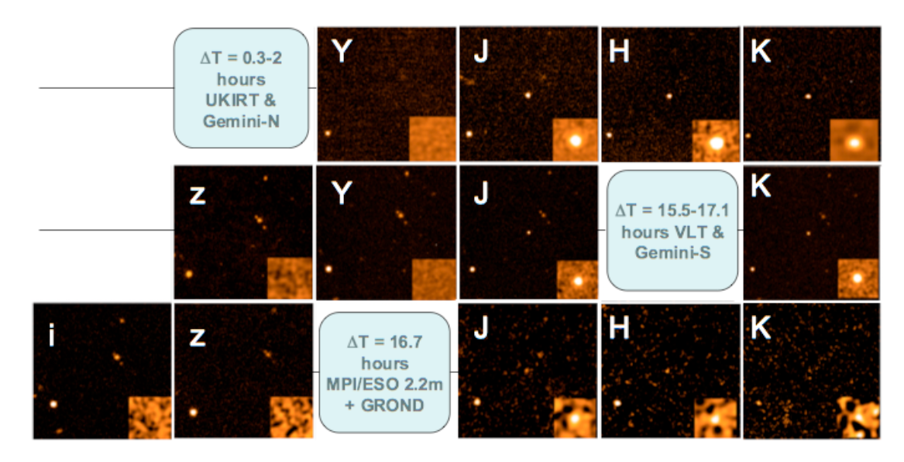
Most distant stellar object yet observed – GRB 090423
Tanvir et al., Nature submitted
Optical drop-out, bright in the near-infrared

Slide 22
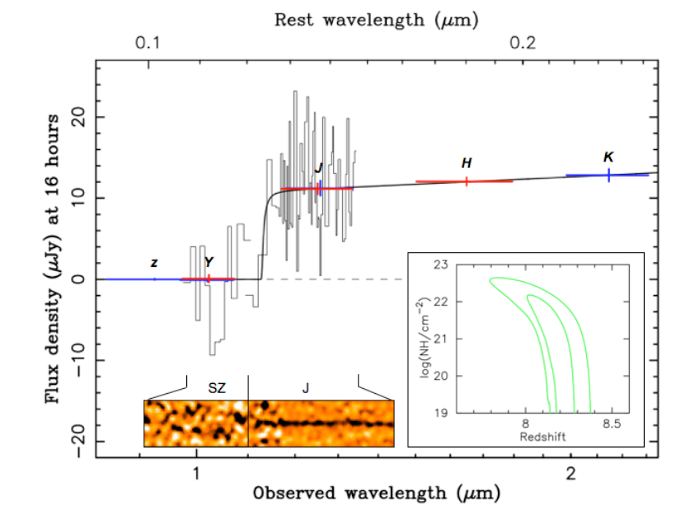
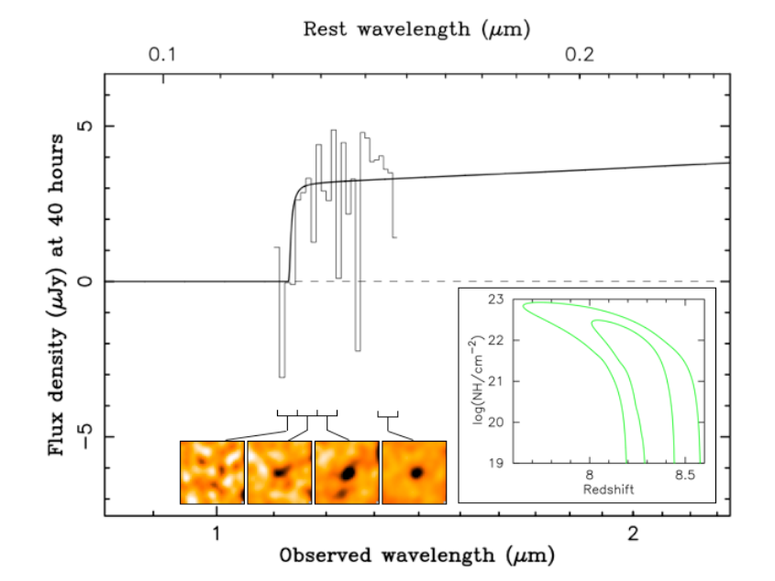
GRB 090423
Spectroscopy 17 hours after outburst
Lyman break indicates a redshift of z≈8.2
ISAAC
SINFONI

Slide 23
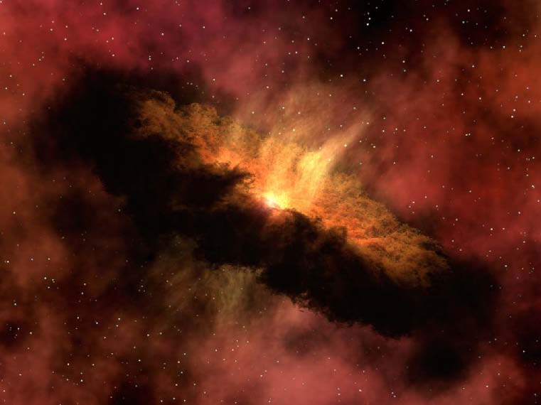
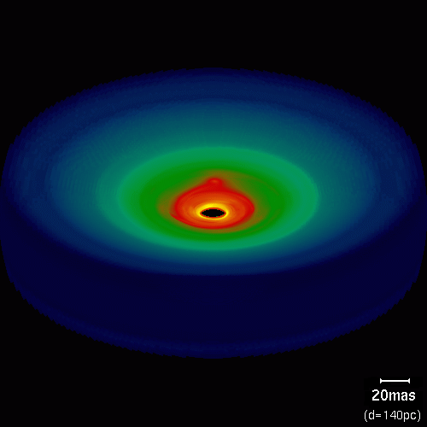
Star and planet formation
Observing the warm cores of molecular clouds
  Important: spatial resolution and large wavelength coverage
  IR observations with large (>8m) telescopes, CanariCam (GTC), VLTI (MATISSE)
  JWST, ELTs
  ALMA will be the champion for
  this field
Wolf & Klahr 2005

Slide 24
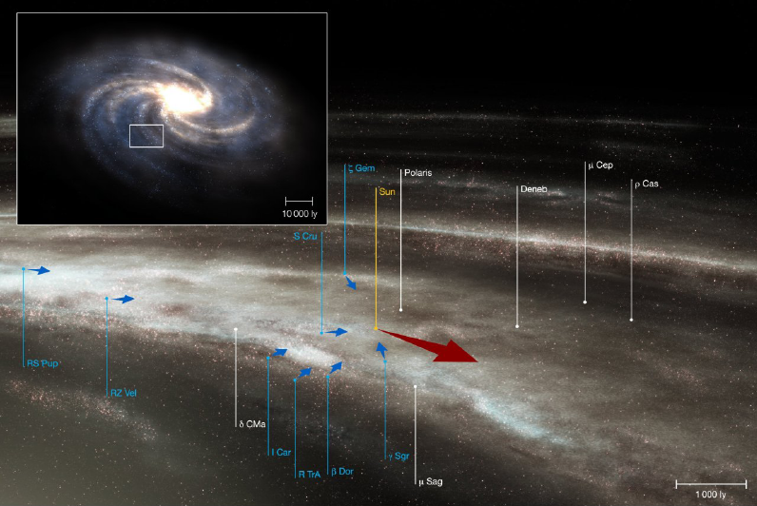
The Milky Way – our home
Radial velocity study of 14000 F and G stars over two decades years
  Plus photometry and Hipparcos parallaxes
Spiral arms
  Gas flows, stellar distribution
Bulge composition, Galactic Centre
Distribution of massive stars

Slide 25
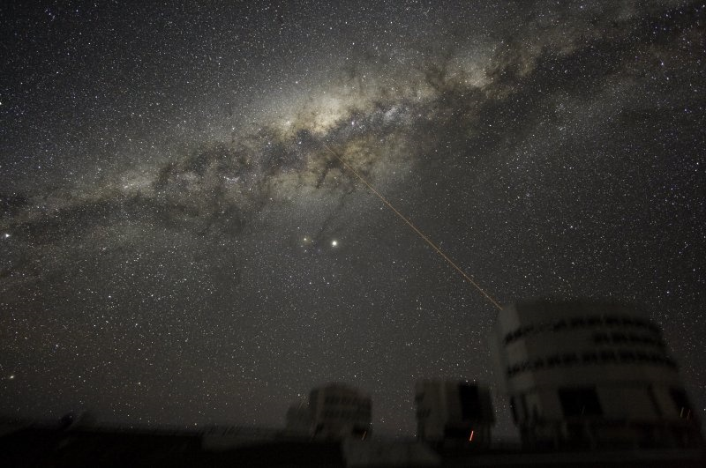
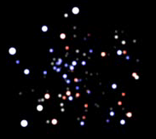
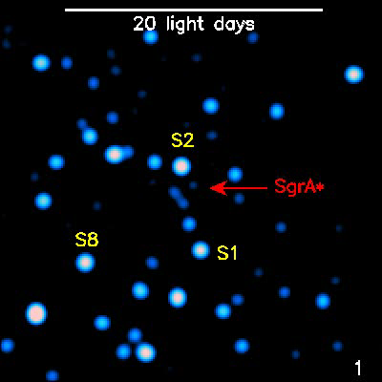
Our own black hole
Mass determination
through stellar orbits
Structure around the
black hole revealed
through flashes
Coordinated studies
with other
wavelengths

Slide 26
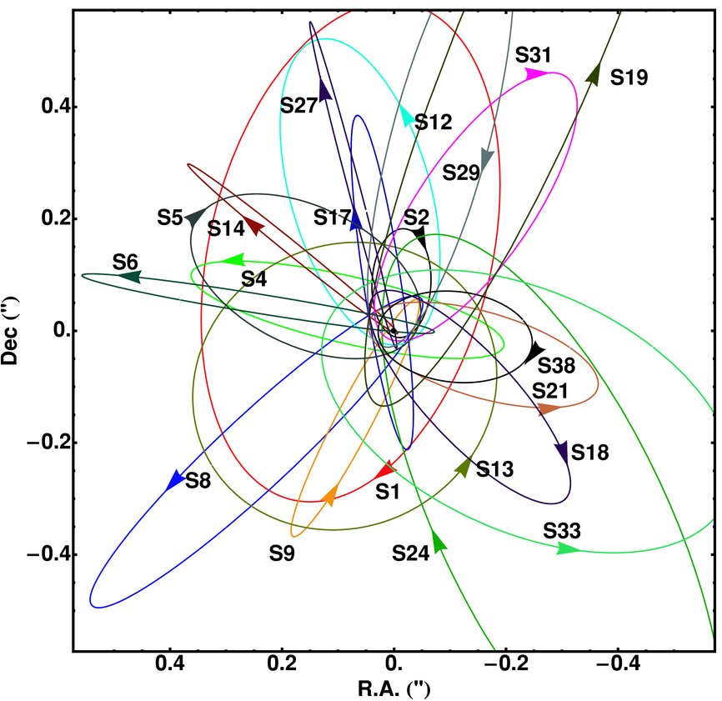
Galactic Centre
Determine the black hole event horizon
  Schwarzschild radius ≈9 microarcseconds
Measure gravity in the strong regime
  Probing the spacetime geometry
  Important: IR observations and spatial resolution → large telescope (>8m) with AO and interferometry
  NACO, Keck AO, GEMS (Gemini),
  GRAVITY (VLTI), ELTs
Gillessen et al. (2009)

Slide 27
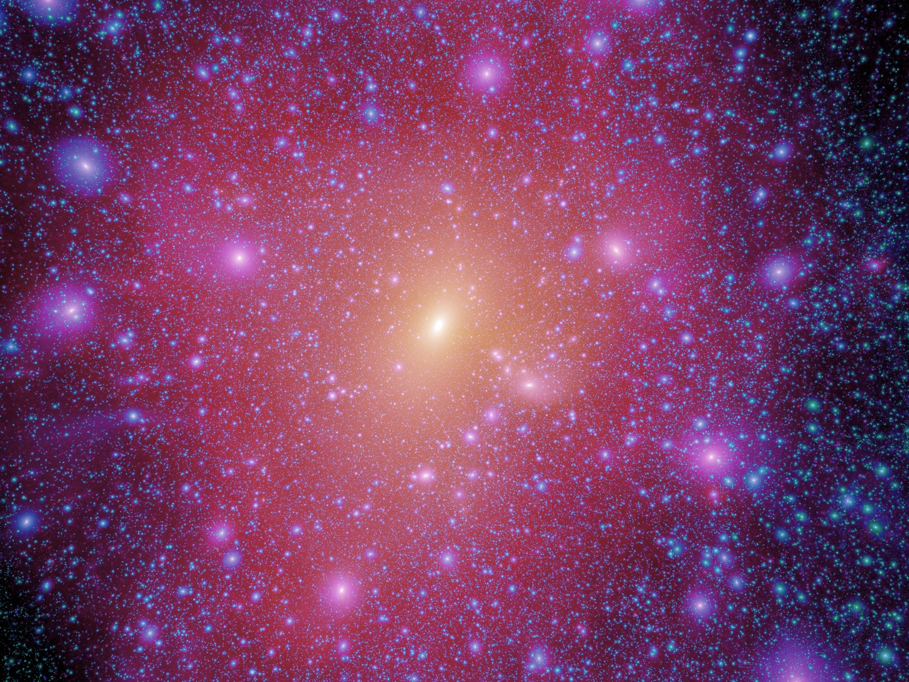
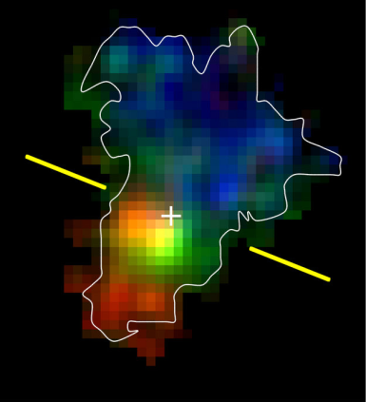
How did galaxies form and evolve?
Characterisation of the Lyman-break galaxies
  Galaxy population at z>3
Discovery of compact, old galaxies at z>1
  “red and dead”, “red distant galaxies”
Characterisation of galaxies at high z
  Internal kinematics
Earliest observable stellar agglomerations
  Ly-α emitters
Millenium simulation (Springel et al.)

Slide 28
The distant universe
Build up of the Hubble sequence
  Star forming vs. passive galaxies
    Important: deep wide-field imaging and massive spectroscopic surveys
    SuprimeCam (Subaru), VST, VISTA, VIMOS upgrade,
    FMOS (Subaru)
  Internal physics and morphologies of galaxies at 1<z<3
    Important: high spatial resolution and spatially resolved spectroscopy
    HST, NACO, SINFONI, OSIRIS (GTC), MUSE, KMOS,
    HAWK-I with AO, JWST, E-ELT
Objects at very high redshifts (‘first light’)
  Search for Ly-α emitters, IGM at high z
    Important: deep surveys, spectroscopic follow-up
    SuprimeCam (Subaru), X-Shooter, NACO, OSIRIS (GTC),
    LRIS (Keck), DEIMOS (Keck), HAWK-I with AO, MUSE, KMOS, EMIR (GTC), JWST, E-ELT
Based on Bergeron (2009) Science with the VLT in the ELT Era

Slide 29
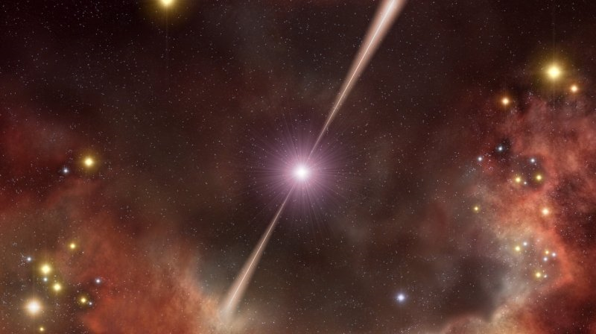
Fashions and other transient phenomena
ESO top ten cited papers are all supernovae and GRBs
  This is more a sign of fashion than sound physics
AGNs – topic of the 4m telescopes
  Topic for 8m telescopes?
Metal-poor stars – originally 8m
(e.g. First Stars programme)
  And now?

Slide 30
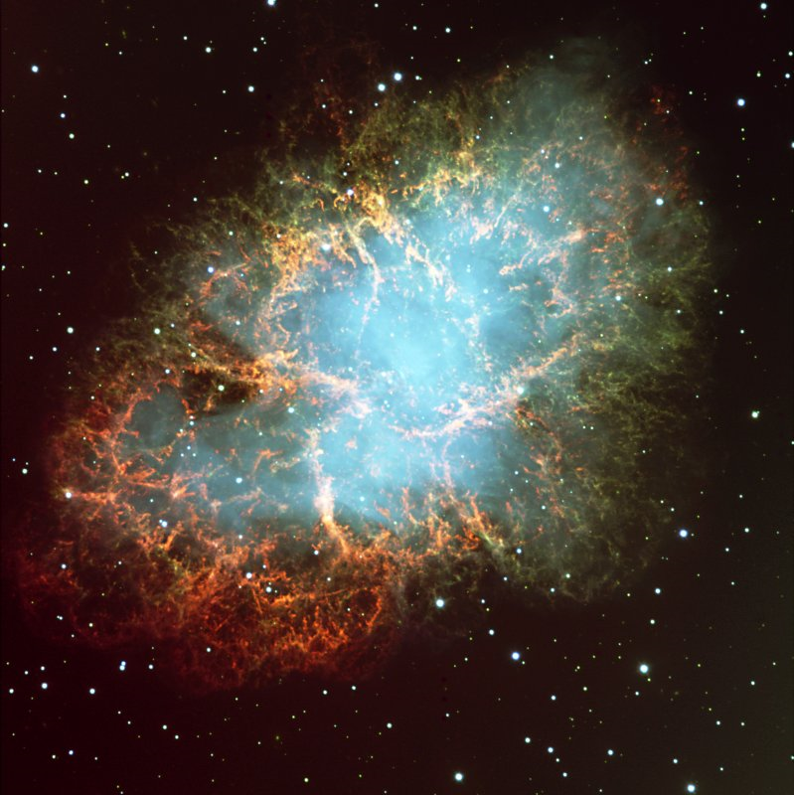
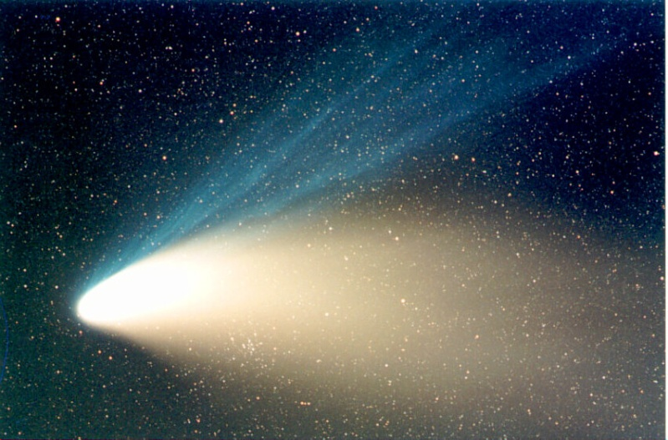
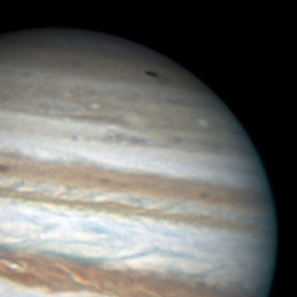
When opportunity knocks
Unique objects
  SN 1987A
    One in a century object?
  Comets
    Hale-Bopp, Hyakutake, 73P/Schwassmann-Wachmann 3, Shoemaker-Levy 9, Halley
  Near-Earth objects
  Solar system event
    Spots on Jupiter
    Volcano eruption on Io?
    Comet impact on Jupiter?
Wesley, 35cm

Slide 31
Questions for the coming years
nature of dark energy
nature of dark matter
when and how did the universe become transparent
  what caused this transition
how did galaxies form
what is the connection between galaxies and black holes
how do stars and planets form

Slide 32
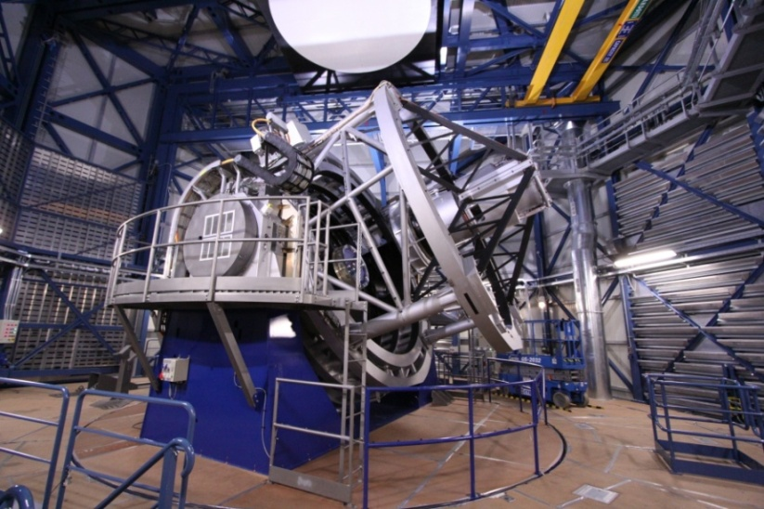
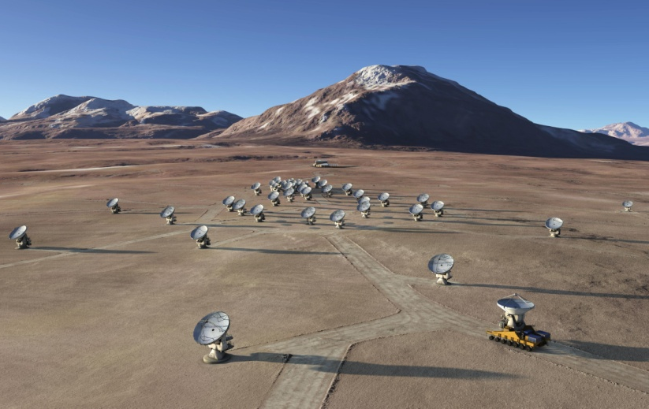
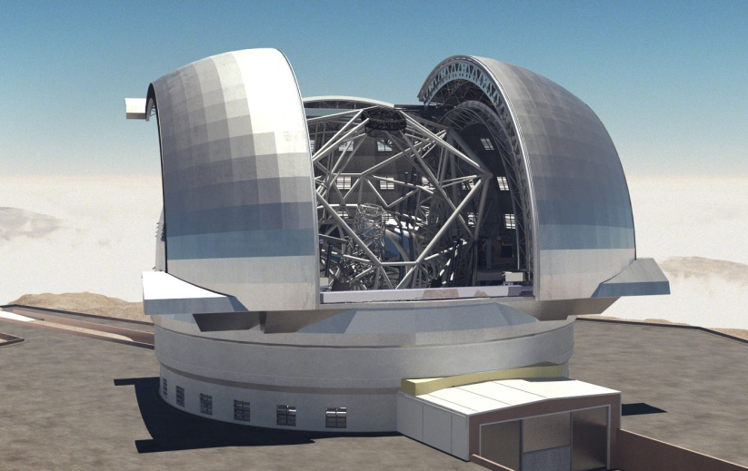
An exciting future
New telescopes
  LOFAR
    open up completely new parameter space
  VISTA/VST
    survey telescopes to map large
    fractions of the sky
  ALMA
    start in the coming years
  E-ELT
    to be constructed in this decade
New missions (ESA’s Cosmic Vision)
  EUCLID
    map the IR extra-galactic sky
  PLATO
    detect earth-like planets

