Slide 1
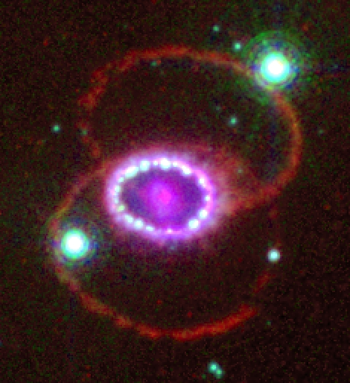
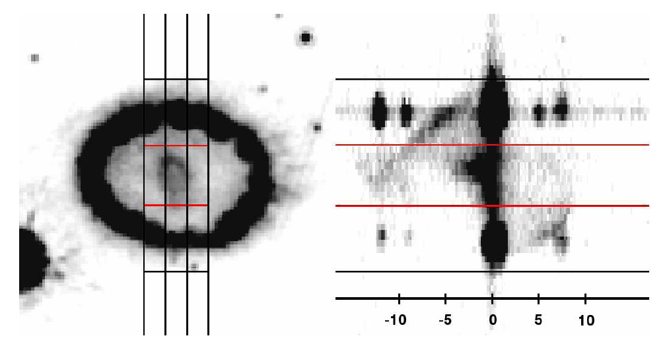
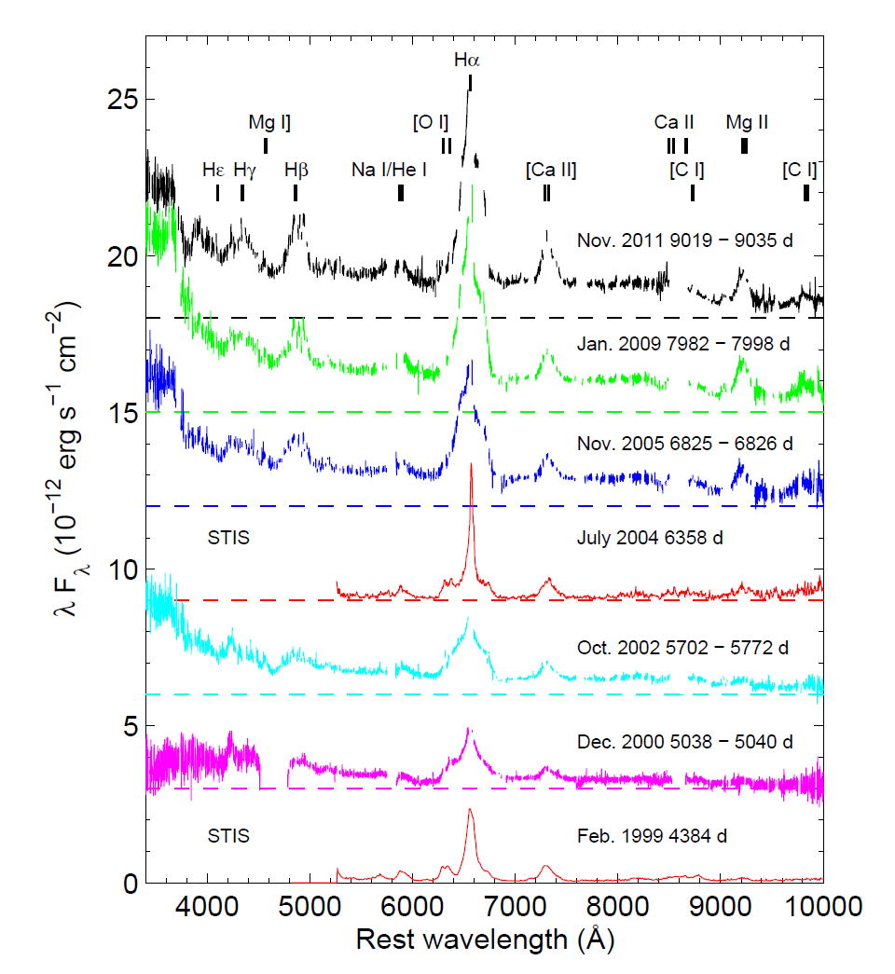
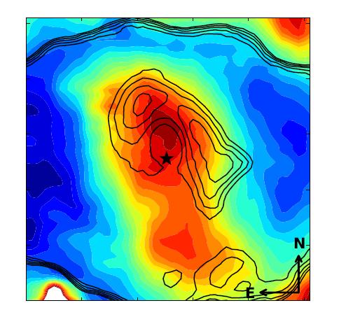
SN 1987A spectacular physics
Bruno Leibundgut
ESO

Slide 2
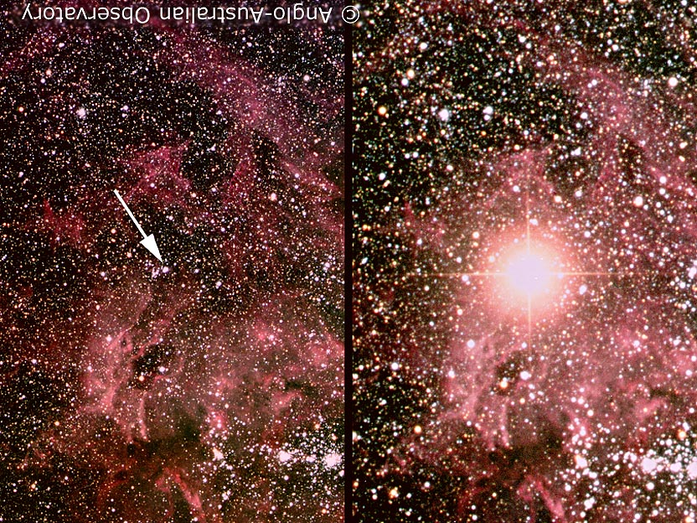
Earliest portrait of SN 1987A
Before February 1987
~24 February 1987
© Anglo-Australian Telescope

Slide 3
Uniqueness of SN 1987A
Neutrino detection
  direct evidence of core collapse
  and formation of a neutron
  star (or black hole)
Naked-eye supernova after >350 years
  detection of X-rays and γ-rays very early
    mixing and direct nucleosynthetic products
  monitoring with HST, VLT, Gemini, Chandra, XMM, ATCA, Herschel, Spitzer, ALMA
Progenitor star observed before explosion
  insight into stellar evolutionary channel leading to a supernova surprise → blue supergiant!

Slide 4
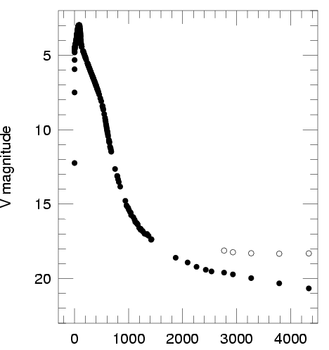
Uniqueness of SN 1987A
18
23
28
Virgo
distance
33
Suntzeff

Slide 5
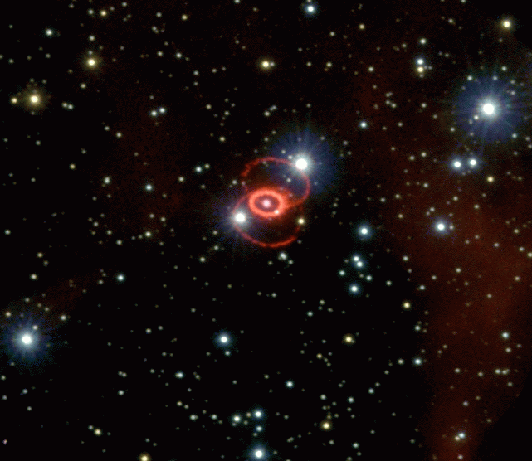
Uniqueness of SN 1987A
Spatially resolved
  separate circumstellar
  environment (rings) from
  the ashes of the explosion (ejecta)
Signatures of an asymmetric explosion
  polarimetry, ‘mystery spot’, spectral line evolution (‘Bochum event’)
Nisenson et al. 1987
Hanuschik & Thimm 1988

Slide 6
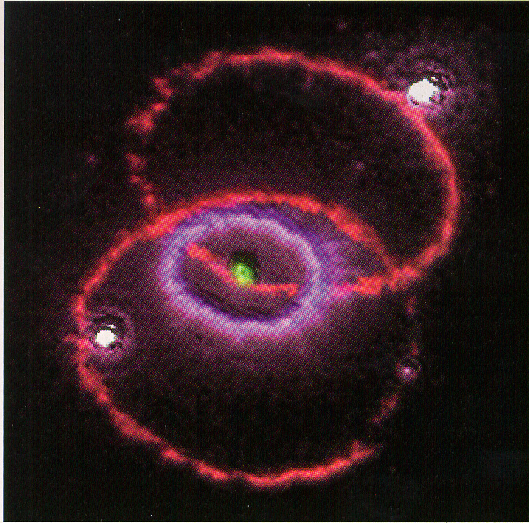
The exciting SN 1987A today
(9606 days since explosion – 26 years old)
Fluorescing rings
Shocks
  outer ejecta reached
  the inner ring
Radioactively heated
material
  inner ejecta
Dust
  in and around the supernova

Slide 7
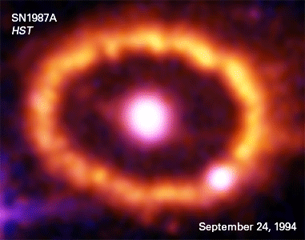
Energy escape from a (core-collapse) supernova
SN 1987A
the best observed supernova ever
Suntzeff (2003)
(also Fransson et al. 2007)

Slide 8
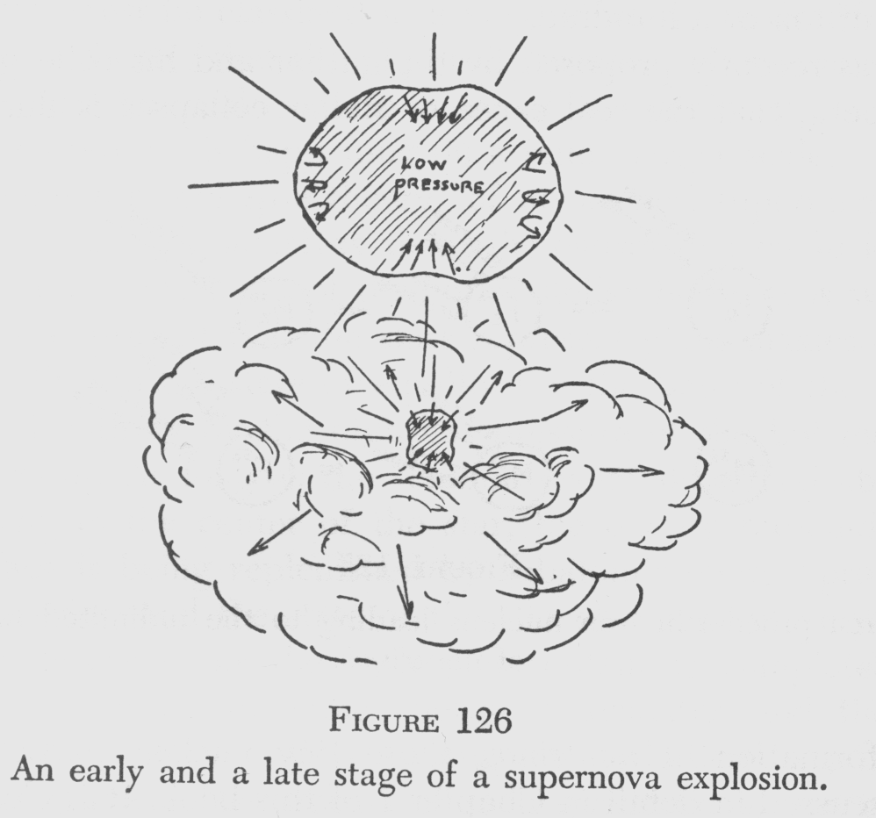
Energy sources
Gravity →Type II supernovae
  collapse of a solar mass or more to a neutron star
Gamow’s picture of
a core collapse supernova

Slide 9
Energy sources
Shock
  breakout
  kinetic energy
Cooling
  due to expansion of the ejecta
Radioactivity
  nucleosynthesis
Recombination
  of the shock-ionised material

Slide 10
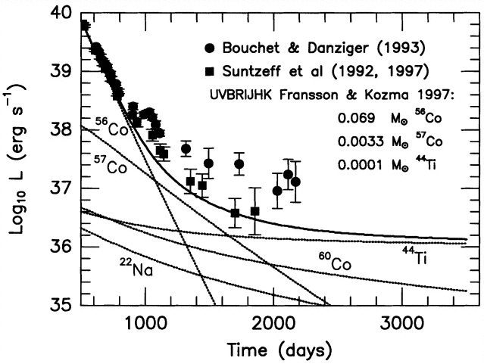
What can drive SN emission at late phases?
Freeze-out
  recombination of atoms at long time-scales

Slide 11
The excitement is back
increase observed in
  X-rays
  optical
  IR
  radio
Bouchet et al.

Slide 12
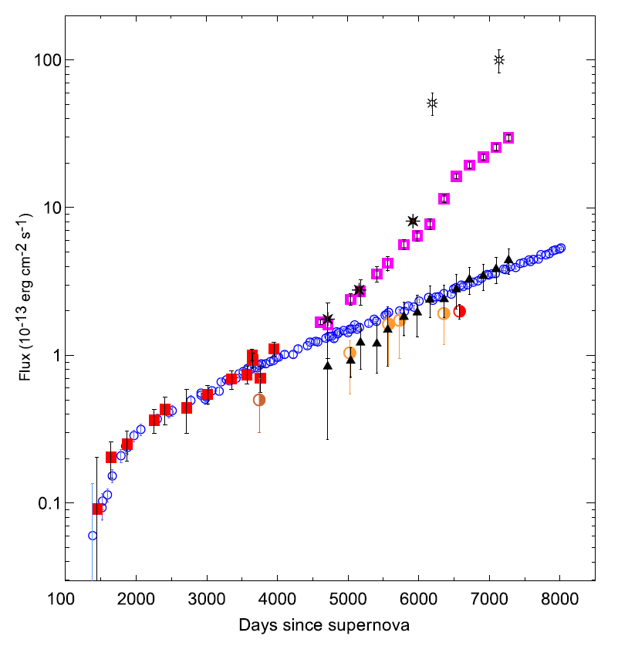
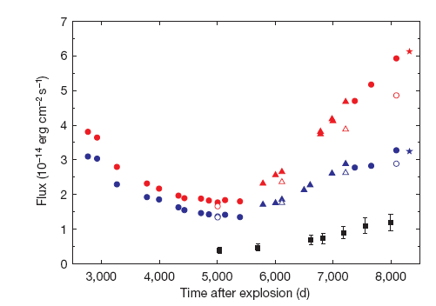
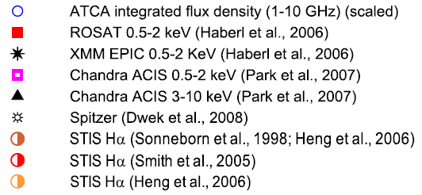
SN 1987A is brightening at all wavelengths
Larsson et al. 2011
Zanardo et al. 2010

Slide 13
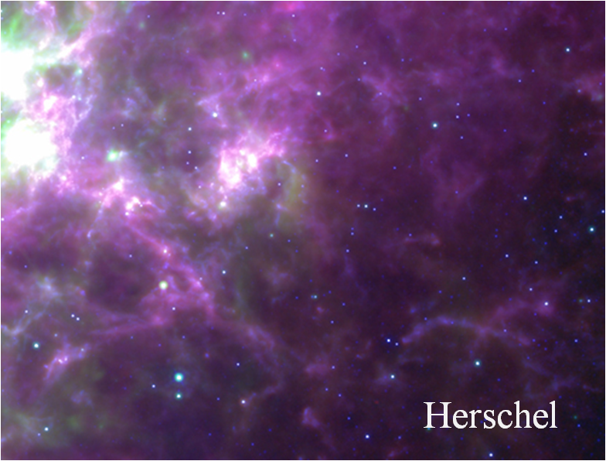
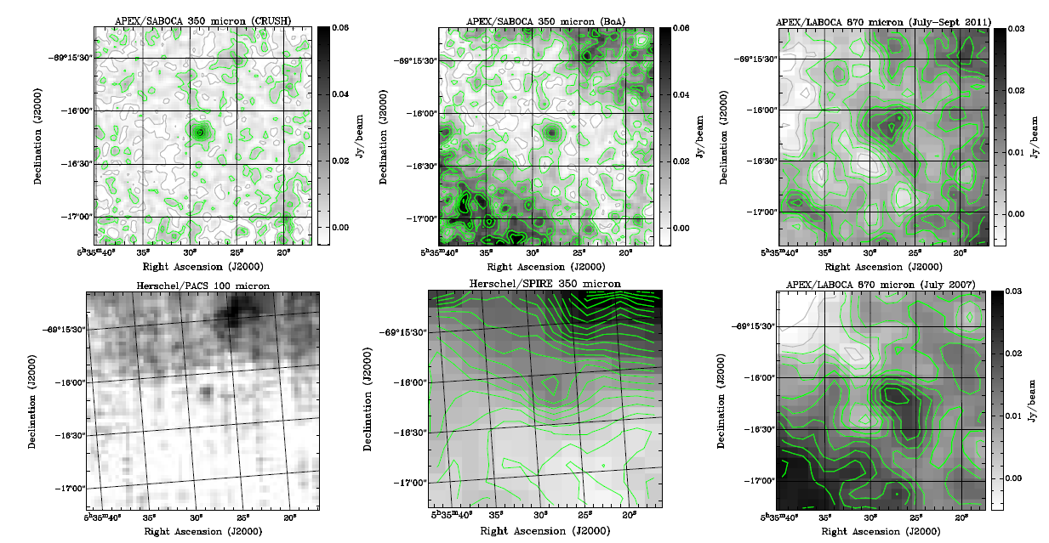
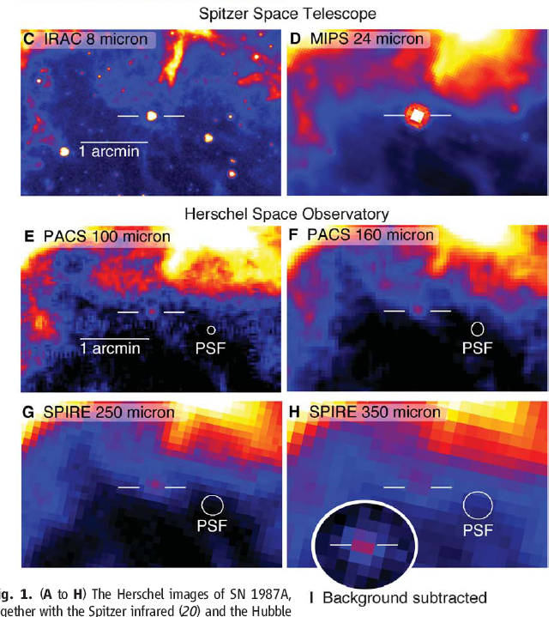
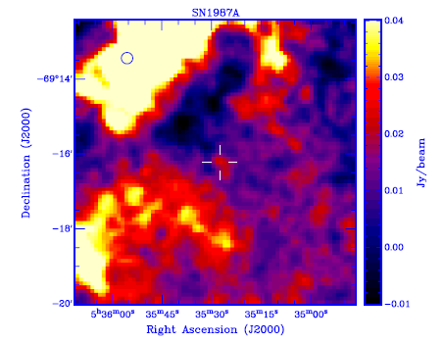
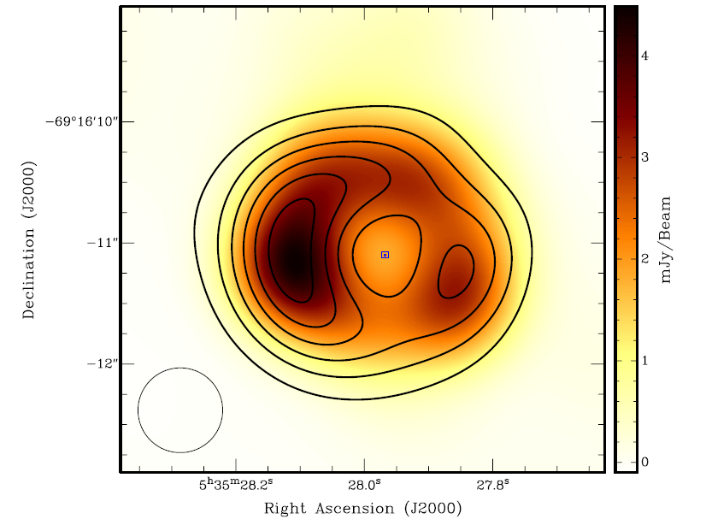
Exciting developments
Detections by Spitzer and Herschel
Detection at mm wavelengths
Start to resolve the radio image
Lakićević et al. 2012
0.87mm - APEX
3mm
3cm (contours)
Lakićević et al. 2011
Lakićević et al. 2012
Matsuura et al. 2011

Slide 14
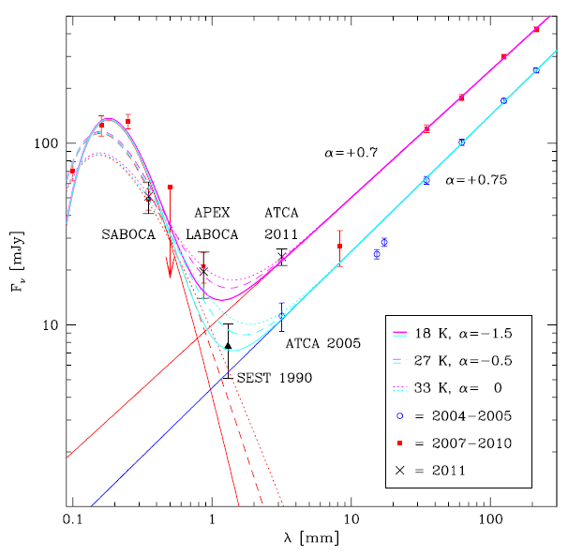
Dust - where is it?
Dust formed early
  ~500 days after explosion
Herschel fluxes indicate cold dust (~20K)
                Matsuura et al. 2011
  ~0.5 M dust in the ejecta
    strongly depends on the temperature
    location in the ejecta not completely obvious
IR/radio SED
  dust – black body emission
  synchrotron emission
Lakićević et al. 2012
Notes:
synchrotron emission with spectral index alpha
second alpha is the dust emission coefficient (kappa/kappa_0)=(lambda/lambda_0)^alpha

Slide 15
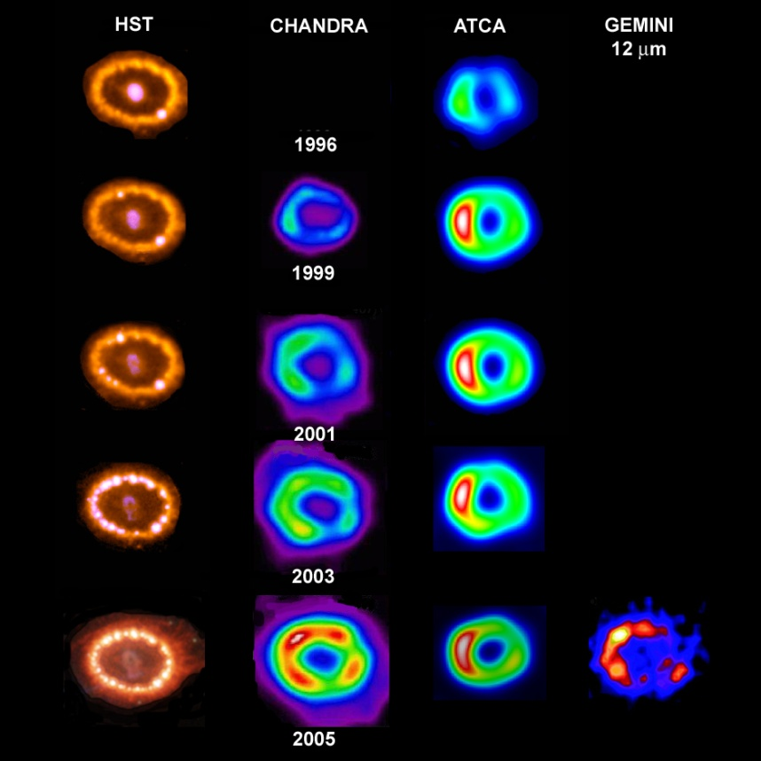
Optical, X-rays and Radio
Park et al
Manchester et al

Slide 16
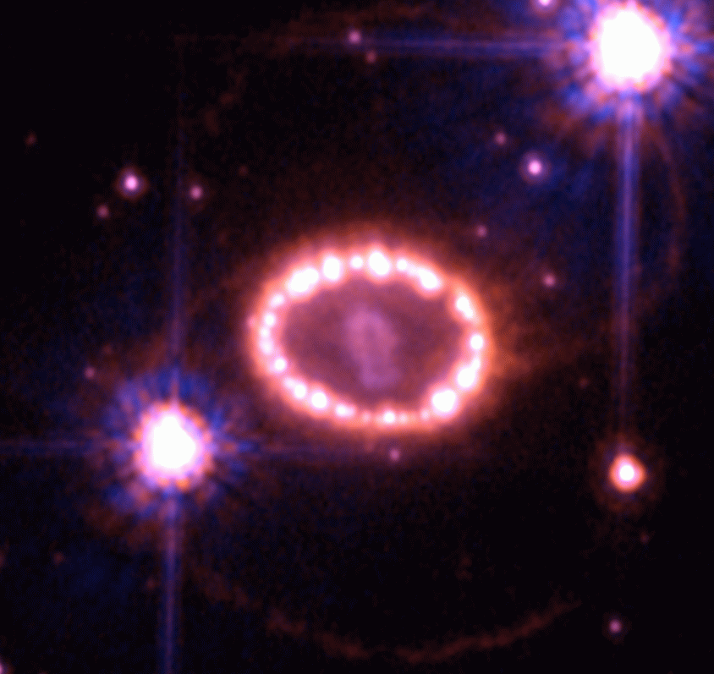
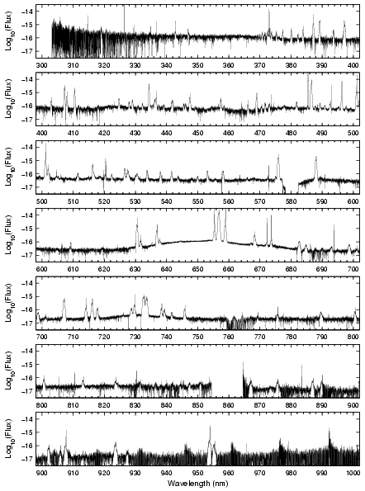
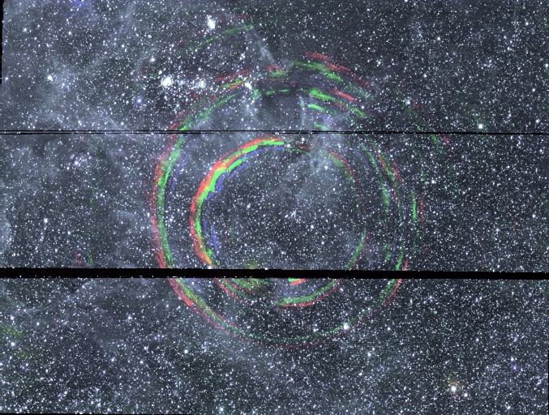
The complex SN 1987A @ 26 years
Combination of several emission sites
  inner ejecta
  shocked ejecta
  shocked inner ring
  ionised inner ring
  outer rings
  light echoes
Courtesy P. Challis, CfA

Slide 17
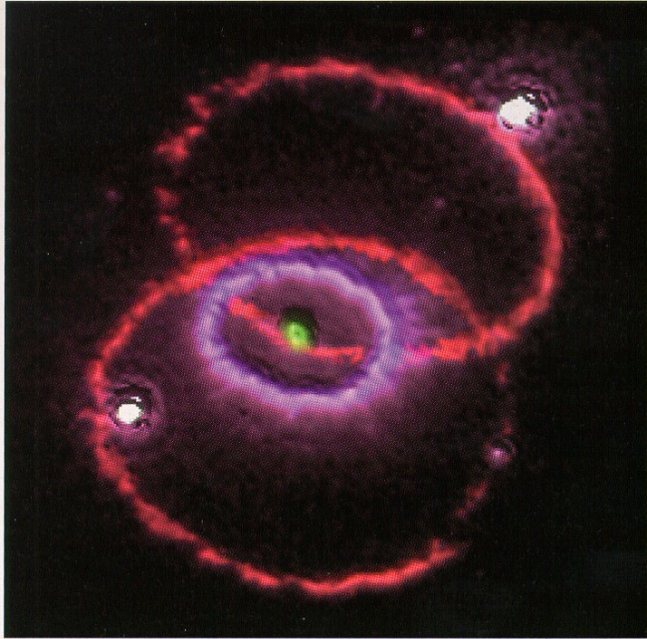
The different emission sites in SN 1987A
SN ejecta
  radioactively heated
  material (‘inner ejecta’)
  X-ray heated ejecta
  dust?
Rings
  density enhancements in equatorial (?) plane
  shock physics
    forward shock (into the ring)
    reverse shock (into the ejecta)
  dust?

Slide 18
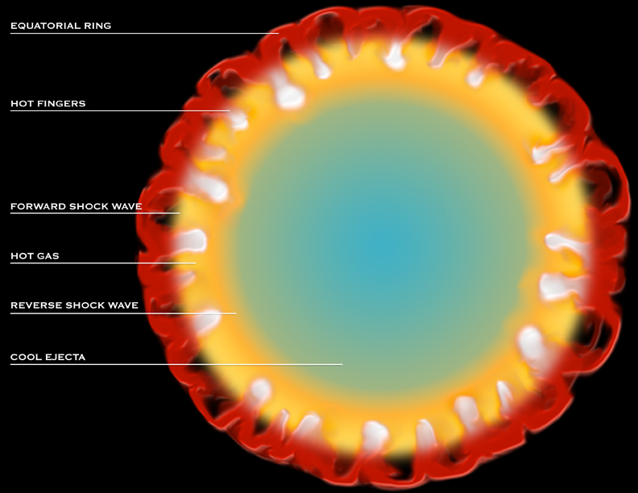
McCray

Slide 19
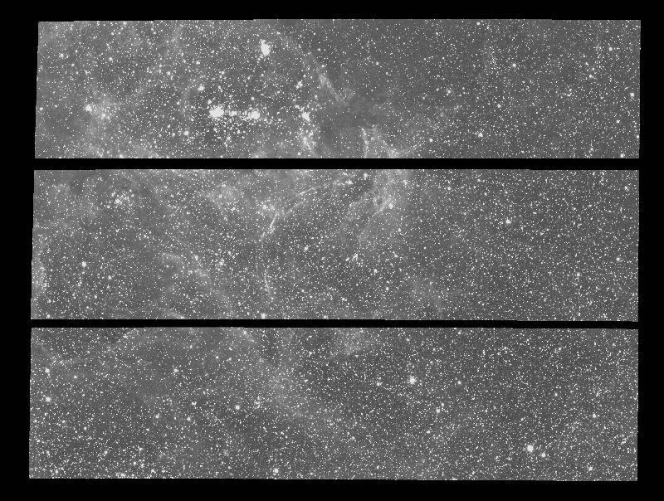
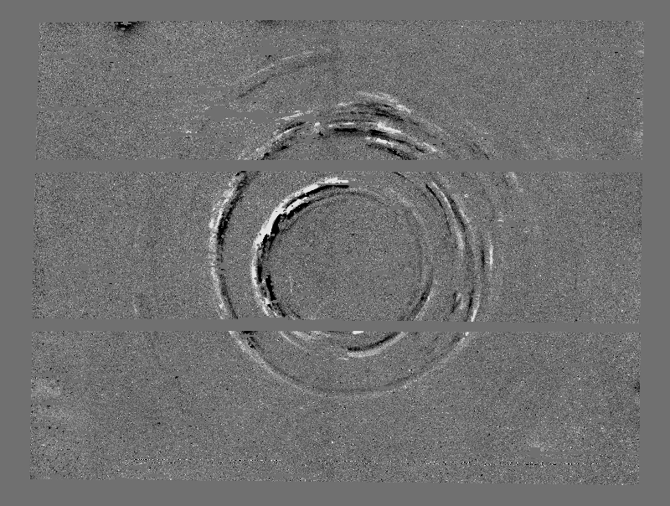
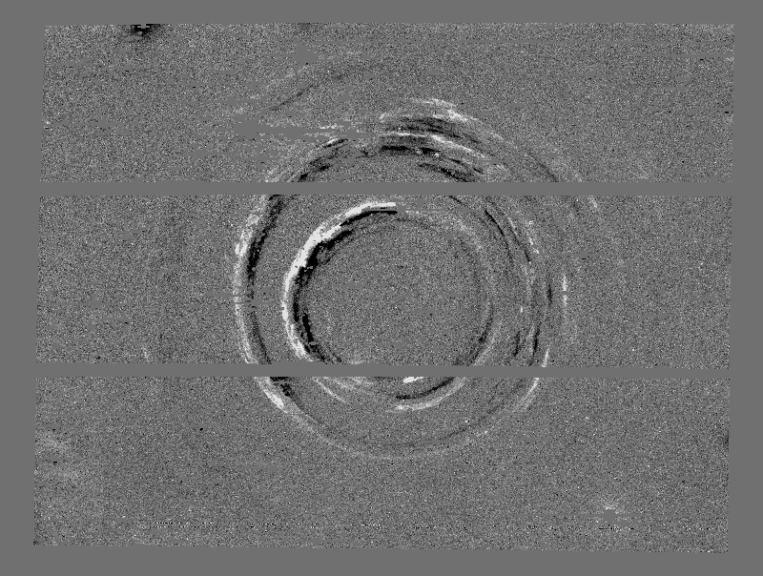
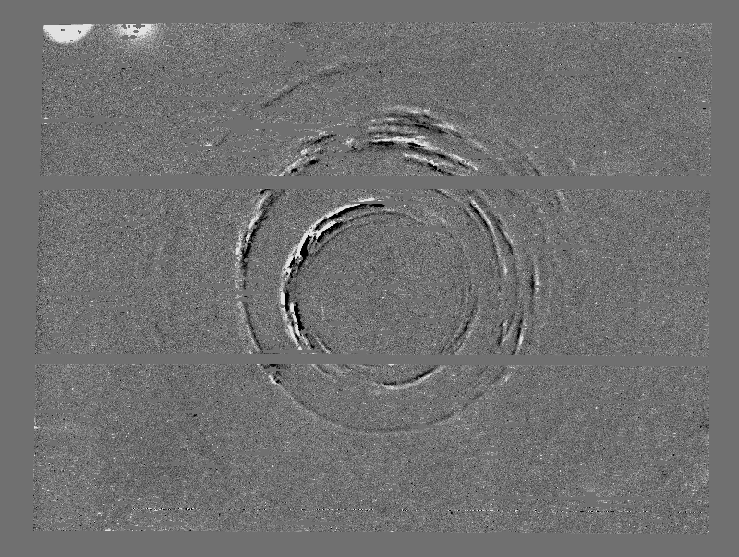
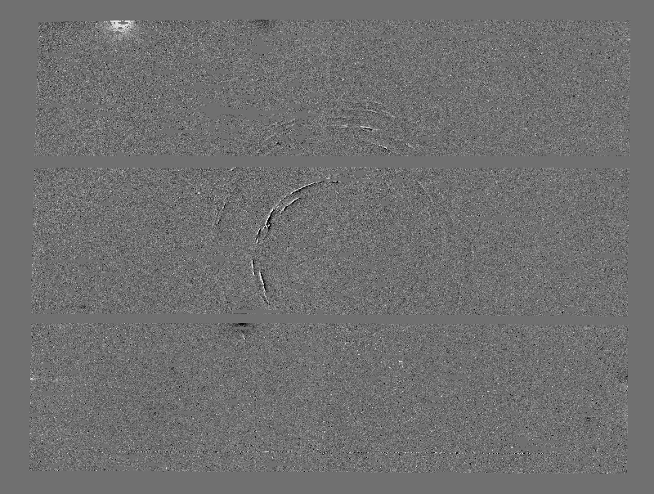
The hidden SN 1987A
2001 – 2001
2002 – 2001
2003 – 2001
2004 – 2001
1 arcmin
Rest et al. 2006

Slide 20
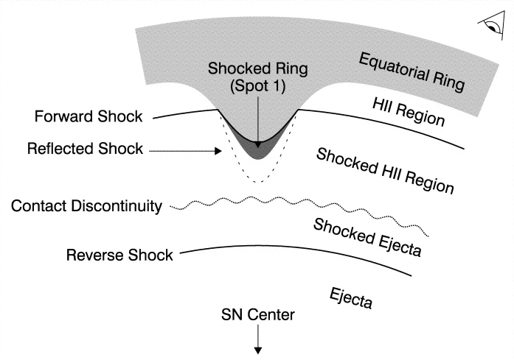
The ring collision
Dominating at all wavelengths
  shock emission increasing for the past 13 years
Emission from the stationary ring
  narrow lines (FWHM ≈ 10 km/s)
  known since 1987 - fading
Shocked ring region (forward shock)
  intermediate lines (~300 km/s)
Reverse shock
  ejecta (~15000 km/s)

Slide 21
High-resolution spectroscopy
VLT/UVES
  310-1000nm, Δv≈6 km/s
  ~170 intermediate
  (~300 km/s) velocity lines
    (half of these are Fe II)
  ring lines (~10 km/s) easily detected
  broad lines from the reverse shock (Hα)
Gröningsson et al. 2008

Slide 22
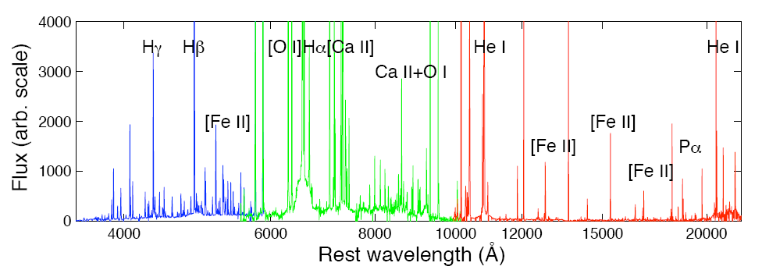
Emission line components
SN 1987A in Dec 2010
  Xshooter

Slide 23
The emission line components
4
Hα
2002
2000
3
Flux
2
1
0
-20000
-15000
-10000
-5000
0
5000
10000
15000
20000
velocity (km/s)
Michael et al. HST/STIS 1999

Slide 24
Intermediate lines – shocked material in the ring
HI, He I, N II, O I-III, Fe II, Ne III-V….. Cooling, photoionized gas behind radiative shock into ring protrusions
Oct 2002

Slide 25
Reverse shock
Forward shock is ionizing the ejecta
  At some point all H atoms will be ionized before they reach the reverse shock and the emission will turn off
  X-rays give the amount
  of ionizing photons
  Monitoring the Hα
  emission will tell
Smith et al. 2005

Slide 26
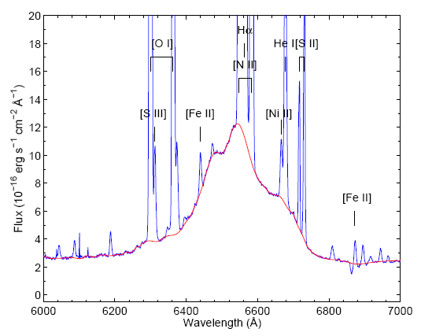
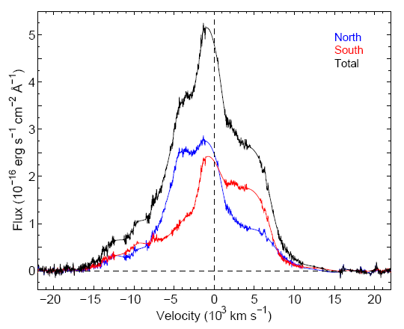
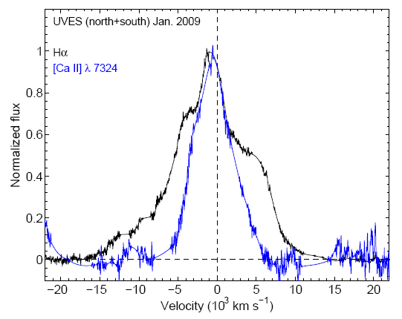
Hydrogen in SN 1987A
‘Clean Hα’
Flux increase by
4 to 6 from 2000 to 2007
v_{max}>11000 km/s
  larger than possible in equatorial ring
  anisotropic expansion
Day 7976
26 Dec 2008
Day 7998
Fransson et al. 2013

Slide 27
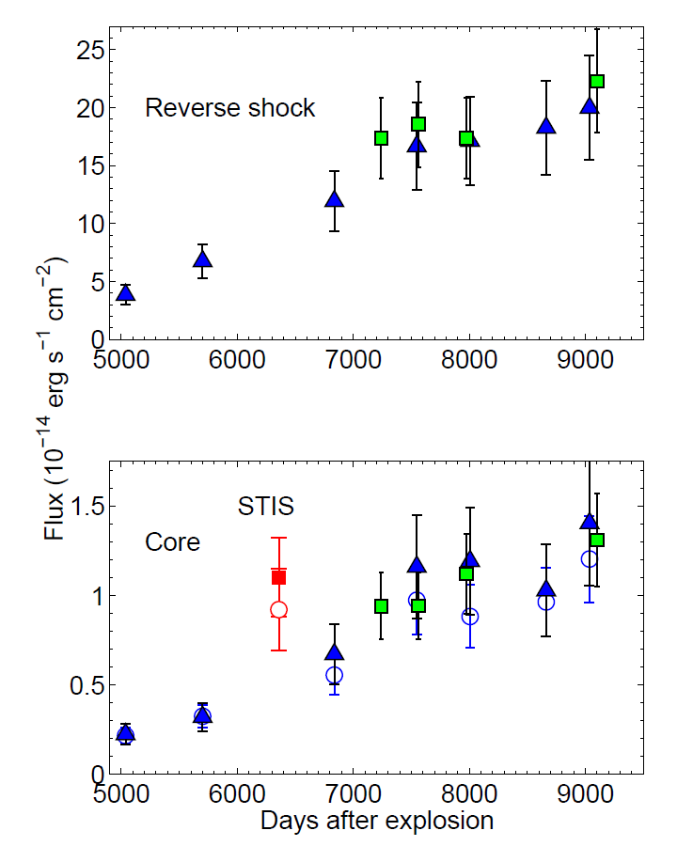
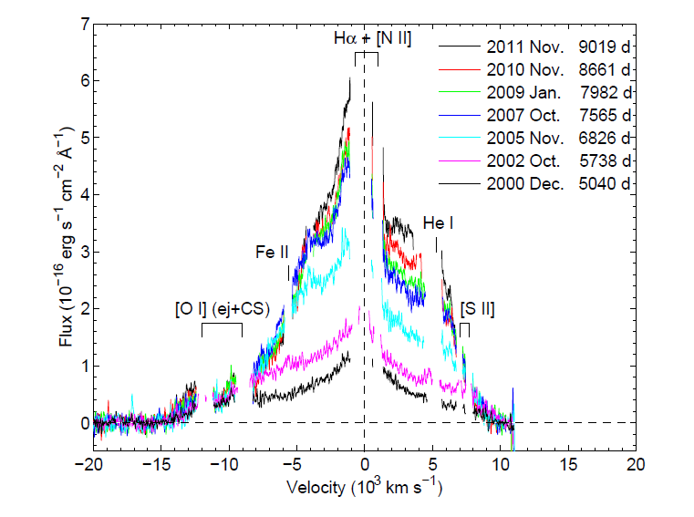
Evolution of Hα
Combination of FORS, UVES and STIS data

Slide 28
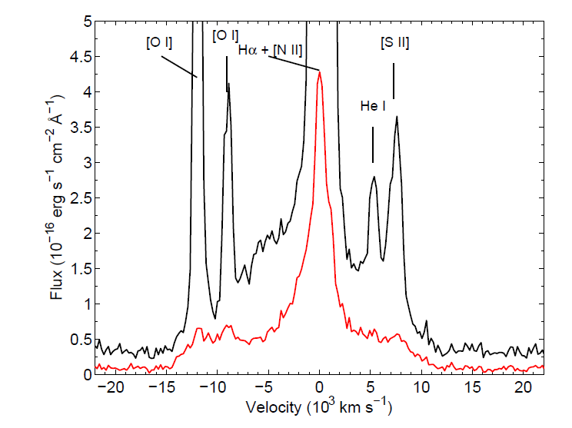
Complex emission
Disentangle the ring from reverse shock from inner ejecta

Slide 29
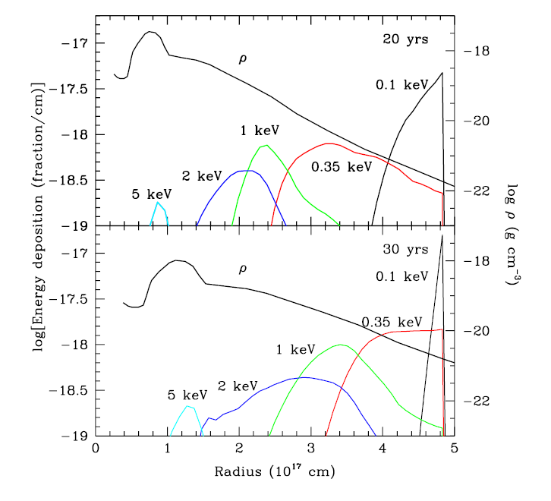
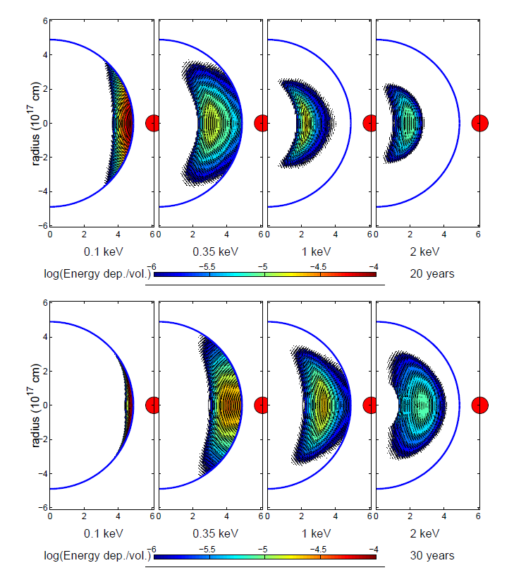
Reverse shock
Only seen in hydrogen lines Hα and Hβ
Lower velocity ‘core’ (<4500 km s⁻¹) from unshocked ejecta heated by X-rays

Slide 30
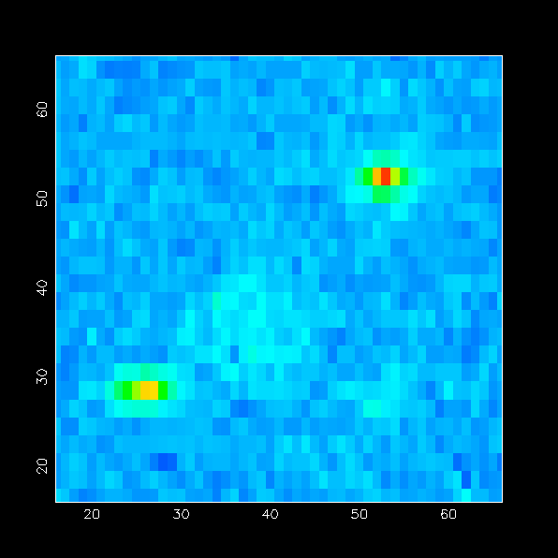
Spatially resolved infrared spectroscopy
separate ring from ejecta
trace the ring in individual lines
get spectra from separate regions
photometry of selected regions

Slide 31
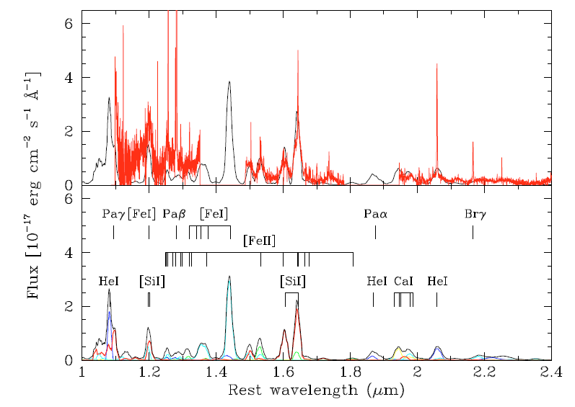
Ejecta resolved
Ground-based near-IR data show spatially
resolved ejecta
2005
Kjær et al. 2010

Slide 32
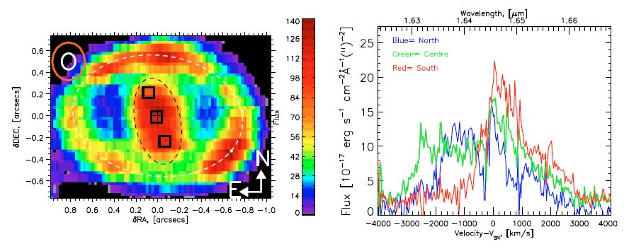
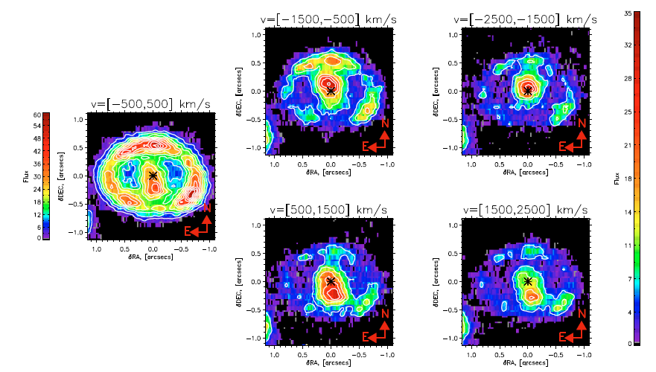
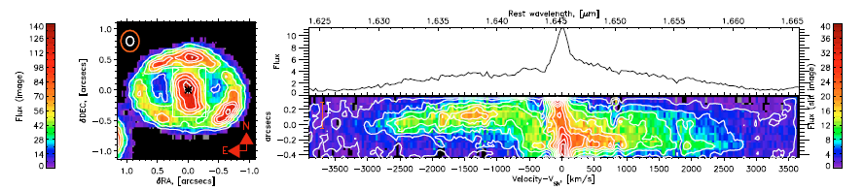
Asymmetry in the ejecta
[Si I] +[Fe II]
[Si I] +[Fe II]
1.64 μm

Slide 33
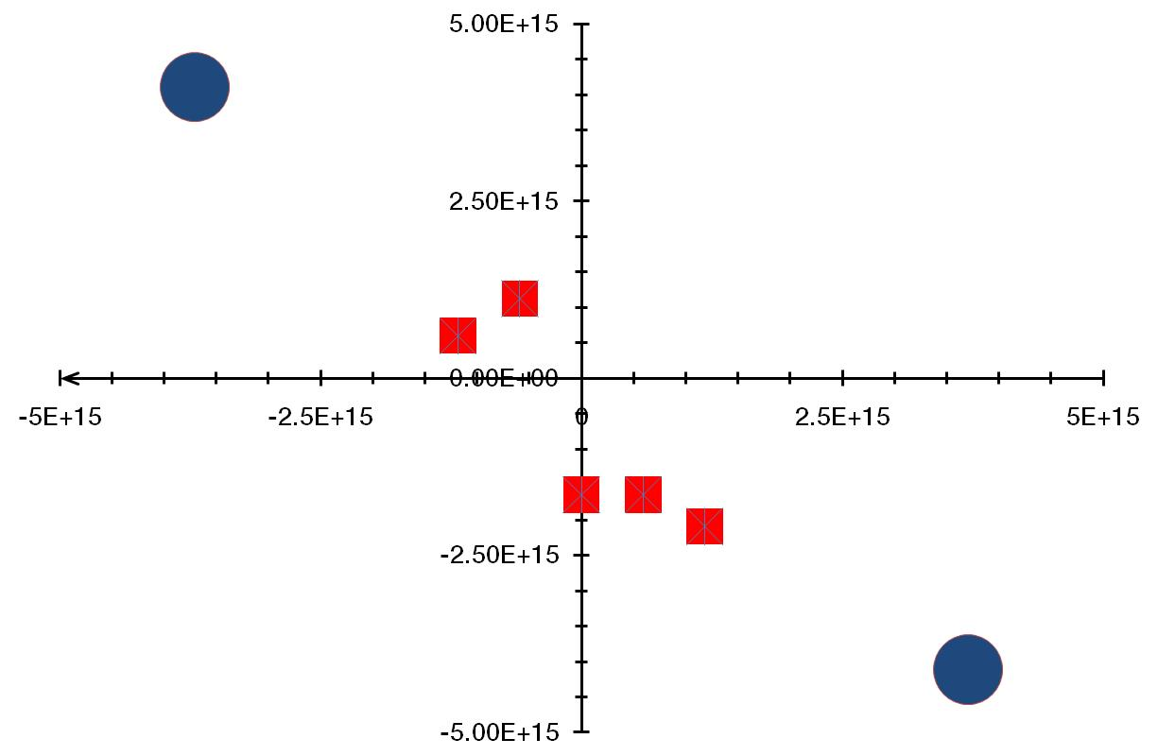
Ejecta kinematics
Southern part is redshifted, northern ejecta are blueshifted
Expansion velocity roughly 3000 to 4000 km/s
This is the same orientation
as the inner ring!
Ejecta lies in the
same plane as the
ring!

Slide 34
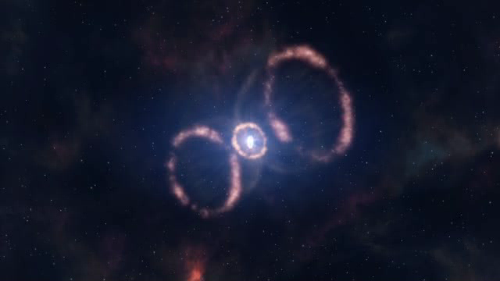
How this could look like

Slide 35
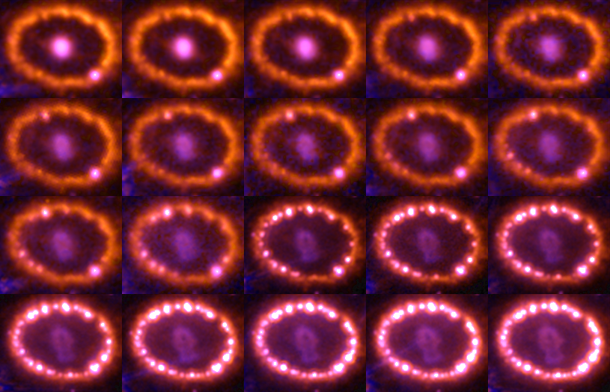
SN 1987A evolution
(1994-2010)

Slide 36
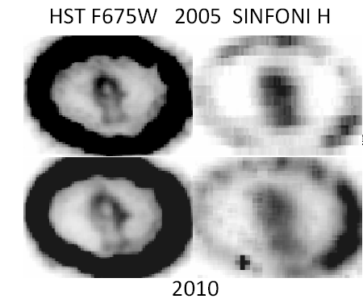
The inner ejecta
Comparison optical vs. IR
  optical
    heated by X-rays
  IR
    radioactive heating

Slide 37


The next surprise
X-raying the ejecta of SN 1987A
  flux of the inner
  ejecta has increased
  again (starting at
  about 13.5 years)
  sign of additional
  energy input
1994
1999
2003
2009
R
B
Larsson et al. 2011

Slide 38
What’s happening?
The outer ejecta has reached the equatorial ring and creates shocks in the dense material
X-rays are emitted in all directions
  heat the inner ejecta
Other possibilities excluded
  reverse shock in HII region → no increase in (broad) Lyα or Hα observed
  pulsar → no trace so far (e.g. in radio or X-rays)
  transition from optically thick to optically thin dust → unlikely to occur at this point

Slide 39


Transition to SN remnant
SN 1987A no longer powered by radioactive decays, but the kinetic energy from the shocks
Heating on the outskirts
→ shell-like structure
Different from the Fe-core
still heated by ⁴⁴Ti
  Kjær et al. (2010);
  SINFONI observations

Slide 40


Evolution of the inner ejecta
1994
1998
2000
Clear change in morphology at optical wavelengths
2003
2006
2009
Larsson et al. 2013
13 Nov 2000
12 Dec 2009

Slide 41

IR observations
[Si I]/[Fe II] 1.644μm
emission
2005
2011

Slide 42
Complementary optical and IR observations
Optical emission clearly different from the IR
  [Si I]+[Fe II]
  concentrated
  towards the center
  Optical (Hα) in a
  ‘shell’
Different energy
sources

Slide 43


‘Integral field’ spectroscopy
30 Aug 1999

Slide 44



Comparison optical and IR
2004/5
Hα
[Si I]
2010/11
18 Jul 2004
21 Oct 2005
31 Jan 2010
2 Jan 2011

Slide 45

3-dimensional picture
Derived from
[Si I]+[Fe II] 1.644μm emission
Emission in the plane of the equatorial ring
Clumpy distribution
Extending out to
~3500 km s⁻¹
Larsson et al. 2013

Slide 46

No sign yet of a neutron star
Collapse to a black hole?

Slide 47
Summary
SN 1987A is as interesting as ever
  ring collision is in full swing
    forward shocks in the ring
    reverse shock in the debris (outer ejecta)
  shocked material can be analyzed through the
  X-rays and the coronal lines
    now heating the inner ejecta as well
  first direct look at an explosion
    resolved inner ejecta (iron core) are the immediate reflection of the explosion mechanism
    confirmation of the standing accretion shock instability (SASI) → neutrino convection in the explosion

Slide 48
More to come
Complete destruction of the ring
Illuminating the outside
  beyond the inner ring
Detailed mapping of the inner ejecta
  details on explosion mechanics and distribution of synthesized material
  dust formation
    where is the dust that formed early on?
    what is the dust composition?
  what will be lost due to the external illumination?
Where is the neutron star?
  limits uncomfortable for the theory

Slide 49
SN 1987A will be the first supernova that we can observe forever.
L. Woltjer

