Slide 1
Supernova Cosmology
Bruno Leibundgut
ESO

Slide 2
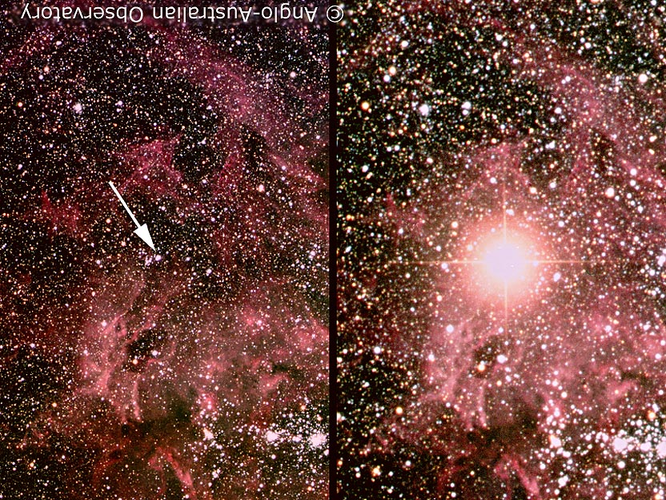
Supernova!
© Anglo-Australian Telescope

Slide 3
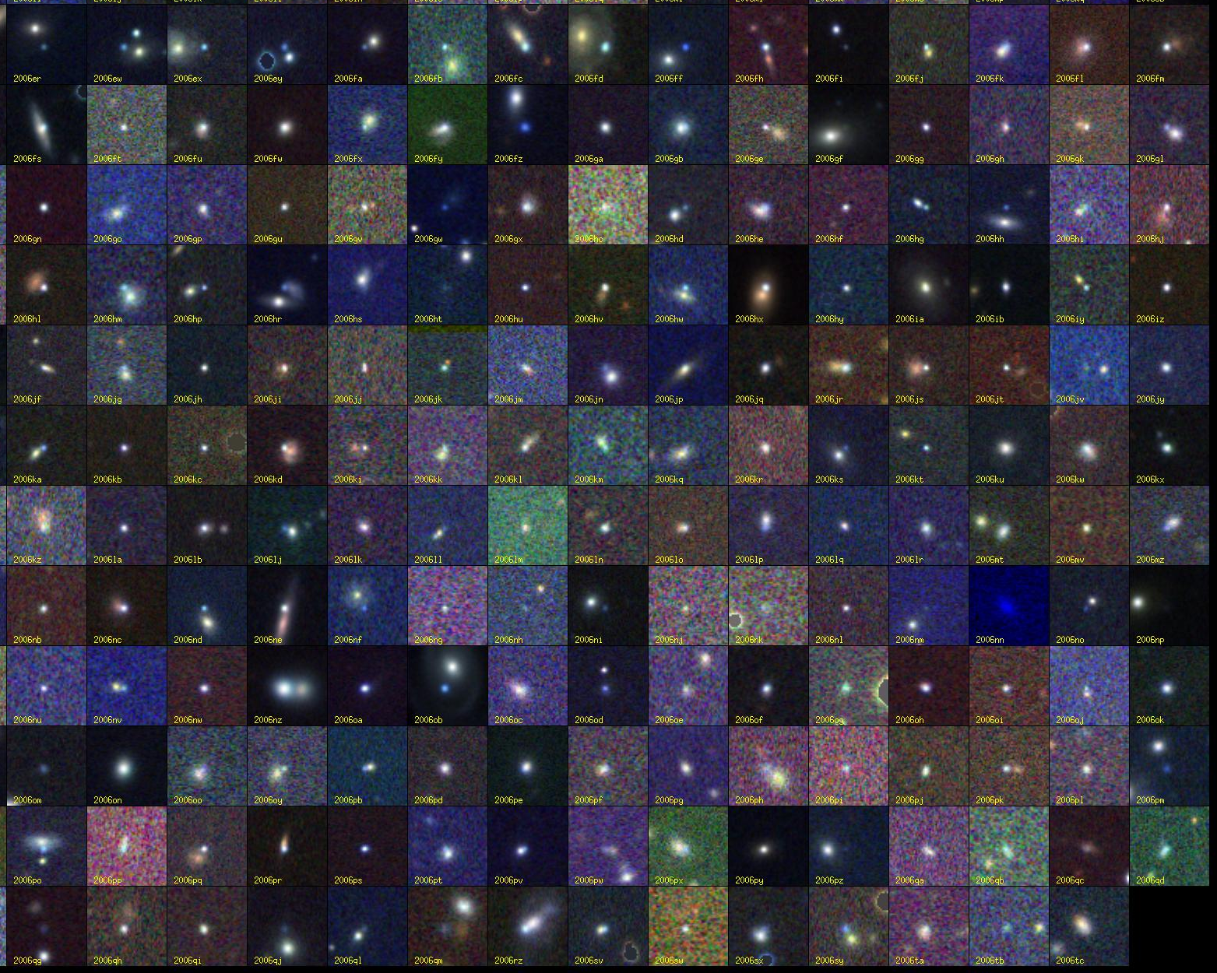
Supernovae!
© SDSSII

Slide 4
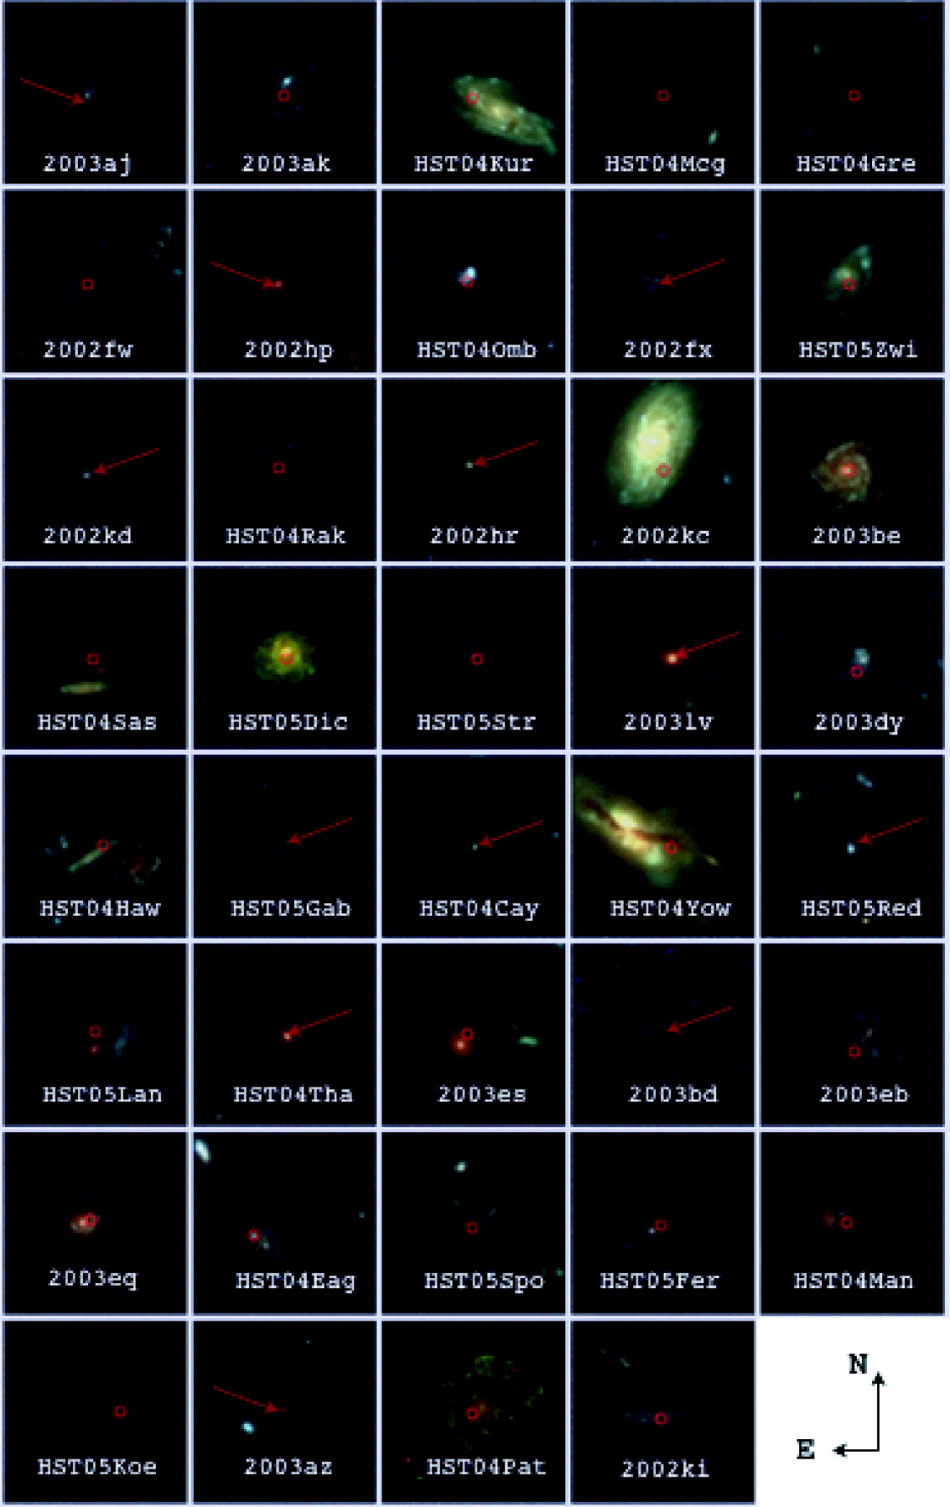
Supernovae!
Riess et al. 2007

Slide 5
What do we want to learn about supernovae?
What explodes?
  progenitors, evolution towards explosion
How does it explode?
  explosion mechanisms
Where does it explode?
  environment (local and global)
  feedback
What does it leave behind?
  remnants
  compact remnants
  chemical enrichment
Other use of the explosions
  light beacons
  distance indicators
  chemical factories

Slide 6
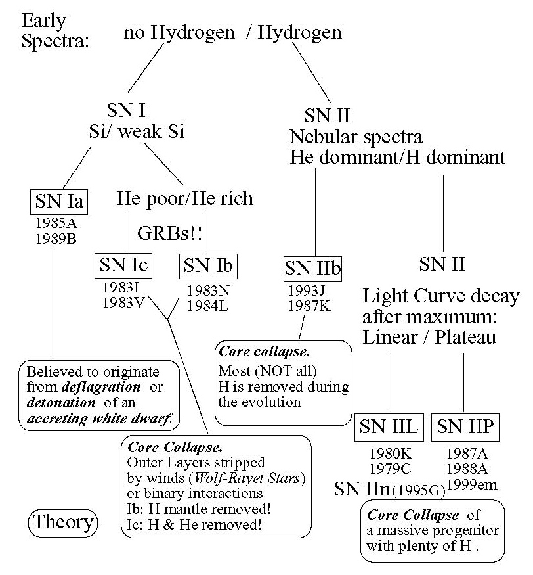
SN Classification

Slide 7
Supernova Types
Thermonuclear SNe
  Progenitor stars have small mass (<8M)
  highly developed stars (white dwarfs)
  Explosive C und O burning
  Binary star systems
  Complete destruction
Core collapse SNe
  Progenitor stars have large mass (>8M)
  large envelope (Fusion still ongoing)
  Burning because of the high density and compression
  Single stars (double stars for SNe Ib/c)
  Neutron star as remnant

Slide 8
Supernova Astrophysics
To measure cosmological parameters (distances) you need to
  understand your source
  understand what can affect the light on its path to the observer (‘foregrounds’)
  know your local environment

Slide 9
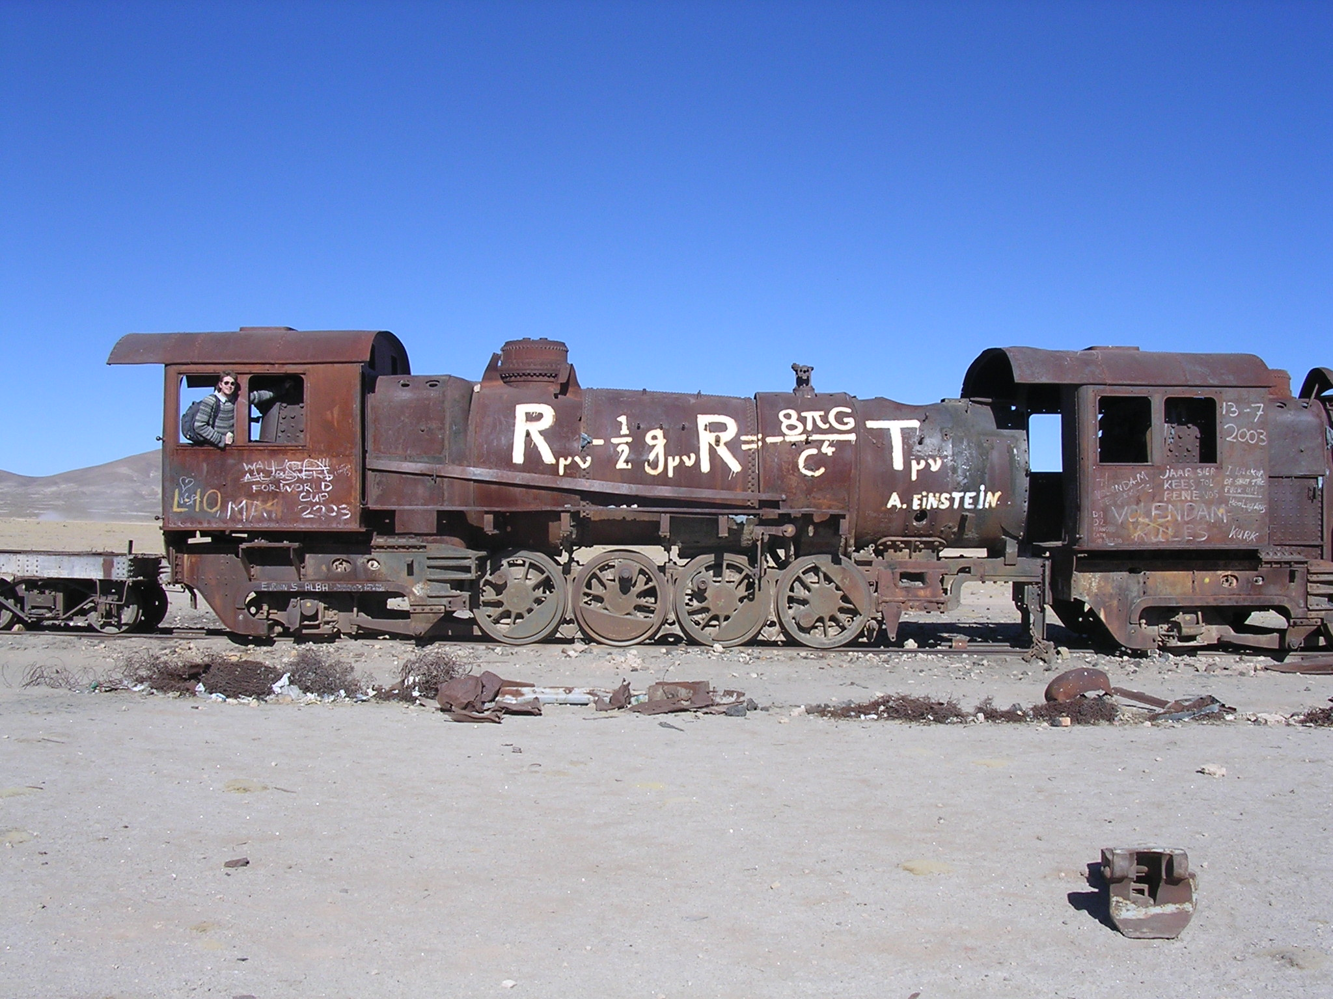
Supernova Cosmology

Slide 10
The expansion of the universe
Luminosity distance in an isotropic, homogeneous universe as a Taylor expansion
Hubble’s Law
deceleration
jerk/equation of state

Slide 11
Friedmann cosmology
Assumption:
homogeneous und isotropic universe
Friedmann-Robertson-Walker-Lemaître metric:
Ω_{M}: matter density
Ω_{k}: curvature
Ω_{Λ}: cosmological constant

Slide 12
Ω=0
Scale factor
‘Mean distance between galaxies’
Ω=1
Ω>1
- 14
- 9
- 7
Time
today
billion years

Slide 13
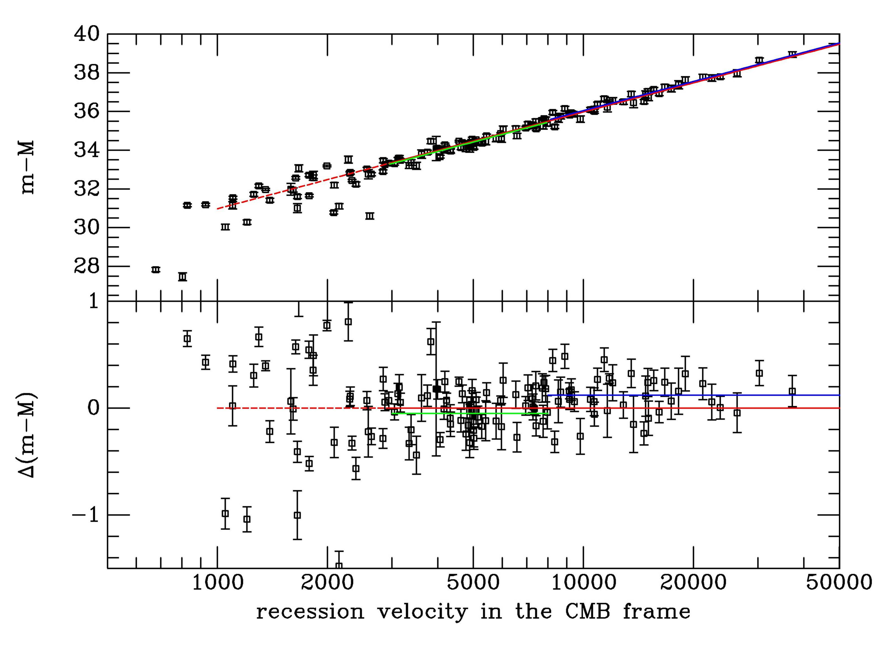
Distance indicator!

Slide 14
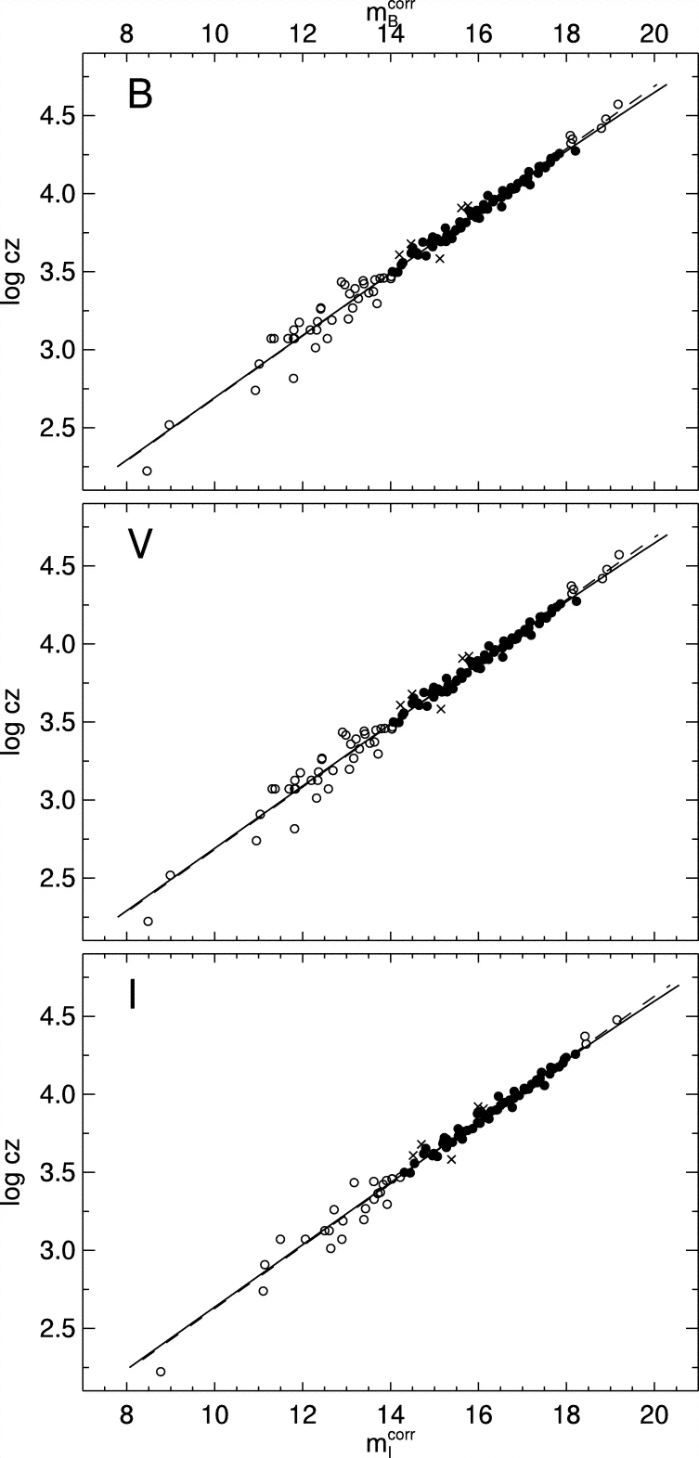
SN Ia Hubble diagram
Excellent distance indicators
Experimentally verified
Work of several decades
Best determination of
the Hubble constant
Reindl et al. 2005

Slide 15
Why no standard candle?
Large variations in
  luminosity
  light curve shapes
  colours
  spectral evolution
  polarimetry
Some clear outliers
  what is a type Ia supernova?
Differences in physical parameters
  Ni mass

Slide 16
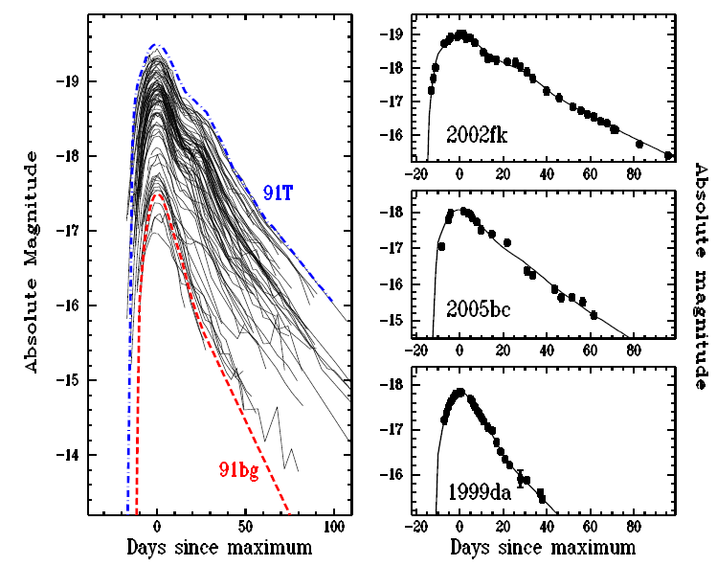
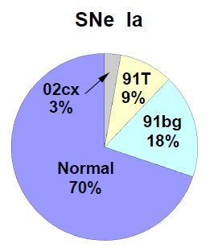
Luminosity distribution
Li et al. 2010

Slide 17
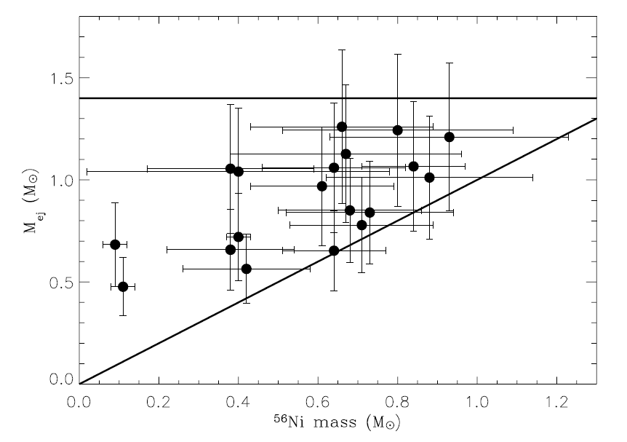
Ejecta masses
Large range in nickel and ejecta masses
  no ejecta mass at 1.4M
  factor of 2 in ejecta masses
  some rather small
  differences
  between
  nickel and ejecta
  mass

Slide 18
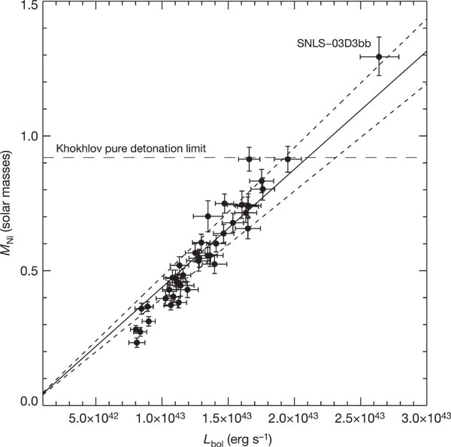
Ejecta masses
Super-Chandrasekhar explosions?
  also
  SN 2006gz, 2007if,
  2009dc
  inferred Ni mass > 1 M
Howell et al. 2006

Slide 19
Type Ia Supernovae
Complicated story
  observational diversity
  many models
  need more constraints

Slide 20
Supernova Cosmology
Required observations
  light curve
  spectroscopic classification
  redshift
Required theory
  cosmological model
  (supernova explosions and light emission)
Required phenomenology
  calibrations (photometric systems)
  normalisations (light curve fitters)

Slide 21
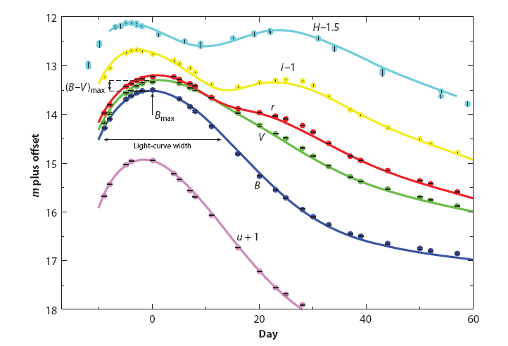
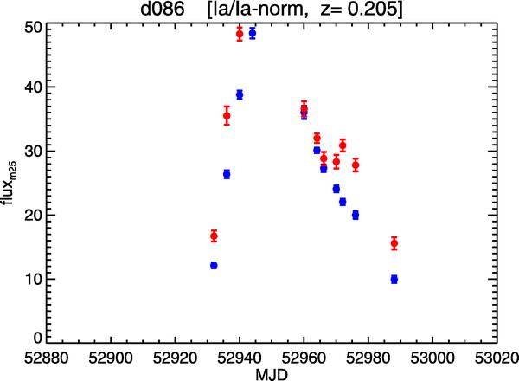
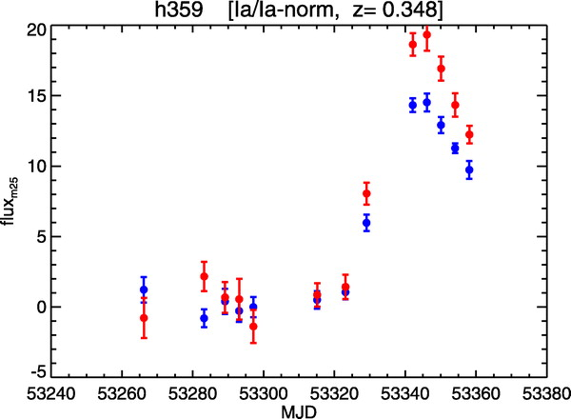
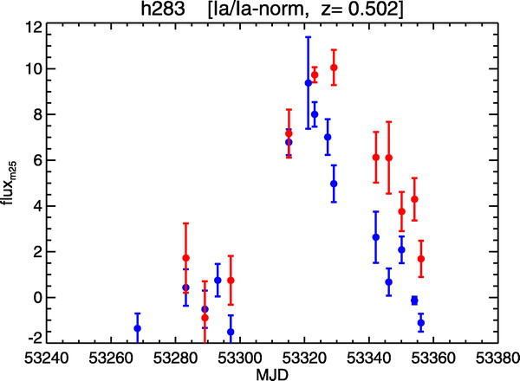
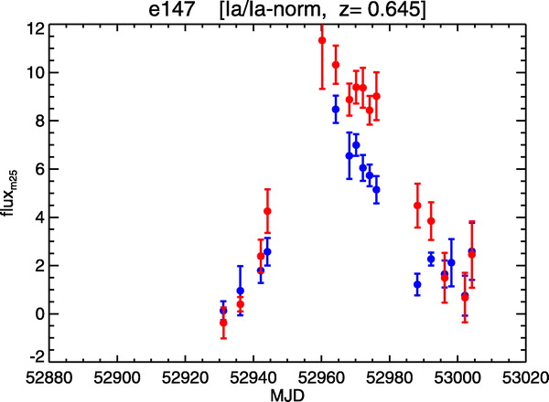
Required observations
Light curves
SN 2007af
Stritzinger et al., in prep
Miknaitis et al. 2007
Miknaitis et al. 2007

Slide 22
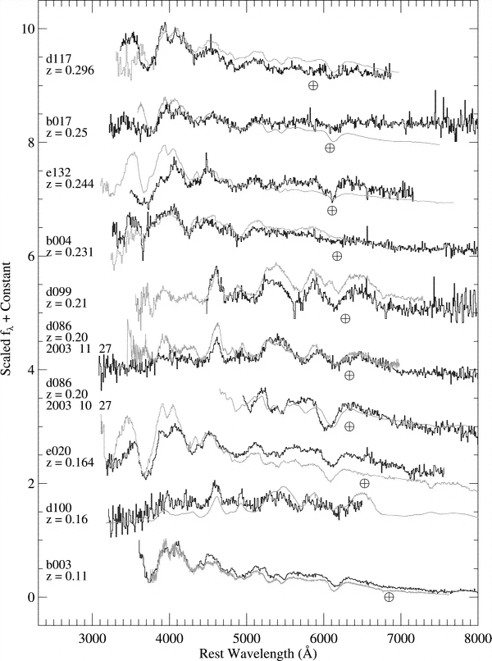
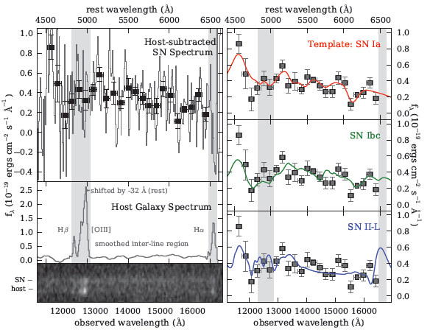
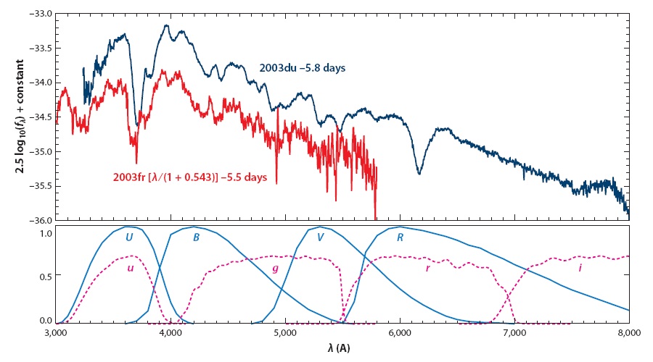
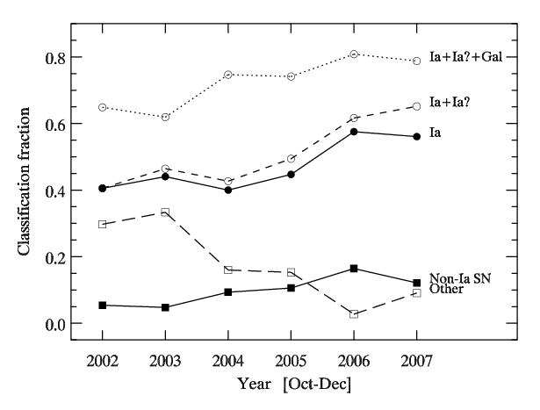
Required observations
Matheson et al. 2007
Spectroscopic
classification
Rodney et al. 2012
Blondin et al., in prep.

Slide 23
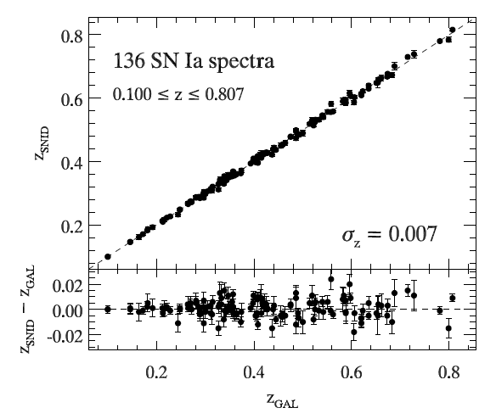
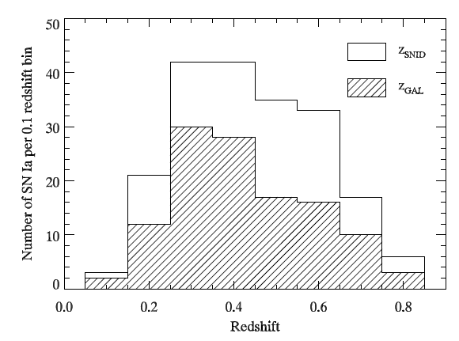
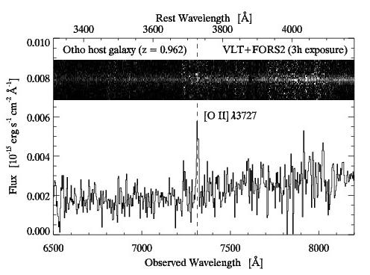
Required observations
Redshifts
Blondin et al., in prep.
Blondin et al., in prep.
Courtesy: Stéphane Blondin

Slide 24
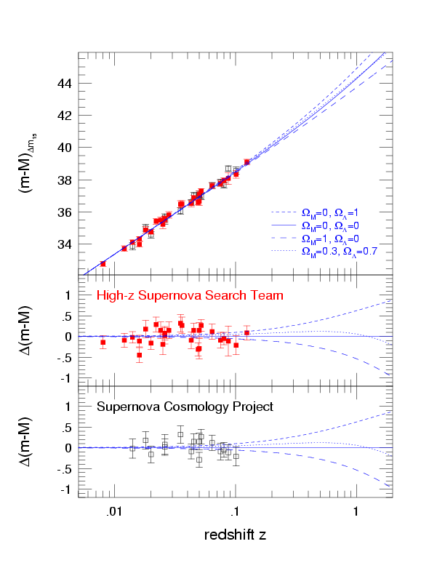
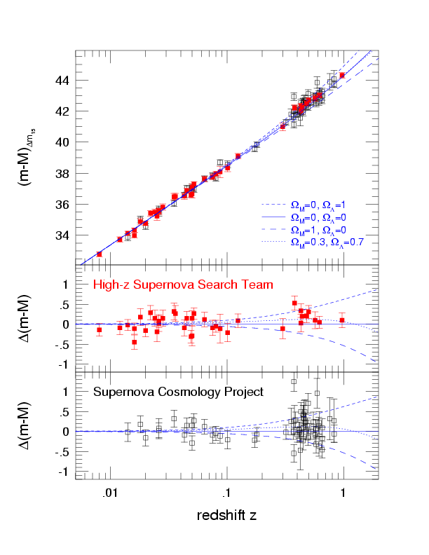
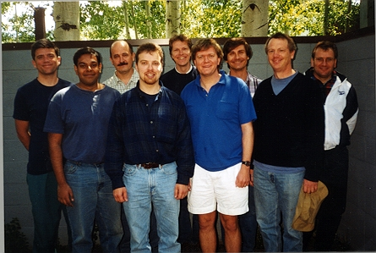
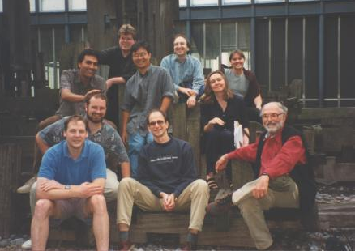
The SN Hubble Diagram

Slide 25
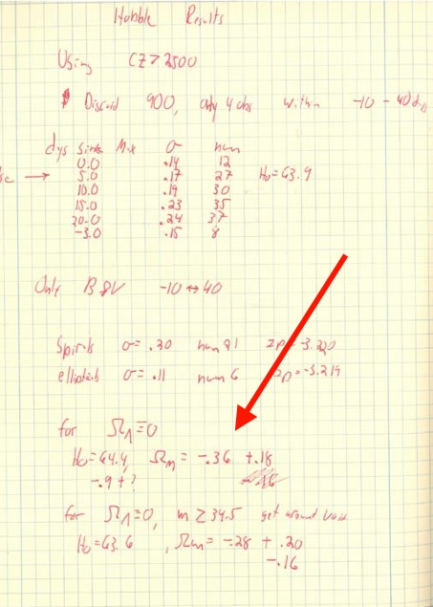
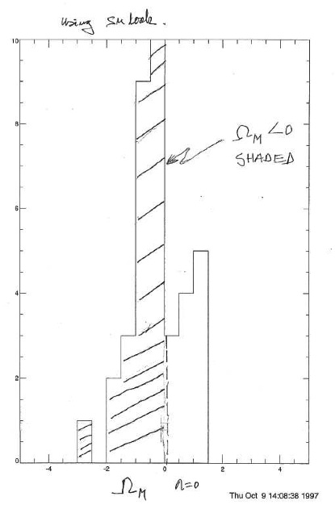
Absurd result
negative matter density
Riess
Goldhaber

Slide 26
If the observational evidence upon which these claims are based are reinforced by future experiments, the implications for cosmology will be incredible.
Preprint August 1999

Slide 27
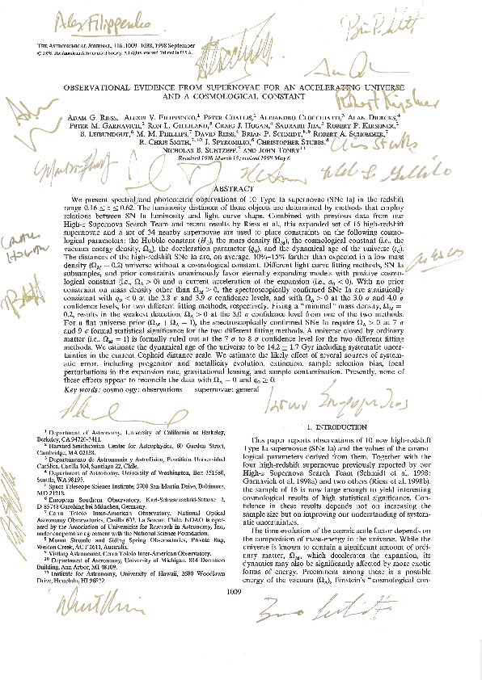
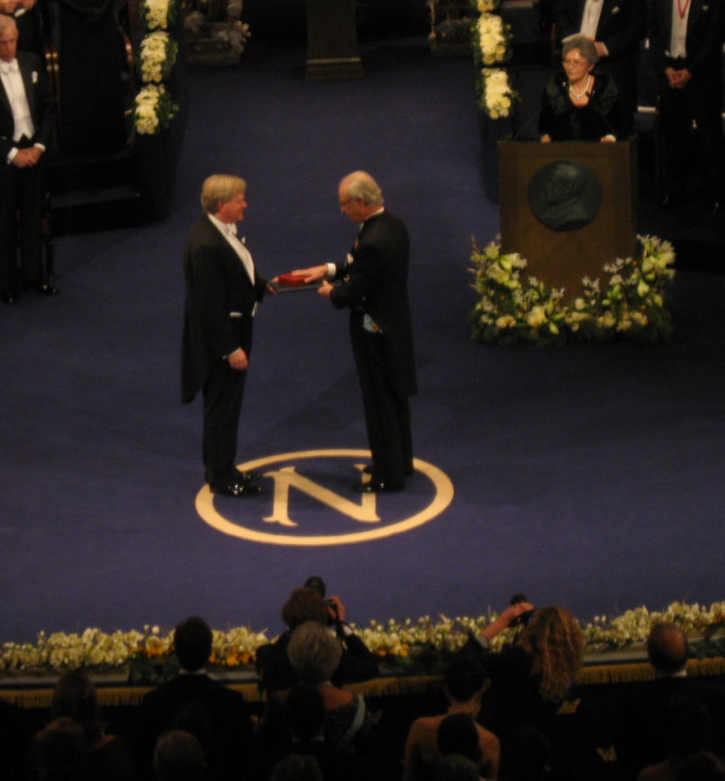
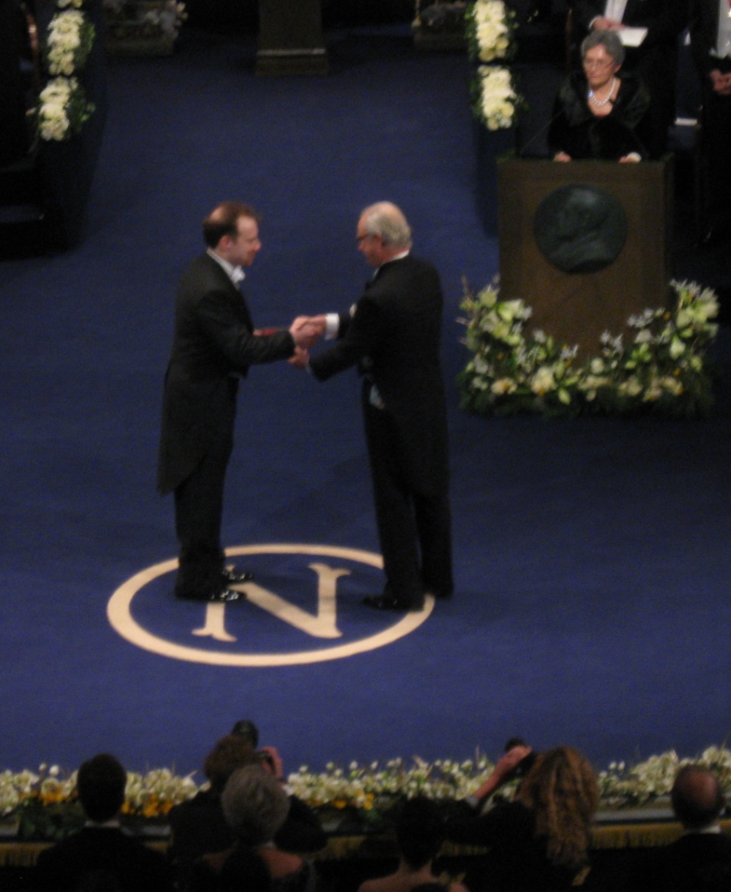
... and the consequences

Slide 28
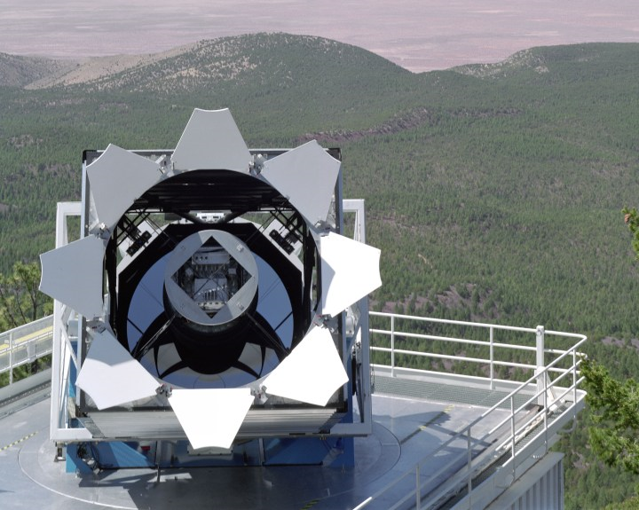
SDSS-II Supernova Search
World-wide collaboration to find and characterise SNe Ia with 0.04 < z < 0.4
Search with Sloan 2.5m telescope
Spectroscopy with HET, ARC, Subaru, MDM, WHT, Keck, NTT
Goal: Measure distances to 500 SNe Ia to bridge the intermediate redshift gap

Slide 29
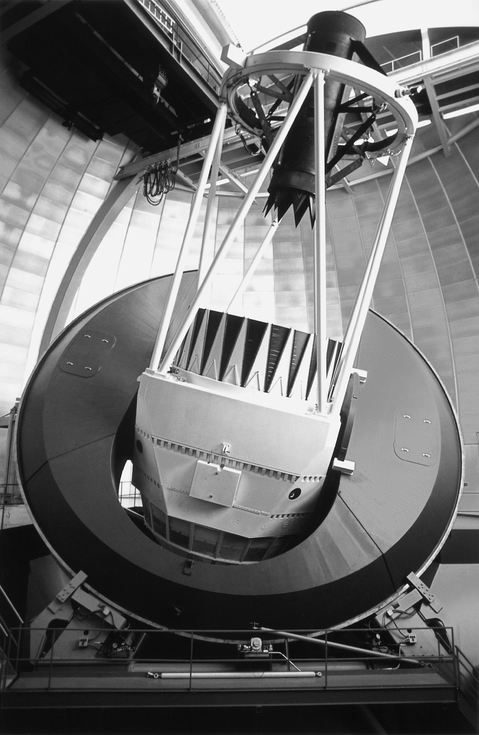
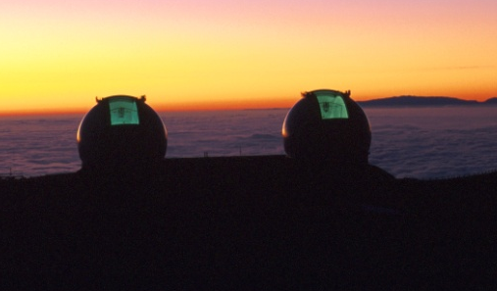
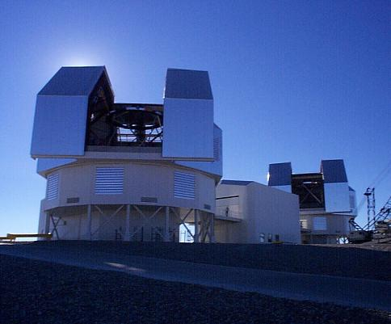
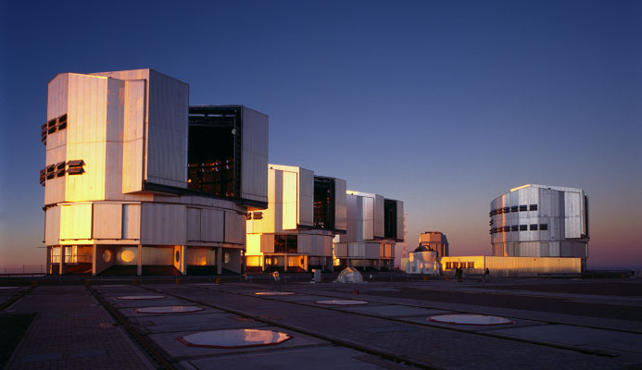
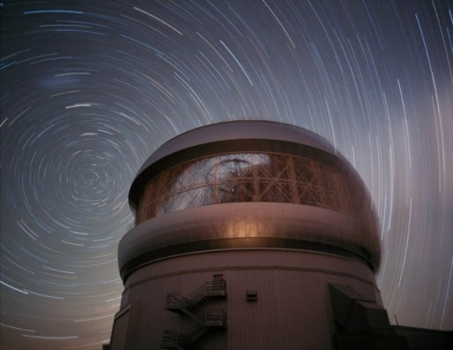
ESSENCE
World-wide collaboration to find and characterise SNe Ia with 0.2 < z < 0.8
Search with CTIO 4m Blanco telescope
Spectroscopy with VLT, Gemini, Keck, Magellan
Goal: Measure distances to 200 SNe Ia with an overall accuracy of 5%
→ determine ω to 10% overall

Slide 30
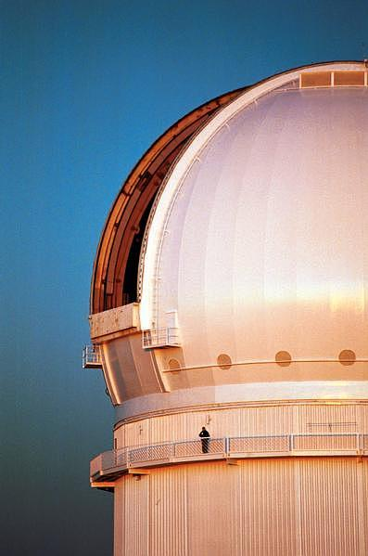
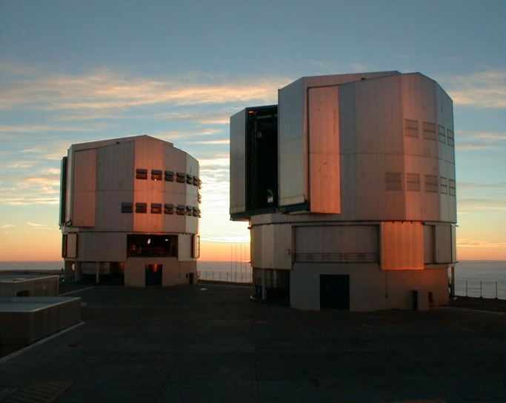
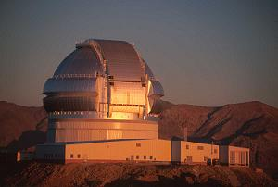
SNLS – The SuperNova Legacy Survey
World-wide collaboration to find and characterise SNe Ia with 0.2 < z < 0.8
Search with CFHT 4m telescope
Spectroscopy with VLT, Gemini, Keck, Magellan
Goal: Measure distances to 700 SNe Ia with an overall accuracy of 5%
→ determine ω to 7% overall

Slide 31
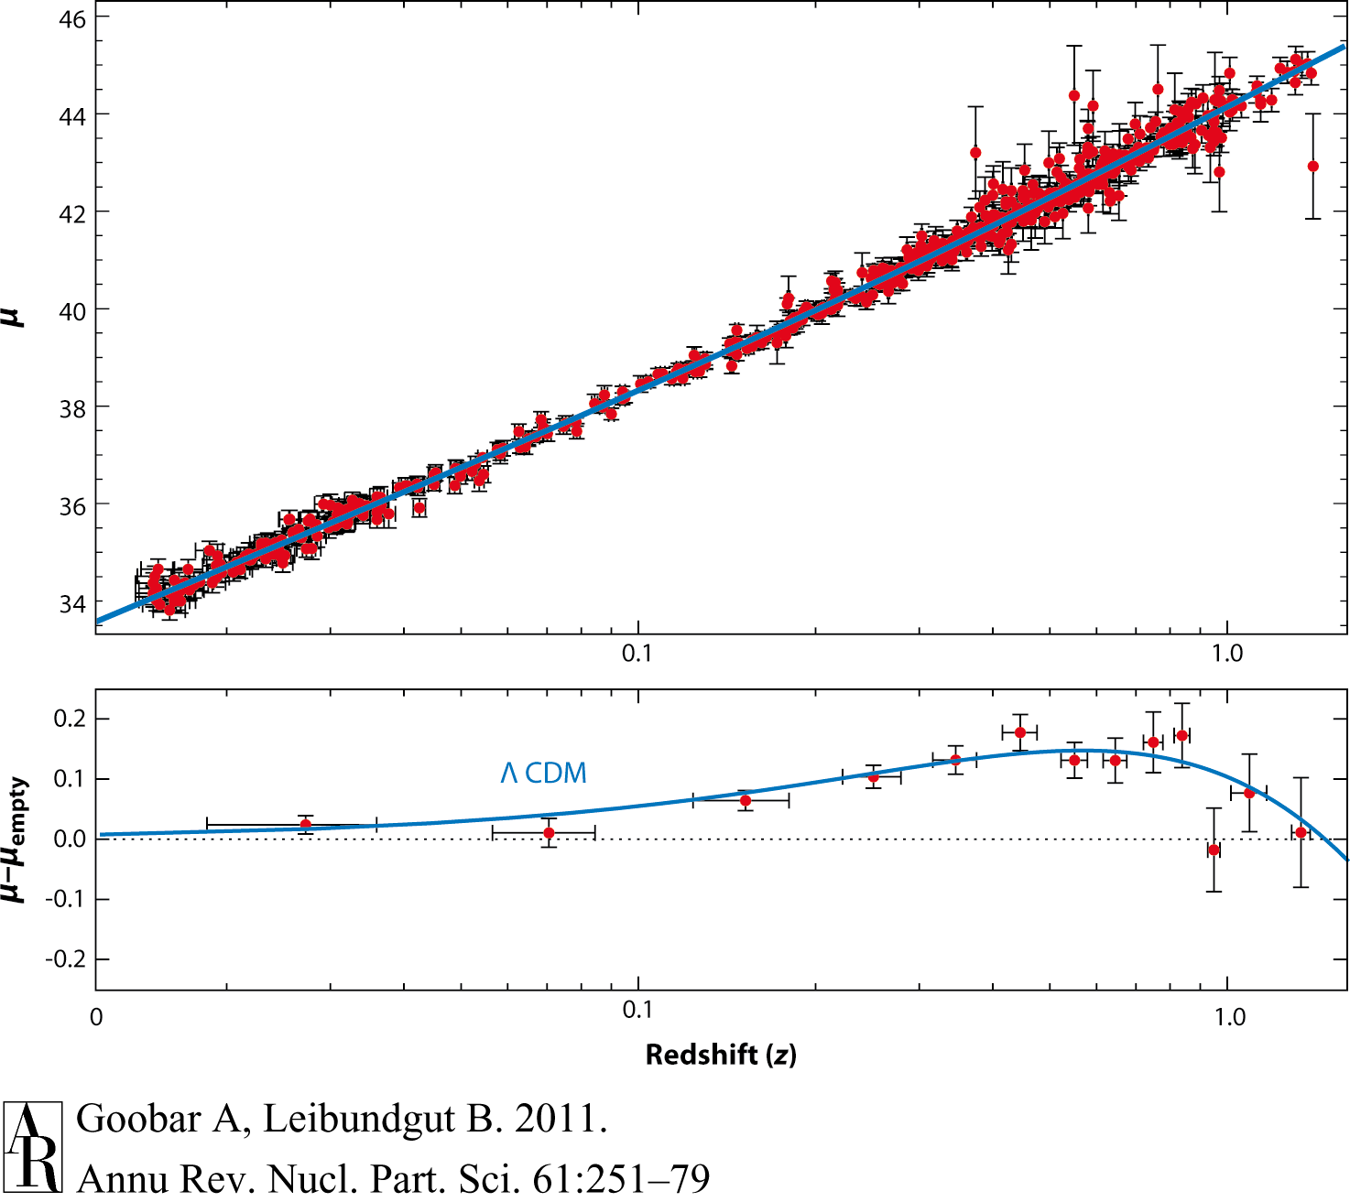
Supernova Cosmology 2011
Goobar & Leibundgut 2011
560 SNe Ia

Slide 32
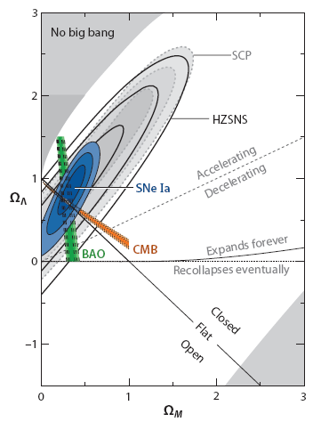
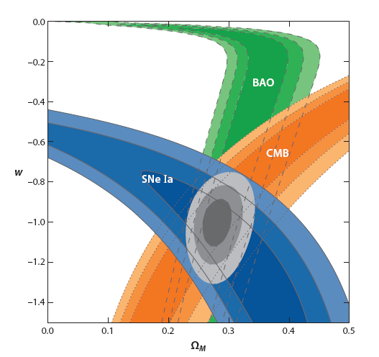
et voilà ...
10 years of progress
Goobar & Leibundgut 2011

Slide 33

Supernova cosmology
ω firmly established
  general agreement between different experiments
N_{SN} | Ω_{M}(flat) | w (constant, flat) | Light curve fitter | Reference
115 |  |  | SALT | Astier et al. 2006
162 |  |  | MLCS2k2 | Wood-Vasey et al. 2007
178 |  |  | SALT2
288 |  |  | MLCS2k2 | Kessler et al. 2009
288 |  |  | SALT2
557 |  |  | SALT2 | Amanullah et al. 2010
472 |  |  | SiFTO/SALT2 | Conley et al. 2011
580 |  |  | SALT2 | Suzuki et al. 2011

Slide 34
Systematics
“[T]he length of the list indicates the maturity of the field, and is the result of more than a decade of careful study.”
Contamination
Photometry
K-corrections
Malmquist bias
Normalisation
Evolution
Absorption
Local expansion field

Slide 35
Systematics
Current questions
  calibration
  restframe UV flux
    redshifted into the observable window
  reddening and absorption
    detect absorption
      through colours or spectroscopic indicators
    correct for absorption
      knowledge of absorption law
  light curve fitters
  selection bias
    sampling of different populations
  gravitational lensing
  brightness evolution

Slide 36
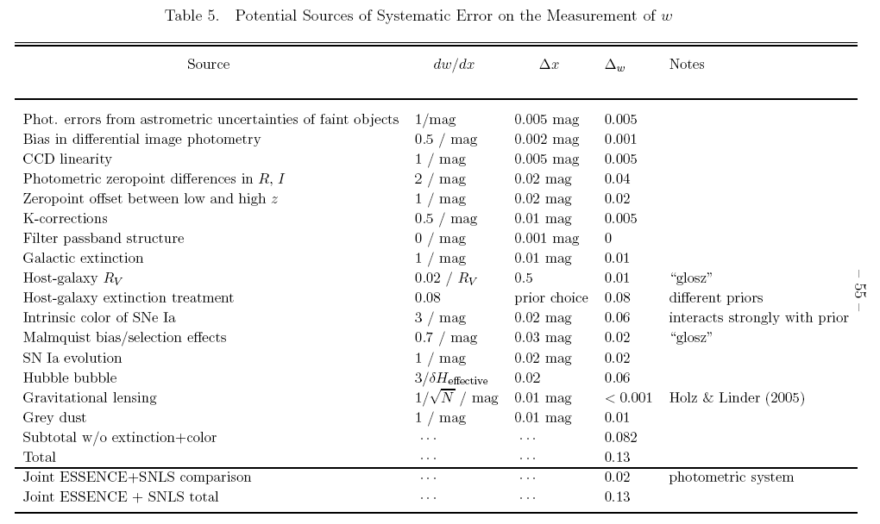
Systematics table
Wood-Vasey et al. 2007

Slide 37
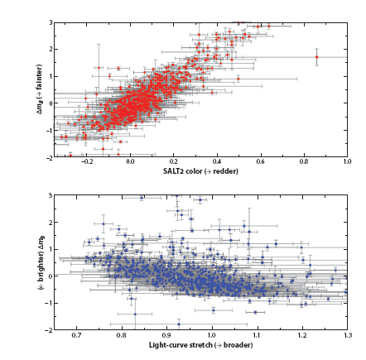
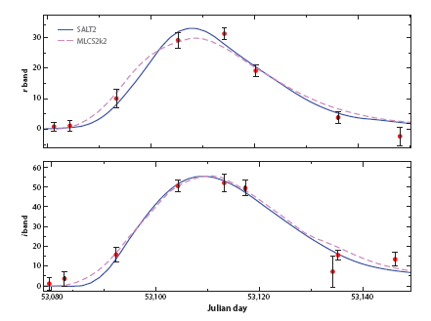
Required phenomenology
photometric calibration
normalisation
  (“standardizable
  candle”;
  “standard crayon”)
  different light curve
  fitters
    Δm₁₅,SALT, SiFTO,
    MLCS
Goobar & Leibundgut 2011
SNLS SN04D2gp
z=0.732

Slide 38
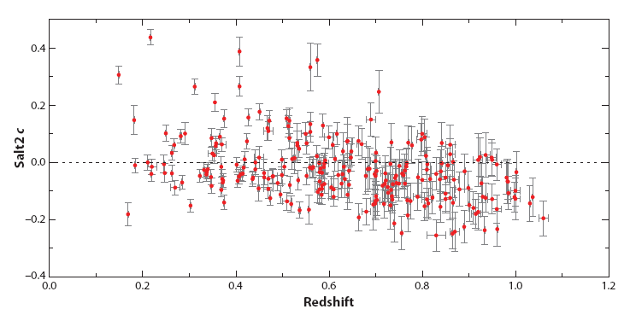
Required phenomenology
Checks
  selection effects? evolution?
Goobar & Leibundgut 2011

Slide 39
What next?
Already in hand
  >1000 SNe Ia for cosmology
  constant ω determined to 5%
  accuracy dominated by systematic effects
Missing
  good data at z>1
    light curves and spectra
  good infrared data at z>0.5
    cover the restframe B and V filters
    move towards longer wavelengths to reduce absorption effects
  I-band Hubble diagram
    Freedman et al.
    Nobili et al.

Slide 40
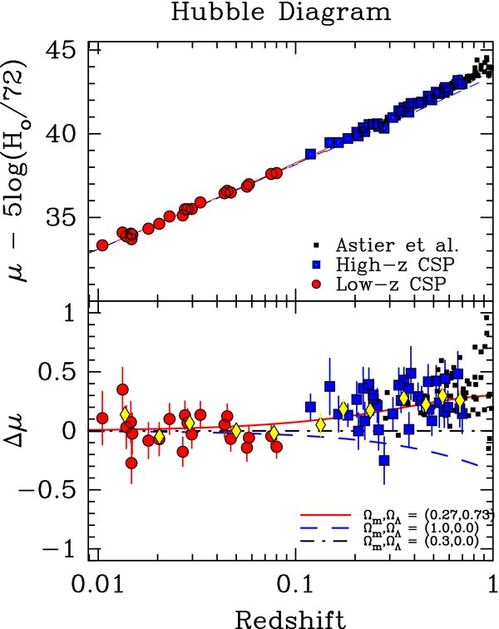
I-band Hubble diagram
Freedman et al. 2009
Currently only 35 SNe Ia
Goobar & Leibundgut 2011
560 SNe Ia

Slide 41
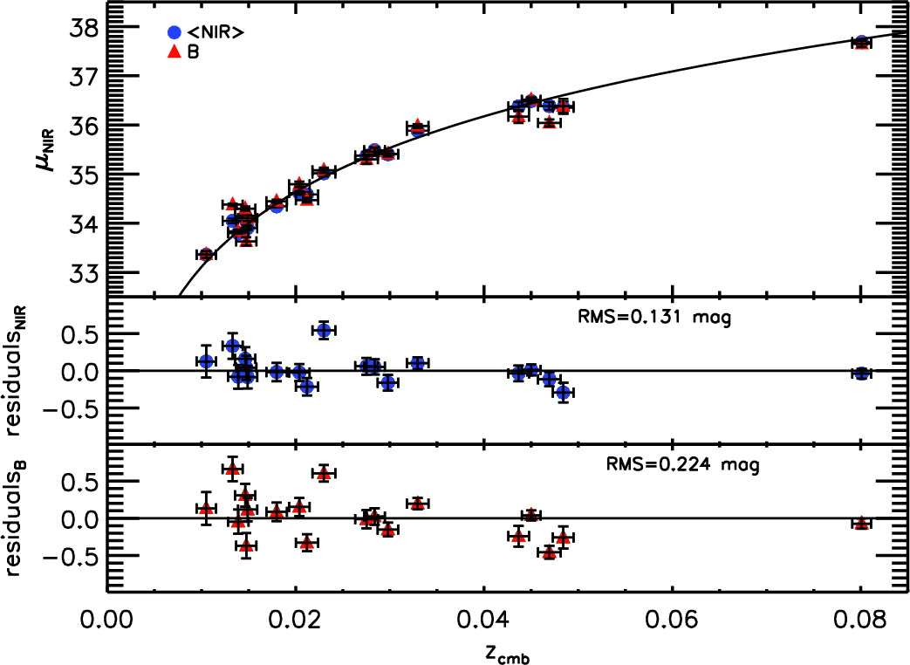

J- and H-band Hubble diagrams
(YJH)
Kattner et al. 2012
Barone-Nugent et al. 2012

Slide 42
Supernova Cosmology – do we need more?
Test for variable ω
  required accuracy ~2% in individual distances
  can SNe Ia provide this?
    can the systematics be reduced to this level?
    homogeneous photometry?
    further parameters (e.g. host galaxy metalicity)
    handle >100000 SNe Ia per year?
Euclid
  3000 SNe Ia to z<1.2 with IR light curves (deep fields) → I-band Hubble diagram
  16000 SNe discovered

Slide 43

Cosmology – more?
Goobar & Leibundgut 2011
(courtesy E. Linder and J. Johansson)

Slide 44


Distant SNe with
CANDELS and CLASH
Multi-cycle HST Treasury Programs
PIs: S. Faber/H. Fergusson
PI: M. Postman
HST MCT SN Survey
PI: A. Riess
SN discoveries and target-of-opportunity follow-up
SNe Ia out to z≈2
Determine the SN rate at z>1 and
constrain the progenitor systems

Slide 45
SNe Ia at high redshifts (z>1.5)
ratio (Ω_{DE}/Ω_{M})₀=2.7; (Ω_{DE}/Ω_{M})_{z=1.5}=0.173
with w₀=-1±0.2 and w_{a}=-1±1; w=w₀+w_{a}(1-a)
within these uncertainties the observed magnitudes change less than 0.1m
  direct test for evolution!
at z>1.5 age of the universe is <4Gyr
  low-mass stars are still on the main sequence
  SN Ia progenitors from more massive progenitor stars
  constrain progenitor models of SNe Ia

Slide 46


SN rates and what they can tell us
Steve Rodney; MCT SN Survey
Graur et al. 2011

Slide 47

SNe at z>1
Jones et al. 2013

Slide 48

Discovery
Rodney et al. 2012

Slide 49




4 arguments for a SN Ia @ z=1.55
  color and host galaxy photo-z
  host galaxy spectroscopy
  light curve consistent with
  normal SN Ia at z=1.55
  SN spectrum consistent

Slide 50

SNe Ia at z>1
SN Ia at z=1.91
SN UDS10Wil
Jones et al. 2013

Slide 51

SN UDS10Wil at z=1.91

Slide 52

Where are we …
SN Factory
Carnegie SN Project
SDSSII
ESSENCE
CFHT Legacy Survey
Higher-z SN Search
(GOODS)
Euclid/WFIRST/LSST
Plus the local searches:
LOTOSS, CfA, ESC

Slide 53
Tasks for the coming years
Concentrate on wavelengths not covered so far
  particular IR is interesting
    reduced effect of reddening
    better behaviour of SNe Ia(?)
Understand the SN zoo
  many (subtle?) differences observed in recent samples (PanSTARRS and PTF)
    subluminous and superluminous
  understand potential evolutionary effects
    spectroscopy important → public spectroscopic survey
    Dark Energy Survey?, Large Synoptic Survey Telescope?, Euclid follow-up?

