Slide 1
Supernova Explosions and
Neutron Stars
Bruno Leibundgut
(ESO)

Slide 2
What do we want to learn about supernovae?
What explodes?
  progenitors, evolution towards explosion
How does it explode?
  explosion mechanisms
Where does it explode?
  environment
    local and global
  feedback
What is left behind?
  remnants
  compact remnants
  chemical enrichment
Other uses of the explosions
  light beacons
  distance indicators
  chemical factories
Notes:
http://cdli.ucla.edu/search/archival_view.php?ObjectID=P211847

Slide 3
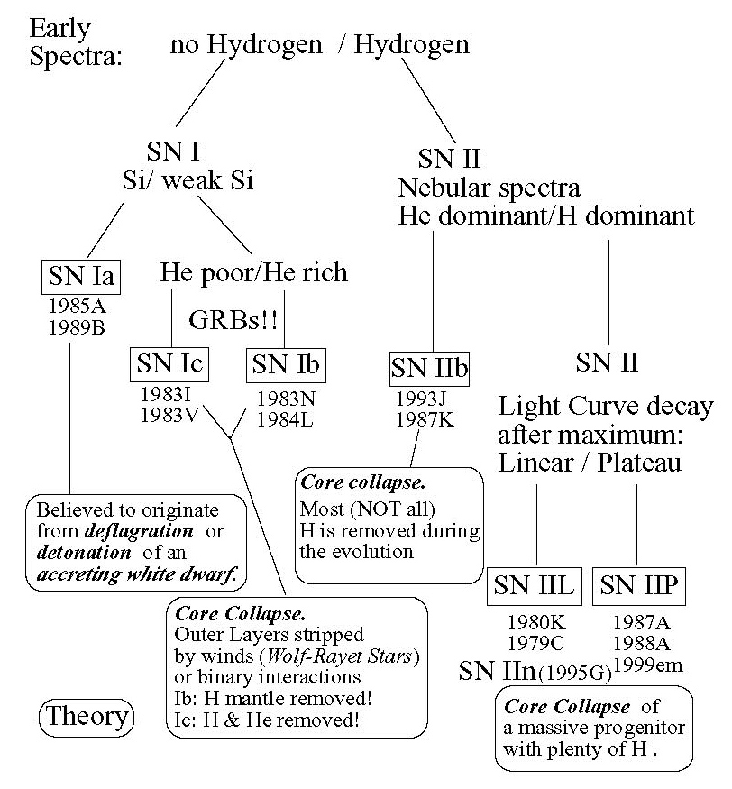
SN Classification

Slide 4
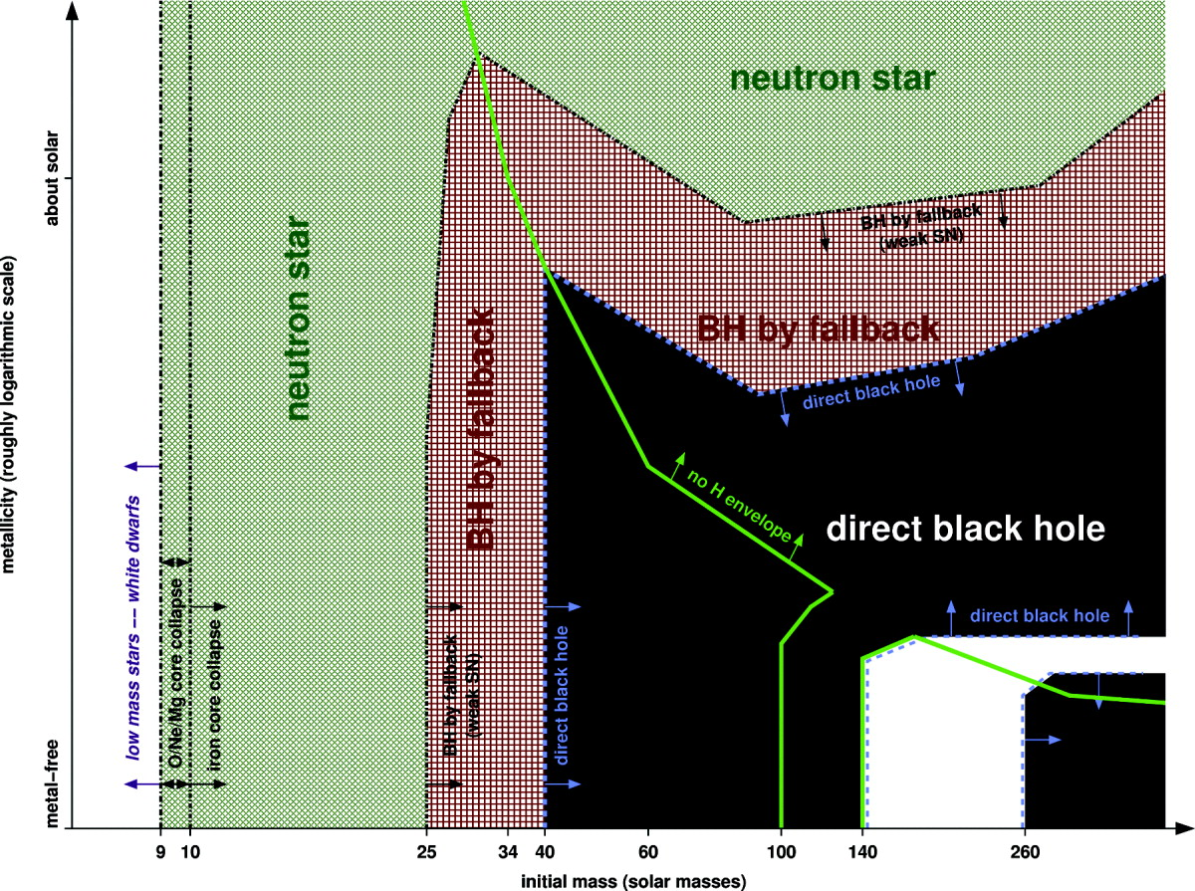
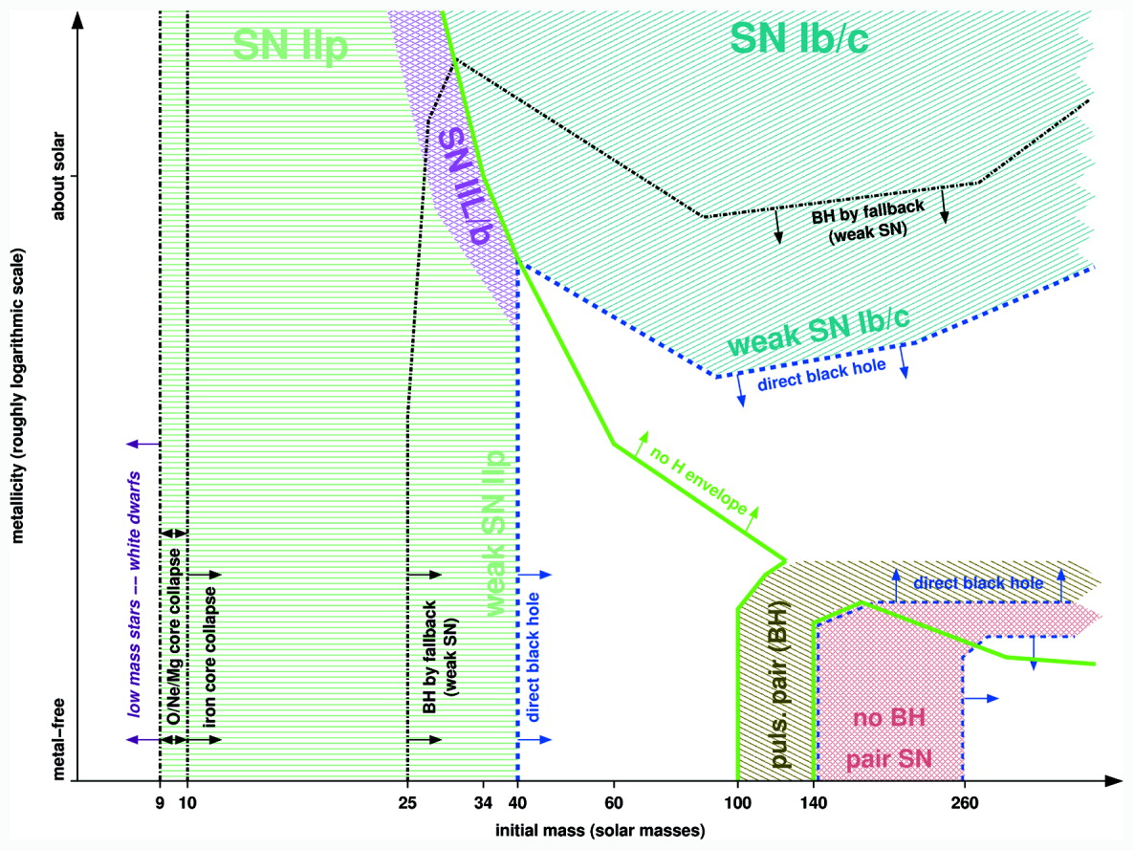
The expectations …
Heger et al. 2003

Slide 5
Difficulties
Supernovae are bright (~10⁴³ erg/s at peak)
Neutron stars (thermal energy typically ~10³⁵ erg/s) are buried near the centre of the explosions
  need to wait until the envelope becomes transparent → can be decades
Supernovae are rare
Supernovae are complicated
  complicated explosion physics
    hydrodynamics, neutrino physics, GR effects
    many unknown parameters
    not enough observational constraints
Abdo et al. (2013)

Slide 6
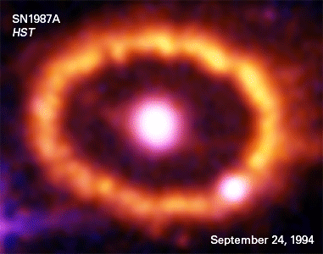
Energy escape from a (core-collapse) supernova
SN 1987A
the best observed supernova ever
Suntzeff (2003)
(also Fransson et al. 2007)

Slide 7
Detecting neutron stars in SNe
Wait until remnant phase
  patience → SN 1987A, Cas A, Crab
Look for signatures in explosion
  magnetar SNe?
Trust explosion models
  still many fundamental uncertainties
Search for ensemble properties
  neutron star kicks

Slide 8
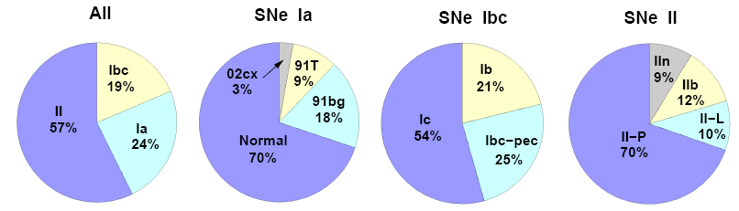
Lick Observatory Supernova Search
Volume-limited sample in the local universe (out to 60 Mpc)
Leaman et al. 2010; Li et al. 2010
Notes:
Pie chart from Li et al. (second LOSS paper) for SNe within 60 Mpc

Slide 9
Type II SNe –
Variable appearance
Anderson et al. (2014)

Slide 10
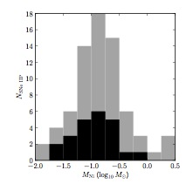
Very different explosions
Yet similar neutrons stars?
76 SNe II from PanSTARRS-1
Sanders et al. (2014)
Notes:
only black histogram is based on real observations of the radioactive tale

Slide 11
Superluminous SNe
Very energetic explosions with >10⁴⁴ erg/s at peak
Ideas:
pair-instability SNe
circumstellar interaction
massive winds
‘bloated stars’
‘internal engine’
Gal-Yam (2011)

Slide 12
Magnetar-driven SNe
Highly magnetic neutron star with high initial spin period
  B≥10¹⁴ G
  P_{i}= 2-20 ms
  energy release
  over days to
  weeks
  Kasen & Bildsten (2010)
  Woosley (2010)
  Dessart et al. (2012)
  Inserra et al. (2013)
Kasen & Bildsten (2010)

Slide 13
Determine the neutron star parameters
Kasen & Bildsten (2010)
Notes:
Figure 4. Dependence of Lpeak and tpeak on the initial magnetar spin and B field. The solid lines are for fixed B14 = 100, 30, 10, 3, 1, 0.3, and 0.1 and varying spin period, whereas the dashed lines are for a fixed P_{i} = 1, 3, 10, and 30 ms and varying B. This calculation assumed E_{sn} = 10⁵¹ ergs and M_{ej} = 5 M⊙ .

Slide 14
Further evidence
Fast rise
blue colours
high temperatures
Nicholl et al. (2013)

Slide 15
Neutron star “tug boat”
Asymmetries in explosion models
  convection
    → standing accretion shock instability
  neutrino convection
    momentum transfer onto neutron star
  density differences
    “tug boat effect”
Janka (2013)
Wongwathanarat et al. (2013)
Notes:
Fig. 2. Entropy-isosurfaces (left) of the SN shock (grey) and of the high-entropy bubbles (green), and entropy distribution in a cross-sectional plane (right) at t = 140, 248, 515 ms, and 1.3 s for model W15-2. The viewing direction is normal to the xz-plane. Length scales are given by the yardsticks below each image. Small Rayleigh-Taylor mushrooms start growing at ∼100 ms (top panels). The rising high-entropy bubbles merge and rearrange to form larger bubbles by the time the explosion sets in (second from top). The NS starts accelerating due to the asymmetric distribution of the ejecta, the acceleration reaching its maximum at ∼500 ms (third from top). At this epoch, the ejecta show a clear dipolar distribution with more dense, low-entropy material concentrated in the hemisphere containing the kick direction. The final NS kick direction has already found its orientation, and its projection onto the xz-plane is shown by the white arrows pointing to the lower right direction. The bottom panels show the entropy structure when the essentially spherically symmetric neutrino-driven wind has developed, visible as the green central region enclosed by the highly aspherical wind-termination shock (lower right panel).

Slide 16
Dependence on Ni distribution
Wongwathanarat et al. (2013)
Notes:
Fig. 15. Volumetric three-dimensional visualization of the nickel distribution for models W15-1, W15-2, L15-1, and L15-2 at the postbounce time given in the top left corner of each panel along with the model name. The semi-transparent isosurfaces correspond to a chosen value of the nickel mass per grid cell of 3 × 1026 g and are displayed at a stage well after all nucleosynthesis processes have seized in our simulations. The orange vectors represent the NS kick directions and are scaled by the corresponding NS velocities (96 km s−1 for the shortest arrow and 575 km s−1 for the longest one). The high-kick models W15-1 and W15-2 in the upper two panels exhibit a clear asymmetry with much more nickel being ejected in the hemisphere opposite to the kick direction. In contrast, the moderate-kick models L15-1 and L15-2 in the lower two panels exhibit a more isotropic distribution of the nickel, in particular no obvious hemispheric asymmetry between kick and anti-kick directions. While the radial distribution of the nickel may be strongly affected and changed by subsequent mixing instabilities that develop after the outgoing shock has passed the composition-shell interfaces of the progenitor star, the hemispheric differences in the nickel ejection will not be destroyed during the later supernova explosion.

Slide 17
Is this observed?
Resolved ejecta observations so far limited
  SN 1987A
Ni (Fe) distribution in SN remnants often difficult
  stable Fe
  pre-explosion Fe
Other elements more easily accessible

Slide 18
Cassiopeia A
Asymmetry in ejecta
  ⁴⁴Ti distributed
  differently from
  Si and Mg
  ‘opposite’ to the
  motion of the
  compact object
⁴⁴Ti
Si/Mg
Grefenstette et al. (2014)
Notes:
Figure 2 | A comparison of the spatial distribution of the 44Ti with the known jet structure in Cas A. The image is oriented in standard astronomical coordinates as shown by the compass in the lower left and spans just over 59 on a side. The 44Ti observed by NuSTAR is shown in blue, where the data have been smoothed using a top-hat function with a radius shown in the lower right (dashed circle). The 44Ti is clearly resolved into distinct knots and is non- uniformly distributed and almost entirely contained within the central 10099 (Methods and Extended Data Fig. 2). Shown for context in green is the Chandra ratio image of the Si/Mg band (data courtesy of NASA/CXC; Si/Mg ratio image courtesy of J. Vink), which highlights the jet–counterjet structure, the centre of the expansion of the explosion2 (yellow cross) and the direction of motion of the compact object (white arrow). In contrast to the bipolar feature seen in the spatial distribution of Si ejecta, which argues for fast rotation or a jet-like explosion, the distribution of 44Ti is much less elongated and contains knots of emission away from the jet axis. A reason for this may be that the Si originates in the outer stellar layers and is probably highly influenced by asymmetries in the circumstellar medium, unlike the 44Ti, which is produced in the innermost layers near the collapsing core.

Slide 19
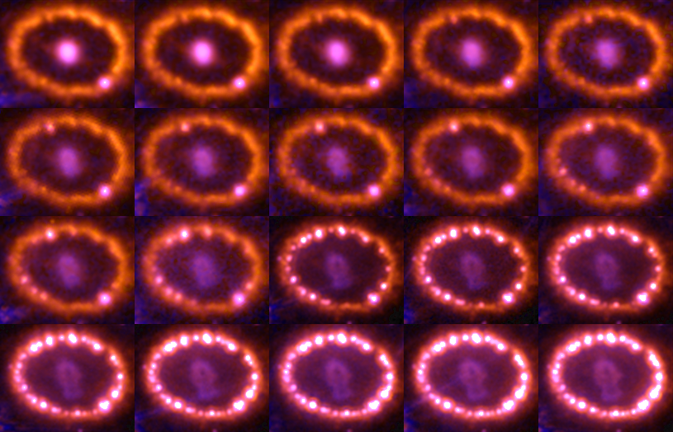
SN 1987A evolution
(1994-2010)

Slide 20
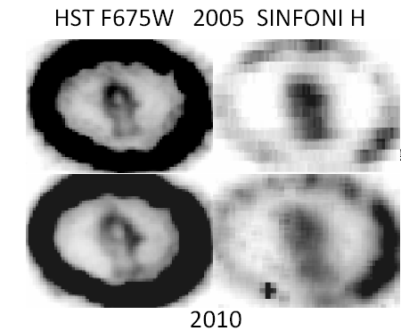
The inner ejecta
Comparison optical vs. IR
  optical
    heated by X-rays
  IR
    radioactive heating

Slide 21
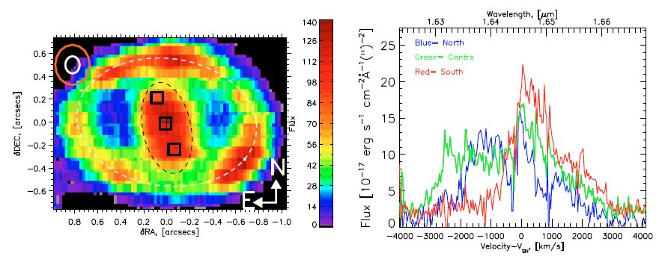
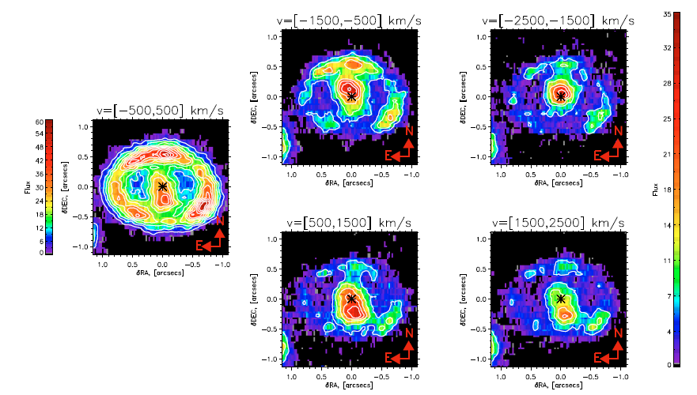
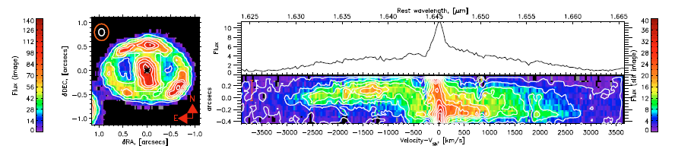
Asymmetry in the ejecta
[Si I] +[Fe II]
[Si I] +[Fe II]
1.64 μm

Slide 22
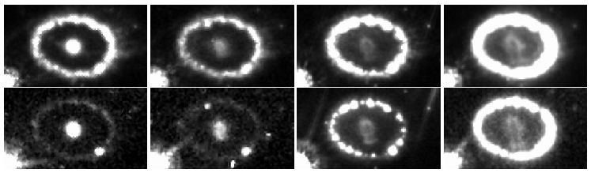
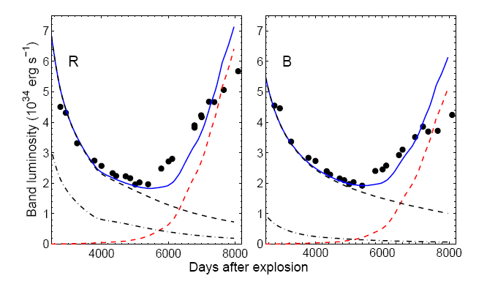
The next surprise
X-raying the ejecta of SN 1987A
  flux of the inner
  ejecta has increased
  again (starting at
  about 13.5 years)
  sign of additional
  energy input
1994
1999
2003
2009
R
B
Larsson et al. 2011

Slide 23
What’s happening?
The outer ejecta has reached the equatorial ring and creates shocks in the dense material
X-rays are emitted in all directions
  heat the inner ejecta
Other possibilities excluded
  reverse shock in HII region → no increase in (broad) Lyα or Hα observed
  pulsar → no trace so far (e.g. in radio or X-rays)
  transition from optically thick to optically thin dust → unlikely to occur at this point

Slide 24
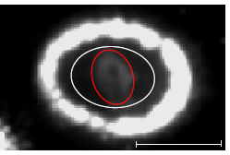
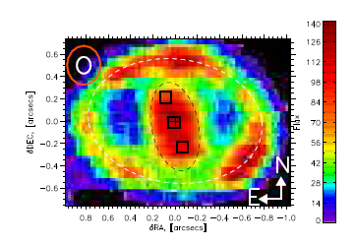
Transition to SN remnant
SN 1987A no longer powered by radioactive decays, but the kinetic energy from the shocks
Heating on the outskirts
→ shell-like structure
Different from the Fe-core
still heated by ⁴⁴Ti
  Kjær et al. 2010;
  SINFONI observations

Slide 25
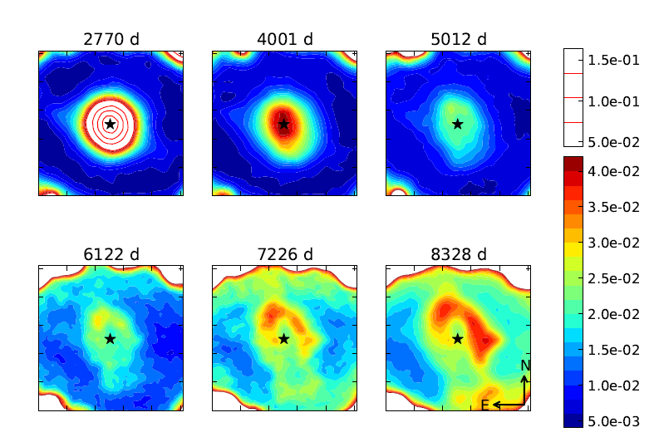
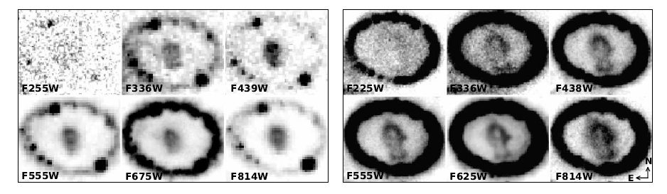
Evolution of the inner ejecta
1994
1998
2000
Clear change in morphology at optical wavelengths
2003
2006
2009
Larsson et al. 2013
13 Nov 2000
12 Dec 2009

Slide 26
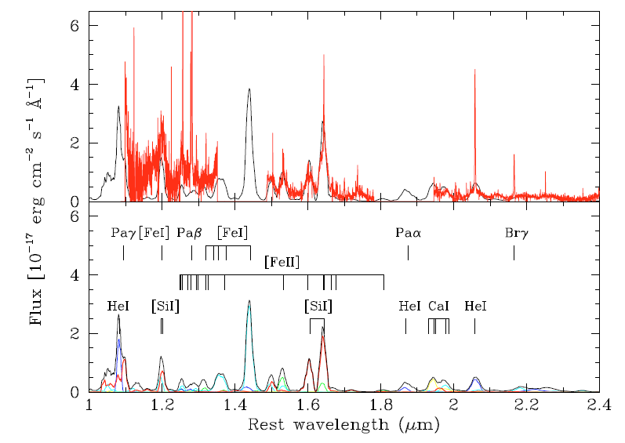
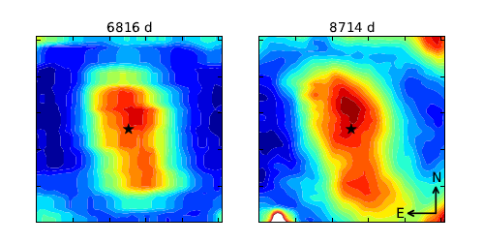
IR observations
[Si I]/[Fe II] 1.644μm
emission
2005
2011

Slide 27
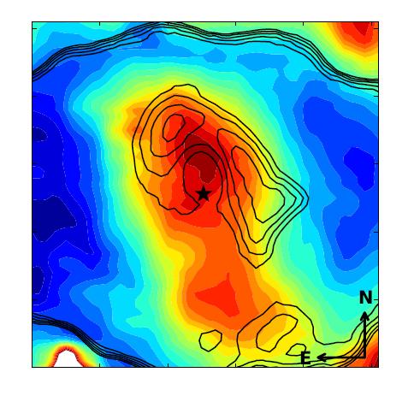
Complementary optical and IR observations
Optical emission clearly different from the IR
  [Si I]+[Fe II]
  concentrated
  towards the center
  Optical (Hα) in a
  ‘shell’
Different energy
sources

Slide 28
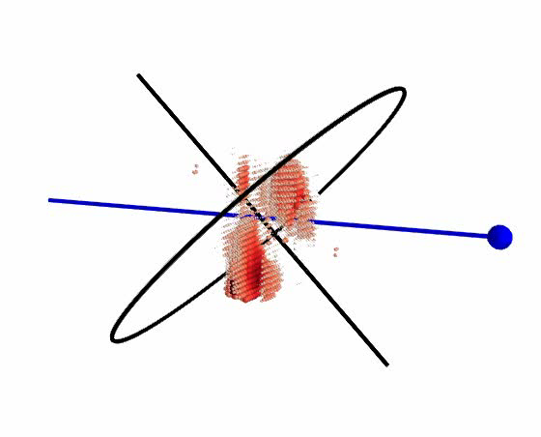
3-dimensional picture
Derived from
[Si I]+[Fe II] 1.644μm emission
Emission in the plane of the equatorial ring
Clumpy distribution
Extending out to
~4500 km s⁻¹
Larsson et al. 2013

Slide 29
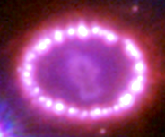
No sign yet of a neutron star

Slide 30
Dust in SN 1987A
Synchrotron emission from the ring
Thermal dust in the inner ejecta
Indebetouw et al. 2014

Slide 31
Summary
Connection between SN explosion and neutron star difficult
  time scales
  isolating explosion material from SN shocks in the interstellar
Some SNe may be powered by the neutron star formed in the explosion
  “fast” rise time + high luminosity
  can be provided by the spin down energy of a magnetar

Slide 32
Summary
Cas A
  indications of asymmetric distribution of ⁴⁴Ti
  opposite compact remnant
SN 1987A
  first direct look at an explosion
    resolved inner ejecta (iron core) are the immediate reflection of the explosion mechanism
    confirmation asymmetries in the explosion
  possibly best chance to look for a neutron star in the coming years
    illumination by external sources?
    dust?

