Slide 1
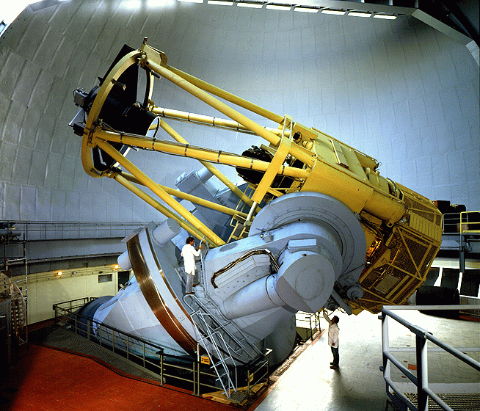
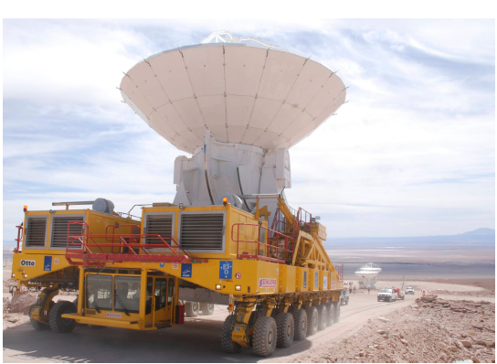
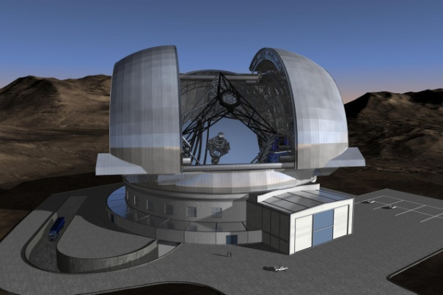
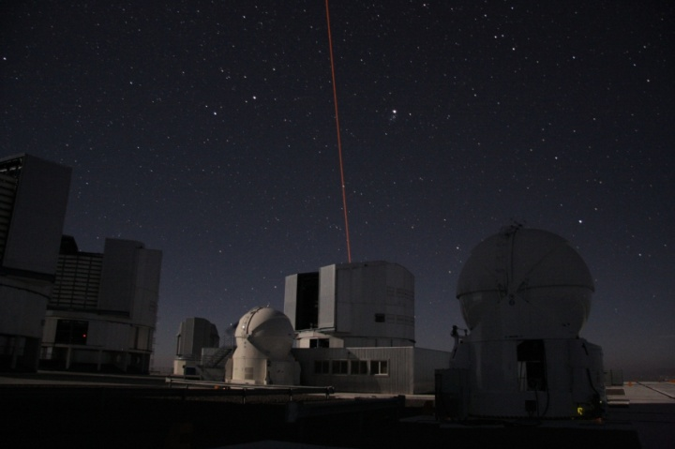
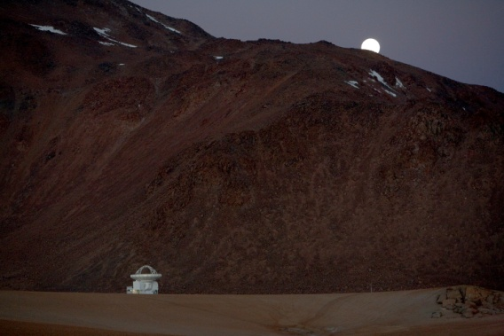
Challenges in Modern Astrophysics: Ground-based facilities
Bruno Leibundgut
(ESO)

Slide 2
Astrophysics in a Golden Age
Full coverage of electro-magnetic spectrum
      MAGIC/HESS →Fermi/INTEGRAL → XMM/Chandra/Swift/Rossi XTE → Galex → HST/Gaia → ground-based optical/IR → Spitzer → Herschel → Planck → IRAM/JCMT/APEX/ALMA → radio telescopes
      20 orders of magnitude in wavelength/frequency/energy
      Large archive collections (e.g. ROSAT, ISO, ESO, HST, MAST)
      Astro-particles joining in
        cosmic rays, neutrinos, gravitational waves, dark matter searches

Slide 3

Astrophysics in a Golden Age
International Year of Astronomy
  Fantastic boost in the public
  Increased awareness
  Strong public support
  Continued interest
    Connected to the ‘big’ questions
    Where do we come from?
    What is our future?

Slide 4
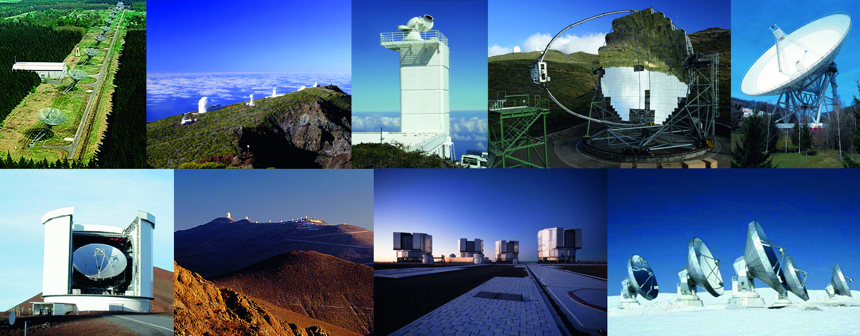
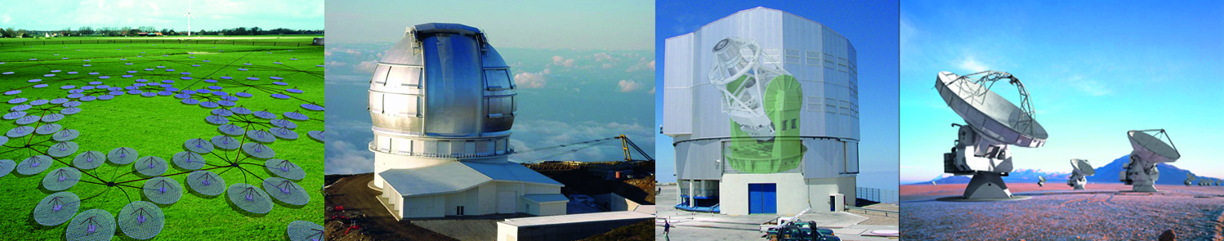

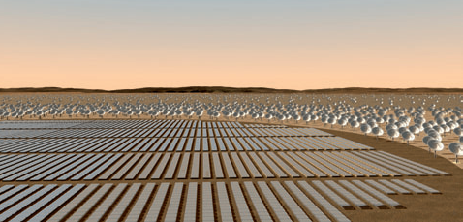
Fantastic opportunities
Already existing ground-based facilities in Europe
  Westerbork, Roque de los Muchachos (GTC, WHT, TNG, NOT, ING, MAGIC), Solar telescope on El Teide, Effelsberg, JCMT, La Silla, Paranal, IRAM (Plateau de Bure, Pico Veleta), HESS
New facilities
  VISTA, VST, LOFAR, ALMA
Under discussion
  E-ELT, SKA, EST, CTA

Slide 5
European ground-based telescopes
Spain
  GTC, WHT, ING, TNG, NOT, MAGIC, Calar Alto, IRAM
  Solar telescopes
France
  CFHT, (Dome C on Antarctica), IRAM
Germany
  LBT, HET, SALT, Calar Alto, MAGIC, HESS, APEX, IRAM
United Kingdom
  Gemini (North and South), (AAT), UKIRT, WHT, JCMT, eMERLIN
Italy
  LBT, TNG, (Dome C)
International
  European VLBI Network, LOFAR, ESO

Slide 6
Access to telescopes
Most observatories have open access policies
  Preference for supporting institutes
OPTICON Access program
  Access to 4m telescopes is supported by OPTICON funding for successful proposals
    ESO 3.6m, NTT, Calar Alto, WHT, TNG, and various others
Archives!

Slide 7
You do not have to observe yourself any longer!
Service observing at many telescopes
Massive surveys publicly available
  Sloan Digital Sky Survey (SDSS)
  CFHT Legacy Surveys
  UK Infrared Deep Sky Survey (UKIDSS)
  GOODS/COSMOS
  VST Public Surveys
  VISTA Public Surveys
  PanSTARRS (US)
  Dark Energy Survey (US/European)
  Large Synoptic Survey Telescope (LSST – US; proposed)
Large Archives
  ING, ESO, HST/MAST (US and mostly space)
  Presentation by Eduardo Gonzalez

Slide 8
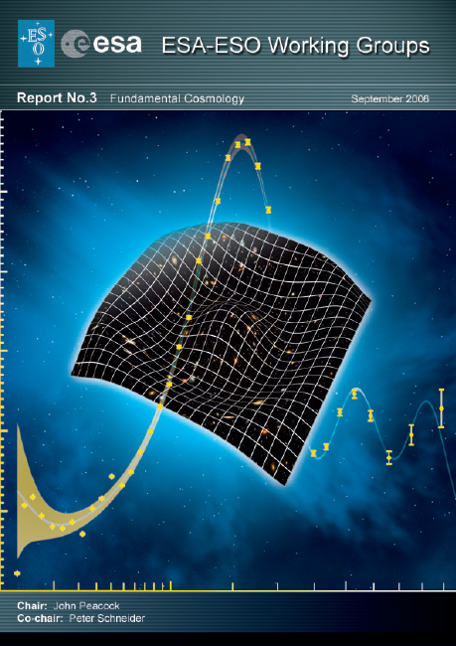
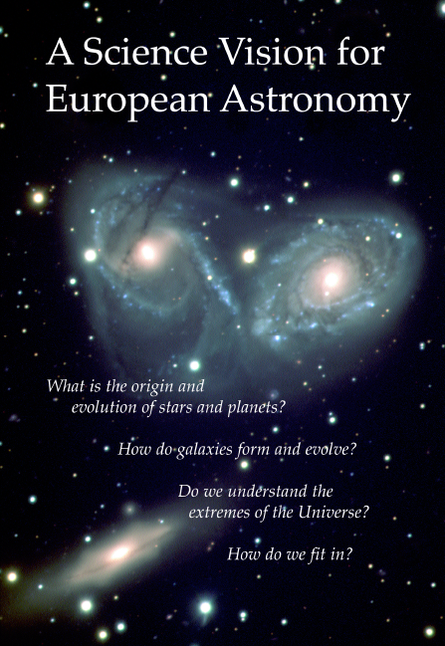
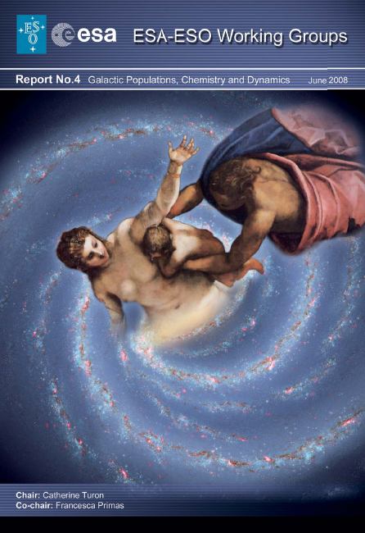

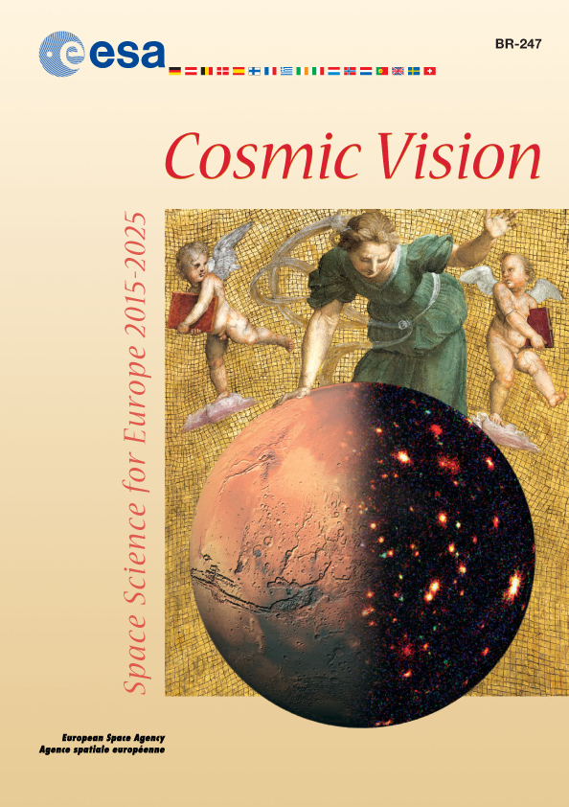
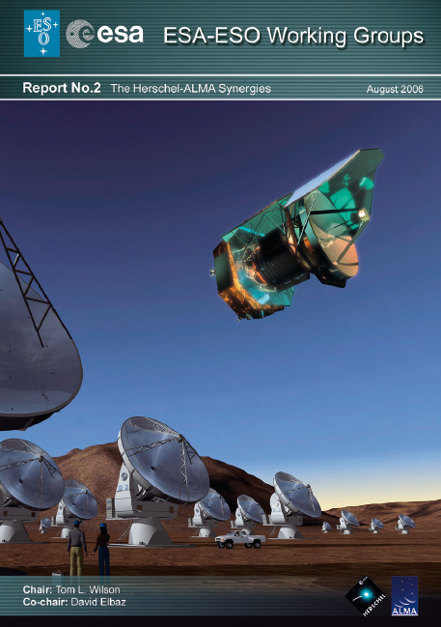
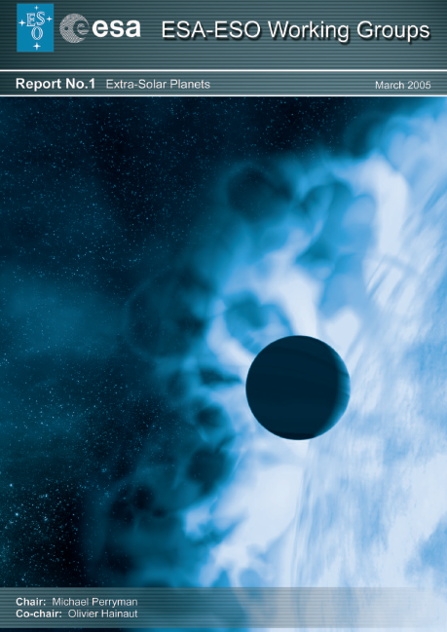
Research themes
Similar for most observatories
Defined in several communities
  Astronet Science Vision and Roadmap
  ESA Cosmic Vision initiative
  National decadal reviews
  Special publications
    ESA-ESO working group reports
    Specific fields (e.g. Connecting quarks with the Cosmos)

Slide 9
Science themes
What matters in the universe?
Planets, planets, planets
How did stars and planets form?
The Milky Way our Home
Our own black hole
How galaxies form and evolve?
Fashions and other transients
When opportunity knocks

Slide 10
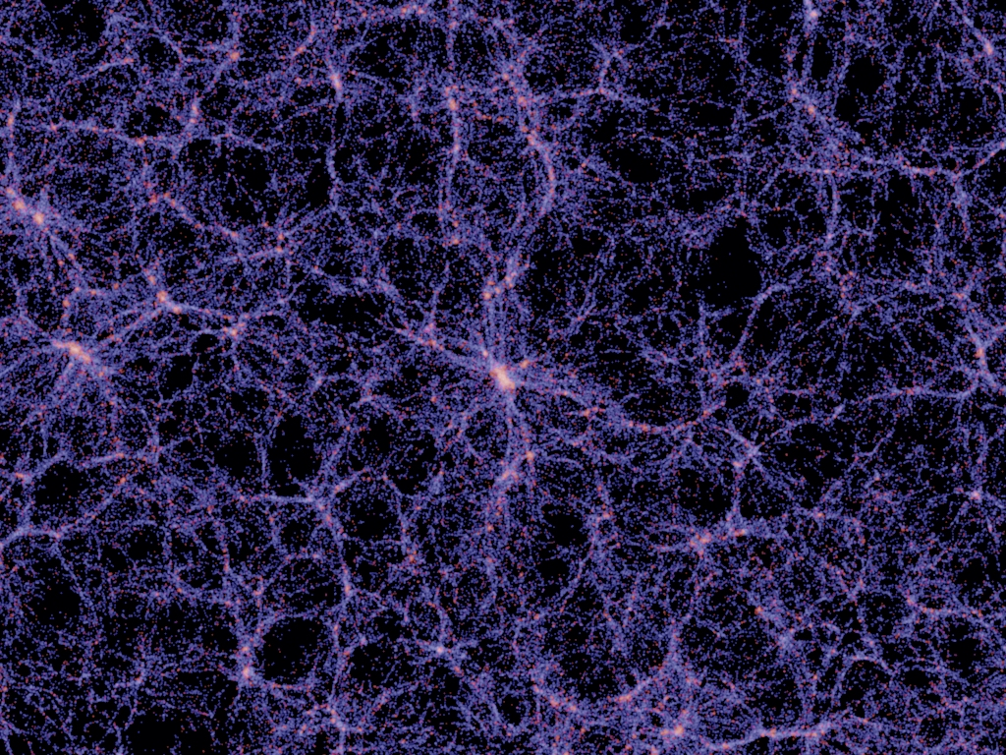
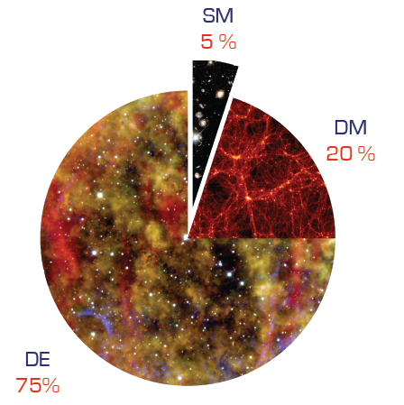
What matters in the Universe?
Characterisation of dark matter and dark energy
  Requires large samples
  Multi-year and (often) multi-telescope projects
    BAO (SDSS, 2dF, WiggleZ, BOSS, HETDEX)
    Weak lensing (CFHT-LS)
    Supernovae (SNLS, ESSENCE, SDSS-II, SN Factory, LOSS, PanSTARRS, DES, LSST)
    Galaxy clusters (REFLEX, NORAS, SPT, DES,, eROSITA, LSST)
    Redshift distortions (VVDS, VIPER)
Millenium simulation (Springel et al.)

Slide 11
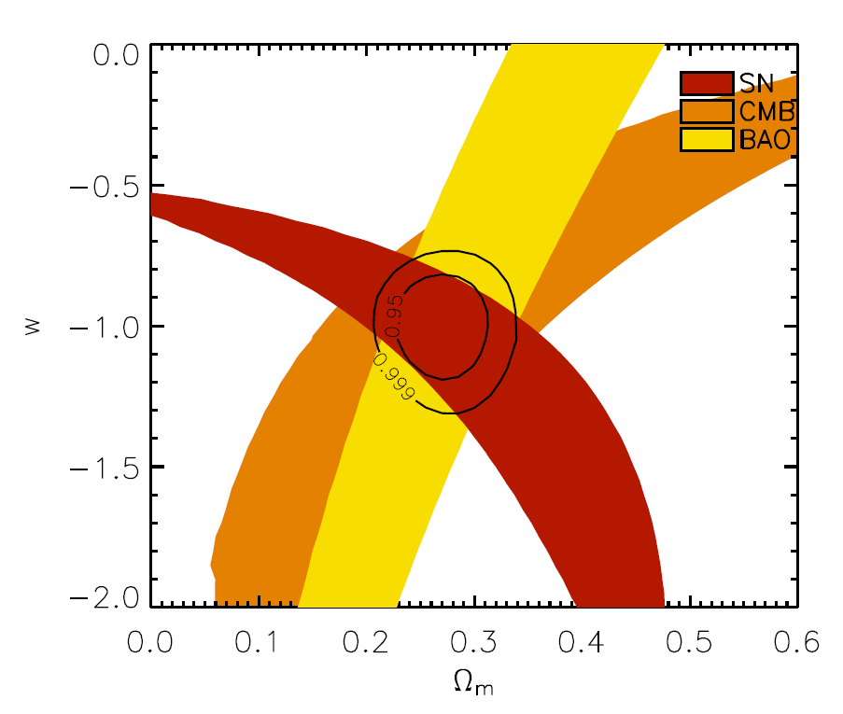
Dark Energy
Weak lensing, BAO, supernovae, clusters
  Important: massive surveys and large sky coverage
  Current state of the art with 4m telescopes (2dF, SDSS, WiggleZ, VIPERS)
  EUCLID → ground-based follow-up/calibrations
    spectroscopic calibration of the photo-z
    spectroscopic follow-up of supernovae
    spectroscopic follow-up for cluster members
    optical imaging for photo-z
  FMOS (Subaru), LSST, HETEX, LAMOST
  8-10m telescopes
Direct measurement of expansion dynamics
  Important: high spectral resolution and stability
  CODEX at E-ELT
Davis et al. (2008)

Slide 12
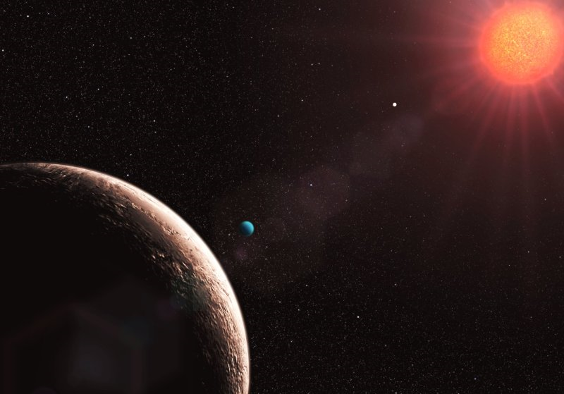
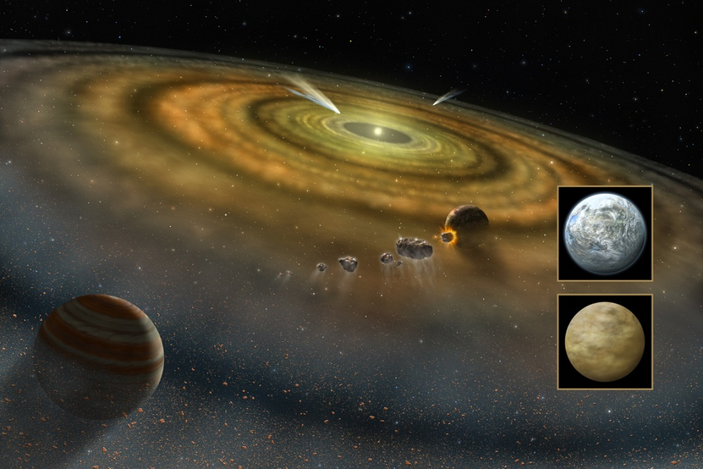
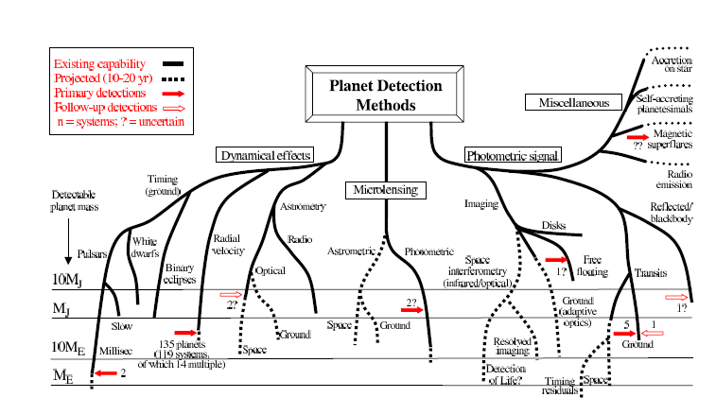
Planets, planets, planets
Planets everywhere
  Radial velocities
  Direct imaging
  Transits
Characterisation
  Planetary systems,
  masses,
  chemical composition,
  temperatures

Slide 13
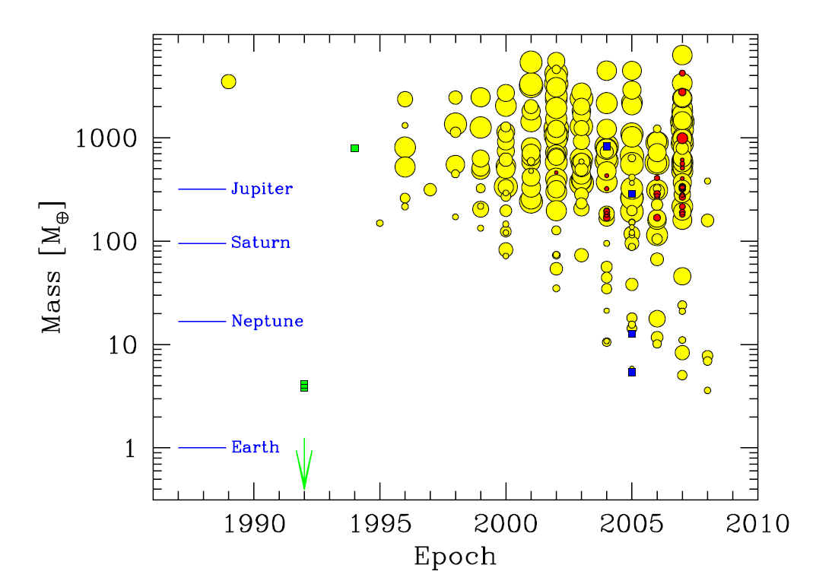
Planets
Radial velocities
  Important: time series and high-resolution spectroscopy
  complementary with space missions (CoRoT, Kepler)
  Currently done with 1m to 10m telescopes
    HARPS/HARPS-N, HIRES, UVES
  ESPRESSO (VLT) and CODEX (E-ELT)
Direct imaging
  Important: spatial resolution and IR
    large telescopes (>8m) with adaptive optics or interferometry (or space telescopes)
  HST, NACO (VLT), NIRI (Gemini), Keck AO, SPHERE (VLT),
  GPI (Gemini), MATISSE (VLTI) and EPICS (E-ELT), JWST, ELTs
Transits
  Important: time series and accurate photometry
  Mostly space missions (photometric stability) and long, uninterrupted time series (CoRoT, Kepler, PLATO)
  Spectroscopy follow-up (HST, 4m to 8m telescopes)
  OSIRIS (GTC)
Udry et al. (2009) Science with the VLT in the ELT Era

Slide 14
The ESO exo-planet machinery
HARPS at 3.6m telescope
  best radial velocity machine at a 4m telescope (supported by UVES on VLT)
  extremely stable spectrograph
  fast pipeline → nearly immediate results
NACO
  adaptive optics system on an 8m telescope
VLTI
  highest spatial resolution for follow-up observations of known systems
NACO/SINFONI/FORS2
  transit measurements
  atmospheres of exo-planets

Slide 15

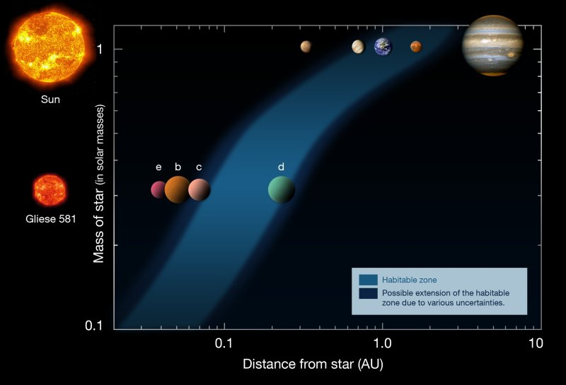
Searching for other earths
HARPS is the most successful planet finder right now
Almost all low-mass planets found with HARPS
  lowest mass planet found (1.9 M⊕)

Slide 16
Gamma-Ray Bursts
Identification relied on optical data
  redshifts, explosion energies, explosion physics
Cosmological probes
  the most distant observable stars
  light houses to measure the intergalactic medium
  tracers of chemical enrichment?
Very short duration
  required special instrumentation and software to observe adequately

Slide 17
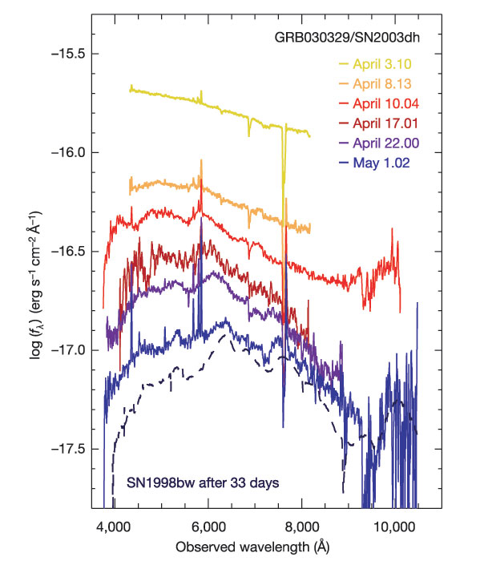
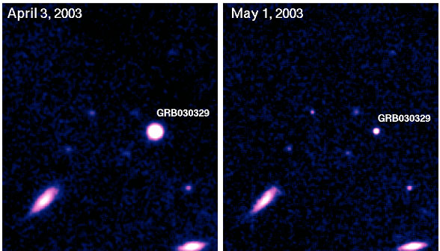
SN/GRB connection
Spectral signatures of supernovae appear in Gamma-Ray Bursts
GRB 030329/SN2003dh (earlier
GRB 980425/SN 1998bw)
  UVES spectrum found z=0.1685, i.e. second closest known GRB – “cosmological” GRB
  FORS1 and 2 observations of afterglow (starting April 3 until May 1)
Hjorth et al. 2003, Nature, 423, 847
Della Valle et al. 2003, A&A, 406, L33

Slide 18
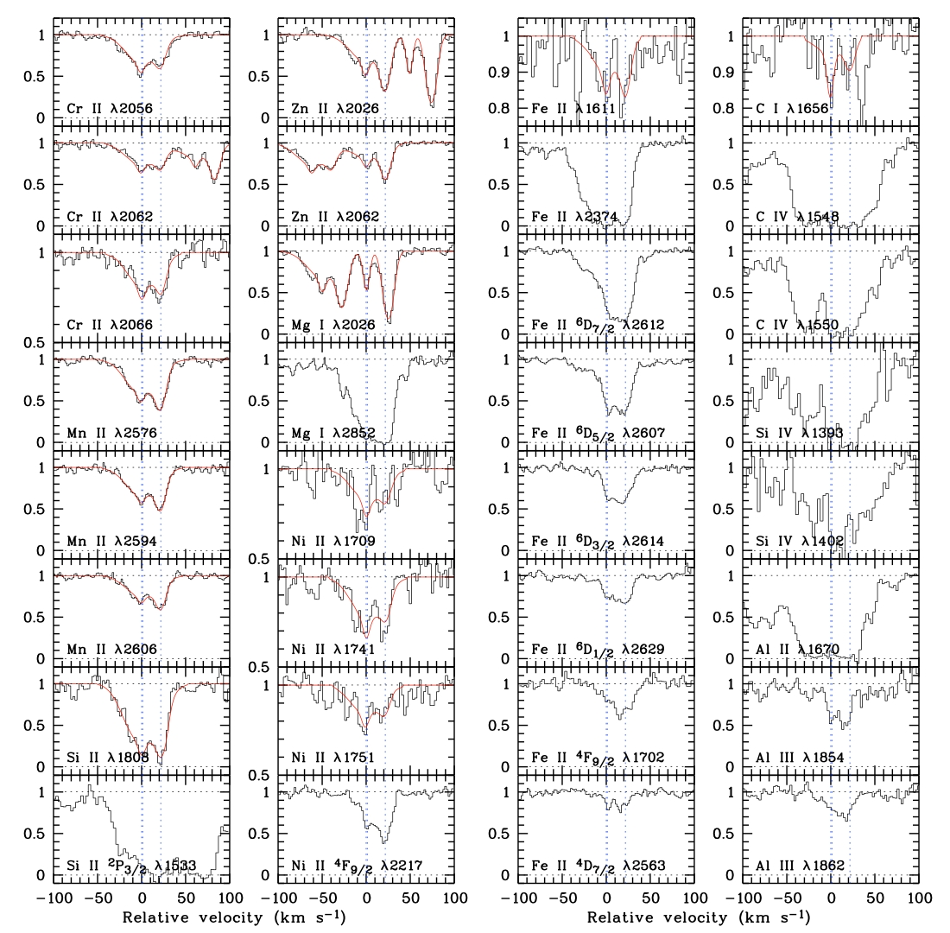
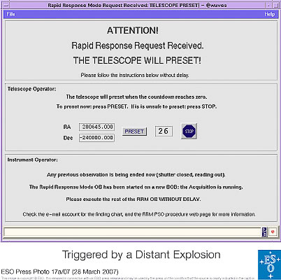
Rapid Response Mode (RRM)
UVES observations of
GRB 060418
10 minutes
after the initial
Swift trigger
Many metal line systems
at 3 redshifts.
[Zn/Fe] >> QSO abs.

Slide 19
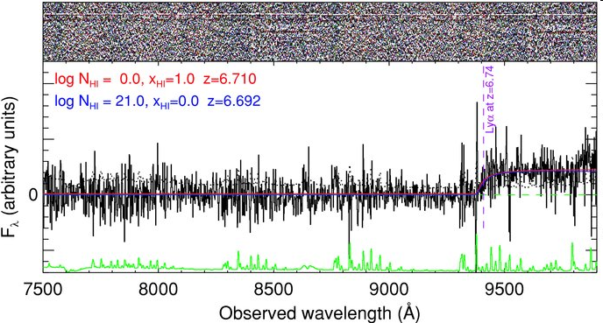
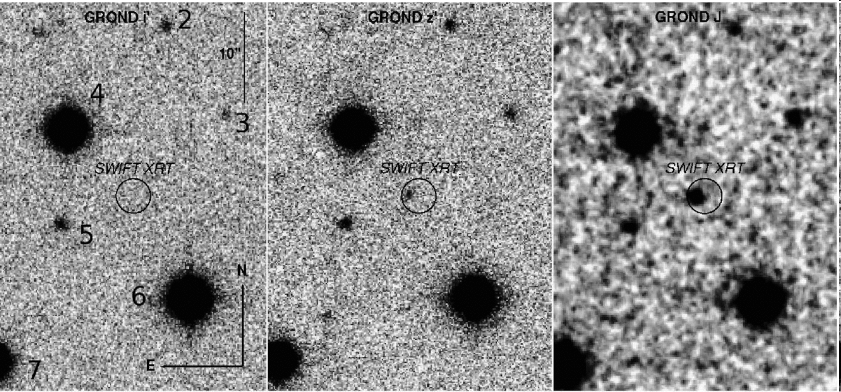
Gamma-Ray Bursts
Most distant stellar objects ever observed
  redshifts 6.7 and 8.2 (tentative)
  lookback time of nearly 12.5 billion years (or 95% of the age of the universe)
VLT equipped with rapid response mode
  allows to observe a gamma-ray burst 10 minutes after detection
i
z
J
GRB080913

Slide 20
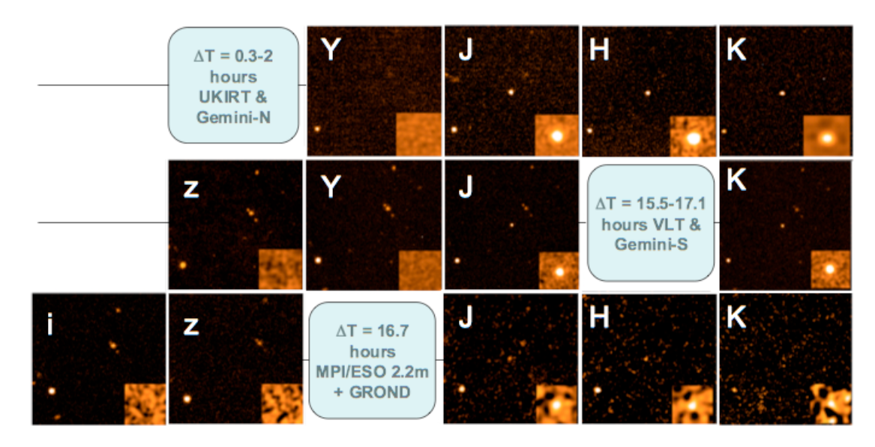
Most distant stellar object yet observed – GRB 090423
Tanvir et al., Nature submitted
Optical drop-out, bright in the near-infrared
Rapid decline

Slide 21
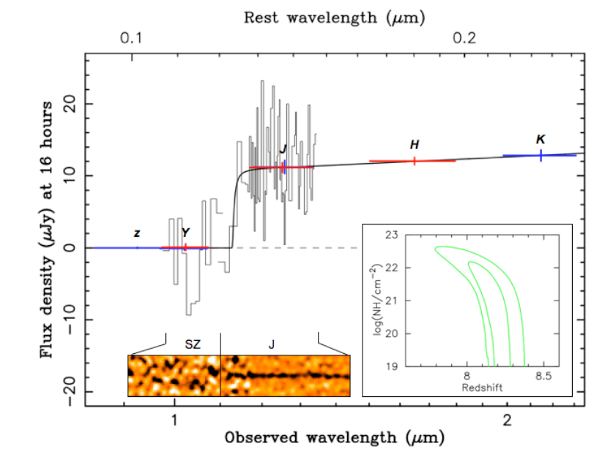
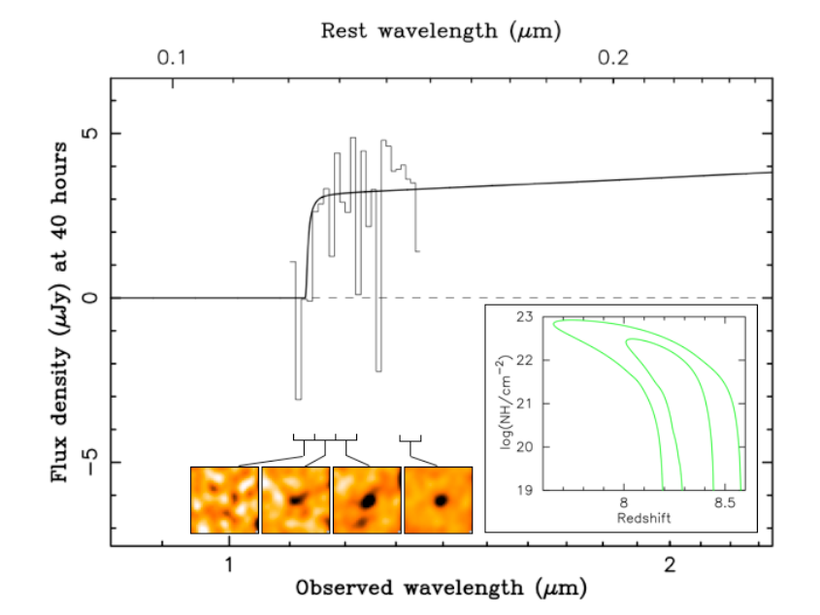
GRB 090423
Spectroscopy 17 hours after outburst
Lyman break indicates a redshift of z≈8.2
ISAAC
SINFONI

Slide 22
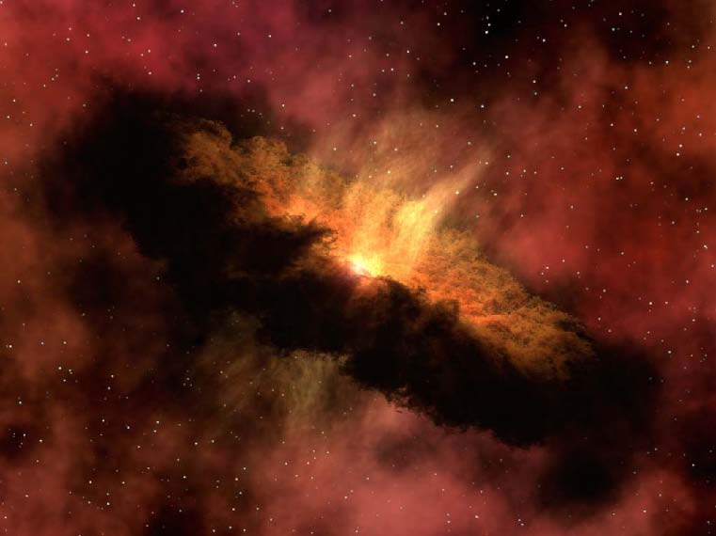
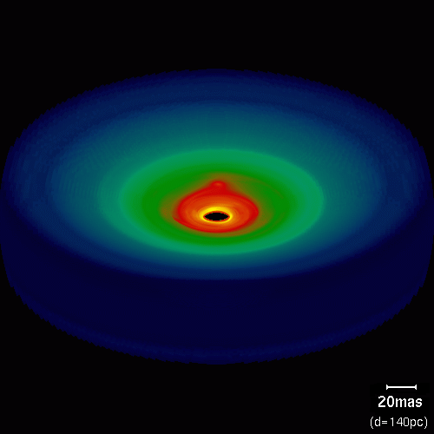
Star and planet formation
Observing the warm cores of molecular clouds
  Important: spatial resolution and large wavelength coverage
  IR observations with large (>8m) telescopes, CanariCam (GTC), VLTI (MATISSE)
  JWST, ELTs
  ALMA will be the champion for
  this field
Wolf & Klahr 2005

Slide 23
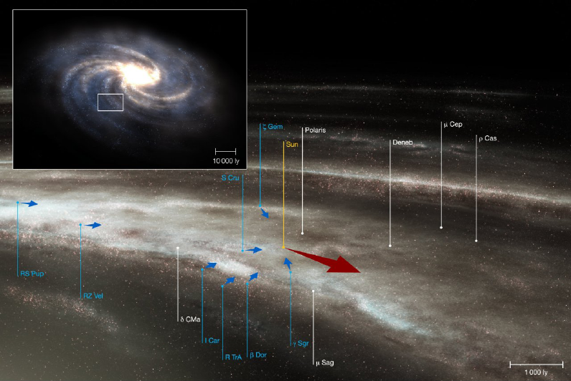
The Milky Way – our home
Radial velocity study of 14000 F and G stars over two decades years
  Plus photometry and Hipparcos parallaxes
Spiral arms
  Gas flows, stellar distribution
Bulge composition, Galactic Centre
Distribution of massive stars

Slide 24
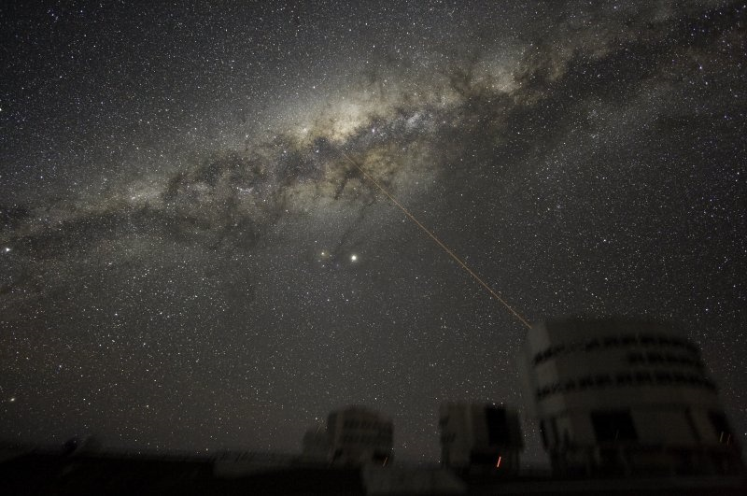
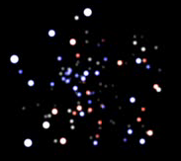
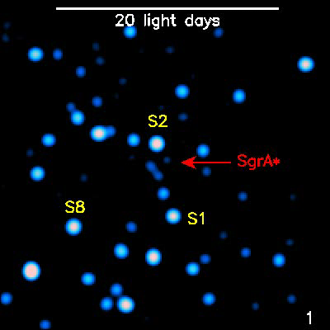
Our own black hole
Mass determination
through stellar orbits
Structure around the
black hole revealed
through flashes
Coordinated studies
with other
wavelengths

Slide 25
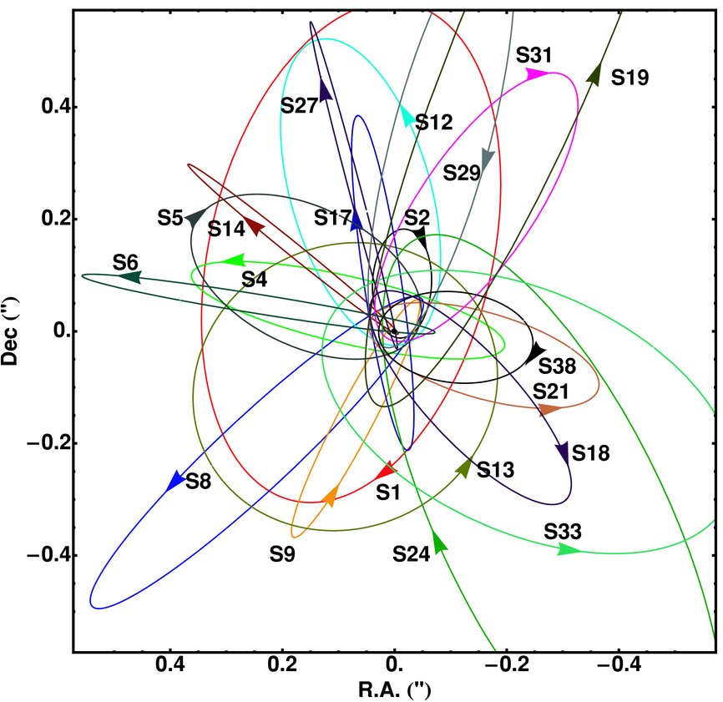
Galactic Centre
Determine the black hole event horizon
  Schwarzschild radius ≈9 microarcseconds
Measure gravity in the strong regime
  Probing the spacetime geometry
  Important: IR observations and spatial resolution → large telescope (>8m) with AO and interferometry
  NACO, Keck AO, GEMS (Gemini),
  GRAVITY (VLTI), ELTs
Gillessen et al. (2009)

Slide 26
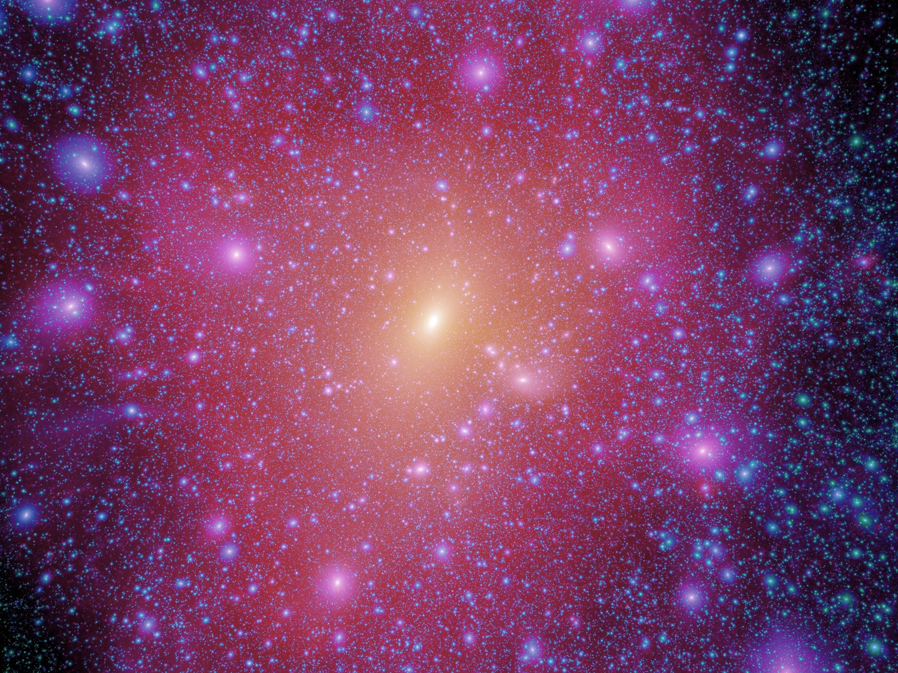
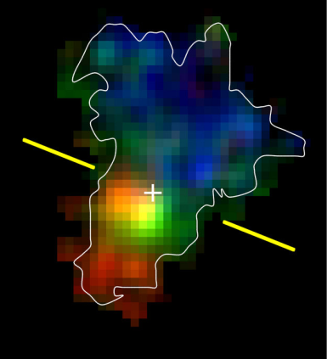
How did galaxies form and evolve?
Characterisation of the Lyman-break galaxies
  Galaxy population at z>3
Discovery of compact, old galaxies at z>1
  “red and dead”, “red distant galaxies”
Characterisation of galaxies at high z
  Internal kinematics
Earliest observable stellar agglomerations
  Ly-α emitters
Millenium simulation (Springel et al.)

Slide 27
The distant universe
Build up of the Hubble sequence
  Star forming vs. passive galaxies
    Important: deep wide-field imaging and massive spectroscopic surveys
    SuprimeCam (Subaru), VST, VISTA, VIMOS upgrade,
    FMOS (Subaru)
  Internal physics and morphologies of galaxies at 1<z<3
    Important: high spatial resolution and spatially resolved spectroscopy
    HST, NACO, SINFONI, OSIRIS (GTC), MUSE, KMOS,
    HAWK-I with AO, JWST, E-ELT
Objects at very high redshifts (‘first light’)
  Search for Ly-α emitters, IGM at high z
    Important: deep surveys, spectroscopic follow-up
    SuprimeCam (Subaru), X-Shooter, NACO, OSIRIS (GTC),
    LRIS (Keck), DEIMOS (Keck), HAWK-I with AO, MUSE, KMOS, EMIR (GTC), JWST, E-ELT
Based on Bergeron (2009) Science with the VLT in the ELT Era

Slide 28
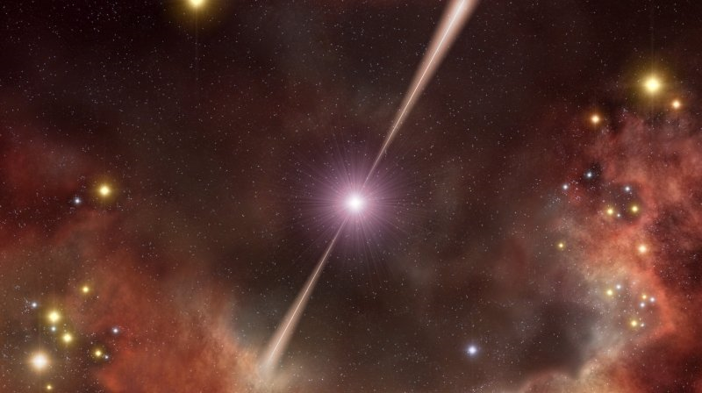
Fashions and other transient phenomena
ESO top ten cited papers are all supernovae and GRBs
  This is more a sign of fashion than sound physics
AGNs – topic of the 4m telescopes
  Topic for 8m telescopes?
Metal-poor stars – originally 8m
(e.g. First Stars programme)
  And now?

Slide 29
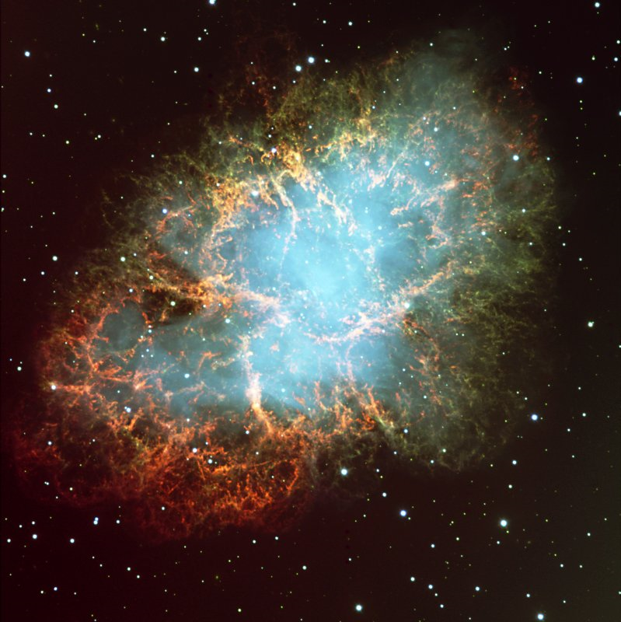
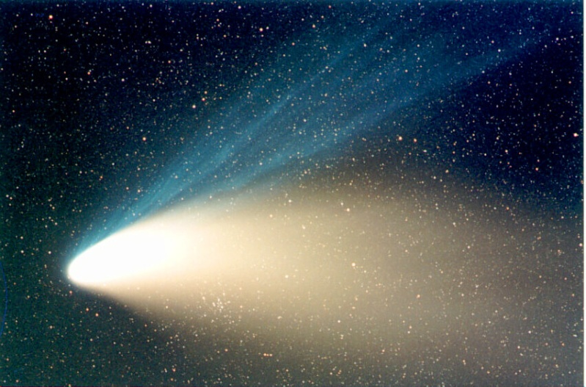
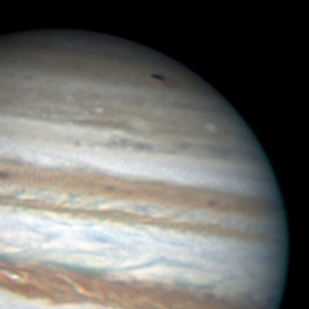
When opportunity knocks
Unique objects
  SN 1987A
    One in a century object?
  Comets
    Hale-Bopp, Hyakutake, 73P/Schwassmann-Wachmann 3, Shoemaker-Levy 9, Halley
  Near-Earth objects
  Solar system event
    Spots on Jupiter
    Volcano eruption on Io?
    Formation of new large spot on Jupiter?
Wesley, 35cm

Slide 30
Role of 2-4m telescopes
Workhorses of optical/IR astronomy
  Distributed resource
    Access at the university level
    Many national telescopes
  Access for many astronomers
  Develop specific strengths
    E.g. time series, large samples
    Examples of successful the 4m telescopes over the past decade
      AAT/2dF, CFHT/Legacy Survey, ESO 3.6m/HARPS, WHT/SAURON and PN.S

Slide 31
The 8m telescope landscape
There are many large optical and infrared telescopes
3 telescope planned with d>20m
Telescope diameter | In operation | Construction or Planned
d>10m | 4
7m < d < 10m | 9 | LSST
5m < d < 7m | 6 | JWST
3m < d < 5m | 16 | VISTA, LAMOST, Discovery Telescope

Slide 32
Role of 8-10m telescopes
Workhorses of optical/IR astronomy
  Distributed resource
    In general have an open access policy
  Access for many astronomers across all regions
  Currently cover all observational parameters
  In the future develop specific strengths
    E.g. time series, wide-field spectroscopy

Slide 33
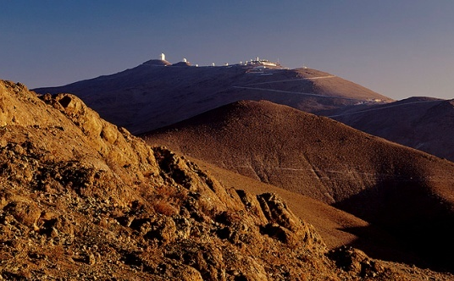
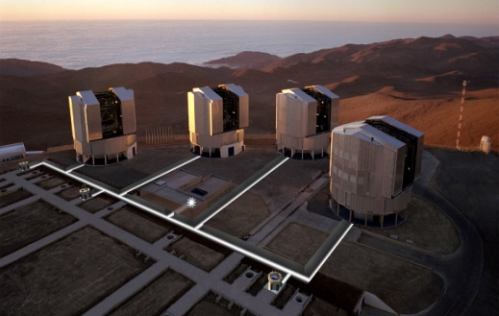
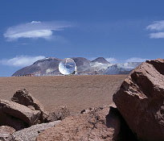
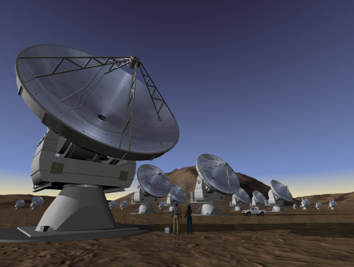
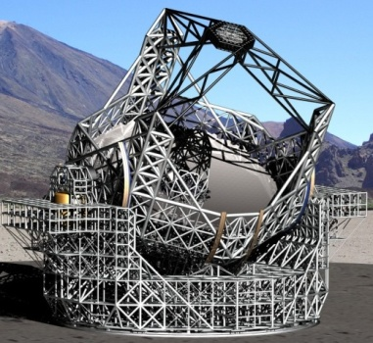
ESO’s program
La Silla Paranal Observatory
  Continue operations of these southern telescopes
  Implement second generation instruments (VLT/VLTI)
  Key surveys with VST and VISTA
  Long-term programs for unique science on La Silla
  Prepare for ALMA science with APEX
Deliver ALMA on time and budget
Design world-leading E-ELT and secure funding for construction and operations

Slide 34
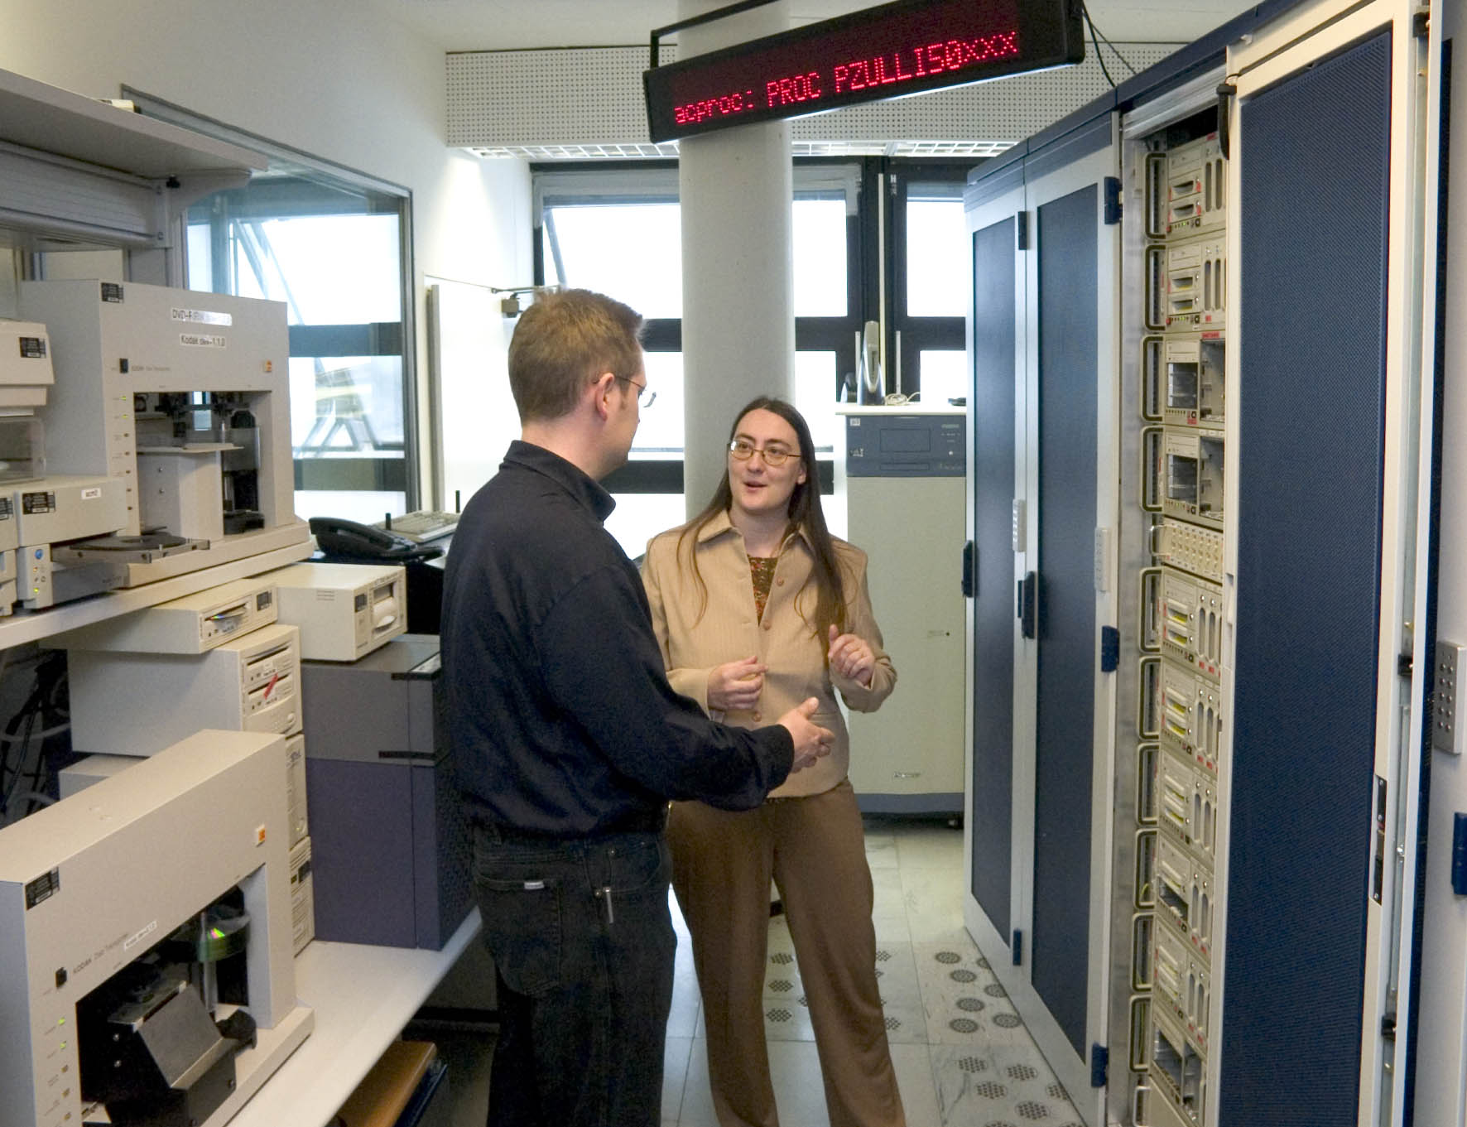






ESO Today
La Silla and Paranal Observatory in full operations
(7 telescopes in 2009, plus four telescopes for interferometry)
APEX in operations on Chajnantor
ALMA under construction (early science in 2011, full operations in 2013)
Operational data archive
European Extremely Large Telescope in design phase
Headquarters in Garching, Germany
Representation in Santiago, Chile

Slide 35

ESO’s world
ESO’s sites
Garching bei München
Chajnantor
Paranal
La Silla
Santiago

Slide 36

La Silla Paranal
VLT
  Continue operations with new instruments
    FORS2, ISAAC, UVES, FLAMES, NACO, SINFONI, CRIRES, VISIR, HAWK-I, VIMOS,
    X-Shooter, KMOS, AOF, MUSE, SPHERE
    MIDI, AMBER, PRIMA, GRAVITY, MATISSE
La Silla
  Continue operations with long-term programmes
    HARPS, EFOSC2, SOFI, visitor instruments
APEX
    Covers sub-mm and mm wavelendths 0.3 to 3 mm
    SHFI (Swedish Heterodyne Facility Instrument), LABOCA, SABOCA, APEX-SZ, CHAMP+, FLASH

Slide 37


La Silla
Medium-size telescopes
  3.6m: HARPS for exo-planet searches
  3.5m NTT: EFOSC2 & visitor instruments
  2.2m in partnership with MPG
Small telescopes
  Closed/funded externally

Slide 38









La Silla: 5 Operational Instruments
3.6m
NTT
2.2m
HARPS
SOFI
WFI
EFOSC2
FEROS
GROND

Slide 39
Access to La Silla 3.6m and NTT
Through the OPTICON Access program non-ESO member state astronomers can get their observing costs reimbursed
Simply apply to ESO under this program
So far, this channel has not been used very successfully → very few proposals!

Slide 40

Paranal

Slide 41


Slide 42

VLT Instruments

Slide 43

VLT/I Spectral Resolution

Slide 44

Very Large Telescope Interferometer

Slide 45





ALMA
In Search of our Cosmic Origins
Science requirements
  Detect CO and [CII] in Milky Way galaxy at z=3 in < 24 hr
  Dust emission, gas kinematics in proto-planetary disks
  Resolution to match Hubble, JWST and 8-10m with AO
  Complement to Herschel
Specifications
  66 antennas (54x12m, 12x7m)
  16 km max baseline (< 10mas)
  30-1000 GHz (10–0.3mm), up to 10 receiver bands
HST
ALMA
5AU
850 GHz

Slide 46




Chajnantor
APEX
  12m sub-millimeter antenna, operated by ESO @ Sequitor
  MPG (50%), Sweden (23%) and ESO (27%)
ALMA
  Transformational science
  66 antennas at 5050m
  Operations support at 2950m
  Global partnership with North America East Asia & Chile
APEX
OSF
OSF

Slide 47




First antenna at 5000m
Leonardo Testi: ALMA, Bonn, 8 Oct 2009
47

Slide 48

Sensitivity and Resolution

Slide 49

History of Galaxies
In the (sub-)millimeter the inverse K-correction compensates for the distance as z increases

Slide 50


ALMA Science
Star Formation, Proto-planets in nearby disks
Astrochemistry
Interstellar medium (Galaxy, Local Group)
High-redshift deep fields
+130 projects in first 3yrs – DRSP 2.1
  http://www.eso.org/sci/facilities/alma/science/drsp/
ALMA Science is for everyone
    High resolution/sensitivity 3D instrument at mm-wl
    100% service observing with full dynamic scheduling
    Complete e2e data flow system
    Science quality images (cubes) delivered to the users
    Raw, calibrations, pipeline processed data and recipes in archive
    Friendly and widespread User Support through ARCs
The Netherlands
Nordic
Bulgaria?
Romania?
UK
CZ
Germany
IRAM
Italy

Slide 51

E-ELT
Detailed design study
  Baseline 42m primary mirror
  Adaptive optics built-in
  Industry strongly engaged
  Study complete in 2010
Project
  Builds on entire expertise at ESO and in the member states
  Construction 2011-2018
  Synergy: JWST/ALMA/SKA

Slide 52





The Science
Contemporary Science: Exo-planets, planet formation, resolved stellar populations beyond the Local Group, Black Holes, the physics of high redshift galaxies, the expansion of the universe, ...
Synergies with other top facilities: ALMA, JWST, survey telescopes, SKA, ...
Discoveries: opening new
parameter space in spatial
resolution and sensitivity, ...
SKA
JWST
ALMA

Slide 53


The Survey Telescopes
Under construction
  VST 2.6m for optical
    Completion in 2010
  VISTA 4.1m for infrared
    Currently in science verification
Science
  Multi-year program of large public surveys
  Coordinated by ESO
  Develops European survey capability
VST
VISTA

Slide 54
ESO Archive
The ESO data archive
  is a rich source of excellent data
  abstracts of previous proposals available
  data public one year after they have been delivered to the PI
  great way to compete with your competitor, if they got observing time
  easy retrieval and selection of calibration data

Slide 55
Get involved
Participate in ESO activities
  get to know the organisation better
  active interactions with ESO people
Have a lively scientific exchange with the (European) astronomical community
  conferences, workshops
  regularly publish your results

Slide 56

European Extremely Large Telescope
Notes:
56

