Slide 1
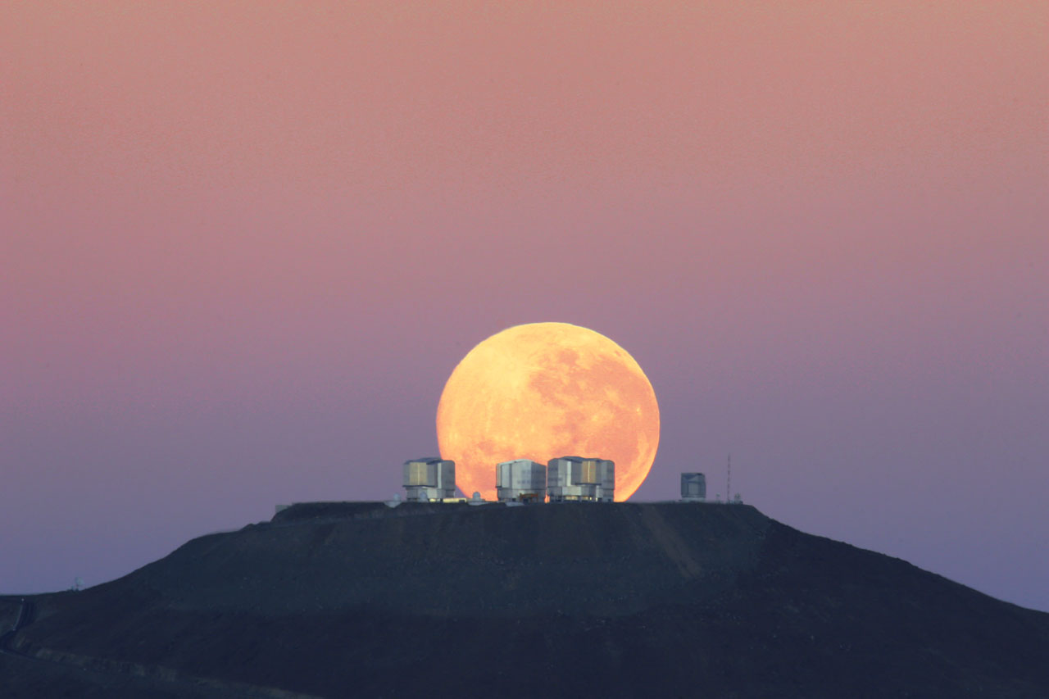
European Southern Observatory
Bruno Leibundgut

Slide 2
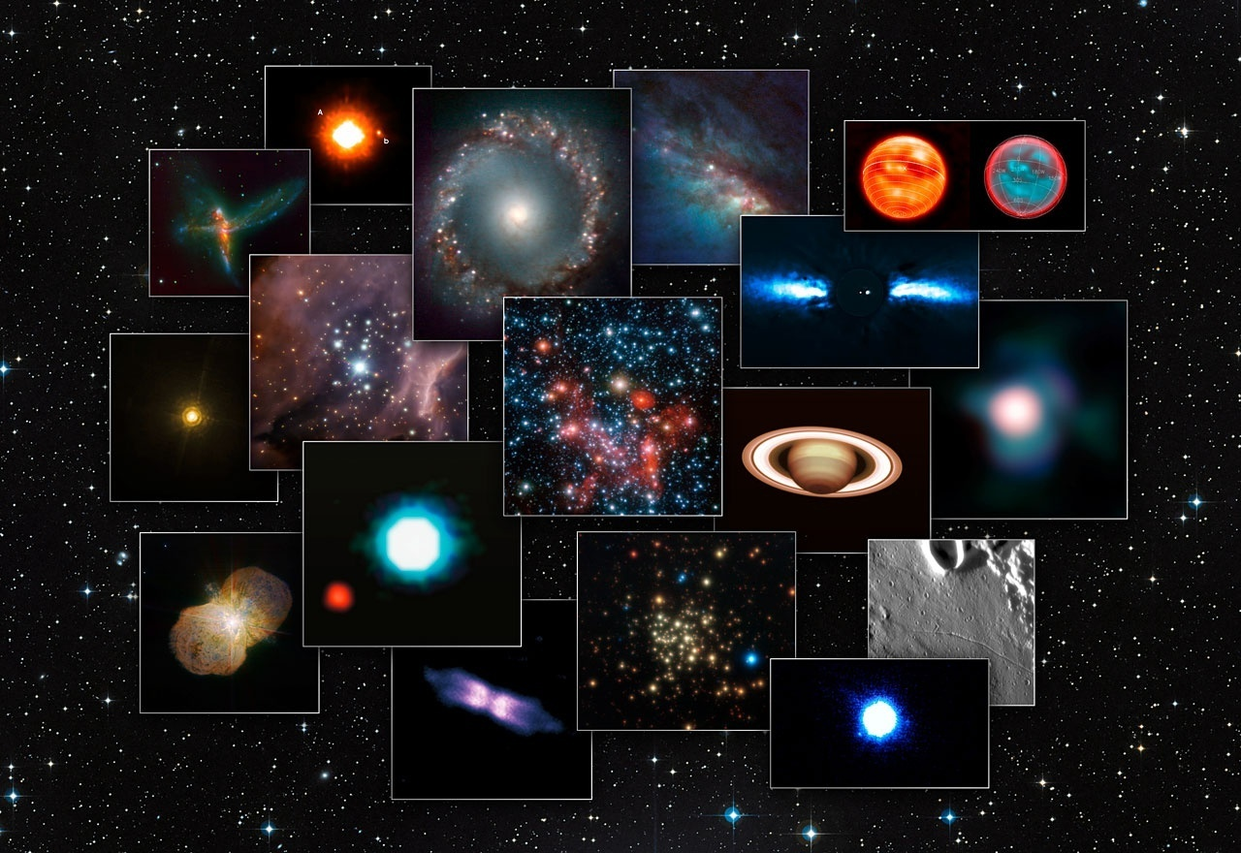

Slide 3
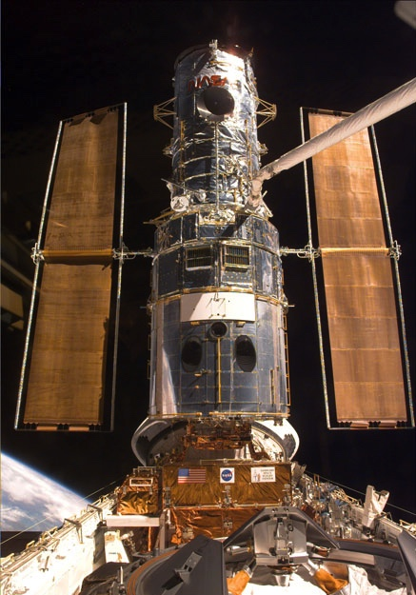
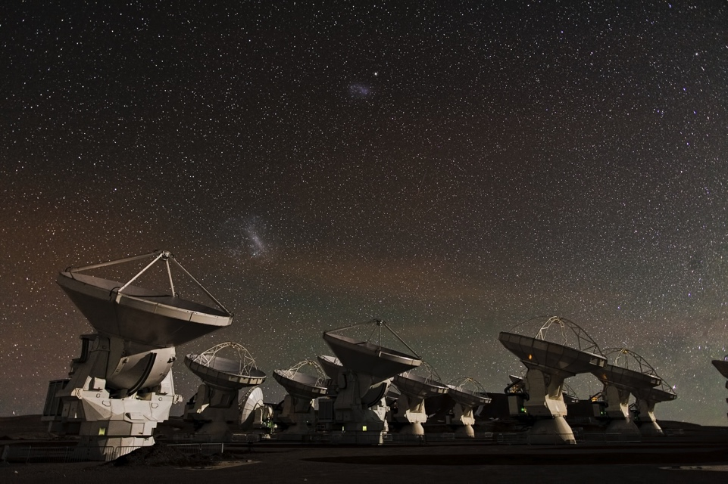
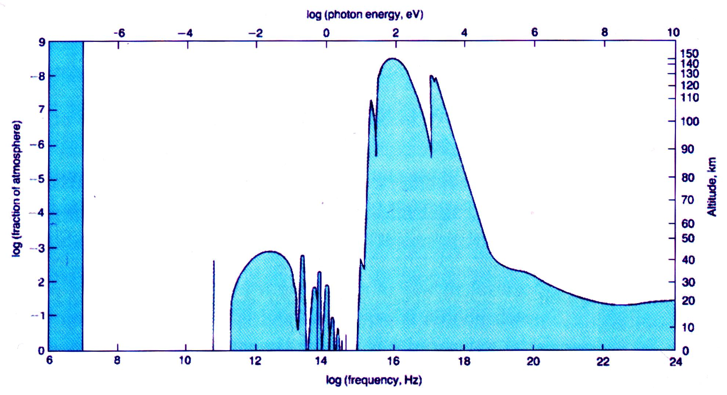
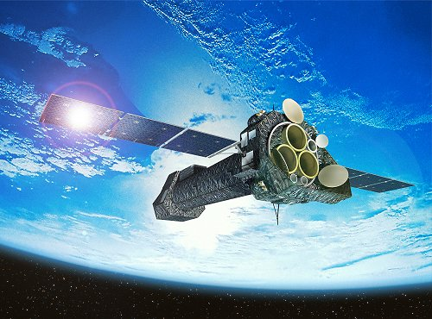
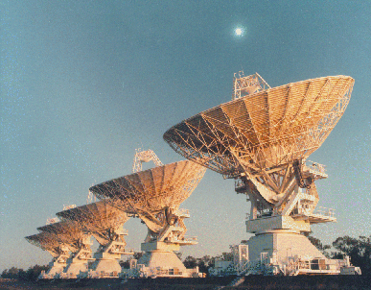
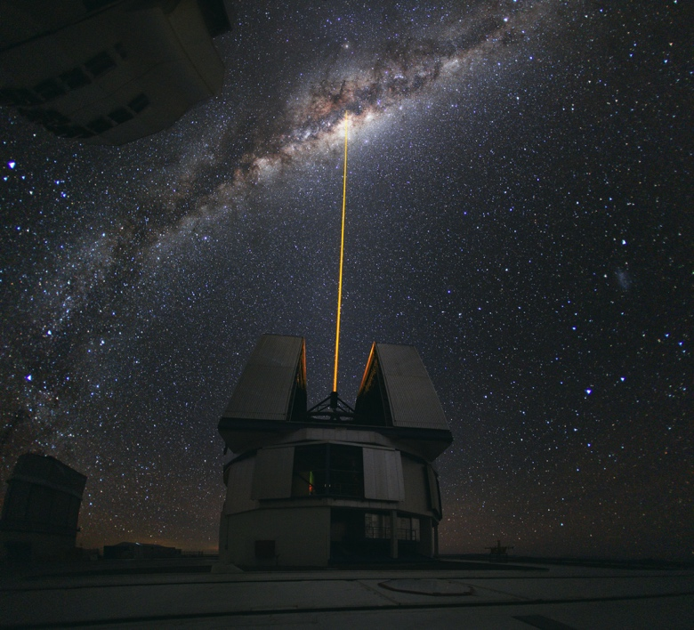
Earth‘s atmosphere
Shield and Window to the Universe
300m
3m
3cm
0.3mm
3μm
30nm
3Å
3pm
30fm
300am
X–
radio
radiation
γ–
visible

Slide 4
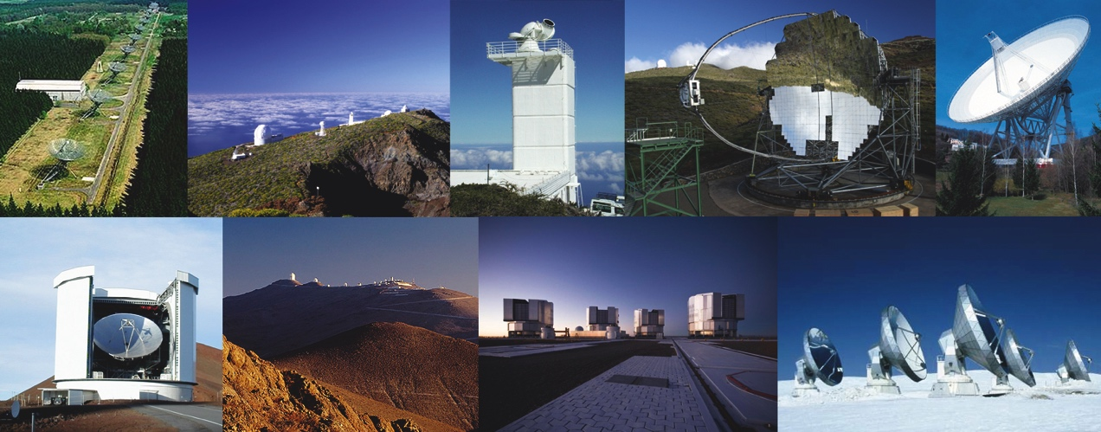
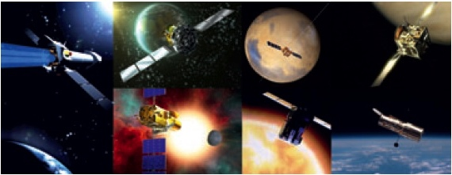
Astrophysics in a Golden Age
Full coverage of electro-magnetic spectrum
      MAGIC/HESS/VERITAS →Fermi/INTEGRAL → XMM/Chandra/Swift/Rossi XTE → Galex → HST/Gaia → ground-based optical/IR → ISO/Spitzer → Herschel → Planck→ IRAM/JCMT/APEX/ALMA/NOEMA → radio telescopes

Slide 5
Astrophysics in a Golden Age
Full coverage of electro-magnetic spectrum
      MAGIC/HESS/VERITAS →Fermi/INTEGRAL → XMM/Chandra/Swift/Rossi XTE → Galex → HST/Gaia → ground-based optical/IR → ISO/Spitzer → Herschel → Planck→ IRAM/JCMT/APEX/ALMA/NOEMA → radio telescopes
        cover 20 orders of magnitude in frequency/wavelength/energy
      Astro-particles joining
        cosmic rays, neutrinos, gravitational waves,
        dark matter searches

Slide 6
Spectacular Results
Cosmology with Planck (see François’ talk)
Discovery of Dark Energy
  Physics Nobel Prize 2011
Constancy of Fundamental Constants
  fine-structure constant, proton- to electron-mass ratio
Exo-planets and planetary systems
Discovery of pre-biotic molecules
Nucleosynthesis and stellar explosions

Slide 7
European Southern Observatory
Mission
  Develop and operate world-class observing facilities for astronomical research
  Organize collaborations in astronomy
Intergovernmental treaty-level organization
  Founded in 1962 by 5 countries
  Today 15 member states, Brazil will become 16th
Observatories in Chile
  La Silla Paranal: VLT, VLTI, 3.6m, NTT, VISTA, VST
  Chajnantor: APEX and ALMA partnerships
Headquarters in Garching and Office in Santiago
Annual budget of ~140 million €

Slide 8
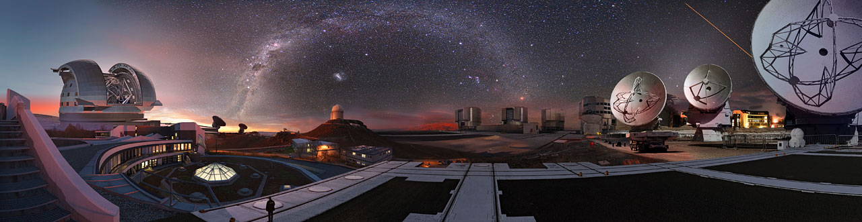
European Southern Observatory

Slide 9
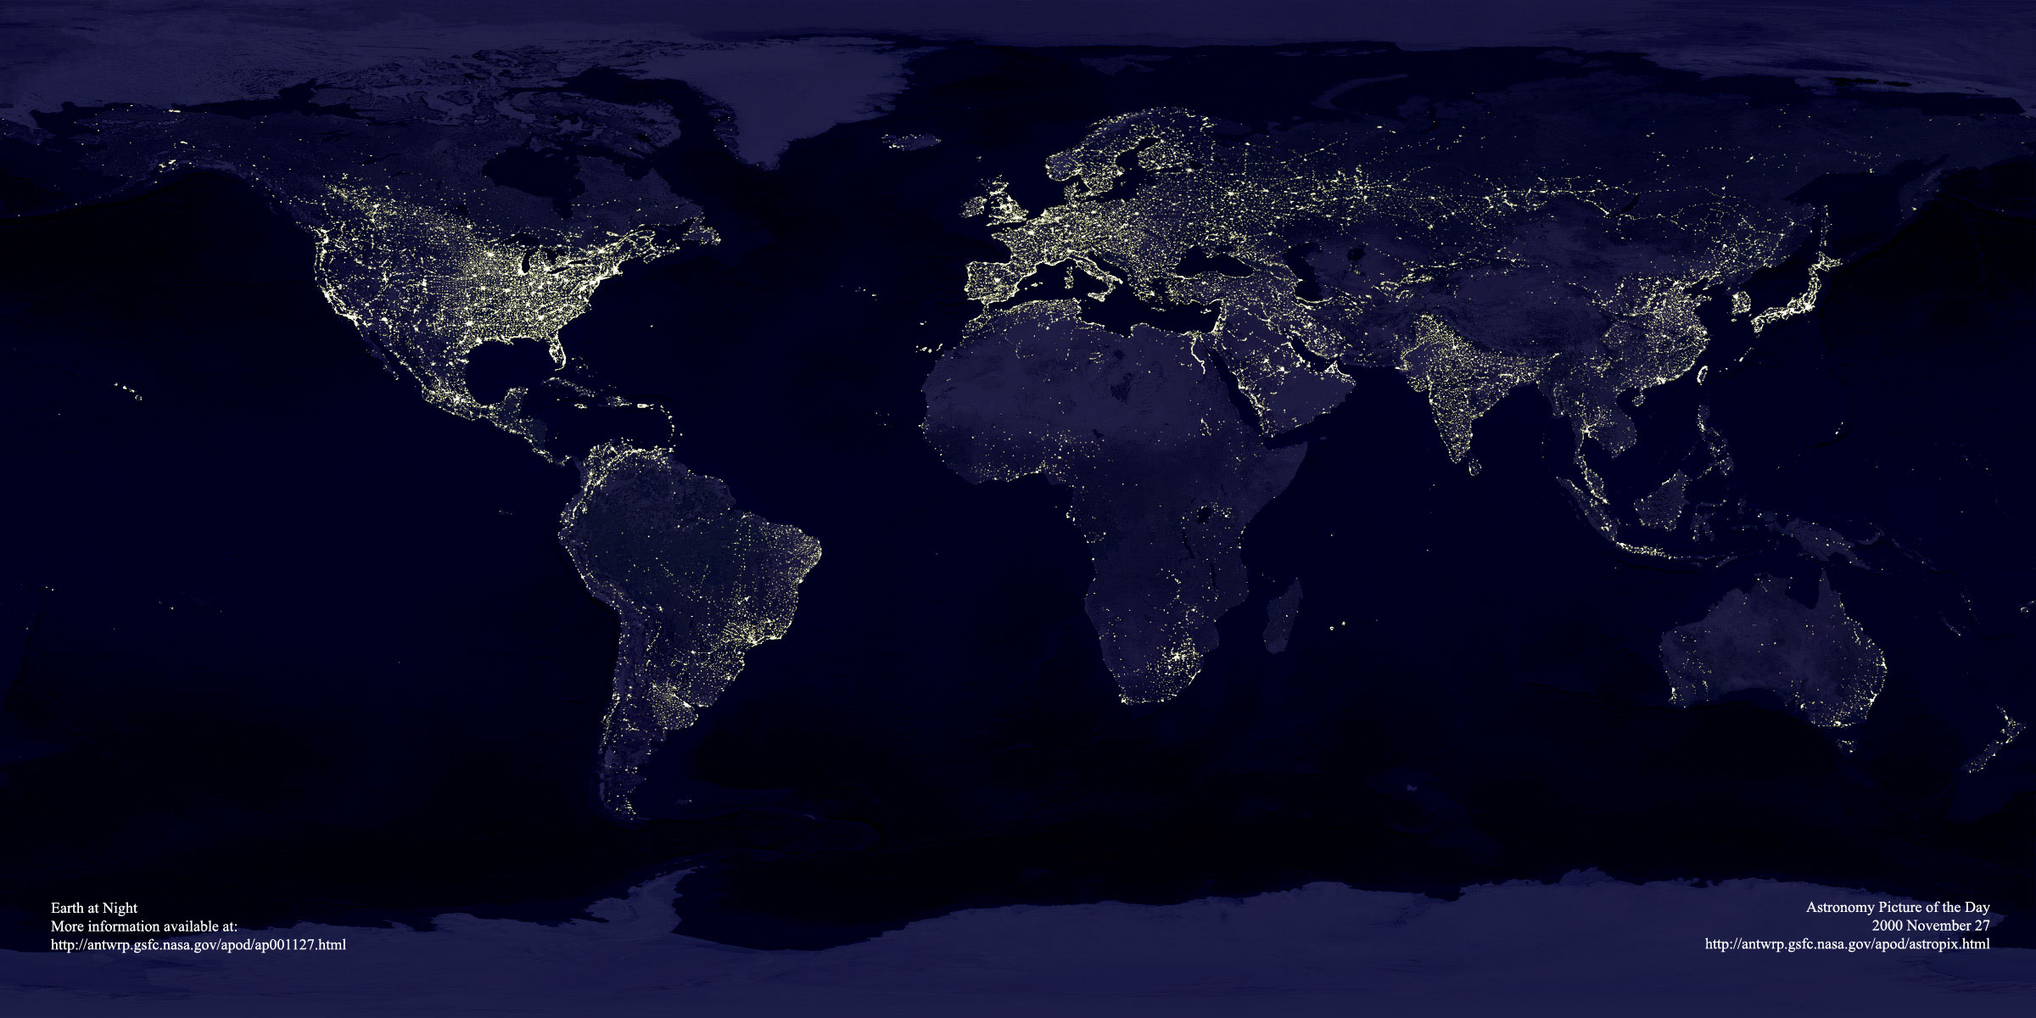
ESO’s World
Garching bei München
Chajnantor
Paranal
La Silla
Santiago

Slide 10
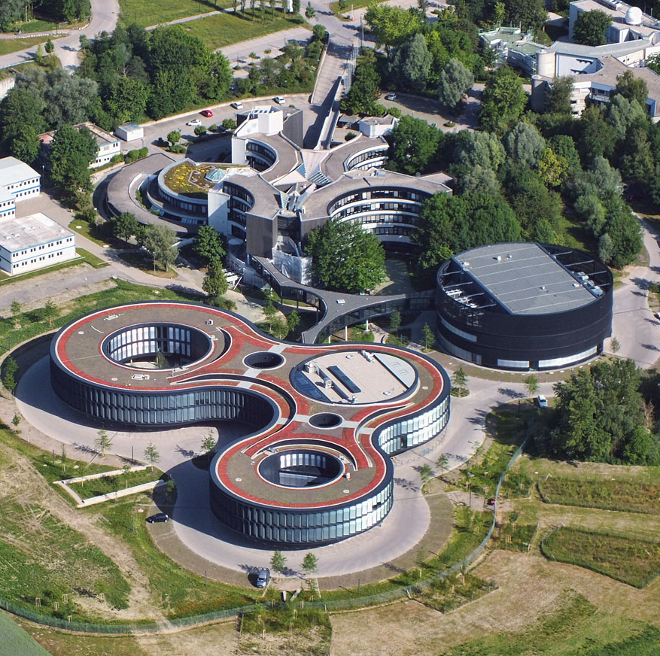
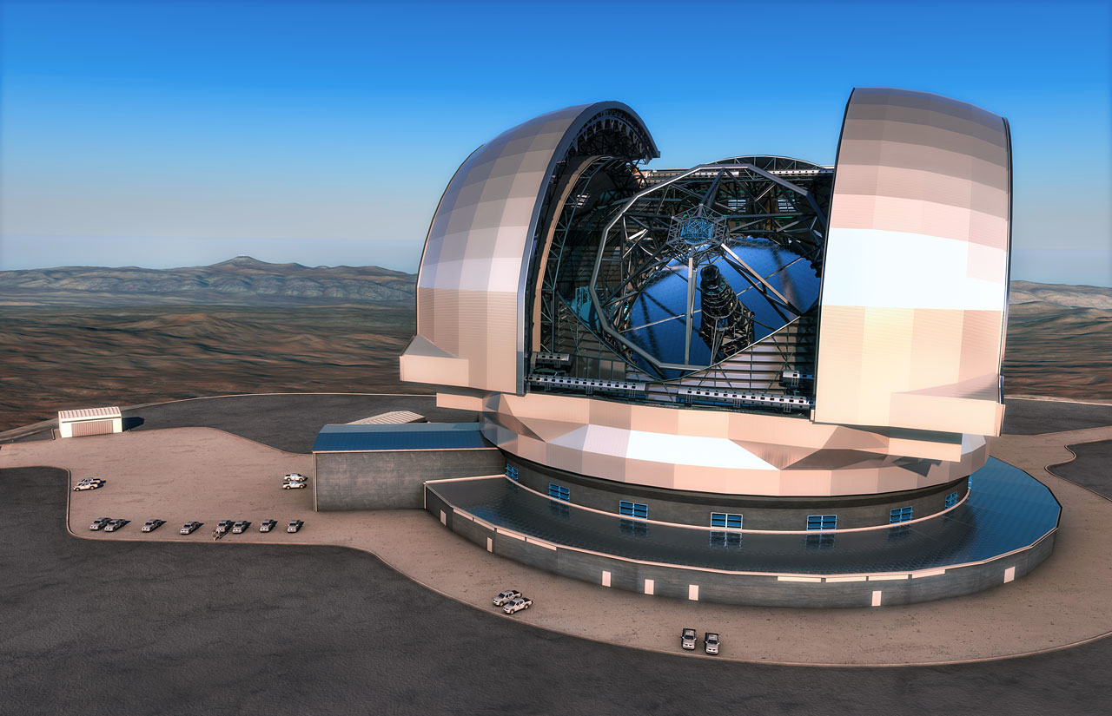
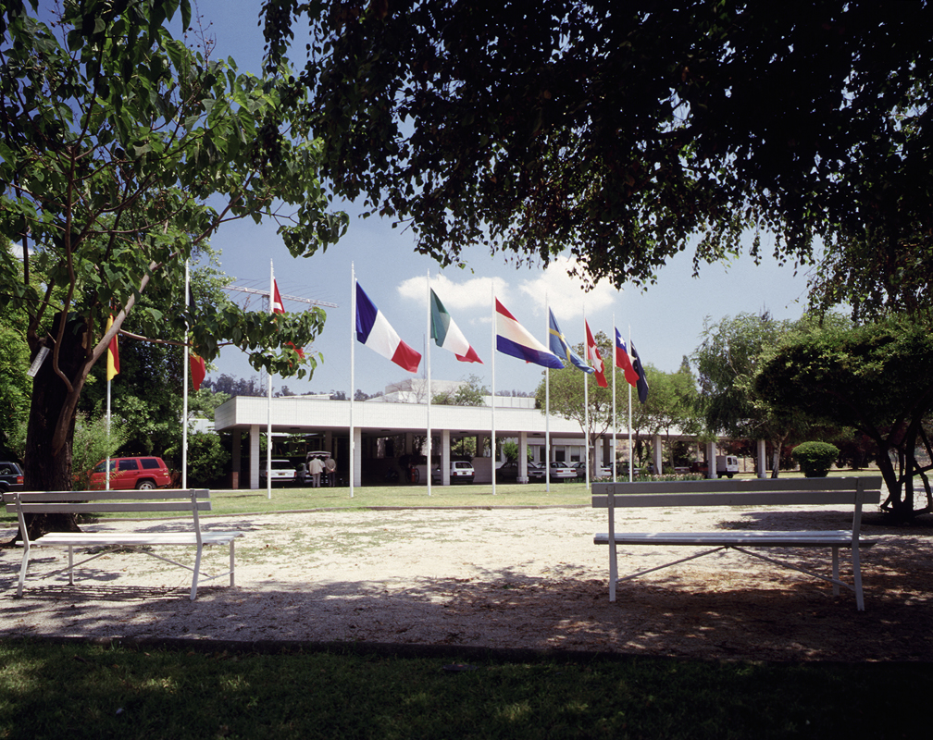

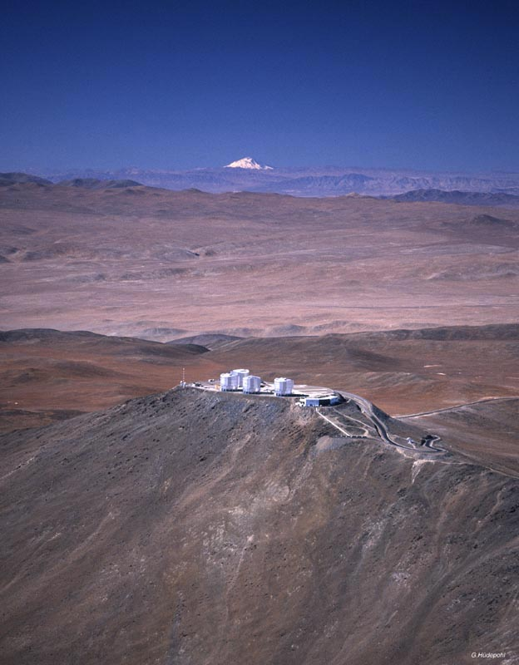
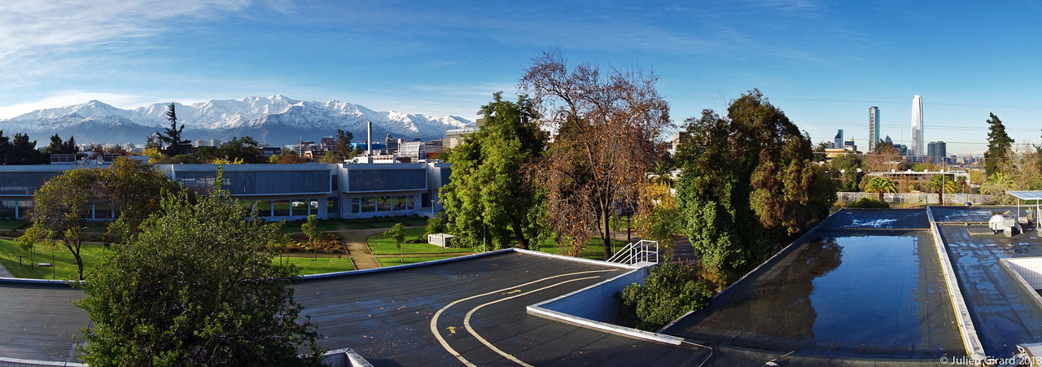
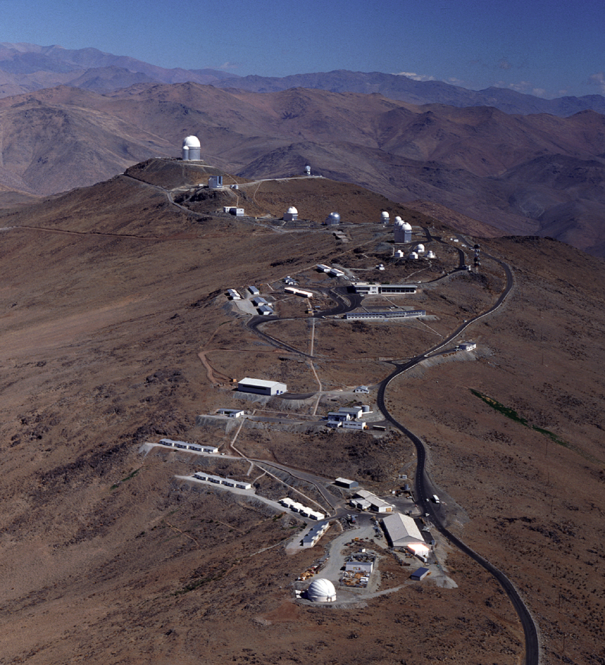
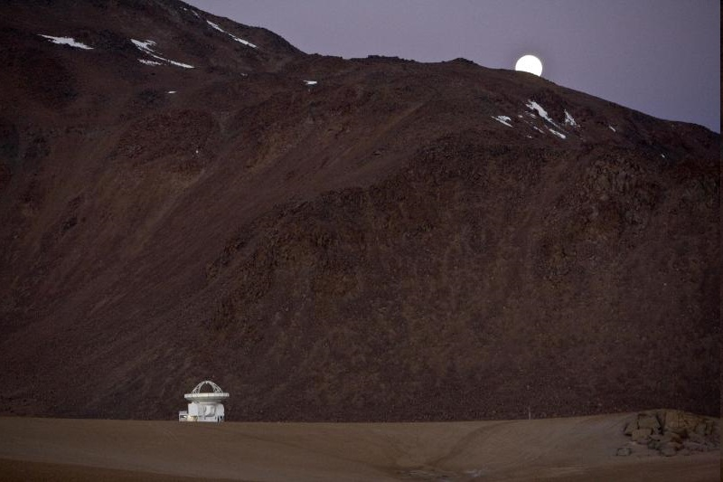
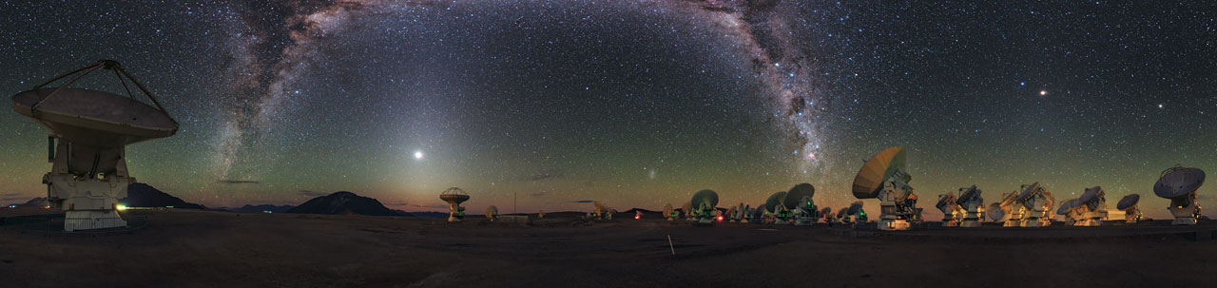
ESO
Observatories La Silla and Paranal in operation
8 Telescopes, plus 4 telescopes for Interferometry
APEX in operation on Chajnantor
Atacama Large Millimeter Array (ALMA)
Public data archive
ESO Extremely Large Telescope under construction
Headquarters in Garching, Germany
Representation in Santiago de Chile
Joint ALMA Office in Santiago

Slide 11
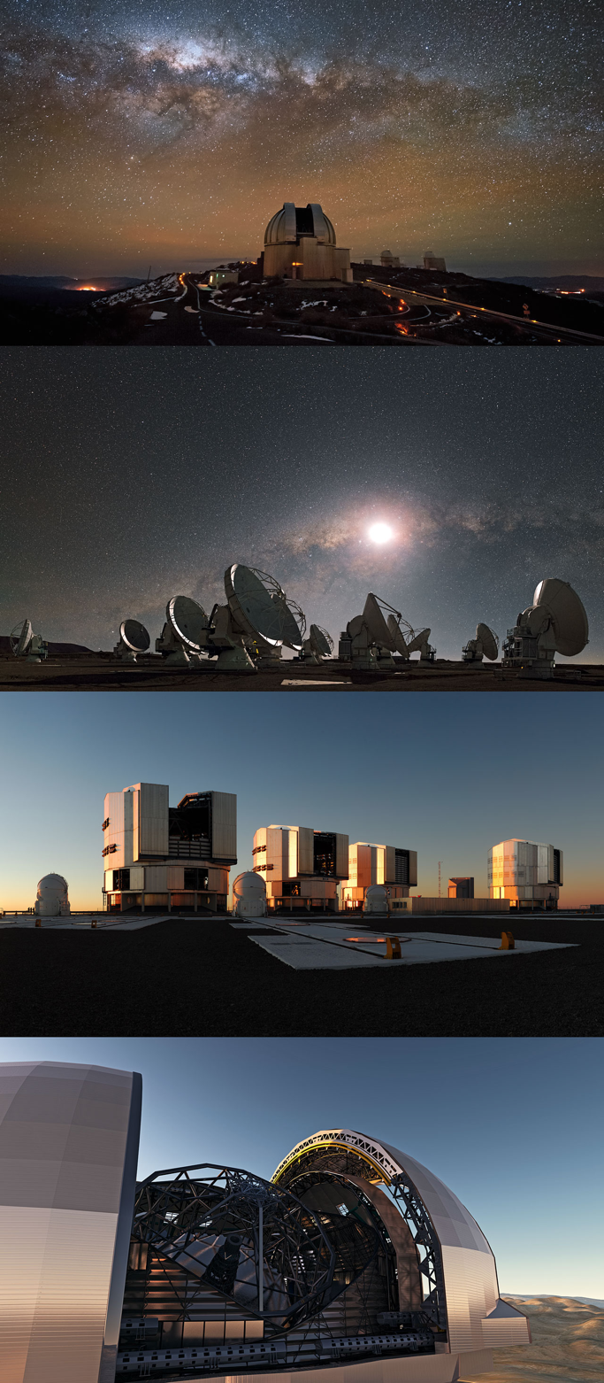
ESO Facilities
Optical near-infrared observatories
  most sensitive to hot black body radiation (T>1000 K)
  atomic transitions
  some molecular transitions
  Very Large Telescope (VLT)
  Survey telescopes (VISTA and VST)
  Extremely Large Telescope (E-ELT)
mm-wavelength observatories
  cold objects (T<100K)
  rotational and vibrational transitions in molecules
  Atacama Large Millimeter Array (ALMA)
  Atacama Pathfinder EXperiment (APEX)

Slide 12
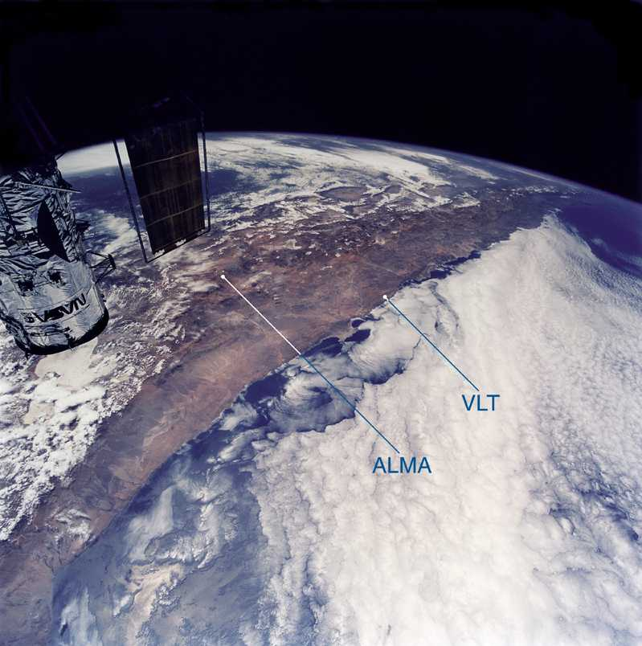

Slide 13
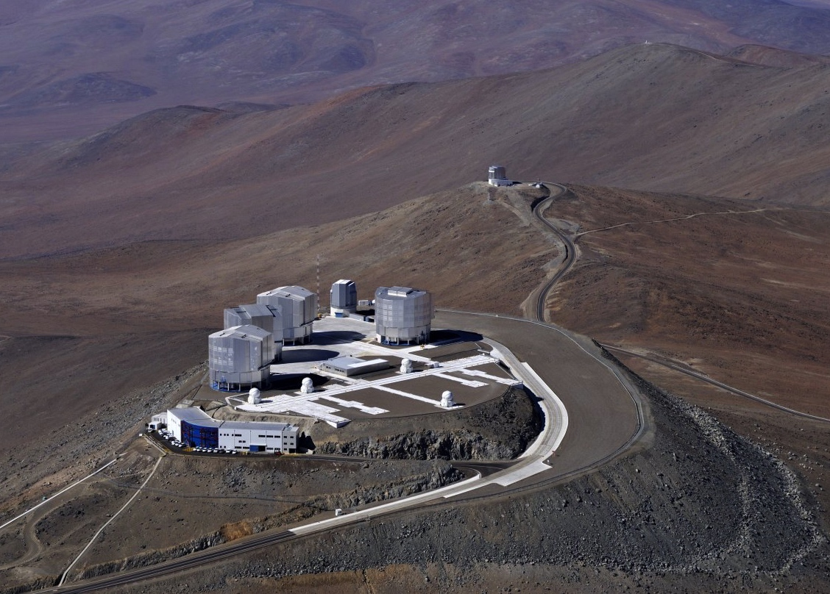
The VLT is the world´s most productive ground-based facility:
more than one scientific paper per day!

Slide 14
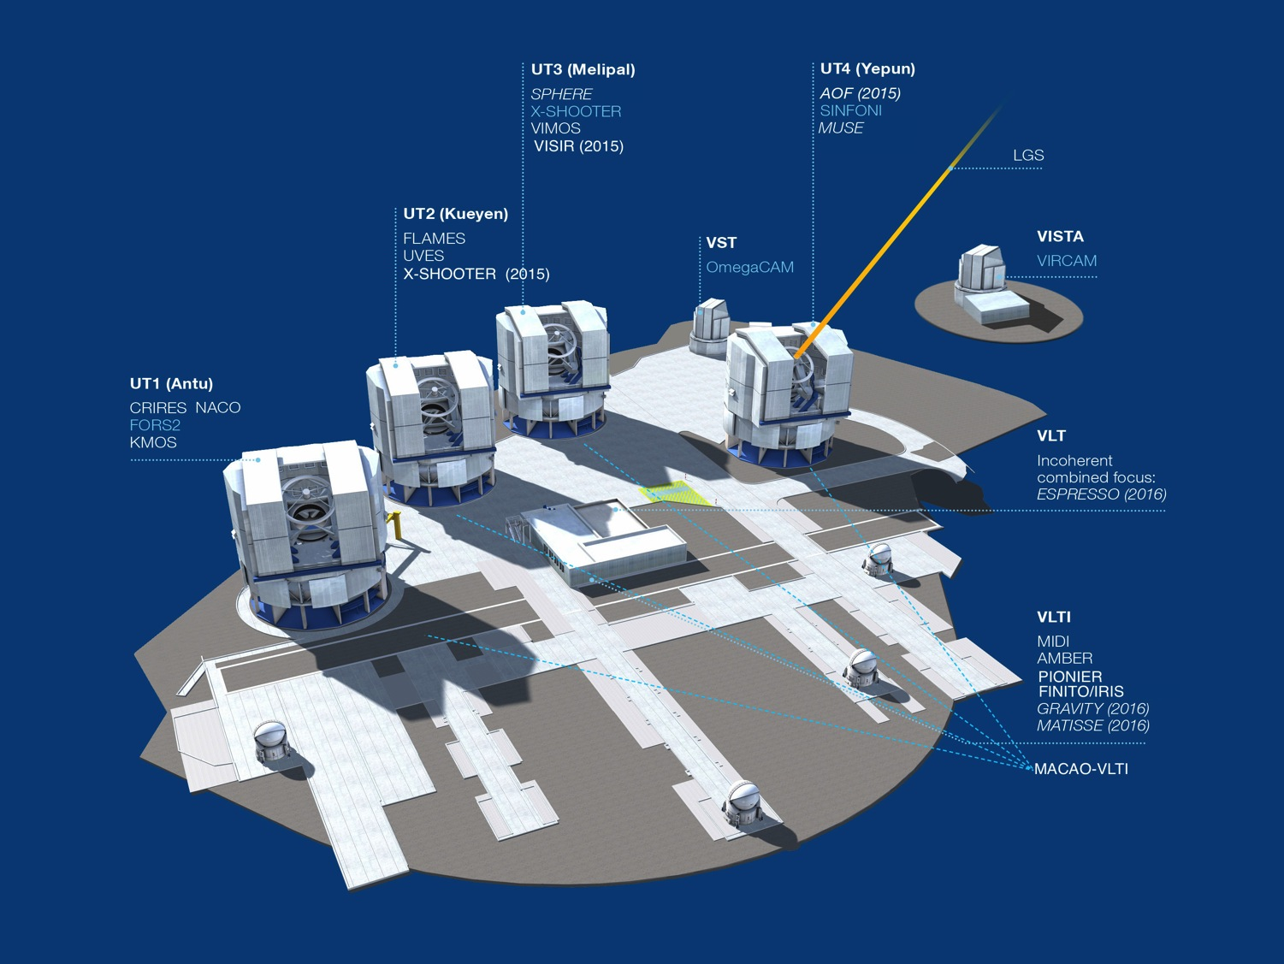

Paranal 2015

Slide 15
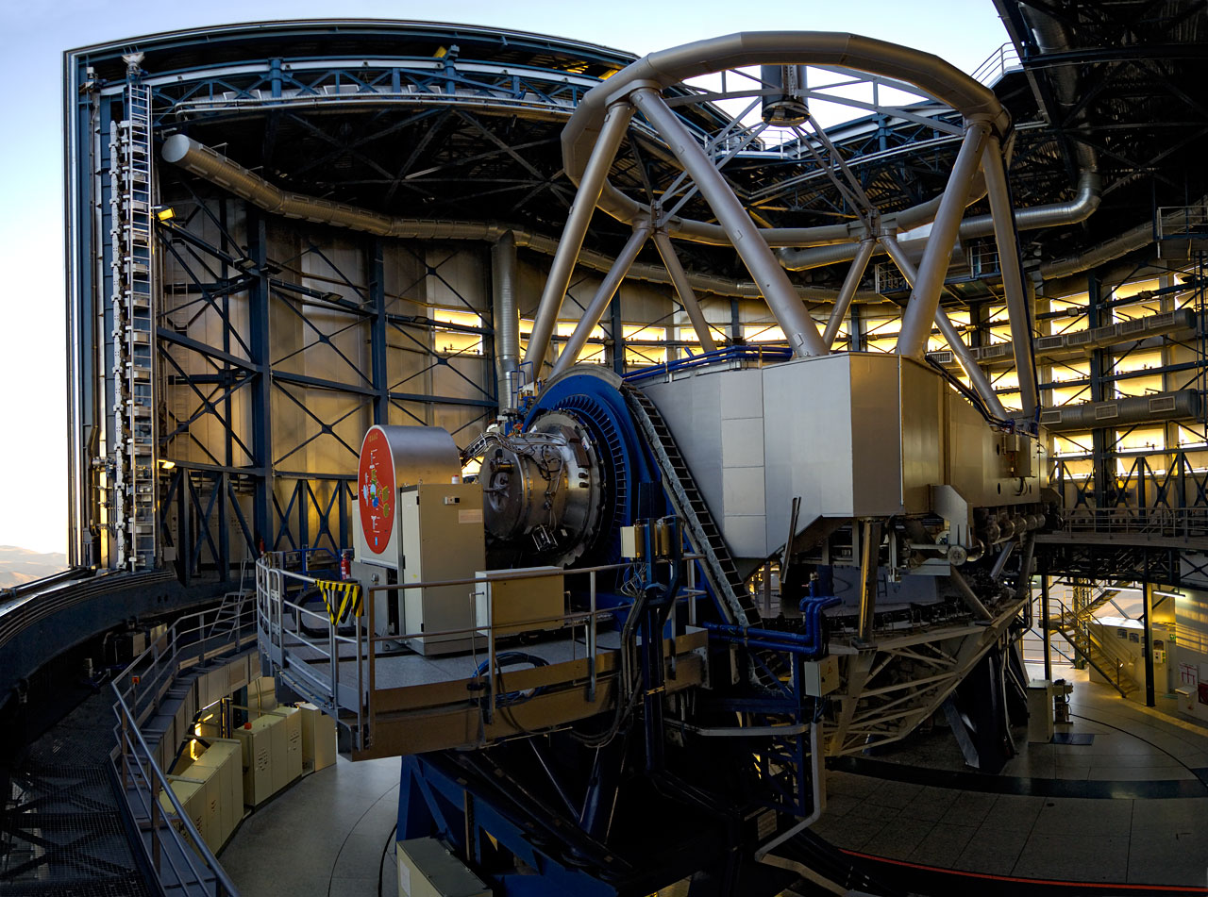
One of the 8m telescopes

Slide 16
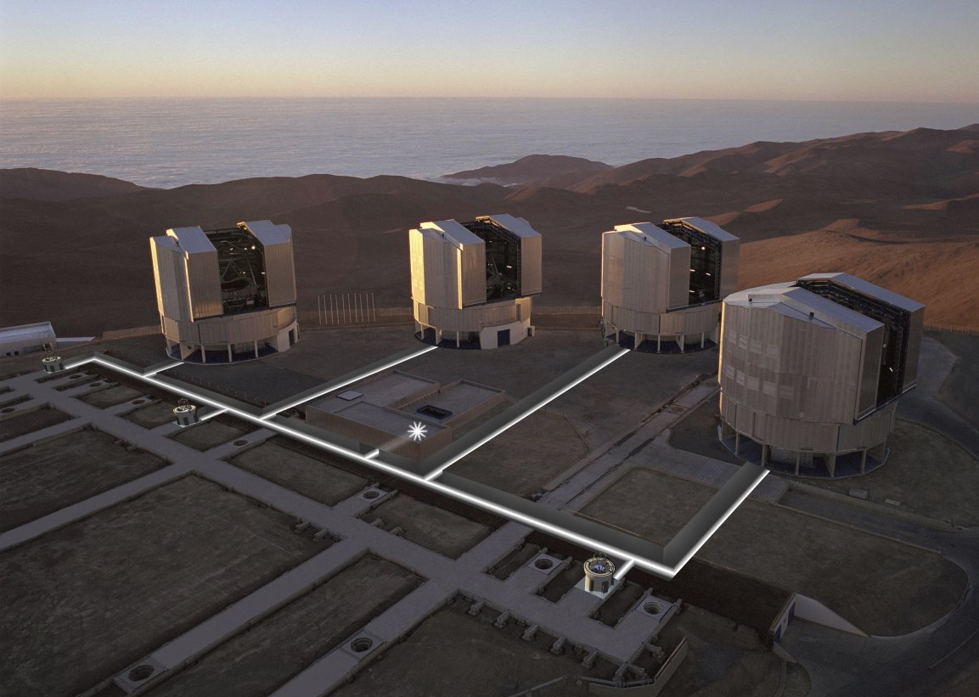
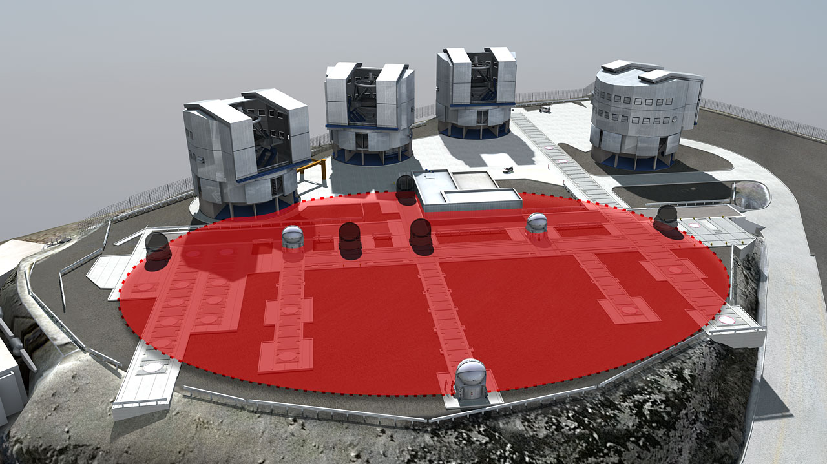
VLTI - Very Large Telescope Interferometry
The VLTI is a virtual 100-Meter Telescope

Slide 17
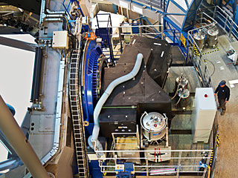
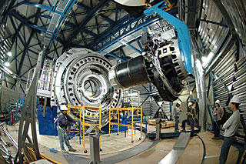
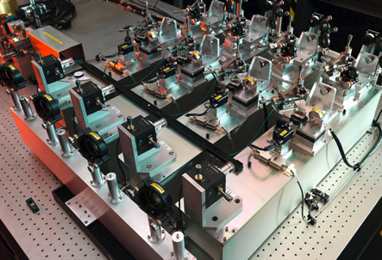
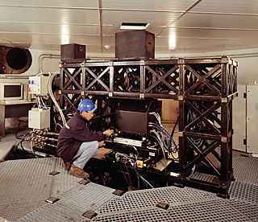
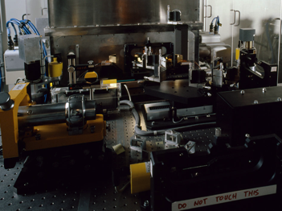
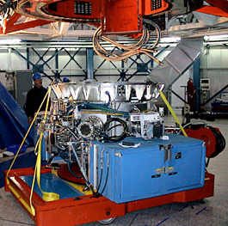
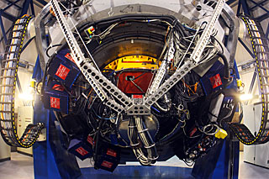
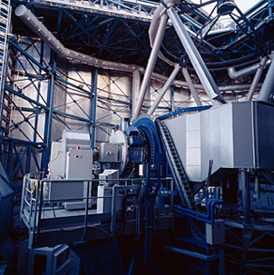
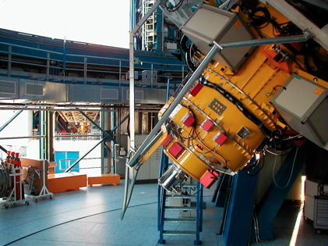
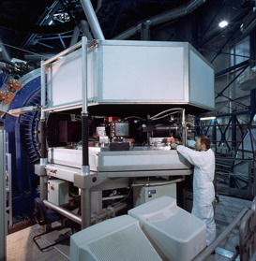
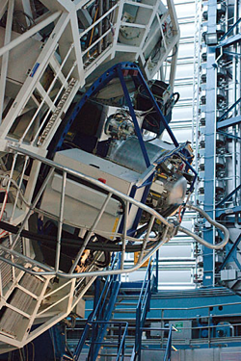
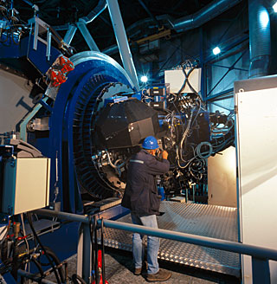
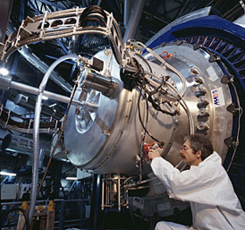
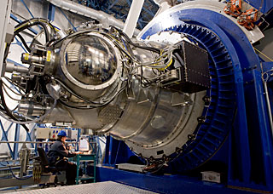
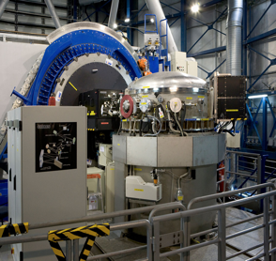
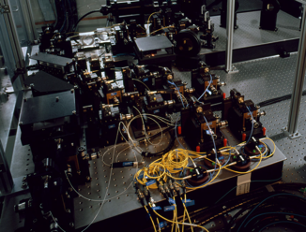
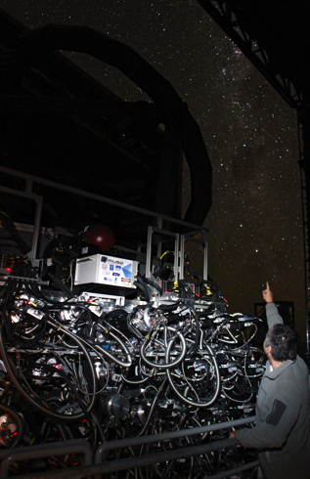
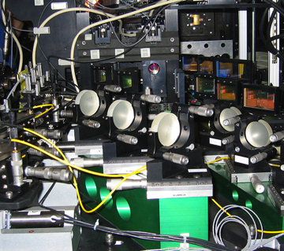
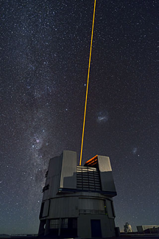
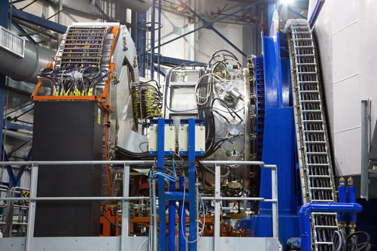
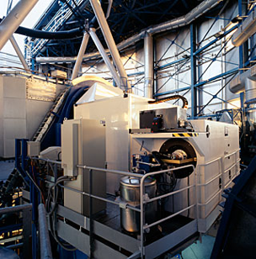

Slide 18
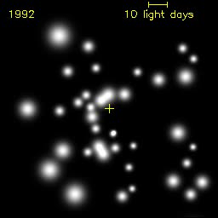
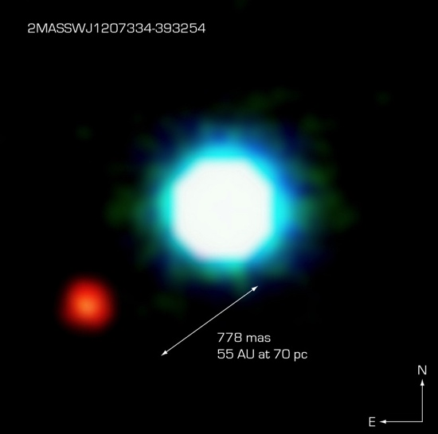
Some Results
Supermassive black hole at the centre of the Milky Way
  test GR in strong gravity
Discovery of accelerated
expansion through supernovae
  test GR in weak gravity
Characterisation of exo-planets
  stability of planetary systems
  exo-planet atmospheres
  search for life
Constancy of fundamental constants
  no changes of fine-structure constant and m_{p}/m_{e}

Slide 19


Black hole at the Centre of the Milky Way
Mass determination through
stellar orbits (about 40 known)
  M ≈ 4⋅10⁶ M
Structure around the black
hole revealed through flashes
Post-Newtonian effects predicted for the next passage of star S2
  direct test of GR in the strong field

Slide 20



Galactic Centre
Pericenter shift probes the nature of the black hole
  measure post-Newtonian effects
Higher order terms necessary to take into account
GR in the strong gravity regime
GRAVITY at VLTI aims at constraining them

Slide 21
Cosmology with high resolution
Measure absorption lines of intervening galaxies towards quasars
Determine line shifts due to changing fine structure constant

Slide 22

VLT/UVES absorber: Δα/α=0

Slide 23

VLT/UVES absorber: Δα/α=10⁻⁴

Slide 24
Currently no change detected
Molaro et al. (2013) Evans et al. (2014)

Slide 25
Temperature of the CMB
Adiabatic expansion of the universe predicts
  T_{CMB}(z)=T₀(1+z)
    deviations would indicate violation of equivalence principle or non-conservation of photons
Direct excitation of interstellar molecules
  Measure rotational transitions of CO as absorption line at different redshifts
    excitation energy close to the CMB temperature

Slide 26
Temperature of the CMB
Pasquier Noterdeame
β=-0.007±0.027
excludes the steady state model by 37σ

Slide 27

Planets, planets, planets
Planets everywhere
  Radial velocities
  Direct imaging
  Transits
Characterisation
  Planetary systems
  masses
  chemical composition
  temperatures
Perryman et al. 2005

Slide 28

Exo-Planets
Emphasis is shifting
  most discoveries expected through transits
  characterisation of atmospheres
  discovery of Earth-like planets
  characterisation of hot Jupiters
Requires different instruments
  Many global ongoing surveys
    Next Generation Transit Surveys (NGTS – Paranal)
    dedicated telescopes hosted at ESO sites (e.g. Swiss Euler)
    future space missions (TESS, CHEOPS, PLATO)
  Continued radial velocity surveys
    masses through the combination with the transits
  Atmosphere characterisation

Slide 29



The ESO exo-planet machinery
High-resolution spectrographs
  HARPS at 3.6m telescope
    best radial velocity machine at a 4m
    telescope, extremely stable spectrograph
  ESPRESSO at VLT in the future
Adaptive Optics cameras
  NACO/SPHERE
    imaging, direct detection
Adaptive Optics spectrographs
  NACO/SINFONI/FORS2
    atmospheres of exo-planets
Interferometry
  highest spatial resolution for follow-up
  observations of known systems
Infrared high-resolution spectrographs
  CRIRES+, NIRPS
    spectroscopy of atmospheres
    low mass host stars → Earth mass planet search

Slide 30


β Pic planet
Planet (~10 M_{jup}) within the massive dust disk
Orbit only a few AU
NACO imaging
SPHERE imaging
  planet – star separation
    ~350 mas
Lagrange et al. 2009, A&A, 493, L21

Slide 31

ALMA
Observe the cold universe
  wavelengths from 300 μm to 1.3 mm (1 THz to 200 GHz)
Global Partnership
  Europe (ESO), North America (USA/NSF and Canada/NRC),
  East Asia (Japan/NINS, Taiwan/NSC/ASIAA, South Korea/KASI)
66 antennas located at 5000m altitude
  50 12m antennas
  12 7m + 4 12m antennas (compact array)

Slide 32

HL Tau
ALMA

Slide 33



Complex molecules in space
Detection of sugar molecule
  glycolaldehyde HCOCH₂OH and several alcohols
    e.g. methyl formate, ketene (CH₂CO), trans-ethanol (t-C₂H₅OH)
  Class 0 binary proto-star with about solar mass
ρ Oph
Jørgensen et al. 2012
Jørgensen et al. 2012

Slide 34
SN 1987A an example of a multi-wavelength study
Neutrino source at explosion
Follow-up observations for 28 years
  HST, VLT, Chandra, XMM/Newton, ATCA
HST - Fransson et al. 2015
SN 1987A in 2013
Indebetouw et al. 2014

Slide 35

SN 1987A
Indebetouw et al. 2014

Slide 36

Distant galaxies with ALMA
Follow-up of mm sources discovered with the South Pole Telescope (SPT)
  Detected many high-redshift galaxies (<z>=3.5)
  860μm ALMA imaging (Cycle 0 – 16 antennas)
    47 candidates → several clearly lensed sources
    Integration times 1 minute
    2 objects at z=5.7 with high star formation rate > 500 M yr⁻¹
Viera et al. Nature 2013; Hezaveh et al. ApJ 2013
Notes:
Figure 1 | Near-infrared and ALMA submillimetre-wavelength images of
SPT targets. Images are 80380. We show 10 sources for which we have
confirmed ALMA spectroscopic redshifts, deep near-infrared (NIR) imaging,
and well-resolved structure in the ALMA 870 mmimaging; source names are in
blue in each panel. The greyscale images are NIR exposures from the Hubble
Space Telescope Wide Field Camera 3 (HST/WFC3, co-added F160W and
F110W filters), the Very Large Telescope Infrared Spectrometer and Array
Camera (VLT/ISAAC: Ks band) or the Southern Astrophysical Research
Telescope Ohio State Infrared Imager/Spectrometer (SOAR/OSIRIS: Ks band),
and trace the starlight fromthe foreground lensing galaxy. The NIR images are
shown with logarithmic stretch, and each panel shows at bottom left in black
the telescope/instrument used to obtain the image. The red contours areALMA
870 mmimaging showing the background source structure, clearly indicative of
strong lensing from galaxy-scale haloes. In all cases, the contours start at 5s and
are equally spaced up to 90% of the peak significance, which ranges from 12 to
35. Spectroscopic redshifts of the background sources are shown in red in each
panel, above the NIR telescope/instrument names. The ALMA exposures were
approximately 2-min integrations, roughly equally divided between the
compact and extended array configurations. The resulting resolution is 0.50.
SPT 0103–45 shows a rare lensing configuration of one lens and two
background sources at different redshifts, one visible with ALMA and one with
HST. SPT 0346–52, with a CO-derived redshift of z55.656, is among the
highest-redshift starbursts known.

Slide 37

Distant galaxies with ALMA
Secure redshifts for many sources
  ALMA 3mm spectroscopy
  Integration times about 10 minutes
    Lines detected of ¹²CO, ¹³CO, Ci, H₂O
Viera et al. Nature 2013
Weiss et al. ApJ 2013
Notes:
Figure 2 | ALMA 3 mm spectra of 26 SPT sources. The vertical axis is
observed flux density in units of mJy, with 30 mJy offsets between sources for
clarity. Spectra are continuum-subtracted. The strong CO lines are indicative of
dust-enshrouded active star formation. The spectra are labelled by source and
redshift. Black labels indicate unambiguous redshifts (18), with the subset in
bold font (12) having been derived from the ALMA data alone. Sources labelled
in blue (5) are plotted at the most likely redshift of multiple options, based on
the dust temperature derived from extensive far-infrared photometry. Three
sources with no lines detected are placed at z=1.85, in the middle of the
redshift range for which we expect no strong lines, and labelled in red. Total
integration times for each source were roughly ten minutes. The synthesized
beamsize ranges from 7”x5” to 5”x3” over the frequency range of the search,
which is inadequate to spatially resolve the velocity structure of the lensed
sources. Transitions of species detected in at least one source are indicated by
vertical lines. Rotational transitions of the 12CO (solid) and 13CO (dashed)
isotopologues are shown in grey. Water lines are marked by blue dashed lines,
ionized water lines by red dashed lines, and atomic carbon ([CI]) by the green
dashed line.

Slide 38

ESO’s next project - E-ELT

Slide 39

Cerenkov Telescope Array
Southern array potentially to be placed near Paranal/Armazonas
cta-observatory.org

