Slide 1
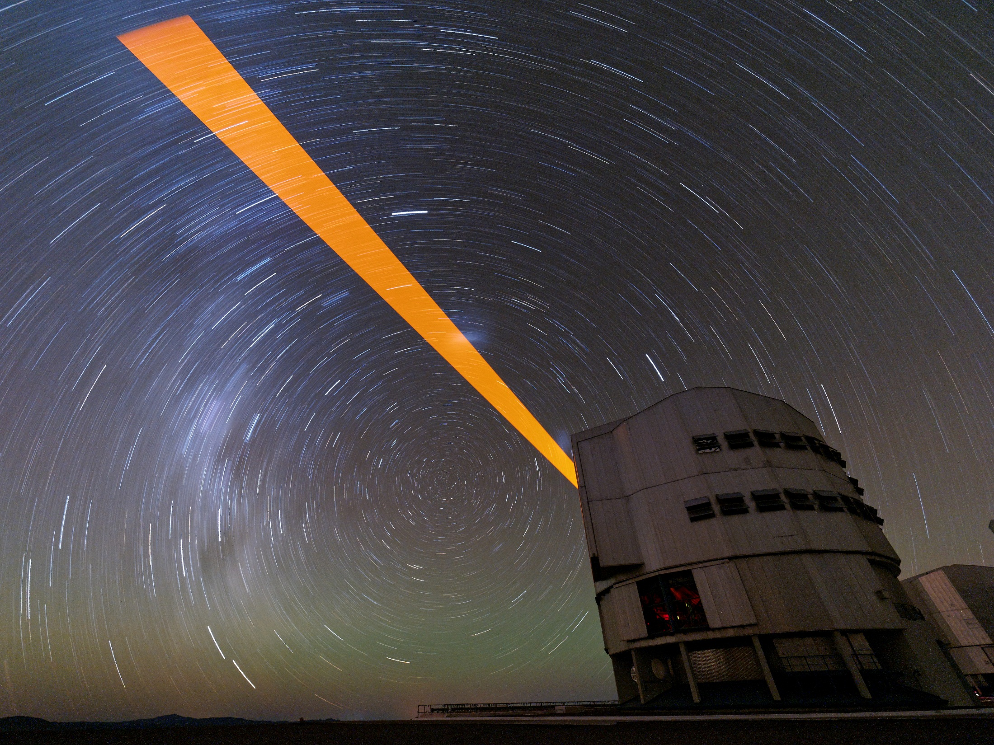
AOF System Tests: from ESO Headquarters… to the Sky!
J. Kolb on behalf of the AOF team
ESO Overview 2016

Slide 2
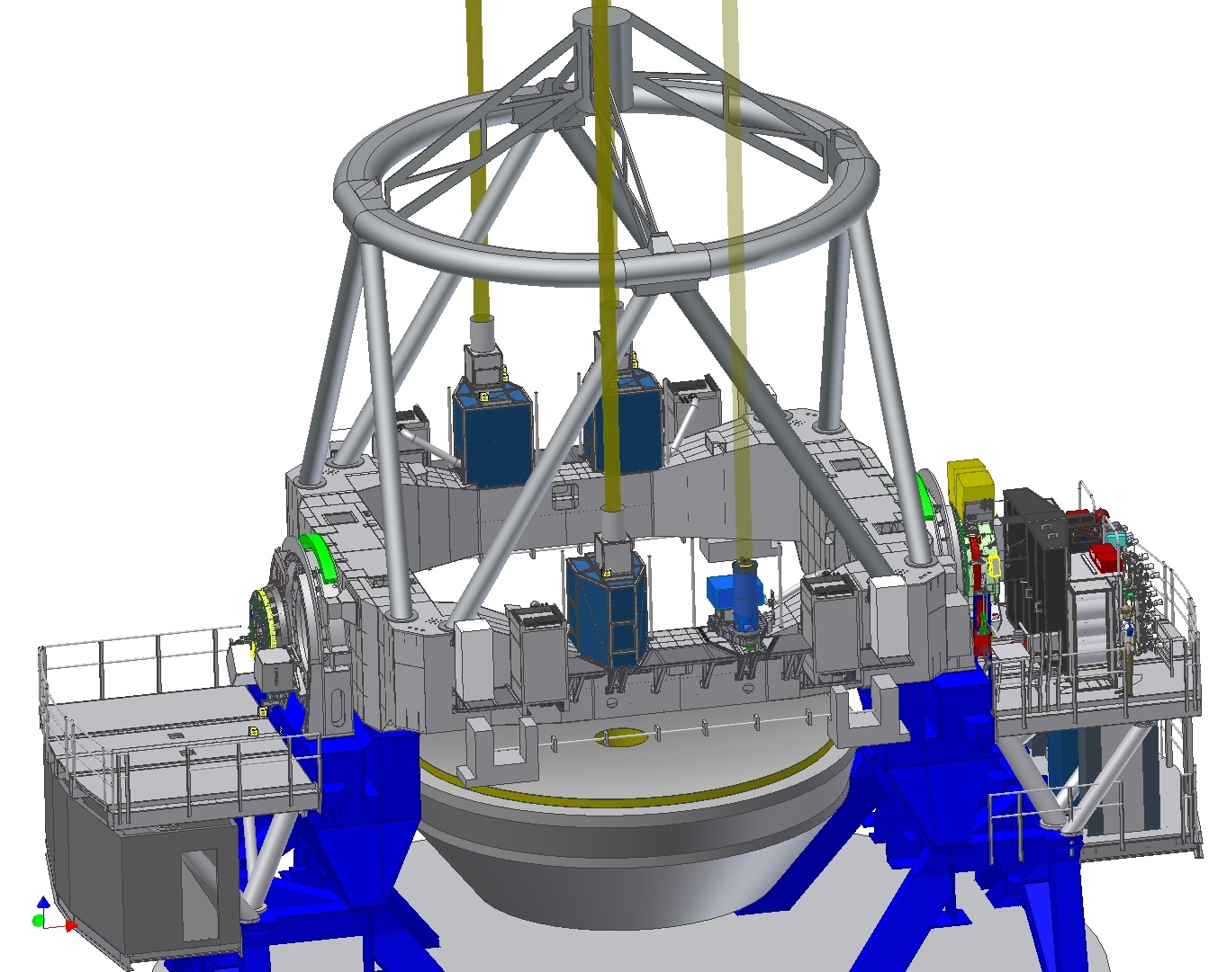
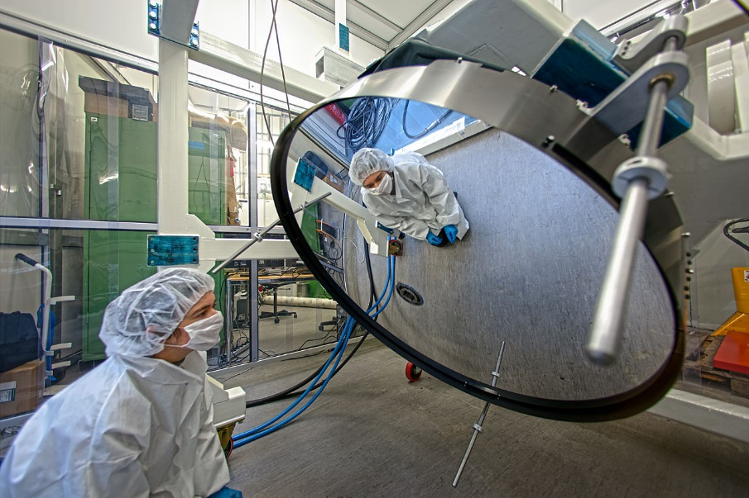
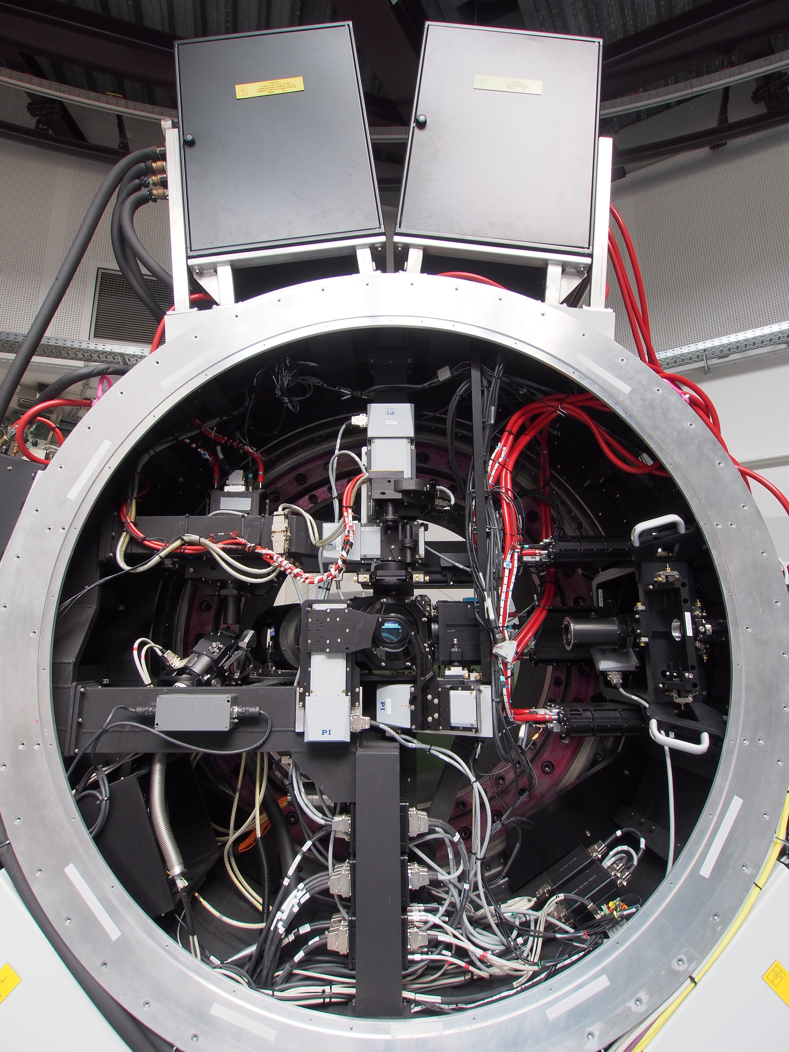
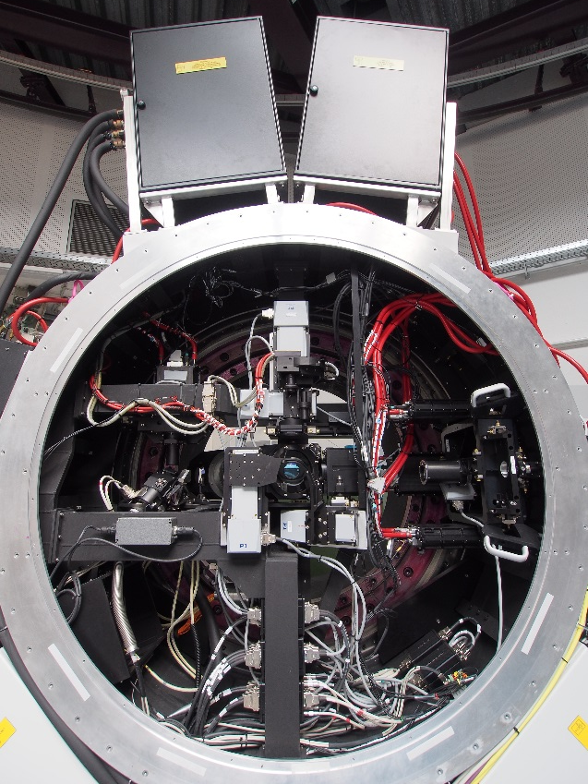
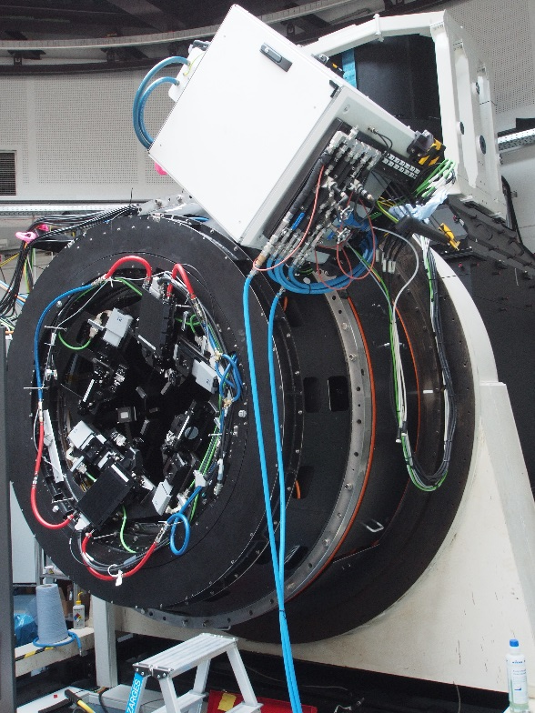
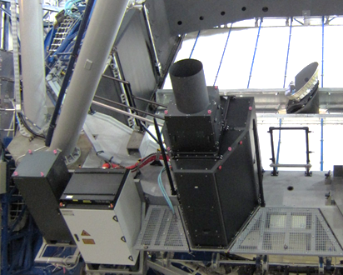
The Adaptive Optics Facility
Wavefront Sensor
DSM
GRAAL
LGS unit
GALACSI

Slide 3
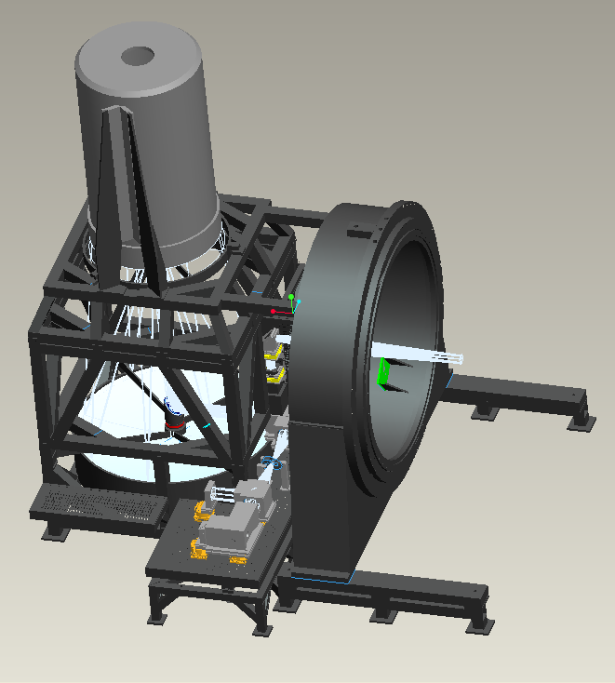
The AOF test Facility
Adaptive Secondary Setup and Instrument Stimulator (ASSIST)
Optical calibration of the Deformable Secondary Mirror
Flattening
Measurement of Influence Functions and comparison with FEA model
Test bench for AOF providing repeatable conditions

Slide 4
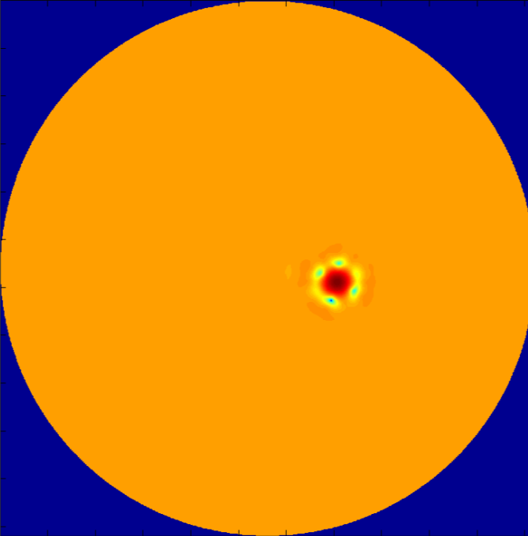

Pseudo-Synthetic Interaction Matrix
Adaptive Telescope → no source upfront the Deformable Mirror to calibrate the IM
Instead, using a model of the DSM Influence Functions, passed through a simulated Wavefront Sensor included measured properties of the actual system like optical mis-registrations.
PSIM
Image quality
No daytime calibration required
Correcting more modes

Slide 5
Dealing with mis-registrations
Pupil shift is expected at the telescope
No room in GRAAL or GALACSI for pupil re-centering mirror → mis-registration online estimation and IM update
Image quality
No daytime calibration required

Slide 6
Matching simulations
Performance measured on ASSIST compared with the simulation results from ESO’s AO simulation tool Octopus
Image quality
Image quality
Measured on several stars in the Field of View of ASSIST
Simulated
Correcting more modes
As the same tool was used to perform the FDR simulations, such results:
Validate the expected performance we will obtain on sky
Allow using Octopus to predict the performance in atmospheric conditions we cannot reproduce in the lab
Use Octopus to debug the behavior of the system in the lab in real-time

Slide 7
Laser Tomography AO
4 LGS at 10 arcsec, Low-Order modes on scientific object (IR). Feeding the Narrow-Field Mode of MUSE
Log scale
H band
FWHM = 360 mas
Diffraction limit = 42 mas
1500 mas
No AO
AO
FWHM gain > 10
Peak Intensity x 30
Strehl Ratio > 10%
625 nm
FWHM = 520 mas
Diffraction limit = 16 mas

Slide 8
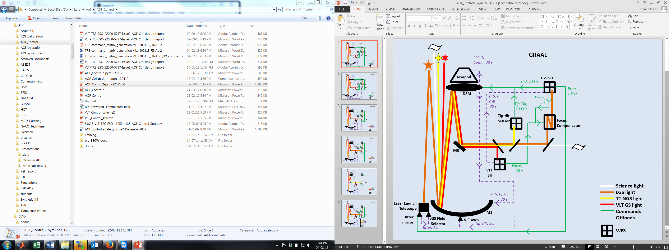
Interaction with the Telescope
Tested in Garching
Interface tested
Tested during first commissioning Oct’ 15

Slide 9
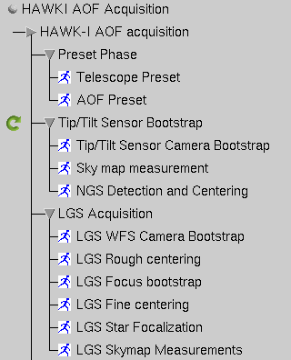
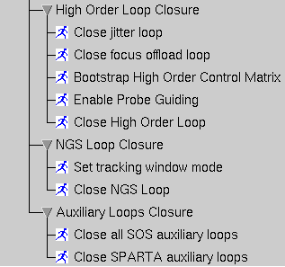
The AOF Acquisition Sequence
Acquisition starts to run during the telescope Preset.
AOF Acquisition overhead (i.e. after the telescope is ready) requirement is 5 min with a goal of 2 min.
It has been timed in the lab to 2 min 45 (+80 or -45 seconds depending on the initial conditions)
The sequence has been successfully tested on the acquisition of one LGS with GRAAL during commissioning in October, and preliminary measured overheads between 0 and 4 minutes.

Slide 10
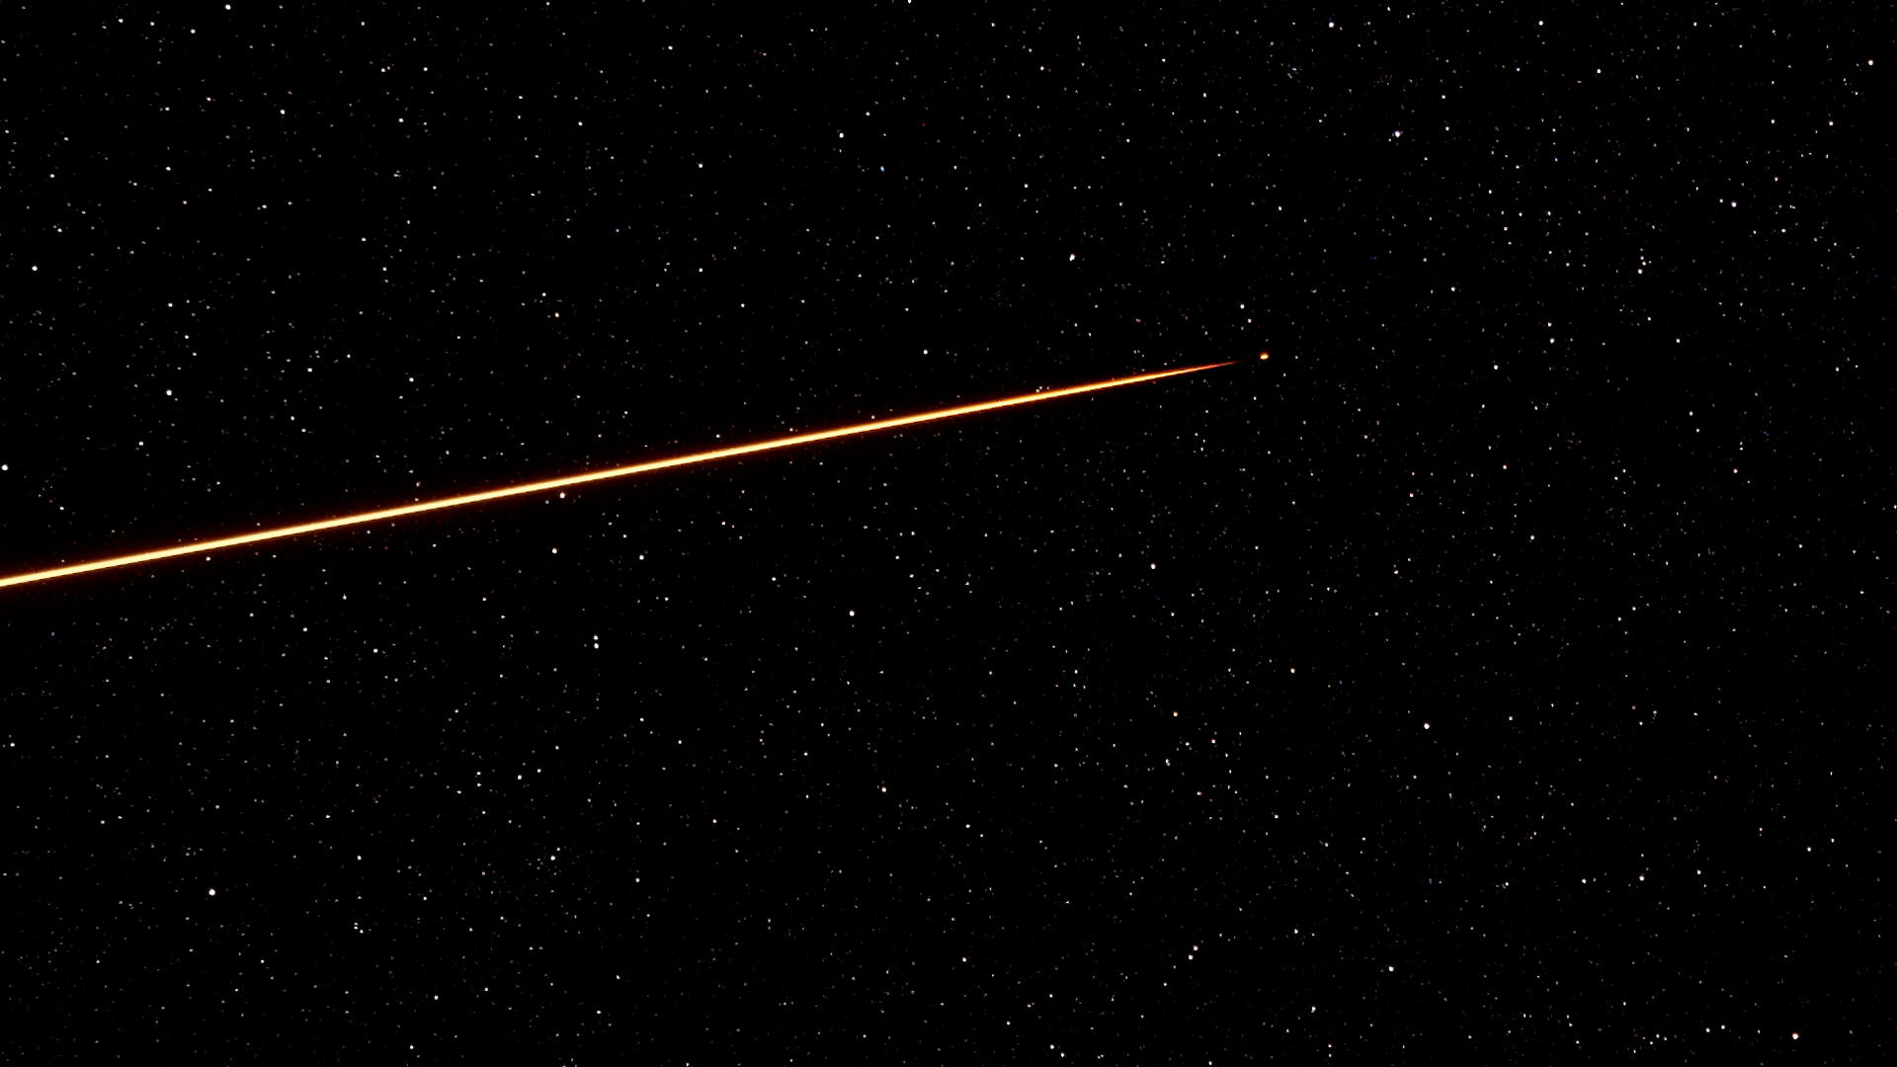
Towards Commissioning
Very first light of 1 LGS on GRAAL
4LGSF currently being installed
DSM at the end of the year
GRAAL and GALACSI commissionings resume in January 2017

