Slide 1
Dark Dust IV
The distance to the stars
Ralf Siebenmorgen, Rolf Chini, Karl Gordon, Jacek Krelowski, Jonathan Smoker
- The distance puzzle and very cold dark dust
- Dark dust (II) model vs. observational constarints
- From the general field in the ISM to individual sources:
“Scrutinizing MW reddening curves” (DD III)
- Model of the absolute reddening towards stars
- Unification of distances

Slide 2
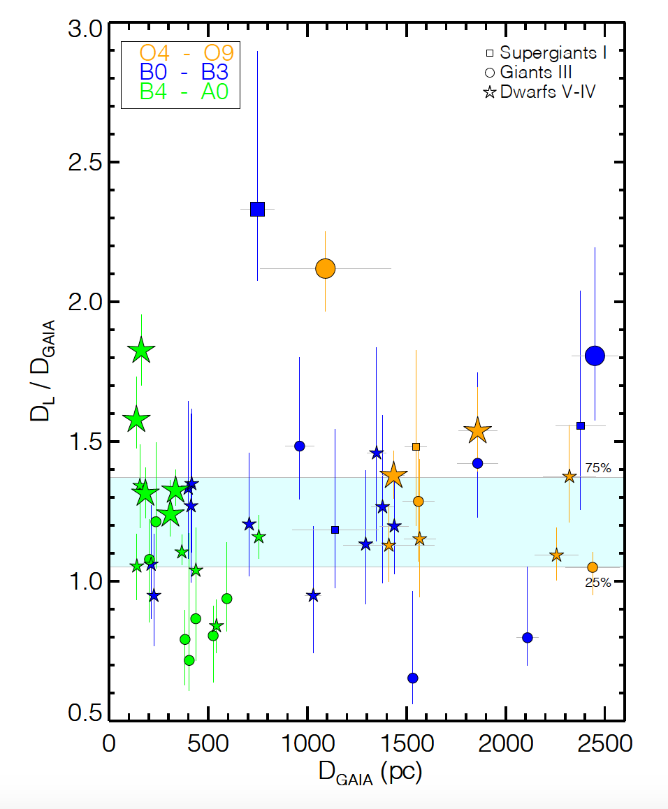
Dark Dust IV:
The distance puzzle
Ralf Siebenmorgen
Overestimate of luminosity distance D_{L}
when compared to GAIA parallax
A_{V} : Valencic+04, Fitzpartick&Massa07, Gordon+09
M_{V} : Bowen+08, Wegner+07
5 log(D_{L}) = V – M_{V} – A_{V} + 5

Slide 3
Dark Dust IV:
The distance puzzle
Ralf Siebenmorgen
Dimming by ‘meteoritic bodies’
(Trumpler, 1930)
5 log(D_{L}) = V – M_{V} – A_{V} + 5

Slide 4
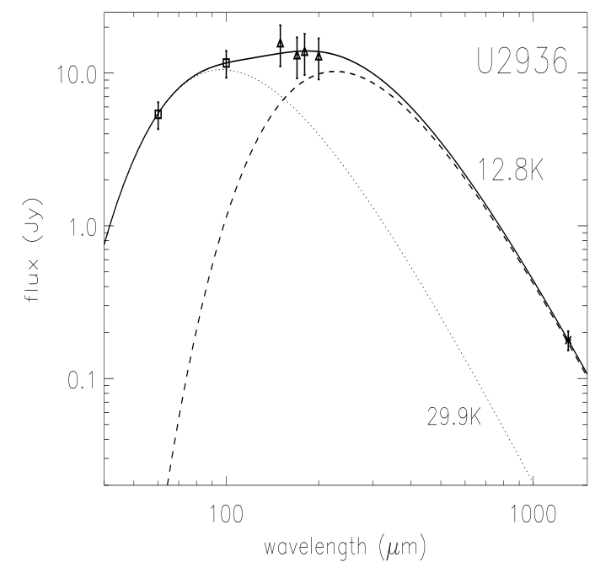
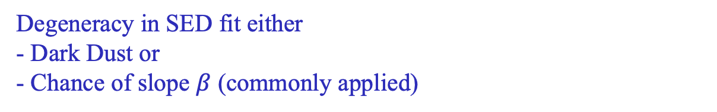
Dark Dust IV:
The distance puzzle and
Very cold dust emission
Ralf Siebenmorgen
Submm excess:
- ISO (S+99)
- Herschel
- ALMA
Degeneracy in SED fit either
- Dark Dust or
- Chance of slope $β$ (commonly applied)

Slide 5
Dark Dust (II) in the general field of the diffuse ISM
Observational constraints of dust models (Hensley & Draine 21):
Solid phase element abundances
Wavelength dependant reddening
Star-light polarization
Dust emission of polarized + unpolarised light,
Account for increased (sub)mm emission by Planck
(2023)

Slide 6
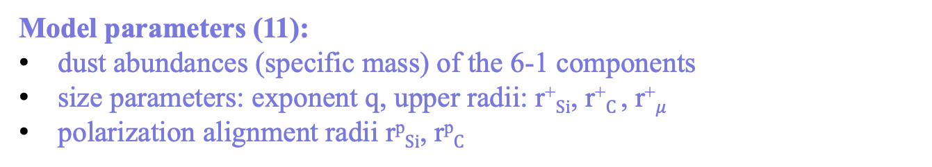
Dark Dust model
Dust populations:
1) Nano-particles <6nm of vSi, vGr, and PAH
2) Submicron spheroids 6nm < a < 300nm of amorphous Si, C
3) Micrometer sized dark dust as fluffy Si+C conglomerates
Model parameters (11):
dust abundances (specific mass) of the 6-1 components
size parameters: exponent q, upper radii: r⁺$Si$, r⁺$C$, r⁺$μ$
polarization alignment radii r^{p}$Si$, r^{p}$C$
(2023)

Slide 7
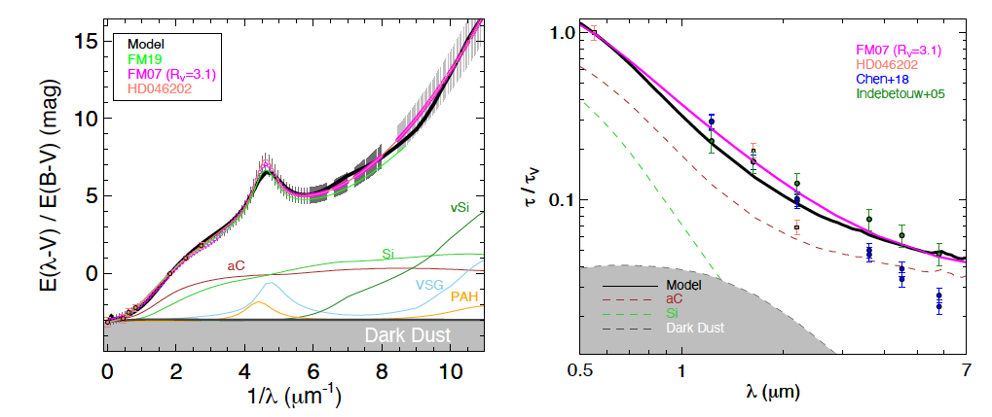
Dark Dust in the general field of the diffuse ISM
a) Dust abundances + b) Reddening
a) All models respect: [C] / [Si] < 5.2
Dark dust provides up to 1$μm$ “non-selective” or “gray” extinction
(2023)

Slide 8
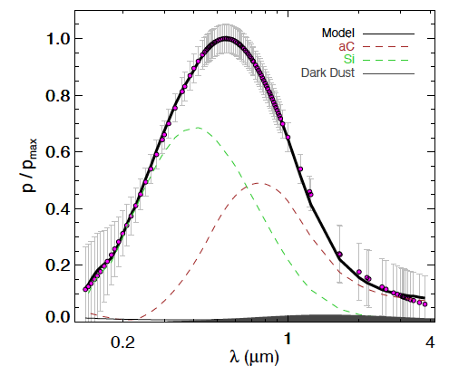
Dark Dust in the general field of the diffuse ISM
c) Starlight polarisation
(2023)

Slide 9
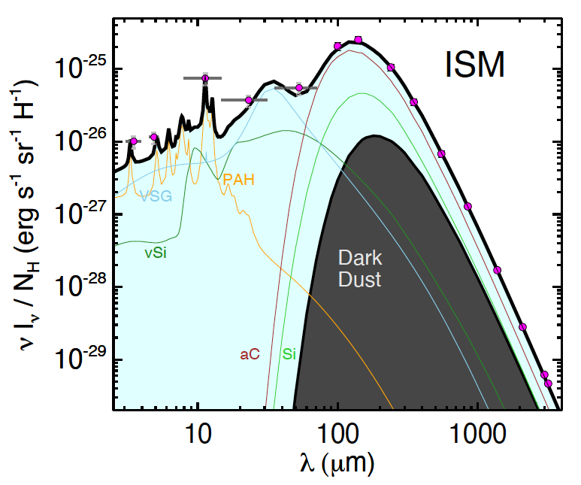

Dark Dust in the general field of the diffuse ISM
d) Dust emission
$\frac{Mgas}{Mdust}$ =125
(2023)

Slide 10
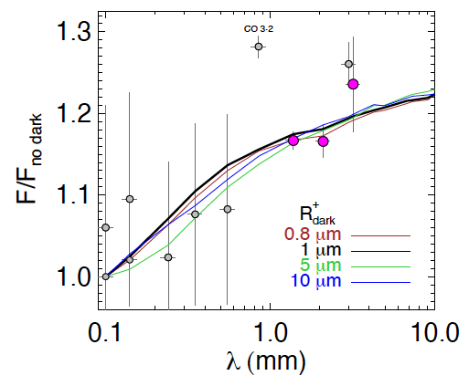
Dark Dust in the general field of the diffuse ISM
e) (sub)mm excess by Planck
Porosity or grain elongation does not impact slope of dust emissivity
(2023)

Slide 11
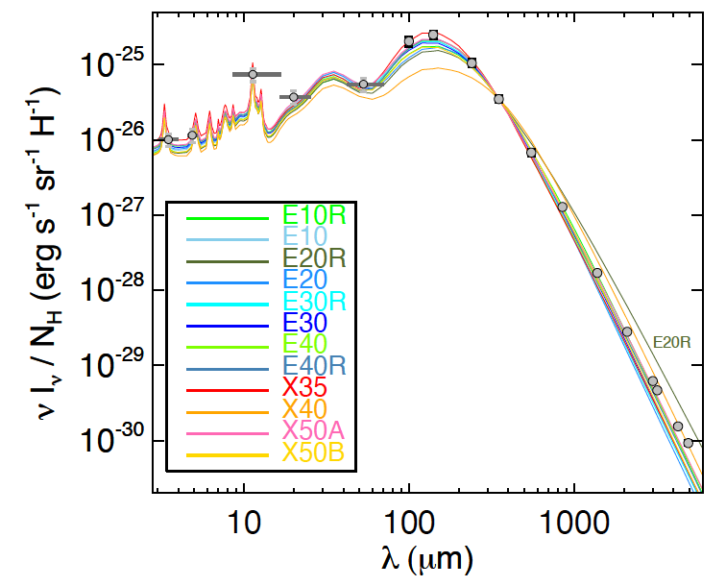
Dark Dust in the general field of the diffuse ISM
d) Dust emission
Mix of new (n,k) data of amorphous Si (Karine Demyk+22)
(2023)

Slide 12
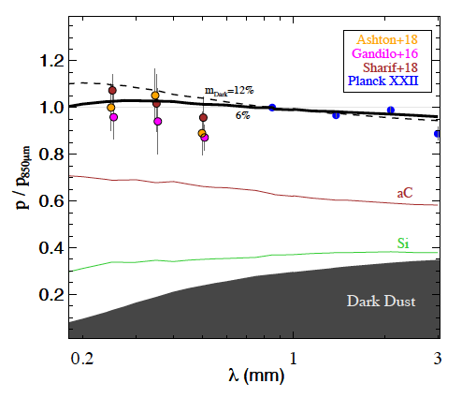
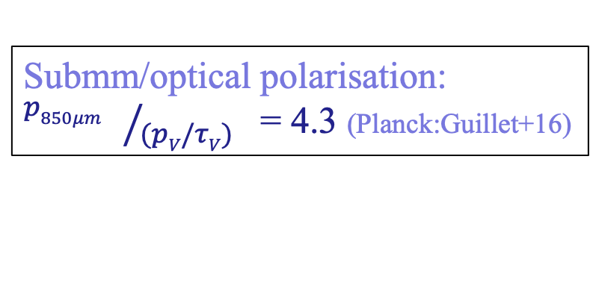
Dark Dust in the general field of the diffuse ISM
d) Polarised emission
Submm/optical polarisation:
${p850μm }/{(pV/τV)}$ = 4.3 (Planck:Guillet+16)
(2023)

Slide 13
Dark dust III - From the general field to individual stars
+ 23

Slide 14
Dark dust III - From the general field to individual stars
Legacy of reddening curves:
#stars
544 IUE/FUSE spectra Valencic+05, Fitzpatrick&Massa07, Gordon+09
186 UVES spectroscopy. S+20
110 FORS2 Large IS Polarisation Survey Bagnulo+17,S+20 + new obs.
+ 20

Slide 15
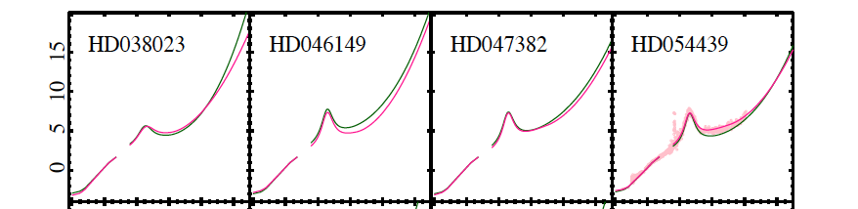
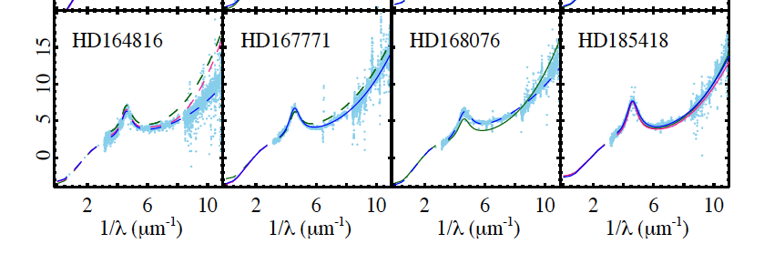

Dark dust III - From the general field to individual stars
E($λ−V) / E(B−V)$
+ 23

Slide 16
Dark dust III - From the general field to individual stars
Scrutinizing reddening curves:
No multiple bright sources within 10” ~IUE apertures
No variability in photometry
No variability in GAIA parallax
MIR/FIR reddening: no emission components
SpL known by precision spectroscopy
SpL of reddened+unreddened star agree
no fast rotators, …
+ 23

Slide 17
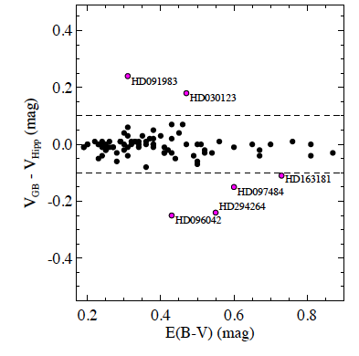
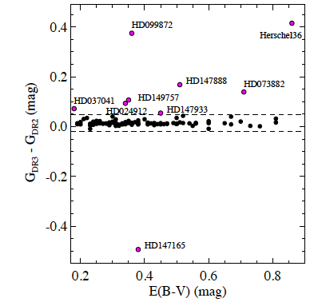
Scrutinizing reddening curves
Photometric variability
HIPPARCOS – Ground based
GAIA: DR3 -DR2
+ 23

Slide 18
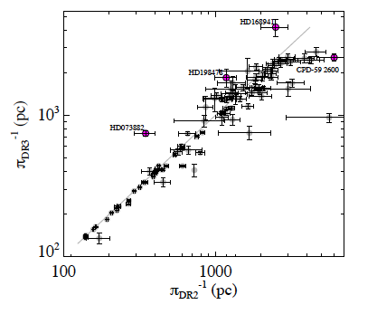
Scrutinizing reddening curves
Variability in parallax
+ 23

Slide 19
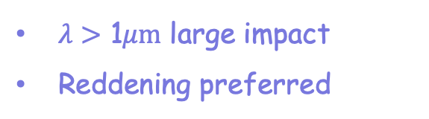
Scrutinizing extinction curves
Impact of binaries
SpL of F_{obs} and F_{nd} differ
extinction
reddening
$λ>$ 1$μm$ large impact
Reddening preferred

Slide 20
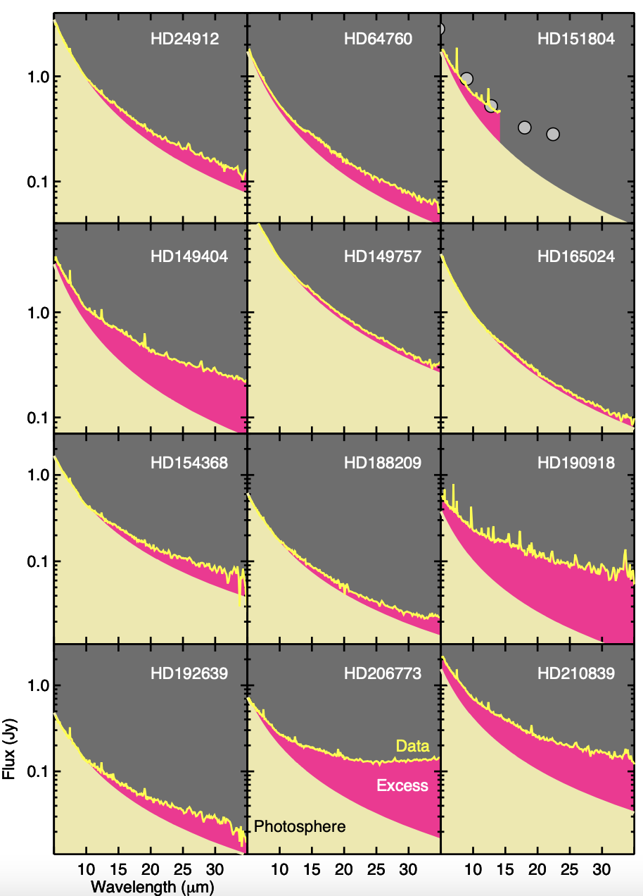
Scrutinizing MIR reddening curves
~50% of OB stars
show MIR/FIR
excess emission
+ (18)

Slide 21
Dark dust III - From the general field to individual stars
Scrutinizing reddening curves (S+23):
No multiple bright sources within 10” ~IUE apertures
No variability in photometry
No variability in GAIA parallax
MIR/FIR reddening: no emission components
SpL known by precision spectroscopy
SpL of reddened+unreddened star agree
no fast rotators, …
=> 47 stars in the high-quality MW sample
of reddening curves
(43% of 110 are OK)
+ 23

Slide 22
Distance unification
Dark dust model for the high-quality MW sample
+ (2018)

Slide 23
Distance unification
Dark dust model for the high-quality MW sample
1) Estimate A_{V} by inserting D_{GAIA} in photometric equation:
A_{V} = V - M_{V} - 5 log D_{GAIA} + 5.
τ_{V} = N^{n} K^{n}_{V} + N^{µ} K^{µ}_{V} : dark dust model with extinction cross section K
τ_{V} < E(H)/1.086 : reddening at infinite small $λ$ is smaller than in H-band
2) Normalize N of dark dust model using observed E(B-V)
E(B-V) = 1.086 (τ_{B} - τ_{V})
(τ_{B} - τ_{V}) = N^{n} (K^{n}_{B} - K^{n}_{V}) + N^{µ} (K^{µ}_{B} – K^{µ}_{V})
=> Model of the absolute reddening
=> Distance unification D_{L} = D_{GAIA}

Slide 24
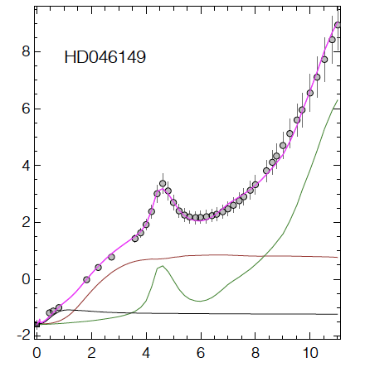

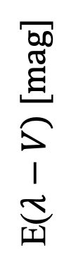
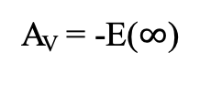
Distance unification
Model of the absolute reddening
E($λ−V) [mag]$
Nano
Large
Dark dust
A_{V} = -E($∞$)

Slide 25
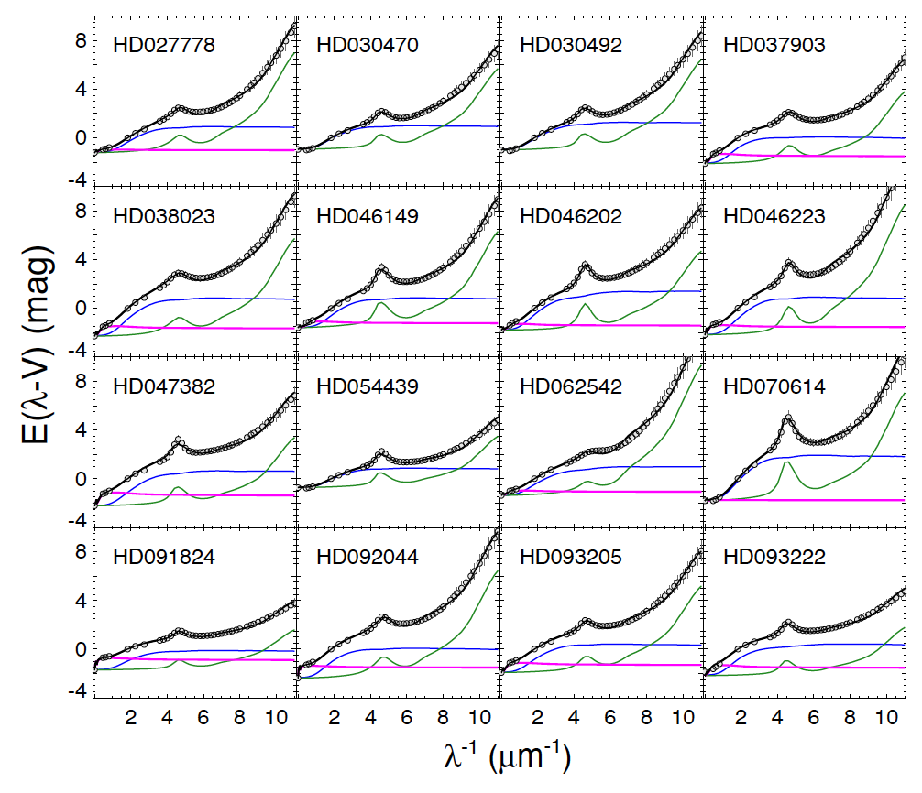
Distance unification
Model of the absolute reddening
Fit all 47 star

Slide 26
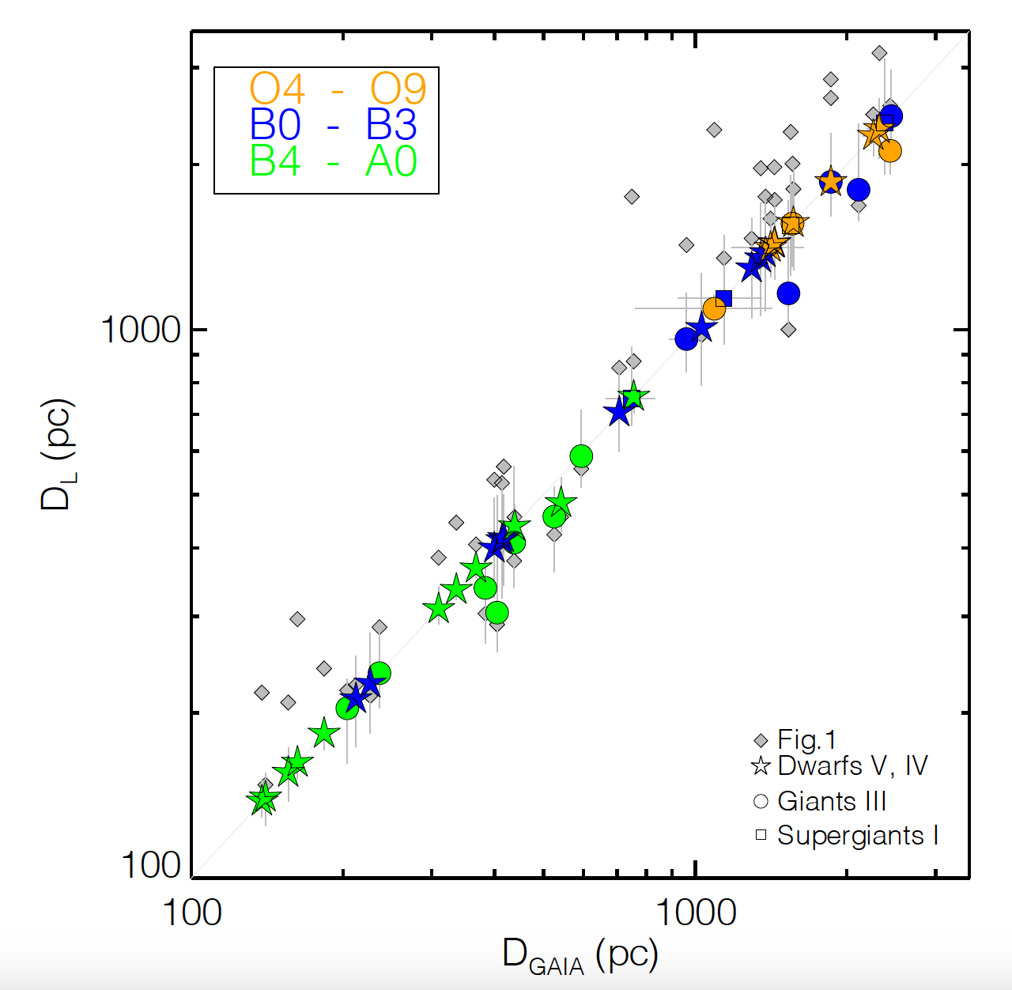
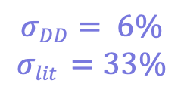
Distance unification
D_{L} = D_{GAIA}
for 85% (40 out of 47)
of the stars
$$σDD= 6\%$$
$$σlit =33\%$$

Slide 27
Dark Dust IV
The distance to the stars
- The distance puzzle and very cold dust emisson
- Model constraints of Dark dust in the diffuse ISM
- From the general field to individual sources:
Scrutinizing MW reddening curves
- Model of the absolute reddening towards stars
- Unification of distances D_{L} ~ D_{GAIA}

Slide 28
Dark Dust IV
The distance to the stars
A_{V} = V - M_{V} - 5 log D_{GAIA} + 5.
The distance puzzle and very cold dust emisson
Model constraints of Dark dust in the diffuse ISM
Scrutinizing MW reddening curves
Model of the absolute reddening towards stars
Unification of distances

Slide 29




Extinction fit
Dust attenuation
Dust extinction cross section
..of particle of population
Specific mass requies realtive
dust abundances
Siebenmorgen et al. (2014)

