Slide 1
Dust extinction, emission & polarisation
in the diffuse ISM
Stefano Bagnulo, Nikolai Voshchinnikov, Nick Cox (PI)
Extinction, emission and polarisation of dust
Large Interstellar Polarisation Survey

Slide 2
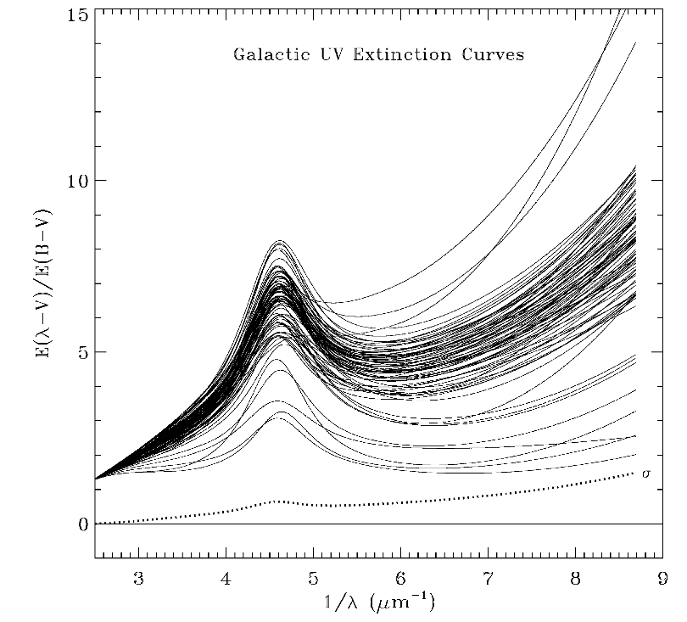
ISM dust
Fitzpatrick (1999)
Simultaneously model :
- Extinction
- Emission
- Polarisation

Slide 3
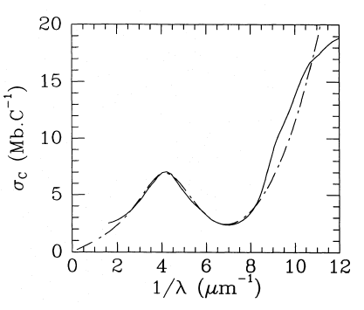
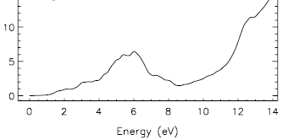
PAH absorption
cross section
+ ‘’2200” bump
Verstraete et al. 1992
Malloci et al. (2007)
Siebenmorgen et al. (2014)

Slide 4
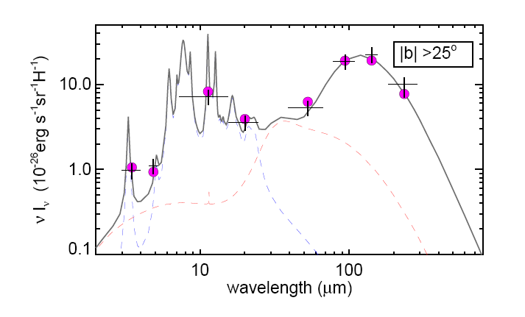
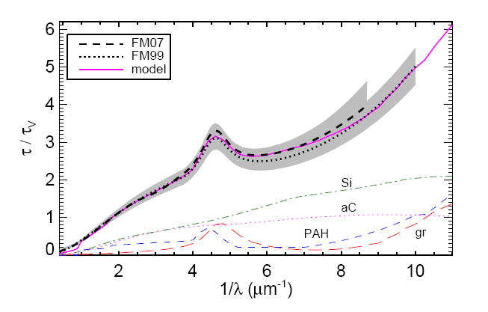
ISM dust Solar neighborhood
Abundances [X/H in ppm]:
31Si + 150aC + 50gr + 30PAH
Si + aC : 60Å < a < 0.2-0.3µm ~ a^{-3.5}
Graphite : 5Å < a < 80 Å ~ a^{-3.5}
PAH : 30, 200 C
Siebenmorgen et al. (2014)

Slide 5
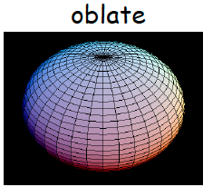
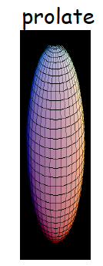
Di-chroic polarisation
Voshchinnikov(2012)
Siebenmorgen et al. (2014)

Slide 6
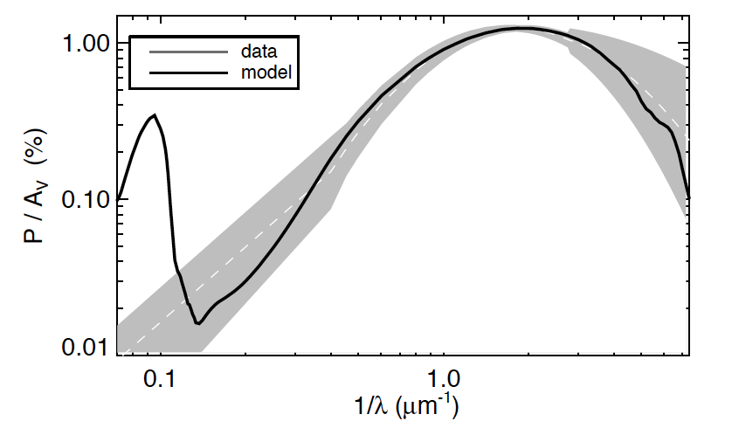
Linear ISM polarisation empirical Serkowski formulae
Siebenmorgen et al. (2014)

Slide 7
Linear polarisation
Silicate feature
Siebenmorgen et al. (2014)

Slide 8
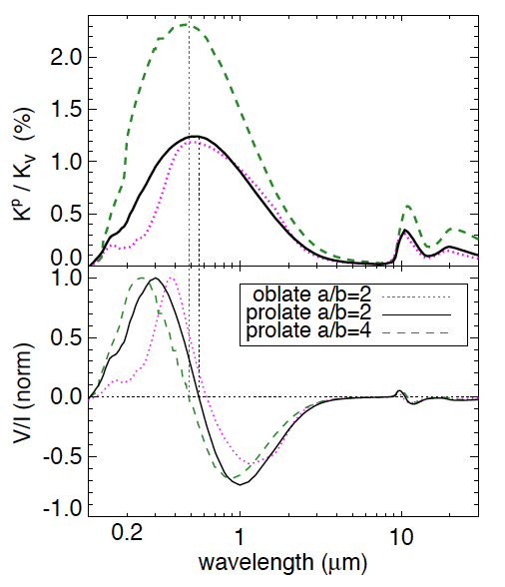
linear polarisation
circular polarisation
Siebenmorgen et al. (2014)

Slide 9
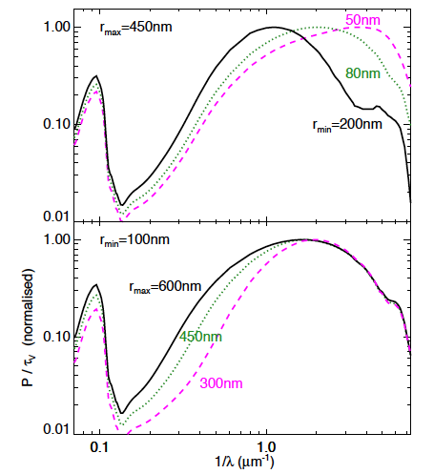
Influence of model parameters:
Upper and lower particle radius
Siebenmorgen et al. (2014)

Slide 10
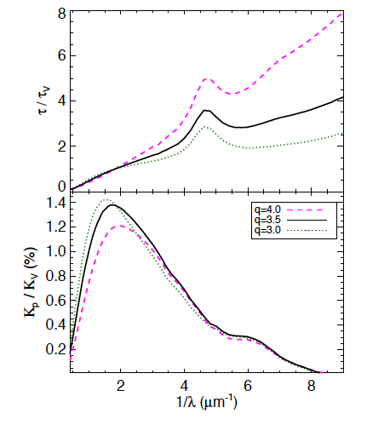
Influence of model parameters:
Exponent of size distribution
Siebenmorgen et al. (2014)

Slide 11
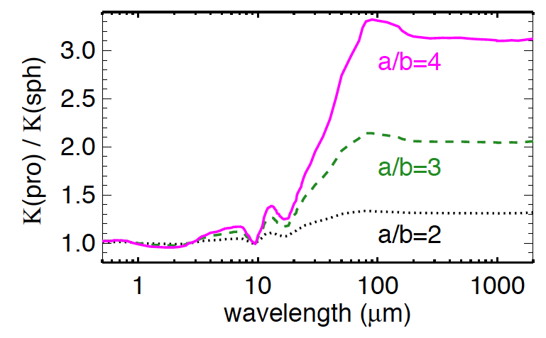
FIR/submm extinction cross section:
Prolate/Sphere
Siebenmorgen et al. (2014)

Slide 12
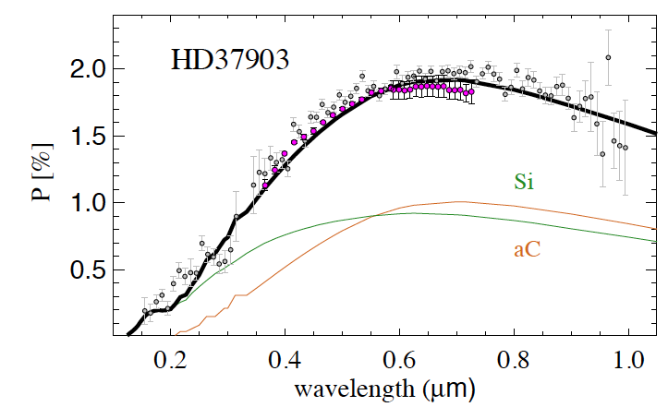
Observing polarisation spectra
FORS/VLT data = space based observations
Siebenmorgen et al. (2014)

Slide 13
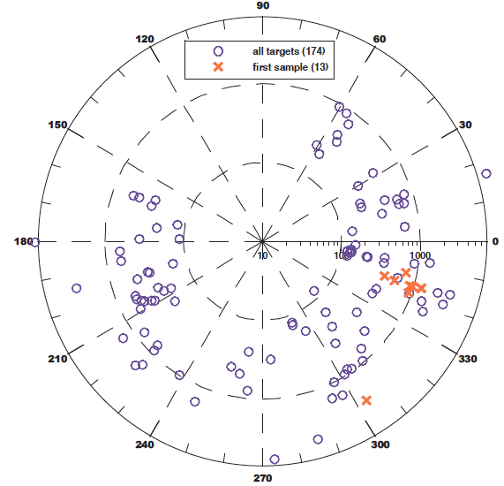
Large Interstellar Polarisation
Survey (LIPS, PI:Cox)
Target distribution (l,b):
- Literature: 174 known stars
- LIPS: 108 targets

Slide 14
LIPS: Calibration
individual reads
Observing
low (<0.3%)
polarisation:
re-binned

Slide 15
LIPS: Calibration

Slide 16
Serkowski parameters:

Slide 17
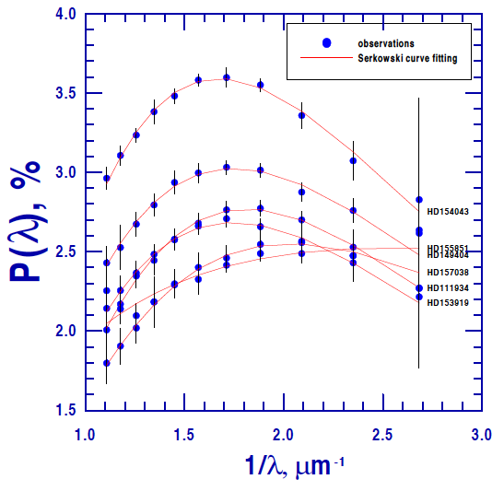
LIPS: First Results
Serkowski fit
strong polarisation

Slide 18
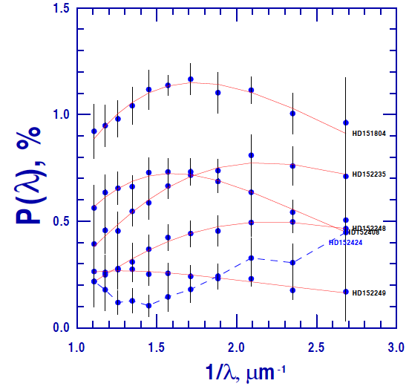
LIPS: First Results
Serkowski fit
low polarisation

Slide 19
LIPS detection statistics of
p_{max,} λ_{max,} K
~108 stars

Slide 20
Distribution of linear polarisation p_{max}
within LIPS

Slide 21
Distribution of Serkowski parameter λ_{max}
within LIPS
<λ _{max} > ~ 5500

Slide 22
Distribution of Serkowski parameter K
within LIPS
K ~ 1.15

Slide 23
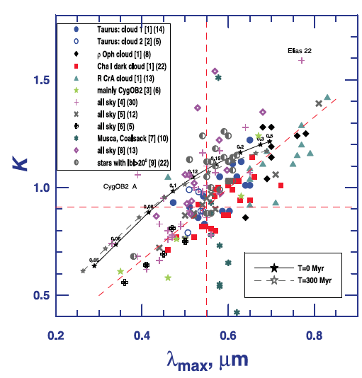
K viz λ_{max}
~174 known stars
from literature
Voshchinnikov &
Hirashita (2014)

Slide 24
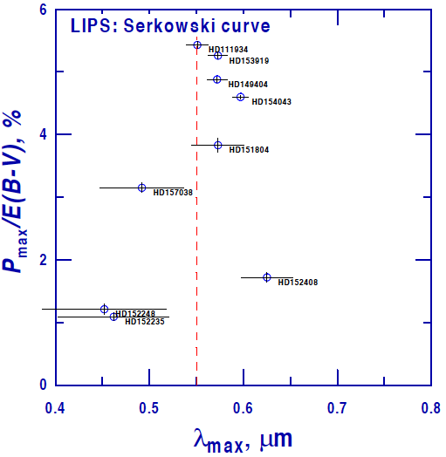
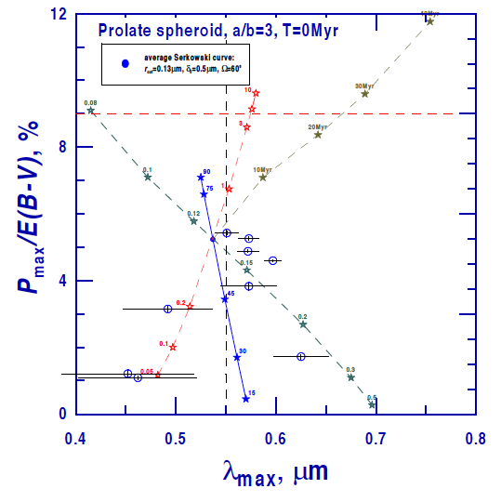
P_{max} viz λ_{max} -> degenerated (Ω, δ₀)
T
δ₀
r_{cut}
Ω
Magnetic filed and/or grain alignment
(Voshchinnikov & Hirashita 2014)

Slide 25
Simultaneous fit of
extinction & polarisation
Siebenmorgen et al. (2014)

Slide 26
Extinction fit
Dust attenuation
Dust extinction cross section
..of particle of population
Υ
Siebenmorgen et al. (2014)

Slide 27
Extinction: 6 fit parameters
Dust attenuation
Particle size
Exponent of size distribution
Relative dust abundances
(n-1) = 4 parameters
Siebenmorgen et al. (2014)

Slide 28
Caveats on extinction fit
Scattering in or out-of-the beam
Siebenmorgen et al. (2014)

Slide 29
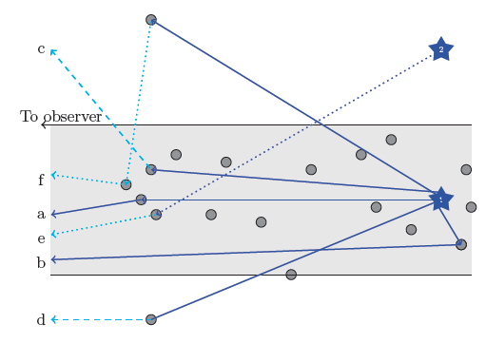
Caveats on extinction fit
Scattering in or
out-of-the beam
dust clump
Scicluna & Siebenmorgen, 2015

Slide 30
Caveats on extinction fits
MW type
SMC type
Milky Way dust ✕ scattering medium ->
SMC type extinction curve
,
, A&A, 2009

Slide 31
Caveats on extinction fit
Scattering (Sicluna & Siebenmorgen 2015)
Particle size
0.5nm ~ OK
Siebenmorgen et al. (2014)

Slide 32
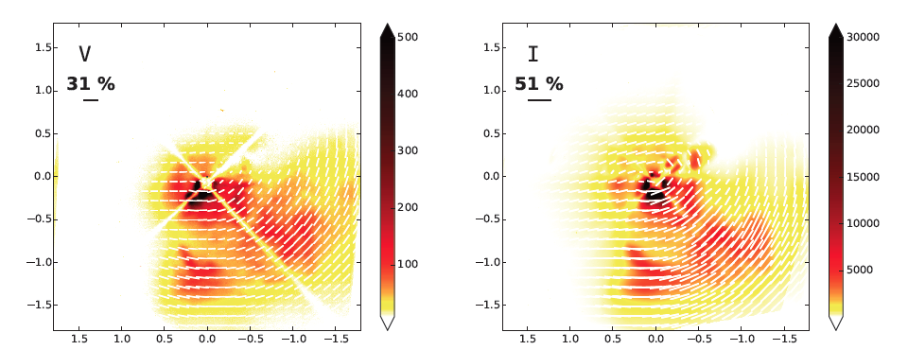
SPHERE: XAO diffraction limited optical polarimetry of supergiant VYCMa
->Mean grain size 50 times larger than in ISM
Scicluna et al (2015)

Slide 33
r₊(Silicates) = r₊(amorph.Carbon)
Particle size
Is the growth of silicates and aC grains similar?
Holds: r₊(ext) = r₊(pol) ?
Siebenmorgen et al. (2014)

Slide 34
Extinction fit parameters
Scattering (Scicluna & Siebenmorgen 2015)
Particle size
Exponent of size distribution
-> simplified assumption
Siebenmorgen et al. (2014)

Slide 35
Extinction fit parameters
Scattering (Scicluna & Siebenmorgen 2015)
Particle size
Exponent of size distribution
Simplified assumption
Relative dust abundances
->
(n-1) = 4 parameters
Siebenmorgen et al. (2014)

Slide 36
Caveats on polarisation fit
For number of dust clouds along the
line-of-sight of LIPS targets > 1
->
Adding-up of Stokes vectors results
in de-polarisation
Siebenmorgen et al. (2014)

Slide 37
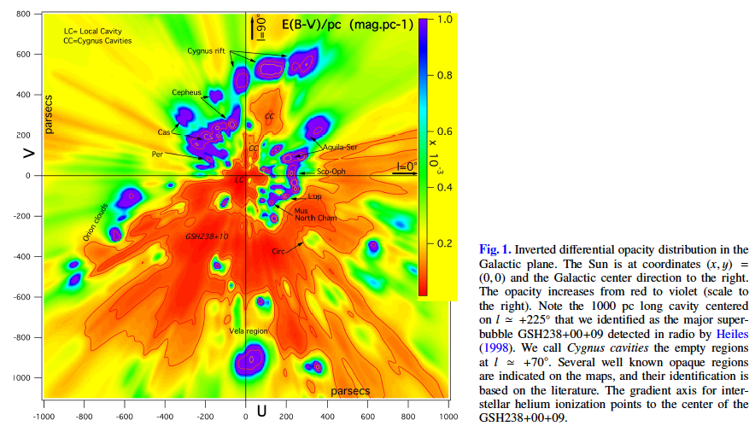
Local dust distribution
(Lallement et al. 2015)

Slide 38
Local dust distribution
By high resolution spectroscopy (UVES@VLT)
of IS lines:
Ca II doublet (warm ISM)
KI line (cold ISM)
NaI, …

Slide 39
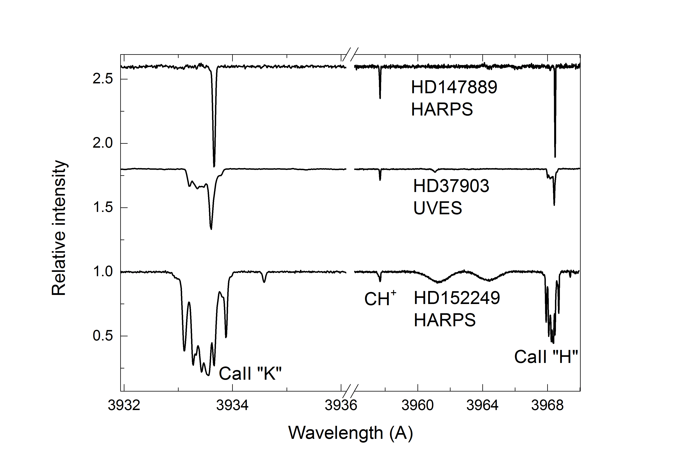
Local dust distribution
1 cloud
1 cloud
dominated
several
velocity
components
Jacek Krelowski, private comm.

Slide 40
52 LIPS targets with UVES spectra

Slide 41
Extinction & polarisation fit
UV extinction
(Valencic et al. 2014)
Optical extinction R_{V}
(F&M2004)

Slide 42
Extinction & polarisation:
… more examples

Slide 43
LIPS: … fit first 7 stars
nvsg = no very small grains
p5 = 5 free parameters
P7 = 7 free parameters

Slide 44
LIPS: … median best fit models
p7
p5
nv
nv = no very small grains
p5 = 5 free parameters
p7 = 7 free parameters

Slide 45
Summary
First results of the Large Interstellar Polarisation Survey includes 108 FORS spectra and 52 existing UVES high resolution spectra.
Optical polarisation explained by aligned prolates, with silicates as major contributor
need 10µm polarisation spectroscopy
Simultaneous fit of extinction + polarisation
- need VSG
- q ~ 3.1
- r₋^{pol} ~ 100nm, r₊ ~ 330nm

Slide 46
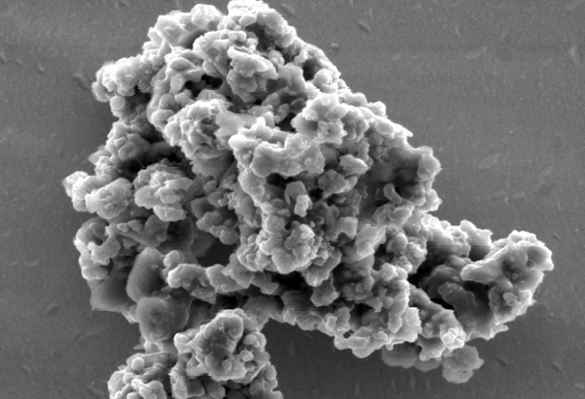
p7
p5
nv
Thank You
nv = no very small grains
p5 = 5 free parameters
p7 = 7 free parameters

