Slide 1
The distance to the stars
- The distance puzzle and very cold dust (Dark Dust IV)
- Dust model vs. observational constraints (Dark Dust II)
- Scrutinizing MW reddening curves (Dark Dust III)
- Model of the absolute reddening towards stars
- Unification of distances

Slide 2
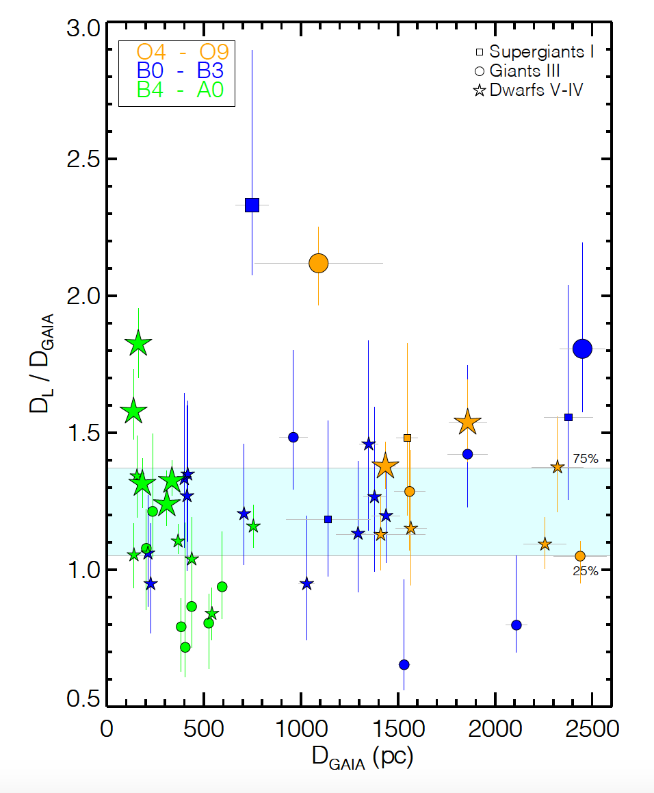
The distance puzzle
D_{L} >D_{GAIA} =>
Compensate overestimate
of luminosity viz. GAIA distance
by extra dimming of the light.
5 log(D_{L}) = V – M_{V} – A_{V} + 5
A_{V} : Valencic+04, Fitzpartick&Massa07, Gordon+09
M_{V} : Bowen+08, Wegner+07

Slide 3
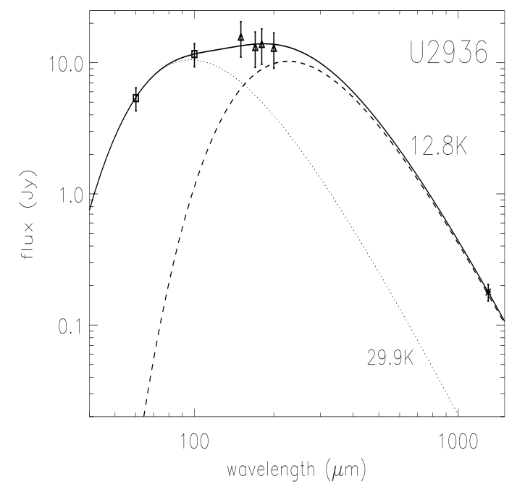
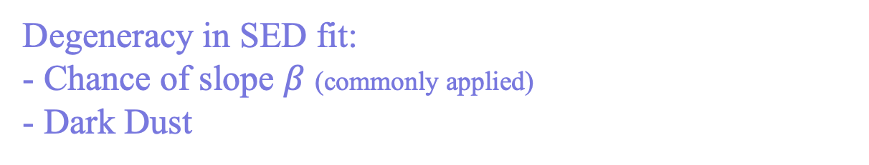
The distance puzzle and
very cold dust emission
Ralf Siebenmorgen
Submm excess:
- ISO (S+99)
- Herschel
- ALMA
Degeneracy in SED fit:
- Chance of slope $β$ (commonly applied)
- Dark Dust

Slide 4
Dark Dust (II) in the general field of the diffuse ISM
Observational constraints of dust models (Hensley & Draine 21)
Solid phase element abundances
Wavelength dependant reddening
Star-light polarization
Dust emission of polarized + unpolarised light,
Account for increased (sub)mm emission in the MW by Planck

Slide 5
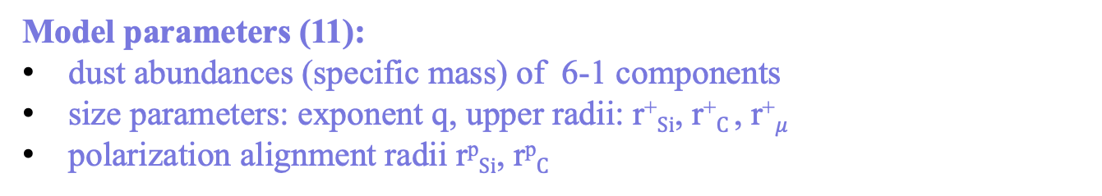
The Dark Dust model
Dust populations:
1) Nano-particles <6nm of vSi, vGr, and PAH
2) Submicron spheroids 6nm < a < 300nm of amorphous Si, C
3) Micrometer sized dark dust as fluffy Si+C conglomerates
Model parameters (11):
dust abundances (specific mass) of 6-1 components
size parameters: exponent q, upper radii: r⁺$Si$, r⁺$C$, r⁺$μ$
polarization alignment radii r^{p}$Si$, r^{p}$C$
(2023)

Slide 6
Dark Dust in the general field of the diffuse ISM
a) Solid phase element abundances
All models respect: [C] / [Si] < 5.2
(2023)

Slide 7
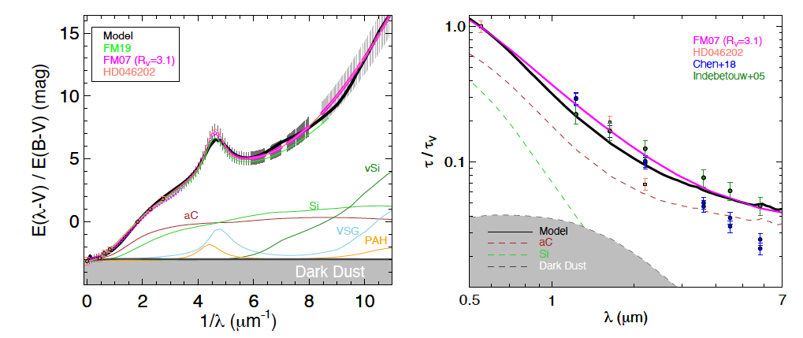
Dark Dust in the general field of the diffuse ISM
b) Reddening
Dark dust reddening at $λ≤$1$μm$ is flat, non-selective, gray
(2023)

Slide 8
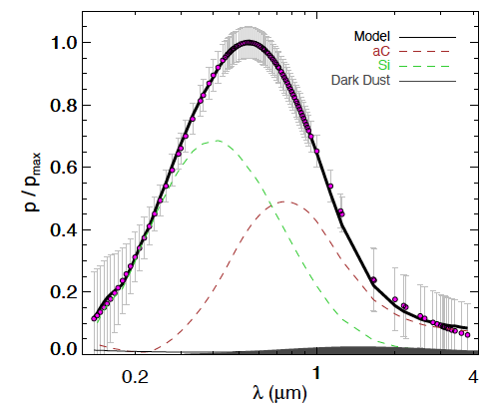
Dark Dust in the general field of the diffuse ISM
c) Starlight polarisation
(2023)

Slide 9
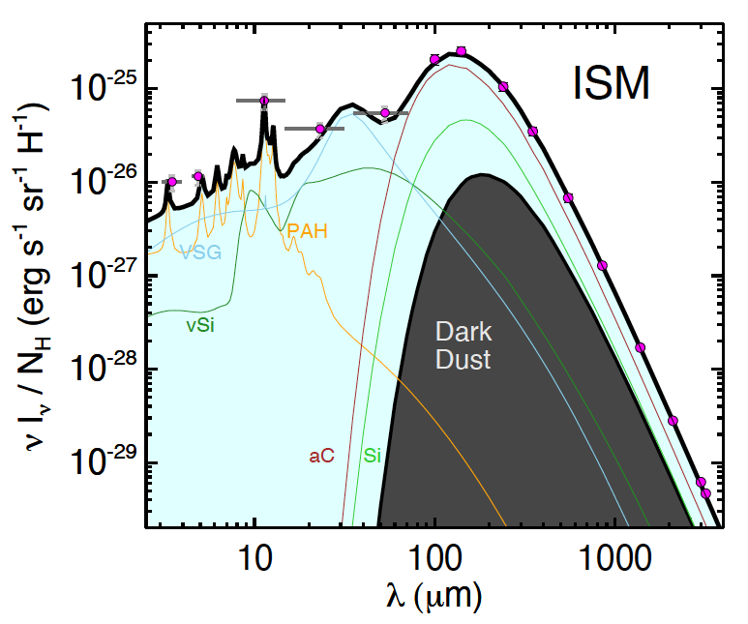
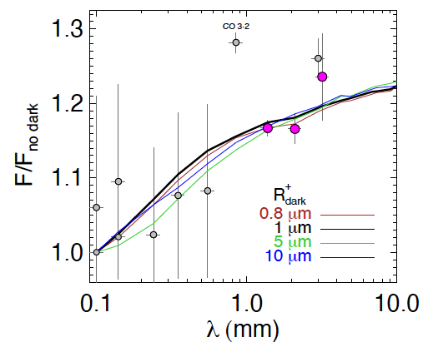
Dark Dust in the general field of the diffuse ISM
d) Emission + mm excess
(2023)

Slide 10
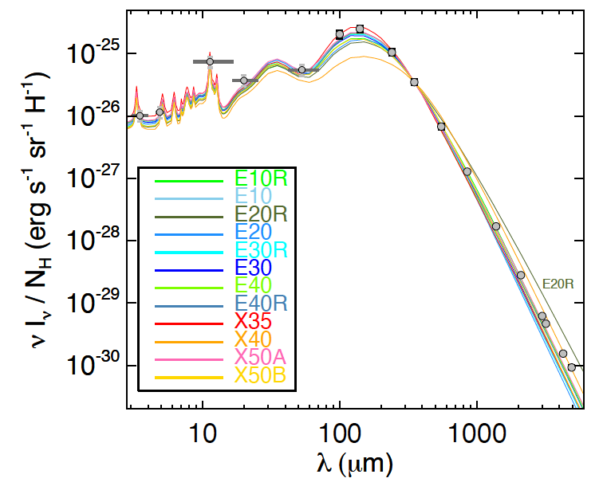
Dark Dust in the general field of the diffuse ISM
Mix of new (n,k) of amorphous Si (Karine Demyk+22)
(2023)

Slide 11
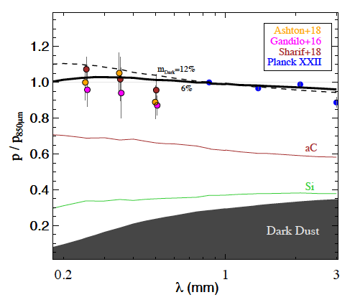
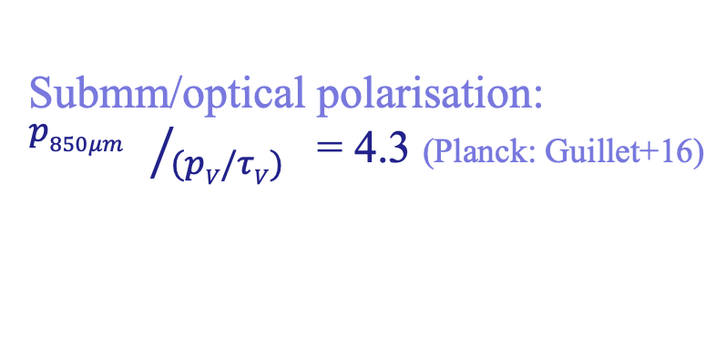
Dark Dust in the general field of the diffuse ISM
d) Polarised emission
Submm/optical polarisation:
${p850μm }/{(pV/τV)}$ = 4.3 (Planck: Guillet+16)
(2023)

Slide 12
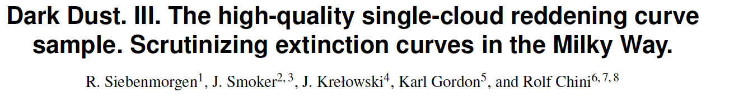
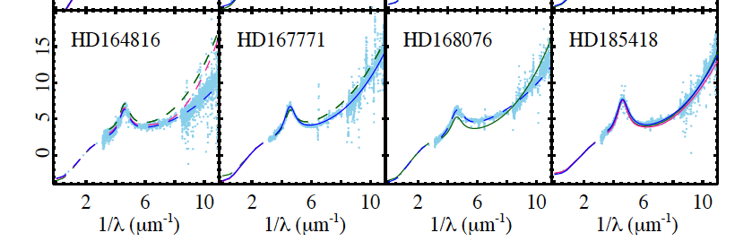

A&A 2023
$$E(λ−V)/(E(B−V)$$
?
?
✓
?
Legacy of reddening curves
544 stars IUE, FUSE
186 “ UVES spectroscopy
110 “ Large IS Polarisation Survey
=> 50 stars in high-quality sample

Slide 13
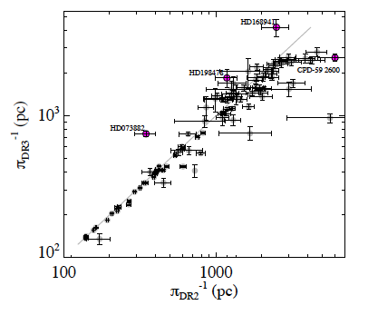
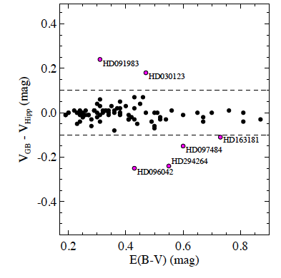
Dark dust III - High quality sample of reddening curves
No multiple bright sources within 10” ~IUE apertures
No variability in photometry
No variability in GAIA parallax
IR reddening: no emission components
Spec type + lum class of reddened +unreddened stars agree
+ (2023)

Slide 14
Scrutinizing extinction curves
Impact of binaries
SpL of F_{obs} and F_{nd} differ
extinction
reddening
Impact on reddening in the NIR is large
+ (2019)

Slide 15
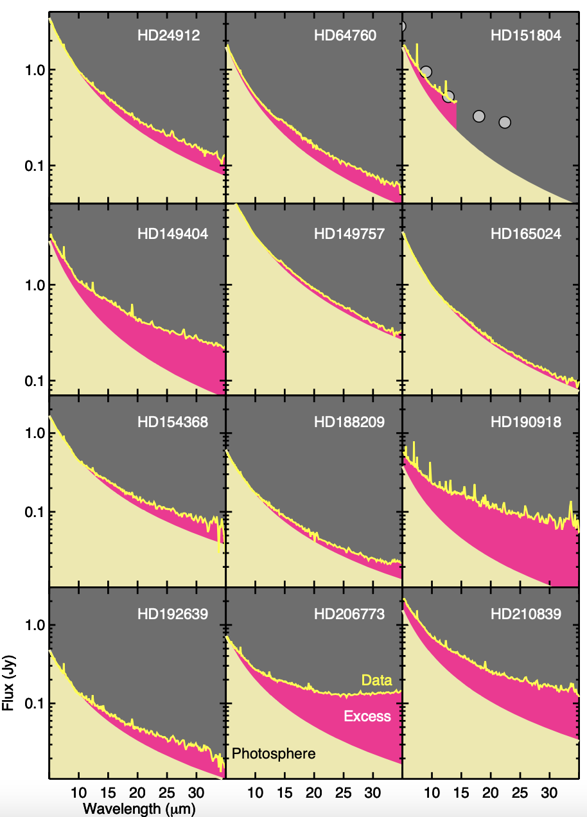
Scrutinizing MIR reddening curves
~50% of OB stars
show MIR/FIR
excess emission
+ (2018)

Slide 16
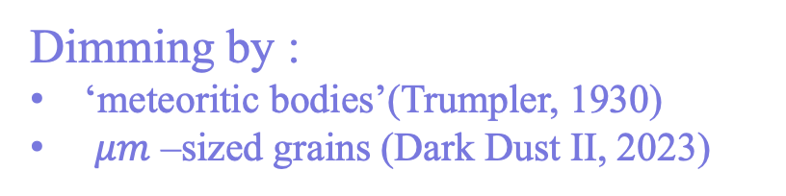
Distance unification
Dimming by :
‘meteoritic bodies’(Trumpler, 1930)
$μm$ –sized grains (Dark Dust II, 2023)

Slide 17
Distance unification by dark dust
1) Estimate A_{V} by inserting D_{GAIA} in photometric equation:
A_{V} = V - M_{V} - 5 log D_{GAIA} + 5.
τ_{V} = N^{n} K^{n}_{V} + N^{µ} K^{µ}_{V} Dark Dust model with extinction cross section K
τ_{V} < E(H)/1.086 reddening at infinite is smaller than in H-band
2) Normalize N^{n,µ} by observed E(B-V)
E(B-V) = 1.086 (τ_{B} - τ_{V})
(τ_{B} - τ_{V}) = N^{n} (K^{n}_{B} - K^{n}_{V}) + N^{µ} (K^{µ}_{B} – K^{µ}_{V})
=>
Model of the absolute reddening
D_{L} = D_{GAIA}

Slide 18
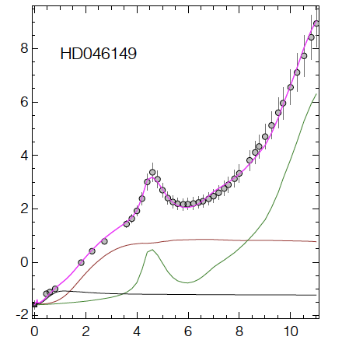

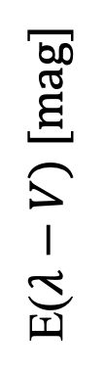

Model of the absolute reddening
Fit all 47 stars
E($λ−V) [mag]$
Nano
Large
Dark dust
A_{V} = -E($∞$)

Slide 19
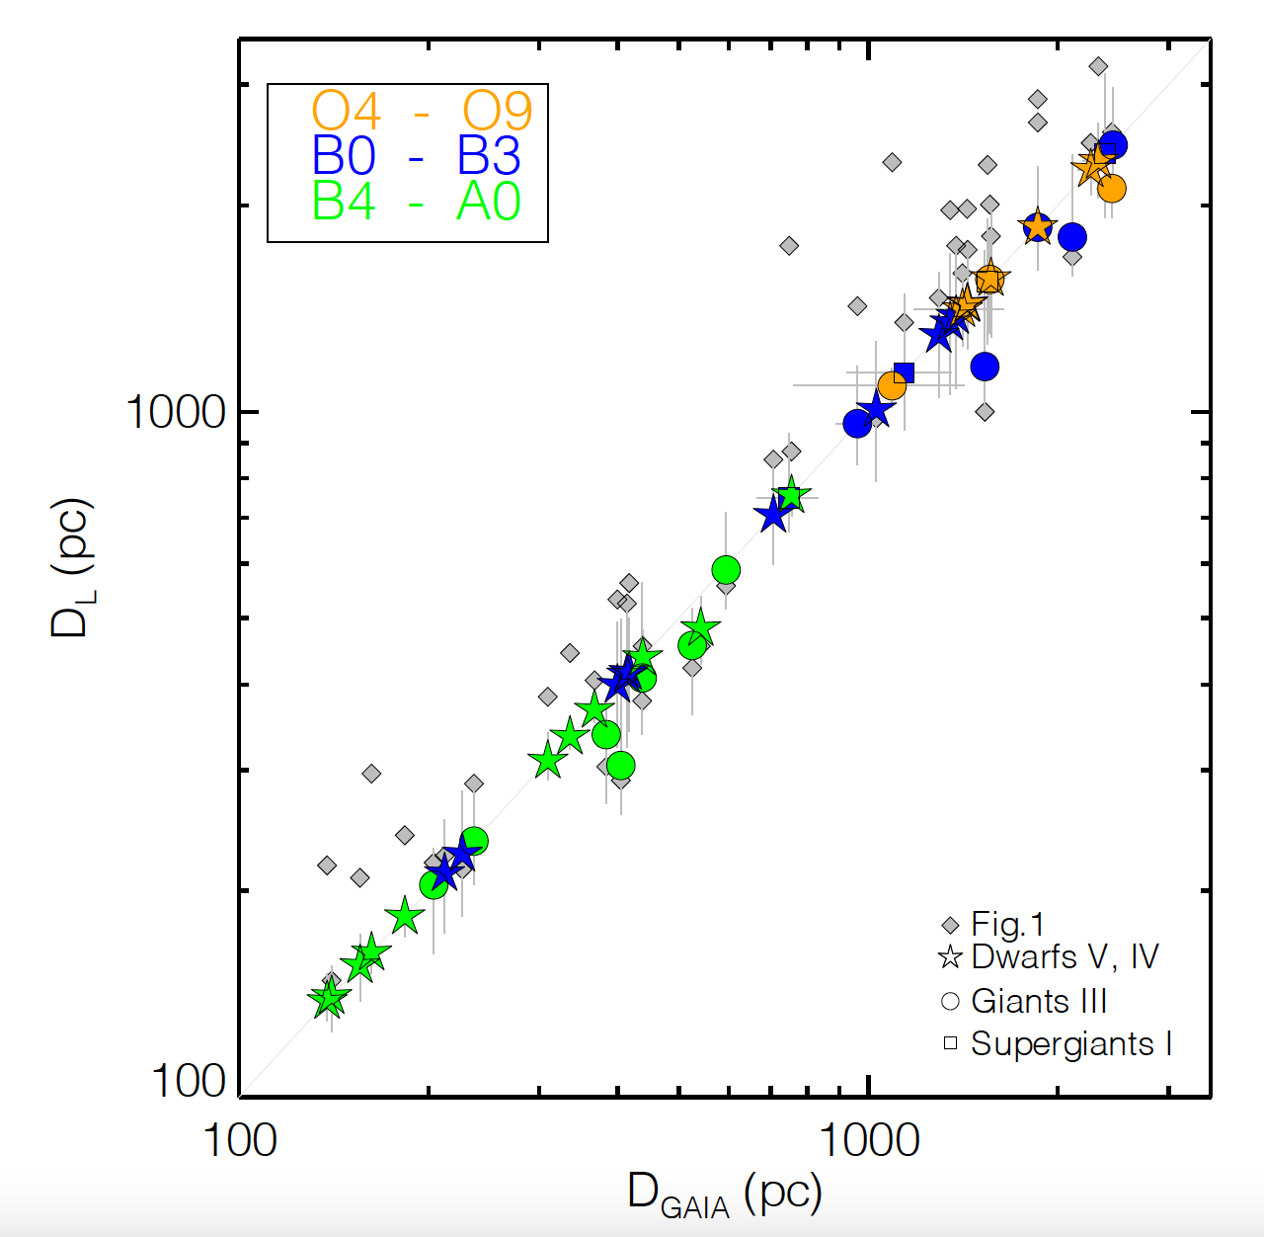
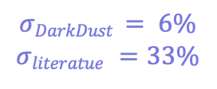
Distance unification
D_{L} = D_{GAIA}
for 40 out of 47 stars
$$σDarkDust = 6\%$$
$$σliteratue =33\%$$

Slide 20
Dark Dust and
the unification of distances to the stars
- The distance puzzle and very cold dust emission
- Dark dust a new component of the ISM
- Reddening of stars: NIR be careful, R_{V} be very careful
- Model of the absolute reddening towards stars
- Unification of distances: D_{L} = D_{GAIA}

Slide 21
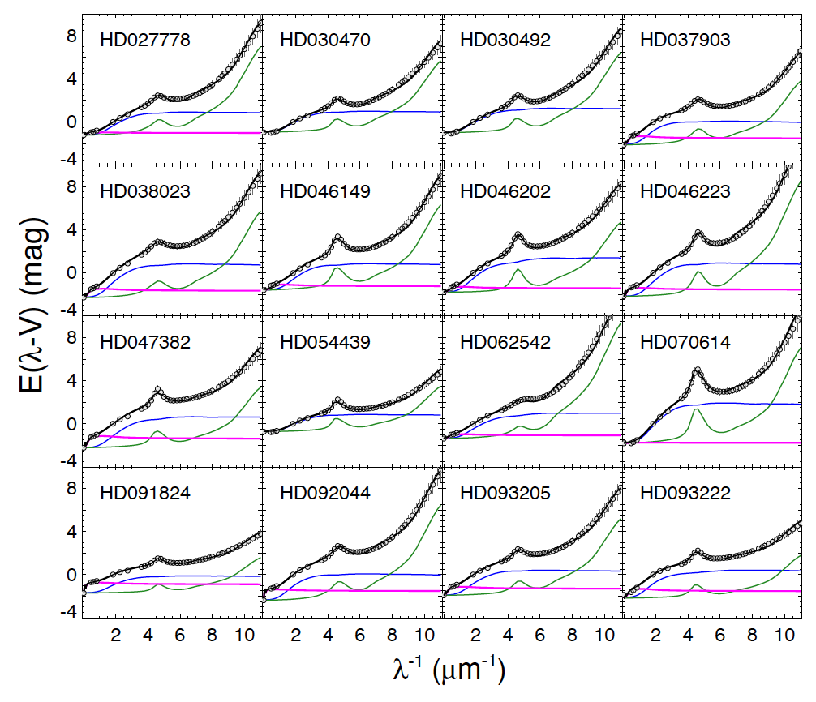
Dark Dust IV
The distance to the stars
A_{V} = V - M_{V} - 5 log D_{GAIA} + 5.
The distance puzzle and very cold dust emisson
Model constraints of Dark dust in the diffuse ISM
Scrutinizing MW reddening curves
Model of the absolute reddening towards stars
Unification of distances

Slide 22
Distance unification
Model of the absolute reddening
Fit all 47 star

Slide 23




Extinction fit
Dust attenuation
Dust extinction cross section
..of particle of population
Specific mass requies realtive
dust abundances
Siebenmorgen et al. (2014)

