Slide 1


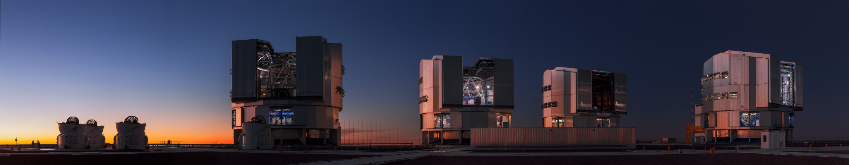
FORS Up
Bringing FORS into the ELT era

Slide 2
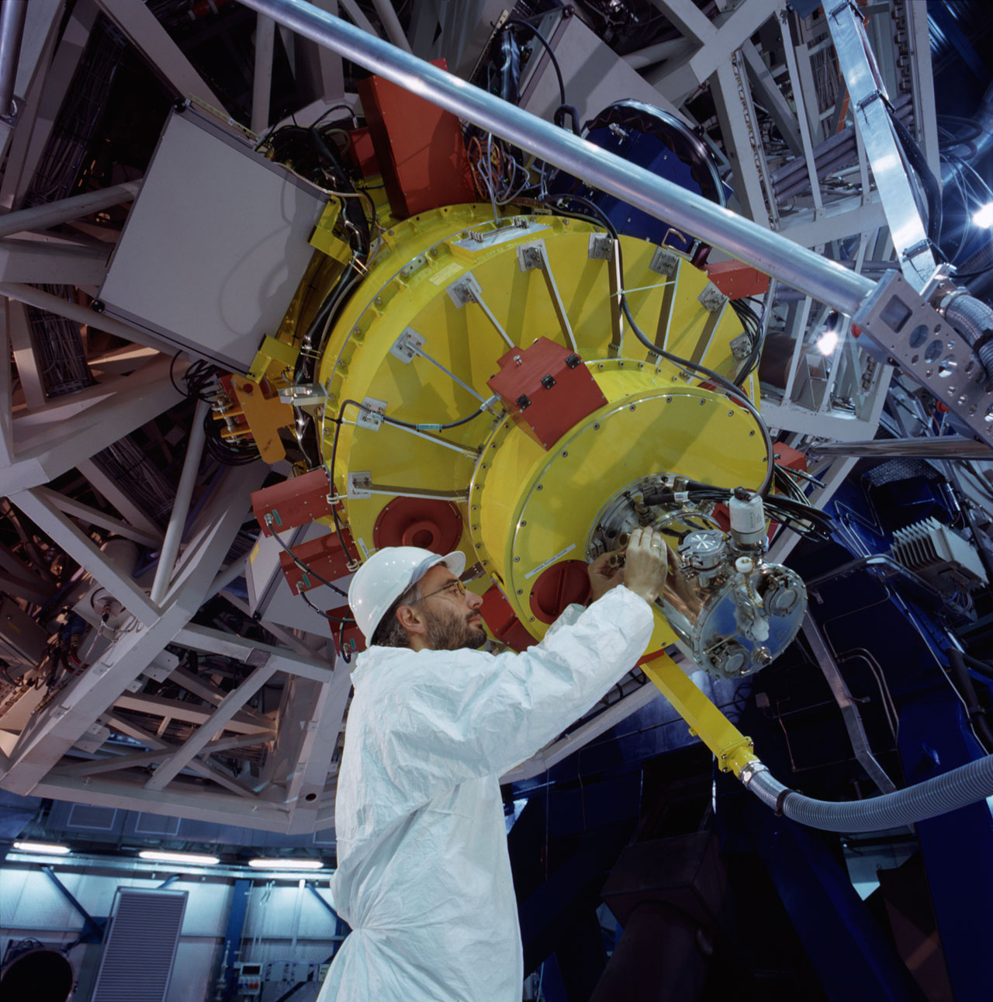
FORS: Project Timeline
1
1990: FORS1 Conception
2
1998: FORS1 First Light
3
1999: FORS2 First Light
4
2009: FORS1 Decommissioning
5
2019: FORS1 Upgrade begins
6
2026: Upgraded FORS1 Commissioning

Slide 3
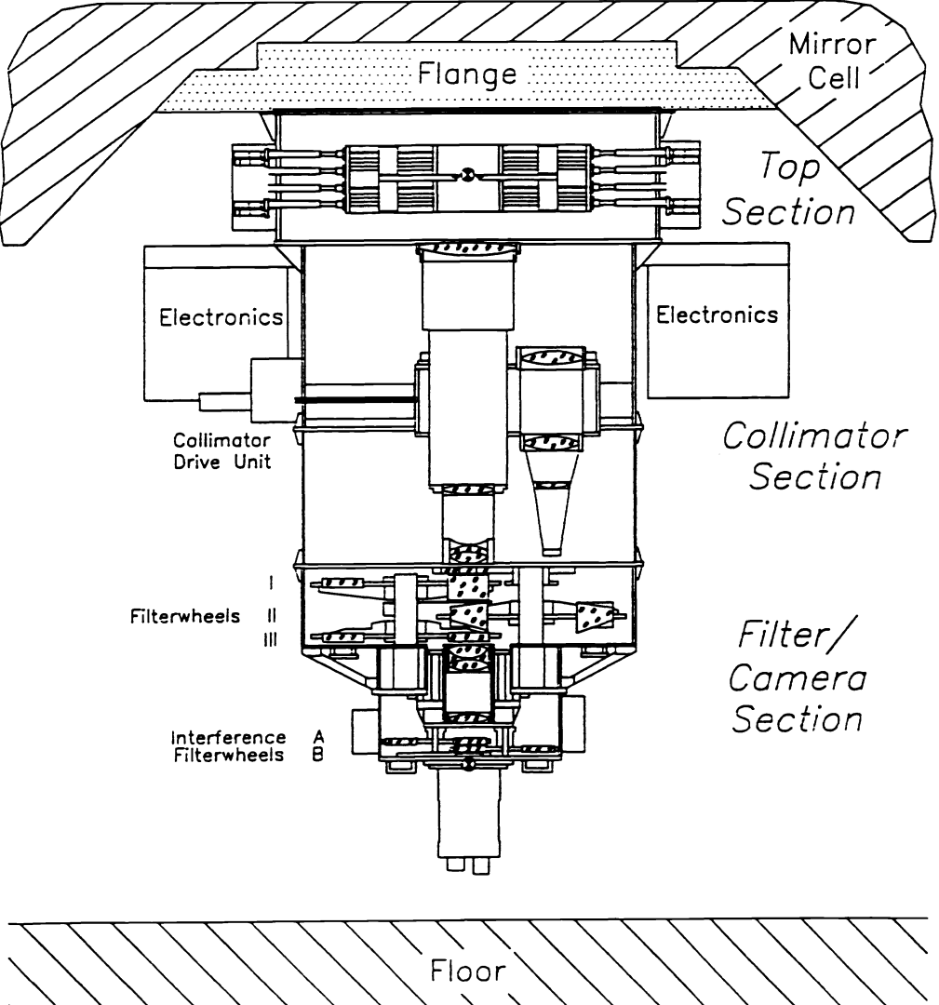
FORS2: Instrument Description
FOcal Reducer and low-dispersion Spectrograph;
Mounted on the Cassegrain focus of VLT UT1;
330-1100 nm wavelength range;
Multi-mode instrument:
OBSERVING MODE | ACRONYM
Imaging
Direct imaging (SR+HR) | IMG
Imaging with occulting bars | OCC
Spectroscopy
Long slit spectroscopy | LSS
Multi-object spectroscopy (movable slits) | MOS
Multi-object spectroscopy (slit masks) | MXU
Wide Slit Spectro-Photometry | SPECPHOT
Polarimetry
Imaging polarimetry | IPOL
Multi-object spectro-polarimetry | PMOS

Slide 4
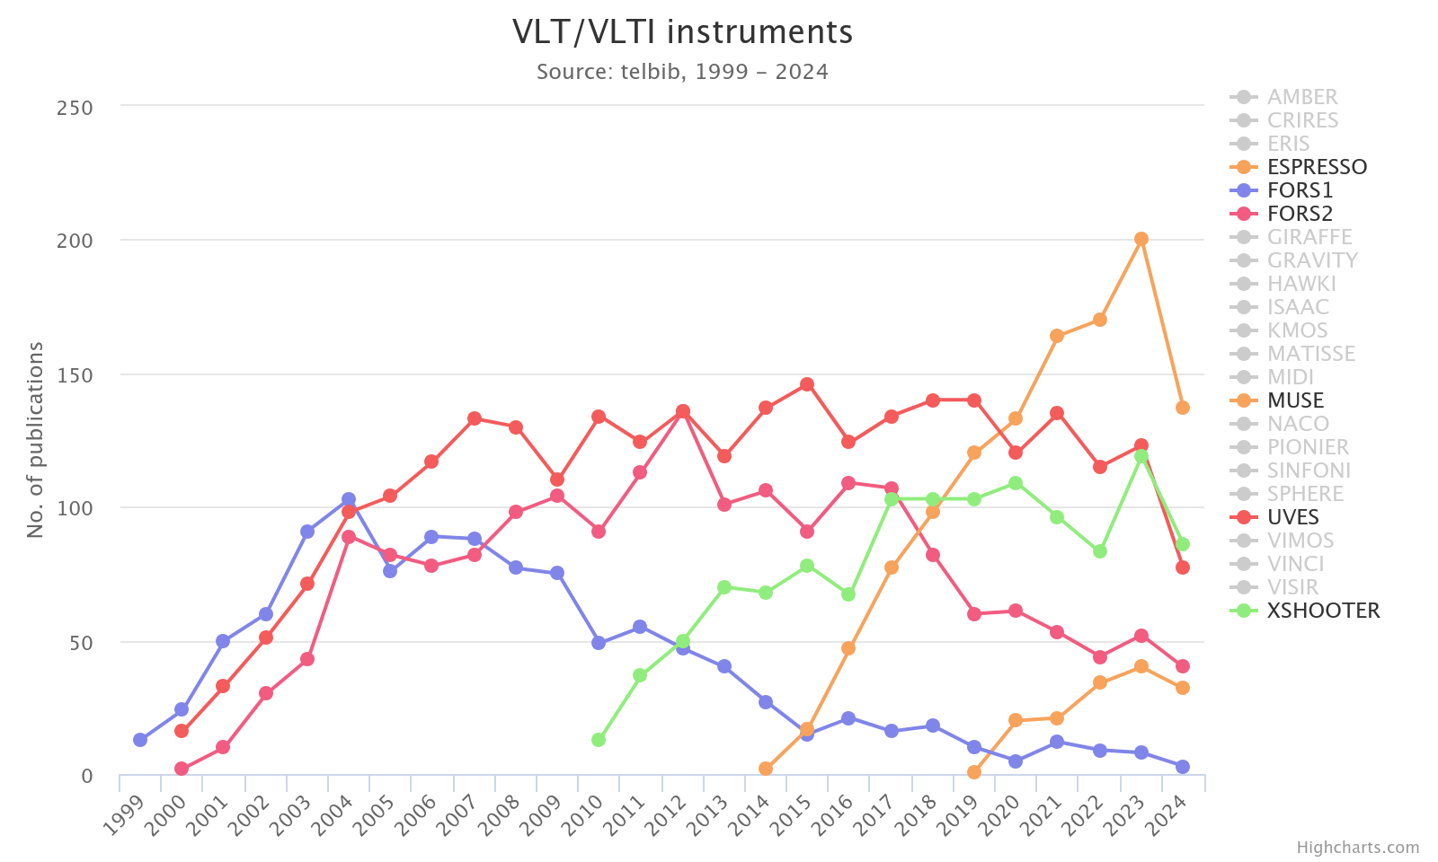
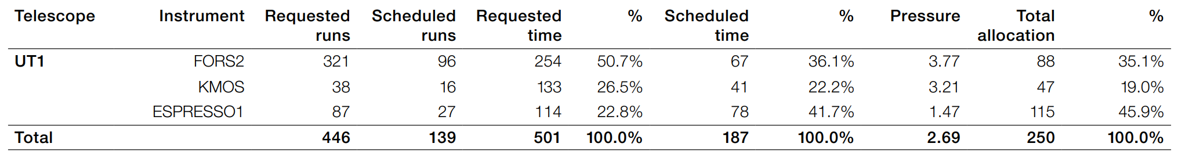
FORS Science

Slide 5
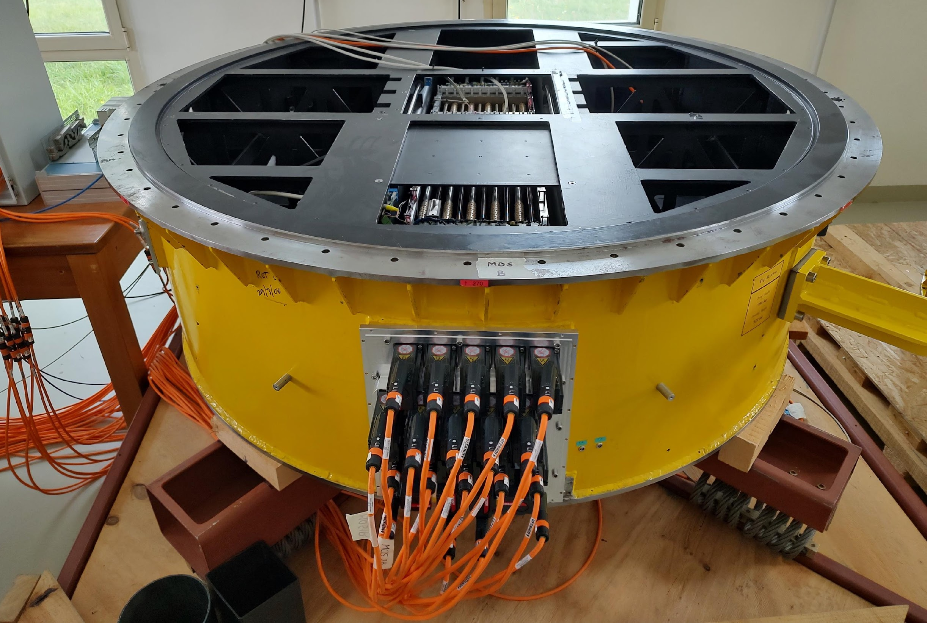
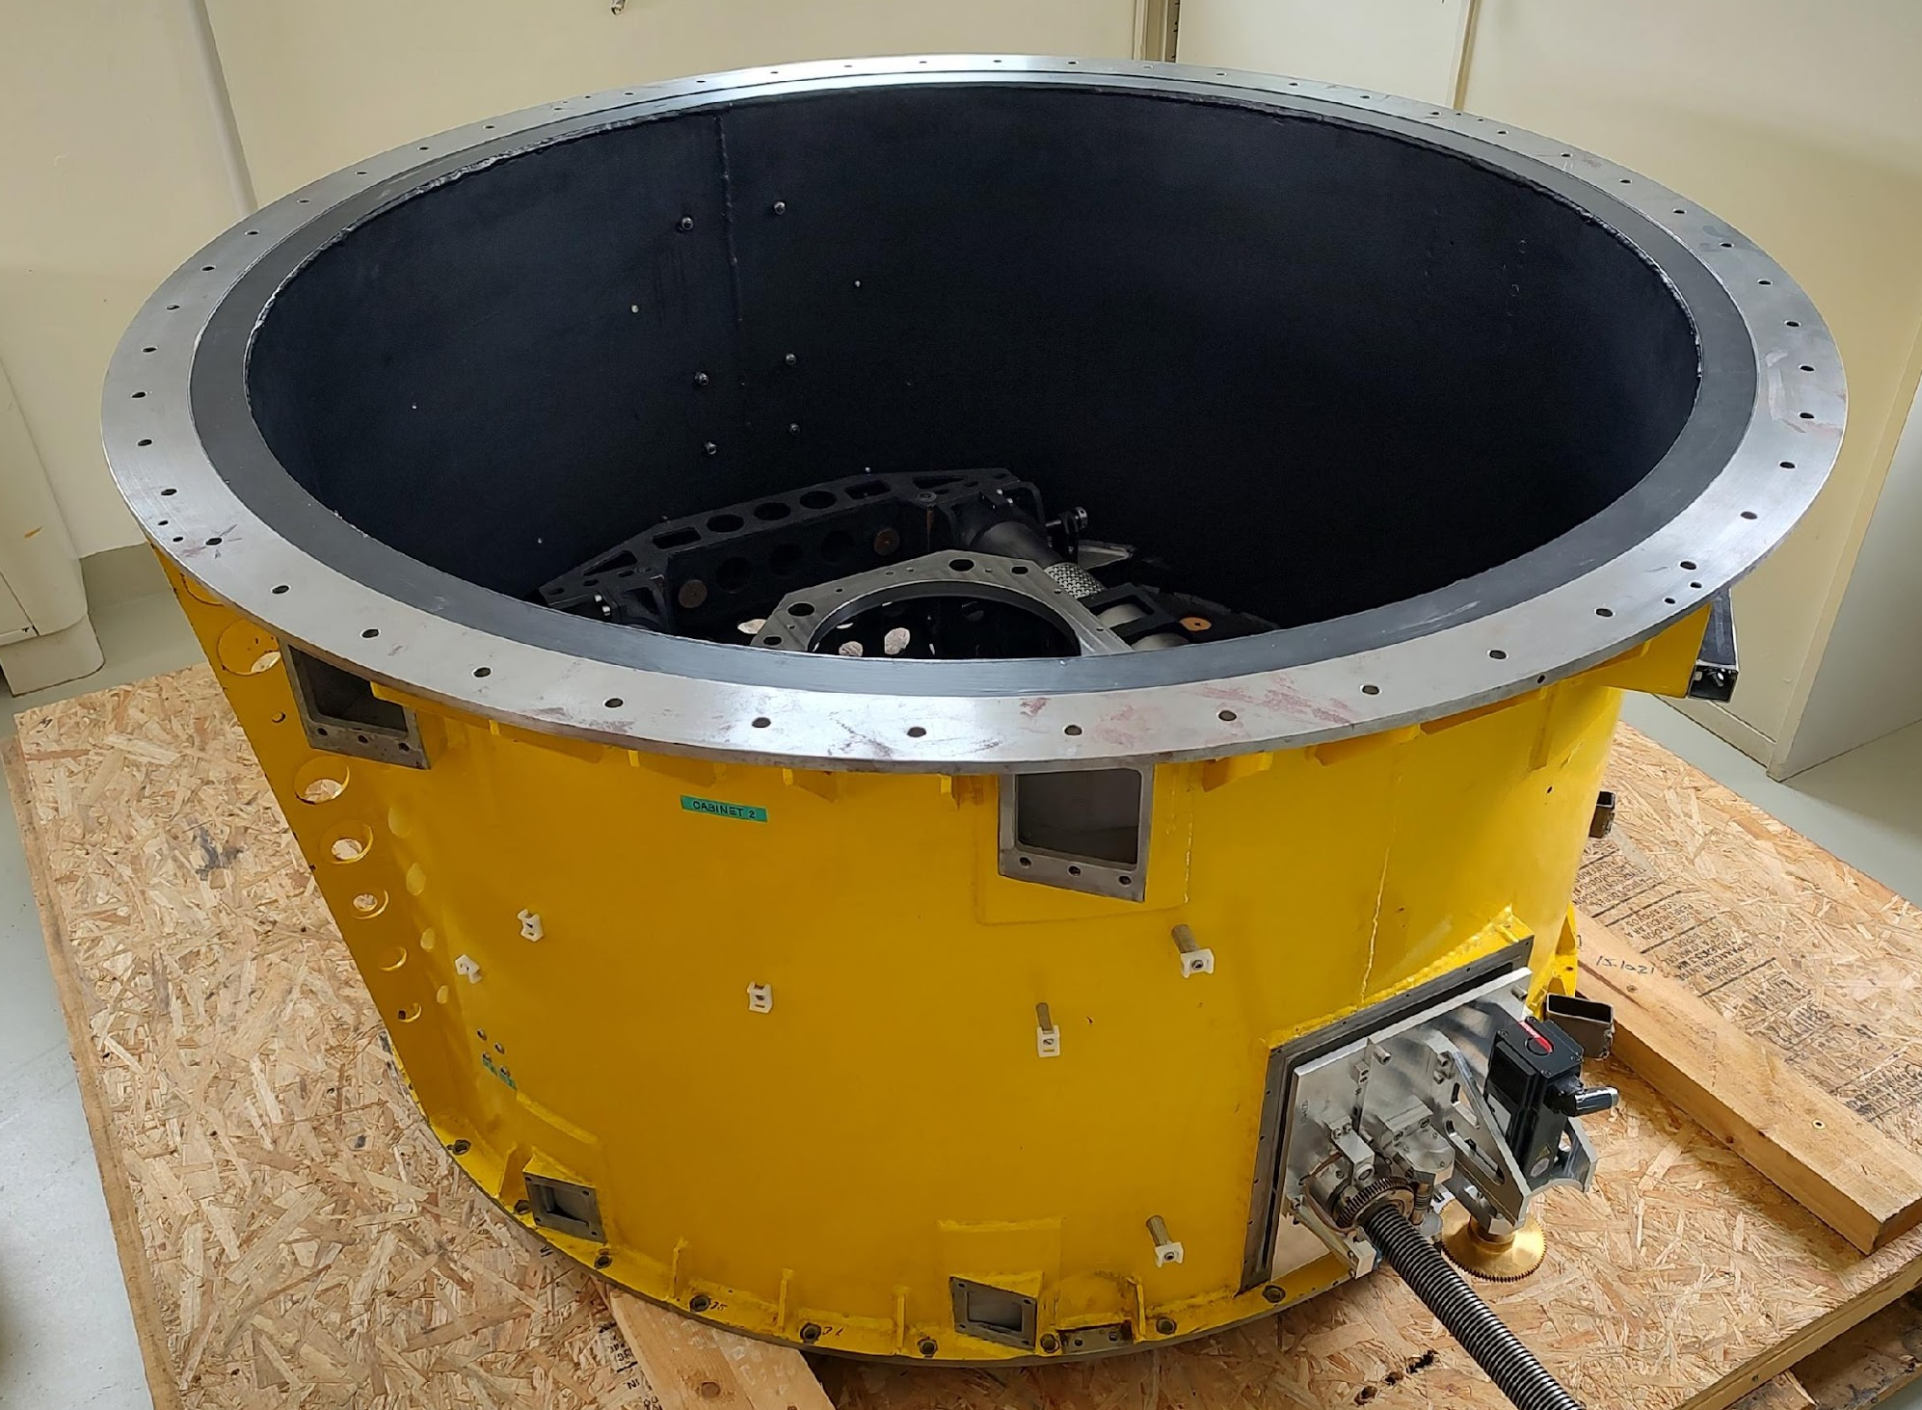
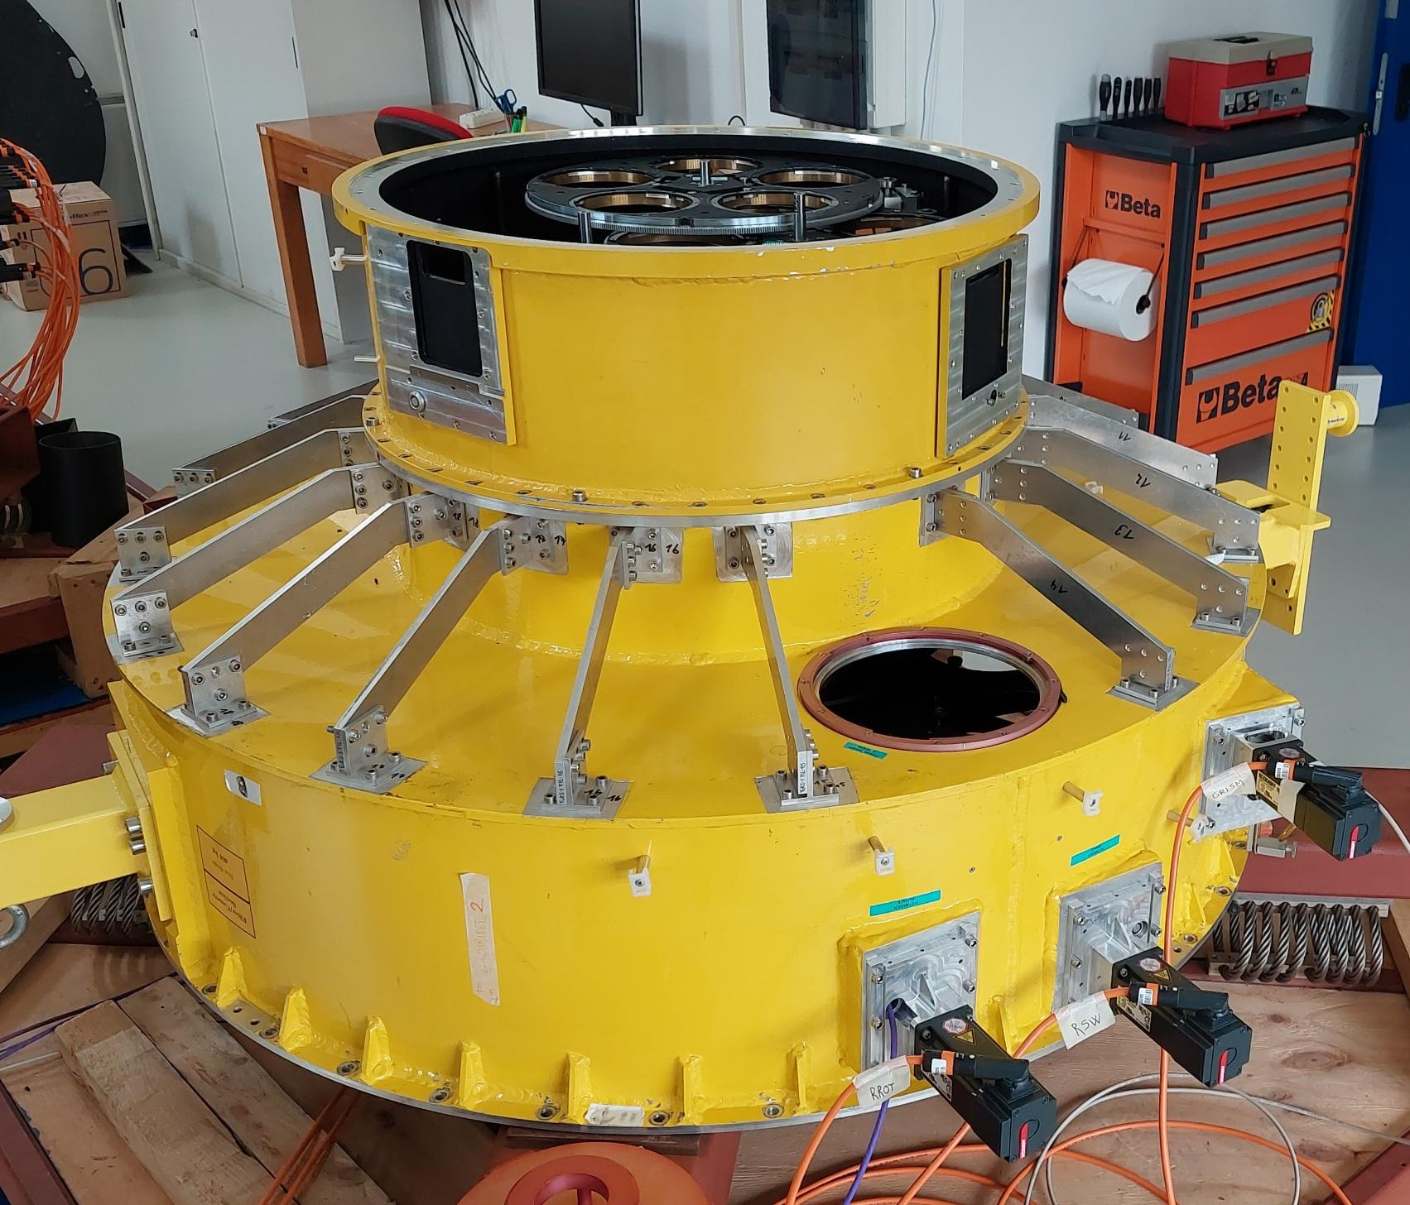
FORS Upgrade
The FORS Upgrade will ensure that FORS1 remains operational for the next 15 years.
New scientific detector;
New calibration unit;
New set of filters and grisms;
New control electronics;
New instrument control software;
New software for preparing multi-object observations (FIMS);
Test bench for the ELT control framework;
The upgraded FORS1 will replace FORS2 at UT1.

Slide 6
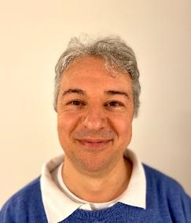
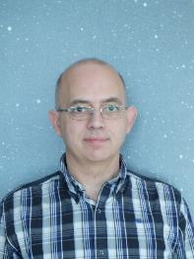

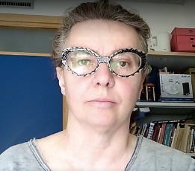
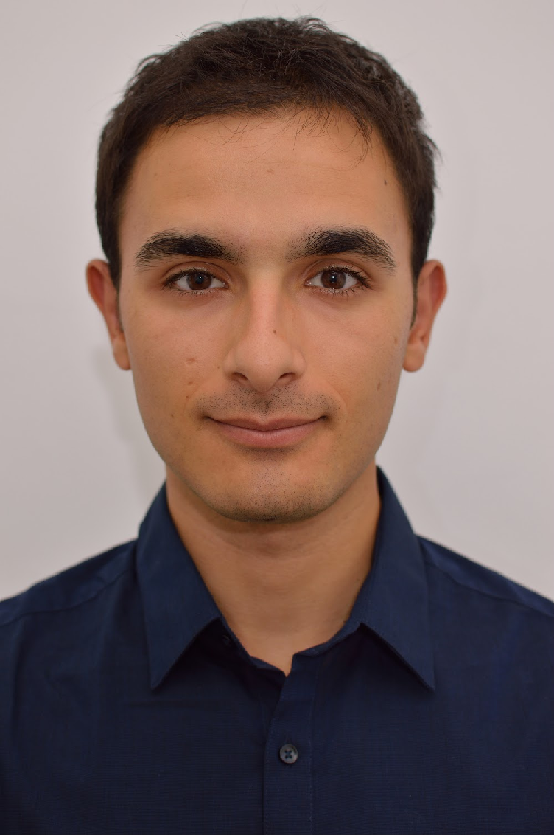

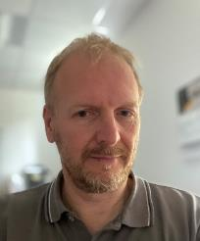
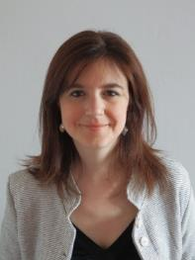

FORS-Up: INAF-OATs Team
Control Software
Paolo Di Marcantonio
Roberto Cirami
Giorgio Calderone
Sara Bertocco
Matteo Porru
Science Reqs. & Verification
Control Electronics
Veronica Strazzullo
Igor Coretti
Veronica Baldini
Antonio Sulich

Slide 7
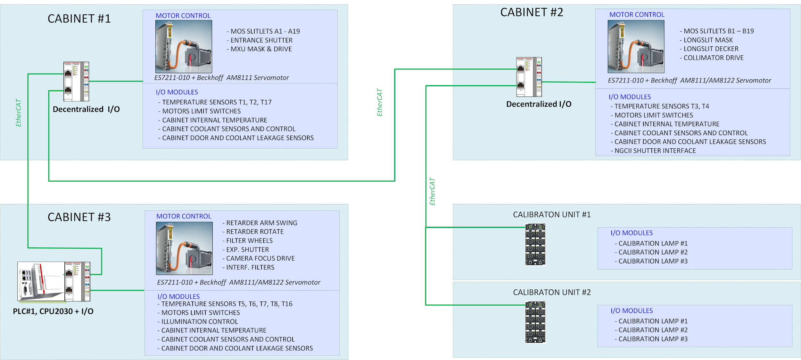
Control Electronics Architecture
CALIBRATION UNIT #1
CALIBRATION UNIT #2
Notes:
The upgrade of the control electronic for FORS involves the replacement of all motors, sensors and cabling, as well as a redesign of the calibration unit. The new electronics architecture, based on the Beckhoff PLC platform, is composed of an embedded CX2030 CPU with dedicated Beckhoff modules able to control all FORS functions, sensors and digital I/O. The embedded computer comes with the software TwinCAT and hosts the OPC UA server, enabling communication with the high-level software. Modules in the cabinets without a CPU are controlled via an EtherCAT connection and bus couplers. A custom low-level software library was developed to control the MOS unit and the exposure shutter. Cabinet #4 (not shown) will control the NGCII and the Cryo-cooler.

Slide 8
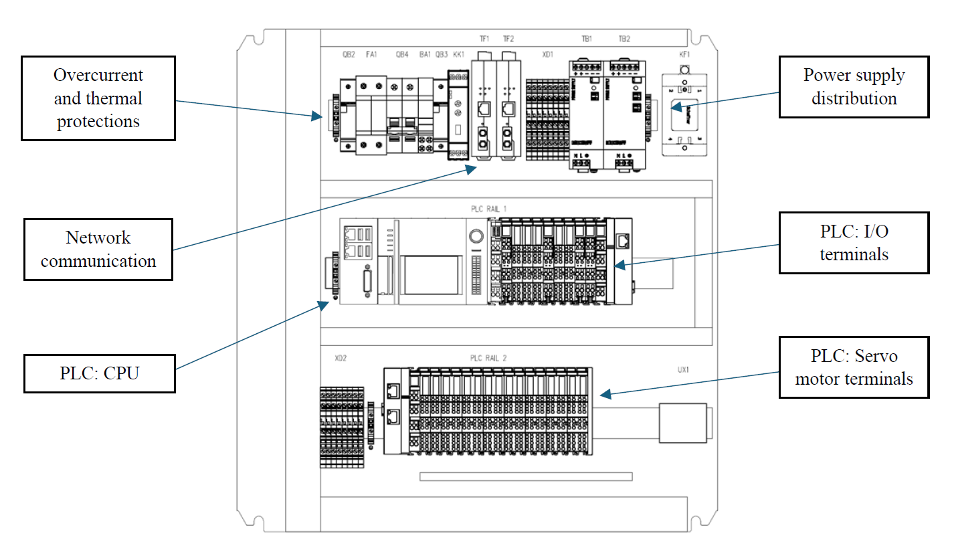
The PLC Cabinet #3

Slide 9
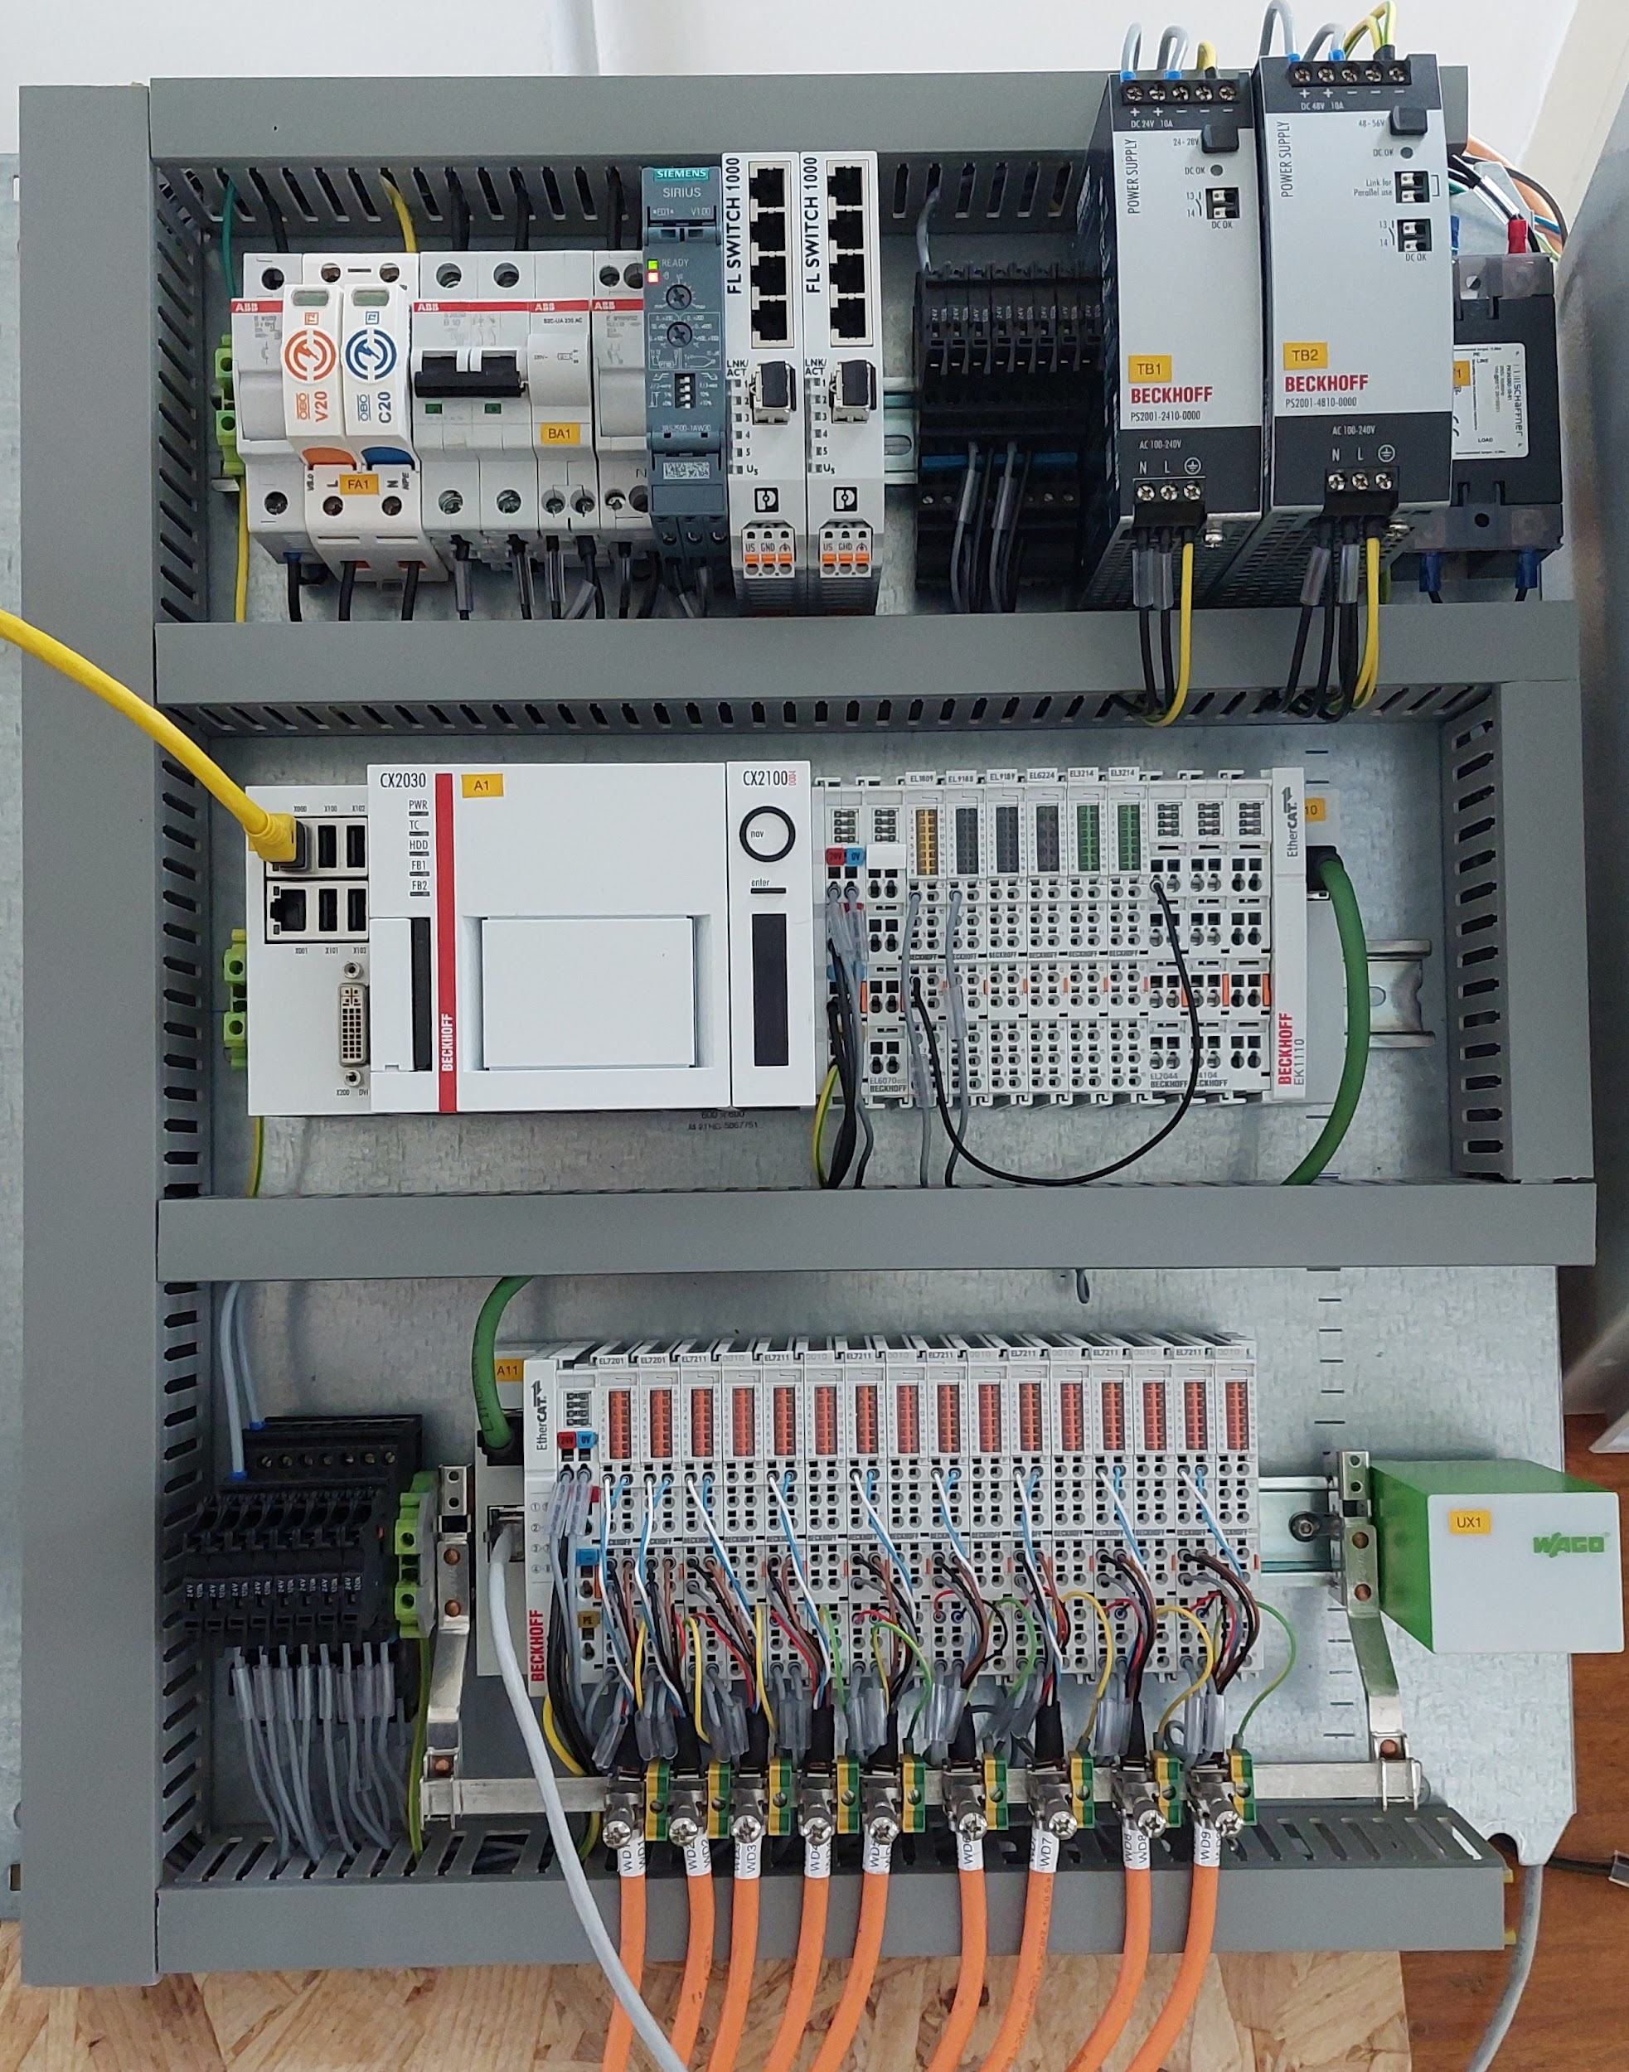
The PLC Cabinet #3

Slide 10
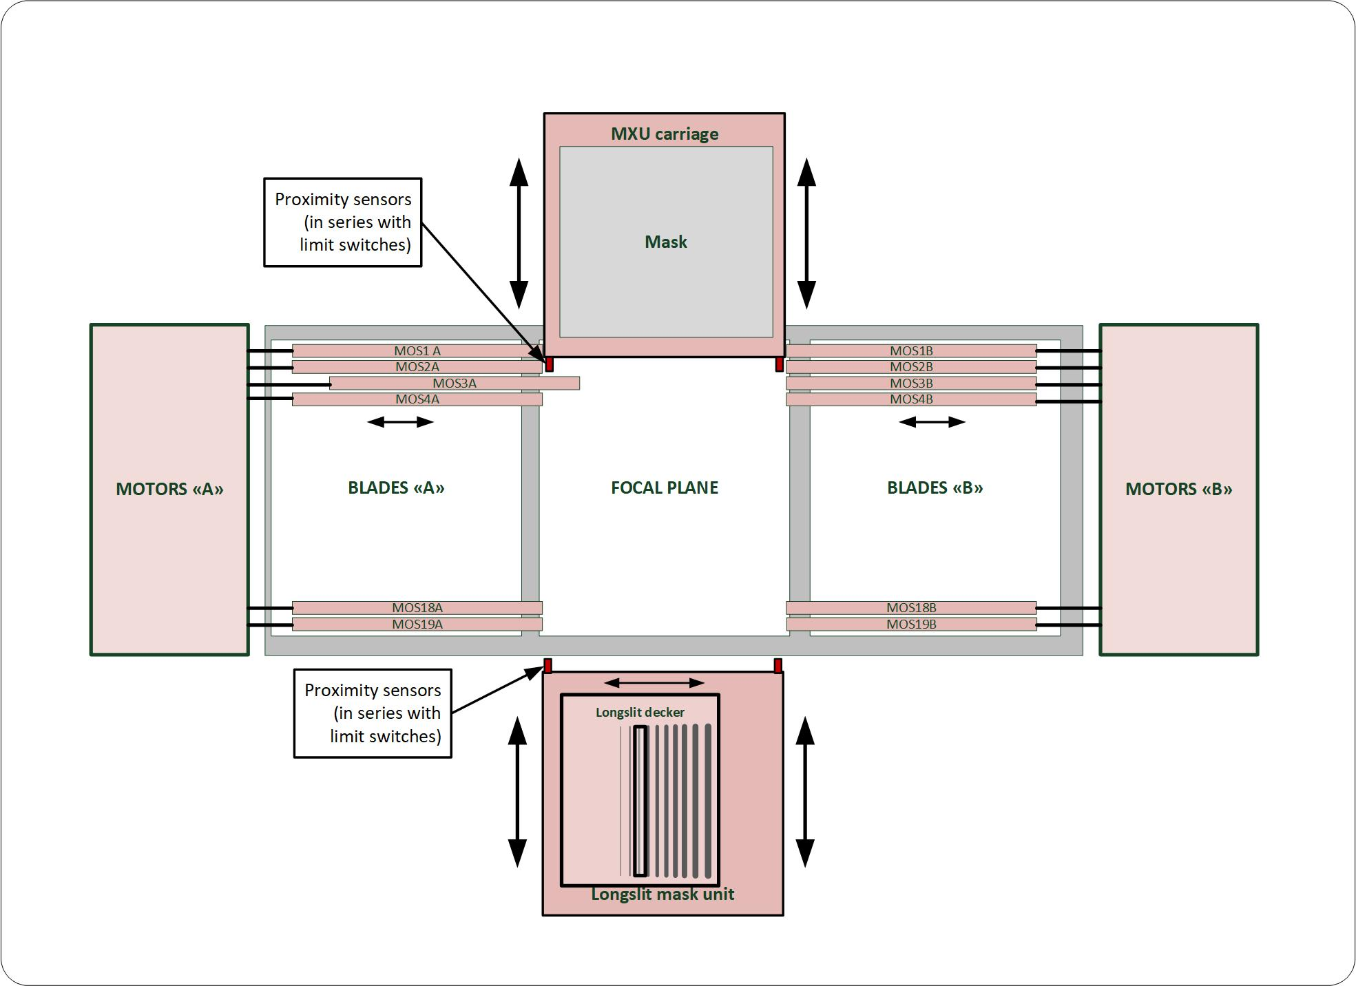
FORS1: Multi-Object Spectroscopy Unit

Slide 11
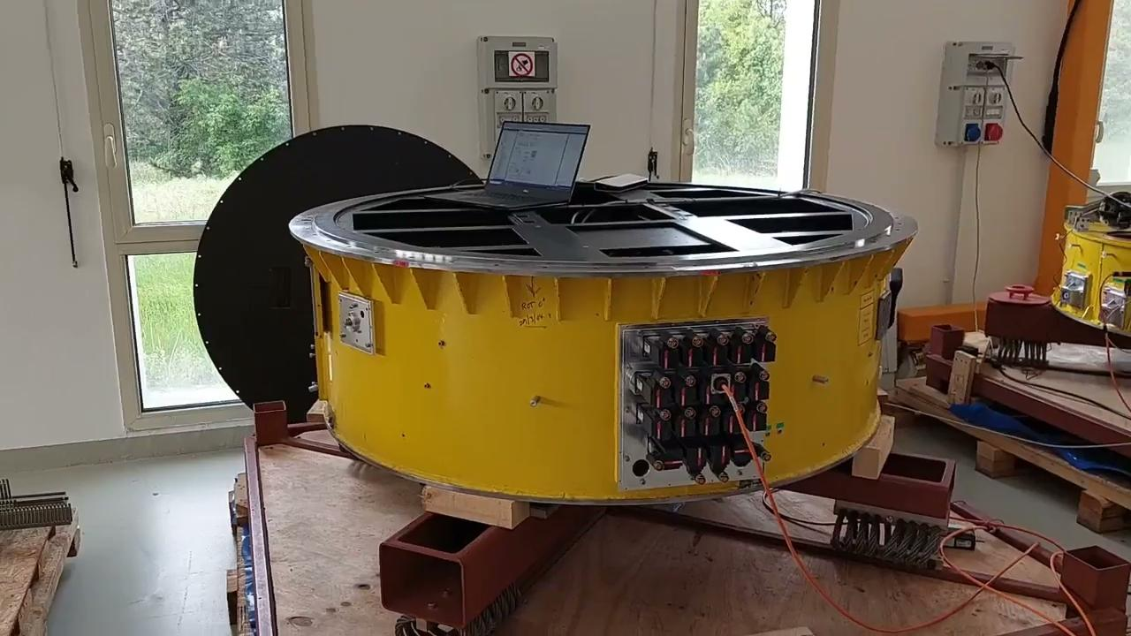
FORS1: MOS Unit

Slide 12
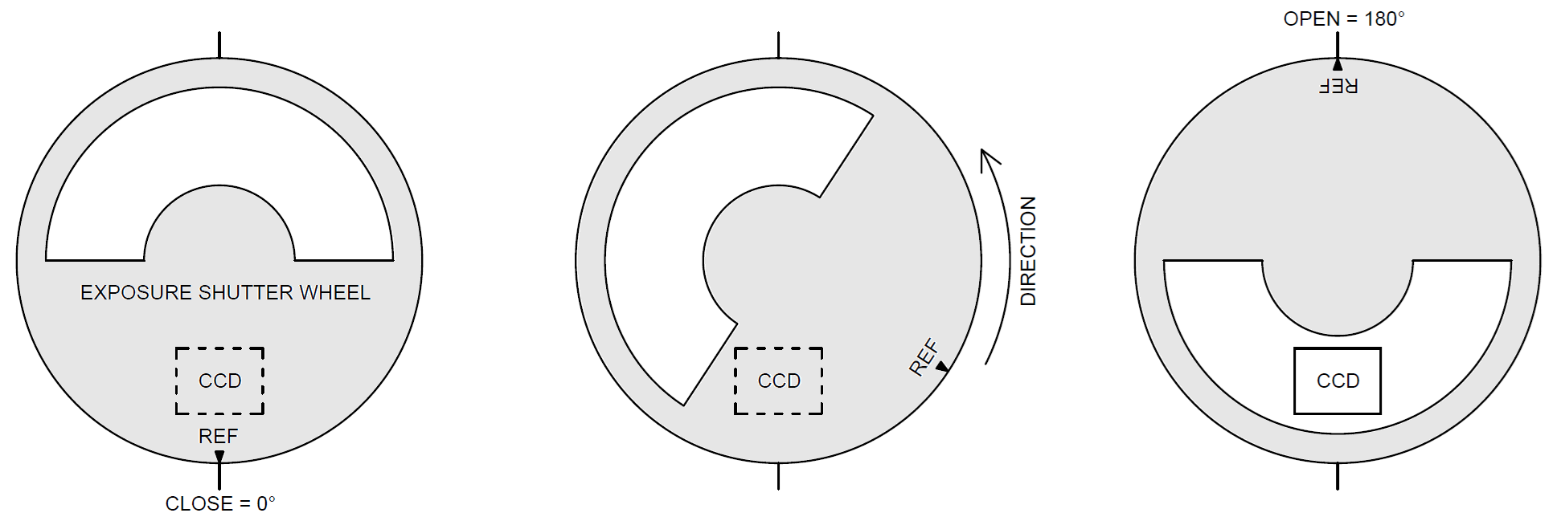
FORS1: Exposure Shutter (XPO)
Notes:
The mechanism of the FORS1 exposure shutter, which is controlled by a single rotative motor and has a non-standard interface with the NGC2 detector controller.

Slide 13
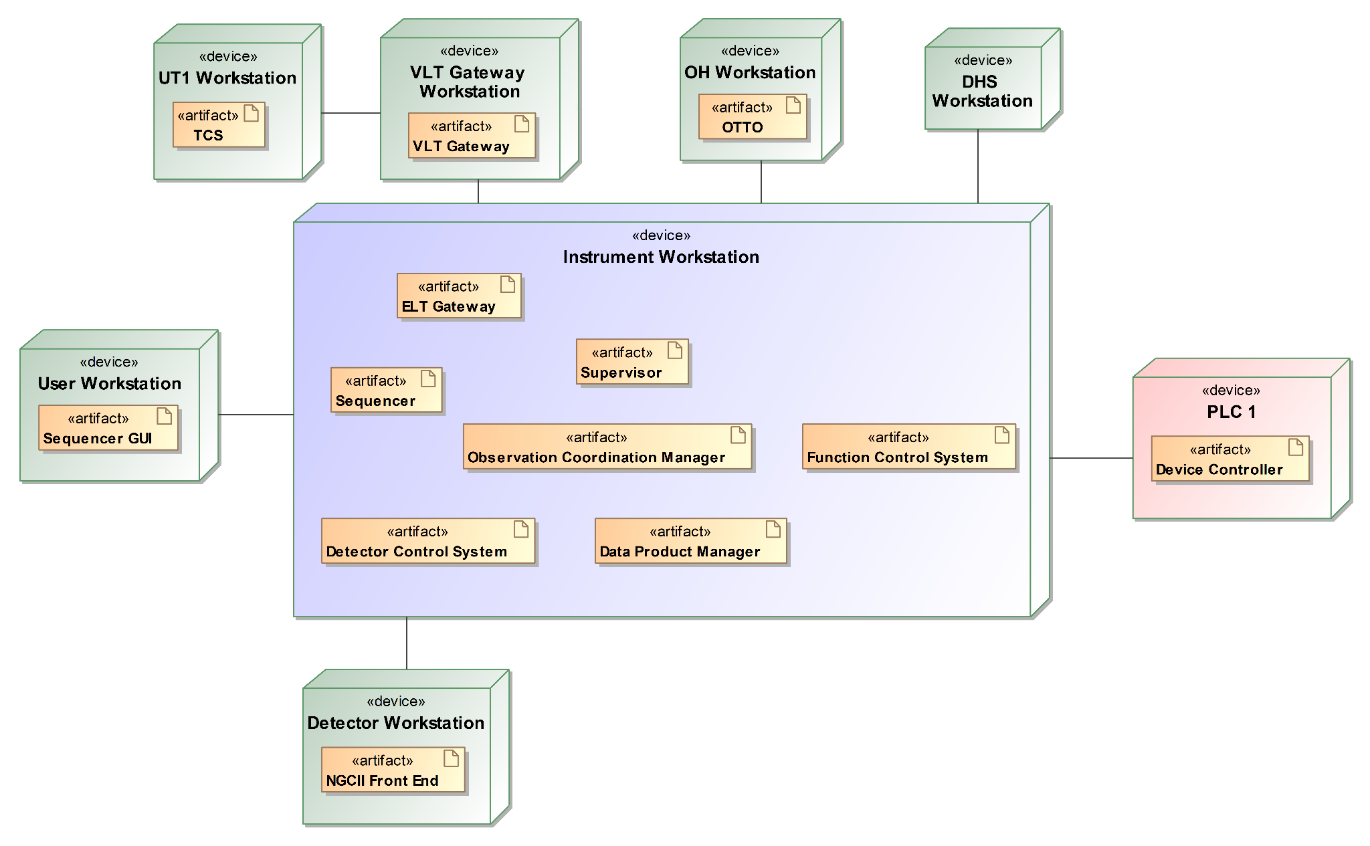
FORS: ICS Architecture
Notes:
Despite being a VLT instrument, FORS1 will transition from the VLT software to the new ELT Instrument Control Software Framework (ELT-IFW), the standard foundation for implementing the control software system for all future instruments that is currently under development at ESO.
The Instrument Workstation (IWS) runs the main high-level processes, with several subsystems to manage and monitor the instrument and the data acquisition.
A Beckhoff PLC runs the low-level software to control the hardware devices; communication between the IWS and the PLC exploits the OPC UA Protocol.
A dedicated Detector Workstation (DWS) running the New General Controller 2 (NGC2) software (provided by ESO) will control the scientific detector.
FORS1 will communicate with the VLT via the ELT-VLT Gateway, that forwards telescope commands from the IWS to the Telescope Control System (TCS) and returns telescope status and data products from the TCS to the IWS.

Slide 14
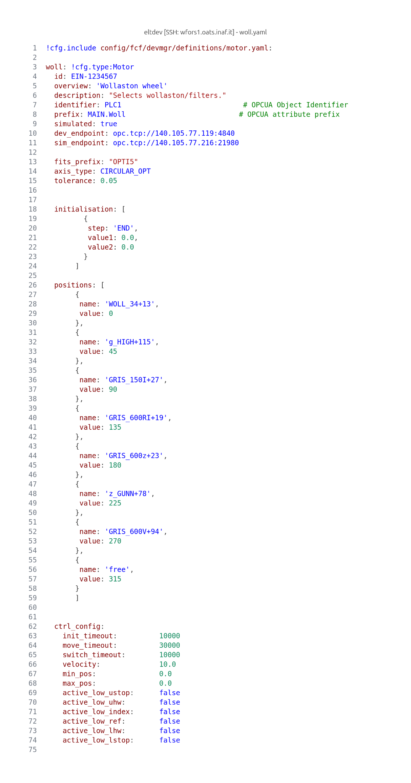
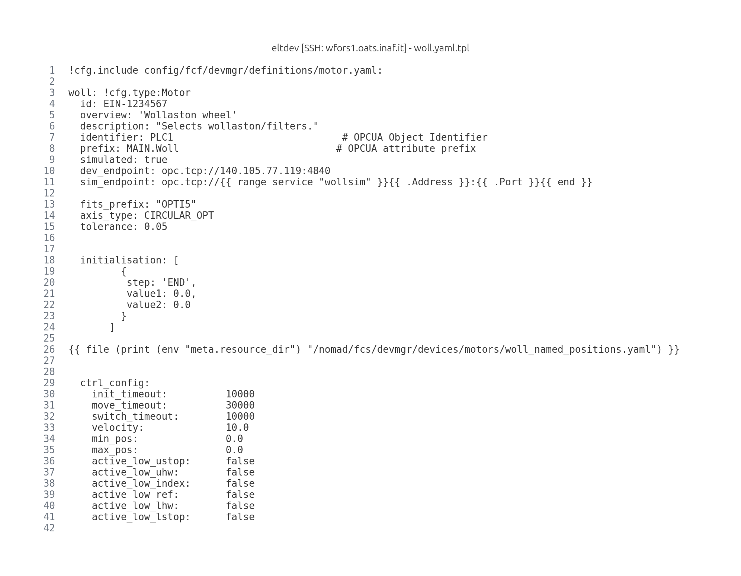
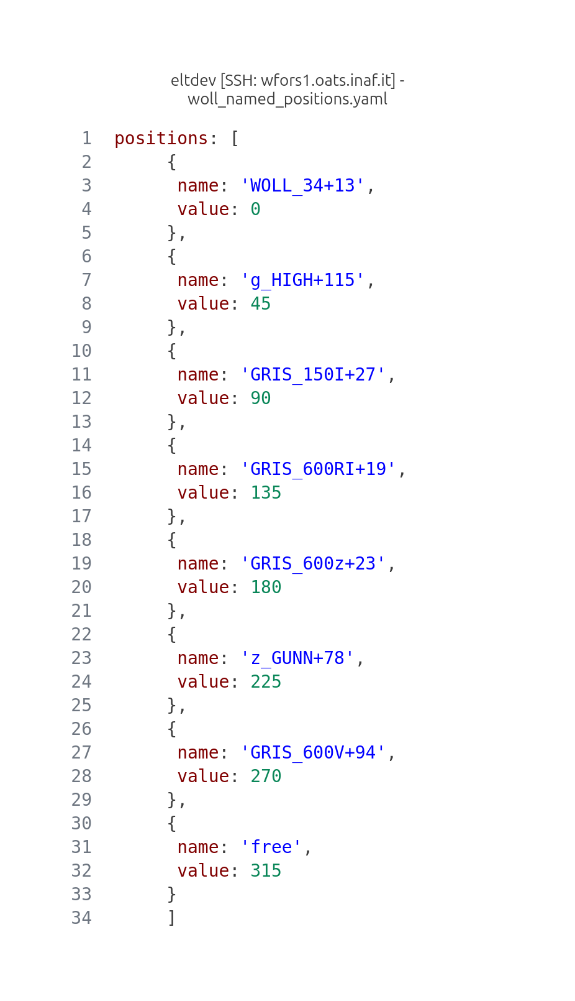
FORS: Motor Configuration
Notes:
As you recall, it is possible to replace FORS optical elements. This involves the redefining of the named positions for the filter wheels. We wanted to separate the motor-specific configuration from the named positions. The nomad hcl syntax allows the inclusion of the list of named positions of a motor into its yaml configuration file.

Slide 15
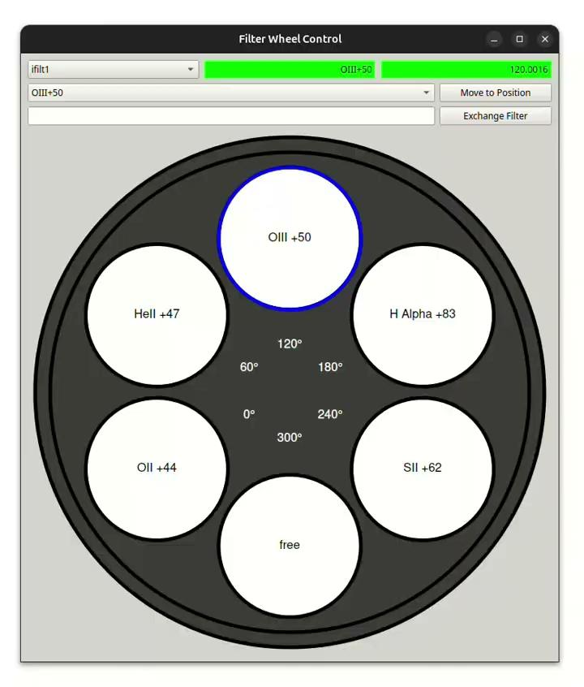
FORS: Graphical User Interfaces
Control User Toolkit (CUT) provided by ESO;
Qt Designer to create graphical user interfaces;
Python to connect the GUIs with the ICS functionalities;
Taurus to perform data binding between device data points and GUIs.
Notes:
Explain that FORS will have replaceable optical elements. This GUI is just a proof of concept and the setup procedure will need to be performed with a sequencer script.

Slide 16
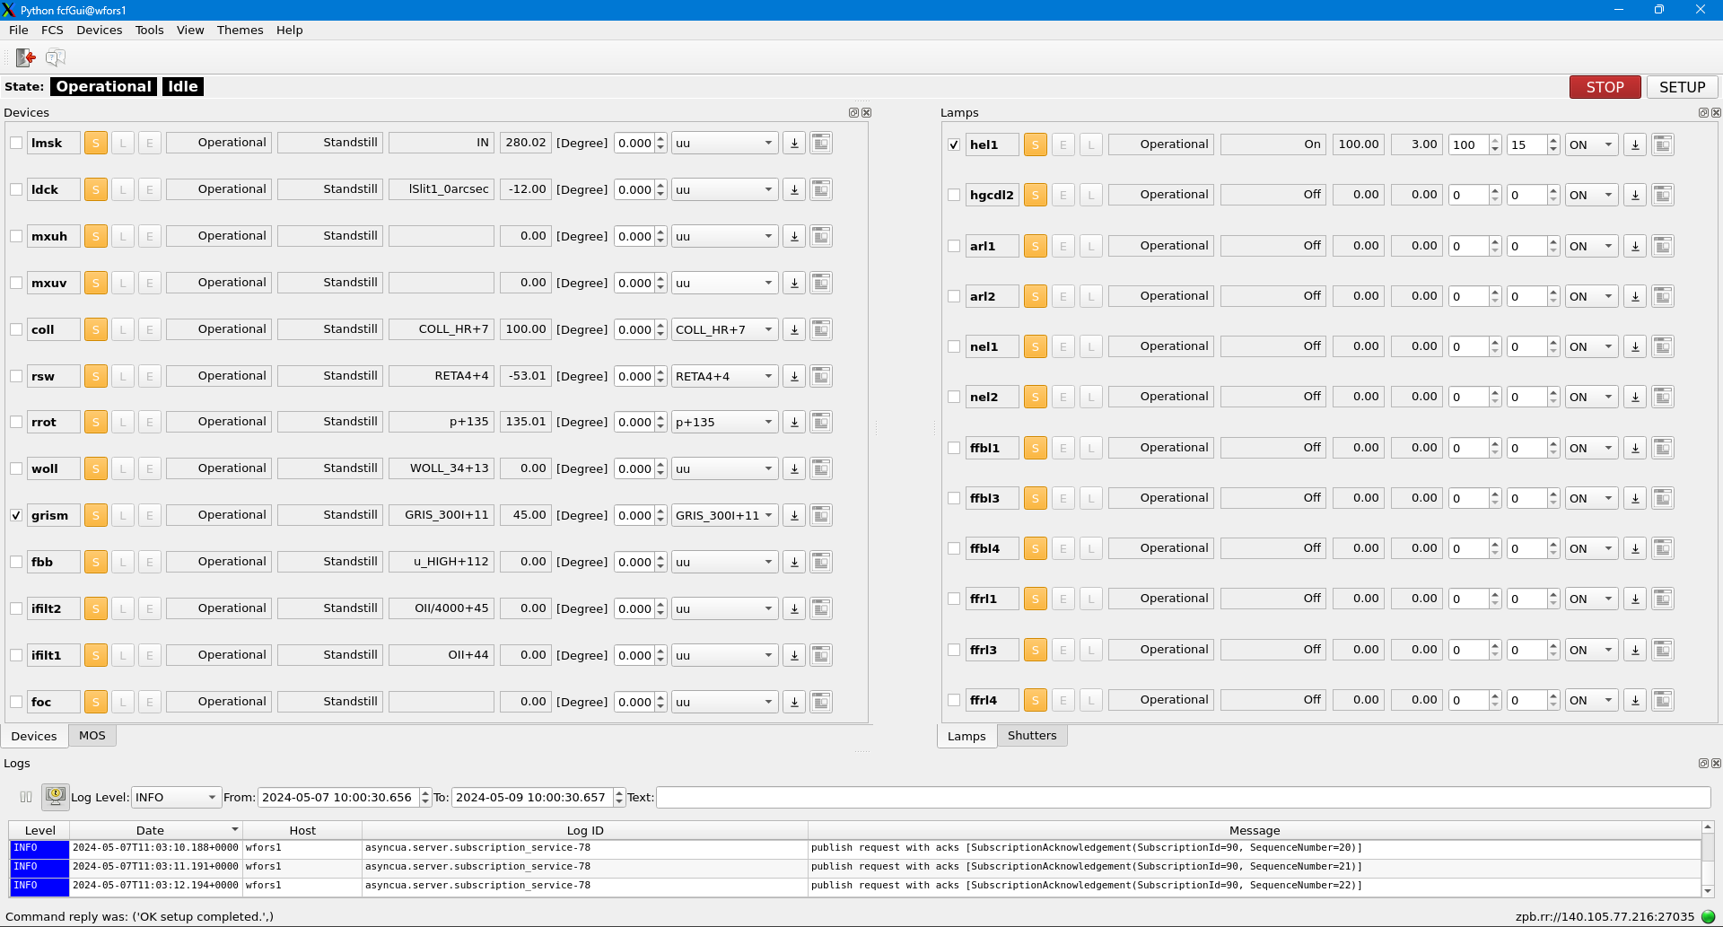
FORS: FCS GUI

Slide 17
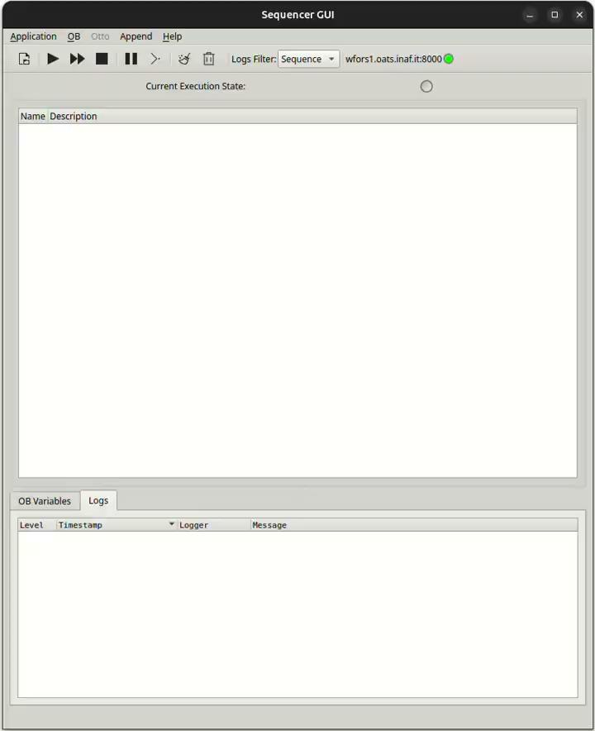
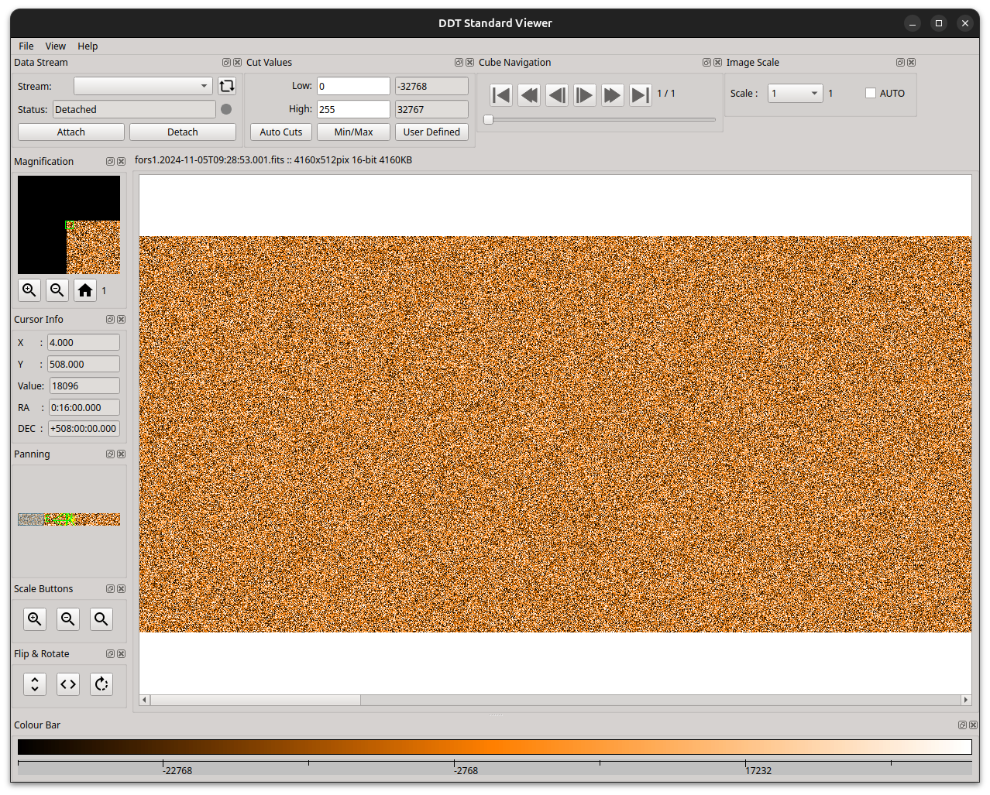
FORS: Templates
Python scripts to perform instrument operations;
Building units of Observation Blocks.
Notes:
The execution of instrument procedures is organized into templates, namely Python scripts that operate individual instrument devices in the proper order. Templates are the building units of the Observation Blocks (OBs), that are executed by the Sequencer.

Slide 18
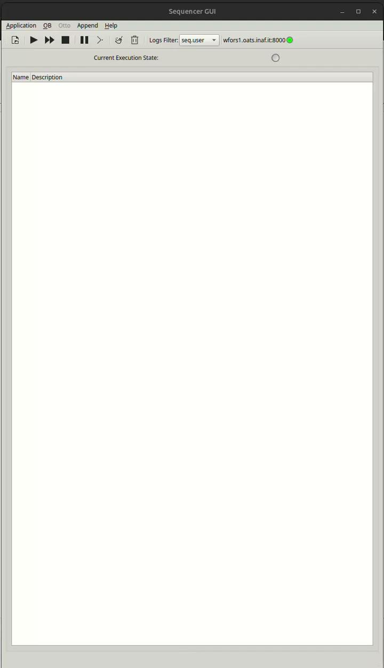
FORS: Startup Script
The FORS ICS will be started with a sequencer script;
System startup requires less than 3 min;
The ICS functionalities are structured into subsystems (OCS, FCS, DCS) coordinated by the SYSSUP;
One device server process (FCS) to control all functions;
One process for each device simulator.

Slide 19
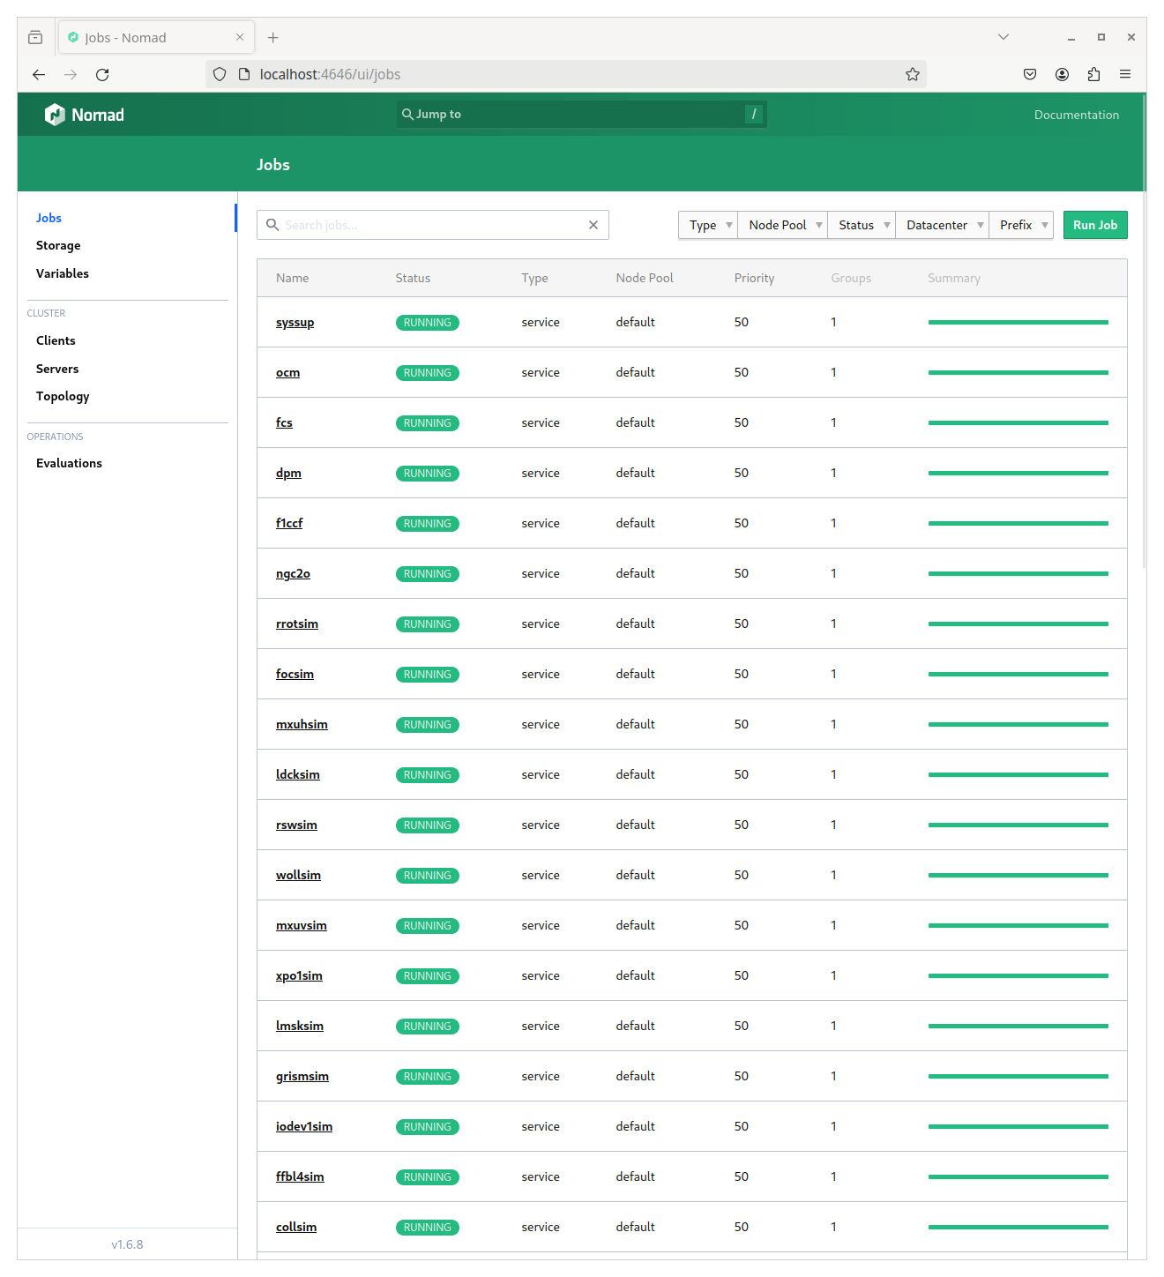
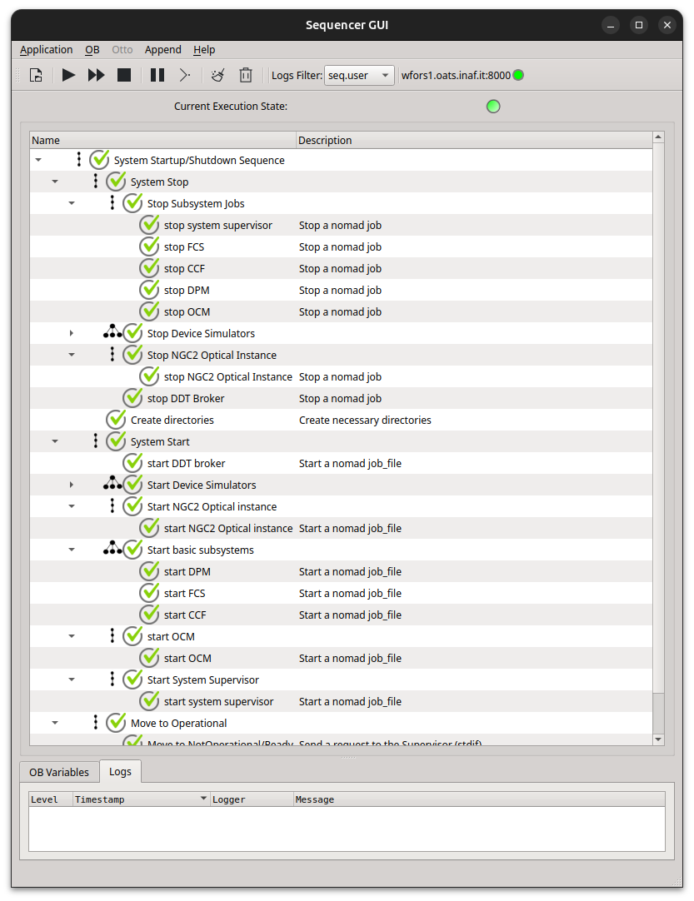
FORS: Startup Script

Slide 20
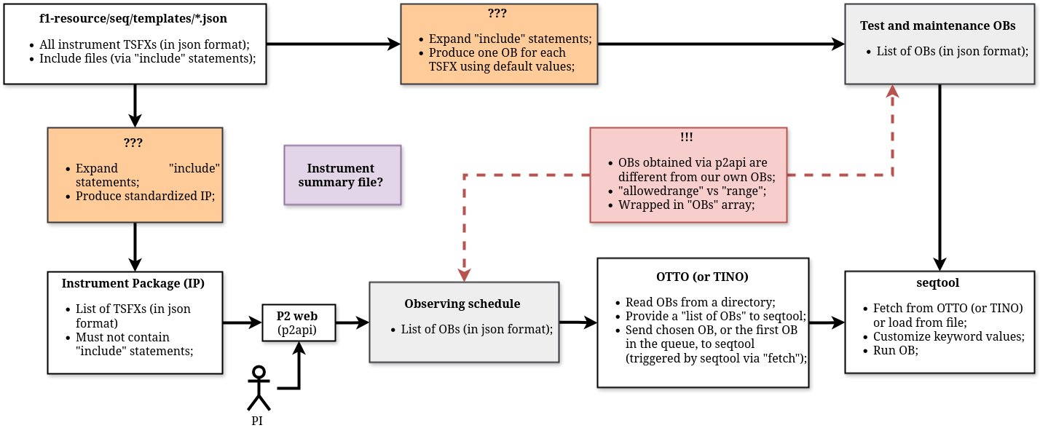
FORS templates: an overview
Notes:
Concerning the template workflow, starting from their definition (upper left corner) to their execution in seqtool (bottom right corner) we identified a couple of functionalities which are not yet implemented in the standard ELT software, marked with a question mark.
Namely, the expansion of an "include" directive, to include a json file into another one, and the automatic generation of OB files using default values.
We tentatively implemented a script to perform these steps, and we are in contact with the ELT software team to understand whether this is a viable option, but no final decision has yet been reached.
There are other minor issues related to the convention used in the OB files, or the use of an "instrument summary file", but these are really minor issues not worth discussing here.

Slide 21
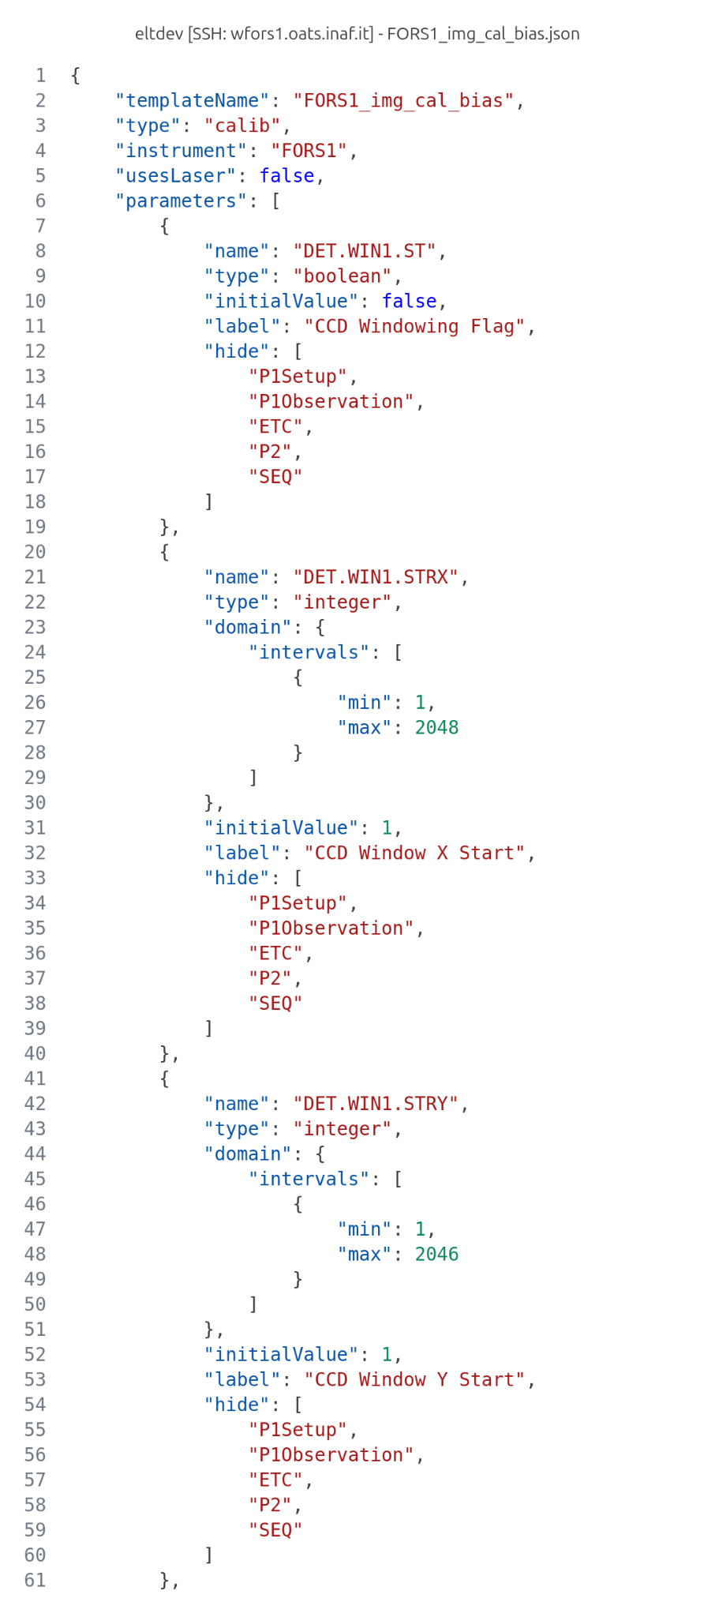
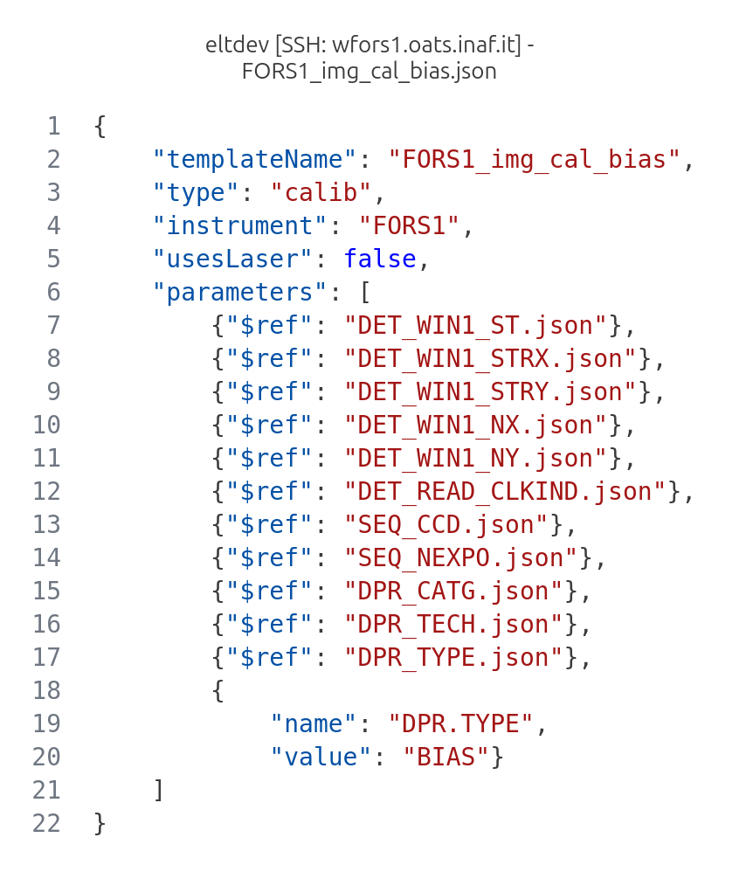
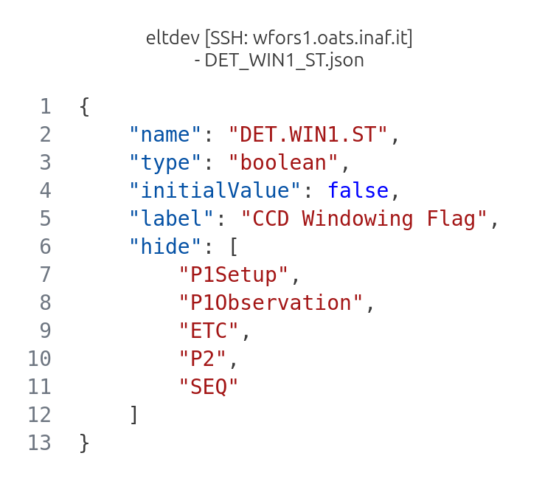
FORS Instrument Package: a proposal
Notes:
IP, a collection of templates to be ingested by p2. FORS has many modes > many templates > possible duplication. To avoid it, we developed a script to perform the inclusion of template parameter definitions and range into the json template signature (old .tsf files).

Slide 22
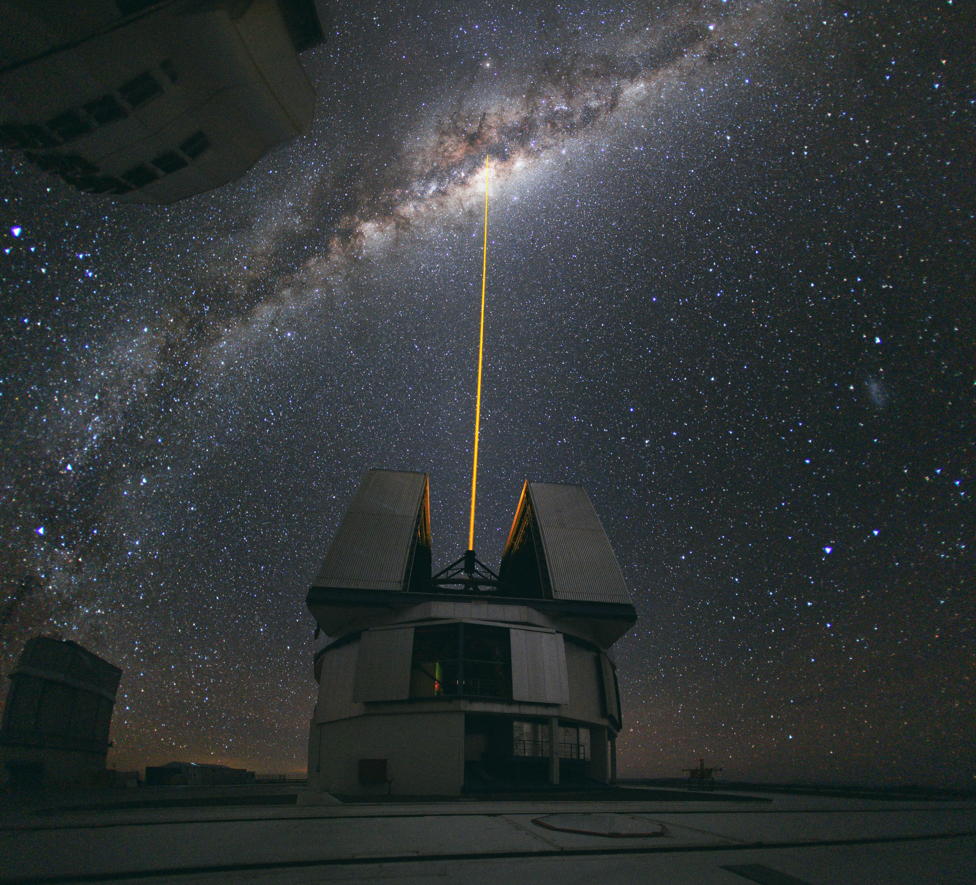

Thank you for your attention!

Slide 23
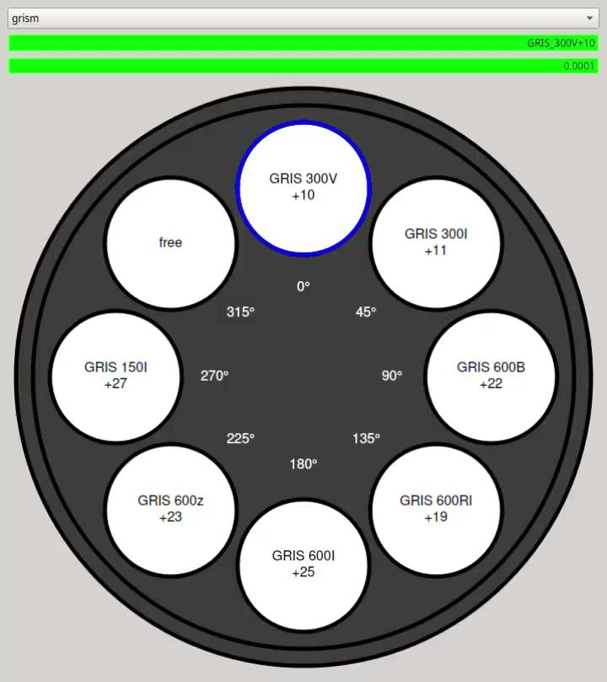
FORS: Graphical User Interfaces
Control User Toolkit (CUT) provided by ESO;
Qt Designer to create graphical user interfaces;
Python to connect the GUIs with the ICS functionalities;
Taurus to perform data binding between device data points and GUIs.

Slide 24
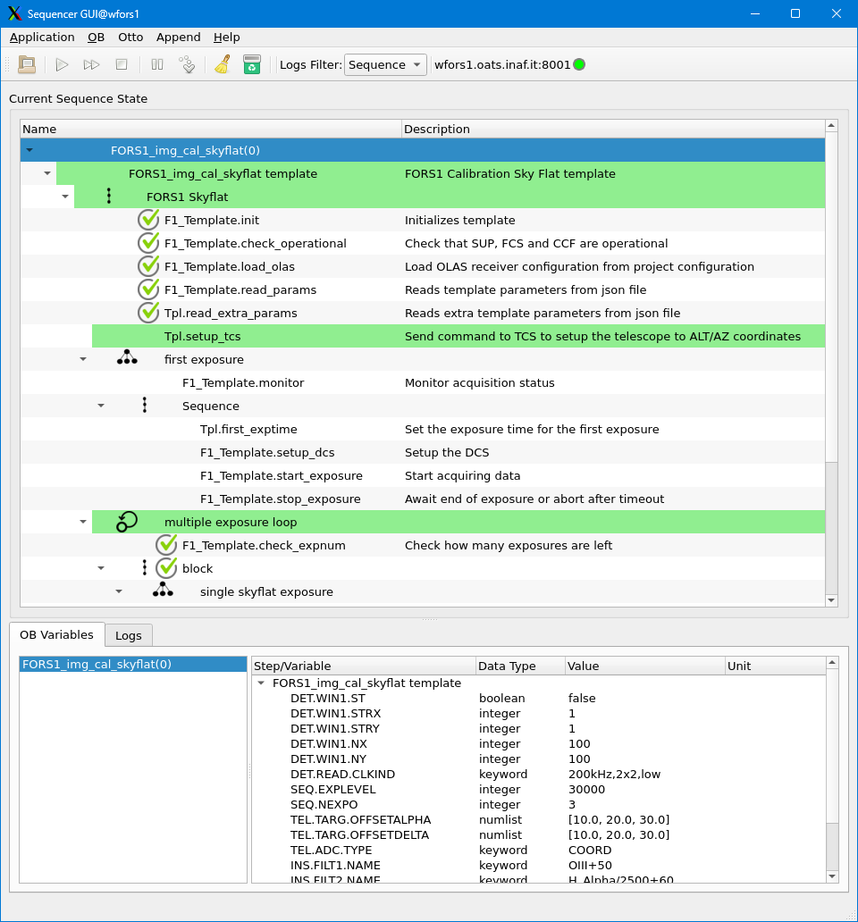
Graphical User Interfaces

Slide 25
FORS: Motor Configuration
Notes:
As you recall, it is possible to replace FORS optical elements. This involves the redefining of the named positions for the filter wheels. We wanted to separate the motor-specific configuration from the named positions. The nomad hcl syntax allows the inclusion of the list of named positions of a motor into its yaml configuration file.

Slide 26
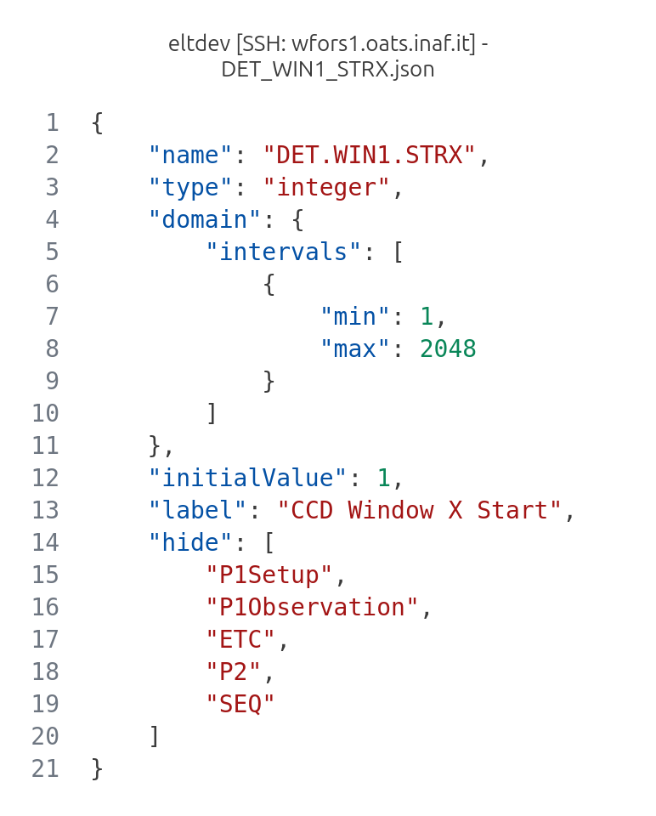
FORS Instrument Package: a proposal
Notes:
IP, a collection of templates to be ingested by p2. FORS has many modes > many templates > possible duplication. To avoid it, we developed a script to perform the inclusion of template parameter definitions and range into the json template signature (old .tsf files).

Slide 27
FORS: Open questions
How will the instrument package and OBs be validated?
Secondary loop framework?
Framegrabber?
How to enforce coherence between the ICS and resource repositories?

