Slide 1


Control UI Toolkit (CUT)
Arturo Hoffstadt Urrutia, Marzena Kaczmarczyk

Slide 2
Introduction

Slide 3
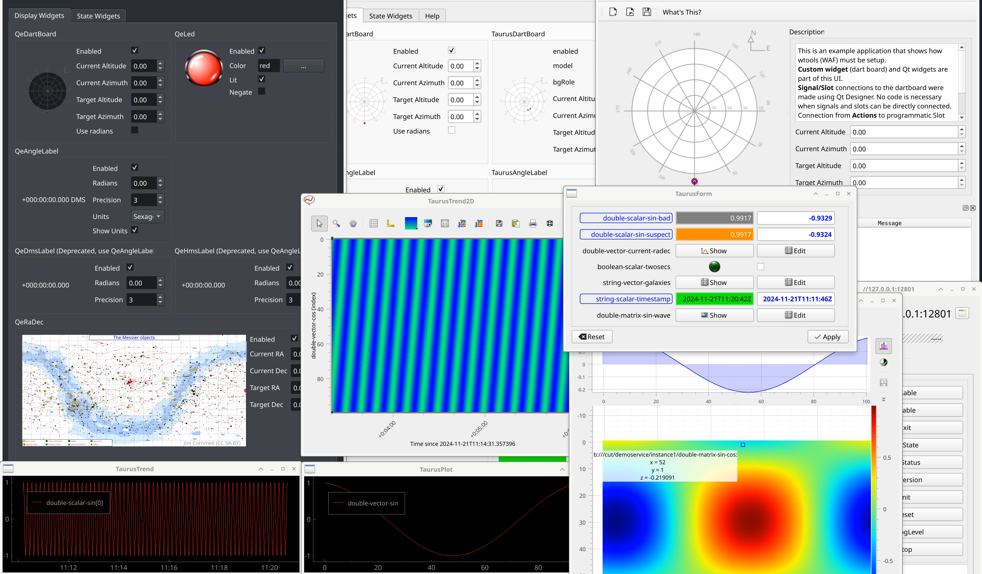
Introduction
The Control UI Toolkit (CUT) is a suite of libraries, tools and examples used to develop Graphical User Interfaces (GUI) for the ELT.
CUT is build using Qt a graphical rendering library, and Taurus as a powerful Model-View-Controller (MVC) layer that allows you to bind datapoints in the control system servers and services to widgets in your graphical application.

Slide 4
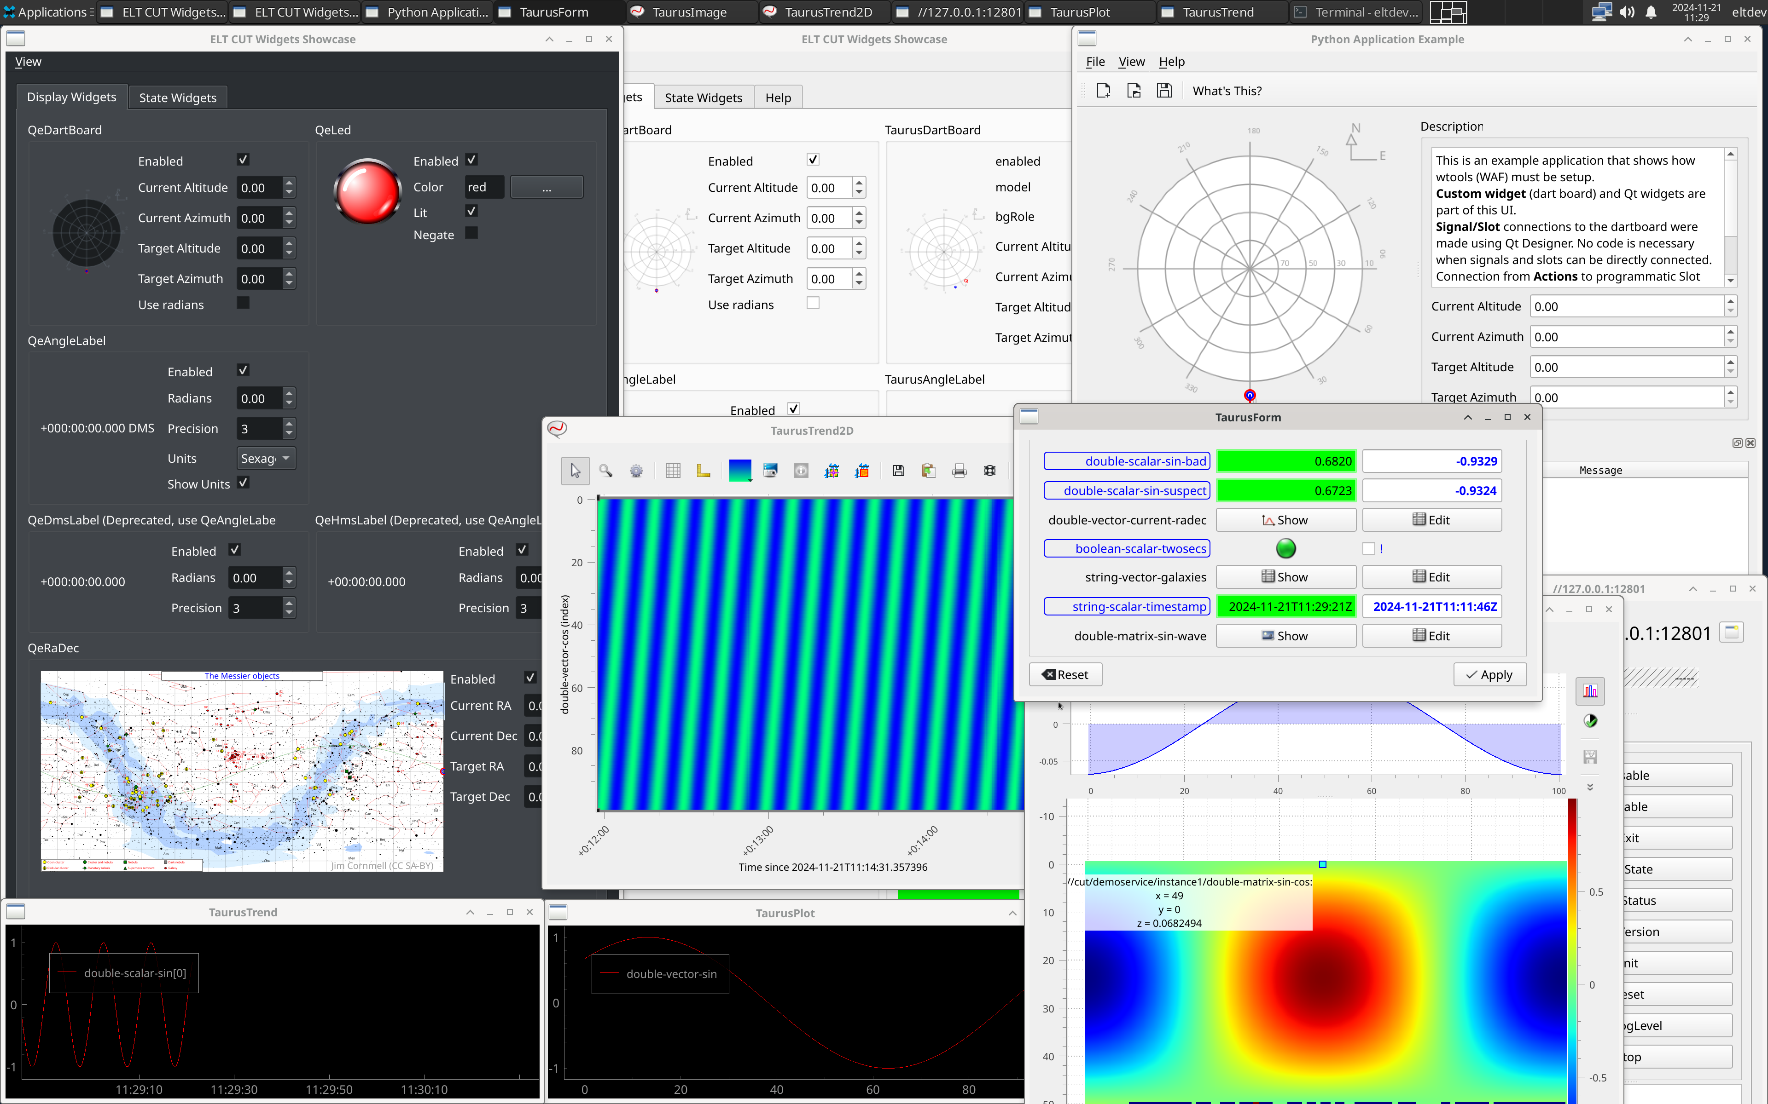
Introduction
The Control UI Toolkit (CUT) is a suite of libraries, tools and examples used to develop Graphical User Interfaces (GUI) for the ELT.
CUT is build using Qt a graphical rendering library, and Taurus as a powerful Model-View-Controller (MVC) layer that allows you to bind datapoints in the control system servers and services to widgets in your graphical application.

Slide 5
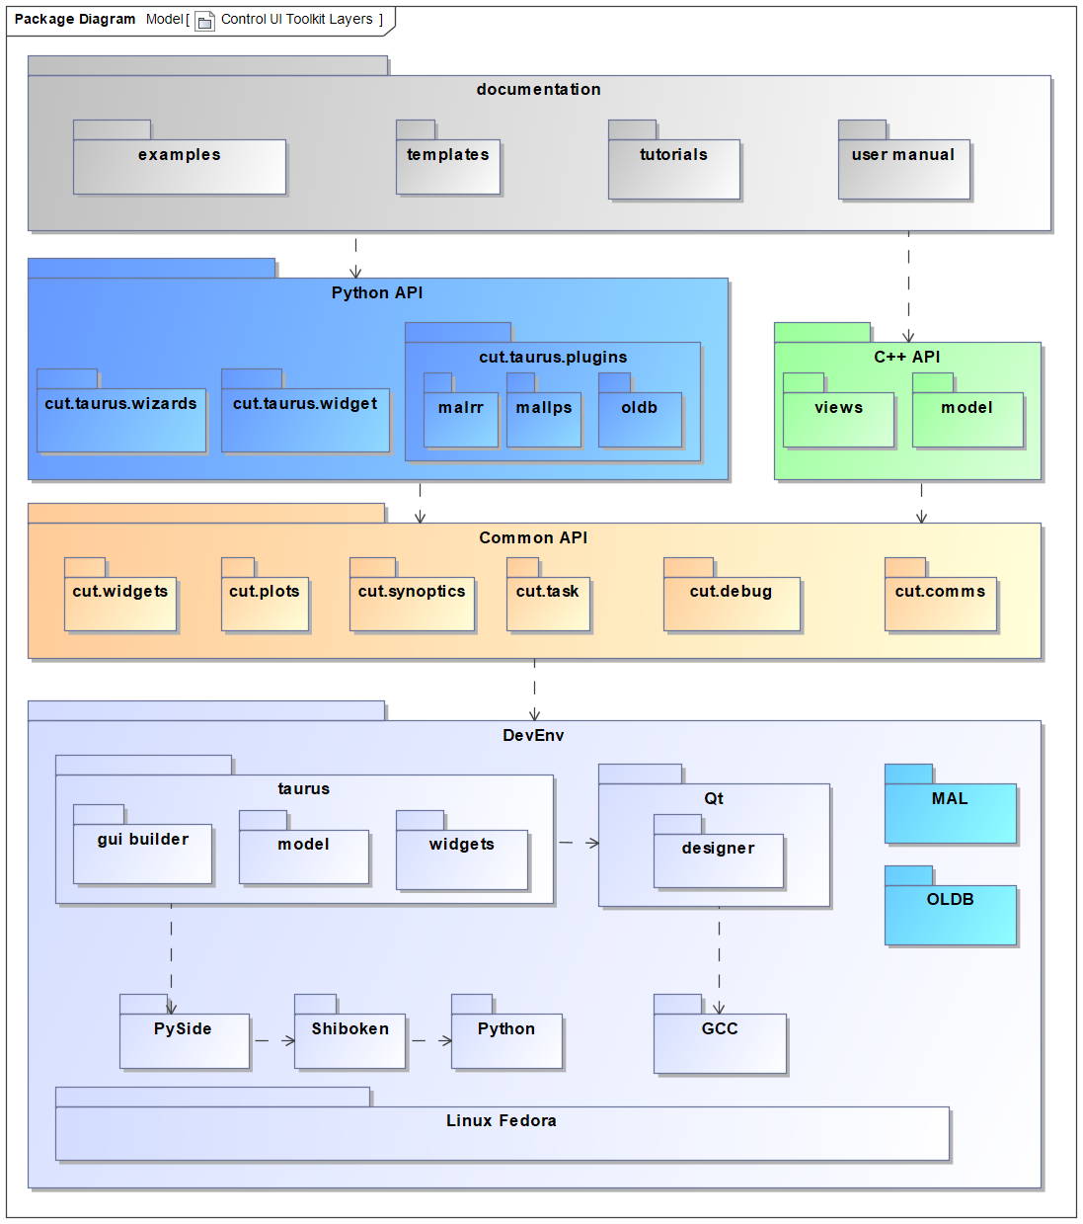
Overview
The Control UI Toolkit foresees the following software artefacts.
https://gitlab.eso.org/ecos/cut
https://gitlab.eso.org/ecos/cut/-/tags

Slide 6
Installation
As root:
dnf –y install elt-cut-devel
Alternatives:
Compilation instructions in the manual
Vagrant provisioned VMs example at: https://gitlab.eso.org/ecos/cut/-/tree/master/util/vagrant
NOTE: recommended when mobile-working due to limited bandwidth.

Slide 7
Documentation

Slide 8
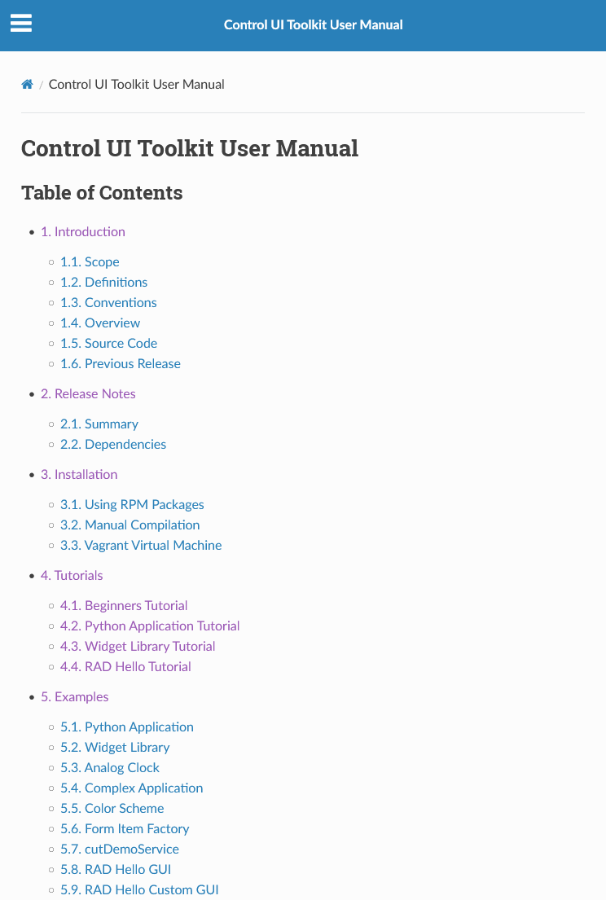
Documentation
User Manual
https://ftp.eso.org/pub/elt/repos/docs/CUT/sphinx_doc/html/index.html

Slide 9
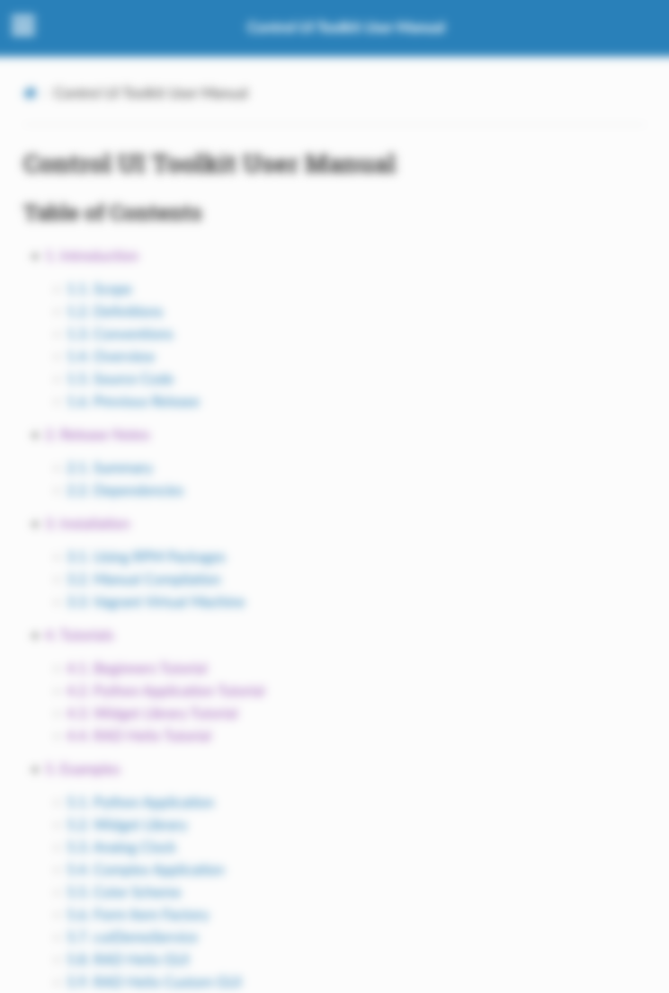
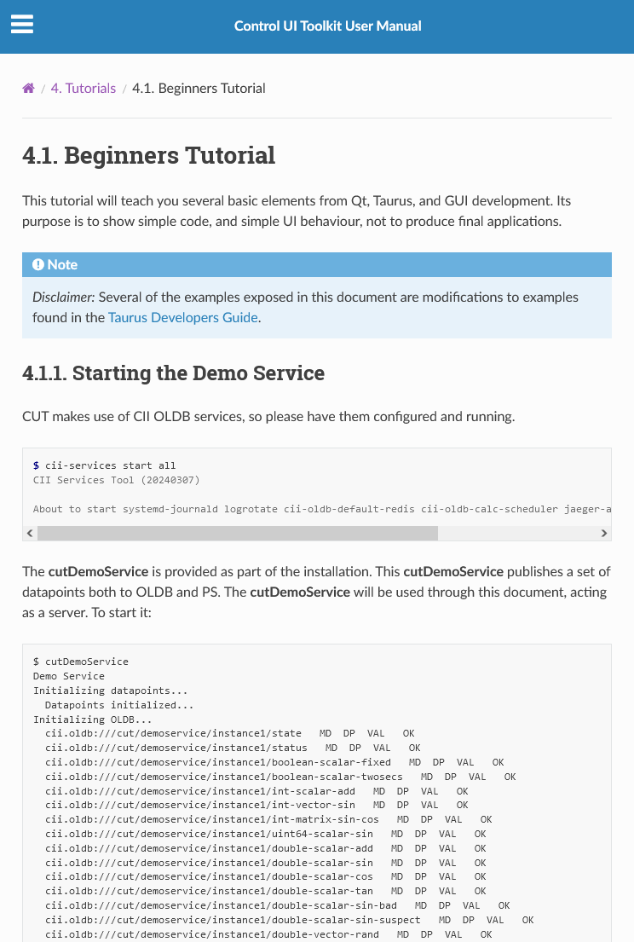
Documentation
User Manual
Beginners Tutorial
https://ftp.eso.org/pub/elt/repos/docs/CUT/sphinx_doc/html/index.html

Slide 10
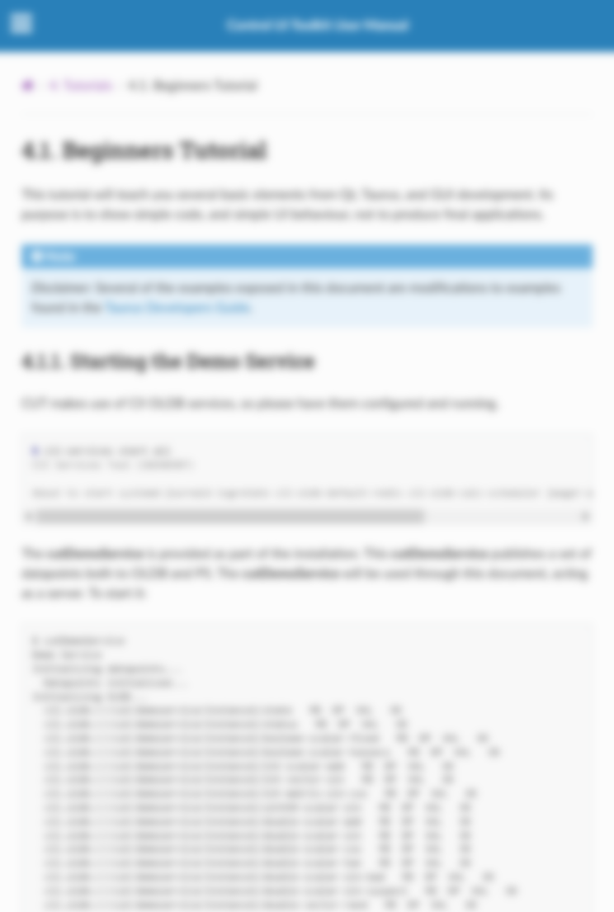
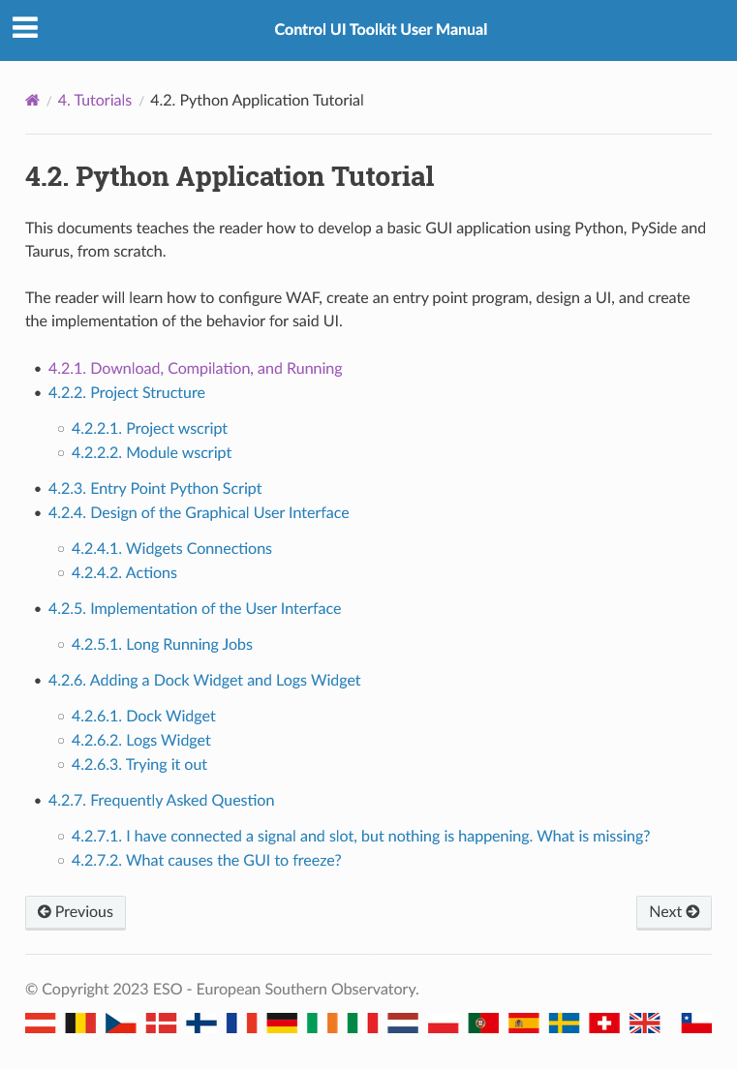
Documentation
User Manual
Beginners Tutorial
Python Application Tutorial
https://ftp.eso.org/pub/elt/repos/docs/CUT/sphinx_doc/html/index.html

Slide 11

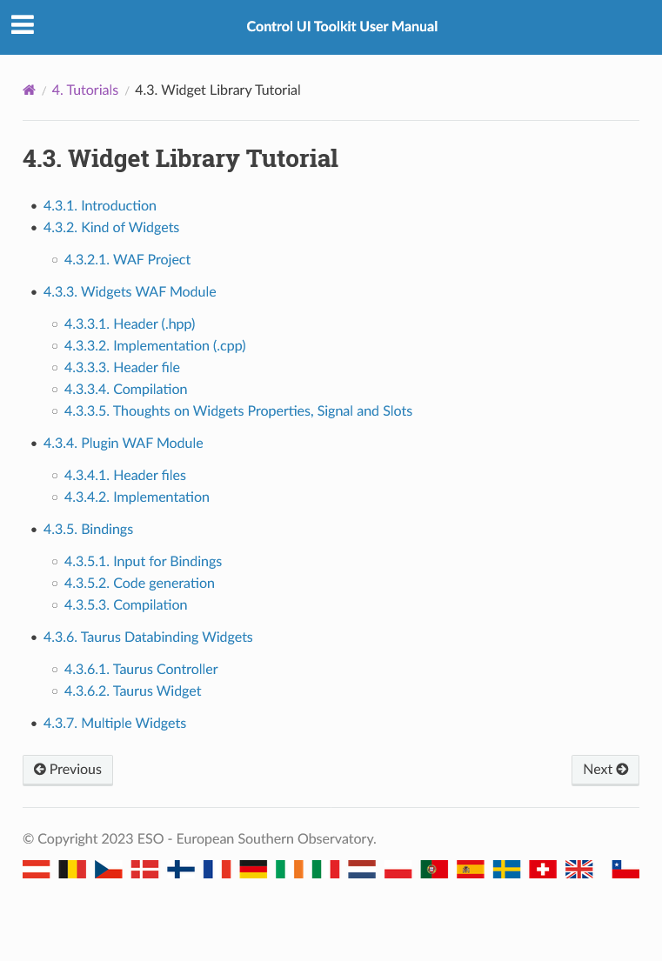
Documentation
User Manual
Beginners Tutorial
Python Application Tutorial
Widget Library Tutorial (Advanced)
https://ftp.eso.org/pub/elt/repos/docs/CUT/sphinx_doc/html/index.html

Slide 12
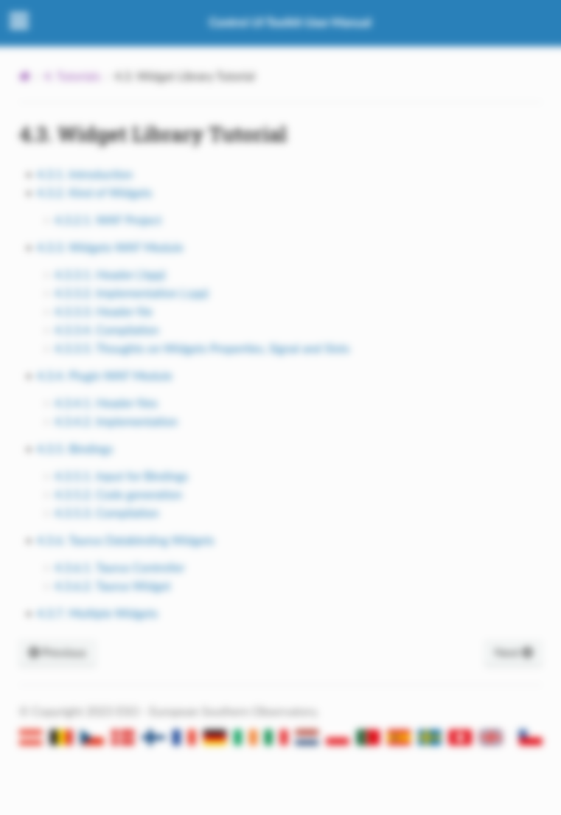
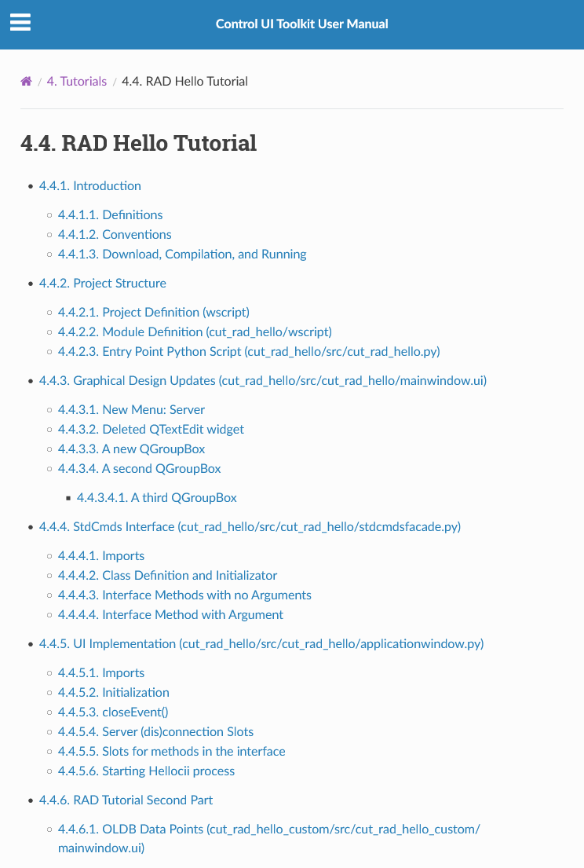
Documentation
User Manual
Beginners Tutorial
Python Application Tutorial
Widget Library Tutorial (Advanced)
RAD Hello Client Tutorial
https://ftp.eso.org/pub/elt/repos/docs/CUT/sphinx_doc/html/index.html

Slide 13
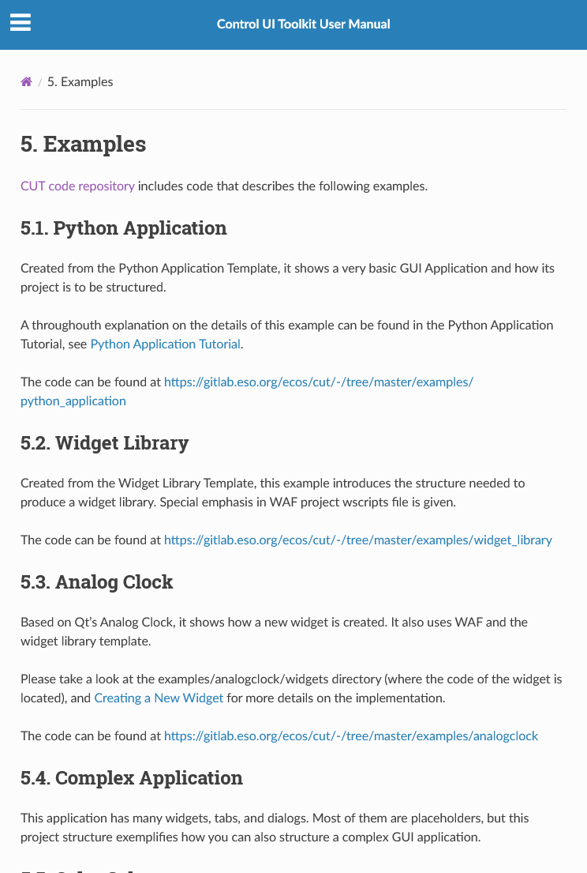
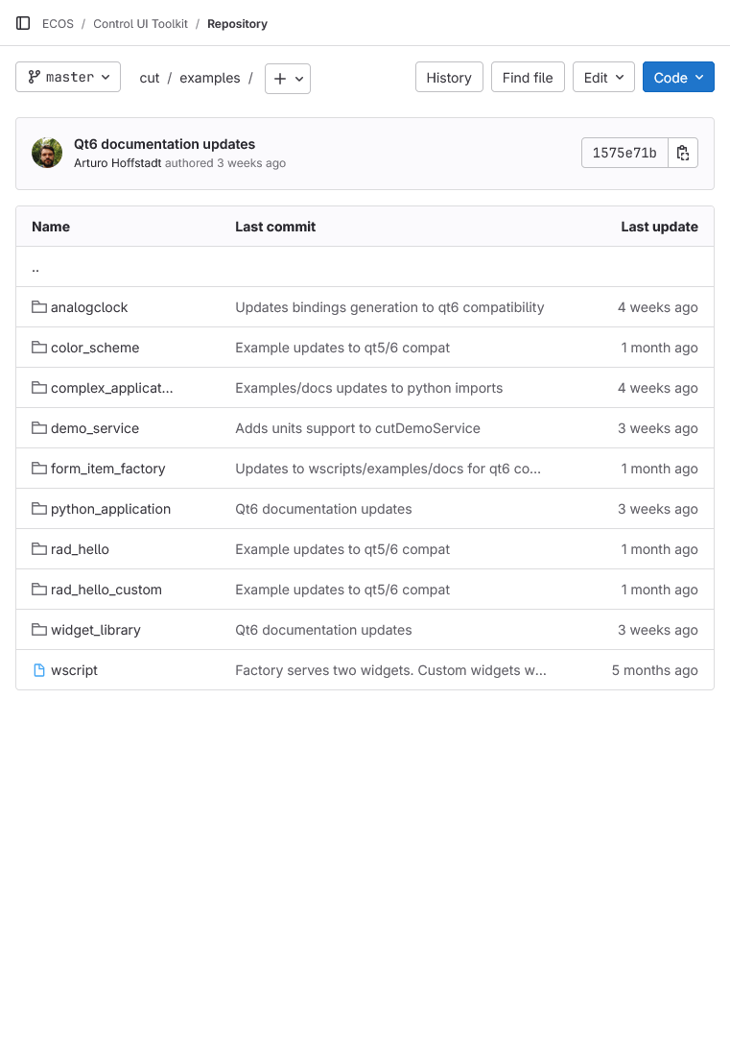
Documentation
Examples Library (with Code)
https://ftp.eso.org/pub/elt/repos/docs/CUT/sphinx_doc/html/index.html

Slide 14
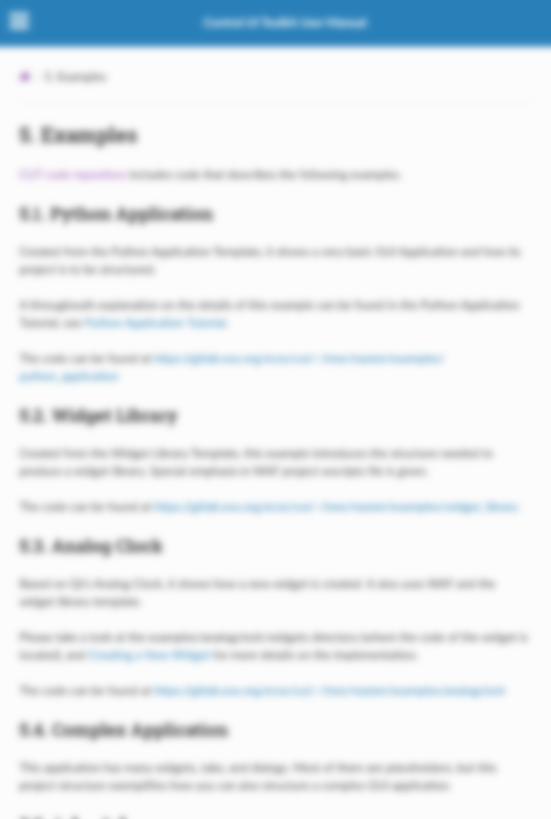
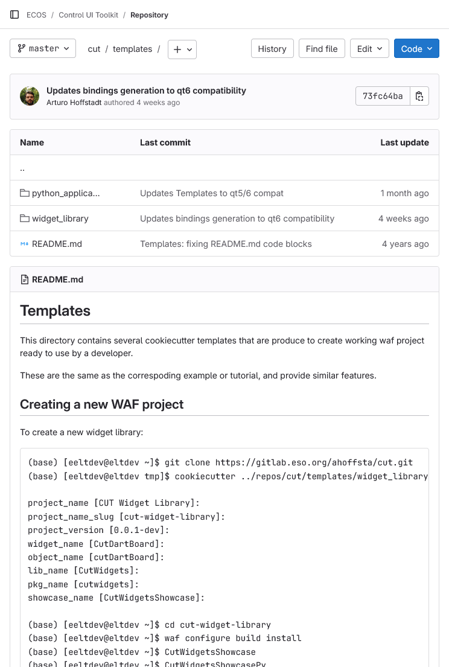

Documentation
Examples Library (with Code)
Templates
https://ftp.eso.org/pub/elt/repos/docs/CUT/sphinx_doc/html/index.html

Slide 15
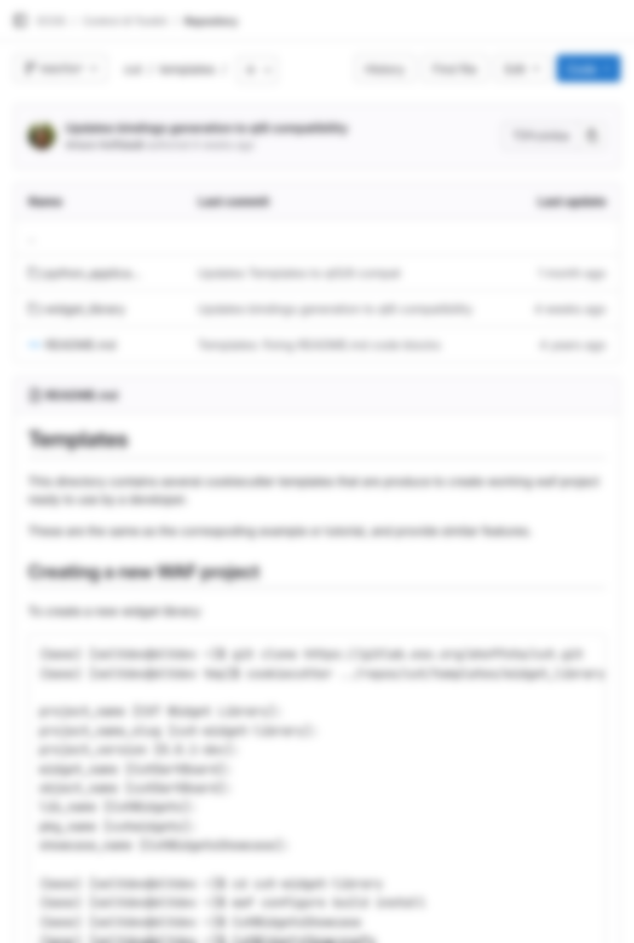
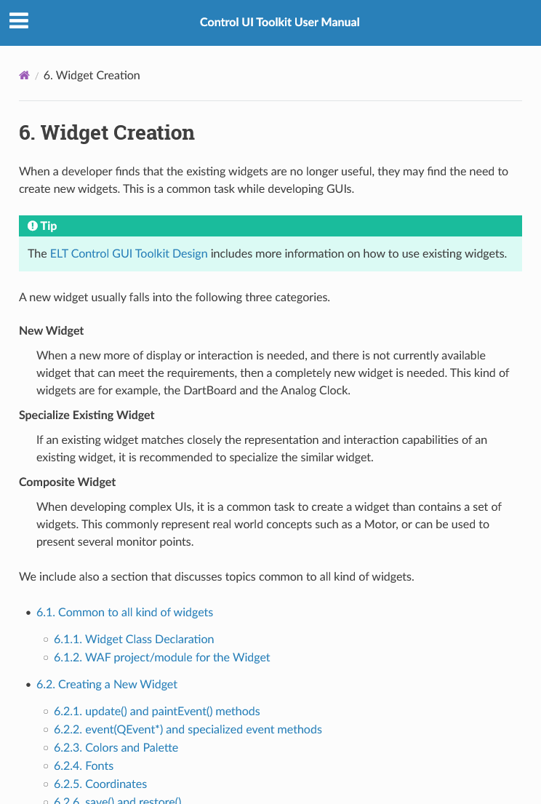
Documentation
Examples Library (with Code)
Templates
Widget Creation
https://ftp.eso.org/pub/elt/repos/docs/CUT/sphinx_doc/html/index.html

Slide 16
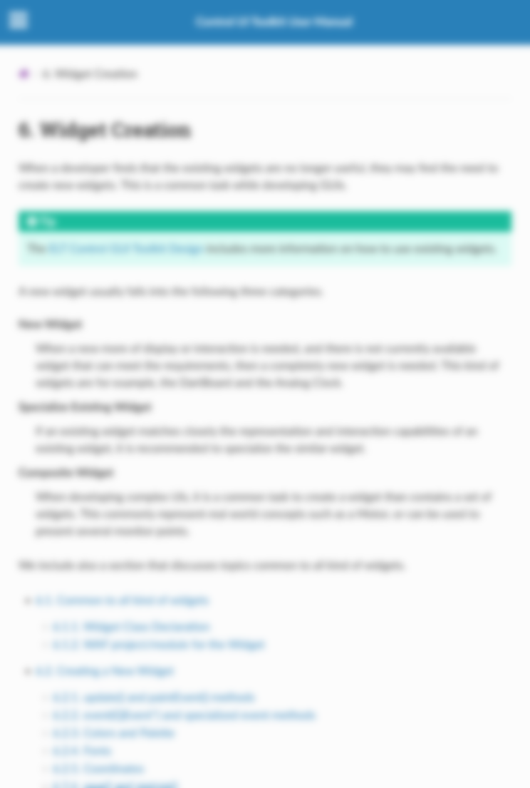
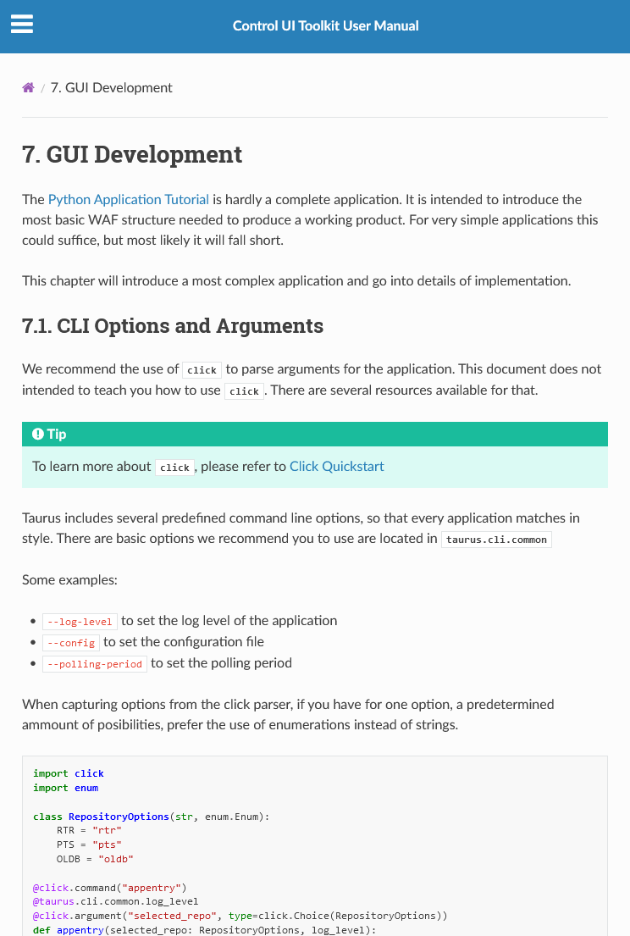
Documentation
Examples Library (with Code)
Templates
Widget Creation
GUI Development
https://ftp.eso.org/pub/elt/repos/docs/CUT/sphinx_doc/html/index.html

Slide 17

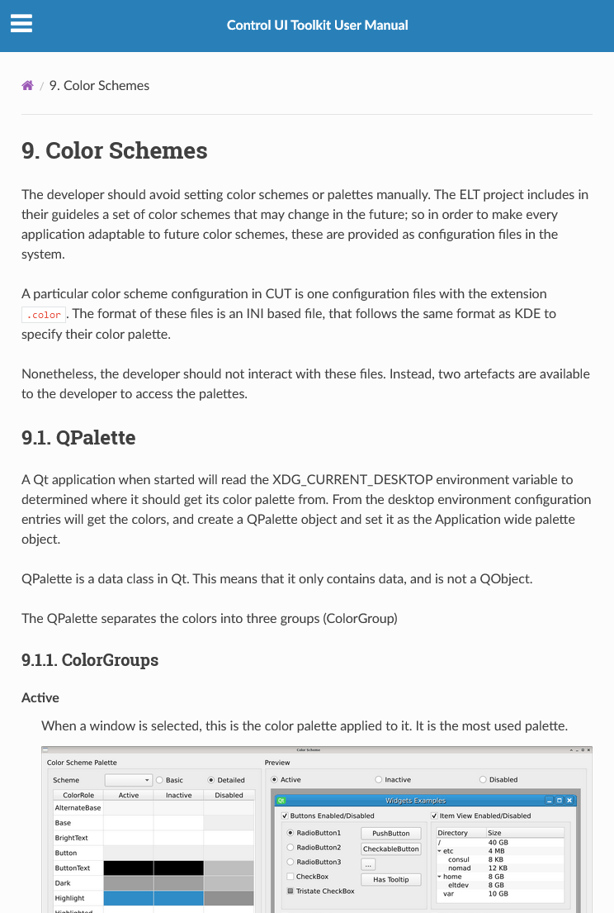
Documentation
Examples Library (with Code)
Templates
Widget Creation
GUI Development
Color Schemes
https://ftp.eso.org/pub/elt/repos/docs/CUT/sphinx_doc/html/index.html

Slide 18
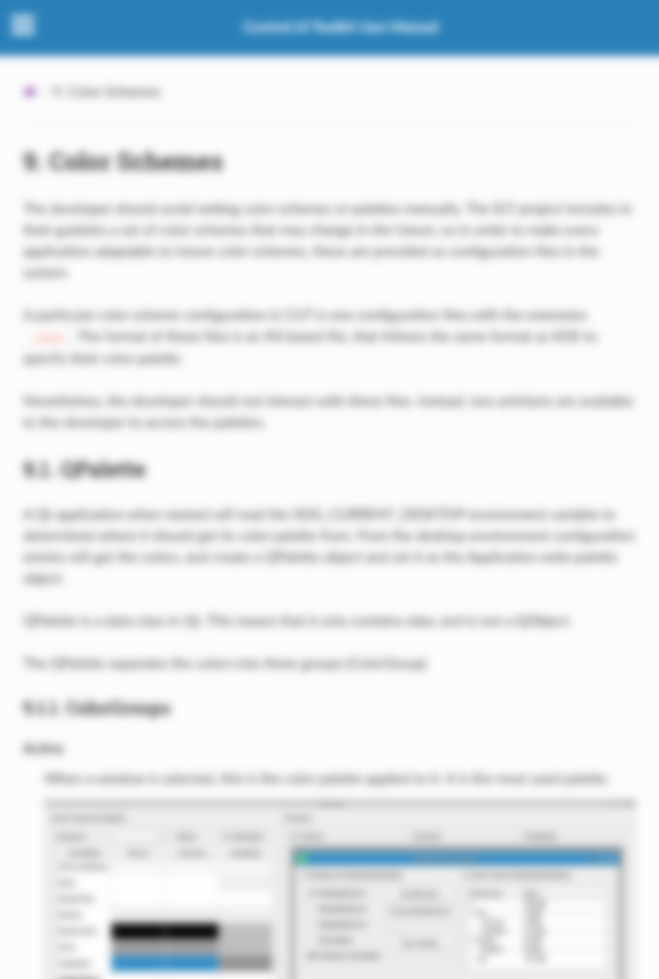
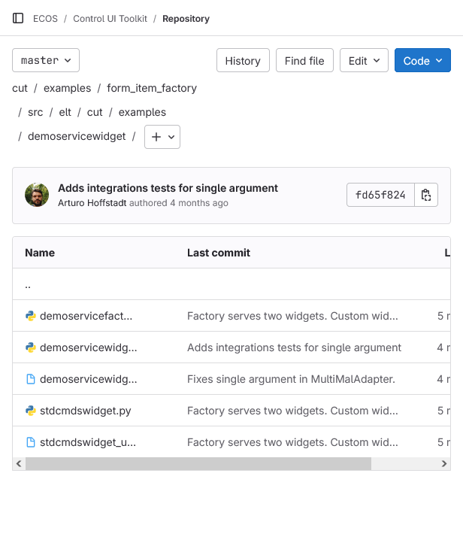
Documentation
Examples Library (with Code)
Templates
Widget Creation
GUI Development
Color Schemes
Custom Form Item Factory/Widgets
https://ftp.eso.org/pub/elt/repos/docs/CUT/sphinx_doc/html/index.html

Slide 19
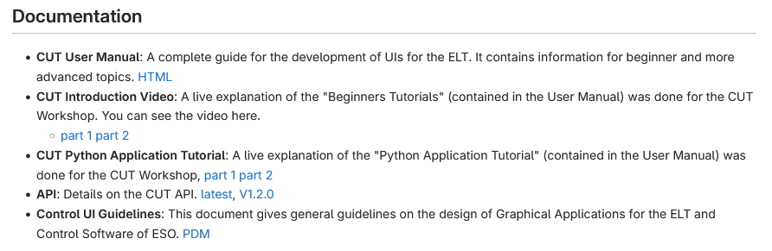
Documentation
CUT Workshops were recorded and are available.
https://gitlab.eso.org/ecos/cut

Slide 20
Quickly create a (prototype) GUI

Slide 21
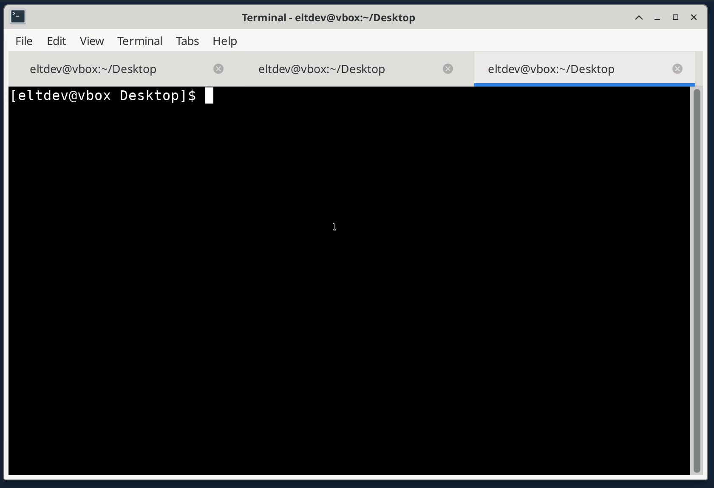
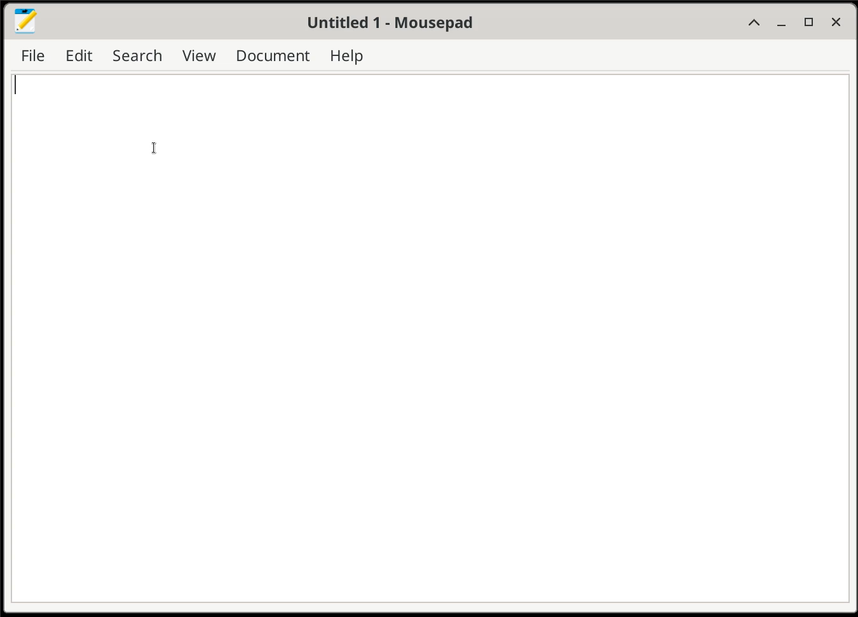
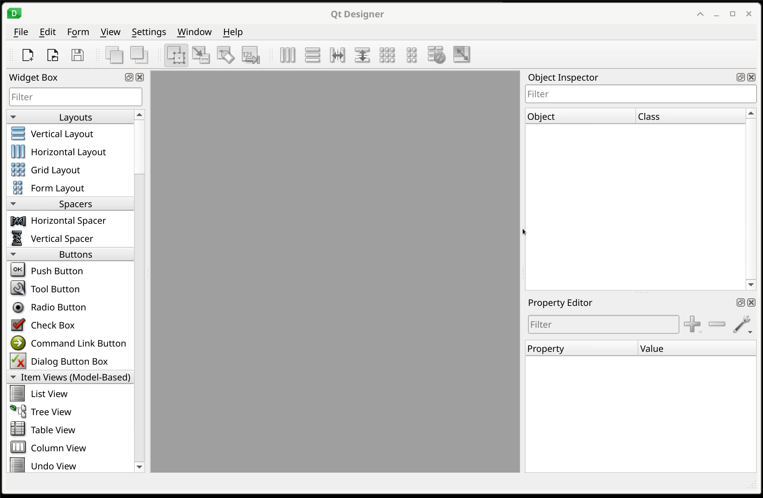
Quickly create a (prototype) GUI
Command Line
Python Code
Qt Designer

Slide 22
Quickly create a (prototype) GUI
Command Line
$> taurus form cii.oldb:///cut/demoservice/instance1/state cii.oldb:///cut/demoservice/instance1/boolean-scalar-twosecs cii.oldb:///cut/demoservice/instance1/int-vector-sin cii.oldb:///cut/demoservice/instance1/strings/string-scalar-timestamp
# Or using bash expansion
$> taurus form cii.oldb:///cut/demoservice/instance1/{state, boolean-scalar-twosecs,int-vector-sin,string-scalar-timestamp}

Slide 23
Quickly create a (prototype) GUI
Python Code
#!/usr/bin/env python3
import sys
from taurus.qt.qtgui.application import TaurusApplication
from taurus.qt.qtgui.panel import TaurusForm
app = TaurusApplication()
tf = TaurusForm()
tf.setModel("cii.oldb:///cut/demoservice/instance1/double-scalar-cos")
tf.show()
sys.exit(app.exec_())

Slide 24
Quickly create a (prototype) GUI
taurus designer

Slide 25
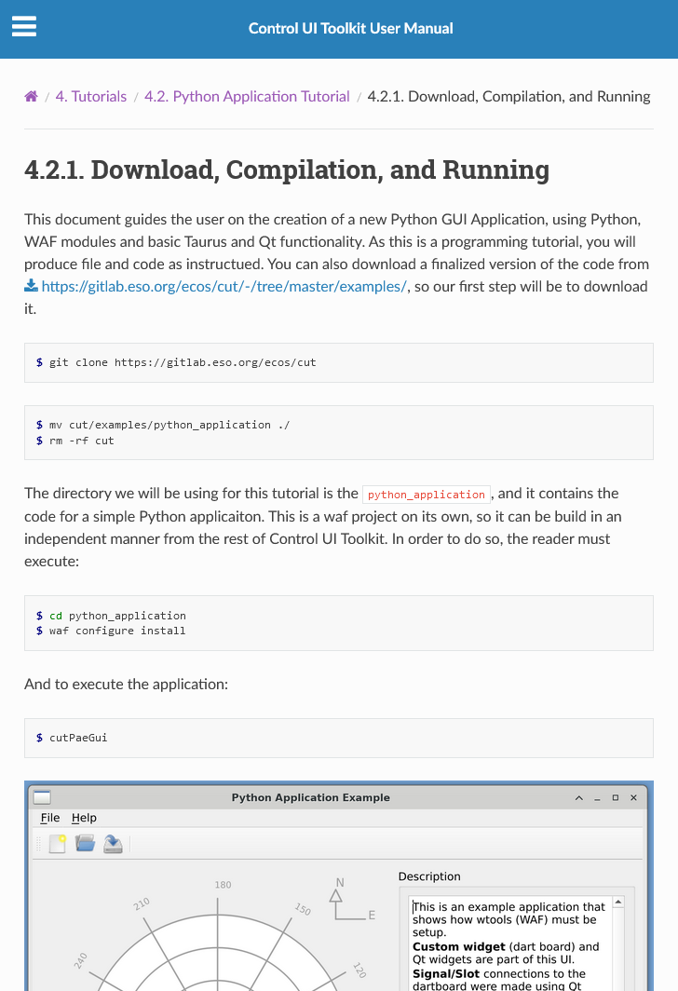
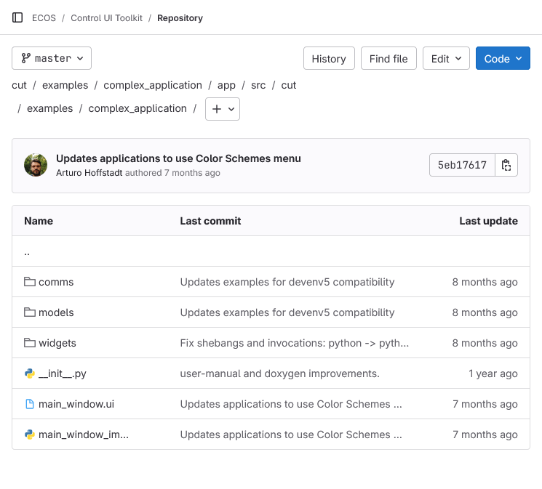
Or develop a complete GUI using Code + Designer

Slide 26
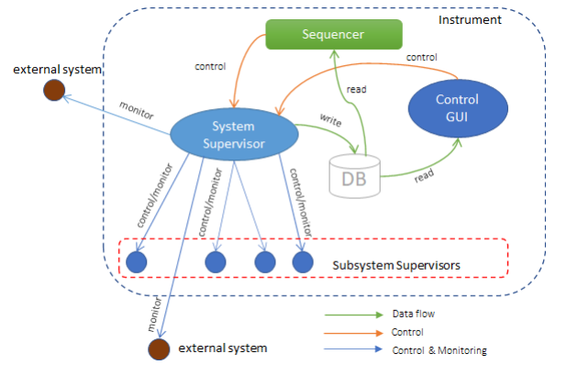
(General) Architecture of GUI Applications
This is the consensus on GUI Architecture for ELT.
GUIs should read values and gather feedback thru the OLDB. OLDB has plenty of metadata such as units, ranges, quality, description, and type.
Control should be done via MAL zpb+rr commands.
The GUI should be stateless if possible. Logic has to be implemented on the server side.
GUI datapoints in OLDB should be at max 5Hz.
Faster transmission should be done using DDT or PubSub.
This allows multiple GUI connection to the server without overwhelming the server process.
(Thanks Mario for the Slide)

Slide 27
Definitions

Slide 28





Event Engine
Handled
Qt in an asynchronous engine. A developer creates a main.py file that serves as entry point for the Qt Application we develop.
This application generates the first and most important UI element and then enters Qt’s event loop. From then on, all execution happens in one thread, asynchronously.
Mouse click
Event Handler
Queue
Event Loop
Event
Event
Event
Event
Event
Event

Slide 29
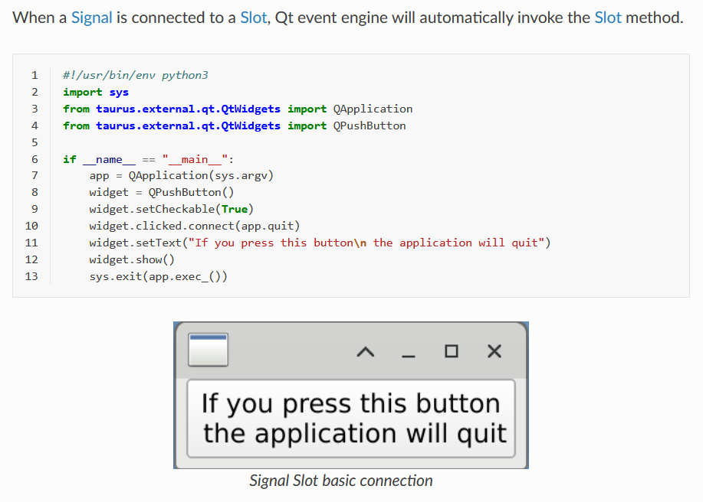
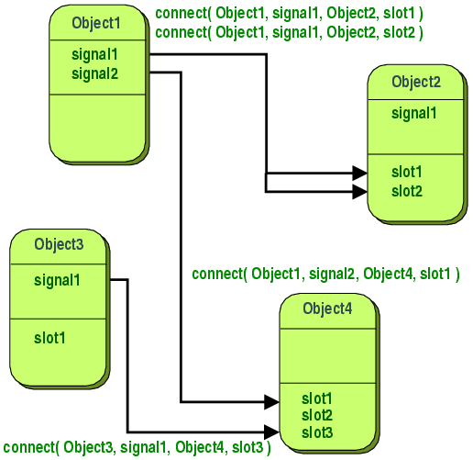
Signal and Slot
A signal is emitted when a particular event occurs. Qt's widgets have many pre-defined signals, but we can always subclass to add our own.
A slot is a function that is called in reponse to a particular signal. Qt's widgets have many pre-defined slots, but it is common practice to add your own slots so that you can handle the signals that you are interested in.

Slide 30
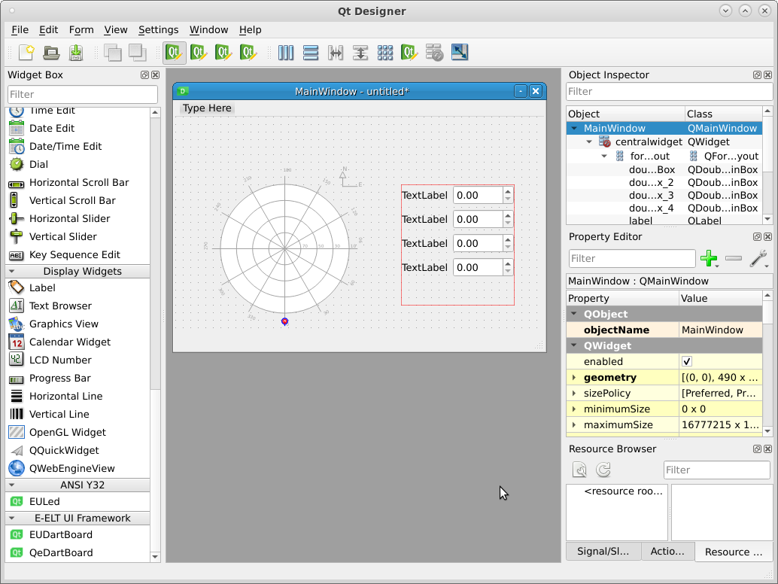
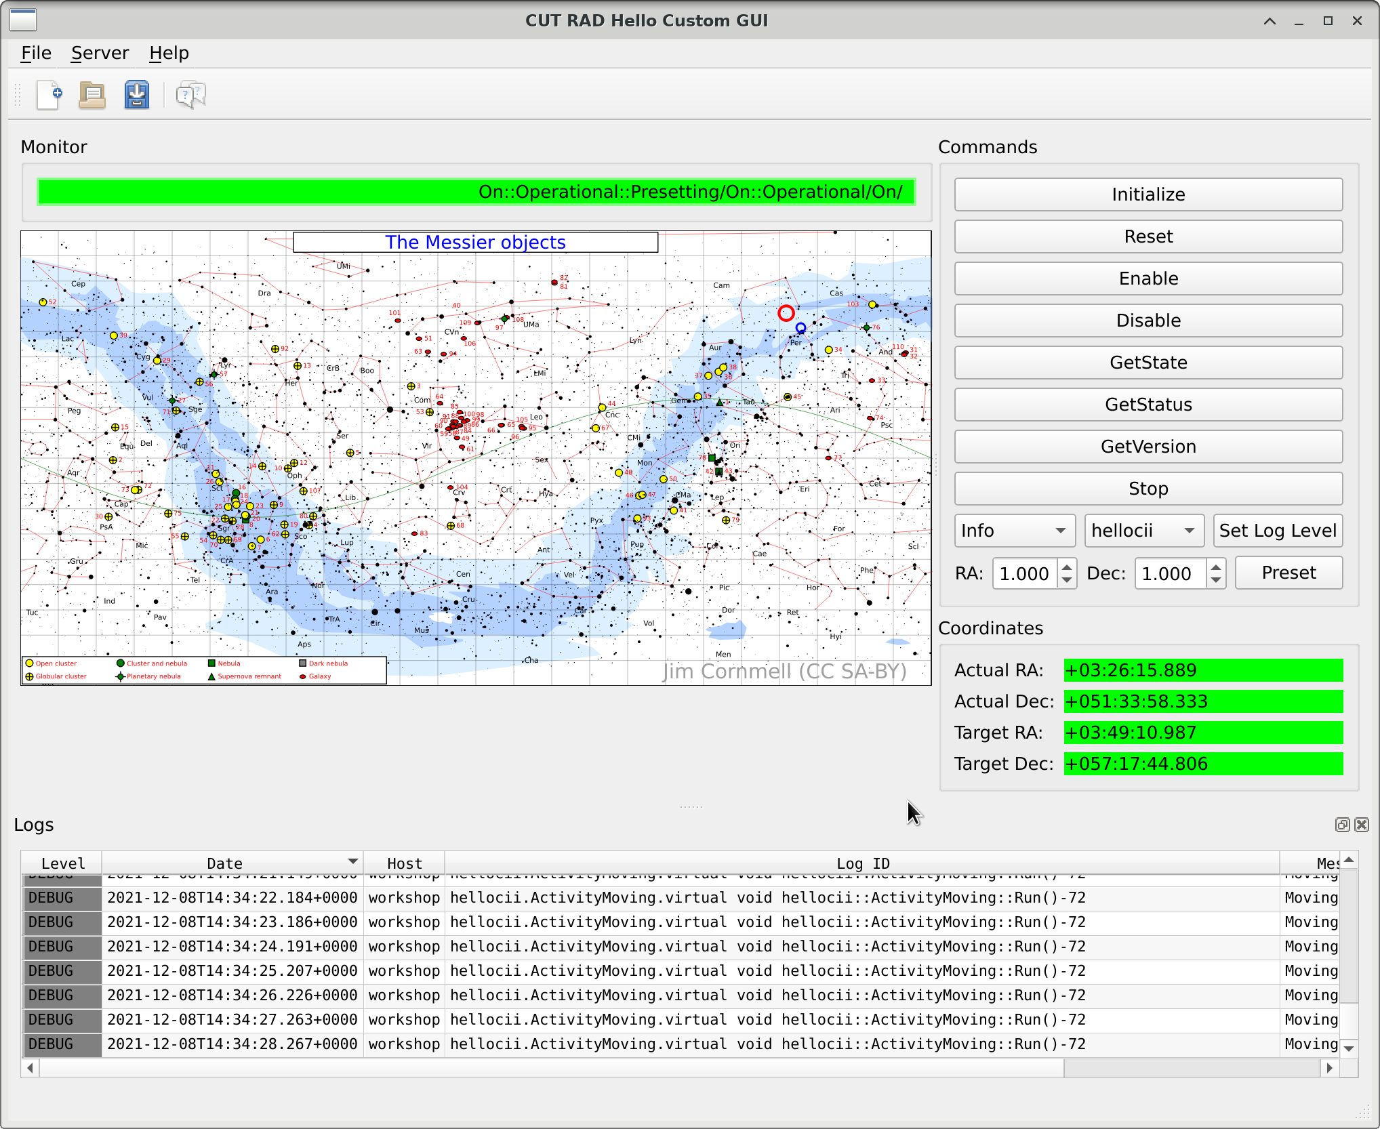
Declarative Databinding
A requirement of CUT.
Declare the UI graphically, including its data-sources.
Data source is defined through “model” property in Taurus Widgets
Currently supporting OLDB and MAL Requests.
2025: MAL Pub/Sub

Slide 31

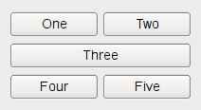

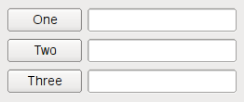
Layouts
Guidelines indicates that GUIs needs to adapt to their window as they are resized.
This can be achieved with Layouts.
Instead of using fixed values for sizes, you let Qt determine the size of the widgets depending on a few instructions
See Beginners Tutorial and Python Application Tutorial on a simple step-by-step use of layouts.

Slide 32
Models

Slide 33
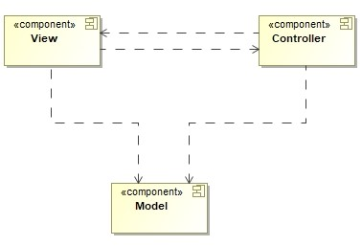
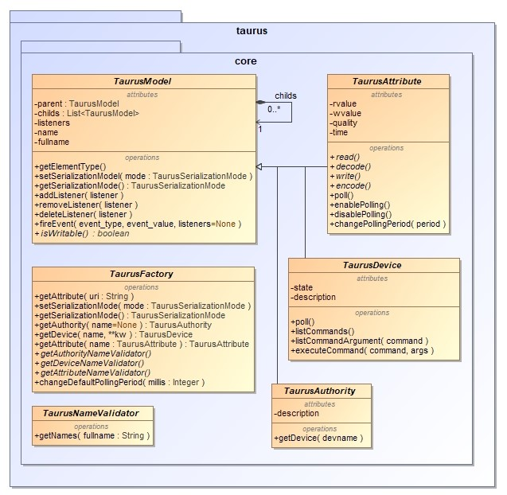
Taurus Model
The Taurus model which is used for data access plugins is based on the MVC design pattern.
Views: Qt Widgets
Controller: TaurusController/TaurusWidget implementation
Model: The taurus.core model. It allows maps to control system concepts.

Slide 34
OLDB Model
Uses standard CII OLDB URIs as models
# | Model name (URI) | Model type | Scheme | Represented data source/control object
1 | cii.oldb:///cut/demoservice/instance1/boolean-scalar-twosecs | Attribute | cii.oldb | Test boolean datapoint, changes state every two seconds.
2 | cii.oldb:///cut/demoservice/instance1/int-scalar-add | Attribute | cii.oldb | Test integer scalar, number gets larger.
3 | cii.oldb:///cut/demoservice/instance1/double-scalar-sin | Attribute | cii.oldb | Test double scalar with value of sin(t)
4 | cii.oldb:///elt/hlcc/telif/mon/state | Attribute | cii.oldb | State variable of HLCC Telescope Interface application.
5 | cii.oldb:///elt/hlcc/telif/mon | Device | cii.oldb | Collection of all datapoints for cii.oldb///elt/hlcc/telif/**

Slide 35
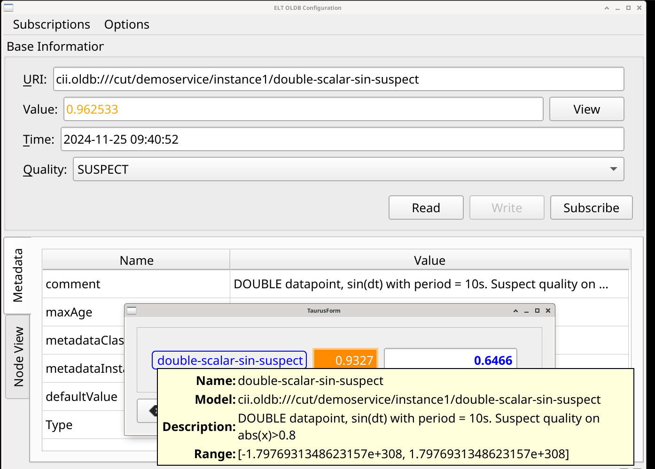
OLDB Model
OLDB Metadata:
Timestamp is displayed in tooltip.
Description is displayed in tooltip.
Units are available as part of the Quantity object (magnitude, units, allows for conversion).
Quality is available depending on widget.
Ranges for numbers are available.

Slide 36
OLDB Model
Supports all datatypes in OLDB (simple datatypes)

Slide 37
OLDB Model
Supports all datatypes in OLDB (vector and matrices)

Slide 38
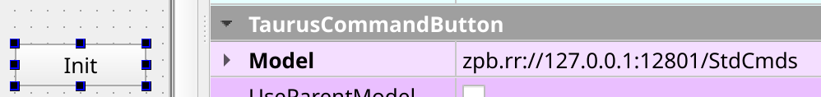
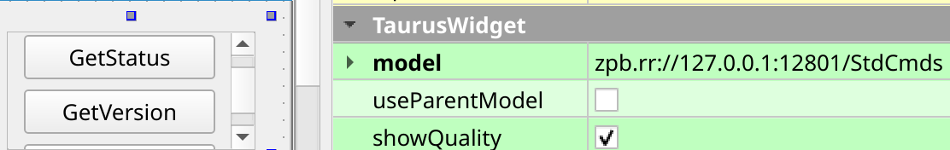
MAL RR Model
Currently support only basic datatypes for return values, and arguments.

Slide 39
MAL RR Model
# | Model name (URI) | Model type | Scheme | Represented data source/control object
1 | mal.rr://localhost:12802 | Device | mal.rr | Demo server application, autodiscovers interfaces.
2 | mal.rr://localhost:12802/StdCmds | Device | mal.rr | Demo server, assumes interface is StdCmds
3 | mal.rr://localhost:12802/Commands?if=::demoserviceif::Commands | Device | mal.rr | Demo server, forces interface used to Commands
4 | mal.rr://elthlccd82:12802/StdCmds | Device | mal.rr | ELT server application in elthlccd82 host.

Slide 40
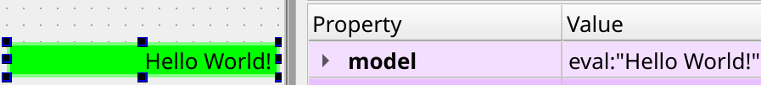
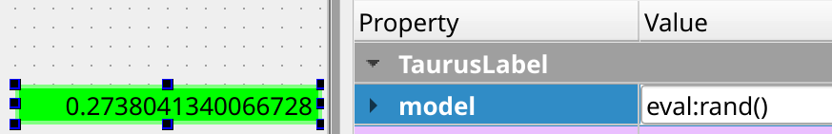
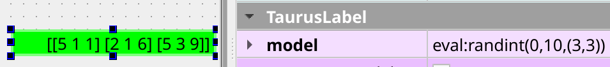
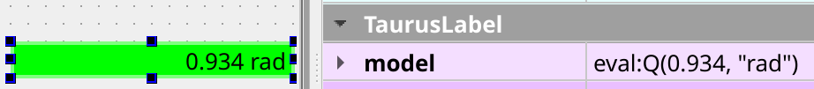
Eval Model
Quickly create models when data sources are not available:

Slide 41
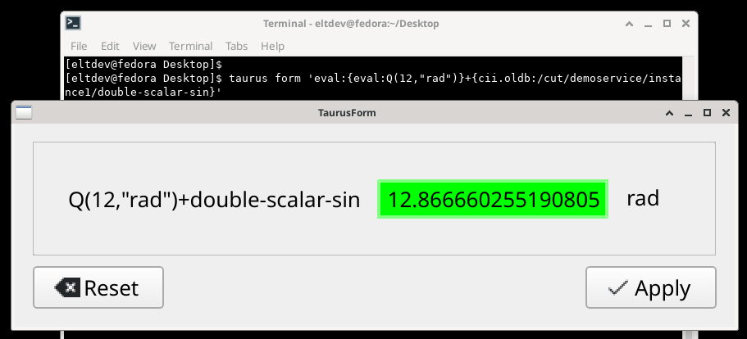
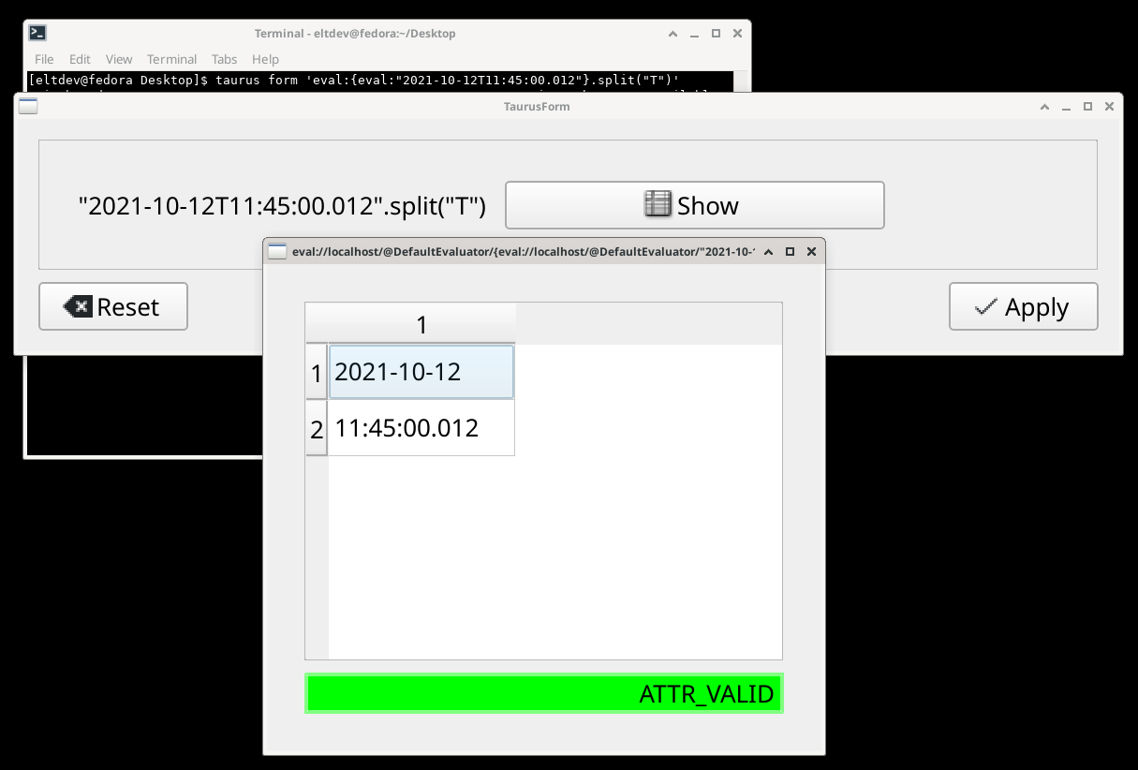
Eval Model
Eval can reference other Attributes and do basic operations on them.
eval:{eval:Q(12,"rad")}+{cii.oldb:/cut/demoservice/instance1/double-scalar-sin}
eval:{eval:"2021-10-12T11:45:00.012"}.split("T")

Slide 42
Widgets

Slide 43
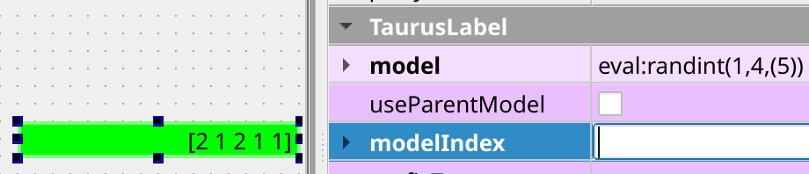
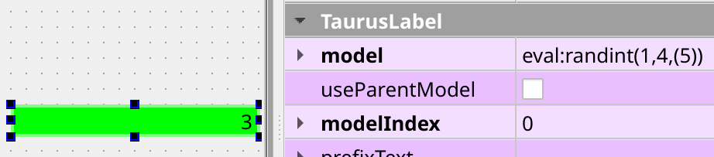
TaurusBaseWidgets
All Taurus Widgets inherits from TaurusBaseComponent and TaurusBase Widgets. They provides
Properties:
model
modelIndex
Methods:
filterEvent
Signals:
valueChangedSignal
modelChanged

Slide 44
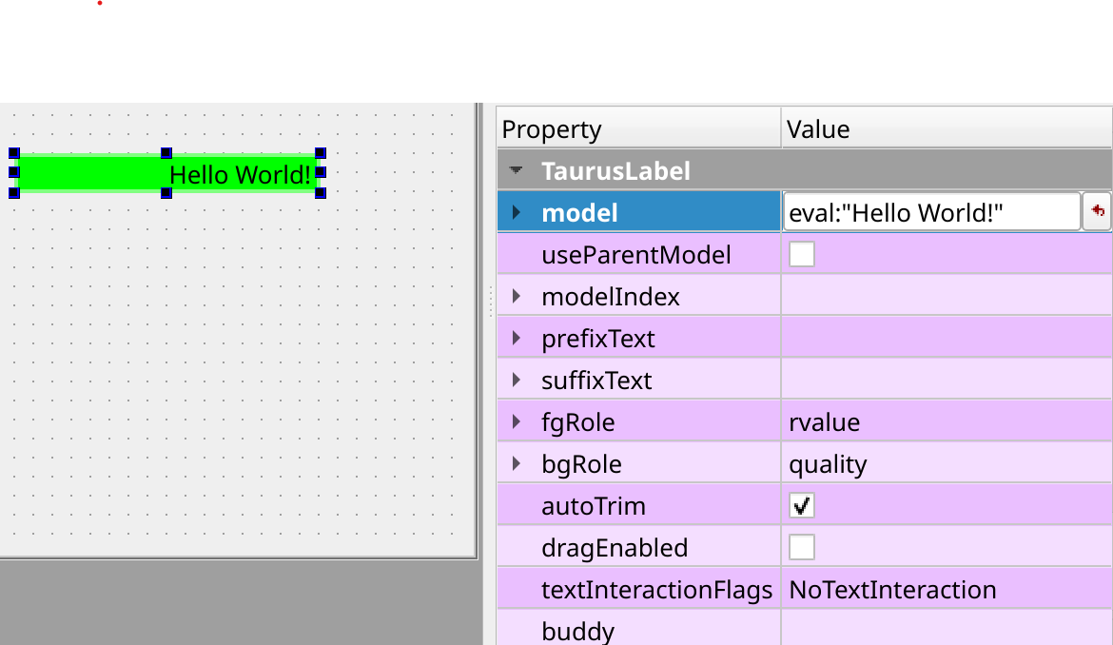
TaurusLabel
Capable of handling multiple data types
Properties:
autoTrim: Specifies whether the text will be trimmed when it doesn’t fit in the available space
bgRole: quality, None
fgRole: rvalue, rvalue.magnitude, rvalue.units, quality
Methods:
setFormat
{:.2e} {:.1f} {"str": "{!r}"}

Slide 45
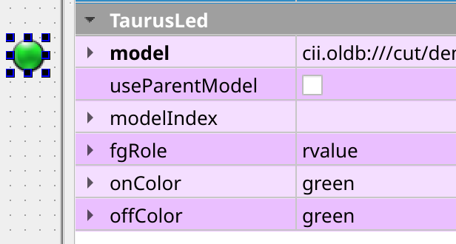

TaurusLed
Properties:
fgRole: value, quality
onColor: blue, green, red, yellow, orange, magenta, grenoble, black, white.
offColor: blue, green, red, yellow, orange, magenta, grenoble, black, white.
ledInverted
blinkingInterval

Slide 46

TaurusForm
Properties:
Model: Can be a list of str.
withButtons: If False, hides the Reset and Apply buttons.
modifiableByUser: If True, the user can modify the model on runtime.
Compact: merges the read/write widgets into one.
Can be used as a CLI tool by the command:
$> taurus form <model>

Slide 47

TaurusCommandButton
Model: has to be a Device. (MAL RR)
Command: the name of the command to execute.
Parameters: set it to the arguments of the command. You can connect a signal to it to pass values dynamically.
DangerMessage: If present, will ask for confirmation before execution with this message.
CustomText: changes the string in the button.
Timeout: currently not available in MAL RR.

Slide 48

TaurusImage
Model: should be a 2d matrix.

Slide 49


TaurusTrend and Plot widgets
Trend widgets expects a scalar value. It keeps the trend in memory. X-axis is the timestamp in OLDB.
Plot widgets expects a vector value. Its X-axis is the index in the array.

Slide 50

TaurusTrend2d
maxBufferSize: number of item in memory.
stackMode: event, deltatime, datetime

Slide 51

Other Widgets
TaurusValueCheckBox
TaurusAttrListComboBox:
- Uses a vector of values, and presents them as entries in a ComboBox.

Slide 52

Other Widgets
TaurusMessageBox
Automatically triggered on exception when using TaurusCommandButton, TaurusDevicePanel.
Or you can invoke it manually using TaurusMessageBox
You can use a decorator in your GUI code to show automatically this dialog when an Exception happens.
from taurus.qt.qtgui.dialog import ProtectTaurusMessageBox
…
@ProtectTaurusMessgeBox(title="Error trying to turn the beam on")
def turnBeamOn(device_name):
d = taurus.Device(device_name)
d.TurnOn()

Slide 53
Other Interesting topics
Some FAQ that were added to the manual.
7.2. Data Manipulation and Taurus
7.3. Data Units and Conversion

Slide 54

Color Schema
Adding color schema changes to the applications is just three lines.
from CutColor import QePalettesModel
…
self._palettes_model = QePalettesModel() self.ui.menuView.addAction(self._palettes_model.colorSchemeMenu())

Slide 55
Future Releases

Slide 56

Future Releases
v3.0.0 (DevEnv6)
Qt5 to Qt6 Migration
Migration guide in the documentation to help you with the transition.
(Almost) no code change.
Mostly waf project configuration changes.
“taurus gui” command availability

Slide 57



Future Releases
MAL discovery interface on RAD apps
MAL PubSub Model
Complete list of widgets in taurus designer toolbox
OLDB Device Support
OLDB Model Chooser

Slide 58
Arturo Hoffstadt Urrutia
<ahoffsta@eso.org>
Marzena Kaczmarczyk
<marzena.kaczmarczyk@itti.com.pl>
@ESOAstronomy
@esoastronomy
@ESO
european-southern-observatory
@ESOobservatory

