Slide 1


Evolution of DevEnv and the road forward
ELT DevEnv Team

Slide 2
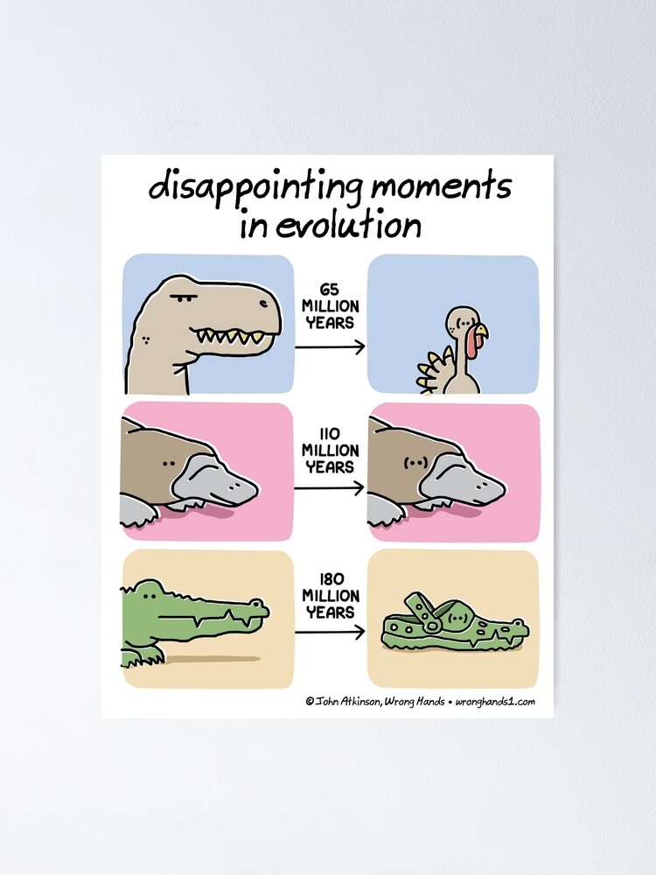
Agenda
  A tour through time of ELT DevEnv evolution:
    what and why changed,
    what have we learned (and what we persist doing wrong),
    where are we heading.
  News about ELT DevEnv 6
  ELT DevEnv 7 and beyond, the roadmap
  But first and fast: who are we? And who is behind DevEnv?

Slide 3

EELT DevEnv 1 (2014 – 2017) - The Dark Ages
  Long, long time ago.... Baseline for control software NI LabVIEW (graphical programming)
    PLCs (Beckhoff and Siemens)
    Matlab for modelling and algorithms
    …. Windows based!
  Many tools to try to automate and analyse these, a mix of reverse engineering and voodoo magic.
  SVN was the version control system (TortoiseSVN anyone?)
  Installation of software was automated using AutoIT:
    Pretty good freeware scripting language to automate GUI installations

Slide 4
EELT DevEnv 2 (2017 – 2020) - The Classical Era
  Based on CentOS 7.x, resembles and shares a lot with VLT distribution
    Many libraries duplicated (Qt, Python, Boost....)
    Some rebuilt by hand and "packaged" with tools (alien, fpm)
    Anaconda brings copies of most other libraries (How many Qts? /opt/Qt, Anaconda, OS, Matlab)
    Correct (kind of) environment is managed by playing with various PATHs
    First versions of common software (CII) but all built by hand, no packaging yet
    Most of ELT projects still in SVN
    Propertiary license required RTI DDS, Matlab
    Our build framework appears: wtools

Slide 5
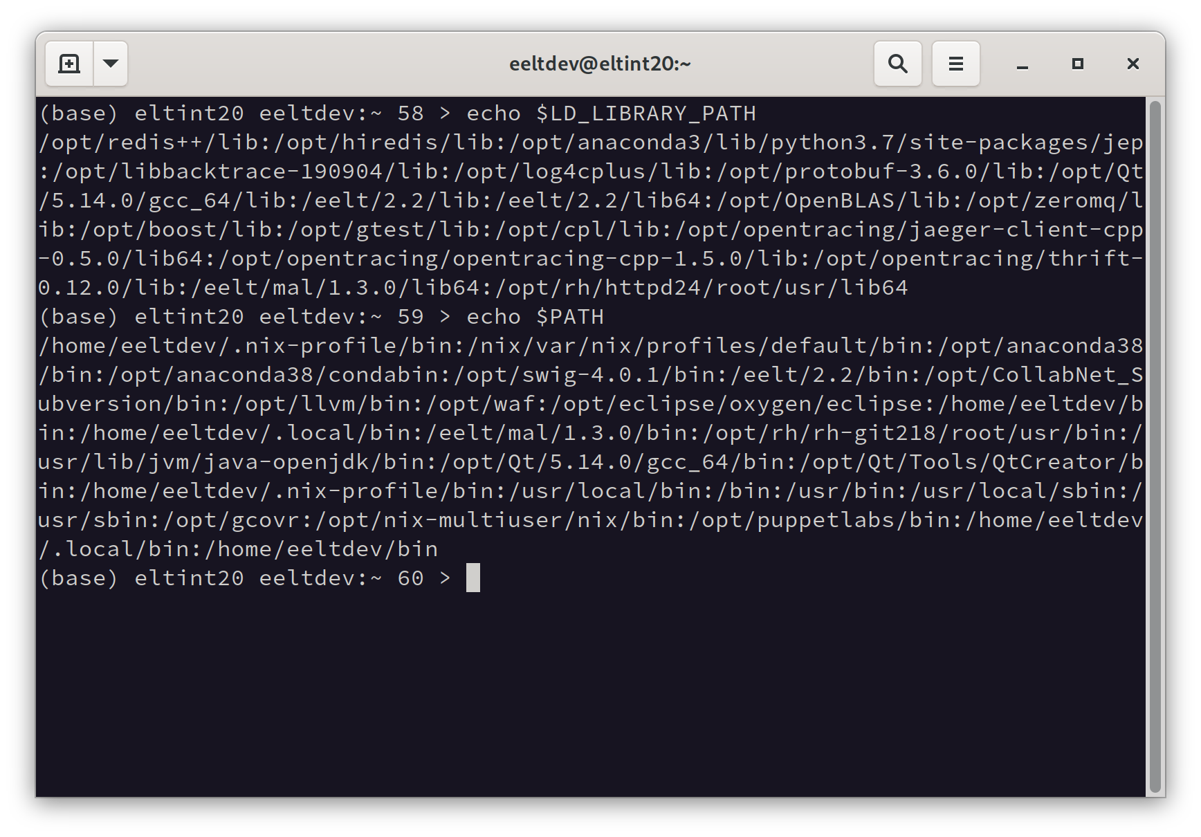
EELT DevEnv 2 - PATHs

Slide 6
ELT DevEnv 3 (2020 – 2022) - Still the Classical Era
  CentOS-8 based: still aligned with VLT
  EELT -> ELT rename
  Less duplication
  ELT software gets packaged, albeit still mostly by hand
    (ie. CII ~a week to package a release)
  Installation/update of CentOS RPMs may easily break software
  First Vagrant images
  Mostly moved to Git (GitLab) by now
  Out there: the IBMHat/CentOS drama ongoing, CentOS becomes a testing distro

Slide 7
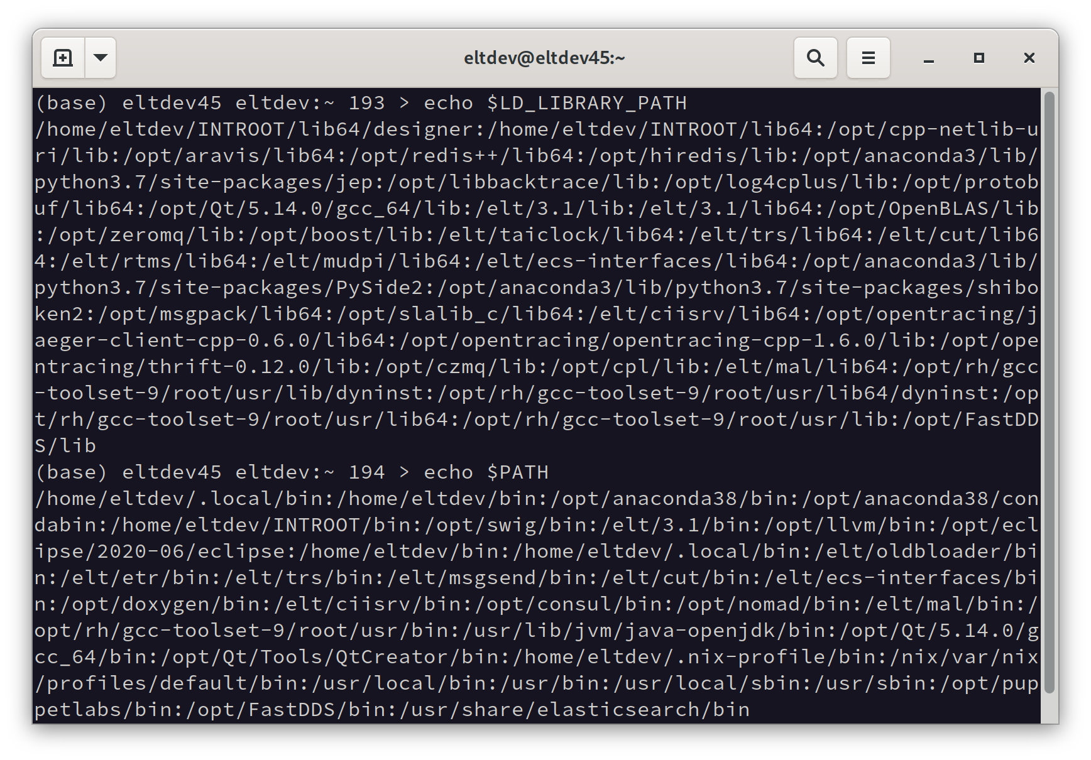
ELT DevEnv 3 - PATHs

Slide 8
Main problems of "classical" approach
  Selective updates make the distribution maintainers work void
    i.e., we haven't rebuilt and check software against new version of boost or Qt
    The distribution maintainers does this work
  Applying updates from base distribution was difficult and we ended up not doing it
  Still wrong version of library/module may be used in corner cases
  Taking Enterprise Linux as a base, versions of packages delivered by OS were conservative
    It's not good for the development phase
  Nix journey as solution to those problems

Slide 9
ELT DevEnv 4 (2022 – 2024) - Enlightenment
  First Fedora (34) based DevEnv. No duplication of packages (Qt, Python...)
  Much more modern tooling from Fedora, possibility to install standard Fedora packages
    Very few packages needed to be rebuilt on top
  Software is packaged with SPEC files,
    albeit manually and not in isolation
  Started contribution of packages back to Fedora project
  Paths are much shorter now and basically just ELT specific software

Slide 10
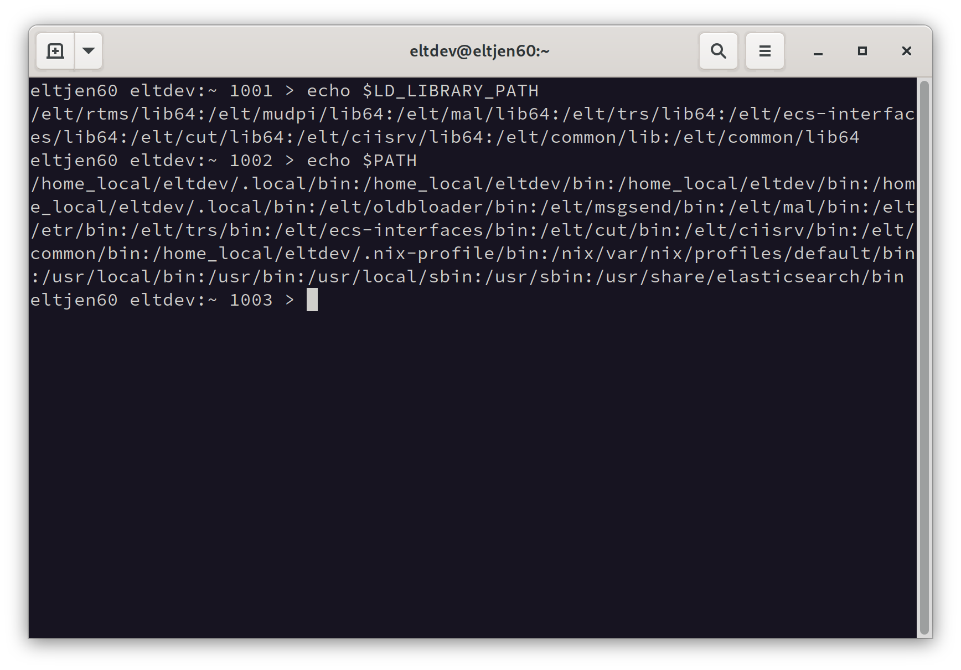
ELT DevEnv 4 - PATHs

Slide 11
SPEC File
Just a short example
Name: elt-wtools
Version: 3.3.1
Release: 2%{?dist}
Summary: A library that extends Waf build system with additional tools
License: ESO proprietary
BuildArch: noarch
URL: https://gitlab.eso.org/eltdev/wtools
Source0: https://gitlab.eso.org/eltdev/wtools/-/archive/v%{version}/wtools-v%{version}.tar.bz2
BuildRequires: python3-devel
BuildRequires: %{py3_dist pytest}
….
%description
The wtools is a library that extends Waf build system with additional tools and introduces a concept of project, package, and module.
%prep
%setup -q -n wtools-v%{version}
%install
make install PREFIX=%{buildroot}/%{_prefix} PYTHON_LIBPREFIX=python%{python3_version}
%check
make test
….

Slide 12
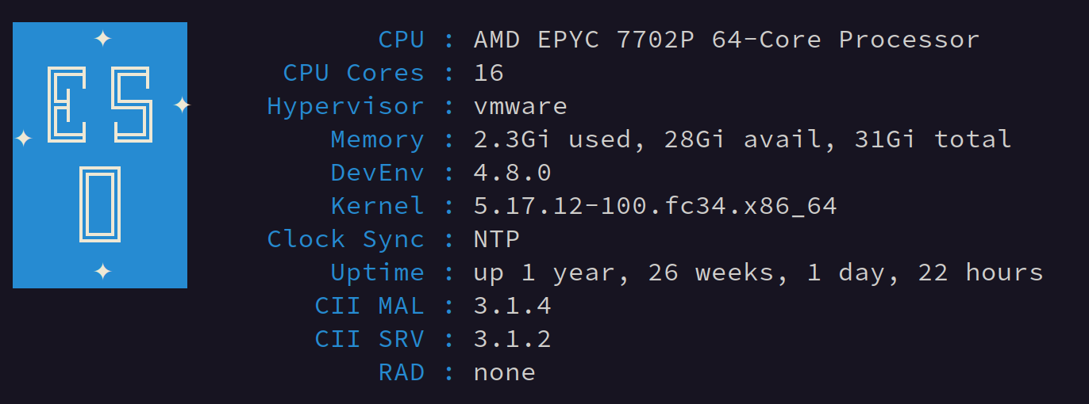
ELT DevEnv 4 – The most important feature

Slide 13
ELT DevEnv 4 - Problems
  ELT DevEnv release is a fixed collection of packages
    Any change requires a new release so releases are rare, every few weeks or months
    Long-lived Beta version where changes accumulate and people work on
    Changes to DevEnv packages are tested on Jenkins
  Packages that are not part of DevEnv (so called "projects") may be released anytime
    No Jenkins tests for those packages
    Ad-hoc coordination between projects
  More automation and streamlining of packaging is still needed....

Slide 14

ELT DevEnv 5 (2024 – 2025) - Industrial Revolution
  Base OS - Fedora 38
  The first ELT DevEnv uses only open-source 3rd party software (and maybe the last)
  RPMs built in isolation
    Mock in the first phase
  OBS was introduced soon after the release
  Base ELT software is no longer part of DevEnv
    ECOS – a new project ELT COmmon Software

Slide 15
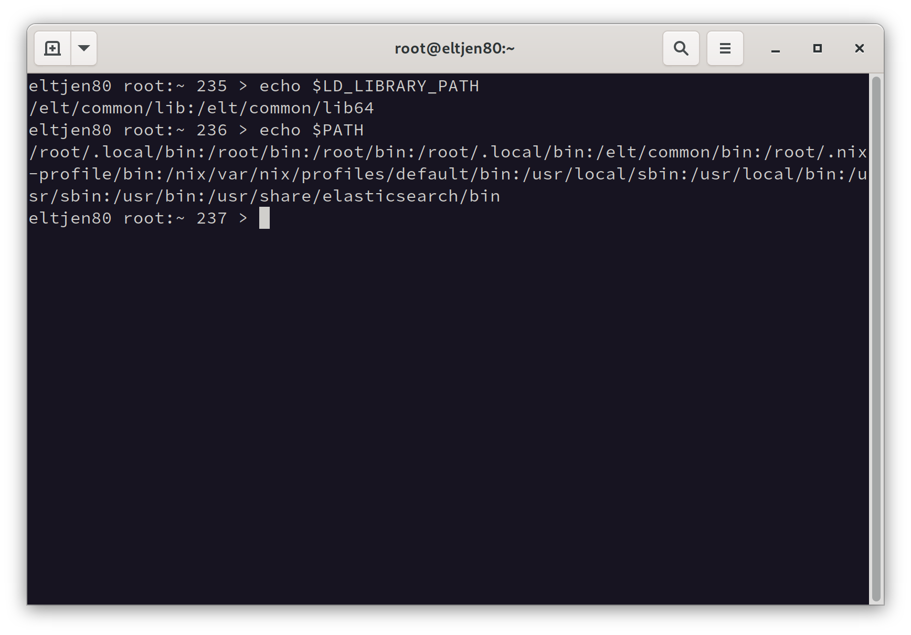
ELT DevEnv 5 - PATHs
  Reduced usage of ENV vars
  LD_LIBRARY_PATH -> ld.so.conf.d
  PYTHONPATH -> PTH files

Slide 16

ELT DevEnv 5 - OBS
  Build infrastructure (for RPMs, DEB, containers) from SUSE
  Web interface as well as command line tool
  Automatic rebuilds of dependency tree on change (also from Fedora!)
  Koji vs. OBS investigation
  Plethora of useful features: RPM signing, publishers, source services, REST API and hooks

Slide 17





ELT DevEnv 5 – OBS Workflow for ELT Software
3
Jenkins verification
SPEC file
2
1
Beta RPM repo
OBS Build
SRC
4
Stable RPM repo

Slide 18
ELT DevEnv 5 - Problems
  Cumbersome verification of beta packages on Jenkins
  Only DevEnv and ECOS packages are verified with integration tests
  The ELT DevEnv-5 release was too late in Fedora's lifecycle
  Infrastructure is not anymore, a bottleneck for delivering software changes
    Now it's a matter of a decision

Slide 19
ELT DevEnv 6 (2024 – 2026 ?) - What's new?
  Fedora 40 (almost) cutting edge-tooling (GCC 14, Kernel 6.11, Qt6)
  Plan to release to higher-level projects around the end of 2024 (while F40 is still maintained!)
  More effort to follow Fedora's standards and packaging guidelines
  The first official ELT DevEnv container
  Jenkins pipelines generated (Job DSL)
  CI uses VMs on-demand (and eventually containers)

Slide 20
ELT DevEnv 6 - Porting
  Qt5 -> Qt6
  Fix deprecation warnings while still on DevEnv-5!!
    GCC 14
    Python 3.12
    Eventual wtools 4

Slide 21
ELT DevEnv 7 – Base OS?
  As we get closer to AIV, the stability of the Base OS is getting more important
  Currently, we consider Fedora 42 and AlmaLinux 10
    The difference in lifecycle and support length
    The difference in update policy
  ELT DevEnv 7 likely won't deliver big features or changes
    More automation
    Minor improvements

Slide 22
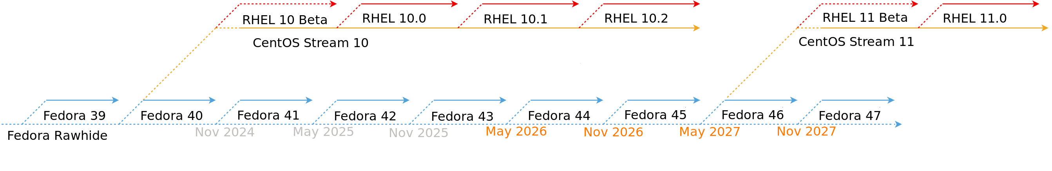
Fedora vs RHEL - Lifecycle
 | Fedora | RHEL
Lifetime | 13 months | 10 years*
Major version release cycle | 6 months | 3 years
Minor version release cycle | - | 6 months

Slide 23
Fedora vs RHEL – Key differences
  RHEL is a subset of Fedora's packages
  RHEL packages go through the Red Hat QA
  Fedora is tested by the community
  Fedora has a more liberal update policy than RHEL
  Fedora uses a more recent version of packages than RHEL
  It's easier to contribute to Fedora than RHEL

Slide 24
Summary
  We learned a lot during this journey!
  In the foreseeable future, ELT Software will be packaged as RPMs
    More advanced solutions like Nix exist
  We are prepared to change the base OS whenever needed
    Fedora, AlmaLinux, openSUSE, Azure Linux, Amazon Linux
  ELT DevEnv is an extension of the base distribution without breaking it
  We reuse tools and follow practices used in Fedora and openSUSE projects

Slide 25
ELT DevEnv & Co. Team
fpellegr@eso.org
pszubiak@eso.org
Very special thanks to Carlos Guirao!
@ESOAstronomy
@esoastronomy
@ESO
european-southern-observatory
@ESOobservatory

