Slide 1


ELT CII/VLT CCS Gateway
Ivan Munoz (imunoz@eso.org),
Christophe Moins (cmoins@eso.org)

Slide 2
What is the ELT CII/VLT CCS Gateway ?
Enables communication between ELT and VLT:
    Exchange of commands between ELT INSW and VLT processes.
    OLDB scanning between VLT and ELT.
    Retrieval of telescope fits header and binary tables.
    Publishing of TCS state.
    Alarm forwarding, log and telemetry ingestion in datalab.
Main goal: Allows to use ELT tech stack (CII) for a VLT instrument.

Slide 3
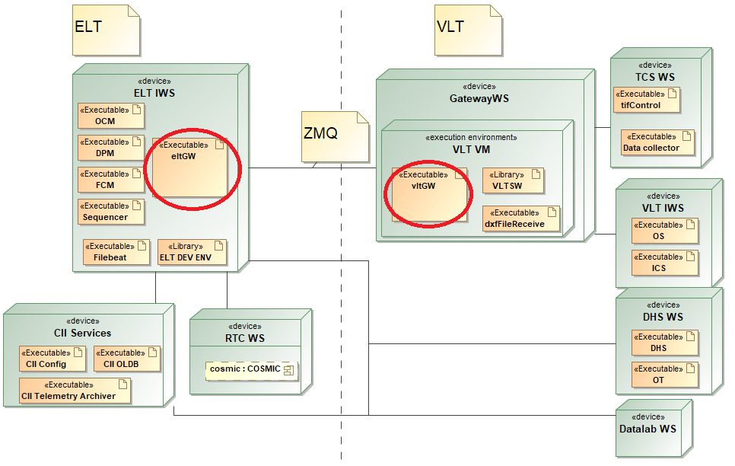
Deployment

Slide 4
Deployment and startup
Two components:
    eltGW: ELT DevEnv
    vltGW: vltSW
eltGW started as a Nomad job on ELT IWS:
    evltgw-services-rep: service for sending commands
    evtlgw-status-pub: publishing service of TCS state
vltGW started on TCS WS or other VLTSW WS in a specific environment
One eltgw/vltgw per instrument

Slide 5
Sending commands to VLT process
  Synchronous or asynchronous Req/Rep communication pattern with MAL
  Command sent from ELT WS using “open” MalVLT interface of ELTGW icd:
  <interface name="MalVLT">
  <method name="send" returnType="string" >
  <argument name="environment" type="string"/>
  <argument name="process" type="string"/>
  <argument name="cmd" type="string"/>
  <argument name="parameters" type="string"/>
  <argument name="timeout" type="float" />
  </method>
  </interface>
  URIs: evltgw-services-rep/vlt or evltgw-services-rep/async_vlt

Slide 6
Sending commands to VLT process
  import ifw.core.stooUtils.consul as consul_utils
  from eltGW.eltgw_mal import MalVLTSyncClientFactory
  cons = consul_utils.ConsulClient()
  vlt_service_uri = cons.get_uri(‘evltgw-services-rep’) + “/vlt”
  TIMEOUT_SEC = 10
  client = MalVLTSyncClientFactory.create(vlt_service_uri, TIMEOUT_SEC)
  reply = client.send(‘wt0tcs’, ‘tifNA’, “STATUS”, “”)

Slide 7
Sending commands to ELT component from VLT
  ELT component: external service exposing a MalELTComponent interface:
  <interface name="MalELTComponent">
  <method name="execute" returnType="nonBasic"
  nonBasicReturnTypeName="ExecuteReply">
  <argument name="command" type="string" />
  <argument name="args" type="string" />
  </method>
  </interface>
  Register with eltGW MalELT interface (evltgw-services-rep/elt, elt _async)
  <interface name="MalELT">
  <method name="register_component" returnType="int8_t"> <argument name="name" type="string" />
  <argument name="uri" type="string" />
  <argument name="timeout" type="float" />
  </method>
  </interface>

Slide 8
Sending commands to ELT component from VLT
  Ccs commands with:
    Environment: wvgw
    Process: outMsgVGW
    Command: EXEC
    Parameters: component, command, args
  msgSend "wvgw" outMsgVGW EXEC "component=eltcomponent,command=sleep,args=5"

Slide 9
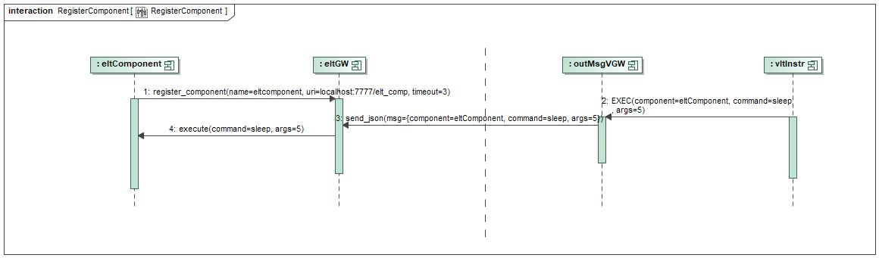
Sending commands to ELT component from VLT

Slide 10
Retrieving metadata
  import ifw.core.stooUtils.consul as consul_utils
  from eltGW.eltgw_mal import MetaDaqSyncClientFactory
  cons = consul_utils.ConsulClient()
  metadaq_service_uri = cons.get_uri(‘evltgw-services-rep’) + “/metadaq”
  TIMEOUT_SEC = 10
  client = MetaDaqSyncClientFactory.create(metadaq_service_uri, TIMEOUT_SEC)
  ACQ_ID = "acq_id“
  reply = metadaq_service_client.StartDaq(ACQ_ID)
  reply = metadaq_service_client.StopDaq(ACQ_ID)
  print(reply.getKeywords())
  print(reply.getFiles())

Slide 11
Requesting TCS State
  Using GetState and GetStatus methods of stdif::StdCmds MAL interface
  URIs:
    evltgw-service-rep/StdCmds for Req/Rep
    evltgw-status-pub/std/status for Pub/sub

Slide 12
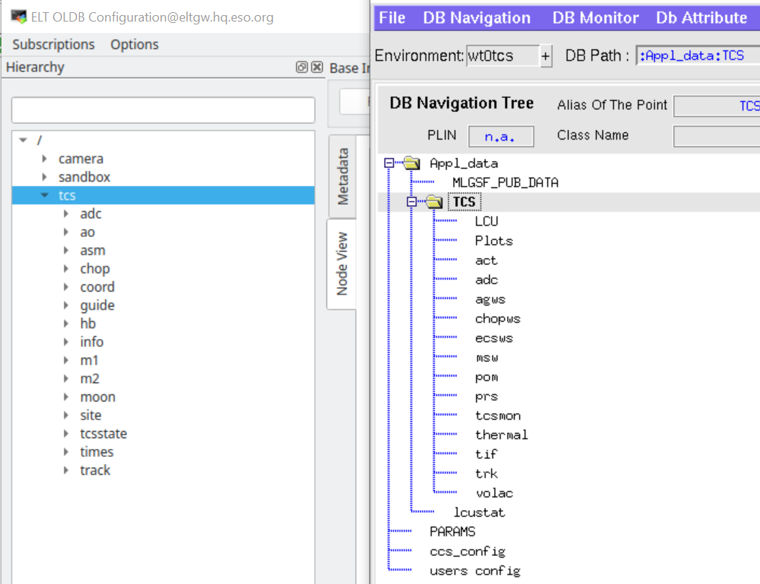
OLDB Scanning from VLT to ELT
Scanning of TCS tree
Event driven
ELT TCS tree structure similar to instrument, to be confirmed
ELT TCS tree structure to be created manually with:
eltGWOldbInit oldbConfig.yaml $ELTGW_ROOT/resource/config/custom_logging.json

Slide 13
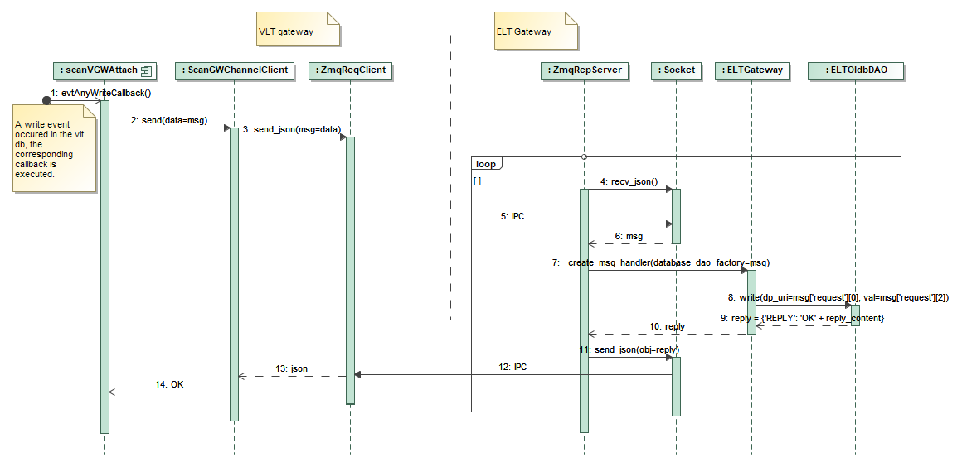
OLDB Scanning from VLT to ELT

Slide 14
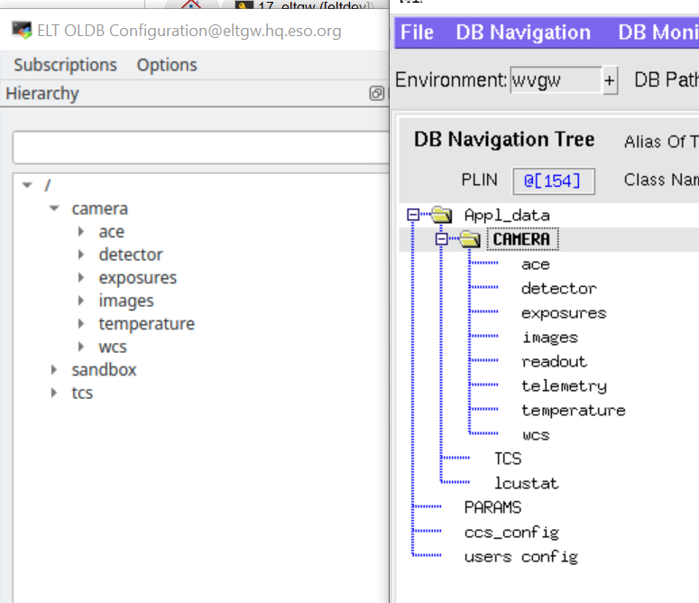
OLDB Scanning from ELT to VLT
Scanning of configurable list of OLDB data points
Event driven
Similar tree on ELT and VLT side
Creation prior to evltgw startup

Slide 15
Alarm forward, telemetry ingestion in datalab
  Paranal datalab: set of data analysis tools and engineering datasets.
  Ingestion in datalab’s Elastic Search
  Alarm forwarding: OLDB data points, callbacks write data in ES.
  Telemetry ingestion, do not go through ELT gateway
    Logs: use of filebeat and logstash
    Telemetry: use of CII Telemetry Archiver.

Slide 16
Ivan Munoz – imunoz@eso.org
Christophe Moins – cmoins@eso.org
@ESOAstronomy
@esoastronomy
@ESO
european-southern-observatory
@ESOobservatory

