Slide 1


HLCC
G.Chiozzi
and the HLCC team

Slide 2
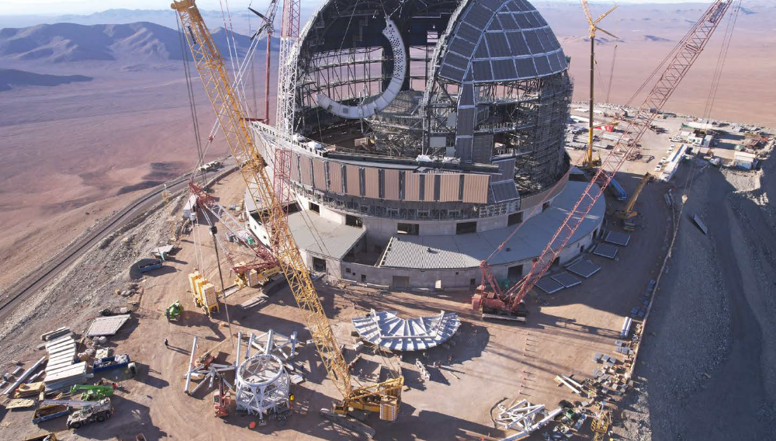
HLCC
Single interface for instruments and operators
Coordination responsibility in CCS
  Command and retrieve information from the LSVs.
  Interacts with TREx
  Publish data for the instruments and other subsystems
Implements core use cases (presetting, offseting, tracking)
Designed for flexibility (for AIV and Commissioning):
  Extensible and dynamically definable state and target variables using python functions
  Sequences and python scripts
Includes the telescope simulator for the instrument teams
(as much as possible the same code, discrimination at deployment time)

Slide 3
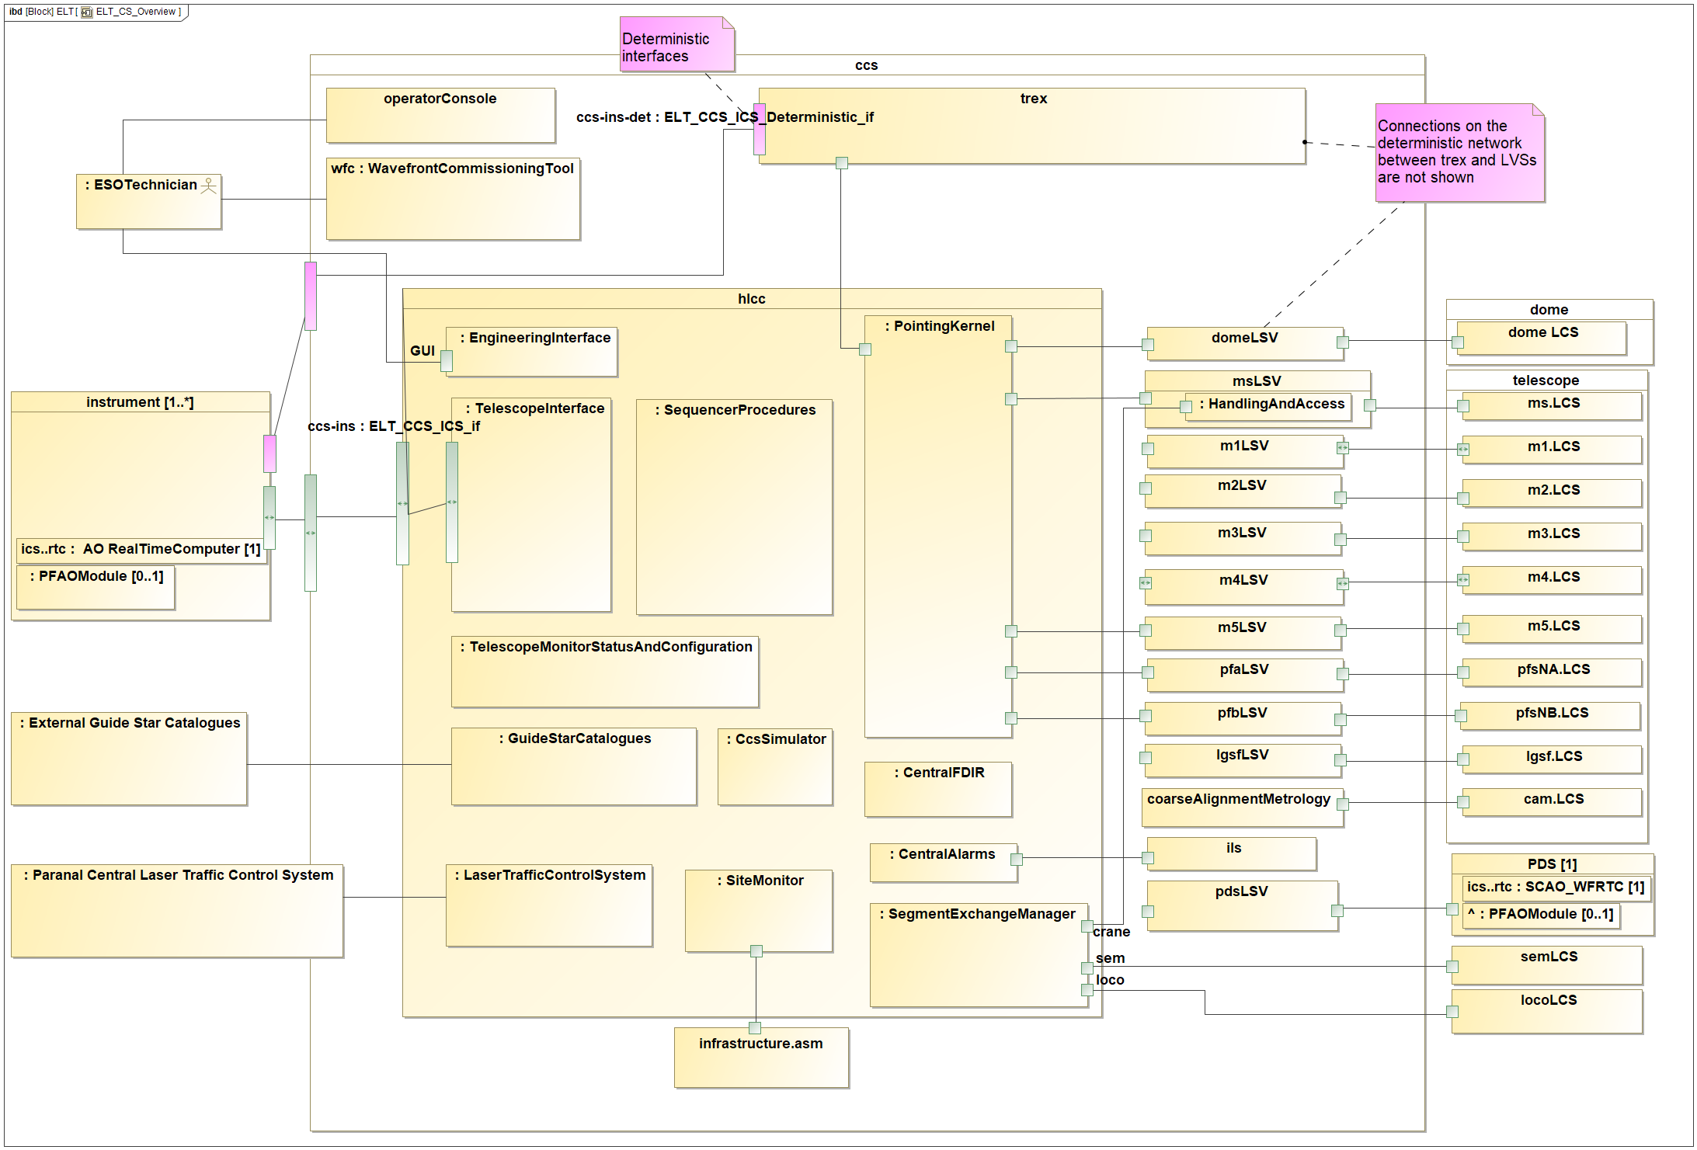
Control System with HLCC - Overview
Notes:
Here you can see a simplified view of the control system, with the main components.
Few words on LCS -> LSV -> HLCC/TREx

Slide 4
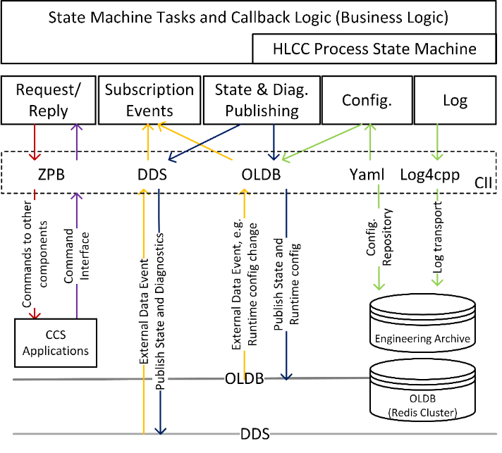
HLCC SW stack
Notes:
Command/reply -> infer status from pub/sub

Slide 5
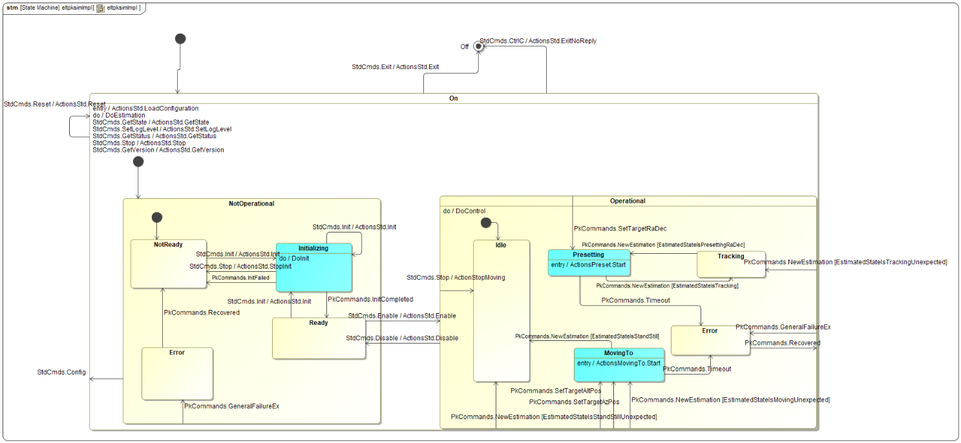
State Machine
Notes:
Implemented with RAD toolkit
Standard state machine + extensions,
SCXML generated and interpreter
Actions Activities
Estimators and Controllers
Estimation events

Slide 6
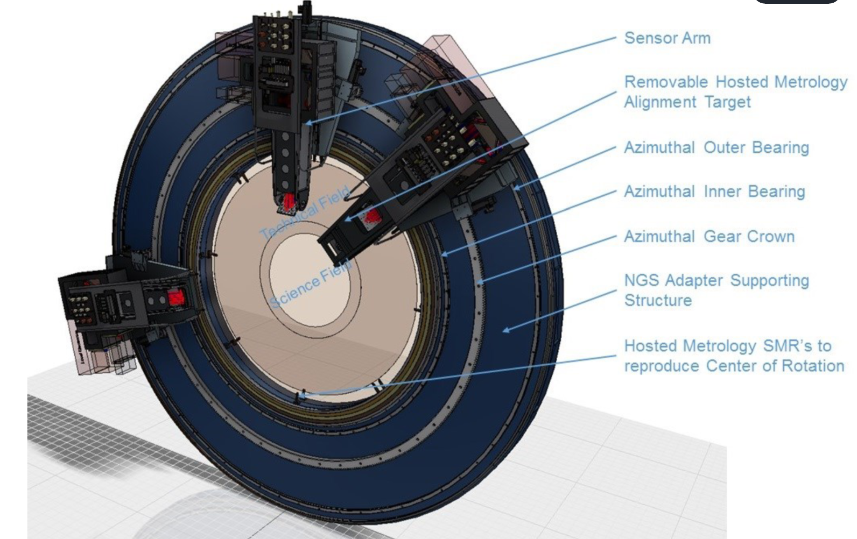
No Backward Calculation
Telescope “does not know” where it is looking based on internal telemetry
PFS is the only source of truth, looking at the sky
If we have guide stars, we can measure where we are and tell clients.
Pointing must just bring
GSs in probes acquisition
range.
Notes:
No backward calculation
Command -> Reply -> state variables

Slide 7
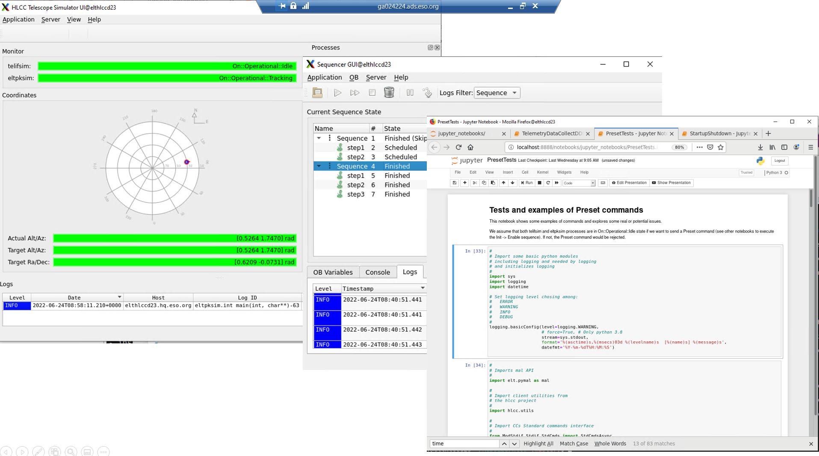
CCS Simulator
Notes:
Pathfinder:
Test infrastructure, architecture and design patterns
Core of incremental development
Developed by features for instrumentation and integration testing

Slide 8
Status
  Technical infrastructure available and routinely used.
  HLCC is a pathfinder for CII, DevEnv, design patterns…
  Architecture and design defined
  1st version of Telescope simulator released with full CCS-INS interface.
  Documentation: https://ftp.eso.org/pub/elt/repos/docs/HLCC/hlcc-doc/
  OneNote: Implemented features in the telescope simulator (Web view)
  Core use cases implemented: system lifecycle, preset, offset, data publishing
  Integrated with MS LSV, PFS LSV, TREx (limited functionality, other LSVs being integrated)
  Installed in ECM and available to commissioning team for testing and development of commissioning procedures.
  Additional use cases and functionality to be integrated as they become available
  CCS-INS ICD being revised: https://pdm.eso.org/kronodoc/HQ/ESO-311982

Slide 9
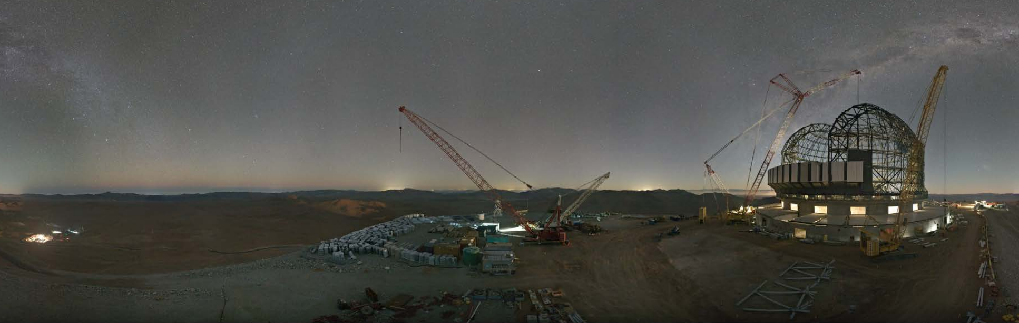

G.Chiozzi – gchiozzi@eso.org
HLCC Documentation: https://ftp.eso.org/pub/elt/repos/docs/HLCC/hlcc-doc/
CCS-INs ICD: https://pdm.eso.org/kronodoc/HQ/ESO-311982
@ESOAstronomy
@esoastronomy
@ESO
european-southern-observatory
@ESOobservatory

Slide 10
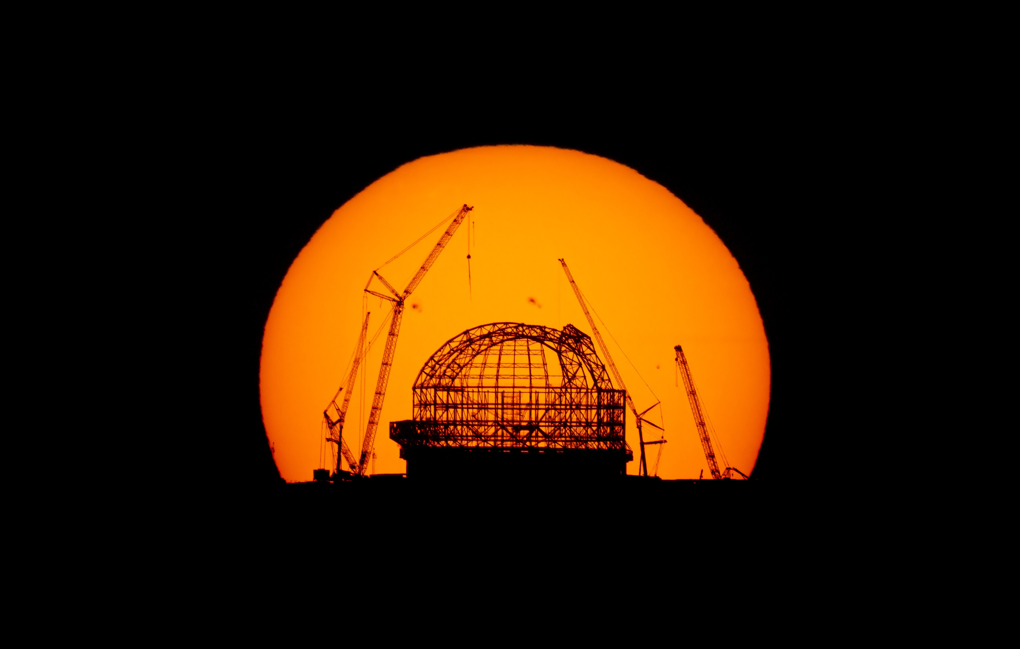
Reserve/unused slides

Slide 11
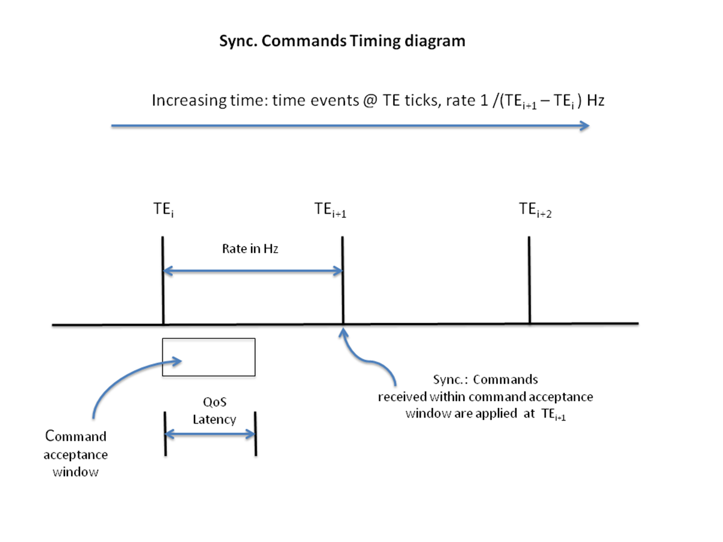
Time System and Synchronization
Central Observatory Clock & network infrastructure
NTP: ~10 ms, PTP ~us
TAI monotonic timescale & UTC wall clock
Synchronization of commands and data:
  Asynchronous.
  At any time
  Synchronous.
  Locked to time tick
Notes:
TRS network protocols:
Precision Time Protocol (PTP) for microsecond range
Network Time Protocol (NTP) for 10’s of milliseconds range.
The International Atomic Time (TAI) timescale as the monotonic clock to measure elapsed times
UTC as wall-clock for timestamps, with UNIX epoch (Midnight, 1 January 1970).
Synchronous Commands frequency-locked to absolute time ticks with zero offset.
A Synchronous Command at any time within time window (from TEi to TEi+1)
determined by the command rate and latency
Expected to be applied at next time event following the reception of the command (TEi+1)

Slide 12
Control Models and Simulation
Most subsystems integrated directly on the telescope.
  Little chances for
    testing with other subsystems before
    testing CCS with real LCSs
Several “ELT Control Models” (ECM)
Partial replica of the ELT control system hardware, software and infrastructure
  Garching Integration Hall
  Portable ECM (test subsystems and instruments)
  Paranal/Armazones facilities
Minuscule-ELT
Mandatory simulation modes
Notes:
control model consists of:
All software needed to run a generic instrument (incl. the ICS high-level framework).
Computers/workstations.
Network equipment to interconnect the control model units and to interface to external systems.
Sample hardware.
Mock-up versions of units interfacing with ICS, i.e. TCS, AO, detector controllers, dataflow systems, etc
Field Electronics Simulation: LCU/LSU simulation of field electronics.
Actuator/Sensor Simulation: LCU/LSU simulation of subsystem actuators/sensors.
LCUs/LSUs and field electronics are present, but not connected to the sensors and actuators of the subsystem.

