Slide 1

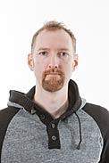
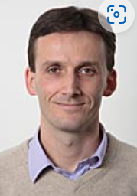
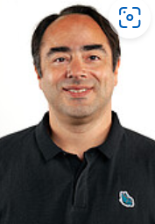
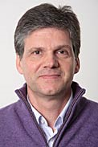
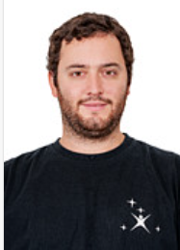
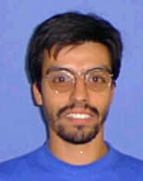
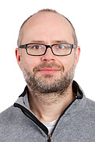
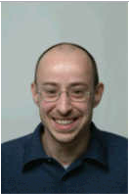

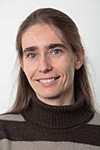
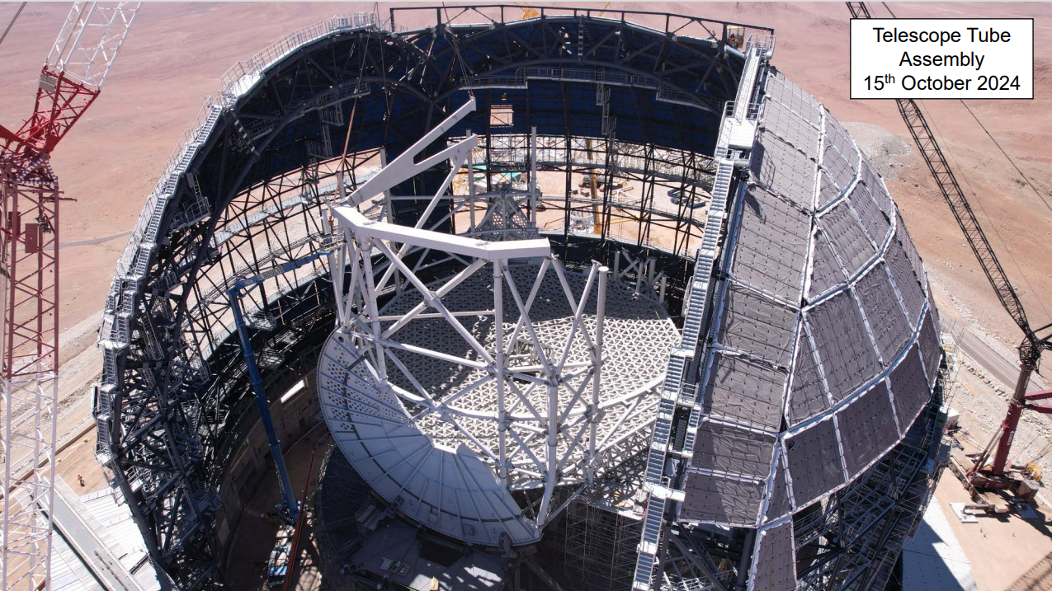
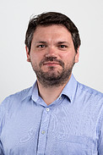
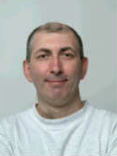
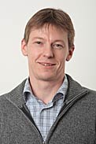
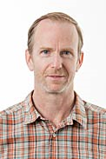
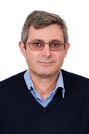
ICS FRAMEWORK
ELT ICS Seminar 2024
Mario Kiekebusch on behalf of the IFW Team
Mauro
Ricardo
Calle
Christophe
Claudio
Dan
Diego
Ivan
Jens
Luigi
Paola
Sylvie
Jakob
Cryo HMI
Igor
DDT
ETR/OCM
Sequencer/ Core Libraries
Calob Tool
PLC Programming/ Hardware Configuration
Widget Library/ Cryo HMI
Sequencer
SW Lead/CCF/ Core Libraries
Application Framework
SQA
Software Engineering / Tools
Pedro
Software Engineering / Tools
SQA
Arturo
Mauro
Lothar
Pablo
Ricardo
GUIs/CUT porting
Graphical Interfaces
Cryogenic Controller
Cryogenic Controller/ Power Control
Sequencer/ Operations

Slide 2
Outlook
Introduction
Component status & key features
Use Cases: PDS
What’s next
  .

Slide 3

Introduction

Slide 4
Introduction
The IFW is one of the software products ESO is developing in the scope of the ELT project.
The IFW has been designed with the goal to help developers building instrument control systems and to reduce maintenance efforts.
The IFW is an evolution rather than a revolution, based on the successful instrumentation framework created for second-generation VLT instruments.

Slide 5
ELT Software Stack
INS1
AO Module
INS2
Applications
RTC Tk
HLCC
IFW
NGCII
Dependencies
Base SW stack
ECOS (cii,if,cut, trs, etc)
DevEnv

Slide 6

IFW
The IFW is made up of several components providing a solution for the control needs in astronomical instruments.
It excludes the control of scientific detectors and RTCs that are cover by other ESO products.
FCF
CCF
DDT
OCS
IFW
SEQ
CalOb
CryoTk
RAD - ETR

Slide 7
IFW version 2024
Miscellaneous Libs: core, rtmstools and wdglib
Data Display Tool (DDT)
Sequencer Tool (SEQ)
Function Control Framework (FCF)
Camera Control Framework (CCF)
Observation Coordination System (OCS)
Calibration Framework (CalOb)
Online Image Processing (ODP)
IFW Low Level: PLC Libraries/ Cryo Toolkit
Test Framework (ETR)
Application Framework (RAD)
Template Instrument
IFW Mega RPM
IFW High-level
IFW Low-level
ECOS
Reference Implementation

Slide 8
Software Evolution
IFW Version 1
IFW Version 2
IFW Version 3
IFW Version 4
IFW Version 5
IFW Version 2024
May 2019
May 2020
May 2021
May 2022
Nov 2023
Aug 2024
Apr 17
May
Direct use of middleware → CII MAL
EasyLogging → log4cplus
Sequencer
CentOS7 → CentOS8
Multiple MAL Interfaces
Standard Interface (stdif)
Adoption of Nomad/Consul
SNV → Git
Data Display Tool (DDT) Beta
OCS
CCF
ODP
  .
YAML → CII ConfigNg
IFW splitted in several GIT projects.
Data Product Manager
Cryo Toolkt
CentOS8 → Fedora34
Redis → OLDB
Softing OPCUA → open62541
log4cplus → CII Logging
Qt C++ → CUT (Python)
Calob Tool
Integration with HLCC
Added RMTS tools
Fedora34 → Fedora38
New versioning scheme.
Separation of MAL interfaces in dedicated repositories.
Cryogenic HMI library

Slide 9
Core Components

Slide 10
Function Control Framework (FCF)
It controls and monitors hardware functions
It provides engineering interfaces for users.
It supports most typical devices in astronomical instruments.
Recently added: SmarAct, Siemens PSU8600, Cabinet Cooling Controller (CCC) , Multi-Axis, Modulator (under development).
Presentation Layer
Device Widget
GUI
CLI
Supervisory Layer
Device Mgr
Device
Device Simulator
Common Software
Control & Automation Layer
Local Device
HMI
Simulator (FB)
Controller (FB)
Modules (C++)
New Technology Telescope – 3.5 metre

Slide 11
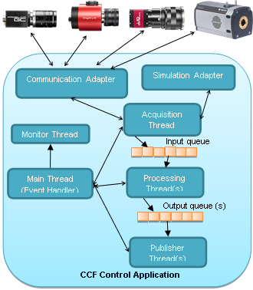
Camera Control Framework (CCF)
It provides control over exposure settings, readout modes, windowing, etc.
Implements the ESO standard DCS interface.
Flexible architecture allowing image acquisition, execution of processing pipelines, and publishing of data in various formats.
It supports GigE Vision and RTMS.
and many hosted telescope projects
New Technology Telescope – 3.5 metre

Slide 12
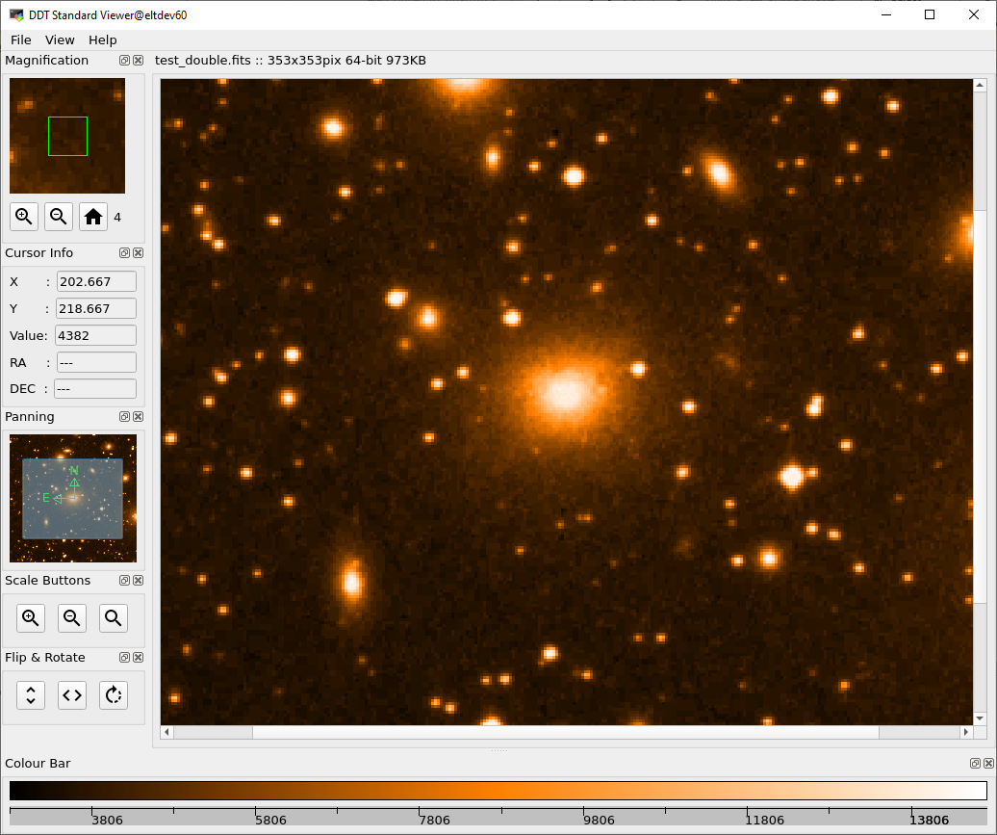
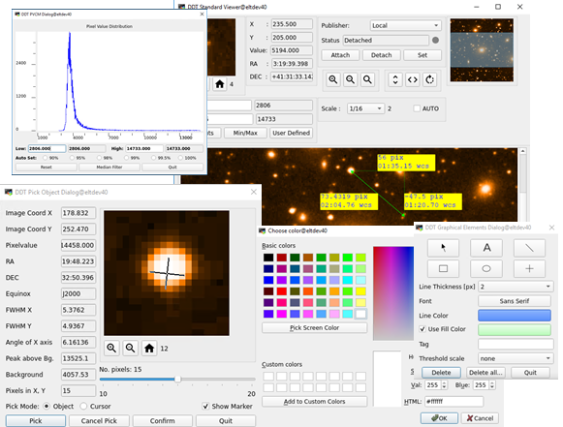
Data Display Tool
The DDT is a comprehensive suite of libraries designed to enable transfer, visualization, and manipulation of data.
It supports connecting to a data stream as well as using FITS files.
Added a multi-viewer display.
Added signal visualization panel
Few new dialogs: metadata sample, monitor sample.
and many hosted telescope projects
New Technology Telescope – 3.5 metre

Slide 13
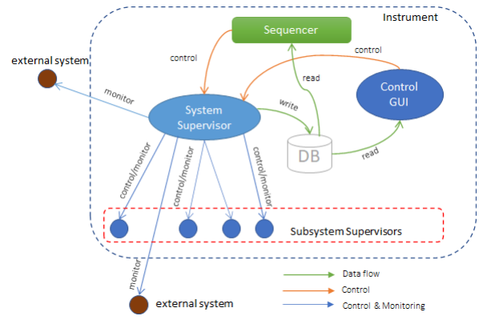

System Supervisor (OCS)
The System Supervisor is one of the top-level components in the control software architecture, aimed to provide state control and monitoring capabilities for all instrument subsystems
It uses the standard interface.
It expose an interface that can be used by the Sequencer or from graphical Interfaces.
It supports hierarchical deployments.
It can generate its own metadata
and many hosted telescope projects
New Technology Telescope – 3.5 metre

Slide 14
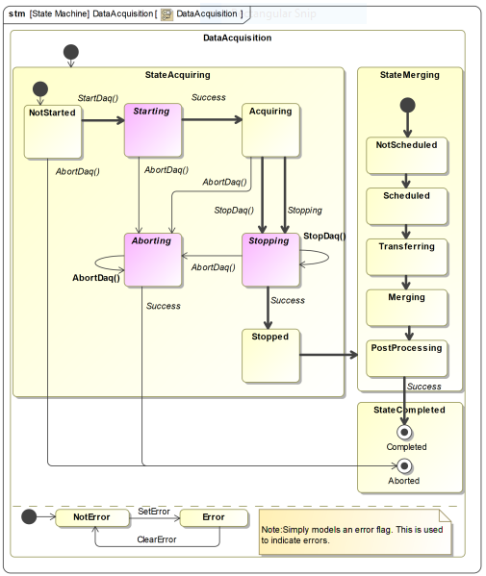
Data Acquisition (OCS)
Data Acquisition refers to the process of acquiring data generated by the instrument subsystems (data sources) in the scope of an instrument observation.
Observation Coordination Manager (OCM): Coordinates the data acquisition process.
Data Product Manager (DPM): Collects the data, merges it in one or more FITS files, and interfaces with the ESO Archive System for long-term storage.
and many hosted telescope projects
New Technology Telescope – 3.5 metre

Slide 15
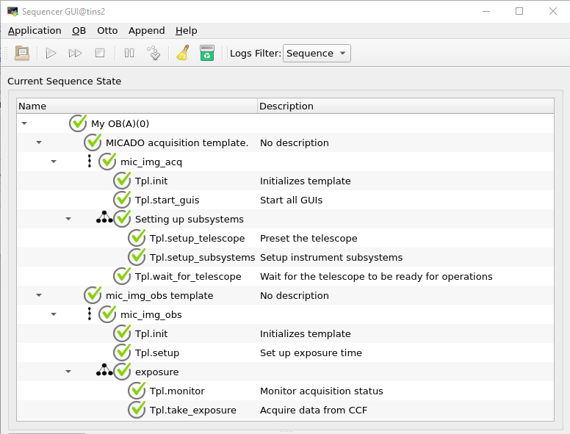
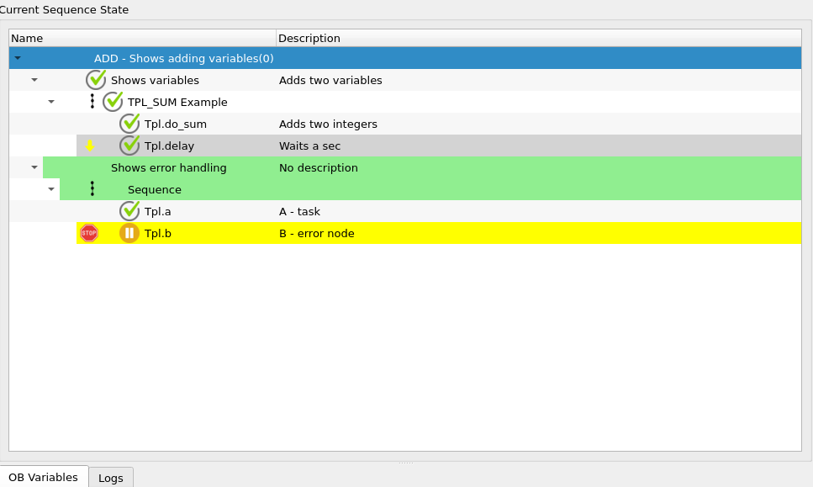
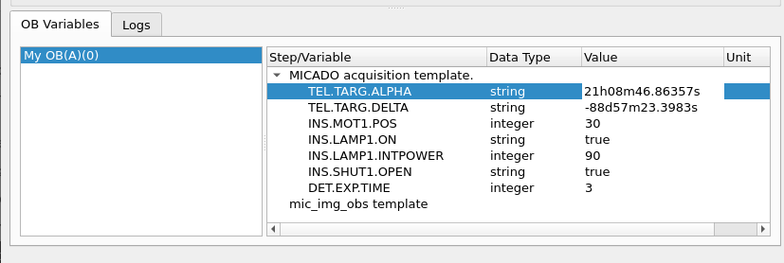
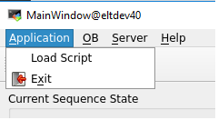
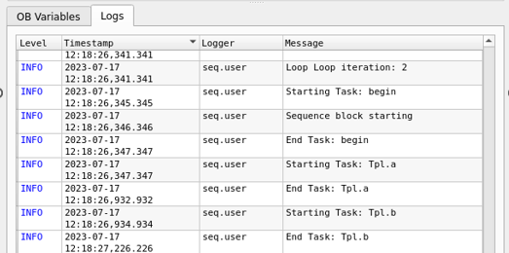
Sequencer Tool
Software component for the executing Observation Blocks (OBs).
OBs are represented by JSON files.
OBs contain a list of observation templates and metadata.
Each template within an OB has an associated Python script.
GUI providing user interaction.
Supports the execution of Engineering Scripts.
New Technology Telescope – 3.5 metre

Slide 16
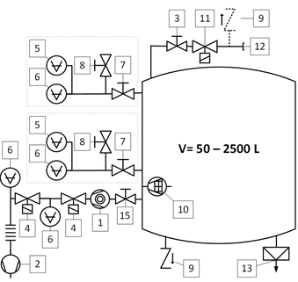
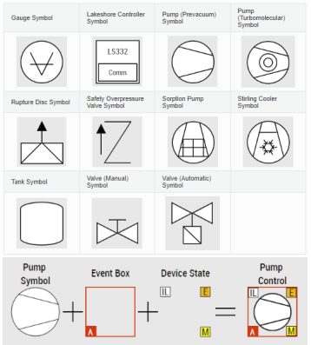
Cryogenic Toolkit
It provides a set of Function Blocks (FB) for the control of ESO Cryogenic standard components.
It provides the implementation of generic sequences, e.g. evacuation, warm-up, cool-down, etc.
It provides a library of user controls and a template application for the HMI development.
and many hosted telescope projects
New Technology Telescope – 3.5 metre

Slide 17
Online Data Processing (ODP)
The Online Data Processing is a simple component aiming to provide a data processing toolkit, flexible and well integrated with the Instrument Control Software.
It simplifies the execution of existing image processing routines from CPL or CLIPM.
Some available routines:
    Full bad pixel support
    Background Estimation
    Point-Source Centroiding
    Fitting
    Barycentre
    Alignment
    Cross-correlation
    Transformation
    Aperture Characterisation
    Variously shaped objects
    Automatic region of interest
and many hosted telescope projects
New Technology Telescope – 3.5 metre

Slide 18
IFW Miscelaneous Libraries
Ifw-core
  Common libraries
    Dictionaries
    FITS files
  Utilities
    Asynchronous shell (acli)
    FindFile, LoadCfg, geturi, logCollector
Ifw-rtmstools
  Library to simplify the send and receive of RTMS packages.
  RTMS to DDT Gateway
Ifw-wdglib
  Library of common widgets
and many hosted telescope projects
New Technology Telescope – 3.5 metre

Slide 19

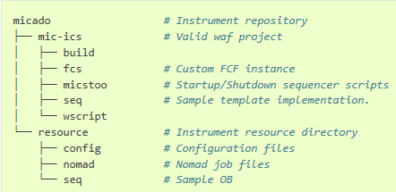
Template Instrument
Generates a mini-instrument software fully functional.
Includes most of the IFW components working together.
Based on Cookiecutter.
Defines an initial project structure.
Provides a fully working waf project.
Configuration samples.
Startup/scripts based on nomad.
Integration with HLCC and NGCII.
Sample IP with few OBs.
Project Template with custom hook
and many hosted telescope projects
New Technology Telescope – 3.5 metre

Slide 20
Use Cases

Slide 21
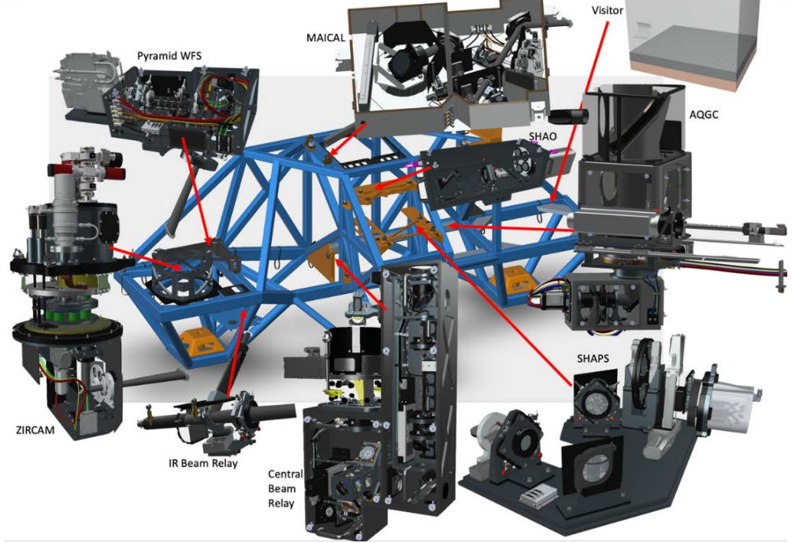
Phasing and Diagnostic Station - PDS
PDS is hosted by the ELT Prefocal Station.
Passed FDR 4Q 2023
Around 70 devices and 120 sensor channels.
No custom devices.
and many hosted telescope projects
New Technology Telescope – 3.5 metre

Slide 22
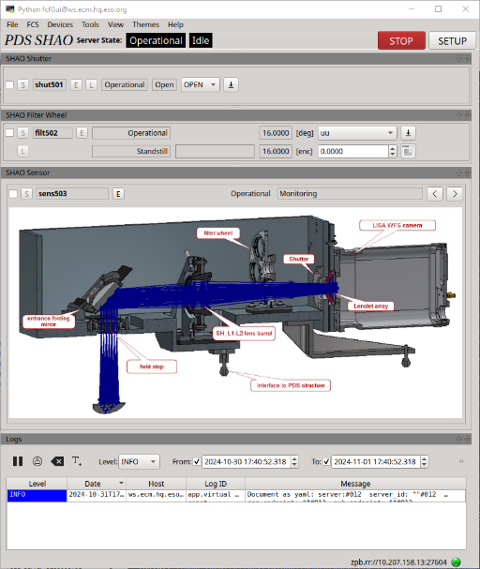
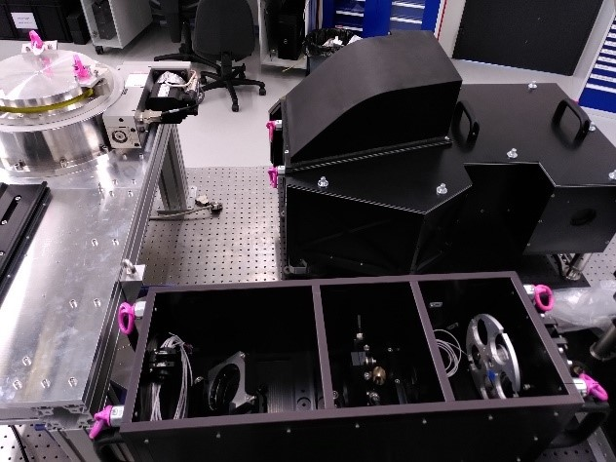
PDS SHAO

Slide 23
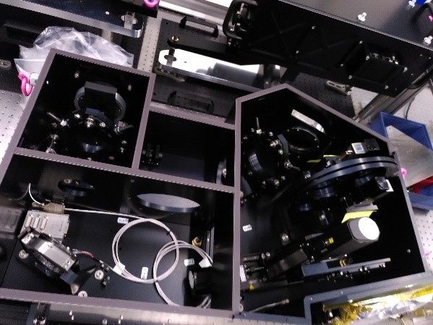
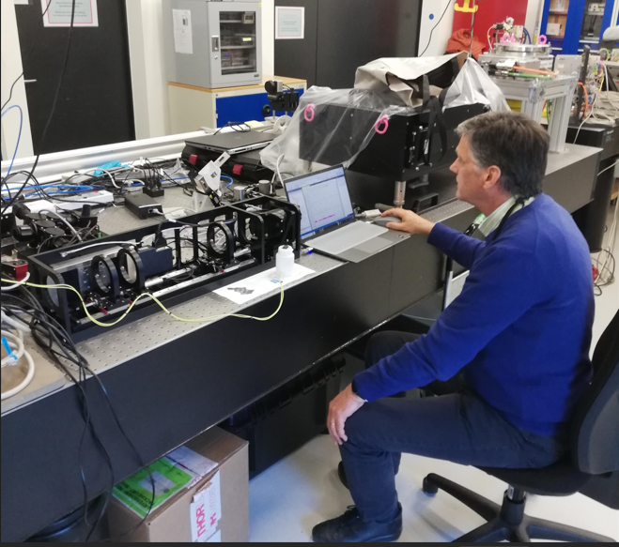
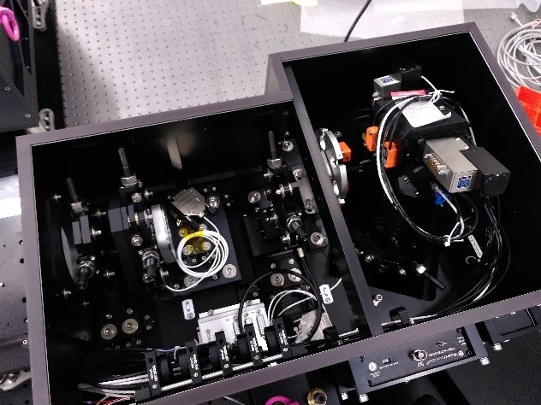
PDS Subsystems

Slide 24
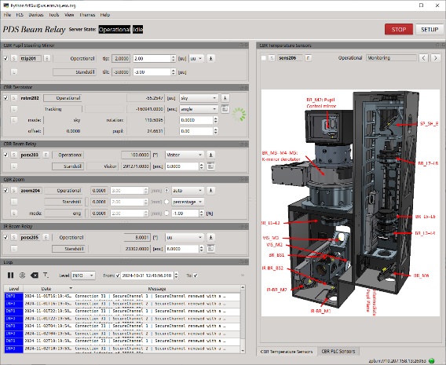
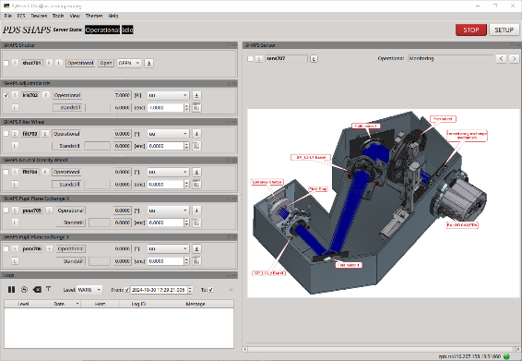
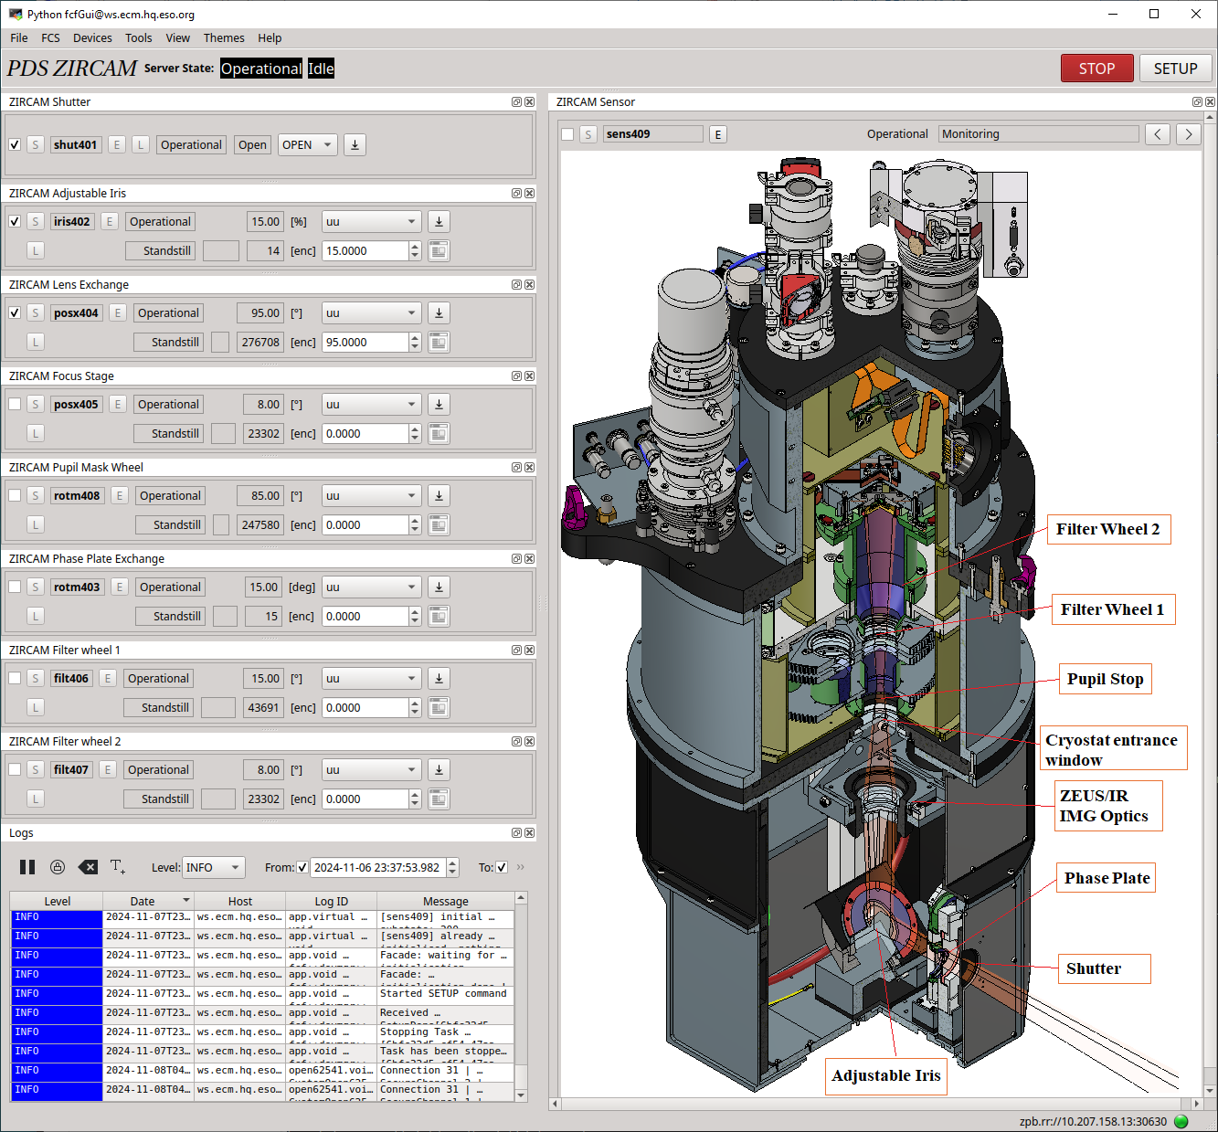
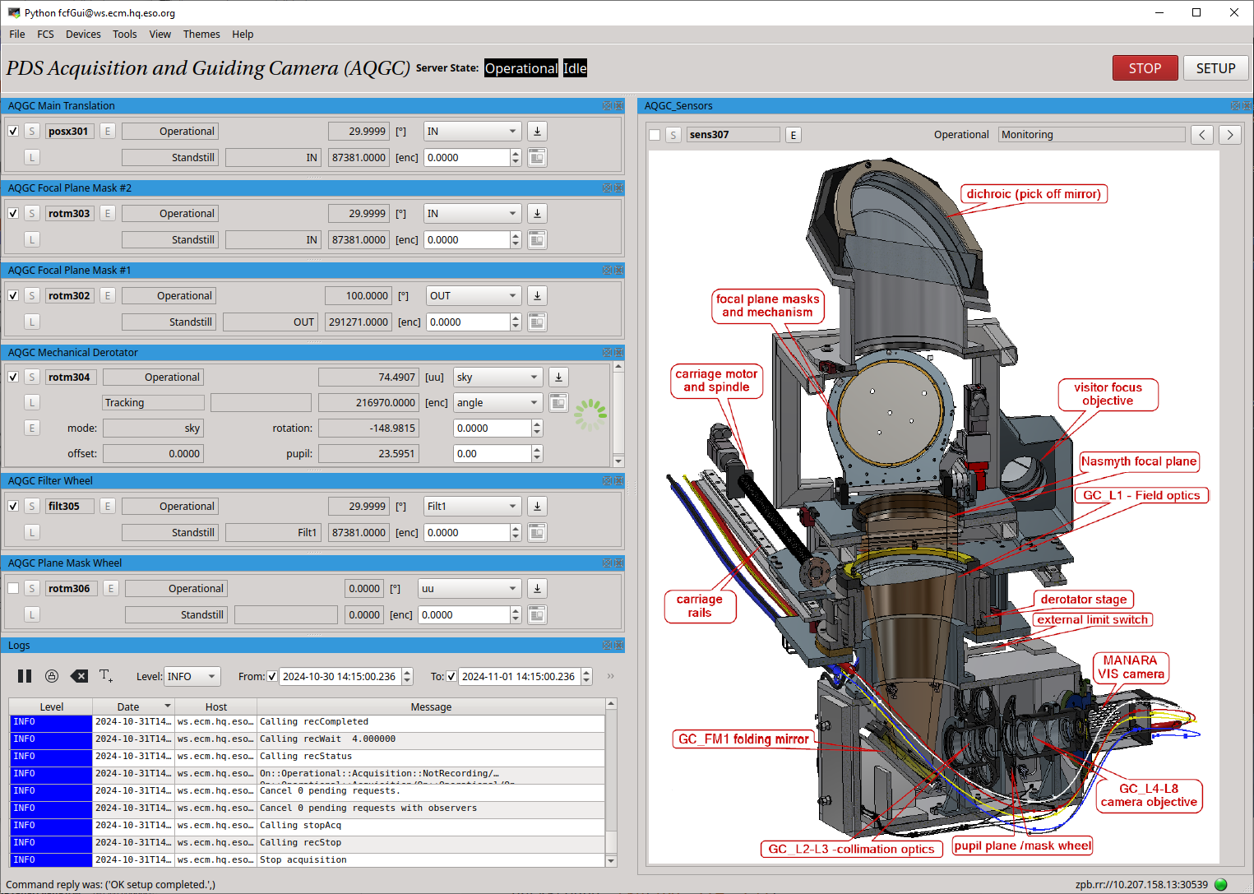
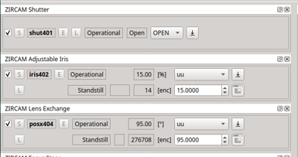
PDS FCS for Subsystems

Slide 25
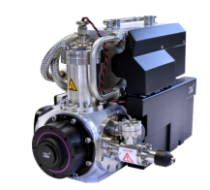
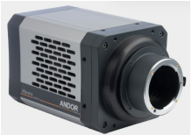
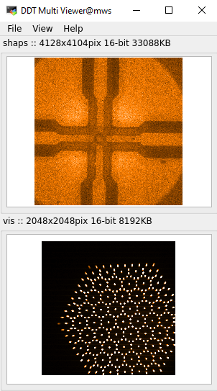
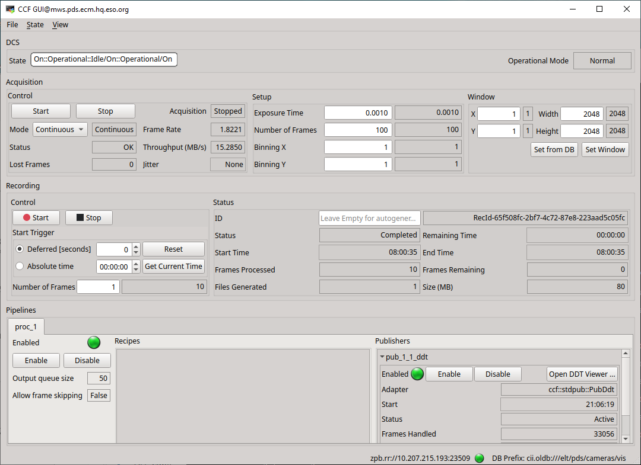

PDS DCS Subsystems
5 sensors:3 COTS cameras including the C-RED-ONE (Freda), one LISA and one IR detector (H2RG).
3 instances of CCF for each COTS camera.
Validation of CCF and DDT
Stable operations at high rates.

Slide 26
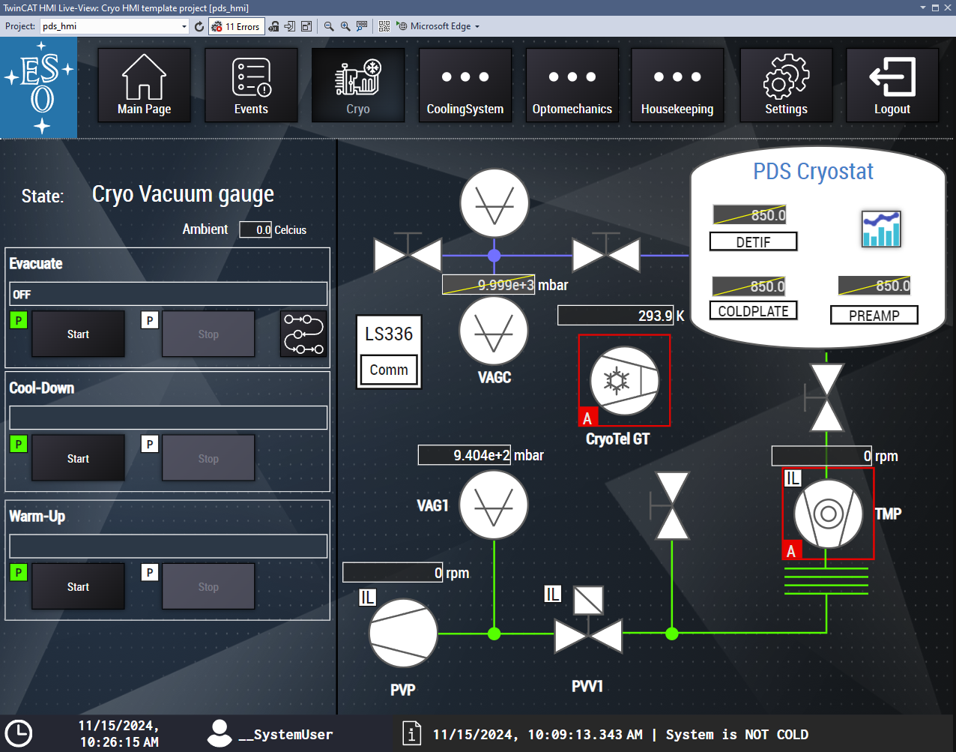
PDS Cryogenic & Vacuum System
Made with IFW Cryo Toolkit components.
Already in operations in the lab.

Slide 27
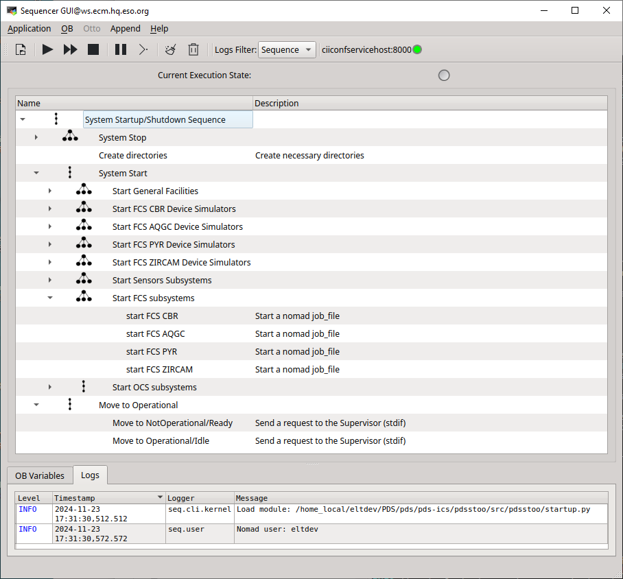
SW Startup/Shutdown
Sequencer Tool to startup/shutdown PDS sw.

Slide 28
Outlook 2025

Slide 29
What’s Next
Tooling.
  Porting to DevEnv6 (Fedora40, Qt6, C++23, etc.)
  PLCs: support for TwinCAT 4026, TC/BSD as a VM
  pub/sub from ZeroMQ to FastDDS.
New Components
  Secondary Loops Manager.
  Frame Grabber Framework (FGF).
  New FCF DevSim: EFISOFT contribution to IFW.
  Framework and User Controls for ICS standard devices (HMI).
  Template Library and tools.
and many hosted telescope projects
New Technology Telescope – 3.5 metre

Slide 30
Summary
We have delivered already 6 versions of the IFW. In version 5 we completed the original scope of the project.
We are transitioning to maintenance but will continue developing the IFW according to the needs of the projects.
The IFW tries to cover the main needs for instrument control. This is complemented with other ESO products like NGCII and RTC toolkit.
Internal projects like the Phasing and Diagnostic Station (PDS) and the Miniscule ELT (MELT) are contributing to validate the IFW internally.
We hope to have ForsUp in Paranal soon to validate the IFW in real operational conditions.
and many hosted telescope projects
New Technology Telescope – 3.5 metre

Slide 31

Luigi Andolfato; Diego Del Valle; Sylvie Feyrin; Arturo Hoffstadt; Mario Kiekebusch; Jens Knudstrup; Christoph Moins; Ivan Muñoz; Dan Popovic; Claudio Reinero; Calle Rosenquist; Paola Sivera; Ricardo Schmutzer; Piotr Szubiakowski
@ESOAstronomy
@esoastronomy
@ESO
european-southern-observatory
@ESOobservatory

