Slide 1


Seminar Info
J. Knudstrup

Slide 2
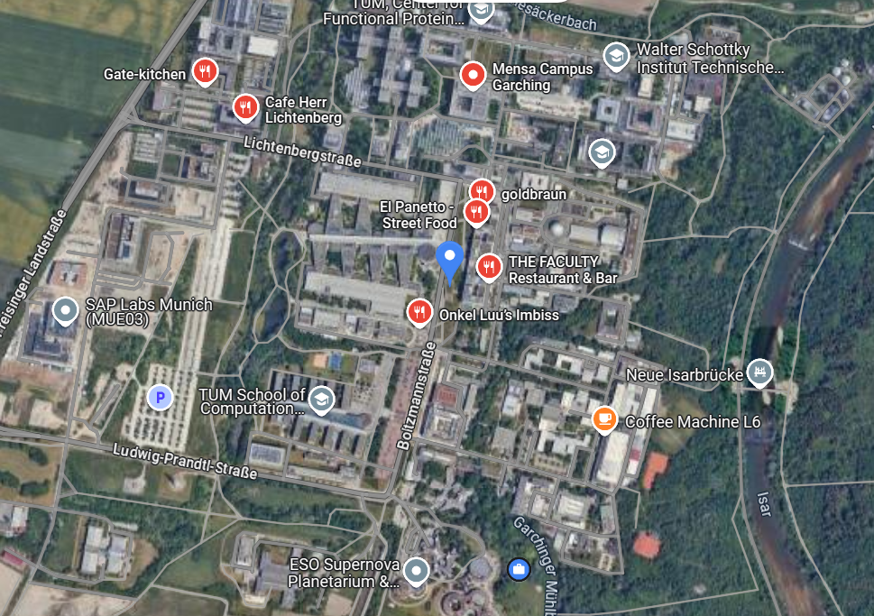
Lunch
First choice: Max Planck Canteen.
Second choice: Street food area close to the Metro.
Alternative: Bring your own food.
More than 1 hour scheduled for the lunch break – hopefully, it’s manageable.
Max Planck: If the short way gate should be open. If locked, try the ‘long way’ and tell at the gate that you are attending this seminar at ESO.
Street food, restaurants, bakery
Max Planck Cafeteria

Slide 3
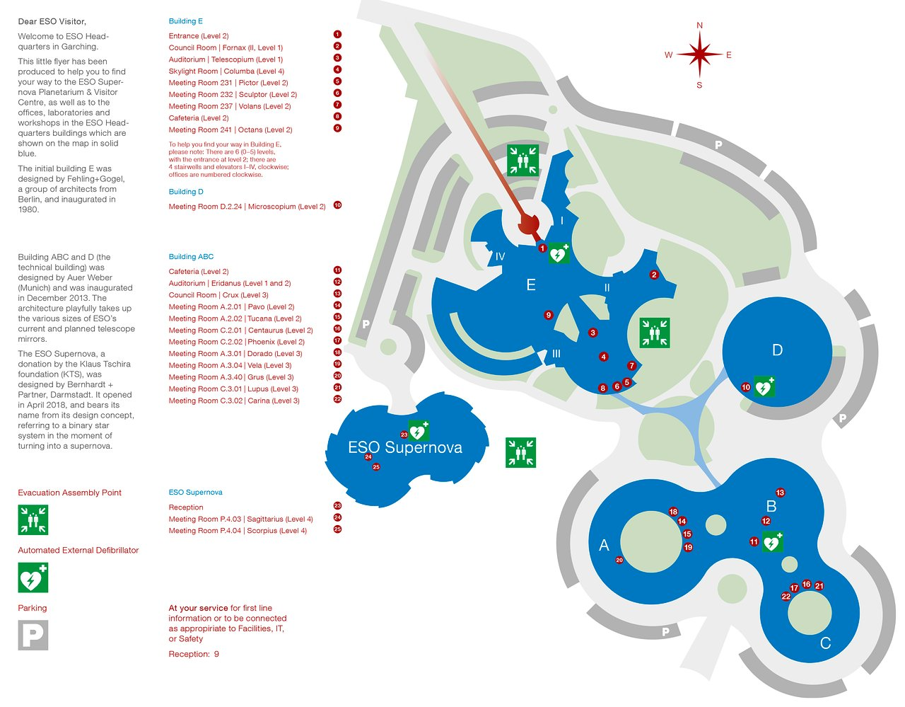
Group Photo
Day 2, 12:20.
During the previous seminars of this kind a group photo was made.
Participants + ESO speakers kindly requested to meet in the North-Eastern courtyard, before going to lunch break.
Thanks!! ☺
1
3
2

Slide 4
Lab Visits
Day 2, 16:30 - 18:00.
Please familiarise yourself with the pick-up points.
Please check what has been allocated is correct.
Note: When more people sign up or change priorities, scheduled events may change (time slot) – please check the latest schedule shortly before the event takes place.
Leave stuff in the auditorium, will be supervised.
Schedule
ESO Reception
Gallery Window
3
Bridge between building E & D

Slide 5
Social Event
Day 3, 17:45.
Participants registered for the event.
Speakers at the seminar.
Venue: “Eridanus Foyer” (Building B, ground floor).
3

Slide 6
Storage of Luggage, Overcoats
Space in the auditorium is limited.
Room 232 has been reserved (located past the cafeteria).
If you have luggage, please kindly store it there.
Same applies for overcoats.

Slide 7
J. Knudstrup – jknudstr@eso.org
@ESOAstronomy
@esoastronomy
@ESO
european-southern-observatory
@ESOobservatory

