Slide 1


CII MAL & Services
Marcus Schilling

Slide 2
CII Overview
Products
CII MAL
  Interface Definition Language
  Communication Libraries
CII Services
  Configuration
  Online Database
  Logging
  Alarm System
  Telemetry
CII APIs are generally available in:
C++
Python
Documentation
https://www.eso.org/projects/elt/develop
  CII Documentation
    CII Manuals all-in-one
    CII Knowledge Base
    CII Demo repository

Slide 3
CII MAL
Communication Patterns:
Request – Reply
Pub – Sub
Middlewares / Protocols:
DDS
ZPB (= ZMQ & Protocol Buffers)
OPC UA
MUDPI
Changes since INS SEM 2019:
Replaced DDS vendor
No longer supports DDS Req/Rep
No longer supports Java

Slide 4
CII Config(-NG)
Changes since INS SEM 2019:
Config-NG takes the place of Config
Config-NG is for Control applications
Config is now CII-internal
Config-NG vs Config:
Config-NG is file-based, no server
Interpreted at run-time, no code-gen
Config-NG Features:
• type definitions
• type inheritance
• metadata
• required/optional attributes
• default values
• file include
• validity checks

Slide 5
CII Config-NG - Example
Definition (yaml)
Usage (C++, Python)
!cfg.typedef mystruct: long_value: !cfg.type:int64 value: !cfg.type:int32 string_value: !cfg.type:string
elems:
a: !cfg.type: mystruct
long_value: 555
value: 333
string_value: some text
#include <config-ng/ciiConfigApi.hpp> [...] using namespace elt::configng; CiiConfigDocument doc = CiiConfigClient::Load("defs.yaml"); CiiConfigInstanceNamespace inst = doc.Instances(); int64_t a = inst["elems"]["a"]["long_value"].As<int64_t>(); std::cout << "a = " << a << std::endl; // output: a = 555

Slide 6
CII OLDB
Datapoints:
Create, Read, Write, Subscribe, Delete
Hierarchical Data Model
Metadata
Tools:
oldbGui, oldb-cli
oldbReset, oldbAdmin
oldbdump, oldbloader
Changes since INS SEM 2019:
No longer supports Java
No longer based on Elasticsearch
Ported CE from Java to Python
initial version, improvements pending
Now supports heartbeat points
(still an experimental feature)
Now supports aliases
In-Mem-Oldb for unit testing
oldb-robot-library for integration testing

Slide 7
CII Logging
Log Output:
Log format is fixed
Log sink: /var/log/elt
Tools:
ciiLogViewer
ciiLogSend
API:
Python: CiiLogManager + python logging
C++: CiiLogManager + log4cplus
C++: spdlog
Changes since INS SEM 2019:
Log Transport: rsyslog (was: ELK stack)
Log Storage: files (was: Elasticsearch)

Slide 8
CII Alarm System
Characteristics:
Located “behind the OLDB”
Acknowledging, Shelving
History
Rule-based
Autonomously raises alarms,
the developer does not
Tools:
Alarm Gui (under development)
Workflow:
Input: Live data
  provided by Developer
Processing: Alarm Rules
  suggested by Developer
  owned by On-Site-Team
Output: Alarms
  handled by On-Site-Team
  mirrored to Developer
-> Workflow example on next slide

Slide 9
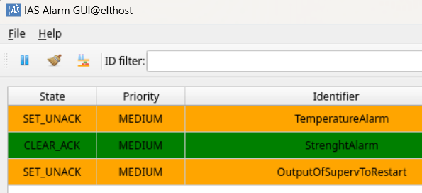
CII Alarm System – Workflow Example
Input from Developer: OLDB value
↓
Alarm Rule by On-Site-Team
↓
↓
Output to On-Site-Team: Alarm
↓
↓
↓
↓
Output mirrored to Developer: OLDB value
ins_temperature_dp->WriteValue(81.3);
alarmId : /alarm/hitemp/ins
shortDesc: TemperatureAlarm
rule : [ max, /ins/temperature, 70.0, 80.0 ]
alarm_hitemp_ins_dp->ReadValue().GetValue();

Slide 10
CII Telemetry
Characteristics:
Located “behind the OLDB”
Monitors OLDB datapoints
Records metadata of points
Applications can push points or series
See follow-up presentation: CII Telemetry

Slide 11
Marcus Schilling – mschilli@eso.org
@ESOAstronomy
@esoastronomy
@ESO
european-southern-observatory
@ESOobservatory

