Slide 1


CII Telemetry
Marcus Schilling

Slide 2
CII Telemetry
Characteristics:
Located “behind the OLDB”
Monitors OLDB datapoints
Records periodically or on-change
Records metadata of points
Applications can actively push points or series

Slide 3
Content
We are still iterating on CII Telemetry; it is not a finalised product.
This talk gives an overview over status and plans.
Where we are
What we provide
What we are working on
What we will provide

Slide 4
Where we are
ELT uses InfluxDB v2
Available as open-source: InfluxDB OSS v2
The “time to awesome” (Influx jargon) is short
  Recording time series in InfluxDB 2 is straightforward
  Comes with built-in Web UI, REST API, Client Libraries, etc.
  Comes with built-in data collectors for OPC UA and system (CPU, etc.)

Slide 5
Where we are – Usages
OLDB Capturing:
  Via ELT tool (monitor OLDB -> send LP via UDP -> Telegraf -> InfluxDB)
  Used in PDS (Phasing and Diagnostic Station)
  Used on MELT (Miniscule ELT)
  MELT additionally captures:
    DDS (via ELT tool)
    OPC UA (via built-in, configuration needed)
    system (via built-in, zero-conf)

Slide 6
Where we are – Usages 2
Custom time-series (non-OLDB)
  Used for performance trending
  Using own custom data models
  Used In TRS (Time Reference System)
  Used in M1 Mirror
  Used in CII

Slide 7
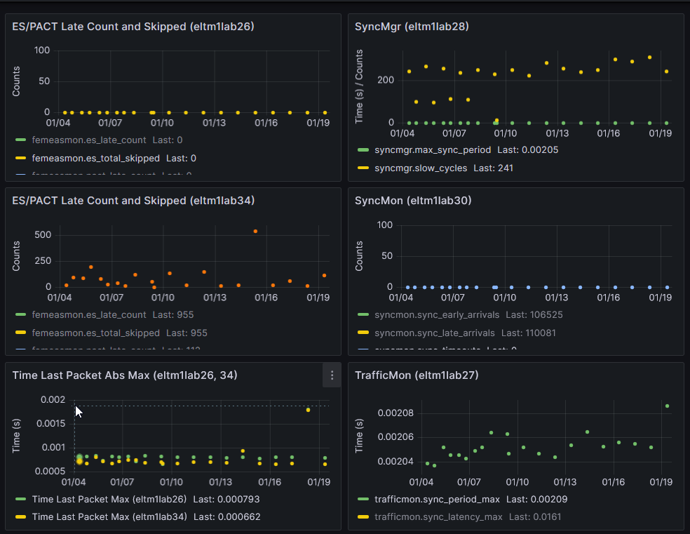
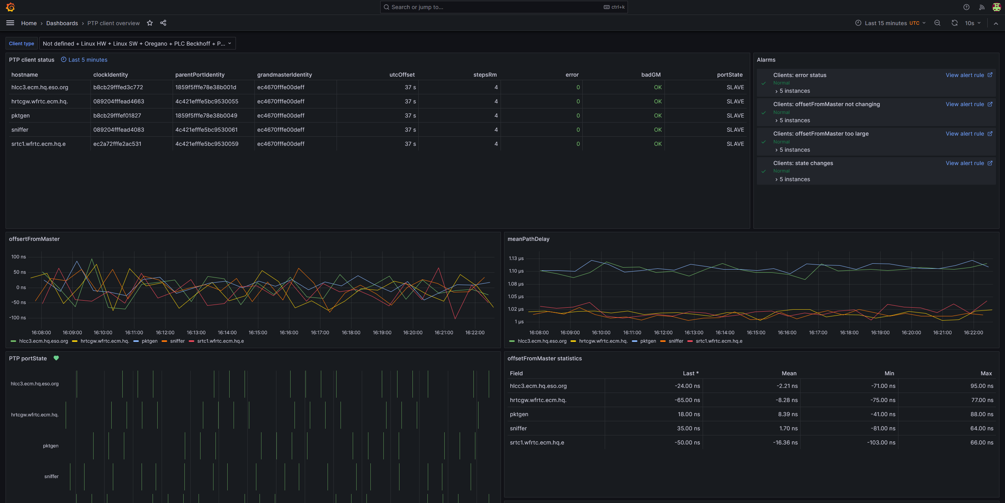
Where we are – Usages 3
Queries/Visualisation:
  One project uses InfluxDB UI (zero-conf, small footprint)
  One project uses API + Pyplot (static, report generation)
  All others use Grafana (powerful, good-looking)
M1 (Grafana)
TRS (Grafana)

Slide 8
What we provide
We have available:
installation tooling
  ansible scripts for installing InfluxDB, Telegraf, Grafana, and setting them up
  docker-compose (resp. podman) file
data collection tooling
  OLDB monitoring
  DDS monitoring
  We are working on better documentation for the above

Slide 9
What we are working on – 1
Recording metadata – what was that time series about?
  Info: origin, type, unit, device SN, description, etc.
  Often stored in supplementary DB, usually an RDB
  But we’d prefer a single DB for ease of administration (cf. TimescaleDB)
Continuity – keep track across renaming/refactoring
  Often solved by keeping an external journal, or by export + re-import
  Journal is the way to go, but we’d prefer it collocated with the time series
Vectors/Matrices
  Not natively supported by InfluxDB
  Do better than string-serialization? Row-/Column-major? Support slicing?

Slide 10
What we are working on – 2
Re-sampling – save on storage space and query time
  Down-sampling tasks require Flux (for its “continuous-query” feature)
  Future of Flux is uncertain, InfluxDB 3 emphasises InfluxQL
  In InfluxDB 3, continuous-queries might be back as InfluxQL + JS/Py VM
Traceability– when was that data inserted, and by whom?
  Low priority, until you need it
Transfer to/from long-term storage
  Implement export + re-import tooling
  Record the location of data in a look-up table

Slide 11
What we will provide
More and better documentation
  How-To
  Guidelines
Data import tool/library
  For injecting points and series into the DB
  Reduces spread of DB-dependencies in the control software
  Planning to ship 1st version with Platform:2025
  A request from the author: If you need to use the InfluxDB API directly, please stick to the same principle: keep it confined to one place, at least as few as possible.

Slide 12
What else
  Pending for integration at Armazones:
  licensing (higher performance than OSS version)
  administration (availability, back-up, replication)
  Activities outside ELT:
  ESO Chile is redesigning its Technical Archive (Data Lake, IOP project)
  ESO IT is working on a TSDB standard for ESO
  Both outcomes will probably influence the ELT (for training of DBAs, etc.)

Slide 13
Marcus Schilling – mschilli@eso.org
@ESOAstronomy
@esoastronomy
@ESO
european-southern-observatory
@ESOobservatory

