Slide 1
OTTO
Otto Tackles Telescope Observations
Unified Observing Tool
T. Bierwirth, November 2024

Slide 2
Today on Paranal
Instrument Workstation 1
Instrument Workstation 1
Instrument Workstation 1
Instrument Workstation 1
Instrument Workstation
Instrument Workstation
BOB
BOB
CCS Transport
fetch OB
report OB status
UT1
Dataflow Workstation
UT2
Dataflow Workstation
Dedicated OT/vOT
installations
for each telescope
OT/vOT
OT/vOT
check for
laser collisions
read OBs from DB
update OB status
LTCS
OB
OB
OB

Slide 3
Today on Paranal
Two different observing tools
  Service Mode: OT
  Visitor Mode: vOT
OT / vOT installed on every telescope console
OT / vOT communicating to BOB via CCS
Laser collision checking against LTCS “Laser Traffic Control System”
Driven by instrument packages in PAF format

Slide 4
(Initial) Drivers for Replacement
Technical obsolescence
  Java Swing GUIs
  code base > 20y old, ”organically grown”
  Overly complex DB schema
Expensive maintainability
Poor extendibility
Closed desktop system
  cannot easily interact with OT / vOT programmatically
  have to be at the respective console to use it

Slide 5
Tomorrow on Paranal and Armazones
single installation
Instrument Workstation 1
BOB
OTTO
Gateway
Instrument Workstation 1
CCS
Instrument Workstation 1
HTTP
BOB
single observing tool
single installation
LASCAR
OTTO
check for
laser collisions
Instrument Workstation 2
ELT
Sequencer
read OBs from DB
update OB status
HTTP Transport
fetch OB
report OB status
OB
OB
OB

Slide 6
Tomorrow on Paranal and Armazones
Single ”unified” Observing Tool OTTO for both VM and SM
Centralized architecture, single deployment
Webbrowser-based user interface
REST APIs
Supporting La Silla, VLT and ELT
Supporting old and new instrument package format
Interfacing to new Laser Collision Avoidance System LASCAR
Extendible with custom OB filtering / ranking algorithms
Enabler for
  higher automation of science operations
  realization of complex new requirements

Slide 7
Operational Drivers for Replacement
Old PAF-based instrument package format verbose,
not easily extendible, no tool support
  move to JSON-based format
  supports hierarchical structure
  initially only a syntax change, but will be extended to support template parameters of type “target” and ”targetlist” possibly with “unified targets”
Science operations wants one telescope operator to drive
several telescopes, with convenient access
  OTTO can be run simultaneously in several browser windows / tabs
  serving different instruments on the same computer
New non-trivial science operations requirements
  Interruptible OBs ”qBits”
  Cross-run scheduling containers
  Custom tweaked OB scheduling algorithms
  QC0 wants to interact with OTTO via APIs to grade OBs automatically

Slide 8
Technology Stack
Chrome / Firefox / Safari
OTTO UI
Angular
Notifications via
Server-sent events (SSE)
OTTO REST API
OTTO
SpringBoot
read OBs from DB
update OB status
OB
OB
OB
SAP ASE ---> Couchbase ?

Slide 9
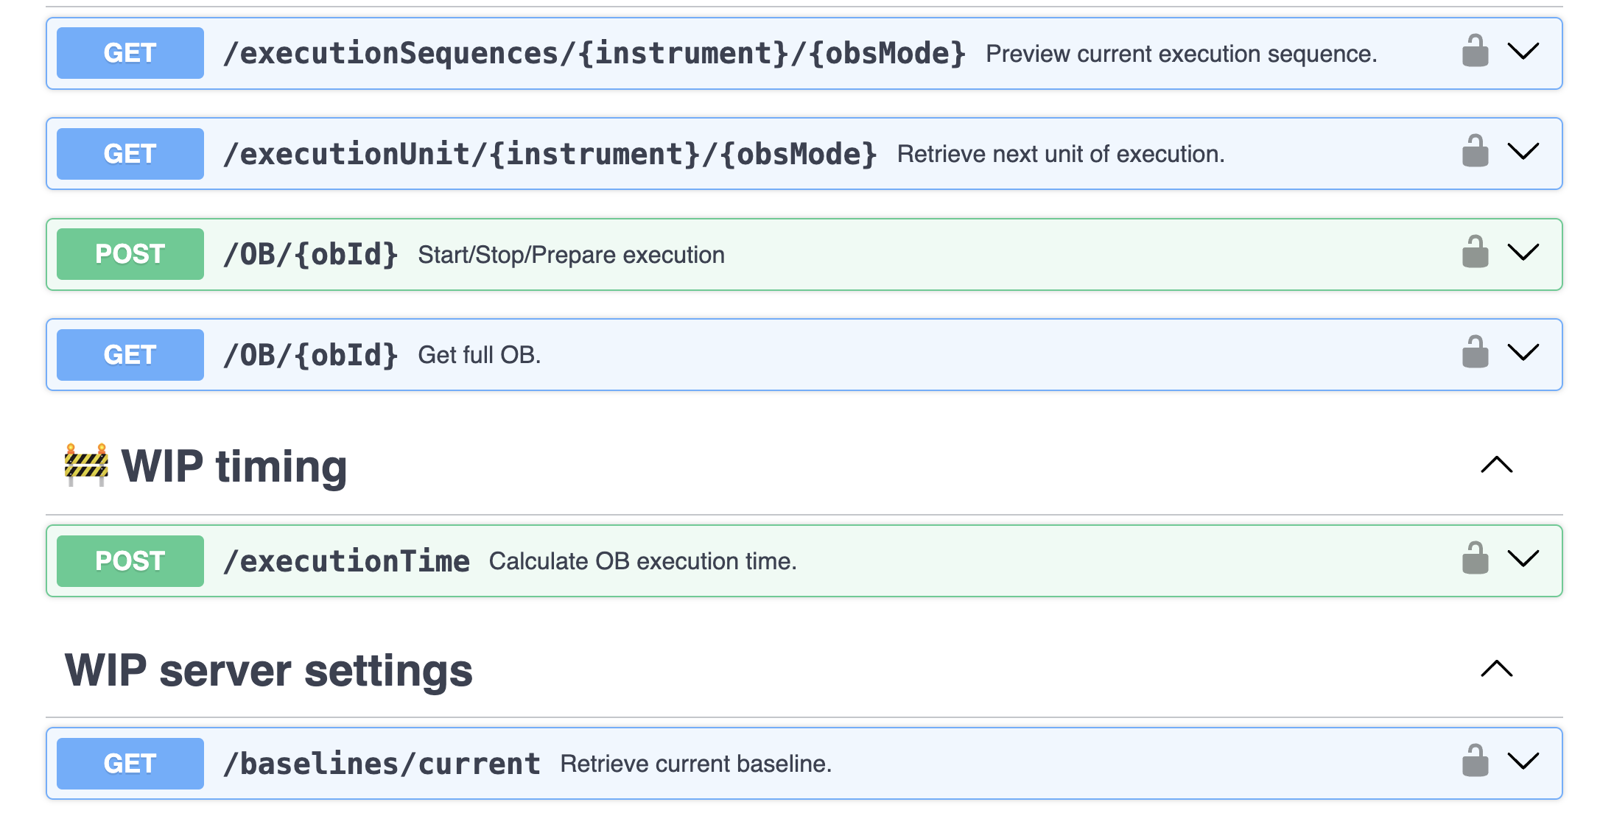
OTTO REST APIs
All functionality for the ELT Sequencer is exposed via formally specified REST APIs using OpenAPI

Slide 10
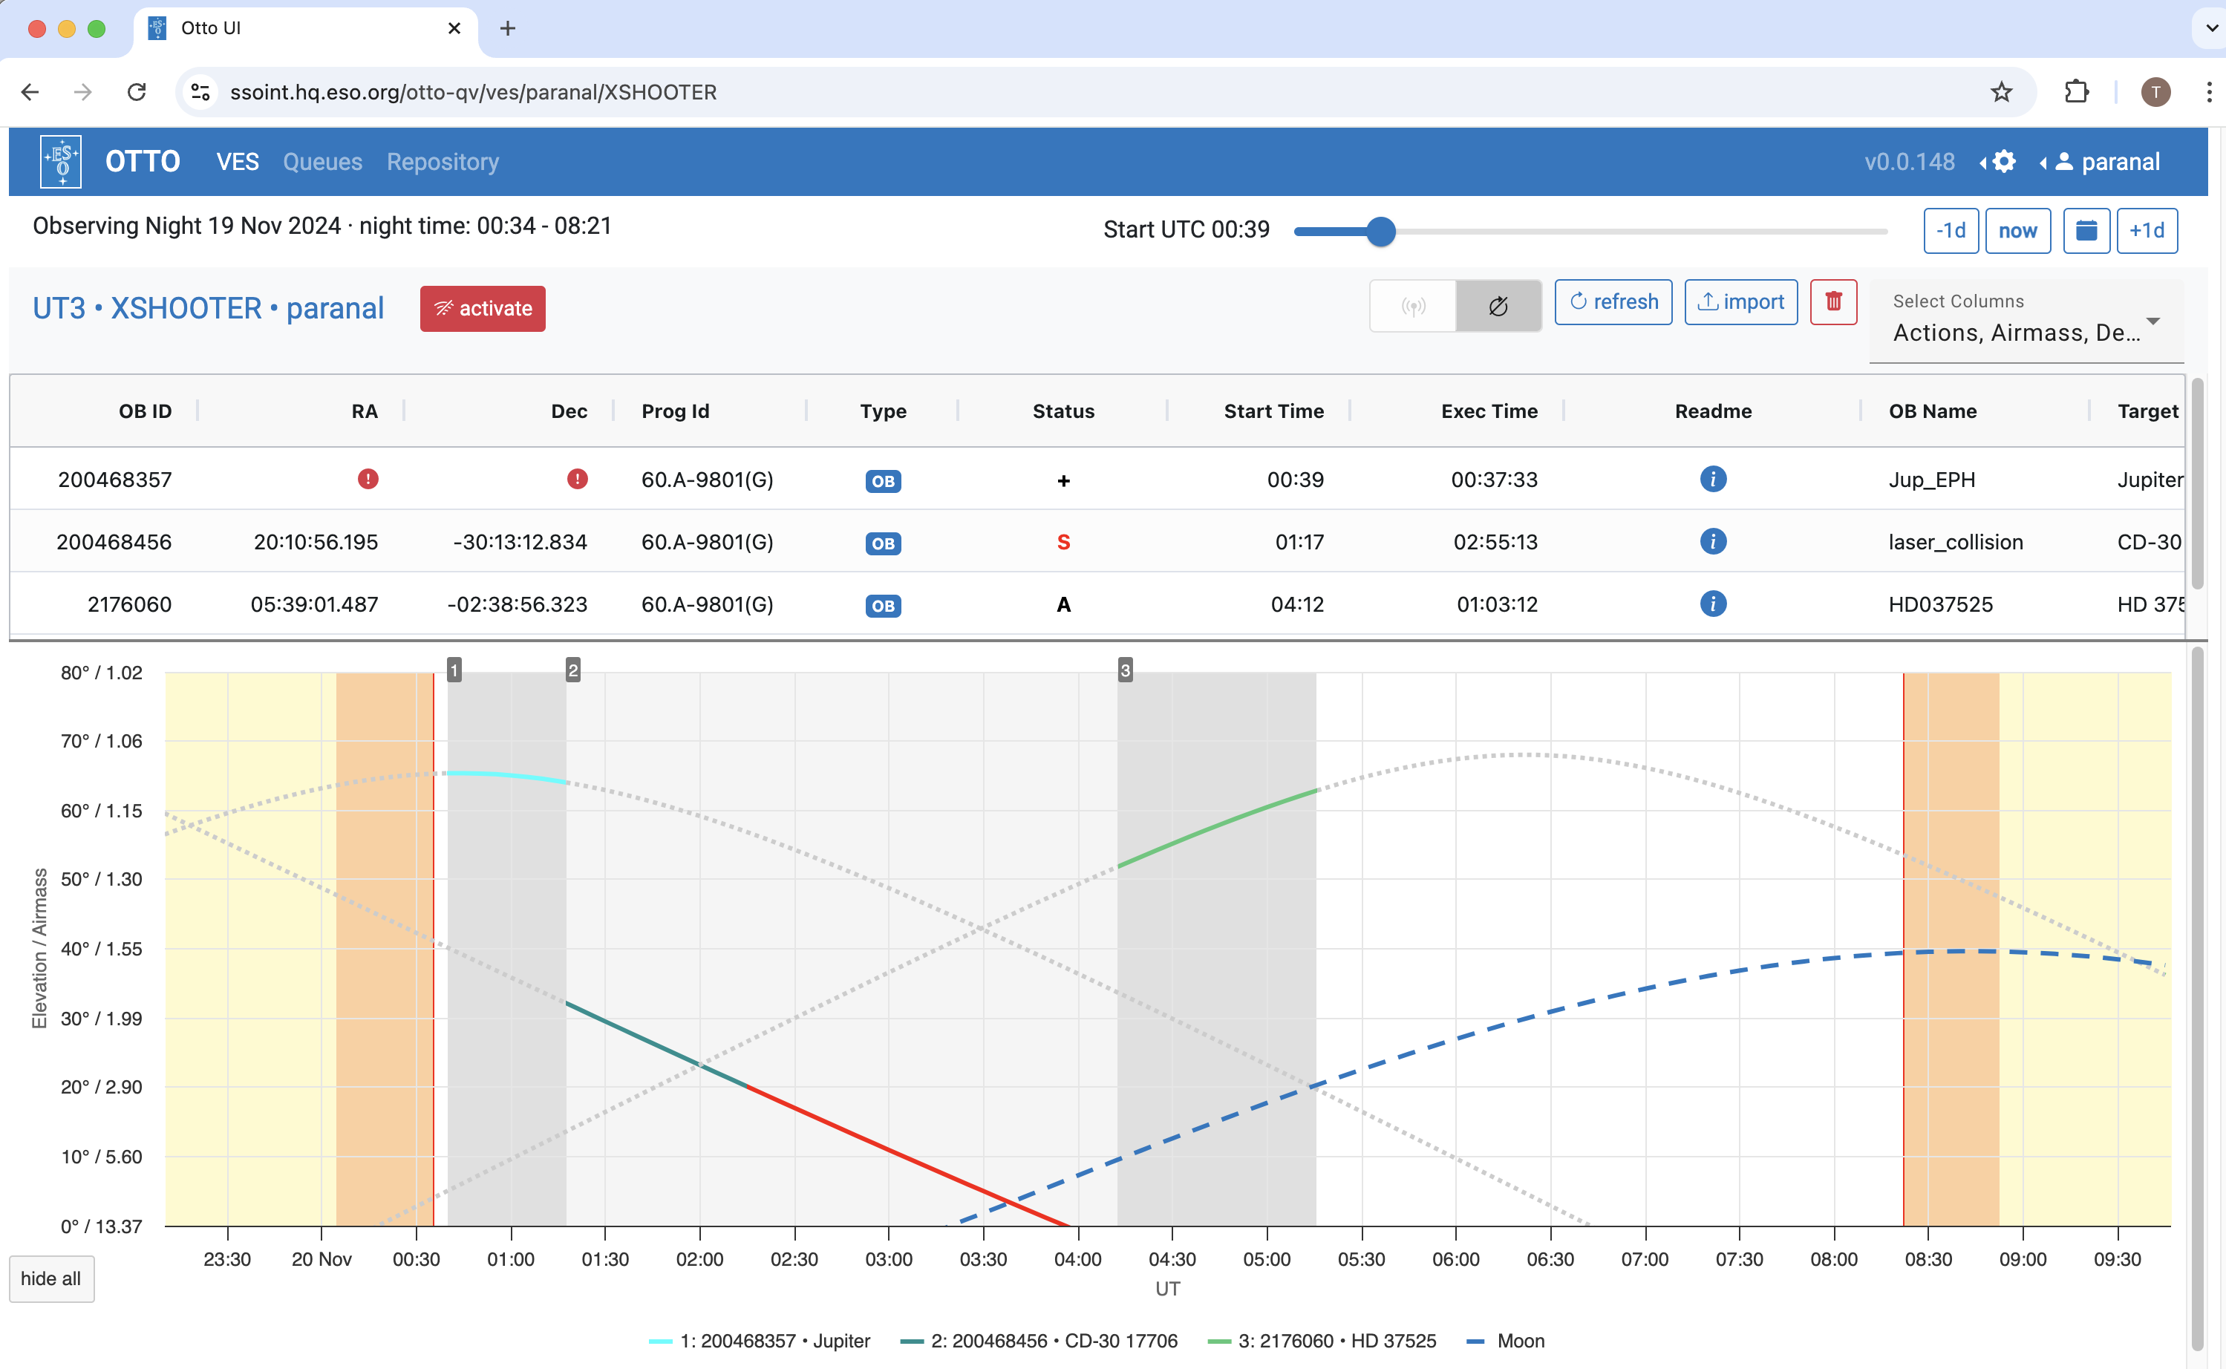
OTTO Visitor Mode on Paranal

Slide 11
Status
OTTO VM being commissioned on VISTA / OMEGACAM
Highly appreciated by Science Operations
To be rolled out to other VLT instruments
over the course of 2025
Conceptual proof that the centralised architecture with
REST APIs and browser UIs works well
incl. the VLT-BOB gateway
but … we have to move away from the ancient DB design, current plans / priorities will only allow us to deliver OTTO SM by end of 2028.
Basic ELT IP format for OB preparation by end of 2025.

