Slide 1


Welcome
Suzanne Ramsay, ESO

Slide 2
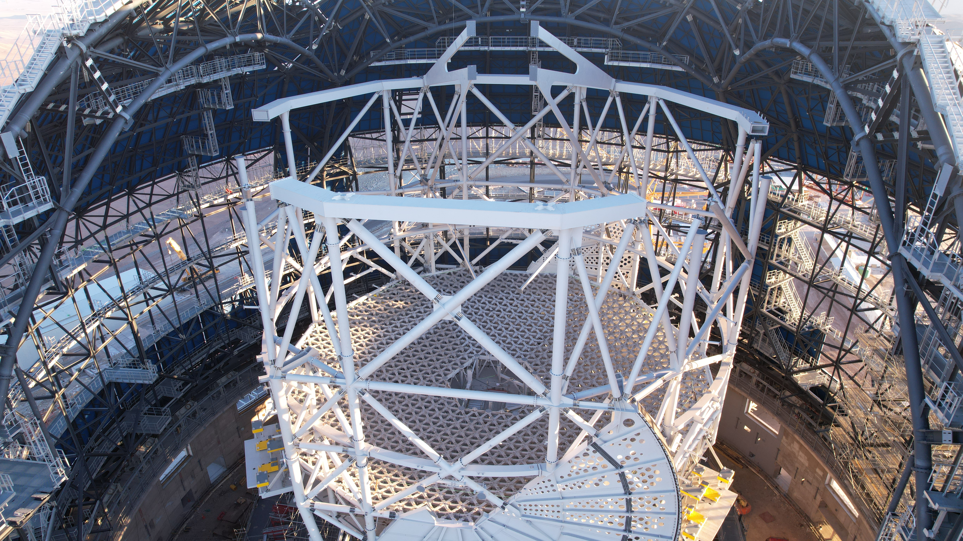
Status ?? October – ????
Telescope Tube Assembly
30th October 2024

Slide 3
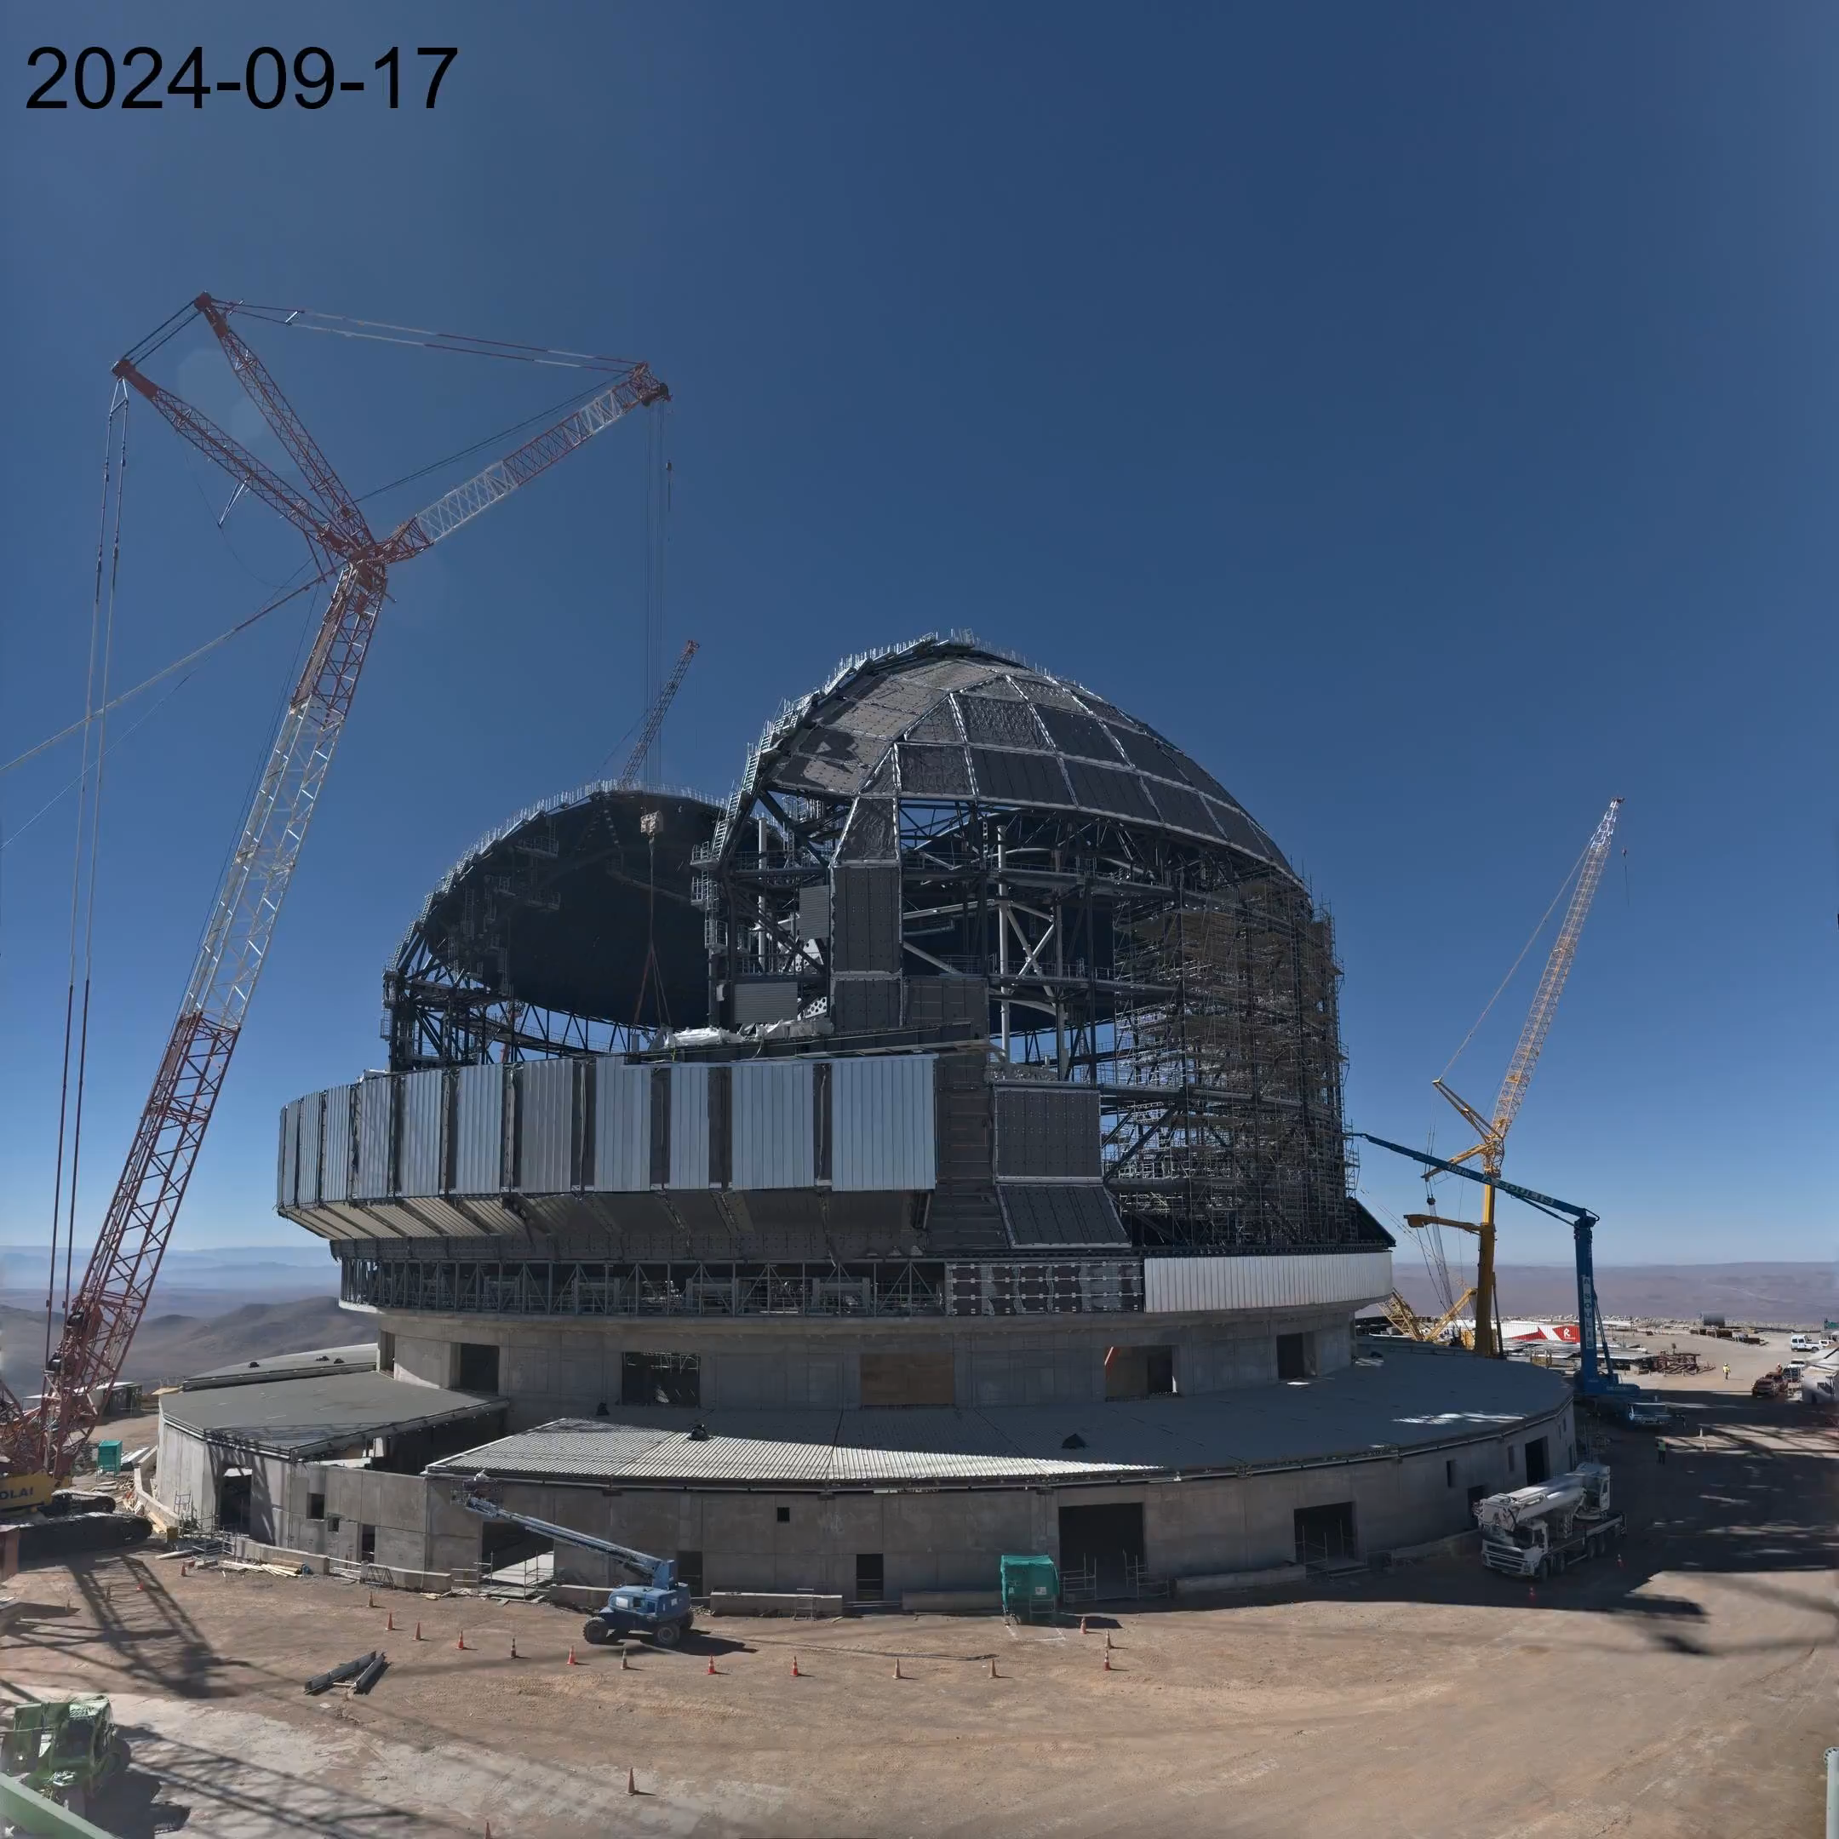
Dome rotation for installation of 2nd altitude track on 18th Sep.

Slide 4
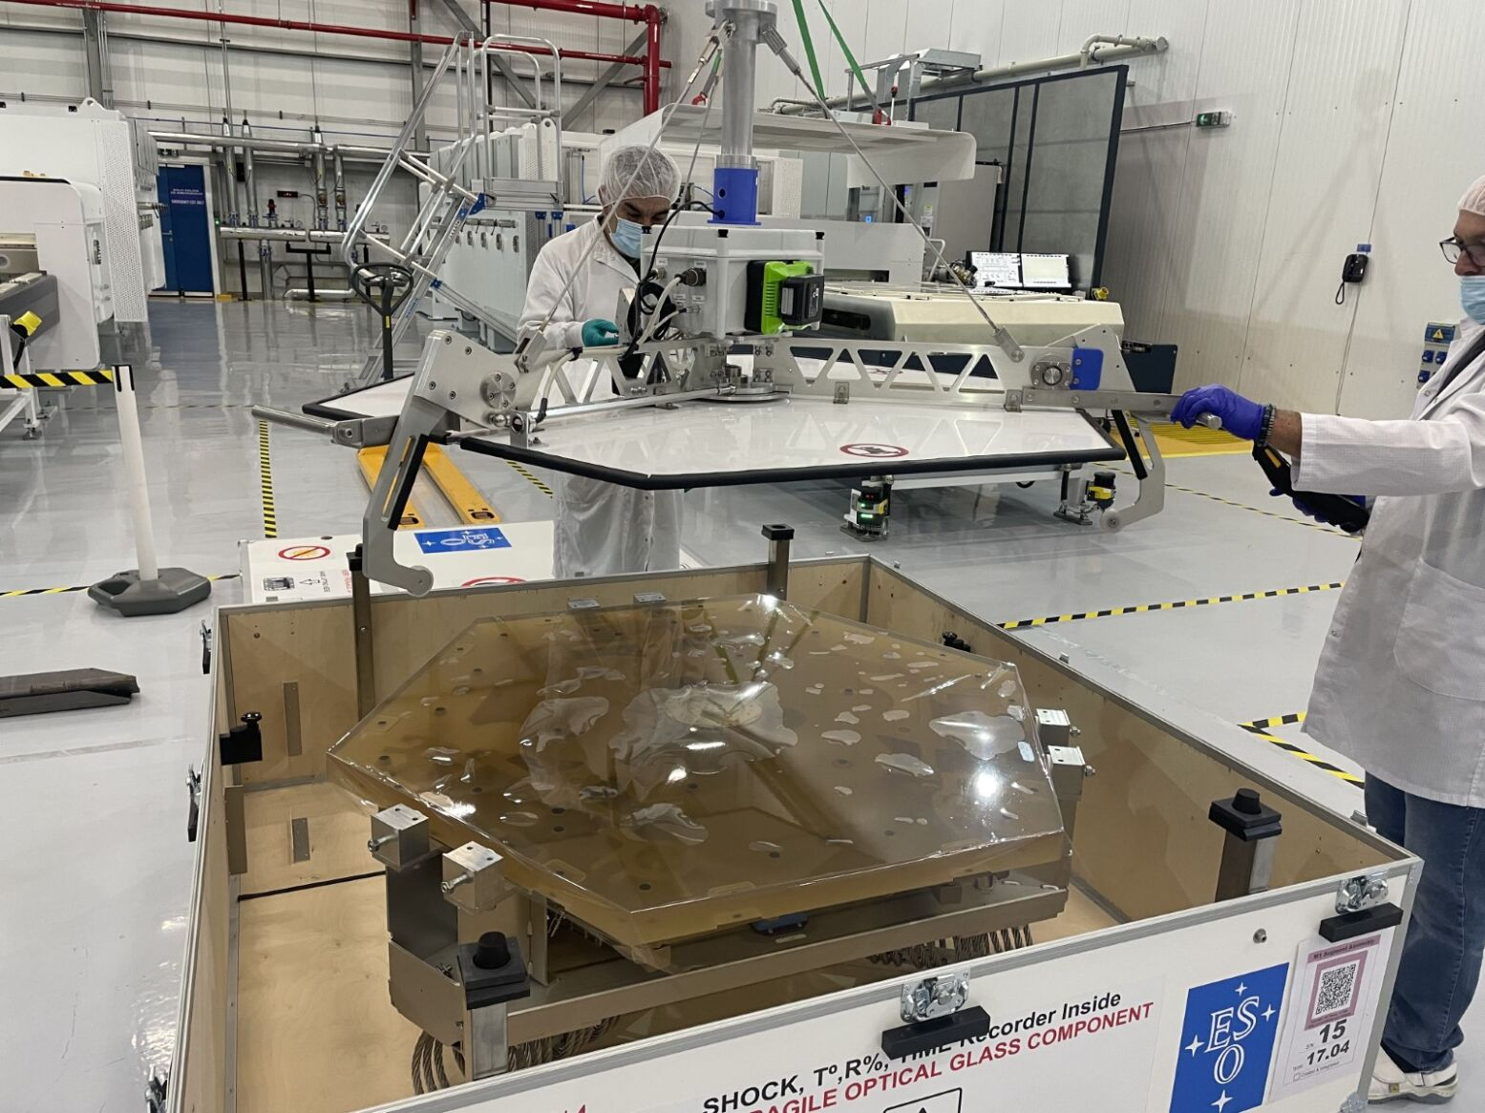
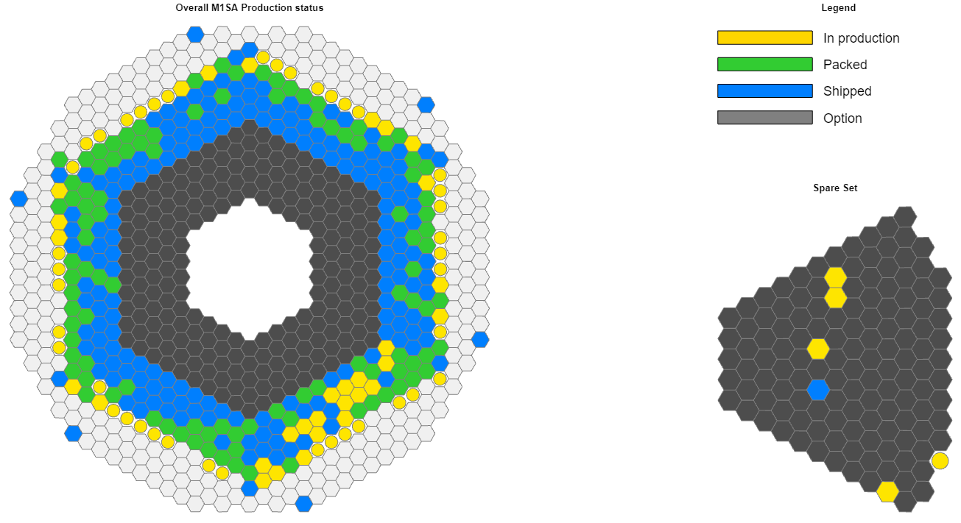
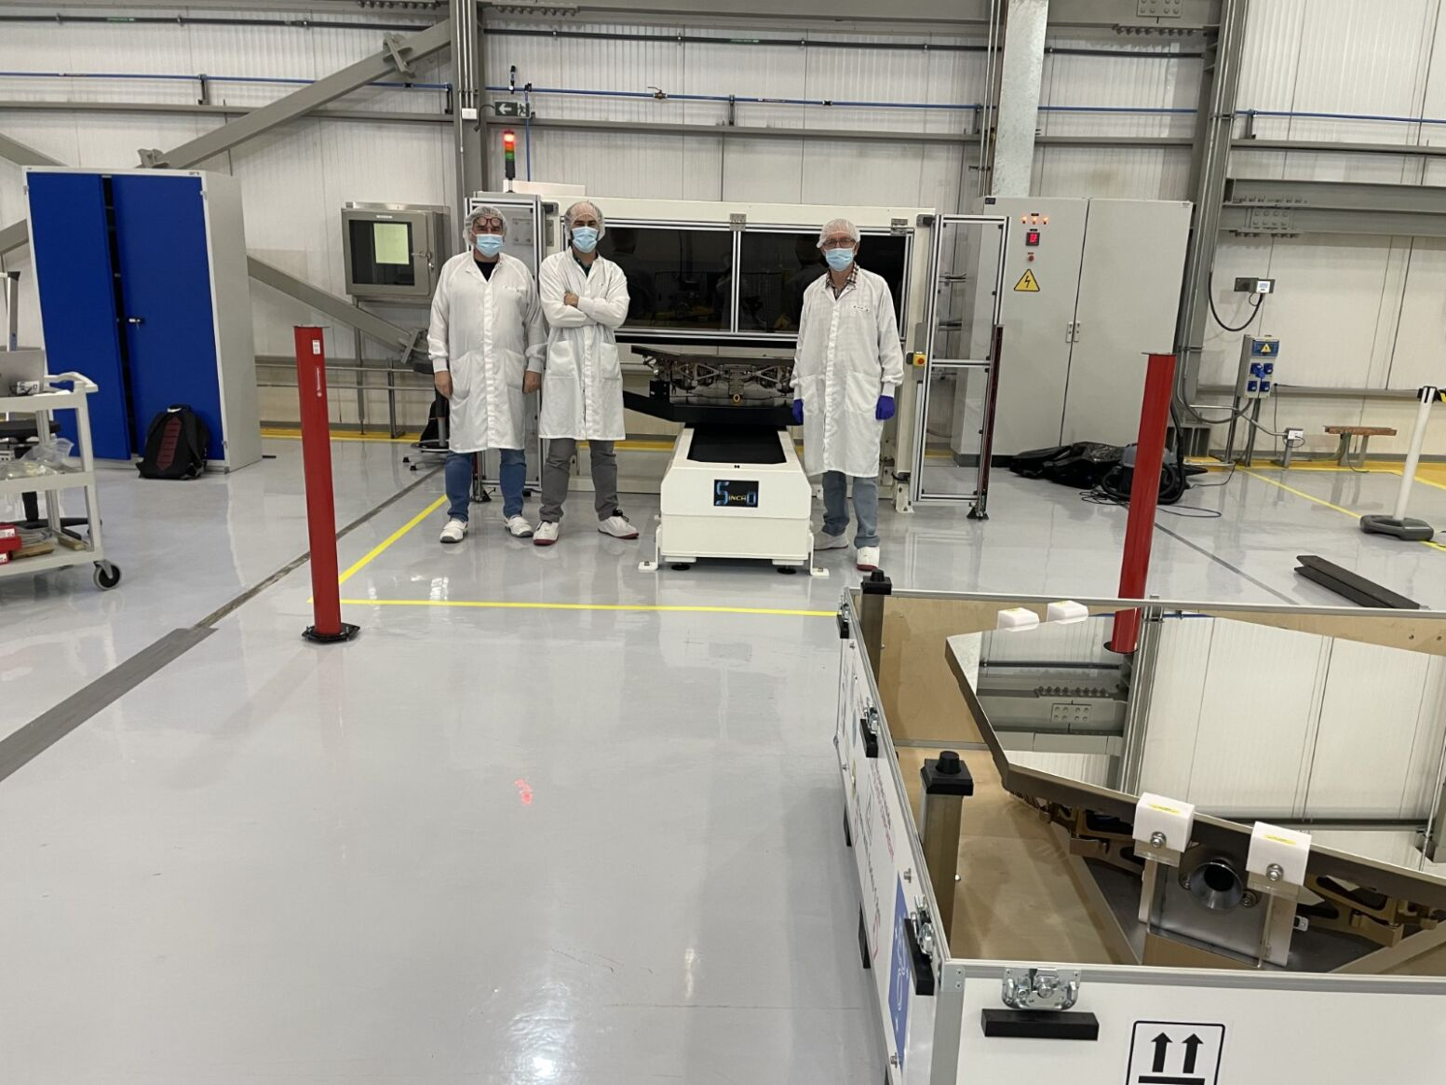
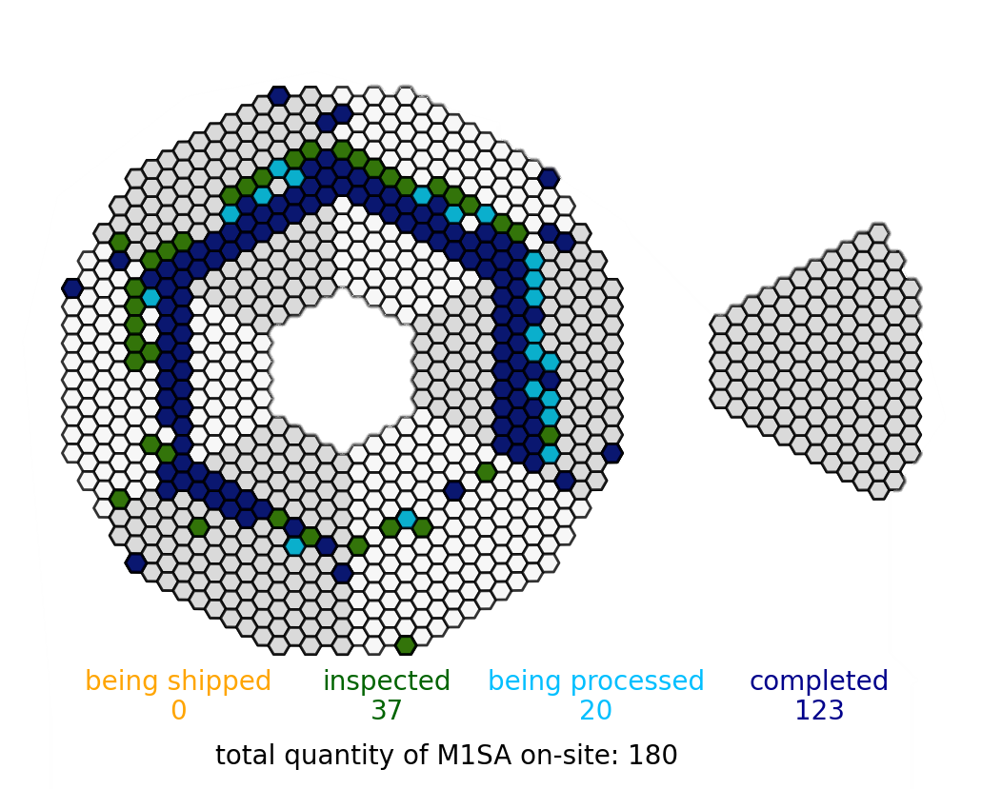
M1 Segment Assemblies
M1SA Status as of mid-September:
  Produced: 282 (+77 in production)
  On-site: 180
  Coated: 134
Notes:
The “being shipped” indicates the last TC received that might require to be shipped back for shock/insurance reasons.
Out of the 39 completed we have 2 with coating issue and 2 with missing welding

Slide 5
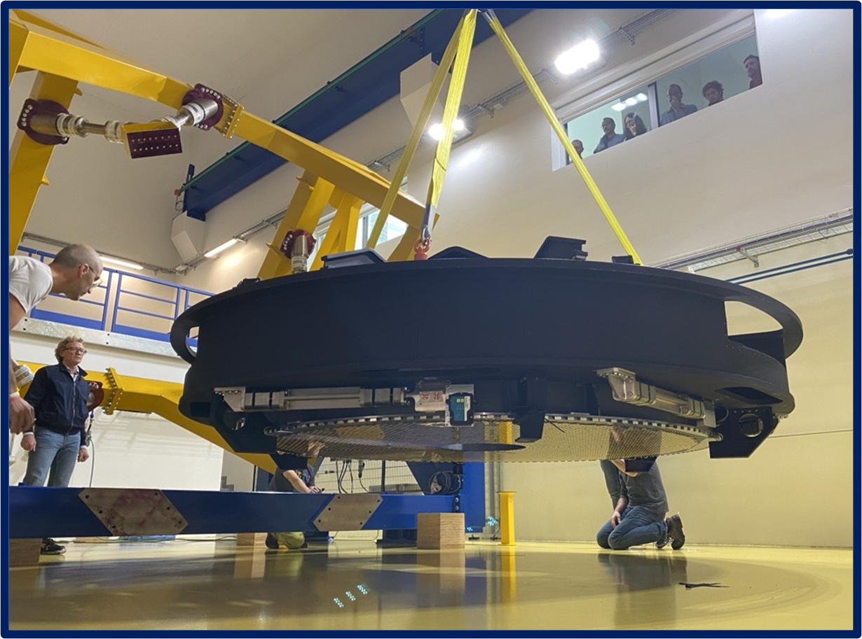
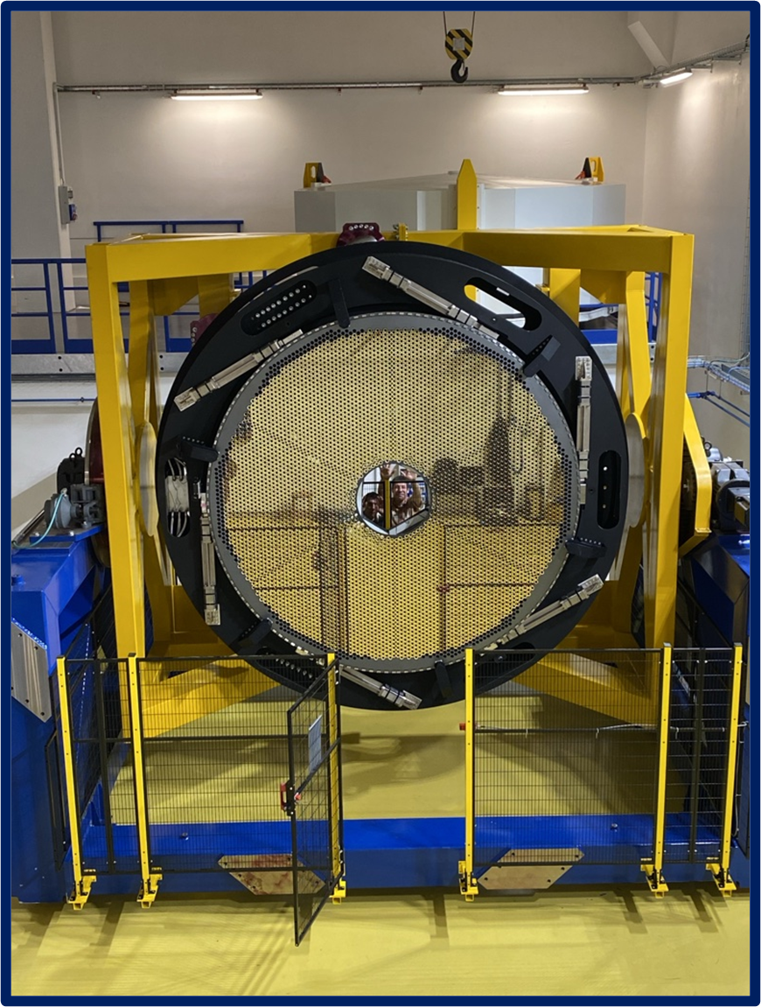
M4 Mirror installed in its stand at Microgate

Slide 6

Credit: B. Häußler/ESO

Slide 7
Suzanne Ramsay – sramsay@eso.org
@ESOAstronomy
@esoastronomy
@ESO
european-southern-observatory
@ESOobservatory

