Slide 1


Cabinet Cooling Controller (CCC)
Claudio Reinero

Slide 2
Introduction
The Cabinet Cooling Control library operates on a Beckhoff PLC, specifically designed to manage temperature regulation within an electronic cabinet.
Its primary function is to regulate the temperature within an electronic cabinet while keeping the door securely closed, thereby minimizing any potential convective airflow that could disrupt observations.
The library implements a control loop, utilizing temperature sensors to monitor conditions, and regulates a valve that manages the coolant flow through the heat exchanger.

Slide 3
Introduction
Inspired by: ESO-288386
“Electronic Cabinet Thermal Control Unit”
Development state
  This device is a newer addition to our suite of PLC libraries.
  As such, it is less mature and may evolve over time. We encourage you to test and provide feedback

Slide 4
Documentation
ESO-320177:
“ELT ICS Framework - Function Control Framework - User Manual”
https://www.eso.org/projects/elt/develop/ifw/IFW-24/ifw-fcf-6.0.0/sphinx/html/docs/start.html

Slide 5
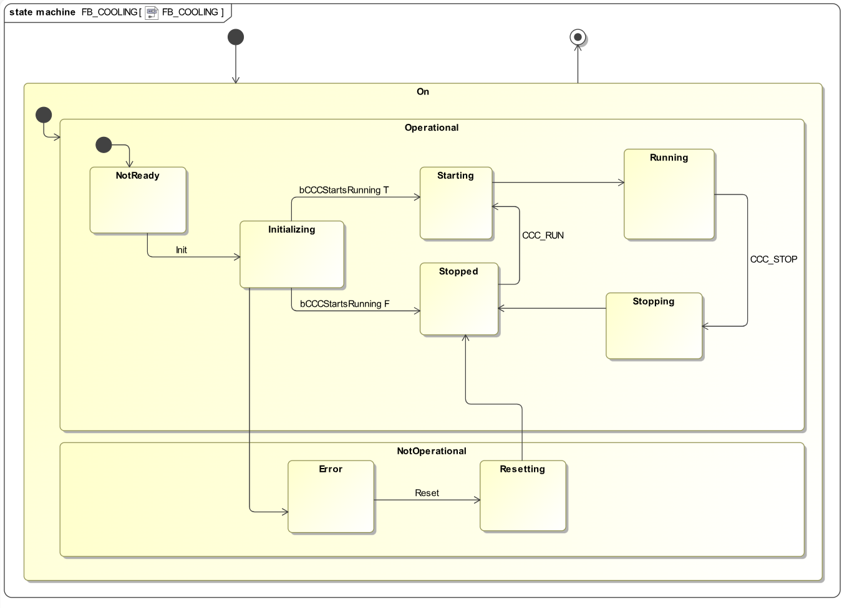
State machine

Slide 6
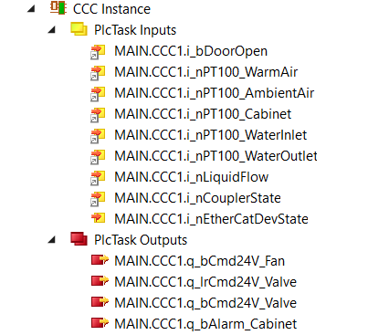
Inputs and Outputs

Slide 7
Valve types
CCC can be configured, via T_COOLING_CFG, to use one of two types of valves
  Open/Close valve
  Multistep valve (analog) for PI control
nValveControlType: INT := 0;
(* Type of valve to be used: 0 = Open/Close, 1 = analog PI controlled *)

Slide 8
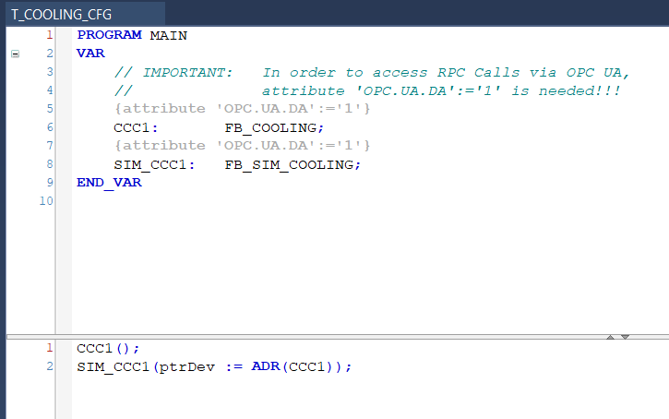
Simulator
A simple simulator is available for the PLC device

Slide 9
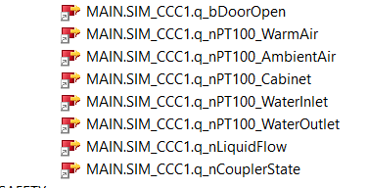
Simulator
Links

Slide 10
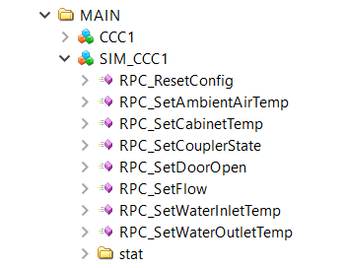
Simulator
RPC calls available

Slide 11
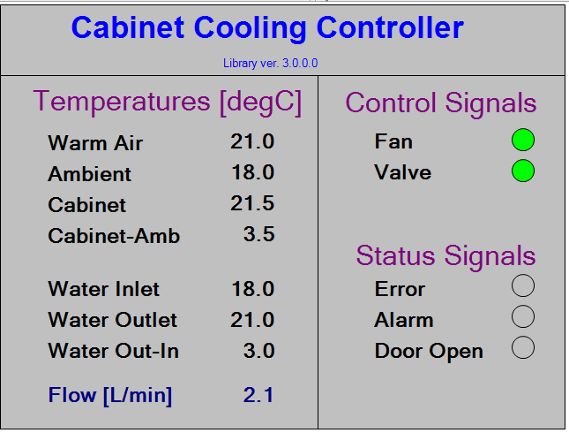
GUI

Slide 12
Logging
CCC makes use of the Event System from Beckhoff
It checks a number of rules to produce an error every cfg.nFaults_WaitTime
- stat.lrTemp_Cabinet > cfg.lrTemp_Cabinet_Max
- stat.lrTemp_Cabinet < cfg.lrTemp_Cabinet_Min
- stat.lrTemp_WaterOutlet - stat.lrTemp_WaterInlet > cfg.lrTemp_Diff_OutIn_Max
- stat.lrTemp_Cabinet - stat.lrTemp_AmbientAir > cfg.lrTemp_Diff_CabAmb_Max
- stat.lrTemp_Cabinet - stat.lrTemp_WaterInlet > cfg.lrTemp_Diff_CabIn_Max
- stat.lrTemp_WaterOutlet - stat.lrTemp_WaterInlet < cfg.lrTemp_Diff_OutIn_Min
- stat.lrTemp_WaterInlet > stat.lrTemp_AmbientAir
- stat.bDoorOpen

Slide 13
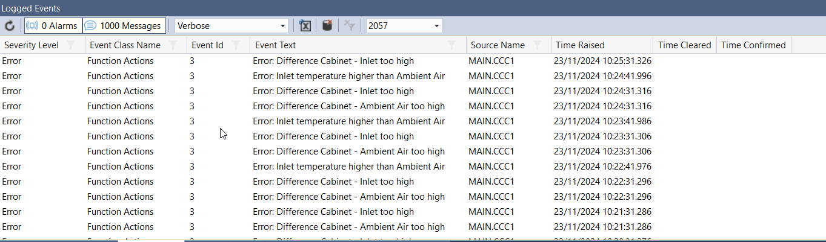
Logging

Slide 14
Alarms
For the time being there is only one electronic alarm

Slide 15
Claudio Reinero
– creinero@eso.org
@ESOAstronomy
@esoastronomy
@ESO
european-southern-observatory
@ESOobservatory

