Slide 1


Cryogenic HMI
Diego del Valle

Slide 2
Introduction
Introduction of a new set of tools to complement Cryogenic Toolkit. Based on Beckhoff TE/TF2000 v1.12.760.59. Deliverables consist of:
  Cryo PLC Example Project: PLC Application
    Cryo Library: PLC Library for standard ESO Cryogenic devices (previous presentation)
    Cryo HMI Library: PLC lib Gateway functions.
  Cryo HMI Template Project: Start-up project to create an HMI Application.
    Cryo HMI Framework Controls: Collection of HMI Framework controls that will interface with Cryo Library
PLC
PLC Application
(Cryo PLC Example Project)
Libraries
Cryo Lib
CryoHmi Lib
ADS
HMI Server TF2000
HMI Application
(Cryo HMI Template Project)
Libraries:
Cryo HMI Framework

Slide 3
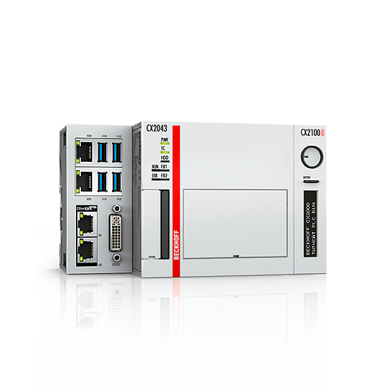
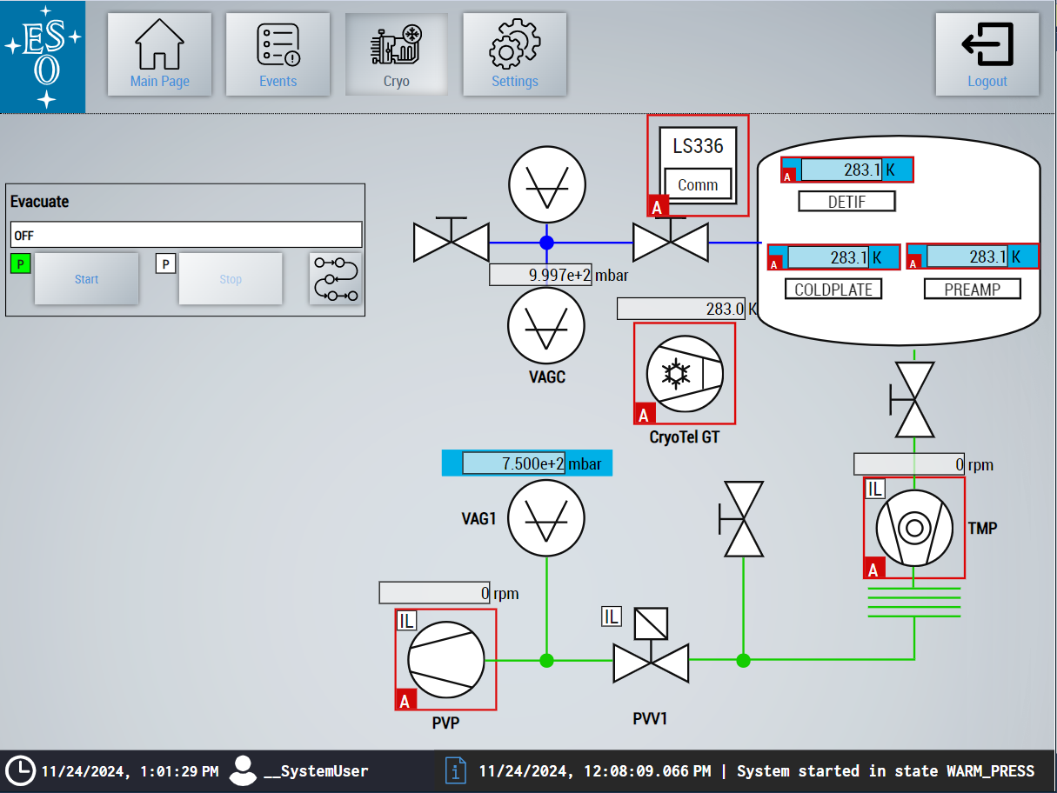
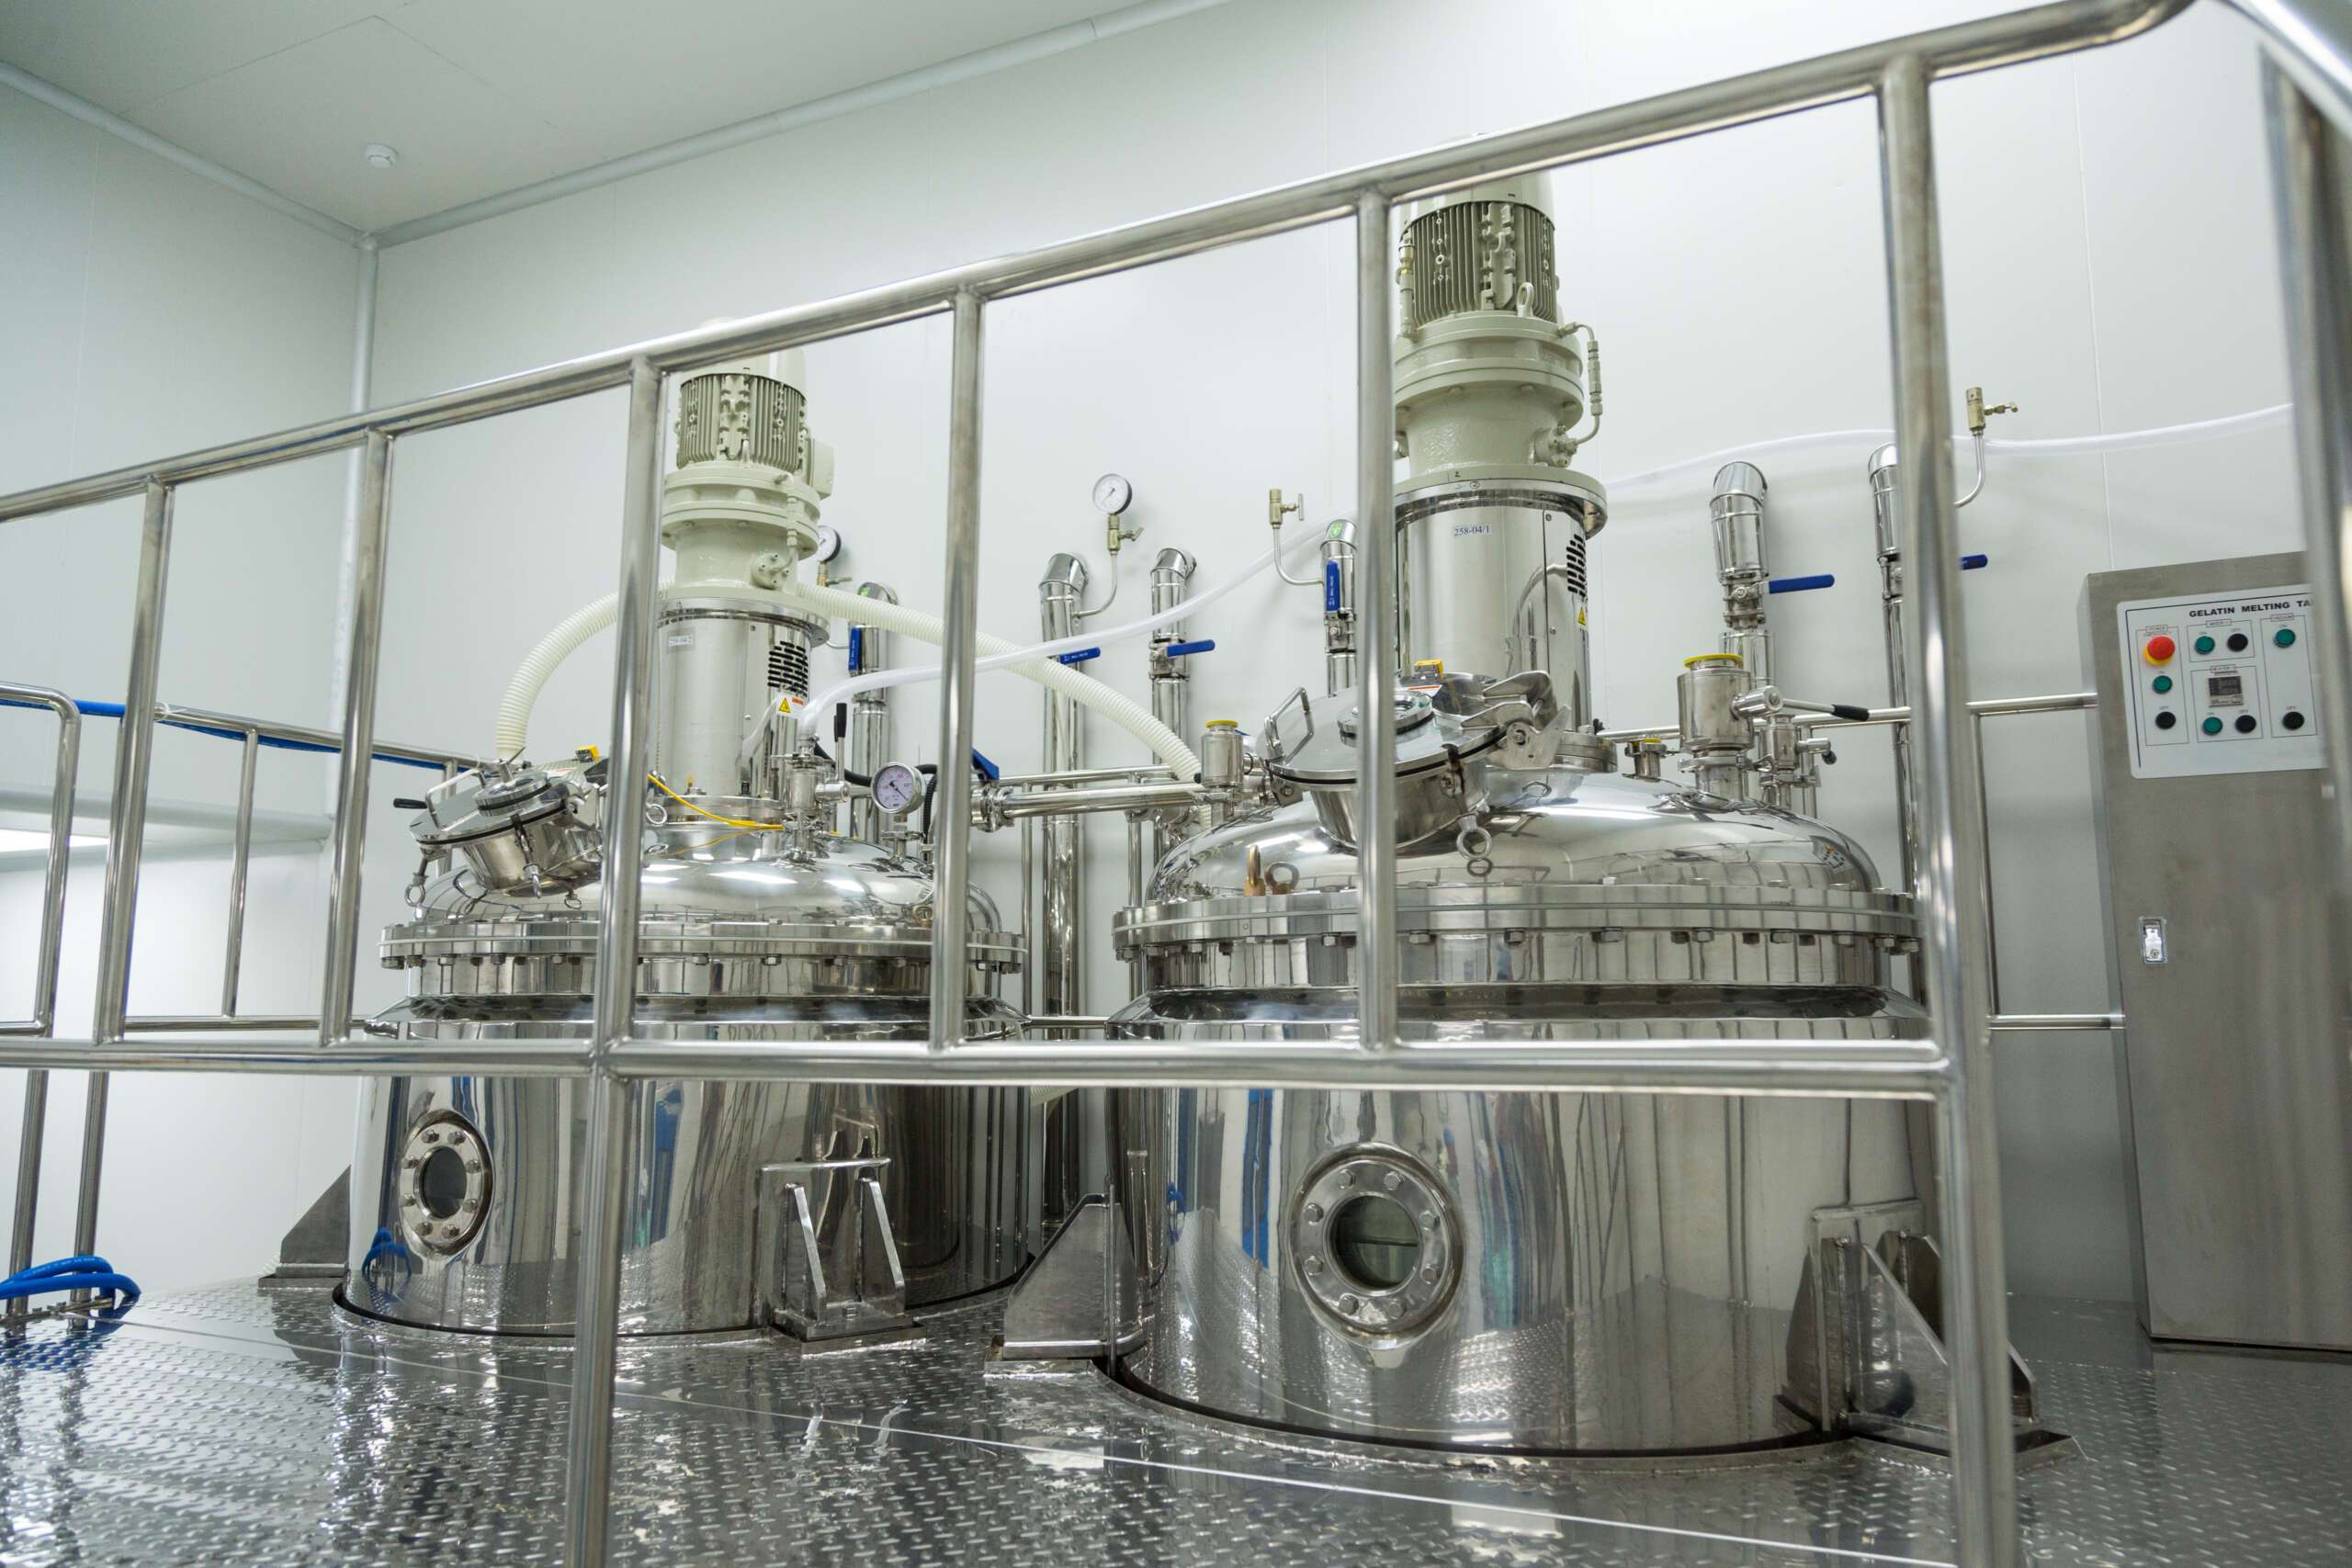
System Overview
It doesn’t replace VISU!

Slide 4
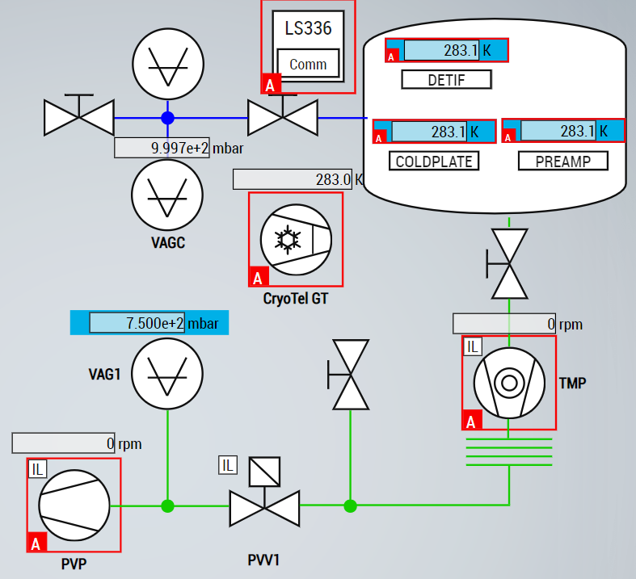
Cryo PLC Example Project
  Starting Point for a PLC Application
  Implements Vacuum vessel 1-50 L volume, based on PDS project.
  Contains ALL Business logic.
  (Almost!) Full HW simulation is available.
  Provides Evacuation sequence.
  Includes Gateway functions to connect to HMI UserControls (cryohmi_1.0.0.0.library).

Slide 5
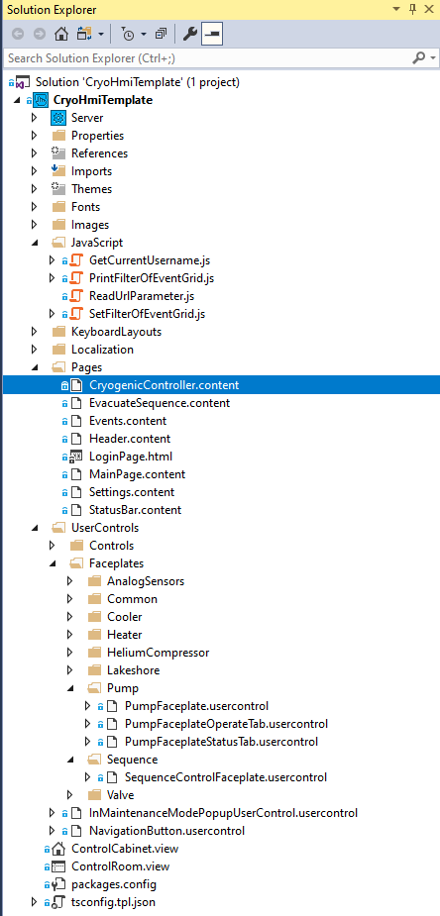
Cryo HMI Template
  Starting point for an HMI Application
  Implements an HMI for CryoPlcExampleProject.
  Gives an intended look and feel of the HMI.
  Provides a project structure.
    Naming Conventions
  No Business Logic! Only makes use of the commands.
  UserControls and Faceplates already created.
  Uses TC Alarm system and EventLogger
  Preconfigured with whitelisting.
PLC
PLC Application
(Cryo PLC Example Project)
Libraries
Cryo Lib
CryoHmi Lib
ADS
HMI Server TF2000
HMI Application
(Cryo HMI Template Project)
Libraries:
Cryo HMI Framework

Slide 6
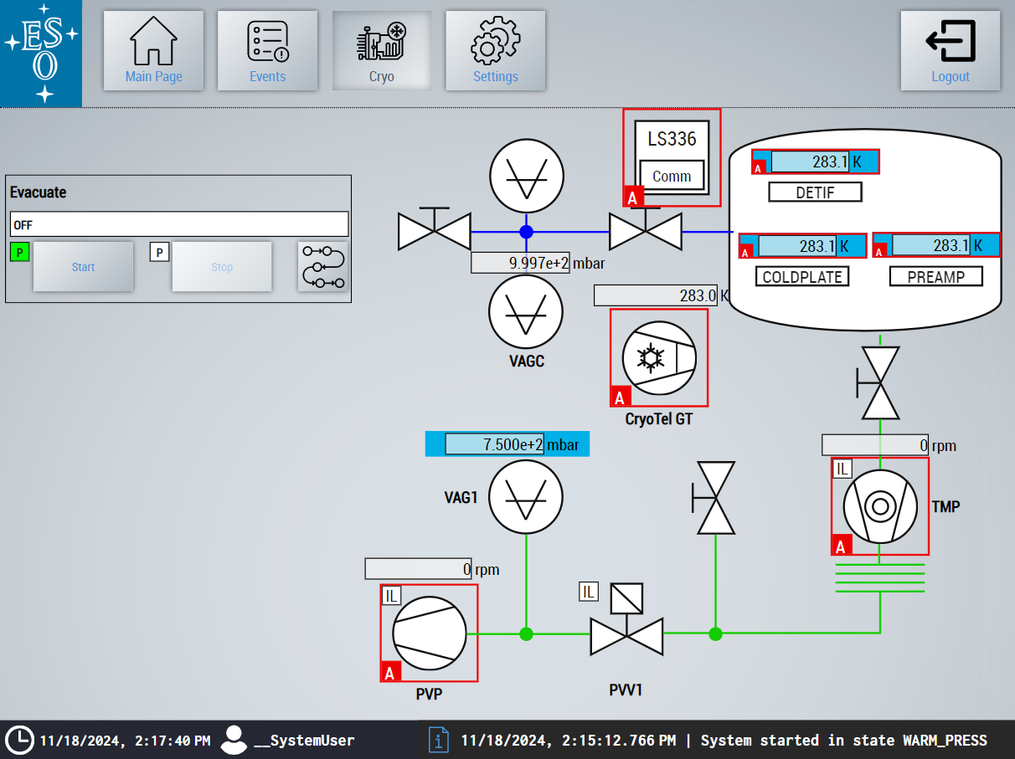
HMI Layout
  Navigation Bar
  Main Content
  Status Bar
    Current Date/Time
    Current User
    Latest created event

Slide 7
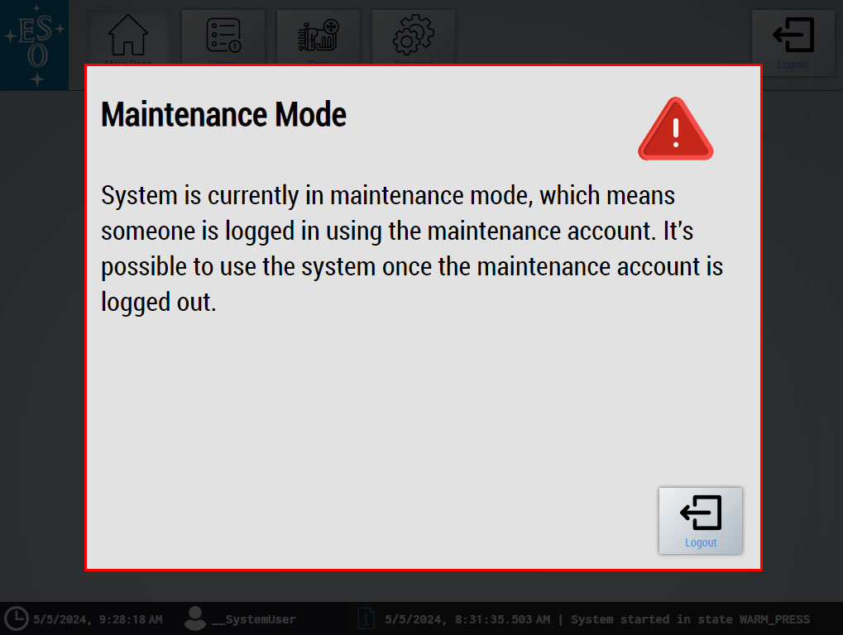
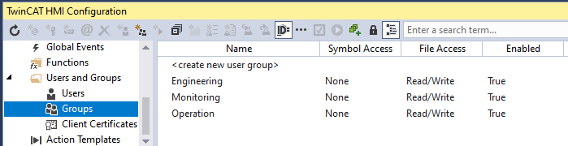
Users and Maintenance Mode
User groups already defined: Engineering, Monitoring, Operation
  Monitoring: Can see the status of the system, no control.
  Operation: Have limited control.
  Engineering: When logged in, all other user will get a popup that fills the whole screen asking them to Log out.

Slide 8
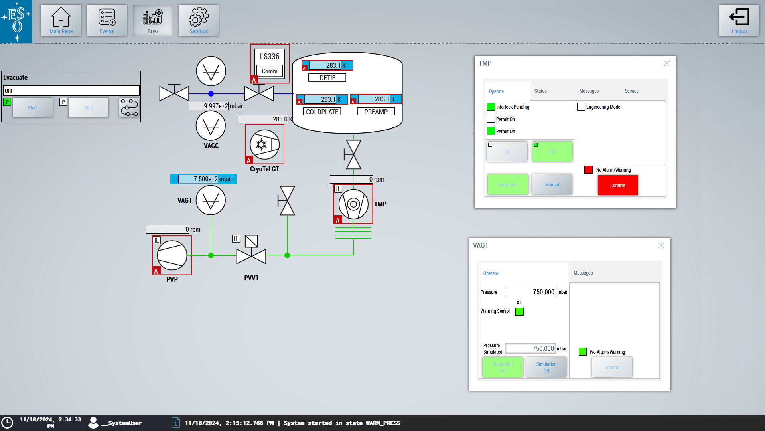
Supported Views
ControlRoom.view (1920x1080)
Not in Scale!
ControlCabinet.view (1024x768)

Slide 9
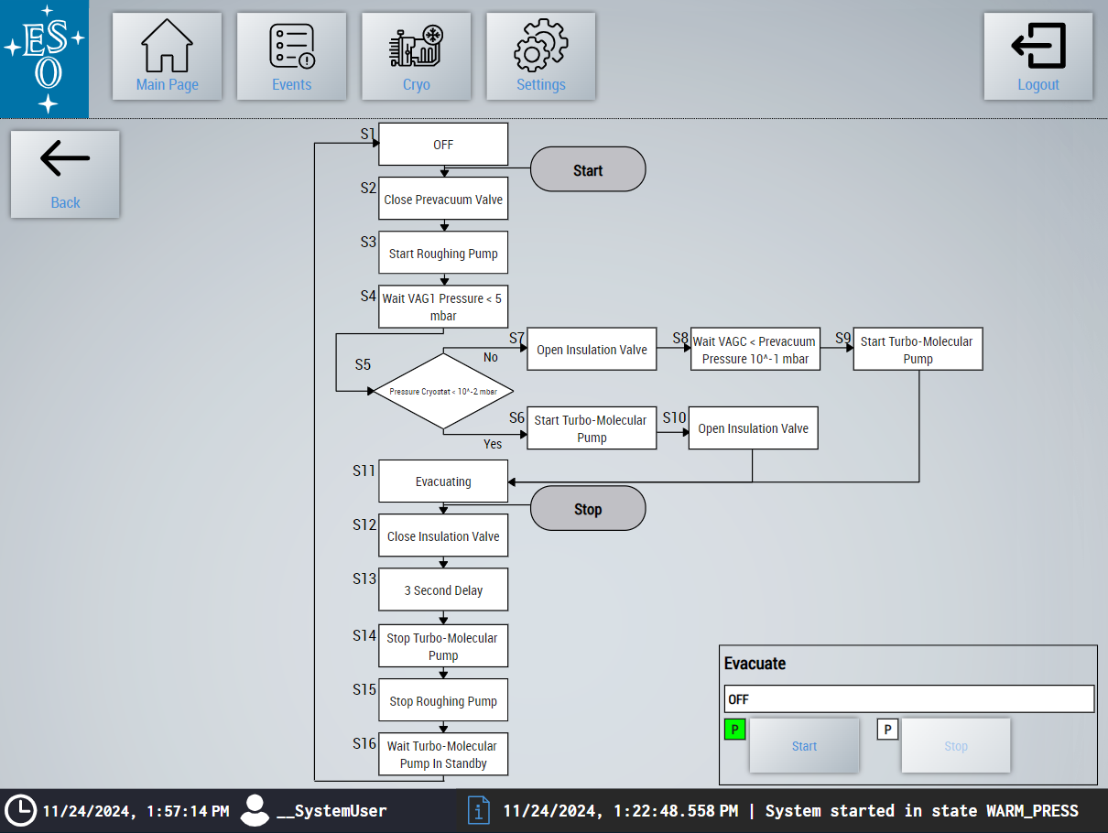
Evacuation Sequence
  Example Sequence provided

Slide 10
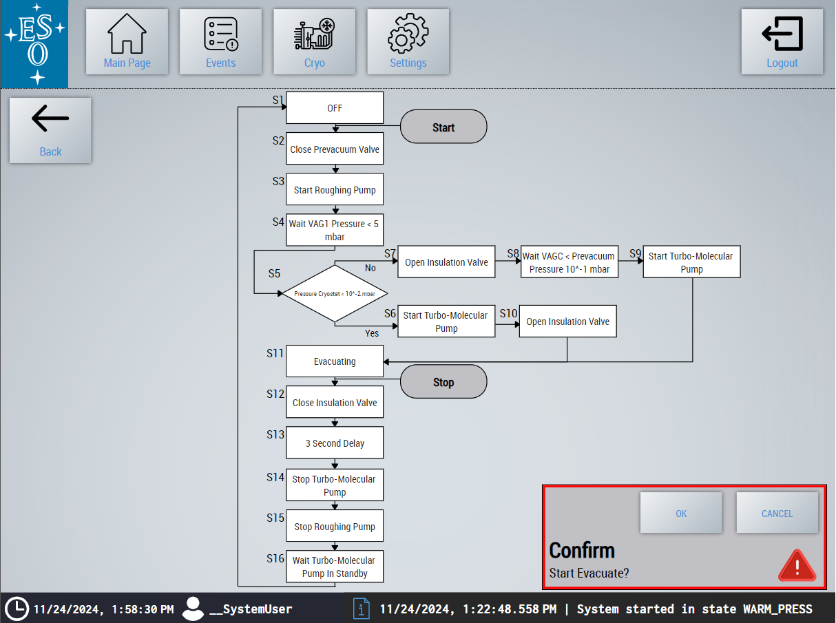
Evacuation Sequence
  Example Sequence provided.
  Start Evacuation has a confirmation step.

Slide 11
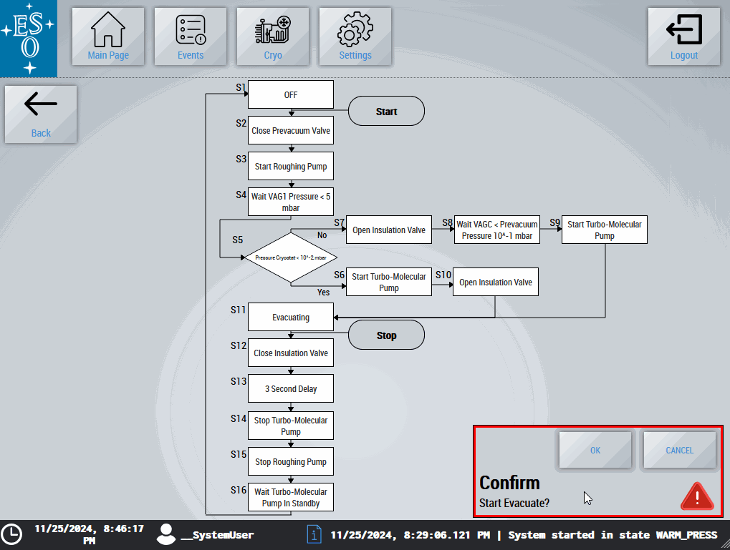
Evacuation Sequence
  Example Sequence provided
  Start Evacuation has a confirmation step.
  Shows the current state of the Sequence.
  Current Step “blinks”

Slide 12
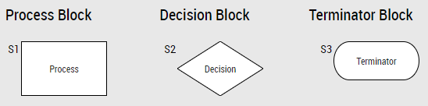
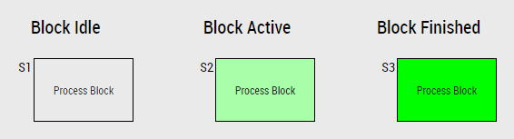
Sequence Blocks
  Implemented on CryoHmiFramework
  Cryogenic application requires sequences for certain procedures (i.e. Evacuation). They can be represented with a subset of flowchart Blocks: Process, Decision and Terminator.
  All of them can be in any of 3 different states: Idle, Active and Finished

Slide 13
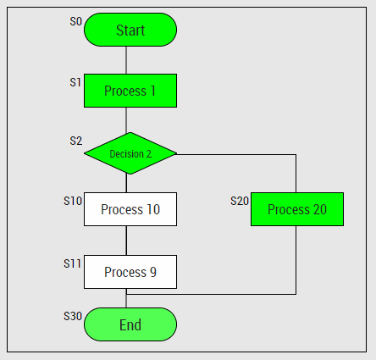
Sequence Container
  Sequence Container Framework Control inherits the TE2000 Container capabilities.
  Sequence Containers also allow the user to interface with the PLC sequence by using a custom json-schema named Sequence Object.
  The container will take care of displaying the current state of a PLC sequence, given that the Sequence in the PLC code uses the Sequence Object.

Slide 14
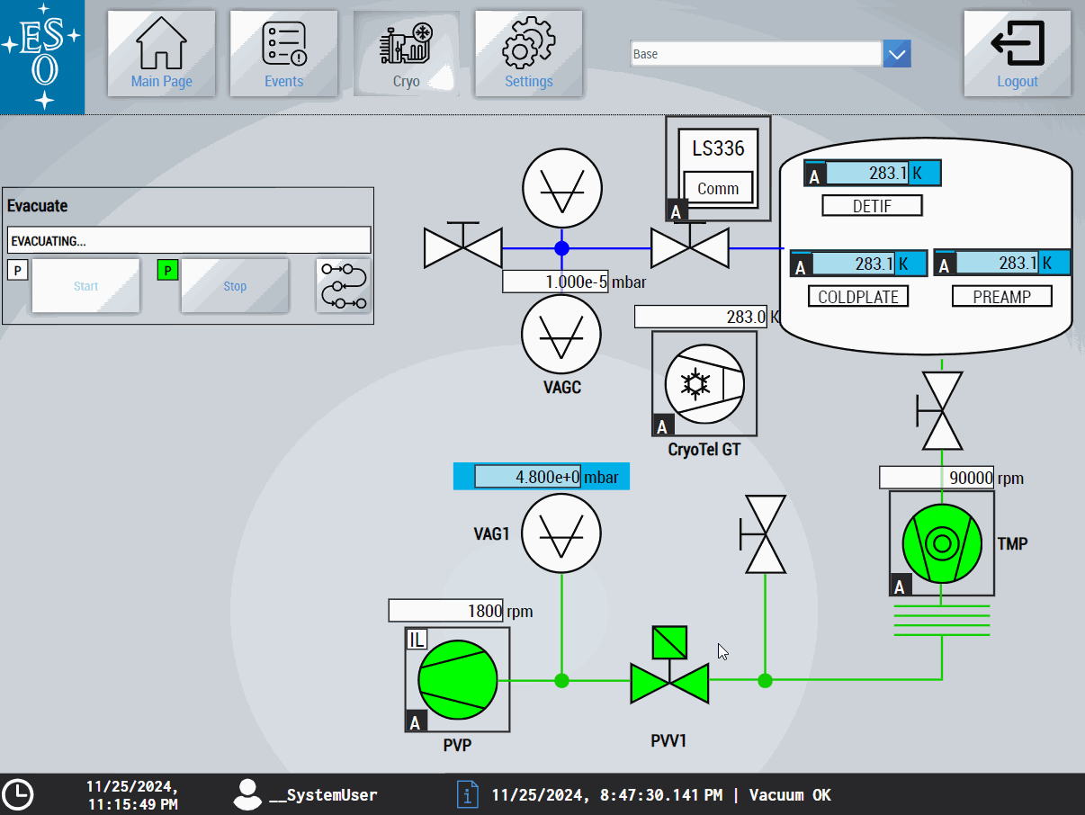
Dark Mode

Slide 15
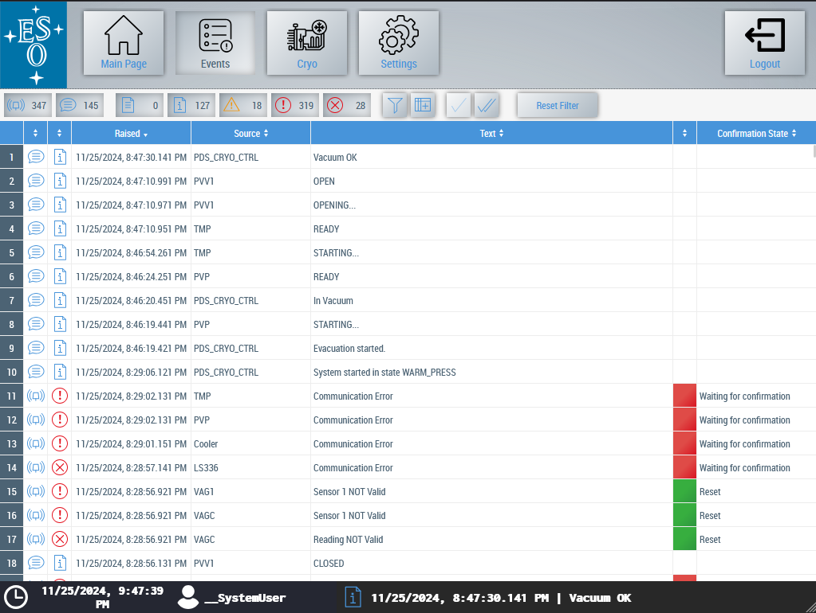
Event Logger
  Each device make use of event system:
    TC Alarm FB
    TC Message FB
  Can be used to confirm Alarms.

Slide 16
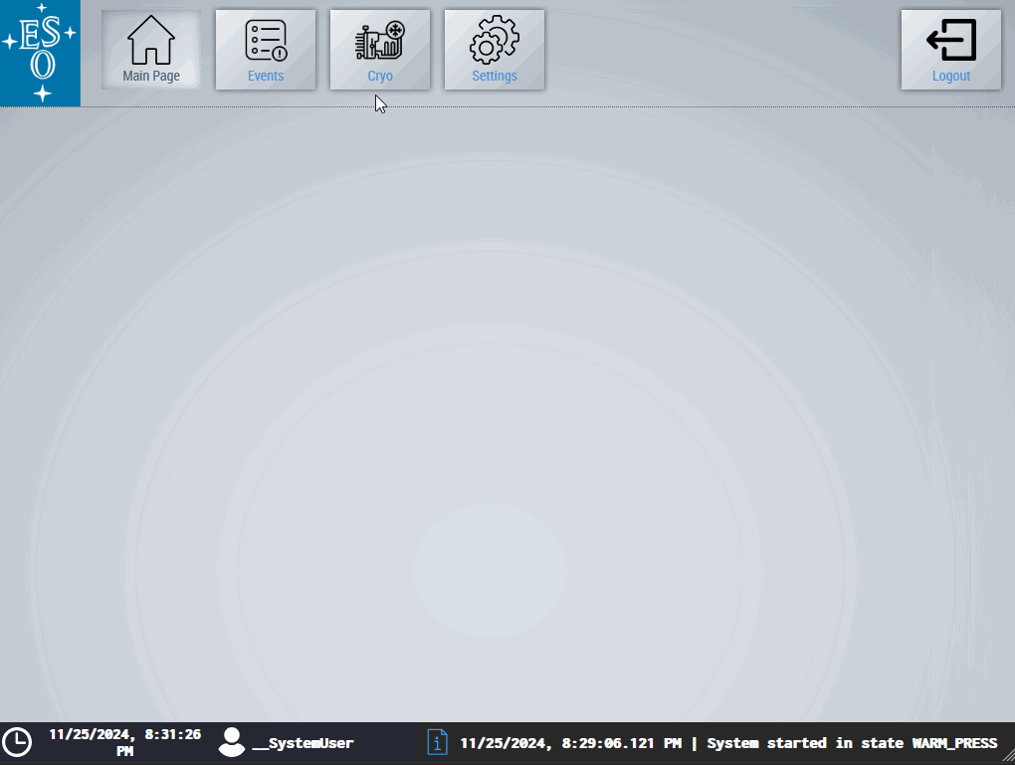
Cryogenic Devices
  Representation of a Cryogenic System.
  Diagram made of:
    Controls
    Faceplates
  Allows interaction with devices.
  Interface via Gateway Function.

Slide 17
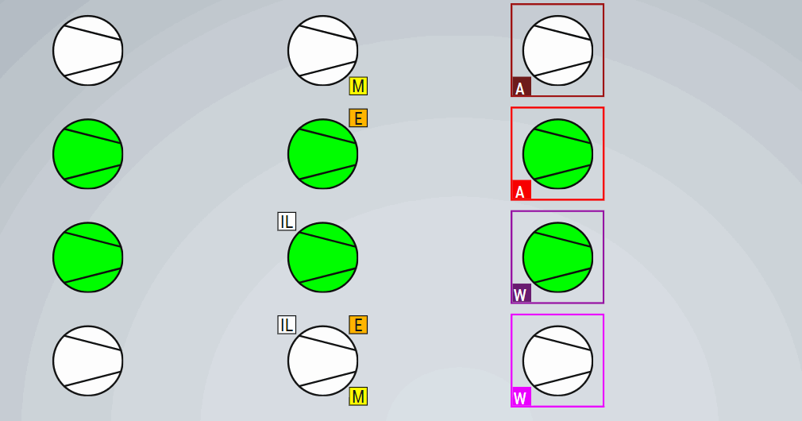
Controls
States
Info
Events
  Symbolic representation of Device and its states
Off
Manual
Alarm Raised
Starting
Engineering
Alarm Confirmed
On
Interlock
Warning Raised
Stopping
Warning Confirmed

Slide 18
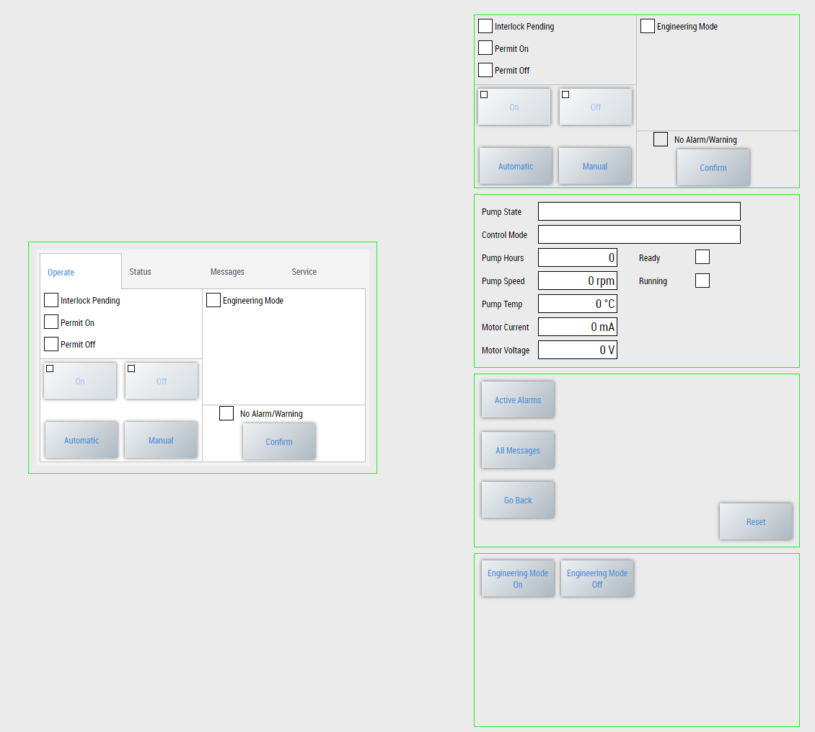
Faceplates
  Provide control and in-depth information of the devices.
  Created as UserControls.
  Used as Pop-Up windows.
  Show all common Values of a device type.
  PumpFaceplate:
    PumpOperateTab
    PumpFaceplateStatusTab
    FaceplateMessageTab (common)
    FaceplateServiceTab (common)

Slide 19
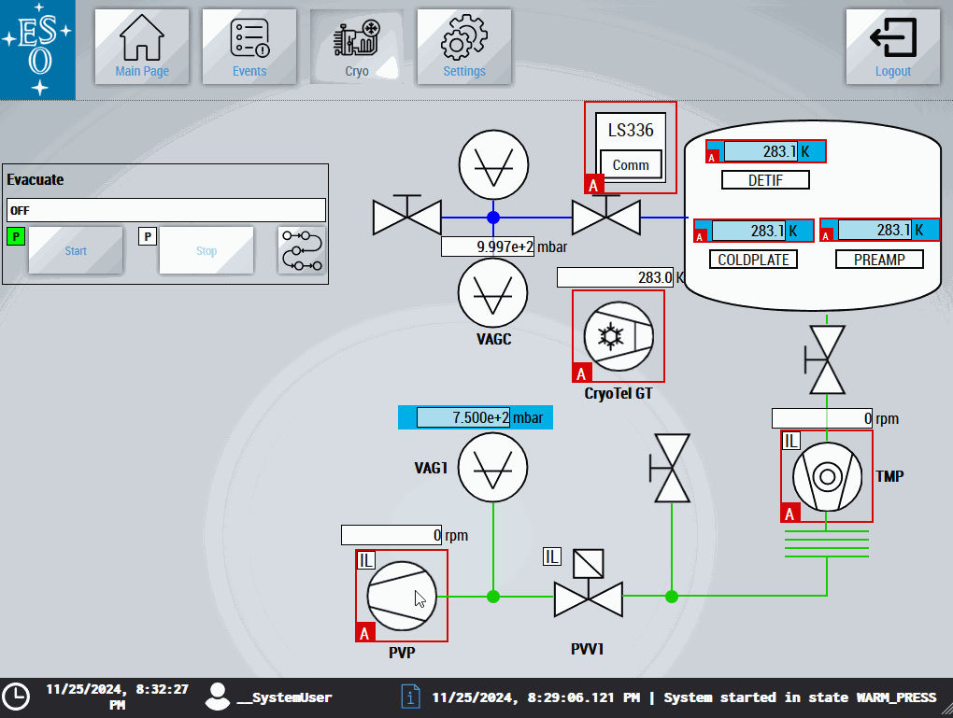
Faceplates and Events
  Device Alarms can be confirmed.
  EventLogger filters:
    Show Active alarms
    Show All messages related to the device.
    Reset Filters

Slide 20
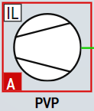
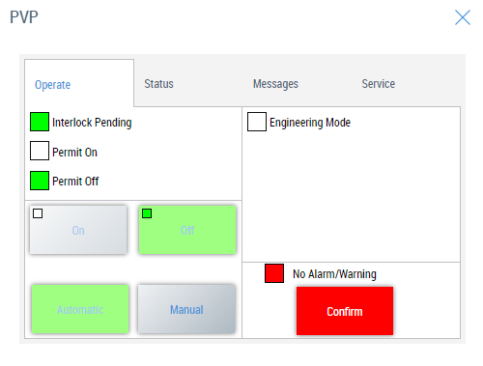
Gateway Functions
  Defines the devices default interface to the HMI Application
PLC Application
(Cryo PLC Example Project)
HMI Application
(Cryo HMI Template Project)
Pump
Pump GW

Slide 21

Cryo HMI Framework Controls
Framework controls are user-specific controls that are not created with the graphical WYSIWYG editor. Framework controls are used if the desired behavior cannot be mapped with the standard controls or a user control. […] a framework control can be used independently of the HMI project, so that the source code can be reused.

Slide 22
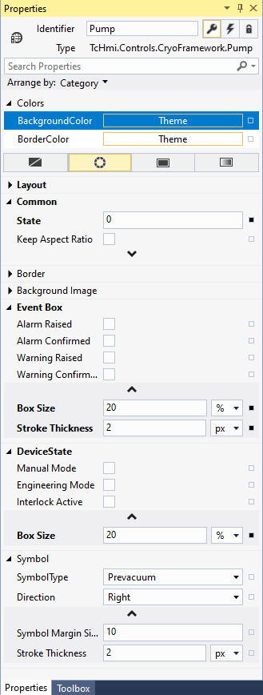
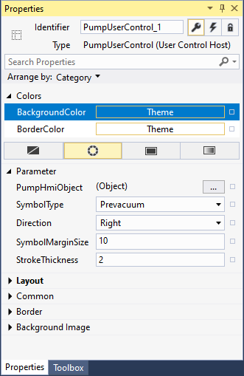

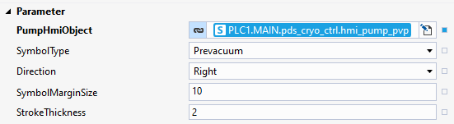
Framework Controls vs UserControls
  Framework Control
  User Control
  Basic Data Types
  More Flexibility and tailored for our use case.
  Export as Nuget packages
  Harder to implement
  Wrappers of Framework Controls
  They interface directly with PLC Gateway functions
  Easy to Use
  Can’t Export
FB_HMI_CRYO_PUMP

Slide 23
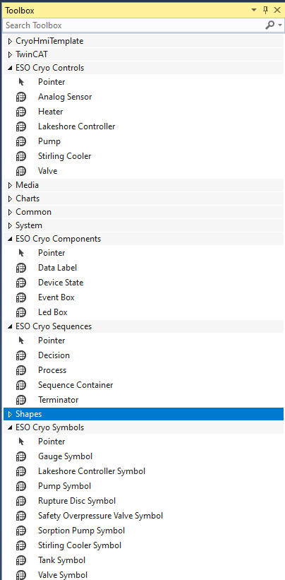
Cryo HMI Framework Controls
PLC
  Framework Controls are separated into four categories
    Symbols
    Components
    Controls
    Sequences
PLC Application
(Cryo PLC Example Project)
Libraries
Cryo Lib
CryoHmi Lib
ADS
HMI Server TF2000
HMI Application
(Cryo HMI Template Project)
Libraries:
Cryo HMI Framework

Slide 24
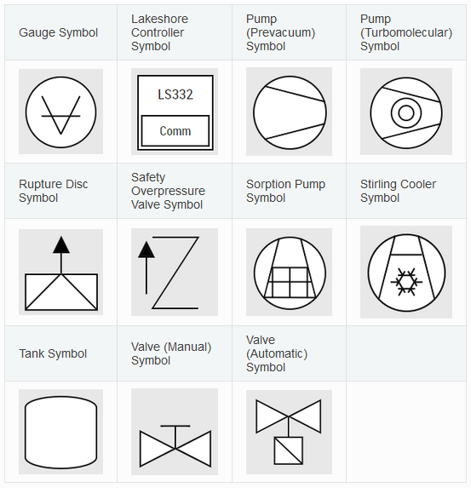
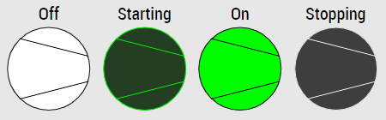
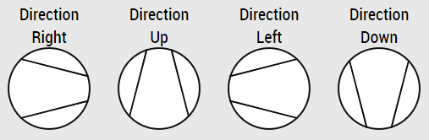
Symbols
  11 Symbols are currently supported.
  They support 4 states.
  Can be rotated on 90 degrees step.
  Vectorial graphics (SVG)
Notes:
Image representation of a Cryogenic device. They all share a common functionality with respect of the composition of the image and its attributes

Slide 25
Symbols Interface
Parameters that can be internally modified or mapped to PLC values.
Name | Group | Description | Availability
Stroke Thickness | Shape | Thickness of the Stroke (default: 1) | All
State | Common | Defines the state of the Symbol: Off, Starting, On, Stopping | All
Value | Common | Text shown on Lakeshore Controller (default: empty) | Lakeshore Controller
Symbol Type | Common | Alternative Symbol to show. Pump: Prevacuum or Turbomolecular; Valve: Auto or Manual. | Only with Pump and Valve Symbol
Direction | Common | Defines the direction the symbol will be drawn: Up, Down, Left, Right (default: Up) | Disabled in Gauge and Lakeshore
Name | Group | Description | Availability
Drawing Stroke Color | Colors | Color of the Drawing Stroke (default: rgb(15, 15, 15), dark: rgb(92, 92, 92)) | All
Drawing Transition Color | Colors | Transition color when state is Starting or Stopping (default: rgb(40, 40, 40), dark: rgb(53, 53, 53)) | All
On Fill Color | Colors | Sets the color that represents On State (default: rgb(0, 255, 0), dark: rgb(1, 165, 1)) | All
Off Fill Color | Colors | Sets the color that represents Off State (default: rgb(255, 255, 255), dark: rgb(255, 255, 255)) | All
Text Font Size | Text | Size of the Font of the Value Attribute (default: 12) | Lakeshore Controller
Text Comm Font Size | Text | Size of the Font for the text on “Comm” rectangle (default: 12) | Lakeshore Controller

Slide 26
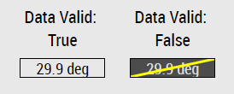
Components – Data Label
  Control that extends the functionality of TE2000 Textblock. It has a flag Data Valid which makes the Control turn grey and adds a crossing yellow line to show the user that whatever data is being displayed it’s not valid anymore.
Name | Group | Description
Data Valid | Common | Data Flag for Validity
Data Invalid Text Color | Colors | Text Color when flag Data Valid: False
Data Invalid Stroke Color | Colors | Crossing line stroke color when flag Data Valid: False
Data Invalid Background Color | Colors | Background Color when flag Data Valid: False
Data Label Interface Table
Notes:
Reusable framework controls that are available primarily to be used in a control composition, but that may also be used individually.

Slide 27
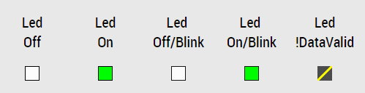
Components – Led Box
  Multipurpose Box that acts as the bare minimum as a LED to show state On and Off with the user selected state colors.
Name | Group | Description
Data Valid | Common | Data Flag for Validity
State | Common | Flag for On/Off State
Blink | Common | Flag to show LedBox blinking. Colors will depend on State flag
On Fill Color | Colors | Led Box color when State: True and DataValid: True.
Off Fill Color | Colors | Led Box color when State: Off and DataValid: True
Led Box Interface Table

Slide 28
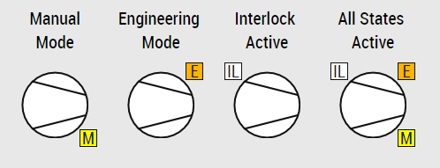
Components – Device State
Shows the user a specific set of device states by adding decoration boxes at the corner of a device symbol. The states are:
  Manual Mode
  Engineering Mode
  Interlock Active
Name | Group | Description
Manual Mode | Common | Device Manual Mode On/Off
Engineering Mode | Common | Device Engineering Mode On/Off
Interlock Active | Common | Interlock is currently Active
Box Size | Shape | Sets the size of the boxes in Pixels or by a percentage all 3 states: Manual, Engineering and Interlock Active (default: 20 %).
Device State Interface Table

Slide 29
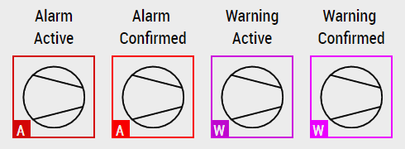
Components – Event Box
  Representation of the raised/confirmed events of the system: Alarm and/or a Warning.
  If an alarm or warning are active, the control will blink between the event color and black to alert the users of the new event. If the event is confirmed, then the control will stop blinking
Name | Group | Description
Alarm Raised | Common | Alarm Raised State (Active or Not)
Alarm Confirmed | Common | Alarm Confirmed State (Active or Not)
Warning Raised | Common | Warning Raised State (Active or Not)
Warning Confirmed | Colors | Warning Confirmed State (Active or Not)
Text Box Size | Shape | Sets the size of the lower left box in Pixels or by a percentage of the Control minimum side length (default: 20 px).
Stroke Thickness | Shape | Thickness of the rectangle that shows Alarm/Warning state. (default: 2 px)
Event Box Interface Table
Don’t mind the 4th pump background glitch!

Slide 30
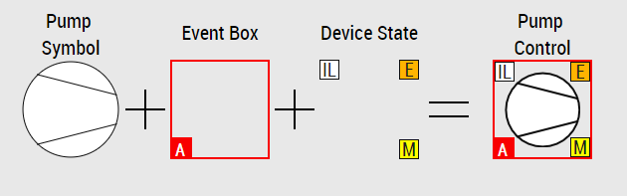
Controls
  Generated by a composition of other Cryo HMI Framework Controls: Symbol, Event Box and Device State.
  With the exception of Analog Sensor. All Controls share common traits. They all have a Symbols that go through 4 different states: Off(0), Starting(1), On(2) and Stopping(3). They also show Alarms and Warning with an Event Box. And finally, they all show their device state through their Device State components
Notes:
High level representation of a Cryogenic Device

Slide 31
Controls Common Interface
Name | Group | Description | Availability
State | Common | INT value that represents the state of the device: Off(0), Starting(1), On(2) and Stopping(3) | All
Keep Aspect Ratio | Common | Maintains a square shape of the Control regardless of the actual size. Recommended value: True | All but Heater Control
Alarm Raised | Event Box | Alarm Raised State (Active or Not) | All
Alarm Confirmed | Event Box | Alarm Confirmed State (Active or Not) | All
Warning Raised | Event Box | Warning Raised State (Active or Not) | All
Warning Confirmed | Event Box | Warning Confirmed State (Active or Not) | All
Box Size | Event Box | Sets the size of the box in Pixels or by a percentage of the Control minimum side length (default: 20 %). | All
Stroke Thickness | Event Box | Thickness of the rectangle that shows Alarm/Warning state | All
Name | Group | Description | Availability
Manual Mode | Device State | Device Manual Mode On/Off | All
Engineering Mode | Device State | Device Engineering Mode On/Off | All but Lakeshore Controller
Interlock Active | Device State | Interlock is currently Active | All
Box Size | Device State | Sets the size of the boxes in Pixels or by a percentage all 3 states: Manual, Engineering and Interlock Active (default: 20 %). | All
Direction | Symbol | Selects Direction of the Symbol | All but Lakeshore Controller
Symbol Margin Size (%) | Symbol | Specifies the margin size of the Symbol with respect of the control. Values over 50% won’t make sense | All
Stroke Thickness | Symbol | Symbol Stroke Thickness in pixels (px) | All

Slide 32
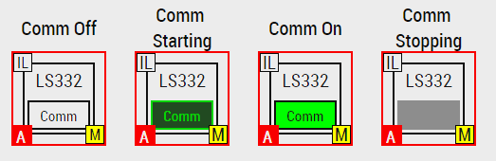
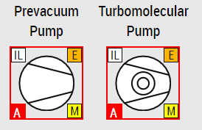
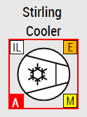
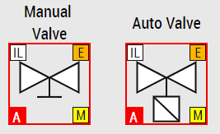
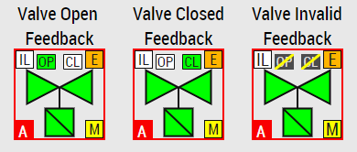
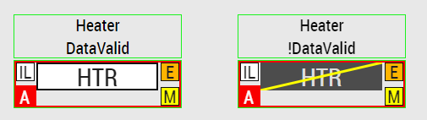
Controls
  Lakeshore Controller
  Pump
  Stirling Cooler
  Valve
  Heater

Slide 33
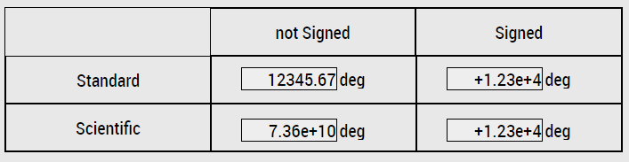
Analog Sensor
  It is basically a super powered numeric label that contains many extras for sensor data display.
  The control allows to select between Standard and Scientific notation and to include the sign in any case.

Slide 34
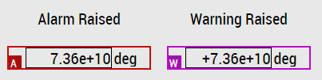
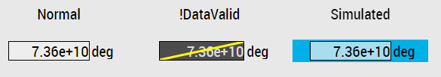
Analog Sensor
  It also supports Event Box
  If the device is in Simulation State, it’ll show a light blue color on the background. It also supports data validity with the same functionality as Data Label.

Slide 35
Analog Sensor
Name | Group | Description
Value | Common | Sensor reading value to be displayed
Notation | Common | Shows numeric value Normal or with Scientific Notation
Decimals | Common | Number of decimals to show in the value.
Signed | Common | Flag to enable plus (+) sign of the value to appear even when it’s a positive value.
Simulated | Common | Flag show a light blue background on this controller to provide visual information that the sensor is in simulation.
Data Valid | Common | Flag for data validity. It works as Data Label.
Unit | Common | Unit Text to be shown next to the value label.
Unit text box Width | Common | Percentage (%) of the horizontal space of the total control used to show the units of the value.
Analog Sensor Interface Table

Slide 36
More information
  Official documentation:
    https://ftp.eso.org/pub/elt/repos/docs/ICS/public/
  CryoHMI specific documentation:
    https://ftp.eso.org/pub/elt/repos/docs/CRYO/framework
    https://ftp.eso.org/pub/elt/repos/docs/CRYO/template

Slide 37
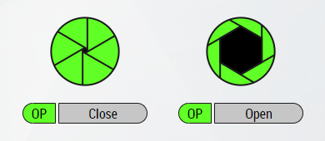
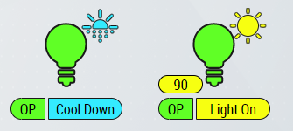
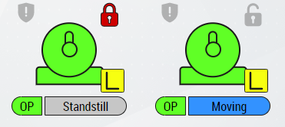
Future Plans on IFW
  Bring to FCS what we have learned.
  Already three devices implemented.
    Shutter
    Motor
    Lamp
  FCF devices are more complex: new ways of displaying information
Shutter
Lamp
Axis Disabled
Motor
Axis Enabled

Slide 38


What’s next
  Follow the development of CryoLib
  Porting to TC 3.1.4026
    TE2000 1.12 1.14
    UserControls (& More) exporting to NuGet package!

Slide 39
Diego del Valle – ddelvall@eso.org
@ESOAstronomy
@esoastronomy
@ESO
european-southern-observatory
@ESOobservatory

