Slide 1


Cryogenic Controller SW Toolkit (PLC Library)
Dan Popovic

Slide 2
What is Cryogenic Controller Toolkit?
Set of FBs for control of standard ESO cryogenic system components.
Based on EtherCAT technology and Beckhoff PLCs.
Provides control solutions for common components and subsystems as defined in Vacuum and Cryogenics Standard Components, ESO-046147 Version 6
The toolkit does not provide a control system.
Design and safety are responsibility of the designer.
Examples of control systems and subsystems based on the Toolkit are available.
They can be used as the starting point for new Cryo projects.

Slide 3
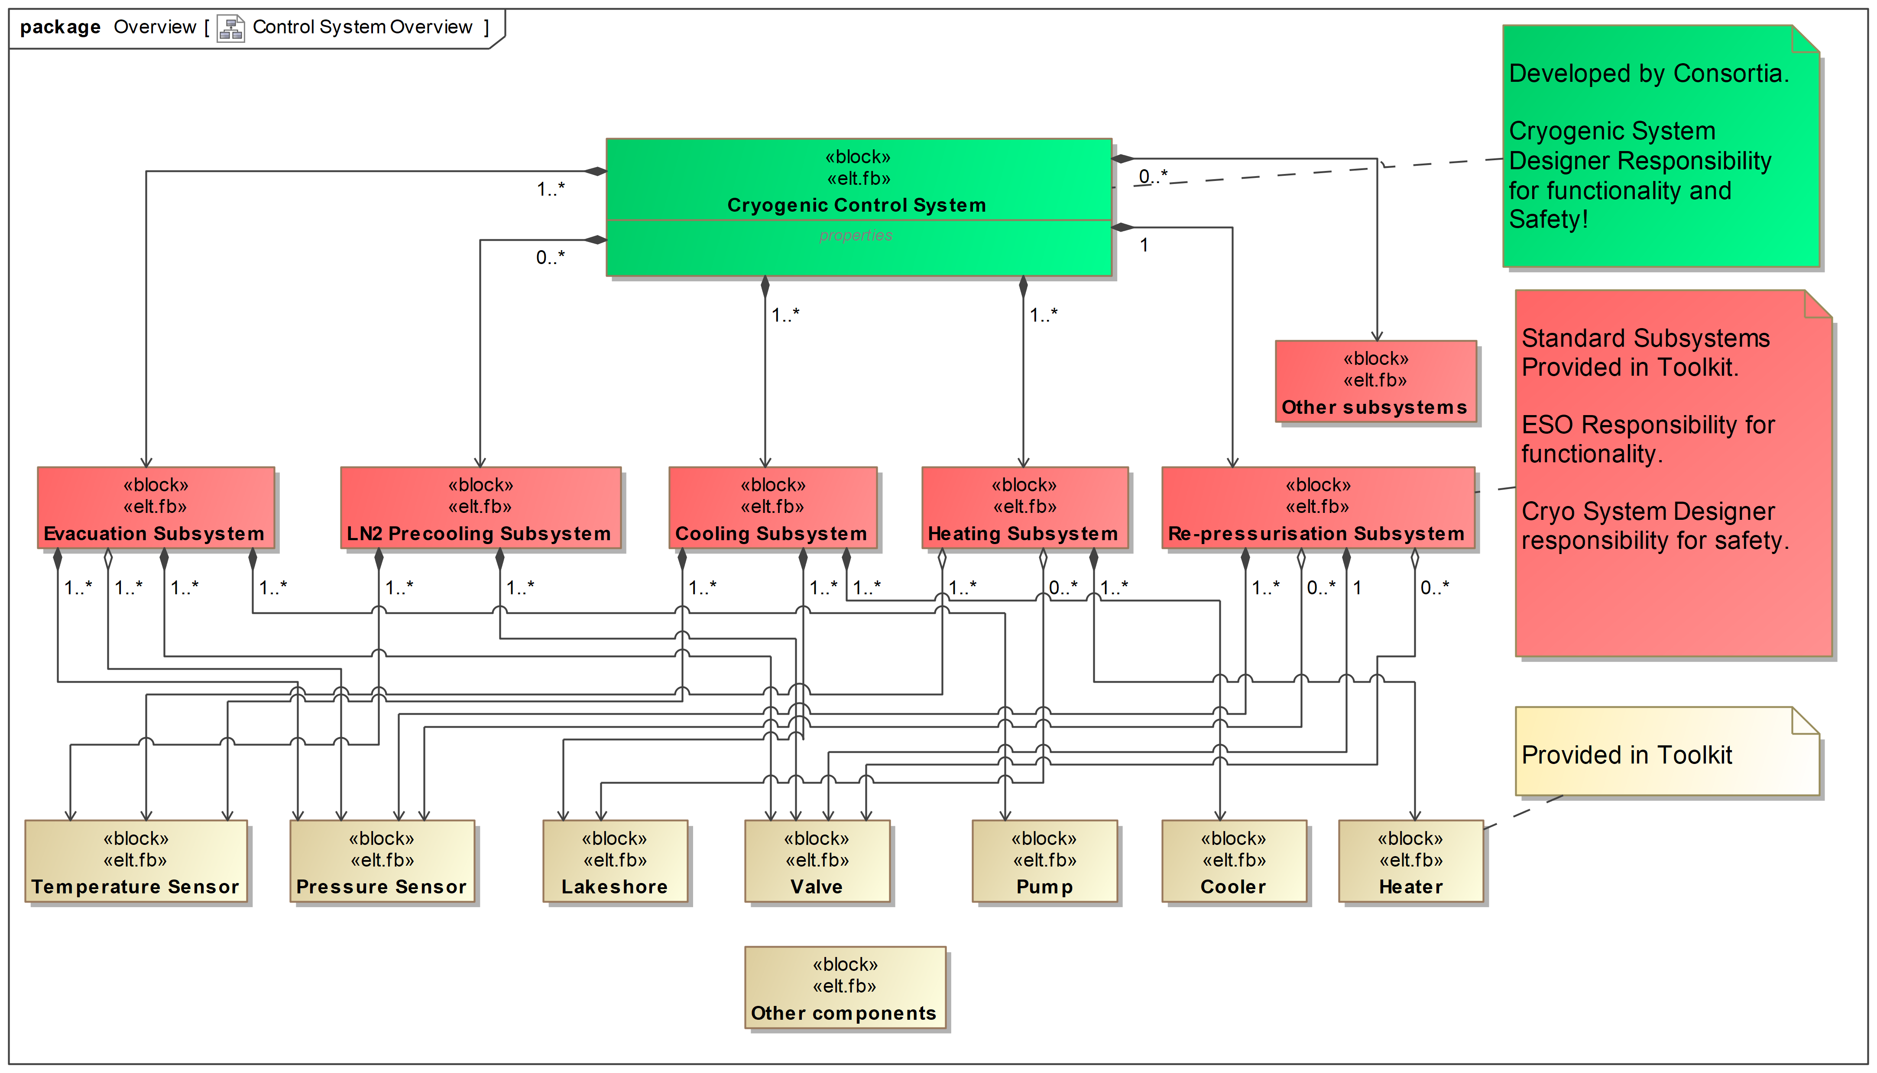
SW Toolkit Overview

Slide 4
Cryo Related PLC Libraries
cryo.library // Cryo components
FB_CRYO_*
cryohmi.library // Interface to HMI
FB_HMI_CRYO_*

Slide 5
SW Toolkit Components
Analog sensors – temperature, pressure, flow
Valves
Pumps
Coolers and Compressors
Heaters
Evacuation systems (currently only 50L and 50,000L)
Lakeshore (rsComm* libraries)
etc.
Note: Components are OPERATIONAL on boot!

Slide 6
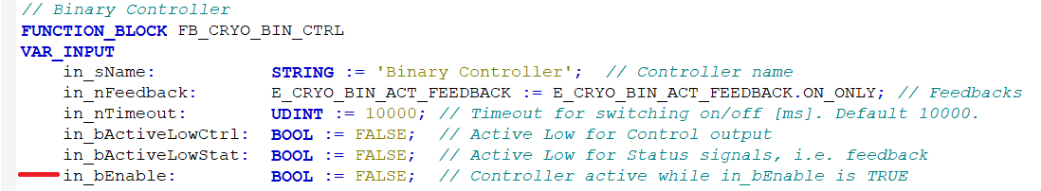
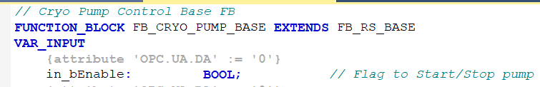
in_bEnable Concept
in_bEnable input parameter is used to control components, e.g.,
ON/OFF, OPEN/CLOSE, START/STOP, etc.
Control loops can be disabled, e.g., heater during evacuation.

Slide 7
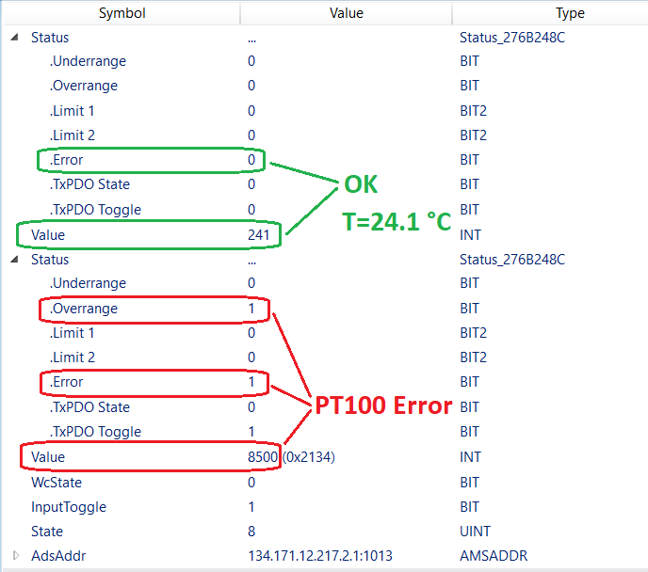
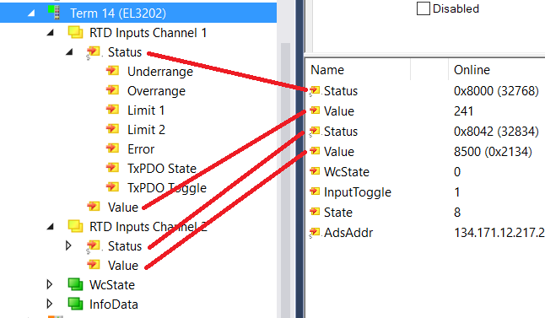
TwinCAT Analog Sensor Process Data

Slide 8
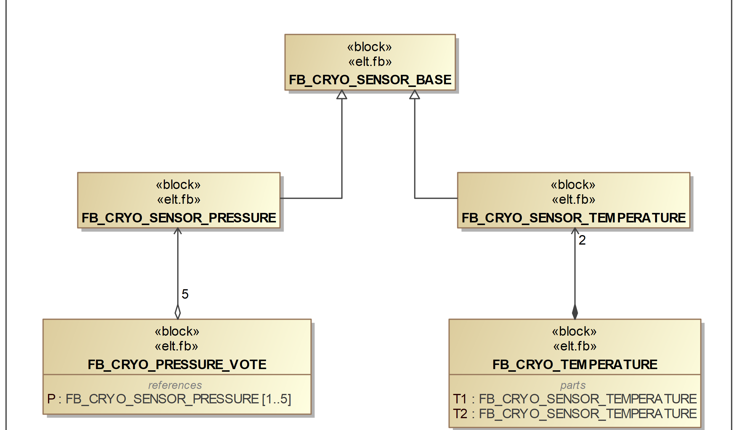
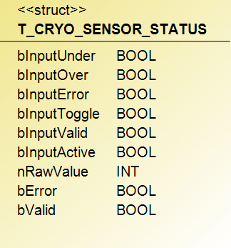
Analog Sensors

Slide 9
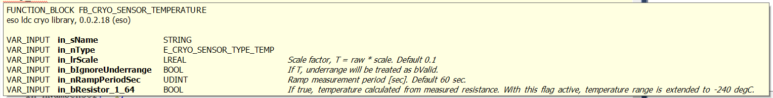
FB_CRYO_SENSOR_TEMPERATURE
Provides temperature in C and K
Provides temperature ramp
By default, Beckhoff supports PT100 temperatures down to -200 C.
By reading resistance (in_bResistor_1_64 = TRUE), range extended down to -240 C.
CoE 0x80n00:19 "RTD element“ must be set to “Resistor 1/64 Ohm”.

Slide 10
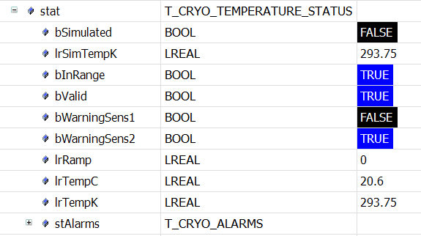
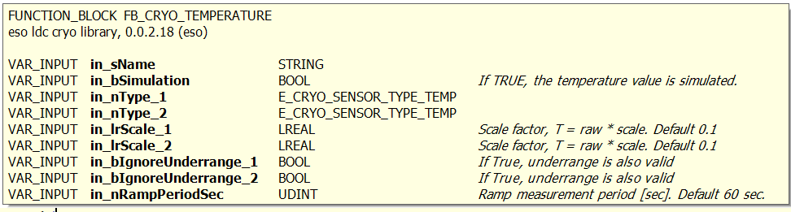
FB_CRYO_TEMPERATURE
Supports two temperature sensors
Takes first Valid reading

Slide 11
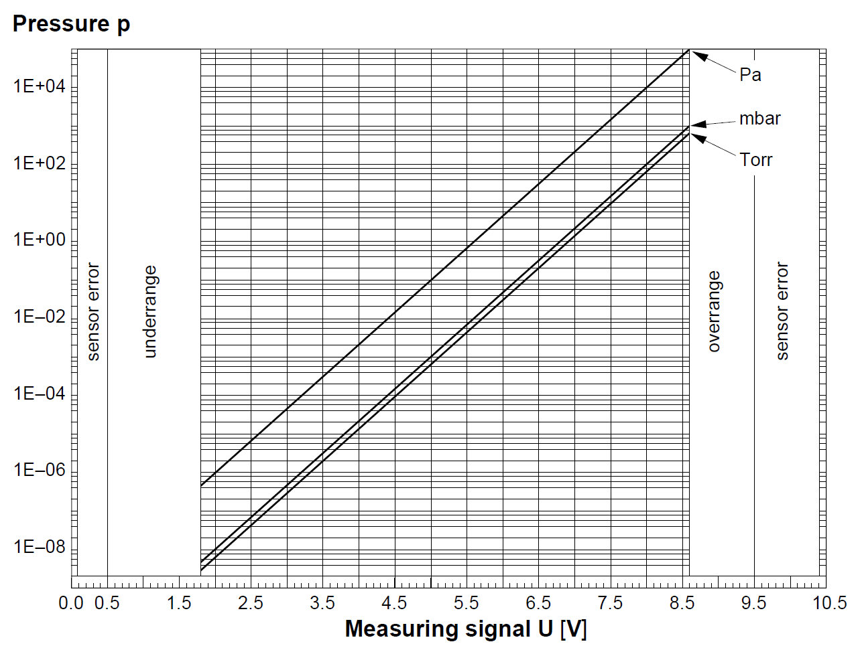
Pressure Transducers Conversion Curves
Configurable pressure transducer type
TYPE E_CRYO_SENSOR_TYPE_PRESS :
(
NONE := 0,
PKR_250 := 1, // Pfeiffer PKR250 & PKR251
CMR_361 := 2, // Pfeiffer CMR361
WRG_D_NW25 := 3, // Edwards WRG-D-NW25
PKR_360 := 4 // Pfeiffer PKR360
);
END_TYPE
Built-in Volt-to-Pressure conversion

Slide 12
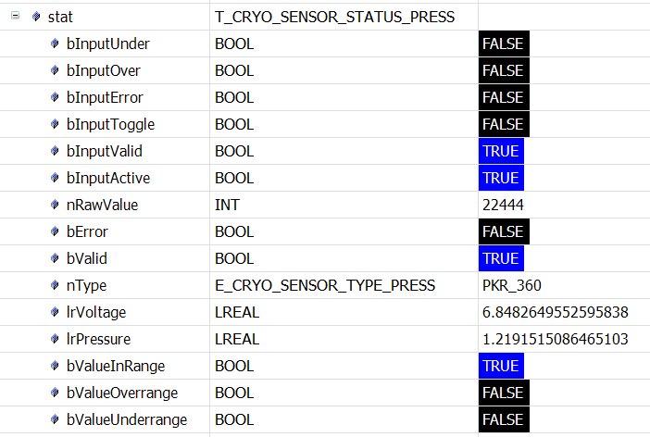
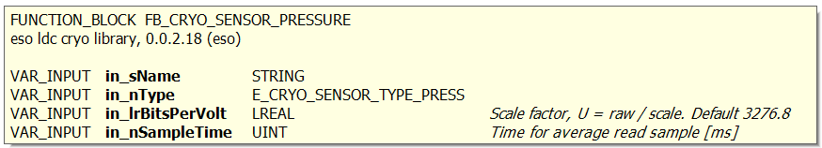
FB_CRYO_SENSOR_PRESSURE
Configurable sample time for averaging, e.g., every 3 sec.

Slide 13
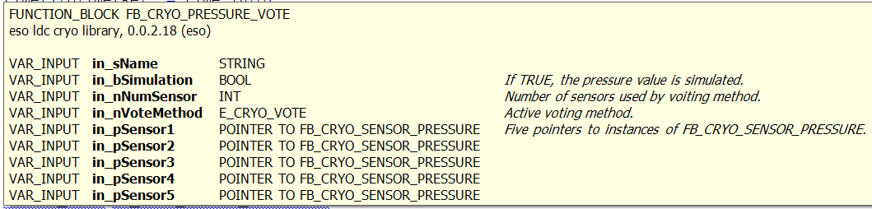
FB_CRYO_PRESSURE_VOTE
Supports up to five pressure sensors
Configurable voting system
TYPE E_CRYO_VOTE :
(
V_AVE := 0,
V_MIN,
V_MAX,
V_1oo2,
V_2oo3,
V_3oo5
);
END_TYPE

Slide 14
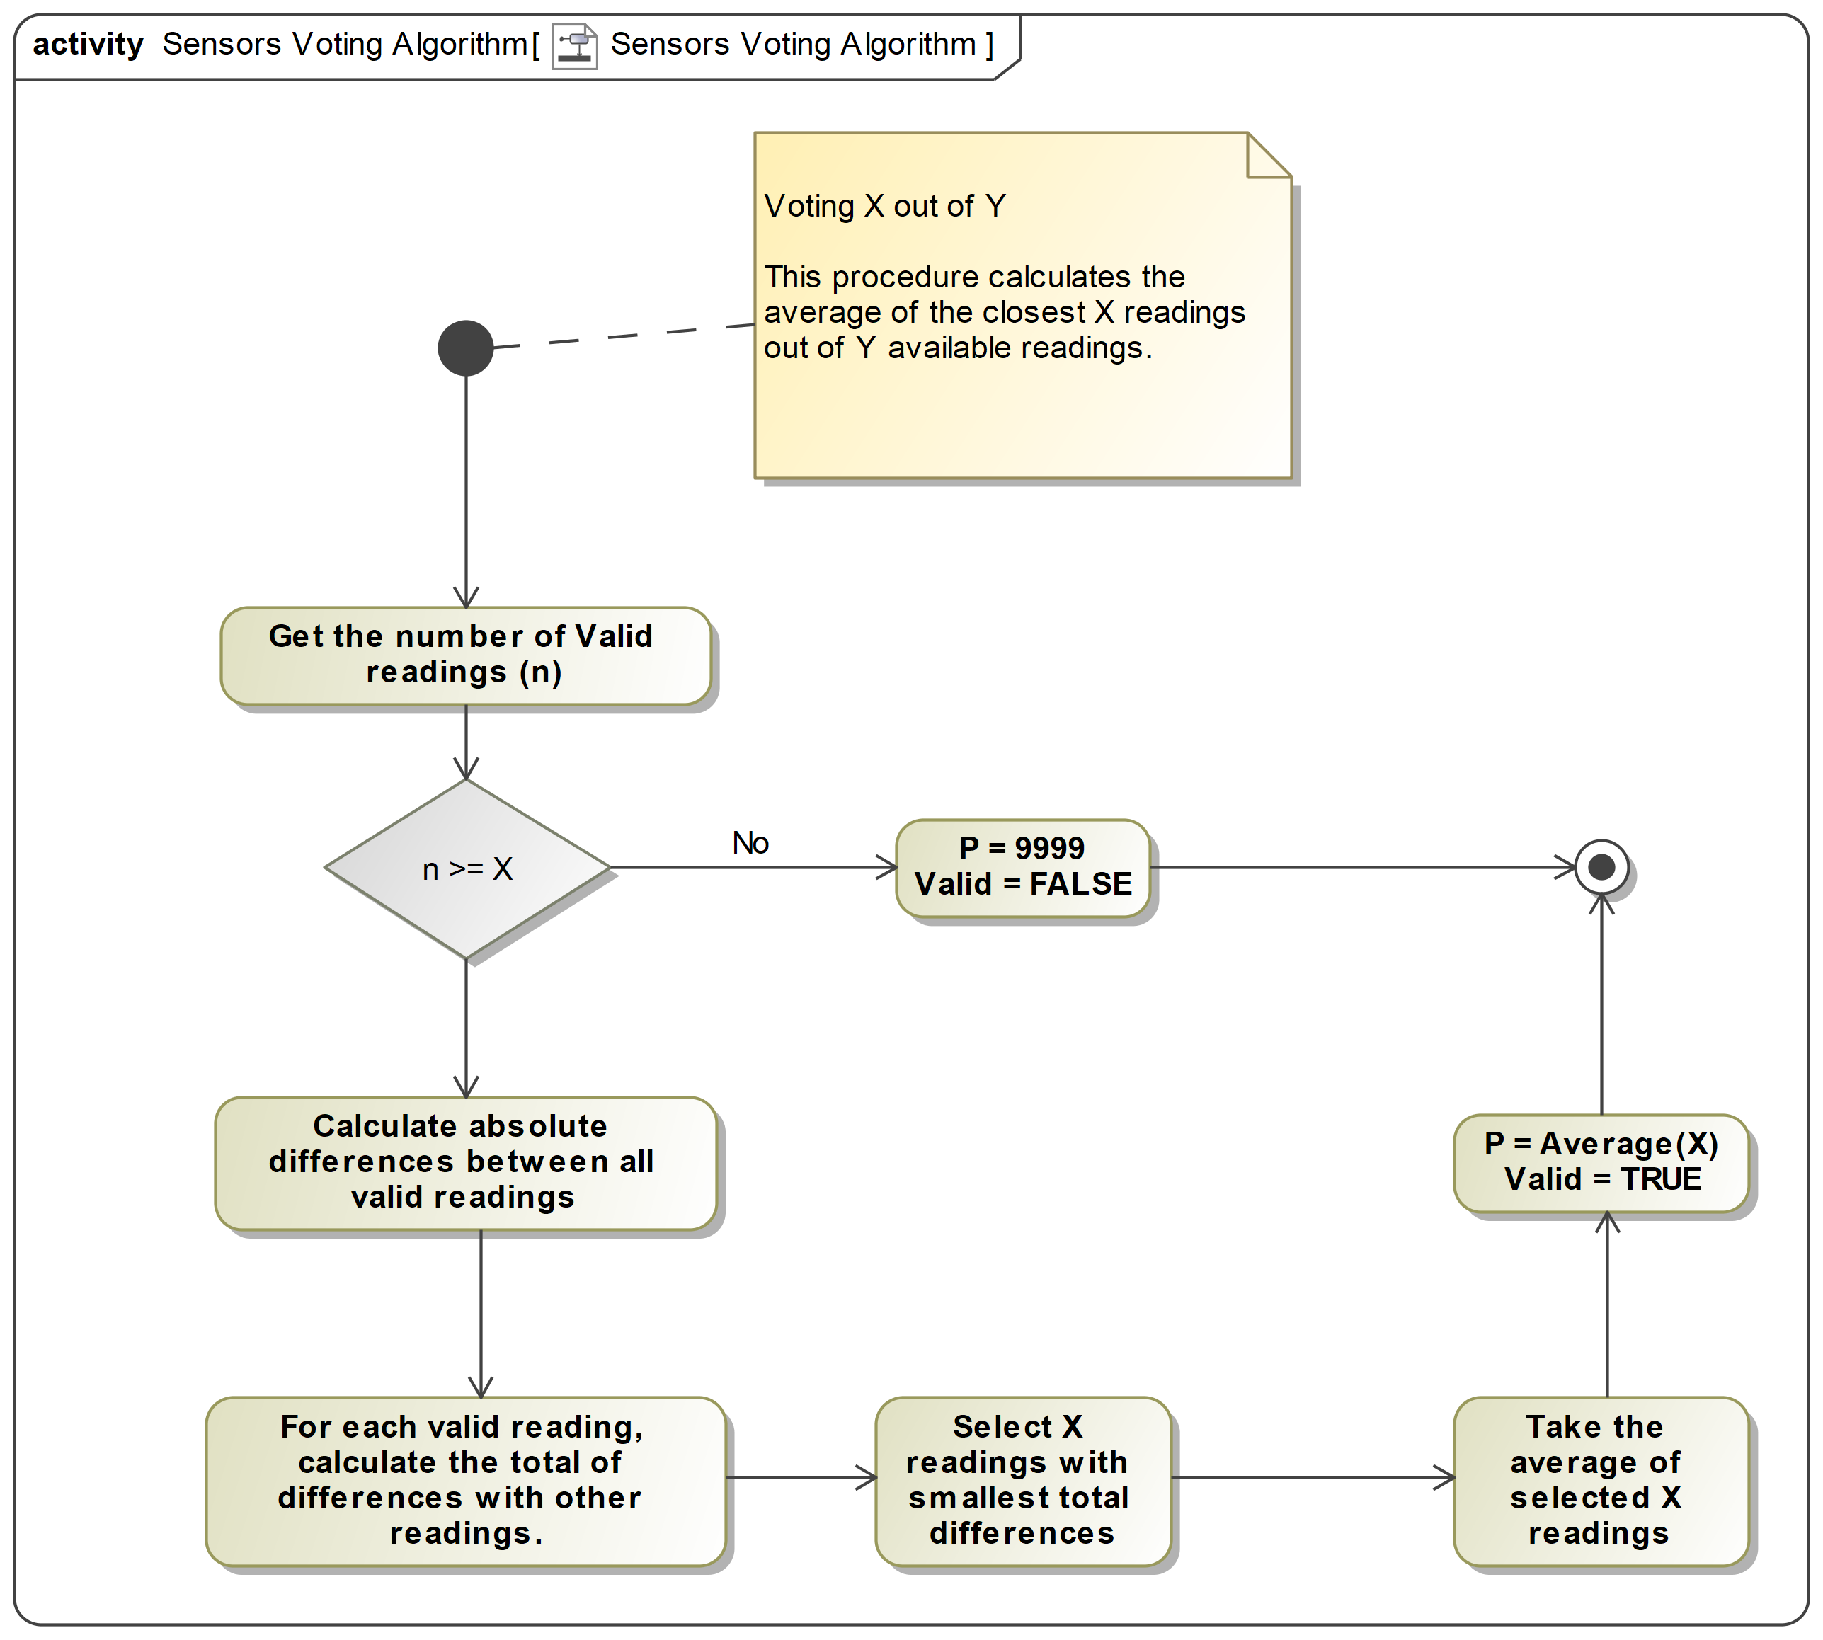
Pressure Voting Logic – X out of Y

Slide 15
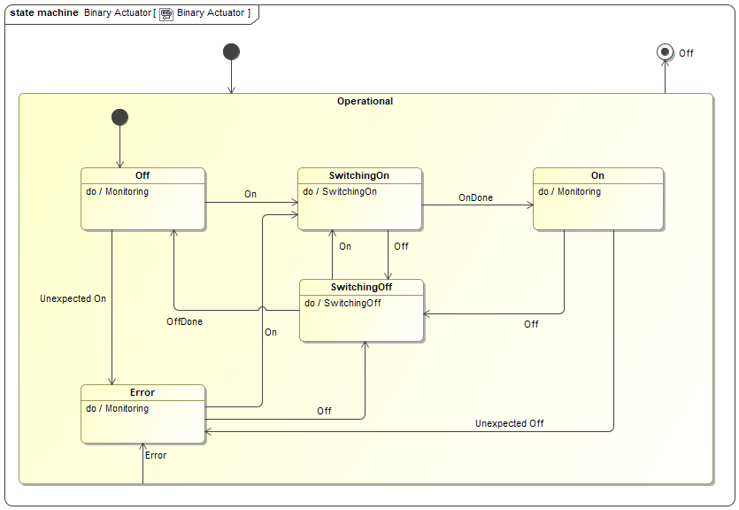
FB_CRYO_BIN_ACT – Binary Actuator
Simple digital ON/OFF actuator used in binary controllers: valves, heaters, etc.
Feedback: ON_ONLY or ON_AND_OFF.

Slide 16
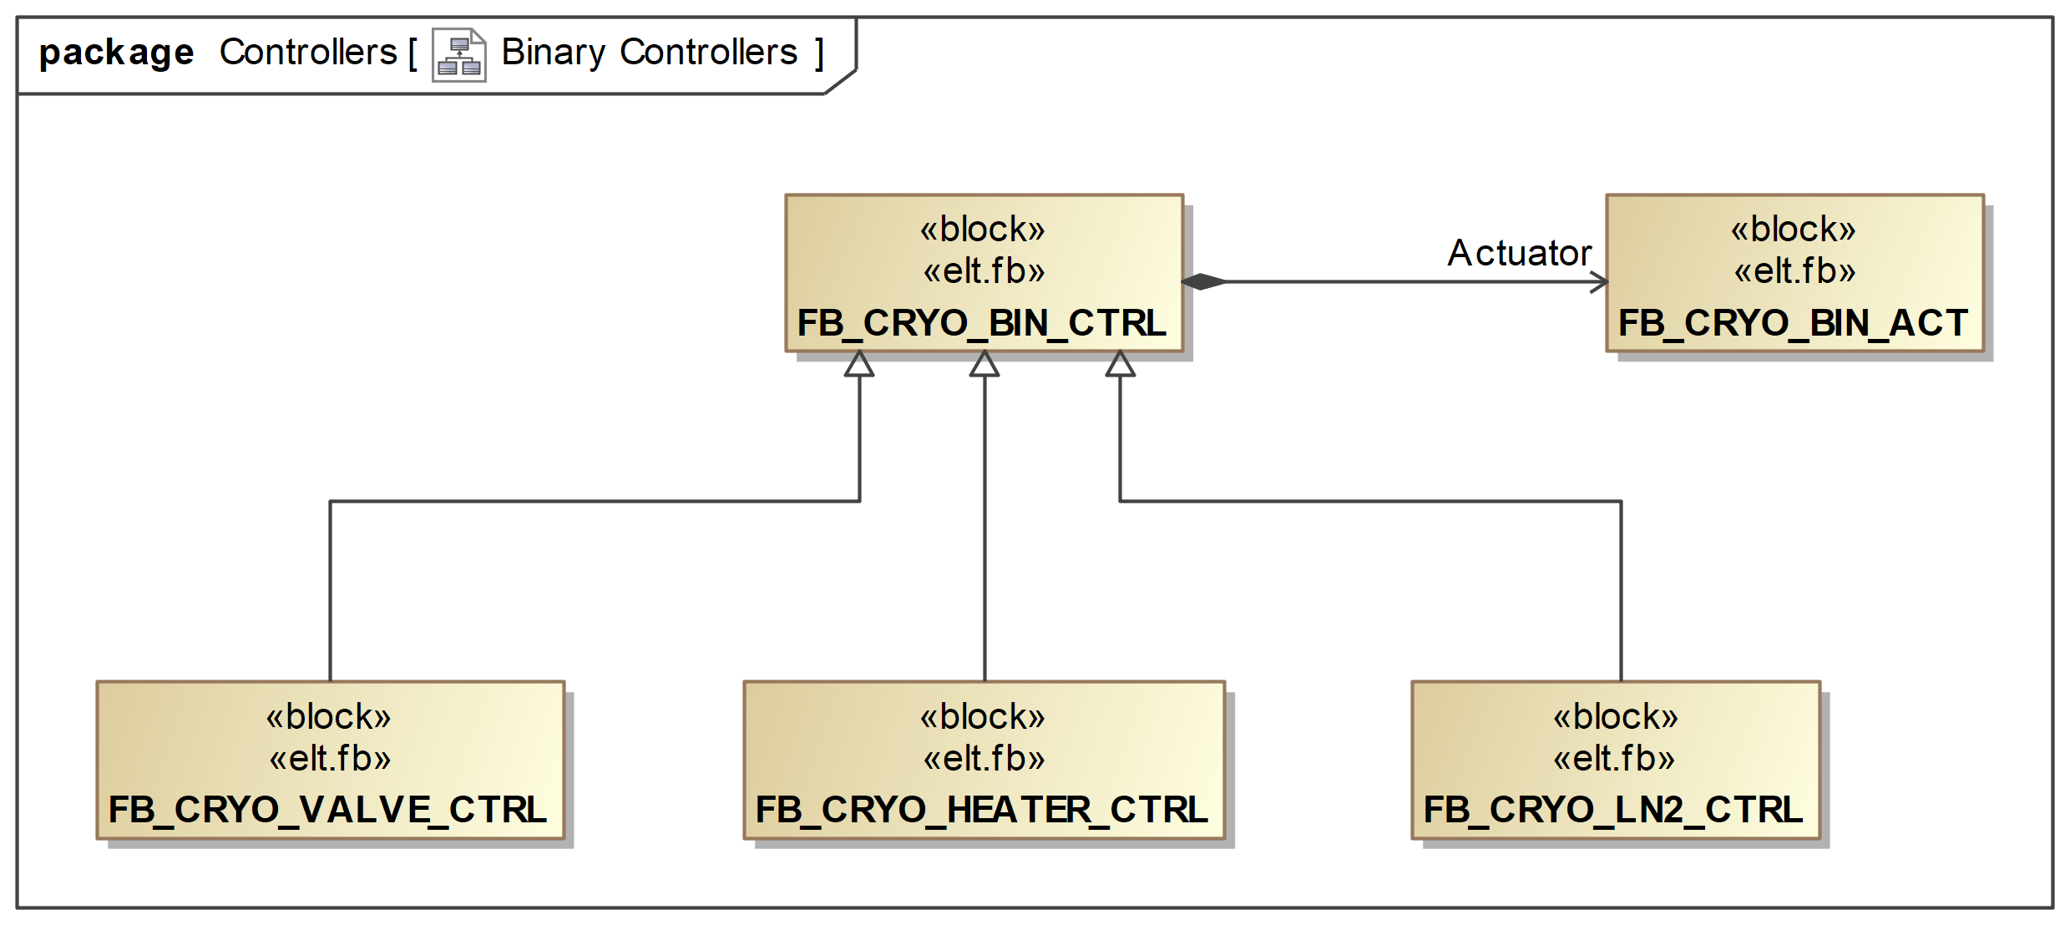
FB_CRYO_BIN_CTRL – Binary Controller
Includes an actuator.
M_GetStateLabel() sets labels, ON/OFF, OPEN/CLOSED, etc.

Slide 17
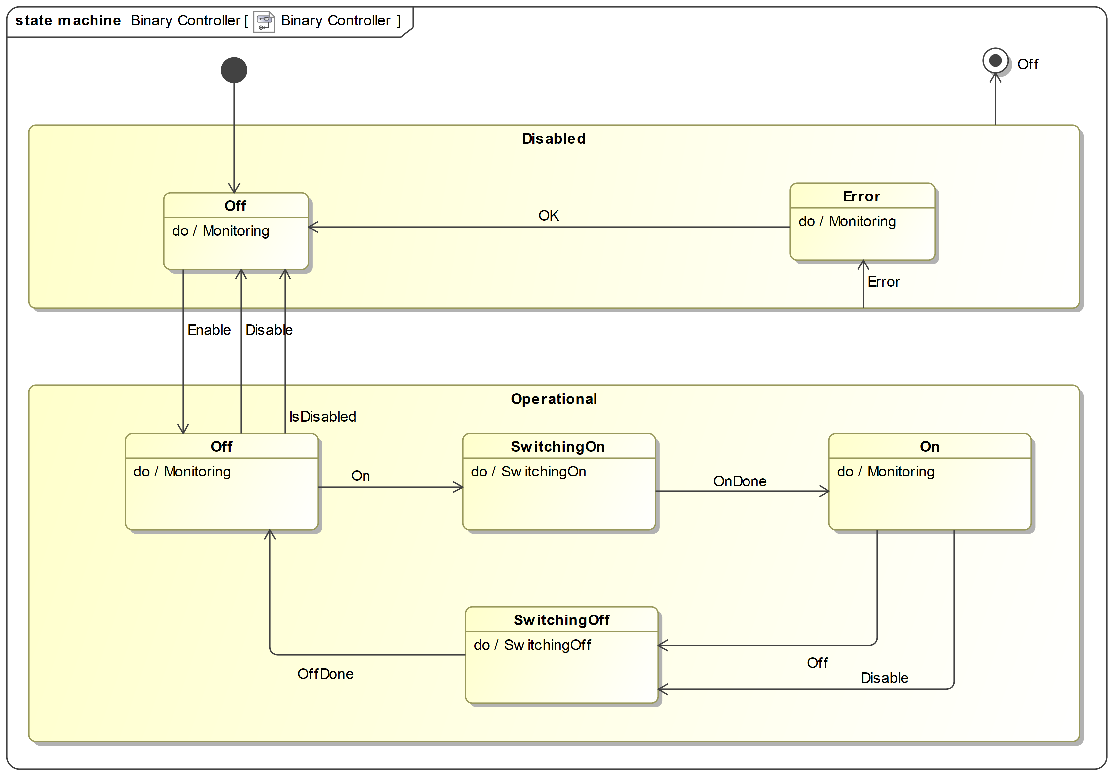
Binary Controller State Machine
Controller can be disabled.

Slide 18
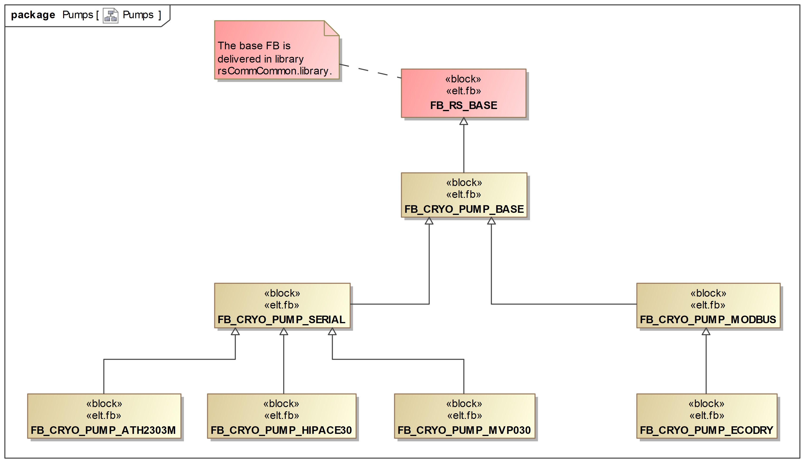
Pumps
Supported models:
ECODRY PVP
MVP030 PVP
HIPACE30 TMP
ATH2303M TMP
More to come…

Slide 19
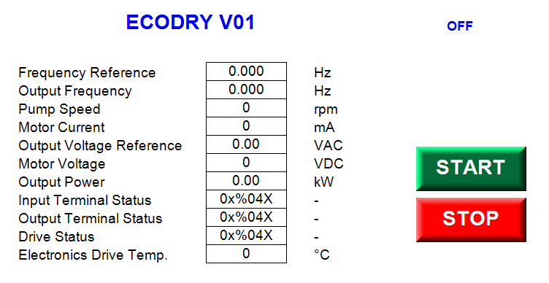
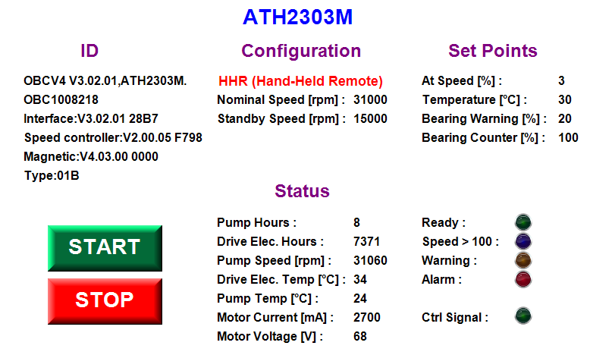
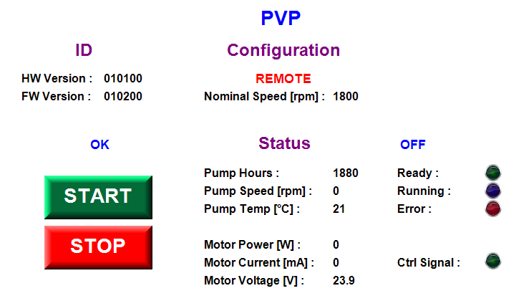
Pump GUIs

Slide 20
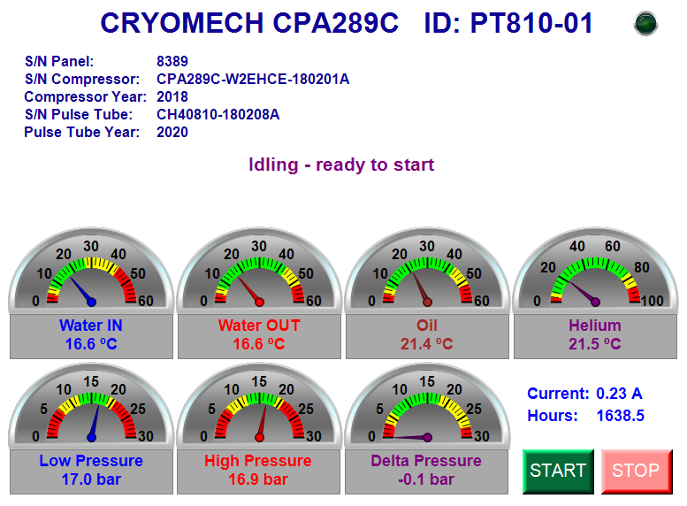
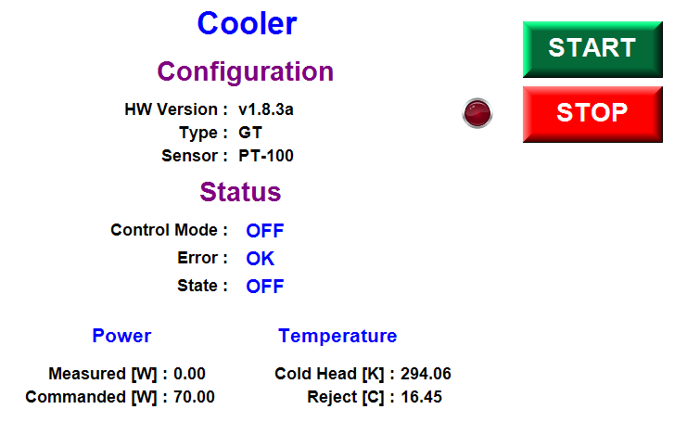
Coolers and Compressors
Supported models:
Cryotel GT
CRYOMECH CPA289C

Slide 21
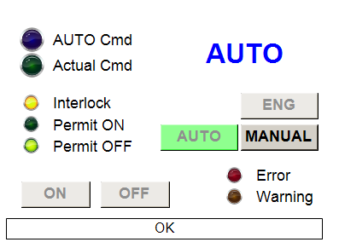
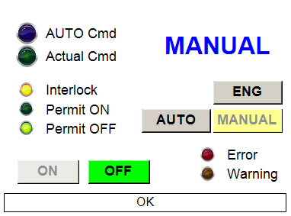
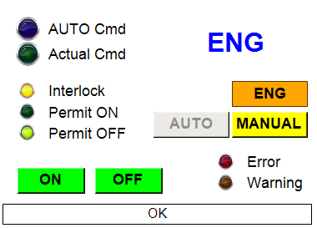










FB_CRYO_CMD_OVERRIDE – Command Override
GUI_CMD_OVERRIDE
Function Ctrl Mode
FB_CRYO_CMD_OVERRIDE
System Cmd
Mode:
Active Cmd
Function
System Interlock
AUTO
e.g. Valve
MANUAL
ENG

Slide 22
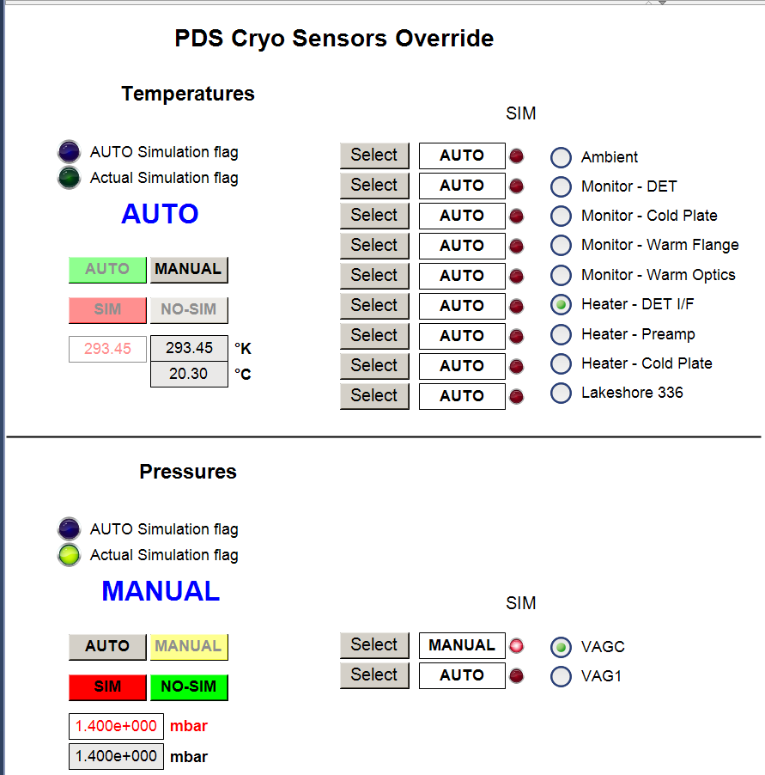
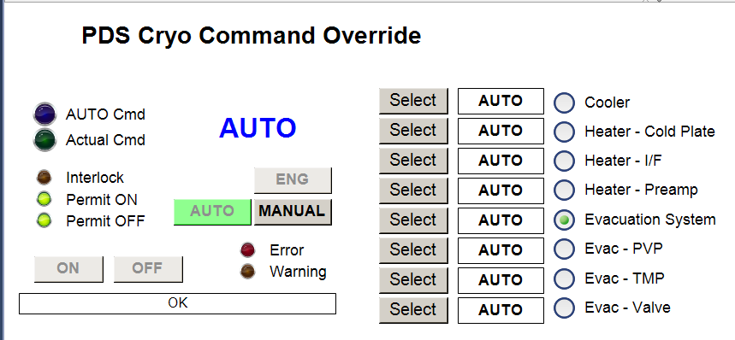
Command and Sensor Override GUI Examples

Slide 23
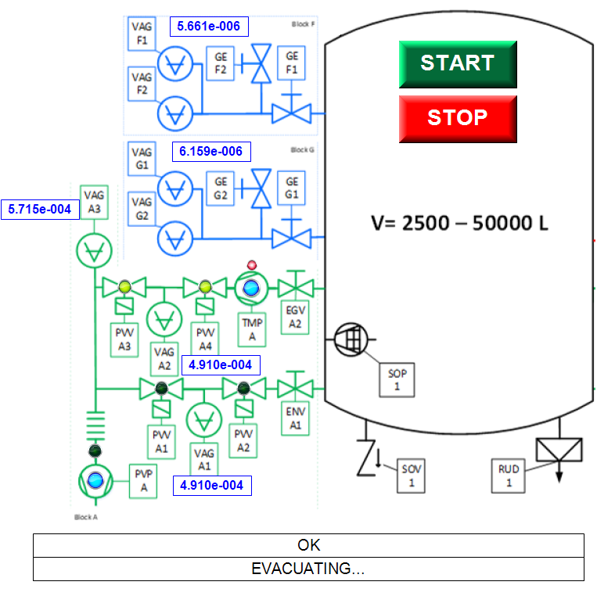
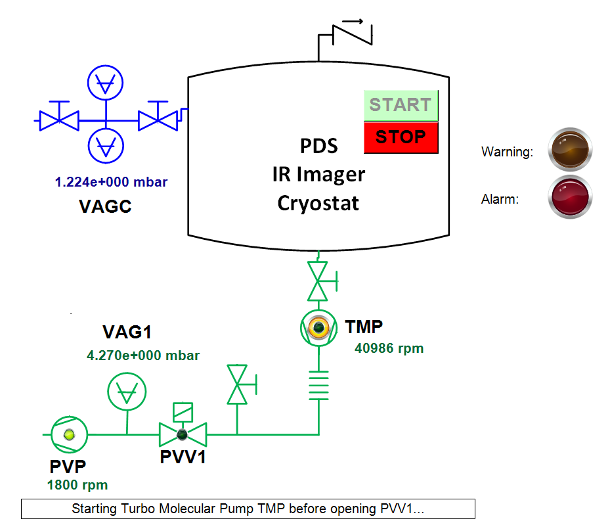
Evacuation Systems
Supported systems: up to 50L (PDS) and up to 50,000L (MICADO) cryostats

Slide 24
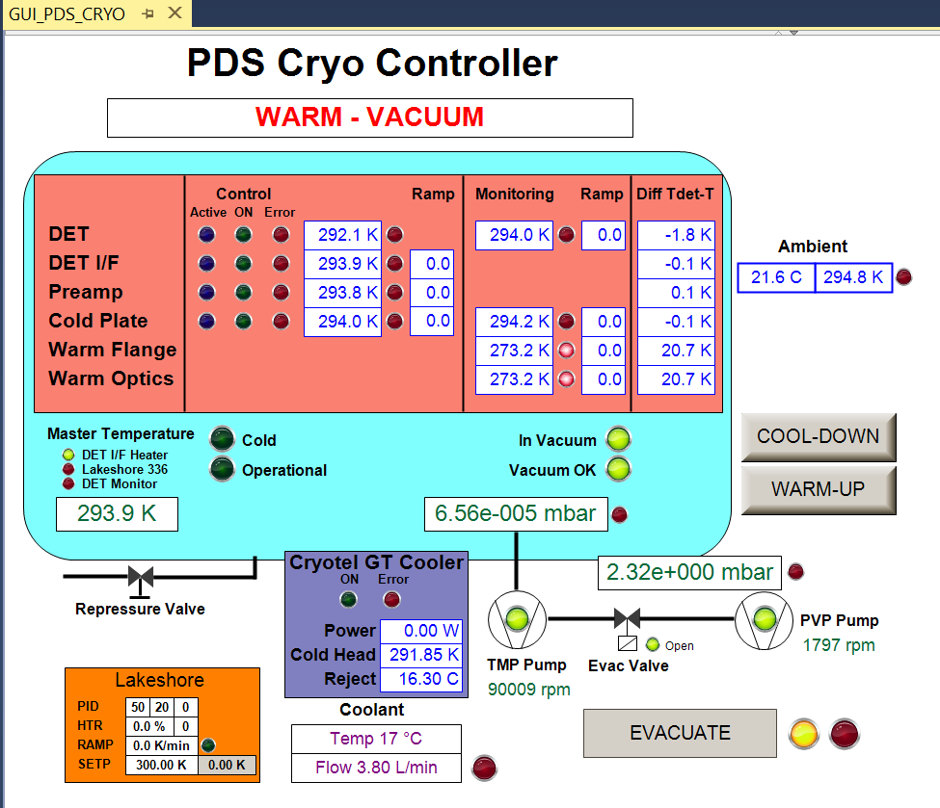
Cryo Controller System - Example

Slide 25
Cryo System Control Cycle
M_ReadSensors(); // Read Temperatures, Pressures, Flow, etc.
M_CheckForSensorErrors(); // Check for sensor HW errors
M_ExecuteControllers(); // Execute Controllers, e.g., valves, pumps, etc.
M_CheckForCommands(); // Capture system commands , e.g., warm-up
M_SafetyCheck(); // Perform a safety check
M_ProcessTriggers(); // System logs, e.g., in vacuum, cold, etc.
M_ProcessHmi(); // Provide information to HMI
M_StateMachine(); // Execute system state machine

Slide 26
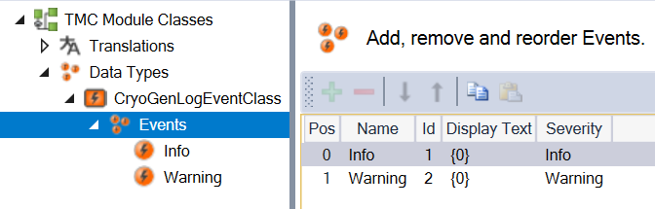
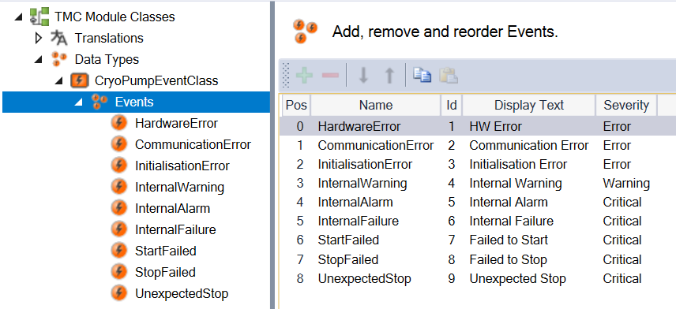
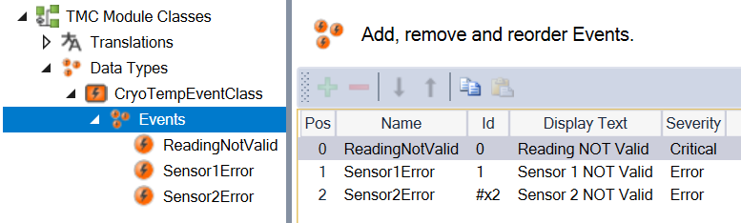
Logs and Alarms
Every Device FB provides Logging and Alarm handling.
Implemented in Type System / Event Classes.

Slide 27
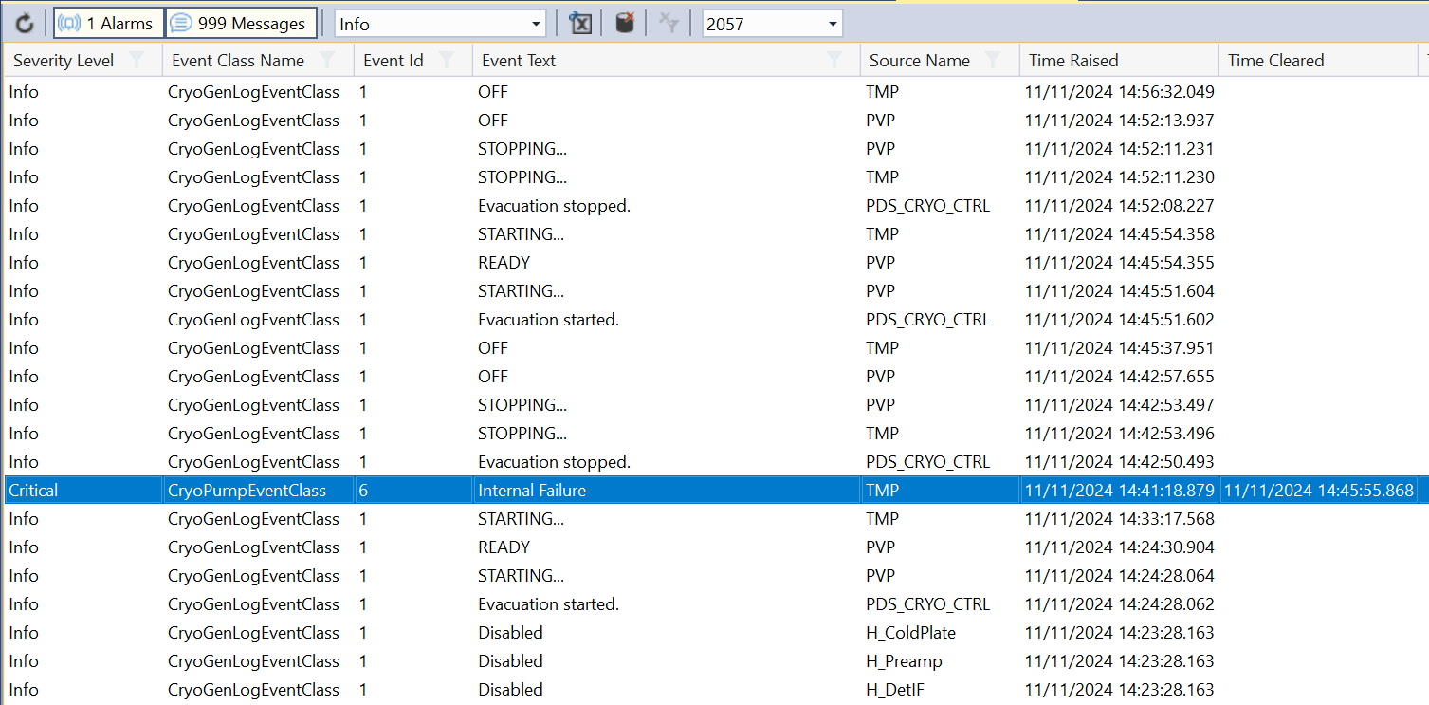
Logs and Alarms – Output Example

Slide 28
Simulation Helper FBs
FB_CRYO_SIM_BOOL_DELAY // Delayed reply of actuator with single feedback
FB_CRYO_SIM_BOOL_DELAY_2 // Delayed reply of actuator with ON/OFF feedback
FB_CRYO_SIM_LREAL // Ramp, sine, curve
FB_CRYO_SIM_SINE // Simple sine wave generator
FB_CRYO_SIM_PRESSURE // Ramp, curve
FB_CRYO_SIM_TEMPERATURE // Ramp, sine
Examples of customized subsystem simulations
- FB_SIM_MICADO_PUMPS
- FB_SIM_MICADO_VALVES
- …

Slide 29
Dan Popovic – dpopovic@eso.org
@ESOAstronomy
@esoastronomy
@ESO
european-southern-observatory
@ESOobservatory

