Slide 1
Data Display Tool (DDT)
Mario Kiekebusch on behalf the ICS Framework Team

Slide 2
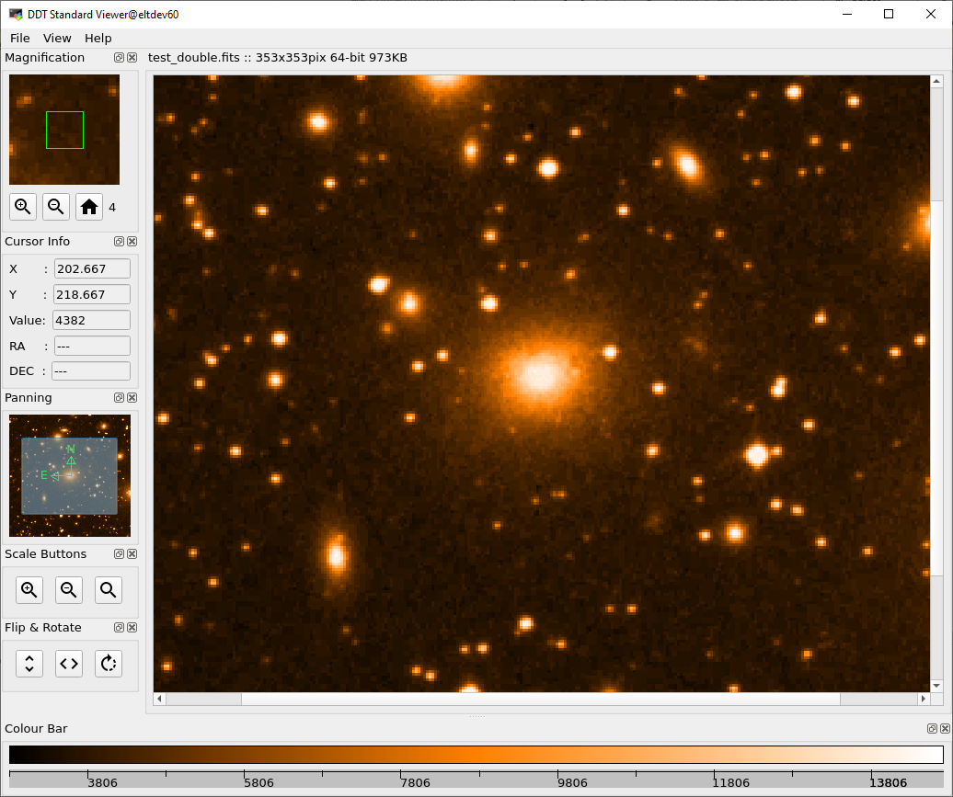

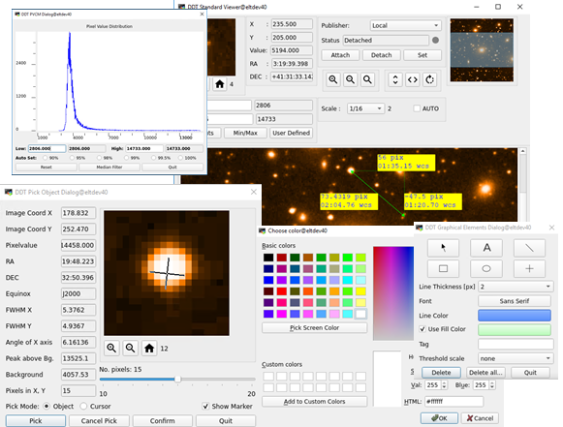
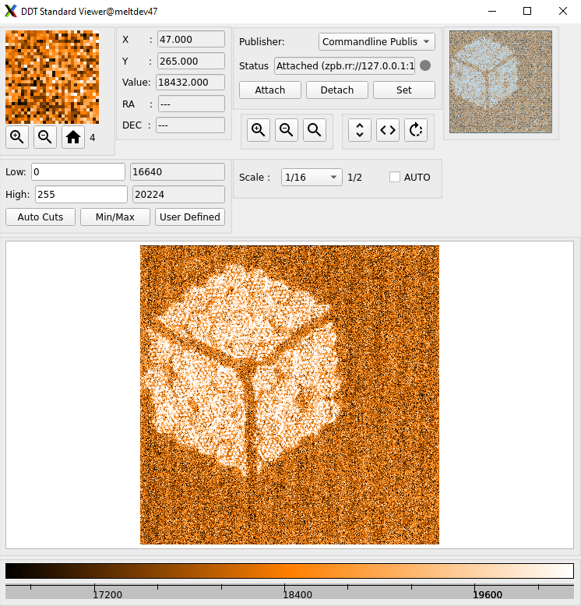
Introduction
The DDT is a comprehensive suite of libraries designed to enable transfer, visualization, and manipulation of data.

Slide 3
DDT Main Components
Data Transfer Library
    Simulators (publishers and subscribers)
Image Handling and Data visualization Library
    FITS functions
    Widget & dialogs
    Viewer (reference implementation)
Python Binding
Remote Interface

Slide 4

Data Transfer Library

Slide 5
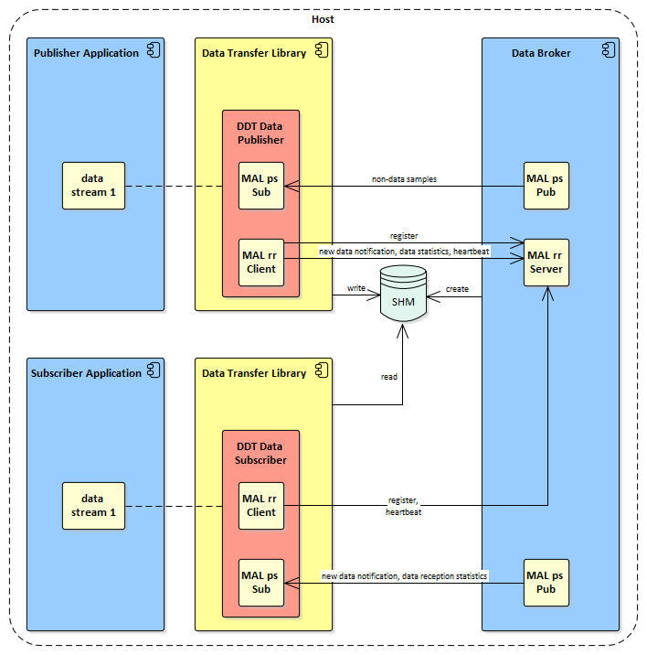
Data Transfer Library
This library covers the needs to transfer data between Publisher and Subscriber applications.
The basic communication channel is a data stream. The components are based on single-producer multiple consumer pattern.
The DDT uses CII MAL for the communication (Req/Rep and Pub/Sub)
The components involved in the data transfer are: Publishers, Subscriber. SHM and Broker.
Multiple domains are supported.

Slide 6
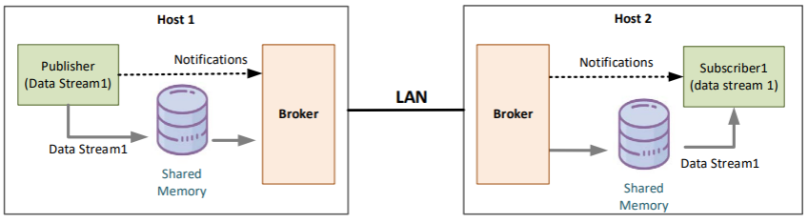
DDT Broker
The Broker is the process that takes care of the communication between publishers and subscribers.
Main features:
Creation and maintenance of the data channels to other Data Brokers.
Monitoring and control of the data streams
Shared memory management.

Slide 7
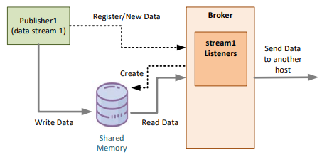
DDT Publisher
The Publisher is the producer of the data.

Slide 8
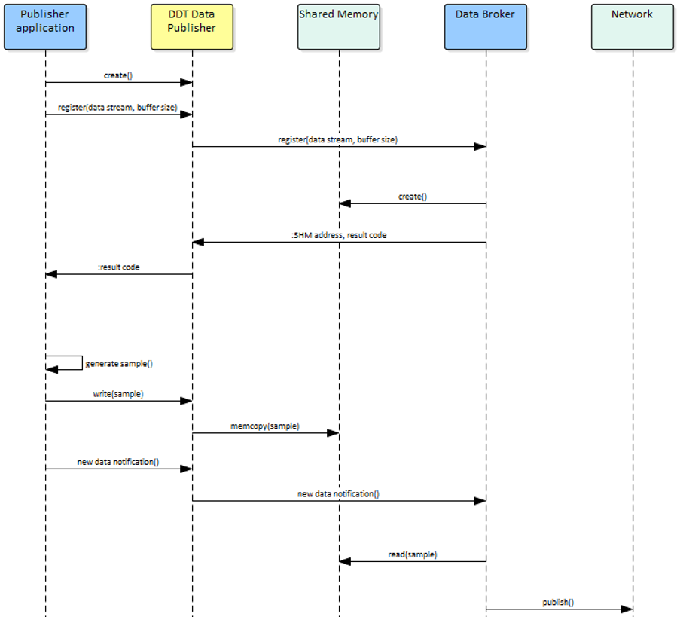
DDT Publisher

Slide 9
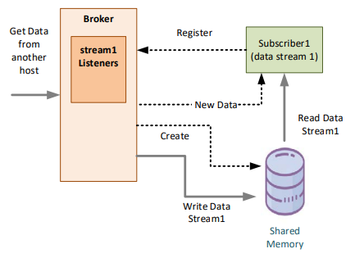
DDT Subscriber
The Subscriber is a process or an application that is interested in receiving a well specified “data stream”. Several subscribers can be listening to one data stream.
A subscriber register at the local Broker to notify interest for a given data stream.
The Broker will notify the subscriber that new data is available as soon as the new data is written into the shared memory.

Slide 10
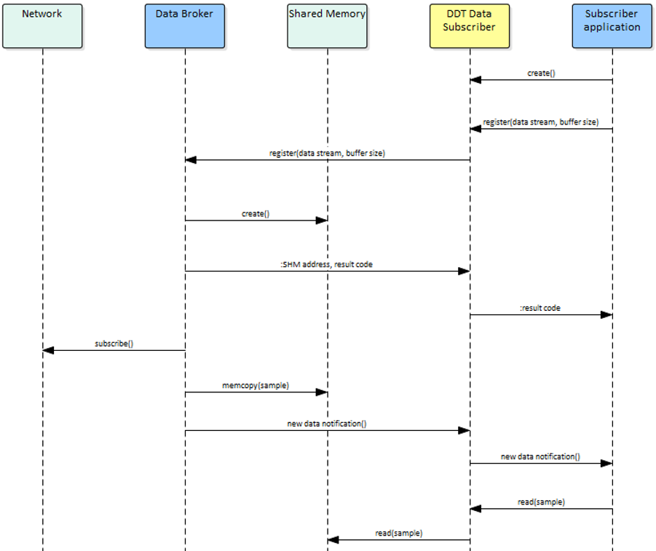
DDT Subscriber

Slide 11

Publisher Simulator
The Publisher Simulator is an example for a publishing application that uses the DDT Publisher Library.
The Publisher simulator can use existing FITS files to simulate the data.

Slide 12

Subscriber Simulator
The Subscriber Simulator is an example for a subscriber application that uses the DDT Subscriber Library.

Slide 13
DDT Viewer

Slide 14
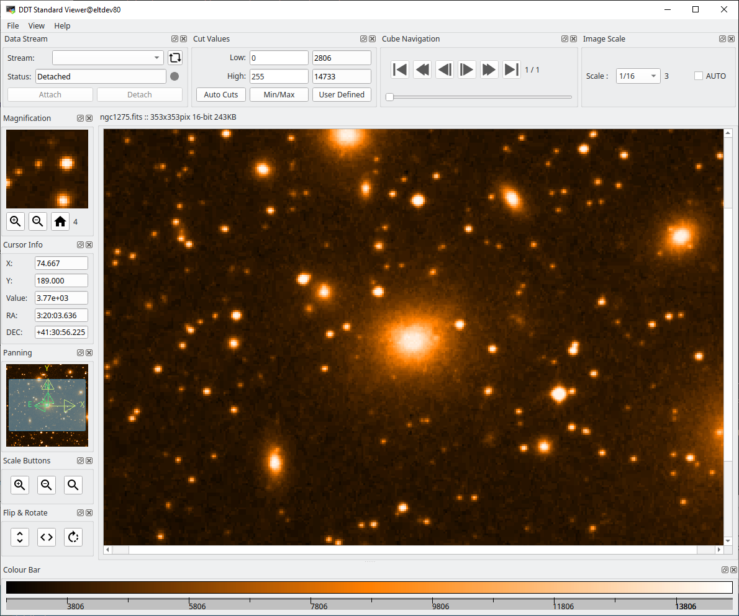
DDT Viewer (ddtViewer)
The DDT Viewer is the reference implementation for a DDT display.
Images are visualized in the image widget from a data stream or from a FITS file.
Controls are provided by auxiliary widgets, e.g.:
    Magnification window
    Cursor Info
    Panning window
    Scale Buttons
    Flip & Rotate

Slide 15
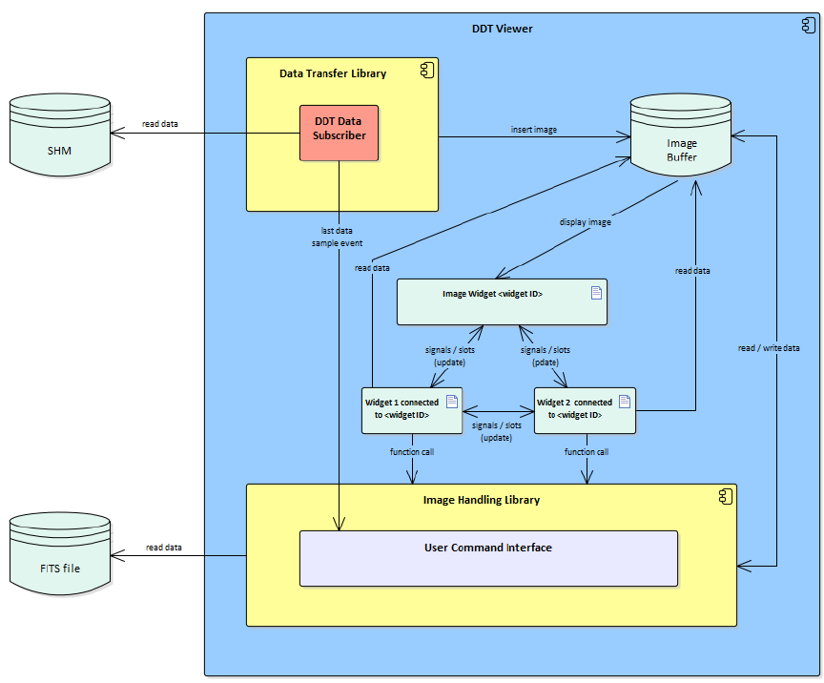
Viewer Design
The Image Widget plays a central role among the widgets of the DDT toolkit, as it holds a reference to the image data that is displayed.
Images are internally stored in an image buffer.
Widgets communicate using the signal/slot mechanism from Qt.

Slide 16
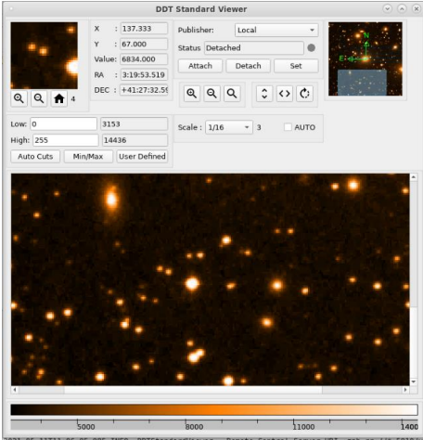
DDT Viewers
Configurable layout

Slide 17
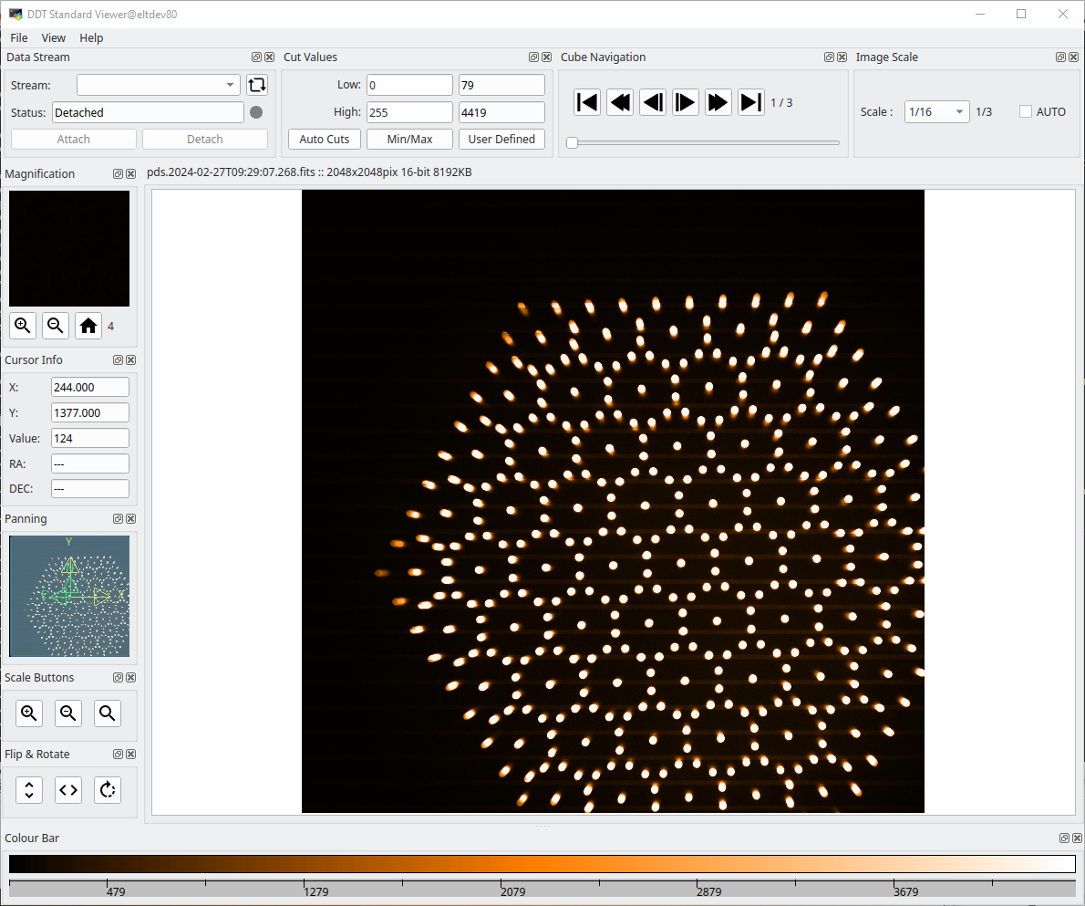
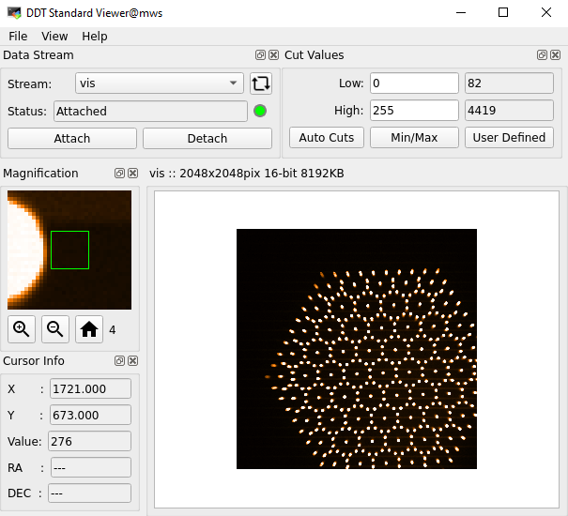
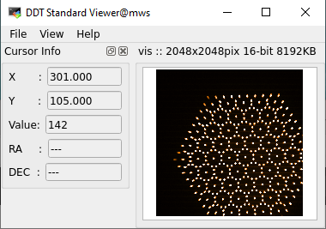
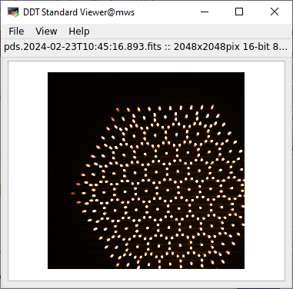
DDT Viewers
Configurable layout

Slide 18
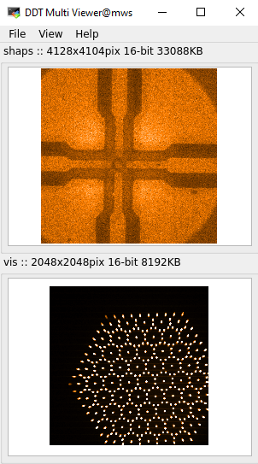
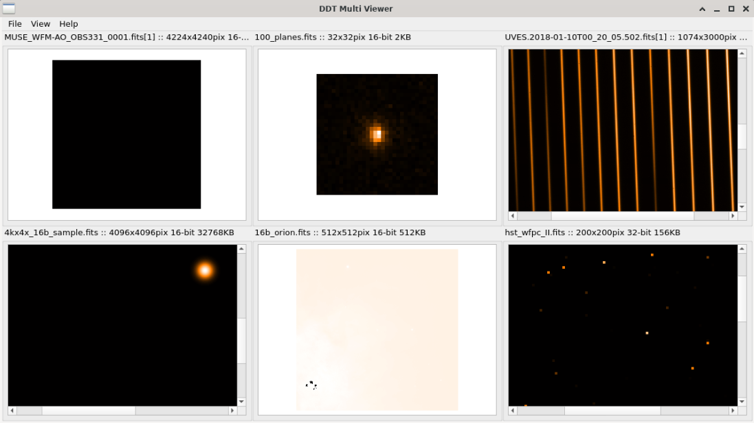
DDT Viewers
Generic Multi-stream viewer.

Slide 19
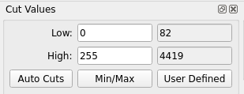

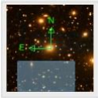

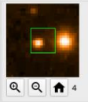
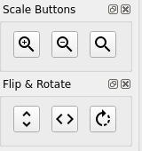
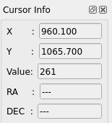
DDT Widgets
DDT widgets that are implemented as Qt Designer Plugins.
All widgets are contained in one single shared library.

Slide 20
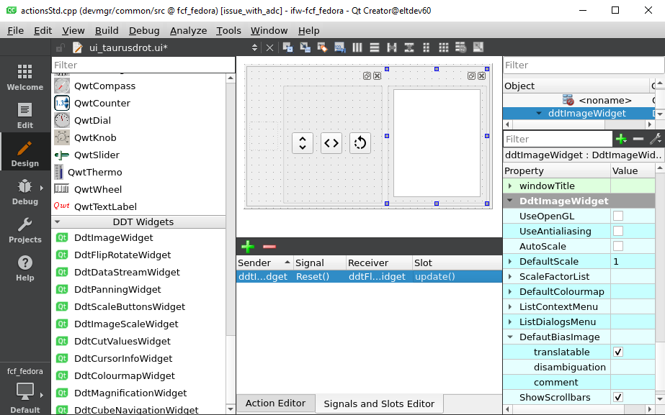
DDT Widgets
UI files can be created using Qt Designer. DDT Provide a set of widgets.
# CursorInfoWidget
self.logger.Write(2, "Attach signals/slots for DDT Cursor Info Widget.")
QObject.connect(
self.ui.ddtImageWidget,
SIGNAL("CursorInfo(double, double, double, QString, QString)"), self.ui.ddtCursorInfoWidget.CursorInfo,
)
QObject.connect(
self.ui.ddtImageWidget,
SIGNAL("Reset()"),
self.ui.ddtCursorInfoWidget.Reset,
)

Slide 21
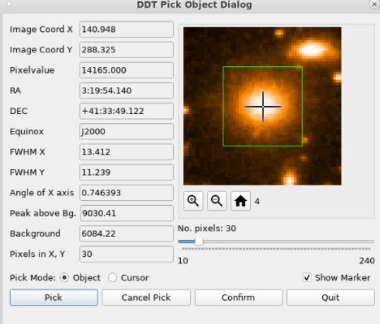
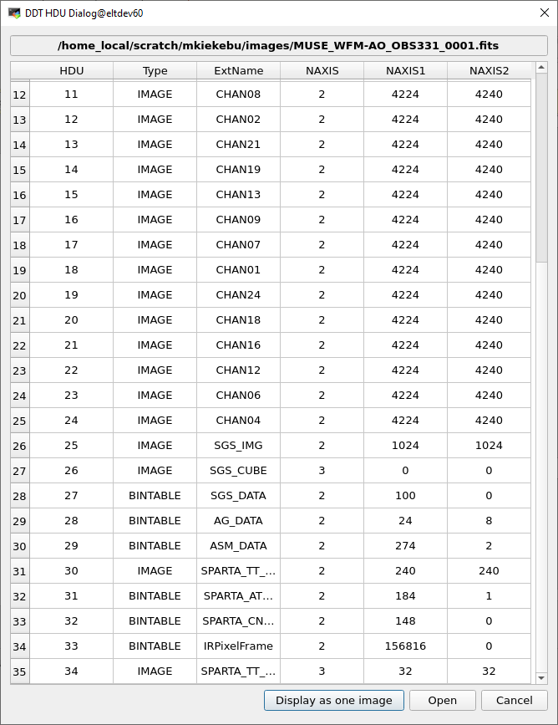
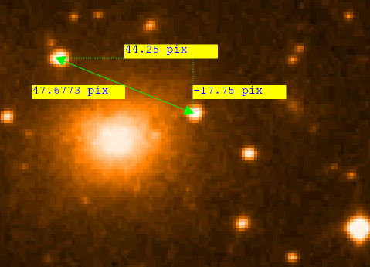
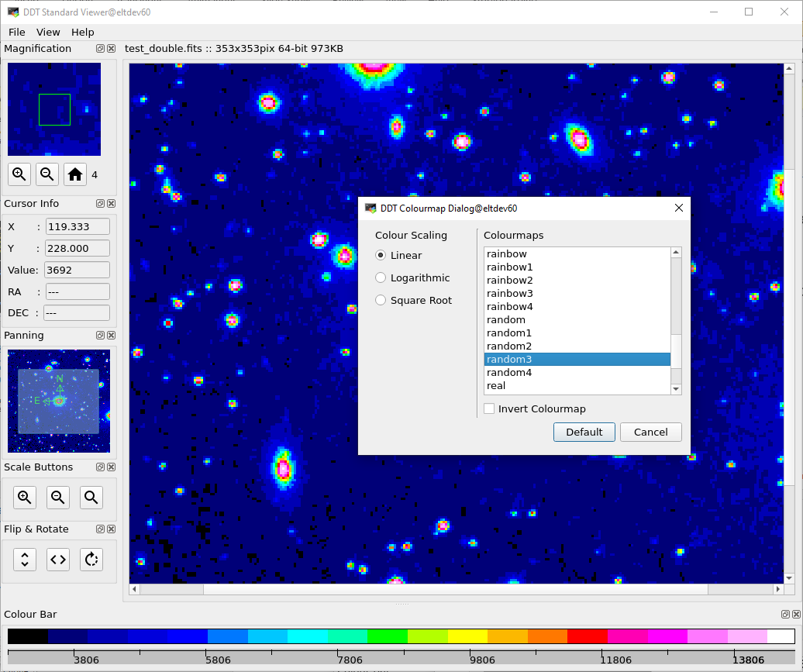
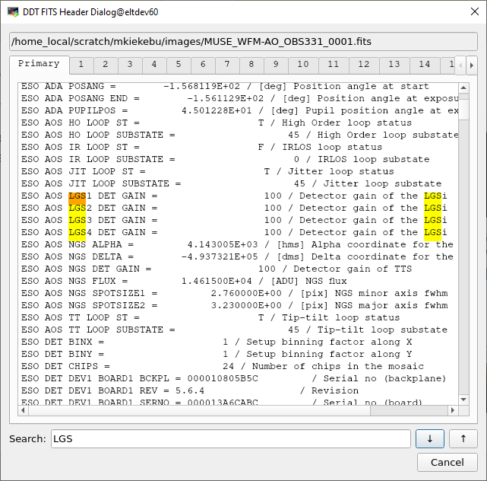
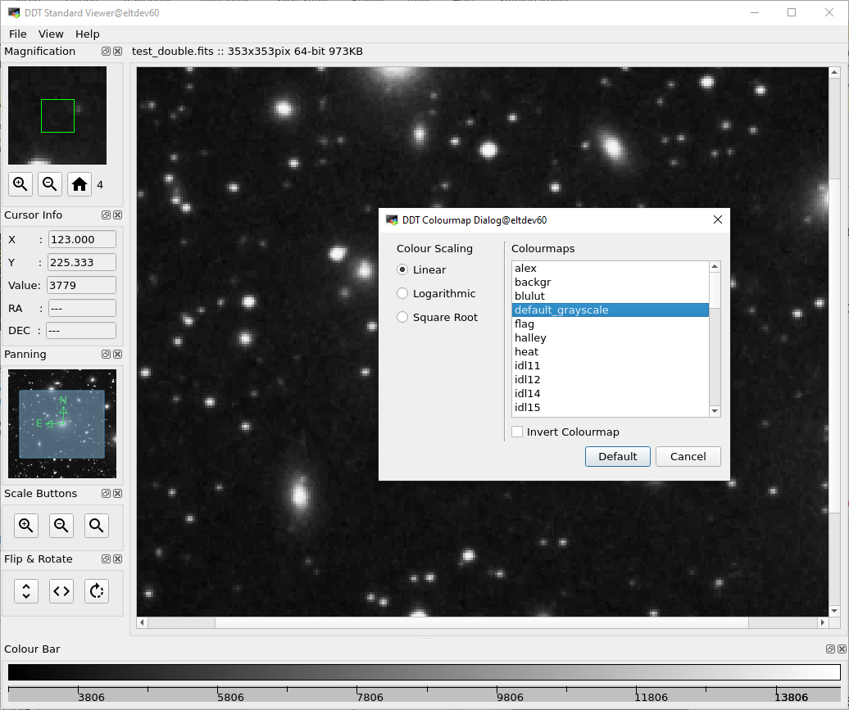
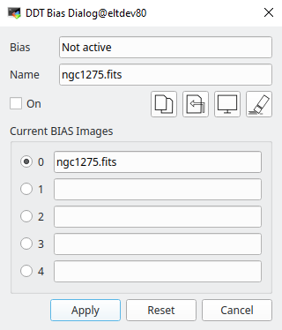
DDT Dialogs
Several dialogs for various purposes.
Customizable list of dialogs.

Slide 22
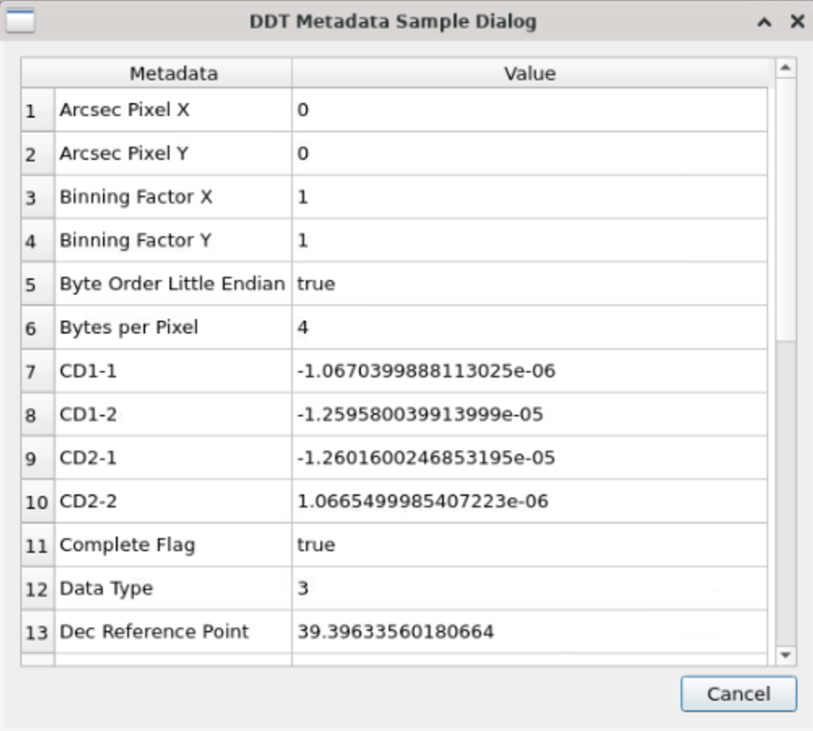
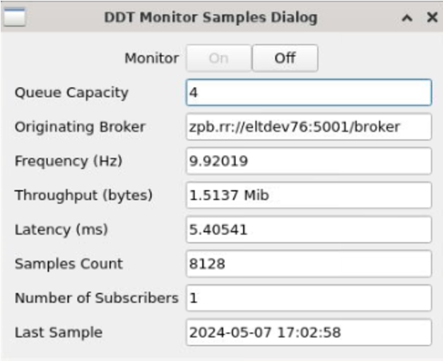
DDT Dialogs
Metadata Sample Dialog
Monitor Sample Dialog

Slide 23
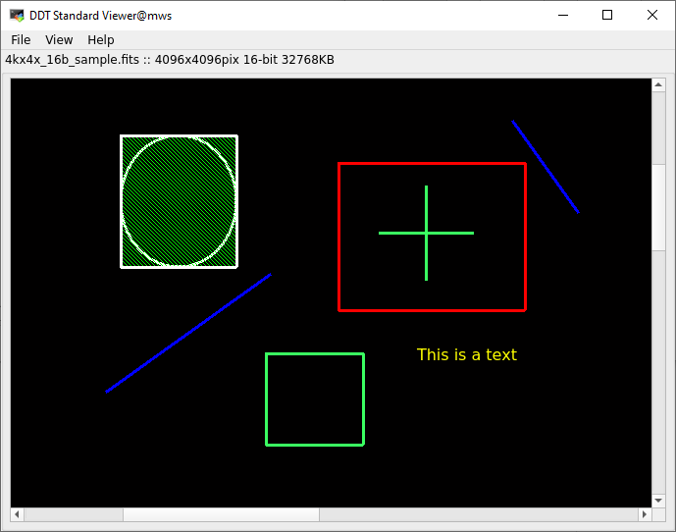
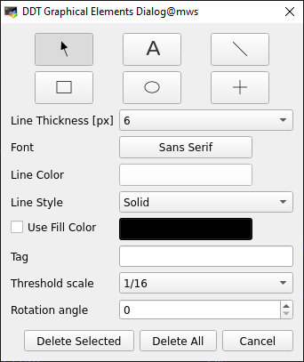
DDT Graphics

Slide 24
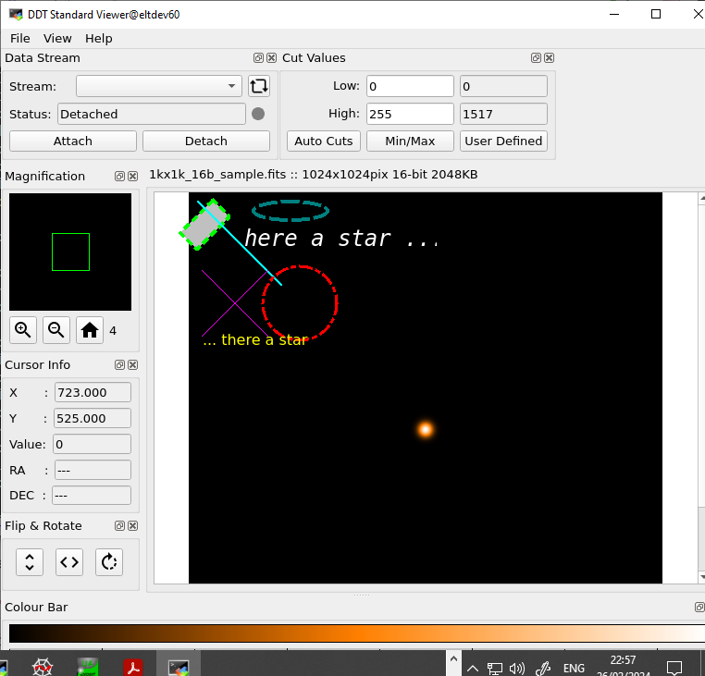
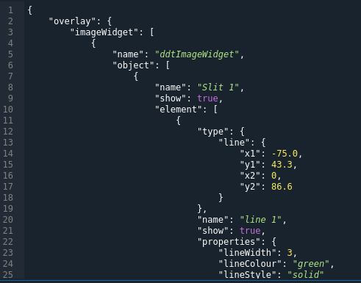
DDT Overlays
Static definition of graphics.
User has control to show/hide these graphics.
API for fine control.
Overlay Format (JSON)

Slide 25
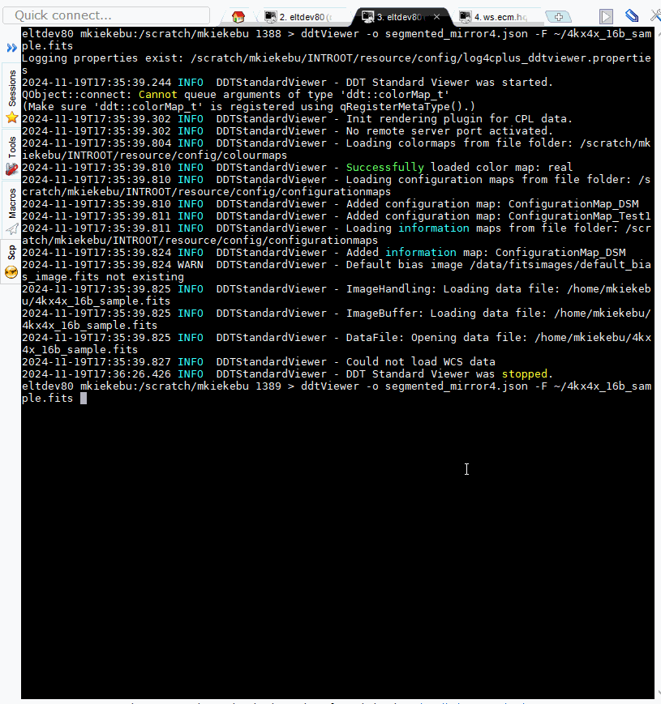
DDT Overlays

Slide 26
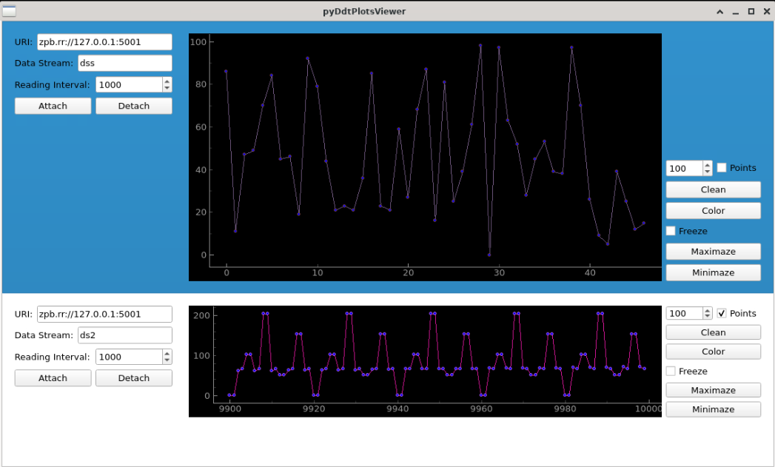
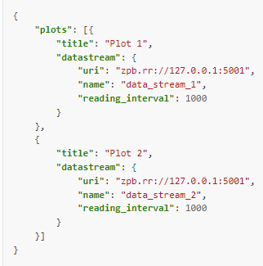
DDT Plot Viewer
Plots Viewer.
JSON configuration file.

Slide 27
Remote Control

Slide 28
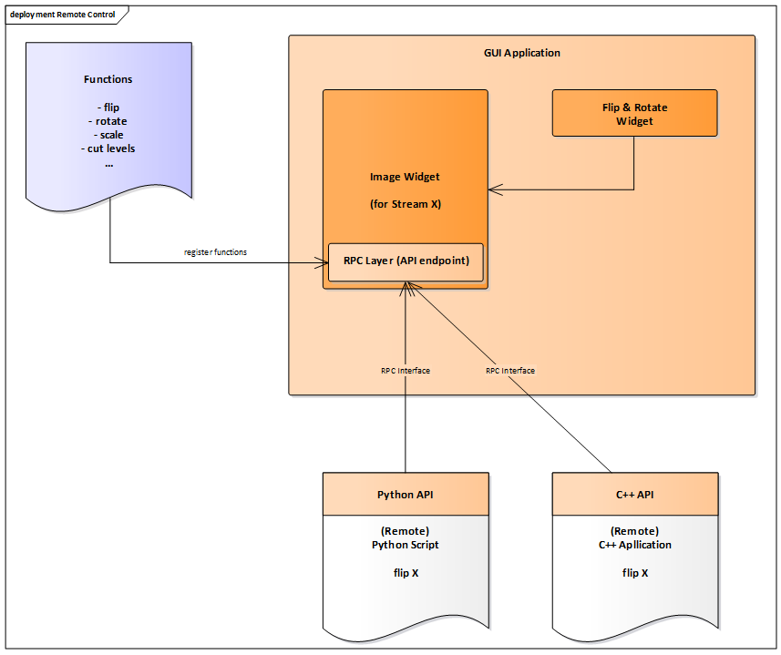
Remote Control
The DDT GUI have the capability to be called from local or remote C++ applications and python scripts via corresponding APIs

Slide 29
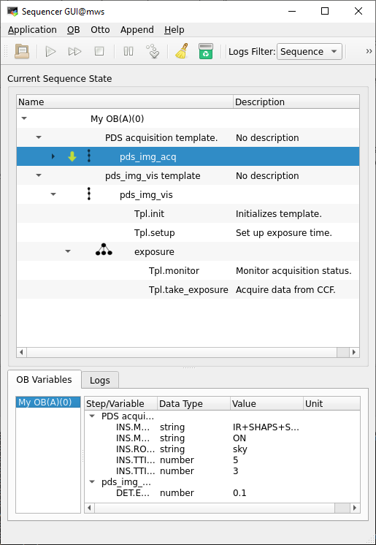
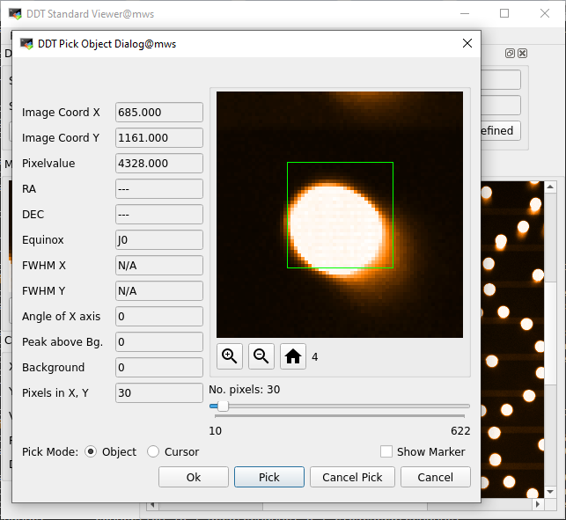
Client
Remote Control
Server

Slide 30
What’s Next
Porting to DevEnv6 (Qt6)
Library to simplify the creation of custom widgets.

Slide 31
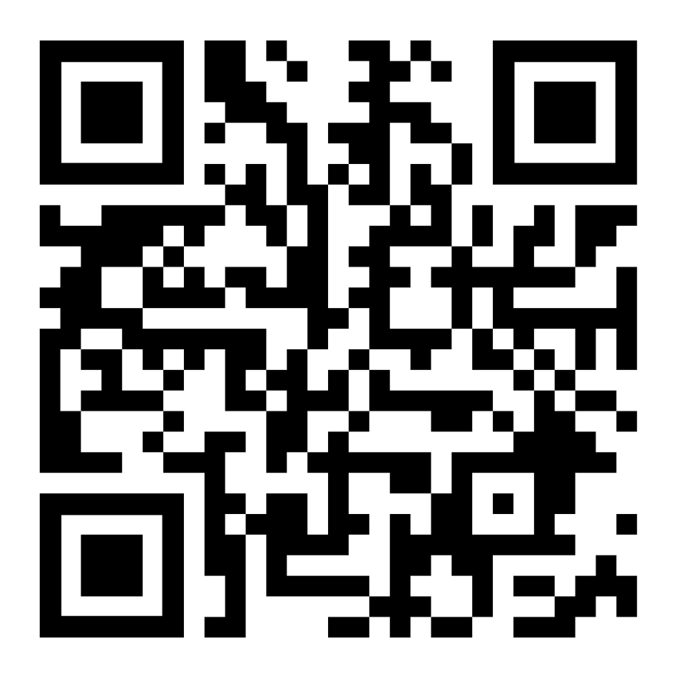
Luigi Andolfato; Diego Del Valle; Sylvie Feyrin; Arturo Hoffstadt; Mario Kiekebusch; Jens Knudstrup; Christoph Moins; Ivan Muñoz; Dan Popovic; Claudio Reinero; Calle Rosenquist; Paola Sivera; Ricardo Schmutzer; Piotr Szubiakowski
@ESOAstronomy
@esoastronomy
@ESO
european-southern-observatory
@ESOobservatory

