Slide 1
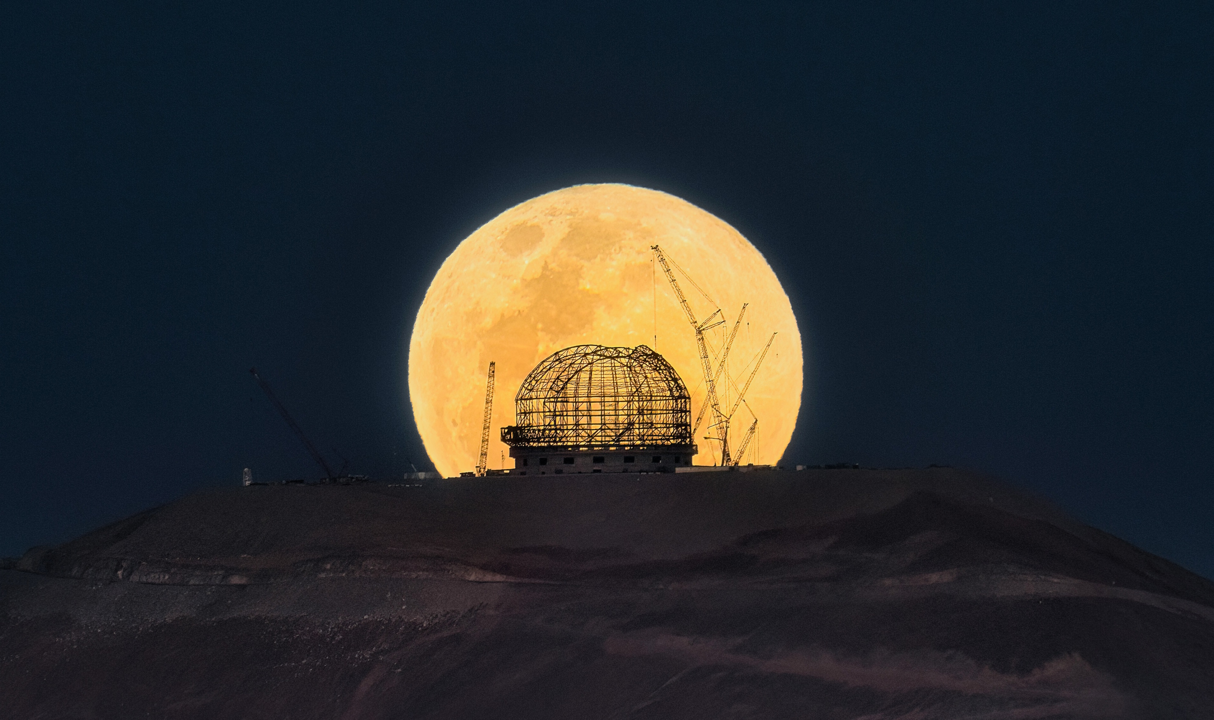
Data Acquisition Framework
Calle Rosenquist (ESO)
Image Credit: J. Beltrán/ESO

Slide 2

Content
  Overview
    Components
    Interactions
  Data Acquisition
    Introduction
    Lifecycle
Image Credit: ESO/L. Calçada

Slide 3
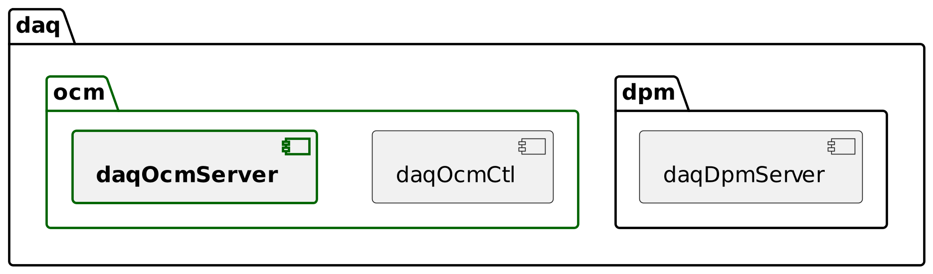
Components and Roles
      Observation Coordination Manager (OCM)
Provide client interface
(request/reply, pub/sub)
Create and control Data Acquisitions
Coordinates execution
Publishes status information
Commands DPM to create the final Data Product

Slide 4
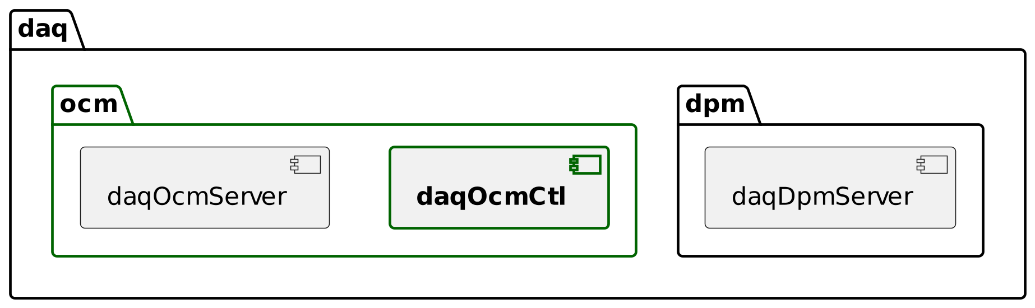
Components and Roles
      OCM client
      Command line client
Server state control (stdif)
  init, enable, disable, exit, ..
Data Acquisition control (daqif)
  start, stop, abort, getstatus, awaitstate, updatekeywords, ...
Monitor Data Acquisition status
  daqOcmCtl --status

Slide 5
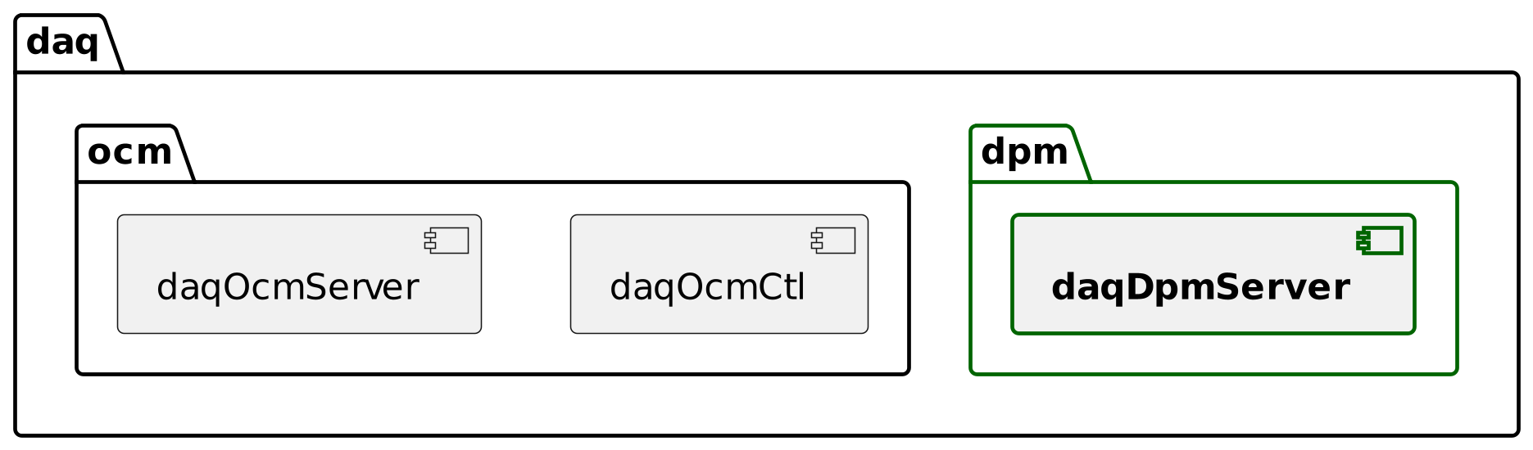
Components and Roles
      Data Product Manager (DPM)
      Responsible for creating the Data Product
Accepts requests (OCM) to create Data Products
Collect input files
Merges according to instructions
Deliver Data Product (typically to the science archive)

Slide 6
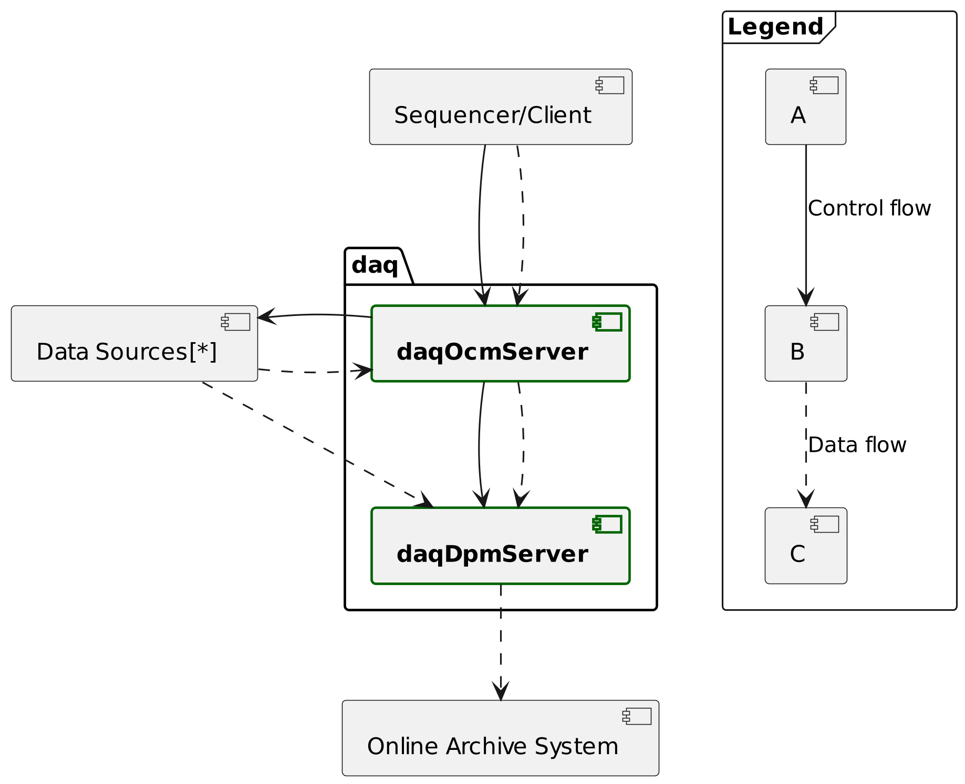
System Interactions
Control via request/reply
Data flow via
  Request/reply payload
  Local file system
  Remote files (e.g. rsync)
Only connection between OCM and DPM is persistent

Slide 7
What is a Data Acquisition?

Slide 8
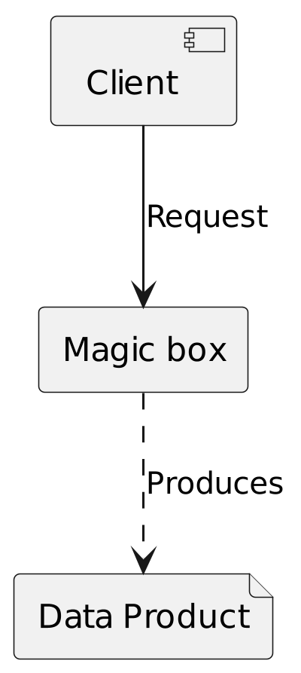
What is a Data Acquisition Anyway?
Introduction
It is the process by which OCM and DPM create a Data Product
Started from a specification
  Where to acquire from (Data Sources)
  How to merge results (Data Product)
  Where to release the file
Each Data Acquisition is handled independently and concurrently
Notes:
So what is a data acquisition?

Slide 9
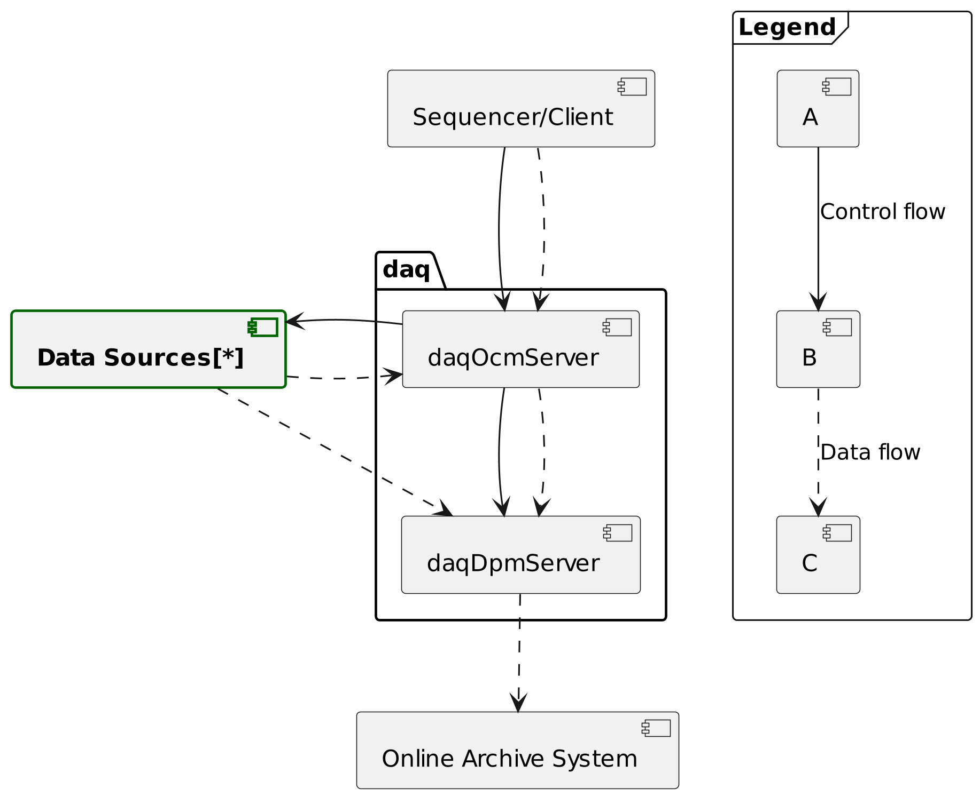
What is a Data Acquisition Anyway?
Data Sources
Two standard interfaces are defined:
Primary data source (recif)
  Determines the acquisition duration
  FITS files only
  E.g. NGC2, Camera Control Framework (ccf)
Metadata source (metadaqif)
  FITS files and/or JSON FITS keywords
  E.g. HLCC (telescope), Function Control Framework (fcf)
Notes:
So what is a data acquisition?

Slide 10
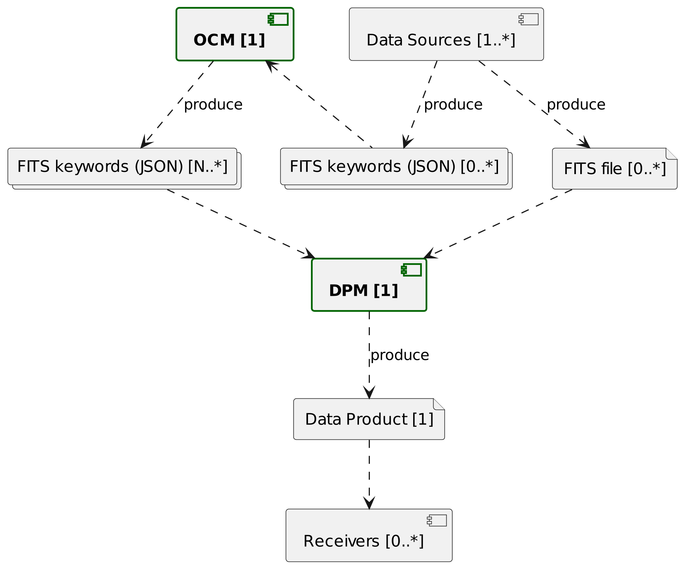
What is a Data Acquisition Anyway?
Data Model
Notes:
So what is a data acquisition?

Slide 11
Data Acquisition Walkthrough

Slide 12
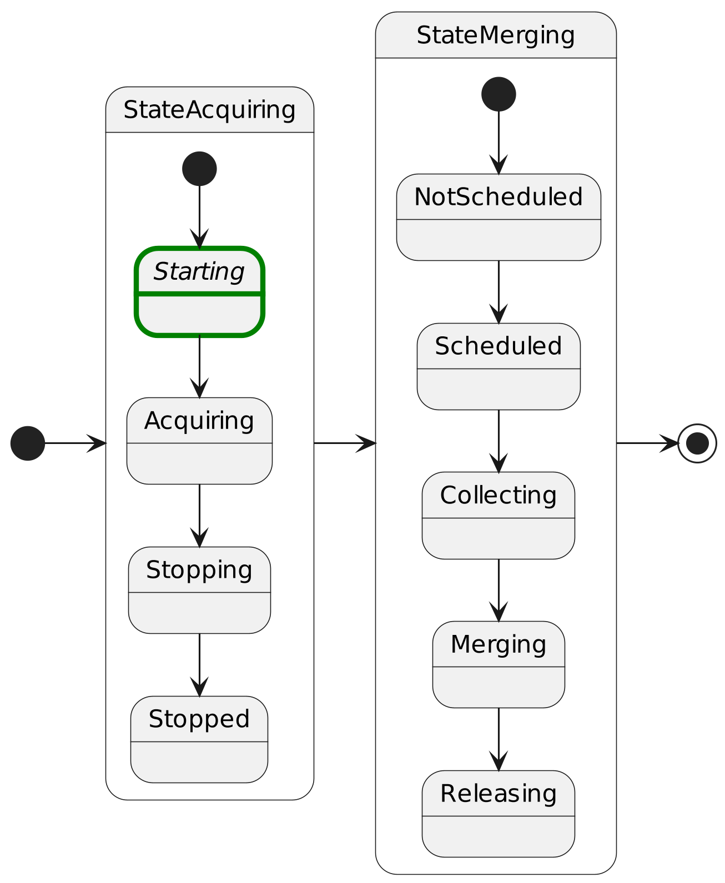
Data Acquisition Walkthrough
      Starting
Initiated with StartDaq/StartDaqV2 OCM requests
  Command completes successfully when each source has started
Aborts on failure to start
  The only case where this is done automatically

Slide 13
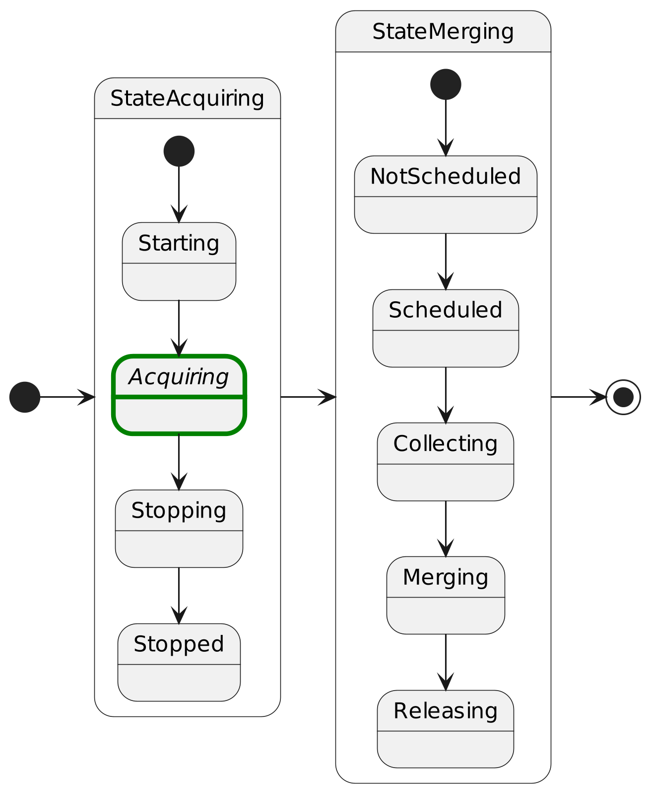
Data Acquisition Walkthrough
      Acquiring
Can use UpdateKeywords OCM request to add/modify FITS keywords
Monitor progress with pub/sub DaqStatus topic containing:
  State & substate
  Error flag indicating one or more problems
  Message providing information about problems
  Data Product file path once created

Slide 14
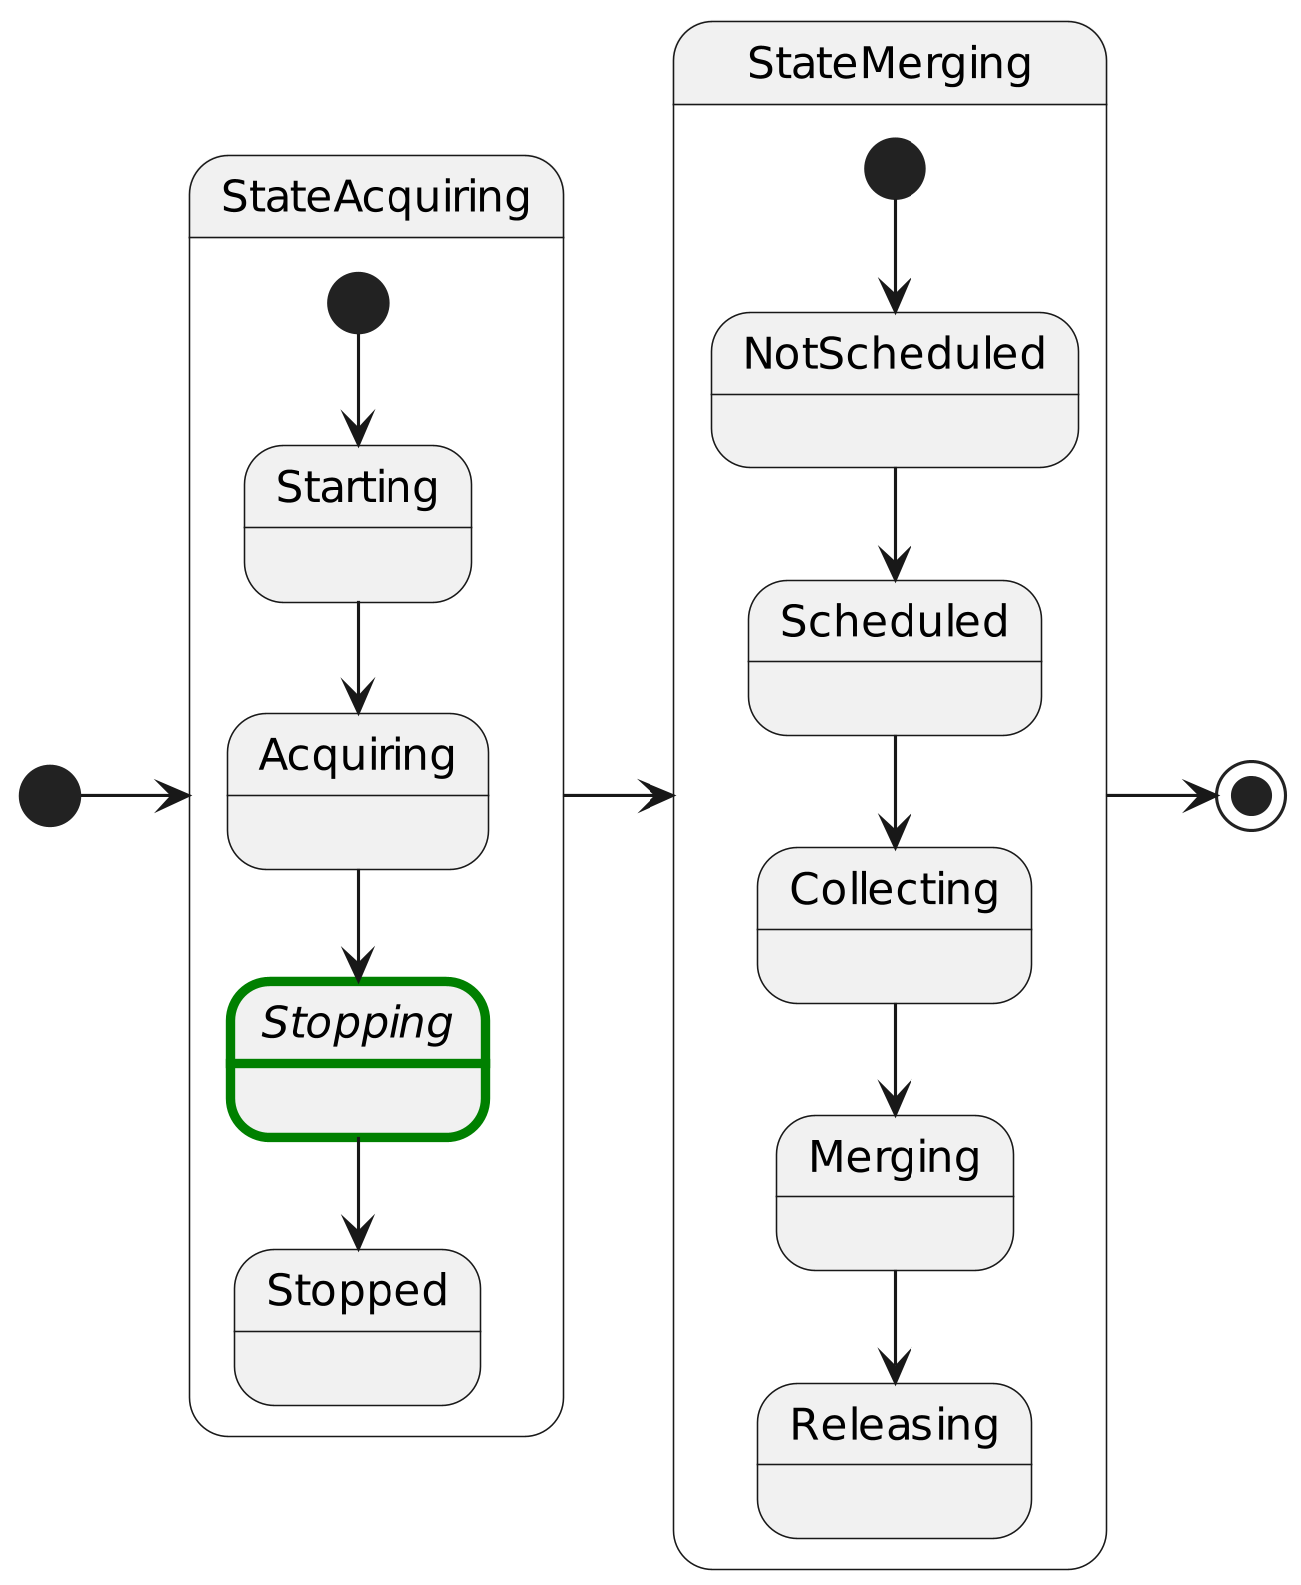
Data Acquisition Walkthrough
      Stopping
Initiated automatically if all Primary Data Sources completes successfully
Initiated manually with StopDaq/ForceStopDaq requests
  Necessary without Primary Data Sources

Slide 15
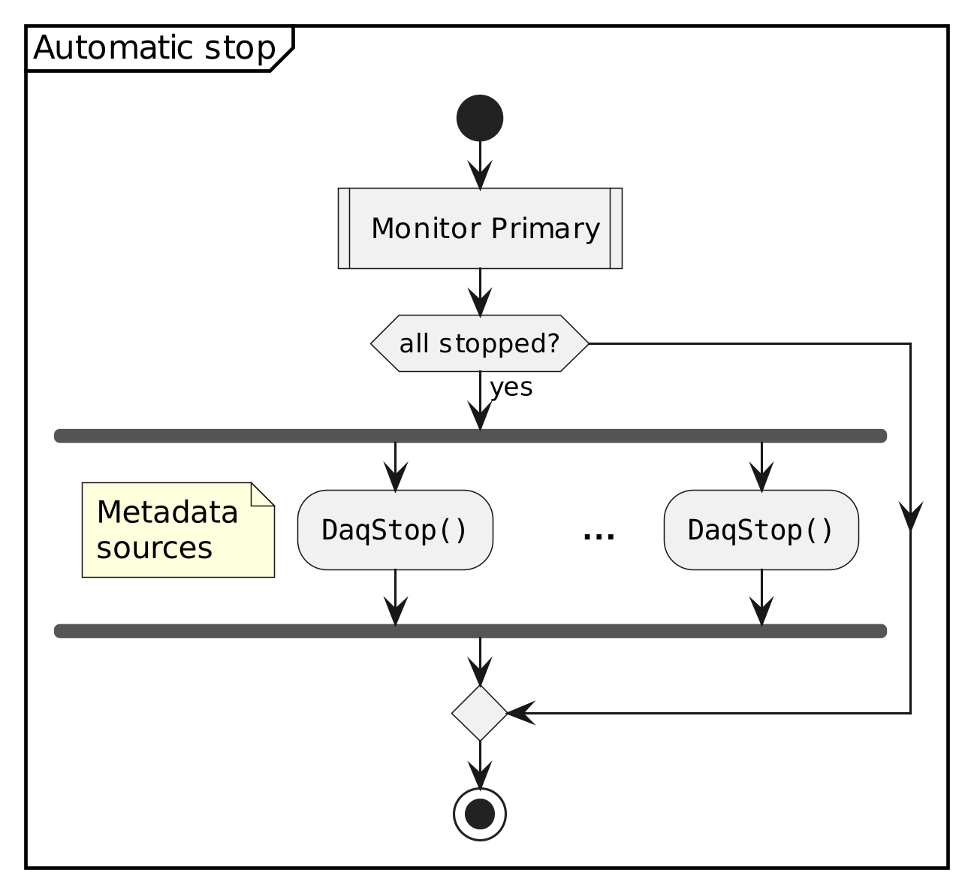
Data Acquisition Walkthrough
      Automatic Stopping Sequence
Initiated when all primary sources are stopped
Then metadata data sources are stopped concurrently
Example scenarios
  Configured integration time
  Detector stopped manually without going via OCM

Slide 16
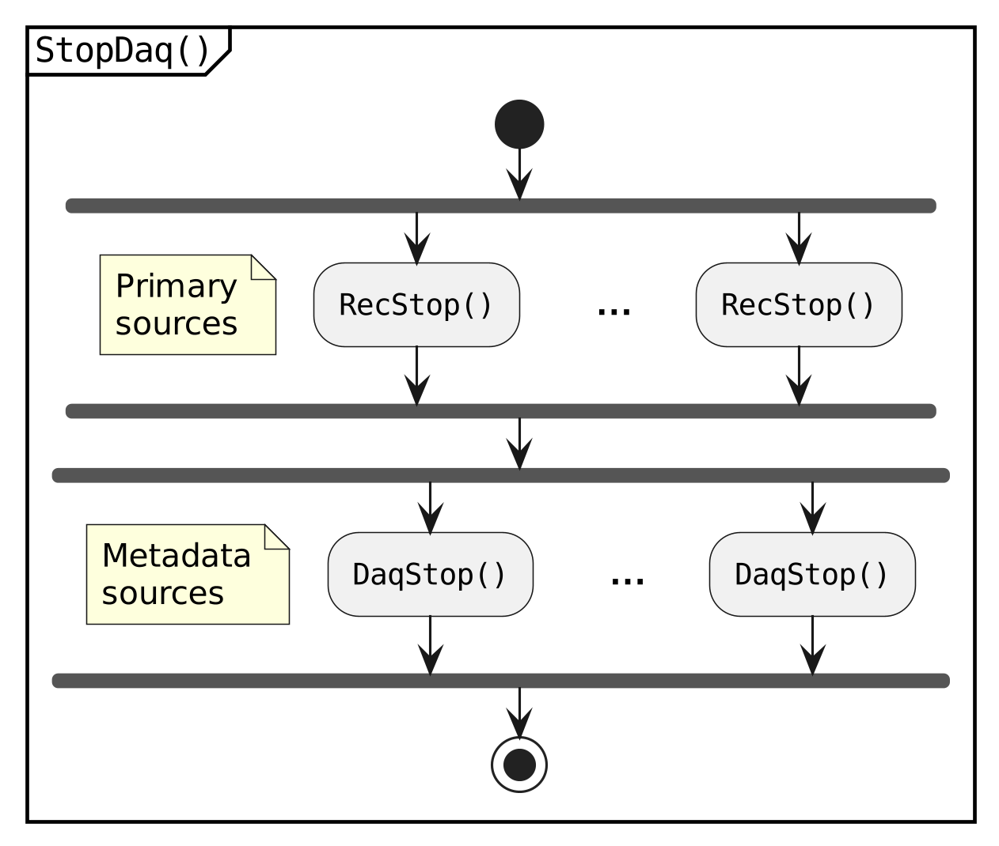
Data Acquisition Walkthrough
      Manual Stopping Sequence
Initiated with OCM StopDaq or ForceStopDaq request
First primary sources are stopped concurrently
Then metadata data sources are stopped concurrently
Note: ForceStopDaq continues on failure (error flag set)

Slide 17
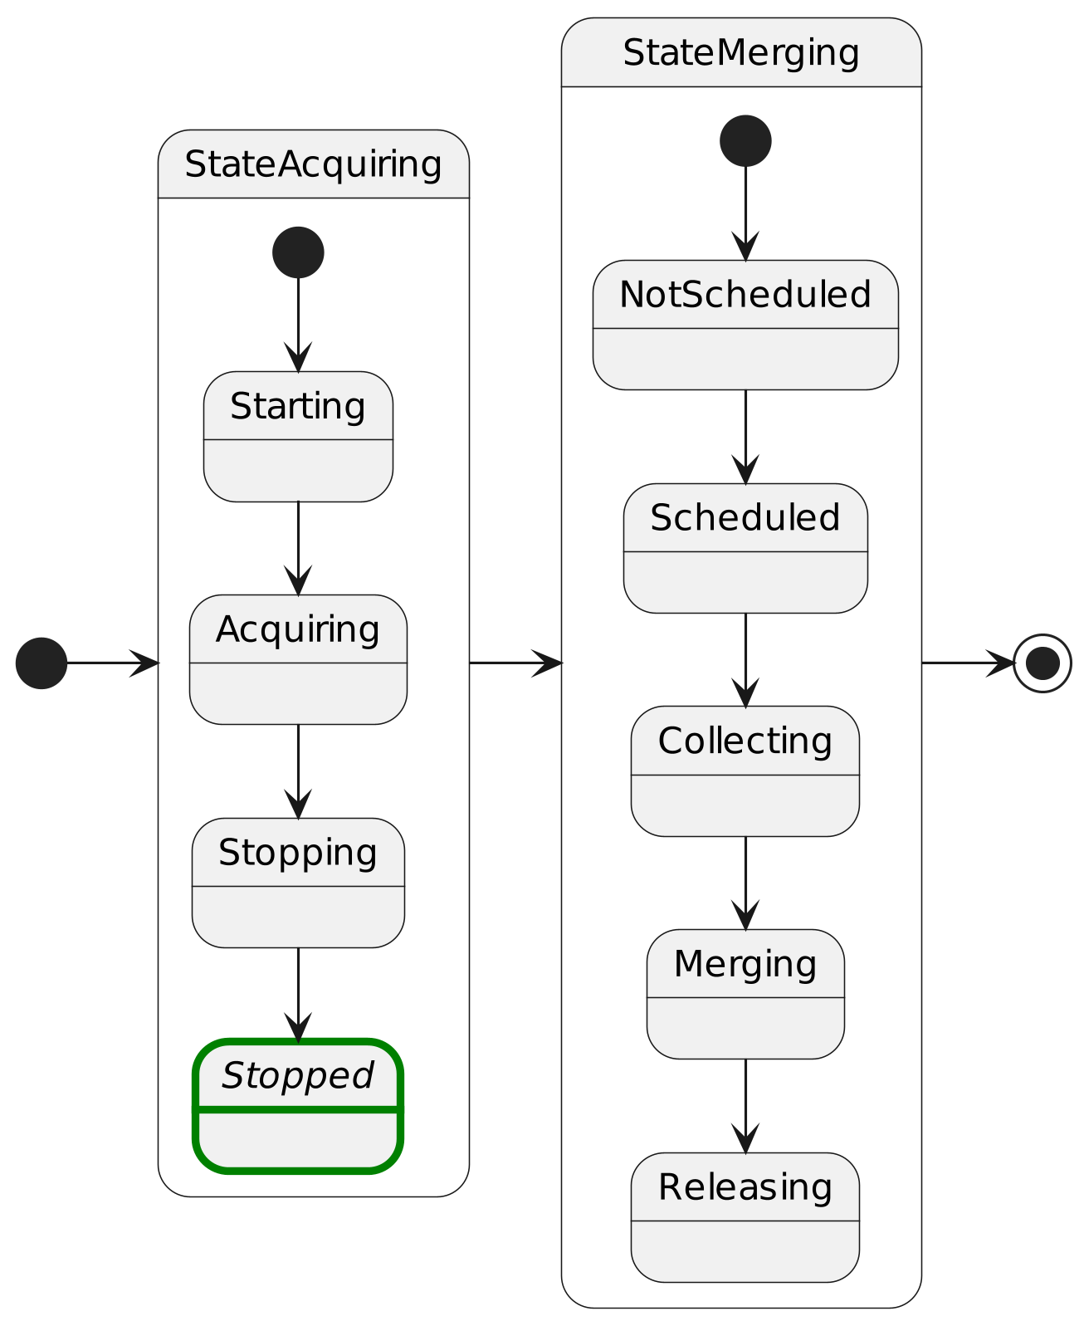
Data Acquisition Walkthrough
      Stopped
All Data Sources have been
  stopped successfully,
  or failed sources ignored with ForceStopDaq
Useful synchronization point for AwaitDaqState OCM request

Slide 18
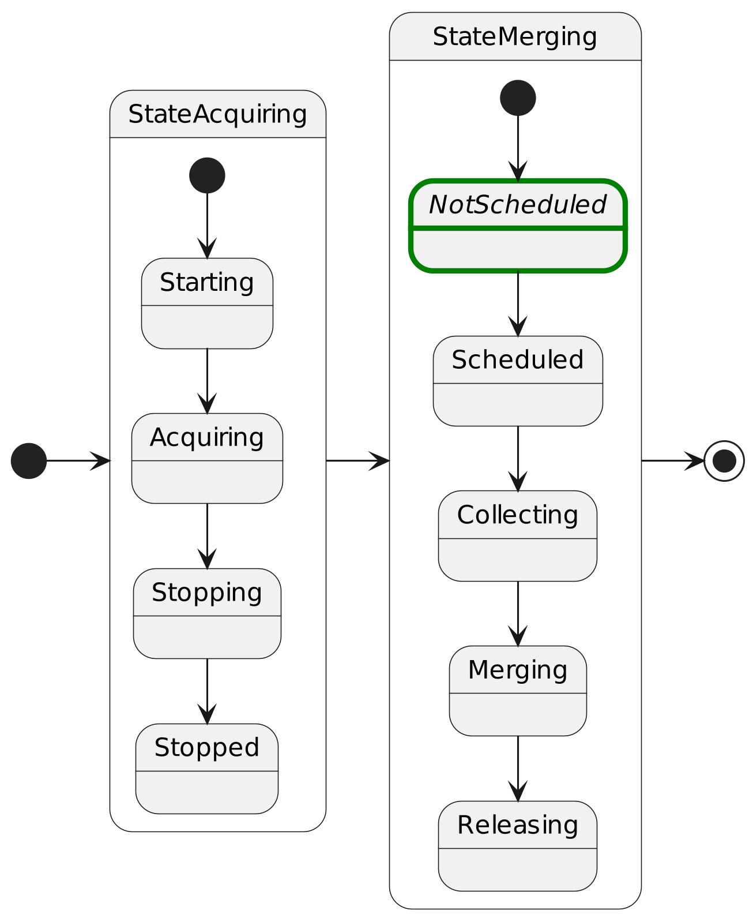
Data Acquisition Walkthrough
      NotScheduled
OCM requests DPM to create Data Product
If DPM is offline or unreachable it will retry
  at application startup and
  once every minute

Slide 19
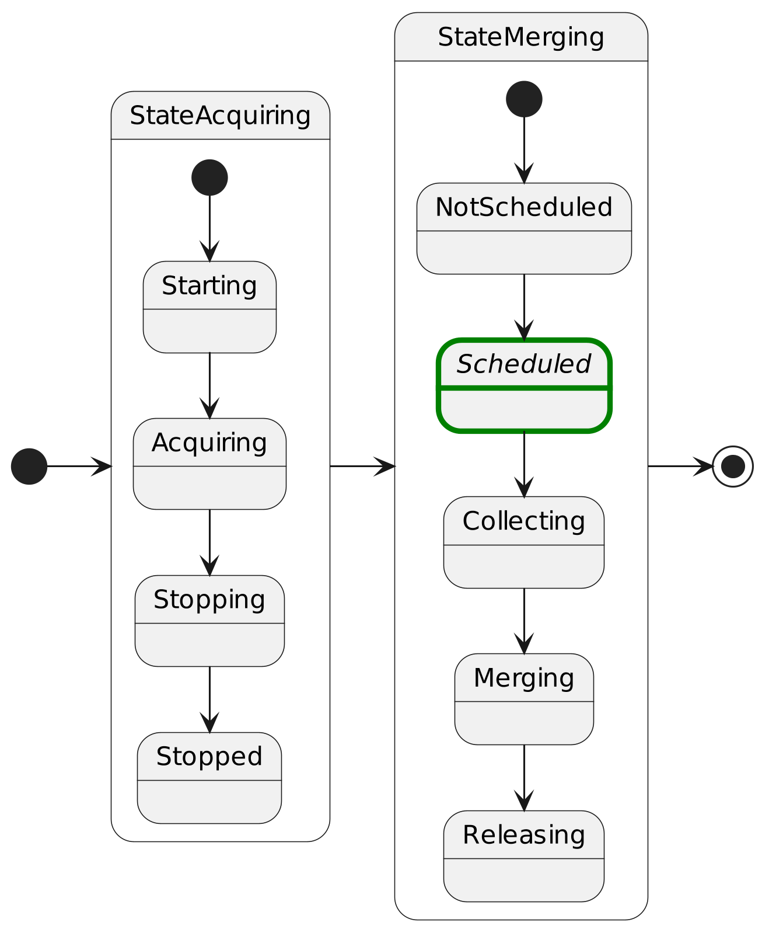
Data Acquisition Walkthrough
      Scheduled
Data Acquisition stored in DPM backlog
DPM takes over responsibility for completing Data Acquisition
Status updates are published and re-published by OCM

Slide 20
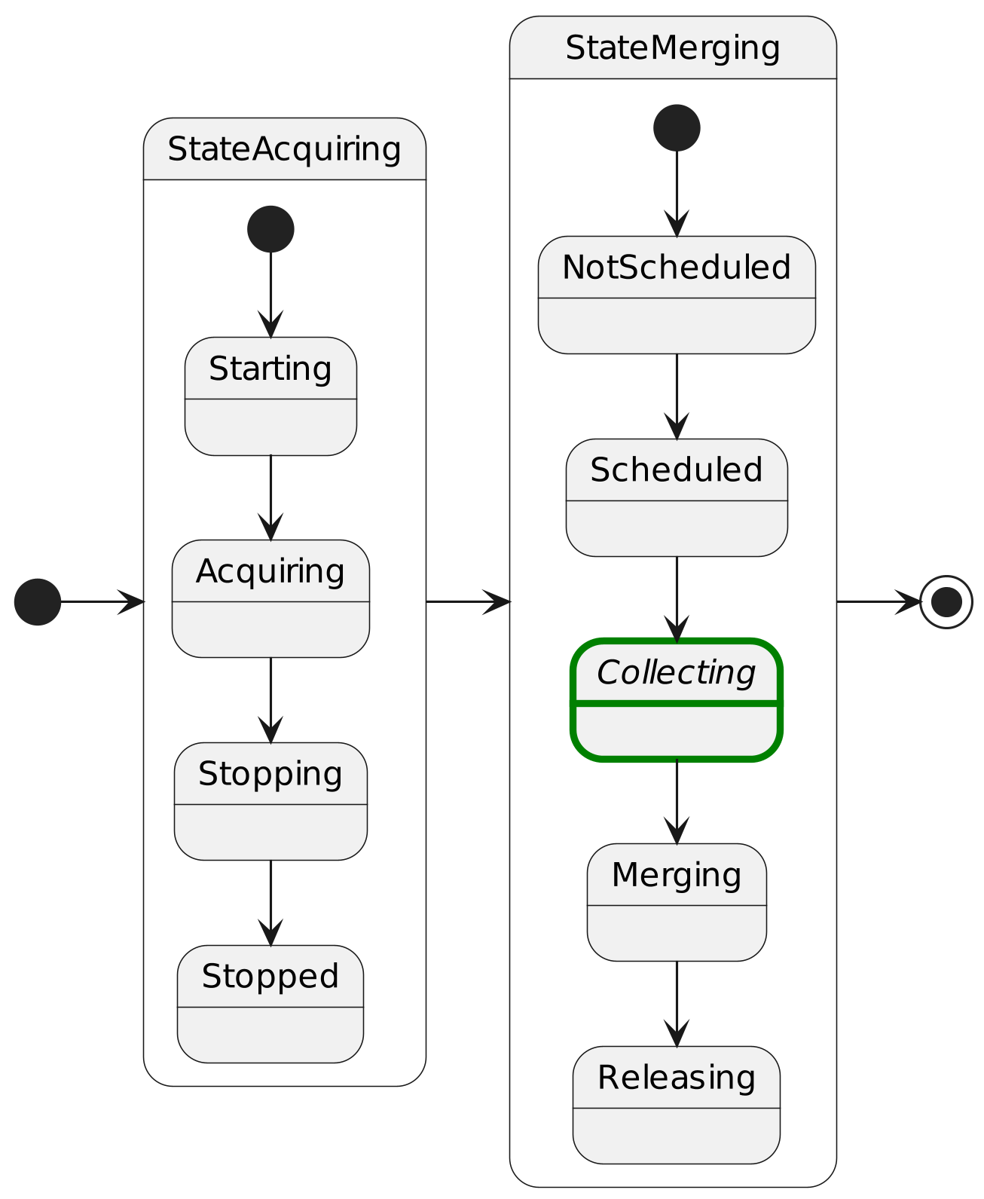
Data Acquisition Walkthrough
      Collecting
Fetching missing source files
  Local mount or
  rsync
Source files are not removed after copy

Slide 21
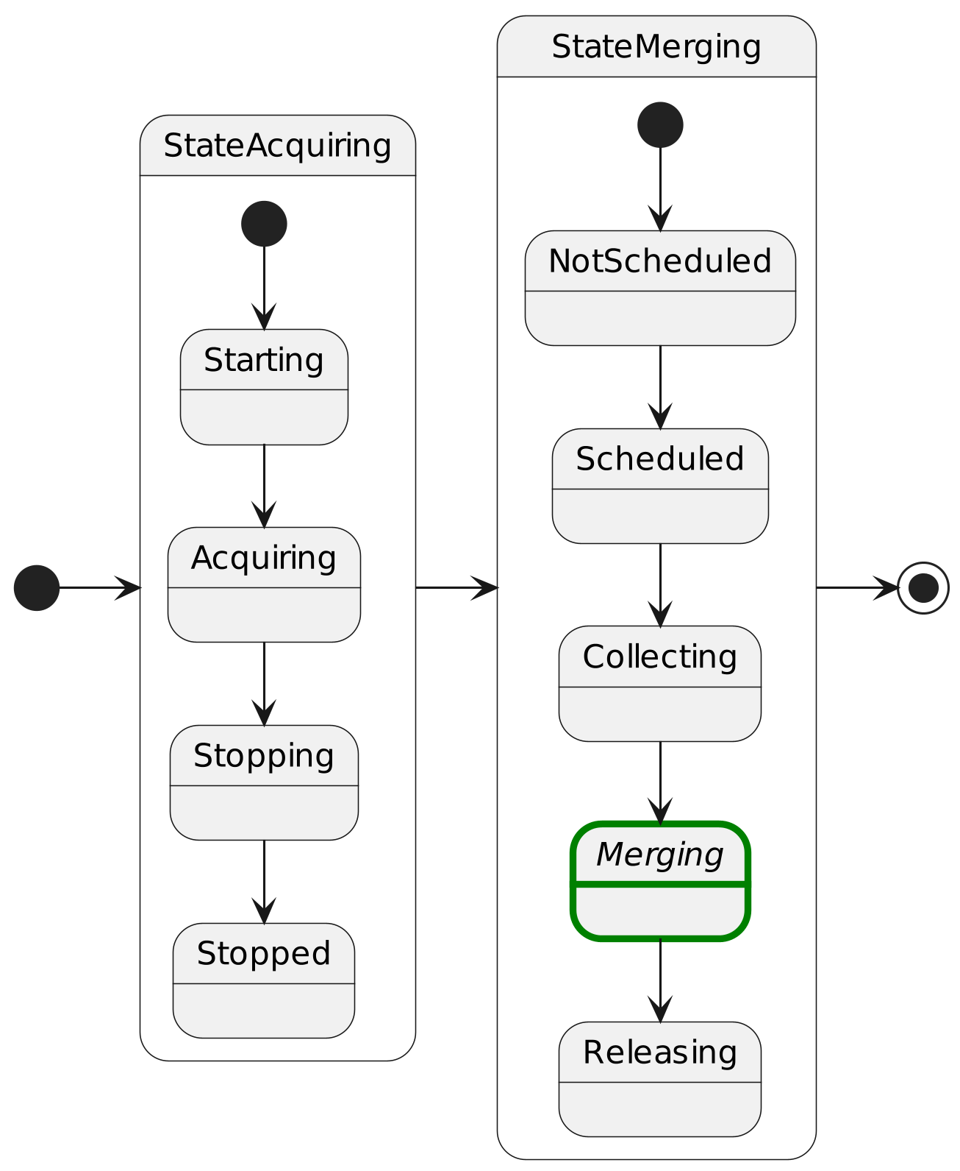
Data Acquisition Walkthrough
      Merging
Executes the merge process
Writes Data Product to {workspace}/result/{FileId}.fits
{FileId} follows ESO science archive requirements
{prefix}.{timestamp}, e.g. LOREM.2024-11-26T16:15:03.127

Slide 22
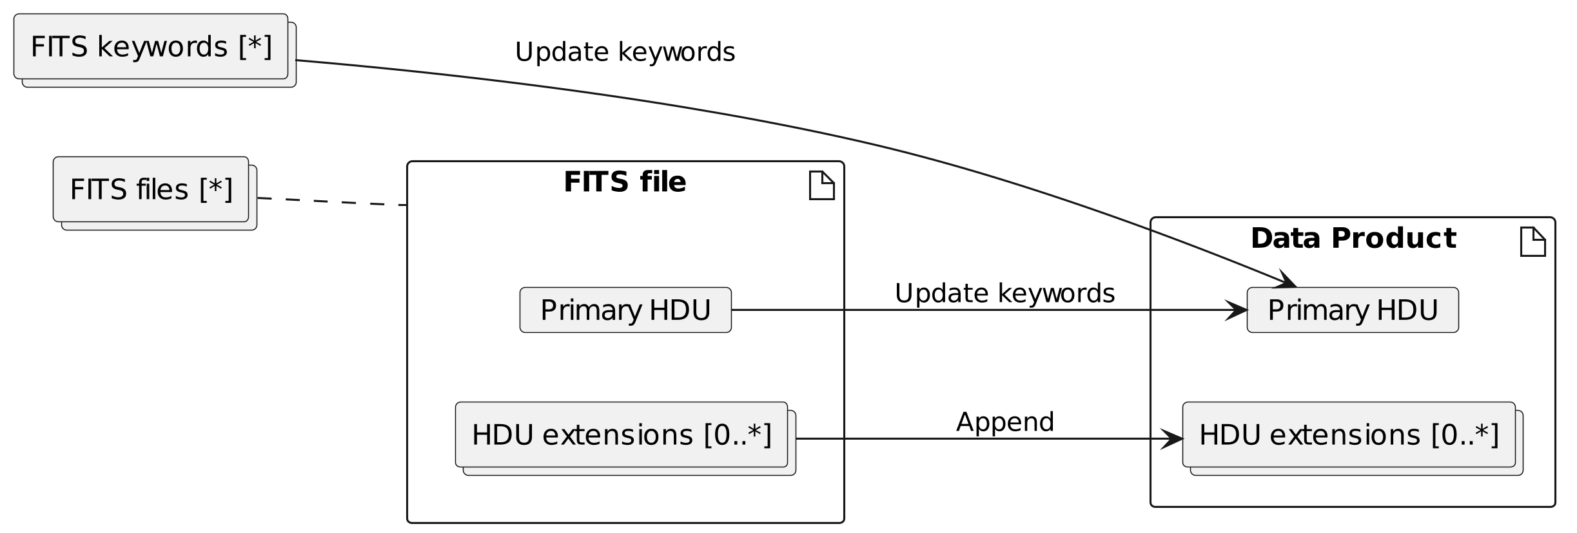
Data Acquisition Walkthrough
      Merging
Keywords are stable-sorted according to DICD
    ESO Data Interface Control Document DICD ESO-044156
HDU extension order follows data source order
Note: Primary HDU with data must be used as merge target

Slide 23
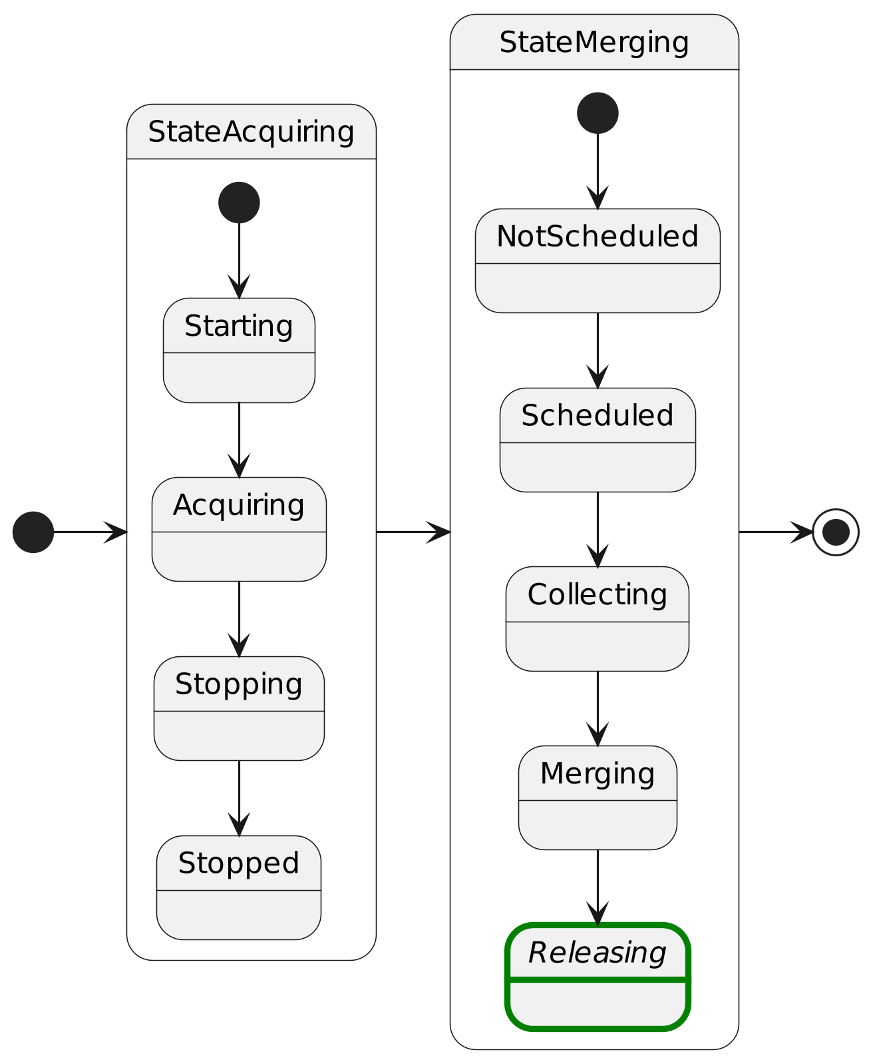
Data Acquisition Walkthrough
      Releasing
Releases Data Product to receivers (typically archive system)
After release the Data Acquisition is completed
  Source files, logs and other files are archived and are safe to delete

Slide 24
Data Acquisition Walkthrough
A note on aborting
  Aborting means "stop + discard" data
  Use AbortDaq which is generally possible in any state
  Use ForceAbortDaq command to force continuation by ignoring errors e.g.
    from Data Sources reporting failures
    from DPM because it's not running
  Propagated as necessary
    Data Sources that are acquiring
    DPM if required
  OCM and DPM discards their created or collected data

Slide 25
Calle Rosenquist
crosenqu@eso.org
@ESOAstronomy
@esoastronomy
@ESO
european-southern-observatory
@ESOobservatory

Slide 26
Deployment

Slide 27
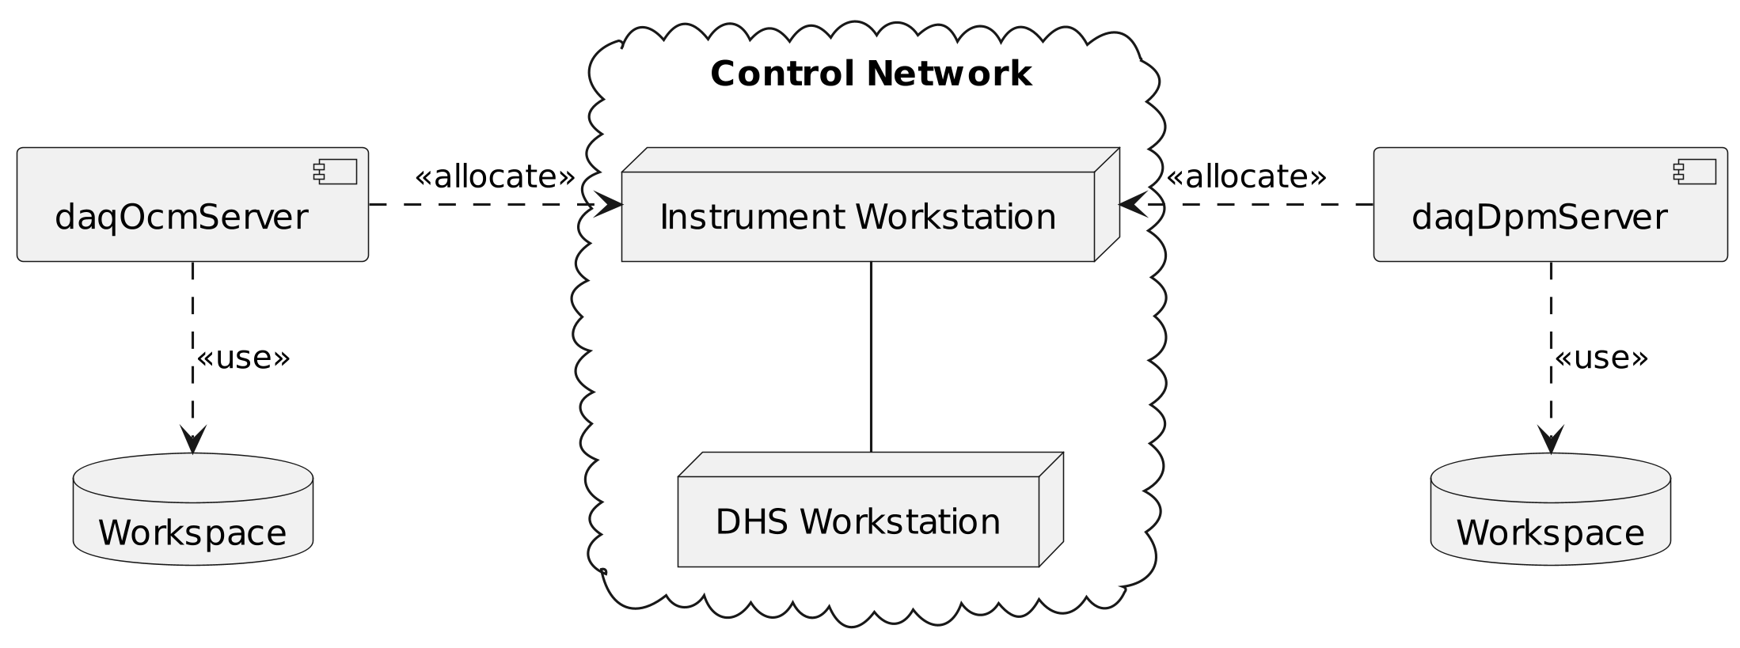
Deployment
      Example 1
      DPM on instrument workstation
Deploys OCM and DPM on same workstation/node
FITS data is first copied to workstation
Data Product is then copied remotely to DHS workstation.

Slide 28
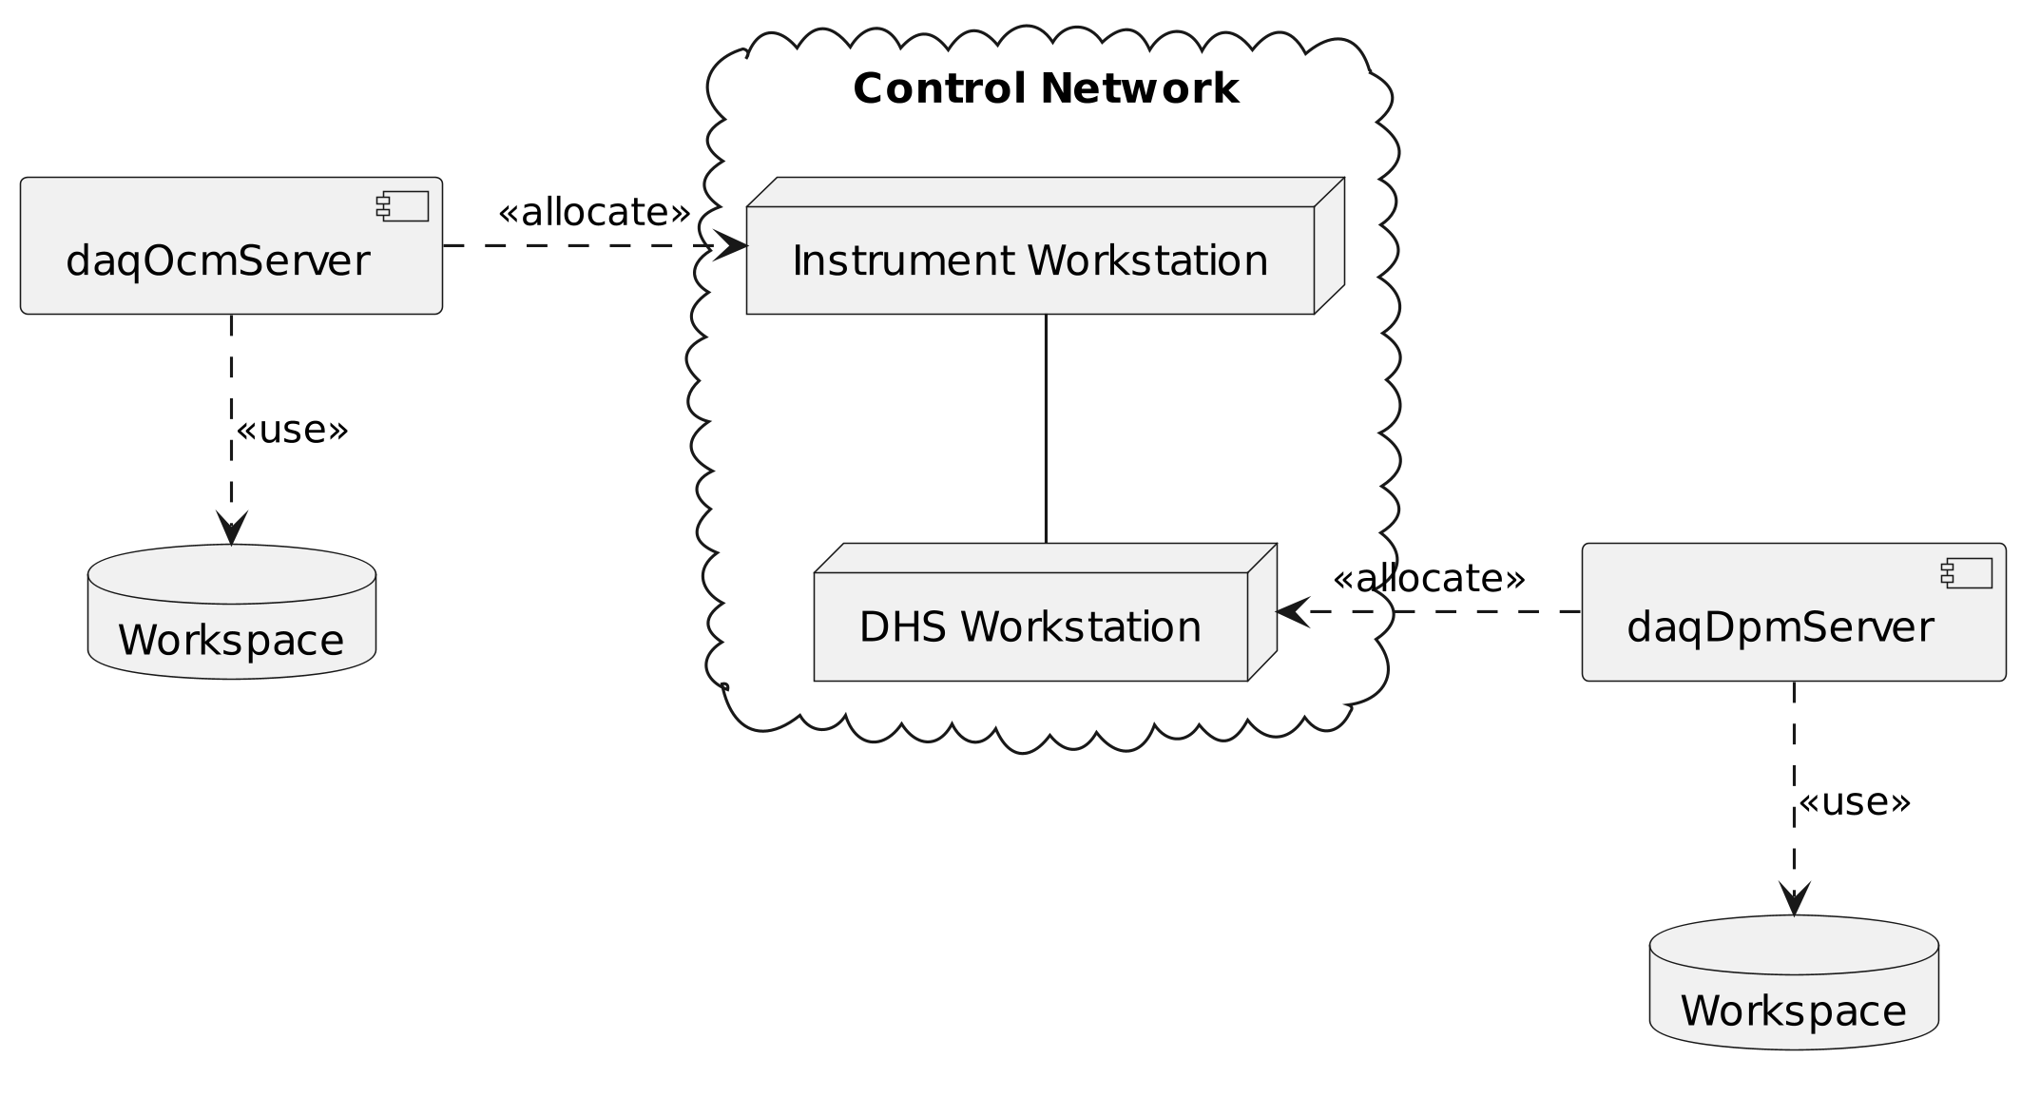
Deployment
      Example 2
      DPM on DHS workstation
Deploys OCM on workstation/node
Deploys DPM on Data Handling Server (DHS)
FITS data is copied directly to DHS
Data Product is then either hard linked or symlinked for archive ingestion

Slide 29
Configuration

Slide 30
OCM Configuration
Notable parameters from manual*
  YAML file daqOcmServer --config {FILE}
  cfg/instrument_id: ESO designated instrument ID, used in Data Product (file name and keywords)
  cfg/dictionaries: List of dictionaries which, if specified, will enable keyword validation in OCM.
    Note: Only keywords seen by OCM are validated. Keywords from FITS files do not pass via OCM.
  cfg/daq/stale_acquiring_hours: [default 14] Determines when Data Acquisitions left in StateAcquiring are considered abandoned at application startup.
  cfg/daq/stale_merging_hours: [default 48] Determines when Data Acquisitions left in StateMerging are considered abandoned at application startup
*) Observation Coordination Manager > Server > Configuration File

Slide 31
DPM Configuration
Notable parameters from manual*
  YAML file daqDpmServer --config {FILE}
  cfg/limits/daq: [default 1] Number of concurrent Data Acquisitions DPM will handle.
  cfg/limits/merge: [default 1] Number of concurrent merge processes DPM will handle.
  cfg/limits/net_receive: [default 0 (infinite)] Number of incoming concurrent file transfers DPM will handle.
  cfg/limits/net_send: [default 0 (infinite)] Number of outgoing concurrent file transfers DPM will handle.
*) Data Product Manager > Server > Configuration File

Slide 32
Deployment
A note on SSH configuration
  Configure SSH is required if Data Sources specify FITS files using `host:path`
  For additional configuration edit `~/.ssh/config`
    See `man ssh_config`
# Generate key if necessary, e.g.
$ ssh-keygen -t ed25519 -N ""
# Install key on hosts DPM need to connect to
$ ssh-copy-id host
# Test connection
$ ssh host

Slide 33
Troubleshooting

Slide 34
Troubleshoot Data Acquisitions
Problems are indicated by Data Acquisition error flag
Check Data Acquisition Status message
  Contains list of alerts identifying concrete problems, e.g.
    Error(s) from Data Sources
    Failing keyword validation
    Problems transferring files
    Failure to merge
Enable debug logs
  "daq" is the root logger (also "daq.ocm", "daq.dpm")
DPM Workspace has a lot of information
  {workspace}/in-progress/{id}/sources
  {workspace}/in-progress/{id}/logs
Reach out to ESO

Slide 35
Starting Data Acquisition
Example "Specification"
  Sources
    One primary source "dcs"
    One metadata source "tcs"
    A couple of keywords
  Create Data Product by merging into "dcs" output
  Release Data Product to archive system

Slide 36
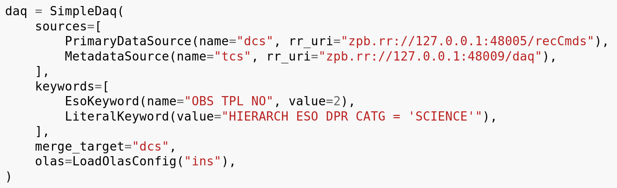
Example Specification
IFW Template Instrument utility SimpleDaq from daq.py

Slide 37
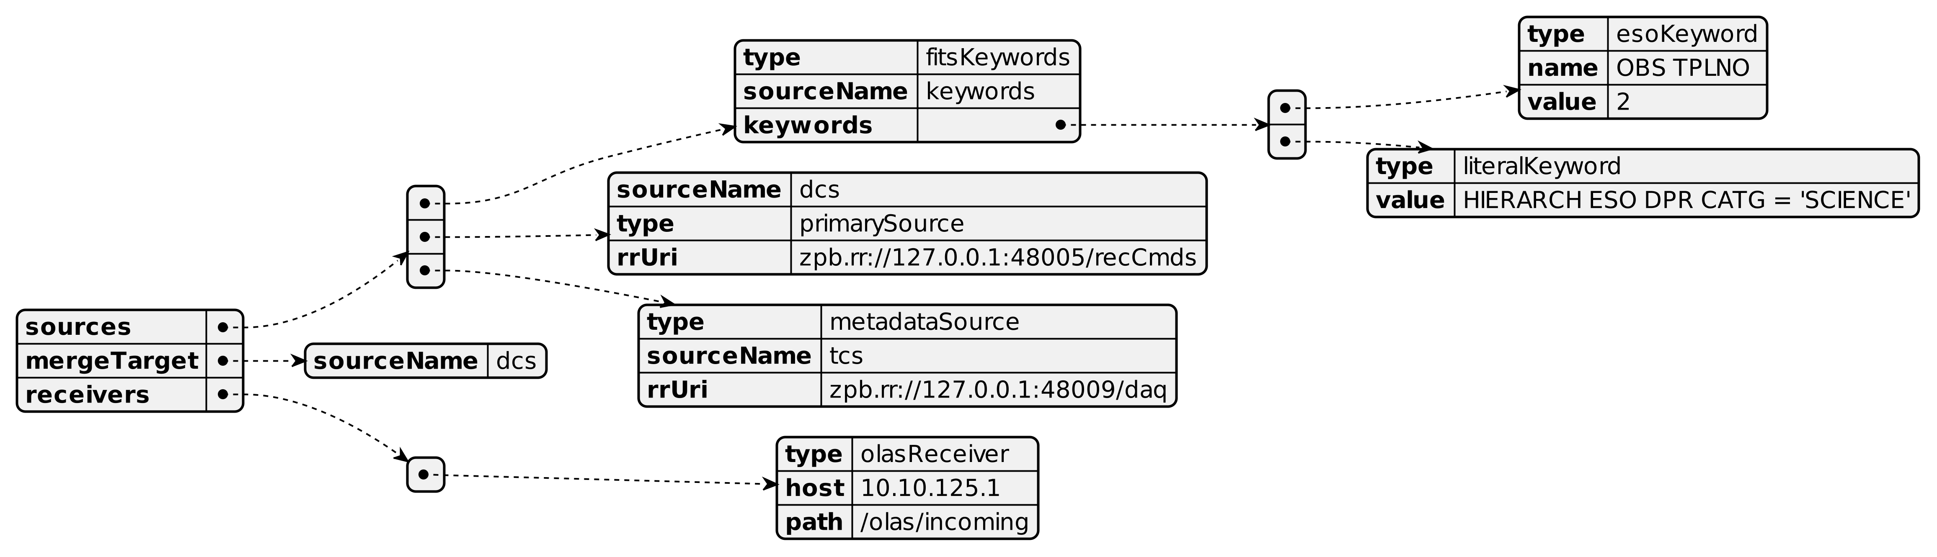
Example Specification
Visual representation

Slide 38
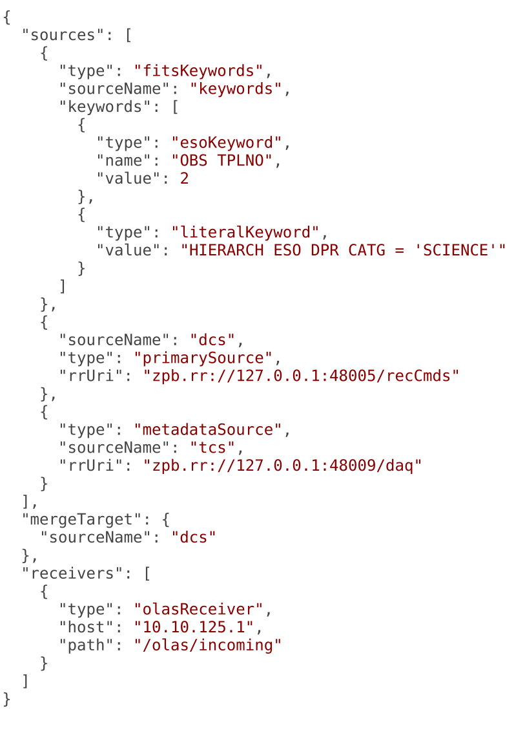
Example Specification
Native JSON

