Slide 1


IFW Device Control Framework – FCF
Device Simulators
J. Knudstrup

Slide 2
Purpose & Scope of FCF DevSim
FCF Device Simulator (DevSim) package:
Small toolkit to implement WS Device Simulators.
Main purposes are to:
  Facilitate development of instrument software under ‘realistic conditions’ without the availability of any hardware.
  Make it possible to develop and execute integration tests (robot/etr) without the availability of any hardware.
  Facilitate troubleshooting of WS software (to the extent possible without hardware).
  Make it possible to run integration tests for SQA purposes in Jenkins.
  Possibly it may be a tool to help designing Special Devices (if it is easier to develop the WS simulator than the real device: Prototyping with DevSim, before actual implementation).
  Make it possible to advance as much as possible with the development, while waiting for hardware components, preventing from implementing/completing the PLC code.

Slide 3
Scope of Device Simulators
Normally it is not the intention/or necessary to implement a 100% true emulation of the PLC code + associated hardware to fulfil the simulator’s purpose.
In general: Implement only enough to develop and execute the Instrument Templates, test the GUIs, implement and run Integration Tests, etc.
Unlike VLTSW: For the ELT IFW, not the intention to use simulation in case of a failing device. A failing device should instead be ‘disabled’, operationally.
--- in fact, you should normally not execute the WS Device Simulators on the production machines.
It is mandatory to provide a Device Simulator for a Special Device.

Slide 4
Standard Device Simulators
Following Device Simulators are supported by IFW for Standard Devices:
  Actuator
  ADC
  DROT
  I/O Device
  Lamp
  Motor
  Piezo
  Shutter
  Planned for IFW25: PSU8600, Multi-Axis Device?

Slide 5
Architecture
Simulation separated from DevMgr to avoid ‘polluting’ code of Device Managers.
Implemented in Python.
Based on:
    SCXML state machine engine (rad/scxml4py)
    OPC UA server SDK (github.com/FreeOpcUa)
Generic SCXML/OPC UA Server toolkit provided by IFW Core Component
    ifw-core/pyutils/opcua/src/ifw/core/opcualib/srvlib
Limitation: Only possible to host one device per DevSim server – work on-going to fix that…

Slide 6
Architecture – cont’d
A Device Simulator loads at start-up:
    SCXML Definition: Defines the state machine.
    OPC UA XML Profile: Defines the OPC UA namespace.
    Cfg: Parameters changing the behavior (YAML based).
PLC
Device
Simulator
Device
Manager
OPC UA
OPC UA namespace must match exactly the PLC device namespace.
Behavior implemented in Python code.
SCXML
OPC UA
XML
Profile
Cfg
IWS

Slide 7
SCXML Definition – Example/Sensor (Extract)
<?xml version="1.0" encoding="UTF-8"?>
<scxml xmlns="http://www.w3.org/2005/07/scxml" xmlns:customActionDomain="http://my.custom-actions.domain/CUSTOM" version="1.0" initial="On">
<state id="On">
<initial>
<transition target="On::NotOperational"/>
</initial>
<state id="On::Operational">
<initial>
<transition target="On::Operational::Monitoring"/>
</initial>
<state id="On::Operational::Error">
<transition event="HwOk" target="On::Operational::Monitoring"/>
<transition event="Disable" target="On::NotOperational::Ready"/>
</state>
<state id="On::Operational::Monitoring">
<transition event="ErrHw" target="On::Operational::Error"/>
<transition event="Disable" target="On::NotOperational::Ready"/>
</state>
</state>
<state id="On::NotOperational">
<initial>
<transition target="On::NotOperational::Ready"/>
</initial>
<state id="On::NotOperational::NotReady">
<onentry>
<customActionDomain:Reset.Execute name="Reset.Execute"/>
</onentry>
<transition event="Init" target="On::NotOperational::Ready"/>
</state>
. . .

Slide 8
OPC UA YAML Profile – Example/Sensor DevSim (Extract)
. . .
CtrlCommand: ctrl.nCommand
CtrlExecute: ctrl.bExecute
. . .
StatState: stat.sState
StatSubstate: stat.sSubstate
StatNState: stat.nState
StatNSubstate: stat.nSubstate
. . .
# Digital input channels:
StatDI1: stat.arrDI[0].bValue
StatDI2: stat.arrDI[1].bValue
StatDI3: stat.arrDI[2].bValue
. . .
# Analog input channels:
StatAI1: stat.arrAI[0].lrValueUser(Double)
StatAI2: stat.arrAI[1].lrValueUser(Double)
StatAI3: stat.arrAI[2].lrValueUser(Double)
. . .
# RPC methods:
RpcDisable: rpc.Disable(O:ReturnValue(Int16))
RpcEnable: rpc.Enable(O:ReturnValue(Int16))
RpcExit: rpc.Exit(O:ReturnValue(Int16))
RpcInit: rpc.Init(O:ReturnValue(Int16))
RpcReset: rpc.Reset(O:ReturnValue(Int16))
RpcState: rpc.State(O:StateStat(String))
RpcStop: rpc.Stop(O:ReturnValue(Int16))
60 lines

Slide 9
OPC UA XML Profile – Example/I/O Device DevSim (Extract)
<?xml version="1.0" encoding="utf-8"?>
<UANodeSet xmlns:xsi="http://www.w3.org/2001/XMLSchema-instance"
xmlns:uax="http://opcfoundation.org/UA/2008/02/Types.xsd"
xmlns="http://opcfoundation.org/UA/2011/03/UANodeSet.xsd"
xmlns:xsd="http://www.w3.org/2001/XMLSchema">
. . .
<UAVariable DataType="Double" NodeId="ns=4;s=MAIN.sensor1.stat.arrAI[2].lrValueUser" BrowseName="4:arrAI[2].lrValueUser"
UserAccessLevel="3" AccessLevel="3">
<DisplayName>arrAI[2].lrValueUser</DisplayName>
<References>
<Reference ReferenceType="HasTypeDefinition">i=63</Reference>
<Reference ReferenceType="Organizes"
IsForward="false">ns=4;s=MAIN.sensor1.stat</Reference>
</References>
<Value>
<uax:Double>0</uax:Double>
</Value>
</UAVariable>
<UAVariable DataType="Int32" NodeId="ns=4;s=MAIN.sensor1.stat.nSubstate" BrowseName="4:nSubstate"
UserAccessLevel="3" AccessLevel="3">
<DisplayName>nSubstate</DisplayName>
<References>
<Reference ReferenceType="HasTypeDefinition">i=63</Reference>
<Reference ReferenceType="Organizes"
IsForward="false">ns=4;s=MAIN.sensor1.stat</Reference>
</References>
<Value>
<uax:Int32>0</uax:Int32>
</Value>
</UAVariable>
. . .
880 lines

Slide 10
DevSim Cfg – Example/I/O Device
opcua_profile: "config/fcf/devsim/sensor/sensor1.namespace.xml"
state_machine_scxml: "config/fcf/devsim/sensor/sensor.scxml.xml"
opcua_identifier: "PLC1"
device_name: "Iodev1"
opcua_prefix: "MAIN.Iodev1"
cfg_sim_delay: 1000
auto_enter_op: True
sim_init_time: 2
cfg_local: False
update_frequency: 5
# Digital input channels:
di1_value: True
# Pars: period high/low [s].
di1_function: "di_square_wave(10.0, 1.0)"
di2_value: True
di2_function: "di_square_wave(5.0, 5)"
di3_value: True
di3_function: "di_square_wave(1.0, 2.0)"
di4_value: True
# Analog input channels:
ai1_value: 1000
# Pars: Period [s], scale, offset.
ai1_function: "ai_sine_wave(10.0, 1.0, 0)"
ai2_value: 256
ai2_function: "ai_sine_wave(1.0, 2.0, 5)"
ai3_value: 512
ai3_function: "ai_sine_wave(20.0, 15, 0)"
ai4_value: 1234

Slide 11
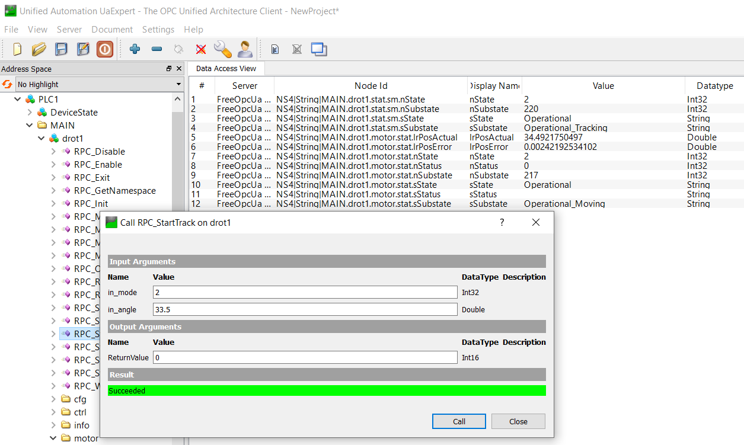
Executing a Device Simulator
$ fcfDevsimDrot --port 7777 --cfg config/fcf/devsim/drot/drot.cfg.yaml --log-level INFO --use-ext-ip
2024-09-22 13:27:40,657:INFO:SmOpcUaSrv:MainThread:serverbase:647:execute_int: Setting up OPC UA server - done
2024-09-22 13:27:40,657:INFO:SmOpcUaSrv:MainThread:serverbase:658:execute_int: Loading configuration: config/fcf/devsim/drot/drot.cfg.yaml
2024-09-22 13:27:40,658:INFO:SmOpcUaSrv:MainThread:serverbase:665:execute_int: Loading OPC UA namespace definition: fcf/devsim/drot/drot1.namespace.xml
2024-09-22 13:27:40,658:INFO:SmOpcUaSrv:MainThread:serverbase:669:execute_int: Found OPC UA namespace definition: /scratch/jknudstr/INTROOT/resource/config/fcf/devsim/drot/drot1.namespace.xml
…
2024-09-22 13:27:40,847:INFO:SmOpcUaSrv:MainThread:serverbase:708:execute_int: Main: Starting State Machine Engine ...
2024-09-22 13:27:40,848:INFO:SmOpcUaSrv:MainThread:serverbase:712:execute_int: Main: Started State Machine Engine
2024-09-22 13:27:40,848:INFO:SmOpcUaSrv:MainThread:serverbase:716:execute_int: Main: Time for initialising: 1.062s

Slide 12
Implementing a new DevSim
Steps:
  Provide design of the device (PLC Controller + DevMgr Device Class).
  a) Implement PLC Controller, PLC Simulator, WS DevMgr Device Class – or
  b) Start developing the DevMgr Device Class + the Device Simulator.
  Generate the DevSim source tree using the provided Cookiecutter template.
  Extract/define the PLC parameters and constants from the design or PLC code (if existing).
  Create the DevSim OPC UA YAML namespace (used to generate the OPC UA XML representation).
  Create the DevSim state machine SCXML definition – should match the PLC Controller state machine.
  Adapt the generated source code according to the (simulated) logic of the device.
  During development: Exercise/test with UA Expert, or similar.
  Validate with DevMgr Device Class, possibly applying same integration test as for real PLC Controller/Simulator/DevMgr Device Class test suite.

Slide 13
DevSim Cookiecutter Template
DevSim Cookiecutter Template: “ifw-fcf/devsim/templates/devsim_tpl/”.
  “ifw-fcf/devsim” template used to create simulators ‘standalone’, for instance adding to an existing Instrument Source Tree.
  “ifw-fcf/devsim” template based on Lamp DevSim
    Should probably simplify it, to make adaptation less cumbersome…
The Template Instrument also features a DevSim Template: “gitlab.eso.org/ifw/ifw-templates”.

Slide 14
Creating the State Machine SCXML Definition/1
SCXML: State Chart XML.
Two approaches:
  Create/edit by hand in text editor (raw XML), or
  Create model in MagicDraw, using ESO COMODO profile (see chapter 6, RAD UM).
  + use COMODO tool to generate the state machine SCXML document from MagicDraw UML project.
First approach not too difficult, once the SCXML format is understood.
  At least for simple state machines …
Probably apply only second approach if a MagicDraw license already available.
  Not worthwhile to purchase MagicDraw licenses just for this purpose …
  Advantage of this approach: UML State Chart Diagram available for the PLC Controller for the documentation.

Slide 15
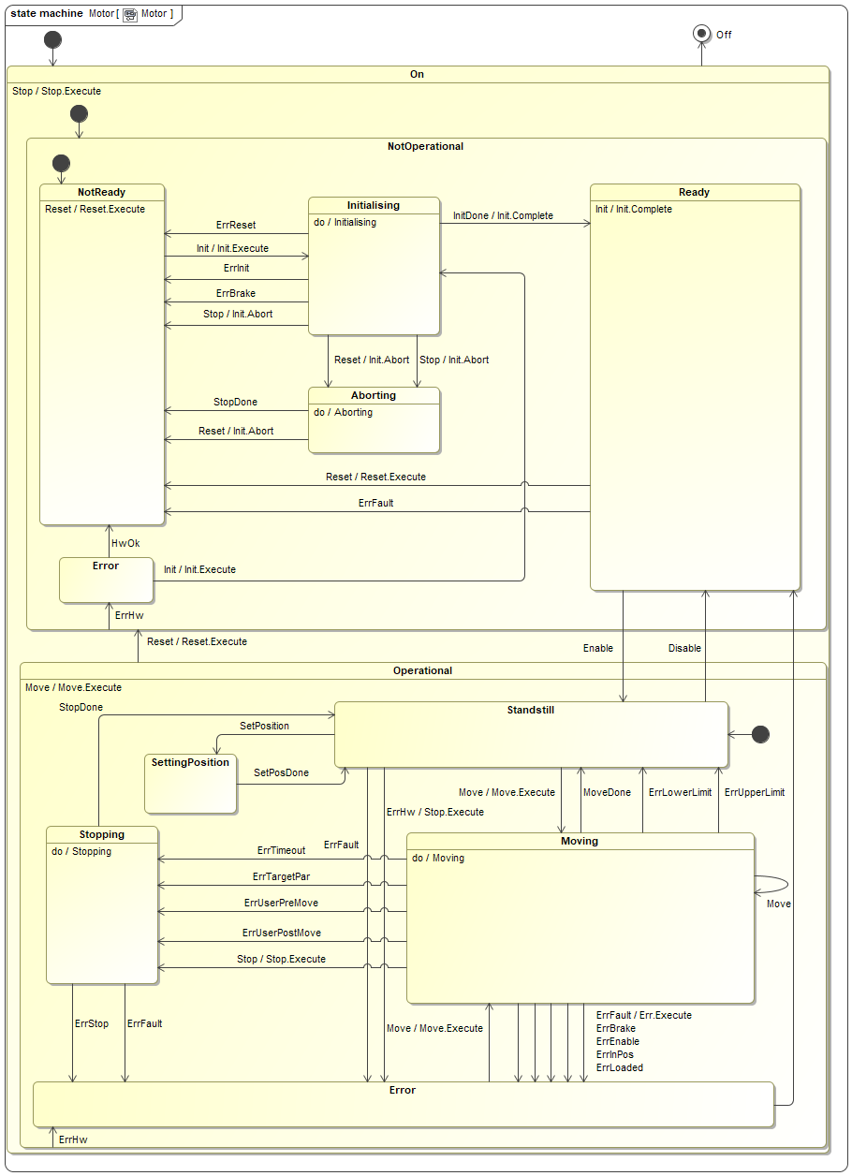
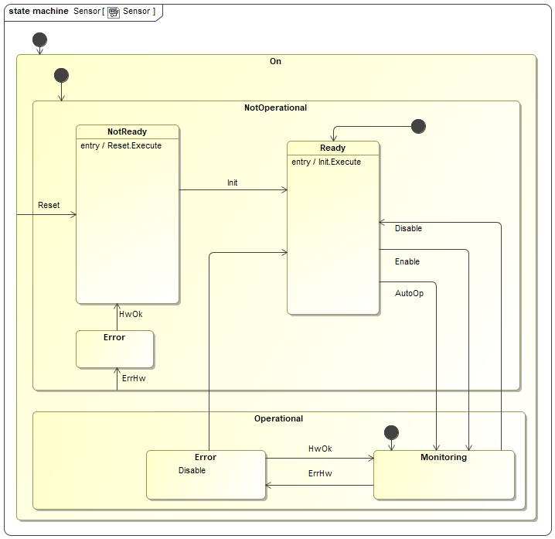
State Machine

Slide 16
Preparing the OPC UA XML Profile
OPC UA XML profile cumbersome (impossible?) to edit by hand.
Simple YAML definition used, which can be edited by a text editor.
Tool provided to generate OPC UA XML profile:
$ coreGenOpcuaProfile [-h] --device DEVICE --name-mapping NAME_MAPPING [--output-file OUTPUT_FILE] [--log-level LOG_LEVEL] [--log-file LOG_FILE] [--verbose]
CtrlExecute: ctrl.bExecute
CtrlIntensity: ctrl.lrIntensity(Double)
CtrlCommand: ctrl.nCommand
CtrlTimeOnLimit: ctrl.nTimeOnLimit(UInt32)
CfgAnalogRange: cfg.nFullRange(UInt32)
CfgAnalogThreshold: cfg.nAnalogThreshold
CfgCoolDown: cfg.nCooldown(UInt32)
…
RpcSwitchOff: rpc.Off(O:ReturnValue(Int16))
RpcSwitchOn: rpc.On(I:in_lrIntensity(Double), I:in_nTimeOnLimit(UInt32), O:ReturnValue(Int16))
<NamespaceUris>
<Uri>http://www.eso.org/xmlLamp1/</Uri>
</NamespaceUris>
<UAObject NodeId="ns=4;s=PLC1" BrowseName="4:PLC1">
<DisplayName>PLC1</DisplayName>
<References>
<Reference ReferenceType="HasTypeDefinition">i=58</Reference>
<Reference ReferenceType="Organizes">ns=4;i=20737</Reference>
<Reference ReferenceType="Organizes" IsForward="false">i=85</Reference>
</References>
</UAObject>
…

Slide 17
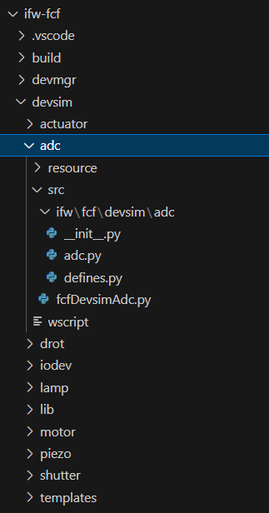
DevSim Module Source Tree
DevSim module
Configuration files, etc.
DevSim library
DevSim class (business logic)
Definition of constants, e.g. PLC constants like error codes, etc.
Application deployment (executable)

Slide 18
DevSim Source – PLC Constants (“defines.py”)
Constants should be the same in PLC code and in simulator to be able to use it 100% seamlessly with Device Manager.
    Extract these from the PLC code, or if simulator implemented first, ensure to use the same on the PLC.
The module will also contain constants used in the DevSim application.
class LampCommand:
NONE = 0
RESET = 1
INIT = 2
STOP = 3
ENABLE = 4
DISABLE = 5
ON = 6
OFF = 7
class LampError:
OK = 0
HW_NOT_OP = 1
INIT_FAILURE = 2
UNEXPECTED_OFF = 3
UNEXPECTED_ON = 4
FAULT_SIG = 5
MAXON = 6
STILL_COOLING = 7
TIMEOUT_DISABLE = 8
TIMEOUT_INIT = 9
TIMEOUT_OFF = 10
TIMEOUT_ON = 11
UNKNOWN_CMD = 1000

Slide 19
Upcoming Development
Existing framework (SDK) to be replaced with a new implementation:
  Collaboration with Sylvain Guieu (EFISOFT).
  Allows for deploying multiple device simulators per (Python) DevSim Server – major issue with present implementation.
  Partially compatible with the existing implementation in terms of configuration.
  Requires porting/re-writing the code (business logic) of the device simulators.
  Based on composition instead of inheritance.
  Planned for IFW25.
  Existing and new frameworks will co-exist for a while, to allow for a smooth transition.
Provide new DevSim for the Siemens PSU (PSU8600) – Multi-Axis Device(?)
Another on-going activity to investigate simulation also on the WS via TwinCAT@BSD running in a virtual machine.
  Soon there will also be a version of TwinCAT available on Linux.
  DevSim to be kept for to obtain self-contained tests with no external dependencies, issues with TwinCAT licenses…

Slide 20
J. Knudstrup – jknudstr@eso.org
@ESOAstronomy
@esoastronomy
@ESO
european-southern-observatory
@ESOobservatory

