Slide 1

ELT ICS Seminar 2024
Mario Kiekebusch on behalf of the IFW Team
Mauro
Ricardo
Function Control Framework (FCF)

Slide 2
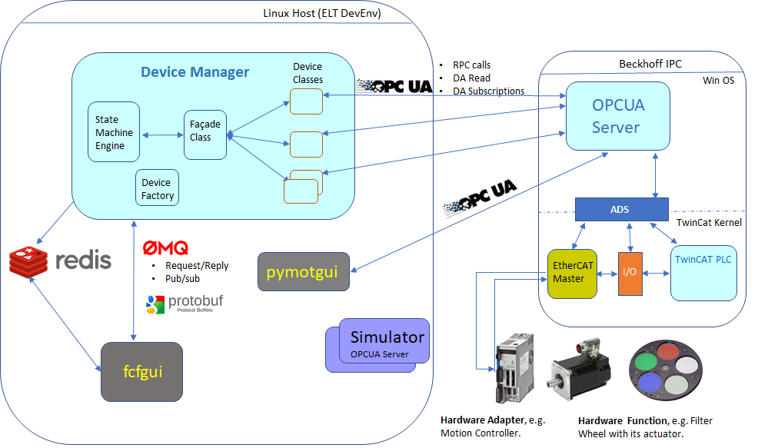
System Architecture
Two main parts: LCS and Supervision.
Communication Interface: OPC-UA
OLDB
CII-MAL
and many hosted telescope projects
New Technology Telescope – 3.5 metre
Notes:
As we know the two parts are communicated through OPC-UA which is our standard.
Actions are triggered using Remote Procedure Call and we use subscriptions to receive the status from the PLC.

Slide 3
FCF – Main Components
A set of PLC libraries implementing the supported device controllers and their engineering HMIs for local control.
A Device Manager controlling a configurable number of devices from a standard ELT WS.
A set of Device Simulators capable of emulating the behavior of a device controller and its interface within a WS.
A generic GUI for the Device Manager that allow users to control devices graphically.
A command line interface (CLI).
  .
Presentation Layer
Device Widget
GUI
CLI
Supervision Layer
Device Mgr
Device
Device Simulator
Common Software
Control & Automation Layer
Local Device
HMI
Simulator (FB)
Controller (FB)
Modules (C++)

Slide 4
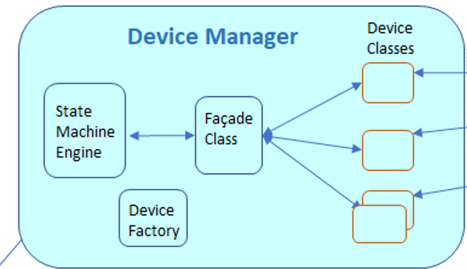
FCF – Device Manager in a nutshell
The Device Manager is a RAD application.
It provides a device factory to create the device instances at runtime.
The devices implements the communication with the LCS (OPCUA)
There is a device façade that takes care of the communication with all devices.
The SM engine interacts with the Device Façade.

Slide 5
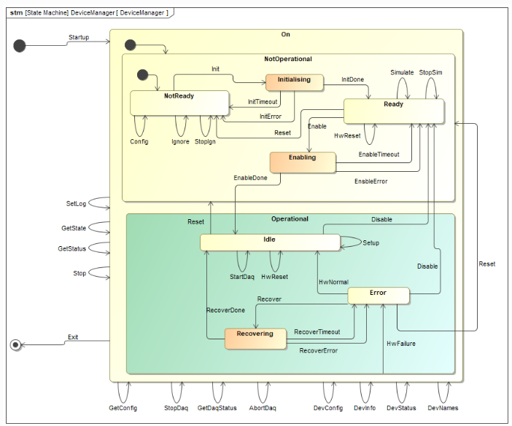
FCF – Device Manager in a nutshell
Connection to the PLCs is done in transition from NotReady to Ready state.
In the same transition, the configuration is passed to the device controller only in case it was not already operational.
In transition from Ready to Operational/Idle enable controllers for operations.

Slide 6

FCF – Supported Devices
WS
Shutter
Actuator
Lamp
Motor
Piezo
Derotator
ADCs
IODev
SmarAct
Multi-Axis
Multi-Trk
PSU8600
Modulator
  .

Slide 7
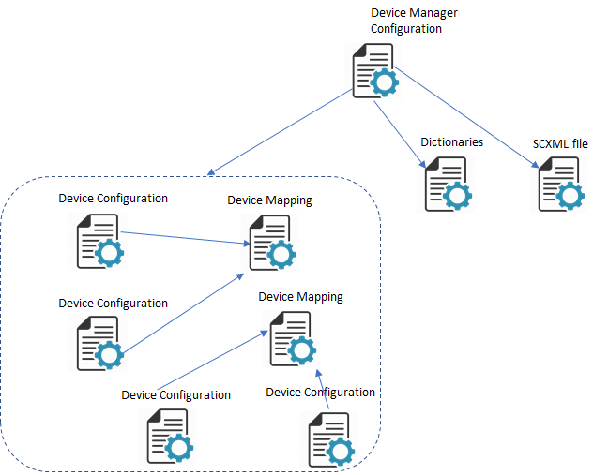
FCF – Device Manager - Configuration
Based on CII ConfigNg.
One file per device and one mapping per device type.
A mapping file maps the device internal symbols with the nodes in the PLC.

Slide 8
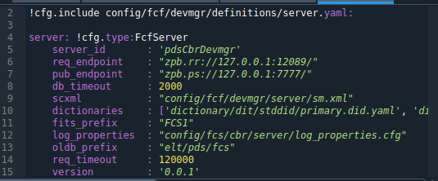
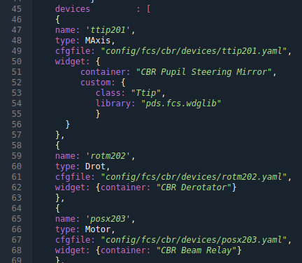
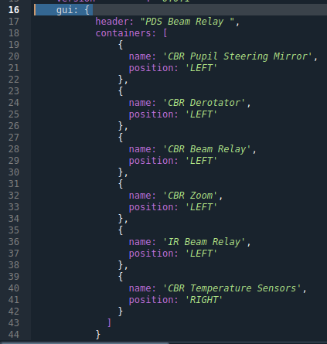
FCF – Device Manager – Server Configuration

Slide 9
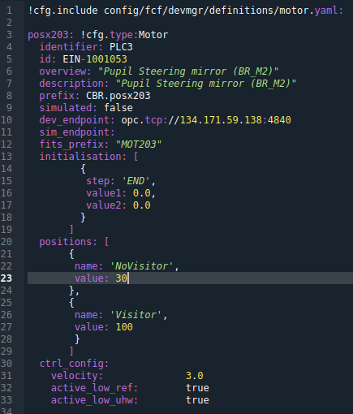
FCF – Device Manager – Device Configuration
Device Configuration

Slide 10
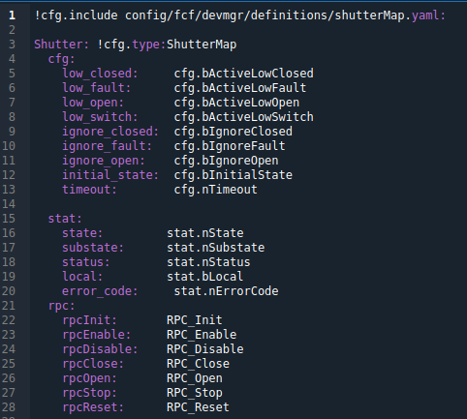
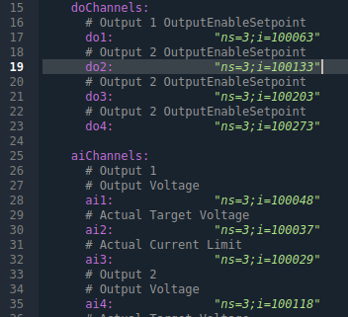
FCF – Device Manager – Device Mapping
Device Mapping

Slide 11
FCF – Device Manager – Requirements
To control many devices in parallel normally during the instrument acquisition phase.
What to control comes mainly from astronomers through the OBs executed by the Sequencer.
The need of generic configurable software to adapt to different instruments.

Slide 12
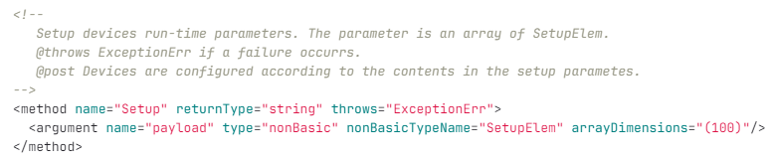
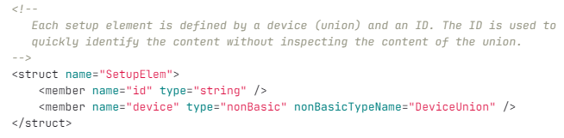
FCF – Device Manager – Setup Command
Setup buffer defined by an array of a unions.

Slide 13
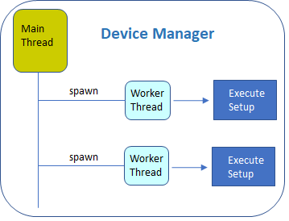
FCF – Device Manager – Setup Command
Device Manager provide parallelism by using worker threads.
When a Stop command is received, all worker threads are terminated.
The reply to originator is done always by the main thread.
  .

Slide 14
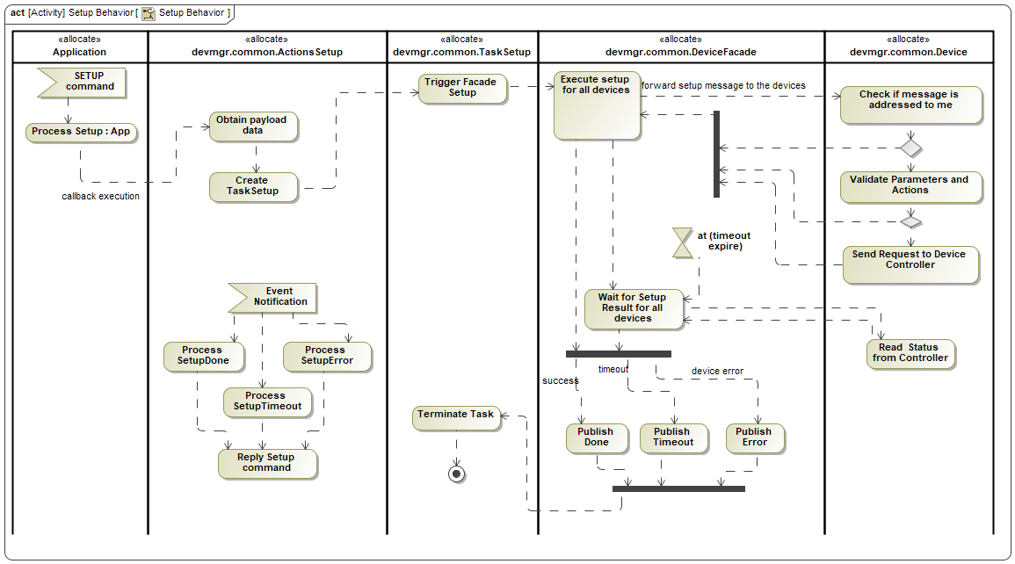
FCF – Device Manager – Setup Command

Slide 15
FCF – Client Interface
Why do we need this?
JSON Files
To provide support for Python context manager.
To enable the usage of command classes for implementing CLI.
To hide the interfaces for the users.
To enable unit conversions.
To convert MAL exceptions to normal python exceptions.
To enable textual representation for the Setup parameters.
Encode
FCF
Python
Library
Message payload
CII FCF interface
Create
Valid message
FCF JSON Schema
CII Python Mappings

Slide 16
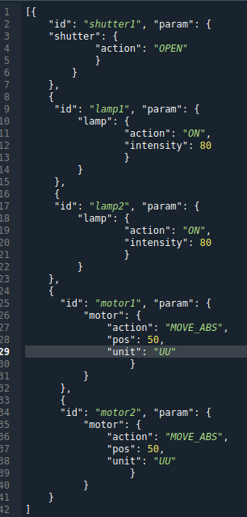
FCF – JSON Format
Resembles the VLT reference files.
Provides a textual representation for the setup parameters.
Enables encoding/decoding of custom device parameters.

Slide 17
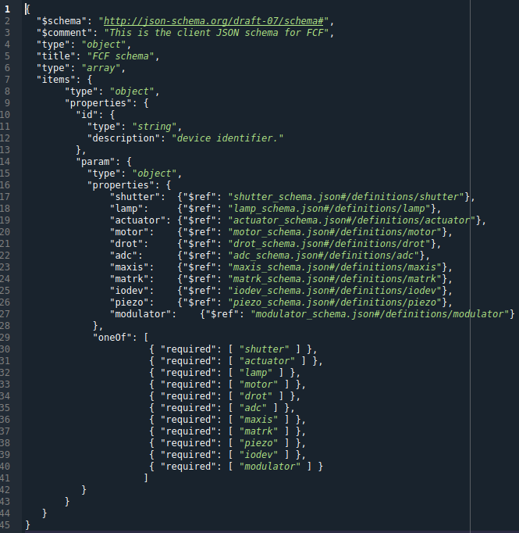
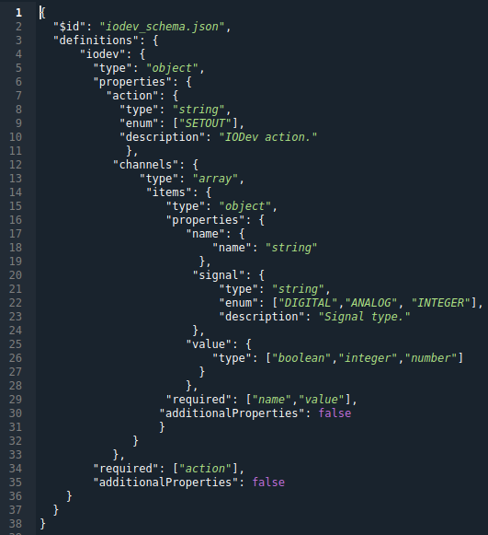
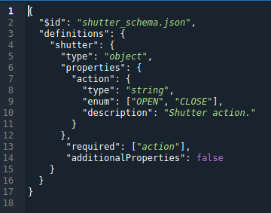
FCF – JSON schemas
The FCF schema allows validation at the client side.
  .

Slide 18
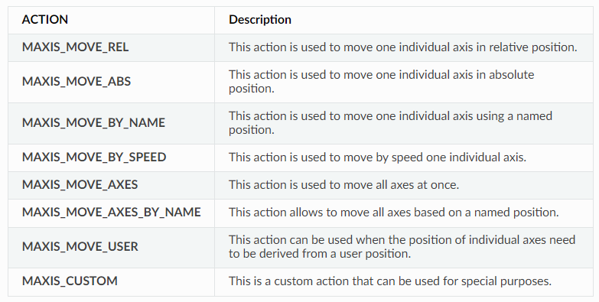
FCF – Multi-Axis
A generic device controlling multiple axes.
Each axis is controlled with a motor device.
Two flavors: One with tracking capabilities and one without.
  .

Slide 19
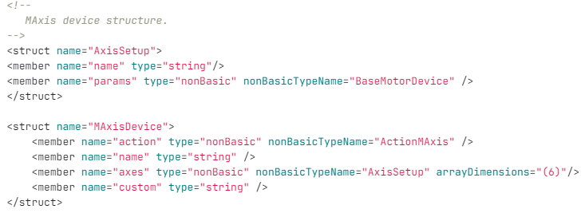
FCF – Multi-Axis – Device Serialization
This device can be used to control up to 6 axes.
  .

Slide 20
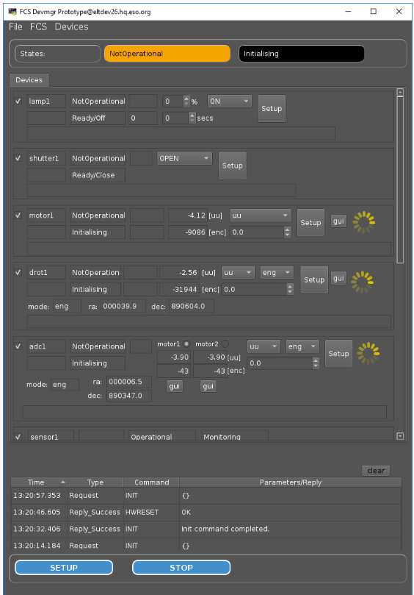
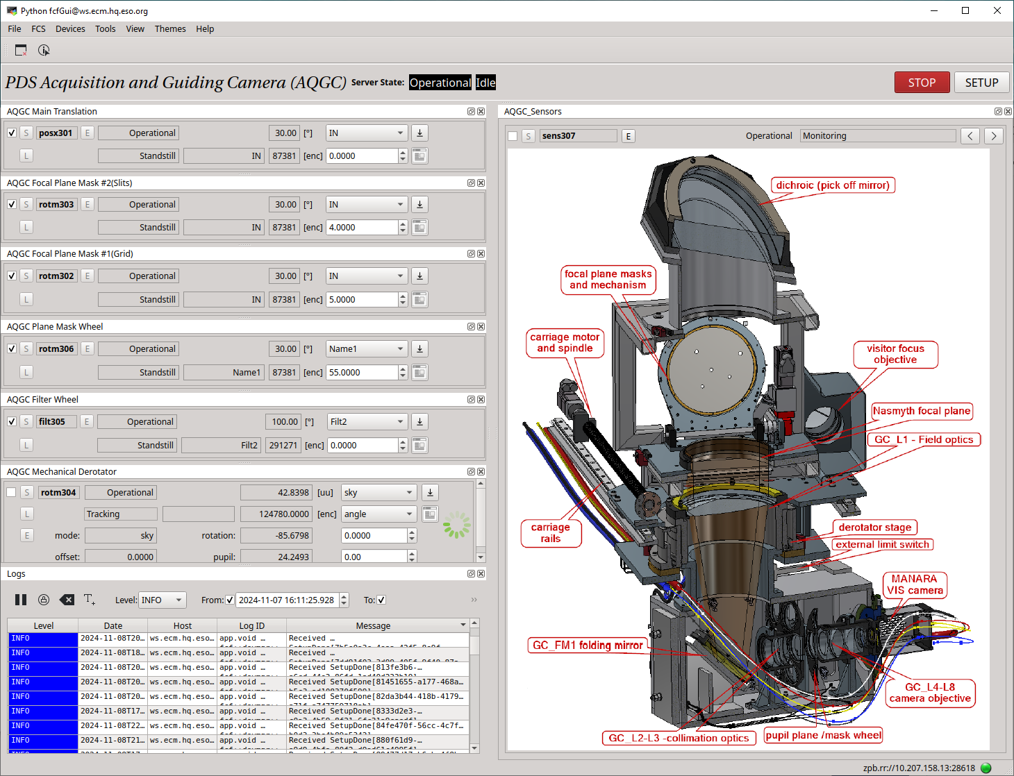
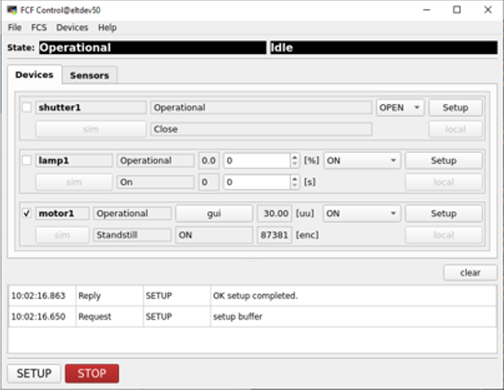
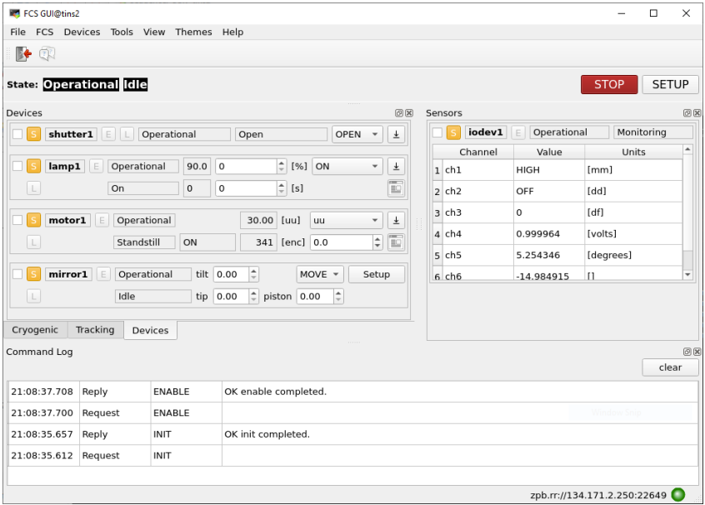
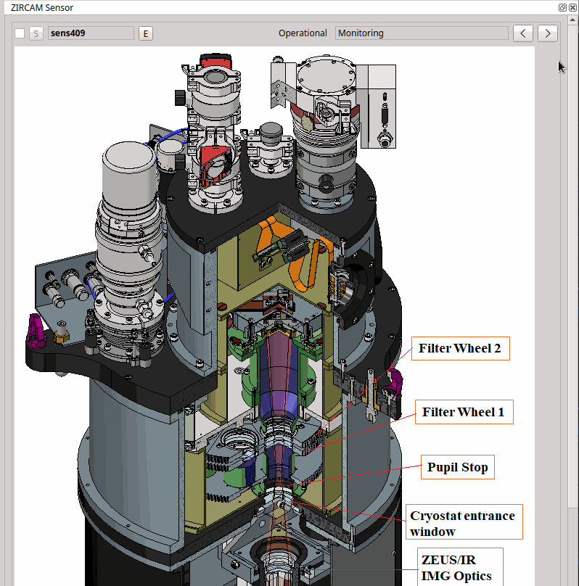
FCF – GUI - Evolution
Look & Feel
Use of Qt Docking and Stacked widgets.
Programming Language
  C++ → Python (CUT)
  Support for custom widgets.
Data Interfaces
  ZMQ subscriptions → Redis Polling → OLDB subscriptions.
  .

Slide 21
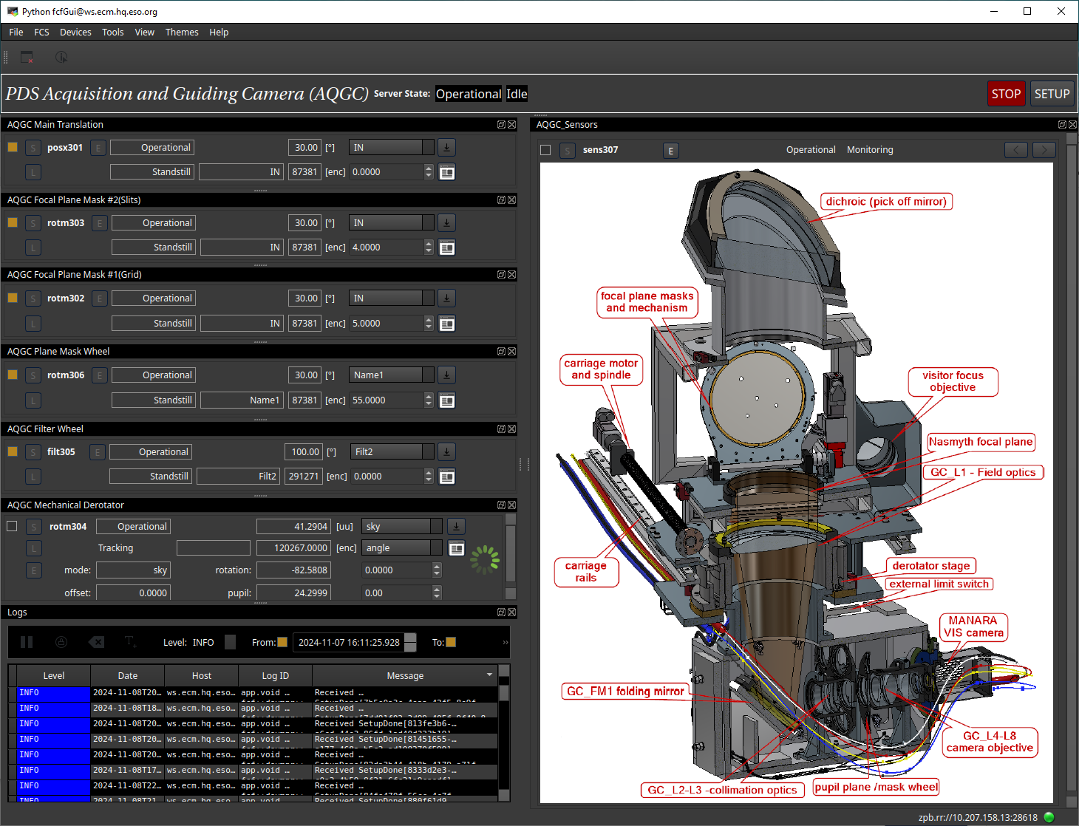
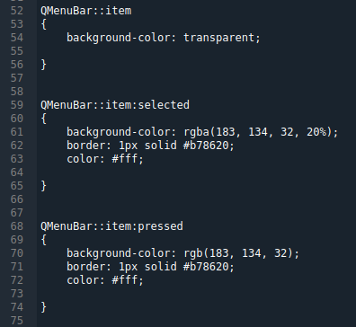
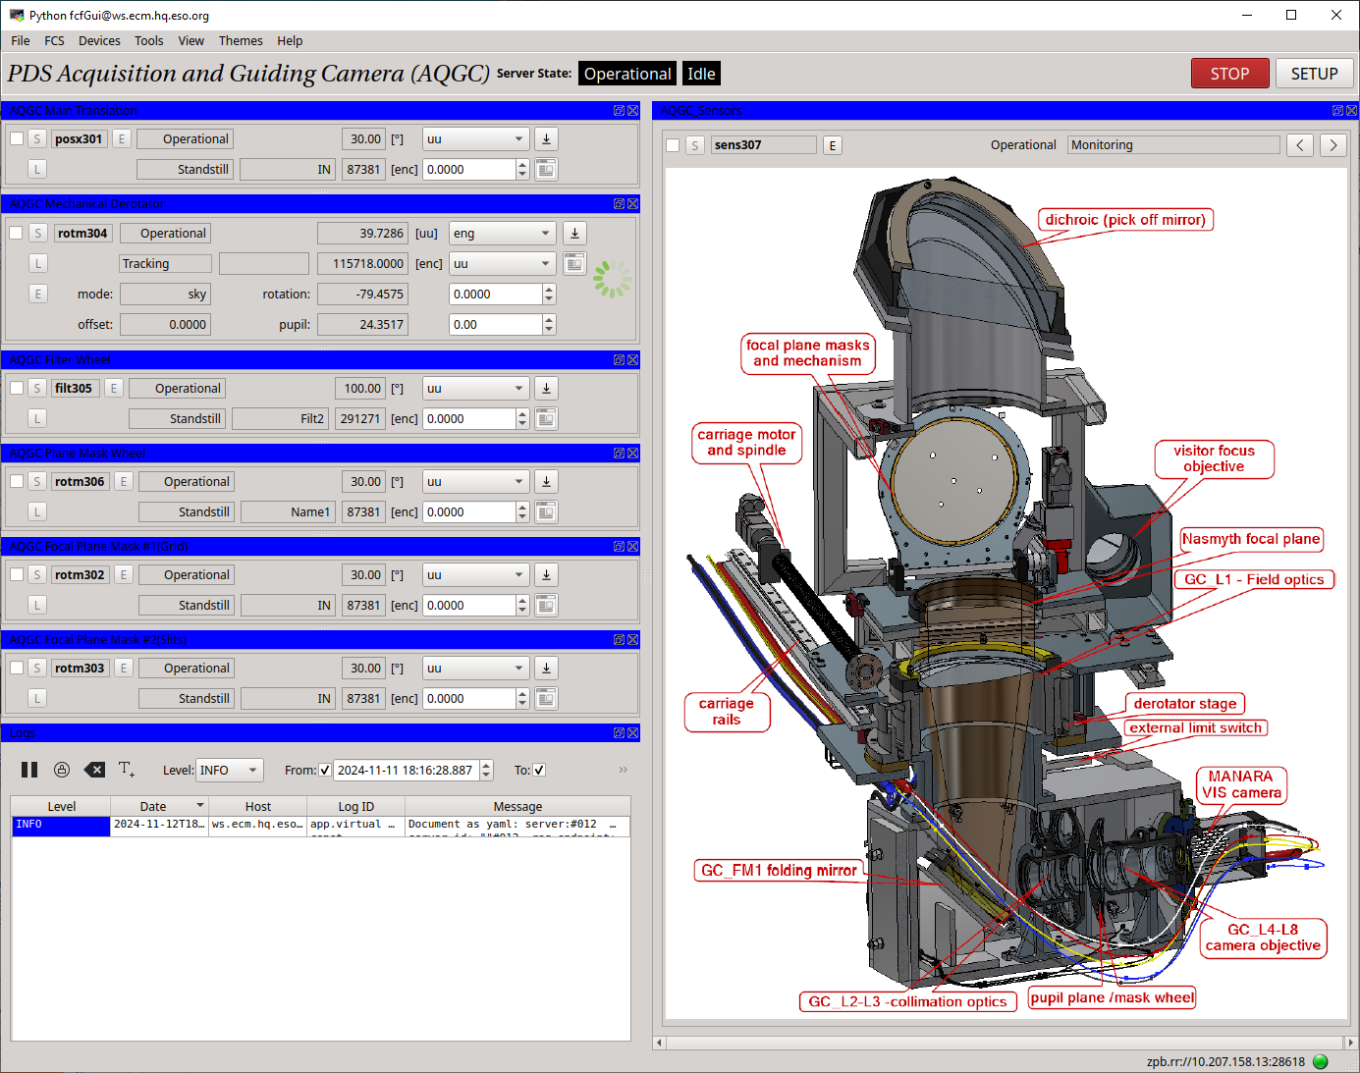
FCF – GUI – Style Sheets
FCF includes a set of predefined configurations.
Custom stylesheets are supported.
pyfcfgui --name fcsaqgc-req --style_file ./Default.qss

Slide 22
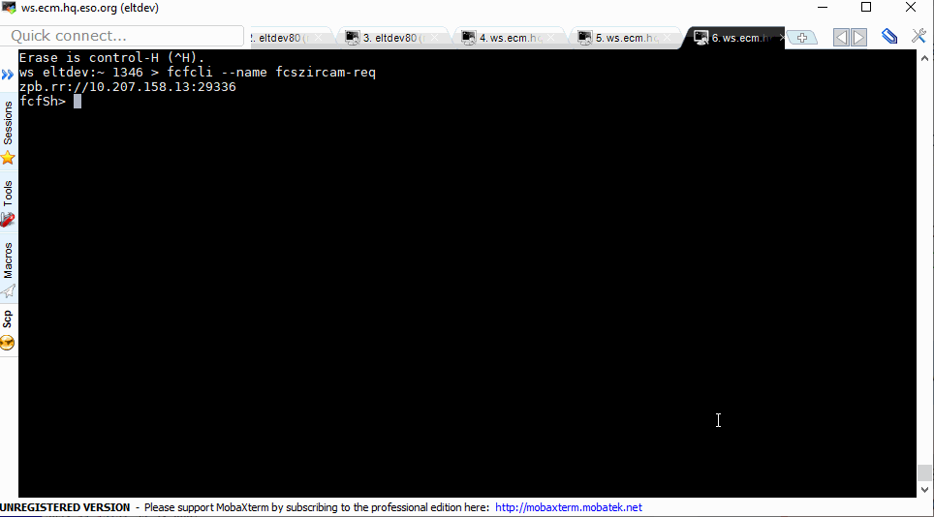
FCF – CLI
Based on the Python Prompt Toolkit.
Commands are asynchronous.
move <motor device>, <target position>
switch_on <lamp device>, <intensity>, <timer>
switch_off <lamp device>
open <shutter device>
close <shutter device>
write_analog <iodev device>, <channel>, <value>
write_digitak <iodev device>, <channel>, <value>
devstatus

Slide 23
FCF – Customizations
FCF enable extendibility at various levels that is required to support instrument specific needs.
How to do it will depend on the specific case. Better to discuss it with the instrument follow-up person to decide what is the best strategy.
Extending standard devices could be an option.

Slide 24
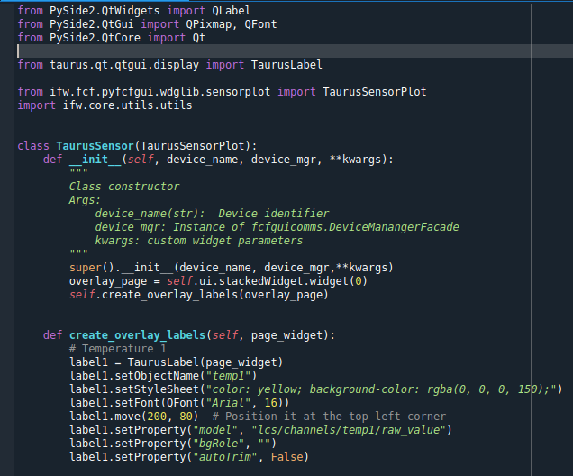
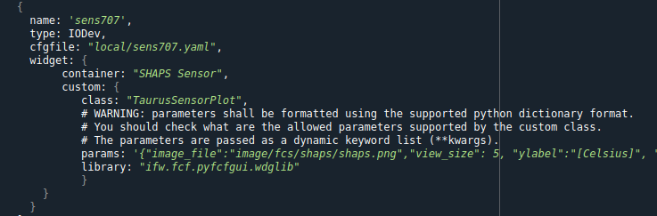
FCF – Custom Widget
With new FCF GUI (python) is possible to use custom widgets.
Custom Device Widget

Slide 25
FCF – Extending PLC configuration
For built-in types, only a new device configuration class is needed without a change in the code of the device.
For more complex types, a new configuration class is needed and therefore a new device implementation.

Slide 26
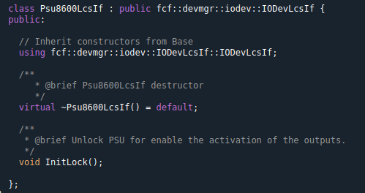
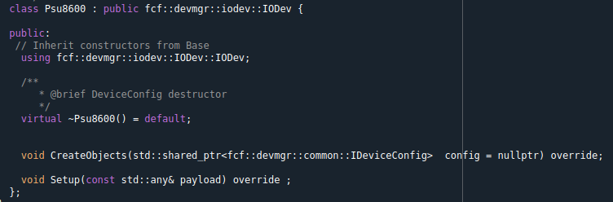
FCF – Custom Devices
Extending an existing device.
  A good example is the PSU8600.

Slide 27
FCF – Custom Devices
Implementing a complete new device.
  The best option is to use example in the template instrument.
  The FCF User Manual (Programming Guide) provides additional information.

Slide 28
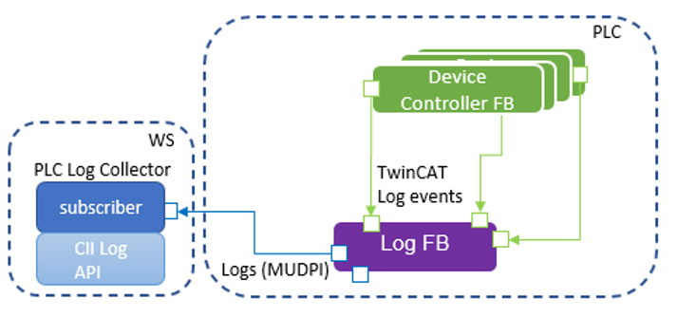
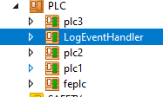
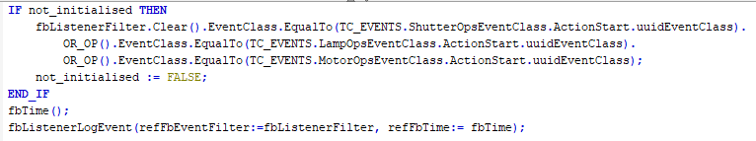
FCF – PLC Logging
Bridge between TwinCAT EventLogger and CII Logging.
Requires two additional components: one in the PLC and another one in the WS.
Solution is non-intrusive.
It uses MUDPI to send the logs. It Requires TwinCAT 3 TCP/UDP Realtime (TF6310).
Sample

Slide 29
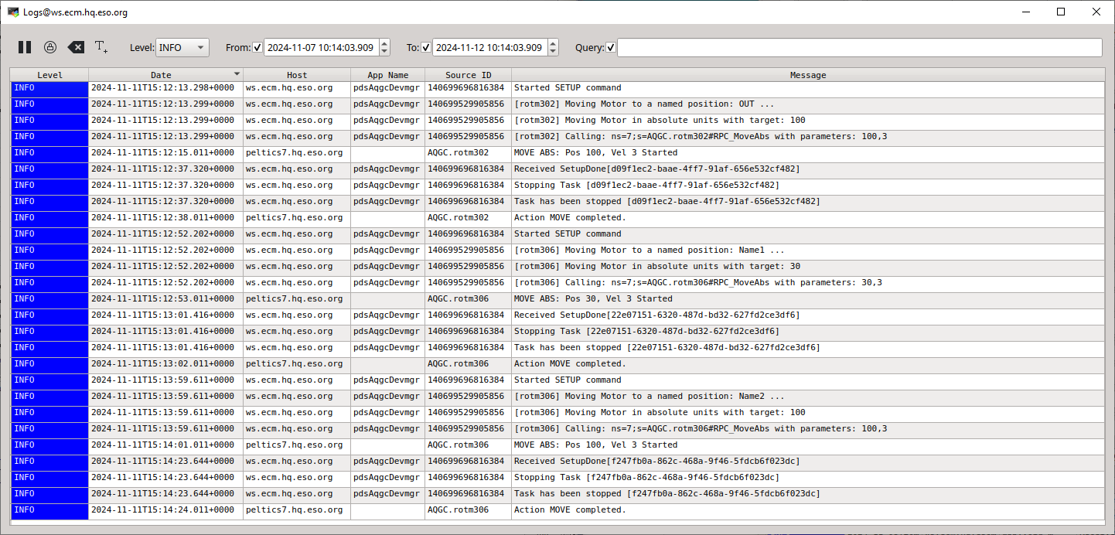

FCF – PLC Logging
PLC Logging

Slide 30

Outlook 2025

Slide 31
What’s Next
Complete implementation of Modulator device.
PLCs: Start evaluation of TwinCAT 4026.
Add auto-reconnection to the FCF GUI.
Porting to new features of CUT
New FCF DevSim: EFISOFT contribution to IFW.
Framework and User Controls for ICS standard devices (HMI).
and many hosted telescope projects
New Technology Telescope – 3.5 metre

Slide 32
Summary
FCF is one of the first components delivered with the IFW.
It supports a large number of devices covering most of the needs from instruments.
It enables customization at different levels to adapt to instrument requirements.
and many hosted telescope projects
New Technology Telescope – 3.5 metre

Slide 33

Luigi Andolfato; Diego Del Valle; Sylvie Feyrin; Arturo Hoffstadt; Mario Kiekebusch; Jens Knudstrup; Christoph Moins; Ivan Muñoz; Dan Popovic; Claudio Reinero; Calle Rosenquist; Paola Sivera; Ricardo Schmutzer; Piotr Szubiakowski
@ESOAstronomy
@esoastronomy
@ESO
european-southern-observatory
@ESOobservatory

