Slide 1


IFW PLC Libraries
Dan Popovic

Slide 2
Topics
Function/Device Control Concept
ELT PLC Library Concept
OPC UA Interface
Logging
Device Simulators
GUI Templates
State Machine Concept
Data model
Integration with the Instrument Control Software
Overview of Supported Functionalities

Slide 3
Documentation
ELT ICS Function Control Framework (FCF)
https://www.eso.org/projects/elt/develop/ifw/IFW-24/ifw-fcf-6.0.0/sphinx/html/
PLC Libraries
https://www.eso.org/projects/elt/develop/ifw/IFW-24/ifw-fcf-6.0.0/sphinx/html/docs/plc.html

Slide 4
ELT Instrument Device Control
Instrument WS
Embedded PC (PLC) – CX2033
Win 10 IoT
TwinCAT 3
PLC Runtime
Device Manager
(OPC UA Client)
Beckhoff
OPC UA
Server
PLC
App
HW
OPC UA
ADS
EtherCAT
ADS
TwinCAT 3 IDE
Legend: Application to be developed

Slide 5
PLC Library Types
Compiled libraries *.compiled-library
    Commercial libraries with hidden source code
    Debugging is not possible
“Normal” libraries *.library
    ESO delivers this type
    Debugging is possible
Location: https://gitlab.eso.org/ifw/ifw-resource.git, folder PLC\libraries

Slide 6
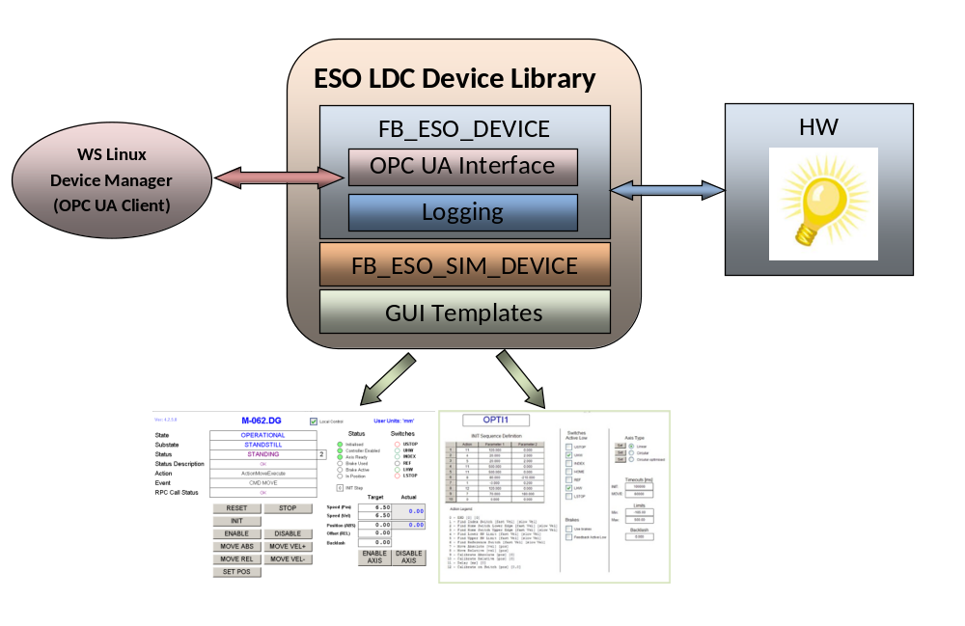
ESO PLC Library Concept

Slide 7
Library Repository vs. Project References
Library Repository is where libraries are installed in TC3 IDE
Project References are libraries used in TC3 PLC project
Every TC3 IDE must install libraries in the Repository
Project References are added from TC3 Library Repository
PLC Project
References
(Lamp + Motor + etc.)
TwinCAT 3 IDE
Library Repository
GIT
Add
Dev xxx
Dev xxx
Add
Lamp
Install
Lamp
Dev xxx
Shutter
Shutter
Lamp
Add
Motor
Motor
Motor
…
…

Slide 8
IFW PLC Library Versions
Library version is included in the library name.
This convention applies to all new library updates.
Examples:
    cryo_0.0.2.17.library
    Motor_4.2.6.0.library
    rsCommCommon_0.2.2.0.library

Slide 9
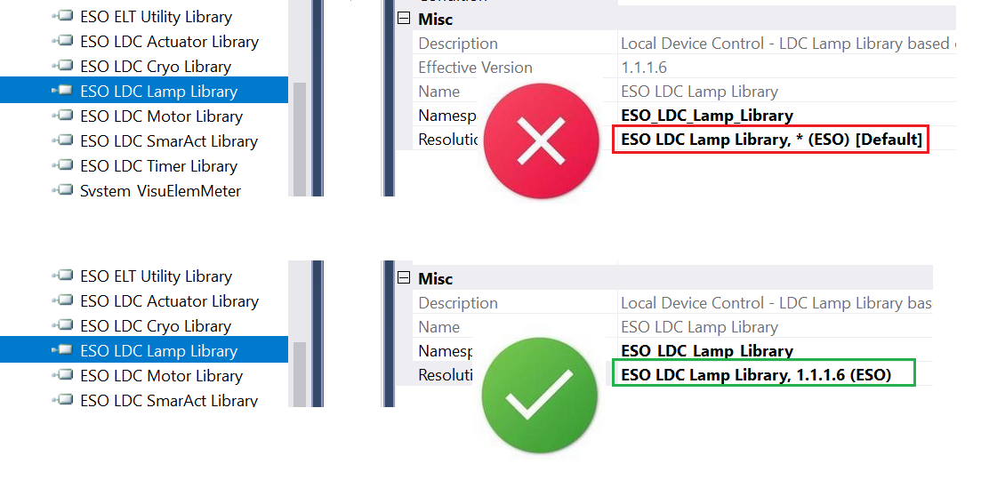
Library Version Control
Library versions MUST be hard-coded in the TwinCAT project !!!

Slide 10
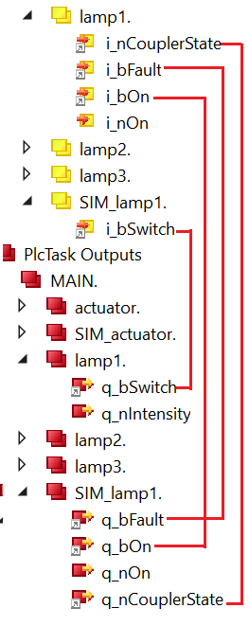
Device Simulators
  Every FB has its own Simulator
    FB_ACTUATOR → FB_SIM_ACTUATOR
    FB_LAMP → FB_SIM_LAMP
    FB_MOTOR → FB_SIM_MOTOR
    FB_XXX → FB_SIM_XXX
  FB code doesn’t handle simulation
  FB_SIM_XXX simulates I/O, i.e., the response

Slide 11
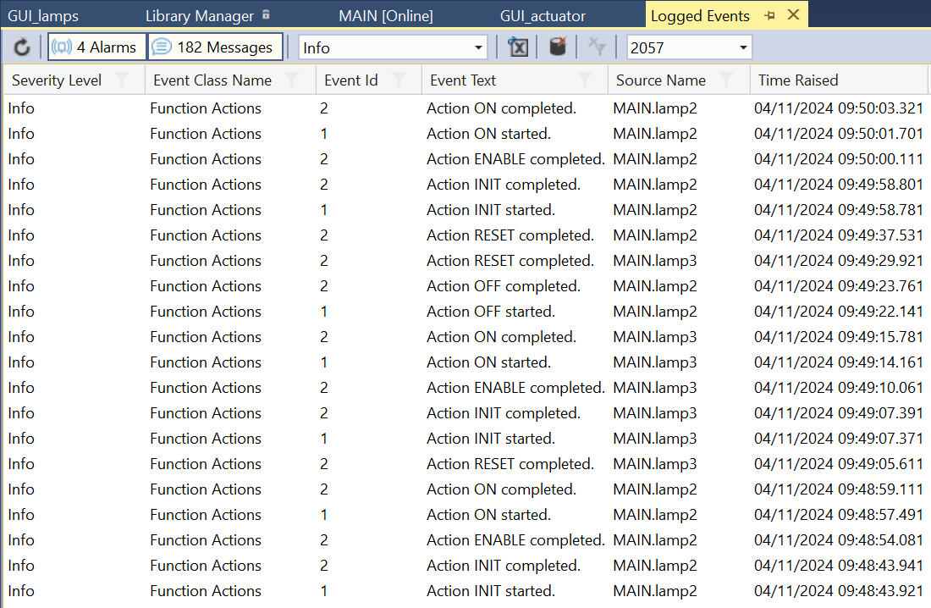
Logging

Slide 12
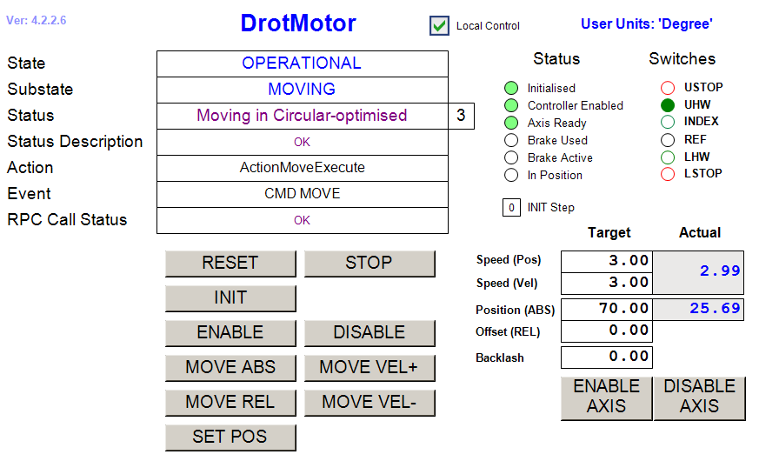
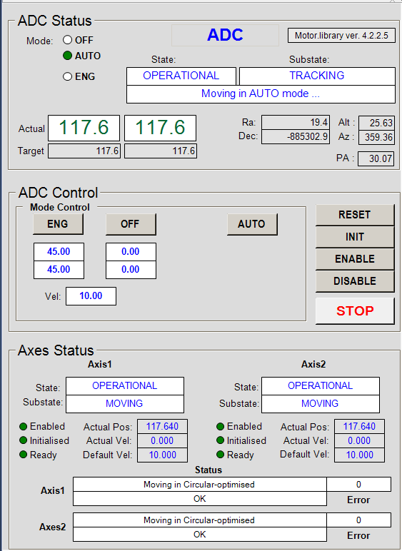
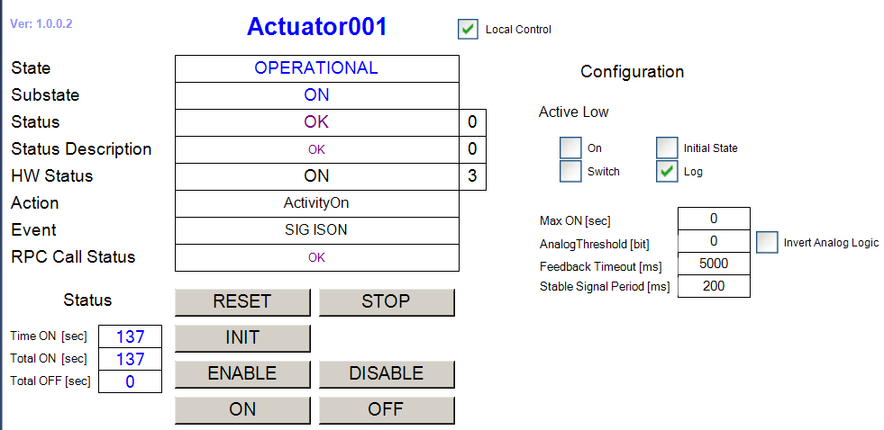
GUI Templates
Every library provides GUI templates for supported devices.

Slide 13
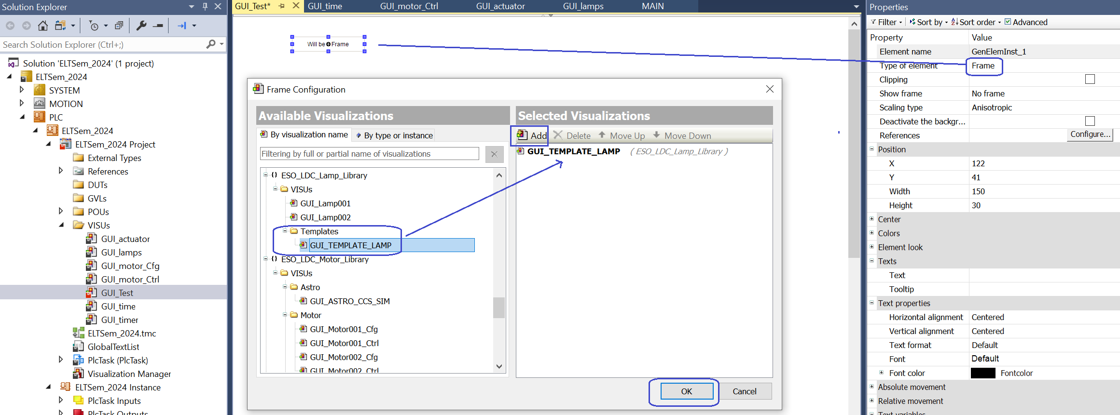
GUI Creation from Templates
Place a Frame on the canvas and select Visualization template.
Set the Reference to FB instance.

Slide 14
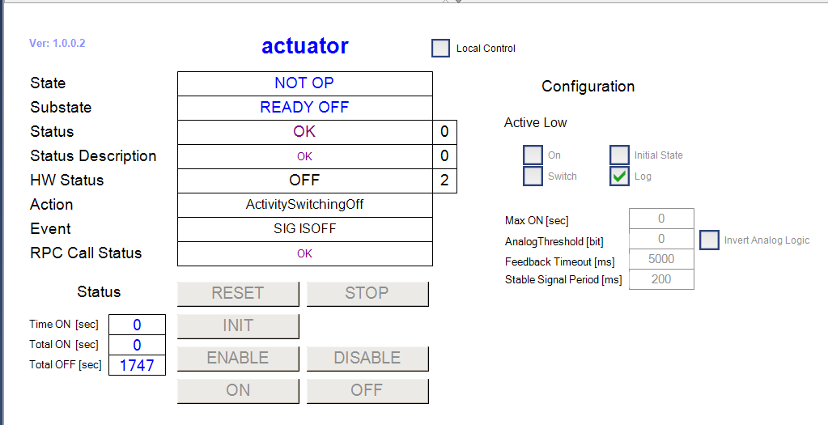

GUI Example

Slide 15
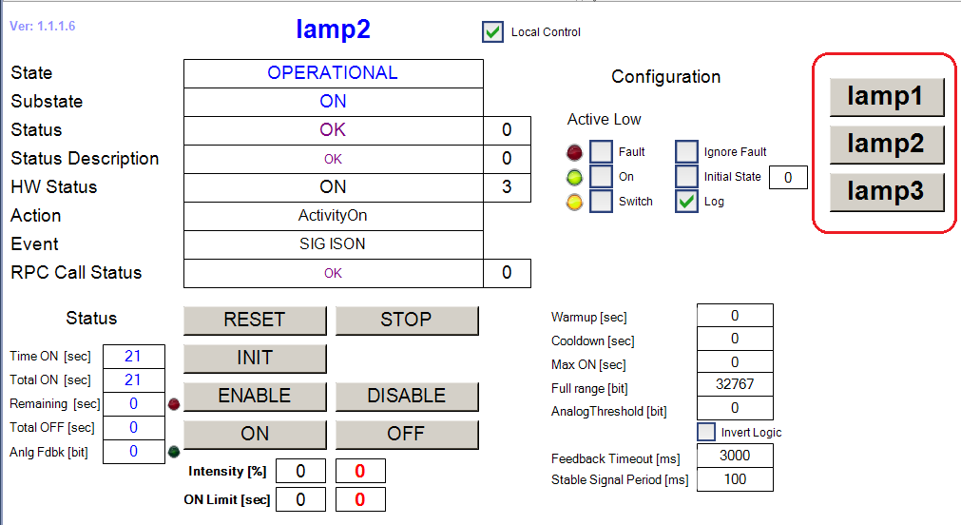


One GUI Fits All
MAIN.nPtrIndex := 1
MAIN.nPtrIndex := 2
MAIN.nPtrIndex := 3

Slide 16
PLC Device States/Substates
Mandatory States: NOT_OP and OP
Mandatory Substates of NOT_OP
    NOT_INITIALISED
    INITIALISING
    READY
    ERROR
Mandatory Substates of OP
    ERROR
    Any specific substate, e.g., OPEN, OPENING, CLOSED, ON, OFF, etc.

Slide 17
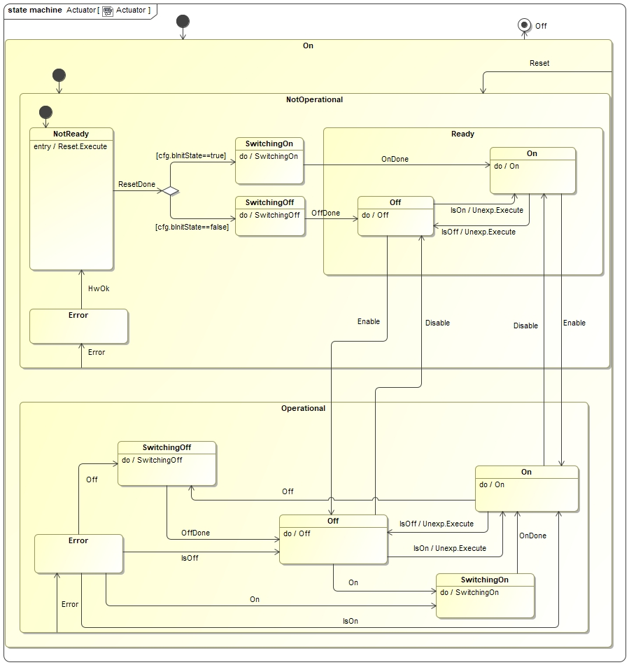
Actuator State Machine

Slide 18
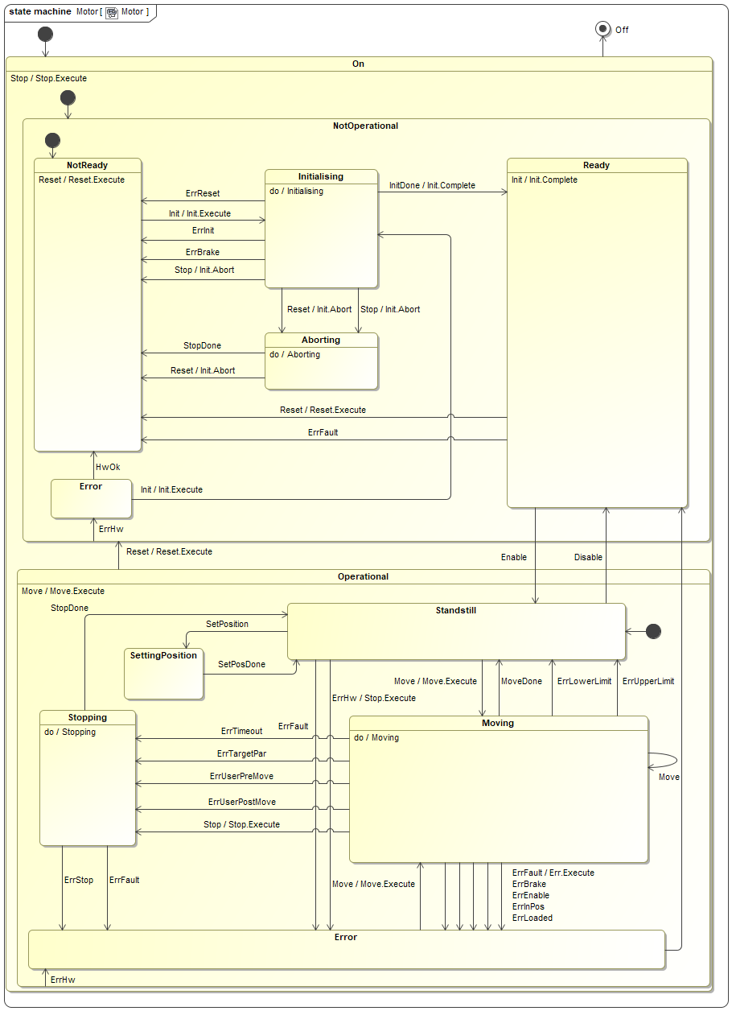
Motor State Machine

Slide 19
PLC Device Data Model
FUNCTION_BLOCK FB_DEV
VAR
{attribute 'OPC.UA.DA' := '1'}
cfg: T_DEV_CFG; // Configuration structure (R/W)
{attribute 'OPC.UA.DA' := '1'}
ctrl: T_DEV_CTRL; // Control structure (R/W)
{attribute 'OPC.UA.DA' := '1'}
{attribute 'OPC.UA.DA.Access' := '1'}
info: T_DEV_INFO; // Info structure (R/O)
{attribute 'OPC.UA.DA' := '1'}
{attribute 'OPC.UA.DA.Access' := '1'}
stat: T_DEV_STAT; // Status structure (R/O)
{attribute 'OPC.UA.DA' := '1'}
{attribute 'OPC.UA.DA.Access' := '1’}
debug: T_DEV_DEBUG; // Debug structure (R/O)
// Outputs q_*
q_bSig1 AT %Q*: BOOL; // Digital OUT
q_nSig1 AT %Q*: INT; // Analog OUT
...
// Inputs i_*
i_bSig1 AT %I*: BOOL; // Digital IN
i_nSig1 AT %I*: INT; // Analog IN
...
i_nCouplerState AT %I*: UINT; // Link it to Coupler->InfoData->State
END_VAR

Slide 20

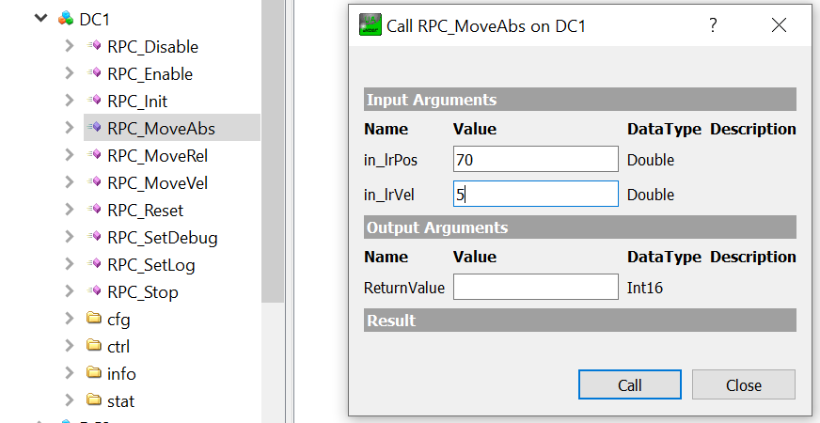
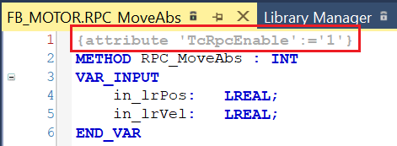
RPC Calls
Simplify Interface to Linux Device Manager - OPC UA Client
Hide the complexity of the internals
Perform checks if command is possible (returns 0 = OK, -xxx = error)
Example: Move to Pos 70 with Velocity 5

Slide 21
Mandatory RPC Calls
RPC_Reset # Reset Device
RPC_Stop # Stop Device
RPC_Init # Initialise device
RPC_Enable # Go to OP State
RPC_Disable # Go to NOT_OP/READY

Slide 22
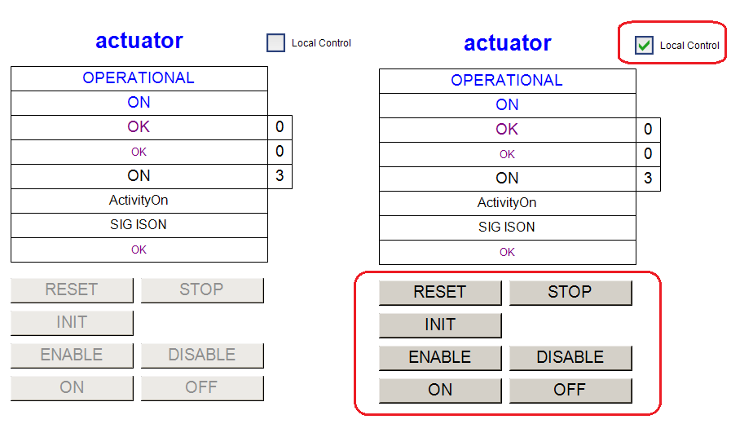
Local Control
Local Mode prevents high level commands while working in close vicinity to HW
Device Manager doesn’t send commands if device is in Local Mode
PLC GUIs control buttons are enabled only in Local Mode

Slide 23
Supported Controllers
Actuator - Generic ON/OFF control
CCC - Cabinet Cooling Control, separate presentation by Claudio Reinero
Cryo - separate presentation by Dan Popovic
Cryohmi - Cryo interface to HMI (separate Cryogenic HMI presentation by Diego Del Valle)
ioDev - Sensors
Lamp
Motor
Piezo - Multi-channel analog piezo control
rsComm* - serial, Tcp/Ip, Tcp/Rt, MODBUS, RS_BASE, Lakeshore, …
Shutter
SmarAct - Modular control system for SmarAct piezo actuators
Timer - Time simulator & trigger synchronization
Utils - MUDPI Protocol

Slide 24
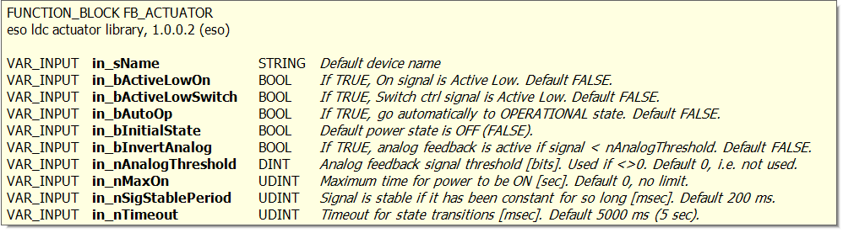
Actuator Library – FB_ACTUATOR
FB for low-level control of actuators, e.g., power control.
Similar to FB_LAMP but HW state (On/Off) not affected by state change. The HW state can only be changed in OPERATIONAL state using ON and OFF commands.
Can be configured to go ON on PLC reboot or on RESET of the controller. Configured with input parameter in_bInitialState.
in_bAutoOp should be set to TRUE, i.e., OP on boot.
Configuration should be hard-coded in PLC program!
actuator(
in_sName := 'actuator’,
in_bAutoOp := TRUE,
in_bInitialState := TRUE);

Slide 25
Timer Library
FB_TIME provides time services to other components running within the PLC, e.g., computation of absolute time.
Can use Local, PTP, NTP or Simulated time.
Must run at 1 ms cycle !!!
FB_TIMER provides synchronization signals with up to 1 µs accuracy.
Outputs mapped to DO with oversampling.

Slide 26
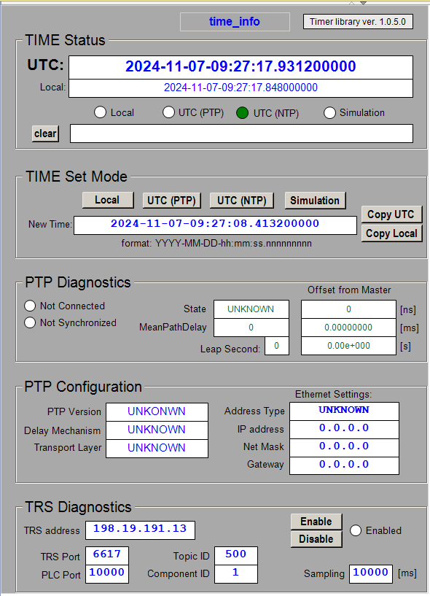
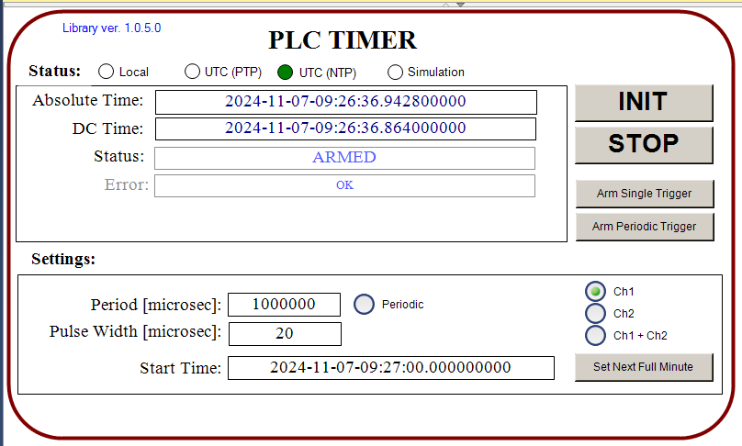
Timer Library GUI Templates

Slide 27
Motor Library – FB_MOTOR, etc.
FB_MOTOR
FB_SIM_MOTOR
FB_MA_BASE # for multi-axis tracking device
    FB_MA_ADC # 2-axis tracking device
    FB_MA_DROT # single axis tracking device
FB_ASTRO # TEL & MUDPI Simulator (simplified slalib in ST)
FB_DIGITAL_SIGNAL_FILTER

Slide 28
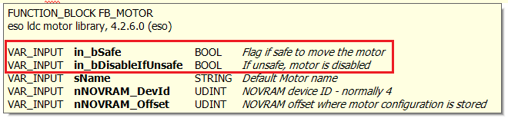
FB_MOTOR Safety Related Input Params
New feature in Motor Library
  in_bSafe - Flag if safe to move the motor
  in_bDisableIfUnsafe - If unsafe, disable the motor
Motor is stopped when entering unsafe condition.
Motor is also disabled if configured to do so.
Once it is safe again, the control continues like nothing happened.

Slide 29
Motor GUI Templates
GUI_TEMPLATE_MOTOR CONFIG
GUI_TEMPLATE_MOTOR CONTROL
GUI_TEMPLATE_MA_ADC
GUI_TEMPLATE_MA_DROT
GUI_TEMPLATE_ASTRO_CCS_SIM

Slide 30
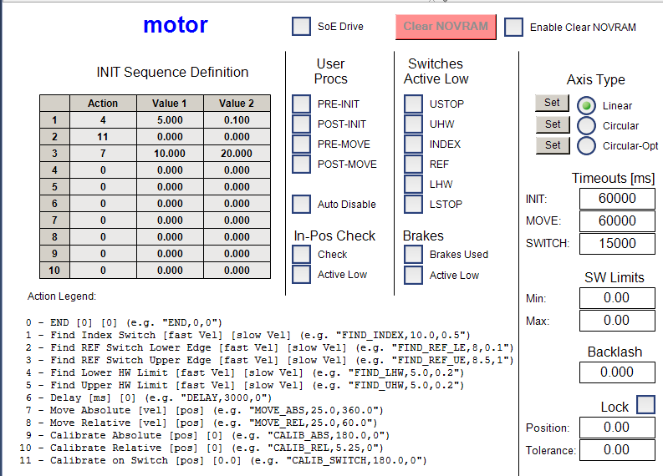
Motor Configuration GUI

Slide 31
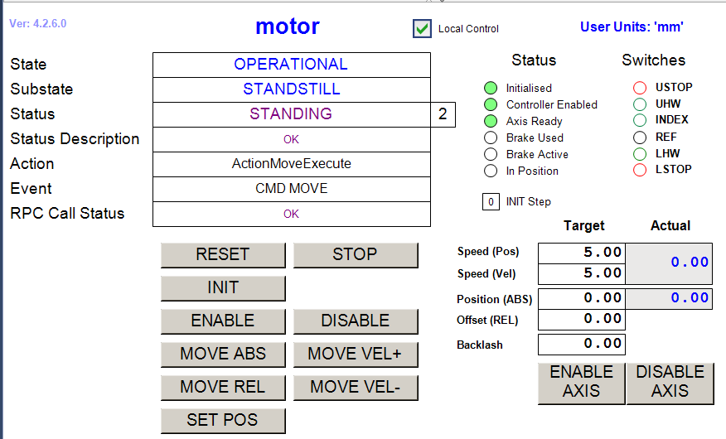
Motor Control GUI

Slide 32
ADC GUI

Slide 33
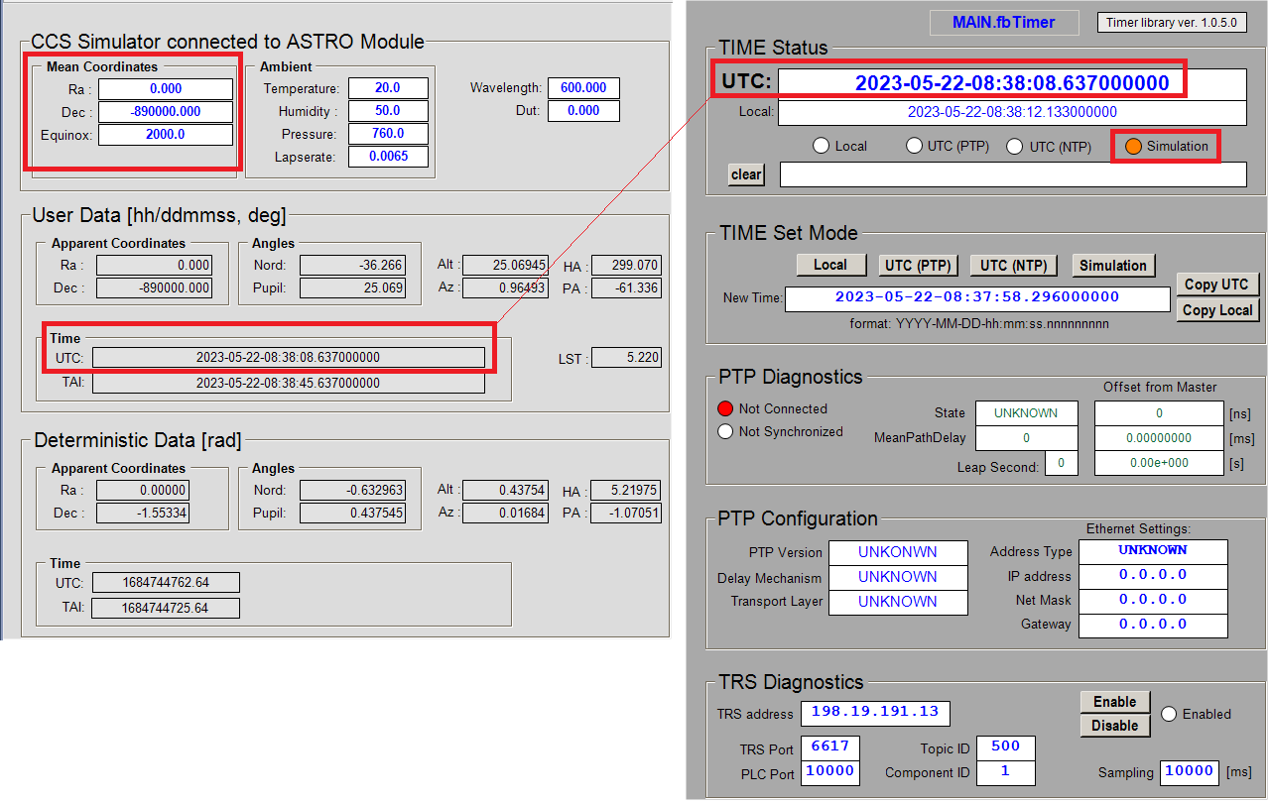
ASTRO GUI

Slide 34

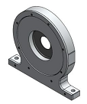
SmarAct Library
Modular Control System
High-precision piezo actuators.
Small form factor. Used where space is limited.
One HW controller, multiple channels
(up to 18).
Tcp/Ip protocol.
Round-Robin fashion for control.
Too slow for multiple actuators.
HARMONI team implemented optimization. Thank you!
To be implemented in the official library.

Slide 35
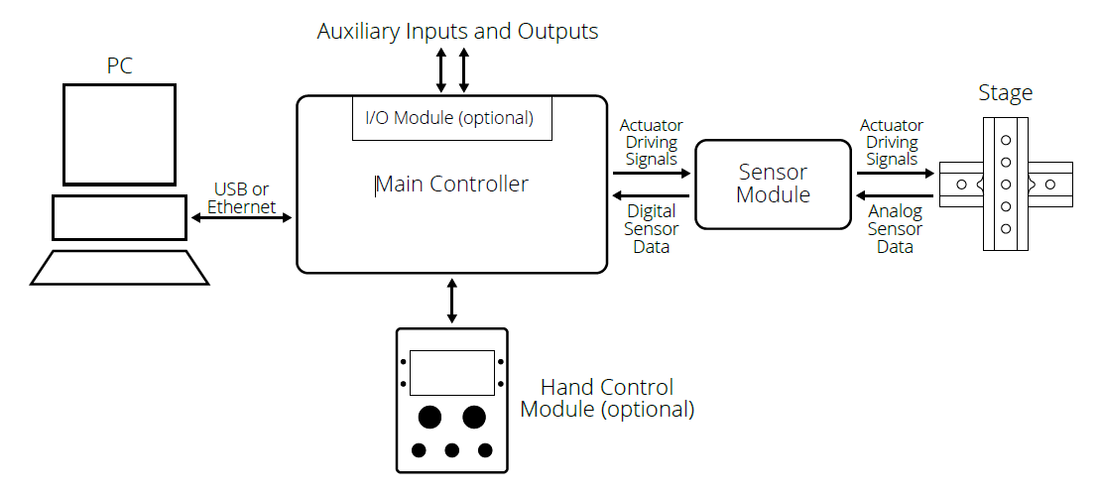
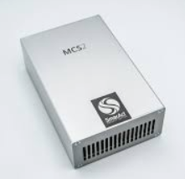
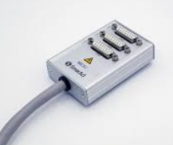
SmarAct Controller MCS2

Slide 36
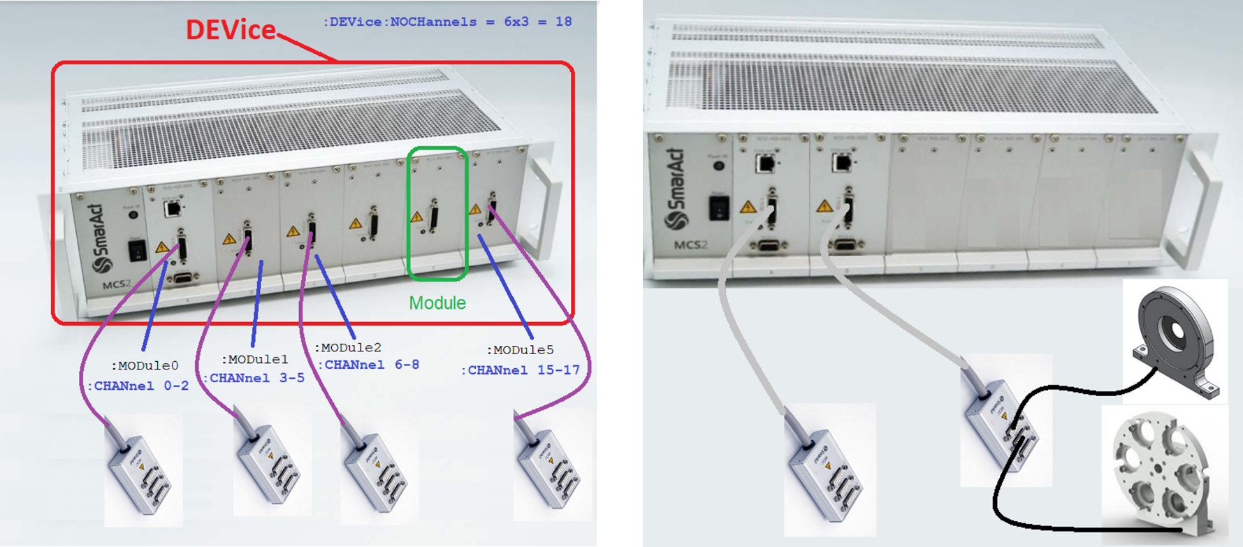
SmarAct HW Configurations

Slide 37
SmarAct FBs
FB_SMAR_ACT_BASE - SmarAct Ctrl App
Talks to MCS2 ctrl. Must be EXTENDED.
FB_SIM_SMAR_ACT - SmarAct Ctrl App Simulator
FB_SA_CHANNEL_BASE - SmarAct single channel Ctrl.
FB_SIM_SA_CHANNEL - SmarAct single channel Simulator

Slide 38
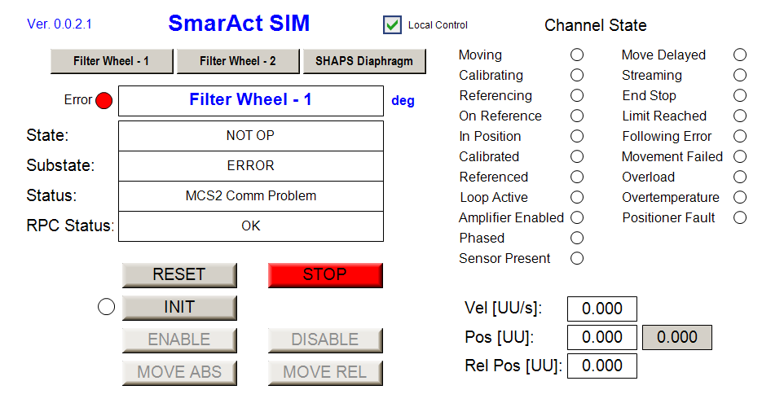
SmarAct GUI Template

Slide 39
Tracking Library trklib
PLC C++ wrapper for slalib.
Not used in ELT.
CCS will send date using MUDPI protocol.

Slide 40
Utilities
Currently includes only the MUDPI protocol.

Slide 41
Dan Popovic – dpopovic@eso.org
@ESOAstronomy
@esoastronomy
@ESO
european-southern-observatory
@ESOobservatory

