Slide 1


ELT ICS Sequencer
Ivan Munoz (imunoz@eso.org),
Christophe Moins (cmoins@eso.org)

Slide 2
What is the sequencer ?
Tool for the execution of Observation Blocks (OBs) and engineering scripts.
Reminder:
  Observation Block: smallest observational unit made of several templates.
  Engineering script: a high level procedure to carry out a specific script.
  Sequencer script: template or engineering script.
Equivalent of VLTSW BOB

Slide 3
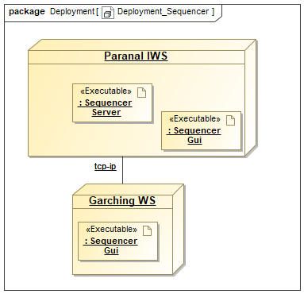
Sequencer deployment
Client Server application
One Server Started with:
seqtool server –address [HOST:]PORT or seqtool gui
One or several clients Started with:
seqtool gui server –address [HOST:] PORT

Slide 4
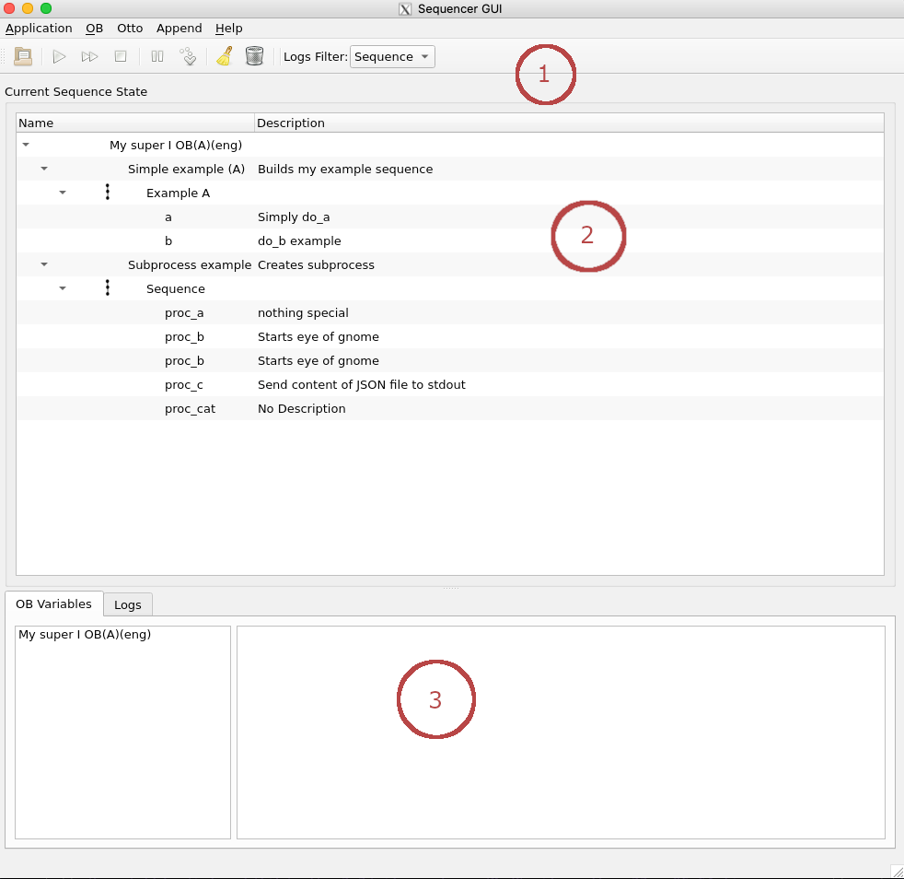
Sequencer GUI
Toolbar
Sequencer tree
Logs and OB variables tabs

Slide 5
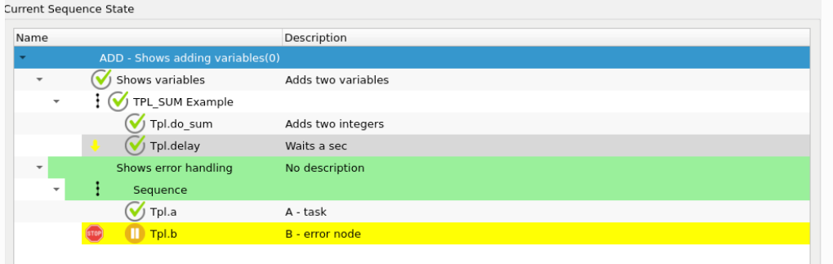
Sequencer GUI: the tree window
Shows the script as a tree whose components can be expanded or collapsed.
Each column shows a single node with its name, state and doc string
Each node can be executed individually

Slide 6
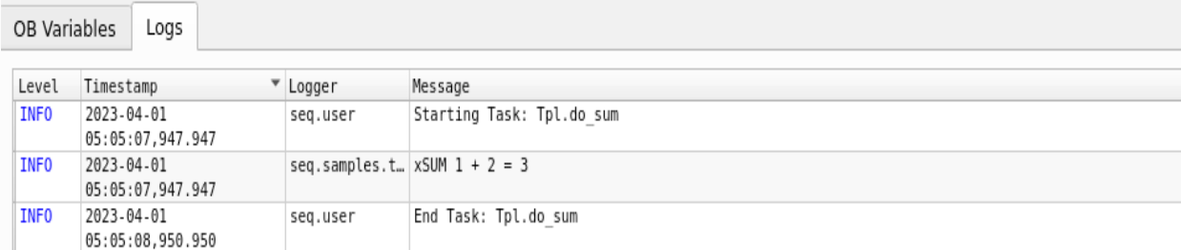
Sequencer GUI : Logs tab

Slide 7
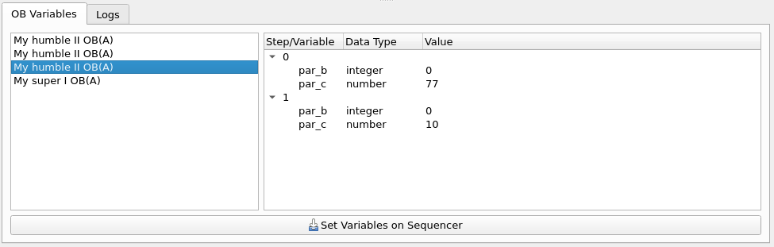
Sequencer GUI : OBs variable tab

Slide 8
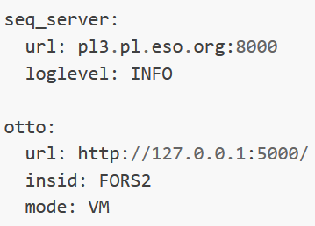
Sequencer GUI: configuration file
Default configuration file:
~/seqgui-conf.yaml
--config option

Slide 9
Sequencer API: writing sequencer scripts
Sequencer scripts are modeled as Directed Acyclic Graph (DAG).
Each node of the graph can be a simple action (python coroutine), a composite node or a complete script.
Python script that contains either:
  A module level create_sequence function
  A class named tpl with static method create_sequence
Nodes are chained using basic node types: Sequence, Parallel and Loop.

Slide 10
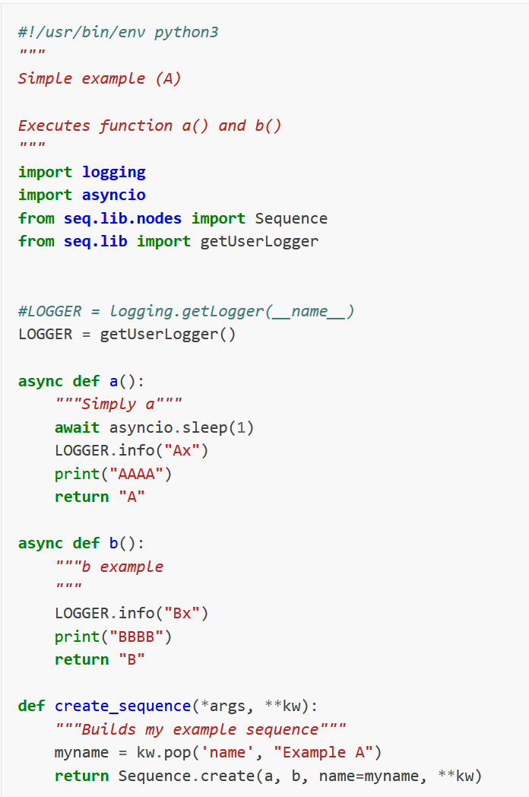

Sequencer API: Sequence of nodes

Slide 11
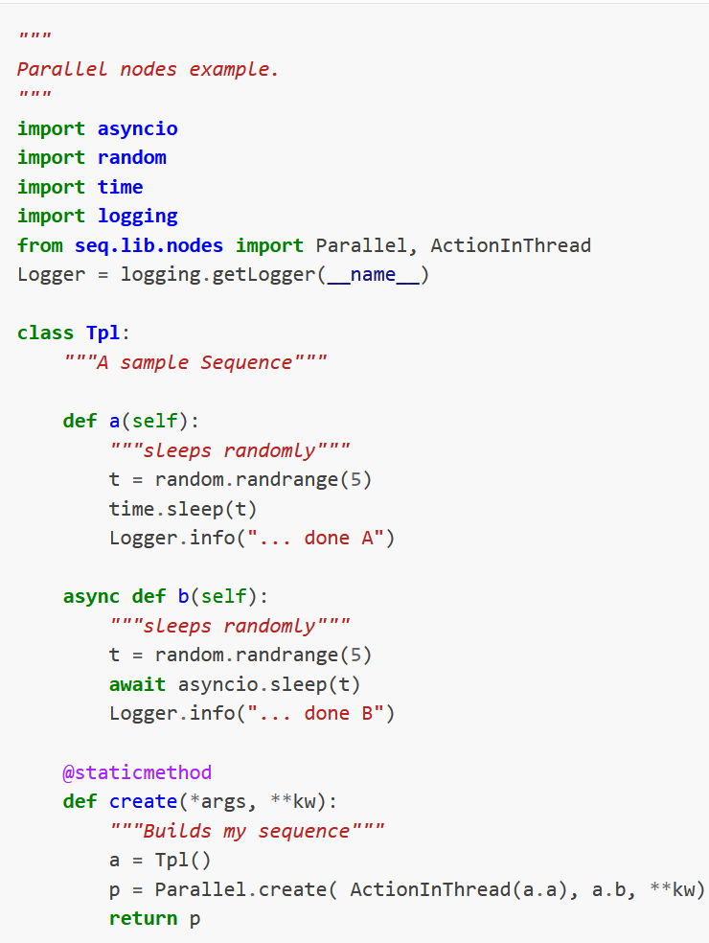
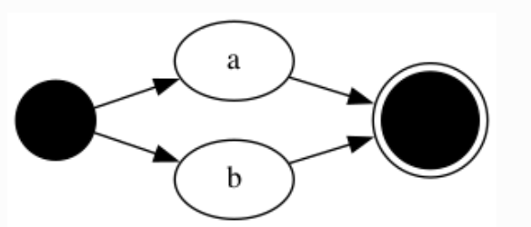
Sequencer API: Executing tasks in parallel

Slide 12
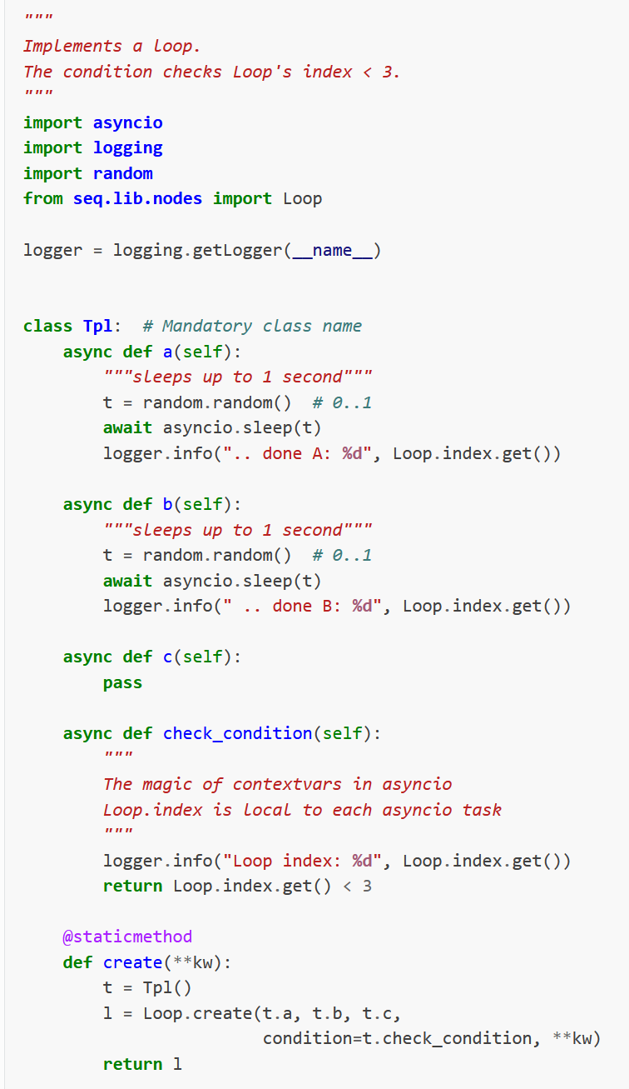
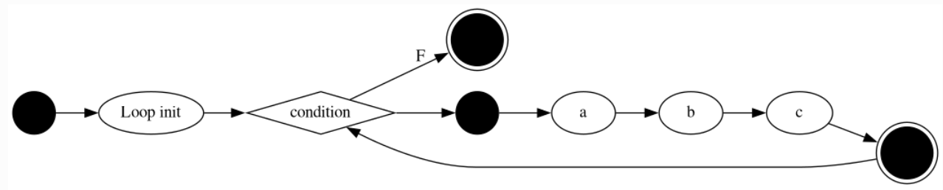
Sequencer API: Executing tasks in a Loop

Slide 13
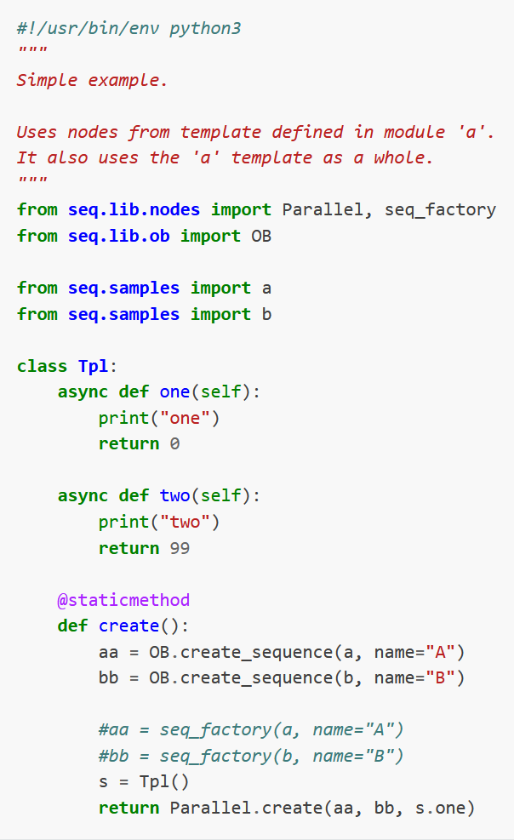
Sequencer API: Embedding Sequencer scripts

Slide 14
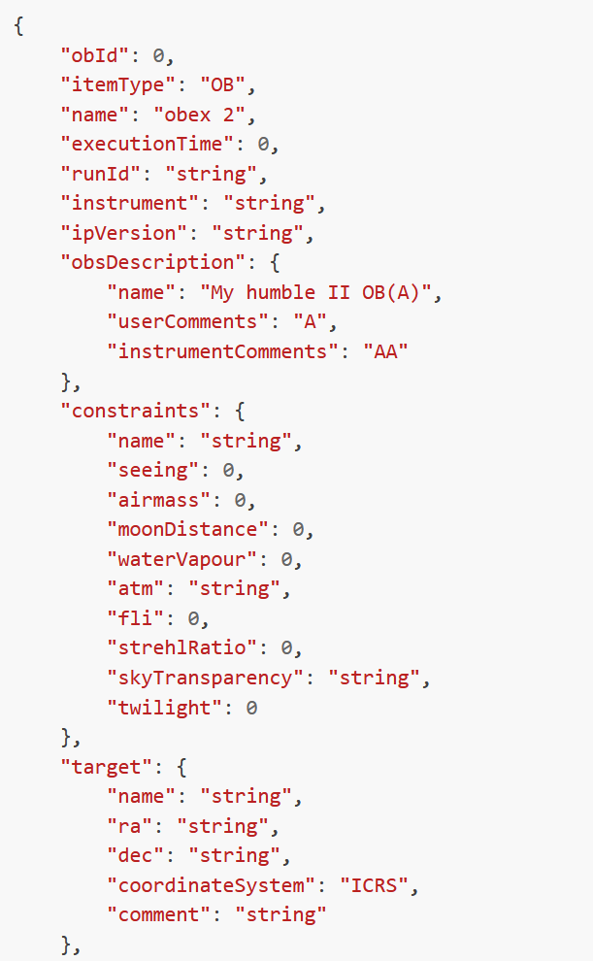
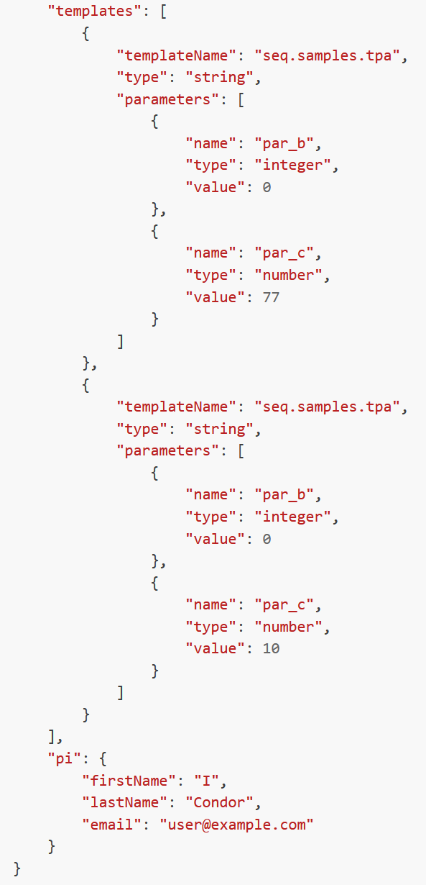
Observation Blocks and Templates
Templates variables are accessed in script using get_param method:
parb = get_param(“par_b”)

Slide 15
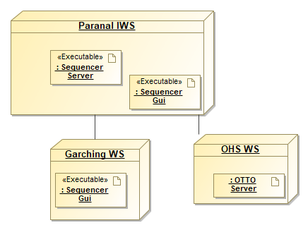
Interface to the Observation Handling Software
OBs are fetched from a server exposing a REST API named OTTO.
OTTO simulator: TINO
Instrument Package (IP): instrument specific information bundle for OB validation.

Slide 16
Ivan Munoz – imunoz@eso.org
Christophe Moins – cmoins@eso.org
@ESOAstronomy
@esoastronomy
@ESO
european-southern-observatory
@ESOobservatory

