Slide 1


TwinCAT/BSD - Initial Tests
Claudio Reinero

Slide 2
Introduction
Several years ago, Beckhoff introduced TwinCAT/BSD
Over time, the supported features have steadily expanded, with the recent addition of the OPC UA server.
Given these developments, we began exploring and testing.
In this presentation, we will provide an overview of our findings and insights.

Slide 3
What is TwinCAT/BSD?
TwinCAT/BSD combines the TwinCAT 3 runtime XAR with FreeBSD, an industrially tested and reliable open source operating system.
TwinCAT/BSD supports all TC3 functions and additionally enables the use of the modern HTML5-based TwinCAT HM
Source:
https://www.beckhoff.com/en-en/company/news/multimedia-sps-2019-twincat-bsd.html

Slide 4
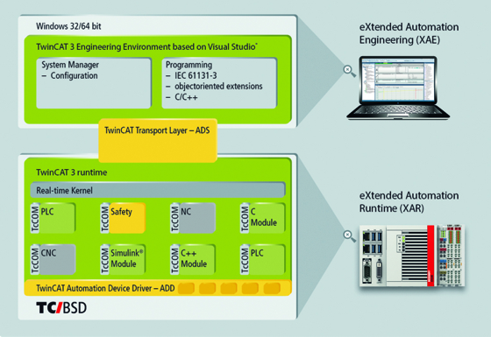
What is TwinCAT/BSD?
In other words it replaces the operative system of Beckhoff PLCs, from Windows CE to FreeBSD.
It is backwards compatible with our applications.
Source:
https://infosys.beckhoff.com/english.php?content=../content/1033/twincat_bsd/56842542196109725067.html&id=4567980173834788286

Slide 5
Why use TwinCAT/BSD?
If it is basically the same, why use it?
  Opportunity to remove Windows from the control network
  It opens a window to some potential features:
    Improved deployment
    Improved testing

Slide 6
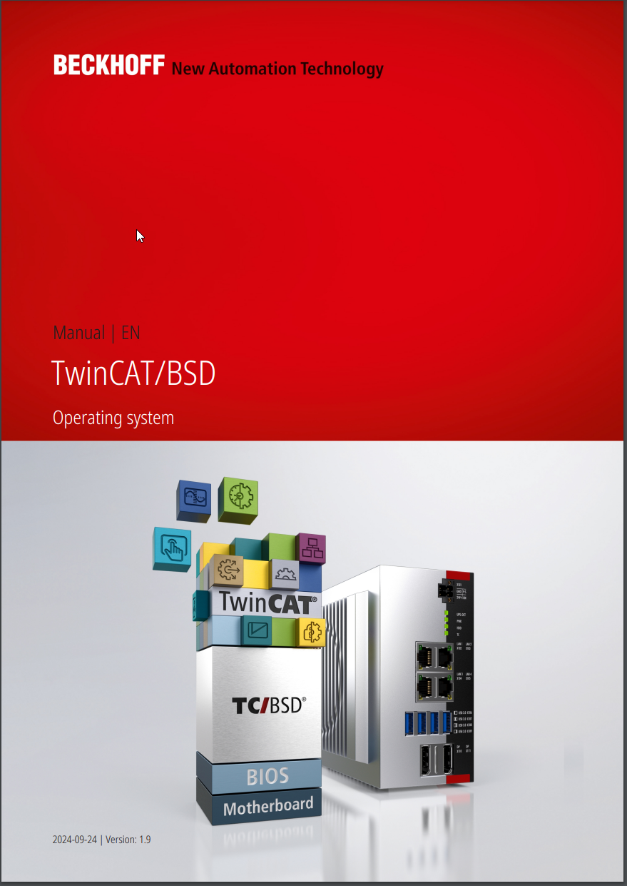
Installing
Beckhoff documentation:
  https://download.beckhoff.com/download/document/ipc/embedded-pc/embedded-pc-cx/TwinCAT_BSD_en.pdf
  https://infosys.beckhoff.com/english.php?content=../content/1033/twincat_bsd/56842542196109725067.html&id=4567980173834788286

Slide 7
Installing
Installing BSD into a PLC is similar to how one installs Linux into a Windows PC (no dual boot)
  Download ISO: https://www.beckhoff.com/en-gb/support/download-finder/search-result/?search=TwinCAT%2FBSD
  Create a bootable USB Stick (https://rufus.ie/ recommended by Beckhoff)
  Put the stick into the PLC
  Configure BIOS by pressing DEL while booting, configure UEFI
  Boot with the USB stick plugged in and press F7
  Select to boot from the USB stick

Slide 8
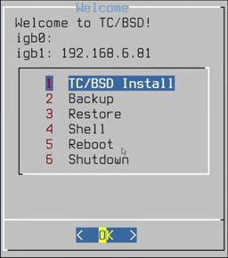
Installing
A simple menu comes up (screen connected directly to the PLC as usual)

Slide 9
Installing
A User and Password should be configured
Then the process should be followed
Finally, remove the USB stick and reboot
The PLC should boot to console now, where you can login with the previous User and Password
The IP should come up in a message if not, you can issue: /sbin/ifconfig to obtain the IP of the PLC.

Slide 10
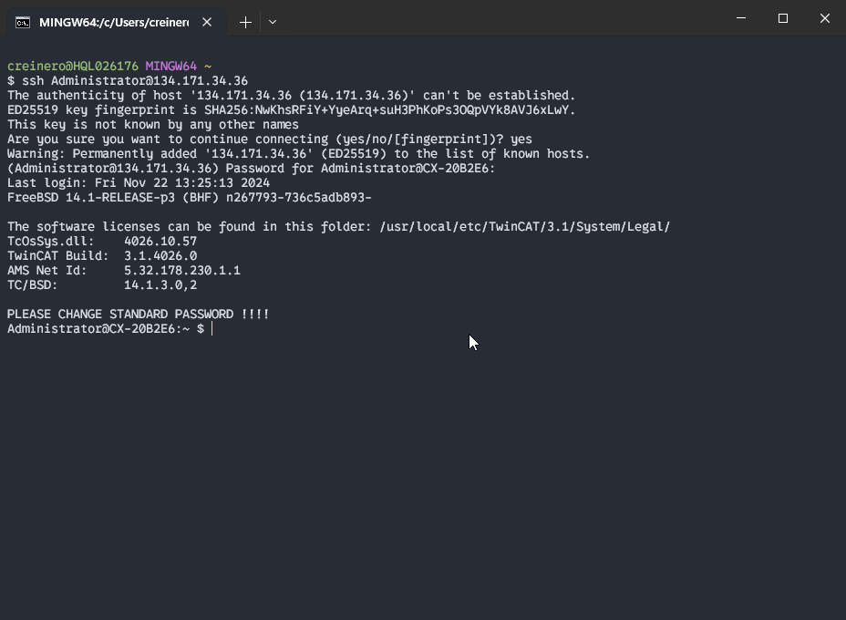
Using TwinCAT/BSD
Access:
  SSH

Slide 11
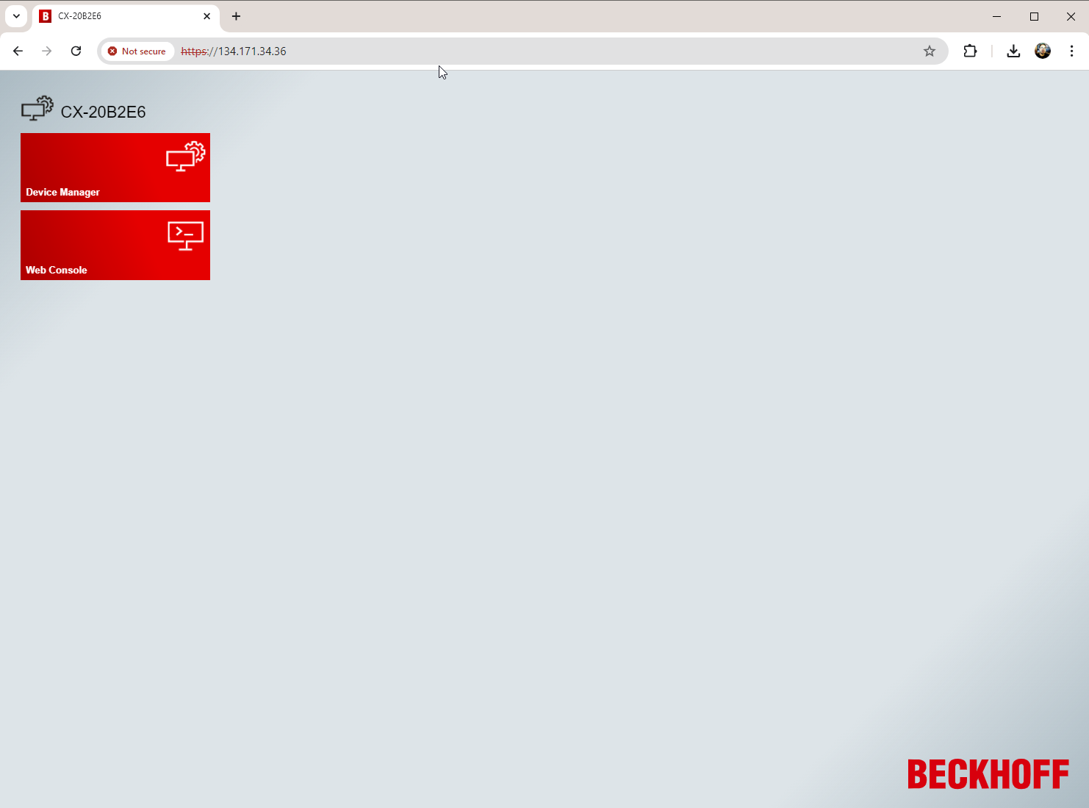
Using TwinCAT/BSD
Access:
  Web

Slide 12
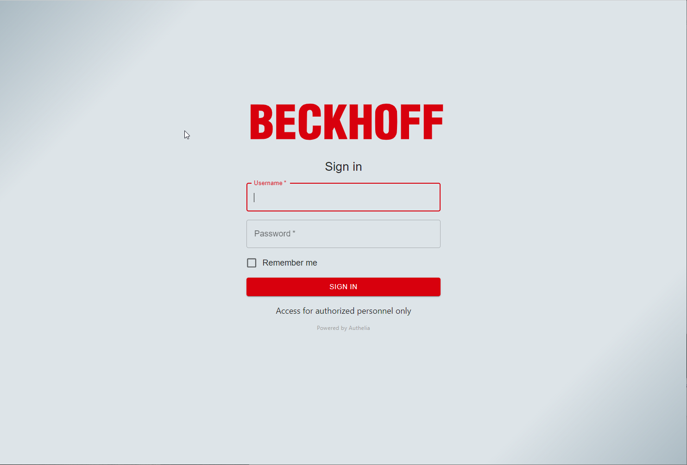
Using TwinCAT/BSD
Access:
  Web

Slide 13
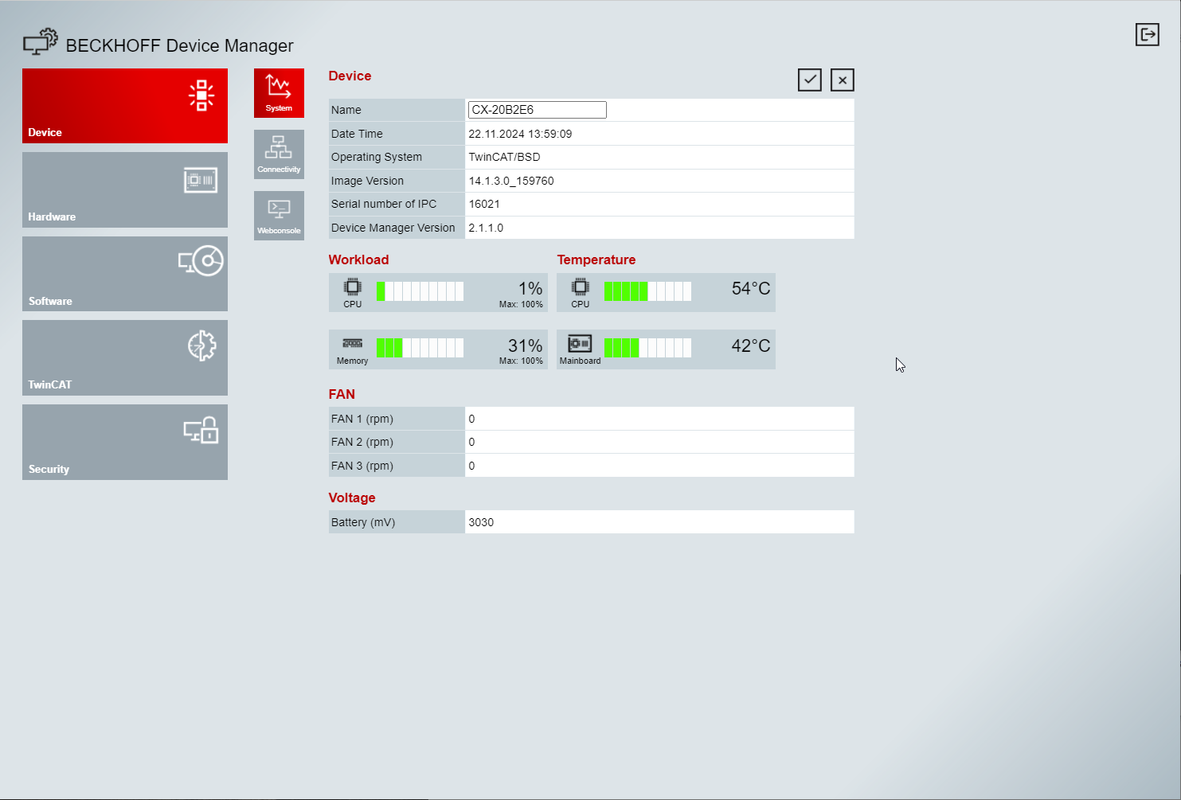
Using TwinCAT/BSD
Access:
  Web

Slide 14
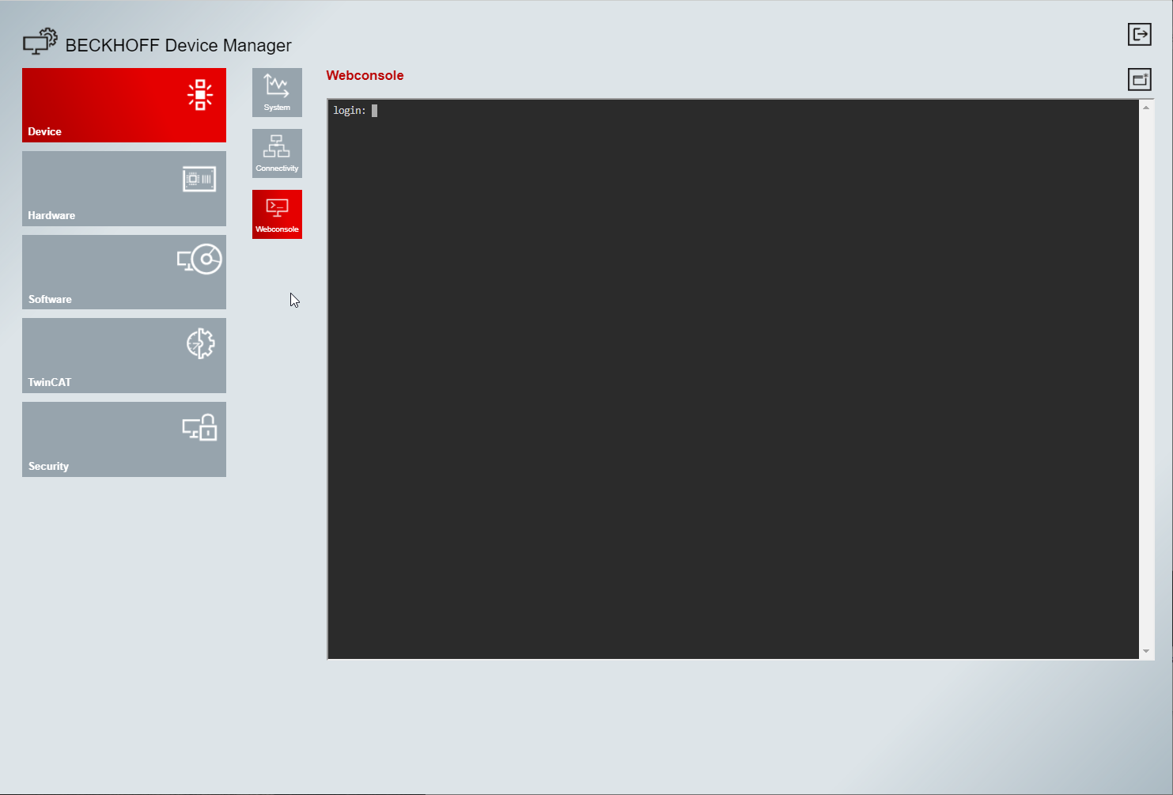
Using TwinCAT/BSD
Access:
  Web

Slide 15
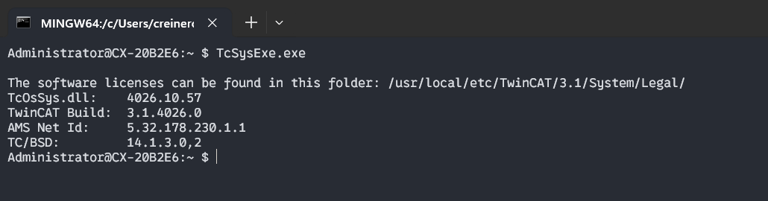
Using TwinCAT/BSD
TwinCAT/BSD Administration:
  The standard utilities comprise a combination of Beckhoff's proprietary tools and FreeBSD utilities.
  It is somewhat surprising that Beckhoff opted for cross-compiled tools that retain certain Windows-specific characteristics, leading to some level of confusion.

Slide 16
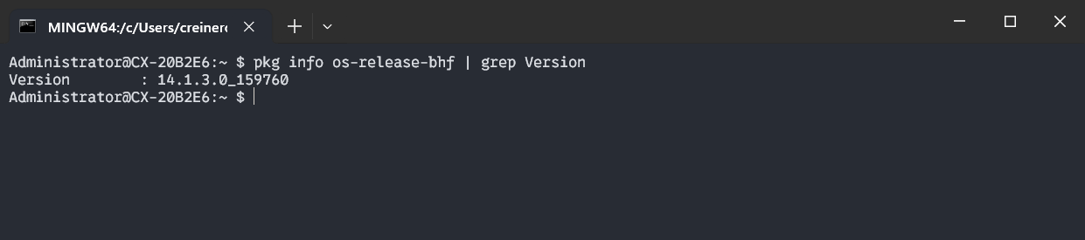
Using TwinCAT/BSD
TwinCAT/BSD Administration:
  Now if we would like to update the system, TwinCAT/BSD uses the standard FreeBSD utility: pkg

Slide 17
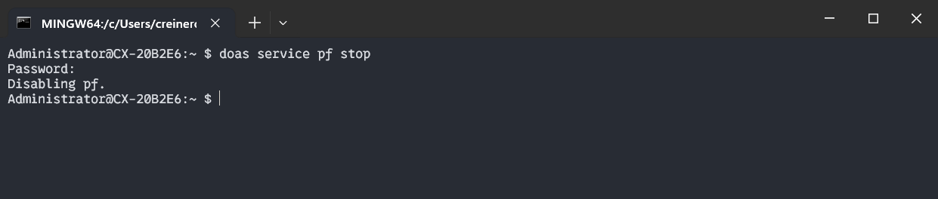
Using TwinCAT/BSD
TwinCAT/BSD Administration:
  For user privilege escalation we have to use: doas
  In my examples I keep the user Administrator just for compatibility, but it does not have super user privileges
  Let’s stop the firewall that comes enabled by default https://infosys.beckhoff.com/english.php?content=../content/1033/twincat_bsd/56842542196109725067.html&id=4567980173834788286

Slide 18
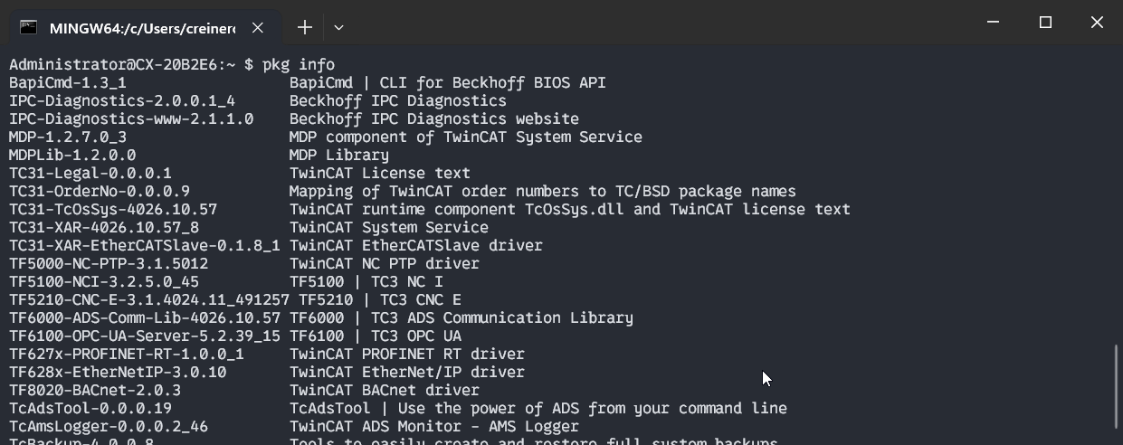
Using TwinCAT/BSD
TwinCAT/BSD Administration – Package Management:
  Look at installed packages

Slide 19
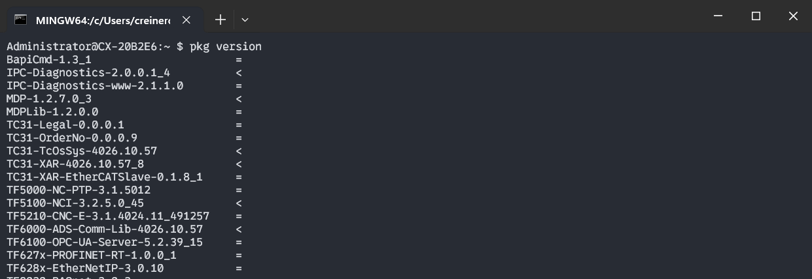
Using TwinCAT/BSD
TwinCAT/BSD Administration – Package Management:
  Lets see if we can update our packages

Slide 20
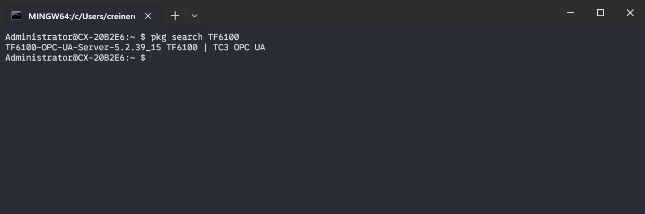
Using TwinCAT/BSD
TwinCAT/BSD Administration – Package Management:
  Search for a package

Slide 21
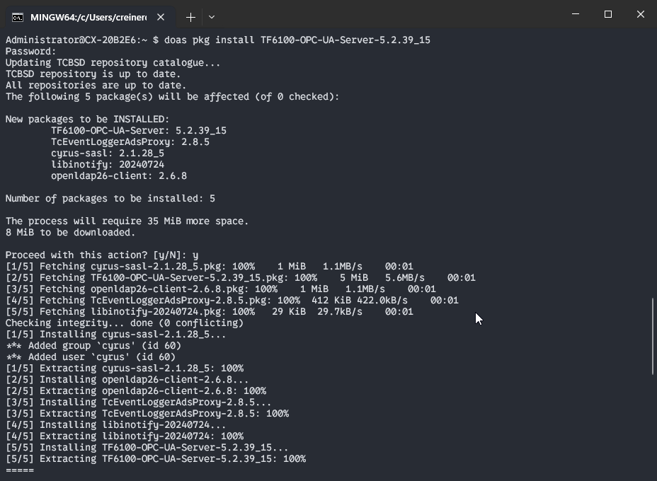
Using TwinCAT/BSD
TwinCAT/BSD Administration – Package Management:
  Install a package
    Let's install OPCUA v5

Slide 22
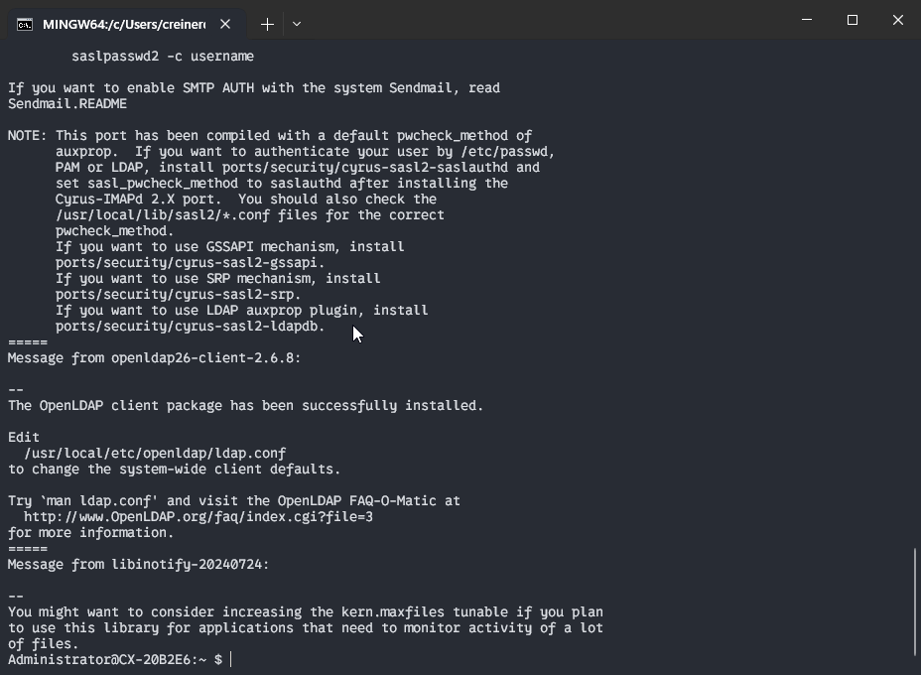
Using TwinCAT/BSD
TwinCAT/BSD Administration – Package Management:
  Install a package
    Let's install OPCUA v5

Slide 23
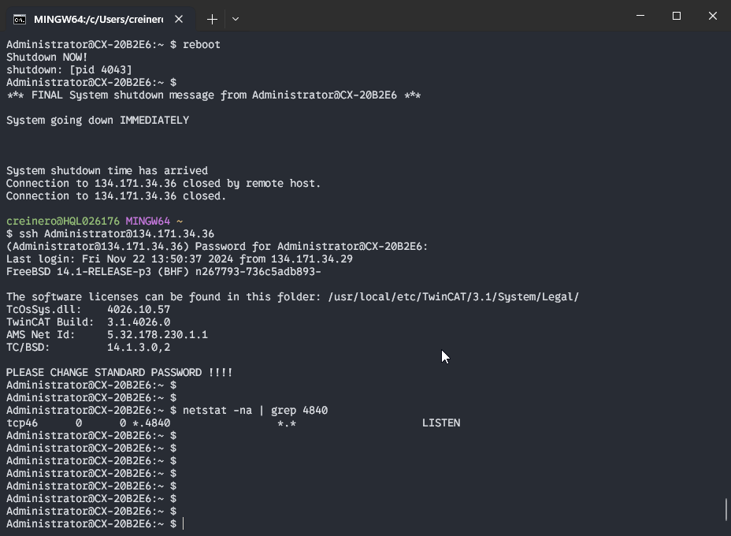
Using TwinCAT/BSD
TwinCAT/BSD Administration – Package Management:
  Install a package
    For this installation we need to reboot
    We can check now if the port for the OPCUA v5 is open

Slide 24
Using TwinCAT/BSD
TwinCAT/BSD Administration – Package Management:
  Install a package
    The rest of the installation of OPCUA v5 is the same as it is for windows (https://infosys.beckhoff.com/english.php?content=../content/1033/tcopcserver/12162127115.html&id=)
    From UA Experts you should see no difference

Slide 25
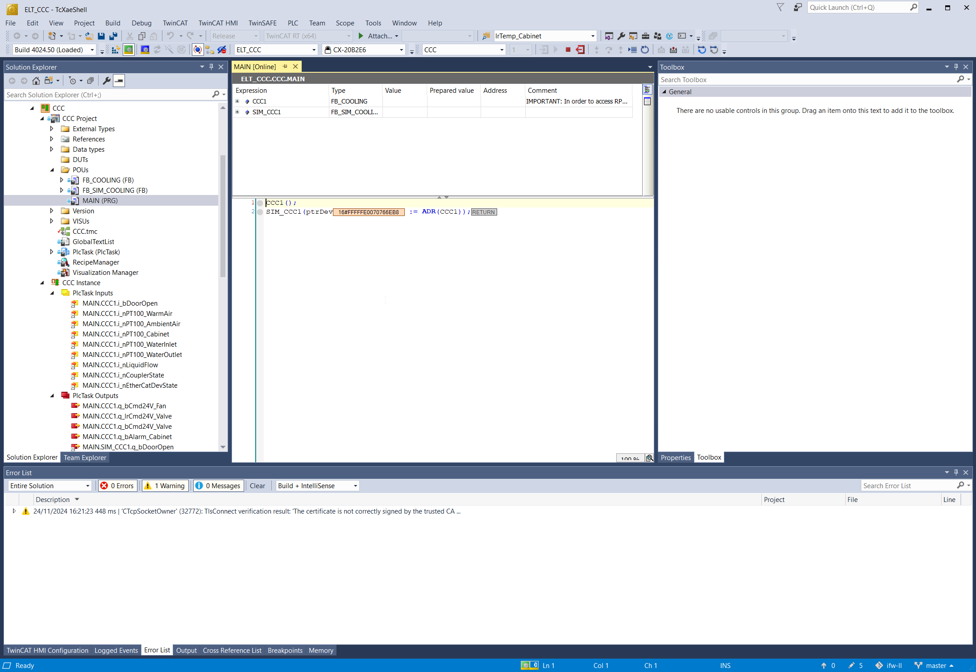
Using TwinCAT/BSD
TwinCAT/BSD Development:
  The usage of TwinCAT/BSD should be totally transparent from this perspective.
  You should use the same development tools and the system should behave the same.

Slide 26
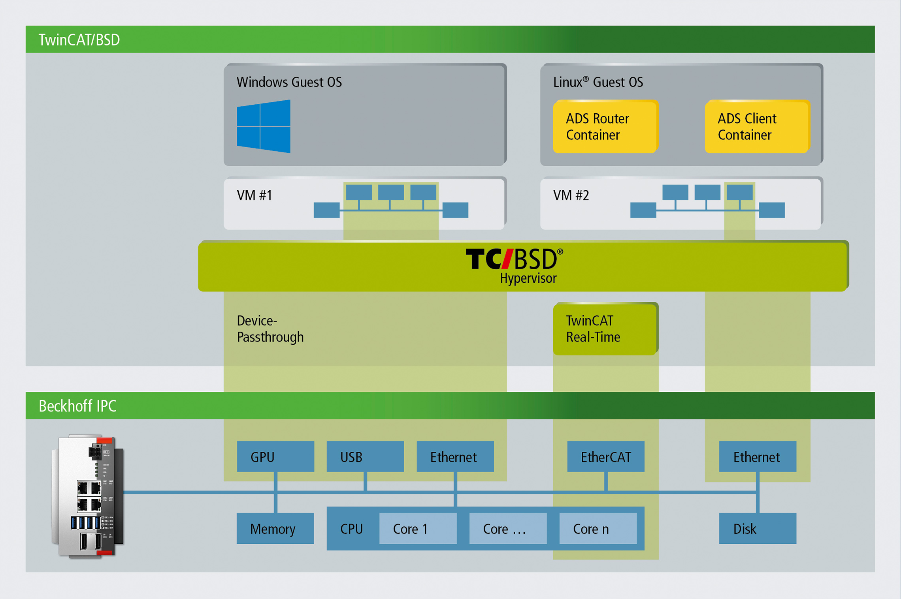
TwinCAT/BSD features Hypervisor
The TwinCAT/BSD Hypervisor is a system feature of the TwinCAT/BSD operating system from Beckhoff and enables the simultaneous execution of virtual machines and TwinCAT real-time applications on a Beckhoff Industrial PC.
Source:
https://www.beckhoff.com/en-en/products/automation/twincat-bsd-hypervisor/

Slide 27
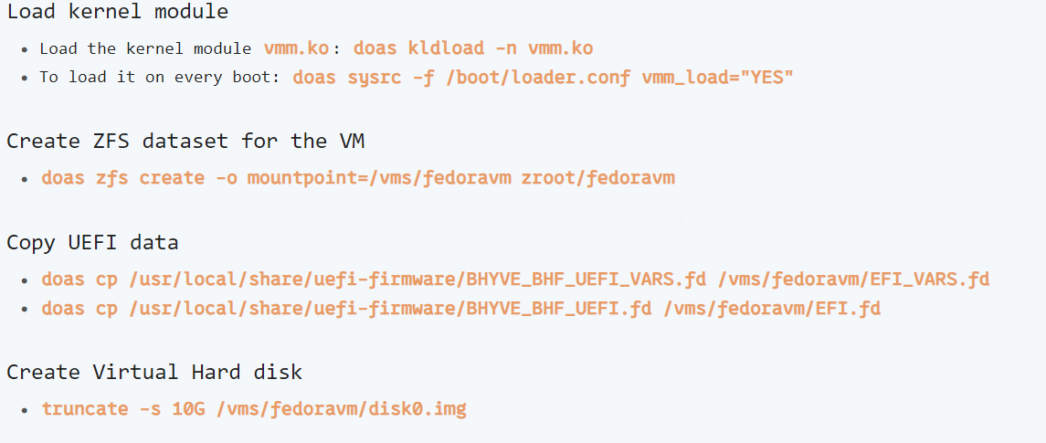
TwinCAT/BSD features Hypervisor
The documentation offers some information and examples. (https://infosys.beckhoff.com/english.php?content=../content/1033/twincat_bsd/56842542196109725067.html&id=4567980173834788286)
Implementing this functionality was not straightforward.

Slide 28
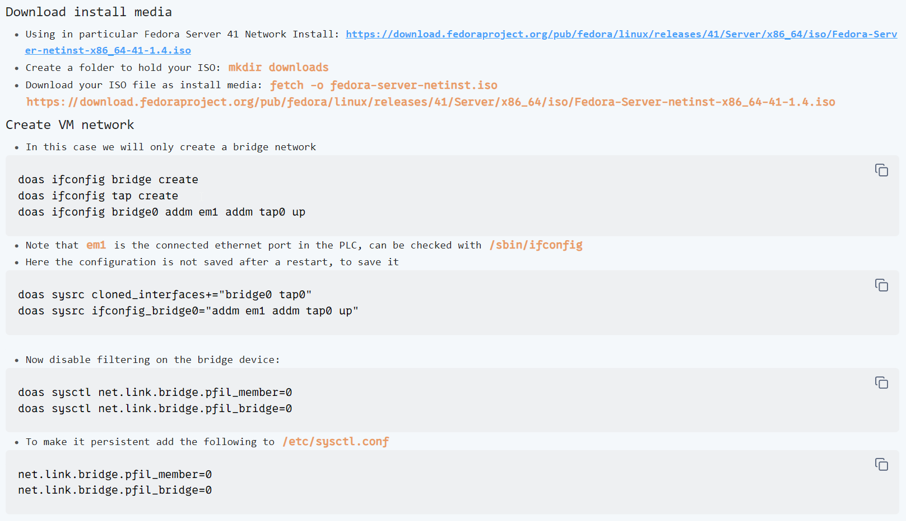
TwinCAT/BSD features Hypervisor

Slide 29
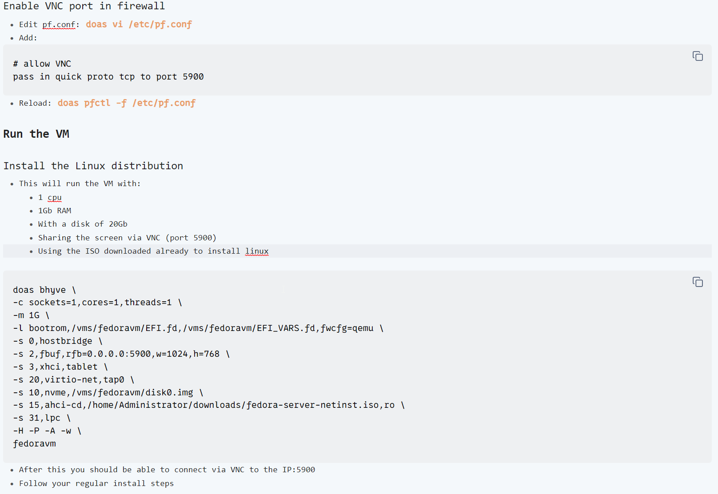
TwinCAT/BSD features Hypervisor

Slide 30
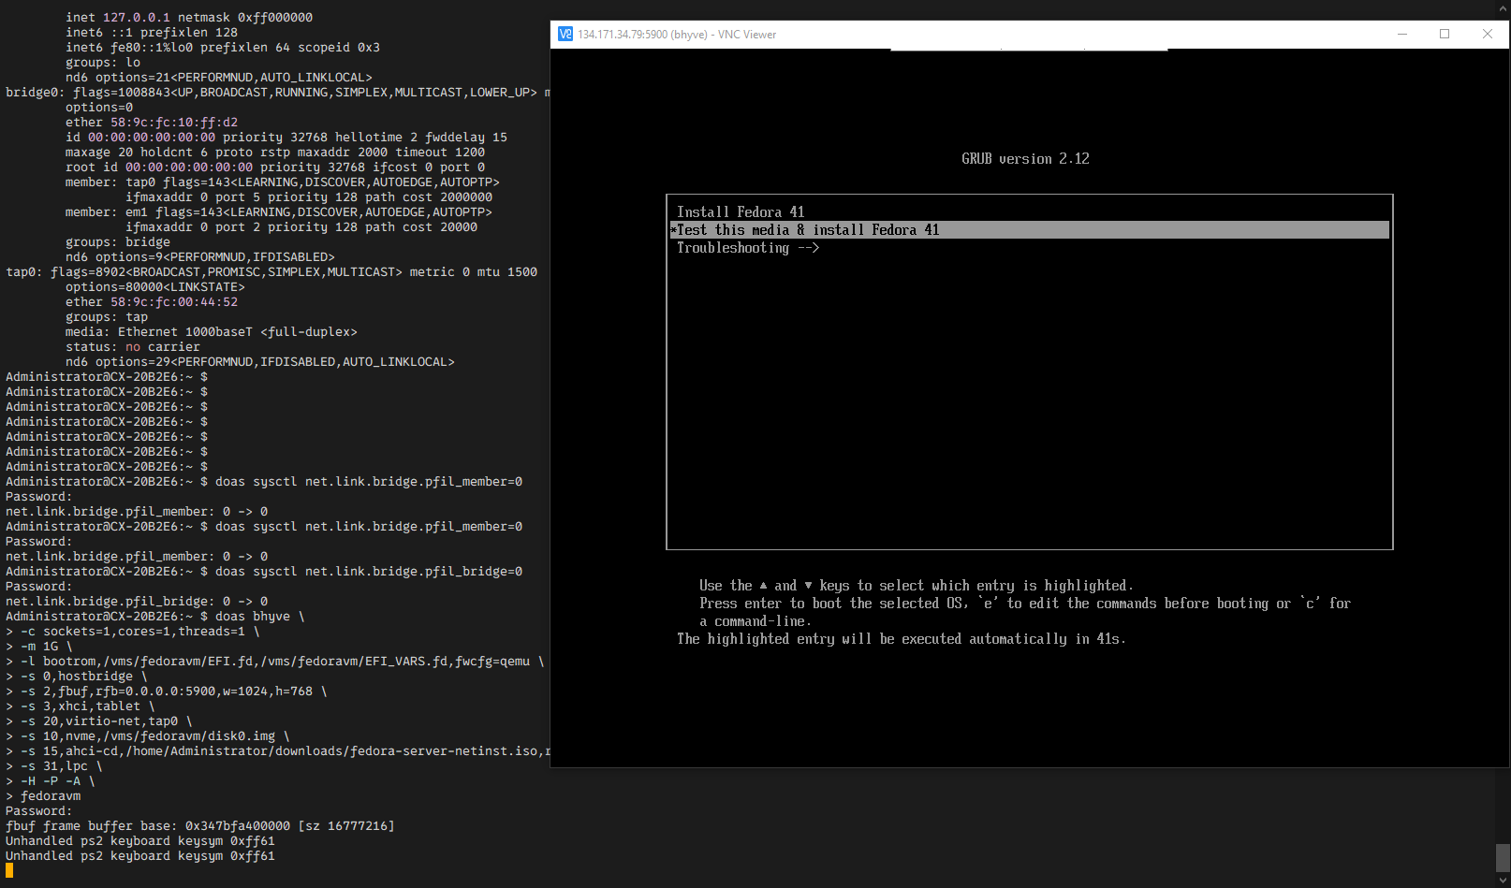
TwinCAT/BSD features Hypervisor

Slide 31
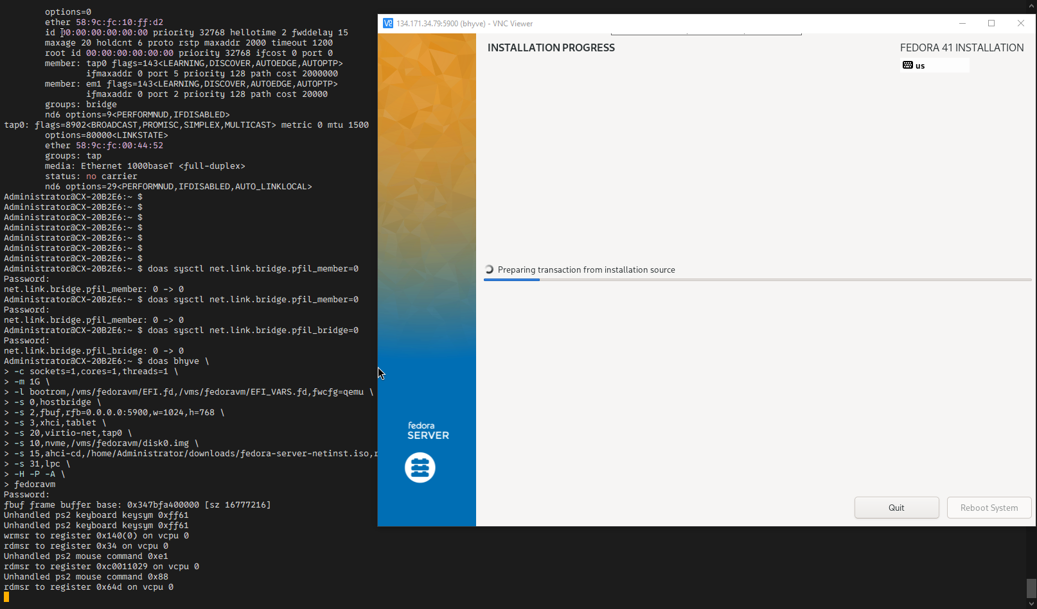
TwinCAT/BSD features Hypervisor

Slide 32
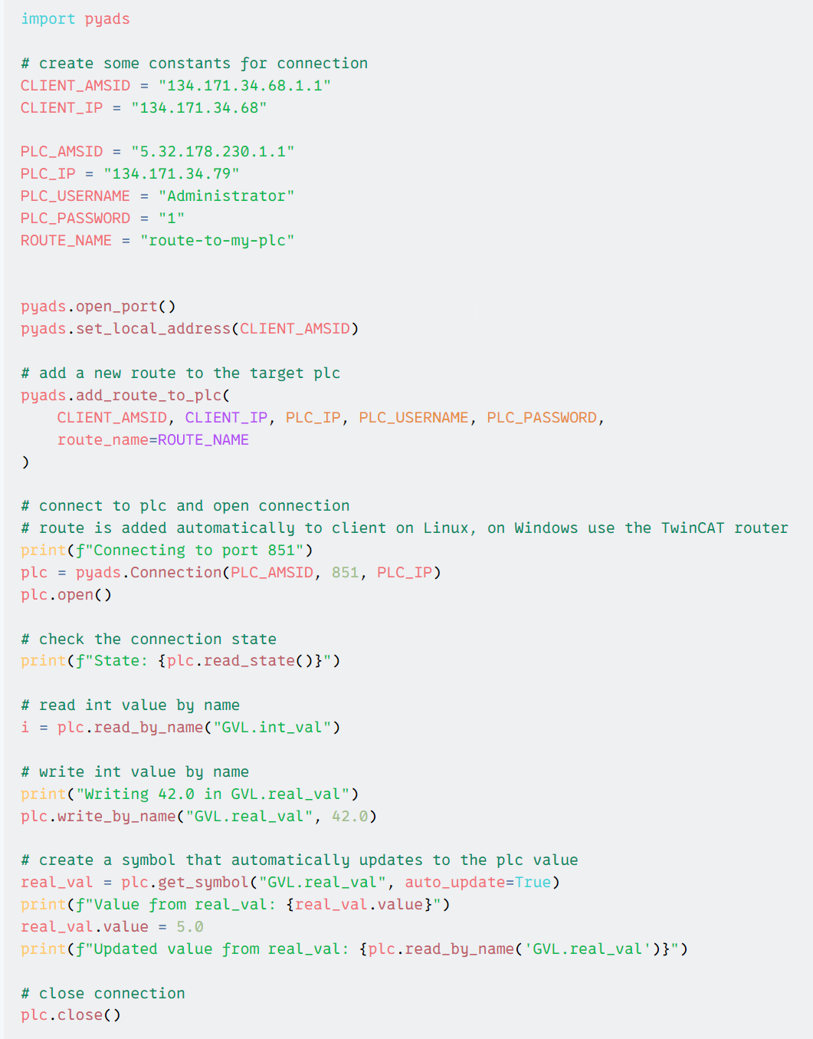
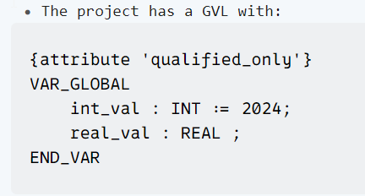
TwinCAT/BSD features Hypervisor
TwinCAT/BSD Hypervisor test:
  Run a PLC application with some variables
  Run a python script on the guest Linux OS which will communicate via ADS with the PLC

Slide 33
TwinCAT/BSD Virtualization
TwinCAT/BSD is based on FreeBSD, which can normally be virtualized.
This functionality is not supported/document by Beckhoff, but it works.
The procedure to make this work is complex, but ideally only has to be done once.
This VM machine will of course not be connected to any terminals
Licensing of the different Beckhoff SW should be dealt with as usual

Slide 34
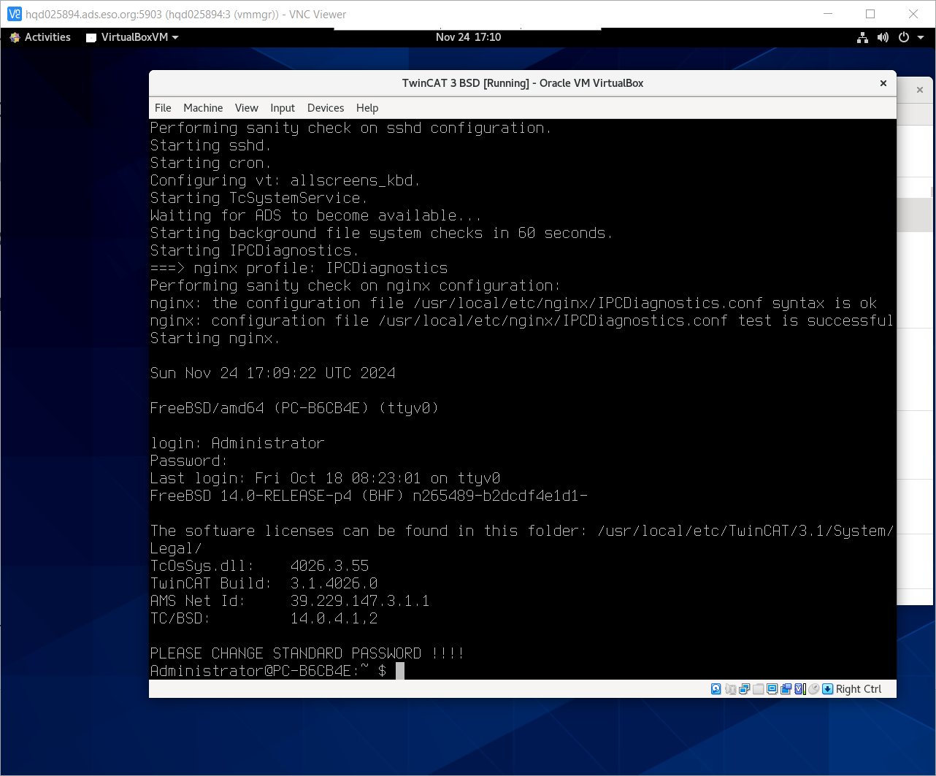
TwinCAT/BSD Virtualization
The end result is a VM running TwinCAT/BSD

Slide 35
TwinCAT/BSD Virtualization
This VM will behave as any other TwinCAT/BSD instance in general terms
The VM should have assigned isolated cores and ~2Gb of RAM for it to work properly.
In our testing this VM would not be performant enough for real time tasks.
Application: PLC Device Simulators
  One could run a TwinCAT/BSD VM
  On this VM deploy PLC devices with its simulator
  Saving money and logistics during the development process

Slide 36
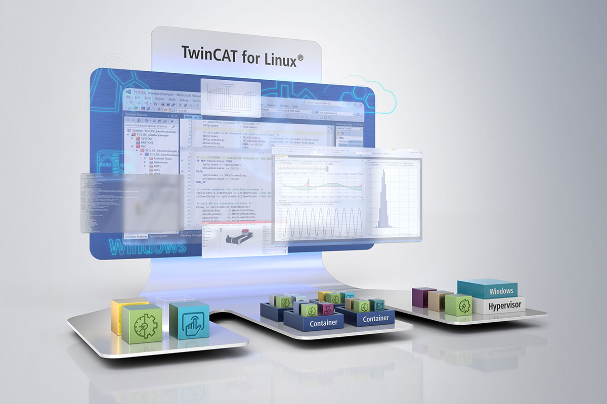
TwinCAT Future
Linux®-based real-time control with TwinCAT
  TwinCAT Runtime for Linux® is based on Beckhoff's own Linux® distribution, which expands the choice of operating systems in addition to Windows and TwinCAT/BSD. The distribution was developed using the free Debian operating system and includes a Linux® real-time kernel as standard for real-time execution of the runtime.
Source:
https://www.beckhoff.com/en-en/products/product-news/linux-r/

Slide 37
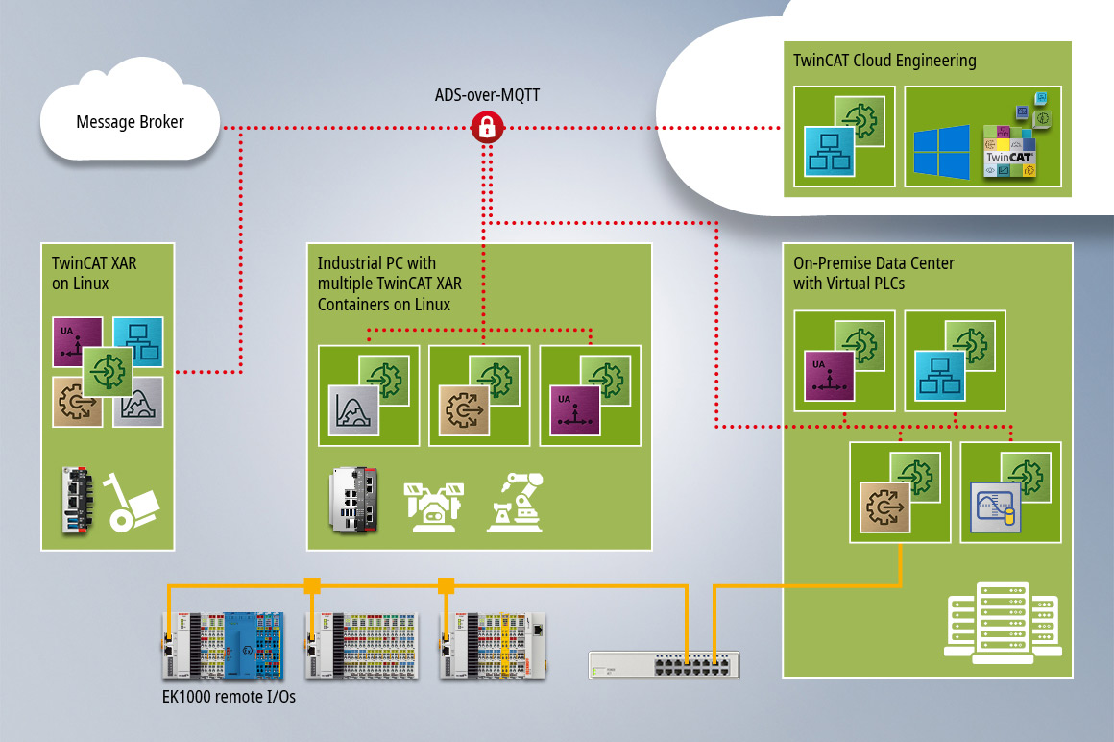
TwinCAT Future
Virtual PLC with Beckhoff
  Not only does TwinCAT for Linux® allow the TwinCAT automation software to be executed on the basis of the Linux® operating system, but it also enables TwinCAT to be distributed and operated in the form of containers.
Source:
https://www.beckhoff.com/en-en/products/automation/virtual-plc/

Slide 38
Claudio Reinero
– creinero@eso.org
@ESOAstronomy
@esoastronomy
@ESO
european-southern-observatory
@ESOobservatory

