Slide 1
METIS ICS & METIS SCAO
Wim Pessemier: Low-level software
Wim De Meester: High-level software
Martin Kulas: METIS AOCS

Slide 2
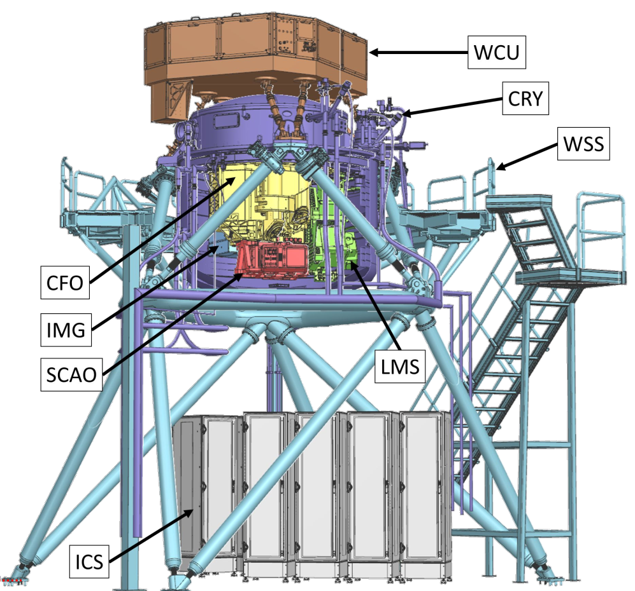
METIS = Mid-infrared ELT Imager and Spectrograph
Covers L, M and N bands
Most subsystems are inside the cryostat, operating at 35 to 100 K
Current status: subsystem AIV

Slide 3
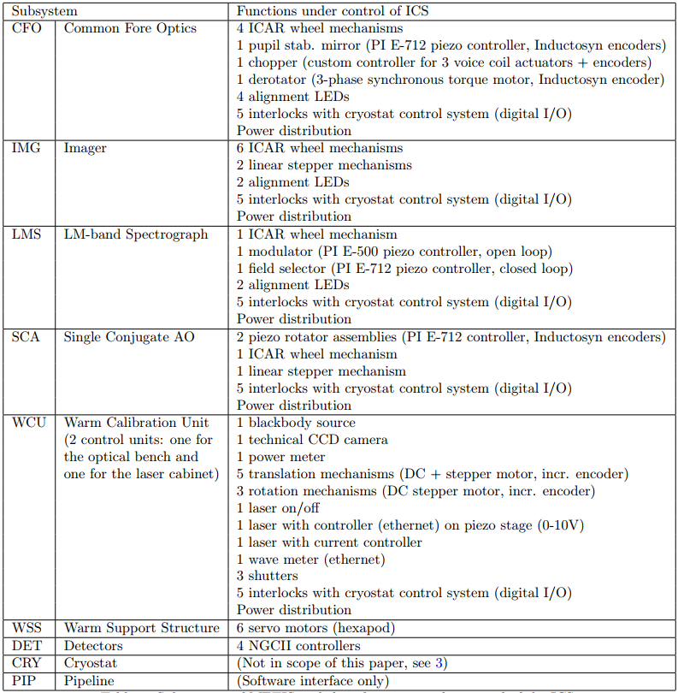
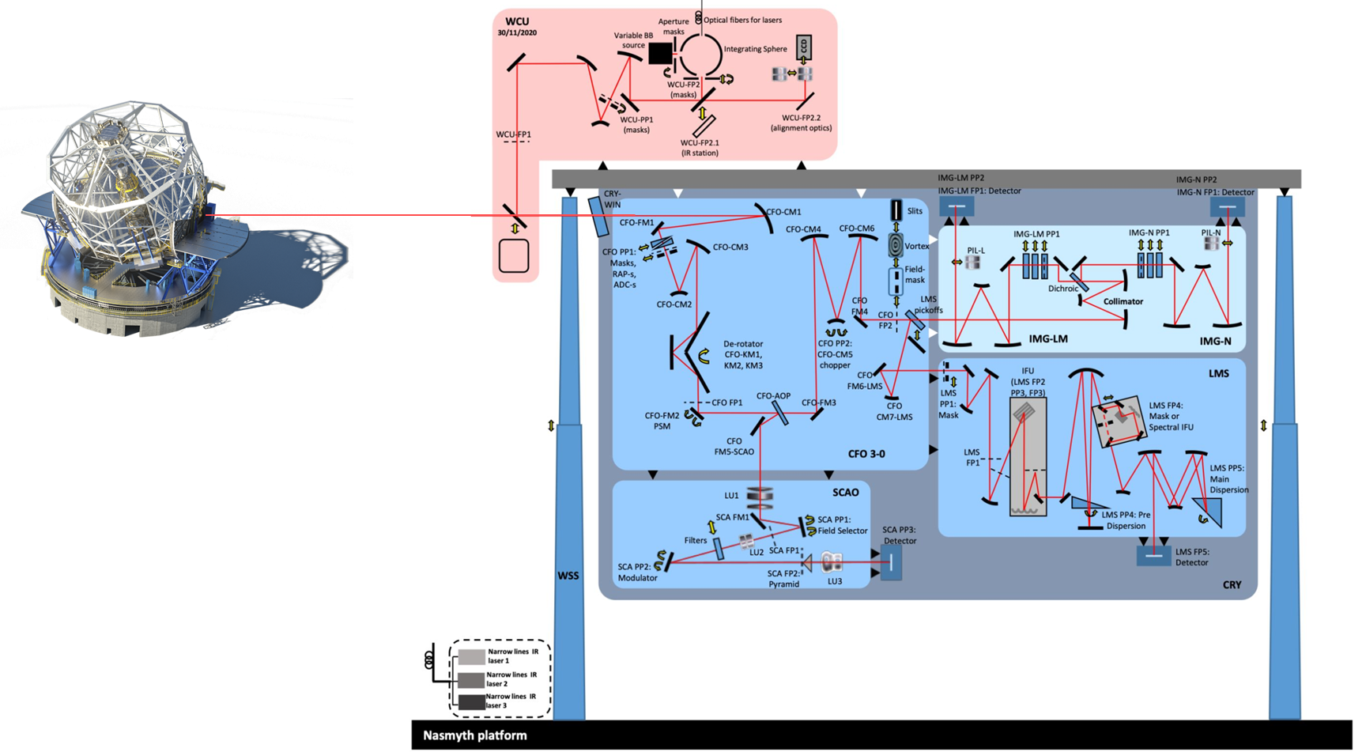
Large number of functions

Slide 4
METIS ICS: Low level software

Slide 5
Low level software
Focus on FCS
  PLC
    Instantiate standard FBs for every standard device
    Develop custom FBs (controller, simulator, GUI template) for every special device
    Group all devices per subsystem, create one big GUI
  Workstation
    Instantiate standard classes for every standard device (=configuration)
    Develop custom classes (C++ controller, Python simulator, pyFcsGui widget) for every special device
    Group all devices per subsystem, define pyFcsGuis per subsystem
Subsystem AIV is ongoing

Slide 6
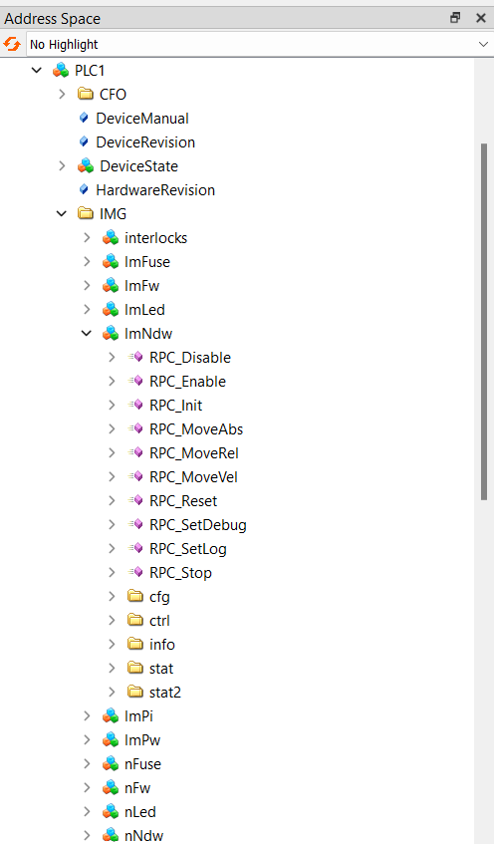
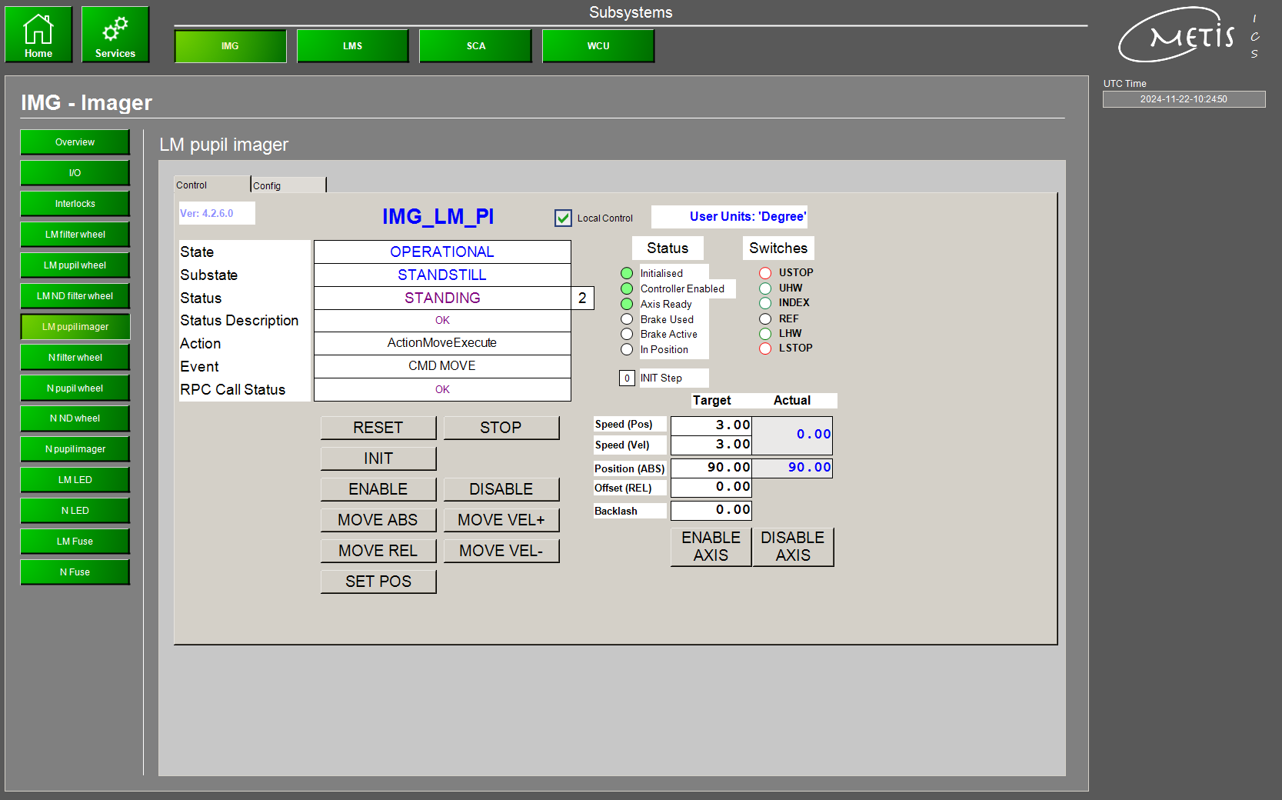
Standard devices
OPC UA address space
PLC GUI (= assembly of VISU templates)
subsystems
devices
simulators

Slide 7
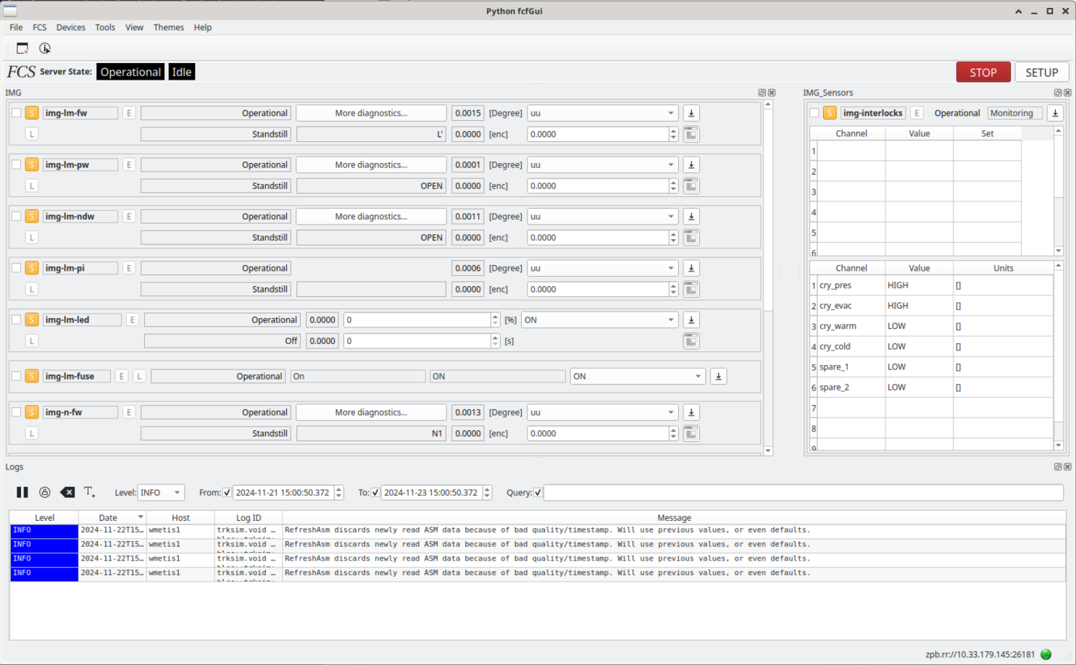
Standard devices
Workstation pyFcsGui

Slide 8
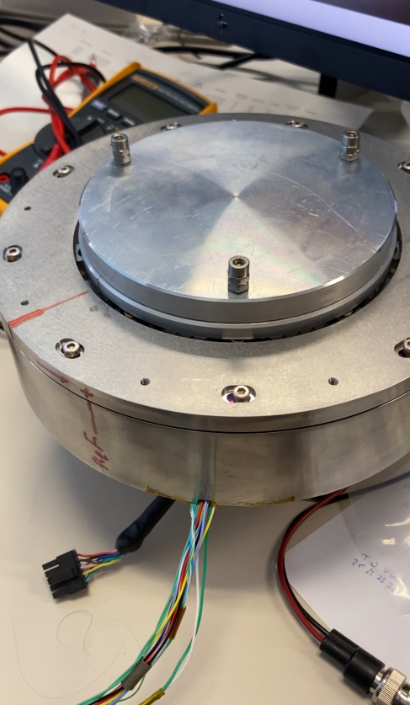
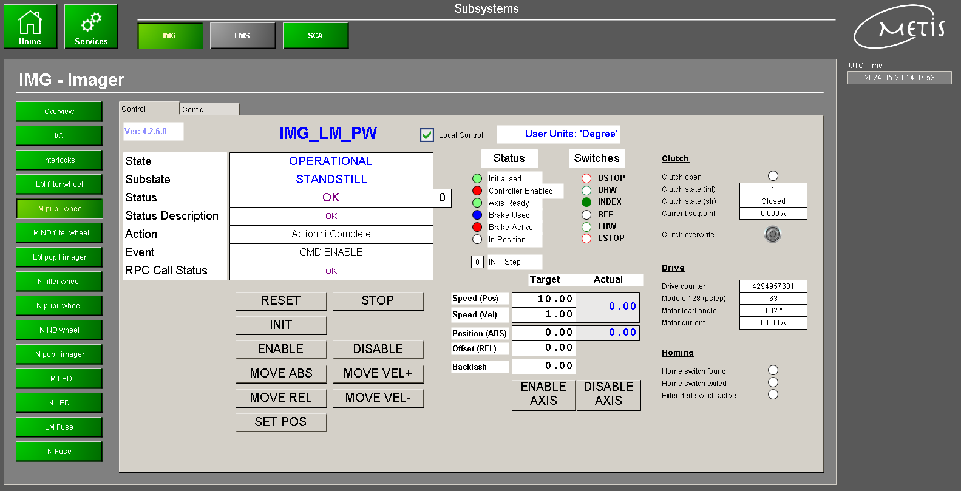
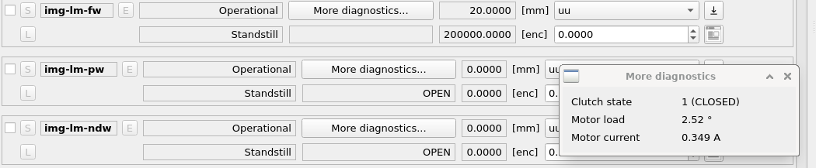
Special devices : ICAR (= extended standard Motor)

Slide 9
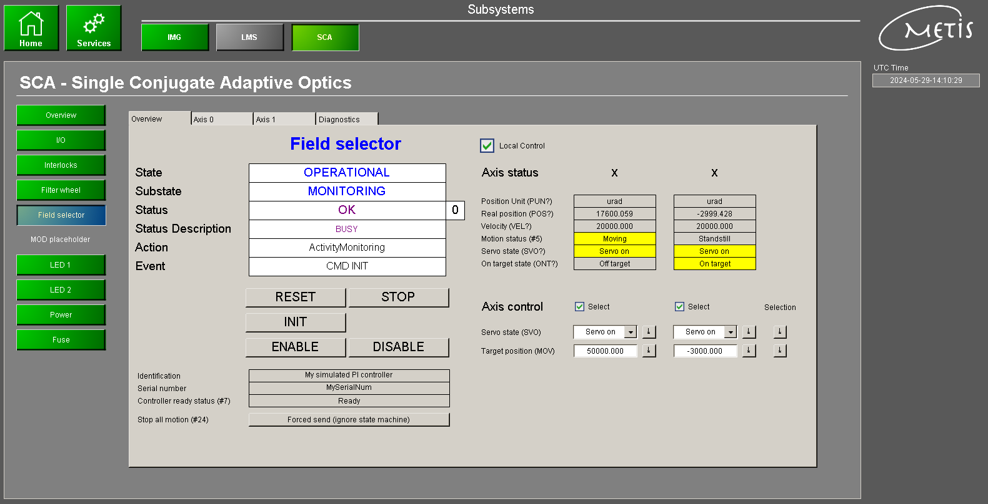
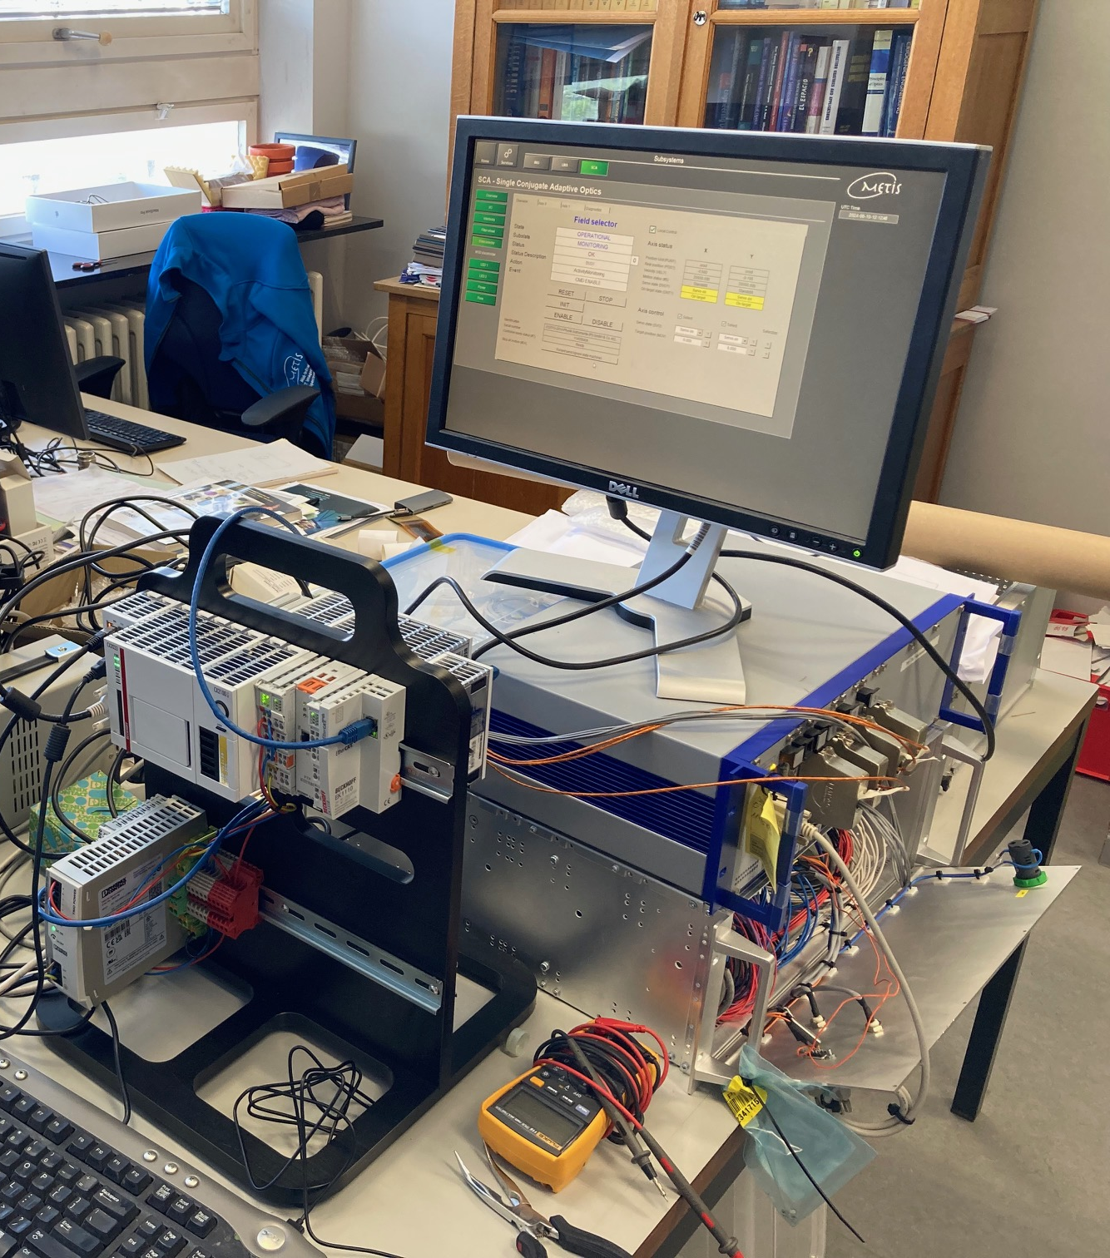
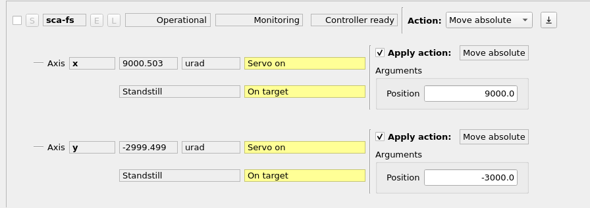
Special devices : Physik Instrumente piezo controller (multi-axis)

Slide 10
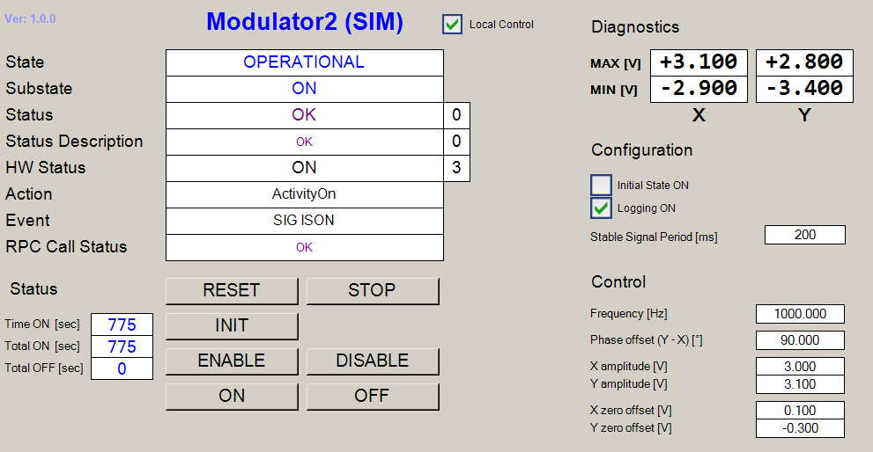
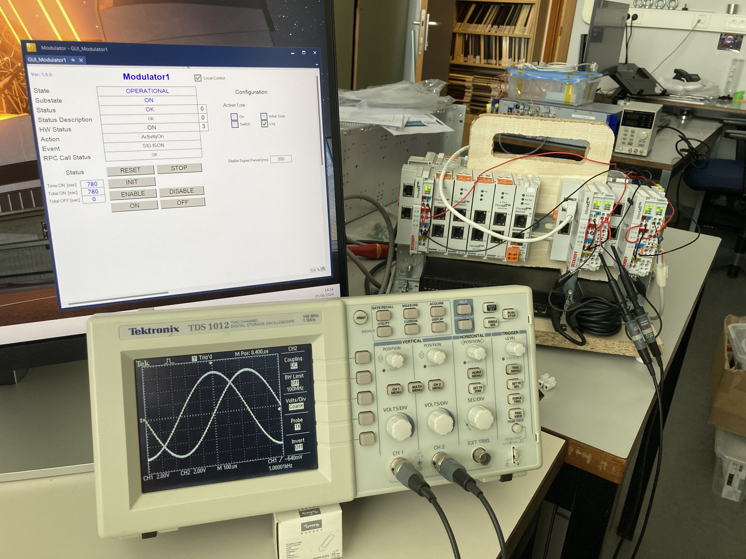
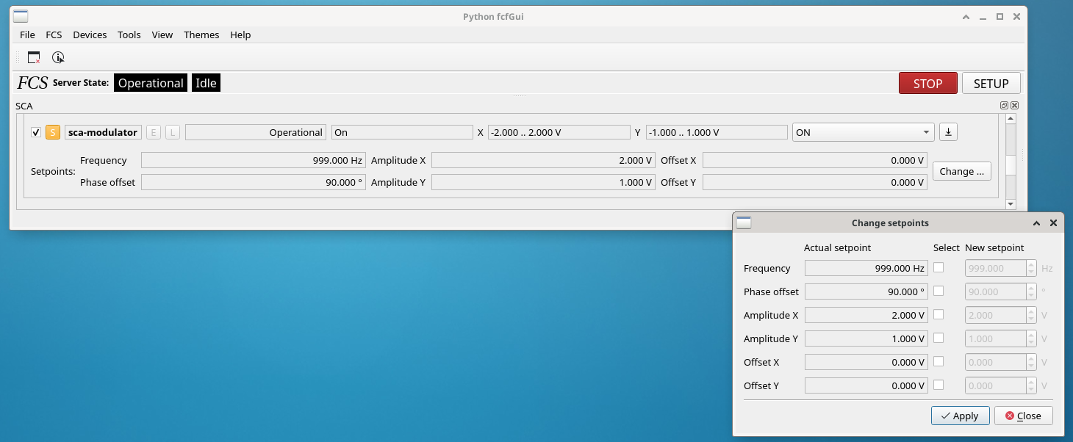
Special devices : Modulator (fast tip-tilt)

Slide 11
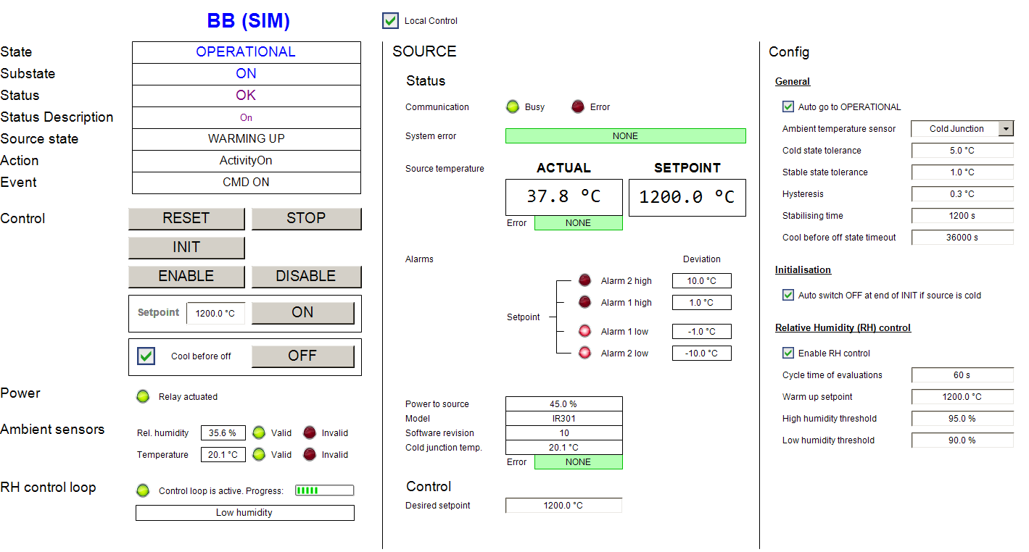
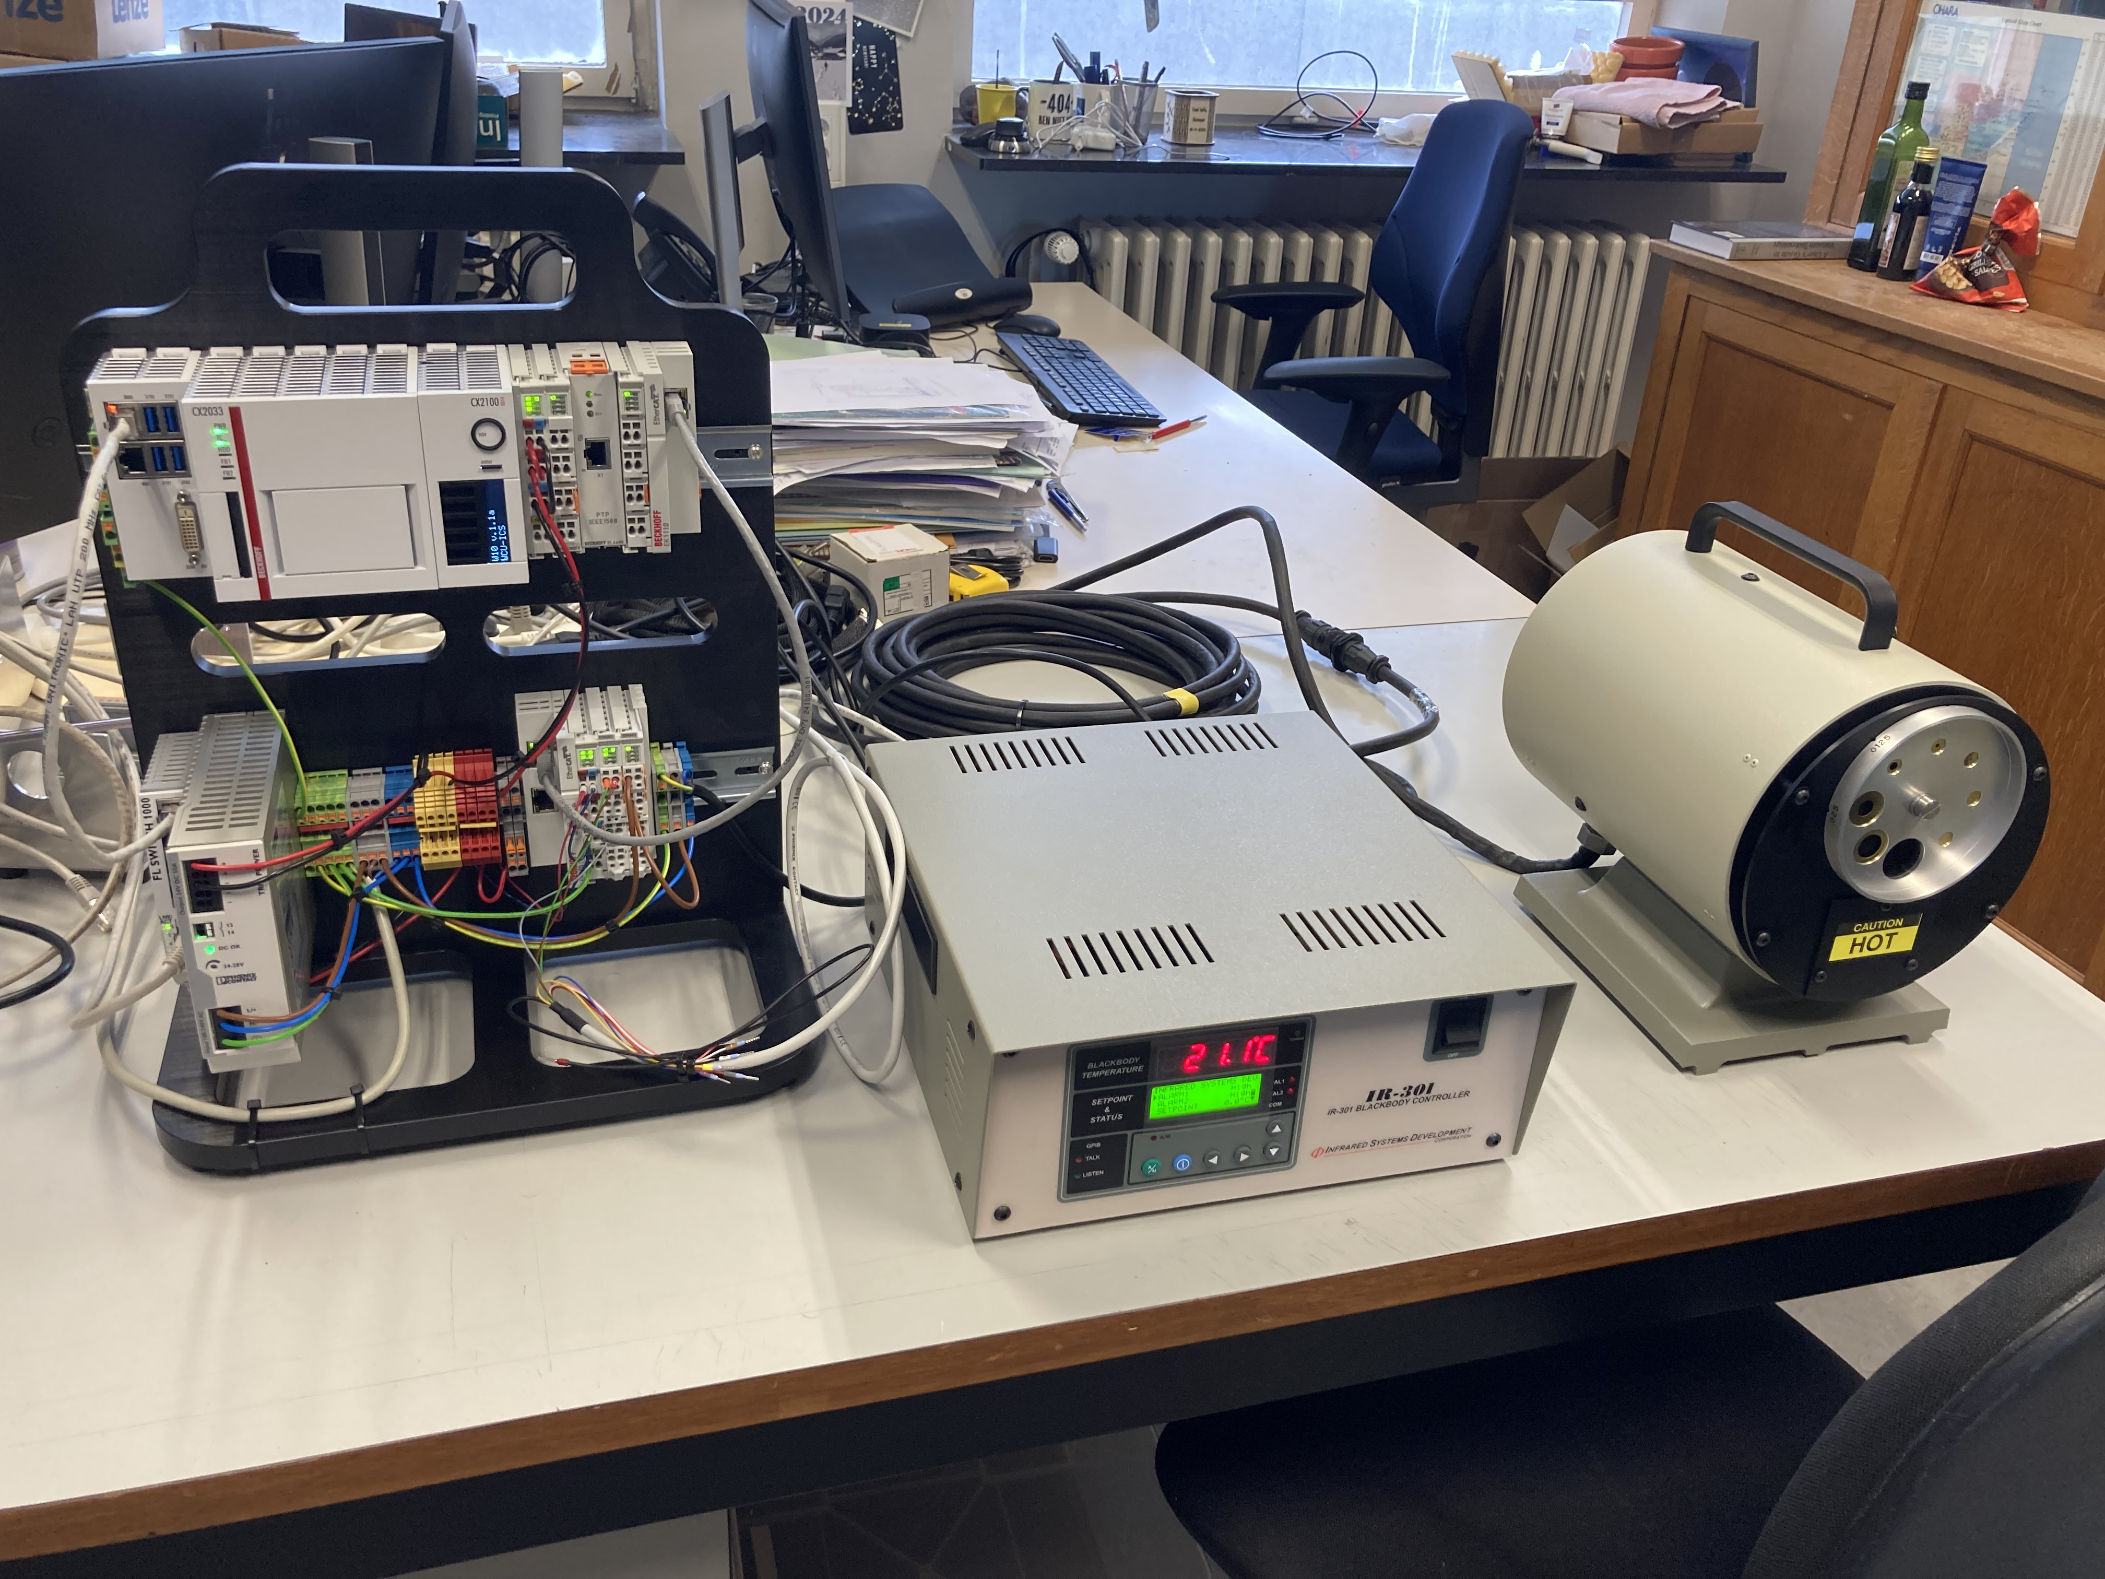
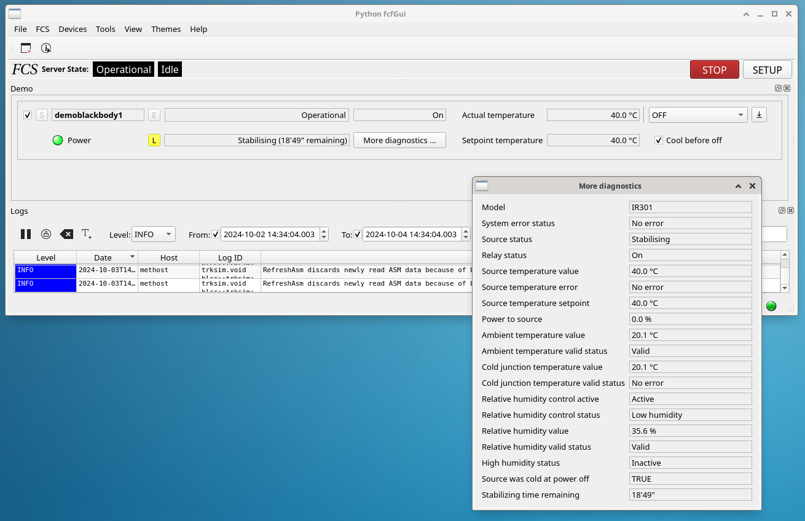
Special devices : blackbody source

Slide 12
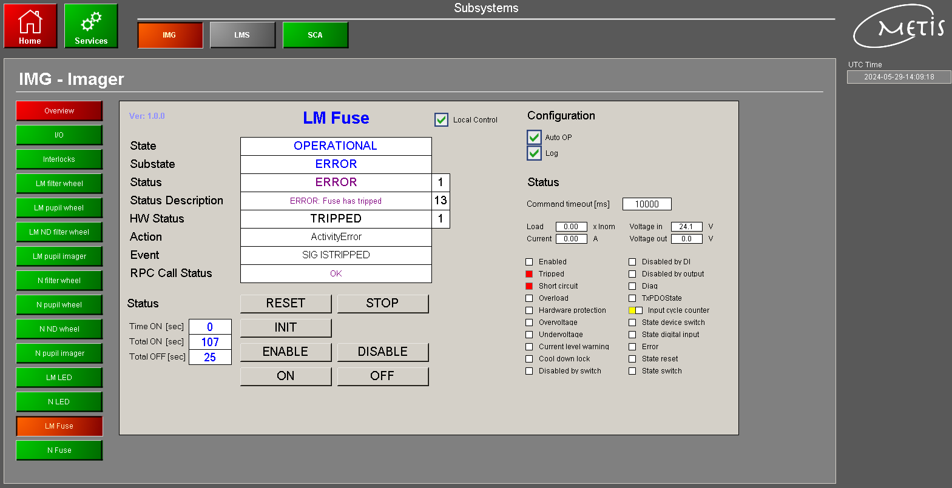
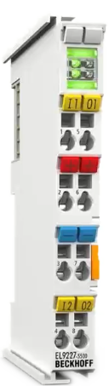
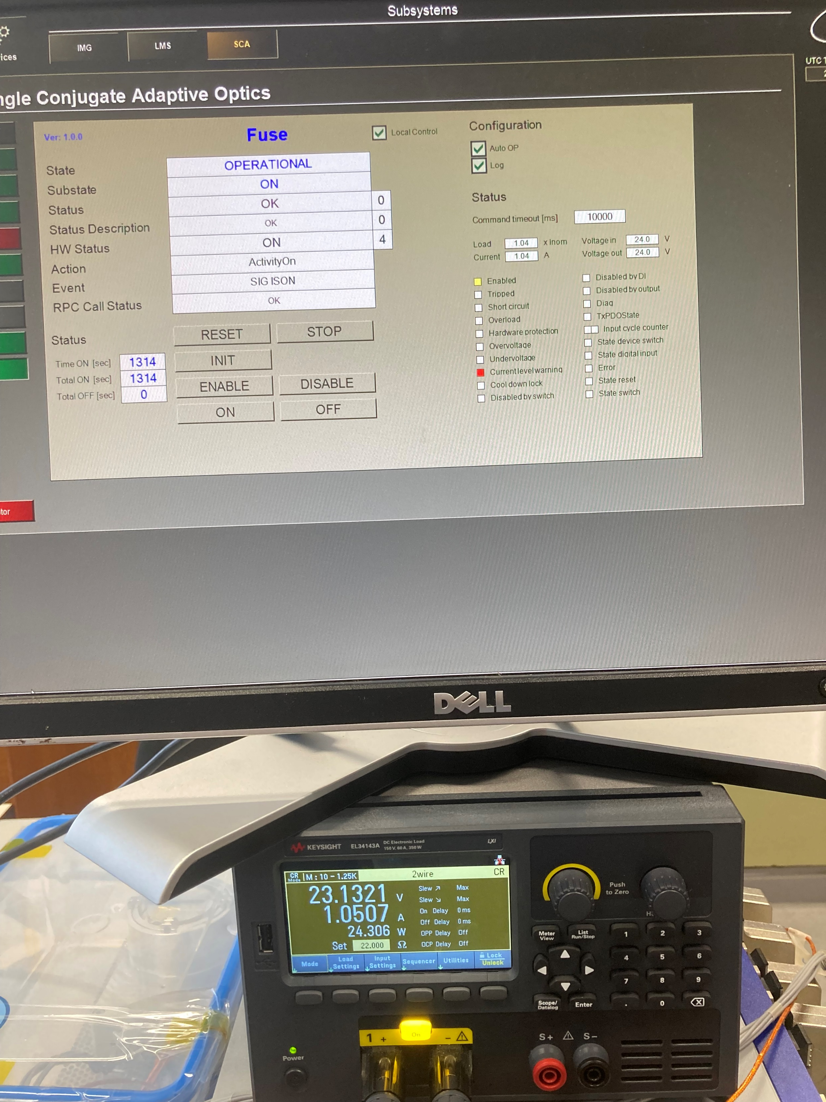
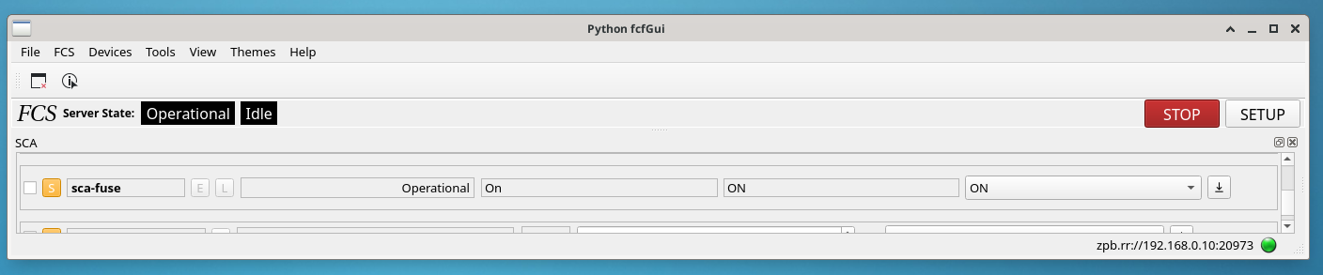
Special devices : Fuse

Slide 13
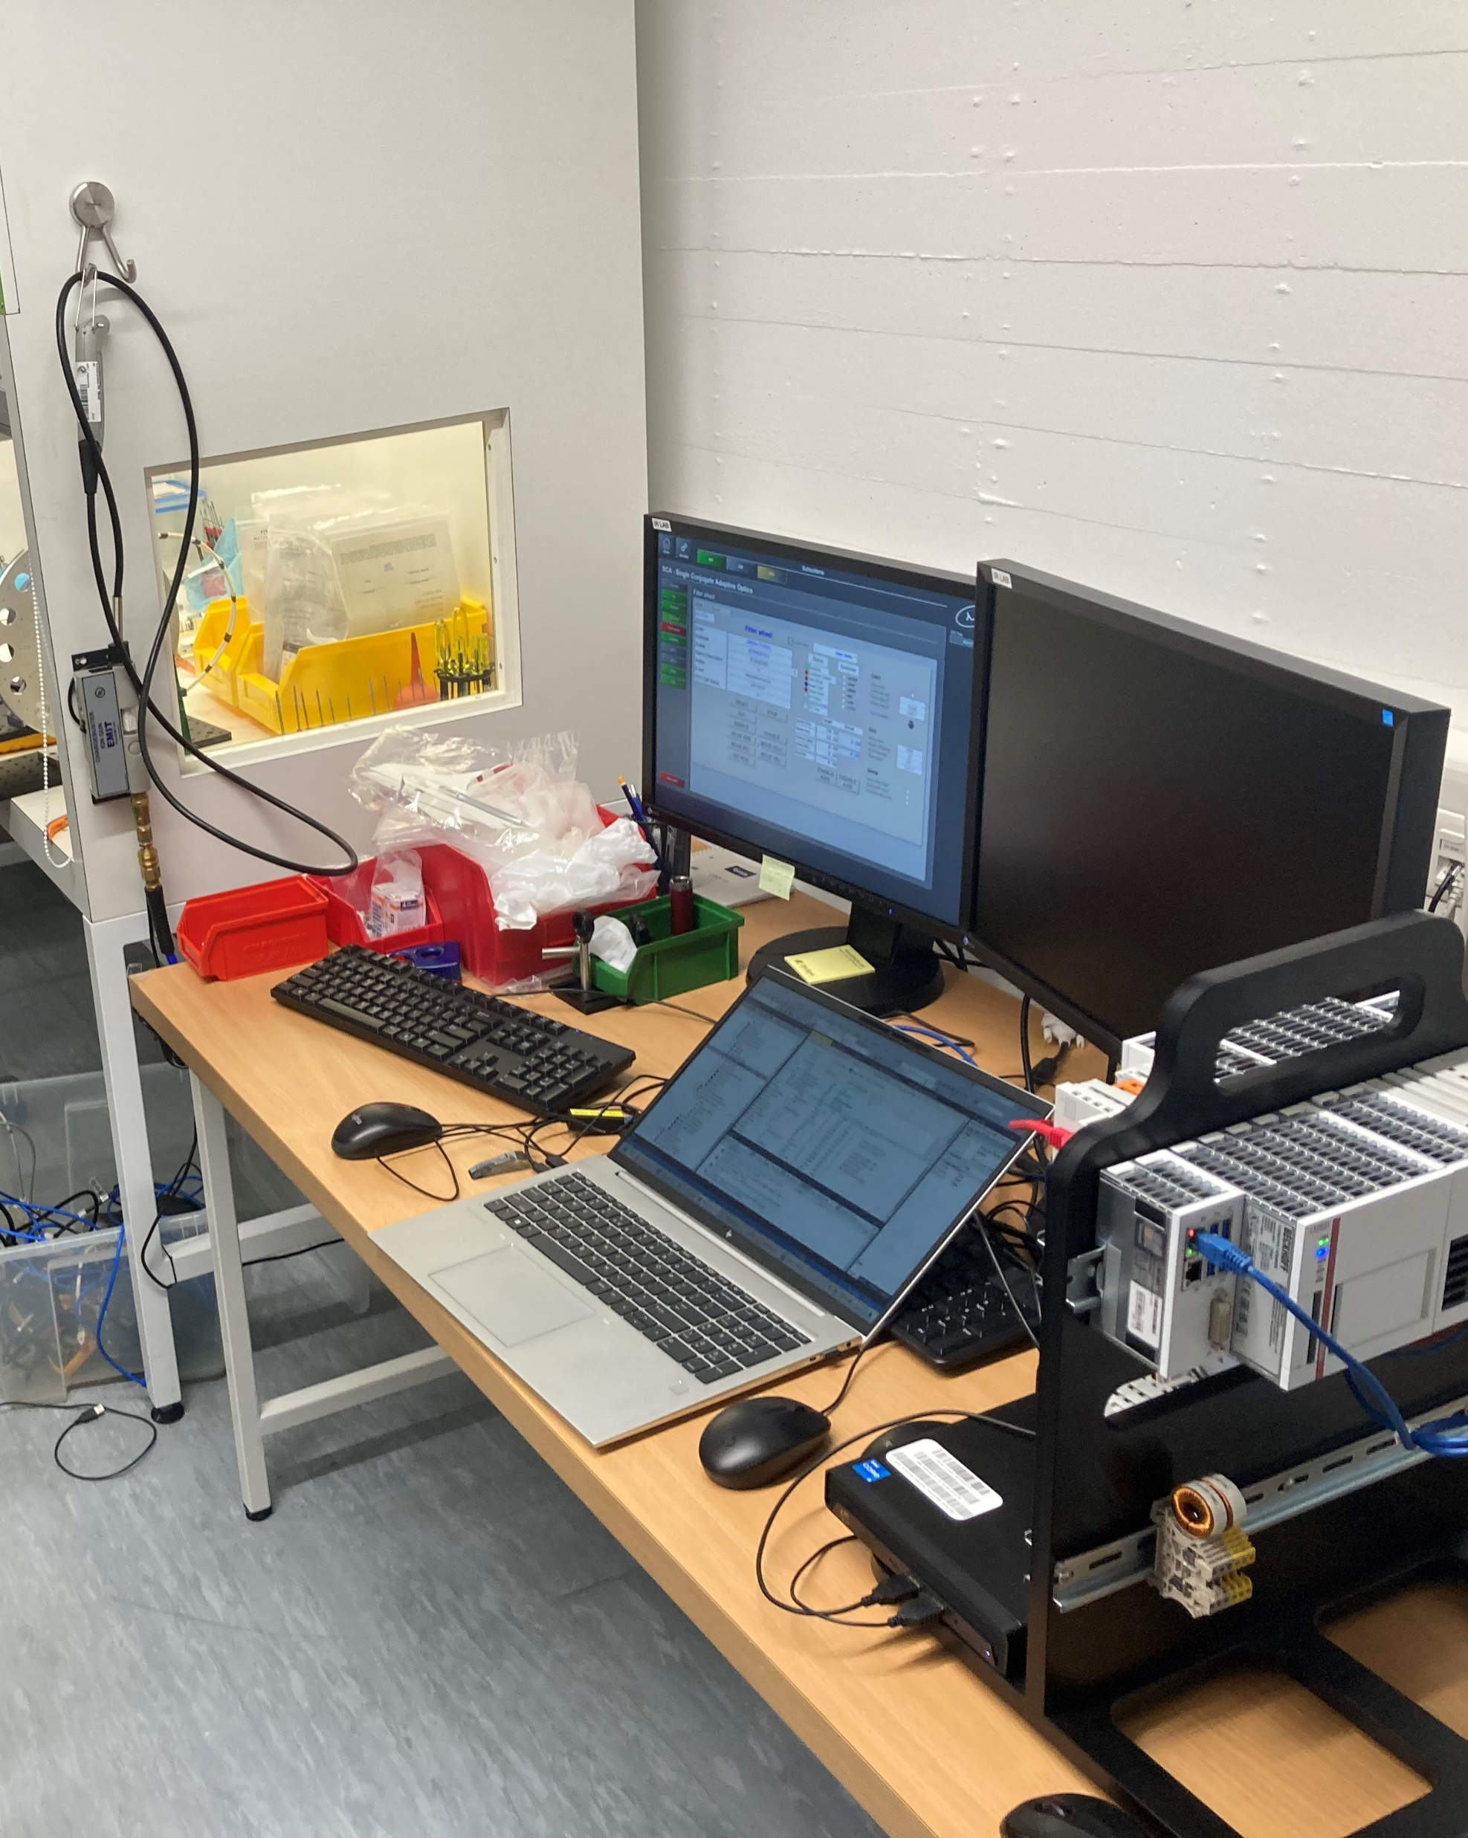
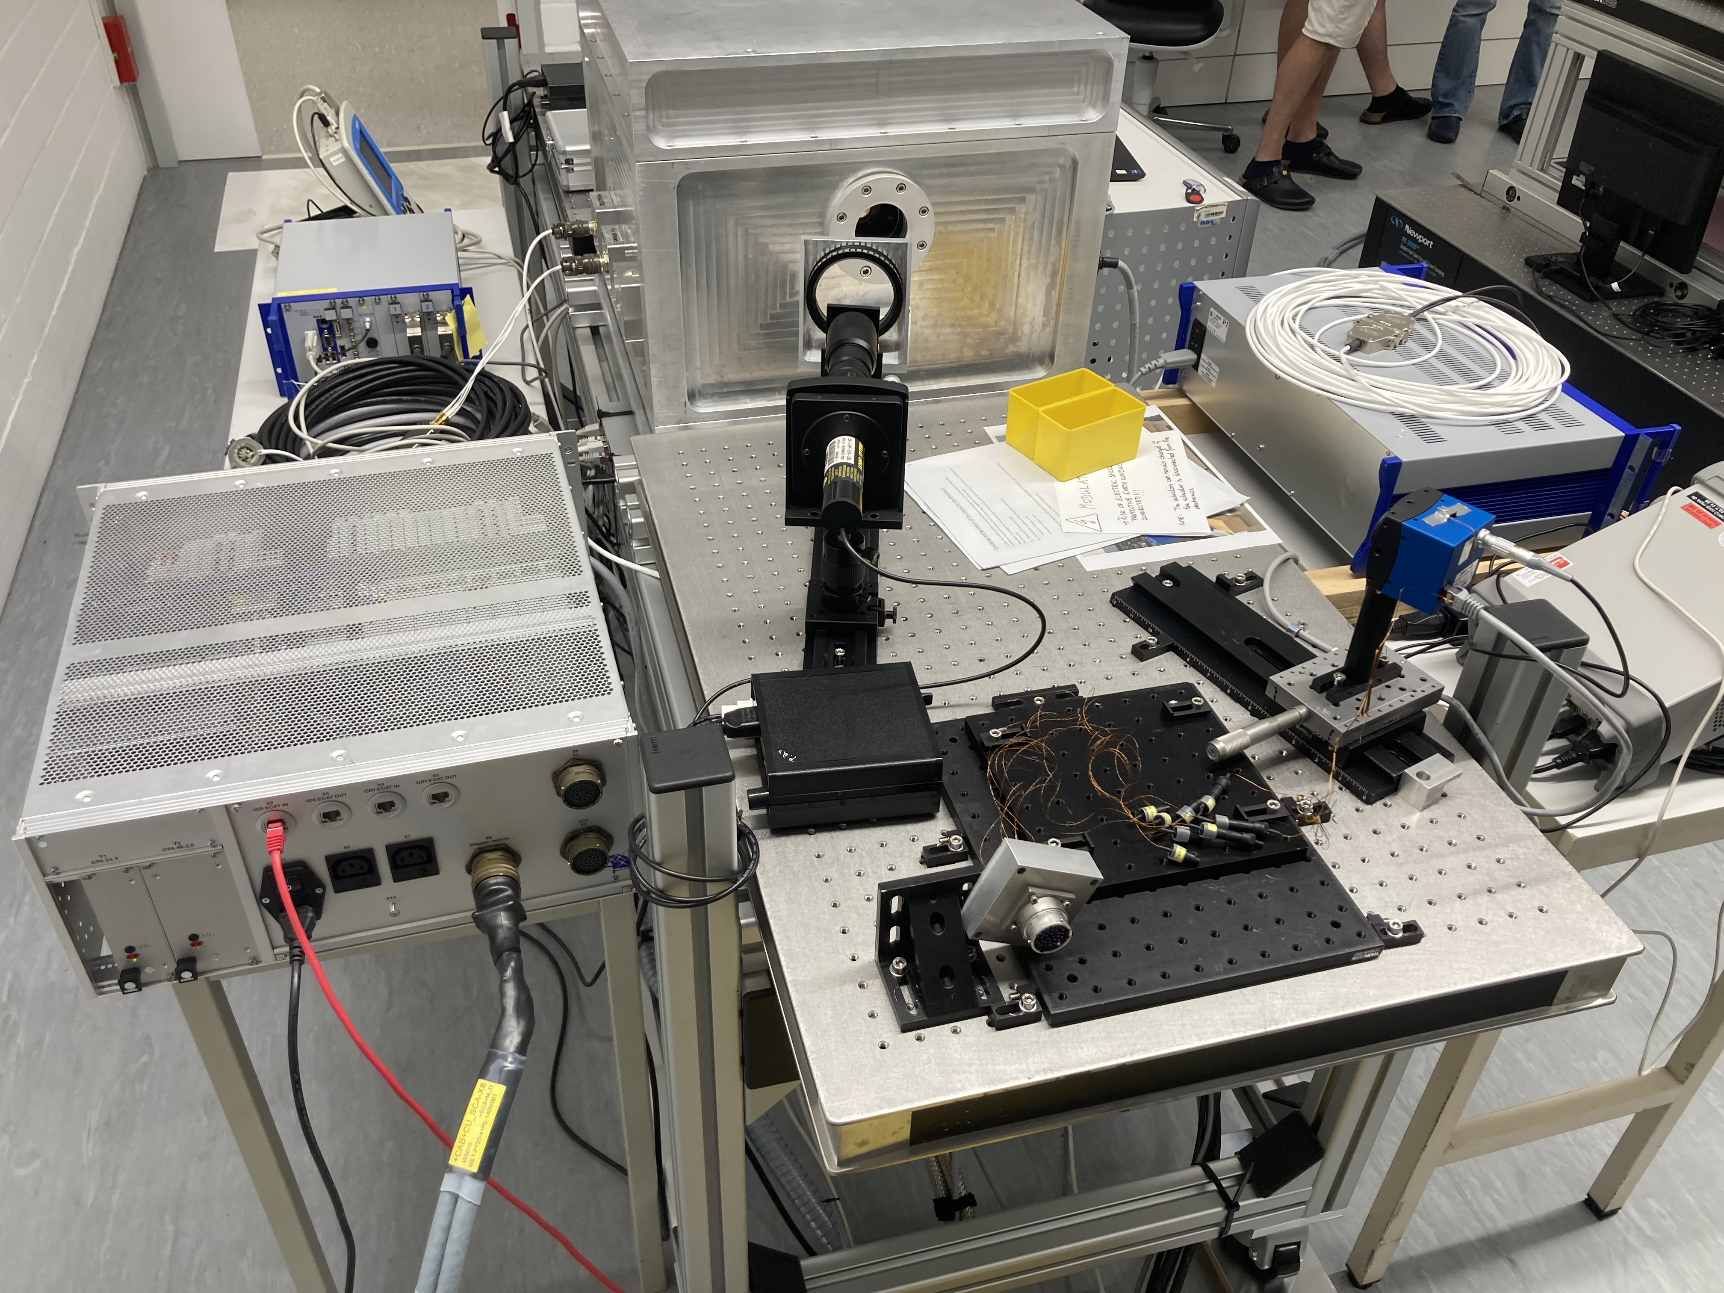
AIV in practice
Modulator Piezo amplifier
Test cryostat
Every subsystem team gets a test-kit + the final hardware
PI E-712
(piezo controller)
Control unit
Test PLC
Test WS
Warm cable towards ICAR

Slide 14
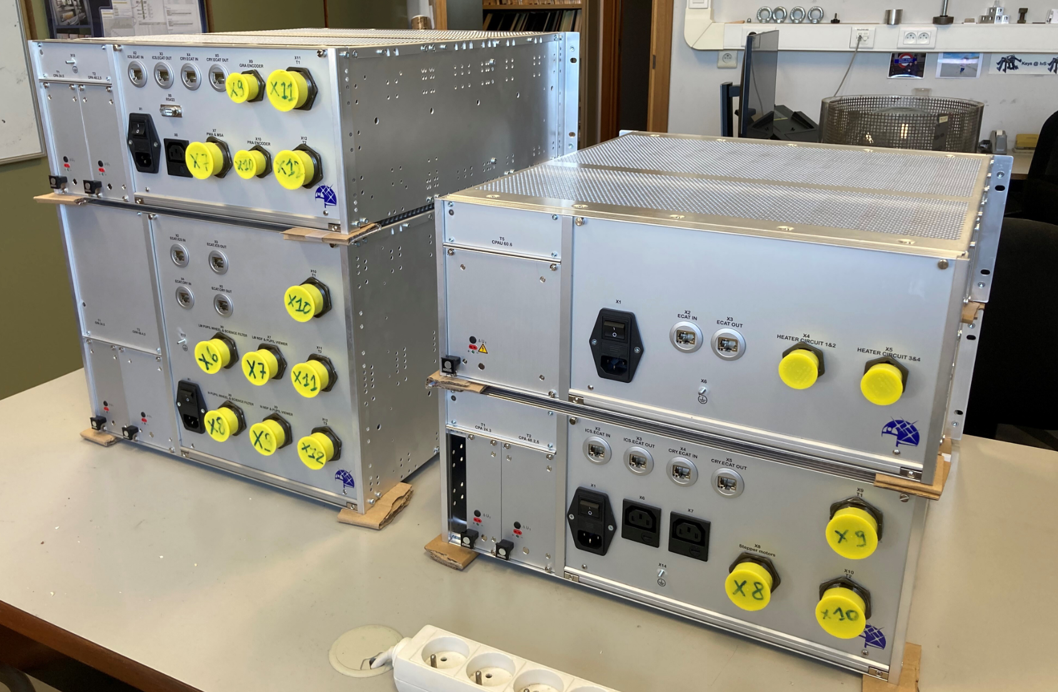
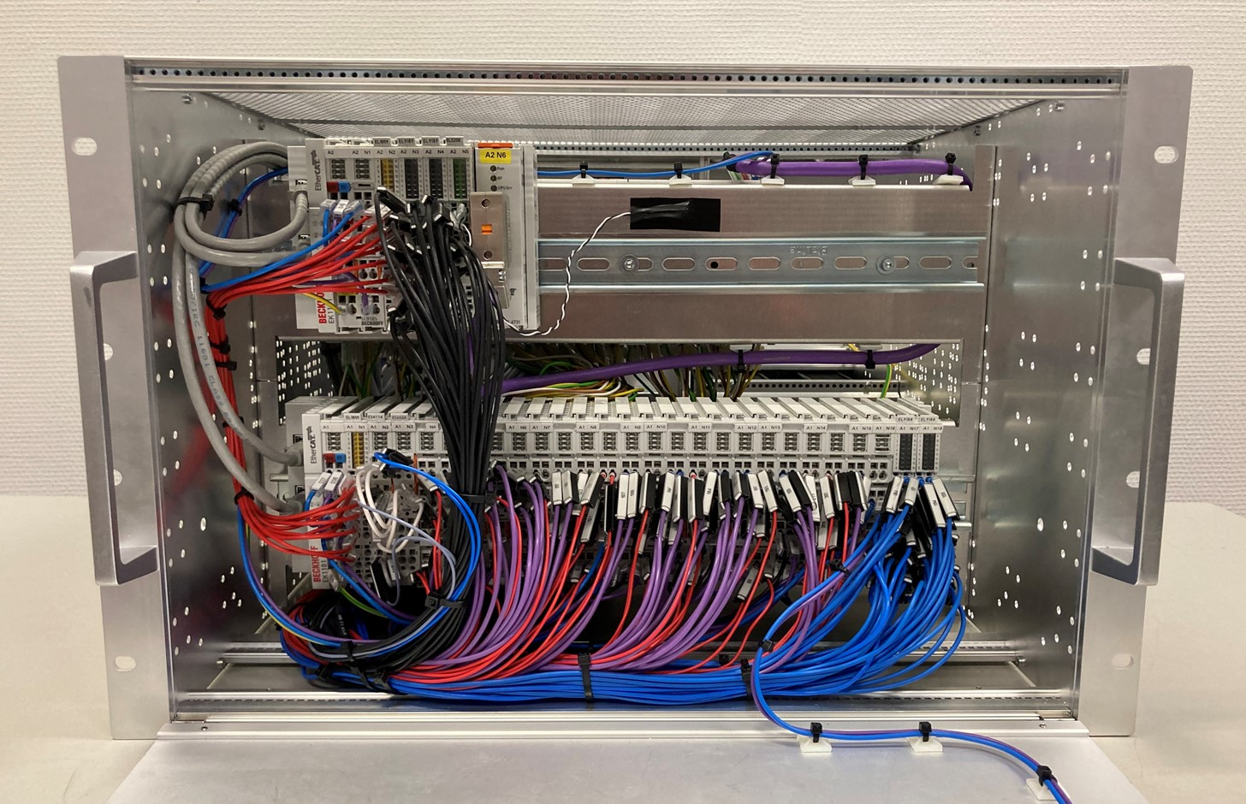
AIV in practice
Control Units (CU) contain all Beckhoff I/O

Slide 15
METIS ICS: High level software

Slide 16
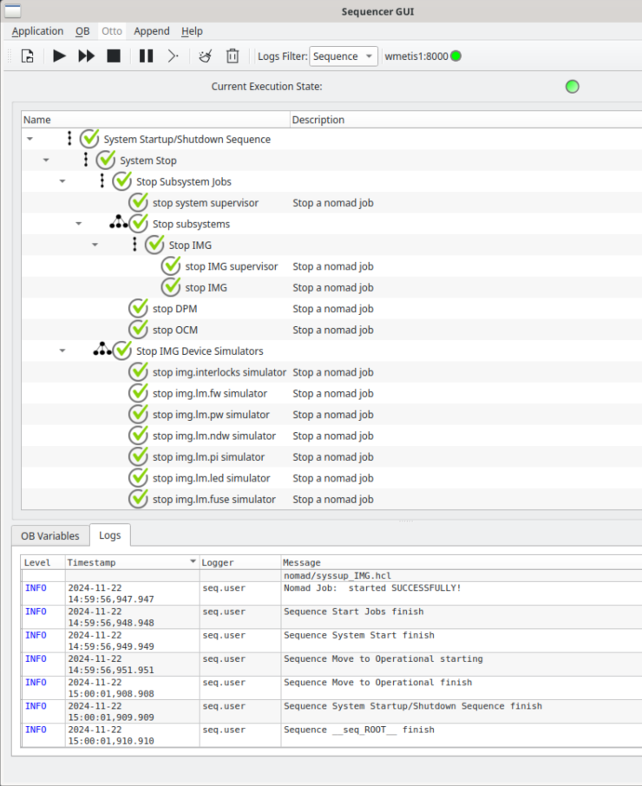
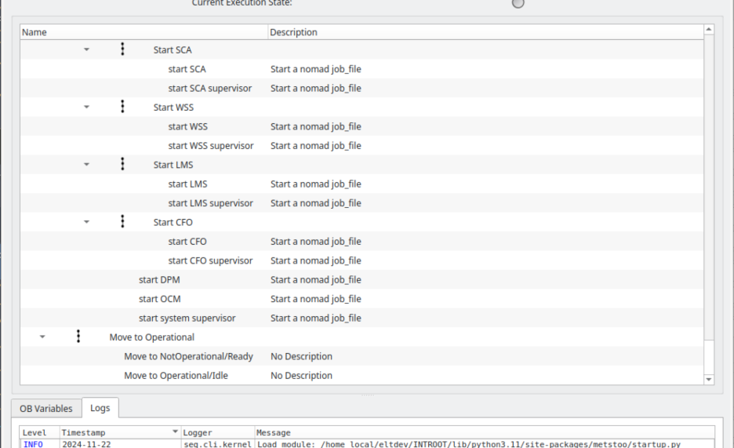
Start-up and shutdown scripts for all subsystems
Supervisor for each subsystem
Includes nomad script to start up InfluxDB, and Grafana

Slide 17
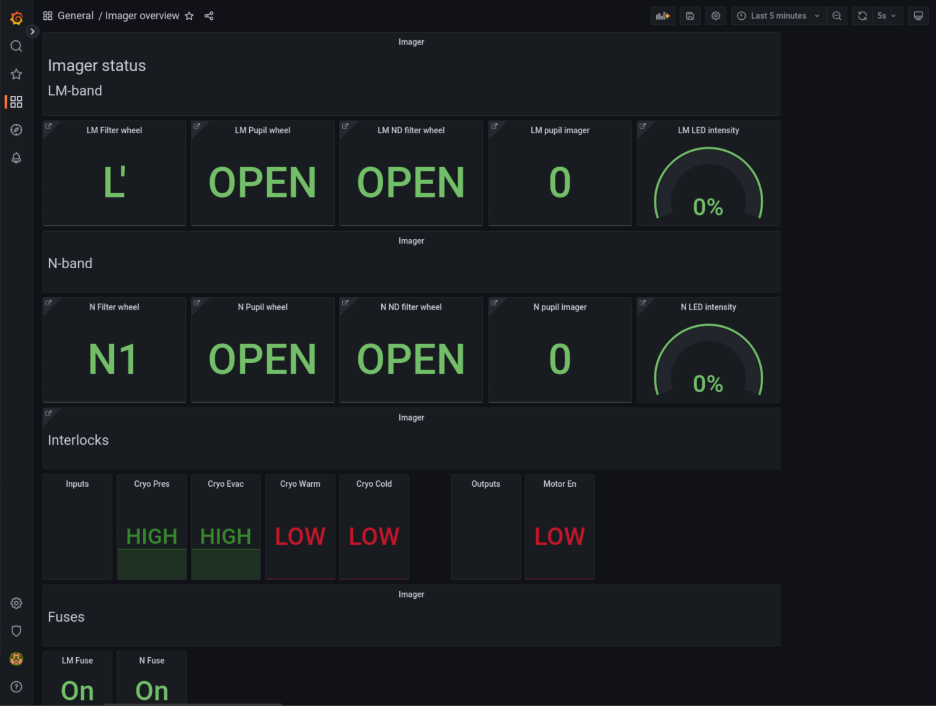
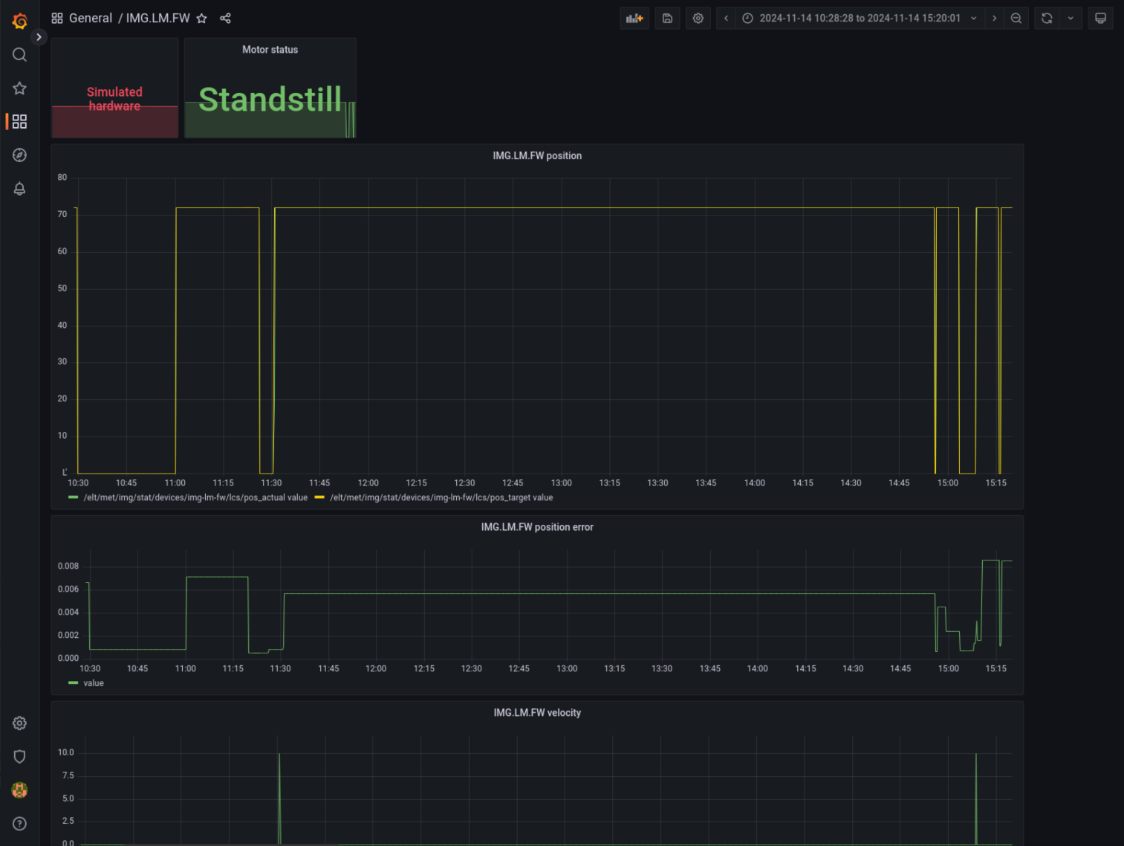
Grafana dashboards:
Overview for all subsystems
Page for every hardware component

Slide 18
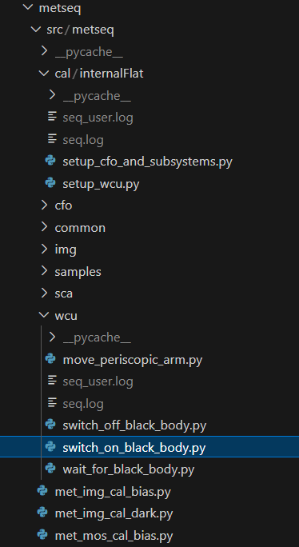
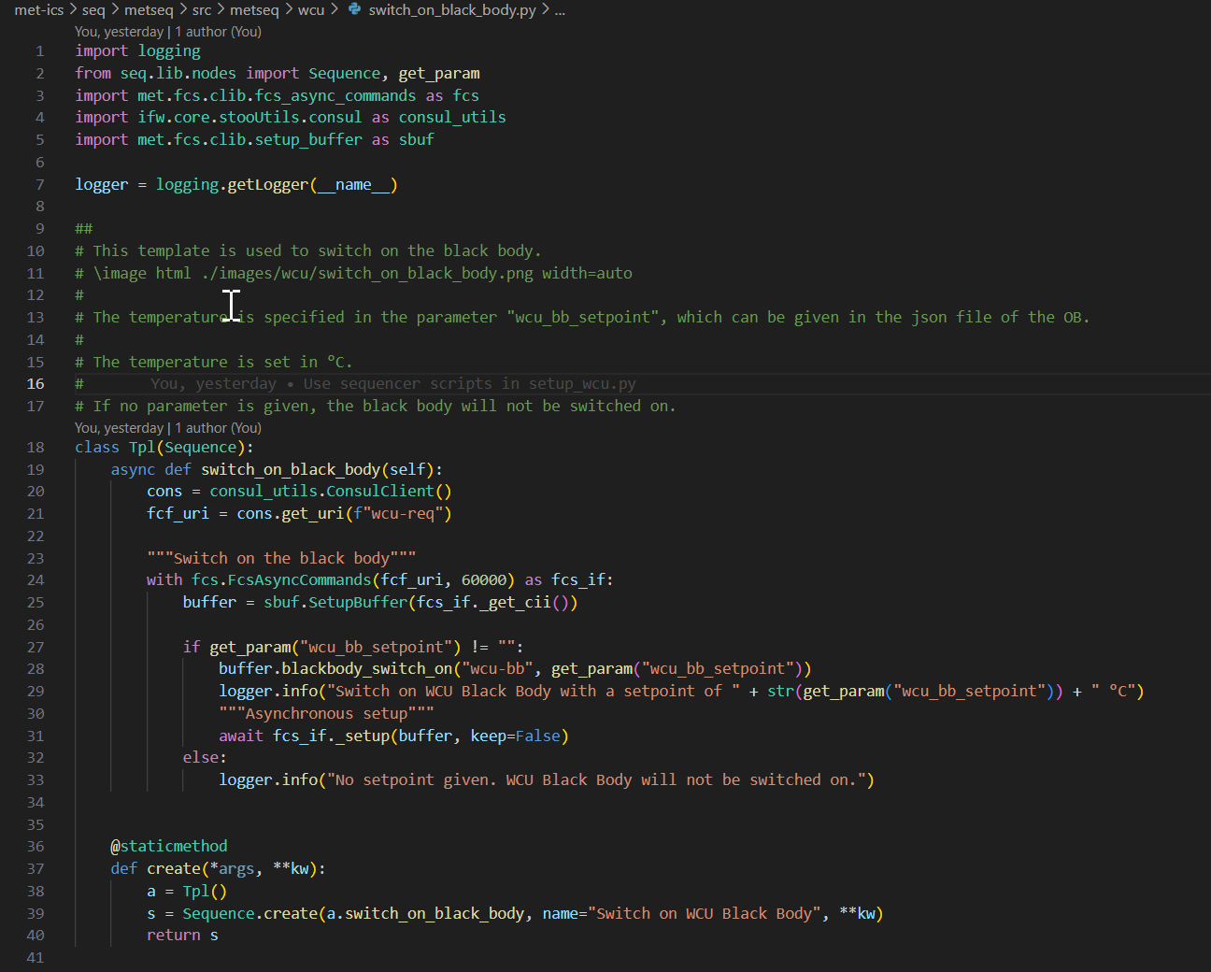
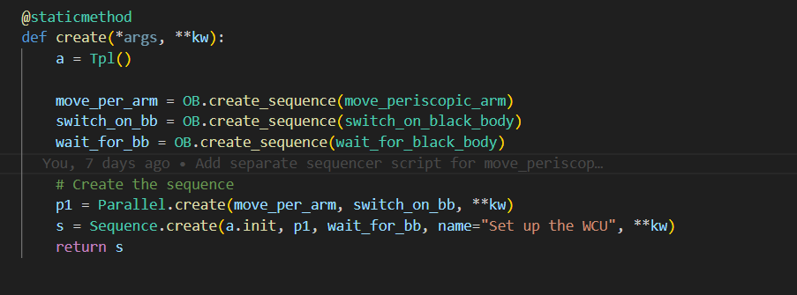
Work on Sequencer scripts (and OBs) from top to bottom and bottom to top

Slide 19
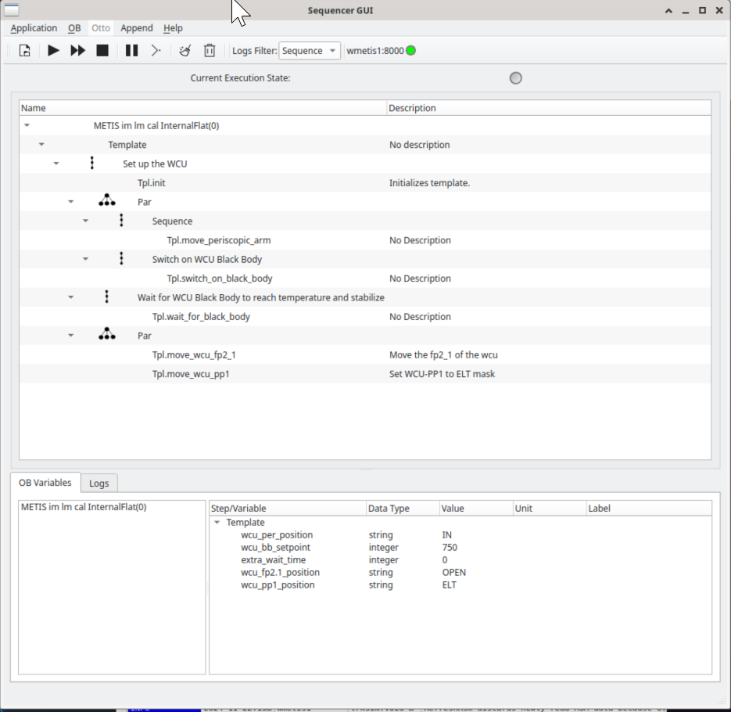
Next steps:
Add IP to sequencer
Use Tino / Otto to select OBs
Integrate SCAO sequencer scripts

Slide 20
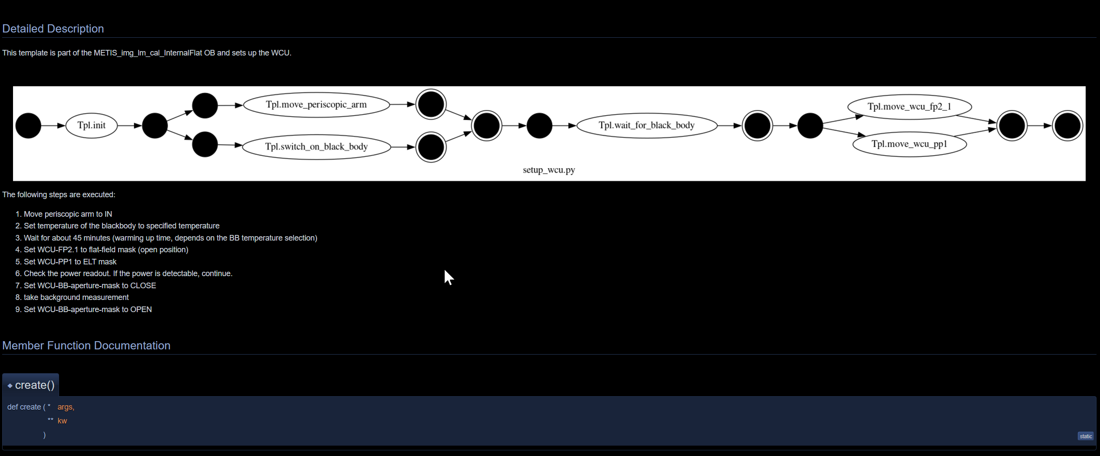
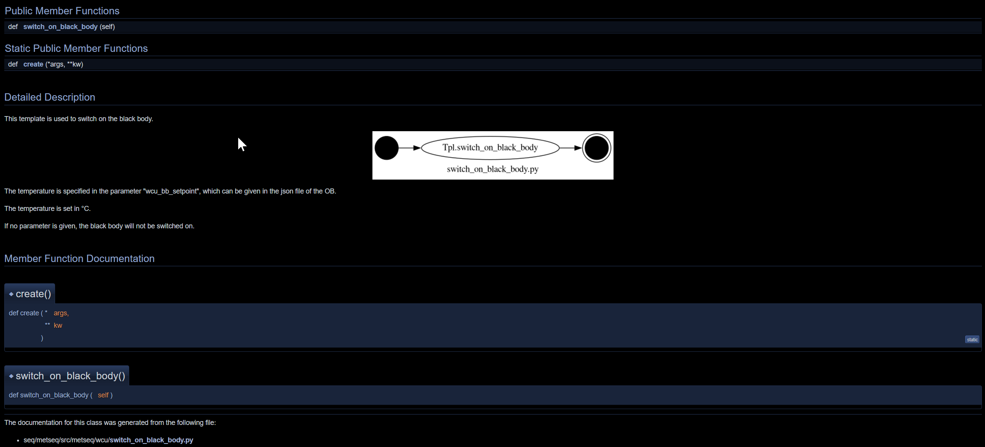
Automatically generated documentation for Sequencer scripts

Slide 21
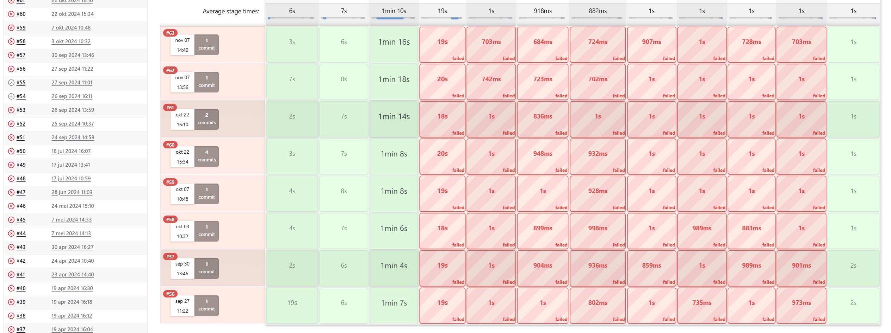
Jenkins builds
Next steps:
Use ESO scrips
Fix build problems

Slide 22
METIS AOCS

Slide 23
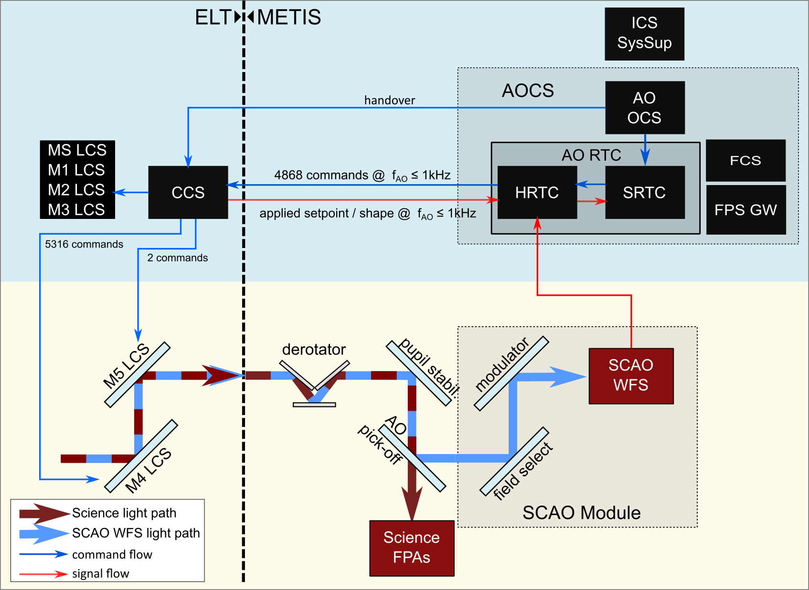
METIS SCAO Simplified Block Diagram
METIS AOCS is responsible for the AO wavefront correction of METIS.
It hosts the main wavefront control loop and a number of secondary control loops. Its real-time computer (RTC) consists of an HRTC and a SRTC.

Slide 24
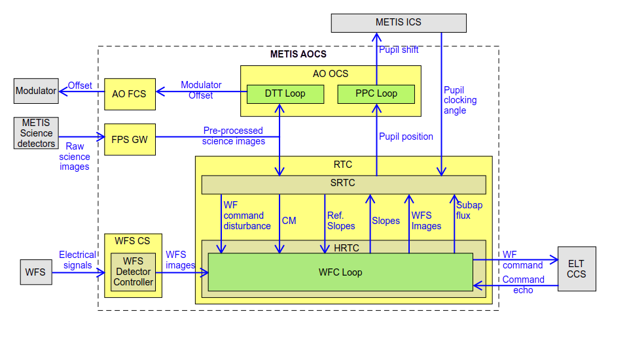
AOCS Subsystems with Main Data Paths

Slide 25
METIS AOCS Implementation Decisions
It adheres to ESO ELT standards.
SRTC is built on top of RTC Toolkit.
HRTC uses GPUs in order to accelerate bulk matrix vector multiplications.
  It runs on ELT DevEnv.
  Only 3rd-party software: NVIDIA CUDA.

