Slide 1


Cryogenics Systems
Matteo Accardo

Slide 2


About my work experience:
3 years Industry: mechanical designer (beverages cooling and dispensing machines)
6 y. INAF Arcetri (Firenze): LBT then Infrared Instr. Team (ESO VLTI AMBER SPG)
2003 joined ESO in the Instrumentation Division.
    Design and integration of cryostats and instrument mechanical subsystems.
    DET cryostats: ERIS, GRAVITY, CIAO, MUSE, IRLOS+ (design, integration, testing)
    Cryo-Vacuum systems: MUSE (design, integration, logic definition and long testing)
    2016 Responsible for the Cryo-Laboratory and connected facilities.
    2021 Head of the Instruments and Cryogenic Group (Mechanical department
Notes:
Increased sensitivity, reduced thermal background, minimized dark current

Slide 3
This presentation:
Brief overview of cryogenics at ESO
  Cryo-Vacuum infrastructure at VLT and future upgrade
  ELT Cryo-Vacuum infrastructure (Headquarters facilities as pathfinder)
Vacuum & Cryogenics Standard Components - ESO-046147
  Examples of different types of hardware: Liq. Nitrogen systems, 20-40K Cryocoolers.
  Vacuum vessels: design principles, requirements and testing.
  Components and configurations for the three vacuum vessel size classes.
Cryo-vacuum control systems as defined in the Vacuum & Cryogenics Standard - ESO-046147
  General Cryo-vacuum control design principles and requirements
  Example: ramping implementation
  Safety
  PLC Sequences
  Graphical User Interface
  Standard Cryo-Vacuum sequences
  3 y. Industry: mechanical designer (beverages cooling and dispensing machines)
  6 y. INAF Arcetri (Firenze): LBT then Infrared Instr. Team (ESO VLTI AMBER SPG)
  2003 joined ESO, working on instrumentation (cryogenics and mechanics).
    Detector cryostats: ERIS, GRAVITY CIAO, MUSE, IRLOS+
    Cryo-Vacuum systems: MUSE, design, integration, logic definition and testing.
    2016 Responsible for the Cryo-Laboratory and connected facilities.
    2021 Head of the Instruments and Cryogenic Group (Mechanical department)
What I will present:Cryogenic cooling based on Liquid Nitrogen (LIN) and cryo-coolers
  LIN: Bath cryostats, Continuos Flow Cryostats, distribution lines with local heat exchangers.
  Cryo-coolers: Gifford-McMahon (GM), Pulse Tube (PT), Stirling.
Vacuum required for thermal insulation in cryogenic systems
Instruments each with own “local” cryo-vacuum system
Telescope provides the cryogenic infrastructure (LIN, Electrical power)
Priority: Standardization and use of commercial-off-the-shelf (COTS) products
Notes:
Increased sensitivity, reduced thermal background, minimized dark current

Slide 4
Cryogenics
Optics, detectors and low noise electronics of instruments cooled as low as 3 Kelvin
Cryogenic cooling based on Liquid Nitrogen (LIN) and cryo-coolers
  LIN: Bath cryostats, Continuos Flow Cryostats, distribution lines with local heat exchangers.
  Cryo-coolers: Gifford-McMahon (GM), Pulse Tube (PT), Stirling.
Vacuum required for thermal insulation in cryogenic systems
Instruments each with own “local” cryo-vacuum system
Telescope provides the cryogenic infrastructure (LIN, Electrical power)
Priority: Standardization and use of commercial-off-the-shelf (COTS) products
Notes:
Increased sensitivity, reduced thermal background, minimized dark current

Slide 5
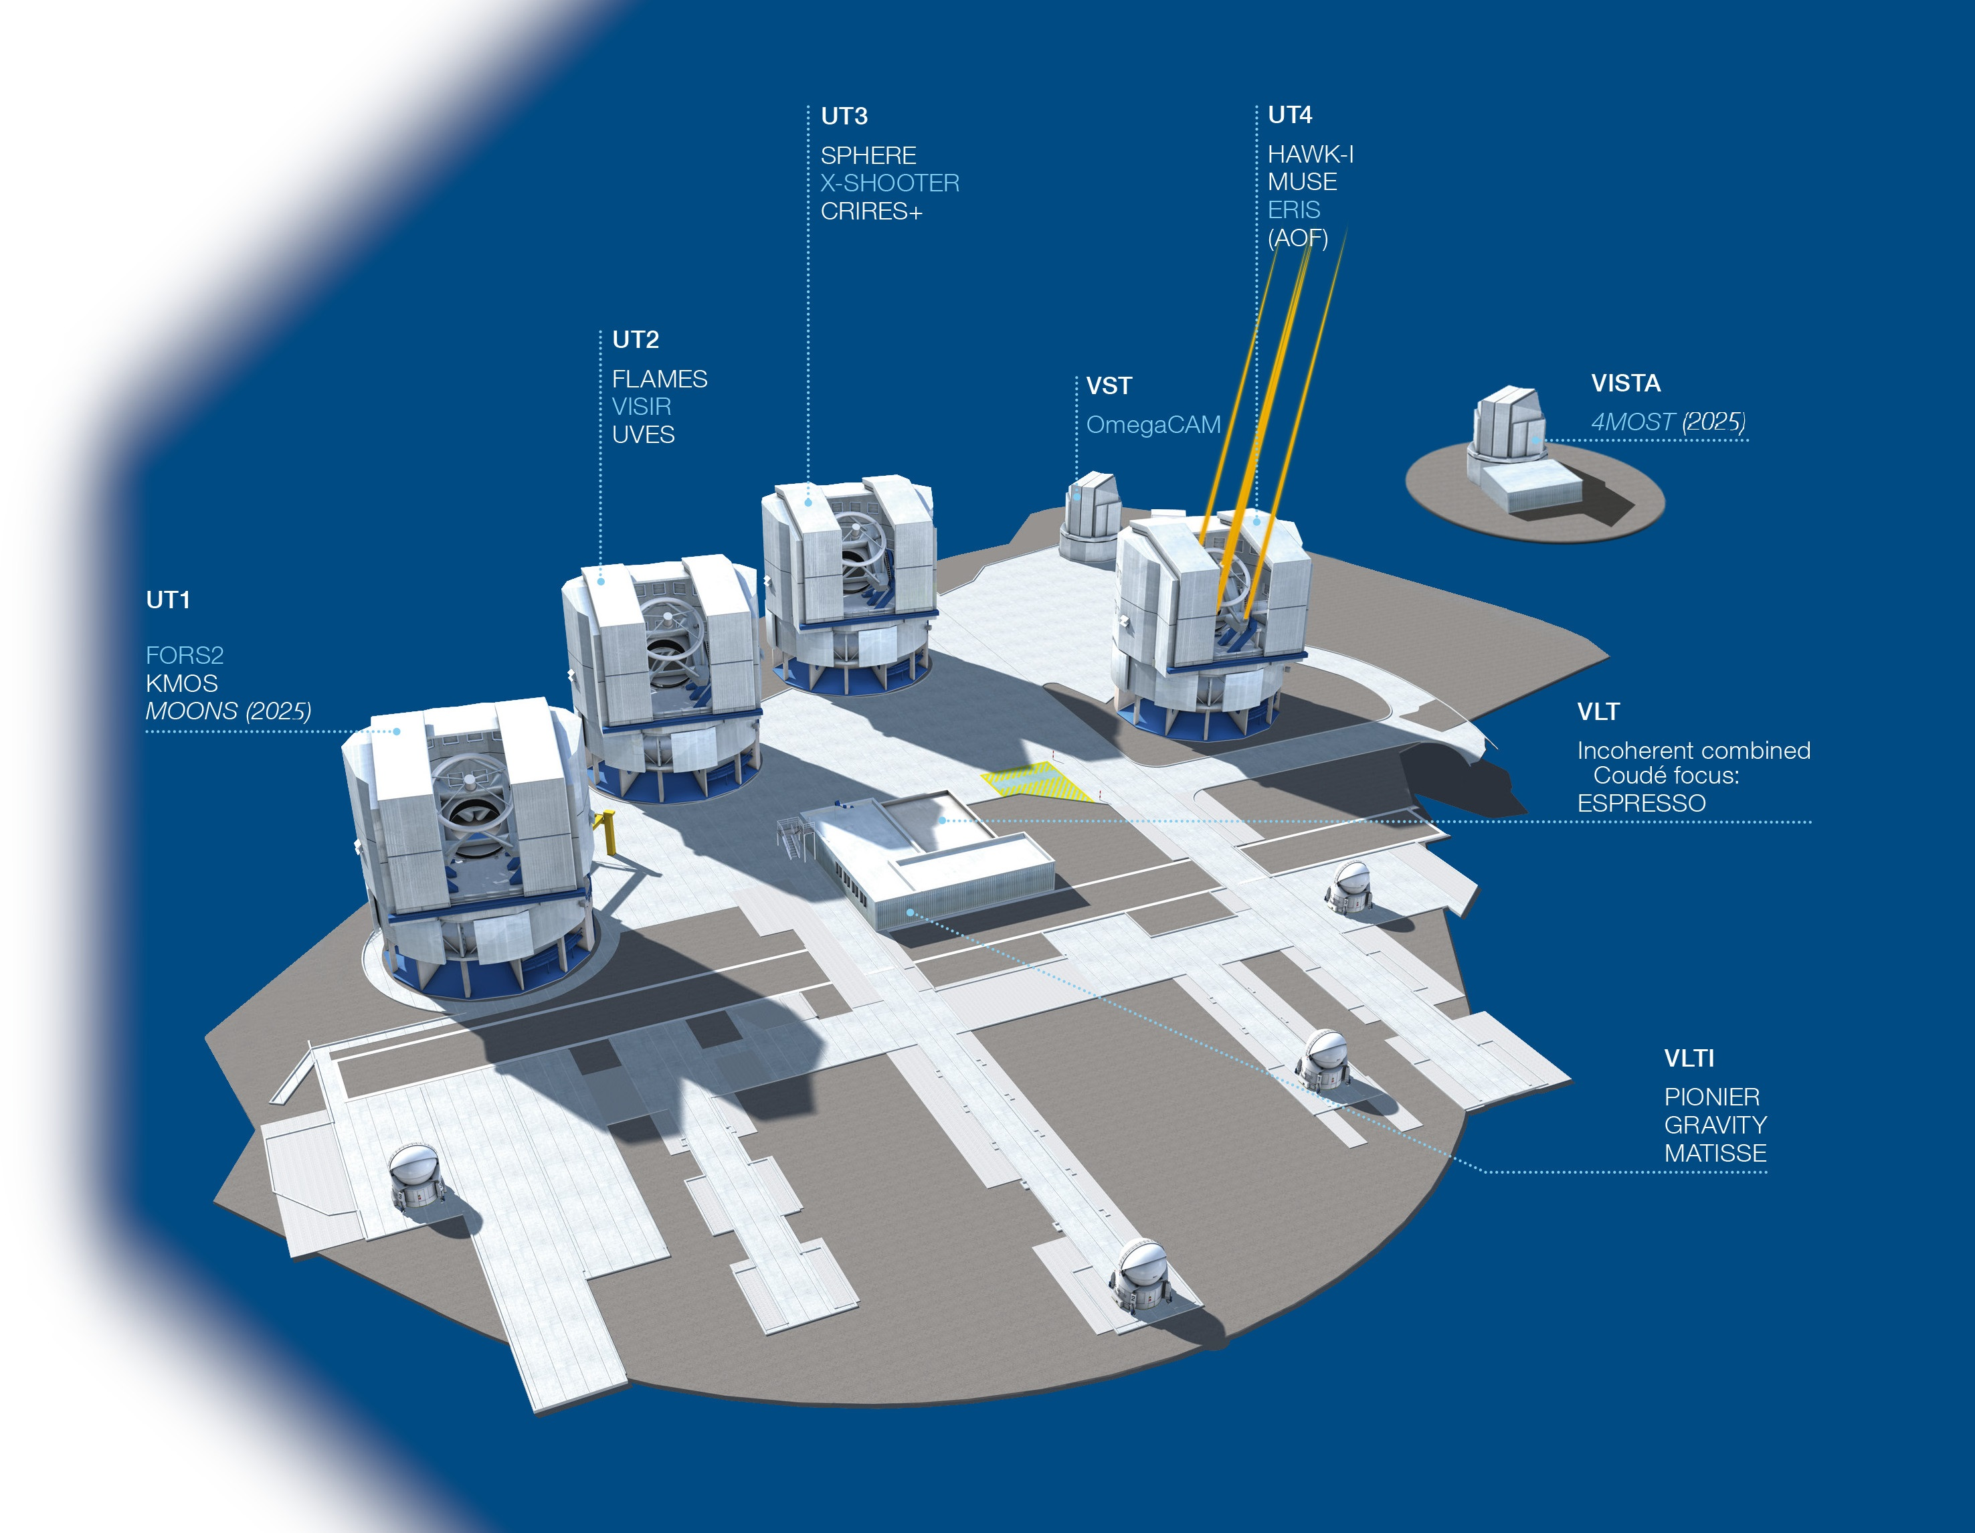
Cryogenics - Paranal Observatory
~ 20 cryogenic instruments in 24/7 operation
Up to Cold mass 500Kg, Vessel 2.5 m³
  MOONS: 3700Kg / 18 m³ (2025)
Majority of them require LIN supply
  Portable tanks 120L → labour-intensive !
Cryo Infrastructure upgrade
  Cryocoolers + fully automated LIN supply
  Three LIN storage tanks (8000 l – 20.000 l)
  Vacuum Insulated fixed distribution lines
  Local LIN buffer tanks and phase separators
  Detector cryostats (small) to be upgraded:
  LIN cooling → Compact Cryocooler
IRIS
4x CIAO
Paranal instrument suite 2024 + 2025
LIN users marked in red
Notes:
MOONS 7 Tons Cold Mass xxx KG at 130K
Figure 2: Left, vacuum fibre feedthroughs on common flange. Right, slit assembly inside cryostat.
In addition to the optical subsystems all the electrical services and various cold fingers are mounted on the optical bench
to provide power, control, and appropriate cooling.
3. CRYOGENIC AND VACUUM SYSTEM OVERVIEW
The MOONS vacuum chamber is around 2.3 m long, 2.2 m width, and 3.5 m high, with an internal volume of around 18
m3. It is a welded construction made from 5083 aluminum. The vessel consists of a central section with mounting feet to
the Nasmyth platform, within which the optical bench is mounted. This is then completed by two clamshell doors, that
attach either side of the central section, to form the enclosure. A similarly constructed radiation shield, wrapped in a
segmented MLI blanket, sits between the outer vessel and optical bench. The vacuum pump set consists of two ATH
2303M Turbo pumps each backed by an ACP 40 roots pump, one set mounted on each door, as shown in Figure 3. The
pressure achieved in 24 hours after evacuation begins is in the mid 10-5 mbar. Base pressure when warm is in the 10-6
mbar range, which then drops into the 10-7 mbar range when cold.
The MOONS cold mass is made up of, approximately, 500 kg of 6082 aluminum radiation shield, 1800 kg of 6082
aluminum optical bench and 1400 kg of glass optics and mounts. This is cooled to an average temperature of 135 K in 48
hours using a liquid nitrogen precool system. The system consists of a high level ‘bath’ manifold with the exhaust fed
directly to atmosphere. The bath manifold feeds 8 pairs of pads on the optical bench and 2 pairs of pads on the radiation
shield. The pads are filled simultaneously by the bath manifold and are spaced over the optical bench to give a uniform
cooling across the bench. At the telescope the system will be fed via liquid nitrogen dewars, and an automated
switchover system will be used, to allow cooling to take place overnight with minimal intervention.
Once the system reaches a set of defined temperatures, the precool switches itself off and the temperature is held cold
using 3 Cryomech 10MD cryocoolers. Two of these are directly attached to the radiation shield and the third to the
optical bench. The bench is set to run at 134 K in deference to the CCD detectors which are not permitted to drop below
130 K. The radiation shield is allowed to cool in an uncontrolled manner and settles out at 76-120 K. The single
cryocooler is responsible for cooling a large mass and so there is a relatively large time constant required for changes to
the bench temperature. It is worth noting that the infrared detectors are cooled to their operating temperature, 40 K, using
a controlled ramp once the pre-cooling is complete. This ensure they are not exposed to dangerous thermal shocks.

Slide 6
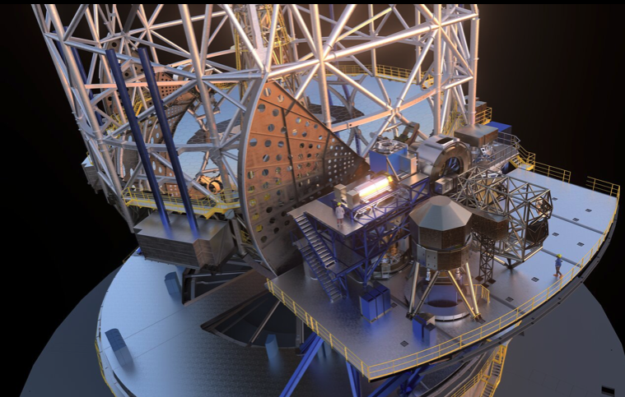
Cryogenics - ELT
Two tennis-court size Nasmyth platforms A and B for instruments
  First light instruments (2028-29):
    MICADO, MORPHEO, METIS, HARMONI
  2030+ instruments:
    ANDES, MOSAIC, 2nd AO, PCS
Instruments weight > 25t
  Vacuum vessel >25m³
  cold mass up to 5t
Fully automated cryo-vacuum systems
Notes:
MOONS 7 Tons Cold Mass xxx KG at 130K
Figure 2: Left, vacuum fibre feedthroughs on common flange. Right, slit assembly inside cryostat.
In addition to the optical subsystems all the electrical services and various cold fingers are mounted on the optical bench
to provide power, control, and appropriate cooling.
3. CRYOGENIC AND VACUUM SYSTEM OVERVIEW
The MOONS vacuum chamber is around 2.3 m long, 2.2 m width, and 3.5 m high, with an internal volume of around 18
m3. It is a welded construction made from 5083 aluminum. The vessel consists of a central section with mounting feet to
the Nasmyth platform, within which the optical bench is mounted. This is then completed by two clamshell doors, that
attach either side of the central section, to form the enclosure. A similarly constructed radiation shield, wrapped in a
segmented MLI blanket, sits between the outer vessel and optical bench. The vacuum pump set consists of two ATH
2303M Turbo pumps each backed by an ACP 40 roots pump, one set mounted on each door, as shown in Figure 3. The
pressure achieved in 24 hours after evacuation begins is in the mid 10-5 mbar. Base pressure when warm is in the 10-6
mbar range, which then drops into the 10-7 mbar range when cold.
The MOONS cold mass is made up of, approximately, 500 kg of 6082 aluminum radiation shield, 1800 kg of 6082
aluminum optical bench and 1400 kg of glass optics and mounts. This is cooled to an average temperature of 135 K in 48
hours using a liquid nitrogen precool system. The system consists of a high level ‘bath’ manifold with the exhaust fed
directly to atmosphere. The bath manifold feeds 8 pairs of pads on the optical bench and 2 pairs of pads on the radiation
shield. The pads are filled simultaneously by the bath manifold and are spaced over the optical bench to give a uniform
cooling across the bench. At the telescope the system will be fed via liquid nitrogen dewars, and an automated
switchover system will be used, to allow cooling to take place overnight with minimal intervention.
Once the system reaches a set of defined temperatures, the precool switches itself off and the temperature is held cold
using 3 Cryomech 10MD cryocoolers. Two of these are directly attached to the radiation shield and the third to the
optical bench. The bench is set to run at 134 K in deference to the CCD detectors which are not permitted to drop below
130 K. The radiation shield is allowed to cool in an uncontrolled manner and settles out at 76-120 K. The single
cryocooler is responsible for cooling a large mass and so there is a relatively large time constant required for changes to
the bench temperature. It is worth noting that the infrared detectors are cooled to their operating temperature, 40 K, using
a controlled ramp once the pre-cooling is complete. This ensure they are not exposed to dangerous thermal shocks.

Slide 7
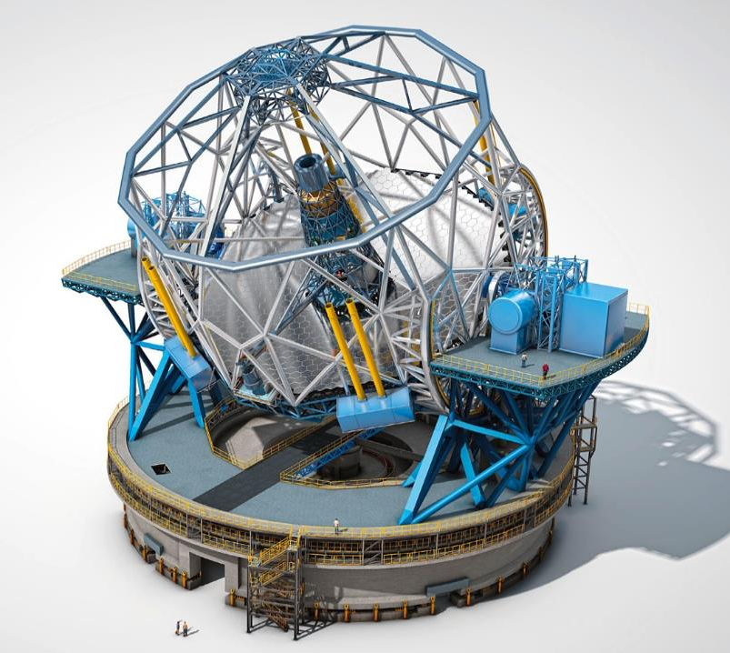
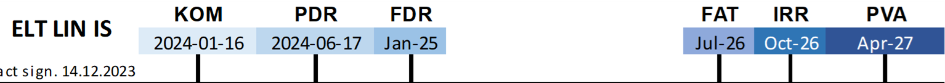
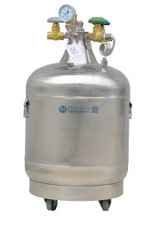
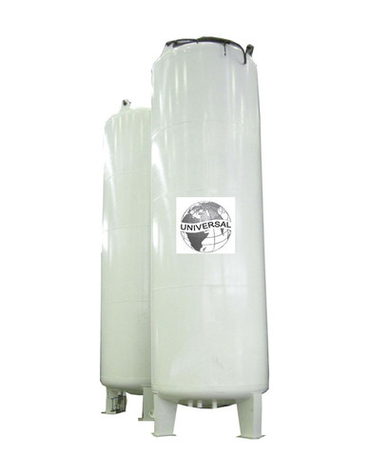
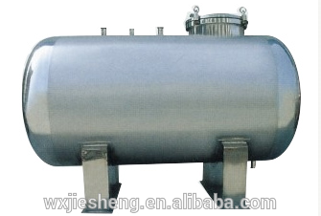

ELT cryogenics infrastructure overview
ELT ≈ 65m
Tilting Altitude
Structure
Cryogenic
instruments
LIN phase separators 0.1 m³
Cryogenic
instruments
Connection for LIN transfer when telescope in park position (1.5 h / day)
NP ≈ 27m
I-NP ≈ 19m
Rotating Azimuth
Structure
LIN buffer tank 4 m³ (2x)
AZ ≈ 11m
He gas compressors
for cryo-coolers (2x12)
Outdoor LIN storage tank 42 m³
To LIN tank 3 m³ in cryo plant room
LIN infrastructure in red
Cryocooler infrastructure in orange
Telescope foundation
at 3046 m above sea level
He gas compressors
in cryo plant room (1x12)
Notes:
MOONS 7 Tons Cold Mass xxx KG at 130K
Figure 2: Left, vacuum fibre feedthroughs on common flange. Right, slit assembly inside cryostat.
In addition to the optical subsystems all the electrical services and various cold fingers are mounted on the optical bench
to provide power, control, and appropriate cooling.
3. CRYOGENIC AND VACUUM SYSTEM OVERVIEW
The MOONS vacuum chamber is around 2.3 m long, 2.2 m width, and 3.5 m high, with an internal volume of around 18
m3. It is a welded construction made from 5083 aluminum. The vessel consists of a central section with mounting feet to
the Nasmyth platform, within which the optical bench is mounted. This is then completed by two clamshell doors, that
attach either side of the central section, to form the enclosure. A similarly constructed radiation shield, wrapped in a
segmented MLI blanket, sits between the outer vessel and optical bench. The vacuum pump set consists of two ATH
2303M Turbo pumps each backed by an ACP 40 roots pump, one set mounted on each door, as shown in Figure 3. The
pressure achieved in 24 hours after evacuation begins is in the mid 10-5 mbar. Base pressure when warm is in the 10-6
mbar range, which then drops into the 10-7 mbar range when cold.
The MOONS cold mass is made up of, approximately, 500 kg of 6082 aluminum radiation shield, 1800 kg of 6082
aluminum optical bench and 1400 kg of glass optics and mounts. This is cooled to an average temperature of 135 K in 48
hours using a liquid nitrogen precool system. The system consists of a high level ‘bath’ manifold with the exhaust fed
directly to atmosphere. The bath manifold feeds 8 pairs of pads on the optical bench and 2 pairs of pads on the radiation
shield. The pads are filled simultaneously by the bath manifold and are spaced over the optical bench to give a uniform
cooling across the bench. At the telescope the system will be fed via liquid nitrogen dewars, and an automated
switchover system will be used, to allow cooling to take place overnight with minimal intervention.
Once the system reaches a set of defined temperatures, the precool switches itself off and the temperature is held cold
using 3 Cryomech 10MD cryocoolers. Two of these are directly attached to the radiation shield and the third to the
optical bench. The bench is set to run at 134 K in deference to the CCD detectors which are not permitted to drop below
130 K. The radiation shield is allowed to cool in an uncontrolled manner and settles out at 76-120 K. The single
cryocooler is responsible for cooling a large mass and so there is a relatively large time constant required for changes to
the bench temperature. It is worth noting that the infrared detectors are cooled to their operating temperature, 40 K, using
a controlled ramp once the pre-cooling is complete. This ensure they are not exposed to dangerous thermal shocks.

Slide 8
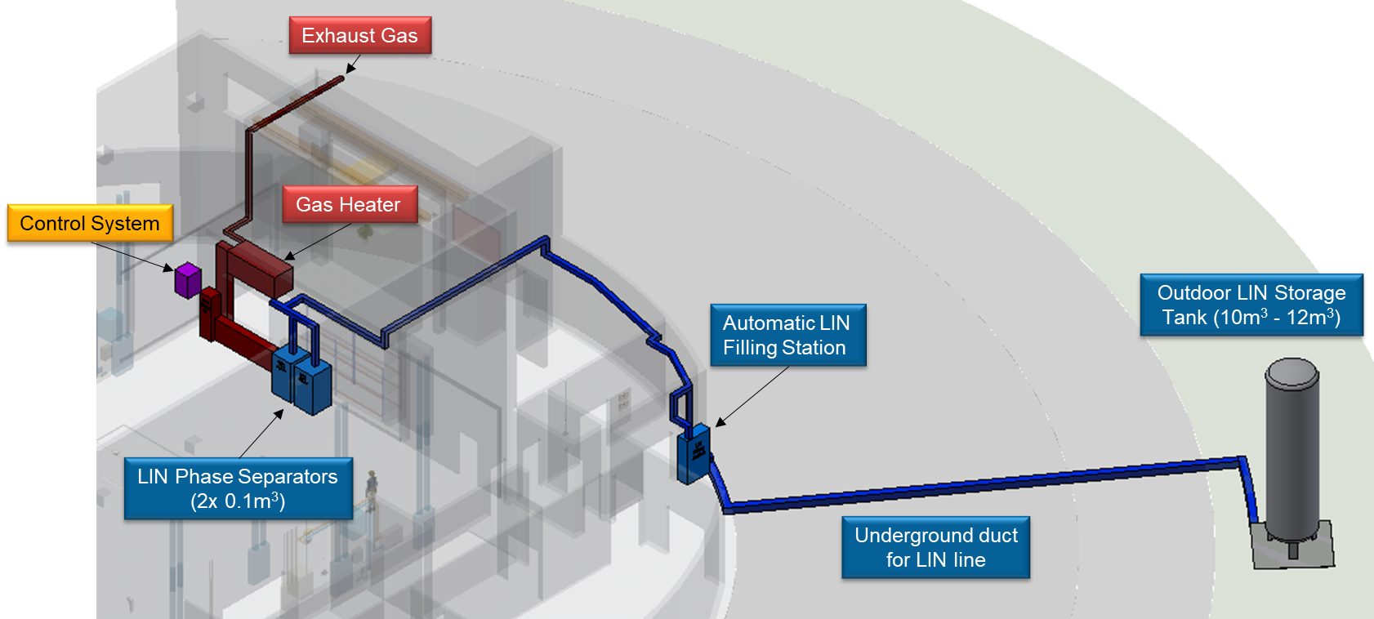
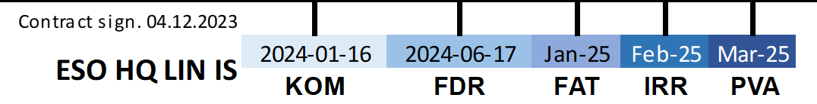
Headquarters - Liquid Nitrogen Infrastructure
Notes:
MOONS 7 Tons Cold Mass xxx KG at 130K
Figure 2: Left, vacuum fibre feedthroughs on common flange. Right, slit assembly inside cryostat.
In addition to the optical subsystems all the electrical services and various cold fingers are mounted on the optical bench
to provide power, control, and appropriate cooling.
3. CRYOGENIC AND VACUUM SYSTEM OVERVIEW
The MOONS vacuum chamber is around 2.3 m long, 2.2 m width, and 3.5 m high, with an internal volume of around 18
m3. It is a welded construction made from 5083 aluminum. The vessel consists of a central section with mounting feet to
the Nasmyth platform, within which the optical bench is mounted. This is then completed by two clamshell doors, that
attach either side of the central section, to form the enclosure. A similarly constructed radiation shield, wrapped in a
segmented MLI blanket, sits between the outer vessel and optical bench. The vacuum pump set consists of two ATH
2303M Turbo pumps each backed by an ACP 40 roots pump, one set mounted on each door, as shown in Figure 3. The
pressure achieved in 24 hours after evacuation begins is in the mid 10-5 mbar. Base pressure when warm is in the 10-6
mbar range, which then drops into the 10-7 mbar range when cold.
The MOONS cold mass is made up of, approximately, 500 kg of 6082 aluminum radiation shield, 1800 kg of 6082
aluminum optical bench and 1400 kg of glass optics and mounts. This is cooled to an average temperature of 135 K in 48
hours using a liquid nitrogen precool system. The system consists of a high level ‘bath’ manifold with the exhaust fed
directly to atmosphere. The bath manifold feeds 8 pairs of pads on the optical bench and 2 pairs of pads on the radiation
shield. The pads are filled simultaneously by the bath manifold and are spaced over the optical bench to give a uniform
cooling across the bench. At the telescope the system will be fed via liquid nitrogen dewars, and an automated
switchover system will be used, to allow cooling to take place overnight with minimal intervention.
Once the system reaches a set of defined temperatures, the precool switches itself off and the temperature is held cold
using 3 Cryomech 10MD cryocoolers. Two of these are directly attached to the radiation shield and the third to the
optical bench. The bench is set to run at 134 K in deference to the CCD detectors which are not permitted to drop below
130 K. The radiation shield is allowed to cool in an uncontrolled manner and settles out at 76-120 K. The single
cryocooler is responsible for cooling a large mass and so there is a relatively large time constant required for changes to
the bench temperature. It is worth noting that the infrared detectors are cooled to their operating temperature, 40 K, using
a controlled ramp once the pre-cooling is complete. This ensure they are not exposed to dangerous thermal shocks.

Slide 9
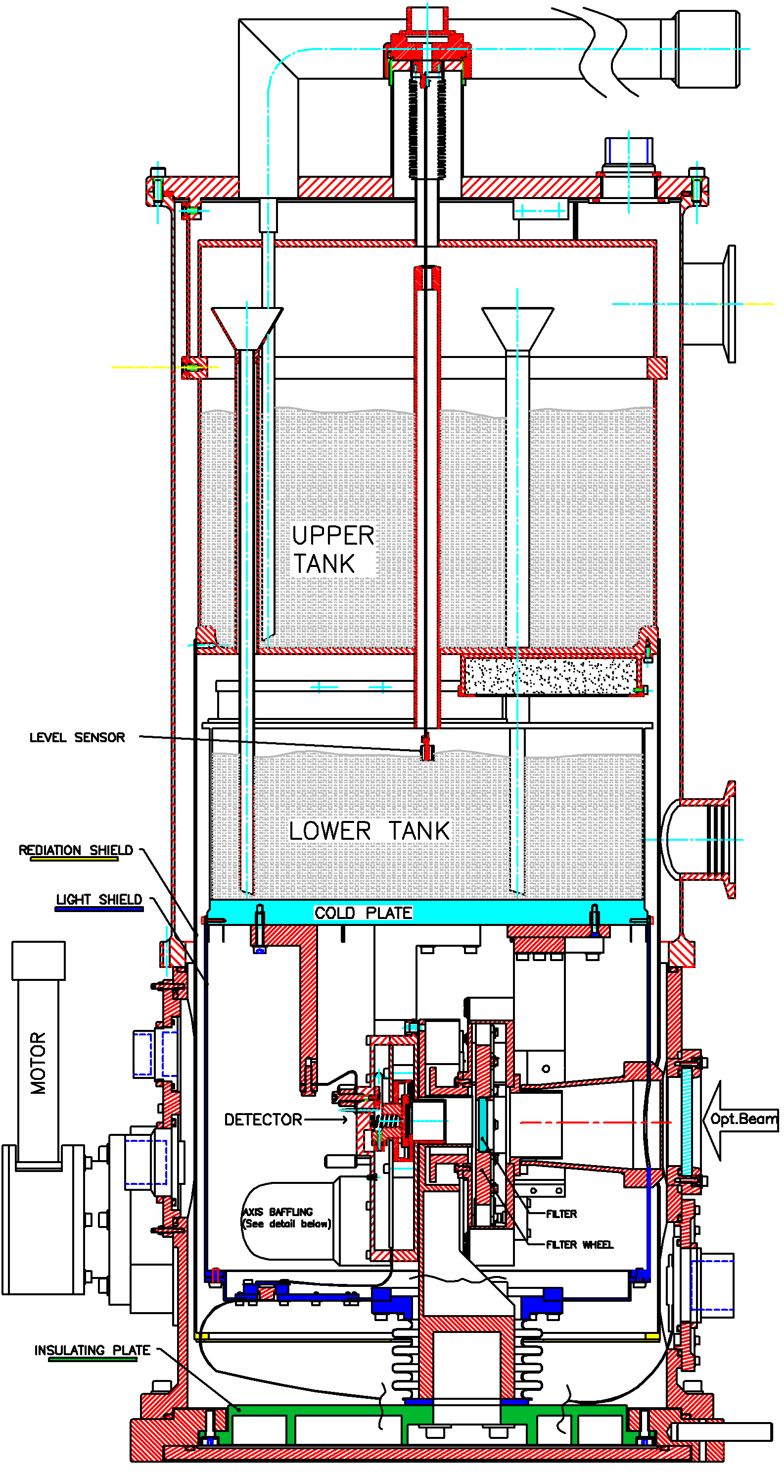
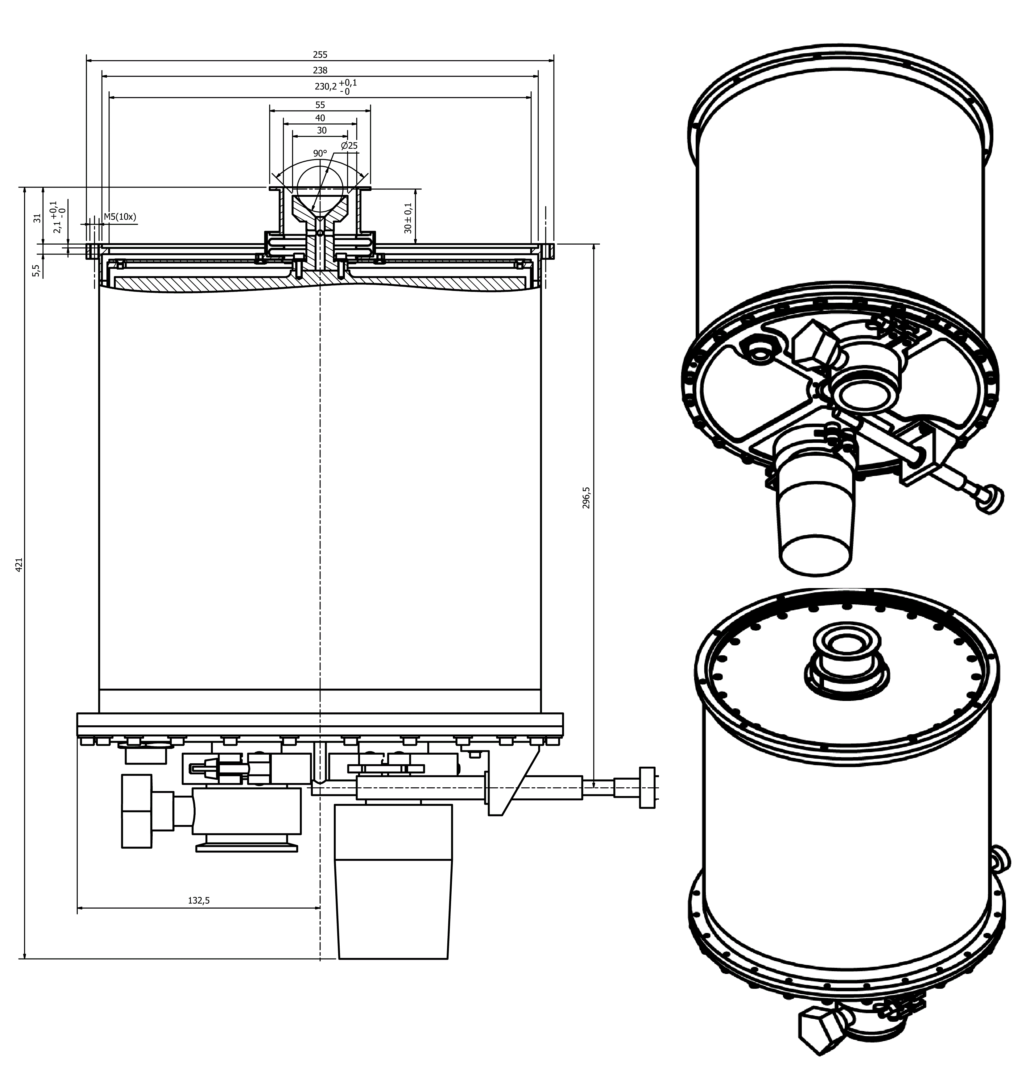
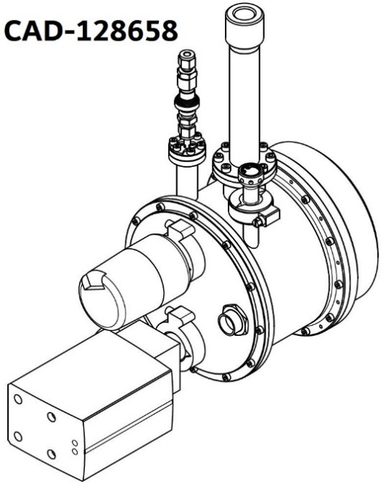
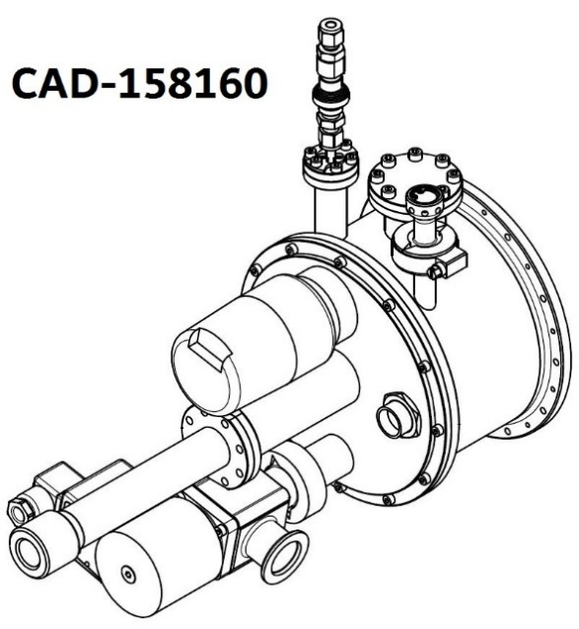
Standardization and Commercial-off-the-shelf products:
Vacuum and Cryogenics Standard Components - ESO-046147 - v. 7
VLTI IRIS - Bath Cryostat
Example from ESO-046147 - v. 7: Liquid Nitrogen cryostats
  Bath Cryostat for Cassegrain Instruments (FORS, X-SHOOTER)
  Bath Cryostat for “table” applications (GRAVITY CIAO, VLTI IRIS, SPHERE IFS)
  Continuos Flow Cryostat (MUSE, IRLOS, ESPRESSO, 4MOST, … )
Continuos Flow Cryostat (CFC)
alternative configurations
Cassegrain Bath Cryostat
Notes:
MOONS 7 Tons Cold Mass xxx KG at 130K
Figure 2: Left, vacuum fibre feedthroughs on common flange. Right, slit assembly inside cryostat.
In addition to the optical subsystems all the electrical services and various cold fingers are mounted on the optical bench
to provide power, control, and appropriate cooling.
3. CRYOGENIC AND VACUUM SYSTEM OVERVIEW
The MOONS vacuum chamber is around 2.3 m long, 2.2 m width, and 3.5 m high, with an internal volume of around 18
m3. It is a welded construction made from 5083 aluminum. The vessel consists of a central section with mounting feet to
the Nasmyth platform, within which the optical bench is mounted. This is then completed by two clamshell doors, that
attach either side of the central section, to form the enclosure. A similarly constructed radiation shield, wrapped in a
segmented MLI blanket, sits between the outer vessel and optical bench. The vacuum pump set consists of two ATH
2303M Turbo pumps each backed by an ACP 40 roots pump, one set mounted on each door, as shown in Figure 3. The
pressure achieved in 24 hours after evacuation begins is in the mid 10-5 mbar. Base pressure when warm is in the 10-6
mbar range, which then drops into the 10-7 mbar range when cold.
The MOONS cold mass is made up of, approximately, 500 kg of 6082 aluminum radiation shield, 1800 kg of 6082
aluminum optical bench and 1400 kg of glass optics and mounts. This is cooled to an average temperature of 135 K in 48
hours using a liquid nitrogen precool system. The system consists of a high level ‘bath’ manifold with the exhaust fed
directly to atmosphere. The bath manifold feeds 8 pairs of pads on the optical bench and 2 pairs of pads on the radiation
shield. The pads are filled simultaneously by the bath manifold and are spaced over the optical bench to give a uniform
cooling across the bench. At the telescope the system will be fed via liquid nitrogen dewars, and an automated
switchover system will be used, to allow cooling to take place overnight with minimal intervention.
Once the system reaches a set of defined temperatures, the precool switches itself off and the temperature is held cold
using 3 Cryomech 10MD cryocoolers. Two of these are directly attached to the radiation shield and the third to the
optical bench. The bench is set to run at 134 K in deference to the CCD detectors which are not permitted to drop below
130 K. The radiation shield is allowed to cool in an uncontrolled manner and settles out at 76-120 K. The single
cryocooler is responsible for cooling a large mass and so there is a relatively large time constant required for changes to
the bench temperature. It is worth noting that the infrared detectors are cooled to their operating temperature, 40 K, using
a controlled ramp once the pre-cooling is complete. This ensure they are not exposed to dangerous thermal shocks.

Slide 10
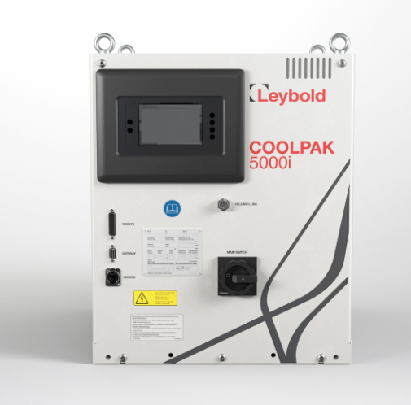
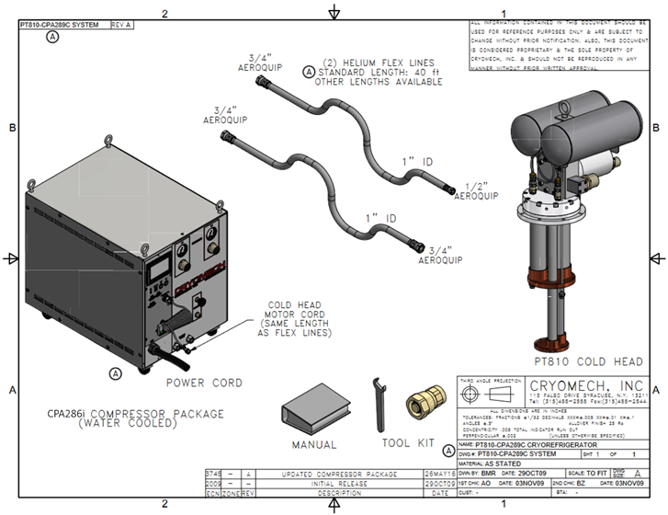
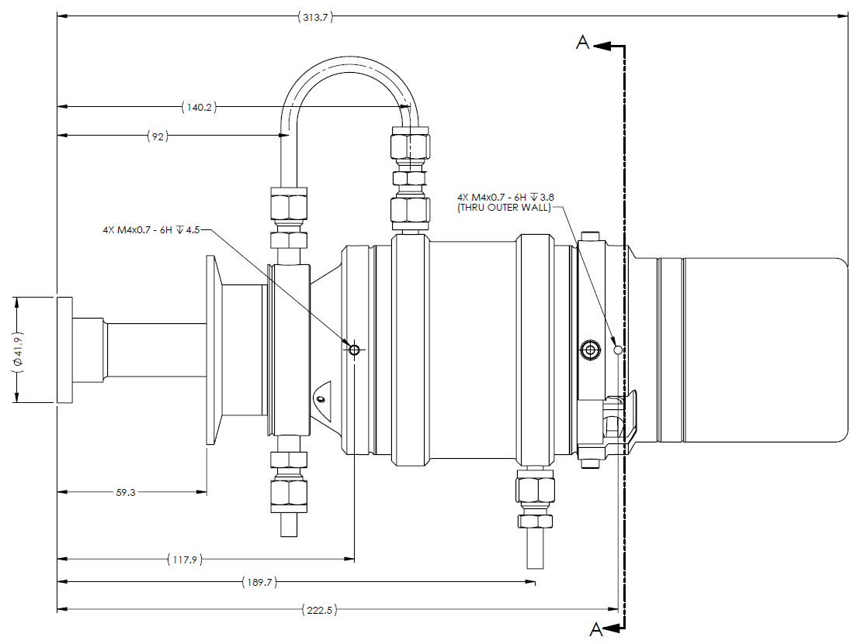
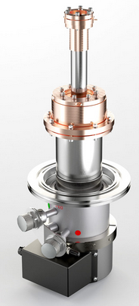
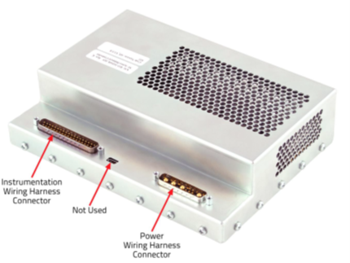
Standardization and Commercial-off-the-shelf products:
Vacuum and Cryogenics Standard Components - ESO-046147 - v. 7
Example from ESO-046147 - v. 7 : 20 / 40K Cryo-coolers
Stirling Cooler
Sunpower CryoTel GT - Gen 2 AVC + controller
Cooling power: 2 W @40K or ~18 W @80K
Lowest achievable temp.: 36K
Power consumption: 250W (!)
+ Meets ELT vibrations requirements thanks to AVC
+ Maintenance free (!)
+ Compact, low power consumption, no compressor
- Limited cooling power.
Installed on ELT phasing and diagnostic station (PDS), and in La Silla on REMIR, foreseen for WFI and HARPS, and …
Gifford-McMahon (GM)
Leybold COOLPOWER 10 MDi + COOLPAK 5000i compr.
Cooling power: 20W @25K(2nd stage), 100W @70K (1st stage)
Lowest achievable temp.: 8K (2nd stage), 28K (1st stage)
Power consumption: 6 to 8 KW
+ Any mounting orientation possible.
- Only for VLT: GM coolers don’t meet ELT vibrations requirements
Installed on VLT IR instruments CRIRES, KMOS and MOONS.
Pulse Tube (PT)
Cryomech PT810 + CPA286i compressor
Cooling power: 14W @20K(2nd stage), 80W @80K (1st stage)
Lowest achievable temp.: 8K (2nd stage)
Power consumption: 8 to 9 KW
+ Meets ELT vibrations requirements.
- Only possible to install as in the figure above, “tip down”.
Foreseen for the ELT instruments HARMONI (4x) and METIS (3x)
Notes:
MOONS 7 Tons Cold Mass xxx KG at 130K
Figure 2: Left, vacuum fibre feedthroughs on common flange. Right, slit assembly inside cryostat.
In addition to the optical subsystems all the electrical services and various cold fingers are mounted on the optical bench
to provide power, control, and appropriate cooling.
3. CRYOGENIC AND VACUUM SYSTEM OVERVIEW
The MOONS vacuum chamber is around 2.3 m long, 2.2 m width, and 3.5 m high, with an internal volume of around 18
m3. It is a welded construction made from 5083 aluminum. The vessel consists of a central section with mounting feet to
the Nasmyth platform, within which the optical bench is mounted. This is then completed by two clamshell doors, that
attach either side of the central section, to form the enclosure. A similarly constructed radiation shield, wrapped in a
segmented MLI blanket, sits between the outer vessel and optical bench. The vacuum pump set consists of two ATH
2303M Turbo pumps each backed by an ACP 40 roots pump, one set mounted on each door, as shown in Figure 3. The
pressure achieved in 24 hours after evacuation begins is in the mid 10-5 mbar. Base pressure when warm is in the 10-6
mbar range, which then drops into the 10-7 mbar range when cold.
The MOONS cold mass is made up of, approximately, 500 kg of 6082 aluminum radiation shield, 1800 kg of 6082
aluminum optical bench and 1400 kg of glass optics and mounts. This is cooled to an average temperature of 135 K in 48
hours using a liquid nitrogen precool system. The system consists of a high level ‘bath’ manifold with the exhaust fed
directly to atmosphere. The bath manifold feeds 8 pairs of pads on the optical bench and 2 pairs of pads on the radiation
shield. The pads are filled simultaneously by the bath manifold and are spaced over the optical bench to give a uniform
cooling across the bench. At the telescope the system will be fed via liquid nitrogen dewars, and an automated
switchover system will be used, to allow cooling to take place overnight with minimal intervention.
Once the system reaches a set of defined temperatures, the precool switches itself off and the temperature is held cold
using 3 Cryomech 10MD cryocoolers. Two of these are directly attached to the radiation shield and the third to the
optical bench. The bench is set to run at 134 K in deference to the CCD detectors which are not permitted to drop below
130 K. The radiation shield is allowed to cool in an uncontrolled manner and settles out at 76-120 K. The single
cryocooler is responsible for cooling a large mass and so there is a relatively large time constant required for changes to
the bench temperature. It is worth noting that the infrared detectors are cooled to their operating temperature, 40 K, using
a controlled ramp once the pre-cooling is complete. This ensure they are not exposed to dangerous thermal shocks.

Slide 11
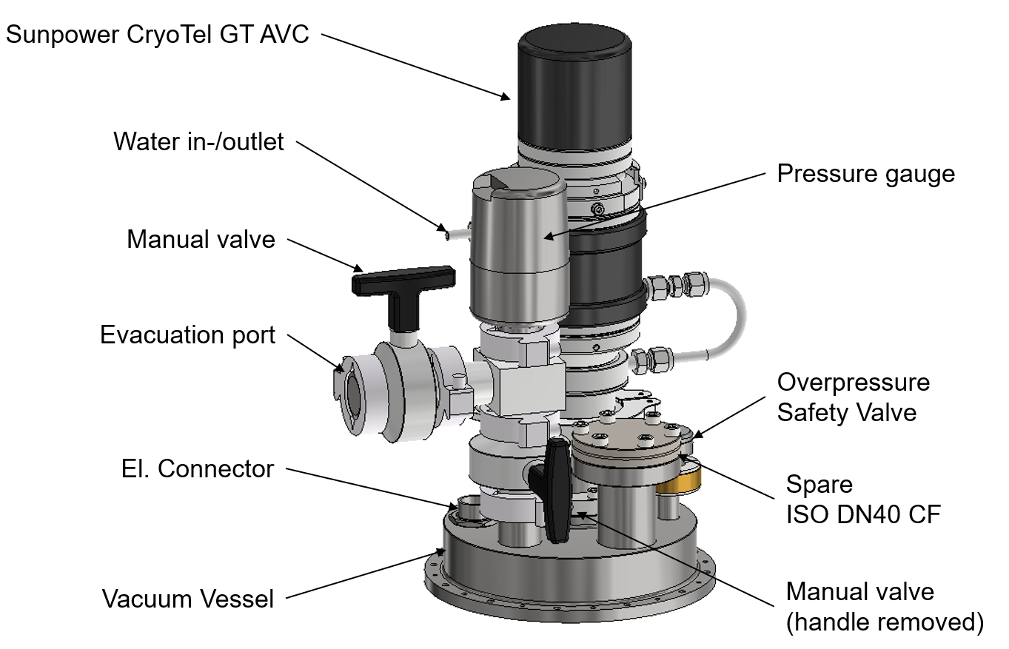
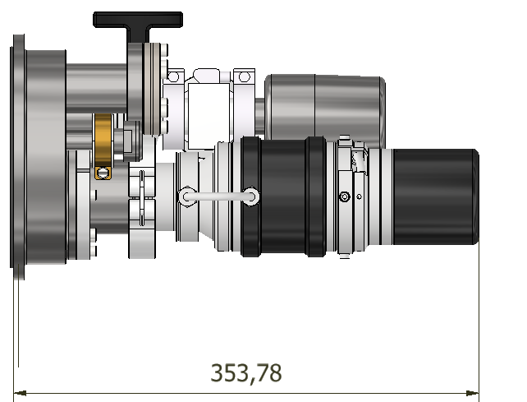
Stirling cooler adaptation for retrofitting LIN systems in operation.
Shortly after successful test of prototype, first use case: REMIR at La Silla.
Stirling Cooler
Sunpower CryoTel GT - Gen 2 AVC + controller
Cooling power: 2 W @40K or ~18 W @80K
Lowest achievable temp.: 36K
Power consumption: 250W (!)
+ Meets ELT vibrations requirements thanks to AVC
+ Maintenance free (!)
+ Compact, low power consumption, no compressor
- Limited cooling power.
Installed on ELT phasing and diagnostic station (PDS), and in La Silla on REMIR, foreseen for WFI and HARPS, and …
Notes:
MOONS 7 Tons Cold Mass xxx KG at 130K
Figure 2: Left, vacuum fibre feedthroughs on common flange. Right, slit assembly inside cryostat.
In addition to the optical subsystems all the electrical services and various cold fingers are mounted on the optical bench
to provide power, control, and appropriate cooling.
3. CRYOGENIC AND VACUUM SYSTEM OVERVIEW
The MOONS vacuum chamber is around 2.3 m long, 2.2 m width, and 3.5 m high, with an internal volume of around 18
m3. It is a welded construction made from 5083 aluminum. The vessel consists of a central section with mounting feet to
the Nasmyth platform, within which the optical bench is mounted. This is then completed by two clamshell doors, that
attach either side of the central section, to form the enclosure. A similarly constructed radiation shield, wrapped in a
segmented MLI blanket, sits between the outer vessel and optical bench. The vacuum pump set consists of two ATH
2303M Turbo pumps each backed by an ACP 40 roots pump, one set mounted on each door, as shown in Figure 3. The
pressure achieved in 24 hours after evacuation begins is in the mid 10-5 mbar. Base pressure when warm is in the 10-6
mbar range, which then drops into the 10-7 mbar range when cold.
The MOONS cold mass is made up of, approximately, 500 kg of 6082 aluminum radiation shield, 1800 kg of 6082
aluminum optical bench and 1400 kg of glass optics and mounts. This is cooled to an average temperature of 135 K in 48
hours using a liquid nitrogen precool system. The system consists of a high level ‘bath’ manifold with the exhaust fed
directly to atmosphere. The bath manifold feeds 8 pairs of pads on the optical bench and 2 pairs of pads on the radiation
shield. The pads are filled simultaneously by the bath manifold and are spaced over the optical bench to give a uniform
cooling across the bench. At the telescope the system will be fed via liquid nitrogen dewars, and an automated
switchover system will be used, to allow cooling to take place overnight with minimal intervention.
Once the system reaches a set of defined temperatures, the precool switches itself off and the temperature is held cold
using 3 Cryomech 10MD cryocoolers. Two of these are directly attached to the radiation shield and the third to the
optical bench. The bench is set to run at 134 K in deference to the CCD detectors which are not permitted to drop below
130 K. The radiation shield is allowed to cool in an uncontrolled manner and settles out at 76-120 K. The single
cryocooler is responsible for cooling a large mass and so there is a relatively large time constant required for changes to
the bench temperature. It is worth noting that the infrared detectors are cooled to their operating temperature, 40 K, using
a controlled ramp once the pre-cooling is complete. This ensure they are not exposed to dangerous thermal shocks.

Slide 12
Standardization and Commercial-off-the-shelf products:
Vacuum and Cryogenics Standard Components - ESO-046147 - v. 7
Standard Vacuum system design requirements and principles:
  Dimensioning of the components of the vacuum system
  Capacity of the pumps
  Safety
  Cleanliness
  Pumping time
  Leak testing methods and pass/fail criteria
Standard configuration for different classes of vessel size:
  1 - 50 L volume
  50 – 2500 L volume
  2500 – 50000+ L volume
Notes:
MOONS 7 Tons Cold Mass xxx KG at 130K
Figure 2: Left, vacuum fibre feedthroughs on common flange. Right, slit assembly inside cryostat.
In addition to the optical subsystems all the electrical services and various cold fingers are mounted on the optical bench
to provide power, control, and appropriate cooling.
3. CRYOGENIC AND VACUUM SYSTEM OVERVIEW
The MOONS vacuum chamber is around 2.3 m long, 2.2 m width, and 3.5 m high, with an internal volume of around 18
m3. It is a welded construction made from 5083 aluminum. The vessel consists of a central section with mounting feet to
the Nasmyth platform, within which the optical bench is mounted. This is then completed by two clamshell doors, that
attach either side of the central section, to form the enclosure. A similarly constructed radiation shield, wrapped in a
segmented MLI blanket, sits between the outer vessel and optical bench. The vacuum pump set consists of two ATH
2303M Turbo pumps each backed by an ACP 40 roots pump, one set mounted on each door, as shown in Figure 3. The
pressure achieved in 24 hours after evacuation begins is in the mid 10-5 mbar. Base pressure when warm is in the 10-6
mbar range, which then drops into the 10-7 mbar range when cold.
The MOONS cold mass is made up of, approximately, 500 kg of 6082 aluminum radiation shield, 1800 kg of 6082
aluminum optical bench and 1400 kg of glass optics and mounts. This is cooled to an average temperature of 135 K in 48
hours using a liquid nitrogen precool system. The system consists of a high level ‘bath’ manifold with the exhaust fed
directly to atmosphere. The bath manifold feeds 8 pairs of pads on the optical bench and 2 pairs of pads on the radiation
shield. The pads are filled simultaneously by the bath manifold and are spaced over the optical bench to give a uniform
cooling across the bench. At the telescope the system will be fed via liquid nitrogen dewars, and an automated
switchover system will be used, to allow cooling to take place overnight with minimal intervention.
Once the system reaches a set of defined temperatures, the precool switches itself off and the temperature is held cold
using 3 Cryomech 10MD cryocoolers. Two of these are directly attached to the radiation shield and the third to the
optical bench. The bench is set to run at 134 K in deference to the CCD detectors which are not permitted to drop below
130 K. The radiation shield is allowed to cool in an uncontrolled manner and settles out at 76-120 K. The single
cryocooler is responsible for cooling a large mass and so there is a relatively large time constant required for changes to
the bench temperature. It is worth noting that the infrared detectors are cooled to their operating temperature, 40 K, using
a controlled ramp once the pre-cooling is complete. This ensure they are not exposed to dangerous thermal shocks.

Slide 13
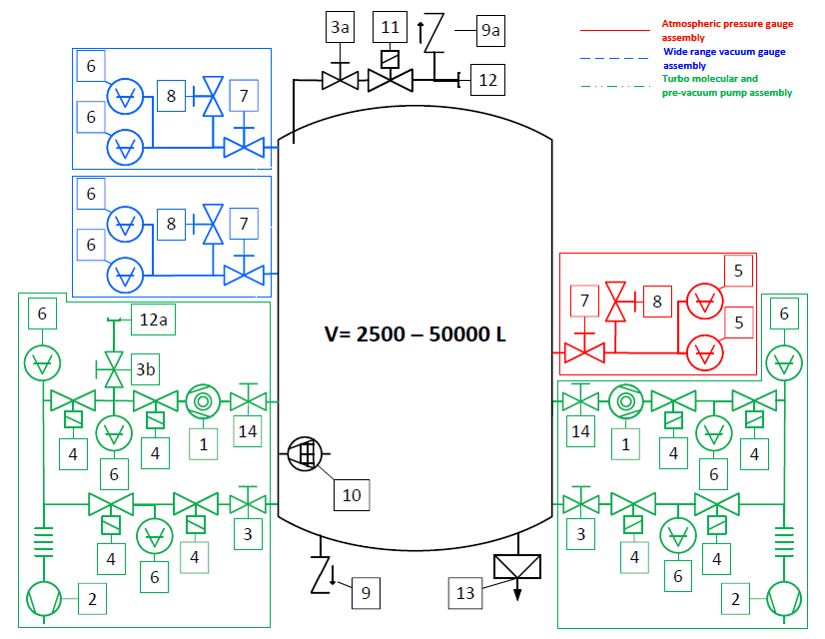
Standardization and Commercial-off-the-shelf products:
Vacuum and Cryogenics Standard Components - ESO-046147 - v. 7
Nr | Acro­nym | Component | Key performance requirements | Interface | Product reference | Supplier | Remark
1 | TMP | Turbo molecular pump | 2150 l/s; active 5-axis magnetic bearing; incl. protection grid at inlet | DN 250 ISO-F (in); DN 40 ISO-KF (out) | ATH2303M, integrated electr., TMBBA662405A+ cap without purge A462026 + torque bridge kit PM 223 167 –Z + water inlet valve 221670 | Pfeiffer Vacuum Bürkert | 1-4 units in parallel, depending on vessel volume See section 3.1.6 Torque bridge kit only mandatory in combination with #14
2 | PVP | Pre-vacuum pump | 55 m³/h; fully dry; low noise; with electromag. valve at gas ballast (→3.1.4) | DN 40 ISO-KF (in); DN 16 ISO-KF (out) | Ecodry 65 plus 161065V22 | Leybold | 1-4 units in parallel, depending on vessel volume
3 | ENV | Engineering valve | Manual operation, normally open | DN 40 ISO-KF | 215377 or 215389 | Leybold | Identical alternatives: VAT 24432-KA01 VAT 24532-KA01
3a | VGV | Venting valve | Manual operation, normally open | DN 16 ISO-KF | 215375 or 215313 | Leybold | Identical alternatives: VAT 24424-KA01 VAT 24524-KA01
3b | LDV | Leak Detector Valve | Manual operation, normally closed | DN 25 ISO-KF | 215376 or 215388 | Leybold | Identical alternatives: VAT 24428-KA01 VAT 24528-KA01
4 | PVV | Pre-vacuum valve / insulating valve | Solenoid valve, normally closed; visible indication of open/closed | DN 40 ISO-KF | 215124V01 | Leybold | Identical alternative: VAT 26432-KA61
5 | HPG | High pressure gauge | Atmospheric pressure gauge; 1100 to 10⁻¹ mbar | DN 16 ISO-KF | CMR 361 PTR24601 | Pfeiffer Vacuum | see also section 3.2
6 | VAG | Vacuum gauge | Wide range gauge; atmosphere to 10⁻⁹ mbar | DN 25 ISO-KF | PKR 360 PTT02140010 | Pfeiffer Vacuum | see also section 3.2
7 | GE1 | Gauge exchange valve 1 | Manual operation valve + ISO-KF T-piece | DN 25 ISO-KF | 110VSM025 + 110RTS025-V (2x) | Pfeiffer Vacuum | Alternative Leybold 215376/88 if space available; for details see section 3.2.1
8 | GE2 | Gauge exch. valve 2 | Manual operation valve | DN 25 ISO-KF | 110VSM025 | Pfeiffer Vacuum | for details see section 3.2.1
9 | SOV | Safety over-pressure valve | Opens to prevent vessel damage in case of over-pressure | DN 16 ISO-KF | 89039 | Leybold | triggering overpressure 150 mbar +/- 40 mbar
9a | SOV2 | Safety over-pressure valve | Opens in case of overpressure in the GAN supply line | G 1/2” BSPP | Type 06002 06002.0400.2000 1.50bar | Herose | To be ordered for triggering overpressure at 1.50bar; safety valve
10 | SOP | Sorption pump | Only to be used in cryostats; operational temperature adjusted to adsorb gas | n/a | n/a |  | the use of a sorption pump is optional
11 | N2V | Re-pressurisation valve | Venting valve, normally closed; visible indication of open/closed | DN 10 ISO-KF | 215024 | Leybold | venting time for 1000 l vessel is 230 sec. For very large vessels two in parallel identical alternative: VAT 21320-KA64-ABM2
12 | N2C | Nitrogen gas connector | Standard KF-port | DN 16 ISO-KF
12a | LDP | Leak Detector Port | Standard KF-port | DN 25 ISO-KF |  |  | Port to connect a leak detector, while making use of the TMP (1)
13 | RUD | Rupture disk | Breaks in case of instant overpressure | DN 50 ISO-KF | KF50-UKB-LS-2 | REMBE | 0.5 bar with DN 50 ISO-KF interface; only applicable to LN2 cryostats
14 | EGV | Engineering gate valve | Manual actuator (hand wheel), open in nominal instrument operation | DN 250 ISO-F | UHV gate valve, series 108: 10848-PE01 | VAT | enables replacement of TMP and pump line insulating valves during instr. operation
Std. vacuum components, vessel 2.5 – 50 m³
P&ID schematic of vacuum vessels >2500 – 50000+ L volume.
Only two parallel pump assemblies shown.
Notes:
MOONS 7 Tons Cold Mass xxx KG at 130K
Figure 2: Left, vacuum fibre feedthroughs on common flange. Right, slit assembly inside cryostat.
In addition to the optical subsystems all the electrical services and various cold fingers are mounted on the optical bench
to provide power, control, and appropriate cooling.
3. CRYOGENIC AND VACUUM SYSTEM OVERVIEW
The MOONS vacuum chamber is around 2.3 m long, 2.2 m width, and 3.5 m high, with an internal volume of around 18
m3. It is a welded construction made from 5083 aluminum. The vessel consists of a central section with mounting feet to
the Nasmyth platform, within which the optical bench is mounted. This is then completed by two clamshell doors, that
attach either side of the central section, to form the enclosure. A similarly constructed radiation shield, wrapped in a
segmented MLI blanket, sits between the outer vessel and optical bench. The vacuum pump set consists of two ATH
2303M Turbo pumps each backed by an ACP 40 roots pump, one set mounted on each door, as shown in Figure 3. The
pressure achieved in 24 hours after evacuation begins is in the mid 10-5 mbar. Base pressure when warm is in the 10-6
mbar range, which then drops into the 10-7 mbar range when cold.
The MOONS cold mass is made up of, approximately, 500 kg of 6082 aluminum radiation shield, 1800 kg of 6082
aluminum optical bench and 1400 kg of glass optics and mounts. This is cooled to an average temperature of 135 K in 48
hours using a liquid nitrogen precool system. The system consists of a high level ‘bath’ manifold with the exhaust fed
directly to atmosphere. The bath manifold feeds 8 pairs of pads on the optical bench and 2 pairs of pads on the radiation
shield. The pads are filled simultaneously by the bath manifold and are spaced over the optical bench to give a uniform
cooling across the bench. At the telescope the system will be fed via liquid nitrogen dewars, and an automated
switchover system will be used, to allow cooling to take place overnight with minimal intervention.
Once the system reaches a set of defined temperatures, the precool switches itself off and the temperature is held cold
using 3 Cryomech 10MD cryocoolers. Two of these are directly attached to the radiation shield and the third to the
optical bench. The bench is set to run at 134 K in deference to the CCD detectors which are not permitted to drop below
130 K. The radiation shield is allowed to cool in an uncontrolled manner and settles out at 76-120 K. The single
cryocooler is responsible for cooling a large mass and so there is a relatively large time constant required for changes to
the bench temperature. It is worth noting that the infrared detectors are cooled to their operating temperature, 40 K, using
a controlled ramp once the pre-cooling is complete. This ensure they are not exposed to dangerous thermal shocks.

Slide 14
Vacuum and Cryogenics Standard Components - ESO-046147 - v. 7
Cryo-vacuum control systems
General Cryo-vacuum control design principles and requirements.
  During cool-down and warm-up, the detector shall at no time be the coldest point inside of the cryostat to avoid contamination of its sensitive area.
  The maximum cool-down rate and warm-up rate of the detector shall be limited by the design of its thermal link and shall not only be limited by the thermal control system.
  The PLC state and procedures shall not be affected by a power cycle. The system shall automatically recover and proceed with the last active sequence.
  The cryo-vacuum system shall be an intrinsic failsafe system under all conditions, not only during nominal operation, but also during a power loss or after power recovery.
  All Lakeshore control loops shall be made redundant under a PLC control system. The cold mode setpoint of the PLC shall be 2 to 5 Kelvin below the Lakeshore controller setpoint so that in case of a broken temperature control the PLC can take over. This implies one control loop for PLC and a separate one for Lakeshore control.
Notes:
MOONS 7 Tons Cold Mass xxx KG at 130K
Figure 2: Left, vacuum fibre feedthroughs on common flange. Right, slit assembly inside cryostat.
In addition to the optical subsystems all the electrical services and various cold fingers are mounted on the optical bench
to provide power, control, and appropriate cooling.
3. CRYOGENIC AND VACUUM SYSTEM OVERVIEW
The MOONS vacuum chamber is around 2.3 m long, 2.2 m width, and 3.5 m high, with an internal volume of around 18
m3. It is a welded construction made from 5083 aluminum. The vessel consists of a central section with mounting feet to
the Nasmyth platform, within which the optical bench is mounted. This is then completed by two clamshell doors, that
attach either side of the central section, to form the enclosure. A similarly constructed radiation shield, wrapped in a
segmented MLI blanket, sits between the outer vessel and optical bench. The vacuum pump set consists of two ATH
2303M Turbo pumps each backed by an ACP 40 roots pump, one set mounted on each door, as shown in Figure 3. The
pressure achieved in 24 hours after evacuation begins is in the mid 10-5 mbar. Base pressure when warm is in the 10-6
mbar range, which then drops into the 10-7 mbar range when cold.
The MOONS cold mass is made up of, approximately, 500 kg of 6082 aluminum radiation shield, 1800 kg of 6082
aluminum optical bench and 1400 kg of glass optics and mounts. This is cooled to an average temperature of 135 K in 48
hours using a liquid nitrogen precool system. The system consists of a high level ‘bath’ manifold with the exhaust fed
directly to atmosphere. The bath manifold feeds 8 pairs of pads on the optical bench and 2 pairs of pads on the radiation
shield. The pads are filled simultaneously by the bath manifold and are spaced over the optical bench to give a uniform
cooling across the bench. At the telescope the system will be fed via liquid nitrogen dewars, and an automated
switchover system will be used, to allow cooling to take place overnight with minimal intervention.
Once the system reaches a set of defined temperatures, the precool switches itself off and the temperature is held cold
using 3 Cryomech 10MD cryocoolers. Two of these are directly attached to the radiation shield and the third to the
optical bench. The bench is set to run at 134 K in deference to the CCD detectors which are not permitted to drop below
130 K. The radiation shield is allowed to cool in an uncontrolled manner and settles out at 76-120 K. The single
cryocooler is responsible for cooling a large mass and so there is a relatively large time constant required for changes to
the bench temperature. It is worth noting that the infrared detectors are cooled to their operating temperature, 40 K, using
a controlled ramp once the pre-cooling is complete. This ensure they are not exposed to dangerous thermal shocks.

Slide 15
Vacuum and Cryogenics Standard Components - ESO-046147 - v. 7
Cryo-vacuum control systems
Ramping Implementation
  A - Ramping controlled by the PLC. (Preferred)
  Two control loops:
  1x PLC redundant, to limit the min. temp. and to allow a controlled warm-up and cool-down
  1x Lakeshore for very precise control of the temperature
  B - Ramping controlled by the Lakeshore ramping function. To be used only if implementation of a redundant control loop is not possible.
Notes:
MOONS 7 Tons Cold Mass xxx KG at 130K
Figure 2: Left, vacuum fibre feedthroughs on common flange. Right, slit assembly inside cryostat.
In addition to the optical subsystems all the electrical services and various cold fingers are mounted on the optical bench
to provide power, control, and appropriate cooling.
3. CRYOGENIC AND VACUUM SYSTEM OVERVIEW
The MOONS vacuum chamber is around 2.3 m long, 2.2 m width, and 3.5 m high, with an internal volume of around 18
m3. It is a welded construction made from 5083 aluminum. The vessel consists of a central section with mounting feet to
the Nasmyth platform, within which the optical bench is mounted. This is then completed by two clamshell doors, that
attach either side of the central section, to form the enclosure. A similarly constructed radiation shield, wrapped in a
segmented MLI blanket, sits between the outer vessel and optical bench. The vacuum pump set consists of two ATH
2303M Turbo pumps each backed by an ACP 40 roots pump, one set mounted on each door, as shown in Figure 3. The
pressure achieved in 24 hours after evacuation begins is in the mid 10-5 mbar. Base pressure when warm is in the 10-6
mbar range, which then drops into the 10-7 mbar range when cold.
The MOONS cold mass is made up of, approximately, 500 kg of 6082 aluminum radiation shield, 1800 kg of 6082
aluminum optical bench and 1400 kg of glass optics and mounts. This is cooled to an average temperature of 135 K in 48
hours using a liquid nitrogen precool system. The system consists of a high level ‘bath’ manifold with the exhaust fed
directly to atmosphere. The bath manifold feeds 8 pairs of pads on the optical bench and 2 pairs of pads on the radiation
shield. The pads are filled simultaneously by the bath manifold and are spaced over the optical bench to give a uniform
cooling across the bench. At the telescope the system will be fed via liquid nitrogen dewars, and an automated
switchover system will be used, to allow cooling to take place overnight with minimal intervention.
Once the system reaches a set of defined temperatures, the precool switches itself off and the temperature is held cold
using 3 Cryomech 10MD cryocoolers. Two of these are directly attached to the radiation shield and the third to the
optical bench. The bench is set to run at 134 K in deference to the CCD detectors which are not permitted to drop below
130 K. The radiation shield is allowed to cool in an uncontrolled manner and settles out at 76-120 K. The single
cryocooler is responsible for cooling a large mass and so there is a relatively large time constant required for changes to
the bench temperature. It is worth noting that the infrared detectors are cooled to their operating temperature, 40 K, using
a controlled ramp once the pre-cooling is complete. This ensure they are not exposed to dangerous thermal shocks.

Slide 16
Vacuum and Cryogenics Standard Components - ESO-046147 - v. 7
Cryo-vacuum control systems – Safety 1 / 2
PLC shall monitor health status of Lakeshore Sensors and Heaters and trigger alarm / warning / automatic reaction, as appropriate.
PLC shall monitor communication with Lakeshore and trigger an alarm in case of timeout / loss of communication.
PLC shall only read values from the Lakeshore and not write. Only exception: ramping implementation B is in use.
Instrument control system shall monitor PLC health status.
PLC shall perform plausibility checks on all sensors and heating resistors. For example:
  Is the sensor value reasonable in the sequence of the system?
  Is the resistance in range?
  Is the rate of the sensor possible during warm-up and cool-down?
  Is the value difference to another sensor reasonable?
  Does the sensor react reasonably to a heating change? See the voting system.
A visualization of active interlocks shall be given on the PLC panel.
An engineering mode shall be implemented to allow the operator to change the status of all functions and to set simulated values for each sensor. This functionality is needed during the AIV phase and for debugging. This mode shall be password protected.
Notes:
MOONS 7 Tons Cold Mass xxx KG at 130K
Figure 2: Left, vacuum fibre feedthroughs on common flange. Right, slit assembly inside cryostat.
In addition to the optical subsystems all the electrical services and various cold fingers are mounted on the optical bench
to provide power, control, and appropriate cooling.
3. CRYOGENIC AND VACUUM SYSTEM OVERVIEW
The MOONS vacuum chamber is around 2.3 m long, 2.2 m width, and 3.5 m high, with an internal volume of around 18
m3. It is a welded construction made from 5083 aluminum. The vessel consists of a central section with mounting feet to
the Nasmyth platform, within which the optical bench is mounted. This is then completed by two clamshell doors, that
attach either side of the central section, to form the enclosure. A similarly constructed radiation shield, wrapped in a
segmented MLI blanket, sits between the outer vessel and optical bench. The vacuum pump set consists of two ATH
2303M Turbo pumps each backed by an ACP 40 roots pump, one set mounted on each door, as shown in Figure 3. The
pressure achieved in 24 hours after evacuation begins is in the mid 10-5 mbar. Base pressure when warm is in the 10-6
mbar range, which then drops into the 10-7 mbar range when cold.
The MOONS cold mass is made up of, approximately, 500 kg of 6082 aluminum radiation shield, 1800 kg of 6082
aluminum optical bench and 1400 kg of glass optics and mounts. This is cooled to an average temperature of 135 K in 48
hours using a liquid nitrogen precool system. The system consists of a high level ‘bath’ manifold with the exhaust fed
directly to atmosphere. The bath manifold feeds 8 pairs of pads on the optical bench and 2 pairs of pads on the radiation
shield. The pads are filled simultaneously by the bath manifold and are spaced over the optical bench to give a uniform
cooling across the bench. At the telescope the system will be fed via liquid nitrogen dewars, and an automated
switchover system will be used, to allow cooling to take place overnight with minimal intervention.
Once the system reaches a set of defined temperatures, the precool switches itself off and the temperature is held cold
using 3 Cryomech 10MD cryocoolers. Two of these are directly attached to the radiation shield and the third to the
optical bench. The bench is set to run at 134 K in deference to the CCD detectors which are not permitted to drop below
130 K. The radiation shield is allowed to cool in an uncontrolled manner and settles out at 76-120 K. The single
cryocooler is responsible for cooling a large mass and so there is a relatively large time constant required for changes to
the bench temperature. It is worth noting that the infrared detectors are cooled to their operating temperature, 40 K, using
a controlled ramp once the pre-cooling is complete. This ensure they are not exposed to dangerous thermal shocks.

Slide 17
Vacuum and Cryogenics Standard Components - ESO-046147 - v. 7
Cryo-vacuum control systems – Safety 2 / 2
To protect the individual warm-up control loops against overheating, thermal switches (see chapter 4.2) shall be installed on the cold structure in a representative position. In addition, the power supply of each warm-up loop shall not be over dimensioned in terms of power.
To protect cryo parts from damage through short circuits (i.e., caused by loose wires resulting from self-desoldering) all circuits shall have appropriate overcurrent protections.
The current through heating resistors shall be monitored constantly, (i.e., 0.1Hz). Also, the voltage across heating resistors shall be measured, in case it is not constant.
The system shall calculate on request the resistance of the heater resistors to check for faults.
The monitoring shall be used for sanity cross checks to detect faults early.
Notes:
MOONS 7 Tons Cold Mass xxx KG at 130K
Figure 2: Left, vacuum fibre feedthroughs on common flange. Right, slit assembly inside cryostat.
In addition to the optical subsystems all the electrical services and various cold fingers are mounted on the optical bench
to provide power, control, and appropriate cooling.
3. CRYOGENIC AND VACUUM SYSTEM OVERVIEW
The MOONS vacuum chamber is around 2.3 m long, 2.2 m width, and 3.5 m high, with an internal volume of around 18
m3. It is a welded construction made from 5083 aluminum. The vessel consists of a central section with mounting feet to
the Nasmyth platform, within which the optical bench is mounted. This is then completed by two clamshell doors, that
attach either side of the central section, to form the enclosure. A similarly constructed radiation shield, wrapped in a
segmented MLI blanket, sits between the outer vessel and optical bench. The vacuum pump set consists of two ATH
2303M Turbo pumps each backed by an ACP 40 roots pump, one set mounted on each door, as shown in Figure 3. The
pressure achieved in 24 hours after evacuation begins is in the mid 10-5 mbar. Base pressure when warm is in the 10-6
mbar range, which then drops into the 10-7 mbar range when cold.
The MOONS cold mass is made up of, approximately, 500 kg of 6082 aluminum radiation shield, 1800 kg of 6082
aluminum optical bench and 1400 kg of glass optics and mounts. This is cooled to an average temperature of 135 K in 48
hours using a liquid nitrogen precool system. The system consists of a high level ‘bath’ manifold with the exhaust fed
directly to atmosphere. The bath manifold feeds 8 pairs of pads on the optical bench and 2 pairs of pads on the radiation
shield. The pads are filled simultaneously by the bath manifold and are spaced over the optical bench to give a uniform
cooling across the bench. At the telescope the system will be fed via liquid nitrogen dewars, and an automated
switchover system will be used, to allow cooling to take place overnight with minimal intervention.
Once the system reaches a set of defined temperatures, the precool switches itself off and the temperature is held cold
using 3 Cryomech 10MD cryocoolers. Two of these are directly attached to the radiation shield and the third to the
optical bench. The bench is set to run at 134 K in deference to the CCD detectors which are not permitted to drop below
130 K. The radiation shield is allowed to cool in an uncontrolled manner and settles out at 76-120 K. The single
cryocooler is responsible for cooling a large mass and so there is a relatively large time constant required for changes to
the bench temperature. It is worth noting that the infrared detectors are cooled to their operating temperature, 40 K, using
a controlled ramp once the pre-cooling is complete. This ensure they are not exposed to dangerous thermal shocks.

Slide 18
Vacuum and Cryogenics Standard Components - ESO-046147 - v. 7
Cryo-vacuum control systems – PLC sequences
The following PLC sequences shall be implemented as required:
  Evacuation
  cool-down (if needed including pre-cooling)
  sorption-pump regeneration
  steady-state operation
  warm-up (selectable auto-start of re-pressurization at end of sequence)
  re-pressurization
  LN2 re-filling
It shall be pre-selectable, if the PLC proceeds automatically with the next sequence, or if an operator needs to activate the following sequence manually.
At least during pre-cooling, sorption-pump regeneration and warm-up, the evacuation sequence must be activated.
It shall be possible to interrupt all PLC sequences at any time with the option to proceed at a later stage.
The PLC shall display for each actuator preconditions for its states.
A Voting system shall be implemented to enable the PLC to decide if a sensor or actuator value is confident and in case of a doubt, to react in a safe way.
Notes:
MOONS 7 Tons Cold Mass xxx KG at 130K
Figure 2: Left, vacuum fibre feedthroughs on common flange. Right, slit assembly inside cryostat.
In addition to the optical subsystems all the electrical services and various cold fingers are mounted on the optical bench
to provide power, control, and appropriate cooling.
3. CRYOGENIC AND VACUUM SYSTEM OVERVIEW
The MOONS vacuum chamber is around 2.3 m long, 2.2 m width, and 3.5 m high, with an internal volume of around 18
m3. It is a welded construction made from 5083 aluminum. The vessel consists of a central section with mounting feet to
the Nasmyth platform, within which the optical bench is mounted. This is then completed by two clamshell doors, that
attach either side of the central section, to form the enclosure. A similarly constructed radiation shield, wrapped in a
segmented MLI blanket, sits between the outer vessel and optical bench. The vacuum pump set consists of two ATH
2303M Turbo pumps each backed by an ACP 40 roots pump, one set mounted on each door, as shown in Figure 3. The
pressure achieved in 24 hours after evacuation begins is in the mid 10-5 mbar. Base pressure when warm is in the 10-6
mbar range, which then drops into the 10-7 mbar range when cold.
The MOONS cold mass is made up of, approximately, 500 kg of 6082 aluminum radiation shield, 1800 kg of 6082
aluminum optical bench and 1400 kg of glass optics and mounts. This is cooled to an average temperature of 135 K in 48
hours using a liquid nitrogen precool system. The system consists of a high level ‘bath’ manifold with the exhaust fed
directly to atmosphere. The bath manifold feeds 8 pairs of pads on the optical bench and 2 pairs of pads on the radiation
shield. The pads are filled simultaneously by the bath manifold and are spaced over the optical bench to give a uniform
cooling across the bench. At the telescope the system will be fed via liquid nitrogen dewars, and an automated
switchover system will be used, to allow cooling to take place overnight with minimal intervention.
Once the system reaches a set of defined temperatures, the precool switches itself off and the temperature is held cold
using 3 Cryomech 10MD cryocoolers. Two of these are directly attached to the radiation shield and the third to the
optical bench. The bench is set to run at 134 K in deference to the CCD detectors which are not permitted to drop below
130 K. The radiation shield is allowed to cool in an uncontrolled manner and settles out at 76-120 K. The single
cryocooler is responsible for cooling a large mass and so there is a relatively large time constant required for changes to
the bench temperature. It is worth noting that the infrared detectors are cooled to their operating temperature, 40 K, using
a controlled ramp once the pre-cooling is complete. This ensure they are not exposed to dangerous thermal shocks.

Slide 19
Vacuum and Cryogenics Standard Components - ESO-046147 - v. 7
Cryo-vacuum control systems – Graphical User Interface
The main panel shall show an overview of the cryo-vacuum system, including vacuum and cryogenic functions.
The sequences shall be started from the main panel. If the sequence is active, it shall be green, if it is blocked by an interlock, it shall be greyed-out and if it is allowed to start it shall be black.
For each sequence it shall be possible to see the sequence in a block diagram including its actual position marked.
In the main overview panel, each device shall change its color to green when active or grey when inactive.
A red mark at each actuator (pumps, valves, heaters, compressors…) shall indicate if it is interlocked.
Separate plots for temperatures and pressures shall be shown on a separate panel for at least the last 24 hours.
An interlock overview panel shall allow the operator to find easily the reason why a sequence has stopped or is not possible at this stage.
It shall be possible to put all sensors and actuators into a simulation mode and to set the values by the operator. This function is password protected. If a device is set to simulation an orange mark at the device shall indicate its simulation state.
It shall be possible to put any actuator in a manual mode, indicated by a yellow mark. This mode cannot override any interlock.
An engineering mode shall be implemented which allows the user to manually change the state of the actuator by ignoring the interlock. This shall be indicated by an orange E. To enter this engineering mode the operator needs to actively activate it in a separate panel.
Notes:
MOONS 7 Tons Cold Mass xxx KG at 130K
Figure 2: Left, vacuum fibre feedthroughs on common flange. Right, slit assembly inside cryostat.
In addition to the optical subsystems all the electrical services and various cold fingers are mounted on the optical bench
to provide power, control, and appropriate cooling.
3. CRYOGENIC AND VACUUM SYSTEM OVERVIEW
The MOONS vacuum chamber is around 2.3 m long, 2.2 m width, and 3.5 m high, with an internal volume of around 18
m3. It is a welded construction made from 5083 aluminum. The vessel consists of a central section with mounting feet to
the Nasmyth platform, within which the optical bench is mounted. This is then completed by two clamshell doors, that
attach either side of the central section, to form the enclosure. A similarly constructed radiation shield, wrapped in a
segmented MLI blanket, sits between the outer vessel and optical bench. The vacuum pump set consists of two ATH
2303M Turbo pumps each backed by an ACP 40 roots pump, one set mounted on each door, as shown in Figure 3. The
pressure achieved in 24 hours after evacuation begins is in the mid 10-5 mbar. Base pressure when warm is in the 10-6
mbar range, which then drops into the 10-7 mbar range when cold.
The MOONS cold mass is made up of, approximately, 500 kg of 6082 aluminum radiation shield, 1800 kg of 6082
aluminum optical bench and 1400 kg of glass optics and mounts. This is cooled to an average temperature of 135 K in 48
hours using a liquid nitrogen precool system. The system consists of a high level ‘bath’ manifold with the exhaust fed
directly to atmosphere. The bath manifold feeds 8 pairs of pads on the optical bench and 2 pairs of pads on the radiation
shield. The pads are filled simultaneously by the bath manifold and are spaced over the optical bench to give a uniform
cooling across the bench. At the telescope the system will be fed via liquid nitrogen dewars, and an automated
switchover system will be used, to allow cooling to take place overnight with minimal intervention.
Once the system reaches a set of defined temperatures, the precool switches itself off and the temperature is held cold
using 3 Cryomech 10MD cryocoolers. Two of these are directly attached to the radiation shield and the third to the
optical bench. The bench is set to run at 134 K in deference to the CCD detectors which are not permitted to drop below
130 K. The radiation shield is allowed to cool in an uncontrolled manner and settles out at 76-120 K. The single
cryocooler is responsible for cooling a large mass and so there is a relatively large time constant required for changes to
the bench temperature. It is worth noting that the infrared detectors are cooled to their operating temperature, 40 K, using
a controlled ramp once the pre-cooling is complete. This ensure they are not exposed to dangerous thermal shocks.

Slide 20
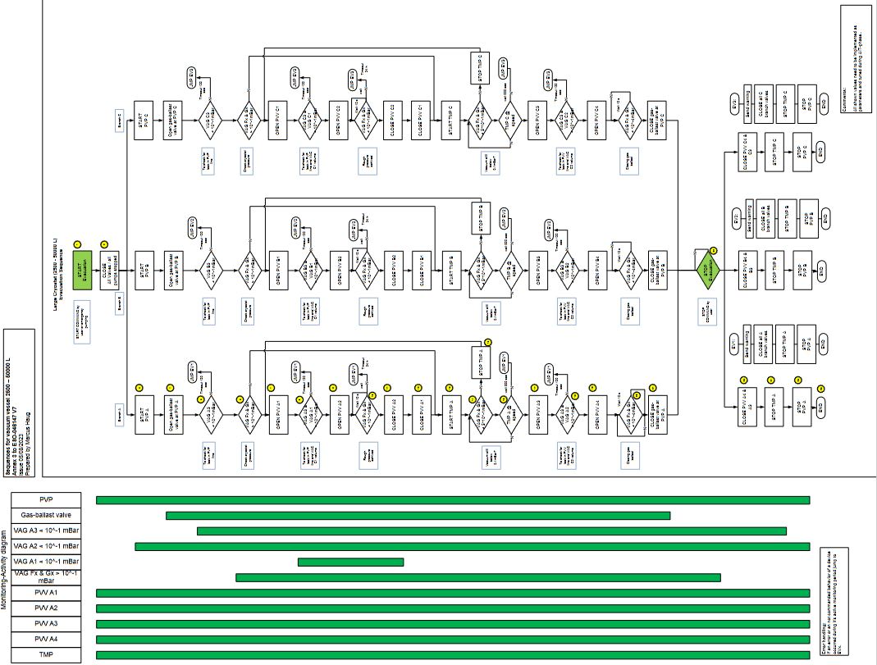
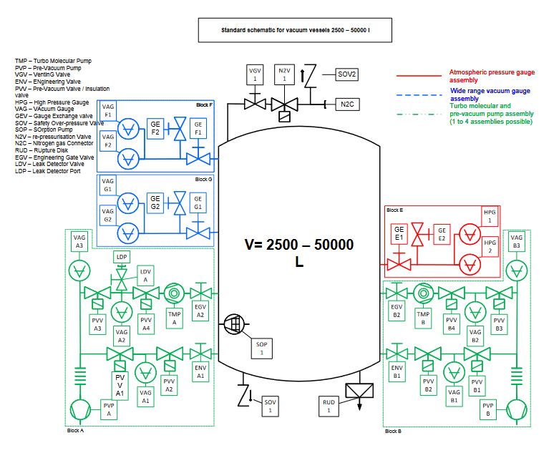
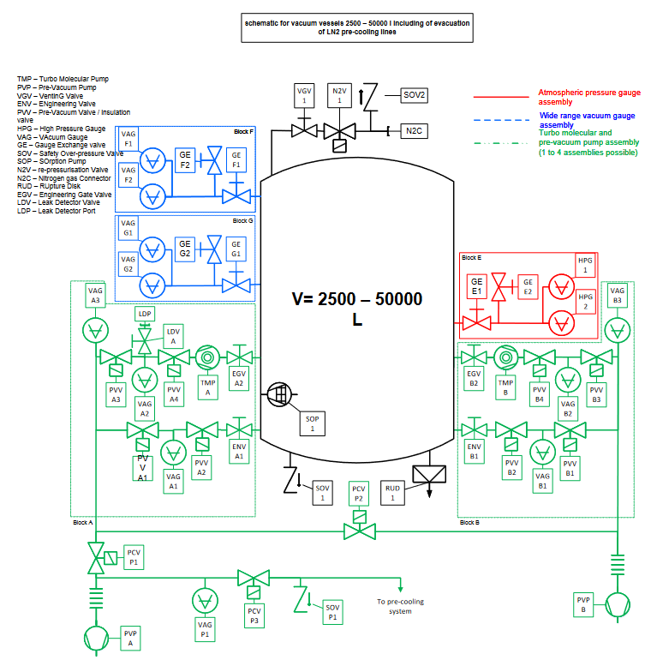
Vacuum and Cryogenics Standard Components - ESO-046147 - v. 7
Cryo-vacuum control systems – Flow charts
For each vessel size class, the Vacuum and Cryogenics Standards document describes via flow-charts the typical main sequences for a cryo-vacuum system.
The provided examples are to be intended as baseline for defining the logic of a cryo-vacuum control system. The sequences shall be adapted and / or extended to the requirements of each individual cryostat.
Notes:
MOONS 7 Tons Cold Mass xxx KG at 130K
Figure 2: Left, vacuum fibre feedthroughs on common flange. Right, slit assembly inside cryostat.
In addition to the optical subsystems all the electrical services and various cold fingers are mounted on the optical bench
to provide power, control, and appropriate cooling.
3. CRYOGENIC AND VACUUM SYSTEM OVERVIEW
The MOONS vacuum chamber is around 2.3 m long, 2.2 m width, and 3.5 m high, with an internal volume of around 18
m3. It is a welded construction made from 5083 aluminum. The vessel consists of a central section with mounting feet to
the Nasmyth platform, within which the optical bench is mounted. This is then completed by two clamshell doors, that
attach either side of the central section, to form the enclosure. A similarly constructed radiation shield, wrapped in a
segmented MLI blanket, sits between the outer vessel and optical bench. The vacuum pump set consists of two ATH
2303M Turbo pumps each backed by an ACP 40 roots pump, one set mounted on each door, as shown in Figure 3. The
pressure achieved in 24 hours after evacuation begins is in the mid 10-5 mbar. Base pressure when warm is in the 10-6
mbar range, which then drops into the 10-7 mbar range when cold.
The MOONS cold mass is made up of, approximately, 500 kg of 6082 aluminum radiation shield, 1800 kg of 6082
aluminum optical bench and 1400 kg of glass optics and mounts. This is cooled to an average temperature of 135 K in 48
hours using a liquid nitrogen precool system. The system consists of a high level ‘bath’ manifold with the exhaust fed
directly to atmosphere. The bath manifold feeds 8 pairs of pads on the optical bench and 2 pairs of pads on the radiation
shield. The pads are filled simultaneously by the bath manifold and are spaced over the optical bench to give a uniform
cooling across the bench. At the telescope the system will be fed via liquid nitrogen dewars, and an automated
switchover system will be used, to allow cooling to take place overnight with minimal intervention.
Once the system reaches a set of defined temperatures, the precool switches itself off and the temperature is held cold
using 3 Cryomech 10MD cryocoolers. Two of these are directly attached to the radiation shield and the third to the
optical bench. The bench is set to run at 134 K in deference to the CCD detectors which are not permitted to drop below
130 K. The radiation shield is allowed to cool in an uncontrolled manner and settles out at 76-120 K. The single
cryocooler is responsible for cooling a large mass and so there is a relatively large time constant required for changes to
the bench temperature. It is worth noting that the infrared detectors are cooled to their operating temperature, 40 K, using
a controlled ramp once the pre-cooling is complete. This ensure they are not exposed to dangerous thermal shocks.

Slide 21
Thank you for attending the presentation!
The content presented is based on the work of the Instruments and Cryogenics systems Group, Mechanical Department, Control Software & Engineering Department, Electronic Engineering Department and System Engineering Department.
Special thanks to Gerd Jakob, Cryogenic Expert, Head of the Mechanical Department, owner of the Cryogenic Standards document, Lead of the ELT Cryogenic Infrastructure and all ongoing large Cryo-infrastructure projects.
I am happy to answer questions now otherwise, feel free to reach out at any time.
Matteo Accardo
Head of Instruments and Cryogenic Systems Group
maccardo@eso.org
@ESOAstronomy
@esoastronomy
@ESO
european-southern-observatory
@ESOobservatory
Notes:
Special thanks to colleagues from various ESO departments for the valuable cooperation and contribution to the cryo-mechanisms developments and cryo-vacuum infrastructure for ELT, Paranal and Headquarters-Garching.

