Slide 1


FREDA Wavefront Sensor Camera
Oliver Pfuhl, Nicola di Lieto, Christophe Moins, Christopher Mandla, Ralf Conzelmann, Leander Mehrgan

Slide 2
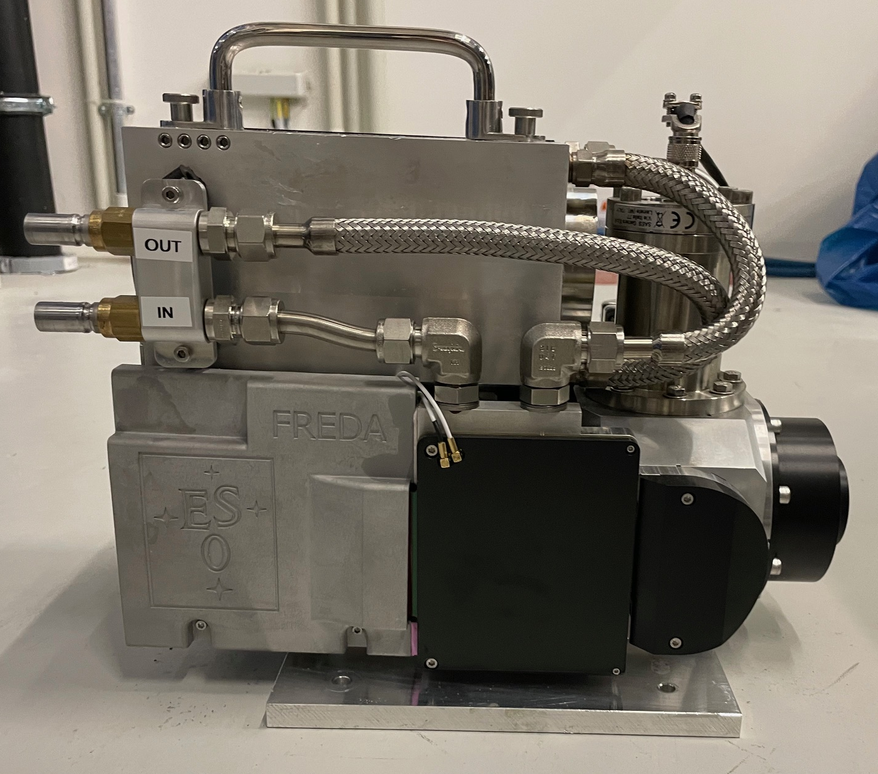
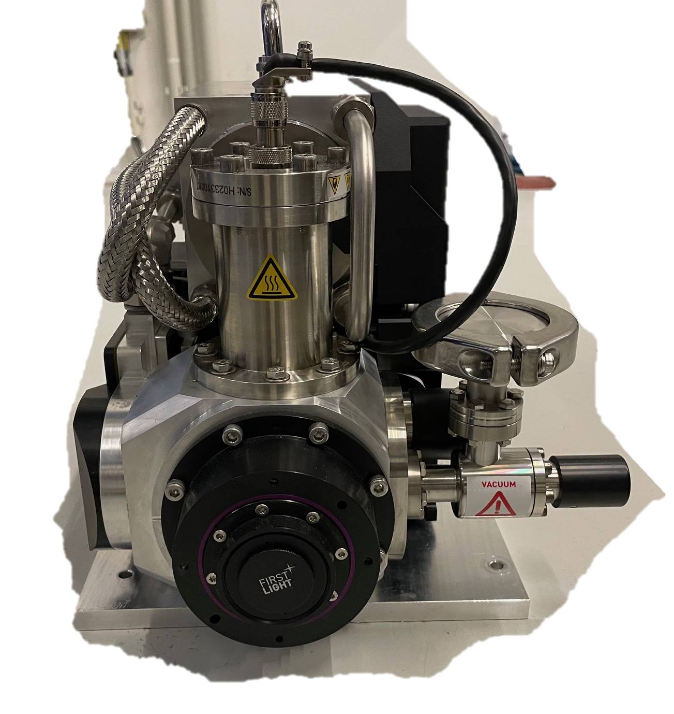
FREDA camera head
C-Red One camera from FLI
Saphira detector 320x256 pixel (up to 3500fps)
Read noise < 1e- rms
Wavelength range: 0.8-2.5um

Slide 3
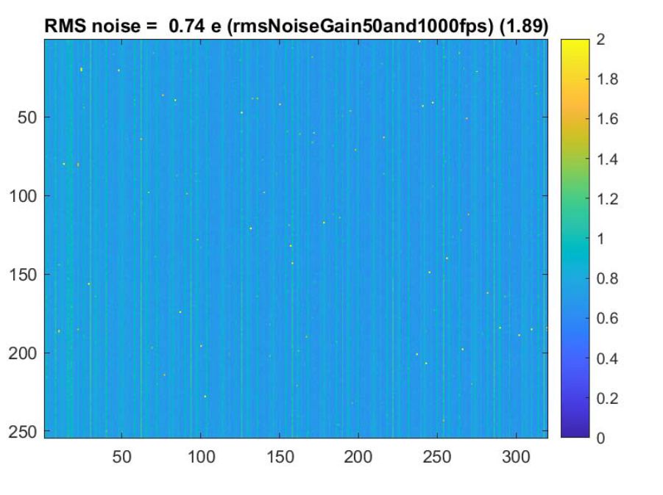
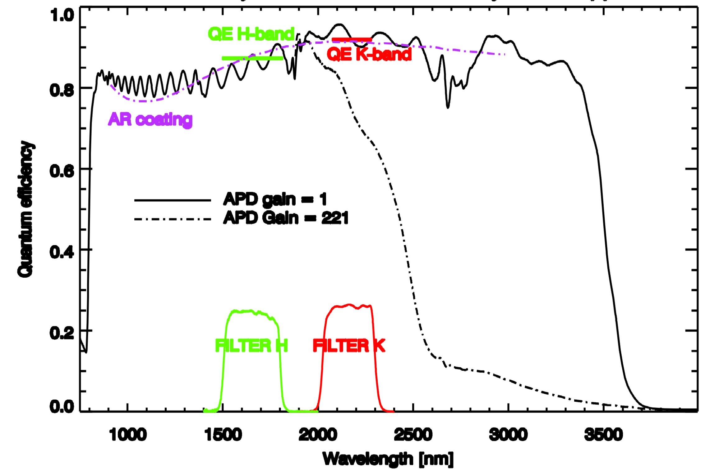
FREDA camera head
C-Red One camera from FLI
Saphira detector 320x256 pixel (up to 3500fps)
Read noise < 1e- rms
Wavelength range: 0.8-2.5um
Finger et al 2014

Slide 4
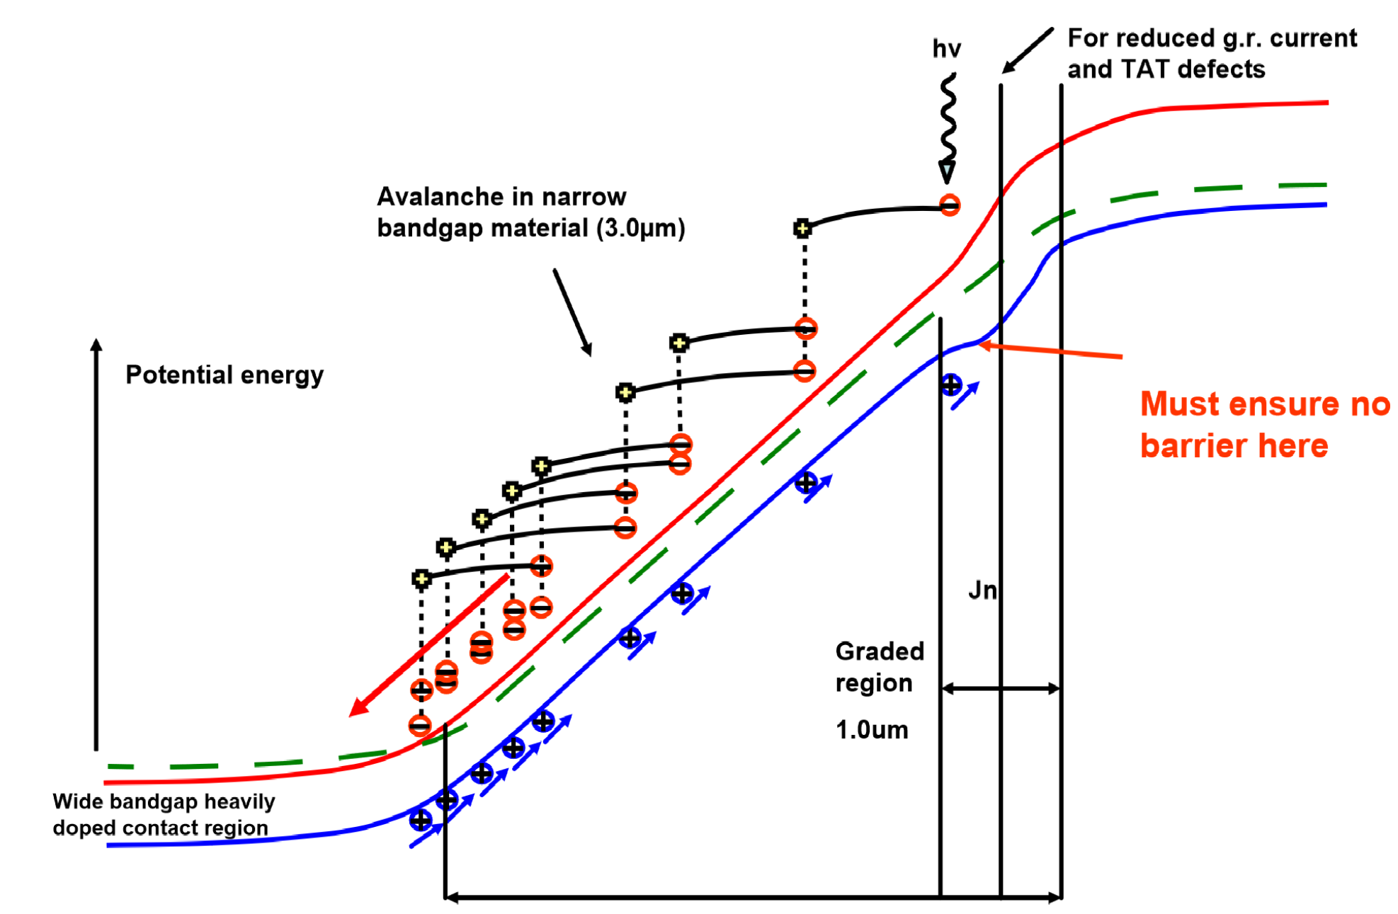
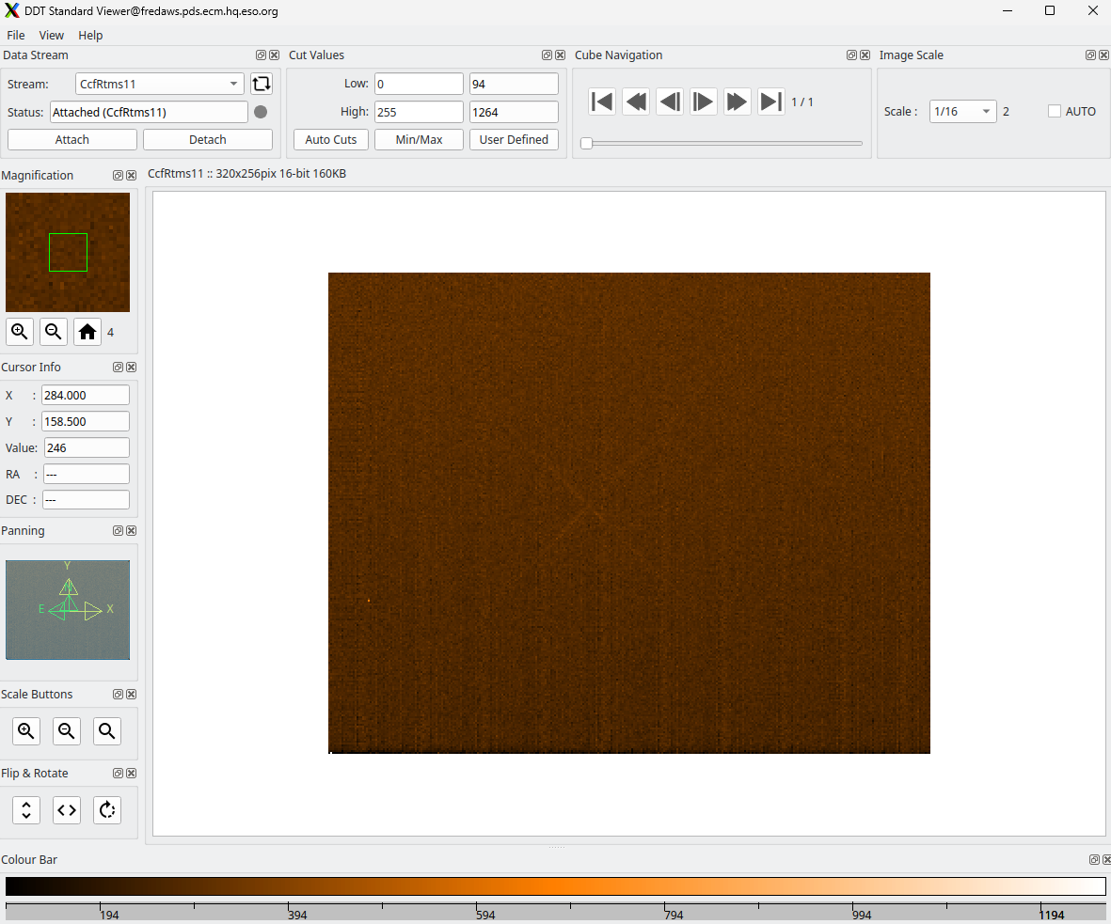
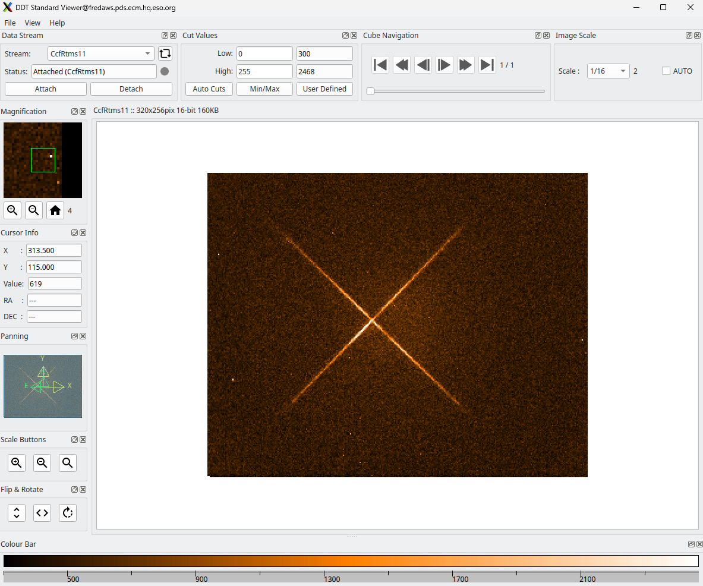
FREDA camera head
Avalanche gain: 1 - 65
eAPD gain 1
eAPD gain 50

Slide 5
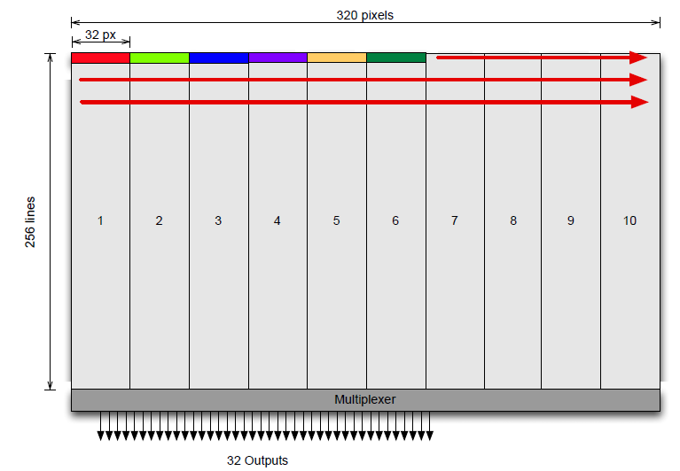
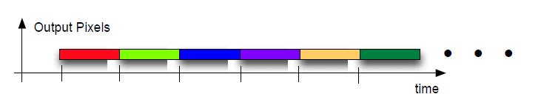
FREDA camera head
Detector reads 32 px simultaneously @ 10MHz
Sensor is read in 10x256 blocks (of 32pix)

Slide 6
FREDA camera head
Default C-Red One camera not compliant with ELT requirements
    CameraLink data interface → 10GigE with RTMS data format
    No synchronization → time synchronization with PTP
    No hardware alarms
    Mech. vibrations out of specification
    Camera surface temperature out of specification

Slide 7
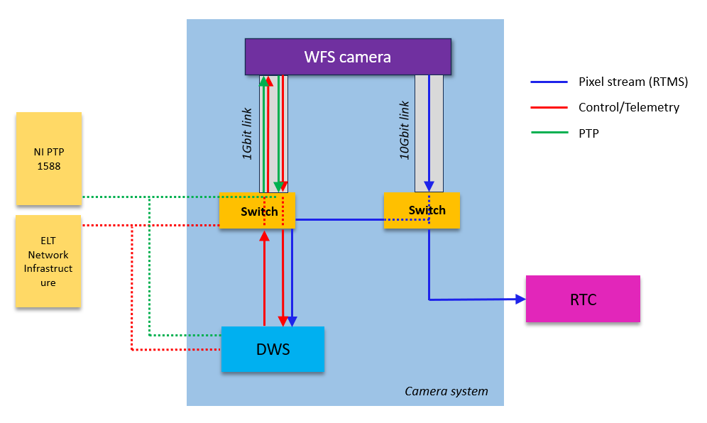
WFS camera network architecture
1Gig Ethernet used for telemetry, control and time synchronization of the detectors
10Gig Ethernet to broadcast the images of the detector in multicast allowing workstations and RTC to subscribe to the data stream

Slide 8
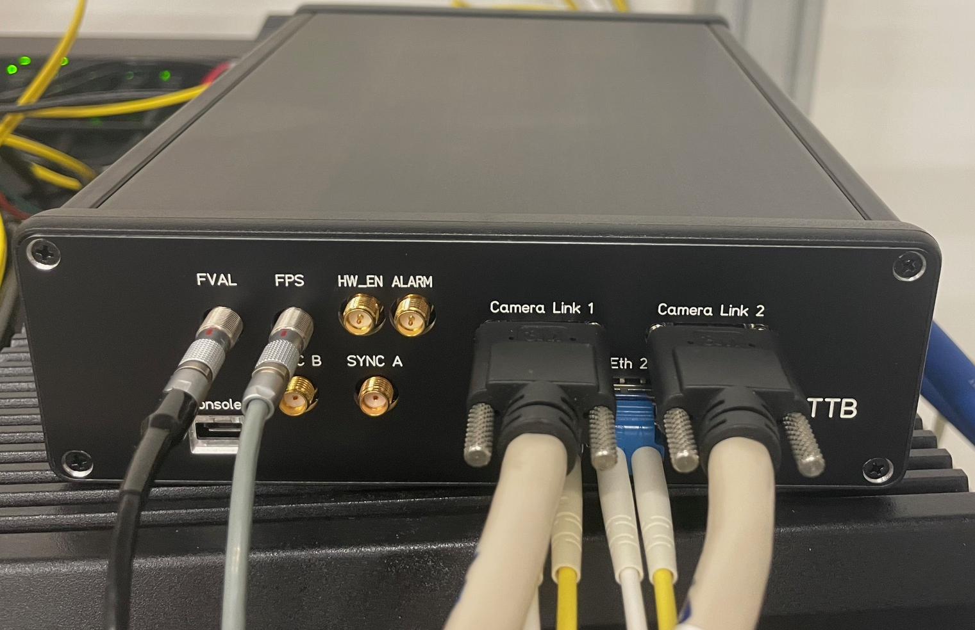
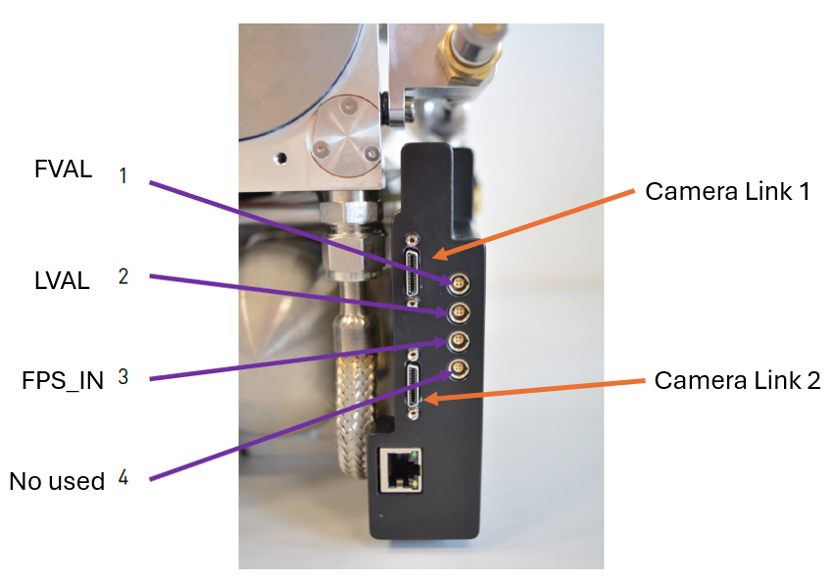
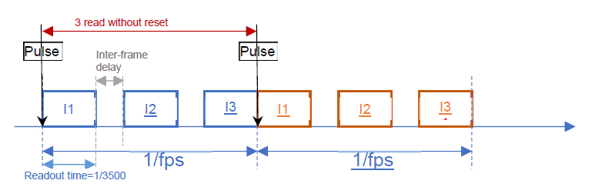
TTBox (RTMS converter)
Connected to PTP & Control Network
TTBox triggers start of exposure (FPS_IN)
Prototype
Camera electronics

Slide 9
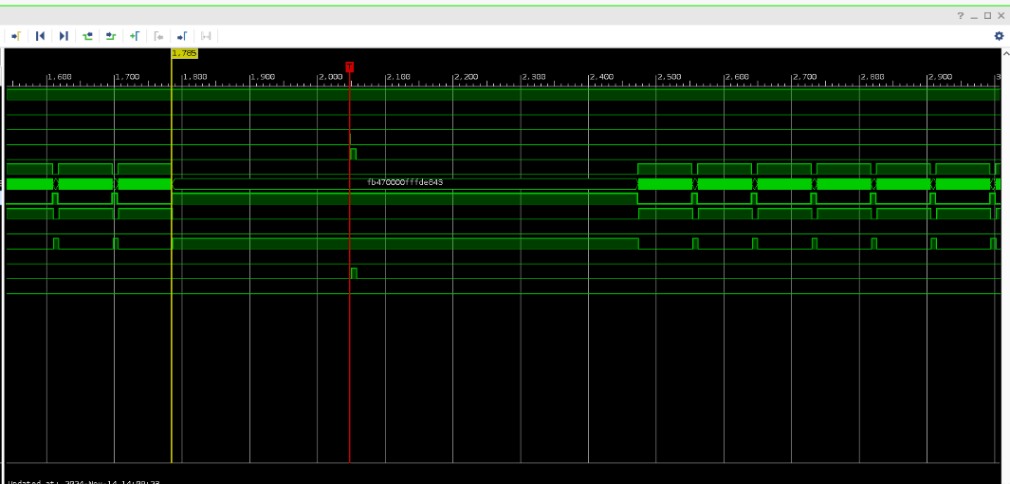
TTBox (RTMS converter)
Connected to PTP & Control Network
TTBox triggers start of exposure (FPS_IN)
Receives images via CamLink
FVAL signals valid image available
TTBox time tags image
Broadcasts pixel stream via RTMS
Prototype
Camera electronics

Slide 10
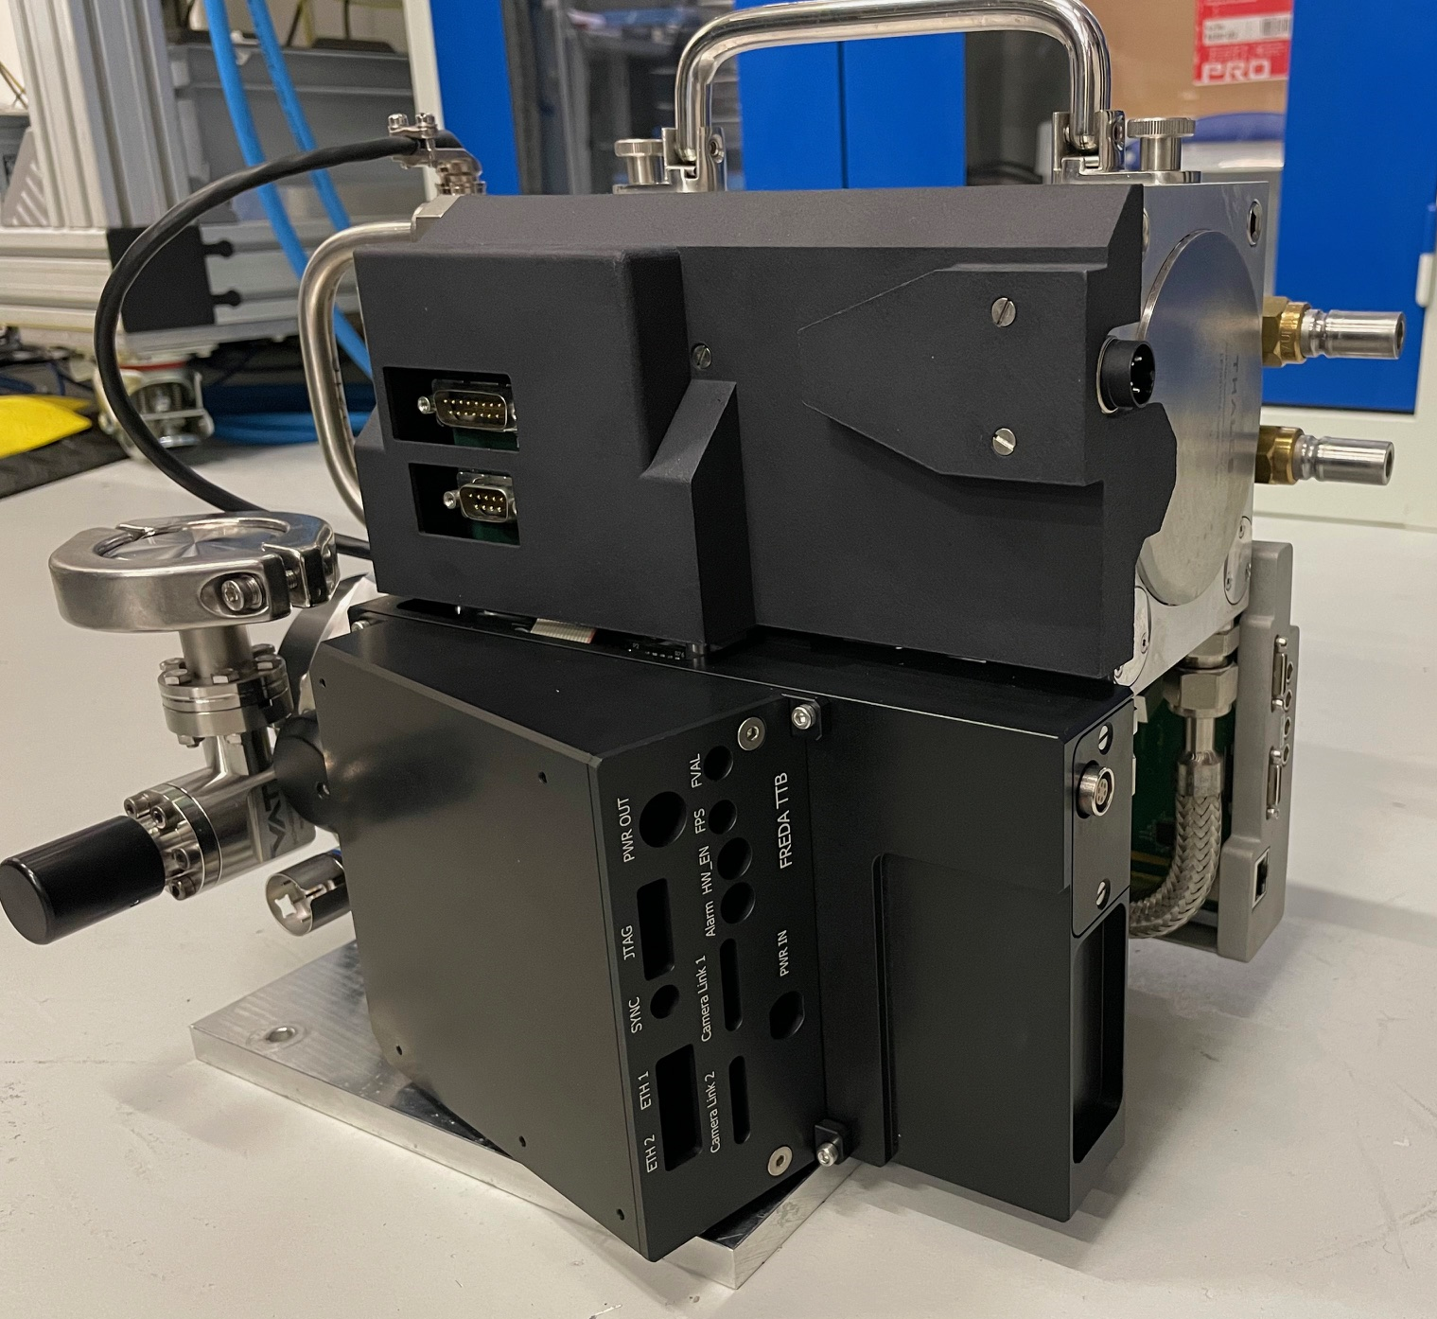
TTBox (RTMS converter)
Connected to PTP & Control Network
TTBox triggers start of exposure (FPS_IN)
Receives images via CamLink
FVAL signals valid image available
TTBox time tags image
Broadcasts pixel stream via RTMS
Prototype
TTBox

Slide 11
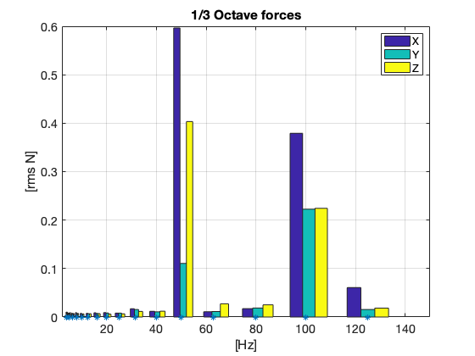
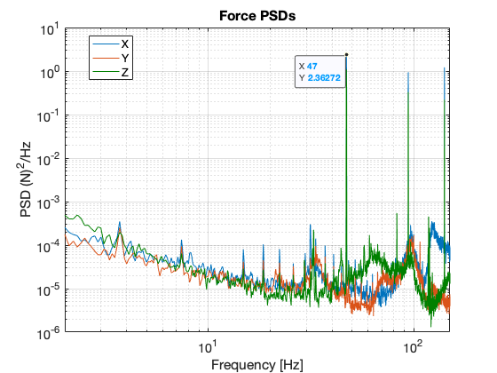
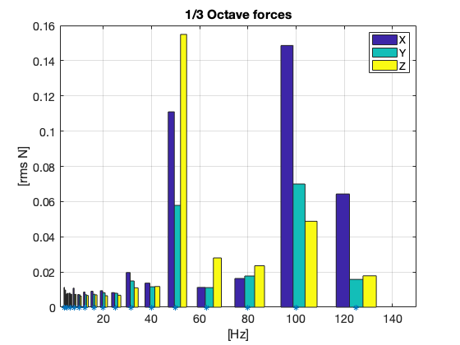
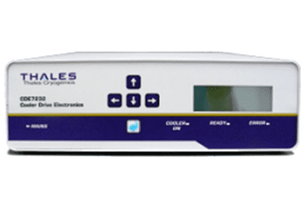
Active Vibration Reduction
Pulse tube cooler introduces vibrations
Default camera out of spec for ELT
=> Retrofit with Active vibration reduction controller
Factor ~4 improvement
Pulse tube frequency can be tuned: 43 .. 51 Hz
Pulse tube controller
Thales CDE7232

Slide 12
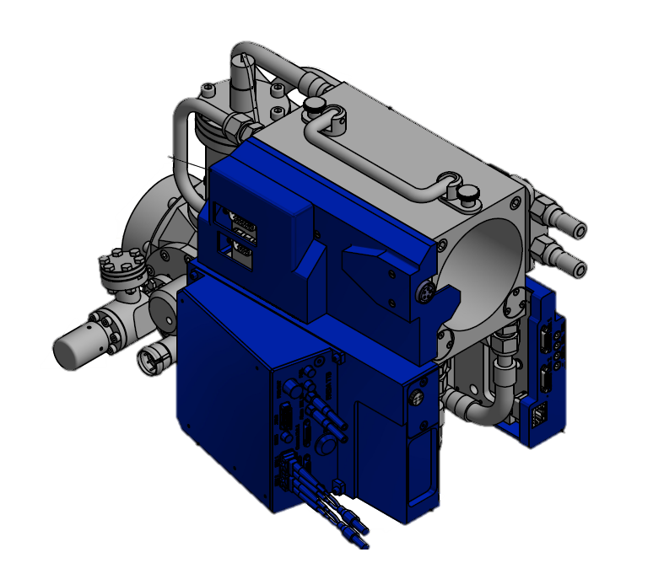
Camera head modifications
Exchange of plastic covers with aluminium covers to:
    Mitigate hot spots
    Provide a mounting interface for the TTBox

Slide 13
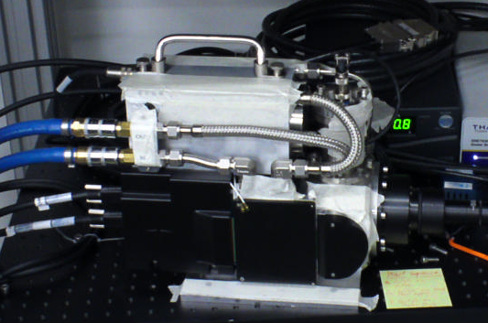
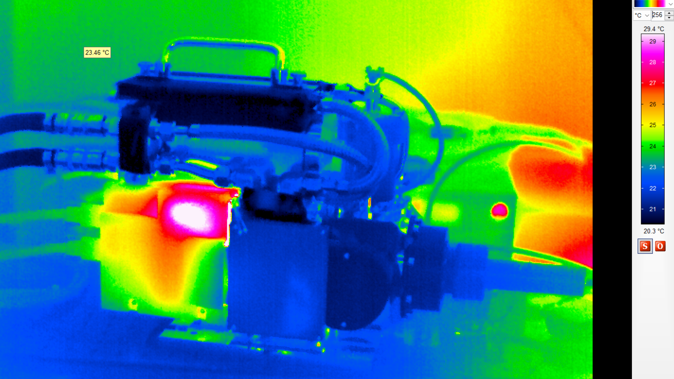
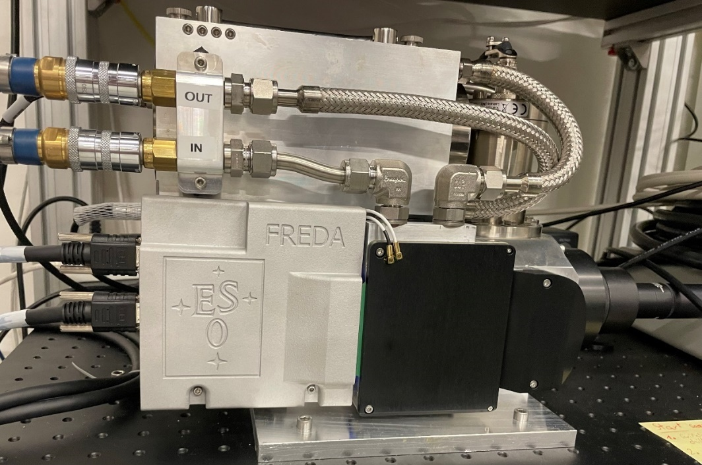
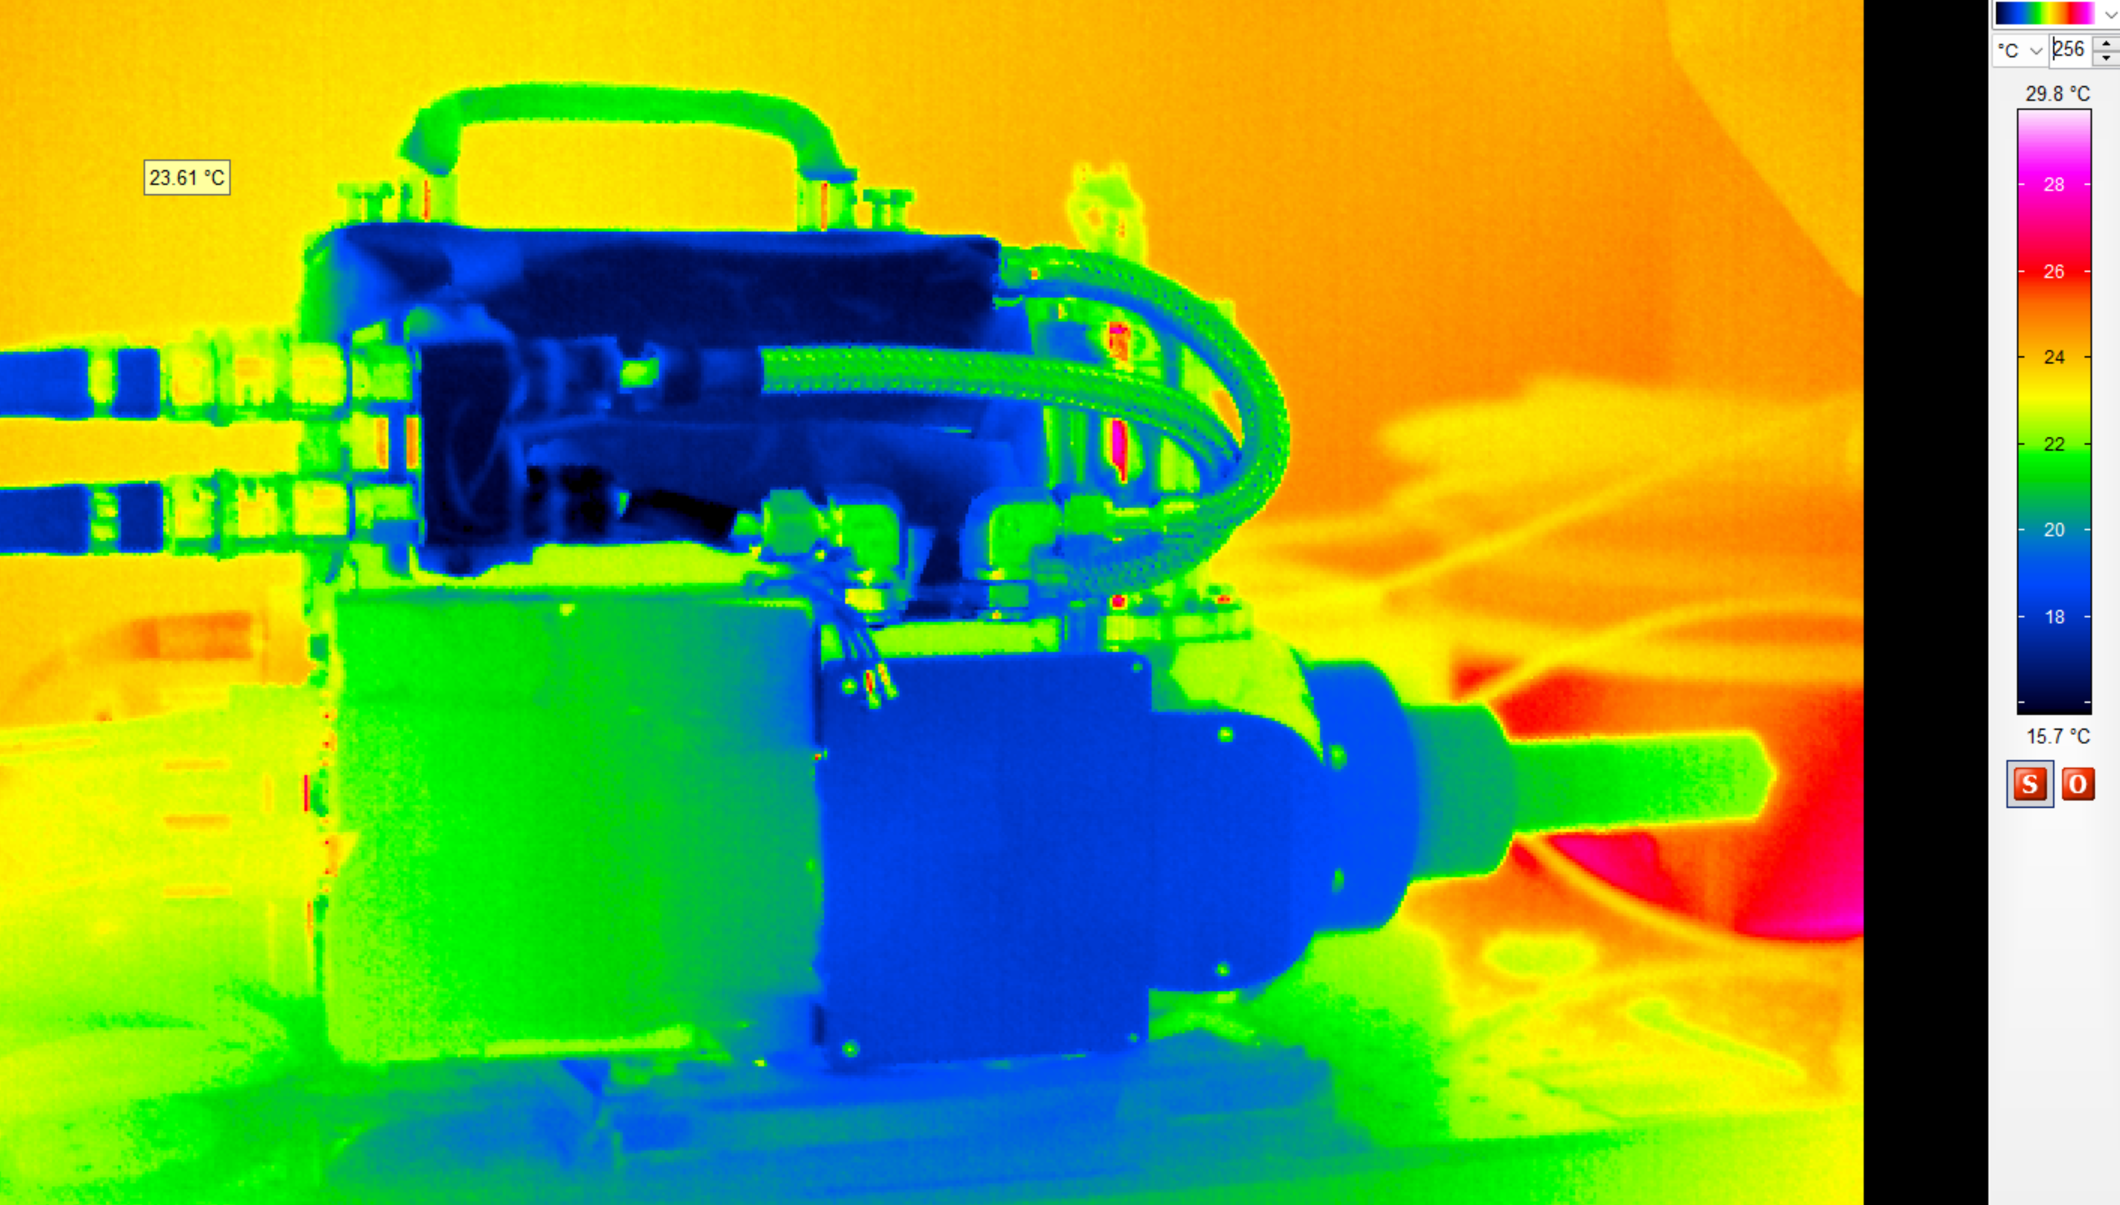
Camera head modifications

Slide 14
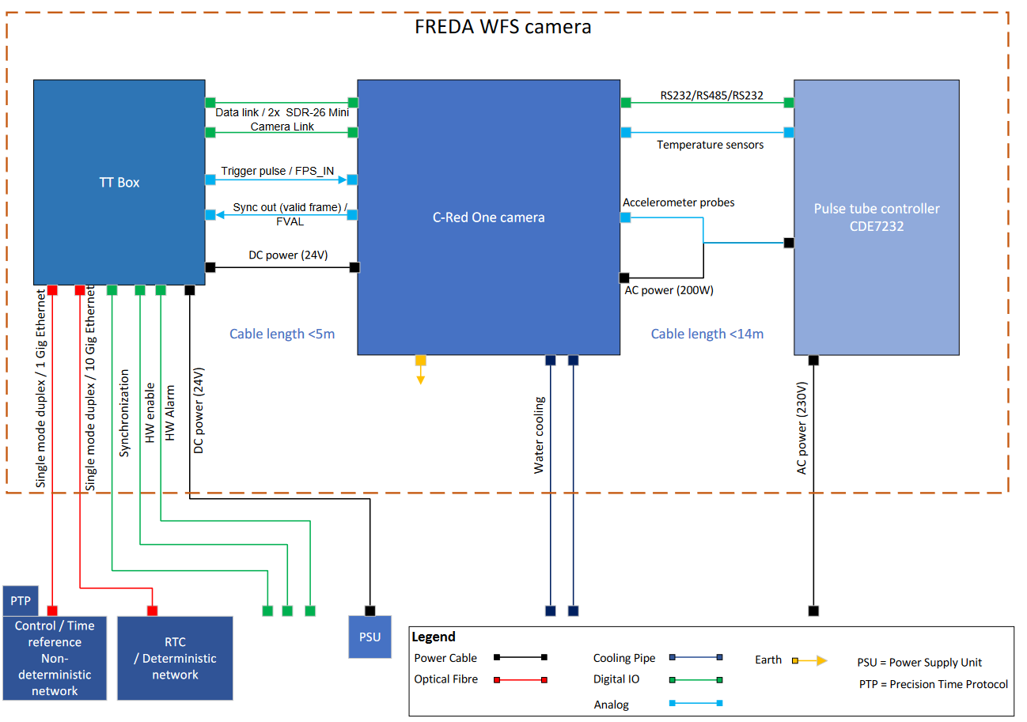
Interfaces

Slide 15
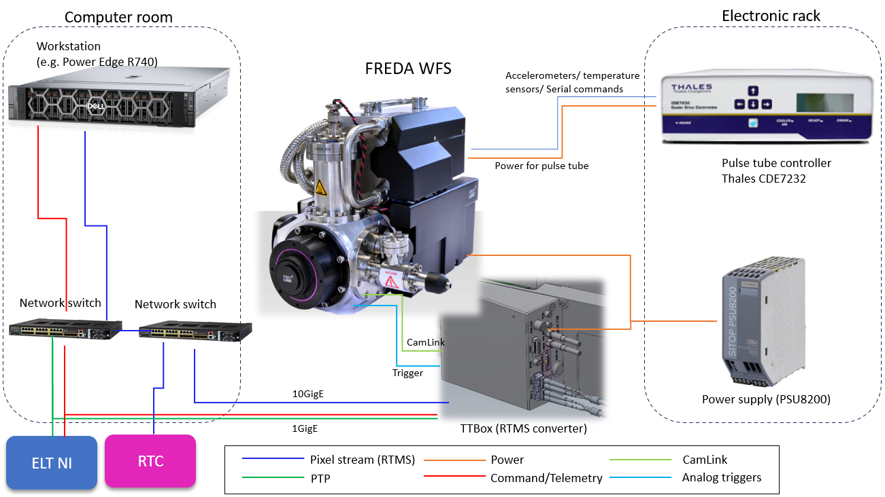
Interfaces

Slide 16
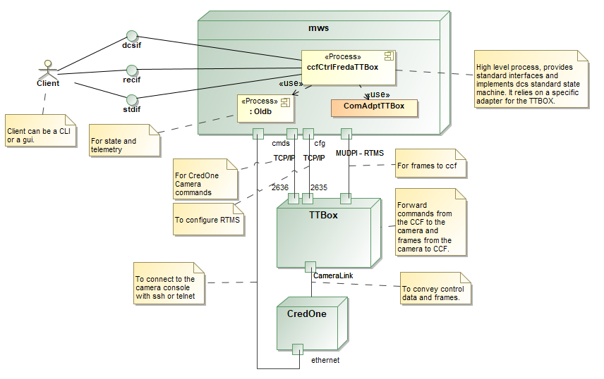
FREDA software integration
Camera control using CCF
TTBox firmware developed inhouse
Camera firmware unchanged
Camera configured using serial commands
Telemetry obtained by querying the camera every ~10s

Slide 17
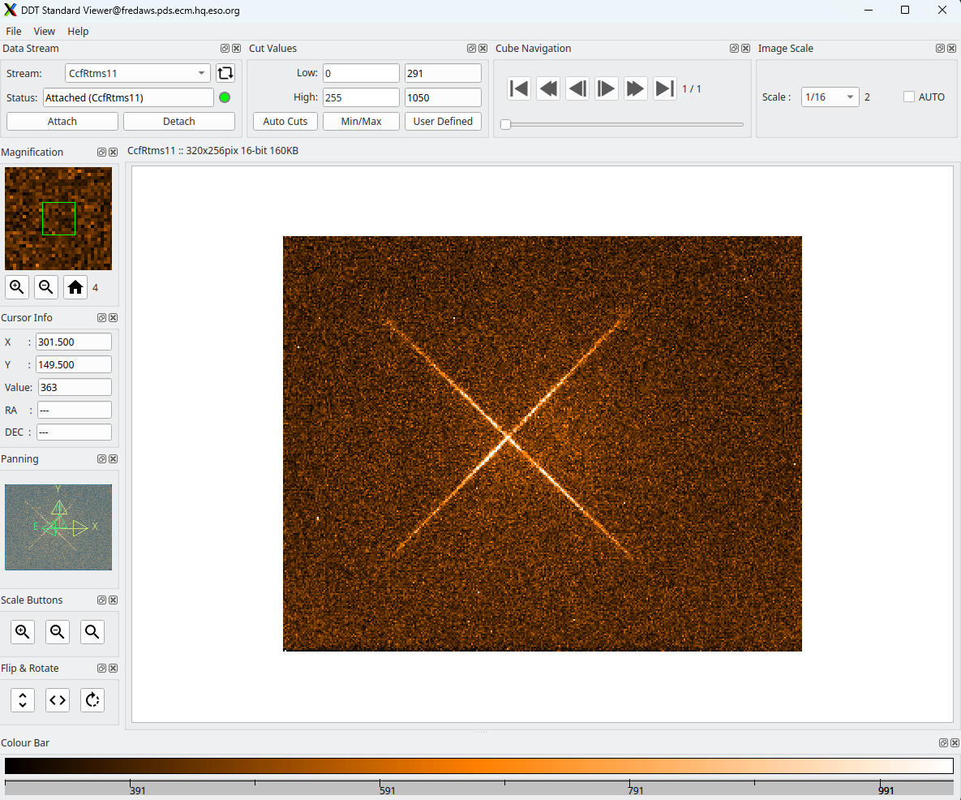
FREDA software integration
Camera acquisition &
control using CCF
Max. frame rate: 1000fps

Slide 18
Oliver Pfuhl – oliver.pfuhl@eso.org
@ESOAstronomy
@esoastronomy
@ESO
european-southern-observatory
@ESOobservatory

