Slide 1


IFW Calob
Claudio Reinero

Slide 2
Introduction
IFW Calob serves as the ELT's version of the VLT Calob tool, designed to fulfill the same core objective.
Its primary function is to programmatically generate the calibration data required for the reduction of scientific data obtained from the instruments.
IFW Calob is developed as both a Software Development Kit (SDK) and a standalone tool, offering greater flexibility and versatility for users.

Slide 3
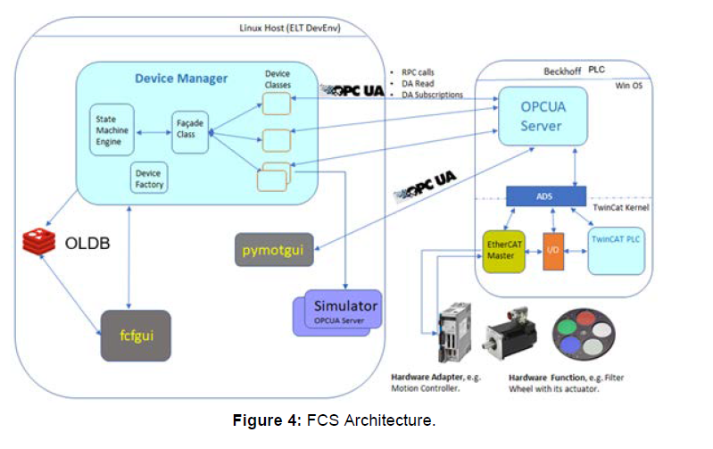
Introduction
  A small ELT to VLT translation:
    IFW : ICS Framework ~ VLT ICS
    FCS : Function Control System
    ~ an ICS instance
    Sequencer ~ BOB
    vOT ~ OTTO
    .obd.json ~ OBD
    .obdx.json ~ OBDX
    FITS == FITS

Slide 4
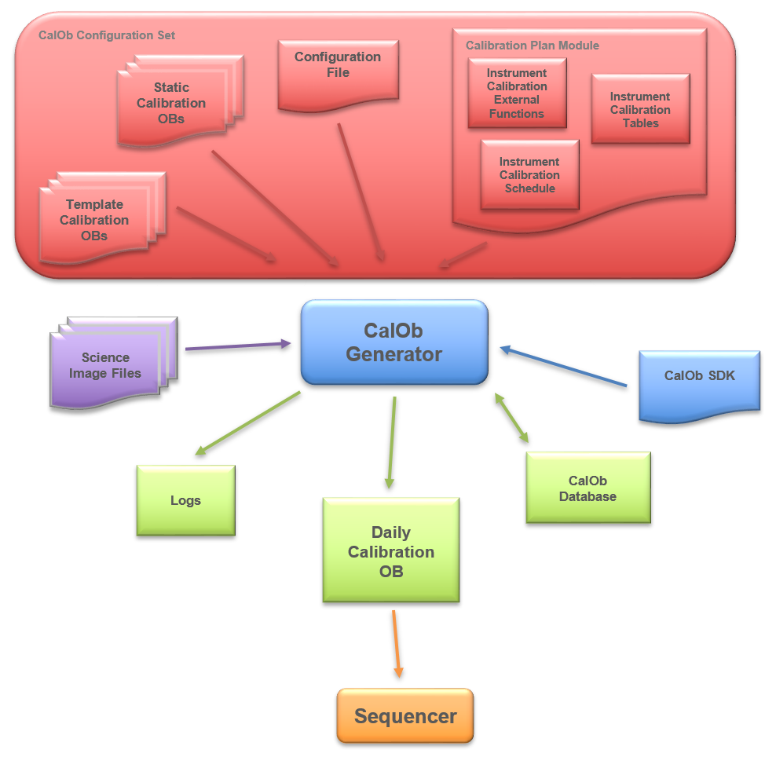
Implementation

Slide 5
Implementation
  VLT Calob was used as a guide, trying to achieve the same functionality and features.
  Implemented using Python v3.9
  Straight forward implementation in ~600 LOC
  (Hopefully) simple to maintain in the future
  No async, no threads, etc
  Uses an sqlite3 DB for history purposes (internal caching)
  Modular design, based on adapters for future extensions

Slide 6
Implementation
  An instrument calibration is now implemented as Python code, which is executed directly.
  We believe this is an improvement because when you develop or modify a calibration schedule for an instrument you get:
    Syntax checking
    Error handling
    Exceptions
    Flexibility/extensibility

Slide 7
Implementation
  FORS2 calibration plan (now called schedule) was initially ported for tests, it is in the order of ~1000 LOC.
    It is good to have some help from Python when writing something like this!

Slide 8
Base Classes for the Calibration Schedule
  An Instrument Calibration Schedule is implemented by subclassing the following base classes provided
class InstrumentCalibrationExternalFunctions():
"""
@brief Class that provides the base for the External Functions
"""
class InstrumentCalibrationTables():
"""
@brief Class that provides the base for the Calibration Tables
"""
class InstrumentCalibrationSchedule():
"""
@brief Class that provides the base for the Calibration Schedule
"""

Slide 9
Calibration Scheduling - Syntax
  The schedule calibrations definitions make use of chaining.
  For example:
# Static calibrations
super().add_static_calib("FORSUP-position-check.obd.json") \
.set_group("AA") \
.rule_min_days_since_last_exec(1)
super().add_template_calib("FORSUP_mos_cal_daycalib.obdx.json") \
.set_group("AC") \
.rule_min_days_since_last_exec(1) \
.rule_only_if_key_eq("INS.MODE", "MOS") \
.rule_only_if_key_diff("TPL.ID", "FORS2_specphot_obs_exp_fast")
  Any rule that is ‘chained’ is appended to the expression as if using a logical AND

Slide 10
Calibration Scheduling - Rules
  When adding a calibration a number of rules can be defined
    All the rules should evaluate to TRUE for the calibration to be considered
    The same set of rules apply for static calibs and template calibs.
super().add_static_calib("FORSUP-position-check.obd.json") \
.set_group("AA") \
.rule_min_days_since_last_exec(1)
super().add_template_calib("FORSUP_img_cal_bias.obdx.json") \
.set_group("AA") \
.rule_min_days_since_last_exec(1)

Slide 11
Calibration Sorting
  Sorting: the place where the resulting calibration should appear in the final product
    The order can be precisely defined by the use of group (def. AA) and order (def. 000).
    The idea is that the group is defined by two letters and the order is defined by three digits.
    The group and order will be sorted in ascending order.
      AA < AB < BB < ZZ | 000 < 001 < 010 < 100
    As the name implies, calibrations of the same group will remain together and will be sorted in the group by the order defined
super().add_static_calib("FORSUP-position-check.obd.json") \
.set_group("AA") \
.set_order(“010") \
.rule_min_days_since_last_exec(1)

Slide 12
Calibration Scheduling
  Execution time : The periodicity with which to schedule a specific Calibration Observation
    The number of days between each execution of the Calibration Observation
    The history of execution is stored in an sqlite DB
    The amount of history it stores can be configured as a number of days
    The tool can be executed disregarding the history stored
super().add_static_calib("FORSUP-position-check.obd.json") \
.set_group("AA") \
.set_order(“010") \
.rule_min_days_since_last_exec(1)

Slide 13
Calibration Scheduling – Rules
  Value of key in header
    Checks for a particular key in the image header and verify its value
    To include the calibration the result should be TRUE, therefore there are two different rules:
def rule_only_if_key_eq(self, key, value)
def rule_only_if_key_diff(self, key, value)
super().add_template_calib("FORSUP_mos_cal_daycalib.obdx.json") \
.set_group("AC") \
.rule_min_days_since_last_exec(1) \
.rule_only_if_key_eq("INS.MODE", "MOS") \
.rule_only_if_key_diff("TPL.ID", "FORS2_specphot_obs_exp_fast")

Slide 14
Calibration Scheduling – Rules
  Complex condition
    The condition is implemented as a one-line of Python, which is executed by the Python interpreter
    Only adds the calibration if a condition using the template syntax evaluates to TRUE
super().add_template_calib("FORSUP_pmos_cal_daycalib.obdx.json") \
.set_group("AD") \
.rule_min_days_since_last_exec(1) \
.rule_only_if_key_eq("INS.MODE", "PMOS") \
.rule_only_if_condition("(h['INS.OPTI4.TYPE'] == 'RETA2' or \
h['INS.OPTI4.TYPE'] == 'RETA4') and h['INS.COLL.NAME'] == \
'COLL_SR'")

Slide 15
Calibration Scheduling – Calibration Tables
  The Calob tables are defined as Python dictionaries
# LSS Slit widths self.tbl["SLIT.WIDTH"] = {
"lSlit0_3arcsec" : 0.3 ,
"lSlit0_4arcsec" : 0.4 ,
"lSlit0_5arcsec" : 0.5 ,
"lSlit0_7arcsec" : 0.7 ,
"lSlit1_0arcsec" : 1.0,
"lSlit1_3arcsec" : 1.3 ,
"lSlit1_6arcsec" : 1.6 ,
"lSlit2_0arcsec" : 2.0,
"lSlit2_5arcsec" : 2.5
}

Slide 16
Calibration Scheduling – Calibration Tables
  Tables with multiple indexes use a tuple as the dictionary index:
# Detector modes
self.tbl['DET.MODE'] = {
("100Kps/2ports/high_gain", 2, 2) : "100kHz,2x2,high",
("100Kps/2ports/high_gain", 1, 1) : "100kHz,1x1,high",
("200Kps/2ports/low_gain", 2, 2) : "200kHz,2x2,low",
("200Kps/2ports/low_gain", 1, 1) : "200kHz,1x1,low",
("625Kps/2ports/low_gain", 2, 2) : "200kHz,2x2,low",
("HIT-MS", 2, 2) : "HIT-MS",
("HIT-OS1-1sec", 1, 1) : "100kHz,2x2,high",
("HIT-OS2-4sec", 1, 1) : "100kHz,2x2,high"
}

Slide 17
Calibration Scheduling – Calibration Tables
  External functions, Calibration Tables, etc, have to be used inside Calibration Templates. Which are defined within double braces: "{{ ... }}"
{
"name": "INS1.GRIS.NAME",
"type": "string",
"value": "{{ clb.x.forsup_grism(h) }}"
},
  In the example the text inside the braces will be evaluated as one line of Python, and the entire string (including the braces) will be replaced by its evaluated value.

Slide 18
Calibration Scheduling – Template Calibrations
  Some objects are provided inside the templates
{
"name": "DET.WIN1.NX",
"type": "string",
"value": "{{ h['DET.WIN1.NX'] * h.get('DET.WIN1.BINX') }}"
},
  Here we can see the use of h. This is a modified Python dictionary which allows access to the image headers.
    h[<key>] Will directly retrieve the value from the image header
    h.get(<key>) Will first look in the previously defined keywords inside the OBD/X and then look for the key in the header

Slide 19
Calibration Scheduling – Template Calibrations
  Some objects are provided inside the templates
{
"name": "DET.WIN1.ST",
"type": "string",
"value": "{{ clb.tbl['DET.WIN'][h.get('DET.WIN1.NX')] }}"
},
  Here we can see the use of clb. This is an object that provides access to the user defined library.
    clb.tbl[<table>][<key>] Will retrieve from the table <table> the value associated with <key>.

Slide 20
Calibration Scheduling – Template Calibrations
  Some objects are provided inside the templates
{
"name": "INS1.GRIS.NAME",
"type": "string",
"value": "{{ clb.x.forsup_grism(h) }}"
},
  Here we can see the use of clb. This is an object that provides access to the user defined library.
    clb.x.<function> Will call the user defined function <function>.

Slide 21
Calibration Scheduling – Template Calibrations
  The template syntax is used for complex conditions when adding calibrations:
super().add_template_calib("FORSUP_pmos_cal_daycalib.obdx.json") \
.set_group("AD") \
.rule_min_days_since_last_exec(1) \
.rule_only_if_key_eq("INS.MODE", "PMOS") \
.rule_only_if_condition("(h['INS.OPTI4.TYPE'] == 'RETA2' or \
h['INS.OPTI4.TYPE'] == 'RETA4') and h['INS.COLL.NAME'] == \
'COLL_SR'")

Slide 22
Calibration Scheduling – Template Calibrations
  The Calibration Template syntax is also used for the initial FITS filtering condition, for example:
condition = "(h['ESO DPR CATG'] == 'SCIENCE' or "
condition += " h['ESO DPR CATG'] == 'CALIB' or "
condition += " h['ESO DPR CATG'] == 'ACQUISITION') and "
condition += " h['ESO DPR TYPE'] != 'BIAS'"
super().add_filter_condition(condition)

Slide 23
Calibration Scheduling – External Functions
  To define additional functions, they should be defined as part of the class derived from InstrumentCalibrationExternalFunctions
  For convenience, they should receive as parameters h and clb to access the image headers and tables if needed.
def forsup_mos(self, h, clb):
txt = ""
mosmax = int(clb.tbl['USERVAR']['MOS_MAX_SLITS'])
for i in range(1, mosmax + 1):
key = f"INS.MOS{i}"
pos = float(h[key + ".POS"])
wid = float(h[key + ".WIDTH"])
txt += f"{key}.POS {pos:.3f} {key}.WIDTH {wid:.3f} "
return txt
{
"name": "INS1.FOCF.SETUP",
"type": "string",
"value": "{{ clb.x.forsup_mos(h, clb) }}"
},

Slide 24
Error Handling & Logging
  A convenience object is available cc , which among other things contain the logger instance.
  It can be used to log at any different level, in line with the logging standard of the ELT
self.cc.logger.debug(f“This is a debug error: {error}")
self.cc.logger.info(f“This is a info error: {error}")
self.cc.logger.warning(f“This is a warning error: {error}")
self.cc.logger.error(f“This is a error error: {error}")
self.cc.logger.critical(f“This is a critical error: {error}")
  The logging will go to console and/or the file log depending on the logging configuration used.
  The logging level is defined via the standard ELT configuration file or command line.
  The logging functions can be used in the schedule definition, external functions definition or the table definitions.
  They cannot be used inside the obd/obdx definitions

Slide 25

Error Handling & Logging
def forsup_exptime(self, h, clb, mode, tech):
highgain = clb.tbl['USERVAR']['DET_HGAIN']
binfact = clb.tbl['USERVAR']['REF_BINX'] * clb.tbl['USERVAR']['REF_BINY']
refslit = clb.tbl['USERVAR']['REF_SLIT']
if "daycal" in h.get('TPL.ID'):
ins = 'INS1'
else:
ins = "INS"
gris = h.get(f"{ins}.GRIS.NAME")
filt = h.get(f"{ins}.FILT1.NAME")
detgain = h.get(f"DET.OUT1.GAIN")
binx = h.get(f"DET.WIN1.BINX")
biny = h.get(f"DET.WIN1.BINY")
coll = f"{h['INS.COLL.NAME']}{h['INS.COLL.ID']}"
techtime = clb.tbl[f'TEXP.{tech}.NORM'][(gris, filt)]
collfact = clb.tbl['COLL.FACT'][coll]
breakpoint()
if mode == "HIT":
slit = self.forsup_slit(h, clb, 'HIT')
ccdfact = 1
…
  The usual python error handling functionality can be used
    You can use try / except blocks
    You can use raise to force clear errors
    You can use pdb and actually debug a miss behaving calibration definition in the schedule, or external function

Slide 26
Demo

Slide 27
Claudio Reinero
creinero@eso.org
@ESOAstronomy
@esoastronomy
@ESO
european-southern-observatory
@ESOobservatory

