Slide 1
NGCII System and Hardware
Mathias Richerzhagen (Speaker)
Matthias Seidel
Alexander Rüde
Omar Sqalli

Slide 2
Introduction
Today, we will answer the FAQ for NGCII
What does it do?
What’s in the box?
?
?
How do I use it?
When can I have one?
?
?

Slide 3
Background Information

Slide 4
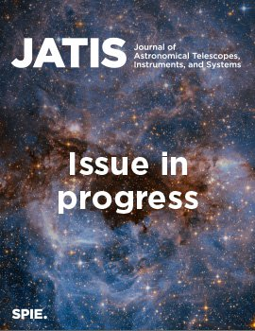
Background Information
Published Information on NGCII
Published journal article in Journal of Astronomical Telescopes, Instruments, and Systems VOL. 10 · NO. 4 | October 2024
  https://doi.org/10.1117/1.JATIS.10.4.046001
  Preprint available at:
  https://doi.org/10.48550/arXiv.2410.22965

Slide 5
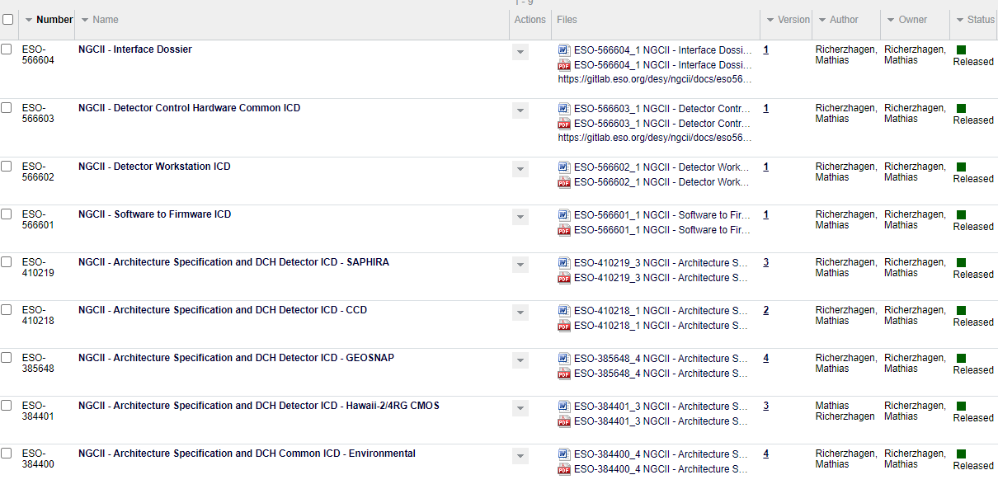
Background Information
Available ICDs
https://pdm.eso.org/kronodoc/HQ/N/473529

Slide 6
What does it do?

Slide 7
What does it do?
NGCII is the detector controller for ELT and new VLT instruments
Supported Detectors
Roadmap
Manufacturer | Detector | Type
Teledyne | HAWAII 2RG | CMOS
Teledyne | HAWAII 4RG | CMOS
Leonardo | SAPHIRA | eAPD CMOS
Teledyne E2V | CCD231-84 | CCD
Teledyne E2V | CCD290-99 | CCD
Teledyne Imaging Sensors | GEOSNAP | Fully Digital ROIC
Manufacturer | Detector | Type
Leonardo | Large SAPHIRA | eAPD CMOS
LBNL | LBNL CCD | Fully Depleted CCD
SOFRADIR | ALFA | CMOS
Raytheon | AQUARIUS | -
Raytheon | VIRGO | -
STA | STA CCD | -
Gpixel | GSENSE | -

Slide 8
What does it do?
Focus on operational stability
NGC1 can read listed detectors limited by detector noise, but…
External Interfaces not ELT compliant
All interfaces Ethernet based
Combined CCD/CMOS circuits
limit performance of both
Dedicated circuits for CCD, CMOS and fully digital detectors
Limited readout speed
Greatly improved internal bandwidth

Slide 9
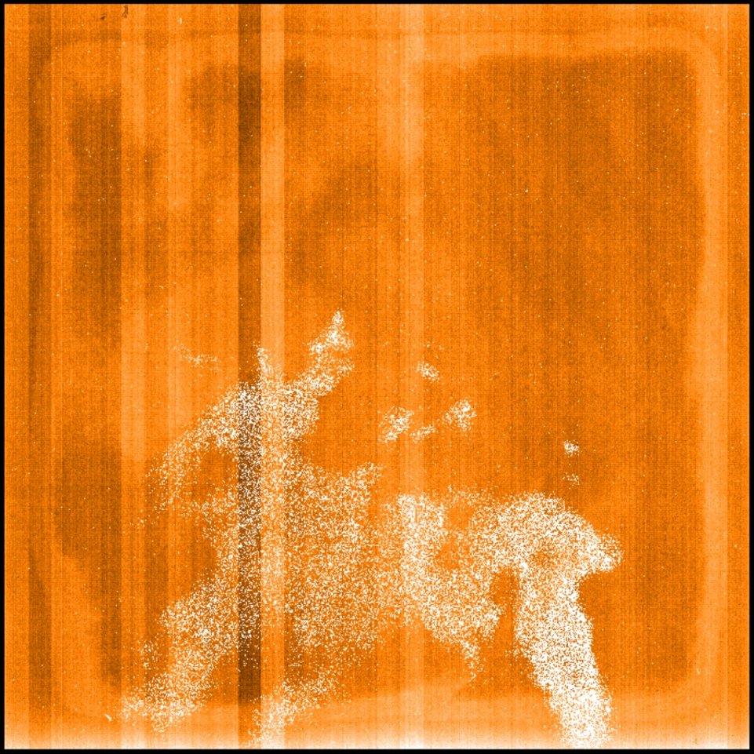
What does it do?
Working well for CMOS already
HAWAII-2RG
Engineering Grade
Detector

Slide 10
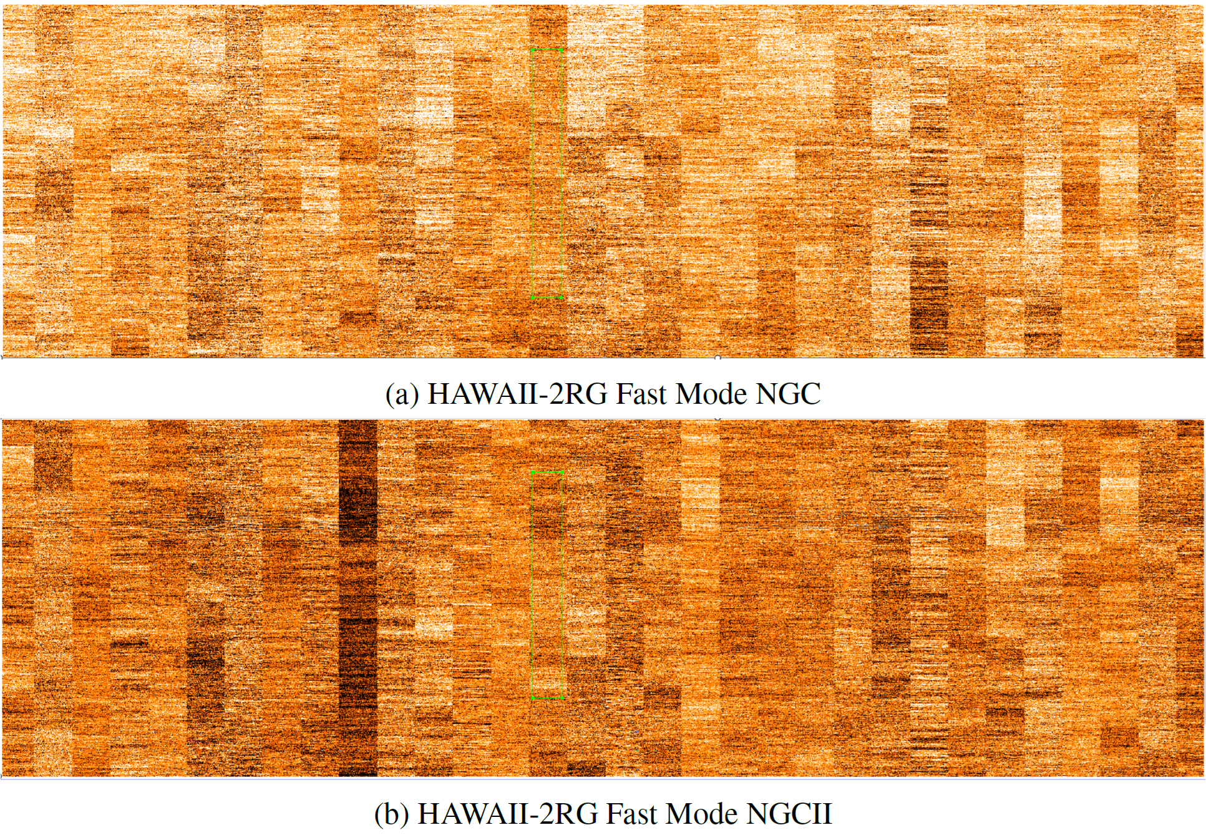
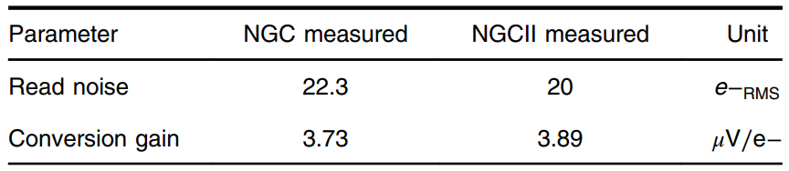
What does it do?
Working well for CMOS already
HAWAII-2RG fast mode noise is detector limited as for NGC1.
HAWAII-2RG slow mode achieving noise levels not seen before at <10e− for simple CDS.

Slide 11
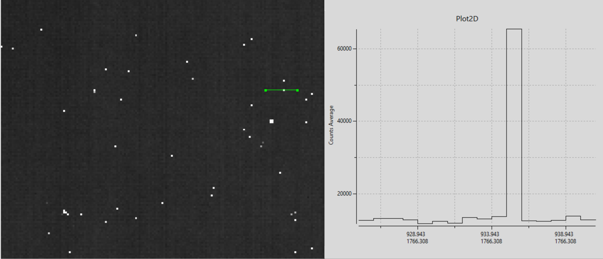
What does it do?
Working well for CMOS already
HAWAII-2RG running at 30fps without observable hot-pixel trailing

Slide 12
What is in the box?

Slide 13
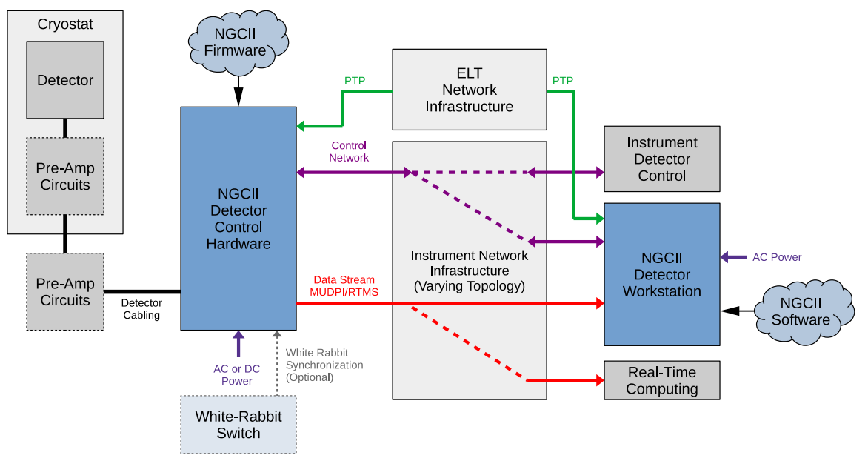
What is in the box?
Parts of the NGCII system

Slide 14
What is in the box?
Parts of the NGCII system
Included:
NGCII Detector Control Hardware
NGCII Detector Workstation
NGCII Firmware
NGCII Software
  NGCII/Core
  NGCII/IR
  NGCII/OPT
Not Included:
Communication Infrastructure
Detector
Preamplifier
Cables
Some of those may be part of the detector work-package but not NGCII so still a deliverable of ESO.

Slide 15
Detector Workstation

Slide 16
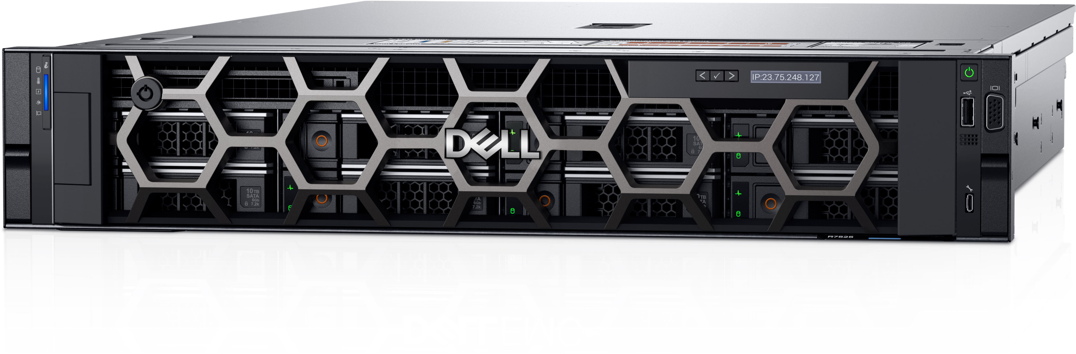
What is in the box?
Parts of the NGCII system – Detector Workstation
  Server PC selected from the list of ESO computer and network standards.
  NGCII makes sure that at least one current configuration is approved for use as DWS.
  Runs ELT Software Environment
  Currently: Dell R7525
    AMD Epyc CPU
    128GB RAM
    Intel X710-DA2 NIC
Some selection criteria:
Highest single core performance available
Known-working network controller
Core affinity of network controller

Slide 17
Detector Control Hardware

Slide 18
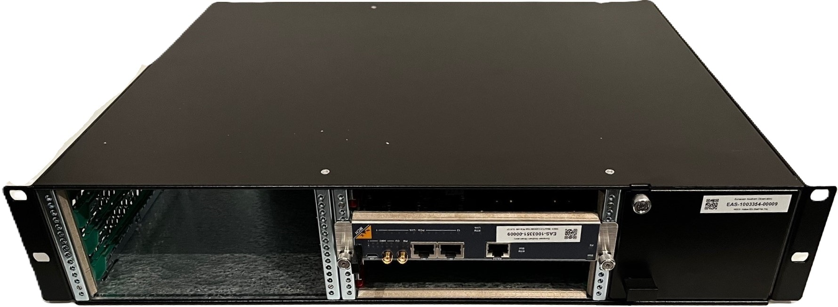
What is in the box?
Parts of the NGCII system – Detector Control Hardware
  2HU 19” rack mount modular card carrier.
  Based on MicroTCA.4
  Controls 1 or 2 detectors. E.g.:
    2x HAWAII-2RG with 32 outputs
    2x CCD231
    1x HAWAII-4RG with 64 outputs
    1x CCD290

Slide 19















What is in the box?
De-facto standard for modular systems in the large science community
  Industrial standard hosted by PICMG
    ESO is an associate member
  Annual conference
  Paid support / consulting available
  Solid industry base

Slide 20
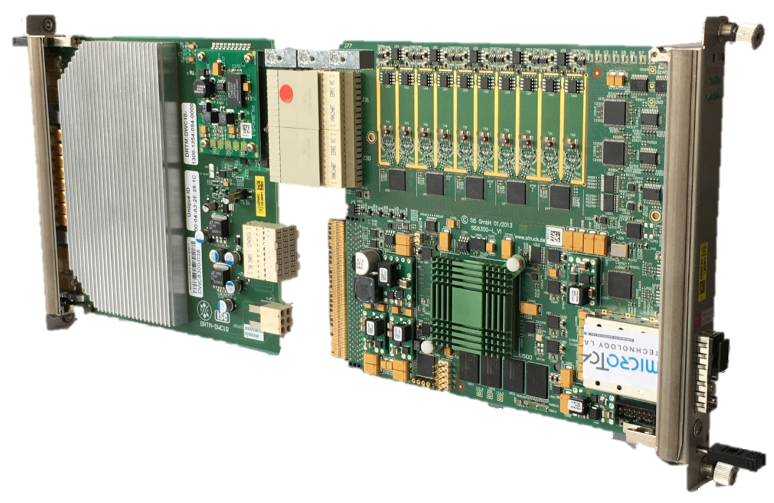
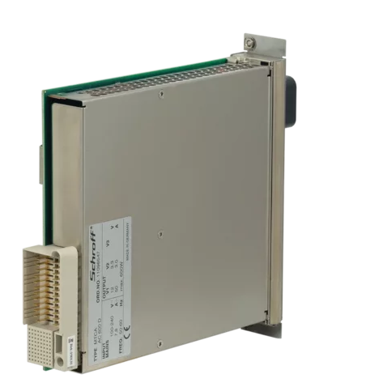
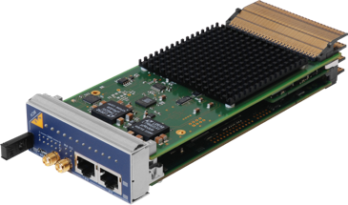
Rear-Transition
Modules [RTM]
Zone 3
Power Supply Unit [PSU]
Detector
Interface
Control and Data
Ethernet
Power
Advanced
Mezzanine
Cards [AMC]
Zone 1
Zone 1 Backplane
PCIe Gen3 x8
12V Power
Management
Etc..
MicroTCA
Carrier Hub [MCH]

Slide 21
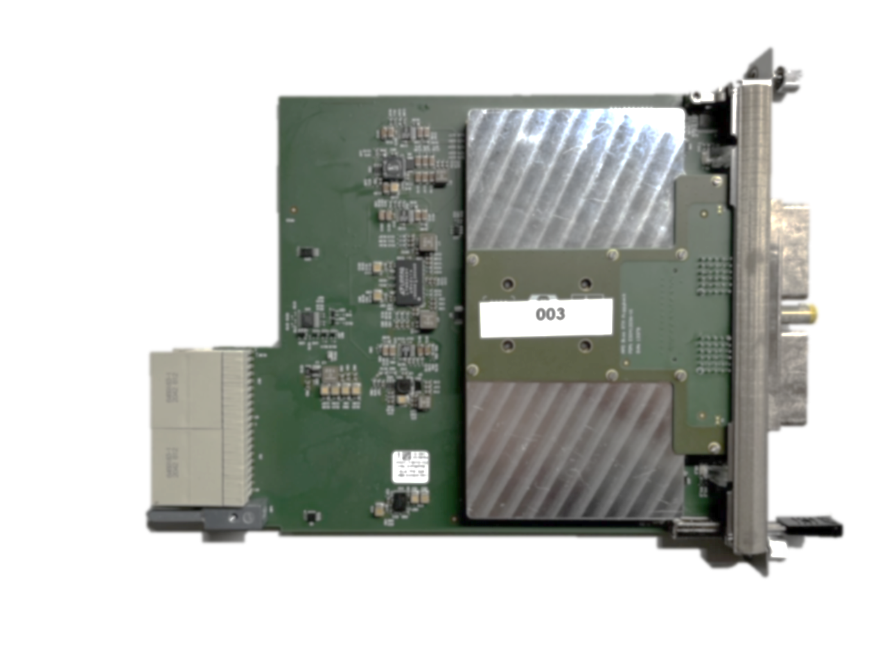
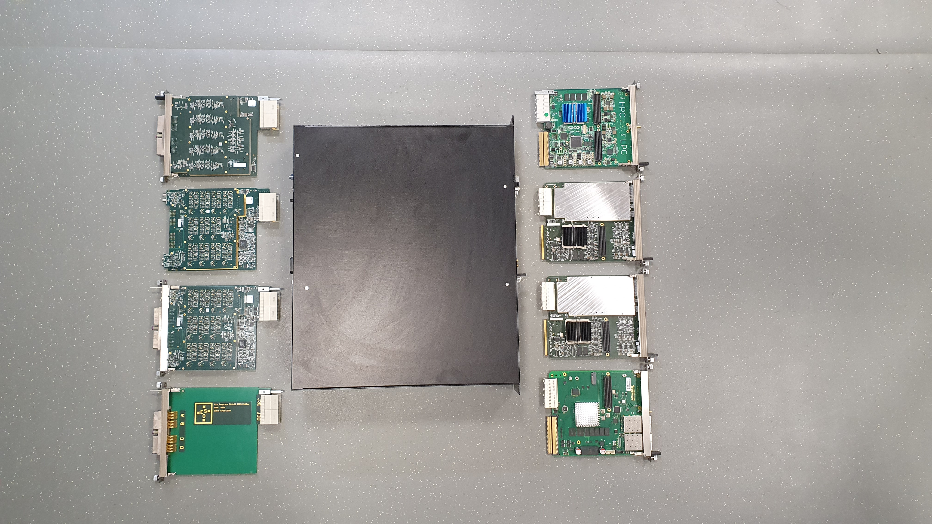
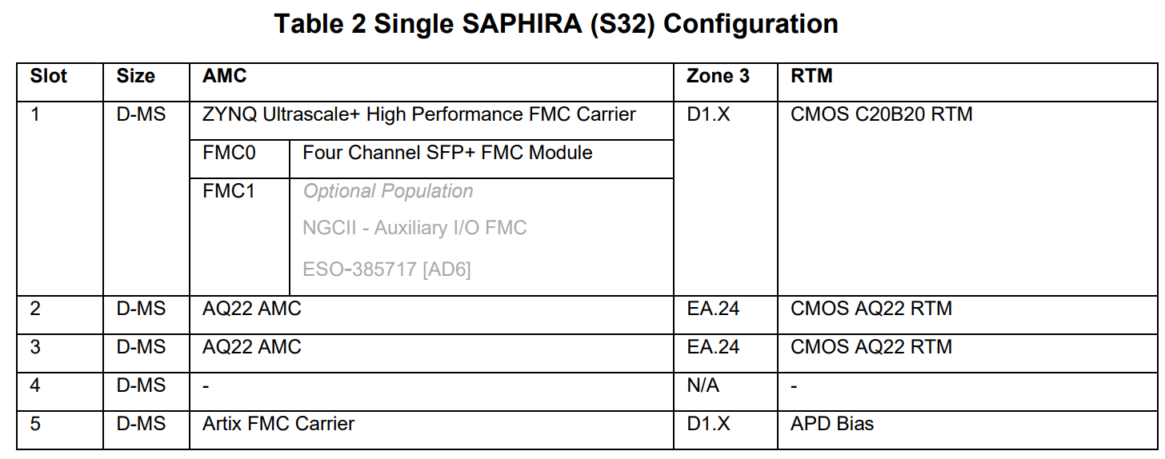
What is in the box?
Example System: METIS SCAO, SAPHIRA32
CMOS C20B20 RTM
NGCII – ICD and Architecture Specification – SAPHIRA
https://pdm.eso.org/kronodoc/HQ/ESO-410219
IOxOS
IFC1414
Shelf + MCH + PSU
2x CMOS AQ22 RTM
2x ESO
AQ22 AMC
APD Bias
RTM
AIES
MFMC
for other system configurations see respective architecture specification…

Slide 22
NGCII Firmware

Slide 23
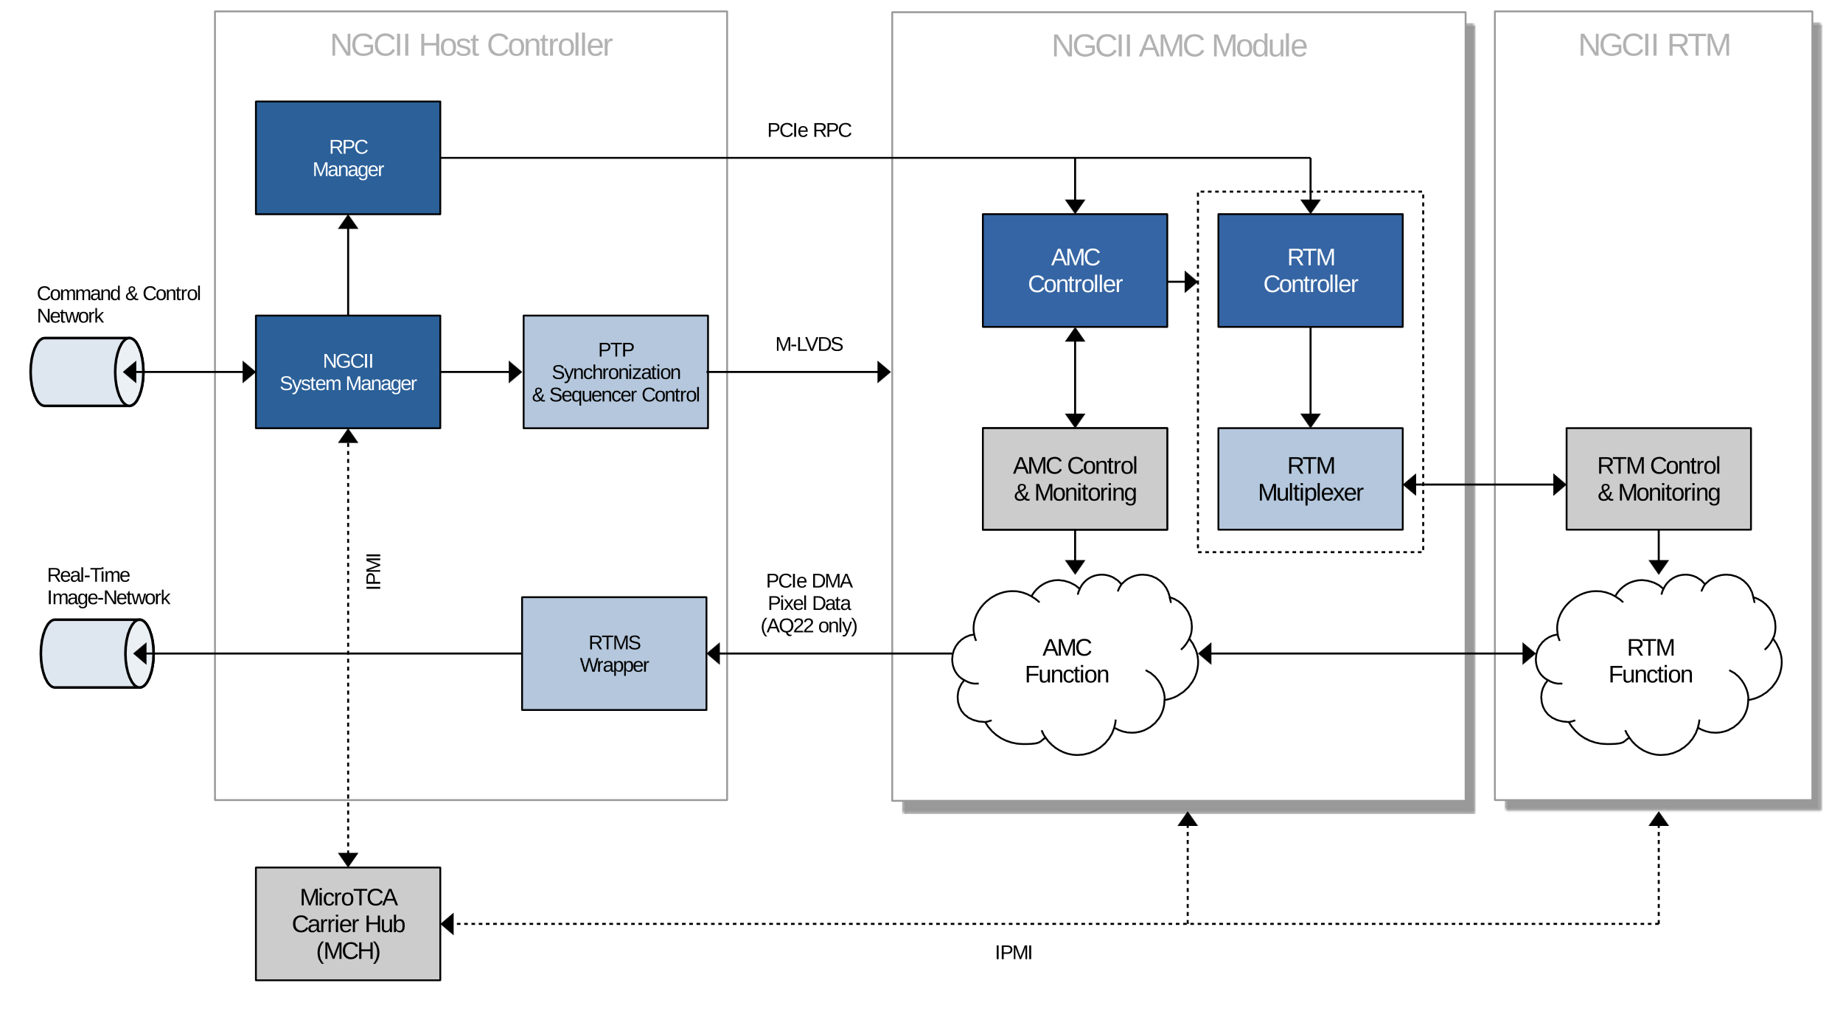
What is in the box?
Parts of the NGCII system – Firmware
Concept approved by external audit!

Slide 24
NGCII Software
See the following talk by Jörg Stegmeier!

Slide 25
How to use it?

Slide 26
Communication Interfaces

Slide 27
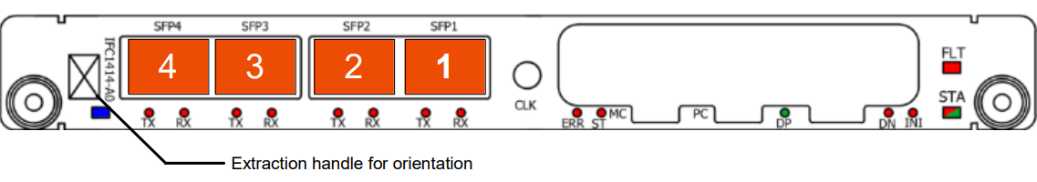
How to use it? :: Communication
Communication Interfaces
  Detector Workstation
    Multiple network interfaces.
    Exact rules for connection described in ESO-566602
  Detector Control Hardware
    Four SFP+ cages on the front panel of the host controller module.
    Exact rules for connection described in ESO-566603
Easier rules of thumb on following slides!

Slide 28
How to use it? :: Communication
Communication Interfaces
STEP 1: Connect DCH and DWS to PTP
Detector
Control
Hardware
Detector
Workstation
Combined link
PTP + P-CND
is possible but not recommended.
Cu, 1GbE
Cu, 1GbE
PTP
PTP
PTP on DWS is not strictly necessary but strongly recommended.

Slide 29
How to use it? :: Communication
Communication Interfaces
STEP 2: Connect maintenance network(s) of DWS
Detector
Control
Hardware
Detector
Workstation
Cu, 1GbE
Cu, 1GbE
PTP
PTP
Cu
Follow ESO networks standards.
Management

Slide 30
How to use it? :: Communication
Communication Interfaces
DWS uplink must be high-bandwidth since it includes image data uplink.
STEP 3: Connect both DCH and DWS to P-CND
Switches possible on platform / in computer room depending on instrument needs.
No specific requirements on P-CND switches.
Detector
Control
Hardware
Detector
Workstation
P-CND
Cu, 1GbE
/
Opt. 1GbE
DAC, 10GbE
Cu, 1GbE
Cu, 1GbE
PTP
PTP
Cu
Management

Slide 31
How to use it? :: Communication
Most basic case:
Direct fibre connection from DCH to DWS
Communication Interfaces
STEP 4: Connect image data link from DCH to DWS through P-RT
Detector
Control
Hardware
P-RT
Detector
Workstation
Opt. 10GbE
P-CND
Cu, 1GbE
/
Opt. 1GbE
DAC, 10GbE
Cu, 1GbE
Cu, 1GbE
PTP
Preferred: add RT capable switches in computer room.
PTP
Cu
Management

Slide 32
Synchronization

Slide 33


How to use it? :: Synchronization
White Rabbit
  White rabbit is a synchronization protocol developed at CERN
    https://white-rabbit.web.cern.ch/
    Sub-nanosecond accuracy and picoseconds precision of synchronization
    Typical distances of 10 km between network elements
  Now part of the PTP standard IEEE1588-2019 as “High Accuracy Profile”
  Advantages over coaxial TTL synchronization:
    No matched cables
    No practical limit to node distance
    No grounding issues

Slide 34
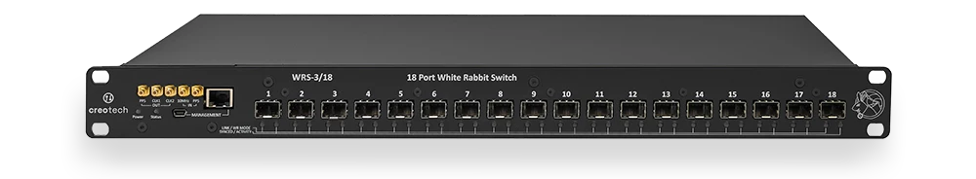
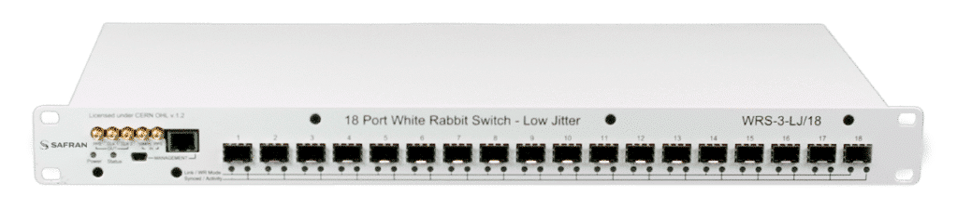
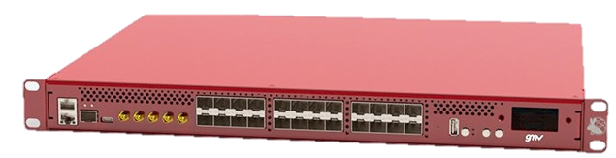
How to use it? :: Synchronization
White Rabbit
The white rabbit switch is open-source hardware.
https://ohwr.org/project/wr-switch-hw-v4
Produced by multiple manufacturers.
CREOTECH (PL)
SAFRAN (FR)
GMV (DE)

Slide 35
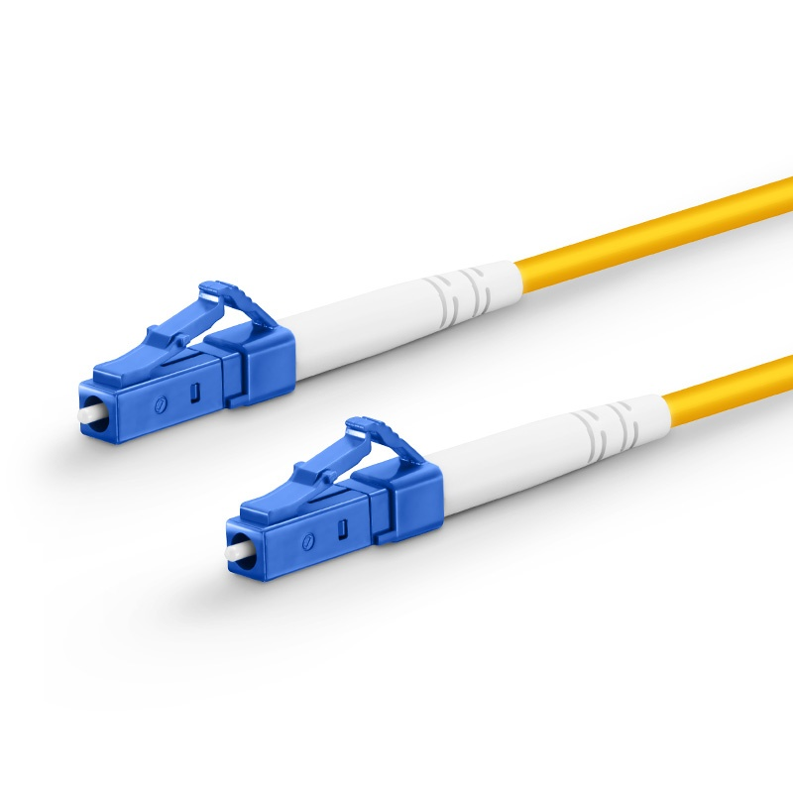
How to use it? :: Synchronization
White Rabbit
  Ideally:
    White Rabbit available as a telescope-wide service, like PTP
  Instruments need to create a local (to the platform) White Rabbit network.
    All NGCII Detector Control Hardware (DCH) units connect to a White Rabbit switch
    WR switch in free-running mode
    No uplink to other equipment
    Dedicated fibres! (1000BASE-BX10, Single LC Type)
This is (currently) not the case!
Data Classification: PUBLIC, ESO-598352 v.1

Slide 36
Shutters

Slide 37
How to use it? :: Shutters
Legacy shutter control interface of FIERA/NGC
Instrument WS / Detector WS
Detector Control HW
NGCII/OPT
Software
NGCII/CORE
Software
NGCII
Firmware
TTL Interface ESO-044439
Legacy shutter control is considered obsolete for
NGCII in VLT and ELT
PLC
Shutter

Slide 38

How to use it? :: Shutters
New shutter control concept
Instrument WS / Detector WS
Detector Control HW
NGCII/OPT
Software
NGCII/CORE
Software
NGCII
Firmware
Ethernet based protocol
Instrument
Control
Network
PLC
Shutter
PTP

Slide 39
Detector Interface

Slide 40
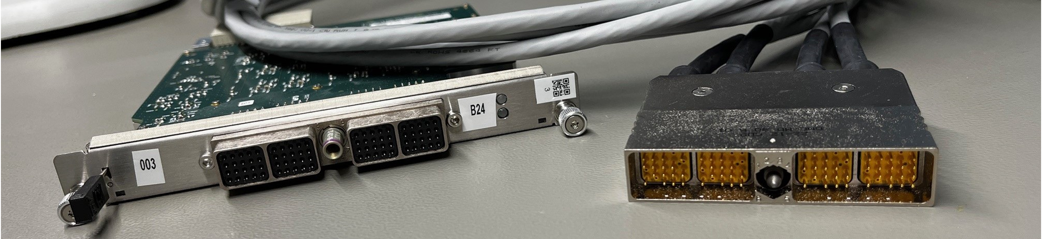
How to use it? :: Detector Interface
Detector Interface
  One to six EN4165 connectors on the rear panel
    Mandatory locking. Requires 3mm hex key for mounting and unmounting
    Mechanical keying. No way to mis-connect in a way that damages the detector
The METIS project is working on a right-angle connector variant!

Slide 41
Power

Slide 42
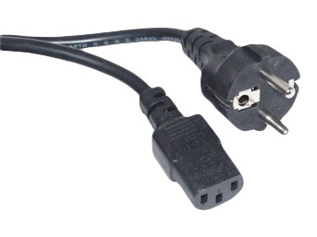
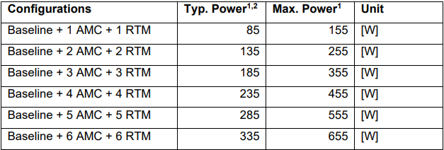
How to use it? :: Power
Power
  Default configuration: 230V AC, C13 connector
  Power consumption in ICD ESO-566603, Table 4
    Typical power for dimensioning of input supply. (Apply generous margin!)
    Maximum power will not be exceeded by NGCII (over current protection will trip before)
  −48V DC power input available as an option.
    Special use-cases, consult ESO.
    External AC/DC converter required.

Slide 43
Cooling

Slide 44
How to use it? :: Cooling
Cooling
METIS vibration tests show:
Exported vibration can be kept below 0.2N_{RMS} with reasonable effort put into cabinet design.
Vibration frequency is 108Hz to 164Hz depending on speed setting. → above most critical range for ELT Nasmyth for normal operation.
Front Side
Fan Tray

Slide 45
When can I have one?

Slide 46
When can I have one?
It depends
For delivery dates of your particular system please contact your ESO detector system engineer.

Slide 47
When can I have one?
Grade of Hardware
Prototype
Core functions performing to specifications.
Suitable for testing detectors.
May be missing some secondary functions.
May have significant reworks.
Delivery outside of ESO only under exceptional circumstances.
Pre-Series
All functions performing to specifications.
No significant reworks.
May not yet have passed environmental testing.
Delivery to Europe possible.
Delivery to Chile after individual approval.
Series
All functions performing to specifications including environmental tests.
Final production version.
Delivery to Europe and Chile.
1-2 systems
~10 systems
∞ systems

Slide 48
When can I have one?
It depends
Firmware Development
Concept
Prototyping
Integration
Testing
Pre-Series
Production
Series
HAWAII-xRG
SAPHIRA
Concept
Prototyping
Integration
Testing
Pre-Series
Series
CCD
GEOSNAP

Slide 49
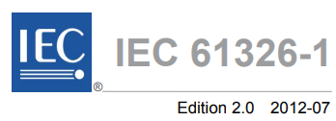

When can I have one?
Thermal Testing:
Environmental Testing
High Temperature Operation
Low Temperature Operation
  Ensure that NGCII will pass instrument level testing during integration.
  Testing three configurations covering all modules:
    SAPHIRA (also representative of HAWAII-xRG)
    CCD231 (also representative of other CCDs)
    GEOSNAP
Cold Start
EMC Pre-Compliance:
ESD
Radiated
Immunity
Radiated
Emission
EN 300 019-1-3 Class 3.1
Conducted
Immunity
(Conducted
Emission)

Slide 50
When can I have one?
It depends
For delivery dates of your particular system please contact your ESO detector system engineer.

Slide 52
Mathias Richerzhagen
Matthias Seidel
Alexander Rüde
Omar Sqalli
@ESOAstronomy
@esoastronomy
@ESO
european-southern-observatory
@ESOobservatory

