Slide 1


Next Generation Controller 2 - NGCII - Software
Jörg Stegmeier

Slide 2
Application Fields
  The NGCII DCS is used for the following purposes:
    NGCII and WFS electronics development
    Detector development and evaluation
    Instrumentation development
    As a subsystem e.g., for the Optical Detectors Applications
    Software development and integration (simulation mode)
    Integrated detector control system at the observatories (VLT, ELT, …)
  The NGCII DCS is used at the following sites:
    ESO (laboratories, integration hall, …)
    ESO Consortia
    ESO Observatories
    Other institutes and observatories (in the scope of collaborations). This implies the installation and usage of the NGCII DCS outside the ESO software environment!

Slide 3
Software Projects
  https://gitlab.eso.org/ics/ngcii/ngc – the NGC/NGCII Core
    The controller interface including tools, services, data acquisition and pre-processing
    No dependencies on ELT DevEnv apart from build system (WAF/wtools)
    Clone is stored in https://svnhq1.hq.eso.org/p1/trunk/Detectors/NGC/PKG/NGC/
    Compiles on VLTSW and stand alone (on Linux)
    Allows hardware development on the legacy workstations in the labs
  https://gitlab.eso.org/ics/ngcii/dcf – the NCGII Detector Control Framework (DCF)
    Common framework to build IR/WFS applications and optical applications for the ELT
    Requires ELT DevEnv

Slide 4
The following contents are available in full detail in the
NGCII Control Software – User Manual (ESO-382532)
See documentation reference on the last slide.

Slide 5
https://gitlab.eso.org/ics/ngcii/ngc
  Controller modules (classes representing the hardware functions)
  Tools-library: watchdog, FITS functions, POSIX threads tuning (priorities, CPU affinity, r/w-locks, …)
  Interface classes (adapters to the NGC/NGCII physical interfaces and communication protocols)
  A pre-processing framework for the IR- and WFS-applications incl. pre-processing microservices for the ESO standard detectors:
    HAWAII1, HAWAII2-RG, HAWAII4-RG, SAPHIRA, LARGE SAPHIRA, AQUARIUS, ALADDIN, ALLADIN2, VIRGO, AO-CAMERAS (CCD220), ALICE (CCD220), LISA
    Processing tasks needed for future detectors (e.g., GEOSNAP) are added as new microservices to the framework. This is an “on demand” development cycle.
    Science CCDs are not handled by the pre-processing framework of the NGC/NGCII core.
  A service module bringing all this together (ngcdcs)
    A built-in request/reply service (tcp/ip, the simple thing)
    A built-in database (volatile) with a basic publishing service (subscribe to TCP/IP event channel)
    Command tool, event tool, debugging tools, …

Slide 6
https://gitlab.eso.org/ics/ngcii/dcf
  RAD state machine implementing the Common DCS ICD (ESO-305615)
  Bridge providing the callbacks for all state machine actions and activities (ECOS - stdif, dcsif, recif)
    Bridge implementation for NGC/NGCII IR and WFS (ngc2_controller, ngcii/dcf/ngc2/…)
    Bridge implementation for optical systems (ngc2o_controller, ngcii/dcf/ngc2o/…)
  CII OLDB interface
  CII request/reply endpoint (MAL-ZPB)
  CII pub/sub endpoint (MAL-ZPB or MAL-DDS)
  CII logging service
  CII configuration service
  Command tool (dcf-cmd), OLDB-tool (dcf-oldb), subscriber tool (dcf-subscribe)
  Graphical user interfaces (dcfGui, …)
  DCF core application (dcf-core) as subsystem for ngcii/dcf/ngc2o

Slide 7
NGCII CORE
  The core assembles the controller functions and the data acquisition functions and interconnects them with an application logic.
NGC/NGCII Core
Actions
(Request-reply, state transitions,
setup &
configuration)
Error handling
and recovery
File handling
(FITS data product)
Application logic
Control modules
Acquisition modules
  Note: The core can be used as control-subsystem without performing data acquisitions

Slide 8
NGCII CORE – Control Modules
  The control modules bundle controller functions to logical units:
  "Controller 3, Board 5, Sequencer” → “sequencer[4]”
  Voltage setting and telemetry (bias modules for NGC version I, AO-CAM, ALICE, LISA, NGCII-C20B20, NGCII-C24, NGCII-B24, …)
  Clock patterns and timing programs (“sequencer programs”)
  Sequencer control (“start”, “stop”, “stop at defined break-point”, …) and status monitoring
  Synchronization (PTP TSU, trigger generation and time stamping unit)
  ADC setup – bandwidth, offset, filter, … (NGCII AQ22 and AQ8)
  Shutter and preamplifier control (for optical applications)
  WFS functions:
    ALICE: Delays, Over-Illumination Protection, Gain Setting & Gain Calibration
    LISA: Gainmap, Row-Groups

Slide 9
NGCII CORE – Usage
  One core can maintain multiple NGC/NGCII controllers (e.g., for MICADO: 1 core → 9 controllers)
  The core can be deployed as a process or as a thread.
  Deployment as a thread allows direct access to the core controller functions and to the core data acquisition. This implies one core per DCS instance. Use case: NGCII IR- and WFS-applications.
  Deployment as a process allows multiple DCS instances to share one core (dcf-core process) to access the controllers. Use case: NGCII optical applications.
NGCII IR/WFS
Application
NGCII-OPT
Application
NGCII-OPT
Application
NGCII-OPT
Application
Core
Thread
dcf-core
Process
dcf-core
Process
NGCII
Controller
NGCII
Controller
NGCII
Controller
NGCII
Controller
NGCII
Controller
NGCII
Controller
Data streams

Slide 10
Deployment Diagram – IR/WFS/CORE
Instrument Workstation
Data Product
  In standalone mode the instrument workstation is skipped, and all processes run on the detector workstation.
  The acquisition microservices subscribe to one or more multicast MUDPI/RTMS data streams and run in an infinite acquisition loop.
  Real-time control applications may directly subscribe to the raw data on the data stream.
  Multiple data streams may require multiple network interface cards or multiple workstations if bandwidth is exceeded.
  One DCS application can maintain multiple controllers/cameras and multiple acquisition microservices.
DDT
Viewer
Standalone process or integrated as a thread into the DCS application
DCS Application
Gateway
NGCII CORE
Non-
Deterministic
Network
Detector Workstation
Acquisition Microservice
NIC 10GbE
Multicast UDP data stream
MUDPI/RTMS
Controller/Camera
Deterministic Network
Data
GbE
10GbE
Setup

Slide 11
Deployment Diagram – NGCII-OPT
Instrument Workstation
DDT
Viewer
Data Product
DCS Application
  The optical DCS application deploys the NGCII CORE as a subsystem to access the controller electronics.
  The recording session follows a more rigid scheme than it is the case for IR/WFS: “wiping” – “integrating” – “reading out” – “completed”
  The recording session implies an active intervention before/after each step, e.g., the application of new voltages in each state and the additional shutter control.
  A merger process assembles all data which is read out during the recording session and publishes it to both the DDT and the data product (FITS file). TBD: Chunk publishing
Merger
NGCII CORE
Non-
Deterministic
Network
Detector Workstation
Acquisition Microservice
NIC 10GbE
Multicast UDP data stream
MUDPI/RTMS
Controller/Camera
Deterministic Network
Data
GbE
10GbE
Setup

Slide 12
NGCII CORE – Data Acquisition
(IR/WFS/CORE)
Services
(Logging, watchdog, instance handling)
Microservice (on Detector Workstation)
Operational-Log
(stdout, configurable)
Acquisition module of NGC/NGCII core
Main()
IR/WFS/CORE
Application
Pre-Processing
Framework
Parameters
Request-Reply
Error-Log/Event
Data
Capture
Thread
Subscribe to frames
Gateway
Results
Publish
Frame Type-A
Data Product
FITS-File(s)
Frame Type-B
Frame Type-C
Receiver
(plug-in)

Slide 13
NGCII CORE – Pre-Processing Framework
  The acquisition is started/stopped and parametrized through an internal request-reply channel.
  The request-reply channel allows the uploading of bad-pixel masks, bias frames and flatfields.
  The incoming data is read via the data receiver into a circular receiver buffer.
  The data receiver is pluggable and can also be used outside the pre-processing framework:
    Plugin: PCIe device driver interface (NGC version 1, AO-Cameras)
    Plugin: TCP/IP (for tests and simulation)
    Plugin: MUDPI/RTMS (NGCII, ALICE-WFS, LISA-WFS)
  A capture thread provides the synchronization between the receiver and the main process.
  After processing the data in the main process, the result frames are given back to the framework, which stores them in circular transfer buffers.
  The data publishing happens in parallel to the processing loop. There are no memory copies involved. When the frame has been processed and should be transferred it is given to a publisher, which distributes the data in parallel to multiple subscribers.

Slide 14
NGCII CORE – MUDPI/RTMS Receiver (1/3)
  The NGCII and the WFS cameras ALICE and LISA send the image data over 10GbE via UDP in the MUDPI/RTMS format.
  The receiver API can be used anywhere within the deterministic network to subscribe to a MUDPI/RTMS datastream (e.g., to implement a customized quick-look channel).
  The receiver API is also used by NGCII optical applications to acquire the image data.
  For best performance, the kernel and network configuration require some system tuning, but with reduced performance the receiver runs with any Linux kernel, architecture and network interface.

Slide 15
NGCII CORE – MUDPI/RTMS Receiver (2/3)
Circular buffer allocated by Pre-Processing Framework (holds n framebuffers)
H = MUDPI Header
LD = RTMS Leader Packet
P = RTMS Payload Packet
TR = RTMS Trailer Packet
H
LD
H
P
H
P
H
TR
H
LD
H
P
H
P
H
TR
…
H
P
H
TR
recvmmsg()
Receiver Thread
iov[0]
iov[1]
iov[2]
iov[3]
iov[4]
iov[5]
iov[6]
iov[7]
…
iov[m-2]
iov[m-1]
P
P
P
P
P
wait()
Capture Thread
move()
P
P
P
P
P
P
framebuffer[0]
framebuffer[1]
framebuffer[n-1]
Pre-Processing Framework

Slide 16
NGCII CORE – MUDPI/RTMS Receiver (3/3)
  The receiver allocates a circular buffer with configurable size. After initialization and start of the transfer it fills the elements, and whenever an element is ready the wait-function sets a timestamp and returns.
  Once all packets needed for one framebuffer are received, the receiver thread sends a notification causing the wait-function to awake. The wait-function then does the final packet processing and returns. The packet processing moves the packet data-payload to the framebuffer, which is mapped to the start address of the respective iovec-region. This way, no additional memory is needed for the framebuffer itself. The wait-function is called by the capture thread of the pre-processing framework.
  The mechanism allows large images to be divided into chunks of small framebuffers as well as multiple small images to be assembled in a large framebuffer.
  The timestamp is taken from the MUDPI header of the leader packet of the framebuffer and is assumed to be a PTP time (TAI) in seconds since Unix epoch.

Slide 17
NGCII CORE – Microservices (1/2)
  The microservices are executable binaries. Goal: The addition of new tasks (e.g., GEOSNAP) cannot interfere with existing tasks (e.g., HAWAII2-RG) or corrupt the overall system like with a monolithic approach.
  Potential memory leaks are cleaned up with “exit”. All fatal errors inside the tasks can be recovered by switching the microservice.
  The microservices can be launched with “exec” and terminated with “kill”. So far, all implemented receivers are “kill -9” (SIGKILL) safe with respect to deadlocks and garbage collection.
  The microservices can be tested by executing them directly from the shell.
  The microservices can run in simulation mode:
    Receiver plug-in running in simulation (for testing the interfaces)
    Built-in simulator, which pre-fills the circular input buffer and emulates the data events through a high-resolution timer (for testing the performance of the pre-processing algorithm)

Slide 18
NGCII CORE – Microservices (2/2)
  The microservices do not depend on configuration-files or -services. All information required to start up the pre-processing framework is rendered from the command line (device names, IP-addresses, port numbers, resource dimensions, …).
  Each microprocess exports a list {name, type, current value} of application specific parameters to the pre-processing framework. The parameters are initialized by the microprocess with a default value and can be updated through the framework interface at runtime. The parameters are multi-buffered. The framework takes care about concurrent read and write accesses and the microservice takes care to apply them at proper time (e.g., only at beginning of next integration ramp, only at beginning of next chop-cycle, next chop-half-cycle, next image, …).
  The parameters can be declared in the microservice and then used in the sequencer programs to tune the clock patterns, and the NGGII core will take care that the parameters are always correctly aligned.
  The microprocess may declare application specific frame types and export them to the subscription list maintained by the pre-processing framework.

Slide 19
NGCII CORE – Data Publishing
  The pre-processing framework provides frame queues for all produced frames.
  The subscription request and the data transfer are done through TCP/IP and do not require a deterministic network.
  The subscription request defines whether the frames are popped from the queues as FIFO or LIFO.
    FIFO subscription is used by DCS to transfer the images from the microservices to the FITS-files (buffered science data).
    LIFO subscription only takes the top of the queue. The typical use case is quick look (raw image display).
  Different frame types can be transferred in parallel to different subscribers. Use case: the display shows raw frames while the averaged frame is transferred and stored to a FITS-file.
  Each subscriber can define its own region of interest (default: full frame).

Slide 20
NGCII CORE – Gateways (1/2)
  The publishing of the microservices data stream is done through gateways. The gateways are transporting the frames/images from the pre-processing microservices to their destination.
  The gateways register to the microservices and publish the data to the target system.
  Gateways/publishers are available for
    ELT DDT
    VLT RTD (legacy)
    Generic shared memory:
    Originally implemented as interface to SAO/DS9
    Can still be used to retrieve the frame data via shared memory
    This mechanism does not require any additional services or brokers running

Slide 21
NGCII CORE – Gateways (2/2)
  For the science data transfer the IR/WFS application runs one internal gateway per microservice as a thread. The gateway thread transports the image data from the microservices to the FITS file(s).
  Additionally, the IR/WFS application hosts multiple configurable gateways to transport the image data to the DDT.
  The DDT gateway can also be executed as a separate process (“ngcddt”, mainly intended for tests and debugging).
  Note: The NGCII optical applications use their own data and pixel processing/sorting chain.

Slide 22
System Startup
  The NGCII main application is launched with the command line:
    ngc2_controller [options]
    -n [ --proc-name ] arg Process name
    -l [ --log-level ] arg Log level: OFF, ERROR, WARN, INFO, DEBUG, TRACE
    -p [ --log-prop-file ] arg Log properties filename
    -c [ --config ] arg Application configuration filename
    -o [ --oldb-prefix ] arg OLDB URI prefix
    -r [ --rr ] arg Request-Reply endpoint URI
    -s [ --ps ] arg Pub-Sub endpoint URI
    -d [ --det ] arg Detector controller configuration
    -b [ --broker ] arg DDT broker URI
    -h [ --help ] Print help messages
    The command line options will override the corresponding values in the application configuration file (as defined in the “-c” option).
  An example application running in workstation simulation mode can be launched with:
    ngc2_controller -c config/dcf/ngc2.yaml (for IR/CORE)
    ngc2_controller -c config/dcf/alice.yaml (for ALICE WFS)
    ngc2_controller -c config/dcf/lisa.yaml (for LISA WFS)

Slide 23
Command Tool
  A command tool is provided to send requests to a DCF-application:
    dcf-cmd [options] <request> [parameters]
    -h [ --help ] - Show options
    -u [ --uri ] URI - URI of request-reply endpoint. Use auto or ? to read the endpoint from
    the OLDB (default: $DCF_URI or zpb.rr://127.0.0.1:12081).
    -s [ --ps ] URI - Override URI of pub-sub endpoint. Only used for deployment requests.
    -o [ --oldb-prefix ] URI - OLDB URI prefix. Use auto or ? to read back the prefix via request-reply
    or "" to disable the OLDB commands (default: $DCF_DB or cii.oldb:///elt/).
    -n [ --proc-name ] URI - Application name (default: dcf)
    -p [ --process ] name - Service process to be launched (for deployment requests)
    -c [ --config ] file - Service configuration file name (for deployment requests)
    -t [ --timeout ] seconds - Reply timeout in seconds or -1 for infinite timeout (default: 5 s)
    -T [ --connect-timeout ] seconds - Connection timeout in seconds if value is positive (default: 0 s - disabled).
  Requests:
    From stdif, dcsif, recif – ECOS interfaces (Init, Enable, RecStart, …)
    Wait – Wait for state “NotOperational::Ready”.
    Execute <cmd> [args…] – Execute low-level command. With IR/WFS/CORE applications
    use <Execute help> to get information on the supported commands.
  Other requests to access the OLDB, to deploy and discover services and to perform system tests are implemented (see User Manual or the output of the “-h” option).

Slide 24
Other Tools
  OLDB Tool
    dcf-oldb [options]
    -h [ --help ] - Show options.
    -d [ --delete ] URI - Delete database point.
    -r [ --read ] URI - Read database point.
    -w [ --write ] URI <value> - Write value or vector of values to database point. Vector syntax can be:
    'v1, v2, v3, ...' or
    '[v1, v2, v3, ...]' or
    '{v1, v2, v3, ...}' or
    '{[v1, v2, v3, ...]}’
    Strings must be enclosed in double-quotes.
    -p [ --poll ] URI <value> [ms] [seconds] - Poll every <ms> milliseconds until the database point matches
    a value. A timeout is raised after the given number of seconds.
    Default is 500 ms interval with infinite timeout.
    -s [ --state ] PREFIX <value> [seconds] - Wait with timeout until the state attribute matches the value.
    The PREFIX is the URI-prefix of the application.
  Subscription Tool
    dcf-subscribe [topic] [publisher endpoint URI]
    The topic can be one of status, state or recstatus. The default endpoint URI is “dds.ps:///DCF/”.

Slide 25
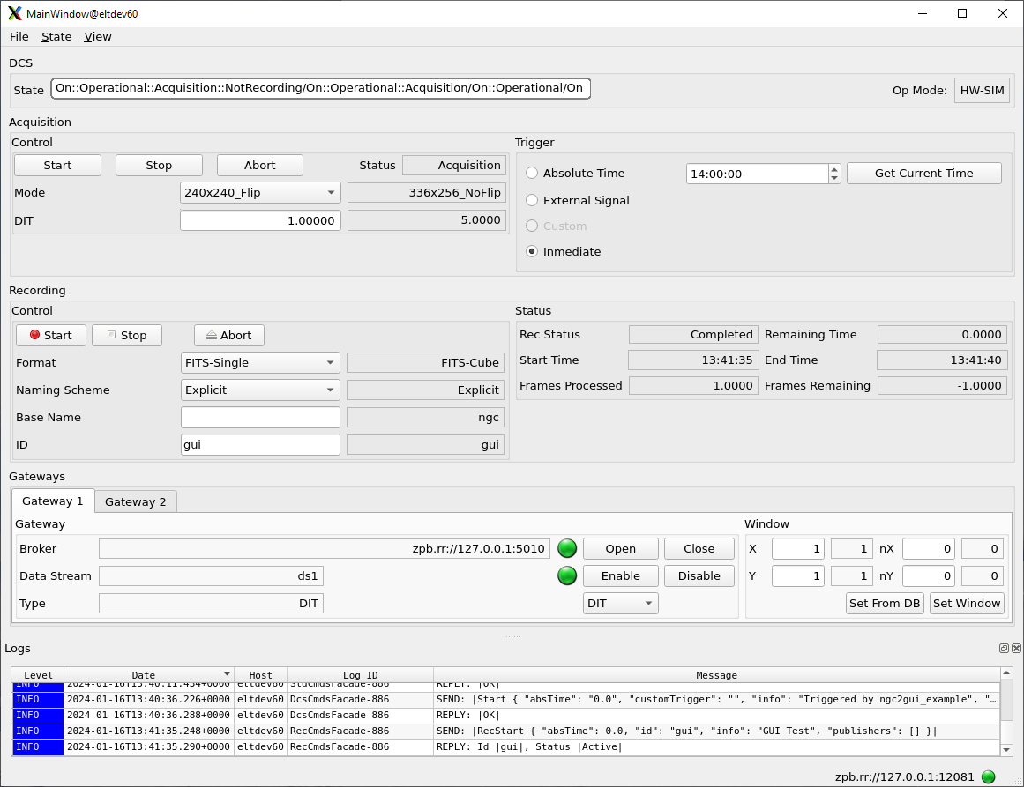
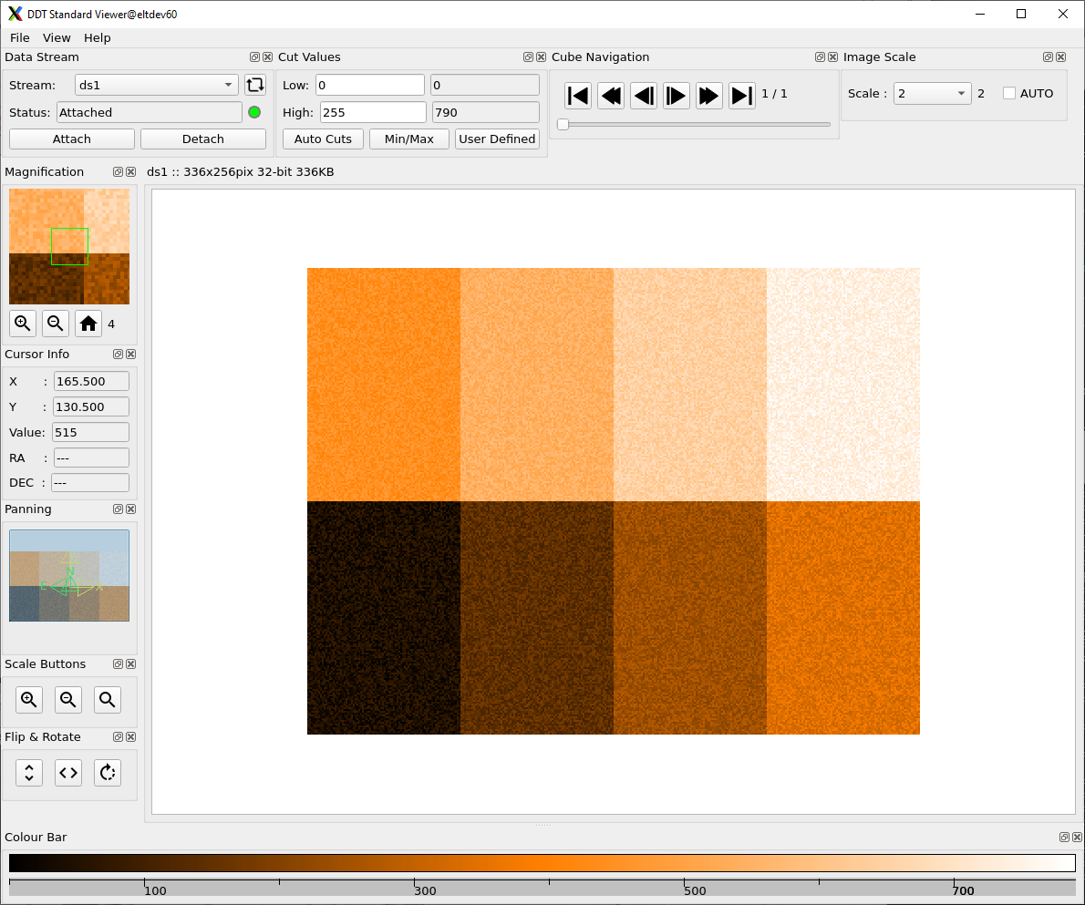
DCF GUI &
DDT Viewer
An Engineering GUI for electronics engineers and detector system developers is on its way!

Slide 26
Documentation
  Released:
  Common ICD between CCS\ICS and Detector Control System (ESO-305615, version 1)
  NGCII Software Design Report (ESO-418495, version 1)
  NGCII Control Software – User Manual (ESO-382532, version 2)
    Covering IR- and WFS-Applications and the CORE subsystem
  Optical NGCII - Software Design Report (ESO-436693, version 1)
  Optical NGCII - Software User Manual (ESO-451391, version 1)

Slide 27
Jörg Stegmeier – jstegmei@eso.org
@ESOAstronomy
@esoastronomy
@ESO
european-southern-observatory
@ESOobservatory

