Slide 1

MORFEO ICSS
Bernardo Salasnich - INAF Astronomical Observatory of Padova
on behalf of MORFEO ICSS team
Instrument Control Systems Seminar 2024
ESO Garching - 27/11/2024

Slide 2

TOPICS
SUMMARY
Introduction
Software Architecture
Example of special device
Example of MICADO-MORFEO interface

Slide 3
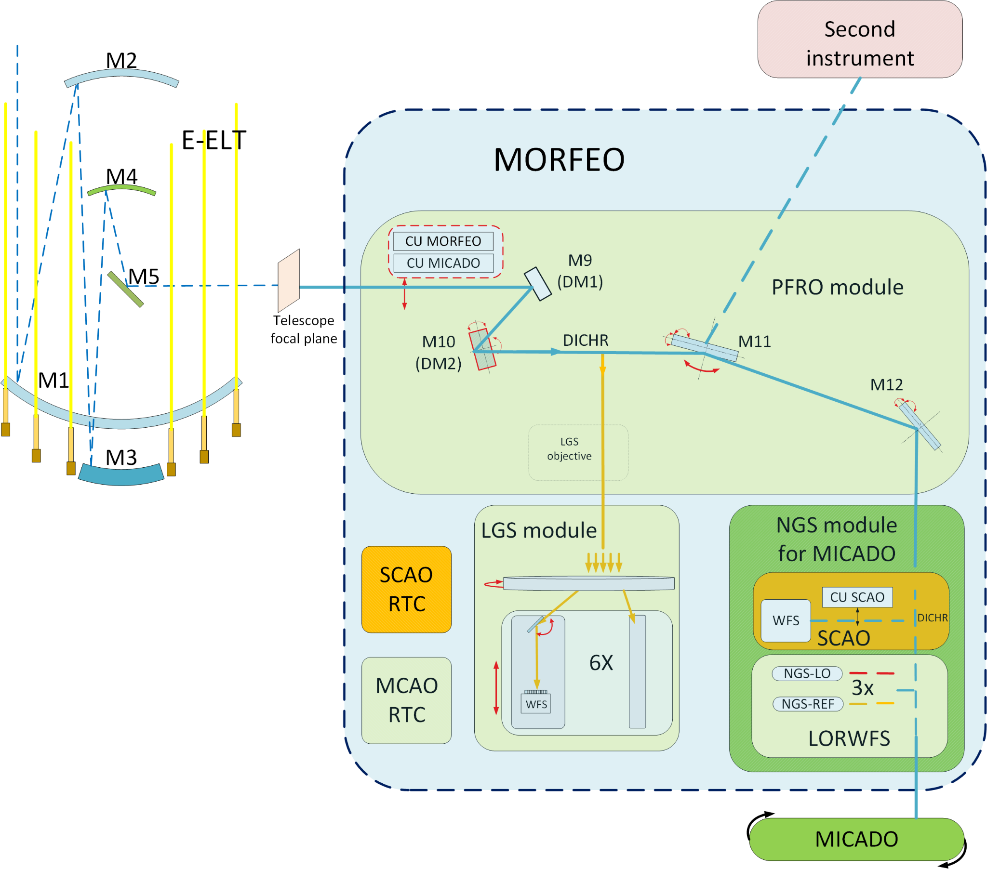
INTRODUCTION
McaO Relay For Elt Observations (MORFEO)
It is an AO module, not an instrument
Project phase: FDR planned for 2025
Commissioning: 2031
First light client: MICADO
Designed for a 2nd generation instrument
Main operational modes: Single and Multi-Conjugated AO
13 WFS cameras (12 MCAO, 1 SCAO)
Thermally controlled environment
MCAO: 100 devices, 200 sensors
2 Real-Time Computers

Slide 4
INTRODUCTION
McaO Relay For Elt Observations (MORFEO)
Post-Focal Relay Opics (PFRO) module:
  designed for up to 2 DMs
LGS-WFS module: up to 6 LGS
  WFS: S.H. 68x68 sub-aps,
~17’’ FoV, 500 Hz
MCAO NGS-module: up to 3 NGS
  Non sidereal objects supported
  MCAO: each NGS sensed by two WFS
  REF-WFS: S.H. 8x8 sub-aps,
~4’’ FoV, 0.1-10 Hz, magR <=23
  LO-WFS: S.H. 2x2 sub-aps,
~1’’ FoV,100-1000 Hz, magH <=21

Slide 5
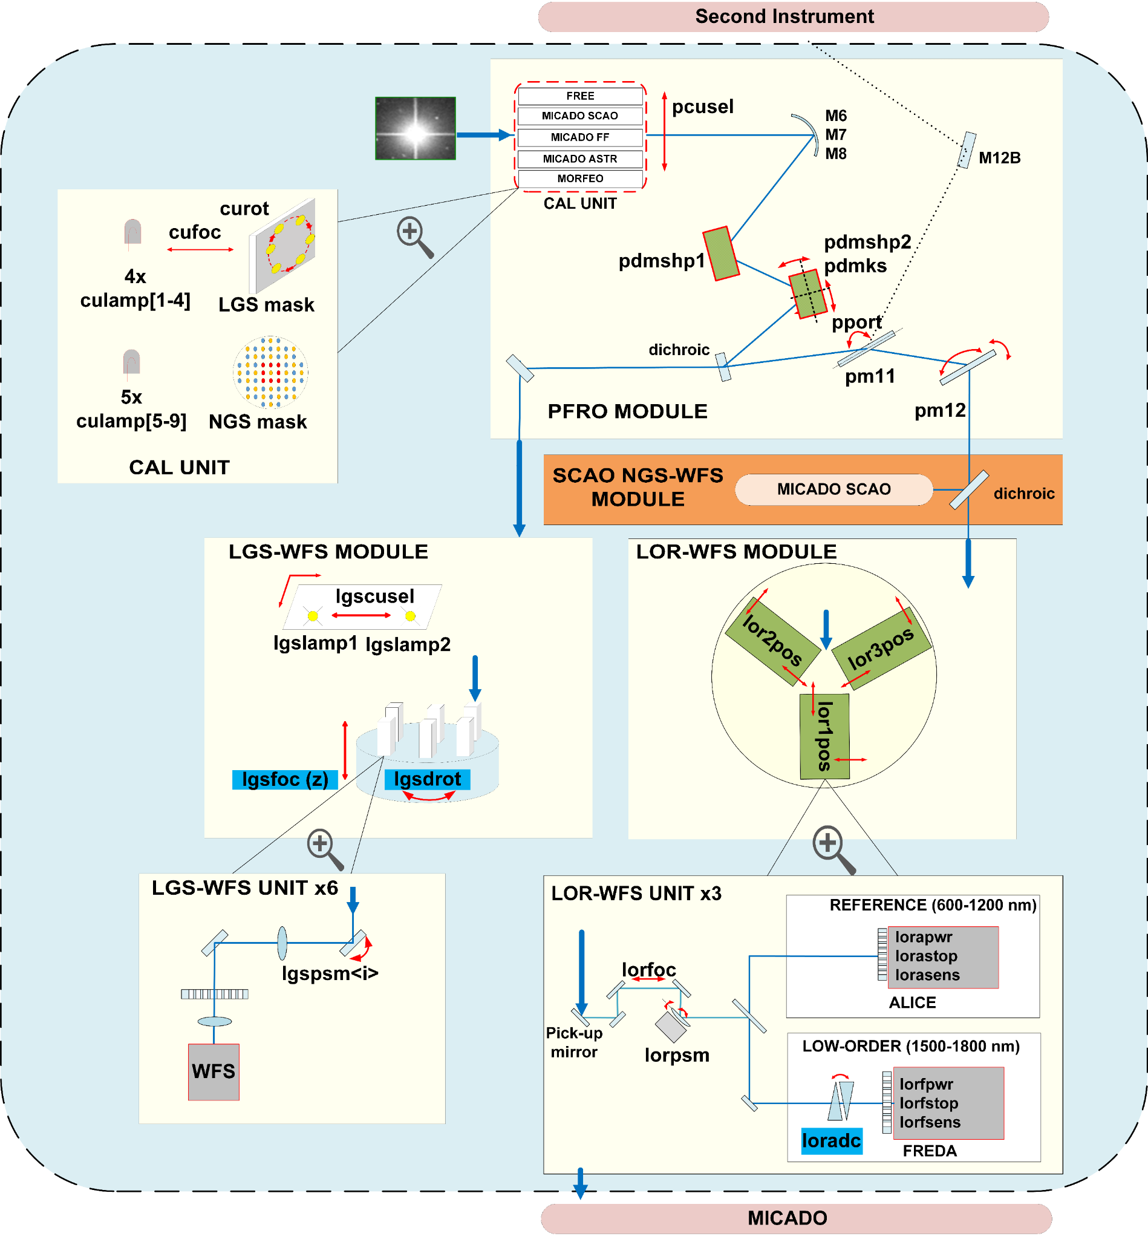
INTRODUCTION
Functional overview
5 subsystems:
  PFRO, LGS, LOR, THCS, CU
  5 FCS
  1 PLC
99 devices
96 standard (5 tracking)
3 special devices (1 tracking)
Type | PFRO | LOR | LGS | THCS | CU | Total
Motor | 2 | 3(**) | 2 | 0 | 2 | 9
MultiAxis | 2 | 0 | 1 | 0 | 0 | 3
Actuator | 1 | 12 | 0 | 0 | 0 | 13
Sensor | 6 | 11 | 5 | 8 | 3 | 33
Ccc | 4 | 0 | 1 | 1 | 1 | 7
Piezo | 0 | 3 | 6 | 0 | 0 | 9
Adc | 0 | 3 | 0 | 0 | 0 | 3
Drot | 0 | 0 | 1 | 0 | 0 | 1
Lamp | 0 | 0 | 2 | 0 | 9 | 11
IoDev | 0 | 0 | 0 | 6 | 0 | 6
Special | 3(*) | 1 | 0 | 0 | 0 | 4
Total | 18 | 33 | 18 | 15 | 15 | 99

Slide 6
SOFTWARE ARCHITECTURE
Main design decisions:
the architecture is modular
MCAO and SCAO modules are well separated so they can be developed almost independently
The system is complex, including several subsystems and components
we present the architecture from different perspectives:
      control
      data acquisition
      supervision

Slide 7
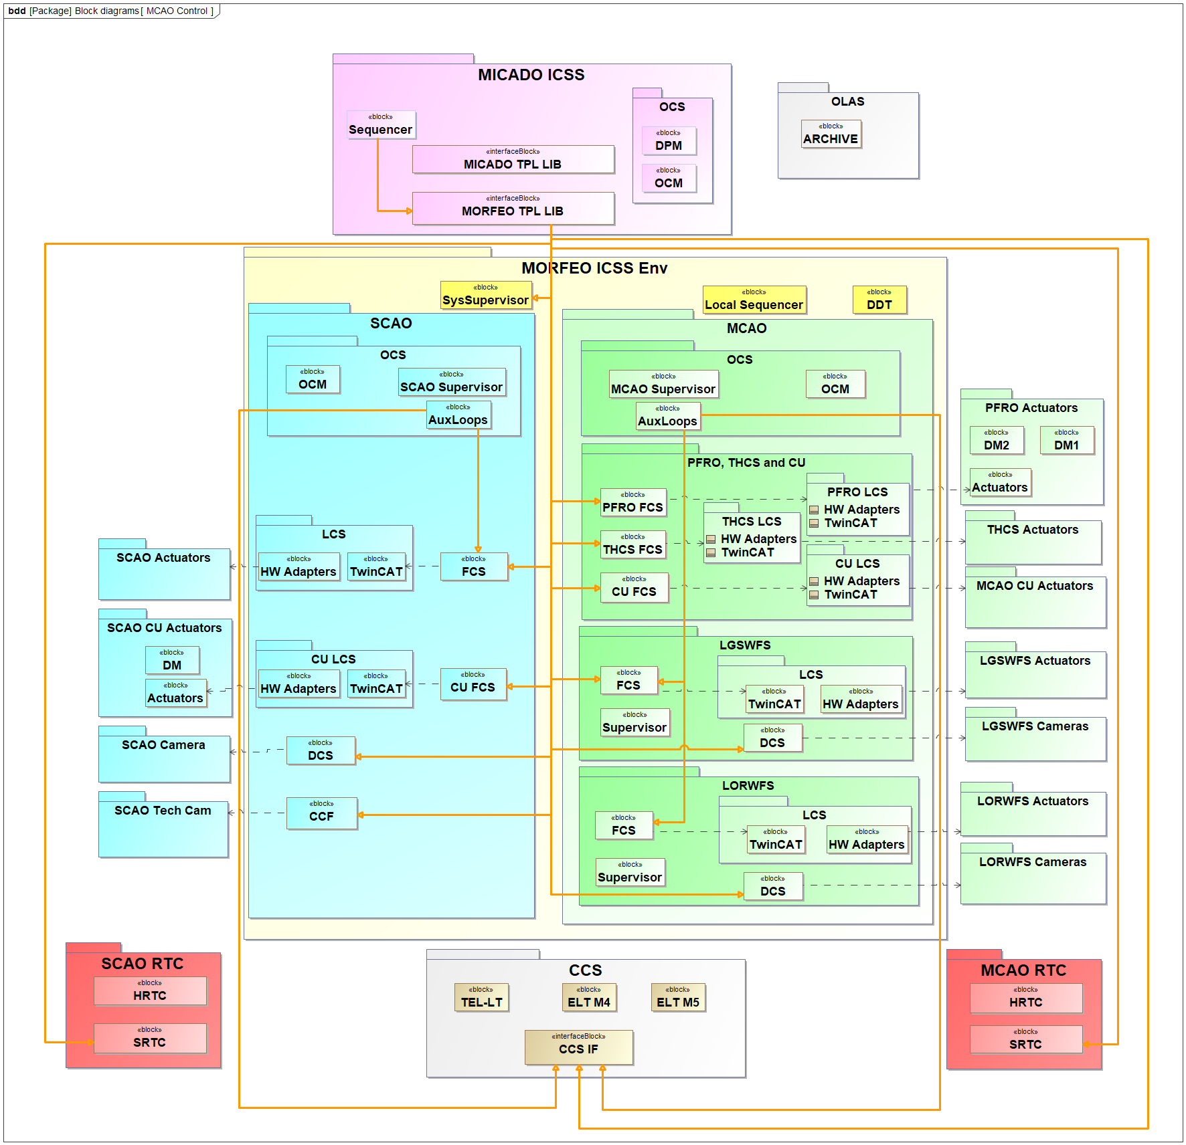
SOFTWARE ARCHITECTURE
Control Perspective
The Sequencer orchestrates the commands to each component
The Sequencer uses a library (MORFEO TPL_LIB) which implements the interface with the subsystems it has to communication to. It uses the standard interfaces provided by IFW2024:
  fcfIF: interface with FCS
  dcsIF: interface with DCS
  supIF: interface with supervisor
  ccsInsIf: interface with CCS
  The IF with RTC will be implemented on the basis of the components provided by the RTC toolkit, so in turn is based on CII MAL. The details of this interface will be encapsulated in a Python library
All commands use the ELT CND network

Slide 8
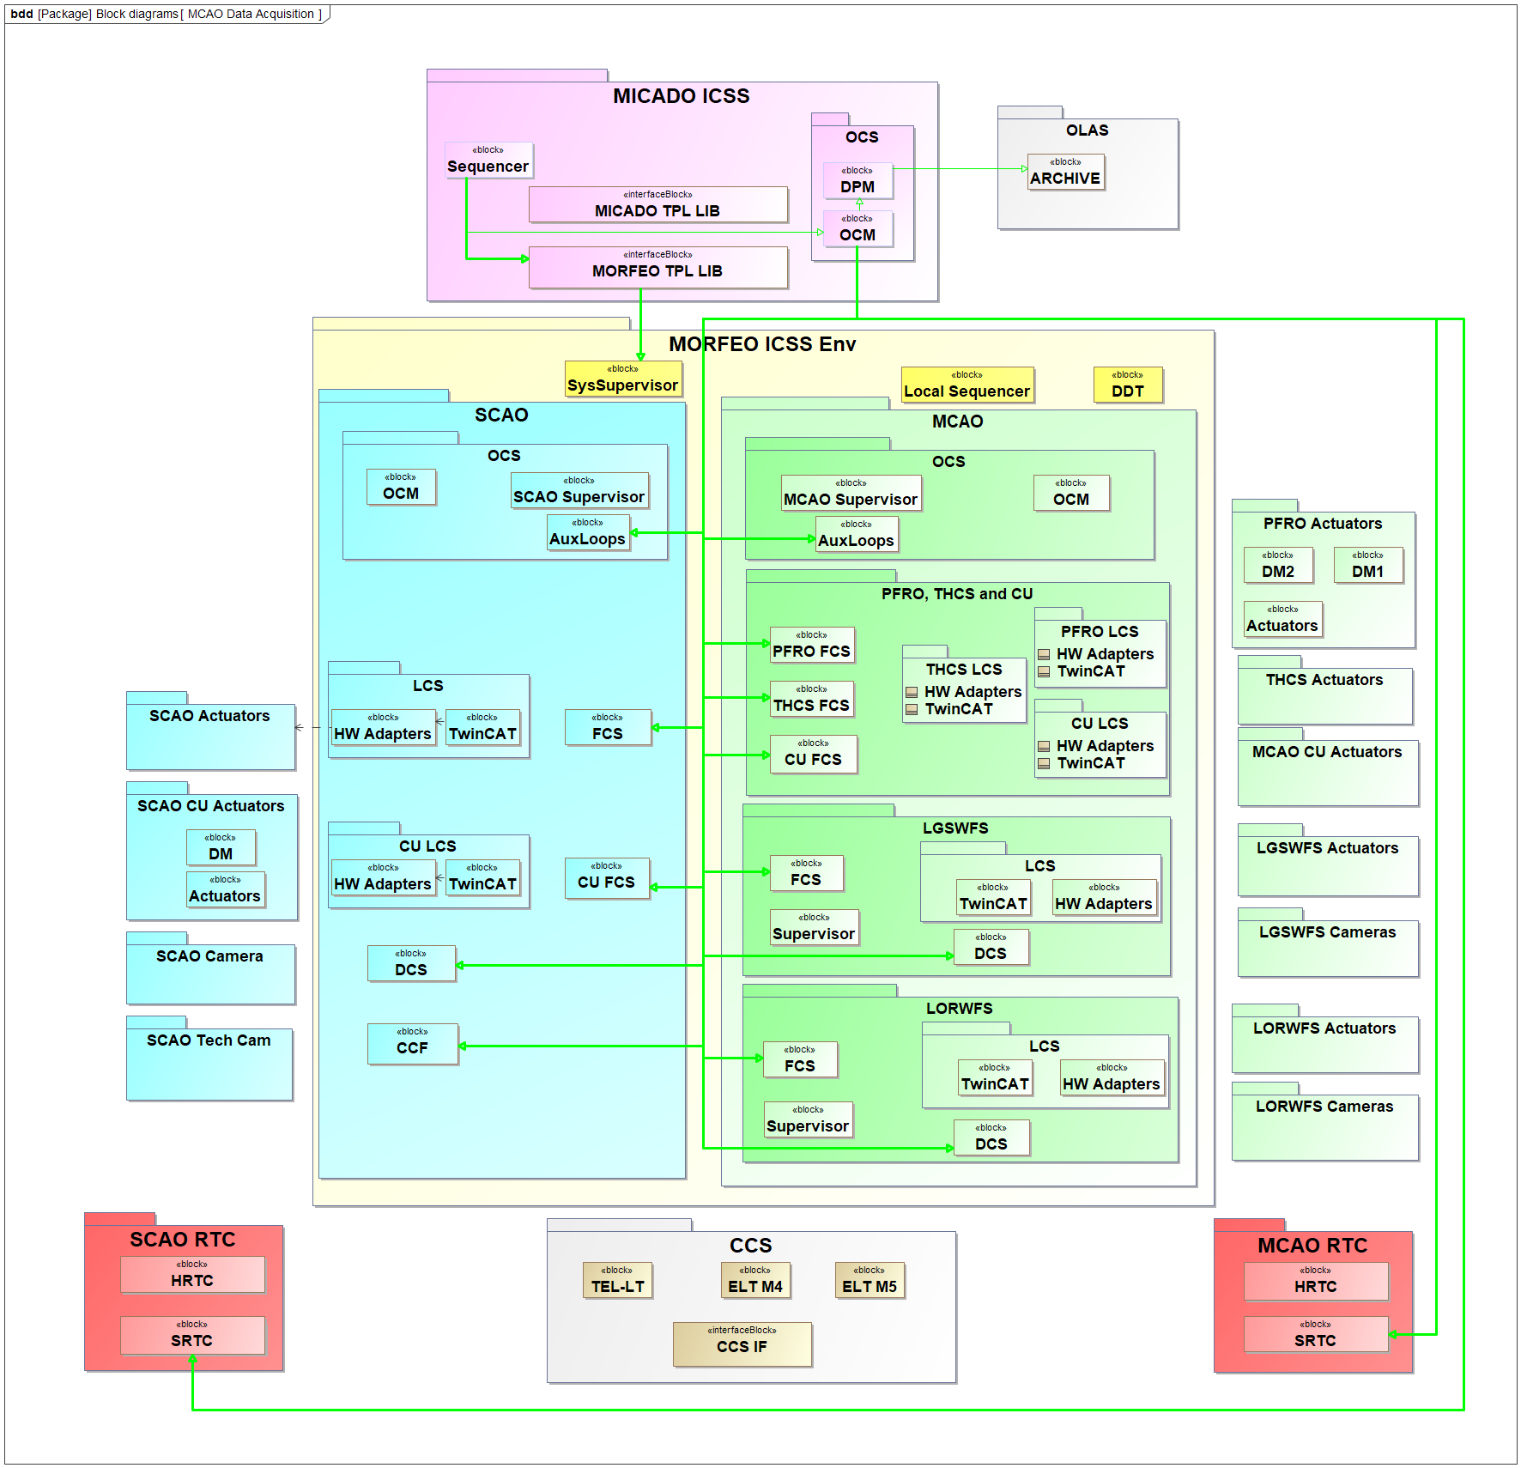
SOFTWARE ARCHITECTURE
Data Acquisition
MORFEO does not produce scientific data.
When MICADO performs an exposure, status and AO parameters for FITS headers have to be recorded by MORFEO ICSS.
Each time MICADO (OCM) informs MORFEO the start of a scientific exposure, MORFEO acquires meta-data from its data producers (FCS, DCS, RTC, Auxiliary Loop processes and CCF).
We foresee an interface:
  with the MORFEO Sys-Supervisor to get the list of data producers: implemented by MORFEO TPL_LIB
  an interface (StartDaq/StopDaq commands) between MICADO OCM and each MORFEO data producers: implemented in/by MICADO.

Slide 9
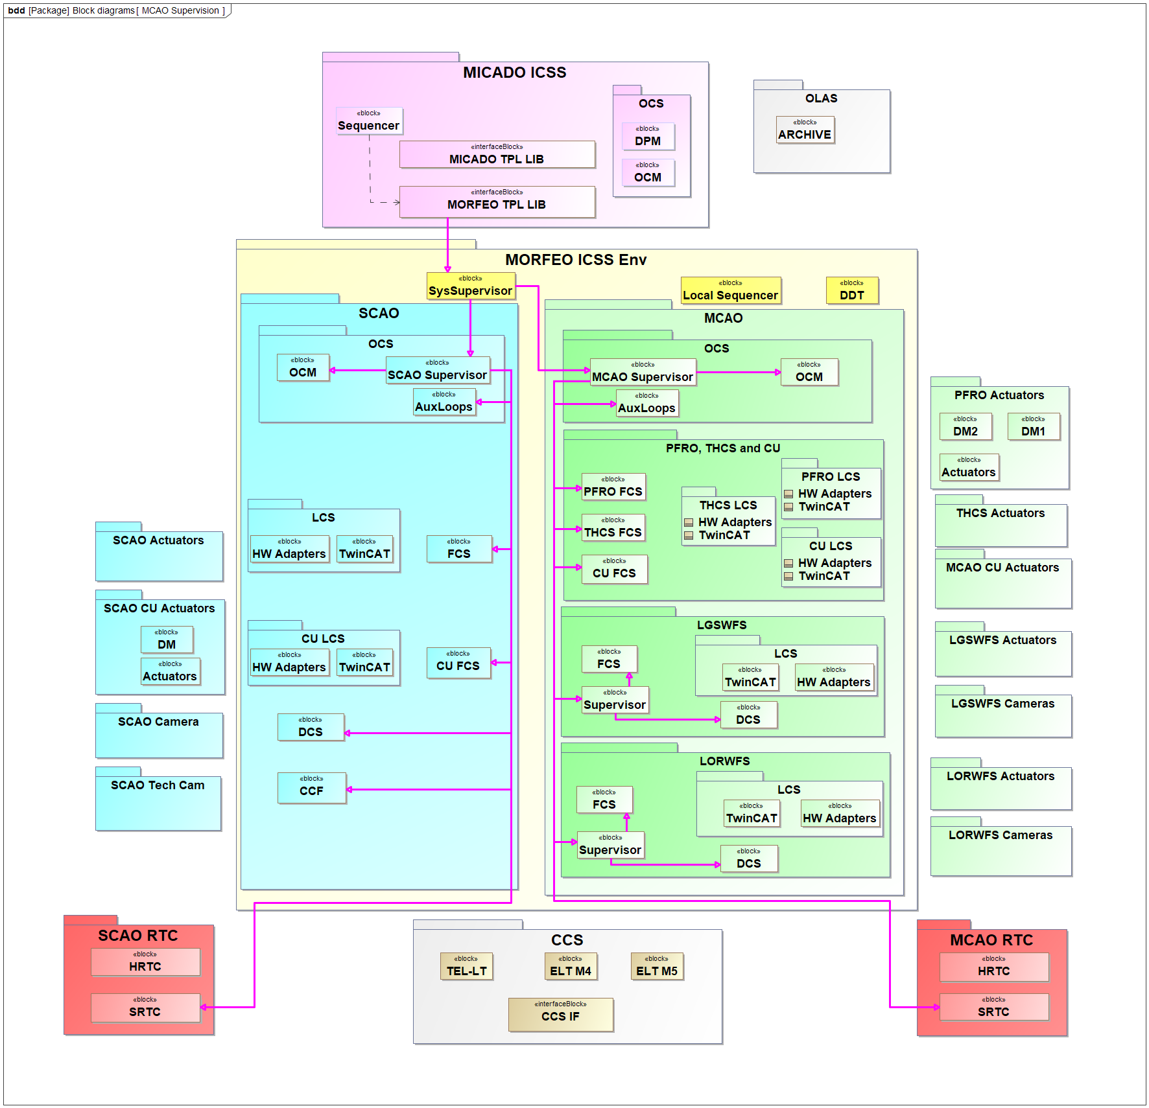
SOFTWARE ARCHITECTURE
Supervision
Notice the nested level of supervisors:
System supervisor
  SCAO sup
  MCAO sup
    LGS-WFS sup
    LOR-WFS sup

Slide 10
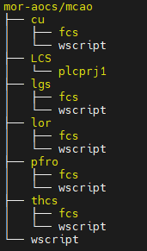
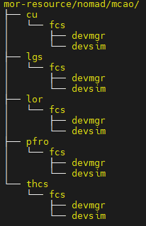
SOFTWARE ARCHITECTURE
SKELETON
The modularity of the architecture is reflected in the code
(note that the project mor-ics does not exist)

Slide 11
SOFTWARE ARCHITECTURE
PECULIARITIES
We agreed with MICADO that all active interactions (commands) to CCS are handled by MORFEO:
commands (preset, offset),
activate telescope handover,
offloads from PFDMs to M4/5
coordinating the rous manouvre etc
as defined in the MICADO-MORFEO ICD
Notes:
Recurrent Optimization of Units Stroke
Re-aligning the telescope mirrors in the most suitable way to relax aberrations accumulated on M4

Slide 12
SOFTWARE ARCHITECTURE
PECULIARITIES
Different software components are involved for SCAO and MCAO. In general we can distinguish 4 use cases:
MICADO operating in MORFEO MCAO mode
MICADO operating in MORFEO SCAO mode
MICADO operating in "MICADO stand-alone" mode
MORFEO operating in "MORFEO stand-alone" mode

Slide 13
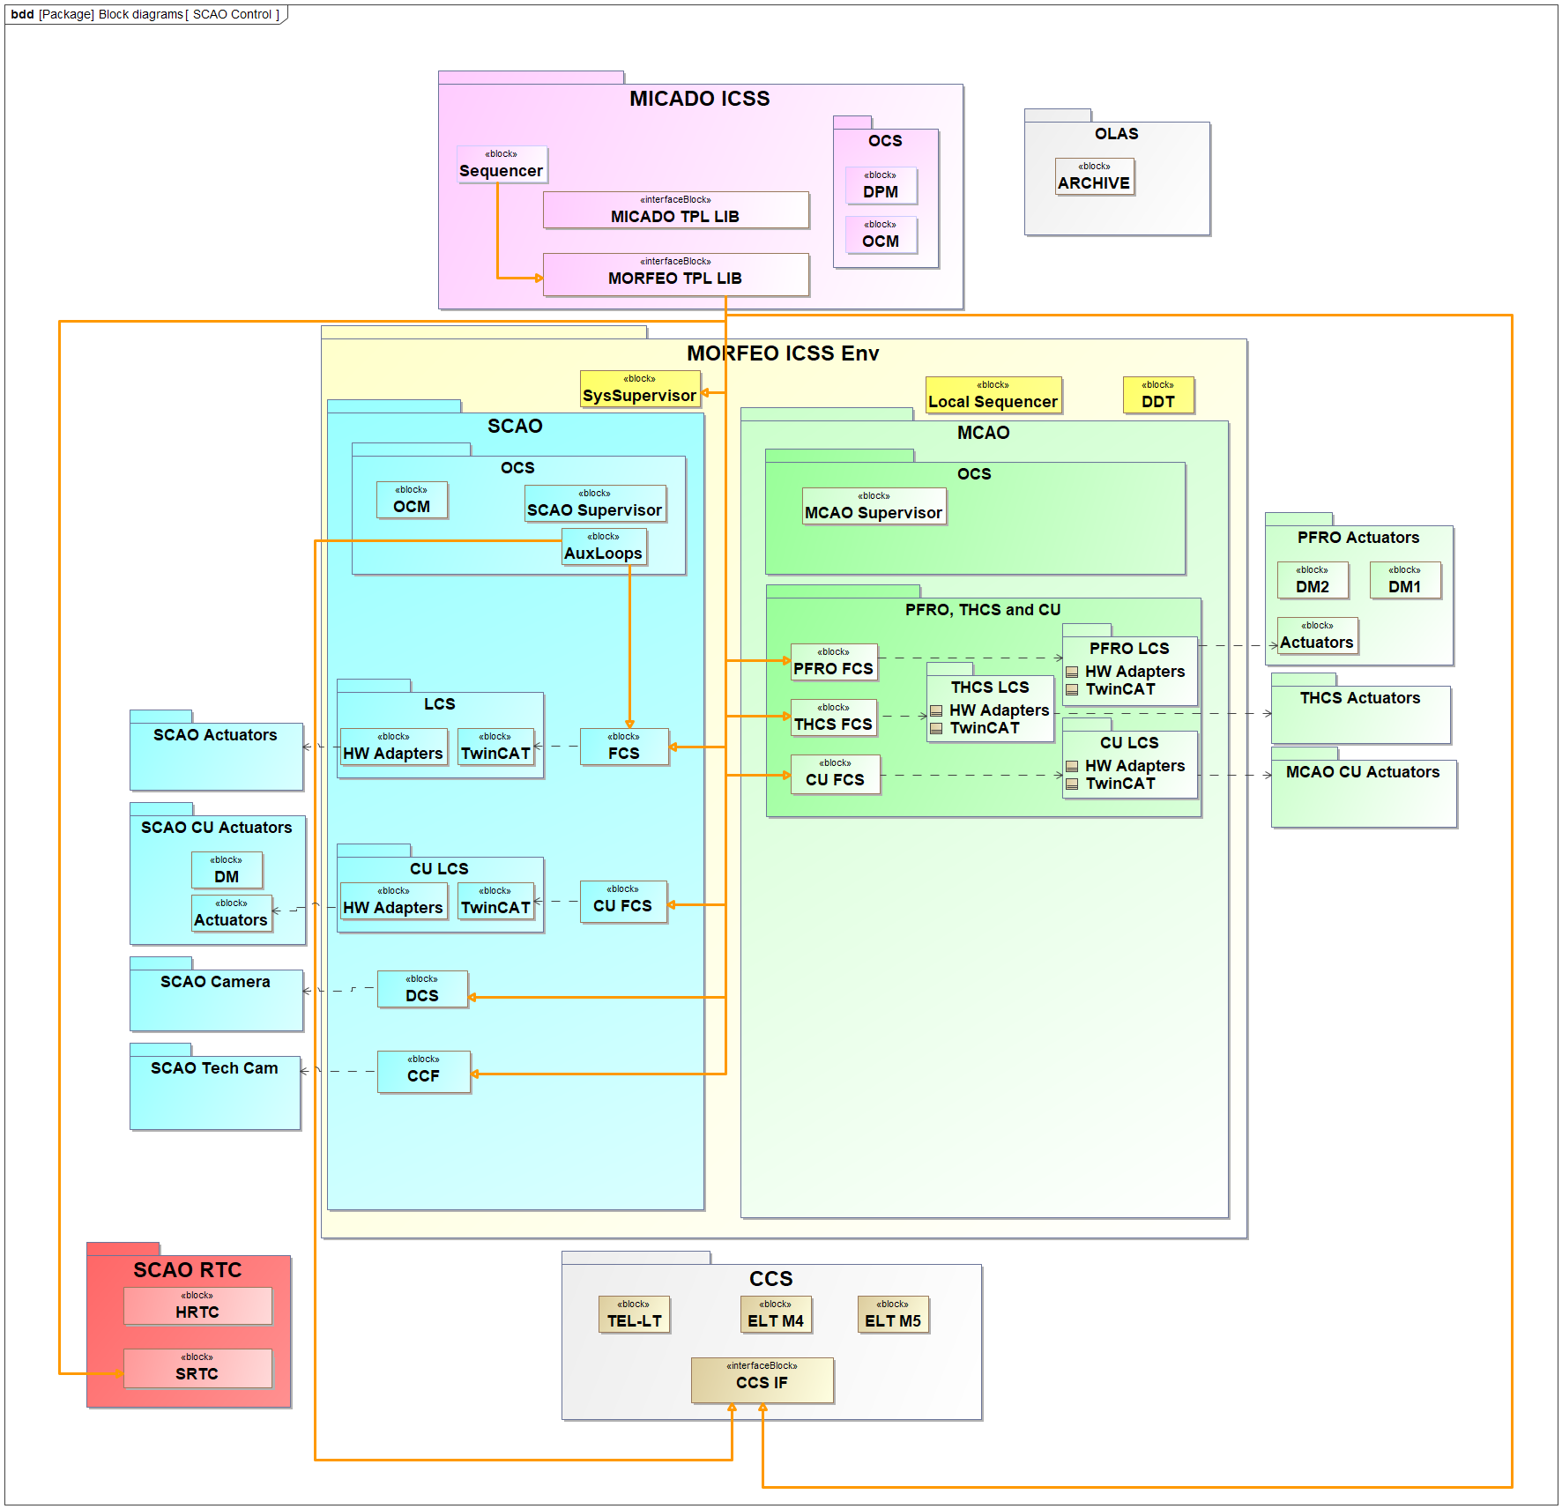
SOFTWARE ARCHITECTURE
PECULIARITIES
Different software components are involved for SCAO and MCAO. In general we can distinguish 4 use cases:
MICADO operating in MORFEO MCAO mode
MICADO operating in MORFEO SCAO mode
MICADO operating in "MICADO stand-alone" mode
MORFEO operating in "MORFEO stand-alone" mode

Slide 14
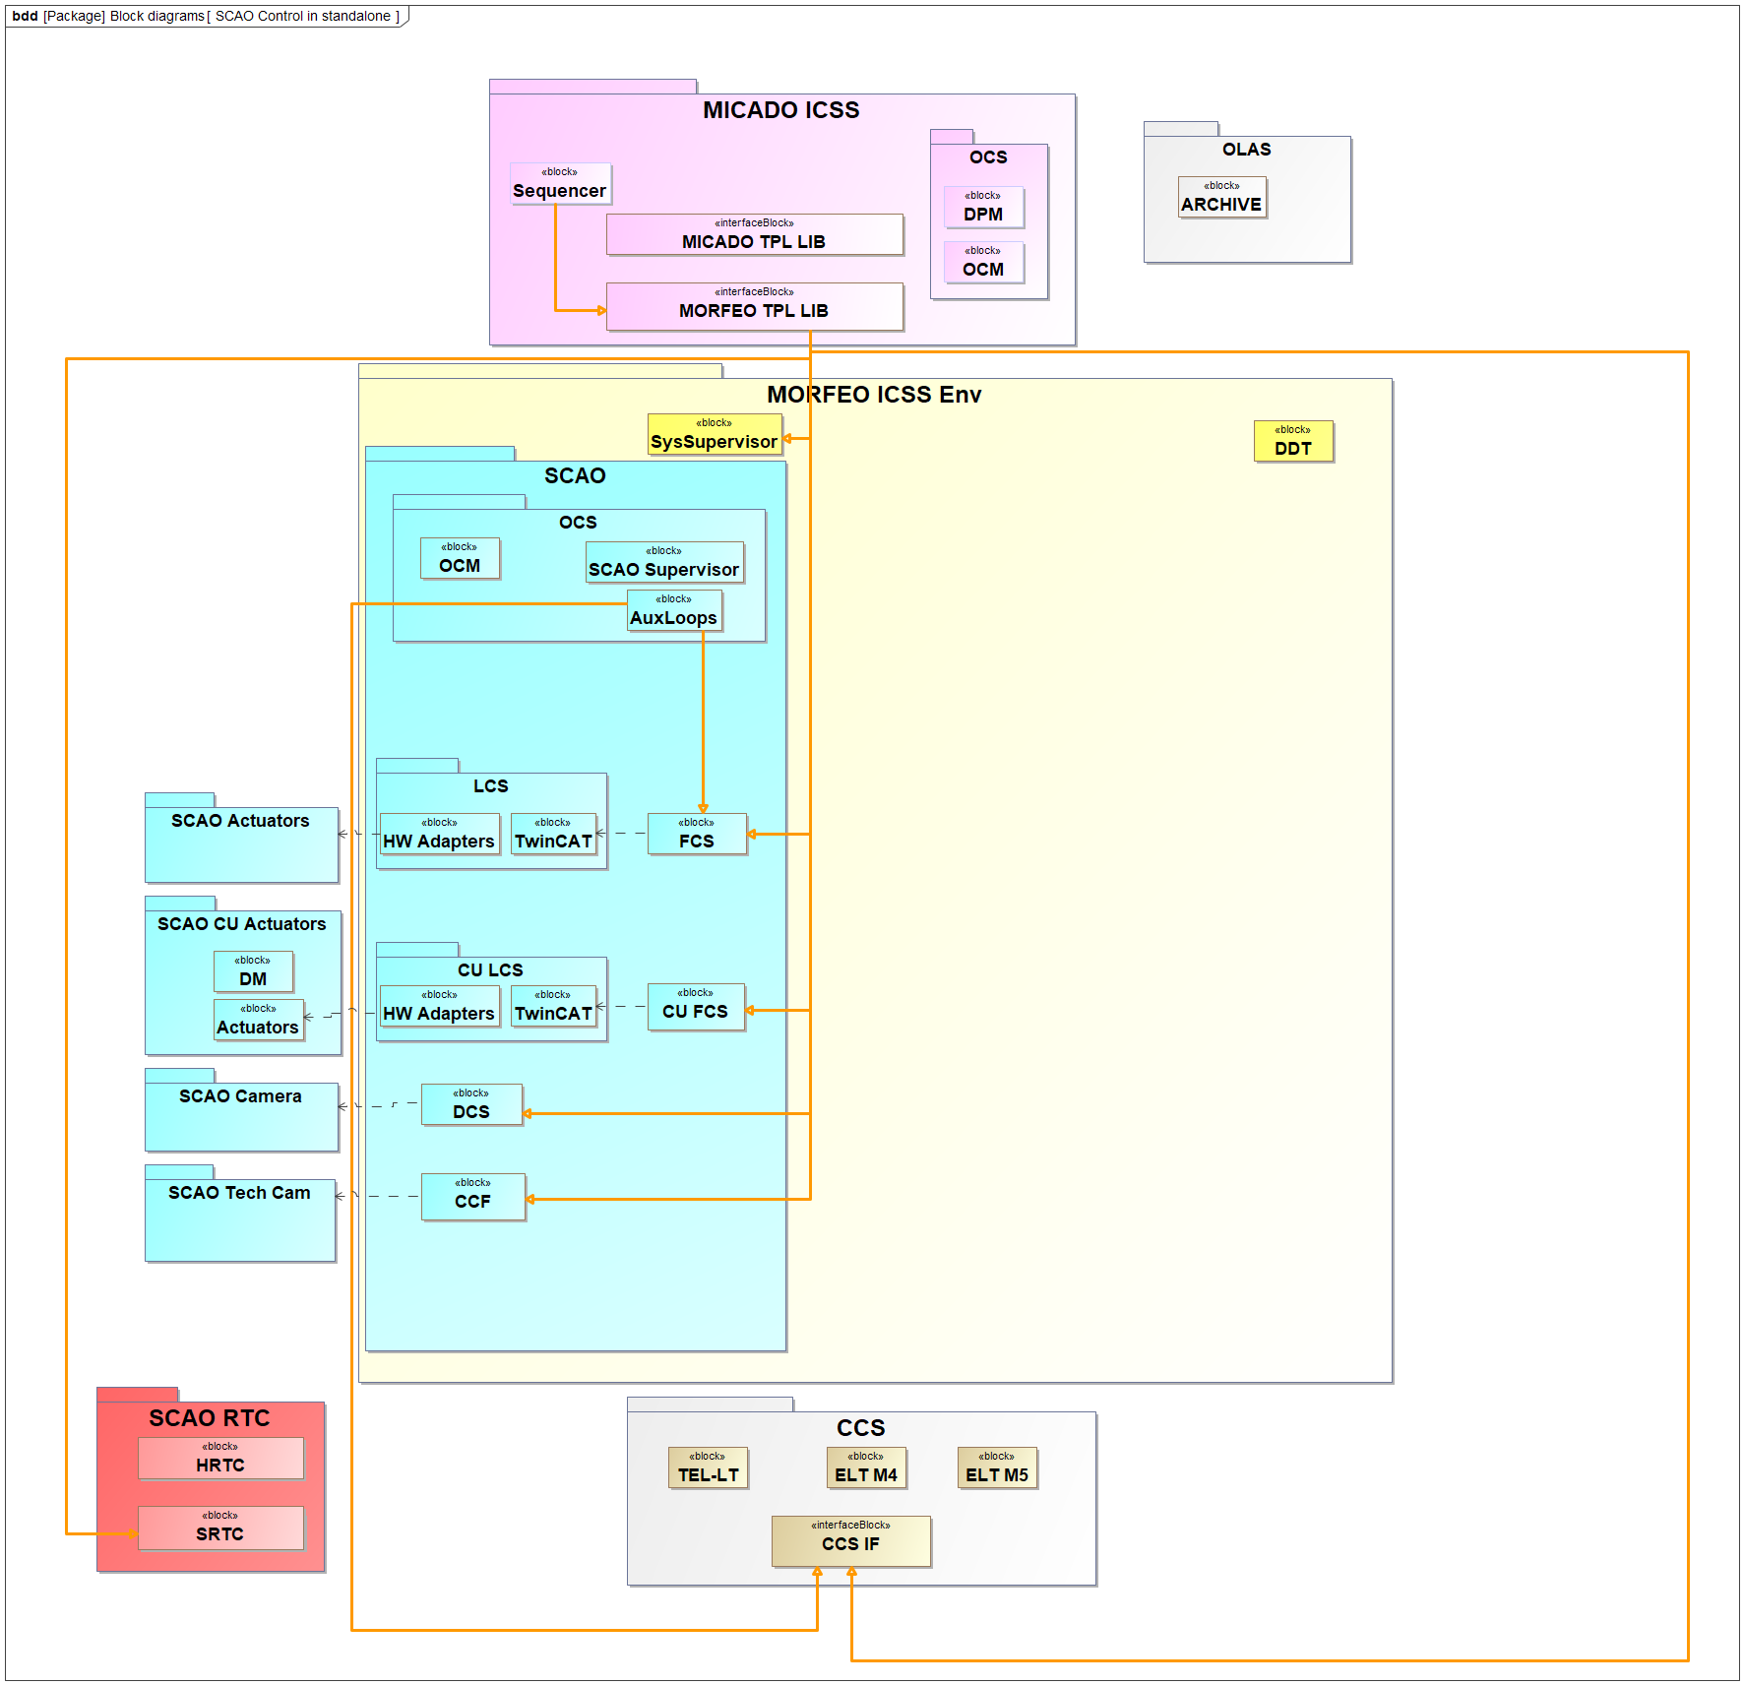
SOFTWARE ARCHITECTURE
PECULIARITIES
Different software components are involved for SCAO and MCAO. In general we can distinguish 4 use cases:
MICADO operating in MORFEO MCAO mode
MICADO operating in MORFEO SCAO mode
MICADO operating in "MICADO stand-alone" mode
MORFEO operating in "MORFEO stand-alone" mode
This mode is used when MORFEO opto-mechanics is not physically present.

Slide 15
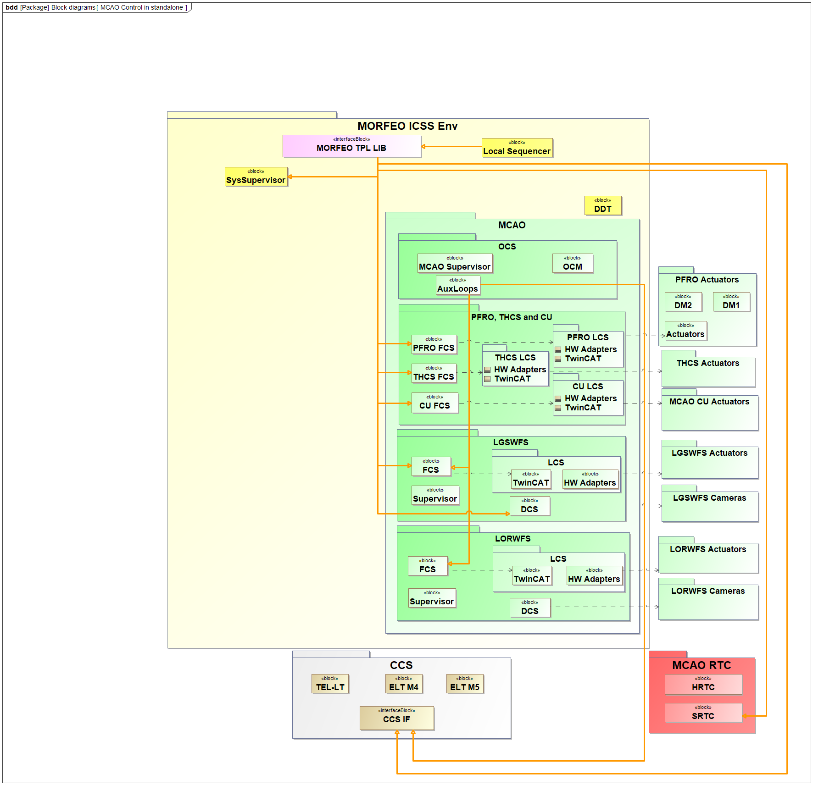
SOFTWARE ARCHITECTURE
PECULIARITIES
Different software components are involved for SCAO and MCAO. In general we can distinguish 4 use cases:
MICADO operating in MORFEO MCAO mode
MICADO operating in MORFEO SCAO mode
MICADO operating in "MICADO stand-alone" mode
MORFEO operating in "MORFEO stand-alone" mode
In this mode MORFEO uses its own Sequencer and its own DPM to run inner calibrations which do not require any MICADO function and to save the produced output files.

Slide 16
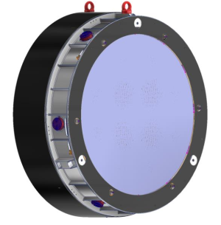
Example of special device
DM shape control – top level requirements
DMs shape control. ICSS shall control (set the shape) of each DM bypassing MORFEO RTC. The functionality is required when MORFEO is operating in SCAO mode.
DMs states. MORFEO ICSS shall be able to change and monitor the state (notOperational, operational) and substates (ready, idle, error, rtcEnabed, rtcDisabled) of both the DMs.
DMs control enable/disable. MORFEO ICSS shall be able to enable/disable the reception of commands from RTC
Optical diameter: 930 mm
1026 actuators, ~500 kg
Provided by Adoptica (Microgate + A.D.S.)
DMs FDR review is ongoing

Slide 17
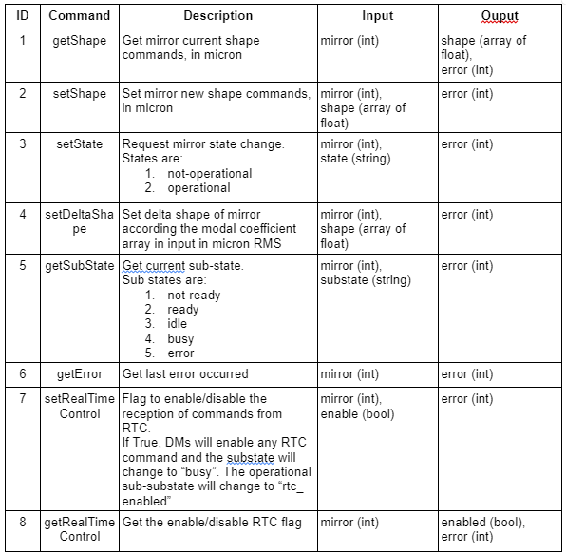
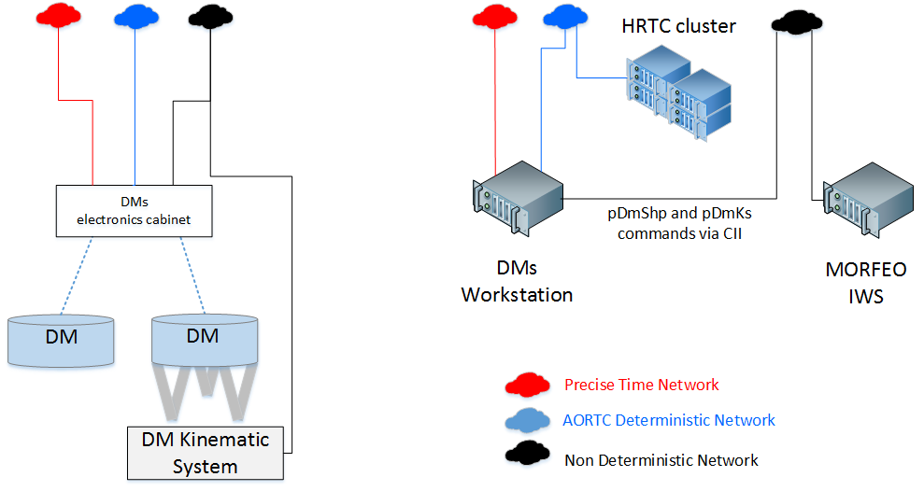
Example of special device
DM shape control - requirements
The DMs are controlled by a dedicated WS
The DMs SW is provided by Microgate
MORFEO needs to interface with it.

Slide 18
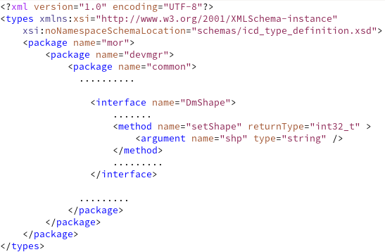

Example of special device
DM shape control
We adapted the “mirror” device
Communication between special device (client) and DM WS (server) is based on CII/MAL zpb.rr protocol.
The interface is defined in an xml file. Example: setShape
We use the waf tool “declare_ malicd” to generate, from the icd, sync and async communication classes for both server and client
The special device class uses an object derived from the sync class implementing the zpb communication

Slide 19
waf build
pdmshp.xml
Operational/Idle
with IFW5
declare_malicd
ESO framework
abstract class ::elt::mal::rr::RrEntity
waf tools generated
MORFEO ICSS
class mor::mcao::pfro::fcs::AsyncDmShape : public virtual ::elt::mal::rr::RrEntity
class mor::mcao::pfro::fcs::DmShape :
public virtual ::elt::mal::rr::RrEntity
class inheritance
class mor::mcao::pfro::fcs::AsyncDmShapeImpl : public mor::mcao::pfro::fcs::AsyncDmShape
SERVER
class mor::mcao::pfro::fcs::DmShapeImpl : public mor::mcao::pfro::fcs::DmShape
class fcf::devmgr::common::DataContext
class mor::mcao::pfro::fcs::DmShapeAsync :
public mor::mcao::pfro::fcs::AsyncDmShape,
public ::elt::mal::rr::ClientRrEntity
CLIENT
class mor::mcao::pfro::fcs::DmShapeSync :
public mor::mcao::pfro::fcs::DmShape,
public ::elt::mal::rr::ClientRrEntity
abstract class fcf::devmgr::common::IDeviceConfig
abstract class fcf::devmgr::common::IDevice
class fcf::devmgr::common::DeviceConfig : public fcf::devmgr::common::IDeviceConfig
abstract class fcf::devmgr::common::Device
std::shared_ptr<DeviceLcsIf> m_lcs_if
abstract class protocol::base::IComm
class fcf::devmgr::common::DeviceLcsIf
std::shared_ptr<protocol::base::IComm> m_comm
virtual void Connect();
virtual void Disconnect();
……….
class mor::devmgr::common::morcomm::MorComm : public protocol::base::IComm
virtual void Connect(...)
virtual void Read(...)
virtual void Write(...)
virtual void Rpc(...)
…..
//! zpb client object
std::unique_ptr<DmShapeAsync> m_pDmShapeAsyncClient;
std::unique_ptr<DmShapeSync> m_pDmShapeSyncClient;
virtual std::shared_ptr<elt::mal::Mal> getMal()
virtual elt::mal::future<void> asyncConnect()
….
virtual ListnerRegistration registerConnectionListner(...)
virtual ::elt::mal::future<int32_t> setShape(vector<int32_t> commands)
virtual ::elt::mal::future<int32_t> setDeltaShape(const std::string & delta)
…….
IComm
class Pdmshp : public fcf::devmgr::common::Device
virtual void Init() override;
virtual void Setup(const std::any & payload)
….
Pdmshp(const std::string &filename …);
void CreateObjects(std::share_ptr<IDeviceConfig> config = nullptr) override;
…
int setShape(vector<int32_t> commands);
RrClient
class pdmshpLcsIf : public fcf::devmgr::common::DeviceLcsIf
…..
int setShape(vector<int32_t> commands);
ICD
Notes:
PSEUDO class diagram
DeviceLcsIf is already provided by the template instrument (➔ generated by cookiecutter)

Slide 20
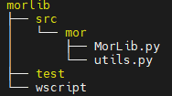

Interface with MICADO
MorLib python library - goal
During standard operations MICADO is the instrument and acts as master: the OBs are MICADO’s OBs
All MICADO templates will be executed by the Sequencer application that is part of the MICADO ICSS
MICADO cannot access directly to MORFEO functionalities
MORFEO TPL_LIB (ESO-351580) is a Python library used by MICADO, at template
level, to control some MORFEO AO functionalities (acquire, close loop etc)
MORFEO TPL_LIB (called MorLib in the example) is developed by MORFEO and
will be the only MORFEO code running on the MICADO workstation.
If properly designed, MORFEO TPL_LIB can be deployed in MORFEO
too and used primarily to create and execute templates in standalone mode.
Notes:
MorLib is what we called MORFEO TPL_LIB in the previous slides

Slide 21
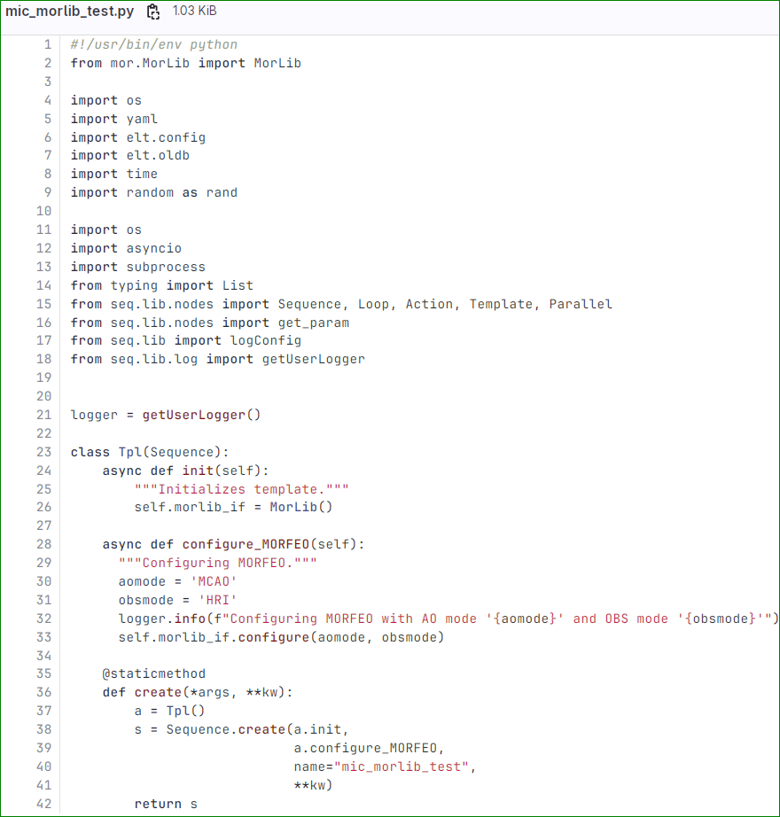
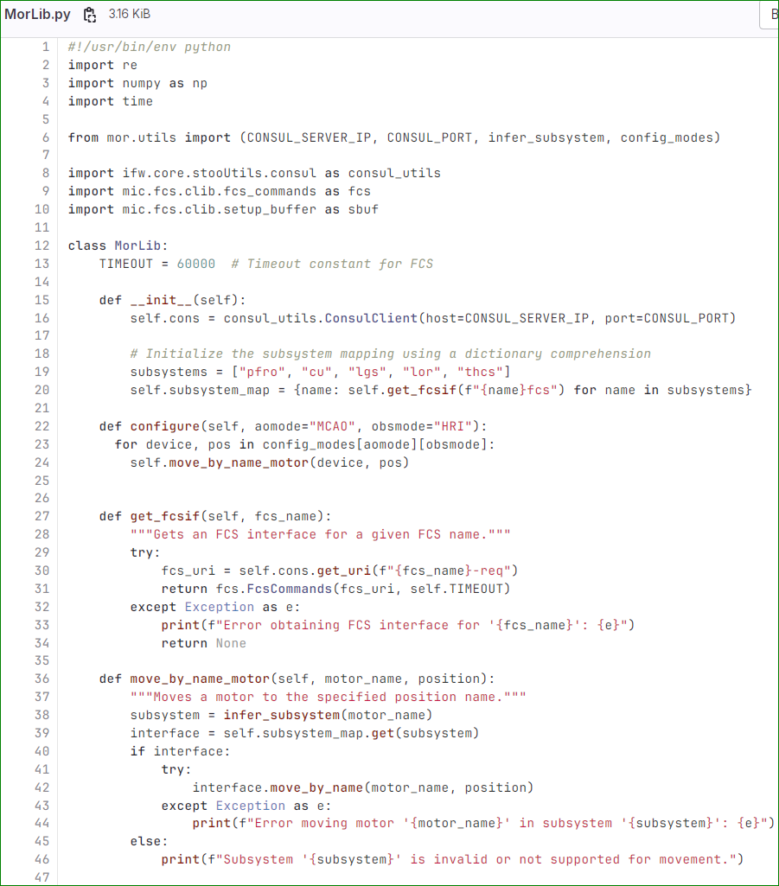
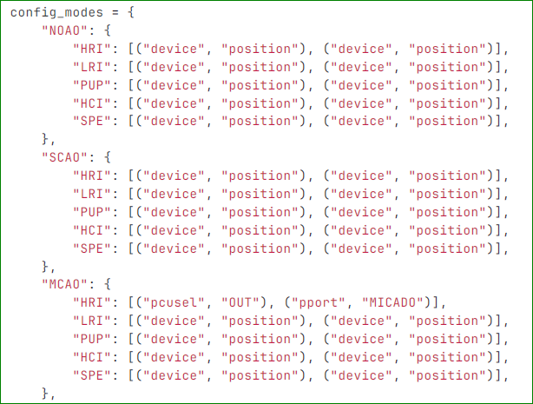
Interface with MICADO
MorLib python library - Example
Notes:
Import and instantiate the class

Slide 22
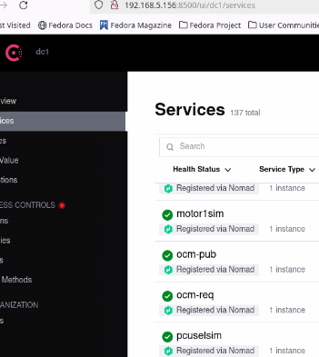

Interface with MICADO
MorLib python library - Example configuration
The previous example assumes that:
MICADO and MORFEO Consul services are configured as client of a common Consul server
In our prototype, the Consul server runs in the CII server node. This ensures interoperability between MICADO and MORFEO, allowing visibility of deployed jobs from either workstation.
MICADO and MORFEO runs their own nomad service. Nomad service is not running in the CII server
PRO (or CONS?): visibility of deployed jobs from either workstation
CONS: When deploying Nomad jobs with the same name from different machines (ccf in our case), it is essential to ensure that the connection is routed to the correct Consul service. This can be done by specifying the correct machine IPs in the YAML files for each job deployment.
MICADO job
MORFEO job
ccfDdt.yaml.tpl: req_endpoint: 'zpb.rr://{{ range service "ccf-pub" }}{{ if eq .Address "193.206.241.175" }}{{ .Address }}:{{ .Port }}{{ end }}{{ end }}/'
ccfDdt.yaml.tpl: req_endpoint: 'zpb.rr://{{ range service "ccf-pub" }}{{ if eq .Address "192.168.5.112" }}{{ .Address }}:{{ .Port }}{{ end }}{{ end }}/'

Slide 23
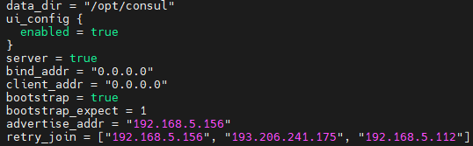
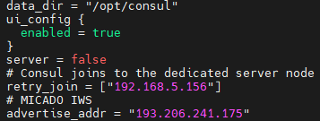
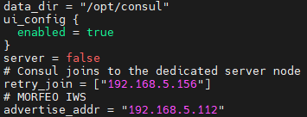
Interface with MICADO
MorLib python library - Example configuration
CII node
192.168.5.156
MICADO node
193.206.241.173
MORFEO node
192.168.5.112
/etc/consul.d/consul.hcl

Slide 24
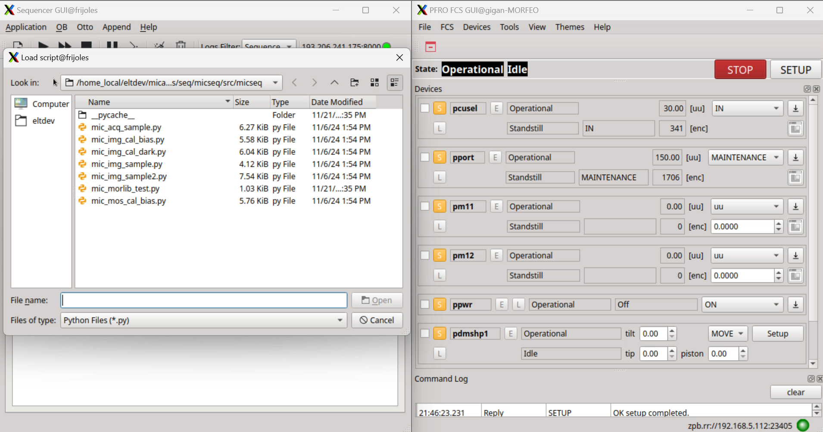
Interface with MICADO
MorLib python library - DEMO
MICADO VM
MORFEO VM

Slide 25


Thank you for your attention
MORFEO ICSS Team:
Bernardo Salasnich, Andrea Baruffolo, Daniela Fantinel, Elia Costa, Fabrice Pancher, Mirko Colapietro, Fulvio Laudisio, Benedetta Di Francesco, Tommaso Lapucci, Daphne Diretto
team.new_member_init(tommaso, daphne)

Slide 27
Example of special device
DM shape control
int Pdmshp::setShape(vector<int32_t> commands) {
........
std::unique_ptr<pdmshpLcIf> pdmshp_if = static_cast<pdmshpLcsIf>(m_lcs_if);
int result = pdmshp_if->setShape(commands);
........
return result;
}
int pdmshpLcsIf::setShape(vector<int32_t> commands){
........
std::unique_ptr<MorComm> morComm = static_cast<MorComm>(m_comm);
int result = morComm->setShape(commands);
........
return result;
}
int MorComm::setShape(vector<int32_t> commands){
........
int result = m_pDmShapeSyncClient->setShape(commands);
........
return result;
}

