Slide 1
ELT Instrument Control Systems Seminar 2024
Project Presentation: HARMONI ICS
M. Larrieu, S. Guieu
27/11/2024

Slide 2
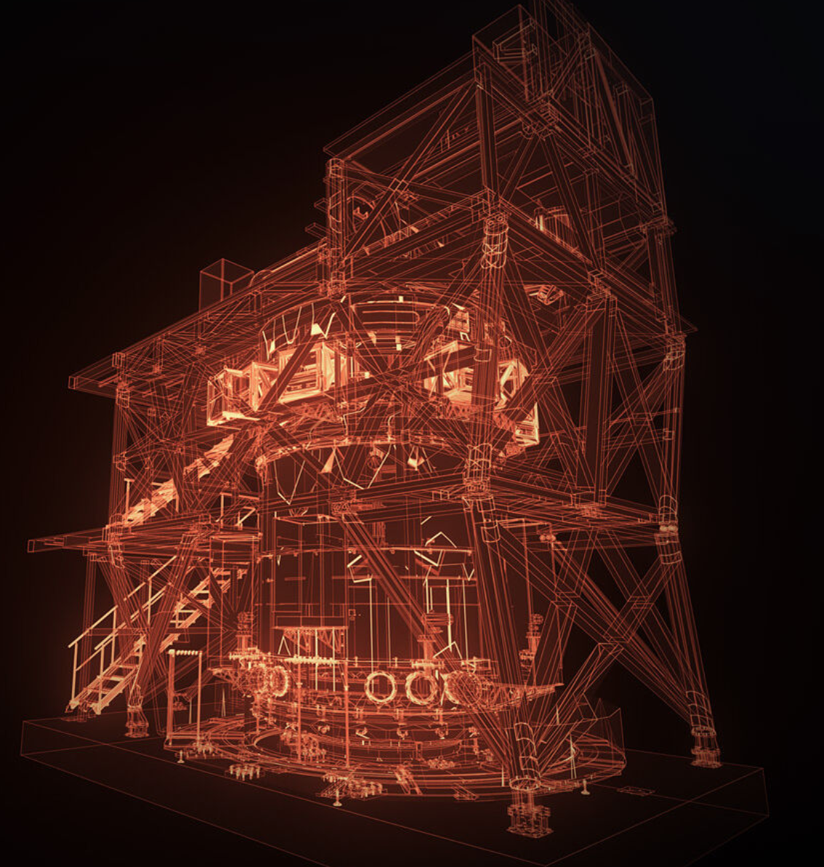
Agenda
1. Overview
  HARMONI, the ELT IFS
  Consortium and time line
  Organisation of HARMONI ICS
  Computing units
  Field buses
2. FCS
  List of devices
  Approach with SmarAct devices
  List of FCSs
  Code generation tools
  Interface with ICE, CECS
3. OCS
  Interface with AOCS
  Data product Management
  Quick look tools
  Pointing model and tracking device architecture
  Secondary processes and their role

Slide 3
1. OVERVIEW

Slide 4
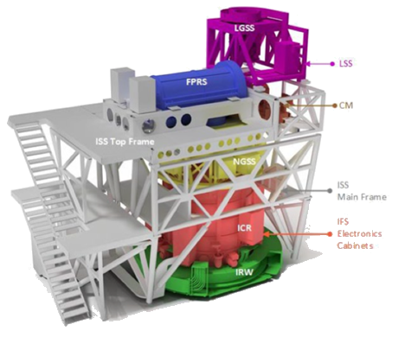
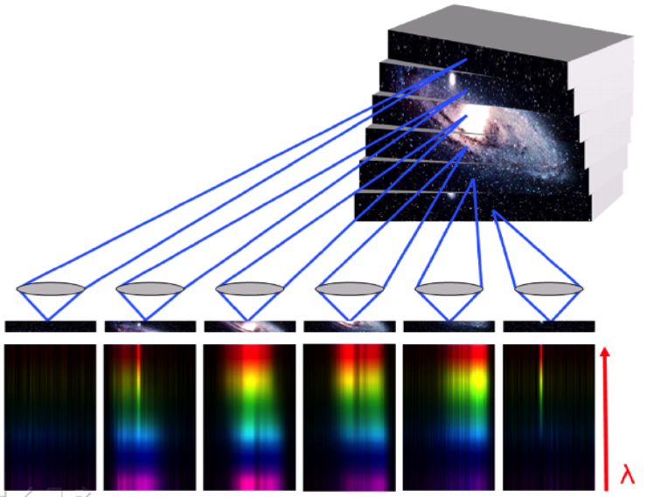
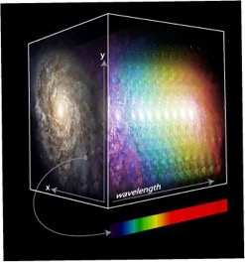
1. HARMONI, the ELT IFS
Integral Field Spectrograph
Science cases
Cosmology, Galaxy Evolution and Black Holes
Stellar Population & Star formation & Transient
Solar System, exo-planet
4 opto-mechanical systems
CARS
Calibration and Relay System
LGSS
Laser Guide Star System
NGSS
Natural Guide Star System
IFS
Integral Field Spectrograph
Field Splitter Optics
Key specs
4 scales (4 to 60 mas/pix)
FOV : 0,6” x 0,8” to 6 x 9"
VIS & NIR (0.4 - 2.4 µm)
R from 3000 to 17000
4 observation modes
NOAO
No Adaptive Optics
LTAO
Laser Tomographic AO
3D data cube
SCAO
Single Conjugate AO
HCAO
High Contrast AO

Slide 5
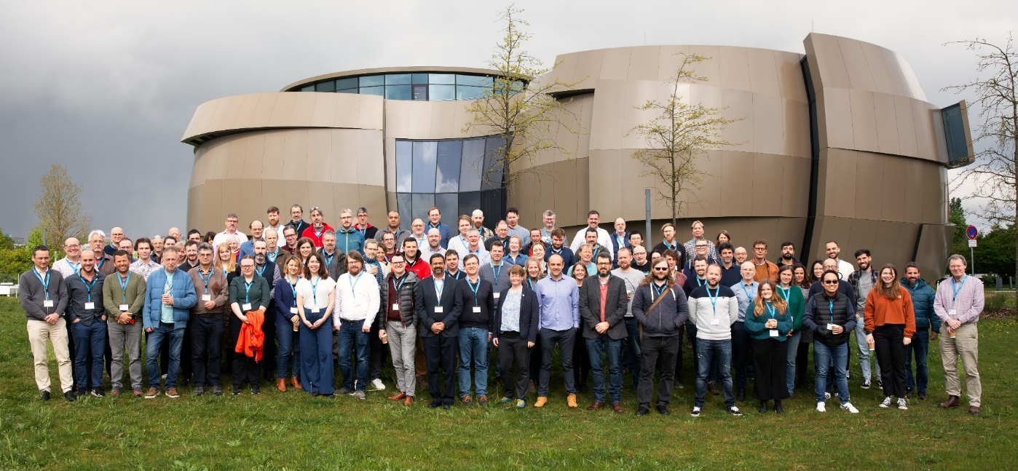





1. Consortium and time line
HARMONI
PI: vacant (U. of Oxford)
PM: Stephen Chittick (UKATC)
SE: Phil Rees & Calum Lithgow (UKATC)
6 systems
HSS
HARMONI Science Software
CARS
Calibration and Relay System
LGSS
Laser Guide Star System
NGSS
Natural Guide Star System
IFS
Integral Field Spectrograph
HCS
HARMONI Control System
Phase A
2010
Project start
2015
PDR
2018
FDR 1 review
2020
ESO Red Flag
2022-2023
Rescoping
Now

Slide 6







1. Organisation of HARMONI ICS
ESO follow-up
Jens Knudstrup (SW)
Pablo Gutierrez (HW)
Rob Donaldson (AOCS)
Software lead discipline engineer:
Arlette Pecontal
Electronics lead discipline engineer: Luis Rodriguez
AO lead discipline engineer:
Tim Morris
HCS
HARMONI Control System
Manager: Dave Melotte
SE: Bethany Johnson
Not part of ICS
Low-level control of the instrument rotator (sub-contracted by UK-ATC)
Cryostat Environmental Control Software (UK-ATC)
Detector Control Software (ESO)
Technical Camera Control Software (University of Durham)
ICE
Instrument Control Electronics
Manager: Angel Alonso
Technical Lead: Luis Fernando & Yolanda Martin
ICS
Instrument Control Software
Manager: Marie Larrieu
Technical Lead: Sylvain Guieu
AOCS
AO Control Software
Manager: Andrew Dunn
Technical Lead: David Barr

Slide 7
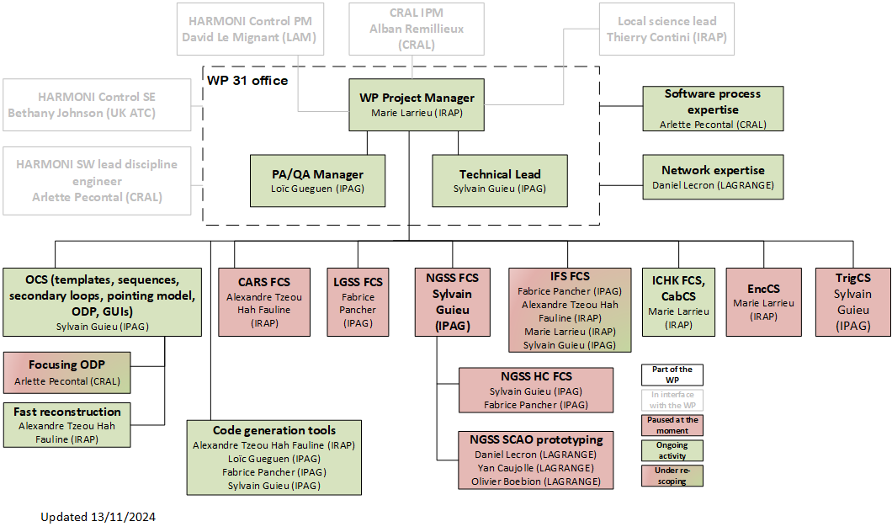
1. Organisation of HARMONI ICS
ESO follow-up
Jens Knudstrup
Impact of the re-scope

Slide 8
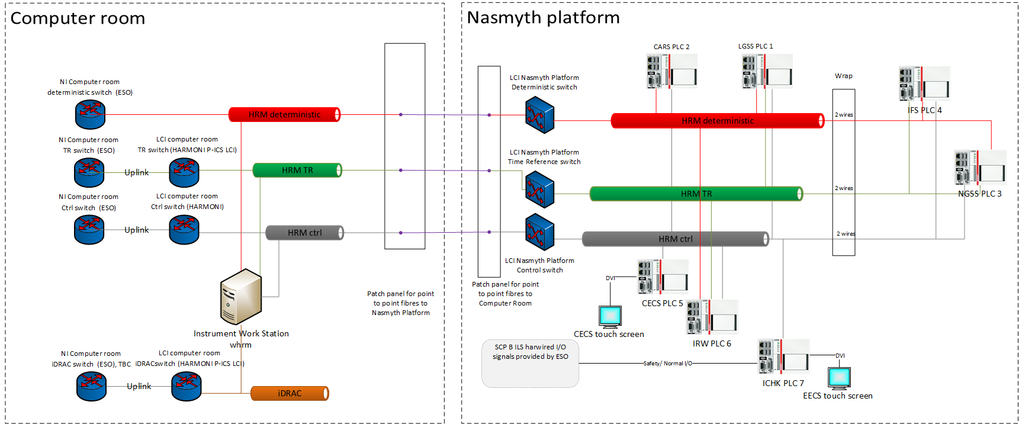
1. Computing units
1 IWS
7 PLCs

Slide 9
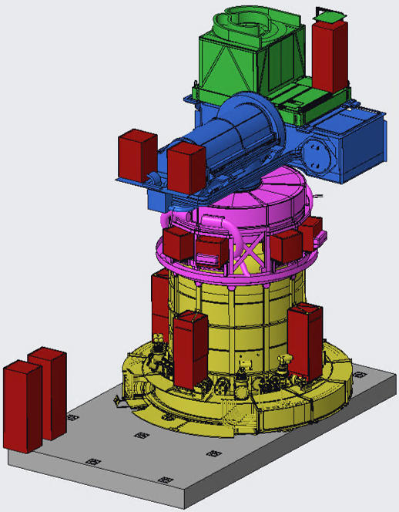
1. Field buses
7 PLCs => 7 EtherCAT branches
15 cabinets
C-LGSS
LGSS branch
LGSS
C-CARS1
C-CARS2
CARS branch
CARS
C_LGSS
C_CARS1
C_CARS2
ICHK branch
C-NGSS1
C-NGSS2
C-NGSS3
C-NGSS4
C-NGSS5
C-NGSS6
NGSS branch
NGSS
C_IFS6
C_NGSS1
C_NGSS2
C_NGSS3
C_NGSS4
C_NGSS5
C_NGSS6
C_CHK
C-IFS1
C-IFS2
C-IFS3
C-IFS4
IRW branch
IFS
IFS branch
IRW
C_IFS1
C_IFS2
C_IFS3
C_IFS4
ICHK
CECS
C_CHK
C_IFS6
CECS branch

Slide 10
2. FCS

Slide 11
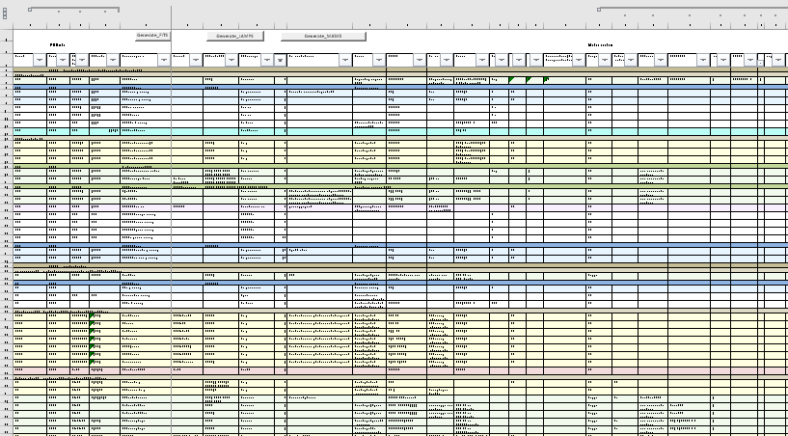
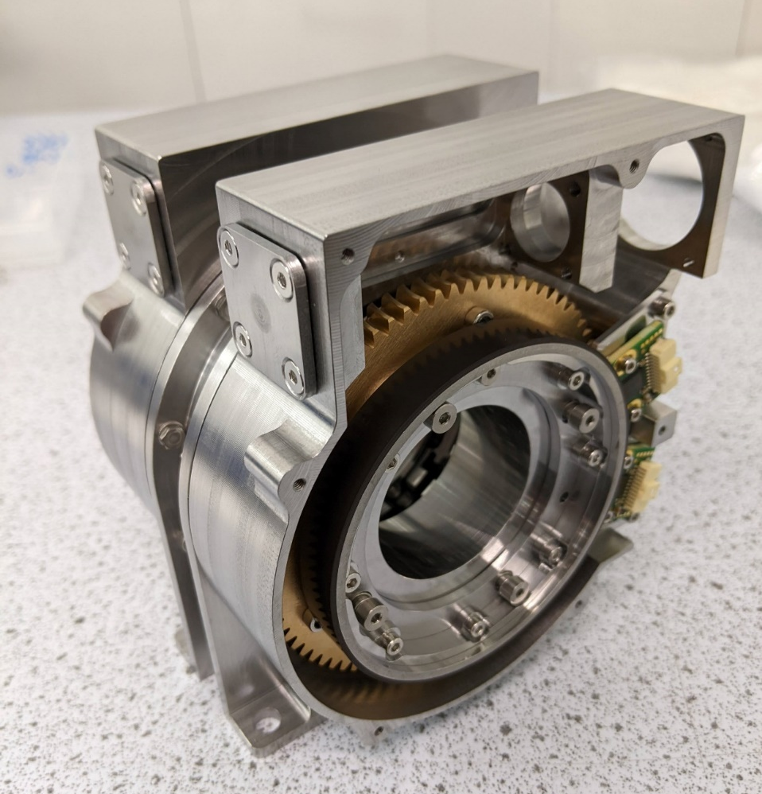
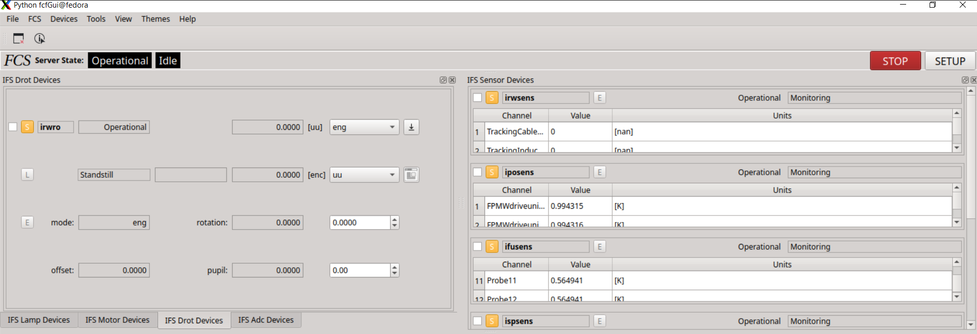
2. List of devices
HW side
98 axes
15 technical cameras
216 temp. probes
(…)
Standard SW devices
22 Lamps
21 Motors
Excel device list
LOB ADC mechanical structure
Test of standard control panel + Agile demos to the opto-mechanical teams

Slide 12
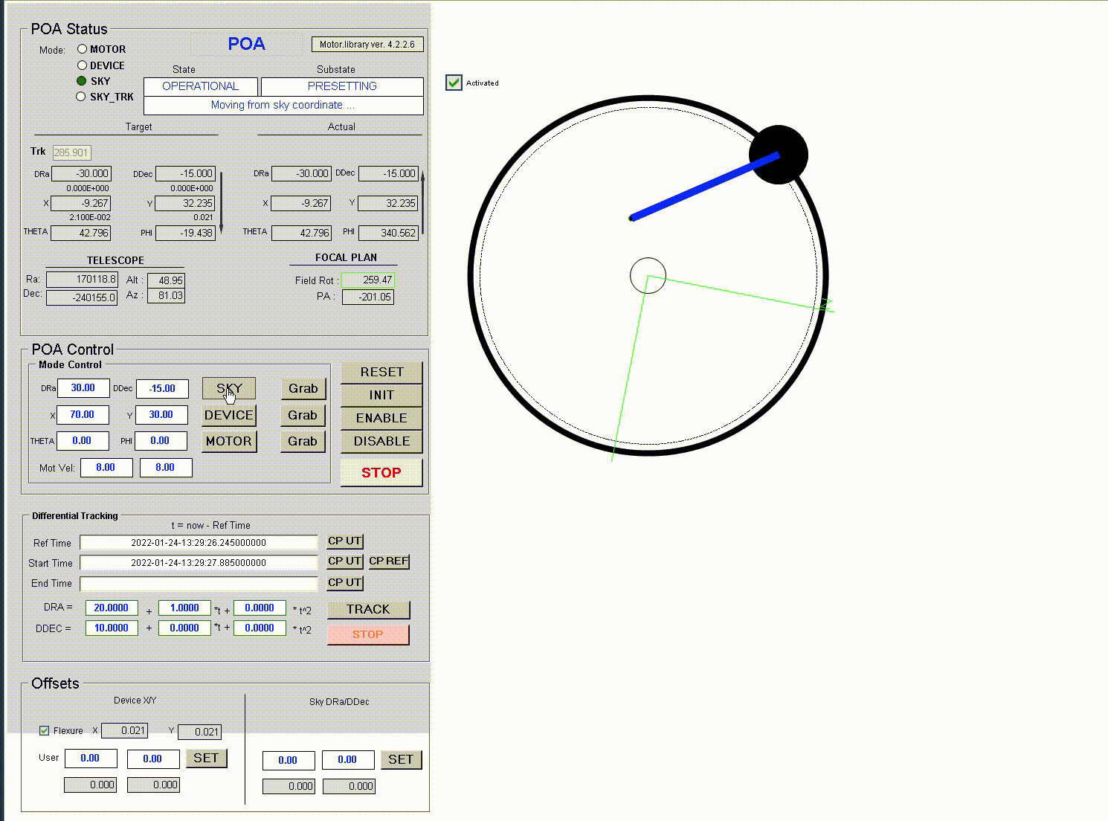
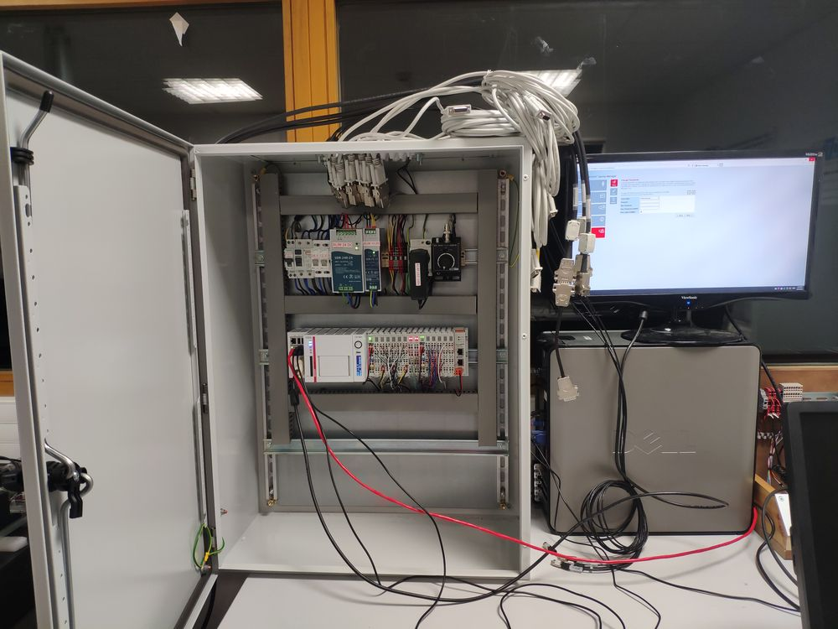
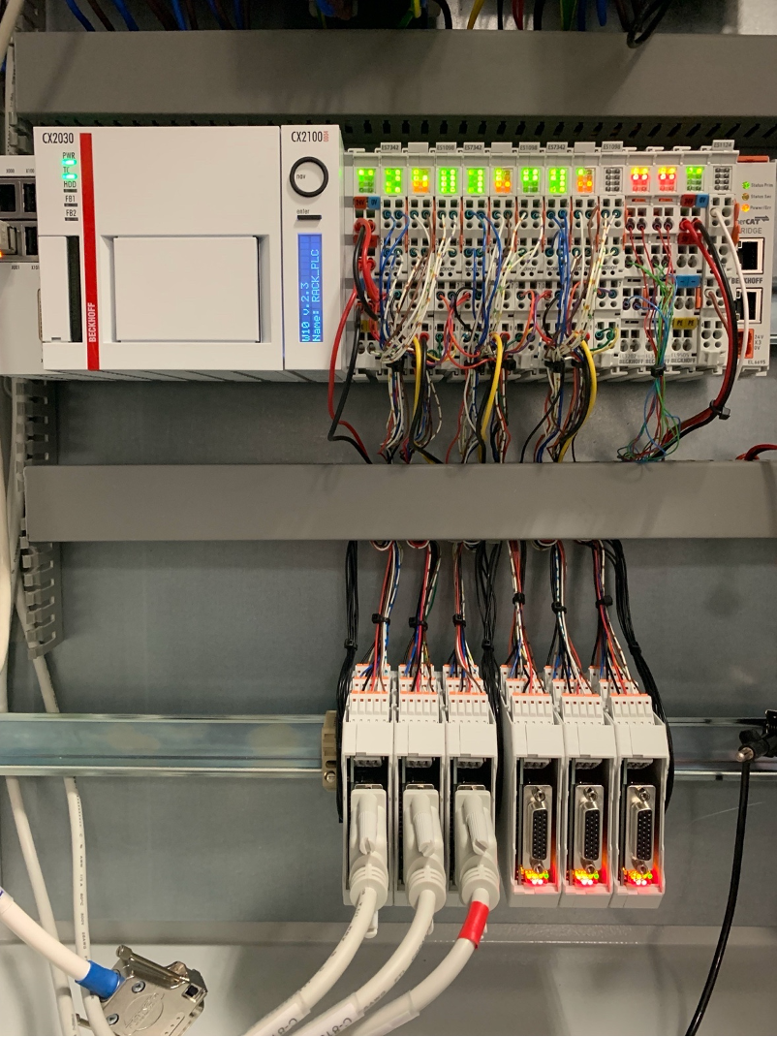
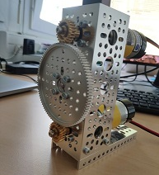

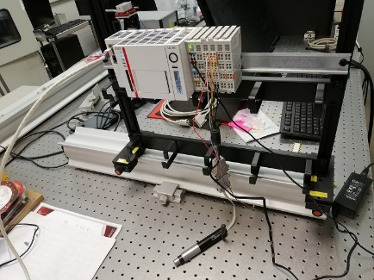

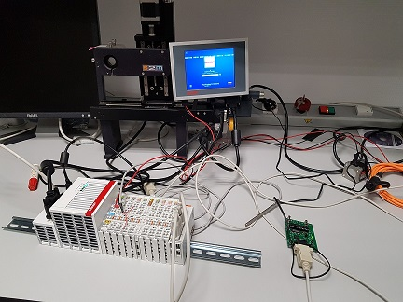



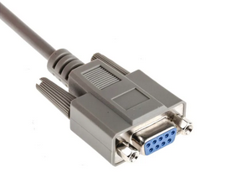
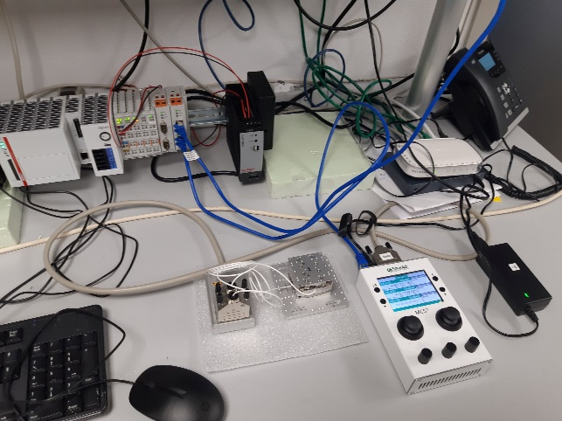
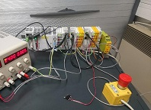
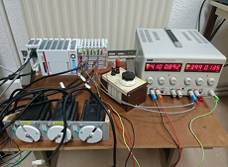
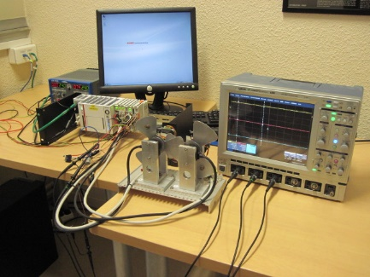
2. List of devices
Special / customized devices (set of HRM libraries)
34 IOdev (627 channels)
3 Motors
3 ROT
2 ADCs
10 Multi-axis
1 Serial RS232
1 Ethernet
5 SmarAct devices on 2 MCS2 controllers
Pick-Off Arm
High Contrast
Tandem control
Generic test bench
Pyramid modulator
Safety
Thermorack 1801
SmarAct OSM
LOB ADC
Fast Shutter

Slide 13
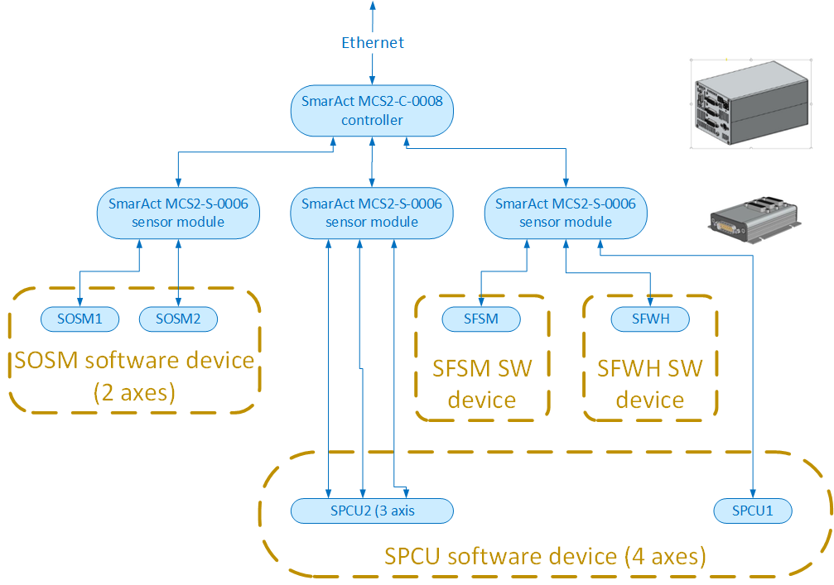
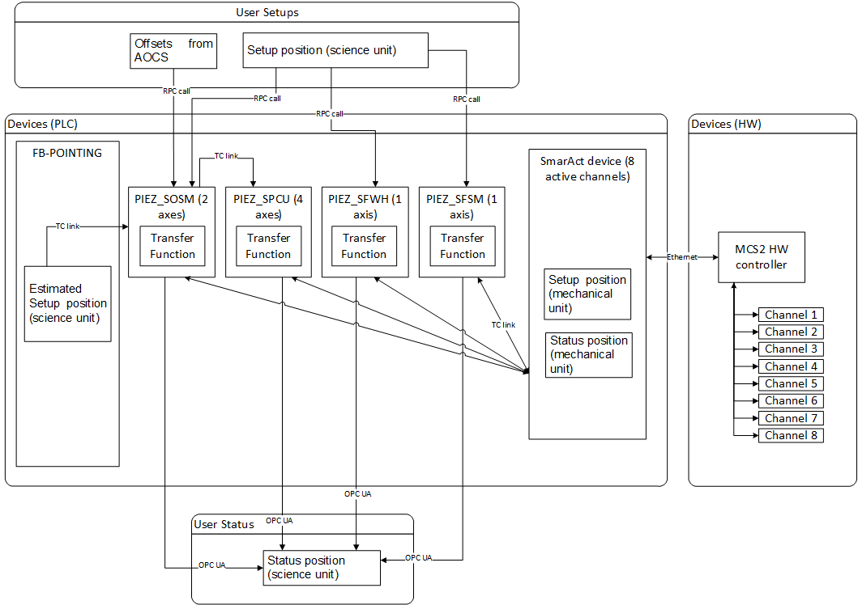
2. Approach with SmarAct devices

Slide 14
2. List of FCSs
Operational modes (ESO spec)
NIGHT
CALIB
DAY
Use cases / observation modes
NOAO
LTAO
SCAO
HCAO
Function Control SW
fcs1 33 devices
(always OP)
fcs2
33 devices
fcs3
12 devices
fcs4
4 devices
fcs5
22 devices
fcs6 61 devices
(always OP)
fcs7 TBC devices
(never OP)
Opto-mechanical system
IFS
CARS
NGSS
LGSS
HCS (ICHK)
IRW PLC
CARS PLC
NGSS PLC
LGSS PLC
PLC (current baseline)
IFS PLC
CECS PLC
ICHK PLC

Slide 15
2. List of FCSs
The fcs1 is grouping all devices necessary to configure the optical science path (warm and cold). It includes all dichroics, shutters, the instrument rotator and many other opto-mechanical devices.
The fcs2 is grouping all devices necessary for the LTAO observation mode, like the Low Order Wavefront Sensors and the Laser Guide Star system devices. The Pick-Off Arm is part of fcs2. The triggering unit in interface with LTAO and NOAO cameras (NGSC, NTRUC, NSGSC, NTTFC, NFIGC) is also part of fcs2.
The fcs3 is grouping all devices necessary for the SCAO observation mode, like the NGSS SCAO sub-system. The Object Selection Mirror is part of fcs3. The triggering unit in interface with SCAO and HC cameras (SPYRC, SBSHC and HZELC) is also part of fcs3.
The fcs4 is grouping all devices necessary of the HCAO observation mode, like the NGSS High Contrast subsystem.
The fcs5 is grouping all devices dedicated to the instrument calibration. Most of the calibration light sources are part of fcs5. Some calibration sources dedicated to SCAO use cases or LTAO use cases are not in fcs5.
The fcs6 is grouping the devices and subsystems dedicated to the instrument’s housekeeping and Safety (cabinet control module, cryo sensors, enclosure monitoring devices, power distribution and glycol distribution monitoring devices, TwinSAFE code).
The fcs7 is grouping the devices dedicated to the instrument alignment. They should never be touched, except at the installation and maybe after an earthquake. Their monitoring (encoder…) should be part of another fcs.

Slide 16
2. Code generation tools
Justification
Large number of devices
A large number of sensors
Many Special devices
Plenty of information already available on the system engineering device list
Right now, on HARMONI, we have extra time and resources available with EFISOFT
Generic tools that can be used on other instruments

Slide 17
2. Code generation tools
Three Generation Tools
DevExport
TwinIoExport
Tmc2fcs generator & tmc2fcs templates

Slide 18
2. Code generation tools
Three Generation Tools:
“Instances” | “Classes”
DevExport
Tmc2fcs
TwinIOExport
For:
Better Quality Control
Better reactivity over requirement changes
Better reactivity over IFW SW changes
More time for other (important) things

Slide 19
2. Code generation tools
Alexandre Tzeou
Devexport : Write All configuration file of std device for each fcs
DevExport (python)
Data
Device List
(Online db
etc…)
Configuration Files
Devmgr cfg
Devsim
Nomad
Fcs# cfg
Importer
Python Structure
Exporter
Templates
- So far planned to be used only in early development phase and AIT (no two ways sync)
- Make more sense if you have a shared storage of device information in the project

Slide 20
2. Code generation tools
Alexandre Tzeou
TwinIOExport : Generate PLC code and HL Software for Sensors (IODEV)
Configuration Files
Devmgr cfg
Devsim
Namespace Mapping
TwinIOExport (python)
Data
Device List
(Online db
etc…)
Importer
Python Structure
Exporter
PLC Code
FB_IODEV_*
Templates
- Can be used for a long time in the project

Slide 21
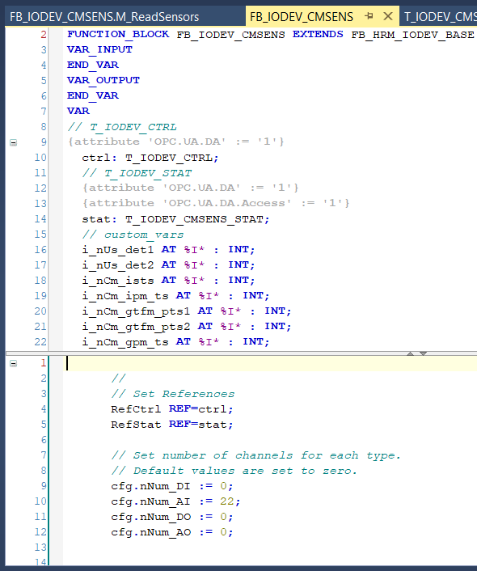
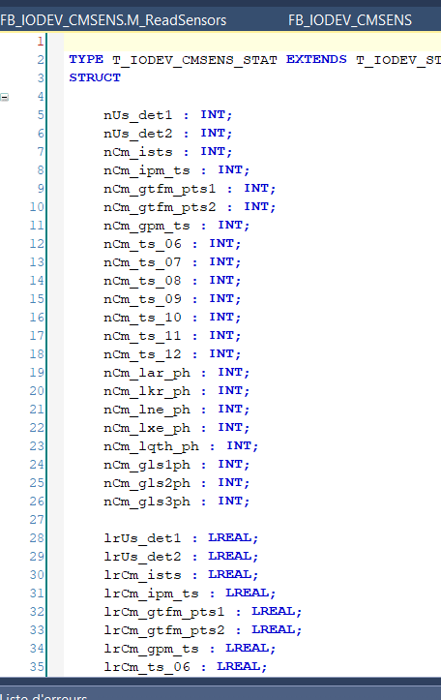
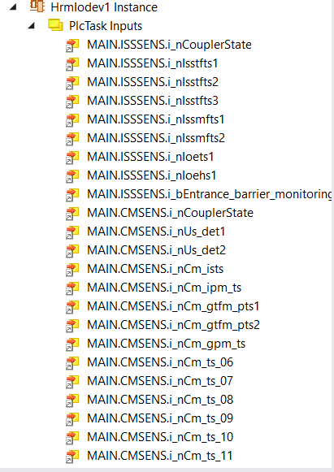
2. Code generation tools
Alexandre Tzeou
TwinIOExport : Generate PLC code and HL Software for Sensors (IODEV)

Slide 22
2. Code generation tools
Code Generation of Special devices
Ideally: We would like to have a model definition of a Device and generate everything but logic business
BUT
- Not Trivial : Model can be as complicated as the code itself
- Time consuming development for the tool
PLC TW3
ST Core
Device Model
Generator
High Level code
- devmgr classes
- devsim
- GUI (draft)
- test sw

Slide 23
2. Code generation tools
Loïc Gueguen
tmc2fcs: Code Generation of Special devices (beta)
Tmc2fcs generator
High Level code
- devmgr classes
- devsim
- GUI (draft)
- test sw
PLC TW3
ST Core
Tmc file
Beckhoff
Tmc2fcs Template

Slide 24
2. Code generation tools
Loïc Gueguen
tmc2fcs: Code Generation of Special devices (beta)
Tmc2fcs generator
High Level code
- devmgr classes
- devsim
- GUI (draft)
- test sw
PLC TW3
ST Core
Tmc file
Beckhoff
Tmc2fcs Template
State Machine
Scxml file

Slide 25
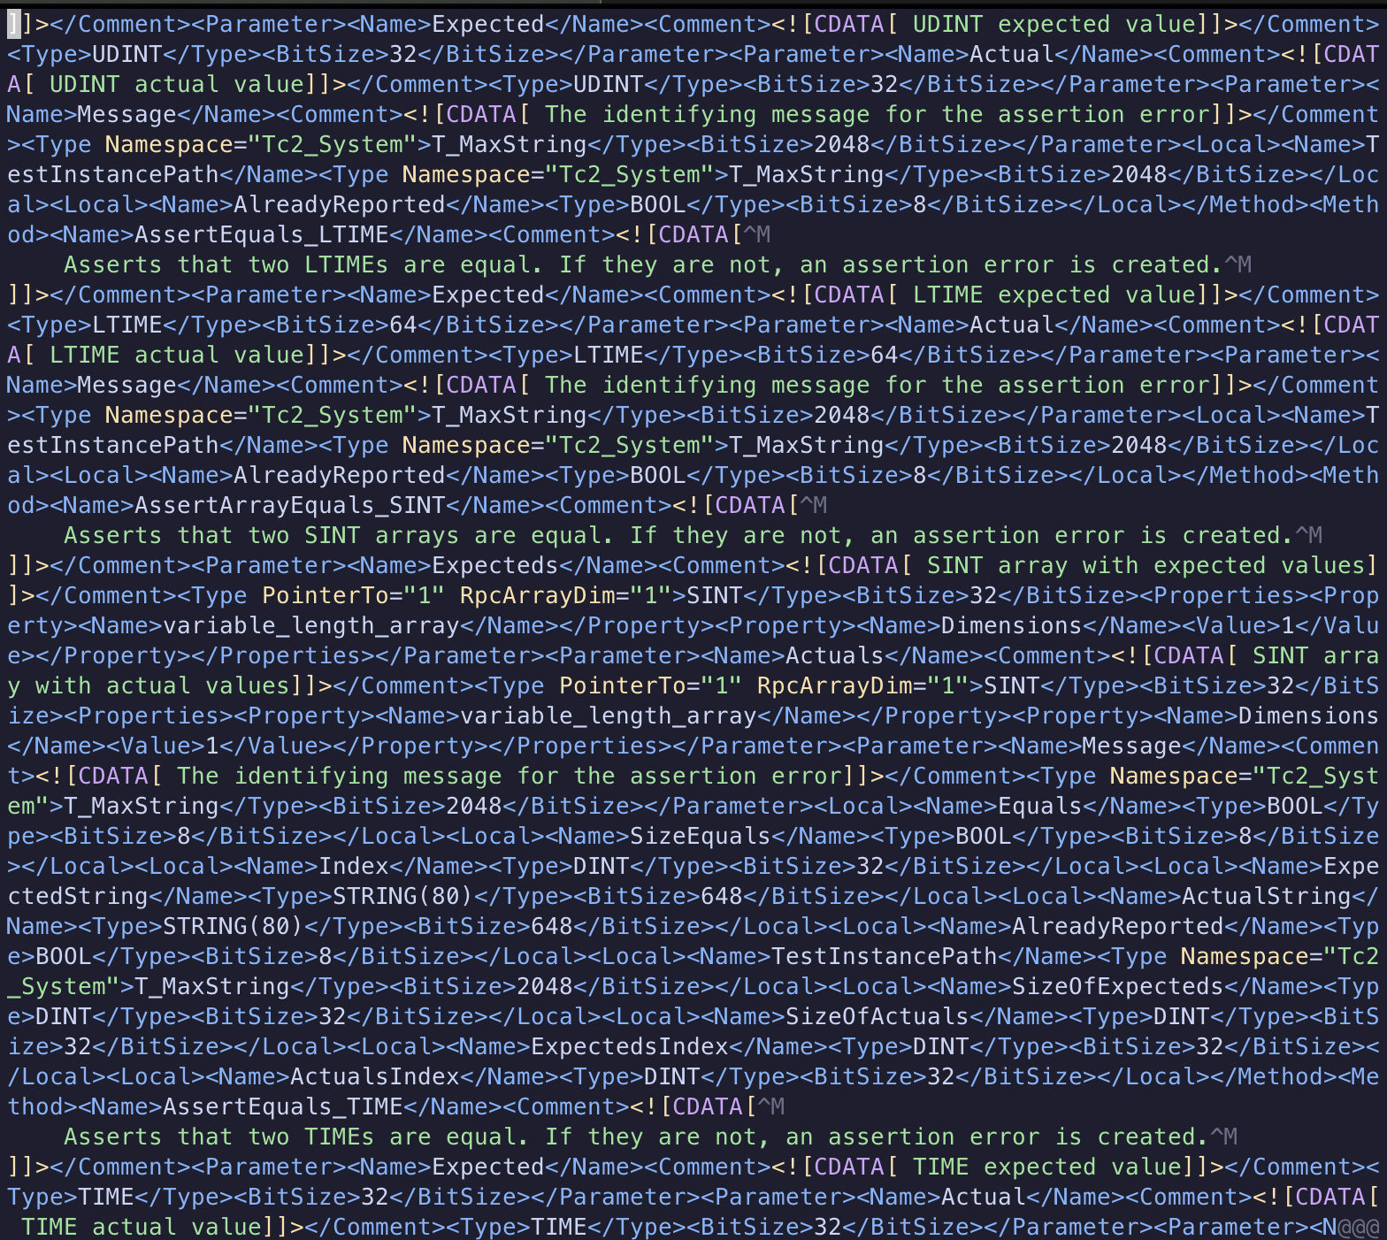
2. Code generation tools
Loïc Gueguen
tmc2fcs: Code Generation of Special devices (beta)
TMC File
Made by Beckhoff @ Project compilation

Slide 26
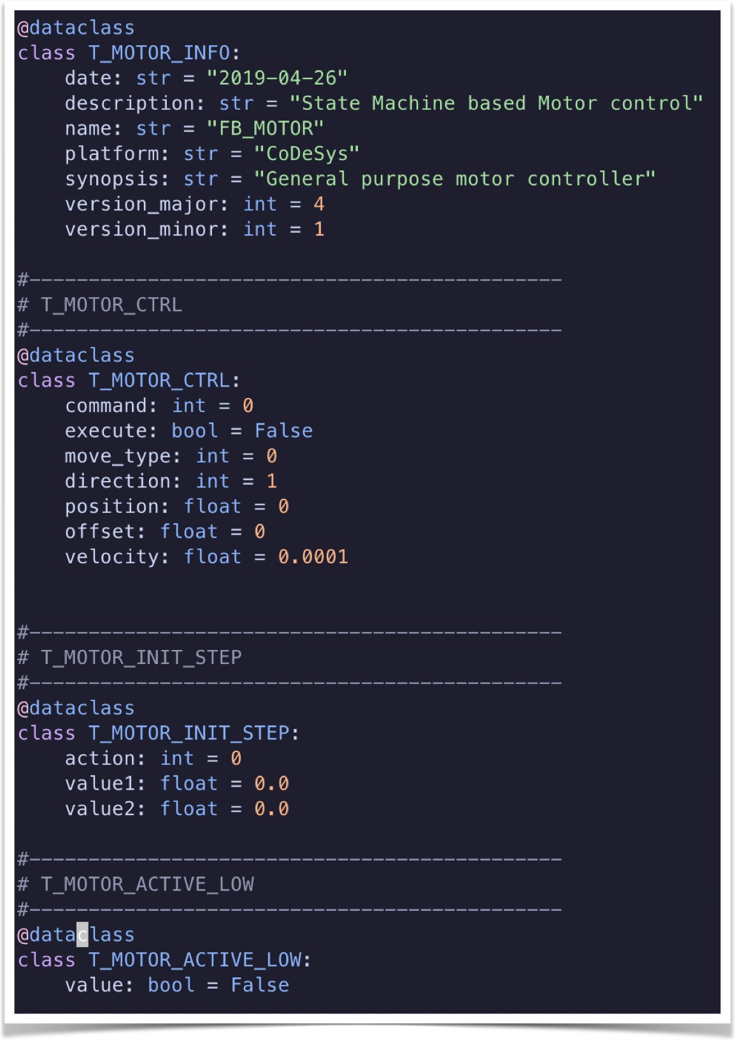
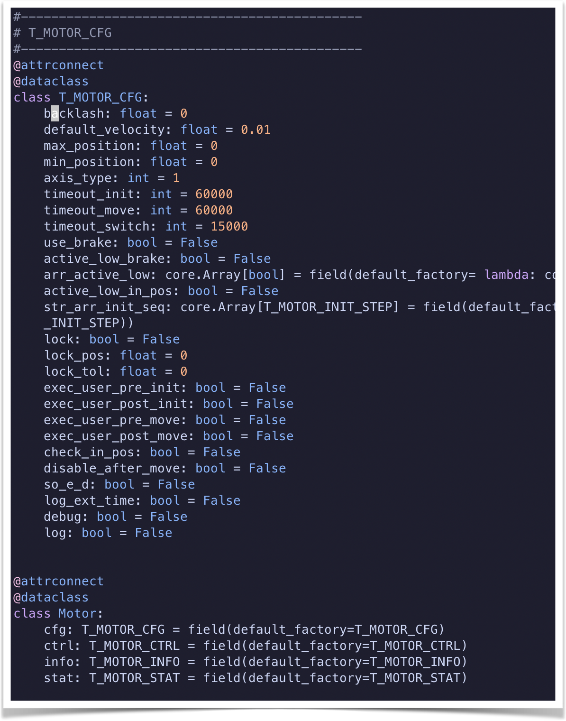
2. Code generation tools
tmc2fcs: Code Generation of Special devices (beta)

Slide 27
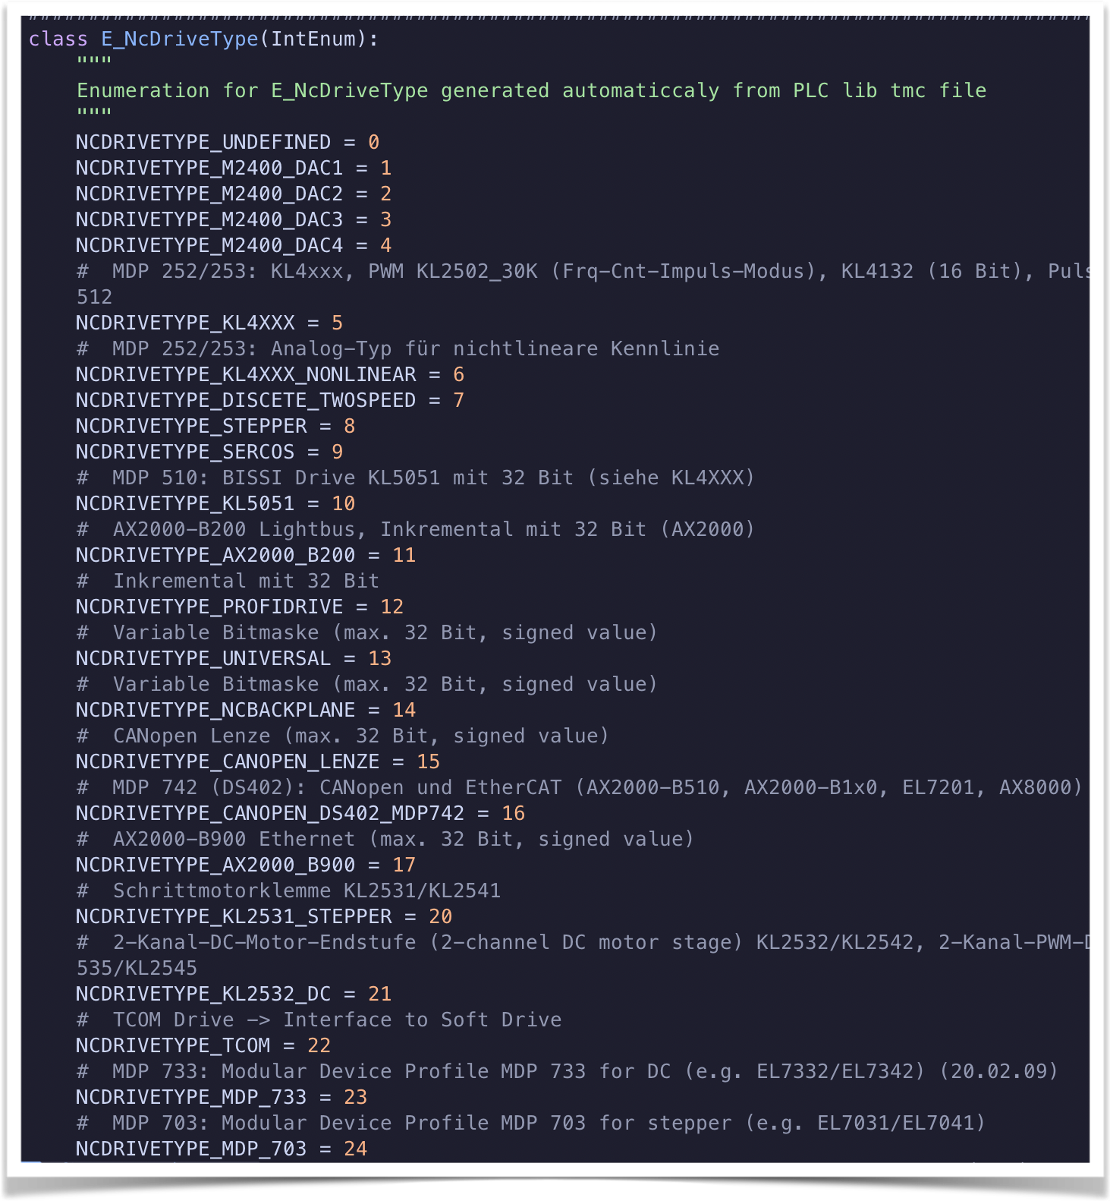
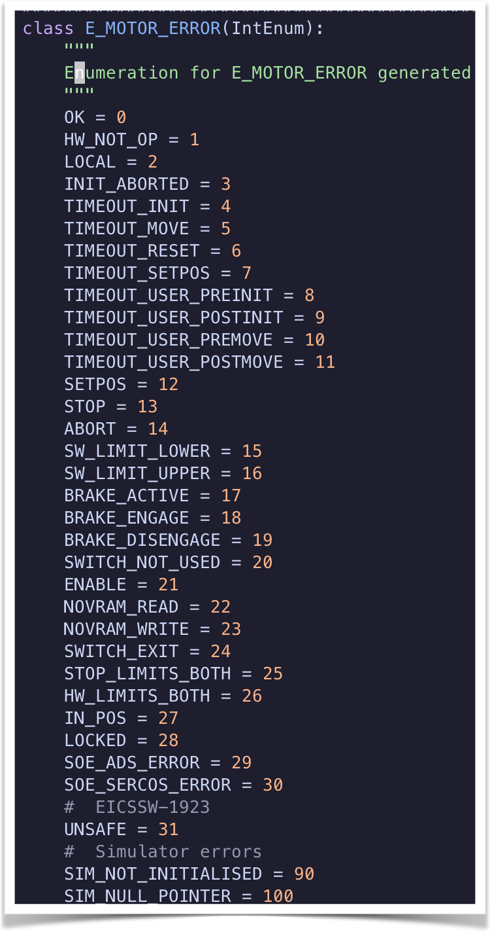
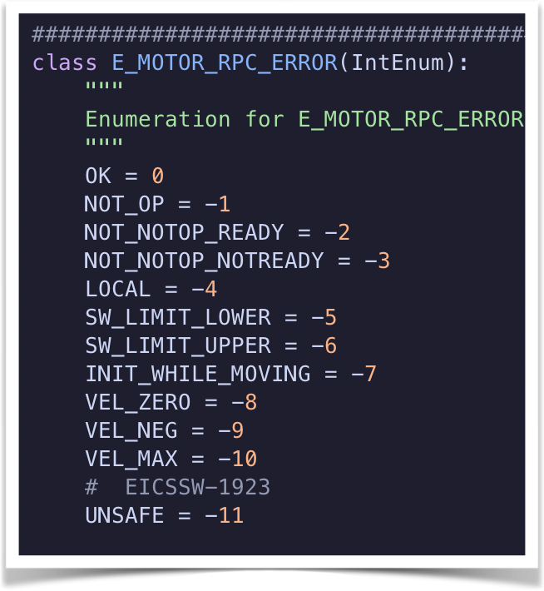
2. Code generation tools
tmc2fcs: Code Generation of Special devices (beta)

Slide 28
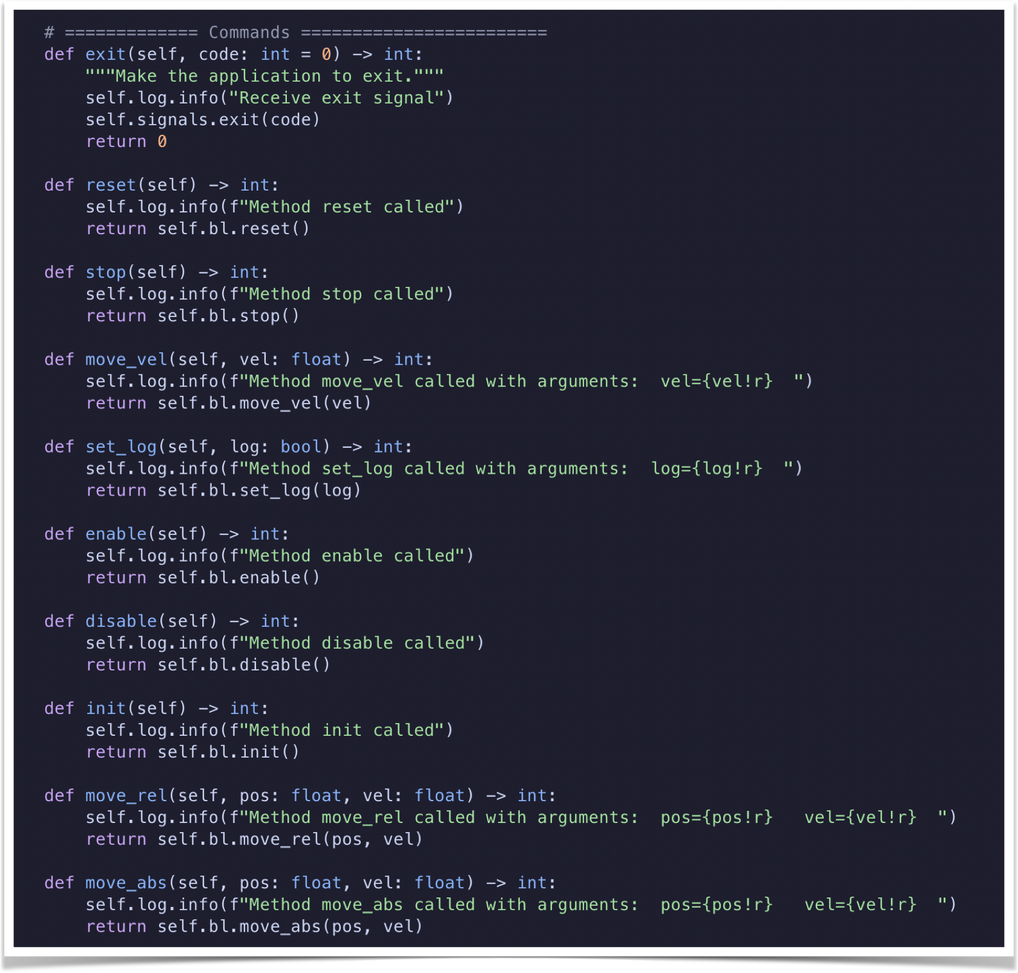
2. Code generation tools
tmc2fcs: Code Generation of Special devices (beta)

Slide 29
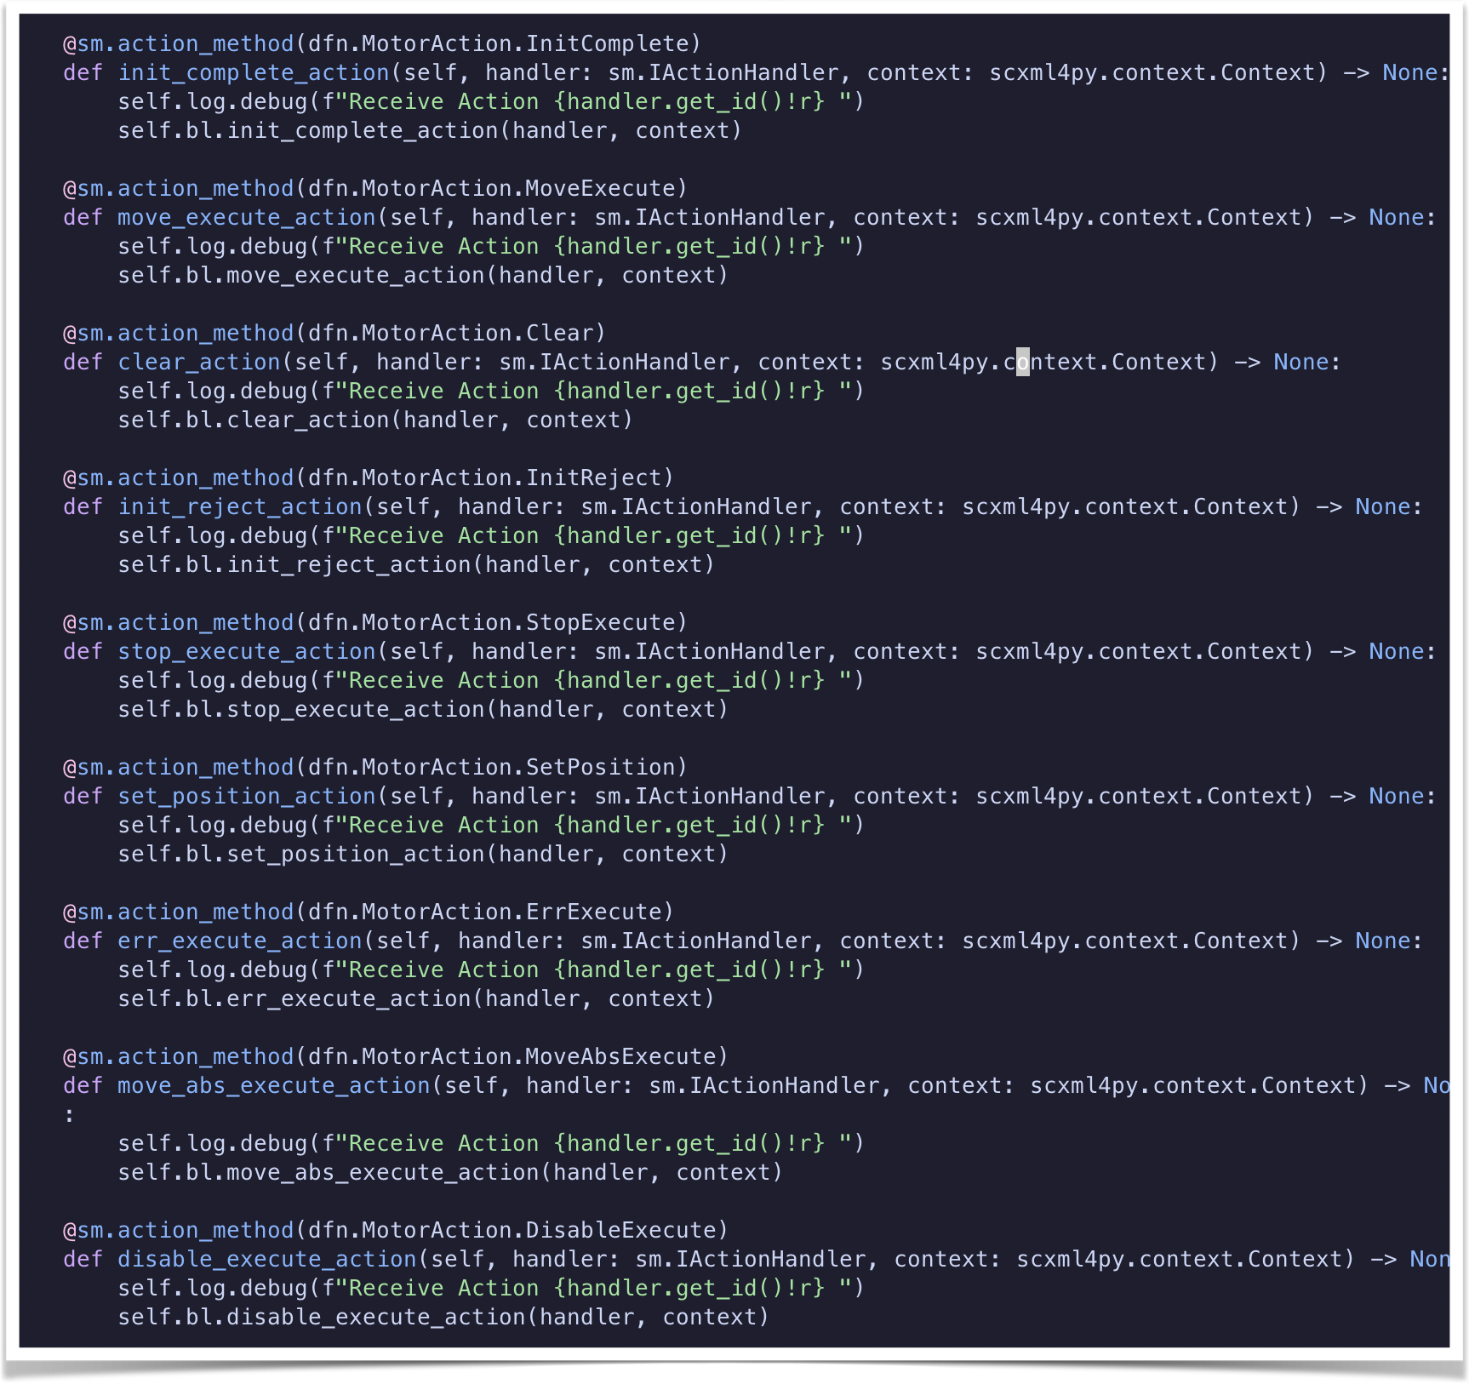
2. Code generation tools
tmc2fcs: Code Generation of Special devices (beta)

Slide 30
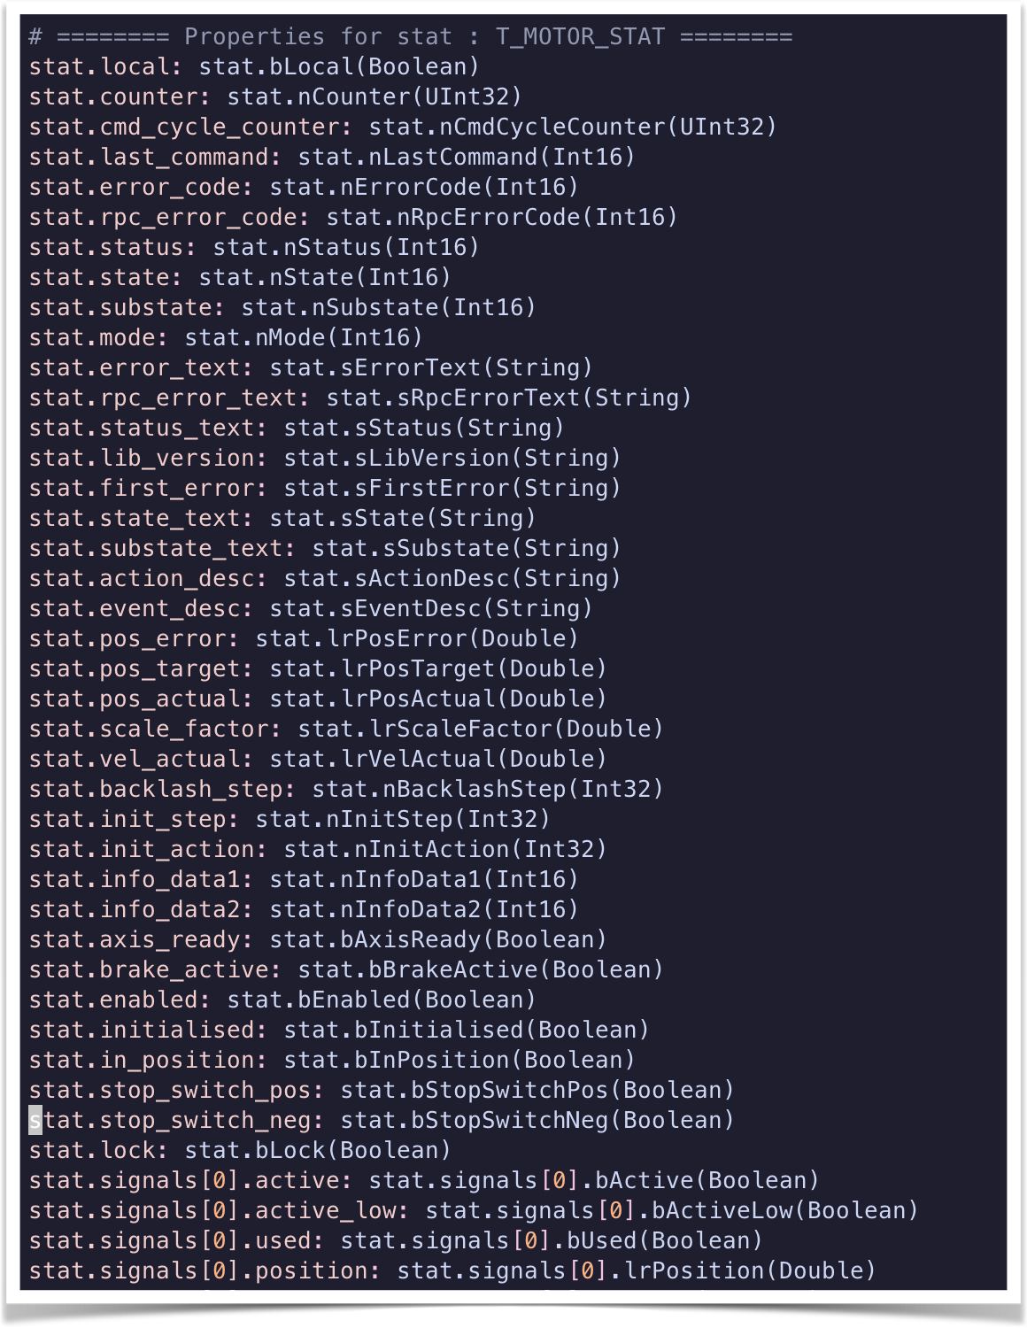
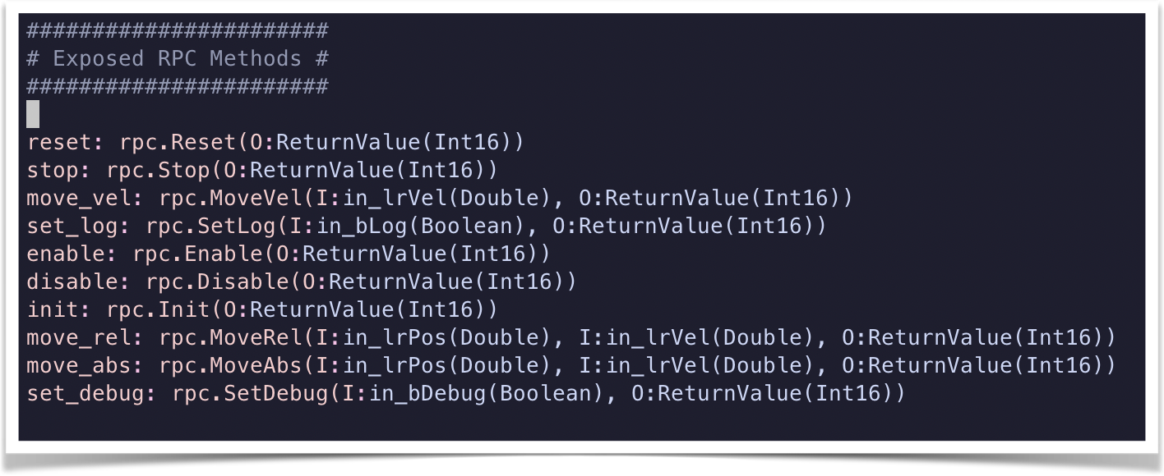
2. Code generation tools
tmc2fcs: Code Generation of Special devices (beta)

Slide 31
2. Code generation tools
tmc2fcs: Code Generation of Special devices (beta)
Features
Export all Structures, Enumerators, tables, FB exposed on OPC-UA.
With name, type, default value and comment !
With a State machine File (scxml).
All state machine function and enumerator can be exported
Template based (scriban) with a lot of functionalities.
Definition of functions, import, object creation.
Possibility to preserve a file for deletion :
{{PRESERVE}}my_file_of_{{lower DeviceName}}.py
Meaning you can generate device make business logic skeleton and prevent business logic to be deleted in the next generation.

Slide 32
2. Code generation tools
tmc2fcs: Code Generation of Special devices (beta)
Status (still beta)
Tmc2fcs Generator 95% done → C# ←
Tmc2fcs Templates for (new) Devsim 90% done (used as Prototype)
Working on:
  Devmgr C++ classes templates and python client
  GUI (Draft of UI) templates
  Config_ng schema (draft) template
  Test software template
  RPM packaging
  Complete documentation

Slide 33
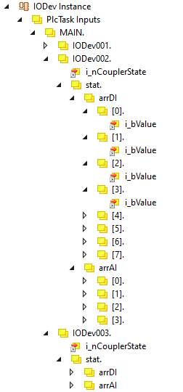
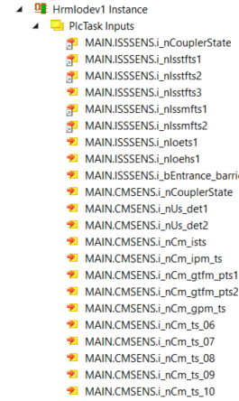
2. Interface with ICE, CECS
Propose to change the standard way of mapping signals to gain traceability.
PLC
HW
NC Task
Mechanisms
Linking
Linking
Scanning
Cabling
=>
Main Task
Sensors
HW Beckhoff modules (ESXXX)
SW boxes scanned on the PLC
Lamps
Development
Integration
Configuration
Tuning
Configuration
ICS
ICE
ESO standard IODev mapping interface. Signal names are generic
HRM IODev mapping interface. Signal names are custom

Slide 34
3. OCS

Slide 35
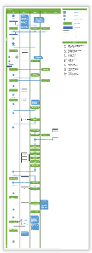
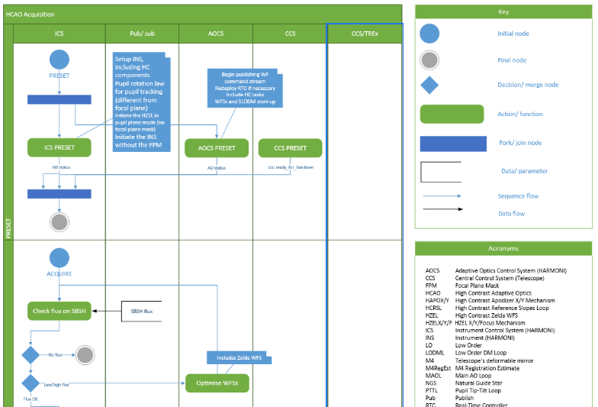
3. Interface with AOCS
Collaborative work to draw detailed Visio observing sequences

Slide 36
3. Data Product Management
Additional extensions
On HARMONI, in case of a NIR observation, we need to group the 8 individual raw data (FITS cubes) spawn by each individual NGCII into a single observation cube. There will be one extension per detector. This is valid both for NIR calibration and observation data.
CHIP 8
CHIP 7
CHIP 6
CHIP 5
CHIP 4
CHIP 3
CHIP 2
CHIP 1
Primary header

Slide 37
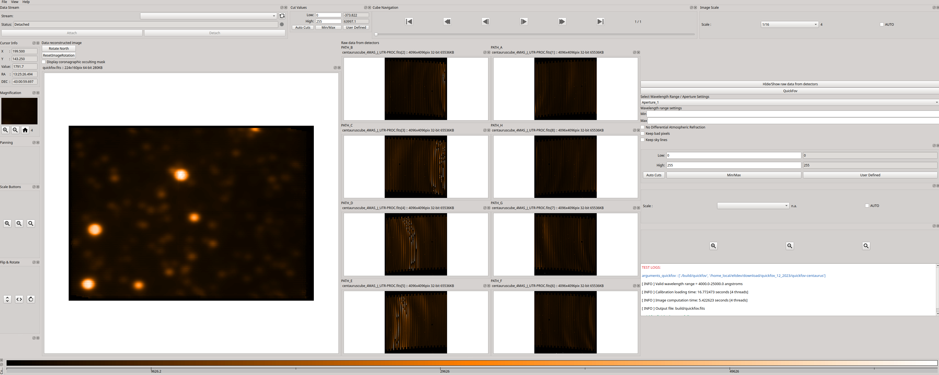
3. Quick Look tools
Goals
Getting familiar with DDT + image threads
Integrating the quickFoV algorithm (HSS team)
Refining and discussing specifications
Fast reconstruction panel prototype

Slide 38
3. Pointing model & tracking devices
The Problems: Tracking device & Interface and distribution
Example: LOWF ADC (ADC for AO Probes)
LOWS ADC
Zenithal Angle
Disp Amplitude

Slide 39
3. Pointing model & tracking devices
The Problems: Tracking device & Interface and distribution
Example: LOWF ADC (ADC for AO Probes)
LOWS ADC
Zenithal Angle
Disp Amplitude
CCS
Elevation

Slide 40
3. Pointing model & tracking devices
The Problems: Tracking device & Interface and distribution
Example: LOWF ADC (ADC for AO Probes)
North
Parallactic Angle
LOWS ADC
Zenithal Angle
Disp Amplitude
CCS
Elevation
Azimuth

Slide 41
3. Pointing model & tracking devices
The Problems: Tracking device & Interface and distribution
SCAO DROT
SCAO ADC
SCAO OSM
HRM DROT POS
North
Parallactic Angle
Zelda HC
POA (Probe) POS
LOWS ADC
Zenithal Angle
Disp Amplitude
Model(s)
CCS
Environmental Data
Elevation
Azimuth

Slide 42
3. Pointing model & tracking devices
Solution: Pointing Model
- One single Kernel to compute all theoretical position and rotation in different coordinate system.
- Design similar to CCS: Control over the control network, MUDPI Broadcasting.
Time
SCAO DROT
Pointing Model
SCAO ADC
Astronomer Input
MUDPI UDP Frames
SCAO OSM
POA
Environment Data
Zelda HC
CCS ?
OLDB ?
HIGH Level SW
GUI/ Status
LOWS ADC

Slide 43
3. Pointing model & tracking devices
Pointing Model Architecture
C++ Library
Pointing Model
Kernel Runtime
OPC-UA
Pointing Model
Manager (server)
CII
Pointing Model
Client
Pub/sub
Cmd/Repl
Used at run time
And preparation tool
Probably running on a PLC, using the Library
Run on WS
Python Client User/Template
Interface
OLDB
MUDPI UDP Frames

Slide 44
3. Secondary processes and their role
Pointing Model
AO Correction manager
Collect AO measured information (rotation error, pupil misalignment, …)
Filter values
Send Offset to devices
CCS control
  Own the non-sidereal ephemeris file
  Send non sidereal coordinate and velocity vector to CCS at a given frequency

Slide 45
Questions?

