Slide 1


DC Motor Tuning with EL7342
Dan Popovic

Slide 2
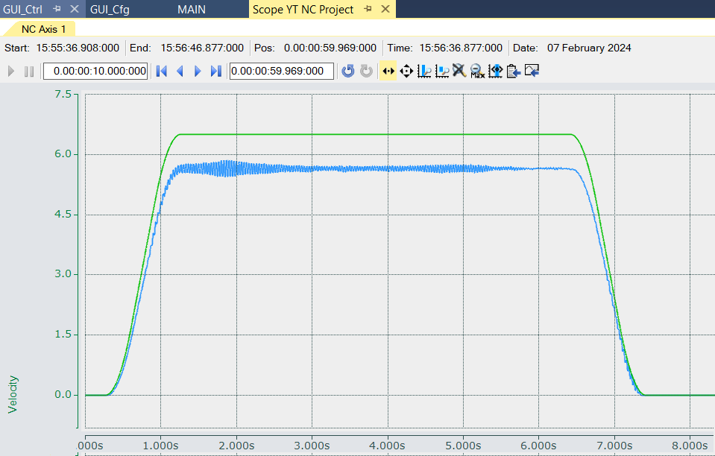
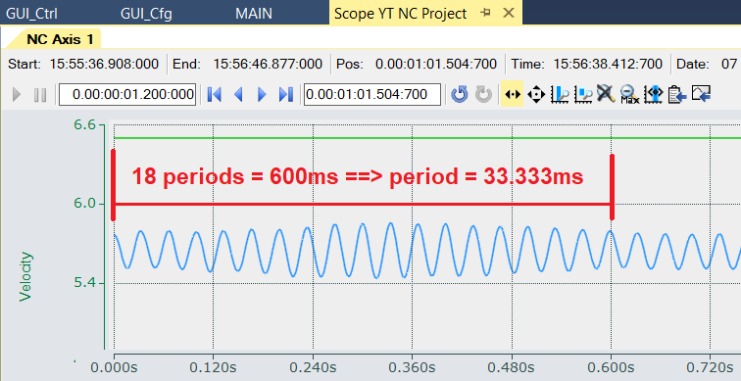
Ziegler-Nichols Tuning Method
Heuristic Technique – Simple and quick method for tuning PID controllers.
Starts by zeroing the integral and differential gains and then raising the proportional gain until the system is unstable.
Gives Ku and Tu.

Slide 3
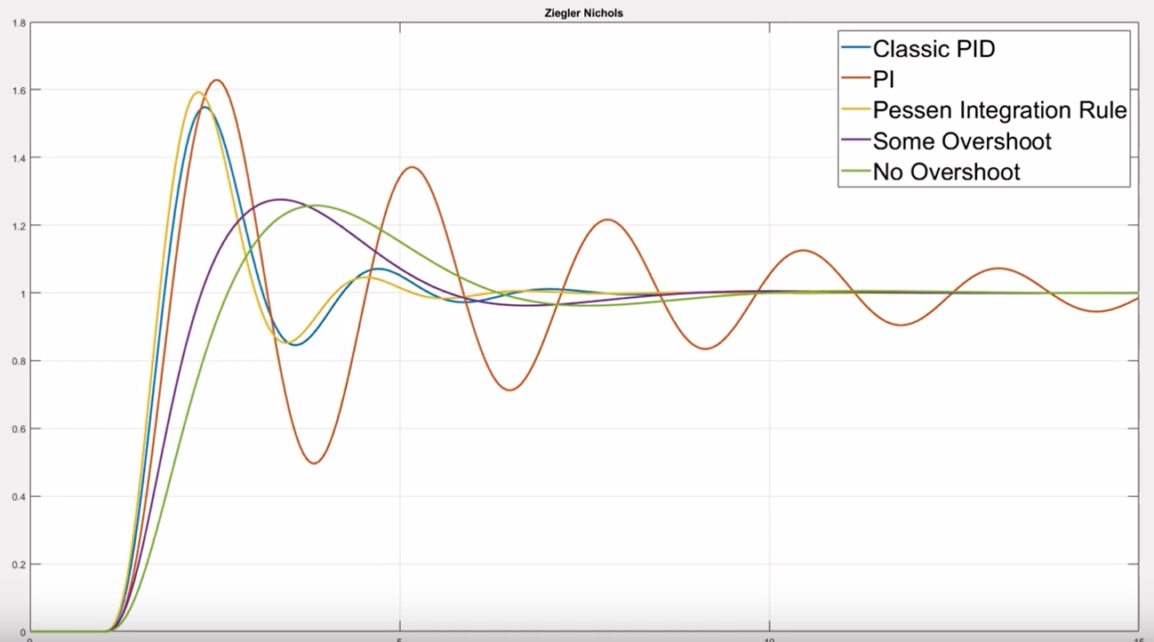
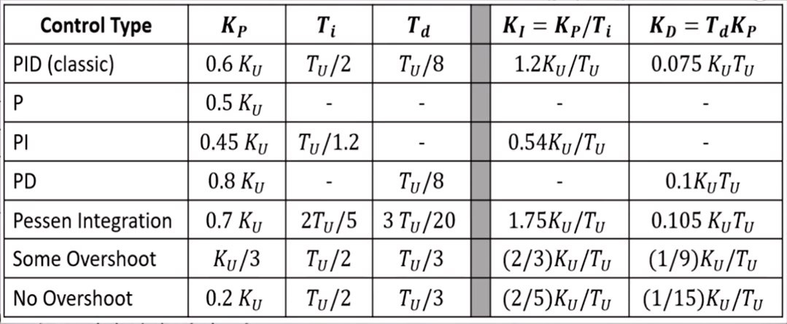
Ziegler-Nichols Performance

Slide 4
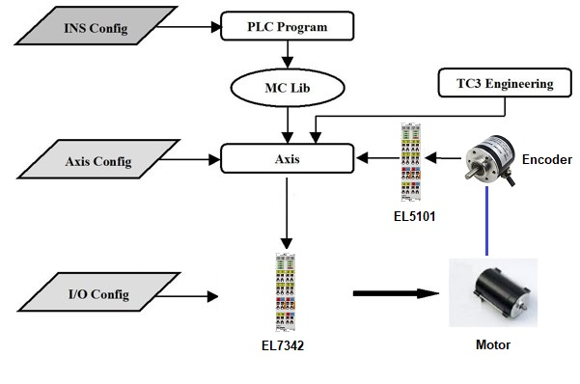
Motor Control Configurations
I/O Terminal
  Maximum/Nominal current
  Nominal Voltage
  Resistance
  Operation Mode
  …
Axis
  Scale factor
  Dynamics
  Control parameters
  Monitoring
  …
Instrument Function
  Axis type (e.g. linear)
  Backlash compensation
  Software limits
  INIT sequence
  …
TC3 Configuration

Slide 5
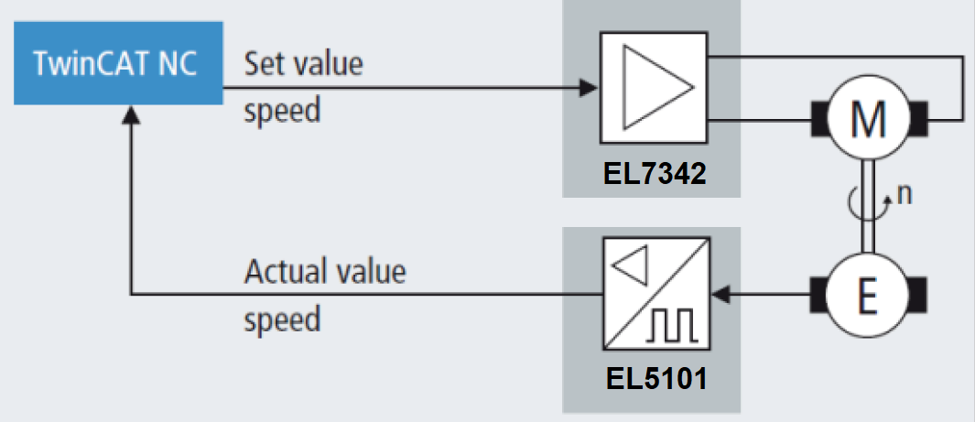
EL7342 Operating Mode - Velocity Direct
This mode is intended for the cyclic velocity interface of the numeric controller (NC).
In this mode, the NC specifies a set velocity.
Ramps for acceleration and deceleration of the motor are also controlled by the NC.

Slide 6
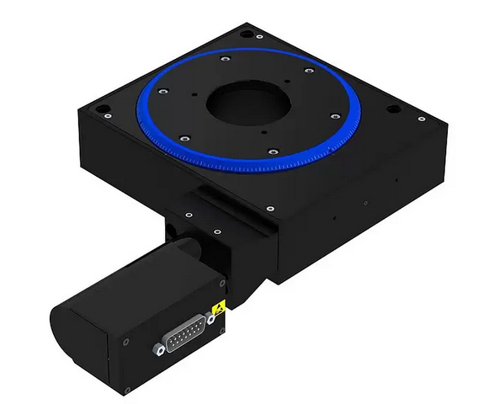
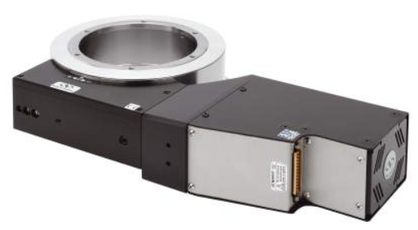
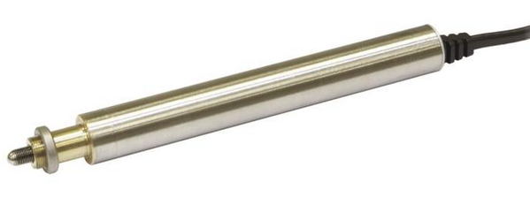
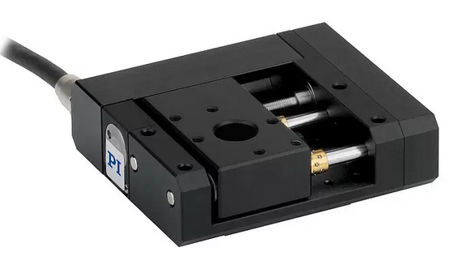
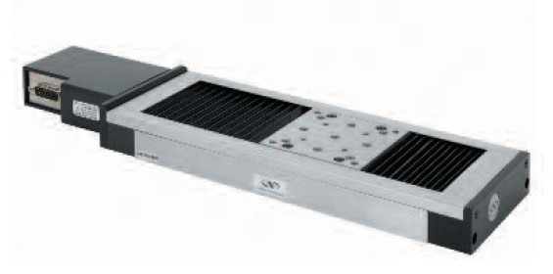
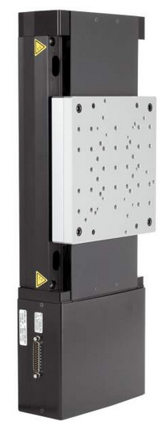
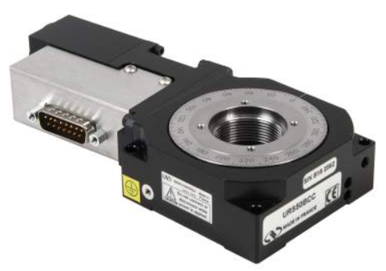
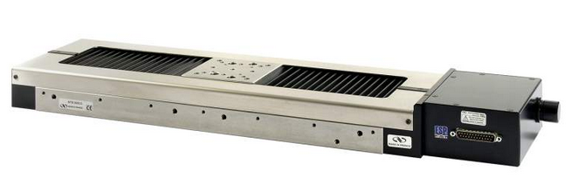
Successfully Tested Stages
M-405.CG
M-062.DG
RV160HAT
TRA6CC & TRA25CC
M-110.DG & M-112.1DG1
IMS300V
UTS100CC
L-509
URS50BCC
MTN300CC
…

Slide 7
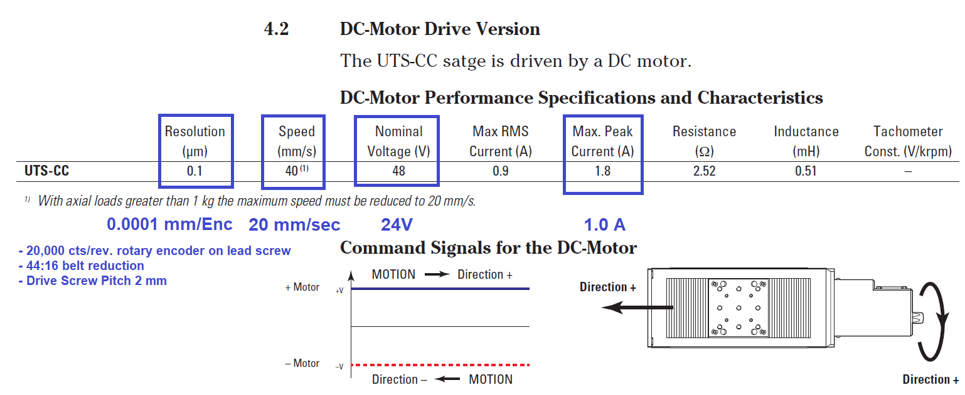
Test Stage: Newport UTS100CC

Slide 8
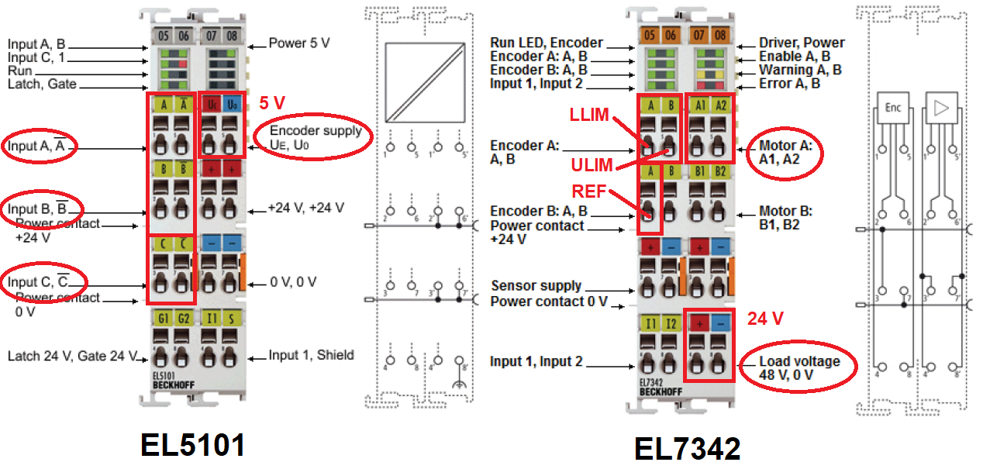
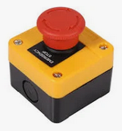
Wiring

Slide 9
Tuning Procedure Overview
Create TwinCAT Project.
Configure CoE parameters of the Motor Output Stage EL7342 CH1.
Configure EL7342 Process Data (Velocity Control Compact)
Configure Axis
Add YT NC Scope Project
Set positive movement direction and encoder count.
Determine Reference Velocity.
Tune Velocity PI Loop using Ziegler–Nichols method.
Tune Position P Loop.

Slide 10
Creating TwinCAT Project
Start new TC Solution
Add PLC project.
Set PLC cycle time to 1ms.
Connect to PLC.
Go to Config mode and Scan the HW.
Select only Device 1 (EtherCAT) and Device 5 (NOV-DP-RAM)
Press OK and 'Scan for boxes'. Accept NC-Configuration.
Say No to 'Activate Free Run'
Set 'NC-Task 1 SAF' cycle time to 1 ms.
Remove unused Axes, if any.

Slide 11
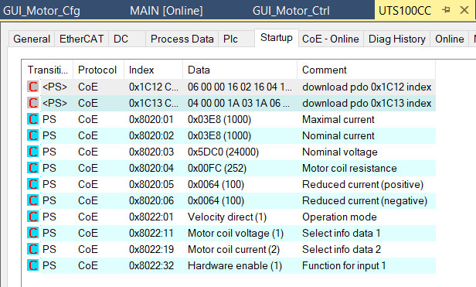
EL7342 CoE Configuration for CH1
Reset EL7342 to factory configuration by writing 0x64616F6C into the CoE object 1011:0 Restore default parameters, SubIndex 001.
Set CoE Startup parameters.

Slide 12
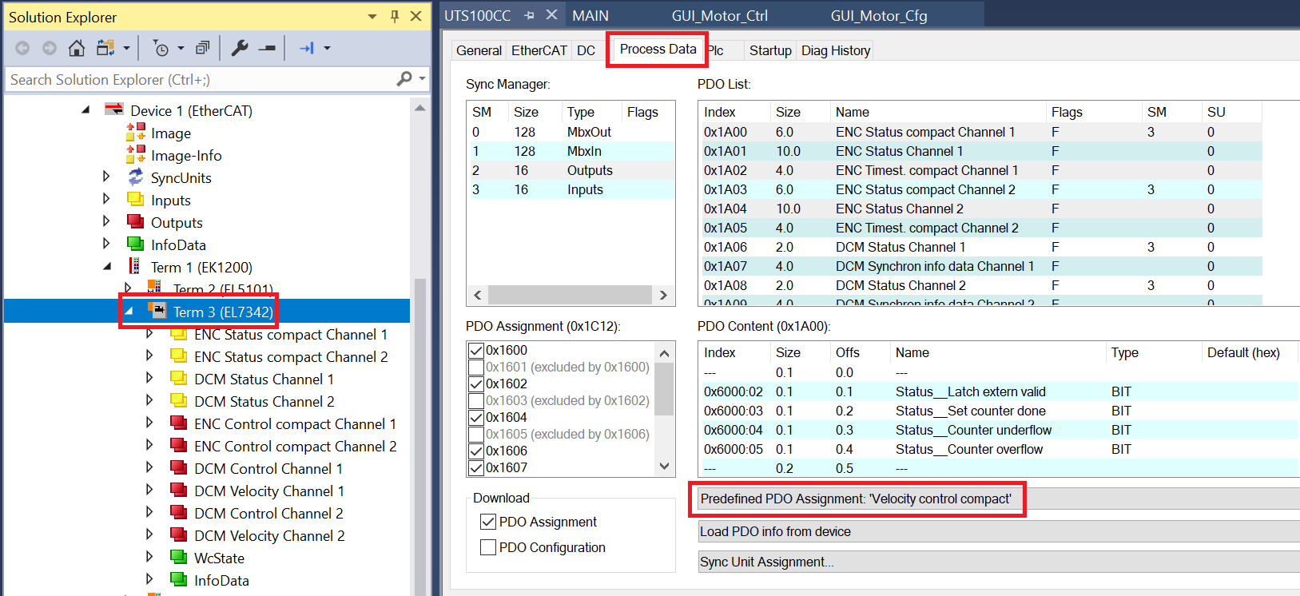
EL7342 Process Data (Velocity Control Compact)

Slide 13
Axis Configuration - Summary
Link Axis Drive to EL7342 CH1 and Enc to EL5101.
Set V_{ref} to a high and safe value.
Set V_{max} = 20 mm/sec.
Set high Axis Dynamics.
Set Axis Scale.
Activate Encoder Time Compensation.
Select “Position P and Velocity PI Controller with Observer (Torque)” Controller
Set Controller Output limit to 1.0.
Set all control parameters to zero.
Activate Configuration.

Slide 14
Axis Configuration in Detail
Under Axis/Settings/Link to I/O…: Select EL7342 CH1.
Under Axis/Enc/NC-Encoder: Select EL5101.
Under Axis/Parameters: Vref = 1.5 x stage max velocity = 1.5 x 40 mm/sec = 60 mm/sec.
Under Axis/Parameters: Vmax = 20 mm/sec.
Under Axis/Dynamics: set Acc/Dec = 0.1 sec, stiff.
Under Axis/Enc/Parameters, set Scale to 0.0001.
Under Axis/Enc, Time Compensation tab, Time Compensation Mode Encoder ON (velocity) with 4 cycles Encoder delay.
Under Axis/Ctrl, NC-Controller tab, select:
“Position P and Velocity PI Controller with Observer (Torque)”
Under Axis/Ctrl/Parameter tab, Other Settings:/ Controller Outputlimit [0.0 ... 1.0] = 1.0.
Under Axis/Ctrl/Parameter: All control parameters (Pos & Vel) = 0.
Activate Configuration. Cancel 'Restart TC System in Run Mode'.

Slide 15
Adding YT NC Scope Project
Add default YT NC Scope Project.
Keep at least Position, Velocity and Position Lag Axis Groups.
Select all attributes in DataPool and set TargetSystem to the real PLC.
While all selected, set Symbol based to True under Symbol ADS.
While all selected, right-click on the list and select Change ADS Symbol… Rename the Axis if needed.
Activate Configuration.
Start recording to check if everything is OK.

Slide 16
Setting Correct Direction and Encoder Count
Activate configuration and go to Run Mode.
Login
Under Axis/Online Enable controller.
Under Axis/Function/Raw Drive Output, select Percent and set 5 [%], Start. Check if the stage moves. If not, carefully increase the percentage until it starts moving.
Once it starts moving, check if the direction of the motor is correct. If not, disable controller and change it in Index 8022:09 “Invert motor polarity”. Activate configuration! Enable controller.
Start again and check if the encoder shows movement in positive direction.
If not, disable controller and change it in EL5101 Index 8010:0E “Reversion of rotation”. Activate configuration! Enable controller.
Add changes to CoE Startup for both EL7342 and EL5101.

Slide 17
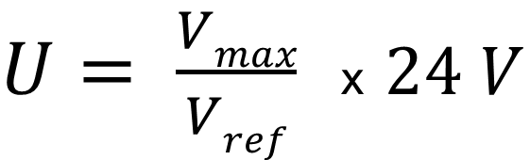
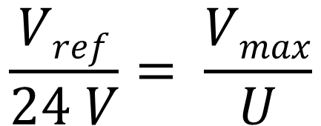
Reference Velocity Explained
Vmax is the user velocity for which we tune the motor. It should also be the default stage velocity.
Vmax is not the maximum possible velocity!
Vref is the equivalent velocity at Nominal Voltage, i.e., at 24V assuming that Vel/Voltage is linear.
Procedure: Adjust Vref until the measured velocity is close to Vmax.
Vref at 24V
24V
$$\frac{Vref}{24 V}= \frac{Vmax}{U}$$
Vmax = 20 mm/s
U = ?
$U= \frac{Vmax}{Vref}$ x $24 V$

Slide 18
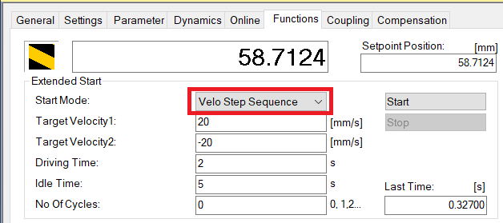
Reference Velocity Adjustment Procedure
Start recording with Scope and monitor the actual Velocity.
Ensure that the stage doesn’t run into end stop during tests !!!
Select Velocity in Raw Drive Output and start moving backwards and forwards at a low velocity, e.g., 10 mm/sec. Adjust the Reference Velocity to get the correct velocity.
Gradually increase to 20 mm/sec while correcting the Reference Velocity at each step.
Set Axis/Parameter/Monitoring / Position Lag Monitoring
to FALSE to avoid following error failure.
Make final adjustment by running Velo Step Sequence
Function Mode [+-20 mm/sec].

Slide 19
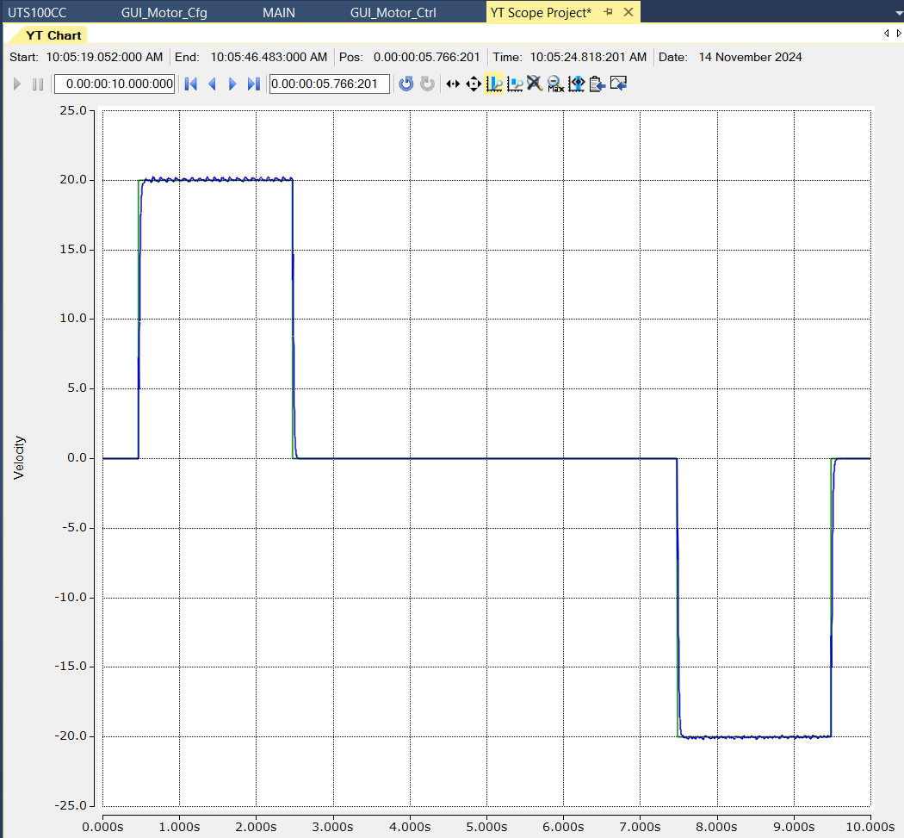
Reference Velocity Scope Recording
In our example, Vref = 50 mm/sec.
Convert Vref to rpm of the motor and enter it in EL7342 CoE 8020:08.
rpm = 50 mm/sec / 2 mm x 60 sec x 44 / 16
rpm = 4538
Note: This step might not be needed because the control loop is in NC, i.e., not in EL7342.
Activate Configuration

Slide 20
Velocity Loop Tuning Using Ziegler-Nichols Method
Estimate current stage position.
Under Axis/Functions, Set Actual Position to the estimated position.
Prevent running into end stops by setting SW limits to, e.g., 20 to 80 mm.
Set the Dynamics to more realistic operational values.
Axis/Dynamics: “Indirect by Acceleration time”. Acc/Dec time = 1 sec.
Push the slider somewhere to the middle of the range to reduce the stiffness.
Download parameters.
In Axis/Ctrl/Parameters/ Position Control Loop,
set ‘Feedforward Velocity: Pre-Control Weighting [0.0 ... 1.0]’ to 1.0
Set Velocity Kv to 0.1

Slide 21
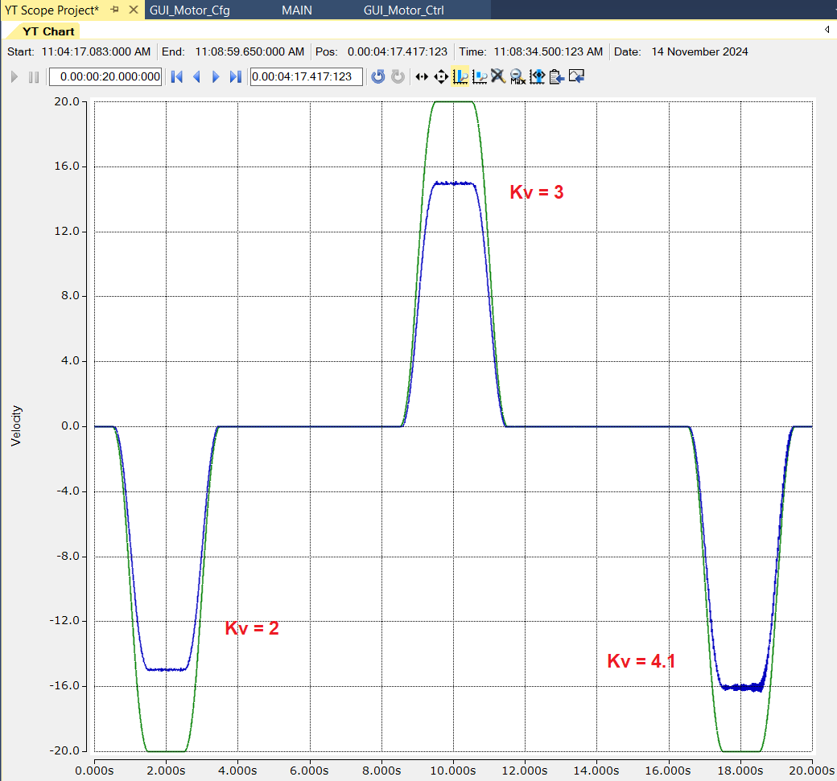
Velocity Loop Tuning Using Ziegler-Nichols Method
Start Recording with Scope and monitor velocity
Run ‘Reversing Sequence’ Function Mode: 30-70 mm, 20 mm/sec, 3 sec idle.
Slowly increase Velocity Kv until velocity starts oscillating.
Stop Sequence.
If the system continues to oscillate, hit the STOP button.
Record Ku = Kv = 4.1. Note that the target velocity has not been reached.

Slide 22
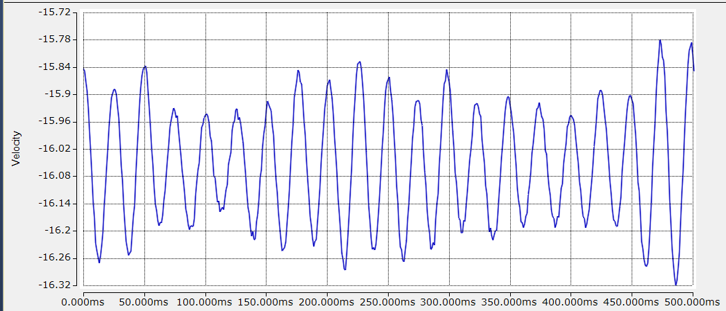
Measuring Tu and Calculating Kv and Tn
Zoom in and measure the oscillation period.
20 x Tu = 500 ms ➔ Tu = 25 ms
Calculate Ziegler-Nichols PI parameters and download them.
Kv = 0.45 Ku = 0.45 * 4.1 = 1.845
Tn =Tu / 1.2 = 25 / 1.2 = ~20.83 ms.
Note: ‘u’ stands for Ultimate

Slide 23
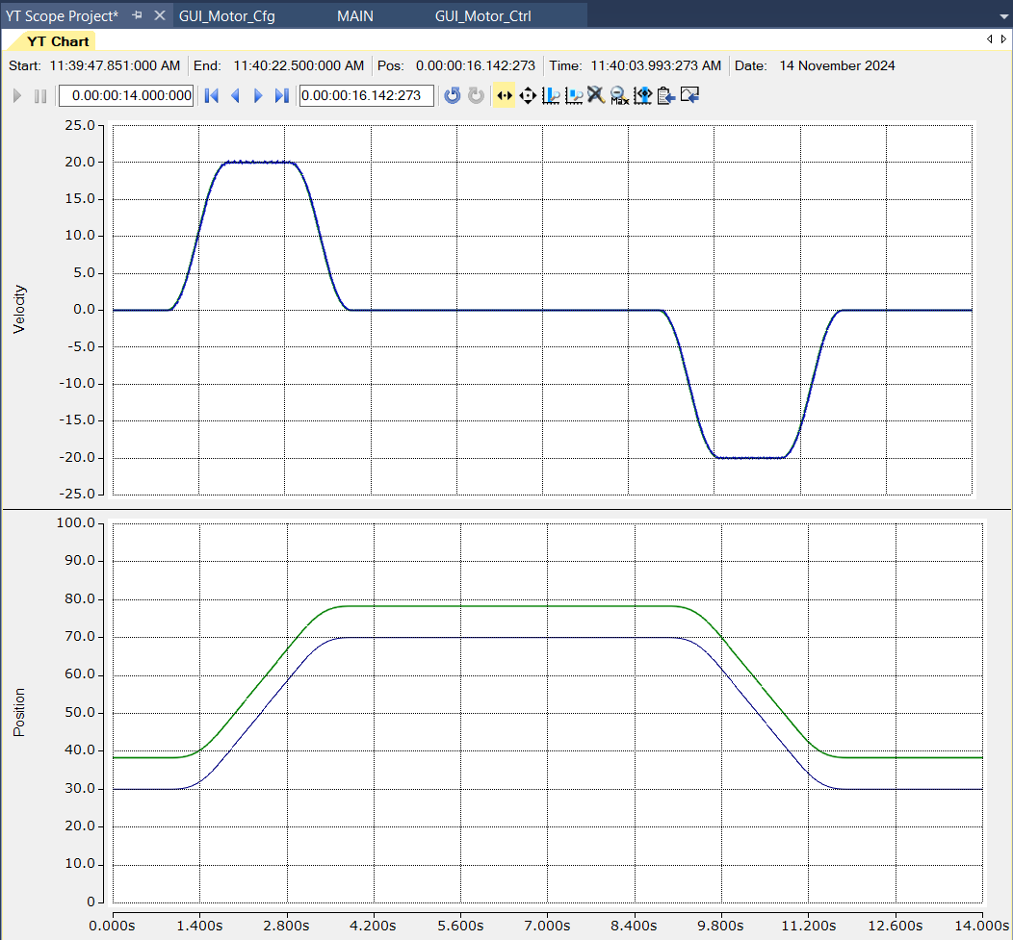
Testing Velocity Loop
In Axis/Ctrl/Parameters/ Velocity Control Loop,
set “Velocity control: Min./max. limitation I-Part [0.0 ... 1.0]” to 1.0.
Download new parameters and test the system. The velocity should now reach the target velocity.
However, the target position still cannot be reached.

Slide 24
Tuning Position Loop
Increase Position Kv in small increments.
Soon, the target position will be reached at the end of each movement.
Continue increasing Position Kv until the position settles quickly at 4th decimal point. (Kv = 25 in our case).
Increase Position Kv by 25% (Kv = 32.5) and check if the system is still stable.
If yes, go back to Kv = 25.
Tuning is complete !

Slide 25
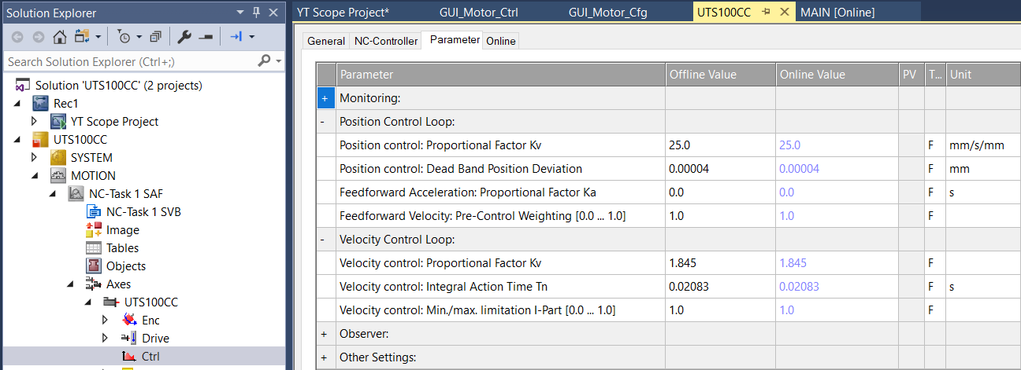
Final Control Parameters

Slide 26
Dan Popovic – dpopovic@eso.org
@ESOAstronomy
@esoastronomy
@ESO
european-southern-observatory
@ESOobservatory

