Slide 1

ELT ICS Seminar 2024
Mario Kiekebusch/Dan Popovic
Mauro
Ricardo
END to END TRACKING DEMO

Slide 2
Some Definitions …
Tracking devices are motorized functions which update continuously the position of one or more motor axes as a function of the telescope coordinates, time or variations of the temperature.
They support at least two modes of operations: one where motor axes are stationary and another one for tracking.
They may require a connection to the ELT time synchronization system.
The tracking device is sending a new set point at every cycle of the tracking loop. The period of the tracking loop is configurable and does not depend on the PLC cycle.

Slide 3
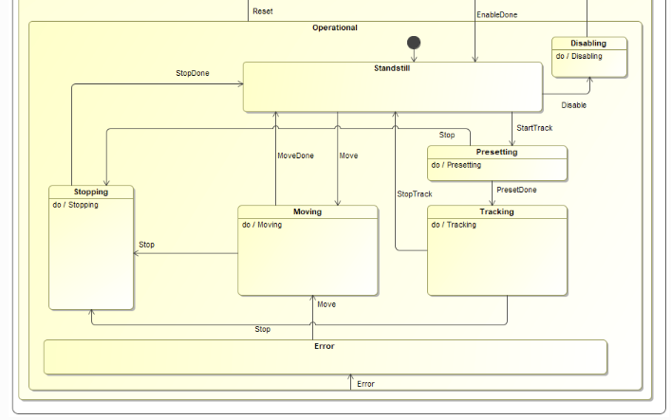
Tracking State Machine

Slide 4
Evolution
Tracking devices in VxWorks (reference implementation).
PLC re-implementation for VLT instruments.
PLC implementation for ELT (without CCS - as pointing kernel)
PLC implementation for ELT (with CCS)

Slide 5
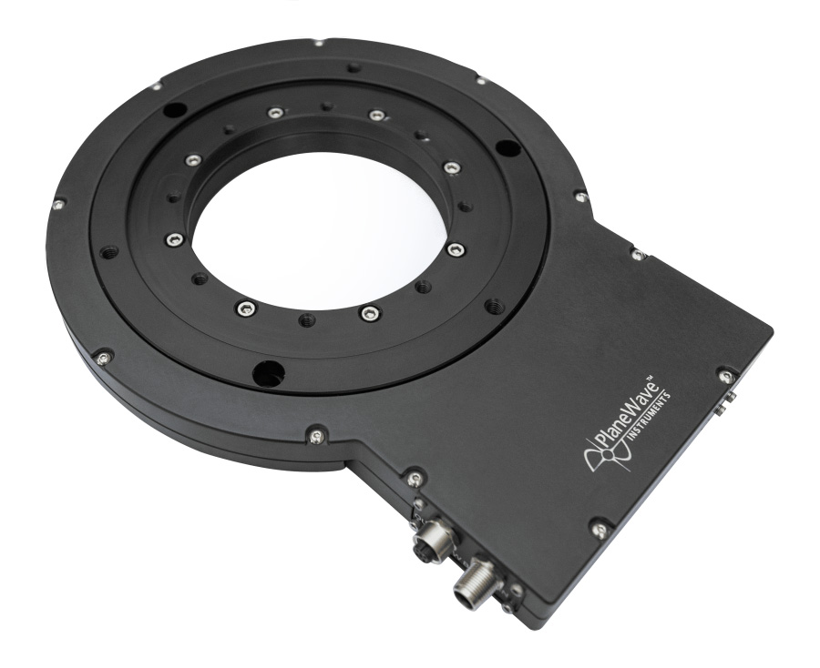


HW & SW Setup
PTP
PLC2
PLC1
EL6688 Process Image
Distributed Clock
Time FB
CCS data
via MUDPI
PTP time offset
DC Time
Time FB
Beckhoff NC Task
Publisher
Motion Controller
UTC time
Motor Status
Motor Control
CCS Receiver FB
Motor FB
CCS Emulator
1Gb point to point
Rotation
Derotator FB
Task Publishing at 20Hz.
It uses C++ modules for the CCS data generation (pointing kernel).
CCS Data is computed ahead of time (50ms).
It requires TwinCAT 3 TCP/UDP Real-Time (TF6311).
CCS data is extrapolated at each PLC cycle.
Rotation is used by the Derotator device during tracking.

Slide 6
HW & SW Setup with ASTRO
ASTRO
PLC2
Distributed Clock
DC Time
Beckhoff NC Task
Time FB
Motion Controller
Motor Status
Motor Control
Motor FB
Rotation
Derotator FB

Slide 7
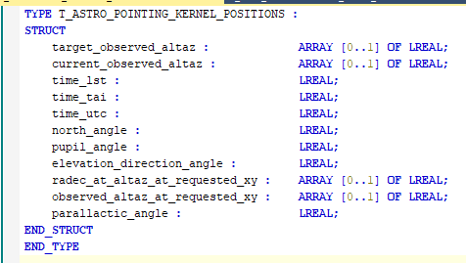
CCS Deterministic Data

Slide 8
DEMO

Slide 9
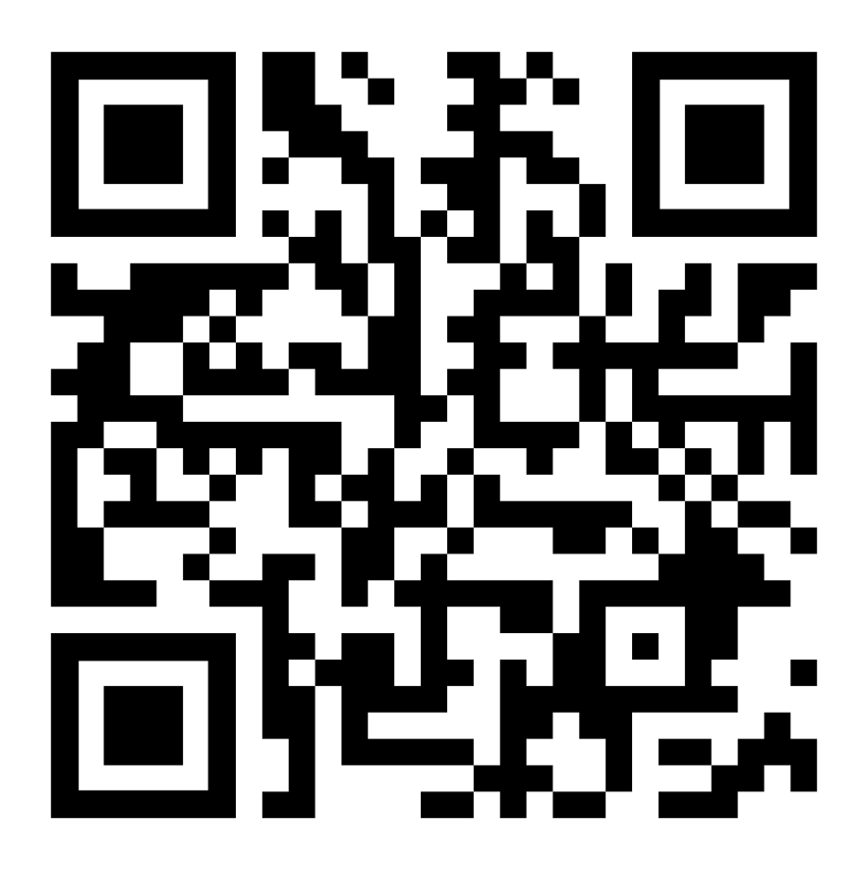
Luigi Andolfato; Diego Del Valle; Sylvie Feyrin; Arturo Hoffstadt; Mario Kiekebusch; Jens Knudstrup; Christoph Moins; Ivan Muñoz; Dan Popovic; Claudio Reinero; Calle Rosenquist; Paola Sivera; Ricardo Schmutzer; Piotr Szubiakowski
@ESOAstronomy
@esoastronomy
@ESO
european-southern-observatory
@ESOobservatory

