Slide 1


Seminar Info
J. Knudstrup

Slide 2
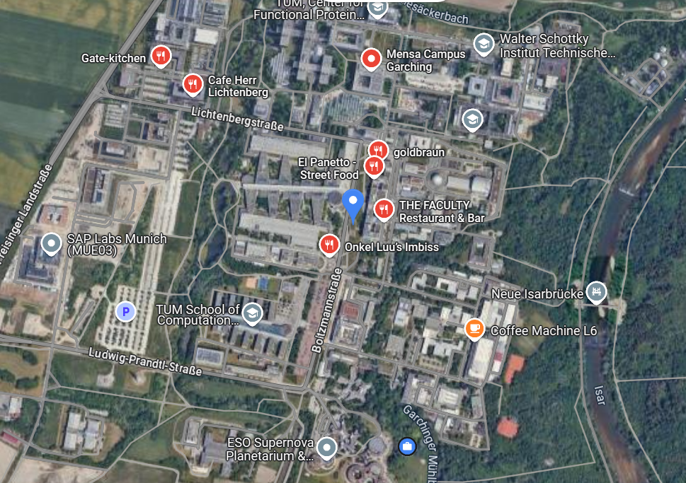
Lunch
First choice: Max Planck Canteen.
Second choice: Street food area close to the Metro.
Alternative: Bring your own food.
More than 1 hour scheduled for the lunch break – hopefully, it’s manageable.
Max Planck: If the short way gate should be open. If locked, try the ‘long way’ and tell at the gate that you are attending this seminar at ESO.
Street food, restaurants, bakery
Max Planck Cafeteria

Slide 3
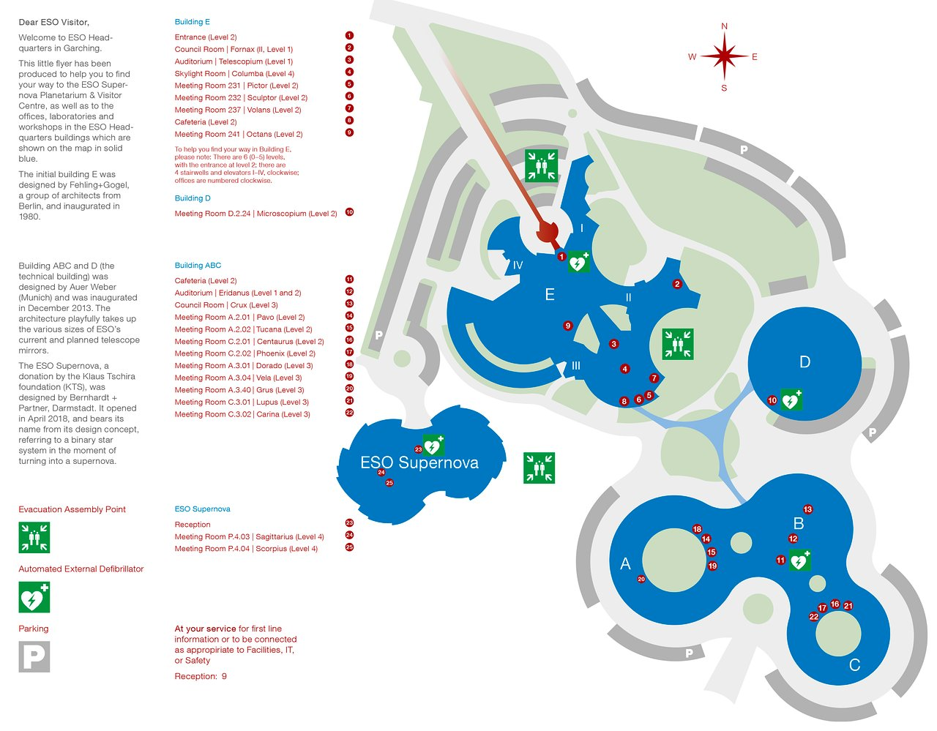
Lab Visits
Please familiarise yourself with the pick-up points.
Please check what has been allocated is correct.
Note: When more people sign up or change priorities, scheduled events may change (time slot) – please check the latest schedule shortly before the event takes place.
Schedule
ESO Reception
Gallery Window
3
Bridge between building E & D

Slide 4
Social Event
Participants registered for the event.
Speakers at the seminar.
Venue: “Eridanus Foyer” (Building B, ground floor).
3

Slide 5
Group Photo – Day 2
During the previous seminars of this kind a group photo was made.
Participants + ESO speakers kindly requested to meet in the North-Eastern courtyard, before going to lunch break (~12:30).
Thanks!! ☺
1
3
2

Slide 6
Open Discussion
Open Discussion scheduled as last session, the last day.
Some topics scheduled.
If you come across something during the upcoming presentations you would like to discuss in more depth, please let me know.
There of course will also be time for questions and discussions in connection with the presentations.

Slide 7
J. Knudstrup – jknudstr@eso.org
@ESOAstronomy
@esoastronomy
@ESO
european-southern-observatory
@ESOobservatory

