Slide 1


IFW Device Control Framework – FCF
Device Simulators
J. Knudstrup

Slide 2
Purpose & Scope of FCF DevSim
FCF Device Simulator (DevSim) package:
Small toolkit to implement WS Device Simulators.
Main purposes are to:
  Facilitate development of instrument software under ‘realistic conditions’.
  Make it possible to develop and execute integration tests (robot/etr) without the availability of any hardware.
  Facilitate troubleshooting of workstation software (to the extent possible without hardware).
  Make it possible to run integration tests for SQA purposes at ESO, in Jenkins.
  Possibly it may be a tool to help designing Special Devices (if it is easier to develop the WS simulator than the real device: Prototyping with DevSim, before actual implementation).
  Make it possible to advance as much as possible, while waiting for hardware components, preventing from implementing/completing the PLC code.

Slide 3
Scope of Device Simulators
Normally it is not the intention/or necessary to implement a 100% true emulation of the PLC code + associated hardware to fulfil the simulator’s purpose.
In general: Implement only enough to develop the Templates, test the GUIs, implement and run Integration Tests, etc.
Unlike VLTSW: For the ELT IFW, not the intention to use simulation in case of a failing device. A failing device should instead be ‘disabled’, operationally.
It is mandatory to provide a Device Simulator for a Special Device.

Slide 4
Standard Device Simulators
Following Device Simulators are supported by IFW for Standard Devices:
  Actuator
  ADC
  DROT
  I/O Device
  Lamp
  Motor
  Piezo
  Shutter
  Planned for IFW25: PSU8600

Slide 5
Architecture
Simulation separated from DevMgr to avoid ‘polluting’ code of Device Managers.
Implemented in Python.
Based on:
    SCXML state machine engine (rad/scxml4py)
    OPC UA server SDK (github.com/FreeOpcUa)
Generic SCXML/OPC UA Server toolkit provided by IFW Core Component
    ifw-hl/core/pyutils/opcua/srvlib
Limitation: Only possible to host one device per DevSim server – work on-going to fix that…

Slide 6
Architecture – cont’d
A Device Simulator loads at start-up:
    SCXML Definition: Defines the state machine.
    OPC UA XML Profile: Defines the OPC UA namespace.
    Cfg: Parameters changing the behavior (YAML based).
PLC
Device
Simulator
Namespace exactly like the PLC device namespace.
Behavior implemented in Python code.
OPC UA
Device
Manager
SCXML
OPC UA
XML
Profile
Cfg
IWS

Slide 7
SCXML Definition – Example/Sensor (Extract)
<?xml version="1.0" encoding="UTF-8"?>
<scxml xmlns="http://www.w3.org/2005/07/scxml" xmlns:customActionDomain="http://my.custom-actions.domain/CUSTOM" version="1.0" initial="On">
<state id="On">
<initial>
<transition target="On::NotOperational"/>
</initial>
<state id="On::Operational">
<initial>
<transition target="On::Operational::Monitoring"/>
</initial>
<state id="On::Operational::Error">
<transition event="HwOk" target="On::Operational::Monitoring"/>
<transition event="Disable" target="On::NotOperational::Ready"/>
</state>
<state id="On::Operational::Monitoring">
<transition event="ErrHw" target="On::Operational::Error"/>
<transition event="Disable" target="On::NotOperational::Ready"/>
</state>
</state>
<state id="On::NotOperational">
<initial>
<transition target="On::NotOperational::Ready"/>
</initial>
<state id="On::NotOperational::NotReady">
<onentry>
<customActionDomain:Reset.Execute name="Reset.Execute"/>
</onentry>
<transition event="Init" target="On::NotOperational::Ready"/>
</state>
. . .

Slide 8
OPC UA YAML Profile – Example/Sensor DevSim (Extract)
. . .
CtrlCommand: ctrl.nCommand
CtrlExecute: ctrl.bExecute
. . .
StatState: stat.sState
StatSubstate: stat.sSubstate
StatNState: stat.nState
StatNSubstate: stat.nSubstate
. . .
# Digital input channels:
StatDI1: stat.arrDI[0].bValue
StatDI2: stat.arrDI[1].bValue
StatDI3: stat.arrDI[2].bValue
. . .
# Analog input channels:
StatAI1: stat.arrAI[0].lrValueUser(Double)
StatAI2: stat.arrAI[1].lrValueUser(Double)
StatAI3: stat.arrAI[2].lrValueUser(Double)
. . .
# RPC methods:
RpcDisable: rpc.Disable(O:ReturnValue(Int16))
RpcEnable: rpc.Enable(O:ReturnValue(Int16))
RpcExit: rpc.Exit(O:ReturnValue(Int16))
RpcInit: rpc.Init(O:ReturnValue(Int16))
RpcReset: rpc.Reset(O:ReturnValue(Int16))
RpcState: rpc.State(O:StateStat(String))
RpcStop: rpc.Stop(O:ReturnValue(Int16))
60 lines

Slide 9
OPC UA XML Profile – Example/Sensor DevSim (Extract)
<?xml version="1.0" encoding="utf-8"?>
<UANodeSet xmlns:xsi="http://www.w3.org/2001/XMLSchema-instance"
xmlns:uax="http://opcfoundation.org/UA/2008/02/Types.xsd"
xmlns="http://opcfoundation.org/UA/2011/03/UANodeSet.xsd"
xmlns:xsd="http://www.w3.org/2001/XMLSchema">
. . .
<UAVariable DataType="Double" NodeId="ns=4;s=MAIN.sensor1.stat.arrAI[2].lrValueUser" BrowseName="4:arrAI[2].lrValueUser"
UserAccessLevel="3" AccessLevel="3">
<DisplayName>arrAI[2].lrValueUser</DisplayName>
<References>
<Reference ReferenceType="HasTypeDefinition">i=63</Reference>
<Reference ReferenceType="Organizes"
IsForward="false">ns=4;s=MAIN.sensor1.stat</Reference>
</References>
<Value>
<uax:Double>0</uax:Double>
</Value>
</UAVariable>
<UAVariable DataType="Int32" NodeId="ns=4;s=MAIN.sensor1.stat.nSubstate" BrowseName="4:nSubstate"
UserAccessLevel="3" AccessLevel="3">
<DisplayName>nSubstate</DisplayName>
<References>
<Reference ReferenceType="HasTypeDefinition">i=63</Reference>
<Reference ReferenceType="Organizes"
IsForward="false">ns=4;s=MAIN.sensor1.stat</Reference>
</References>
<Value>
<uax:Int32>0</uax:Int32>
</Value>
</UAVariable>
. . .
880 lines

Slide 10
DevSim Cfg – Example/Sensor
OpcUaProfile: config/fcf/devsim/sensor/sensor1.namespace.xml
StateMachineScxml: config/fcf/devsim/sensor/sensor.scxml.xml
CfgSimDelay: 1000
AutoEnterOp: True
SimInitTime: 2
CfgLocal: False
UpdateFrequency: 5
# Digital input channels:
DiCh1Value: True
# Pars: period high/low [s].
DiCh1Function: "di_square_wave(10.0, 1.0)"
DiCh2Value: True
DiCh2Function: "di_square_wave(5.0, 5)"
DiCh3Value: True
DiCh3Function: "di_square_wave(1.0, 2.0)"
DiCh4Value: True
# Analog input channels:
AiCh1Value: 1000
# Pars: Period [s], scale, offset.
AiCh1Function: "ai_sine_wave(10.0, 1.0, 0)"
AiCh2Value: 256
AiCh2Function: "ai_sine_wave(1.0, 2.0, 5)"
AiCh3Value: 512
AiCh3Function: "ai_sine_wave(20.0, 15, 0)"
AiCh4Value: 1234

Slide 11
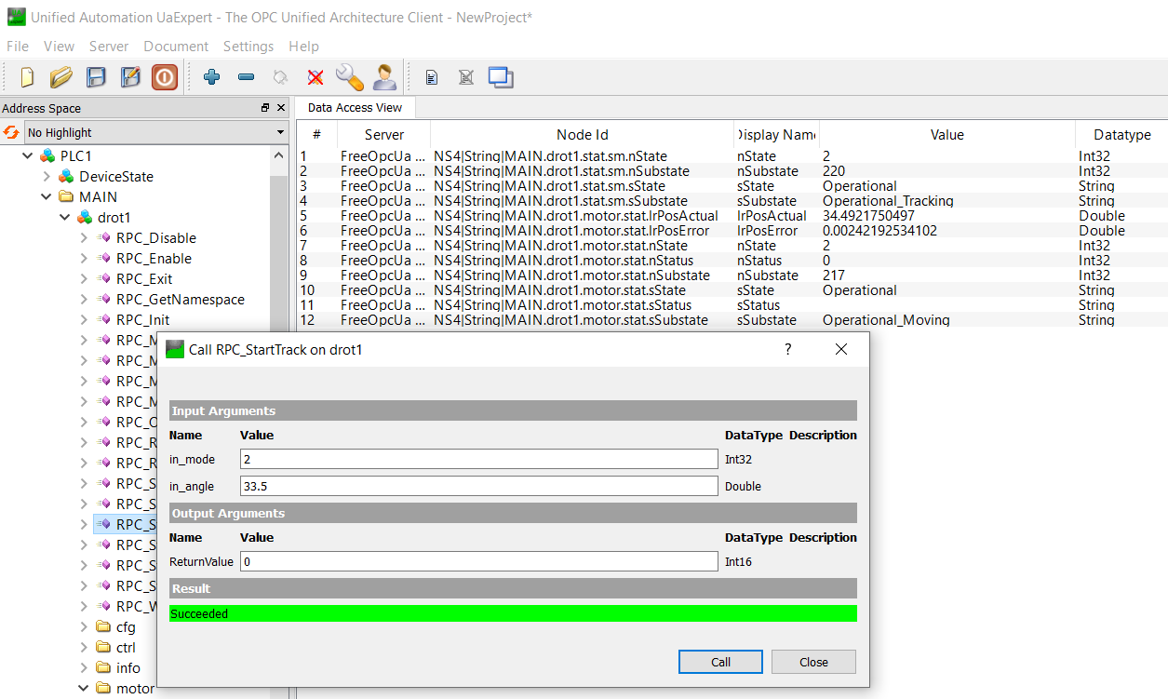
Executing a Device Simulator
$ fcf_devsim_drot --port 7777 --cfg config/fcf/devsim/drot/drot.cfg.yaml --log-level INFO --use-ext-ip
2021-09-22 13:27:40,657:INFO:SmOpcUaSrv:MainThread:serverbase:647:execute_int: Setting up OPC UA server - done
2021-09-22 13:27:40,657:INFO:SmOpcUaSrv:MainThread:serverbase:658:execute_int: Loading configuration: config/fcf/devsim/drot/drot.cfg.yaml
2021-09-22 13:27:40,658:INFO:SmOpcUaSrv:MainThread:serverbase:665:execute_int: Loading OPC UA namespace definition: fcf/devsim/drot/drot1.namespace.xml
2021-09-22 13:27:40,658:INFO:SmOpcUaSrv:MainThread:serverbase:669:execute_int: Found OPC UA namespace definition: /scratch/jknudstr/INTROOT/resource/config/fcf/devsim/drot/drot1.namespace.xml
…
2021-09-22 13:27:40,847:INFO:SmOpcUaSrv:MainThread:serverbase:708:execute_int: Main: Starting State Machine Engine ...
2021-09-22 13:27:40,848:INFO:SmOpcUaSrv:MainThread:serverbase:712:execute_int: Main: Started State Machine Engine
2021-09-22 13:27:40,848:INFO:SmOpcUaSrv:MainThread:serverbase:716:execute_int: Main: Time for initialising: 1.062s

Slide 12
Implementing a new DevSim
Steps:
  Provide design of the device (PLC Controller + WS DevMgr Device Class).
  a) Implement PLC Controller, PLC Simulator, WS DevMgr Device Class – or
  b) Start developing the DevMgr + DevSim.
  Generate the DevSim module source using the provided DevSim Cookiecutter template.
  Extract the PLC parameters and constants from the design or PLC code.
  Create the DevSim OPC UA namespace (YAML → OPC UA XML representation).
  Create the DevSim (PLC Controller) state machine SCXML definition.
  Adapt the generated source code according to the design (activities, OPC UA parameter handling).
  Exercise/test with UA Expert, or similar, during development.
  Validate with DevMgr Device Class, possibly applying same integration test as for real PLC Controller/Simulator/DevMgr Device Class test suite.

Slide 13
Using the DevSim Template
DevSim Cookiecutter Template: “ifw-hl/fcf/devsim/templates/devsim_tpl/”.
Note: Template for instrument source tree provided: “gitlab.eso.org/ifw/ifw-templates”.
    Includes also DevSim template.
“fcf/devsim” template used to create simulators ‘standalone’, for instance adding to an existing Instrument Source Tree, generated with “ifw-templates”.
“fcf/devsim” template based on Lamp DevSim
    Should probably simplify it, to make adaptation less cumbersome…

Slide 14
State Machine SCXML Definition/1
SCXML: State Chart XML.
Two approaches:
  Create/edit by hand in text editor (raw XML), or
  Create model in MagicDraw, using COMODO profile (see chapter 6, RAD UM).
  + use COMODO tool to generate the state machine SCXML chart.
First approach not too difficult, once the SCXML format is understood.
  At least for simple state machines …
  Need to have the state machine in a diagram format – need this anyway for the design description.
Probably apply only second approach if MagicDraw license already available.
  Not worthwhile to purchase MagicDraw licenses just for this purpose …

Slide 15
Preparing the OPC UA XML Profile
OPC UA XML profile cumbersome to edit by hand.
Simple YAML definition used, which can be edited by a text editor.
Tool provided to generate OPC UA XML profile:
$ core_gen_opcua_profile [-h] --device DEVICE --name-mapping NAME_MAPPING [--output-file OUTPUT_FILE] [--log-level LOG_LEVEL] [--log-file LOG_FILE] [--verbose]
CtrlExecute: ctrl.bExecute
CtrlIntensity: ctrl.lrIntensity(Double)
CtrlCommand: ctrl.nCommand
CtrlTimeOnLimit: ctrl.nTimeOnLimit(UInt32)
CfgAnalogRange: cfg.nFullRange(UInt32)
CfgAnalogThreshold: cfg.nAnalogThreshold
CfgCoolDown: cfg.nCooldown(UInt32)
…
RpcSwitchOff: rpc.Off(O:ReturnValue(Int16))
RpcSwitchOn: rpc.On(I:in_lrIntensity(Double), I:in_nTimeOnLimit(UInt32), O:ReturnValue(Int16))
<NamespaceUris>
<Uri>http://www.eso.org/xmlLamp1/</Uri>
</NamespaceUris>
<UAObject NodeId="ns=4;s=PLC1" BrowseName="4:PLC1">
<DisplayName>PLC1</DisplayName>
<References>
<Reference ReferenceType="HasTypeDefinition">i=58</Reference>
<Reference ReferenceType="Organizes">ns=4;i=20737</Reference>
<Reference ReferenceType="Organizes" IsForward="false">i=85</Reference>
</References>
</UAObject>
…

Slide 16
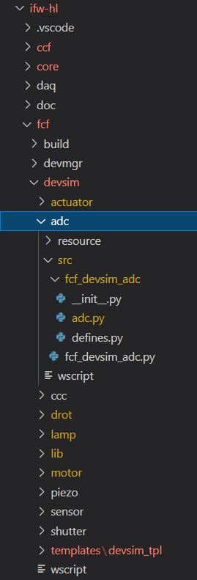
DevSim Source - Structure
DevSim module
Configuration files + examples
DevSim library
DevSim class + business logic
Definition of constants, e.g. PLC constants like error code, etc.
Application deployment

Slide 17
DevSim Source – PLC Constants
Constants should be the same in PLC code and in simulator to be able to use it 100% seamlessly with Device Manager.
    Extract these from the PLC code, or if simulator implemented first, ensure to use the same on the PLC.
The module will also contain constants used in the DevSim application.
Example: From “Devsim Lamp defines” (extract).
class LampCommand:
NONE = 0
RESET = 1
INIT = 2
STOP = 3
ENABLE = 4
DISABLE = 5
ON = 6
OFF = 7
class LampError:
OK = 0
HW_NOT_OP = 1
INIT_FAILURE = 2
UNEXPECTED_OFF = 3
UNEXPECTED_ON = 4
FAULT_SIG = 5
MAXON = 6
STILL_COOLING = 7
TIMEOUT_DISABLE = 8
TIMEOUT_INIT = 9
TIMEOUT_OFF = 10
TIMEOUT_ON = 11
UNKNOWN_CMD = 1000

Slide 18
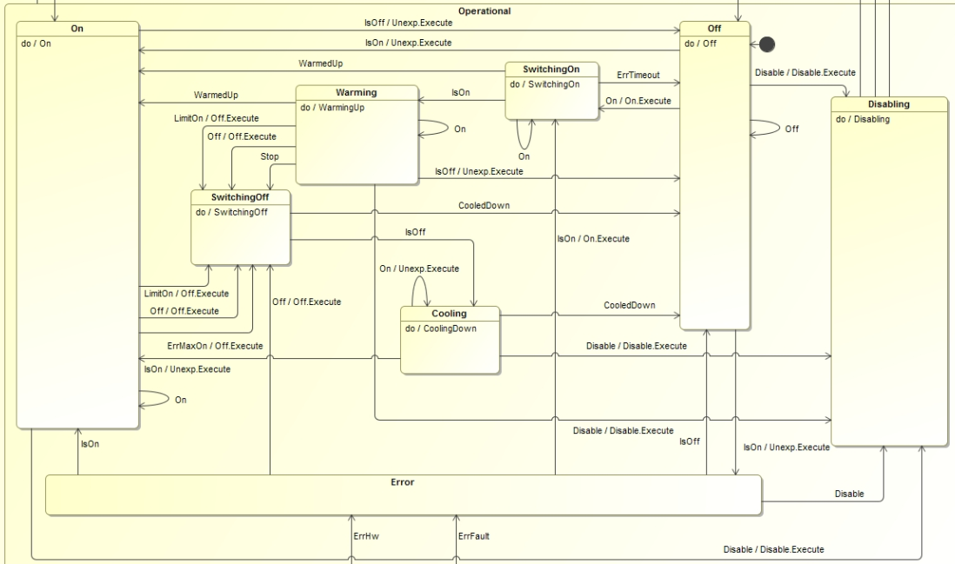
State Machine Handling

Slide 19
Upcoming
Provide new devsim for the Siemens PSU (PSU8600).
Existing framework (SDK) to be replaced with a new implementation:
  Collaboration with Sylvain Guieu (EFISOFT).
  Allows for deploying multiple device simulators per (Python) process – major issue with present implementation.
  Partially compatible with the existing implementation in terms of configuration.
  Requires porting/re-writing the code (business logic) of the device simulators.
  Based on composition instead of inheritance.
  Planned for IFW2025.
  Old and new frameworks will co-exist for a while, to allow for a smooth transition.
Considerations on-going to offer simulation also on the WS via TwinCAT@BSD running in a virtual machine.
  DevSim to be kept for simplicity (execution-wise) and to obtain self-contained tests with no external dependencies.

Slide 20
J. Knudstrup – jknudstr@eso.org
@ESOAstronomy
@esoastronomy
@ESO
european-southern-observatory
@ESOobservatory

