Slide 1

IFW Camera Control Framework - CCF
J. Knudstrup

Slide 2
Purpose & Scope of CCF
Toolkit for integrating Detector Control Software (DCS) applications.
Implements the standard DCS interface (commands, state machine, OLDB…).
Control of mainly COTS Technical Cameras used for the instrument control and for WFS purposes.
CCF does not necessarily aim at delivering ready-to-use executables for every use case imaginable.
Some binaries provided, but specific binaries shall be prepared for specific purposes (instrument/camera/protocol/recipe/publisher specific).
A number of adapters can be implemented to provide specific behaviour.

Slide 3
Main Deliverables
CCF SDK used to integrate (develop) CCF DCS solutions.
Following Control Applications with support for:
    GigE Vision.
    ENVision (control: OPC UA/data stream: RTMS).
    RTMS (RTMS subscription, no control).
    Simulation only.
Data Processing Recipes (for now only Centroiding, more planned…).
Data publishers for FITS, the DDT and RTMS.
A C++ client interface class + command line utility.
A synchronous and asynchronous client library and interactive command line utility (CLI).
A GUI widget library with status and control widgets customised for CCF.
A generic engineering GUI, based on the above, allowing to do base operations on a CCF instance.

Slide 4
Internal Threads
Four types of CCF internal threads used:
    Acquisition Thread: Controlling camera + receiving image data.
    Monitor Thread: Supervising the execution and associated camera, generating run-time statistics.
    Processing Threads: Processing data on-the-fly, applying Processing Recipes (Processing Recipe Adapters).
    Multiple internal processing pipelines possible.
    Publisher Threads: Publishing the processed data to the targets of interest (via Publisher Adapters).
In addition, various threads related to the CII and 3rd party libraries executed in the application.
    I.e., you will see more threads than the CCF specific threads, for instance in “htop”.
Architecture makes it possible to receive, process and publish the data in parallel for maximum parallelism.
The number of Processing and Publisher Threads, are configurable and will be created dynamically at start-up.
Must deploy one Processing Thread and one Publisher Thread.
Only one Data Publisher Adapter per Publisher Thread possible.

Slide 5
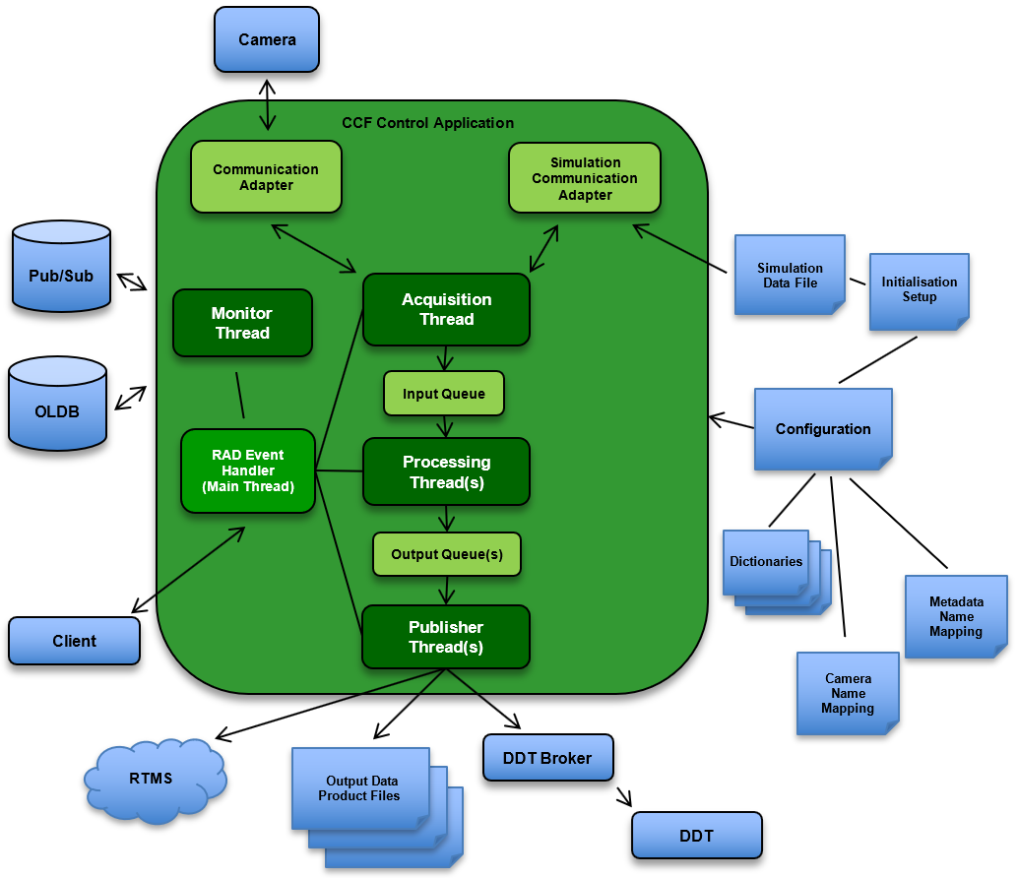
Architecture
Only needed to deploy one process.
Data Frames transferred internally via Frame Queues:
    One Input Queue.
    One Output Queue for each Processing Thread.

Slide 6
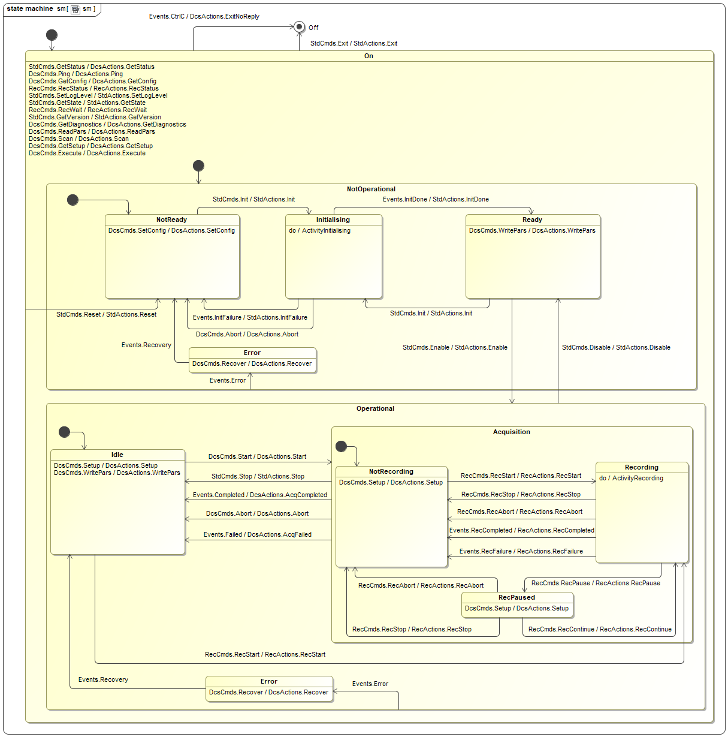
State Machine
Standard state machine for all DCS’ (“dcsif”) – same for NGC/OPT and NGC/IR.
Based on the standard ELT control application state machine.
    CCF application + SCXML state machine definition, generated using the Comodo Code Generator from the MagicDraw model.
When “Start” command submitted, SM enters “Acquisition” substate and detector data is acquired.
With the “RecStart” command it is possible to request recording (storing) data on disk.
Submitting “RecStart” while “Idle”: Acquisition started automatically, may be automatically stopped.

Slide 7
Adapters
User can adapt a dedicated CCF-based DCS via the adapters to meet specific requirements.
Following types of adapters supported:
    Communication Adapter: Implements communication with associated camera via the given protocol/hardware. Can also be used for simulation purposes.
    Processing Recipe Adapter: Processing the data on-the-fly.
    Data Publisher Adapter: Publishes the data to specified targets.
    Monitor Adapter: Collects and generates statistics and executes Monitor Adapter (if provided).
    Method Execution Adapter: Can be implemented and provided to add specific behaviour (via “Execute” request, corresponds to RPC).
Some standard adapters are provided:
    Communication: GigE Vision (Aravis SDK), RTMS (no control), ENVision (control: OPCUA/data: RTMS).
    Processing: Centroiding (more Processing Adapter planned).
    Publishers: DDT, FITS, RTMS.

Slide 8
CII MAL Request/Response & Pub/Sub Interfaces
Interface to DCS type of applications has been standardised:
    Same interfaces used by NGC and CCF.
I.e., all DCS’s have the same request/response, pub/sub interface + state machine.
CII MAL interface definitions stored in the ECS project in Git:
    https://gitlab.eso.org/ecos/ecs-interfaces
Standard CII MAL interfaces used:
    “stdif”: Used by all ELT applications.
    “dcsif”: All DCS applications, also NGC.
    “recif”: Used for recording type of applications.

Slide 9
CII MAL Request/Response & Pub/Sub Interfaces - Cont’d
IFW24: Not all commands implemented (yet):
  “stdif”: Stop, Init, Reset, Enable, Disable, GetState, GetStatus, GetVersion, Exit, SetLogLevel.
  “dcsif”: Abort, Execute, GetConfig, GetDiagnostics, GetSetup, Ping, ReadPars, Recover, Scan, SetConfig, Setup, Start, WritePars.
  “recif”: RecAbort, RecContinue, RecPause, RecStart, RecStatus, RecStop, RecWait.
Pub/Sub topics:
    “stdif::StatusTopic”/”std/status”: Current state of the CCF instance.
    “dcsif::RecStatus”/”rec/recstatus”: Latest/current Recording Status.
Usage of Pub/Sub vs OLDB:
    Pub/Sub for inter-process synchronization/coordination + for ‘high performance purposes’.
    OLDB for presenting information to the user in GUIs, various ‘slow’ client applications data sharing etc.

Slide 10
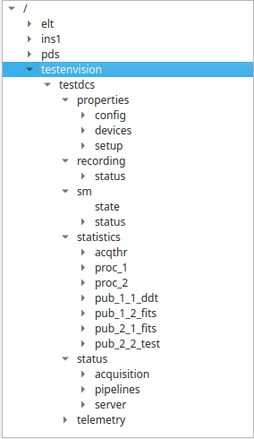
Online Database
Basic key name:
    “<cfg: OLDB prefix>/<cfg: CCF instance name>.<category>.[<sub-category>.]<parameter/key>”.
Main categories:
    “properties”: Configuration and setup parameters.
    “recording”: Status on an ongoing or previously executed recording.
    “sm”: Application state (status of state machine).
    “statistics”: Run-time statistics of the various internal tasks (threads).
    “status”: Status information of various internal tasks and the associated camera.
    “telemetry”: Contains the values sampled by the Telemetry Service.
Examples:
    “cii.oldb:///ccftest/testdcs/properties/config/pipelines/proc_2/publishers/pub_2_1_fits/adapter”
    “cii.oldb:///ccftest/testdcs/properties/devices/testsimcamera1/chunkmodeactive”
    “cii.oldb:///ccftest/testdcs/status/devices/testsimcamera1/gige_vision/sensorwidth”
    “cii.oldb:///ccftest/testdcs/statistics/acqthr/frame_rate”
    “cii.oldb:///ccftest/testdcs/status/pipelines/proc_1/recipes/recipe_1_1_centroid/sigma_error_x”

Slide 11
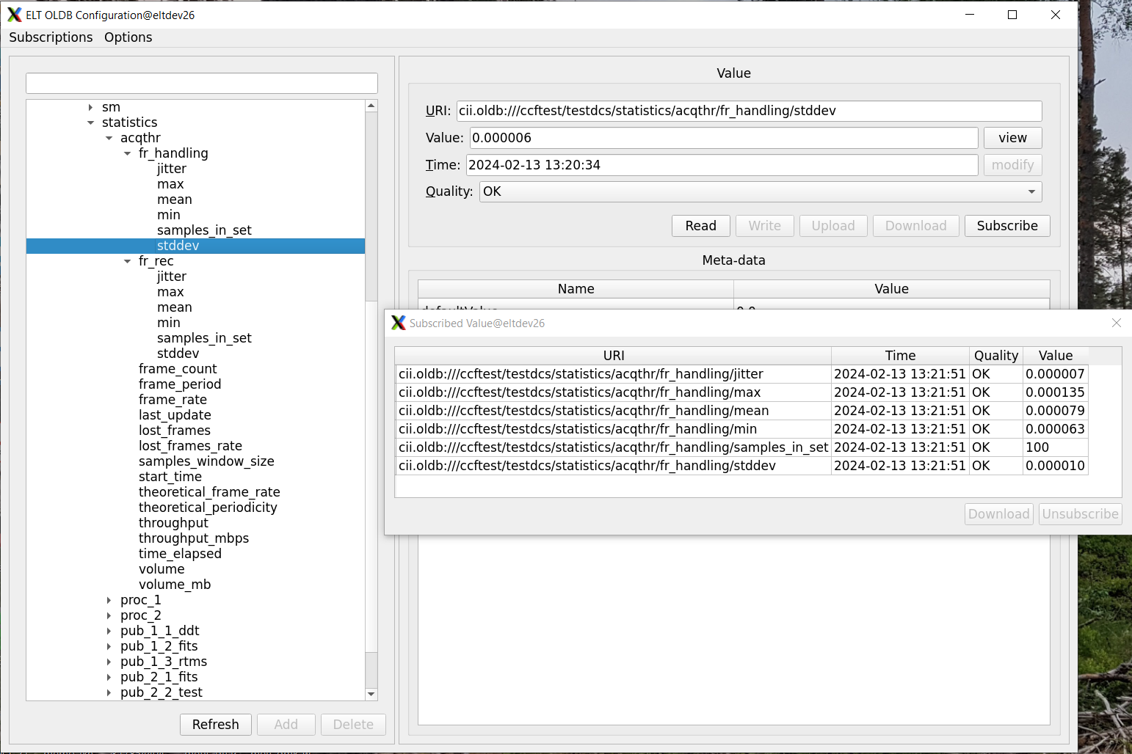
Run-Time Statistics
Various run-time statistics is produced during operation and updated in the OLDB.
The Acquisition, Processing and Publisher Threads, produce some run-time information (frames received/completed, number of frames/volume handled…).
Information about frames lost and skipped also registered.
The Monitor Thread collects the data periodically, computes the statistics and update this in the OLDB.
Update rate and number of samples in sliding window configurable.
Use statistics in OLDB to verify proper execution of the DCS application!

Slide 12
CCF CLI – Programming API
import time
import ifw.ccf.clib.ccf_commands
uri = "zpb.rr://127.0.0.1:12091"
client = ifw.ccf.clib.ccf_commands.CcfCommands(uri)
status = client.reset()
status = client.init()
status = client.enable()
status = client.state()
print(f"Status of State command: {status}")
status = client.setup("expo.time=1.1")
print(f"Status of Setup command: {status}")
prefix = "proc_1.fits"
setup_pars = f"{prefix}.basename=example_client,{prefix}.nb_of_frames=10,{prefix}.format=MEF,{prefix}.overwrite=false"
status = client.setup(setup_pars)
print(f"Status of Setup command: {status}")
status = client.recstart()
print(f"Status of RecStart command: {status}")
for n in range(10):
status = client.recstatus()
print(f"Status of RecStatus command: {status}")
time.sleep(1)
status = client.stop()
status = client.state()
print(f"Status of State command: {status}")

Slide 13
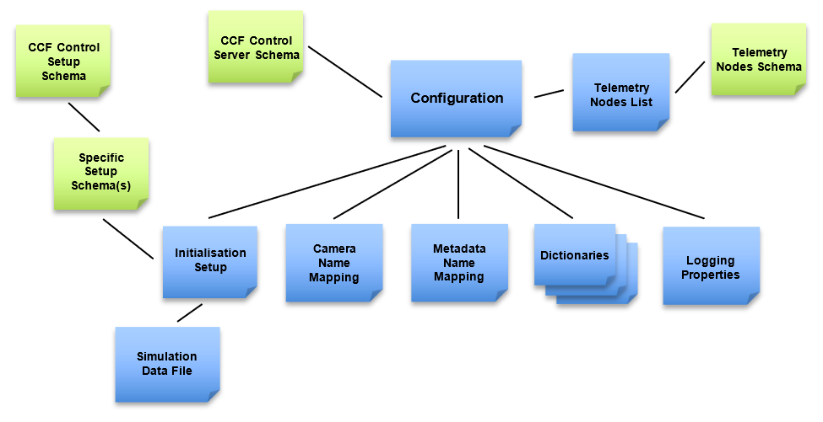
Configuration
The configuration is based on the CII Cfg Service.
Based on “ifw-core” “bat/config” – same base for all IFW applications.
The configuration (and associated files) shall be stored in a location, searchable via the “CFGPATH” environment variable.

Slide 14
Example Configuration/1 (Extract)
!cfg.include schema/ccf/common/server.schema.yaml:
server: !cfg.type:CcfServerTypeDef
server_id: 'TestDcs'
req_endpoint: 'zpb.rr://127.0.0.1:12091/'
pub_endpoint: 'zpb.ps://127.0.0.1:51235/'
db_timeout: 5000
scxml: 'config/ccf/control/sm.xml'
log_properties: 'config/ccf/control/log.properties'
req_timeout: 60
dictionaries: ['dictionary/dit/stddid/primary.did.yaml',
'dictionary/ccf/common/ccf.did.yaml']
oldb_prefix: 'CcfTest'
fits_prefix: 'DET1'
simulation: false
init_setup: 'setup/ccf/control/example.setup.yaml'
recording:
metadata_map: 'config/ccf/control/metaData.mapping.yaml'
rec_hist_size: 1000
rec_hist_expiration: 2147483647
tasks:
monitoring:
period: 1
nb_of_samples: 100
mon_adpt_active: true
mon_adpt_disable_during_acq: true
mon_adpt_period: 10
. . .

Slide 15
Example Configuration/2 (Extract)
processing: [
{
pipeline: 'proc1',
output_queue_size: 20,
allow_frame_skipping: false,
recipes: [
{
name: 'centroid',
adapter: 'ccf::stdrecipe::RecipeCentroid'
},
. . .
],
publishers: [
{
name: 'ddt',
adapter: 'ccf::stdpub::PubDdt'
},
{
name: 'fits',
adapter: 'ccf::stdpub::PubFits'
},
{
name: 'rtms',
adapter: 'ccf::stdpub::PubRtms'
}
]
},
. . .

Slide 16
Example Configuration/3 (Extract)
. . .
devices: [
{
name: 'BigEye',
width: 1620,
height: 1220,
max_resolution: 12,
resolution: 12,
protocol: 'GigE Vision',
mapping: 'config/ccf/protocols/aravis/avt.mapping.yaml',
address: '134.171.12.196',
sim_address: 'InternalSimulator’,
. . .
properties: [
{
name: 'StreamBytesPerSecond',
value: '115000000',
write_on_init: true
},
{
name: 'PixelFormat',
value: 'Mono16',
write_on_init: true
},
{
name: 'GevSCPSPacketSize',
value: '1500',
write_on_init: true
},
. . .
}
]
}
]
New Cfg Parameters, normally for the Communication Adapter, can only be added in the “devices/properties” element.
Parameters for the other types of adapters may also be added in the “devices/properties” element.
No schema validation applied to new parameters – validation -- to be done by the adapter…
Parameters configured with “write_on_init=true” will be written to the device (via the Communication Adapter) during initialisation.
Can be given either as the device name or the internal name defined in the Name Mapping.

Slide 17
Example Initialisation Setup (Extract)
!cfg.include schema/ex/setupExample.schema.yaml:
dcs: !cfg.type:ExSetupTypeDef
expo:
mode: 'Continuous' # Continuous, Finite
nb: 10
time: 1.123
frame_rate: 100.0
win_start_x: 0
win_start_y: 0
win_width: 512
win_height: 512
bin_x: 1
bin_y: 1
. . .
proc1:
enabled: true
centroid:
enabled: true
delay: 0.0
max_centre_error: 0.5
max_sigma_error: 3
robustness: 7
. . .
A setup schema shall be prepared, matching the configuration

Slide 18
Allocation of Thread Names
The names of the internal threads are assigned by user in the configuration.
Configuration based on common schema provided by CCF.
Necessary to make specific schema for the Initialisation Setup, matching the names allocated in the configuration.
The names allocated in the configuration, maps into setup keyword prefixes.
Should select names describing the purpose of the threads.

Slide 19
Setup Parameter Names
processing: [
{
pipeline: 'proc1',
output_queue_size: 20,
allow_frame_skipping: false,
recipes: [
. . .
],
publishers: [
{
name: 'fits',
adapter: 'ccf::stdpub::PubFits'
},
. . .
]
},
. . .
!cfg.include schema/ex/setupExample.schema.yaml:
dcs: !cfg.type:ExSetupTypeDef
expo:
mode: 'Continuous' # Continuous, Finite
nb: 10
time: 1.123
. . .
. . .
proc1:
enabled: true
. . .
fits:
enabled: true
basename: 'PubFitsTest1'
max_size: 100 # MB
nb_of_frames: 7
format: 'Single' # Single, Cube, MEF
overwrite: true # true
rec_mode: 'All' # All, I:<nb>, P:<period>
. . .
Configuration
Initialisation Setup
“dcs.expo.time” or “expo.time”
“dcs.proc1.fits.basename” or “proc1.fits.basename”

Slide 20
Defining Specific Setup Parameters
It is possible to add new setup parameters, used by the various adapters.
Typically for Recipe and Publisher Adapters, new parameters will be defined.
These shall be defined in the CCF Setup Schema, matching the configuration for the CCF Instance.
It is up to the individual adapter to check if a setup parameter has been updated.
When a Setup Command is submitted to a CCF Instance, internally a signal is sent to the various threads, “Setup Signal”, indicating to setup the adapters by invoking a method provided by these.

Slide 21
Internal Handling of Setup Parameters
Request Handling Thread (RAD Event Handling), sends a signal to all threads that new setup parameters are available.
Each thread will take of handling/processing the parameters relevant for that thread.
After handling the setup parameters, they acknowledge to the RAD Request Handling Thread if the processing was successful.
When setup parameters are submitted, they stored in a Staging Setup Repository.
When the setup parameters have been completed, successfully, the parameters are updated in an internal Setup Status Repository and in the OLDB.
The adapters can access the Staging Setup Parameters, e.g. via this method:
Another method is (example):
template <class TYPE> bool HasStagingPar(const std::vector<std::string>& names, TYPE& value)
for (auto par : ccf::GetSetup().GetSetupCmdStagingPars()) {
. . .
}

Slide 22
Retrieving Current Setup Parameters
> ccfCli --uri zpb.rr://127.0.0.1:12091 (*)
zpb.rr://127.0.0.1:12091
ccf> getsetup <pattern>
reply> = dcs.expo.bin_x=1
dcs.expo.bin_y=1
dcs.expo.frame_rate=100.0
dcs.expo.mode=Continuous
dcs.expo.nb=10
dcs.expo.time=1.123
dcs.expo.win_height=512
dcs.expo.win_start_x=0
dcs.expo.win_start_y=0
dcs.expo.win_width=512
dcs.proc_1.enabled=true
. . .
dcs.proc_1.fits.basename=PubFitsTest1
dcs.proc_1.fits.delay=0
dcs.proc_1.fits.enabled=true
dcs.proc_1.fits.format=Single
dcs.proc_1.fits.max_size=100
dcs.proc_1.fits.nb_of_frames=7
dcs.proc_1.fits.nb_of_hdr_blocks=1
dcs.proc_1.fits.overwrite=true
dcs.proc_1.fits.rec_mode=All
. . .
*: When using Nomad, the service name can be used: “ccfCli --name <service>”

Slide 23
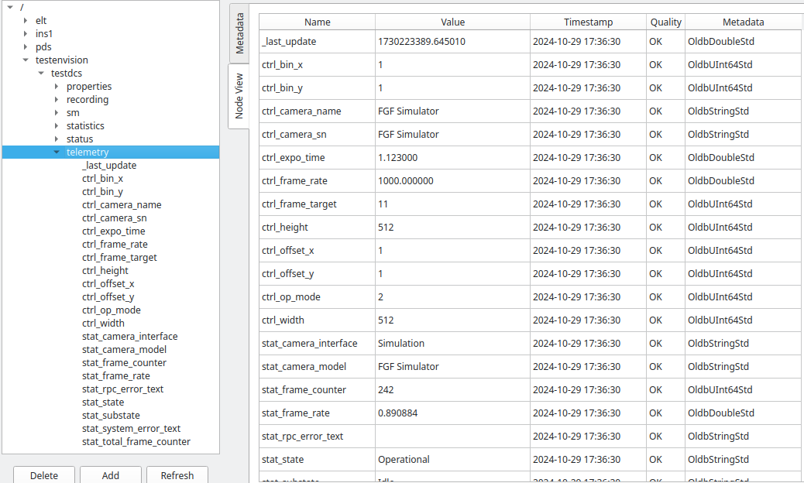
Telemetry Service
!cfg.include schema/ccf/common/telemetry_node_list.schema.yaml:
telemetry: !cfg.type:TelemetryNodesTypeDef
nodes: [
{
name: 'ctrl.nOpMode’
oldb_node: 'ctrl_op_mode’
},
{
name: 'ctrl.lrExpoTime’
oldb_node: 'ctrl_expo_time'
},
{
name: 'ctrl.lrFrameRate’
oldb_node: 'ctrl_frame_rate'
},
. . .
The Telemetry Service is used to read out parameters from the associated camera periodically and store these in the OLDB.
Nodes to be sampled specified in Telemetry Nodes document.
Possible to disable Telemetry automatically while in Acquisition State.
Based on periodic sampling – maybe subscription will be supported in the future.
Configuration:
tasks:
monitoring:
period: 1
. . .
telemetry:
enabled: true
period: 10.0
disable_during_acq: true
nodes_list: 'config/ccf/protocols/envision/envision.telemetry.yaml'

Slide 24
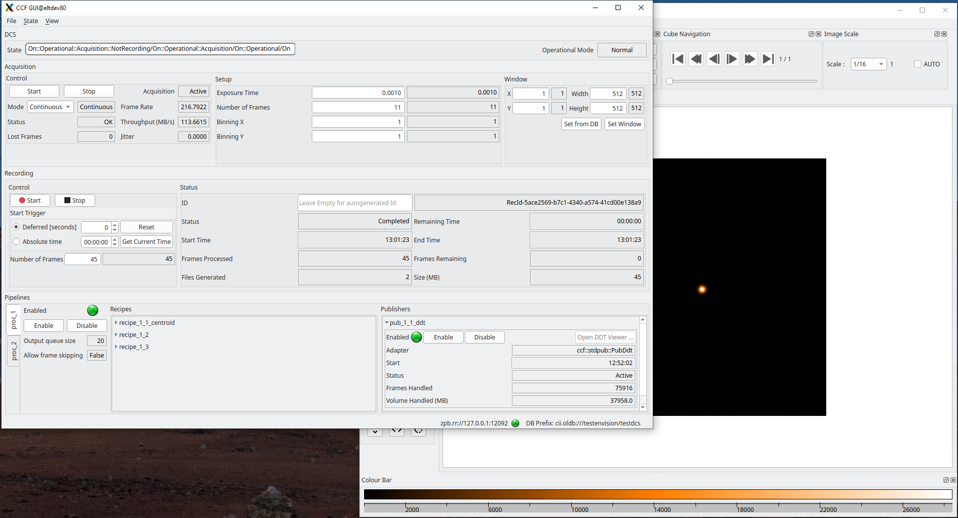
CCF GUI

Slide 25
Installation & Deployment
Independent Git project with its own WAF build structure.
Build and installed as a standard IFW component.
Relying on following environment variables:
    DATAROOT: Directory on the host machine in which Output Data Products will be generated. The storage location will be rendered as “$DATAROOT/<cfg key: sys.image_dir>”. The ‘image’ sub-directory in “DATAROOT” will be created automatically by CCF Control, if not existing.
    CFGPATH: The “CFGPATH” environment variable, is a colon separated list of paths, pointing to possible Resource Directories in which resource data of different kinds are located.
    INTROOT/PREFIX: In this release, the example configurations delivered with the CCF Package as well as the libraries, header files and binaries, are installed into the location pointed to by “INTROOT”. This may change in the future.
In order to obtain a CCF executable, a deployment module is needed.
    It defines which adapters are available in the CCF application.
Four ready-to-use executables delivered with the package:
    ccfCtrlSim: Pure simulation CCF application. Includes standard Processing and Publisher Adapters.
    ccfCtrlAravis: GigE Vision executable, also including the standard adapters.
    ccfCtrlRtms: Provides RTMS Communication Adapter, no camera control (passive receiver).
    ccfCtrlEnvision: Implements the ENVision Protocol (control OPCUA, data transfer: RTMS).

Slide 26
Example Deployment C++ main()
#include <ccf/control/application.hpp>
. . .
#include <ccf/protocols/aravis/comAdptAravis.hpp>
/// Application main.
int main(int argc, char* argv[]) {
ccf::control::Application& application = ccf::control::Application::Instance();
LOG4CPLUS_INFO(ccf::Logger(), "Application started");
// Allocate and register Normal Mode and Simulation Communication Adapter
// factory objects.
ccf::protocols::aravis::ComAdptAravis* com_adapter =
new ccf::protocols::aravis::ComAdptAravis();
ccf::control::ComAdptSim sim_com_adapter;
application.RegisterComAdapters(*com_adapter, sim_com_adapter);
delete(com_adapter);
// Register Processing Recipe Adapter factory objects.
LOG4CPLUS_INFO(ccf::Logger(), "Allocate and register Processing Recipe “
“Adapter factory objects ...");
ccf::stdrecipe::RecipeCentroid centroid_recipe_object;
ccf::stdrecipe::RecipeCentroid::AddRecipeFactoryObj(centroid_recipe_object);
// Register Publisher Adapter factory objects.
LOG4CPLUS_INFO(ccf::Logger(), "Allocate/register Publisher Adapter factory objects ...");
ccf::stdpub::PubFits fits_pub_factory_object;
ccf::common::PubBase::AddPubFactoryObj(fits_pub_factory_object);
ccf::stdpub::PubDdt ddt_pub_factory_object;
ccf::stdpub::PubDdt::AddPubFactoryObj(ddt_pub_factory_object);
ccf::stdpub::PubRtms rtms_pub_factory_object;
ccf::stdpub::PubRtms::AddPubFactoryObj(rtms_pub_factory_object);
ccf::common::PubBase base_pub_factory_object;
ccf::common::PubBase::AddPubFactoryObj(base_pub_factory_object);
LOG4CPLUS_INFO(ccf::Logger(), "Execute the application ...");
int stat = application.Execute(argc, argv);
LOG4CPLUS_INFO(ccf::Logger(), "Application terminating ...");
return stat;
}

Slide 27
Simulated Behaviour
An internal simulator in the form of a Simulator Communication Adapter is provided (“ccf::control::ComAdptSim”).
Simulation therefore is executed in the Acquisition Thread.
Core CCF not ‘instrumented’ due to the simulation, since handled in adapter.
    Core CCF ‘doesn’t know’ it is using a simulator, even though it is running inside the application.
Provides simulation based on play-back of an existing FITS file.
Other simulation types may be provided later (generation of various patterns in memory).
Possible to provide context specific simulators as Communication Adapters, if required for a project.

Slide 28
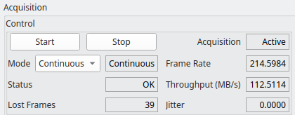
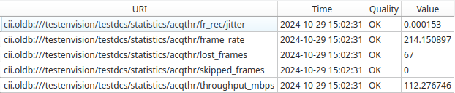
Performance Monitoring
Various OLDB parameters available to monitor the performance of the system.
The following parameters can be used as indicators:
  Lost frames: Frames lost during reception.
  Skipped frames: Frames that couldn’t be scheduled in internal queues.
  Frame Rate: Frame rate measured (Hz, frames/s).
  Throughput: Amount of data handled (MB/s).
  Frame Reception Jitter: Jitter of the periodicity, receiving frames.

Slide 29
Health Monitoring
Telemetry Service: Reads out parameters periodically, will detect error if issues with device or communication, also when system is idling.
Data Acquisition Thread: Checks continuously if frames arrives as expected (see cfg below).
Monitor Adapter: Can be used to implement specific checking customised for specific cameras – probably not needed, normally.
OLDB Parameters: Various available to monitor the health of the system; the following parameters can be used as indicators:
  CCF State: In case of issues, will enter “Error”.
  Acquisition Timeout: Time since last frame received monitored and error reported in case an issue is detected + log.
  Last update of statistics.
  + lost frames, skipped frames, frame counter, frame reception jitter (mentioned on previous slide).
!cfg.include schema/ccf/common/server.schema.yaml:
server: !cfg.type:CcfServerTypeDef
. . .
acquisition:
max_rate: 1000
input_queue_size: 10
allow_lost_frames: false
allow_frame_skipping: false
fr_periodicity_chk_tolerance: 100
fr_periodicity_chk_auto_error: true
fr_periodicity_chk_min_timeout: 30.0

Slide 30
Use Cases
Test cameras:
  Allied Vision Technology Bigeye G-132B/NIR Cool (GEV/CCF Aravis Adapter).
  Allied Vision Technology GC1600H (GEV/CCF Aravis Adapter).
  Allied Vision Technology Mako G-158 (GEV/CCF Aravis Adapter).
MELT:
  Xenics IR (ZEUS) (Specific CCF Adapter).
  Kl400 (SHAPS) (Specific CCF Adapter).
  Lumenera (SHAO) (Specific CCF Adapter).
  The Imaging Source DMK 33GX287 (GEV/CCF Aravis Adapter).
PDS:
  Andor Marana (CoaXPress/SW FG/CCF ENVision Adapter) - 2048 x 2048 pixels, 50 Hz.
  Andor Balor (CoaXPress/SW FG/ CCF ENVision Adapter) – 4128 x 4104 pixels, 10 Hz.
  Freda/TTBox - C-RED ONE (TTBox Socket Interface, RTMS) – 320 x 256 pixels, 1000 Hz.

Slide 31
Upcoming Development
ENVision Adapter: Porting to “llnetio” to replace “mudpi”/”rtms” libraries.
Re-implementation of the Aravis-based GigE Vision Adapter – joint VLT SW/ELT SW project started to create base GigE Vision Communication Adapter (“CamCom Project”).
Develop further CCF Widget lib and CCF GUI.
Improve simulation (support windowing, binning).
Add more Processing Adapters (one scheduled for IFW25: Average Recipe).
Implement missing commands.
Support burst-mode for FITS file generation via internal frame buffering.
Requests from users, bug fixes…

Slide 32
J. Knudstrup – jknudstr@eso.org
@ESOAstronomy
@esoastronomy
@ESO
european-southern-observatory
@ESOobservatory

